Slide 1
The Global Effort Towards at 10 TeV Muon Collider
July 29, 2026
Karie Badgley
On behalf of the US Muon Collider Collaboration
Advanced Accelerator Concepts 2026

Slide 2
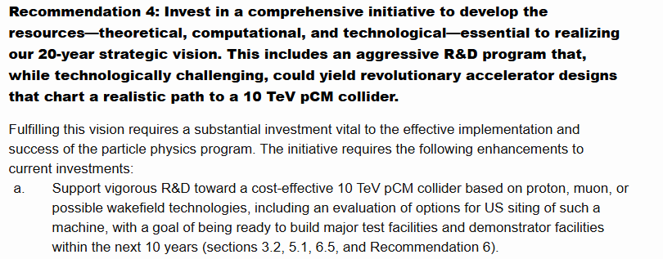
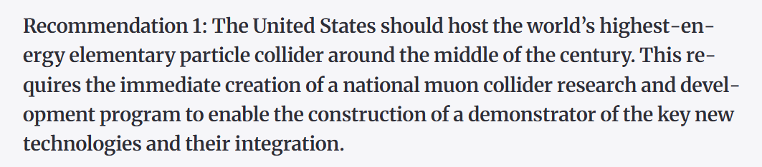

The 10 TeV pCM Recommendation
The 2023 Particle Physics Prioritization Panel (P5) and the 2025 National Academy of Sciences recommended immediate and aggressive R&D toward a muon collider
2020 update of the European Strategy for Particle Physics Update (ESPPU) recommended an R&D program on technology for bright muon beams
P5 Report
NAS
ESPPU

Slide 3



IMCC and USMCC
International Muon Collider Collaboration
50+ institutions
US scientist actively engaged and involved in IMCC leadership
EU funded MuCol design study to develop a collider concept based on realistic collider components
  Report (~early 2027) to inform next ESPPU
muoncollider.web.cern.ch
US Muon Collider Collaboration
~300 members
Inaugural annual meeting held Aug 2024
Upcoming meeting Dec 2026
www.muoncollider.us
Notes:
Values from consolidated parameters report

Slide 4

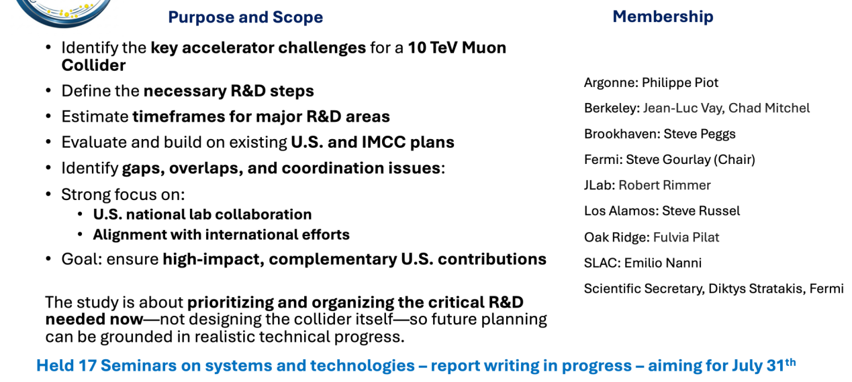
National Lab Accelerator Study Group for a Muon Collider
Slide credit: D. Stratakis

Slide 5
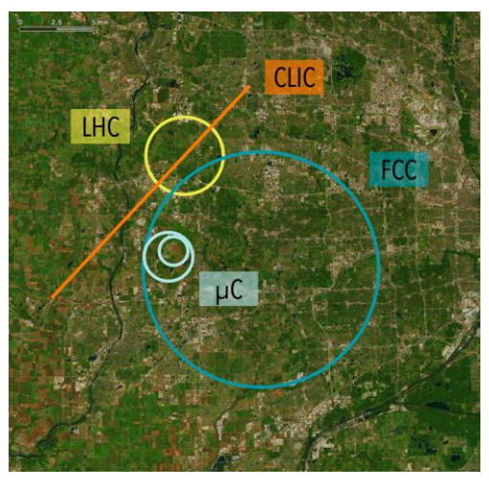
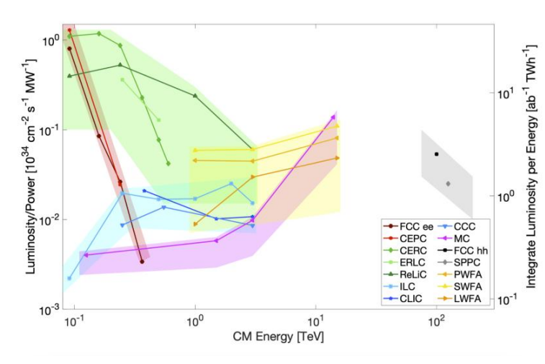
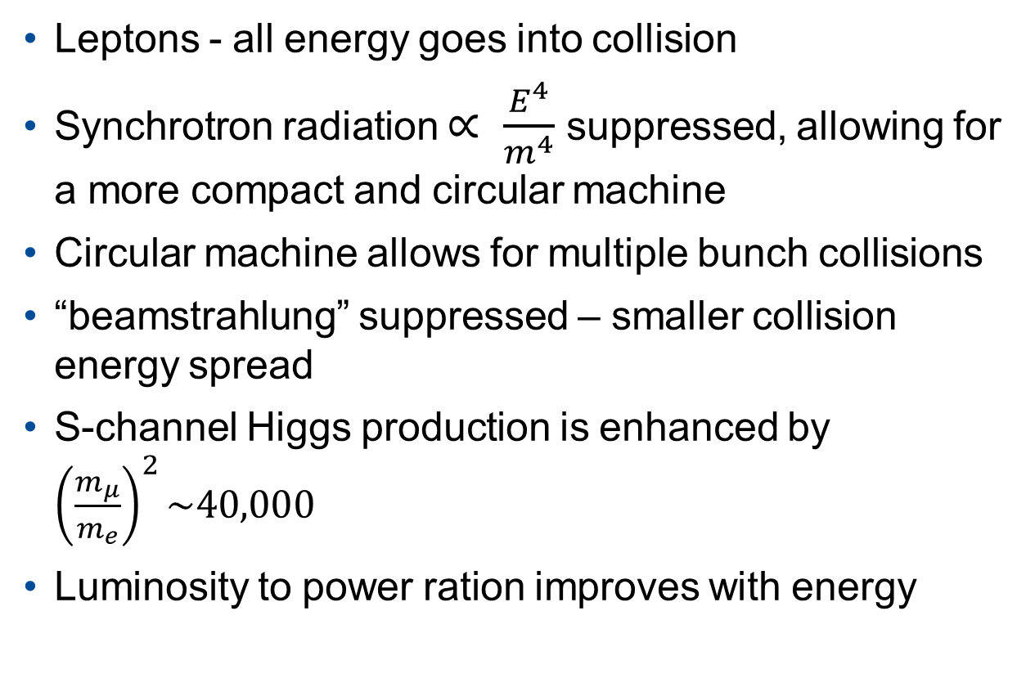
Why Muons?
Leptons - all energy goes into collision
Synchrotron radiation $∝ \frac{E^{4}}{m^{4}}$ suppressed, allowing for a more compact and circular machine
Circular machine allows for multiple bunch collisions
“beamstrahlung” suppressed – smaller collision energy spread
S-channel Higgs production is enhanced by ${\left(\frac{m_{μ}}{m_{e}}\right)}^{2}\sim 40,000$
Luminosity to power ration improves with energy

Slide 6
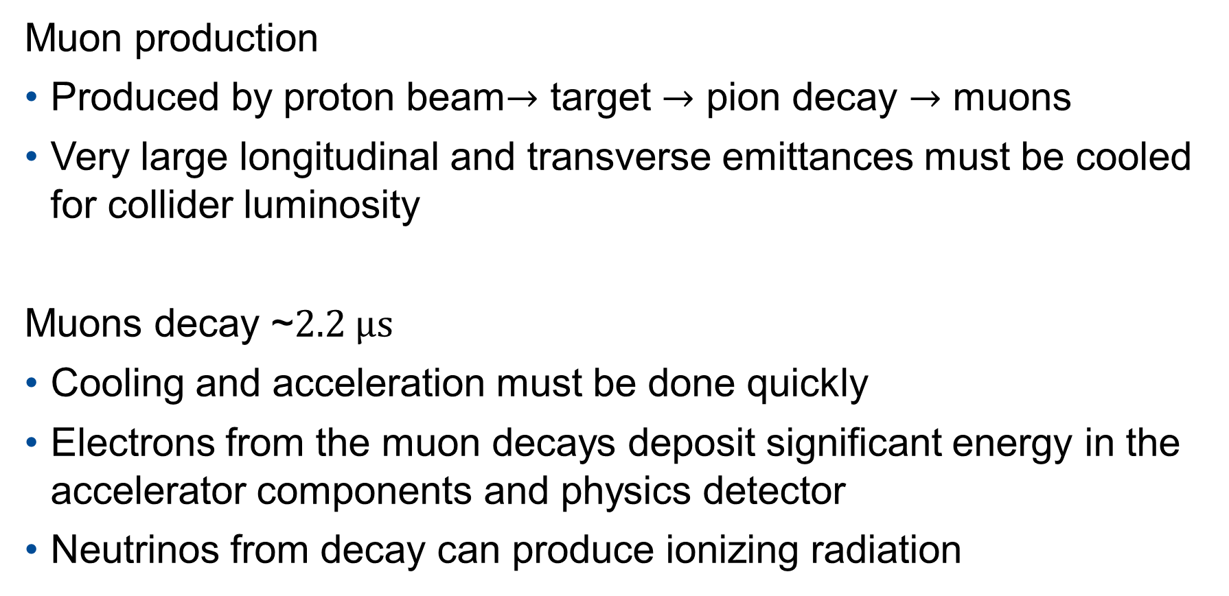
Muon Challenges
Muon production
Produced by proton beam$→$ target $→$ pion decay $→$ muons
Very large longitudinal and transverse emittances must be cooled for collider luminosity
Muons decay ~$2.2 μs$
Cooling and acceleration must be done quickly
Electrons from the muon decays deposit significant energy in the accelerator components and physics detector
Neutrinos from decay can produce ionizing radiation

Slide 7
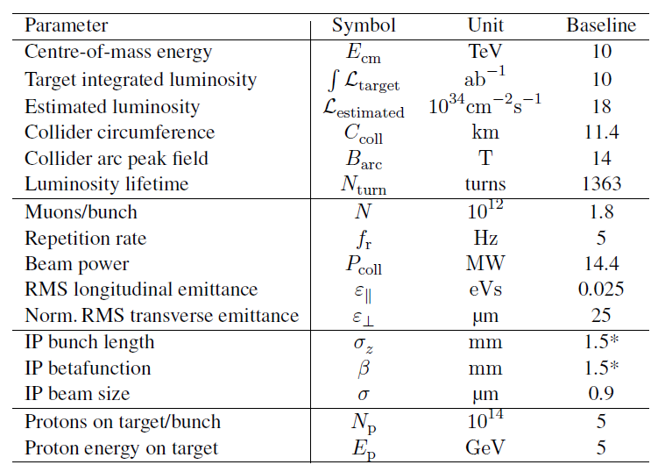
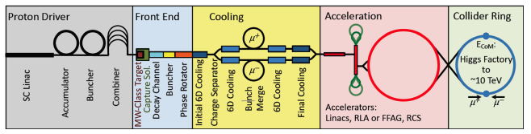
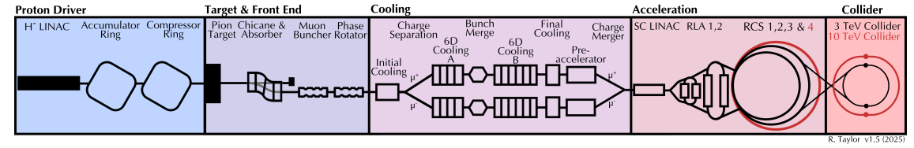
Muon Collider Overview
Muon Accelerator Program (MAP) (2011-2016)
MuCol Consolidated Parameters Report
IMCC
MW-scale proton driver to deliver short and intense bunches
LINAC and 2 RLAs accelerate to 62.5 GeV
Collider Ring for counter propagating muons
200 MeV bunches
High power muon production target
Ionization cooling to reduce 6D emittance
Rapid Cycling Synchrotrons accelerate to 5 TeV

Slide 8
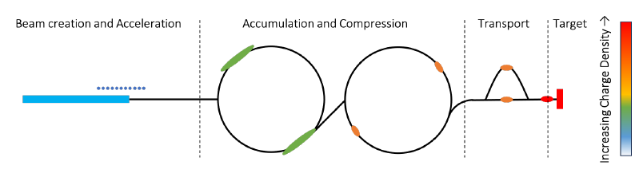
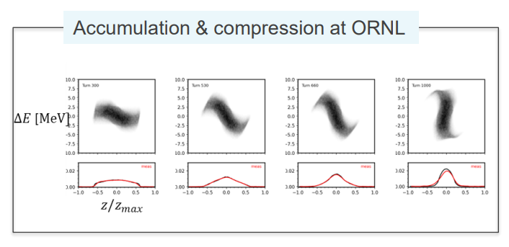
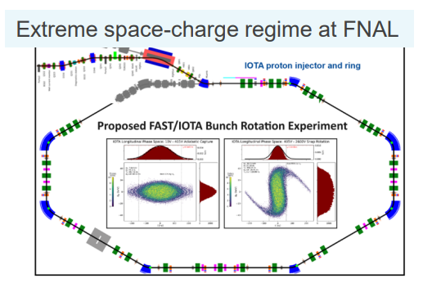
Proton Driver
>2 MW at 5-10 Hz, pulse length ~2 ns
5-20 GeV to maximize pion yield
Multi MW proton sources exist (PIP-II, SNS, ESS)
  R&D needed to modify for the MuC
Requires beam manipulations that need to be experimentally verified
Relevant R&D ongoing at ORNL and IOTA at Fermilab

Slide 9
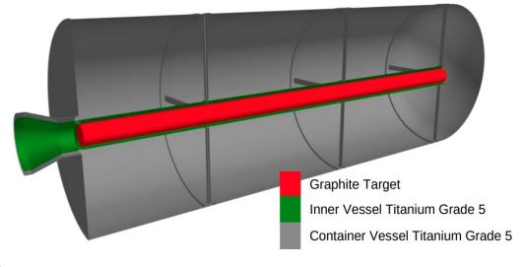
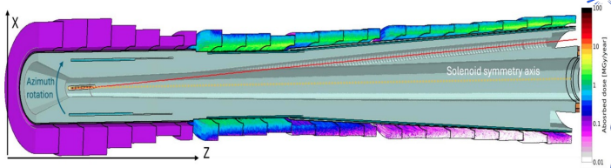
Target
Energy deposition on target beyond current operating targets
High pion/ muon yield and high thermal stress tolerance align with high power target goals for future neutrino facilities
Graphite looks promising but R&D needed
Considering alternatives
  Fluidized tungsten
  Liquid Pb
Target enclosed in multi-T SC solenoid
Spent proton beam line maturing
  Sufficient magnet shielding
  Need to determine DPA limit on HTS

Slide 10
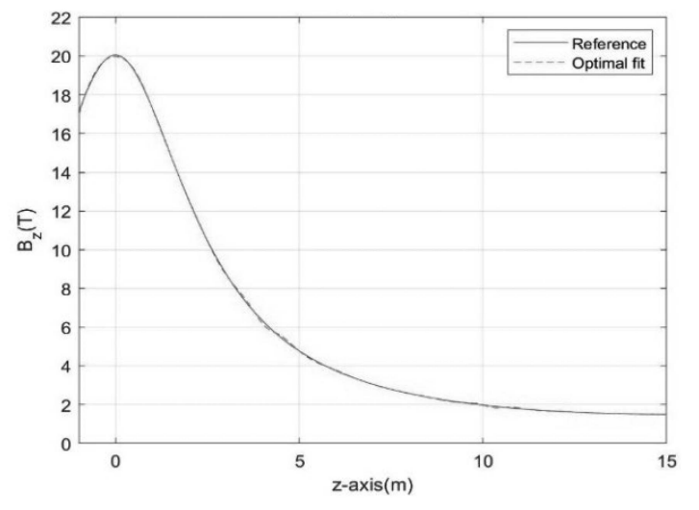
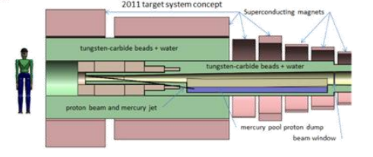
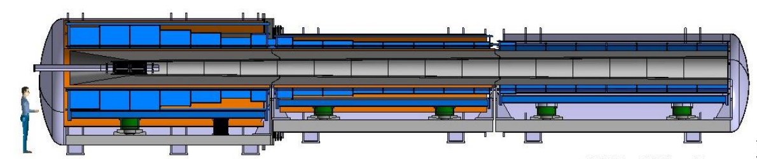
Target & Front End Solenoids
Evolution of MAP design to IMCC design
Resistive hybrid to full HTS
Increased solenoids spacing for support structure
Increased bore shielding
Simplify power supply-all coils at the same current

Slide 11
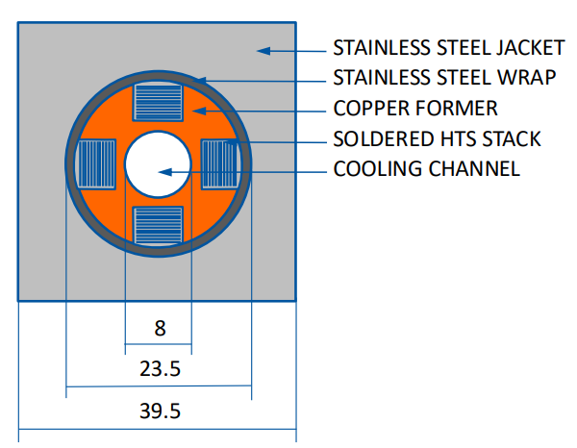
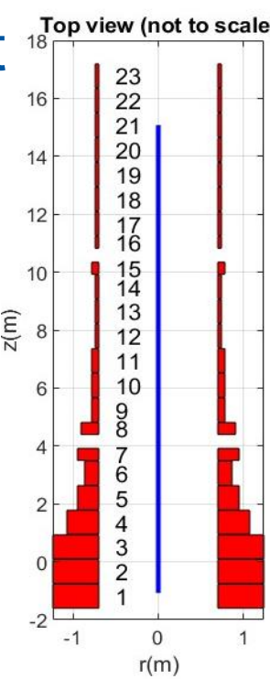
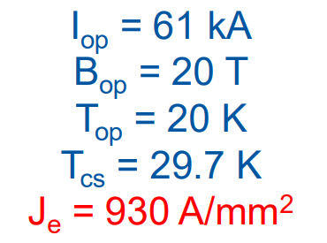
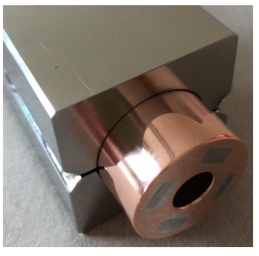
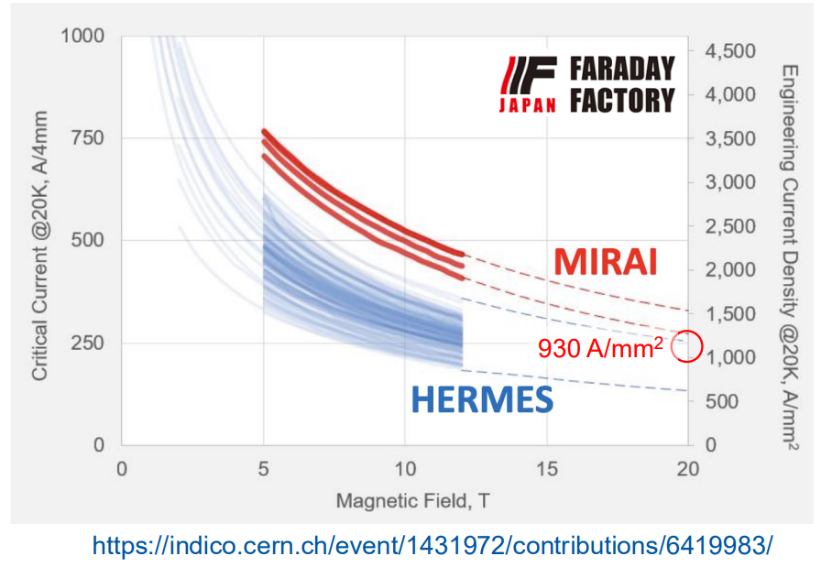
Target & Front End Solenoids
23 solenoids tapering from 20 T down to 2 T
Large 1.38 m bore
Coil beyond state of the art - R&D needed
Benefiting from overlap with Fusion

Slide 12
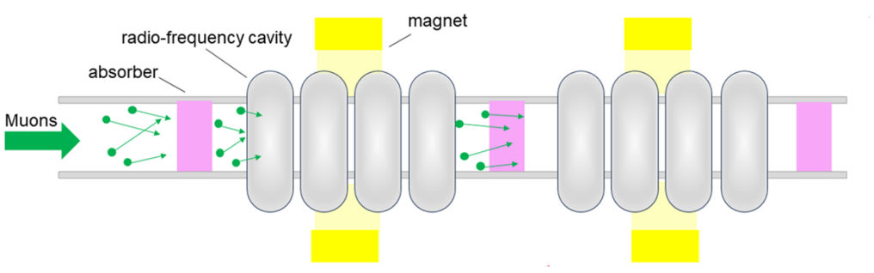
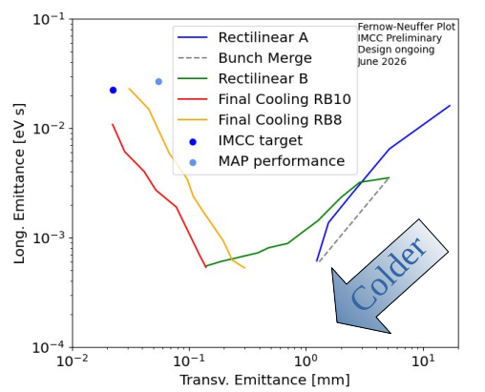
Cooling
D. Stratakis
Magnetic field for focusing and dispersion
Ionization energy loss in all 3 planes in absorber, larger momentum through thicker material
Energy restored in longitudinal direction by RF
6D emittance needs to be cooled by 6 orders of magnitude!
Experimentally demonstrated in the MICE experiment and Muon g-2

Slide 13
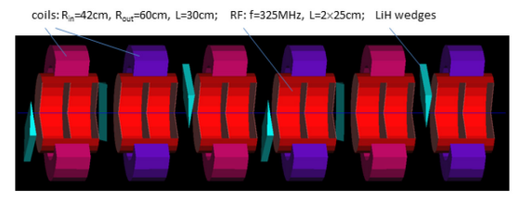
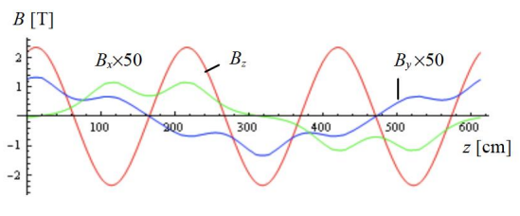
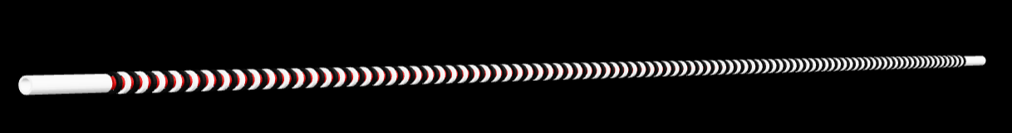
Initial Cooling
One idea: Helical FOFO (HFOFO)
Alternating polarity, tilted solenoids (periodic rotations in x and z, pitch and roll) to generate rotating dipole
~30 periods with 6 solenoids and RF cavities per period
Modest magnetic fields, current density <100 A/mm² - can be achieved with current technology
D. Neuffer, 2016
Example of one period
C. Riggall, 2025

Slide 14
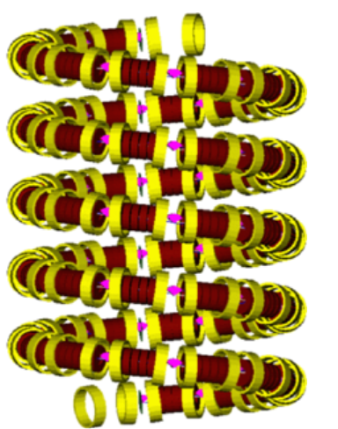
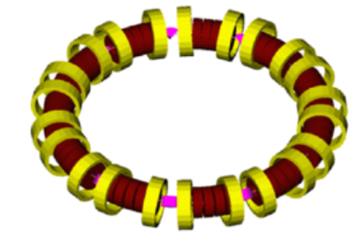

6D Cooling Schemes Considered
Ring
Guggenheim helix
Rectilinear
Helical - Not pictured

Slide 15
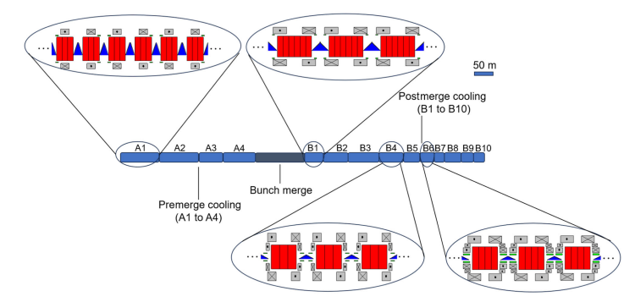
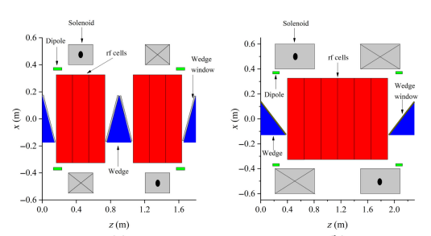
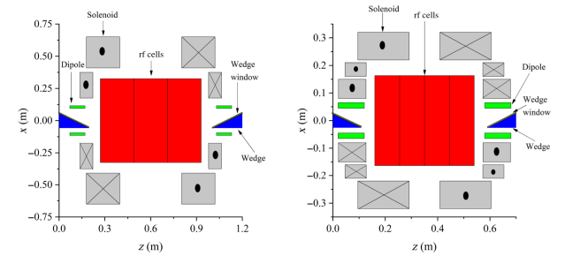
6D Cooling
Solenoids with superimposed dipole
  MAP used titled solenoids
  IMCC solenoids with separate dipoles
Two lattices: pre-merge (A), post-merge (B)
  A 4 stages
  B 10 stages (IMCC variant with shorter 8 stage)
Each stage has ~100 cells
At least three current designs, more in progress
Large forces (tens of MN) due to alternating field direction and nearby coils
R. Zhu, 2025
A1 cell
B1 cell
B4 cell
B6 cell

Slide 16
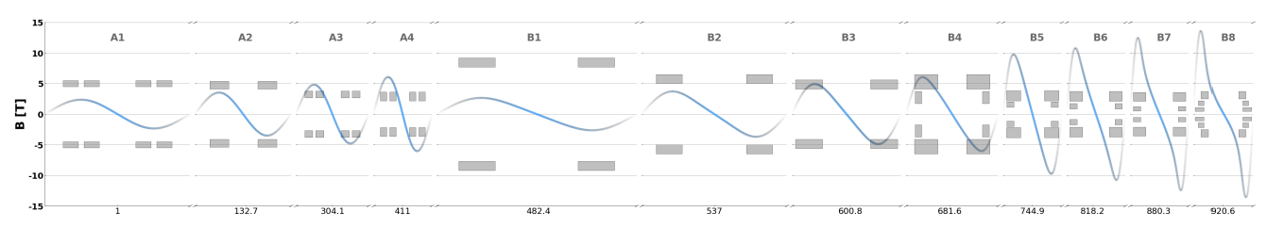
6D Cooling Solenoids
Fields ~sinusoidal
Axis field from 2-17 T
Bore radius 70-600 mm
Over 25 unique solenoids
Two branches, one for each sign
One charge branch requires ~3,000 magnets, so a total of ~6,000 solenoids!

Slide 17
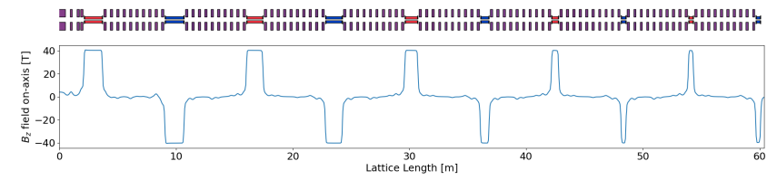
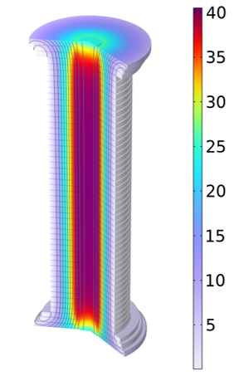
Final Cooling
https://arxiv.org/pdf/2510.27437
MAP
At least 3 lattice designs at present, depending on 6D cooling choice
  IMCC- beam after 6D cooling stage 8 and after stage 10
MAP design 10 alternating high field solenoids separated by 10 lower field solenoids
Required field up to ~43 T!
Current density ~632 A/mm²
R&D needed on HTS magnets
60 mm
730 mm
*B. Bordini et al., "Conceptual Design of a ReBCO Non/Metal-Insulated Ultra-High Field Solenoid for the Muon Collider," in IEEE Transactions on Applied Superconductivity, 2024

Slide 18
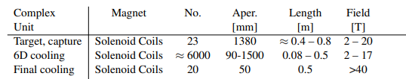
Beyond State-of-the-Art
Field vs Bore of Superconducting Solenoids
MC Final Cooling
MagLab 40 T
LTS = Low Temperature Superconductors (NbTi, Nb₃Sn)
HTS = High Temperature Superconductors (REBCo, Bi-2223, Bi-2212)
State-of-the-Art
MC Target, decay, & capture 20 K
MC 6D Cooling
Plot from Mark Bird with MuC modifications

Slide 19
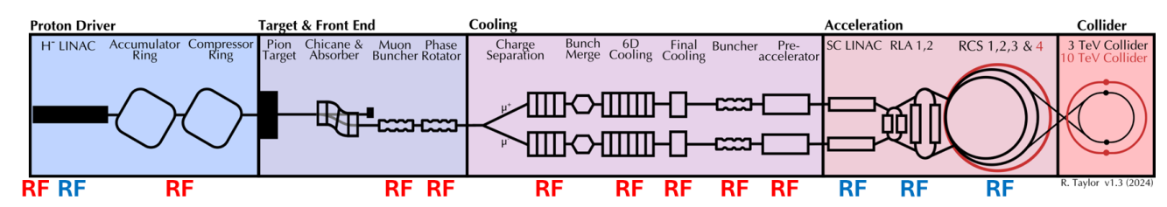
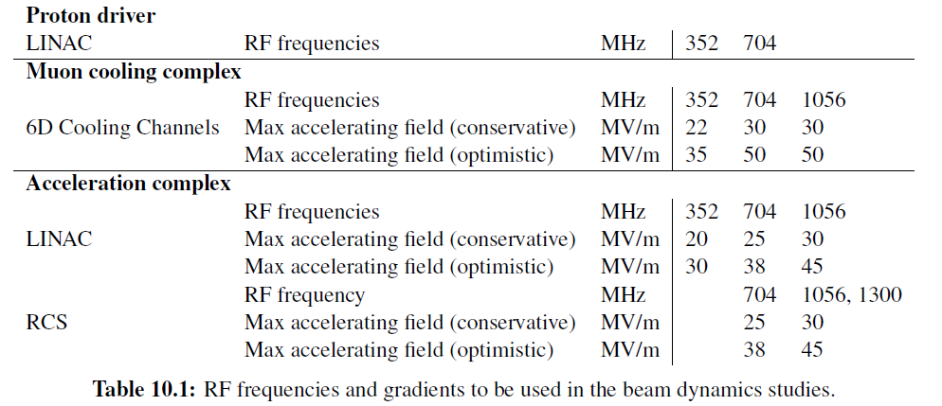
RF
NC RF for Proton Driver:
RFQ and drift tube linac for initial acceleration
Longitudinal gymnastics in Accumulator and Compressor ring
Similar to RF in existing high power proton machines – no significant R&D needed
NC RF for Front End and Cooling:
Large charge and beam size, sub-relativistic
Tightly packed with SC Solenoid, multi-Tesla B field, large gradient
~2,000 cavities per branch
Major R&D area
SRF for Acceleration
Large charge, short bunch
High efficiency at large gradients
Longitudinal and transverse stability
Maintain beam quality
MuCol Consolidated Parameters Report

Slide 20
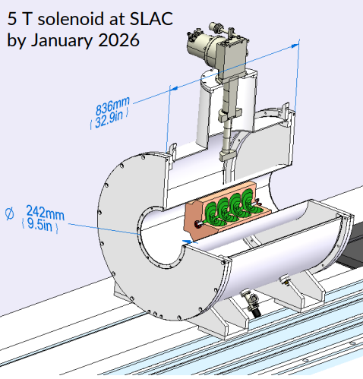
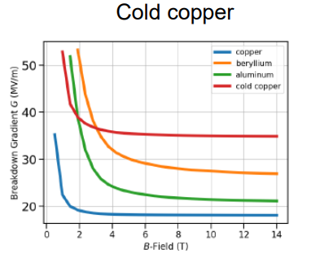
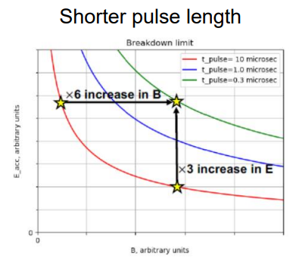
NC RF Challenges and R&D
In the cooling channel: high peak power (~MW), short pulse length, low rep rate (~Hz), tightly packed with SC solenoids and absorbers
Frequency 200 MHz to 800 MHz, High gradient 20-30 MV/m
Good vacuum and surface cleaning, Cu cavities can reach gradients for cooling, 325 MHz (36 MV/m) and 650 MHz (48 MV/m), but not in a magnetic field!
Need to restart Cu cavity testing from MICE/MAP
SLAC setting up new test area with 5T background field
Investigate alternative methods for high E in external B
  Cooling Cu
  Copper alloy
  Shorter pulse length
Gas filled cavity?
Thursday Plenary:
D. Merenich et al, NAPAC2025
S. Arsenyev et al. 2021

Slide 21
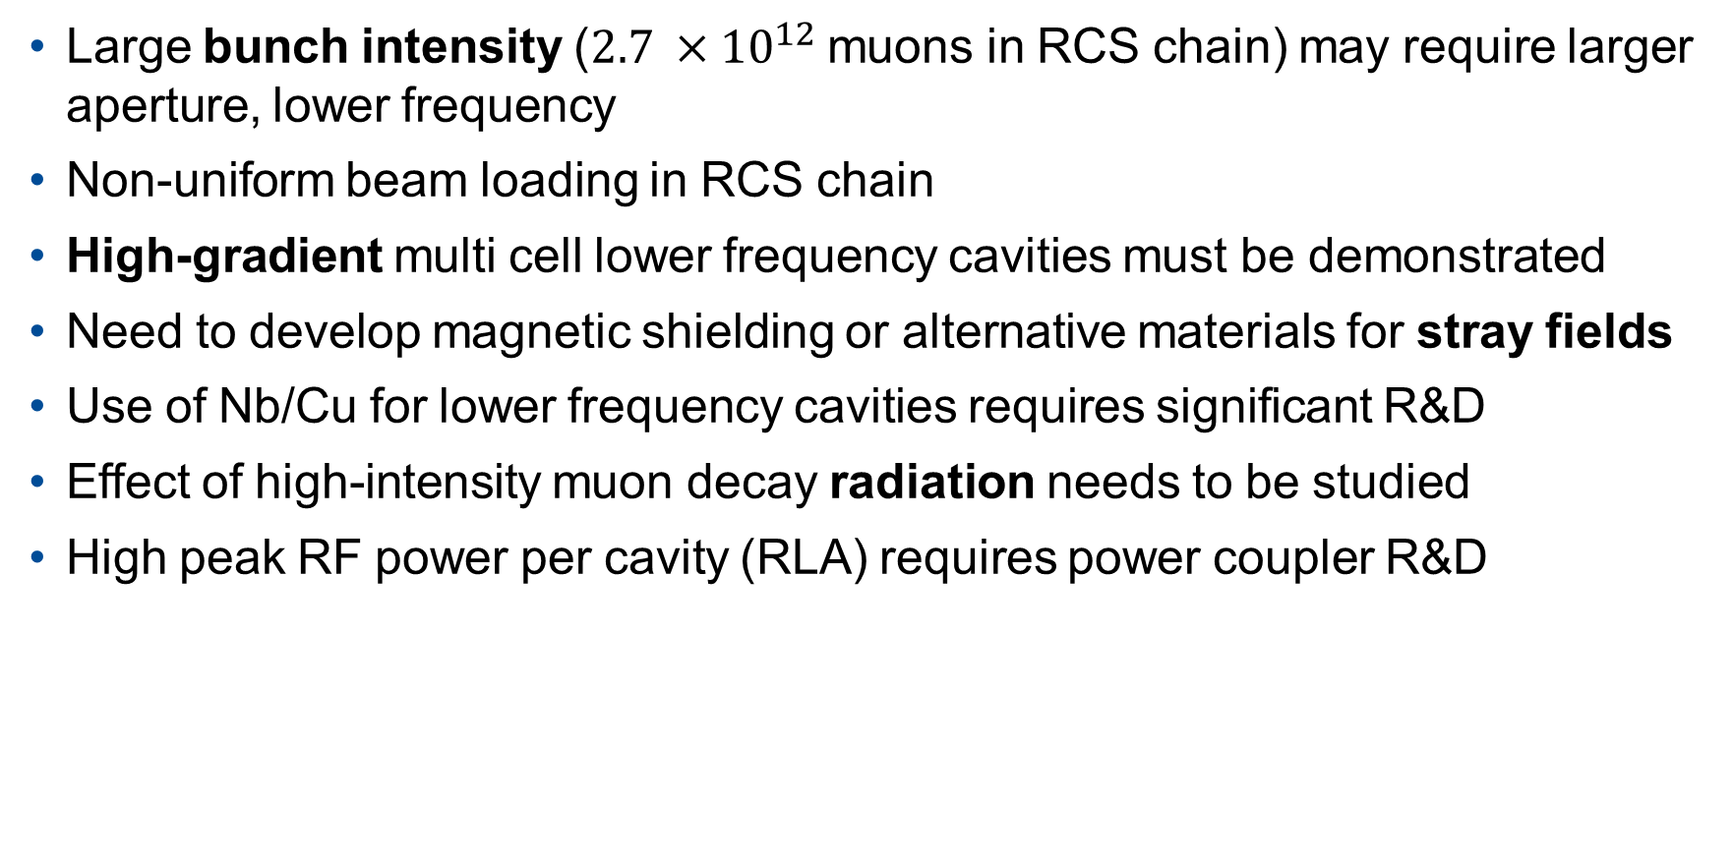
SRF Challenges and R&D
Large bunch intensity ($2.7 ×{10}^{12}$ muons in RCS chain) may require larger aperture, lower frequency
Non-uniform beam loading in RCS chain
High-gradient multi cell lower frequency cavities must be demonstrated
Need to develop magnetic shielding or alternative materials for stray fields
Use of Nb/Cu for lower frequency cavities requires significant R&D
Effect of high-intensity muon decay radiation needs to be studied
High peak RF power per cavity (RLA) requires power coupler R&D

Slide 22
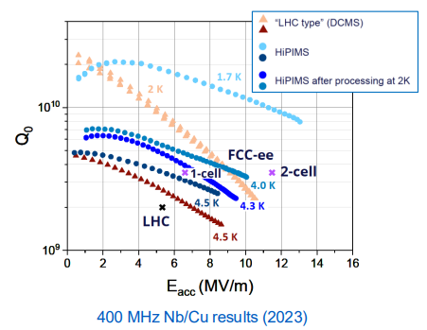
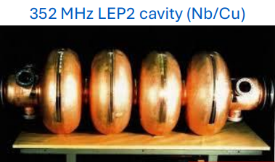
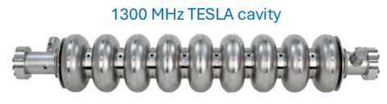
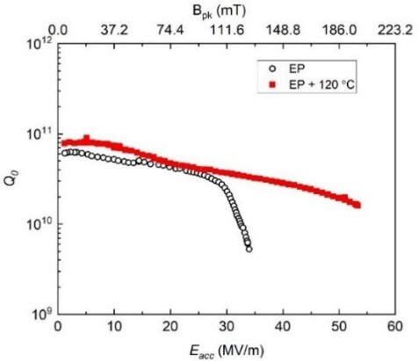
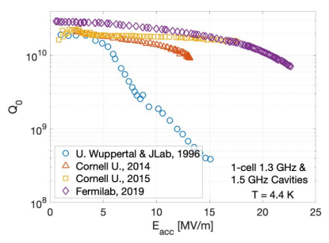
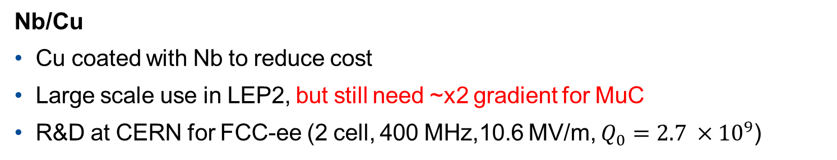
SRF Technology
Nb/Cu
Cu coated with Nb to reduce cost
Large scale use in LEP2, but still need ~x2 gradient for MuC
R&D at CERN for FCC-ee (2 cell, 400 MHz,10.6 MV/m, $Q_{0}=2.7 ×{10}^{9}$)
Nb
1300 MHz developed for future ILC, similar parameters to MuC
European XFEL using this technology, gradients exceeding 26 MV/m
Sensitive to magnetic field
Nb₃Sn/Nb
Less sensitive to trapped magnetic flux
Progress, but gradient still low and material is brittle
More R&D needed
53.3 Mv/m 650 MHz at Fermilab

Slide 23
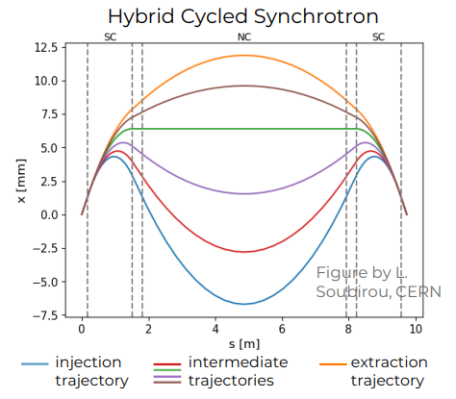



Acceleration
Low Energy (250 MeV to 62.5 GeV)
Superconducting LINAC and two recirculating linear accelerators (RLA)
Preliminary optics for the RLA2, but no optics design yet for LINAC or RLA1
High Energy (up to 5 TeV)
4 rapid cycling synchrotrons (RCS)
Further optimization of lattice needed
High gradient SRF cavities 650-1300 MHz
Fast ramping (4000 T/s) NC magnets
  10s of GW in resistive dipoles
10-16 T DC SC magnet
NC Dipole Optimization M. Breschi, F. Boattini
SC Dipole Optimization M. Breschi, F. Boattini

Slide 24




Collider Ring
Would like the smallest possible circumference to maximize collisions in muon lifetime
Arc magnets and interaction region (IR) dipoles and quads must have high field and large aperture to accommodate shielding
  heat load of 500 W/m (muon decay and synchrotron radiation) reduced by shielding to below 5 W/m
  Requires 30-40 mm tungsten
Minimize straight sections with combined function magnets to reduce collimated neutron beam
Main dipoles up to 16 T, 140 mm bore
Arc combined function
  Dipole/Sext 14T, 7100 T/m², 100 mm bore
  Dipole/quad 8T, 320 T/m, 100 mm bore
Lattice design and magnet requirements still being updated
  Design in place for 3 TeV, 10 TeV more challenging $β$(5$→$1.5 mm)
  HTS magnet development needed
A. Lechner
16 T ReBCO block dipole L. Alfonso, et al 2026

Slide 25


Muon Cooling Demonstrator
Would like to demonstrate operation of integrated components
  RF cavities capable of operating in multi-T background fields
  Solenoids capable of operating in high background field and withstand forces/stresses
  Realistic cooling cell (Late stage cells in the cooling channel much more challenging)
  Measurement and characterization tools/simulations
  Power, cooling,….
IMCC has laid out a staged approach
  Potential locations CERN- TT7 facility, CTF3
IMCC Demonstrator Workshop SLAC Dec 2026
  Fermilab 2024, INFN Milan 2025
Studies for having a demonstrator in the US ongoing
  Poster on Monday:

Slide 26

Looking Forward
Recent comments from DOE:
We will not be able to support vigorous R&D toward a cost-effective 10 TeV pCM
We plan to reduce funding to the General Accelerator R&D (GARD) program
Limited R&D funding for the next 5 years to enable new projects
Unlikely to initiate any new major construction projects for the next 6-7 years
All is not lost
Large community momentum
Several significant technology challenges = R&D opportunities
Look for funding overlap with other areas
  Fusion, FCC-ee, neutrino facilities …

Slide 28


Slide 29



REBCO-Structure
www.superpower-inc.com
Rare-earth Barium Copper Oxide
  yttrium, lanthanum, samarium, neodymium, gadolinium and europium
Fabrication
  Physical vapor deposition- pulsed laser, sputtering, molecular beam epitaxy,…
  Chemical vapor deposition- Metal-organic chemical vapor deposition, plasma enhanced
  Atomic layer deposition
a-b plane of crystal structure ~ along plane of tape
Critical current density is highly anisotropic, depends on B field orientation to crystal structure
  Design winding to minimize perpendicular field?
c
b
J Jaroszynski et al 2022 Supercond. Sci. Technol. 35 095009
a

Slide 30






REBCO- Fabrication and Winding
Formed as wide tape and mechanically or laser slit to desired width, leads to non-uniformity in thickness at the edges
Non-uniform thickness creates voids in winding, voids lead to kinks and non-uniform turn-to-turn resistance
M. Small 2021
300 turns
J. Bang 2025 Little Big Coil
R. Unterrainer 2025

Slide 31







REBCO-Mechanical Limits
Longitudinal driven by plastic deformation of substrate causing cracking in REBCO
Transverse compression driven by stress concentration
Loading direction
Grains of Hastelloy
M. Sugano et al 2005 Supercond. Sci. Technol. 18 S344
Maeda et al. 2014
Limits bend radius
Several images taken from G. Vernassa’s talk Performance Limitations of UHF REBCO Solenoids

Slide 32



REBCO-Mechanical Limits
Cracks at slit edges
Layered structure vulnerable to delamination
Delamination driven by local defects
  Cracks, delamination nucleation sites, inclusions…
Need non-destructive method of characterizing tapes
Stress concentration at crystallites
Slit edge side
Slit edge side
Ag
Ag
Mixed
crack./delam.
EuBCO
Delamination
EuBCO
Y₂O₃
MgO
MgO
Y₂O₃
Al₂O₃
Adapted from P. Gao et al., Supercond. 2023
Al₂O₃
Hastelloy® C-276
1 μm
Hastelloy® C-276
2.5 μm
Several images taken from G. Vernassa’s talk Performance Limitations of UHF REBCO Solenoids

Slide 33







Screening Currents – Little Big Coil Program
12 NI pancakes in 31 T background field
Stress from screening current caused plastic deformation
Orientation of slit edge appeared to play a role
  Result of crystal tilt and non-uniform Jc instead
M. Wang, 2019
J. Bang, 2025

Slide 34

REBCO – Additional R&D Areas
YateStar measurement of critical current at 77K of SuperPower tape
Non-uniform critical current across width of tape
  Use multiple tapes in parallel
Quench protection
  Slow normal zone propagation ~cm/s
  Non-insulated vs insulated
Low resistance splice method
Radiation damage
Need to match simulation to experiments
  Couple electromagnetic and mechanical simulations
  Screening currents change inductance
Test larger coils
  Cooling, powering, quench protection
…
Paul Yu
T. Mulder

