Slide 1
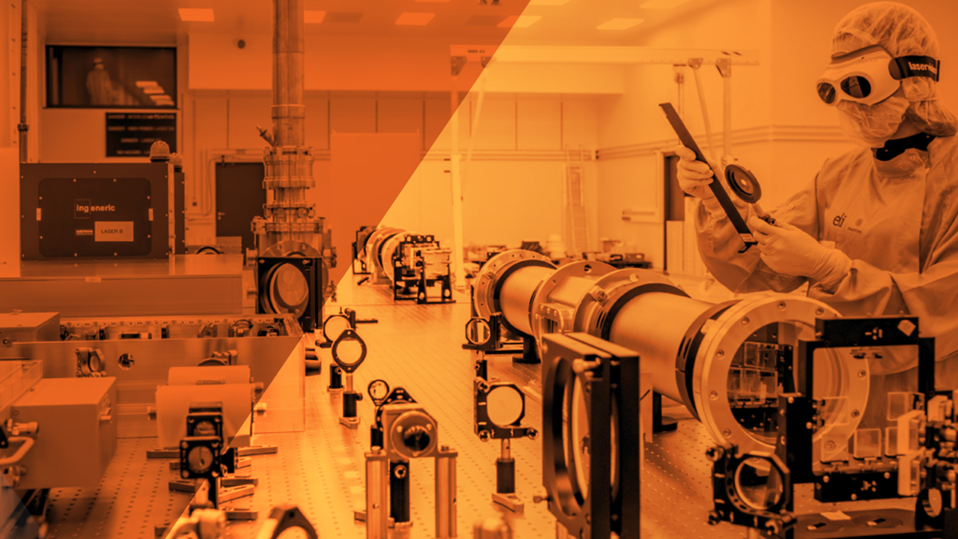



High Repetition Rate LWFA with all-optical guiding for user experiments at ELI Beamlines
Gabriele Maria Grittani
J. Šišma, M. Nevrkla, F. Vitha, S. Lorenz, I. Zymak, A. Špádová, A. Kollárová, M. Jech, A. Jančárek, D. Peceli, C. M. Lazzarini, L. V. N. Goncalves, P. Valenta, S. V. Bulanov (ELI Beamlines)
J. E. Shrock, E. Rockafellow, A. J. Sloss, G. Brewster, B. Miao, S. W. Hancock, H. M. Milchberg (UMD)
Advanced Accelerator Concepts, UCLA, 30th July 2026
A European Research Infrastructure Consortium

Slide 2











Acknowledgments
C. M. Lazzarini, M. Nevrkla, S. Lorenz, F. Vitha, J. Sisma, A. Spadova, A. Kollarova, L. Vilanova, M. Jech, I . Zymak, P. Valenta, A. Cimmino, D. Horvath, R. Versaci, B. Rus, P. Szotkowski, J. Novak, R. Antipenkov, A. Grenfell, V. Sobr, P. Bakule, D. Kramer, C. Kamperidis, D. Papp, N. Hafz, K. Hideghety, J. Dudas, R. Szabo, R. Molnar, S. V. Bulanov, P. Tomassini, D. Margarone
H.-K. Liu, C.-E. Lin, P. Chen
A. Pirozhkov, T. Wei, M. Kando
J. Williams, B. Pagano, F. Treffert, S. Kerr
L. Labate, L. A. Gizzi
B. Reagan, J. Rocca
E. Gerstmayr, C. MacAnespie, K. Fleck, G. Sarri
J. Shrock, E. Rockafellow, A. Sloss, G. Brewster, S. Hancock, H. Milchberg
T. Ditmire, C. Hojbota, M. Hegelich
B. K. Russell
S. S. Bulanov
A. G. R. Thomas, R. Herbst, Y. Ma

Slide 3
Outline of the talk
The Extreme Light Infrastructure and the ELI Beamlines User Facility
Development of the laser electron acceleration user program at ELI Beamlines
0.2 Hz and 3.3 Hz LWFA with all-optical guiding in ELBA laser electron collider
1 kHz LWFA with all-optical guiding in ALFA beamline

Slide 4

The Extreme Light Infrastructure (ELI)

Slide 5

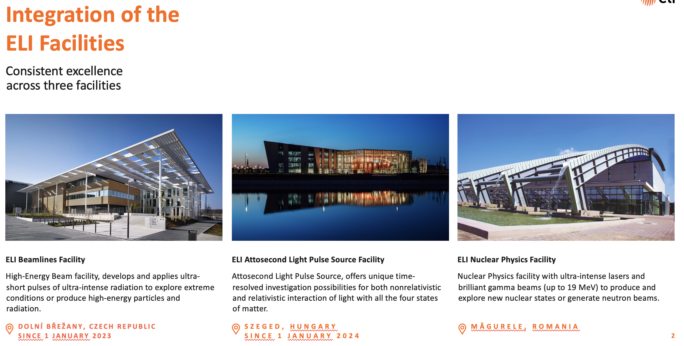

Slide 6
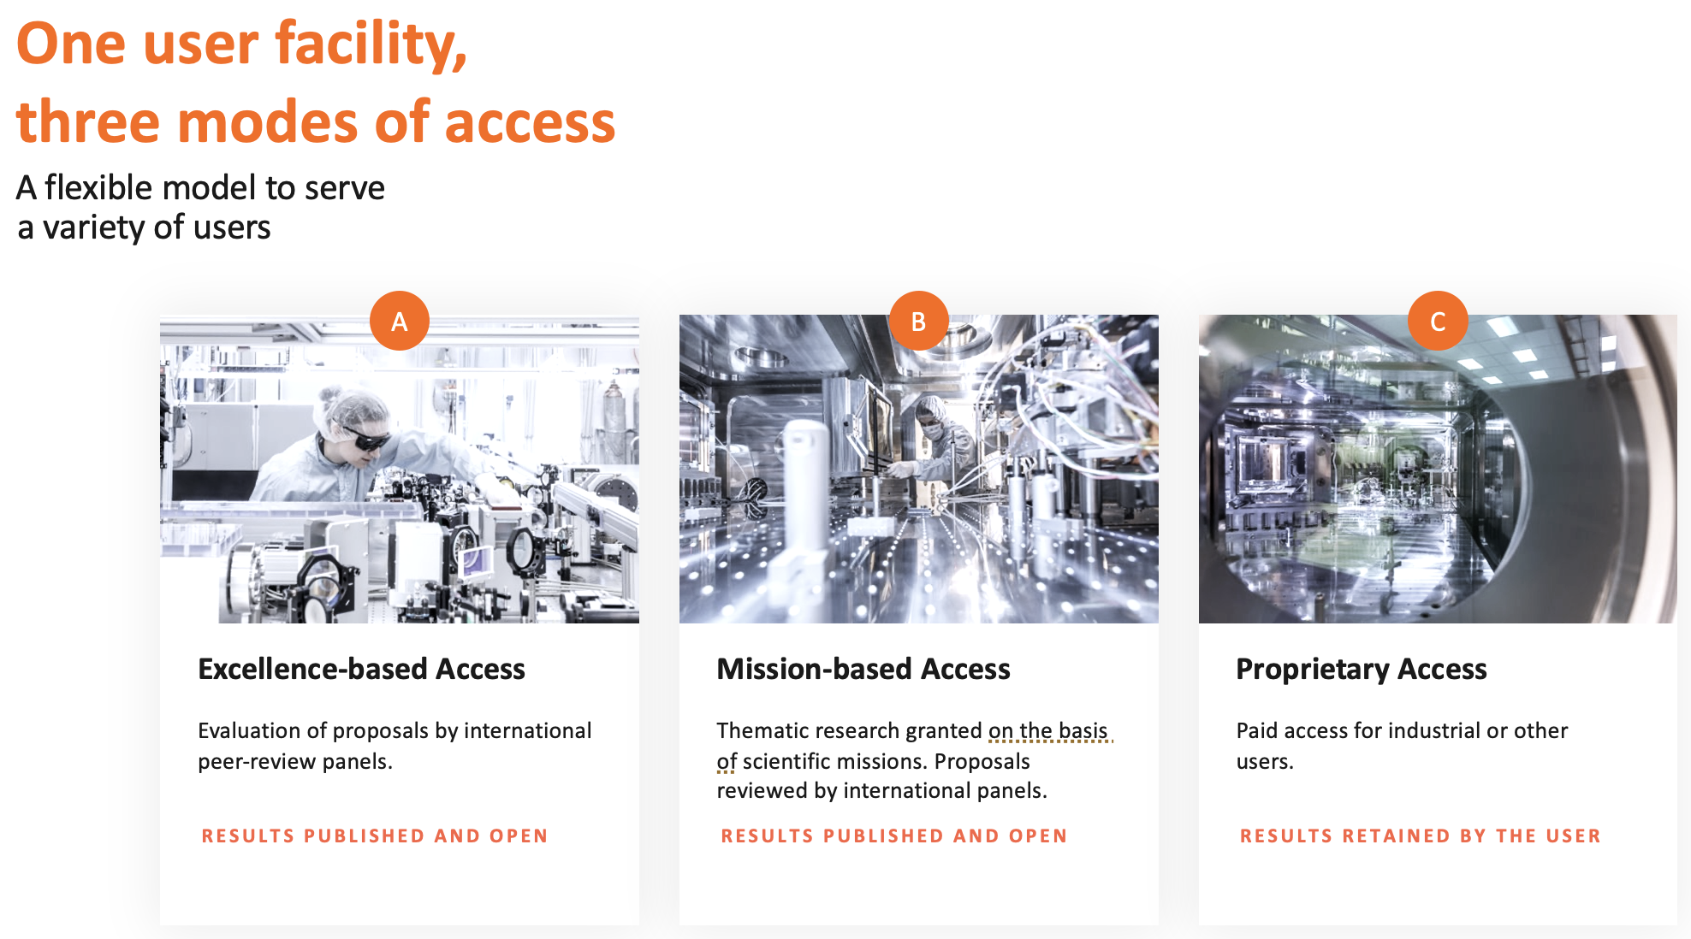

Slide 7
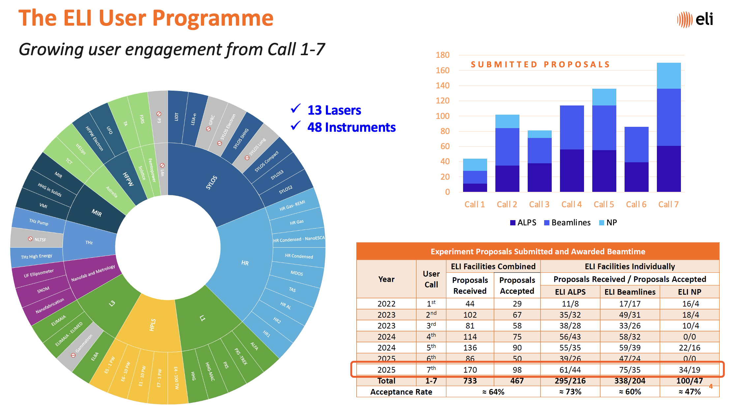
ELI Beamlines Facility

Slide 8
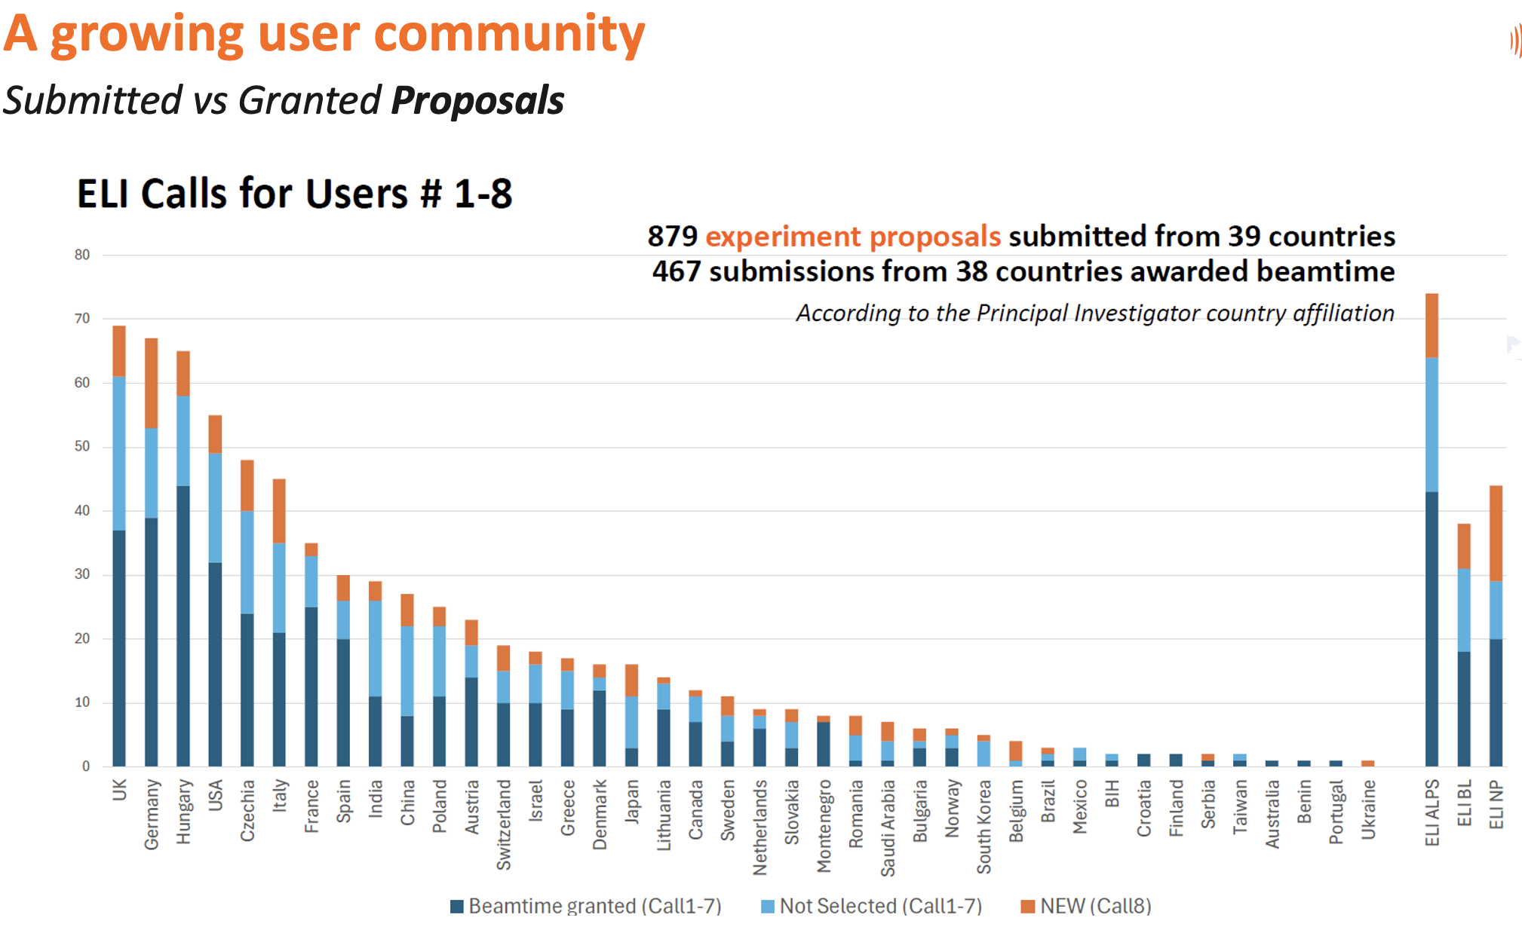
ELI Beamlines Facility

Slide 9
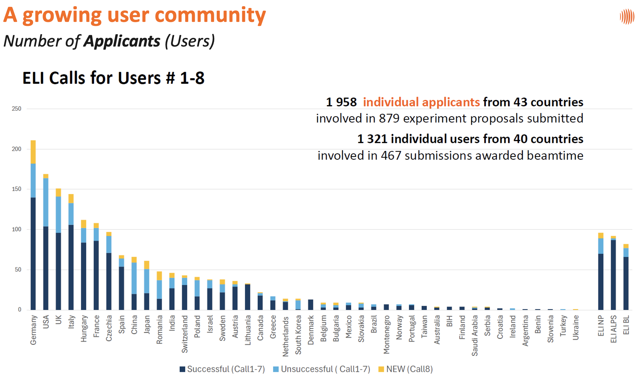
ELI Beamlines Facility

Slide 10
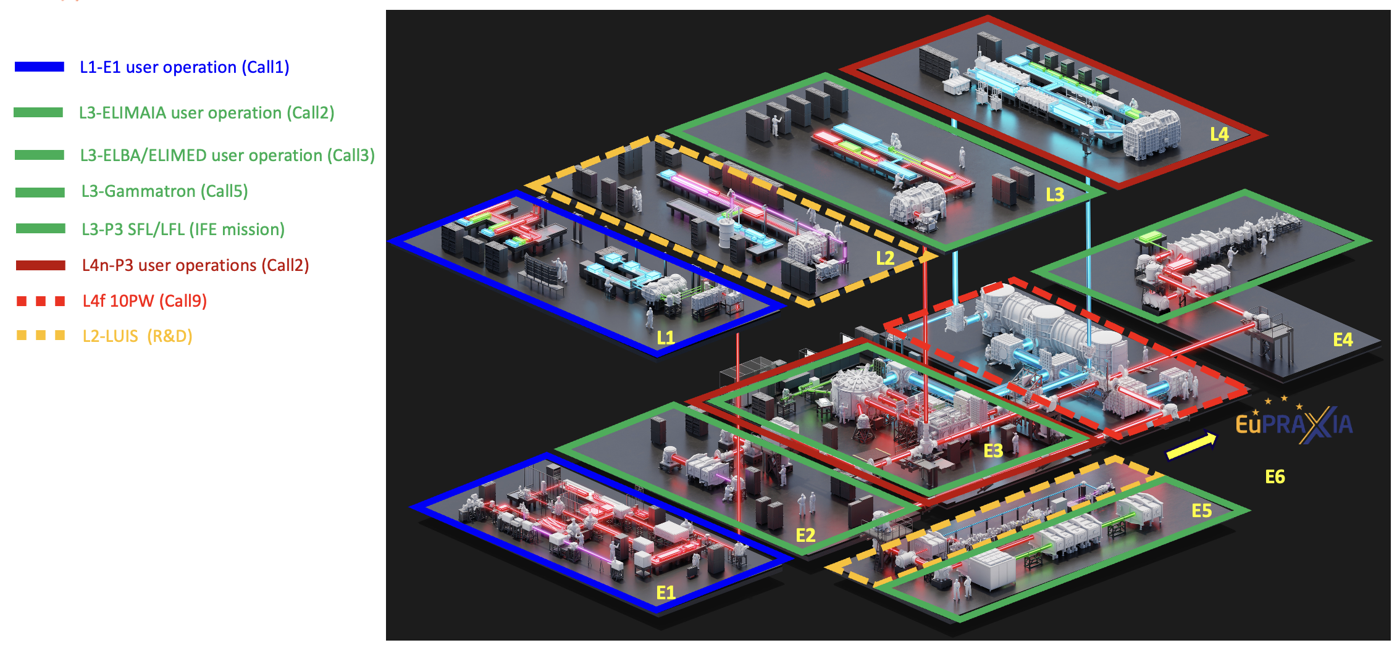
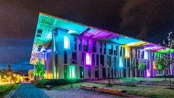
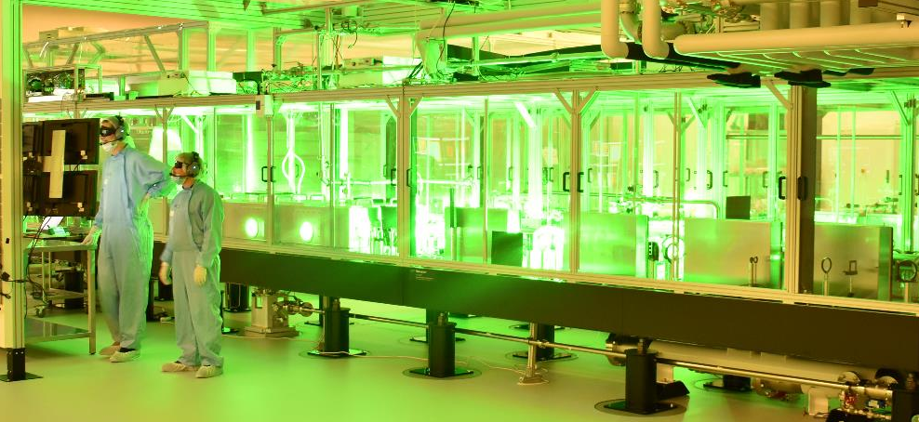
ELI Beamlines Lasers
User Science Areas and Mission
Exploit high-energy and high-flux particles and photons through dedicated beamlines driven by high-energy and high repetition-rate (high average power) PW-class lasers for ultrafast radiobiology, ultrahigh dose-rate/FLASH radiotherapy research, material science, etc.
Deliver ultrahigh laser intensities (>10²² W/cm²) on target for high-field physics, including SF-QED (kJ-class and 10s-J-class, high rep. rate lasers)
Exploit multi-beam configurations in exp. stations for pump-probe setups to study ultrafast dynamics in the kHz regime (AMO science and structural biology) and in the kJ/ns regime (HEDP, including IFE research)

Slide 11
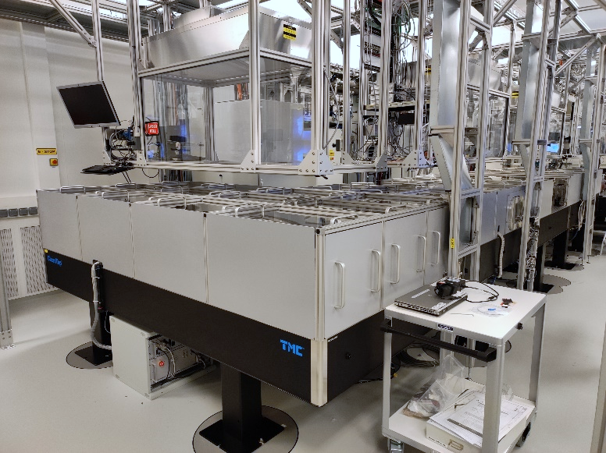
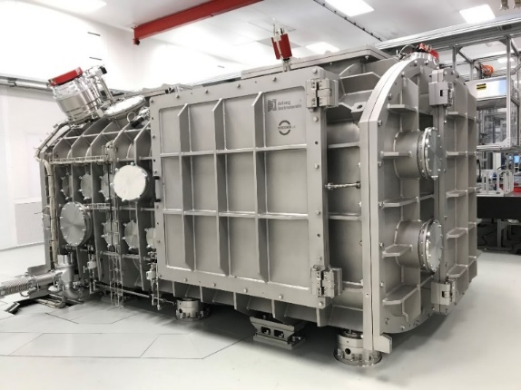
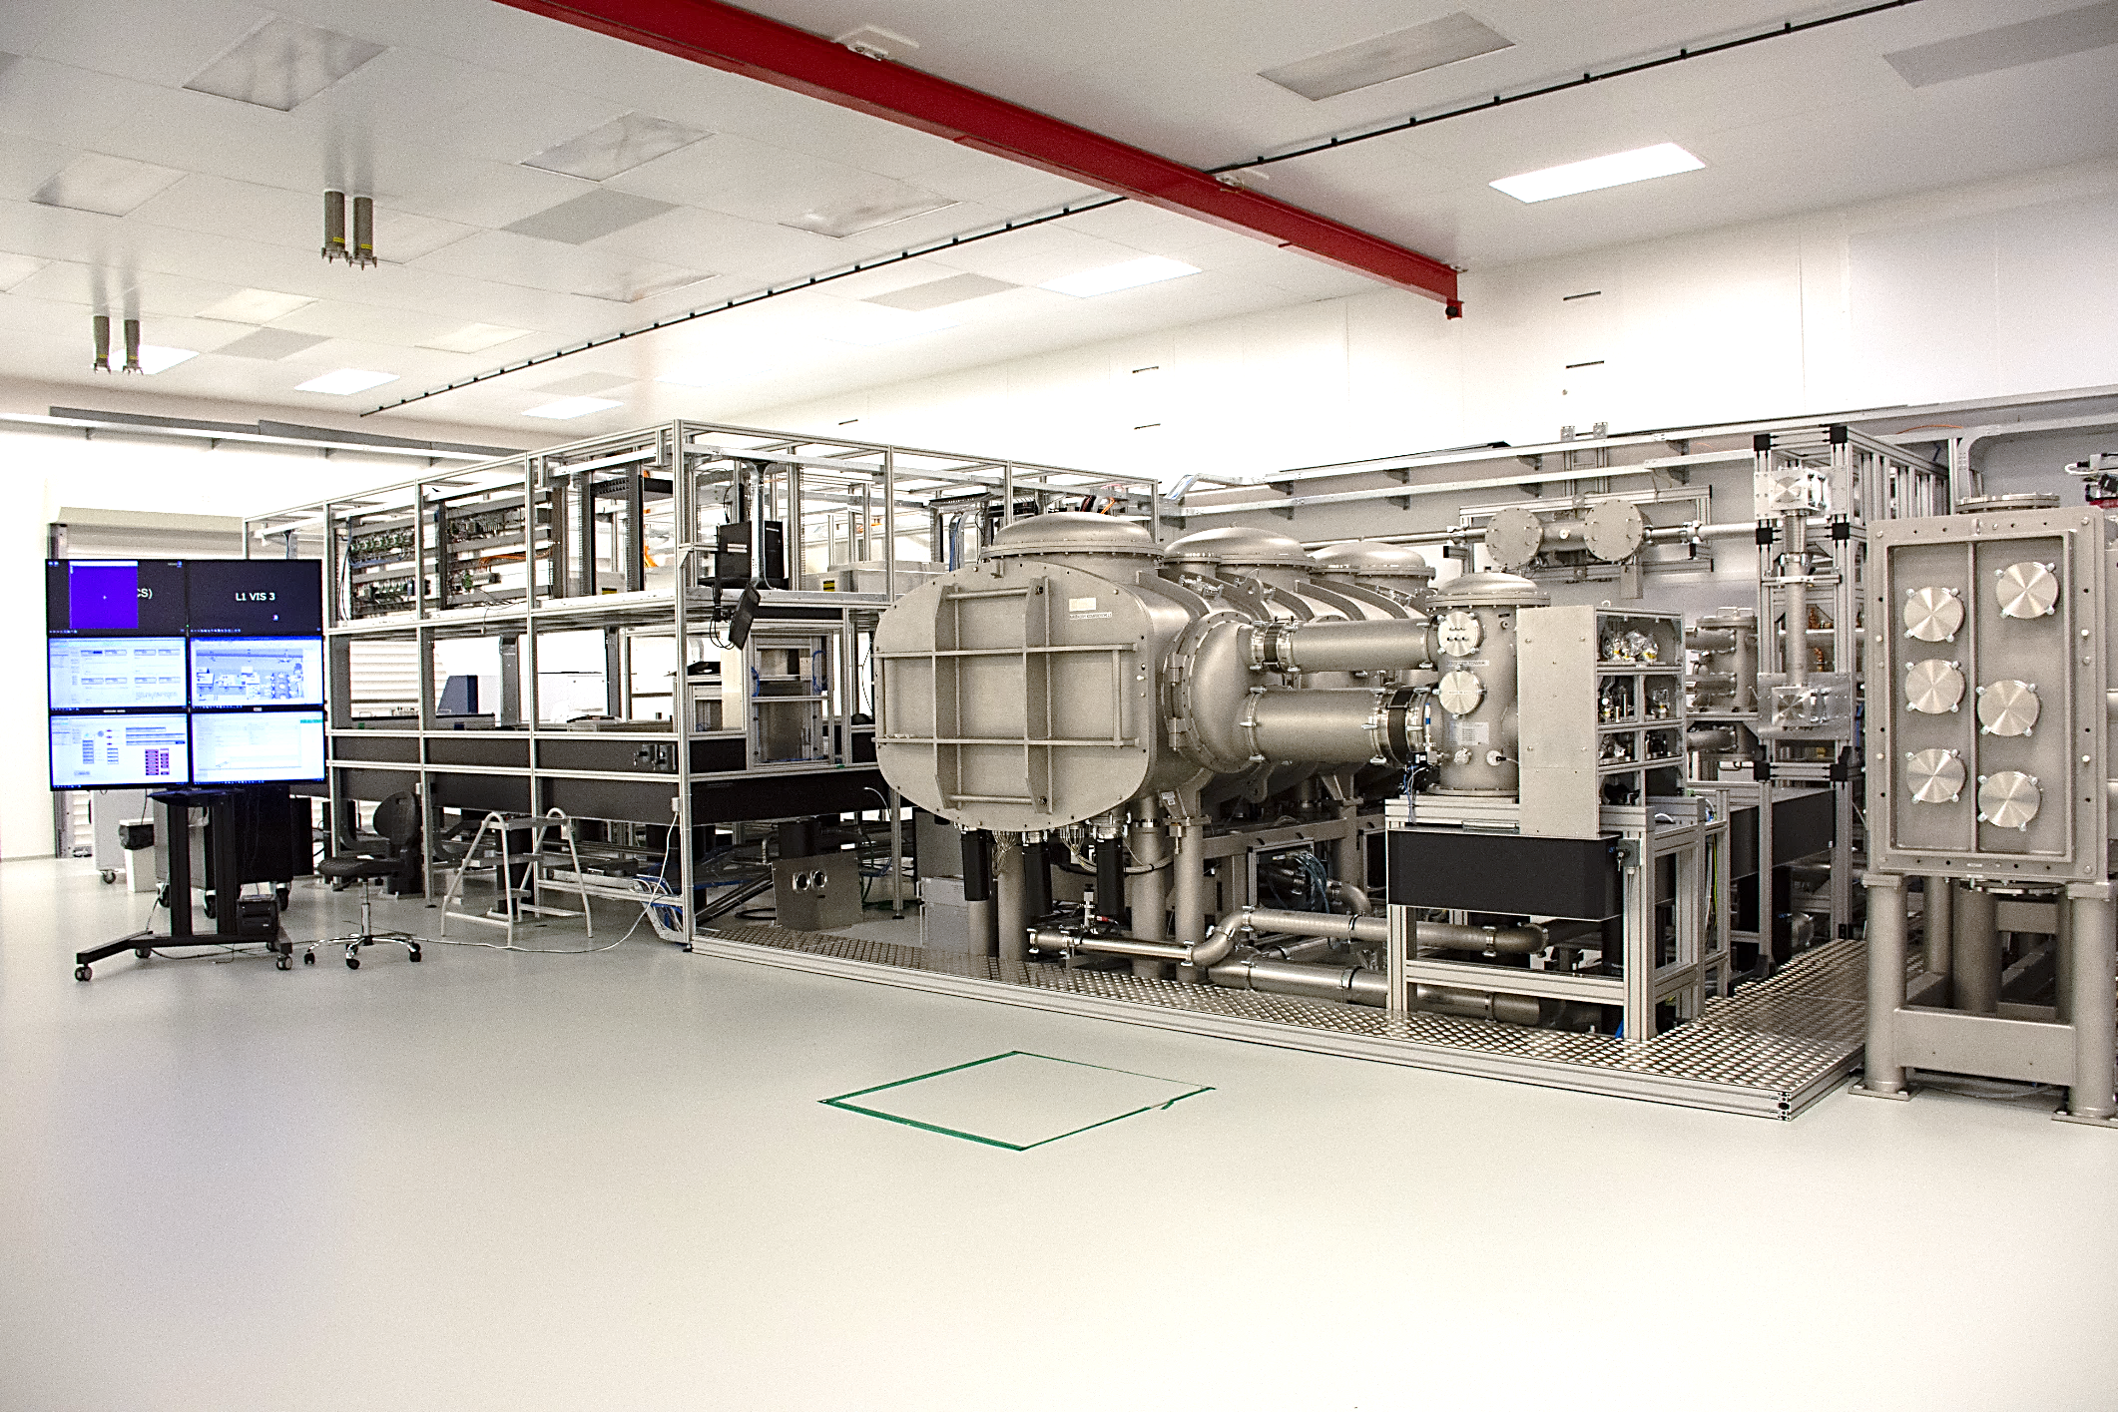
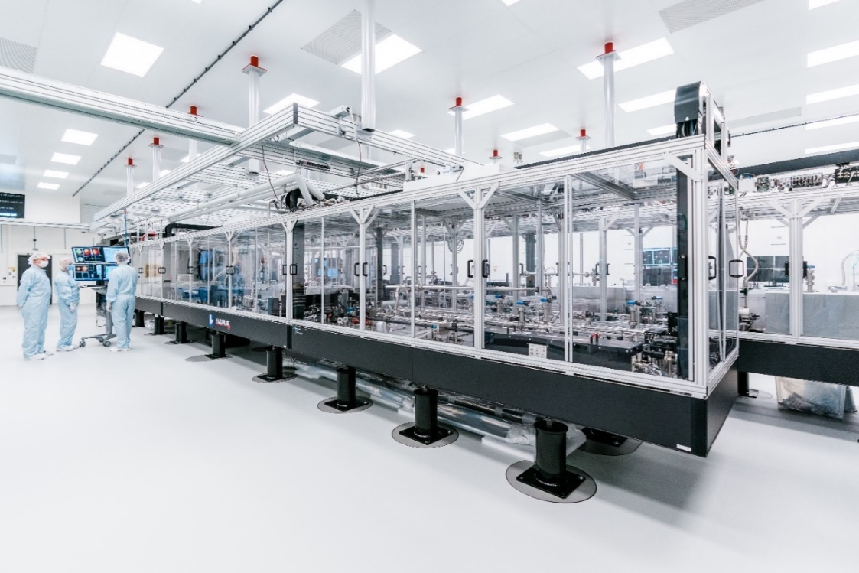

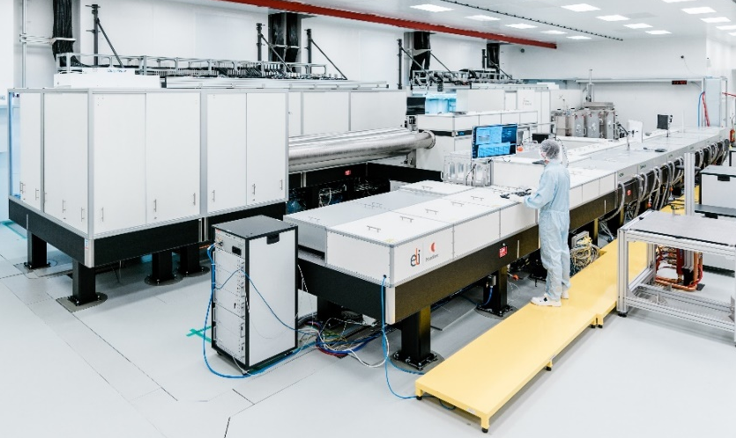
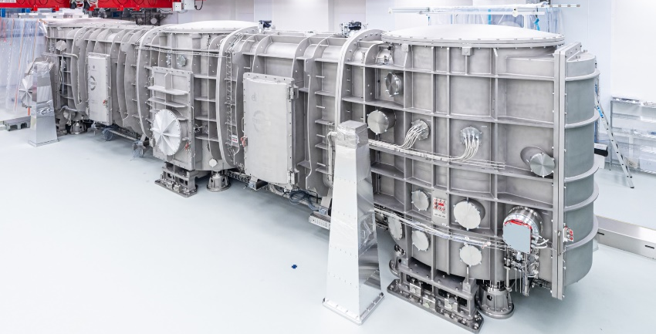
ELI Beamlines Lasers
L1-ALLEGRA 100mJ/12fs/1kHz (>5TW) laser system
(in operation – 50mJ/15fs/1kHz)
L2-DUHA: 3J/20fs/20-100Hz (>100TW) laser system
(under development)
10s MeV
ALFA beamline
EUPRAXIA
Thin disk Yb:YAG (diode-pumped) pump, ps OPCPA
Auxiliary (FSYNC) 15 mJ /12 fs beam
Cryogenic He-cooled slab Yb:YAG (diode-pumped) pump, ns OPCPA
Expected availability for commissioning experiments: Q4 2025
L3-HAPLS: 30J/30fs/10Hz (1PW) laser system
(in operation – 15J/27fs/3.3Hz)
L4-ATON: 1.5kJ/150fs/1shot/min (10PW) laser system
(long pulse in operation – 1.2kJ (0.6kJ @2w)/2-10ns/1shot/min)
multi-GeV – ELBA beamline
10s GeV / kJ LWFA
future plans
[Ludwig et al., Sci. Rep. 15 25902 (2025)]
Mixed Nd:glass (>15nm spectral bandwidth)
ns-kJ pulses with programmable temporal shaping (150ps steps)
10PW commissioning on target: Q4 2025
He-cooled (diode-pumped) Nd:glass pump, Ti:Sa
Ramping to 1PW, 3.3Hz (Q1 2027)

Slide 12
We had the laser parameters as an input. Our task was to design beamlines and to develop of a user program around them. We target 8-12 applications per instrument, per call (2 calls/year).
Who needs beamtime at a laser electron accelerator?
What can we reliably offer to users?
What we have been doing to answer to these questions:
Dedicated User Conference (yearly)
Dedicated technical reviews and workshops
Intensive participation in LWFA experiments at other facilities
Constant presence at related conferences and workshops
Active involvement with the user community in discussing new ideas that could turn into a user proposal
Develop robust technology
Guaranteed and best-effort parameters philosophy
Reliable LWFA beamline with all the latest toys
LWFA Source development (e.g. guiding, hybrid)
Detector and radiobiology (electron beam with fs duration and tunable parameters)
Electron beam + high intensity laser experiments (e.g. QED, Compton, Flying Mirror)

Slide 13
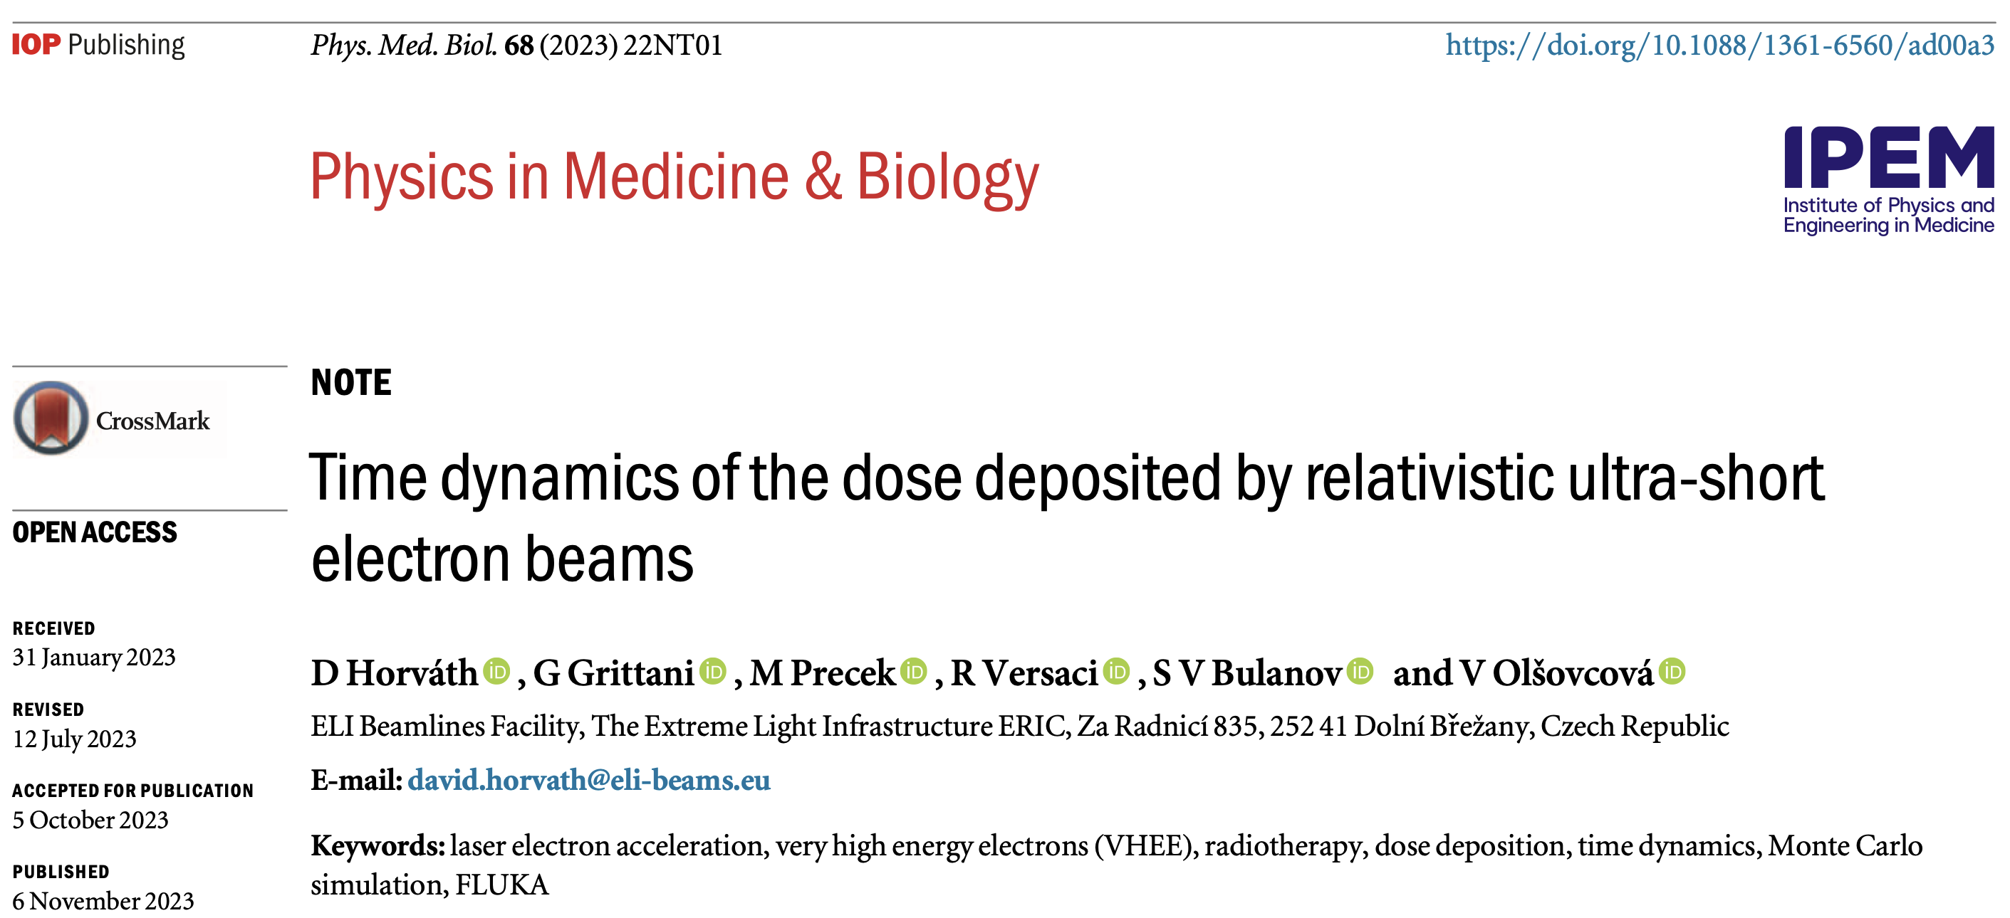
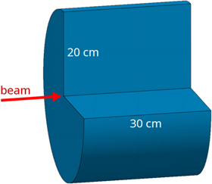
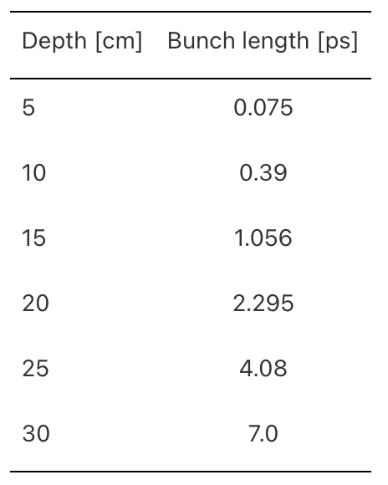
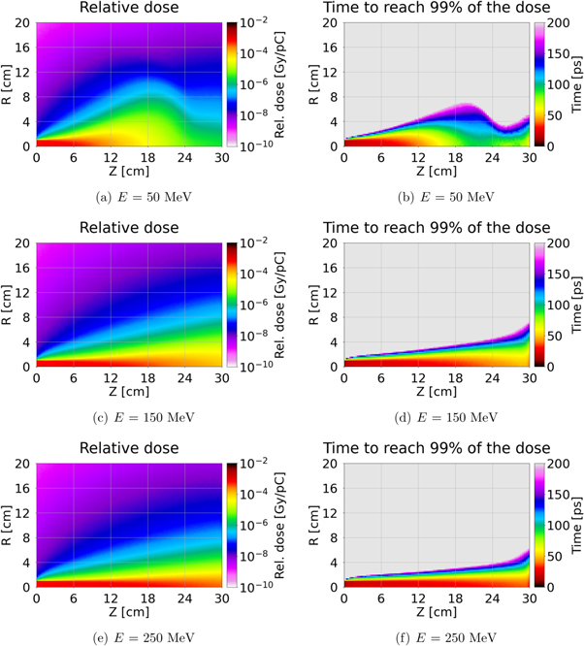
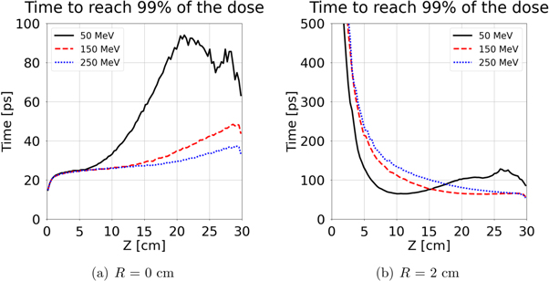
A femto-second electron beam at the exit of the plasma will not necessarily deposit the dose in femto-second time scale.

Slide 14
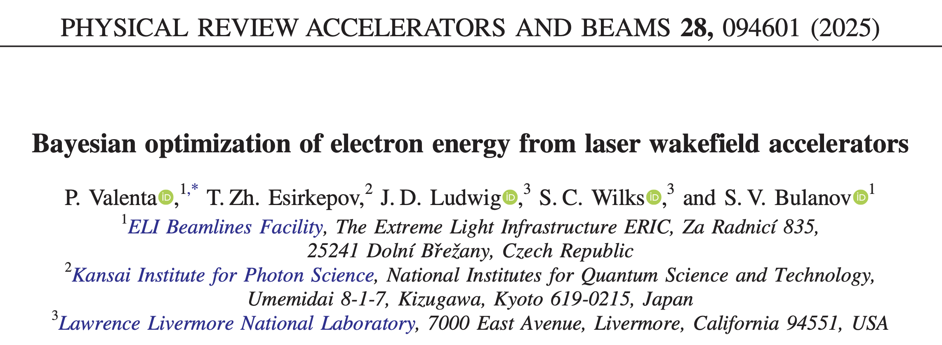
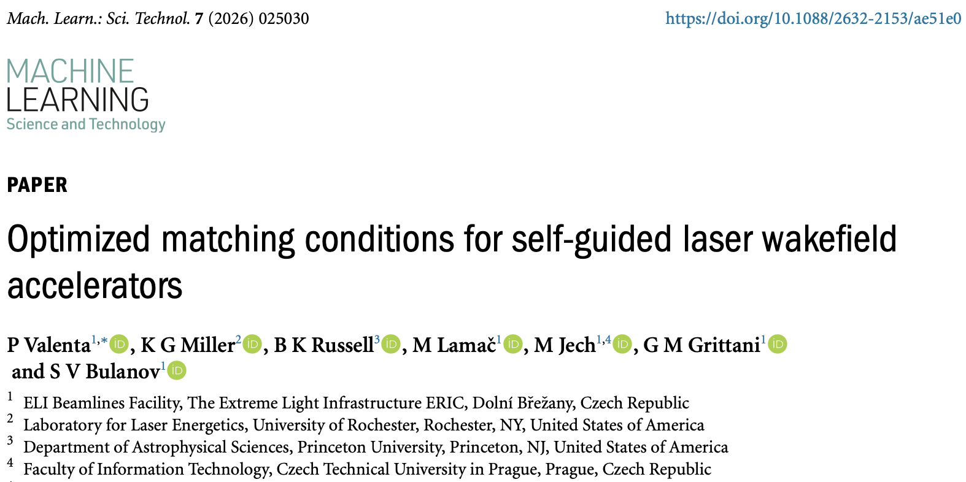
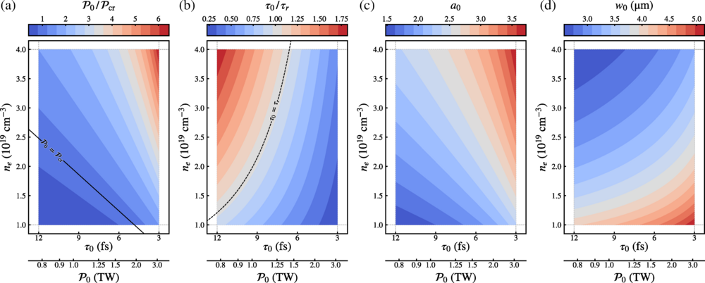
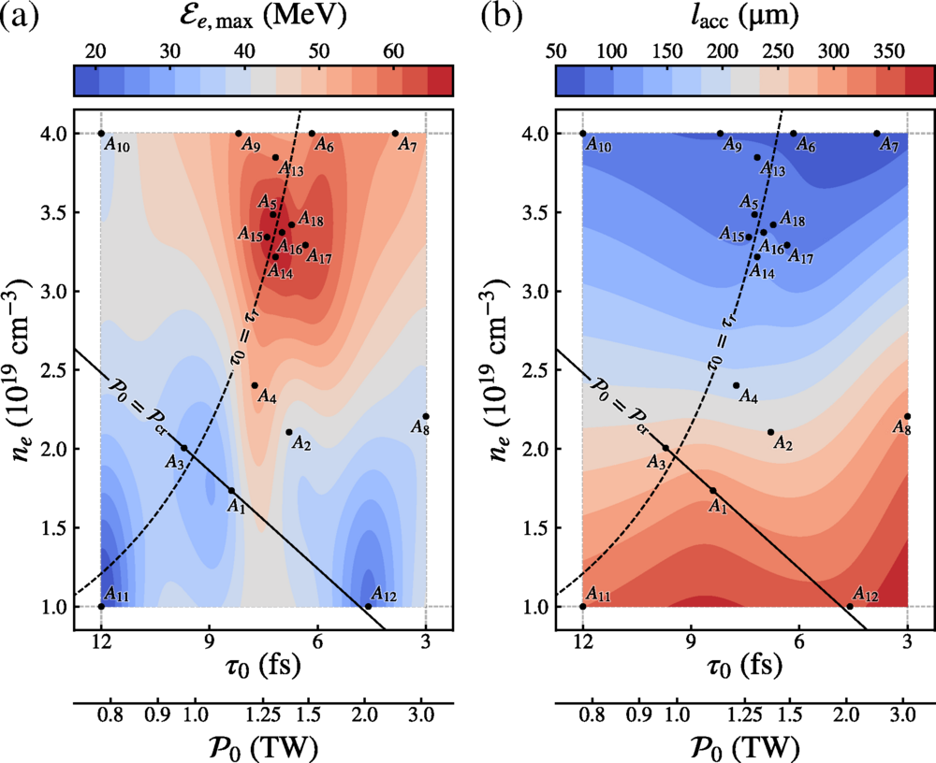
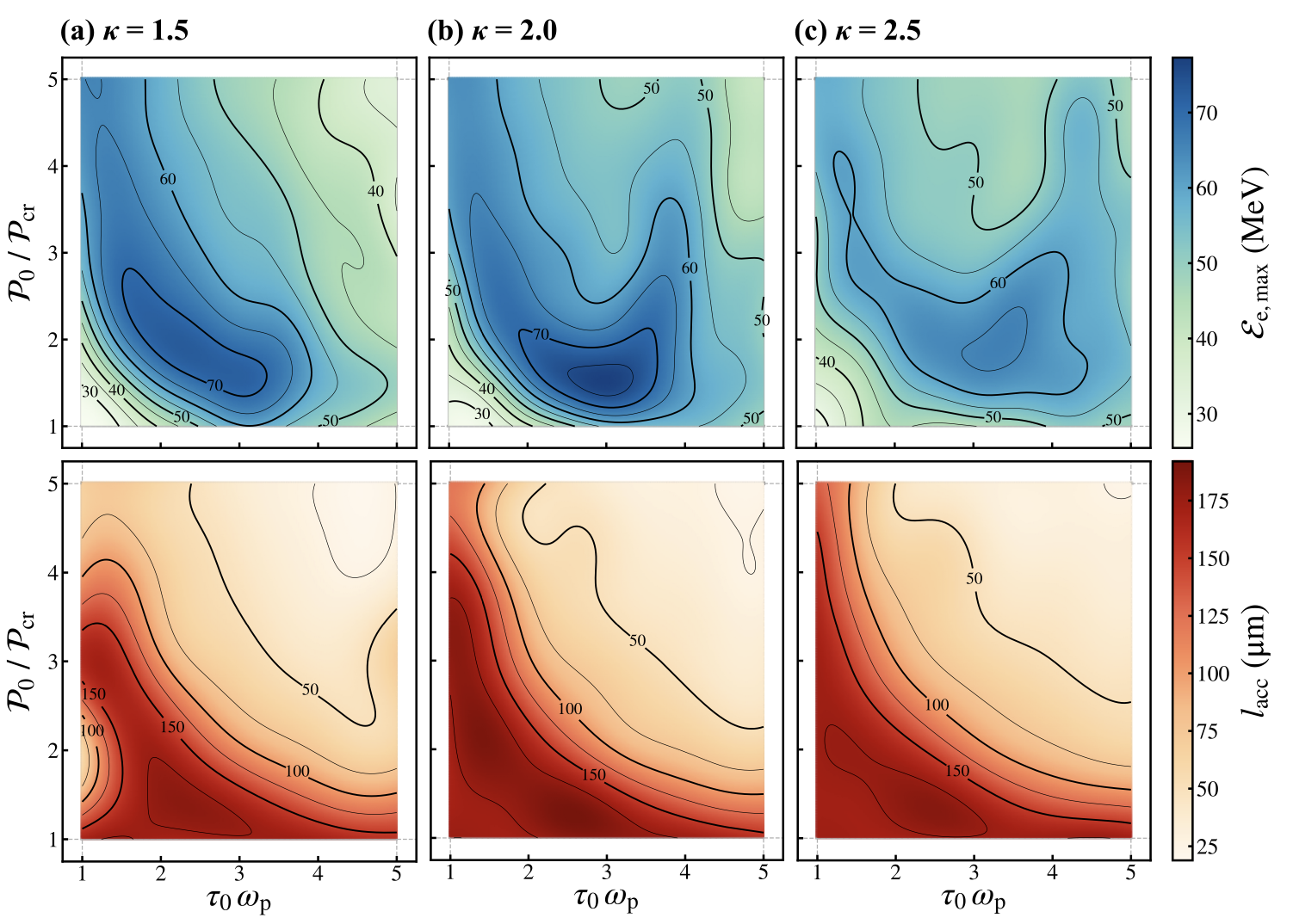
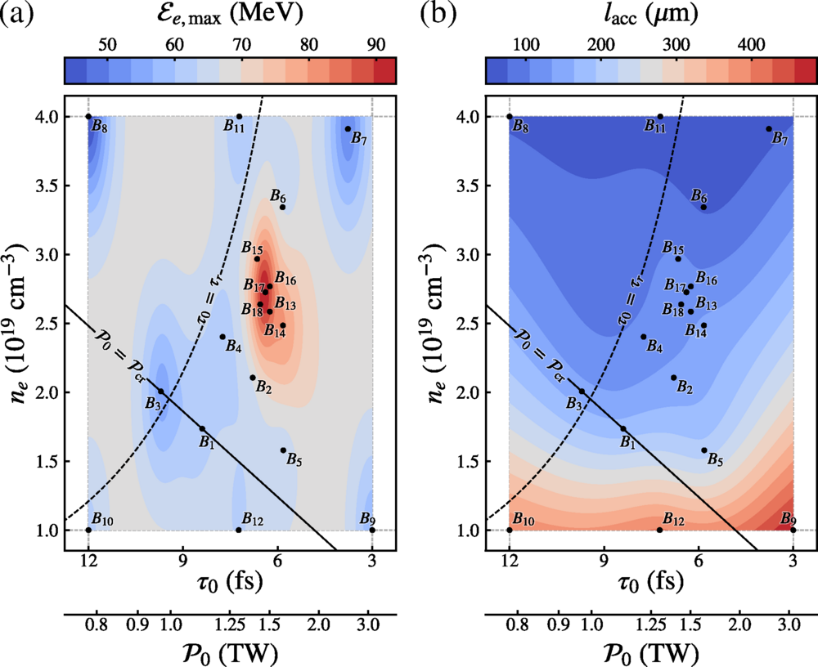
When estimating the electron beam parameters for a laser electron accelerator, the fixed parameter is the laser energy.
Self-guided LWFA
Guided LWFA

Slide 15
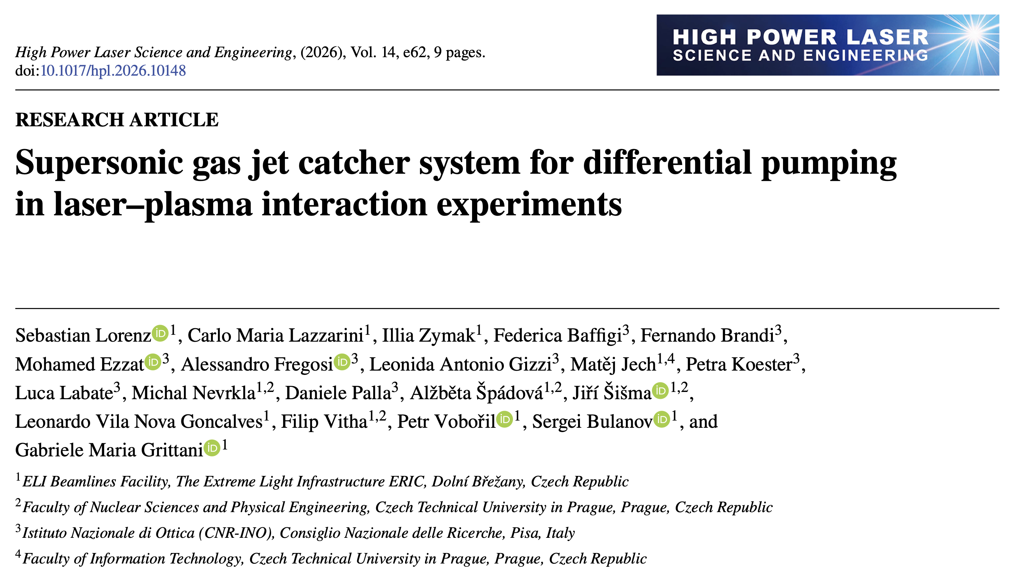
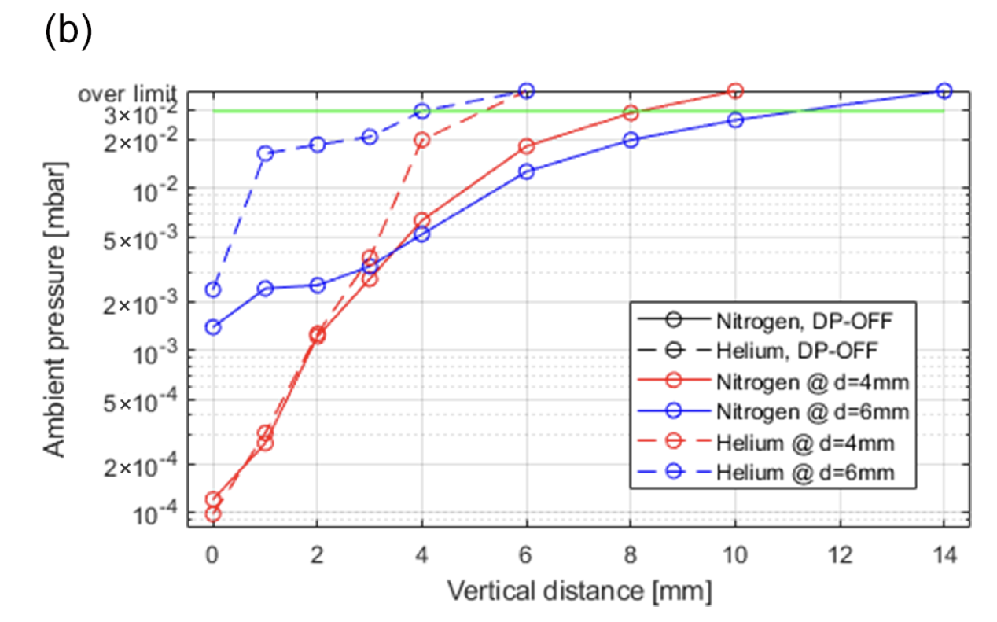
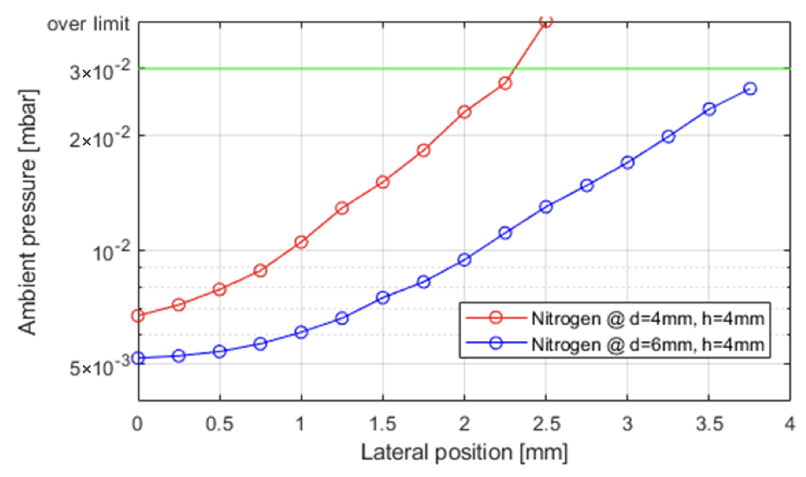
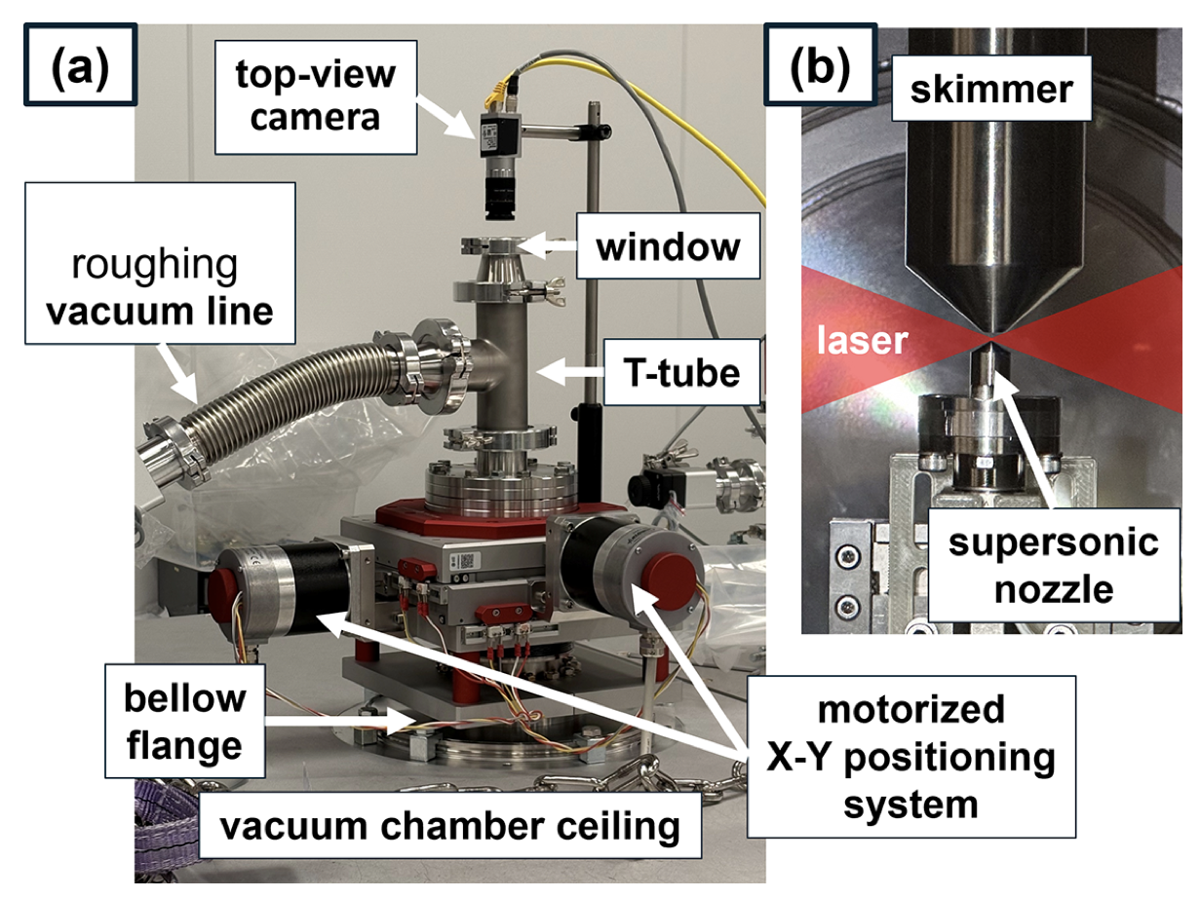
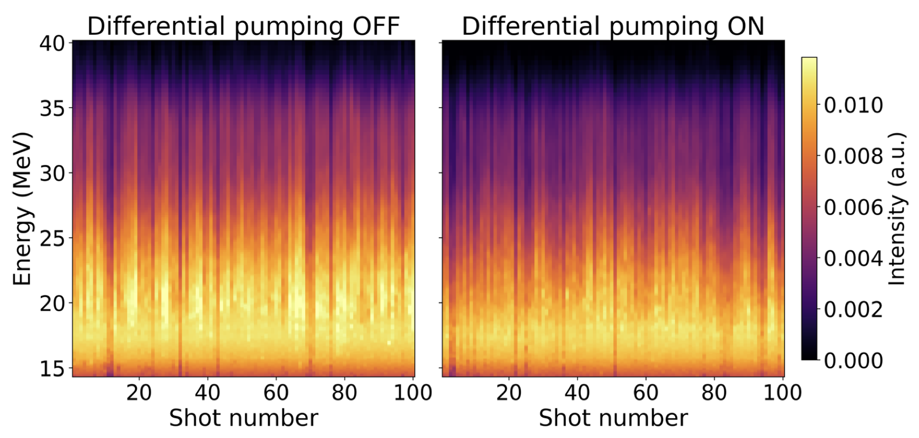
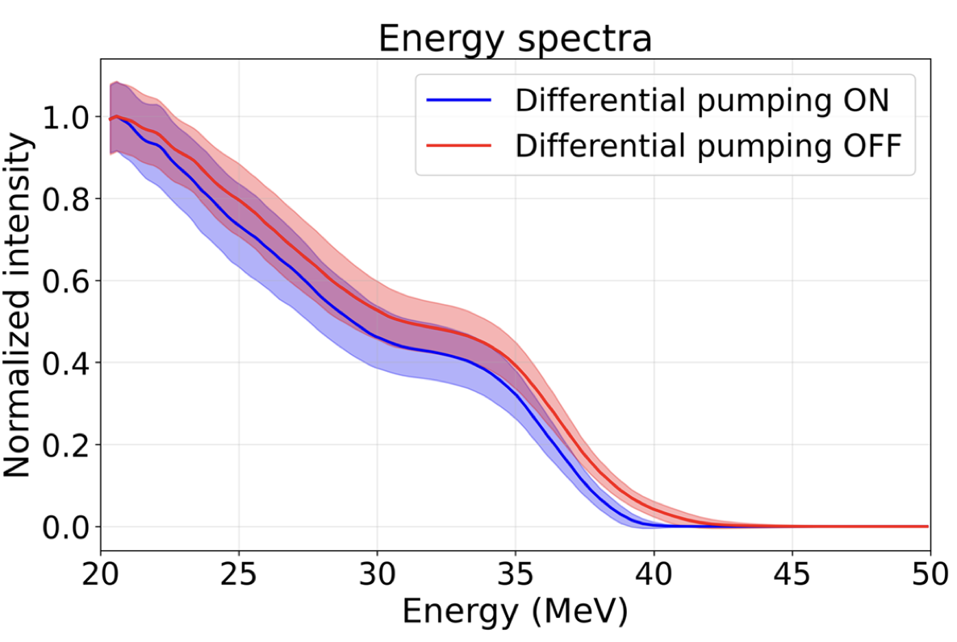
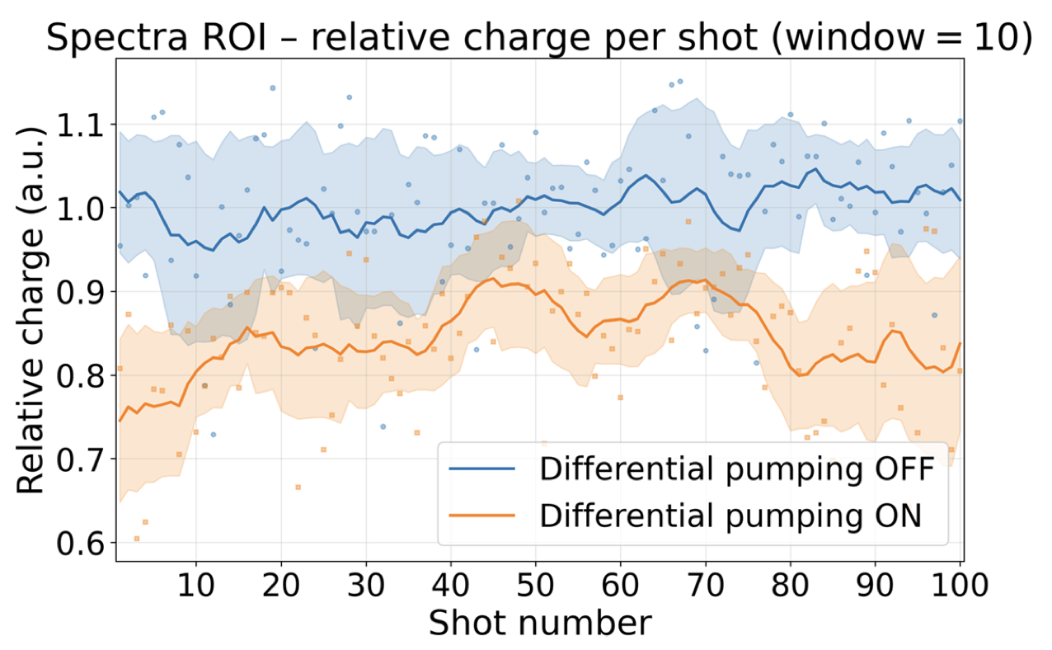
In-house developed differential pumping enables continuous flow operation of nozzles up to 2 mm at LWFA relevant backing pressures.

Slide 16
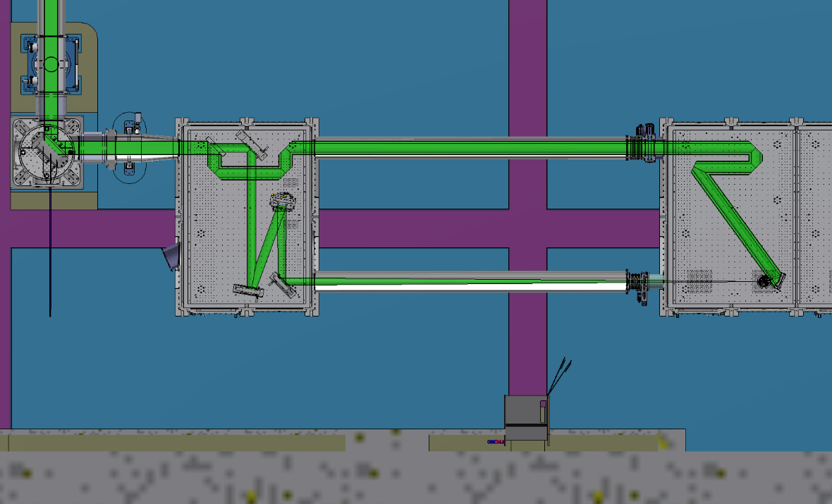
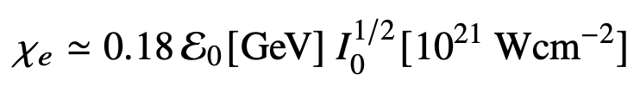
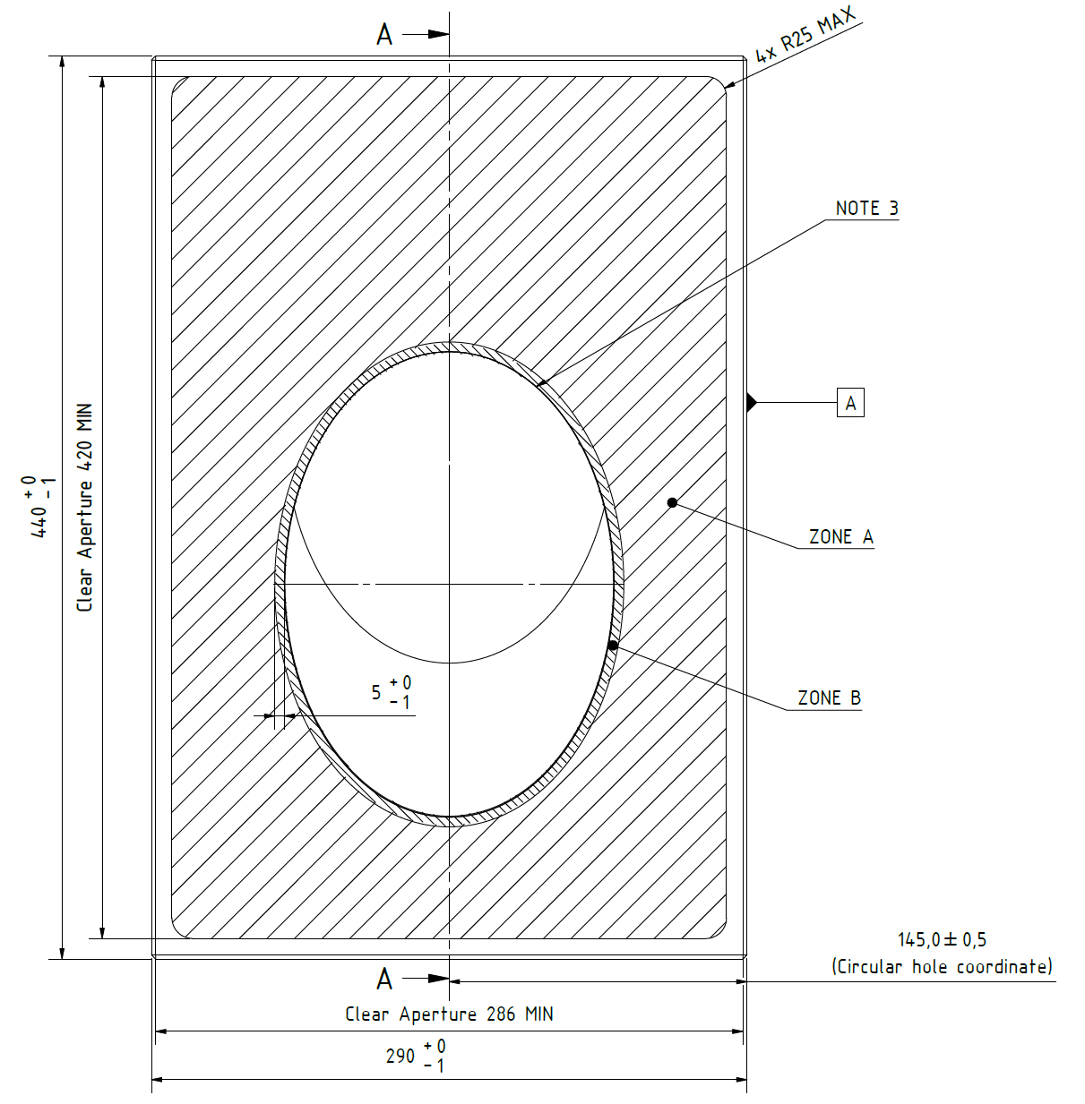
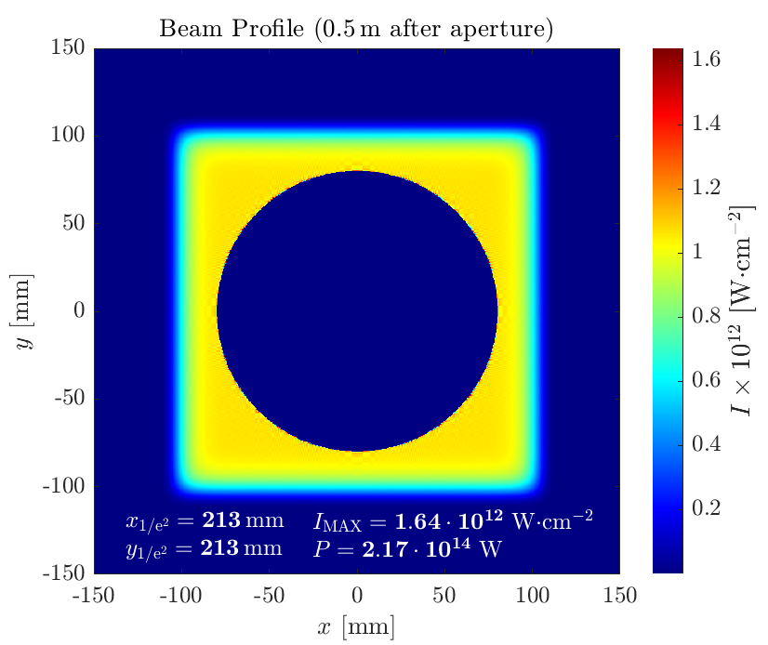
ELBA laser electron collider has been designed to approach parameters relevant for QED studies.
Parameter | Current L3 Performance | Nominal L3 performance
Laser energy before WS splitting | 15 J | 30 J
Laser time duration | 27 fs | 30 fs
Repetition Rate | 3.3 Hz | 10 Hz
Laser Wavelength | 800 nm | 800 nm
Laser Energy for LWFA | 13.5 J | > 10 J
Electron beam energy (mean of QME peak) | 2.5 GeV | > 2 GeV
Energy spread (FWHM) | 10 % | < 20%
Electron beam charge in QME peak | 10s pC | > 40 pC
Electron beam divergence | 0.7 mrad | < 2 mrad
Electron beam pointing stability | 0.4 mrad | < 2 mrad
Laser Energy for Collider Laser | 1.5 J | > 10 J
Focal number | 1.5 | 1.5
Focal length | 375 mm | 375 mm
Focal spot FWHM | 2 μm | < 2 μm
Peak intensity | 1 x 10²⁰ W/cm² | >3 x 10²¹ W/cm²
Collision angle | 20° | 0° and 40°
LASER
ELECTRON
X~1 @ 5 GeV, 10²¹ Wcm⁻²
CP LASER
Key Technology is 50:50 Wavefront Splitting to enable high temporal synchronization of the LWFA beam and the CP laser

Slide 17
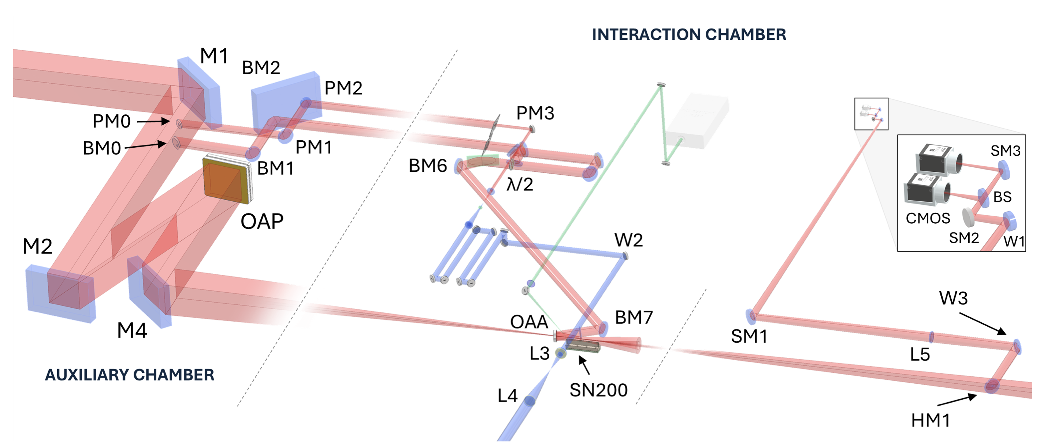
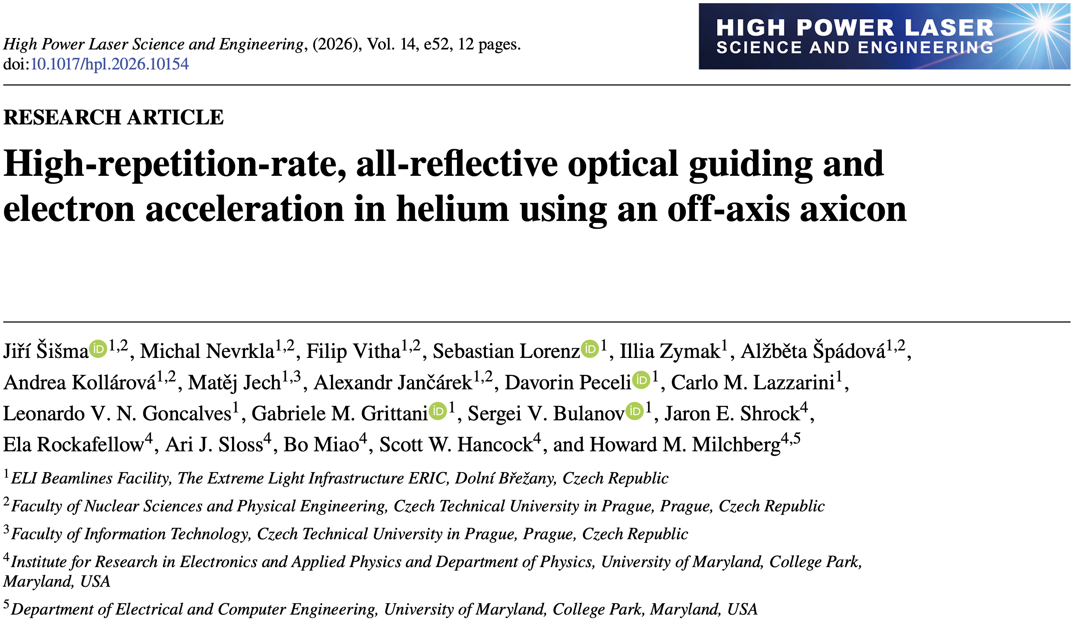

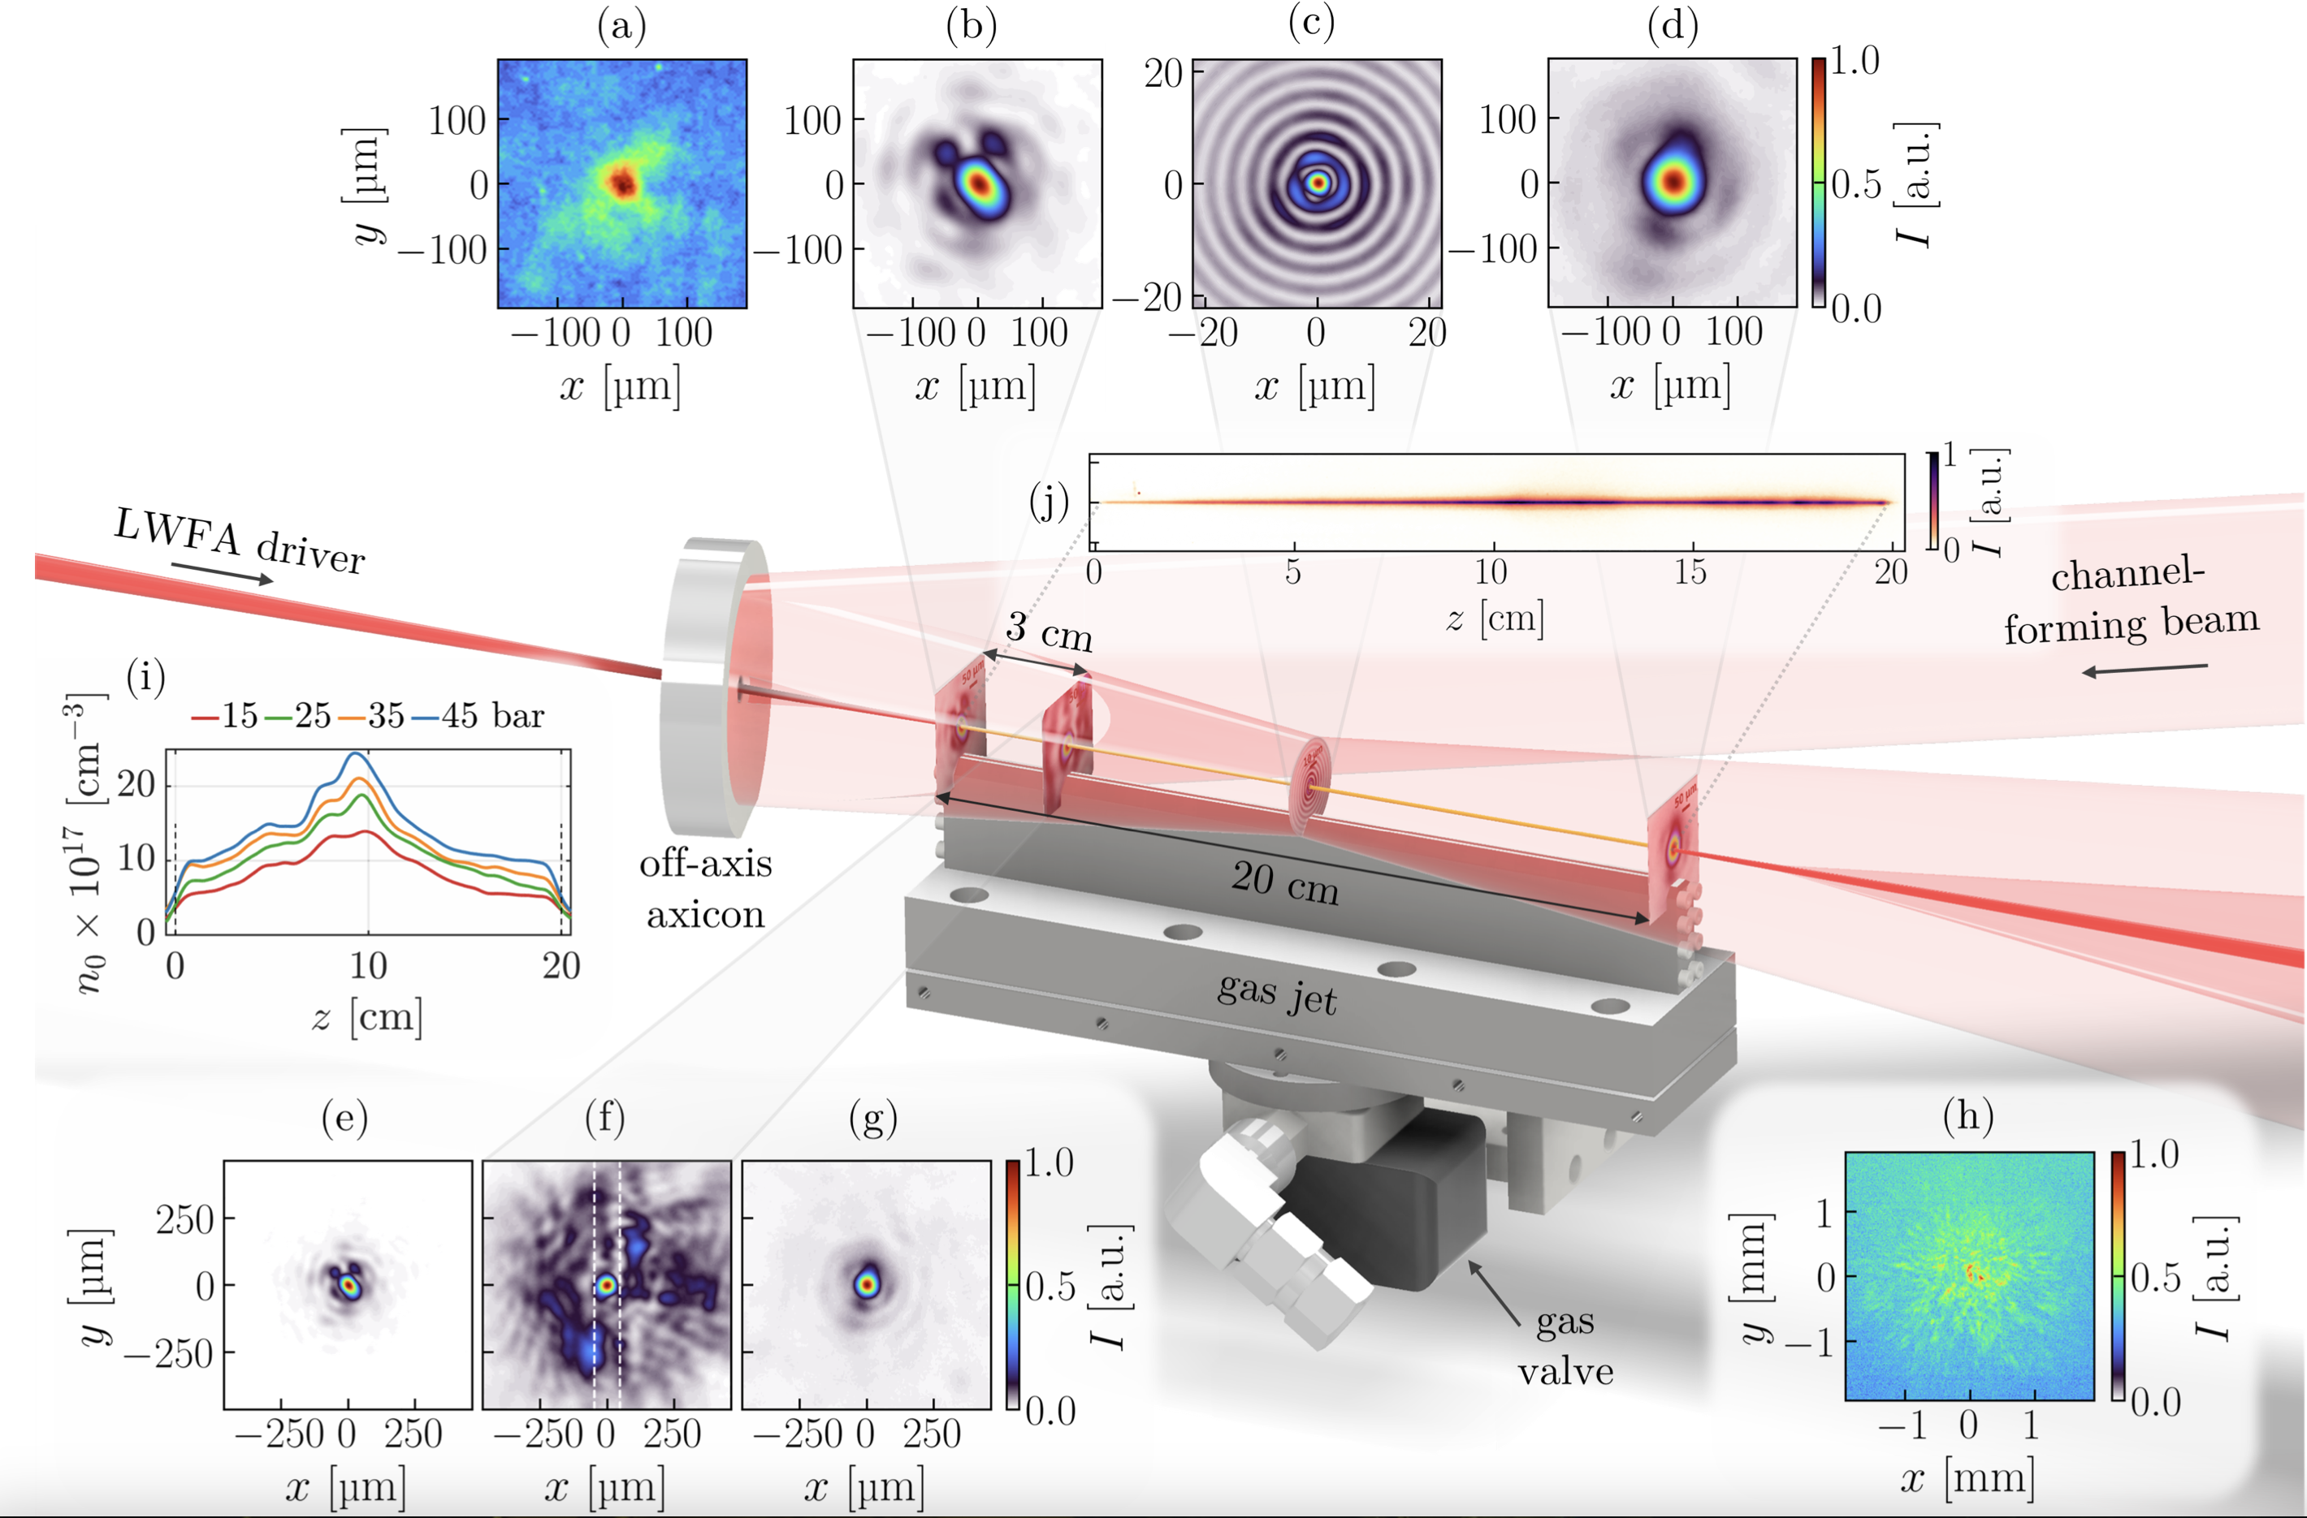
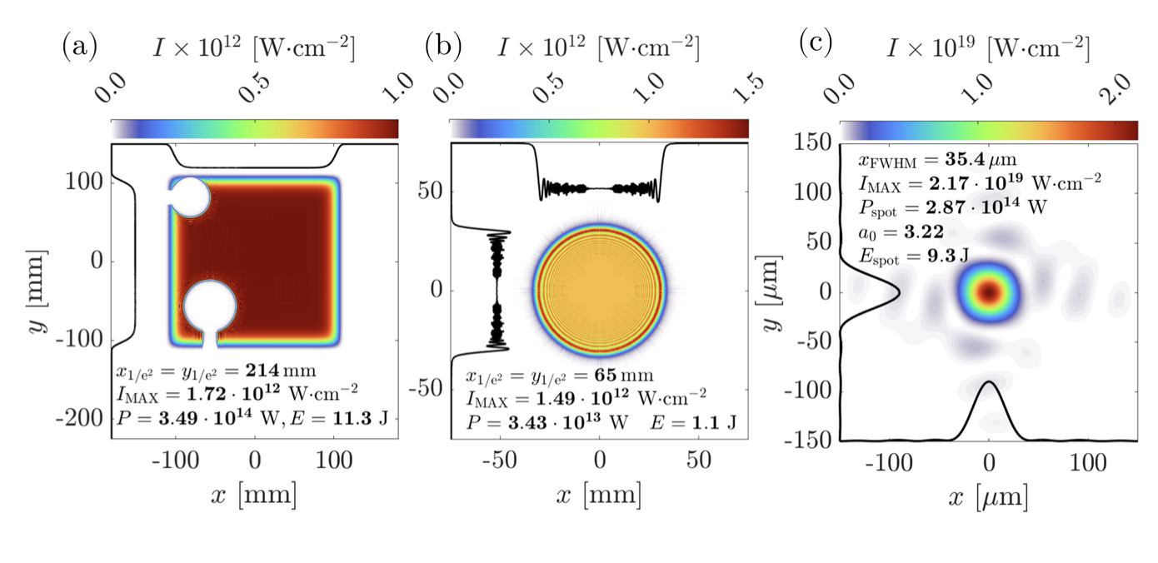
We attracted the UMD team to implement all-optical guiding, in order to reach 5 GeV and improve pointing stability. But we had to figure out how to do it with a single laser beam.

Slide 18
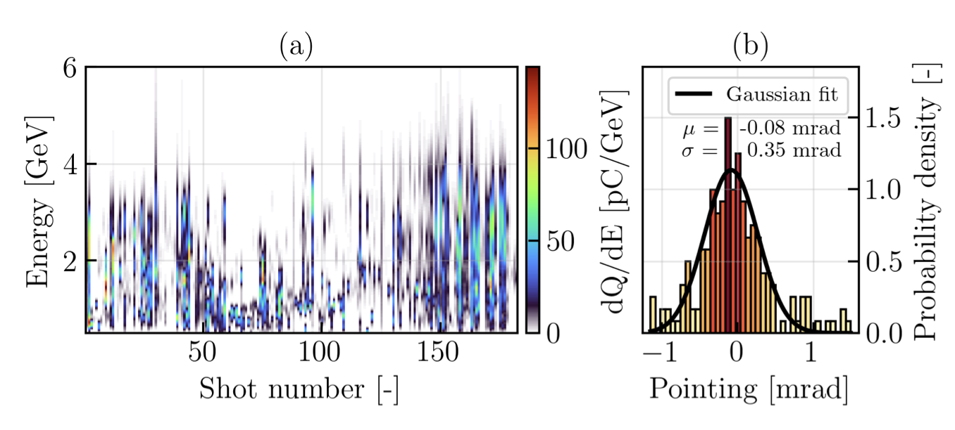
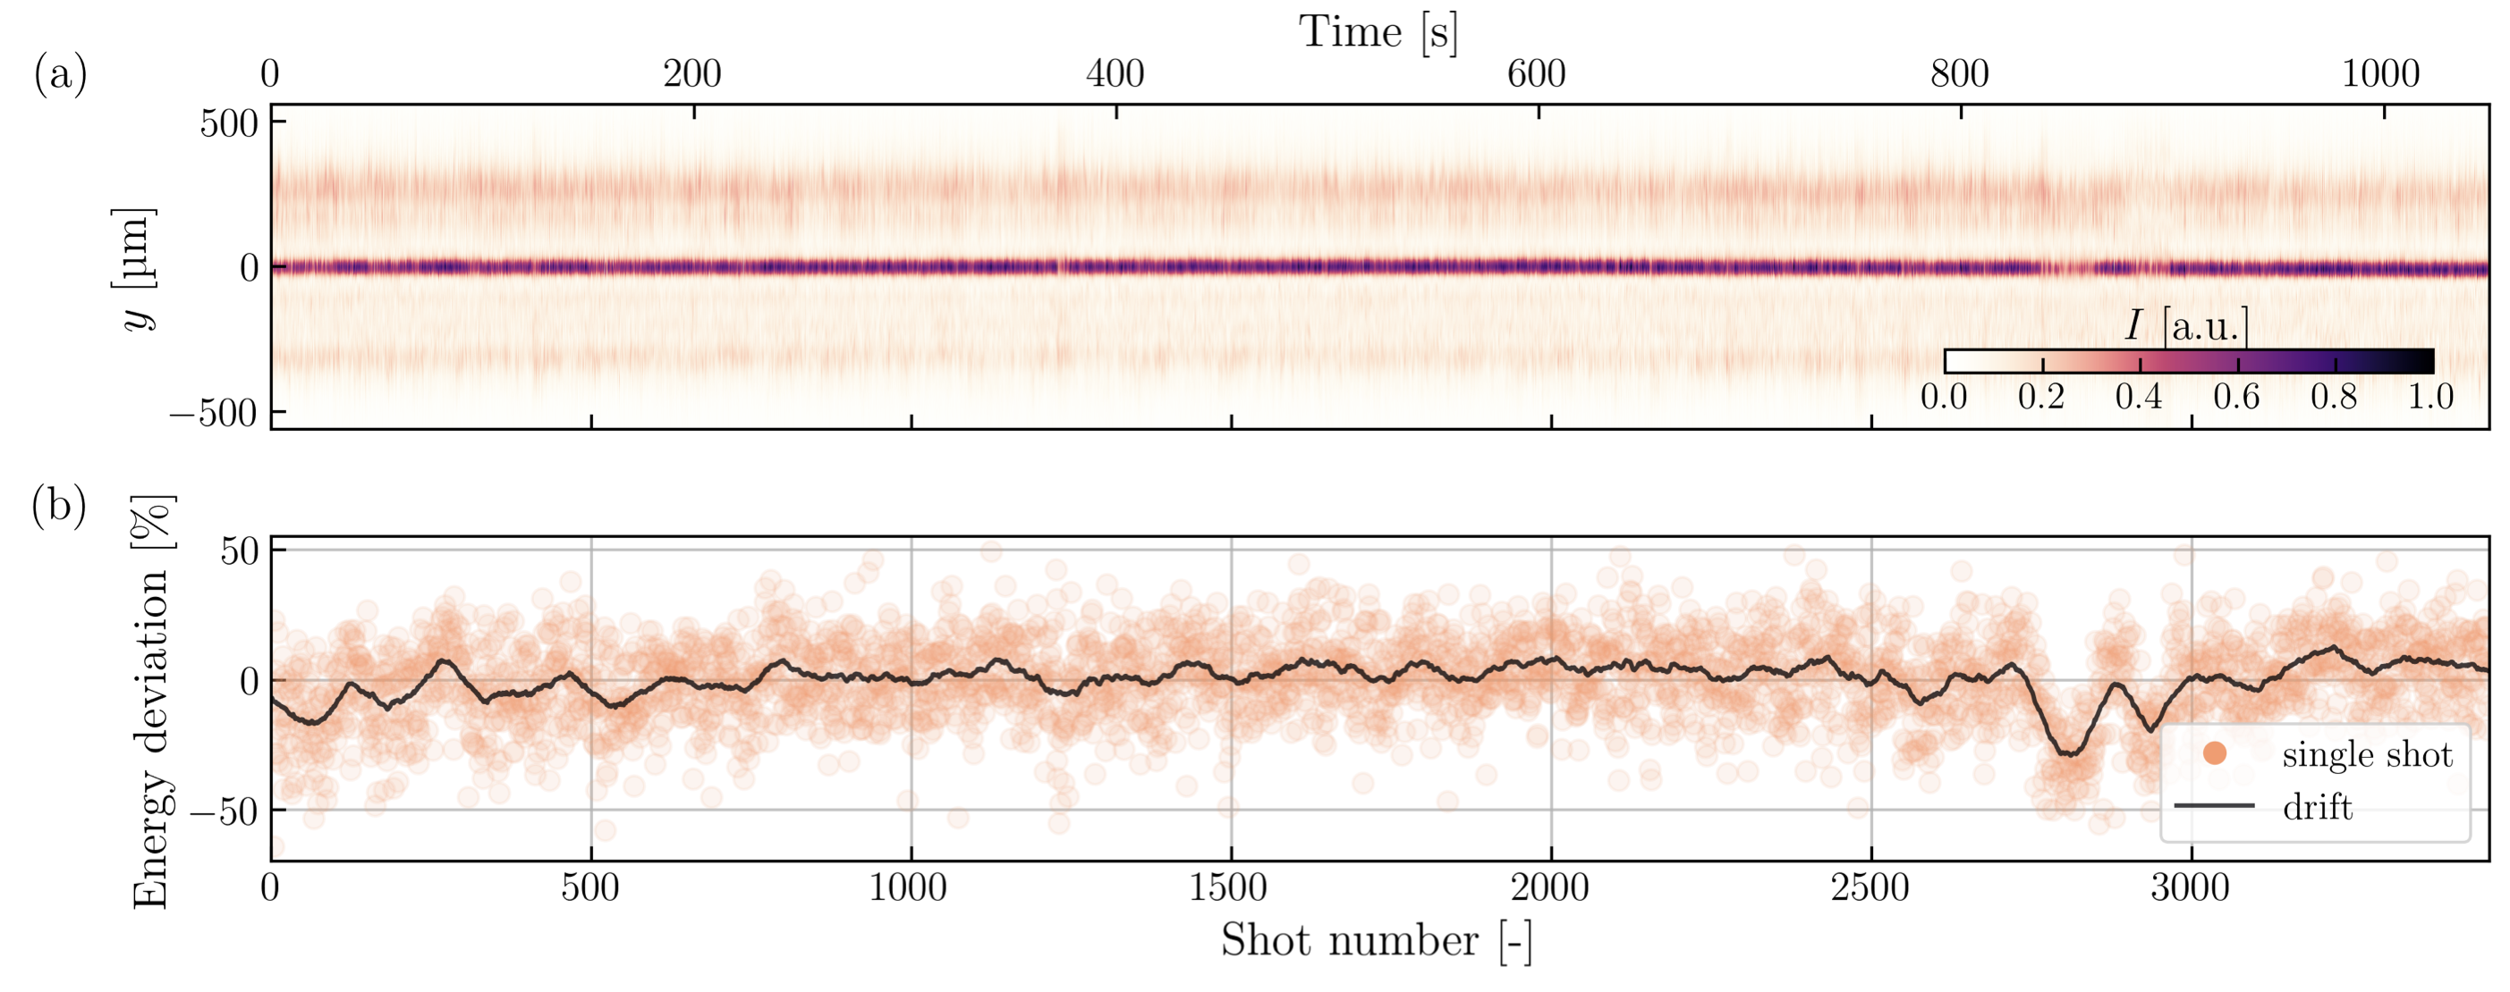
We achieved up to 6 GeV with 0.35 mrad pointing stability. The guiding scheme has been demonstrated up to 3.3 Hz. But these beams are almost not usable for QED due to spectral instability.

Slide 19
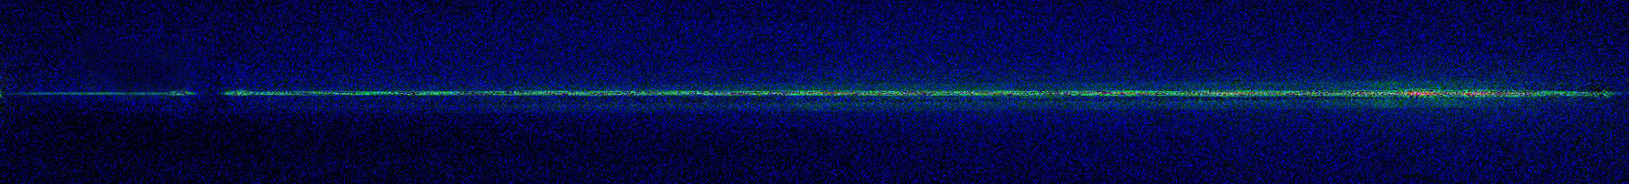
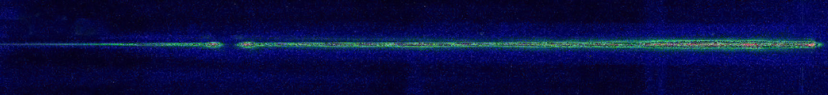
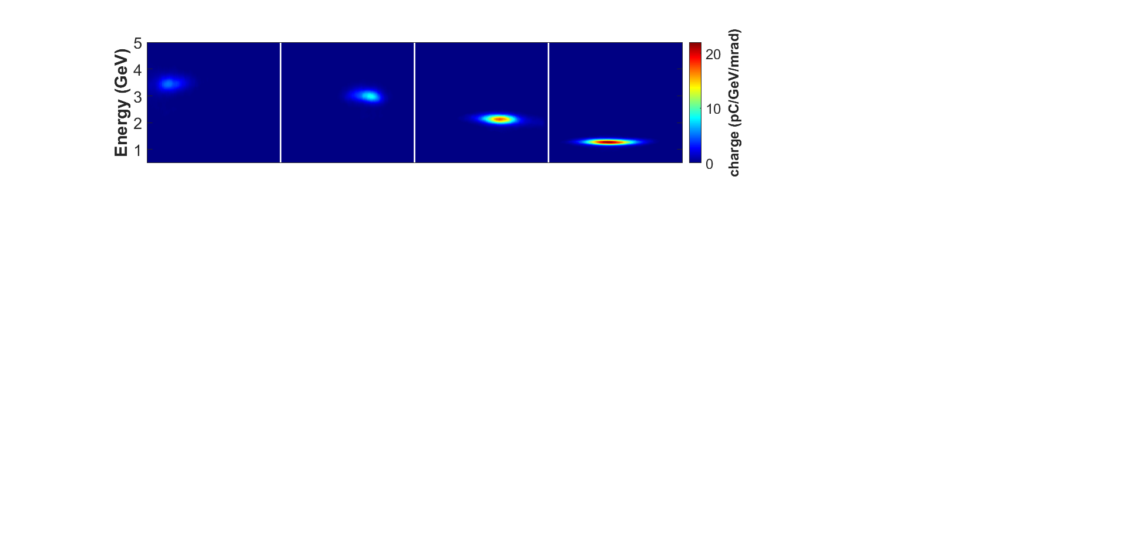
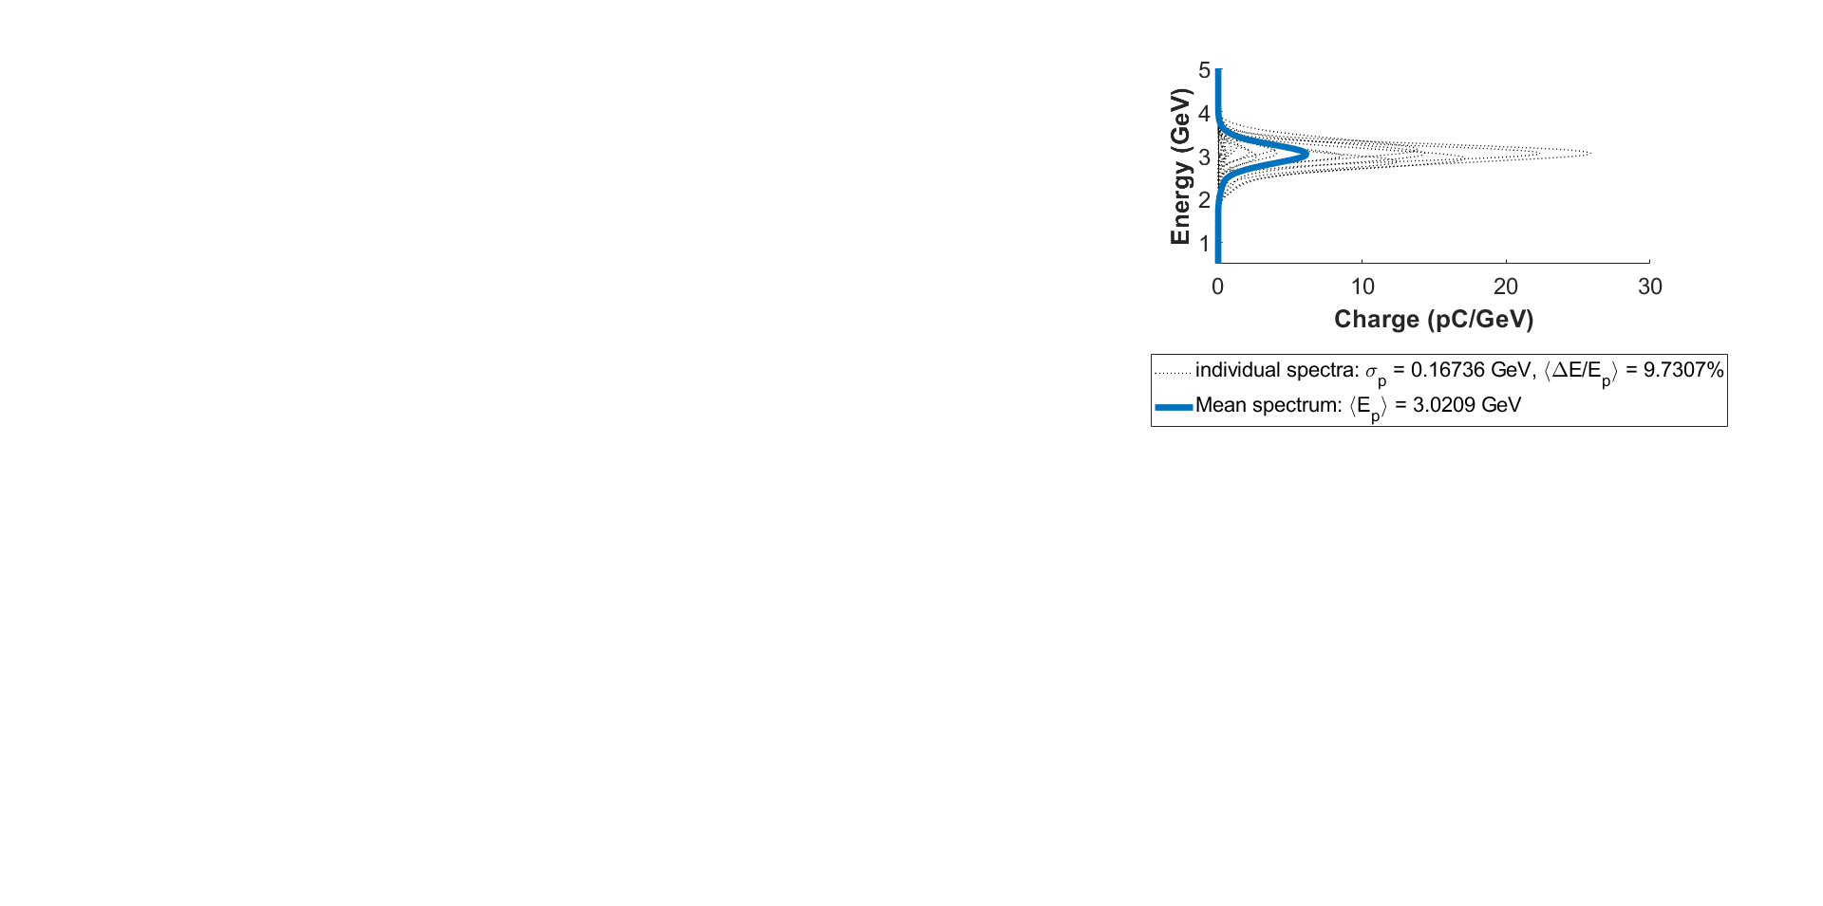



We developed two techniques that enabled high quality beams. Pi-step enables the most monochromatic beams.
Phase shift from funnel-mouthed plasma
Plasma Fluorescence
adapted from J. Shrock’s talk on Monday
2.4 cm
$$R_{d,1}=1.28 cm$$
$$R_{d,2}=1.54 cm$$
5.8 cm
Mean
Resolution limit!
Low variance in $E_{p}$

Slide 20
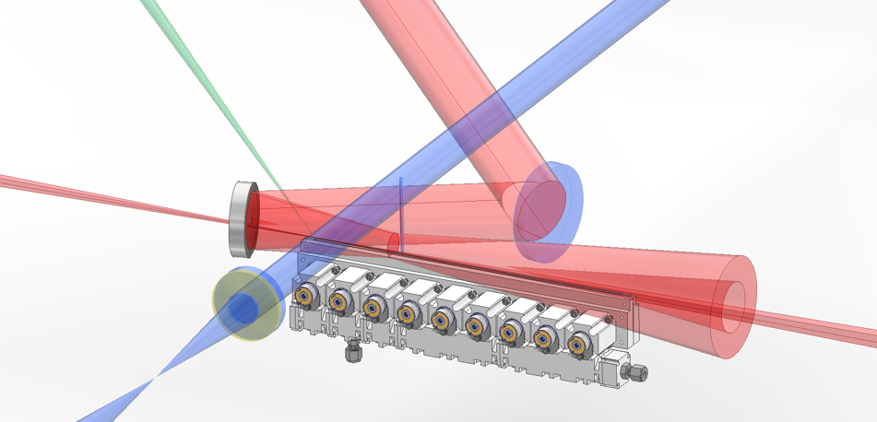

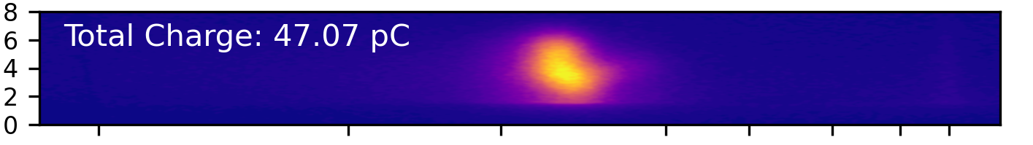
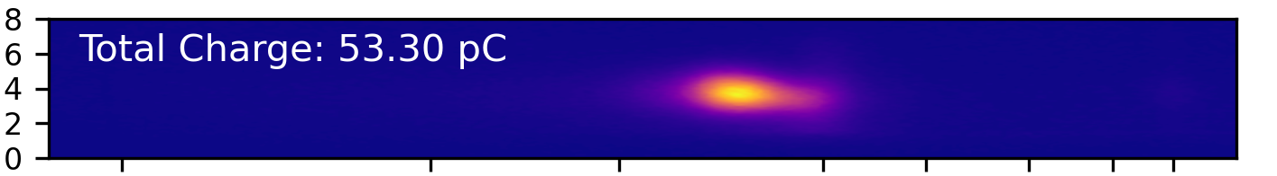









We developed two techniques that enabled high quality beams. Localized Ablation Injection enables high charge beams.
channel forming beam
Electron spectra for 3 bar backing pressure (UMD gas jet) and laser ablation energy 60 mJ
Showing 9 successful shots (out of 13 consecutive)
Green rectangle – shots not hitting the slit properly (influence on charge and energy)
Orange dashed line – approximately @ 1.2 GeV (average energy for this data set)
(a)
ns-pulse
Localized ionization Florescence figure
pi-step phase plate
LWFA drive pulse
(b)
BM7
off-axis
axicon
Abl. laser E | Beam generation eff. [%] | Avg. energy
All beams | 70% (16 beams out of 23) | 1.26 ± 0.17 GeV
50 mJ | 75% (3 beams out of 4) | 1.13 GeV
55 mJ | 71% (5 beams out of 7) | 1.34 ± 0.07 GeV
60 mJ | 69% (9 beams out of 13) | 1.19 ± 0.03 GeV
He Gen. VII Jet
Modeling paper published + experimental paper in prep.

Slide 21
Upramp enables reaching monochromatic 5 GeV beams.
Flat – Density increasing
(b)
Injection in 4 mm region
Ramp
Acceleration dephasing limited. 20 cm density ramp increases energy by ~2x.
adapted from E. Rockafellow’s talk on Monday
E. Rockafellow et al., in preparation

Slide 22



ALFA the first laser electron accelerator with same energy and average dose rate of a medical linear accelerator for radiotherapy. But with much higher instantaneous dose rate.
Designed: 100 mJ / 1 kHz / 15 fs & synchronised to facility clock (GPS)
Laser diagnostics
Probe delay line for shadow+interferometer
OPCPA
1100 mm
f =1”
900 mm
e⁻
ALFA beamline
L1 laser
f = 2”
Other
end-stations
Independent stages
for slit and magnet

Slide 23


By using different gases, we can tune the electron beam properties.
Feature (average over thousands pulses) | High energy mode | High power mode
Energy | 32 ± 5 MeV | 22 ± 2 MeV
Energy Spread (FWHM) | 8 MeV (25%) | 15 (68%)
Current* | 12 ± 6 pA | 276 ± 28 pA
Divergence* (FWHM) | 2.1 ± 0.8 mrad | 7.8 ± 1.2 mrad
Pointing* (std) | 6.9 mrad | 4.2 mrad
Electron Beam Power Output* | 0.4 mW | 6 mW
He/N mixture
Pure N

Slide 24



There is growing evidence that both ultra-high instantaneous dose rates and very high energy electrons (100-250 MeV) can have beneficial effects in cancer treatment.
J. Wenz et al., Nature Photonics 13 (4), 263-269 (2019)
J. Bedford and U. Oelfke, Physics and Imaging in Radiation Oncology 32, 100670 (2024)

Slide 25

Laser wakefield accelerators can produce beams as short as 1 fs. ALFA can operate up to 1 kHz pulse repetition rate.
J. Wenz et al., Nature Photonics 13 (4), 263-269 (2019)
C. Lazzarini et al., manuscript under review

Slide 26

Laser wakefield accelerators produce divergent beams with dose rate tunable with the distance from the source.
C. Lazzarini et al., manuscript under review

Slide 27




ALFA is over-subscribed for radiobiology experiments, since it enables a new dose delivery time profile. The main limitation is the pointing stability.
Radiochromic film at the entrance
Front film dose line plots
1 cm
F6
F7
F8
F9
F10
Depth dose profile in different positions
Achievements:
Dose of ~ 30 Gy in 60 sec confirmed with Alanine
Max dose rate 0.5 Gy/sec over cm²
R50 at 5-6 cm
60 sec irradiation
Preliminary

Slide 28
ALFA is over-subscribed for radiobiology experiments, since it enables a new dose delivery time profile. The main limitation is the pointing stability.
Target: zebrafish embryos in 2x2 cm target area
10 mm
First ever on-demand in-vivo irradiation of biological sample with kHz electrons
On-demand target doses (within 10%) at specific hour agreed 48 hours in advance
Volume dose uniformity < 10% at 1 cm depth, 4 cm²
C.M. Lazzarini et al., «Controlled kHz laser-driven electron irradiations for pre-clinical applications», submitted,
https://doi.org/10.48550/arXiv.2603.10058

Slide 29

We asked UMD team to work together to solve this problem. We developed and installed a new beamline that enabled kHz LWFA beams.
adapted from G. Brewster’s talk on Monday

Slide 30

We demonstrated kHz LWFA beams with 10x improved pointing stability and comparable electron beam energy.
Conditions:
Higher density N₂
2 mm channel
Quasimonoenergetic beams likely from beam loading
Few-mrad divergence with ~mrad pointing stability
Series of 100 consecutive bursts (not single shots) with ~45 mJ on target
adapted from G. Brewster’s talk on Monday

Slide 31

We demonstrated kHz LWFA beams with 10x improved pointing stability and comparable electron beam energy.
2 mm N₂ channel, high energy parameter space
Real signal in high-energy region!
adapted from G. Brewster’s talk on Monday

Slide 32
ELBA and ALFA received 69 user proposals so far. The acceptance rate is stabilizing around 30%-40%.

Slide 33
THANK YOU FOR YOUR ATTENTION!
gabriele.grittani@eli-laser.eu

Slide 34






Conventional sources of electron beams are based on electrostatic acceleratorion (X-ray tube) or on radiofrequency acceleration (linac).
Electrostatic acceleration: X-ray tube, up to MeV
Radiofrequency acceleration: linac, up to 300 MeV for laboratory scale facilities

Slide 35
Conventional sources of electron beams are based on electrostatic acceleratorion (X-ray tube) or on radiofrequency acceleration (linac).
Electrostatic acceleration: X-ray tube, up to MeV
Radiofrequency acceleration: linac, up to 300 MeV for laboratory scale facilities

Slide 36
Conventional sources of electron beams are based on electrostatic acceleratorion (X-ray tube) or on radiofrequency acceleration (linac).
Electrostatic acceleration: X-ray tube, up to MeV
Radiofrequency acceleration: linac, up to 300 MeV for laboratory scale facilities

Slide 37




Laser wakefield electron acceleration (LWFA) is the most compact technology to produce VHEE electron beams.
Laser wakefield acceleration: ultra-short (fs) and up to 10 GeV in laboratory scale facilities

Slide 38
Laser wakefield accelerators can produce beams as short as 1 fs. They can operate up to 1 kHz pulse repetition rate.
J. Wenz et al., Nature Photonics 13 (4), 263-269 (2019)
C. Lazzarini et al., manuscript under review

Slide 39
There is growing evidence that both ultra-high instantaneous dose rates and very high energy electrons (100-250 MeV) can have beneficial effects in cancer treatment.
J. Wenz et al., Nature Photonics 13 (4), 263-269 (2019)
J. Bedford and U. Oelfke, Physics and Imaging in Radiation Oncology 32, 100670 (2024)

Slide 40
Laser wakefield accelerators produce divergent beams with dose rate tunable with the distance from the source.
C. Lazzarini et al., manuscript under review

Slide 41



In order to keep the dose deposition as short as the electron beam duration, higher beam energy is required.
D. Horvath et al., Physics in Medicine and Biology 68 (22), 22NT01 (2023)

Slide 42


ELI is devoted to deliver stable and reproducible particle beams for external user experiments.
S. Lorenz et al., Accepted on High Power Laser Science Engineering
C. Lazzarini et al., manuscript under review

Slide 43





ALFA at ELI Beamlines delivers electron beam with same energy and same average dose rate of a medical linac.
Parameter | High Power Mode | High Energy Mode
Energy (MeV) | 22±2 | 32±5
Energy Spread (MeV) | 15 (68%) | 8 (25%)
Average Current (pA) | 276±28 | 12±6
Divergence (mrad) | 7.8±1.2 | 2.1±0.8
Power (mW) | 6 | 0.4

Slide 44



ESYLOS at ELI ALPS holds the potential to be the world’s first laser-driven VHEE beamline at 1 kHz.
Available to Users since Nov 2024
Applications
User experiments
At eSYLOS chamber
Positron generation and detection at high repetition rates
Systematic study of CEP effects
LWFA dosimetry mapping
Machine learning at kHz rep rates
THz streaking
At dedicated endstation (IFIR)
Irradiation of biological samples
  Zebrafish embryos
  Cell cultures
eSYLOS key features
1 kHz shot-to-shot data acquisition
2 DMs available (laser side and within chamber)
Two focusing OAPs : 605 mm and 300 mm
14 30 50
Electron output (as of Dec 2025)
20 × 50 mrad divergence
Pointing: 0.5 × 0.4 mrad RMS
Electron energy: 49 MeV peak
Electron charge: 94±5 pC total
  (60.0±3.5 pC above 30 MeV)
Total e- energy : 3.3 mJ (5% effic.)
Operation statistics and on-target specs
>6 hours daily, uninterrupted e-beam delivery at 10 Hz and/or 100 Hz
1.5 hours continuous operation at 1 kHz
On-target energy at 8 fs :
  Tunable 12 - 76 mJ

Slide 45



EPW at ELI ALPS delivers up to GeV electron beams. It will be available to Users from May 2026.
Applications /
User experiments
(from Apr 2026)
Fast betatron x-ray μ-tomography (μCT) // VHEE cancer therapy (200-400 MeV)
Electron/X-ray Energy Boosting schemes // Light Sources with GeV electrons
ePW key features and operational regimes
2 DMs available (laser side and after final compressor)
Two focusing OAPs :
  f/15 : high charge/”low energy” ebeams (for VHEE cancer therapy)
  f/55 : ”low charge”/high energy ebeams (for betatron x-ray μ-CT
f#15: up to 400 MeV, nC-level (single-shot) (reduced aperture laser)
f#55: ~1 GeV, nC-level (single-shot) (full aperture laser)
X-rays >10 keV
GeV+ electrons
F=10 m OAP
On-target laser energy @ 21 fs:
7.5 J (f/55 – full aperture)
3.5 J (f/15 – reduced aperture)
Commissioned in Sep 2025 Available to Users from May 2026

Slide 46


ELBA delivers stable multi-GeV laser electron accelerator for users. The size of E5 experimental hall enables future scenarios with electron-based tertiary sources (positrons, muons).
Parameter | Value
Energy (GeV) | 5±0.5
Energy Spread (MeV) | 0.5 (10%)
Charge per pulse (pC) | 108±28
Divergence (mrad) | 1.4±0.3
Power (mW) | 63

Slide 47
ELBA offers to users all-reflective guided LWFA configuration up to 15 J and up to 3.3 Hz.
J. Sisma et al., Accepted on High Power Laser Science Engineering

Slide 48
ELBA offers to users all-reflective guided LWFA configuration up to 15 J and up to 3.3 Hz.
J. Sisma et al., Accepted on High Power Laser Science Engineering

