Slide 1
SHORT-PULSE X-BAND PHOTOGUN: FROM FIRST DEMONSTRATION TO RECENT RESULTS & FUTURE DEVELOPMENTS
PETS
Gongxiaohui Chen
07/27/2026

Slide 2
outline
Introduction to Structure wakefield acceleration (SWFA)
Two beam acceleration (TBA) at Argonne Wakefield Acceleration (AWA) facility
Motivation for short-pulse acceleration
Selected highlights of the X-band photogun (Xgun):
  Phase scans @ different gradients
  Understanding of the short-pulse operation and beam performance
  Longitudinal phase space (recent work)
Future developments

Slide 3
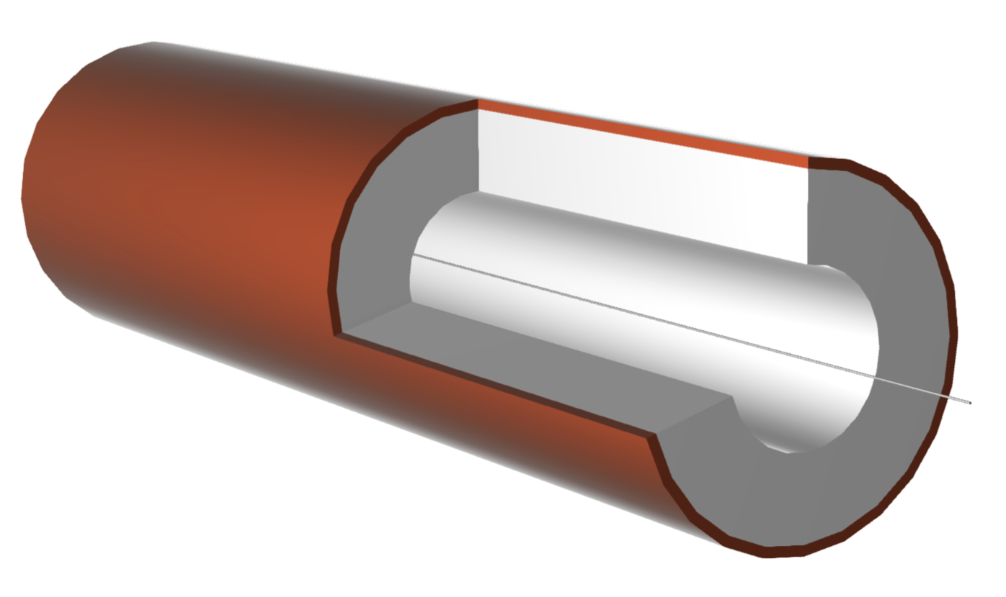
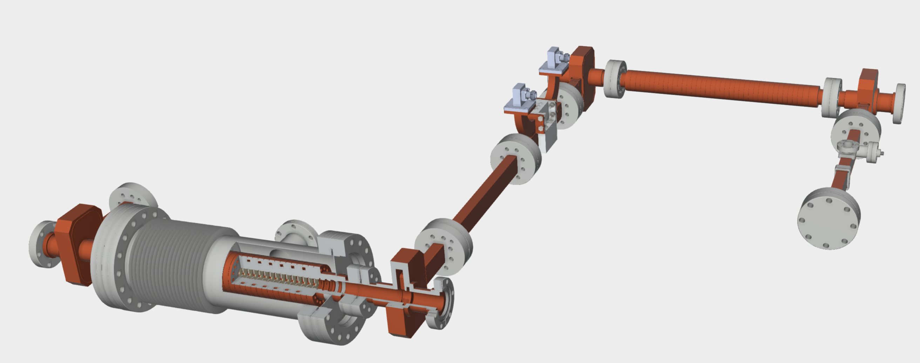

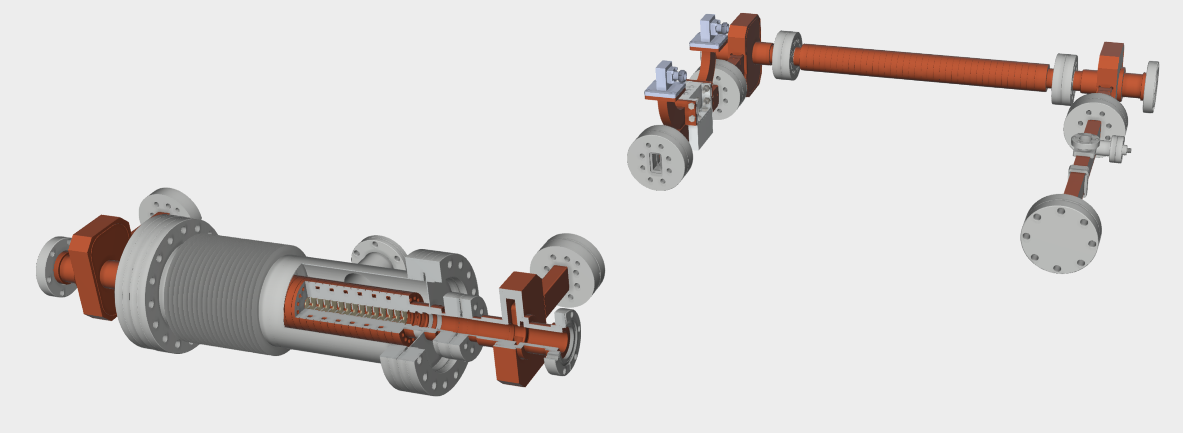

Structure wakefield acceleration
CWA and TBA
Collinear Wakefield Acceleration (CWA)
Two Beam Acceleration (TBA)
power extraction and transfer structure (PETS)
metal shell
drive beam (train)
dielectric
LINAC or gun
drive beam
extracted RF pulse
main beam
main beam
Drive and main beam propagate in the same structure.
Energy is transferred locally from the wakefields of the leading bunch to a trailing bunch.
Drive and main beams propagate in separate beamlines and different structures.
RF power is extracted from the drive beam and transferred to the main beamline.

Slide 4
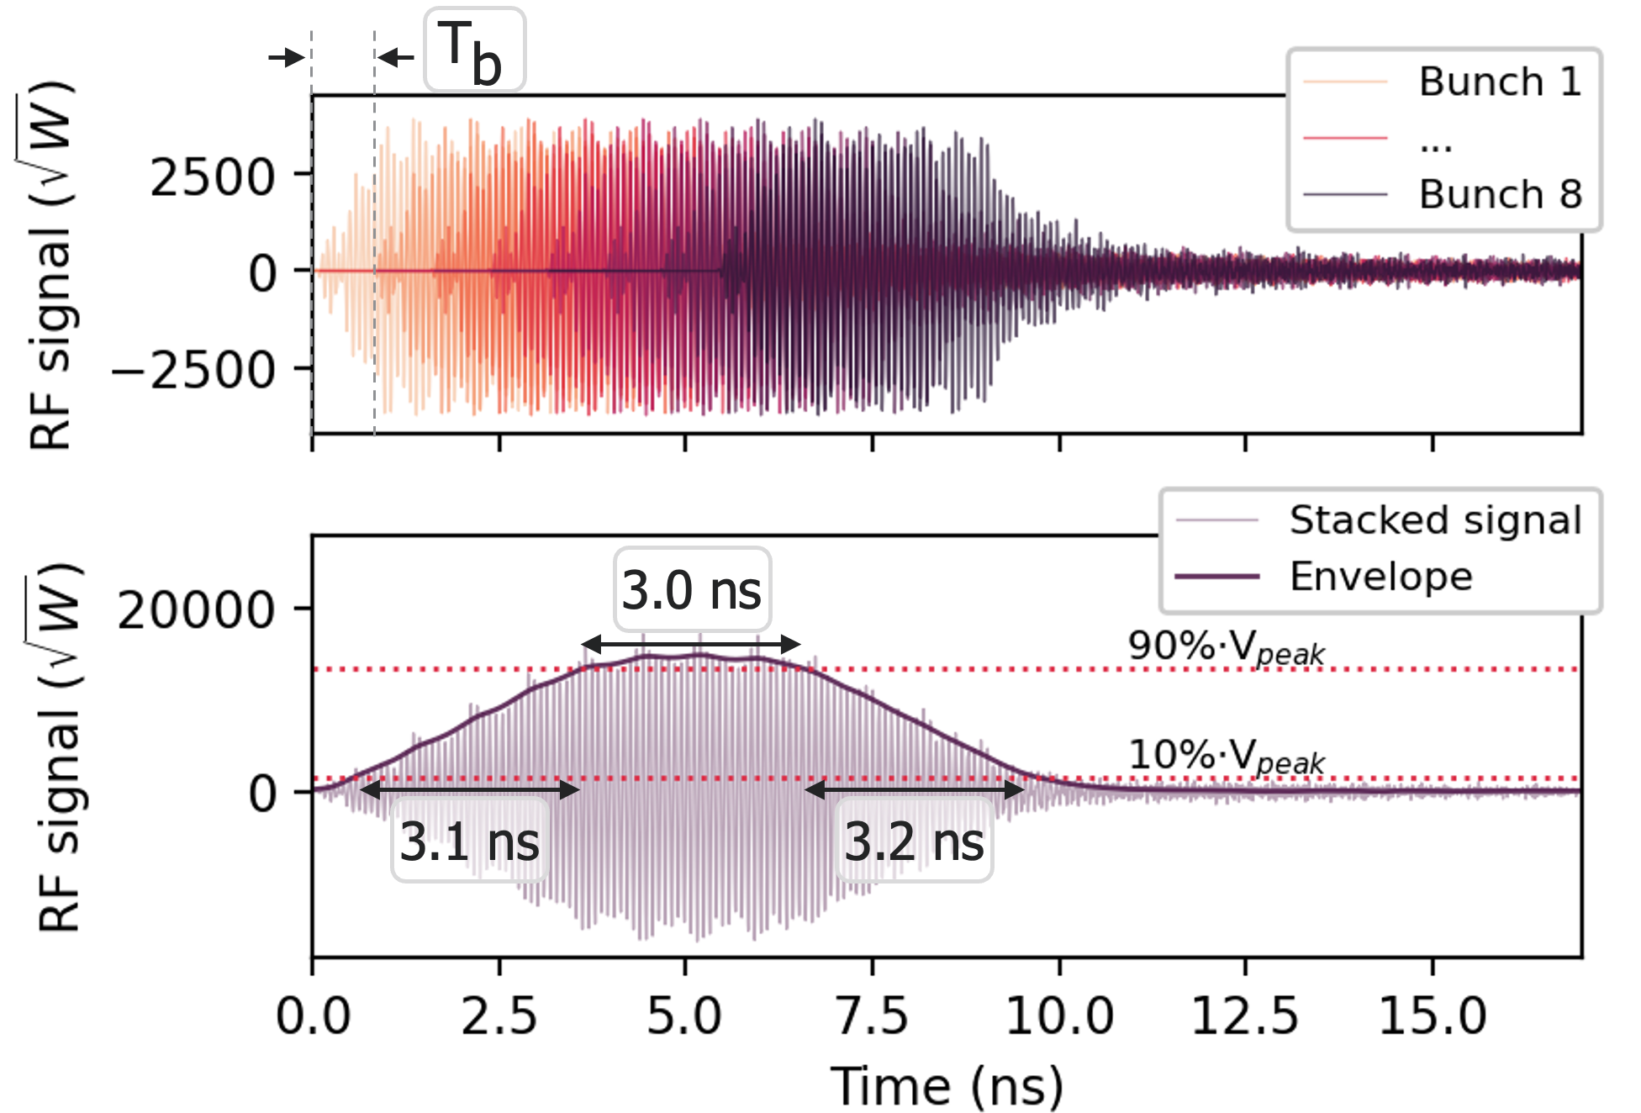
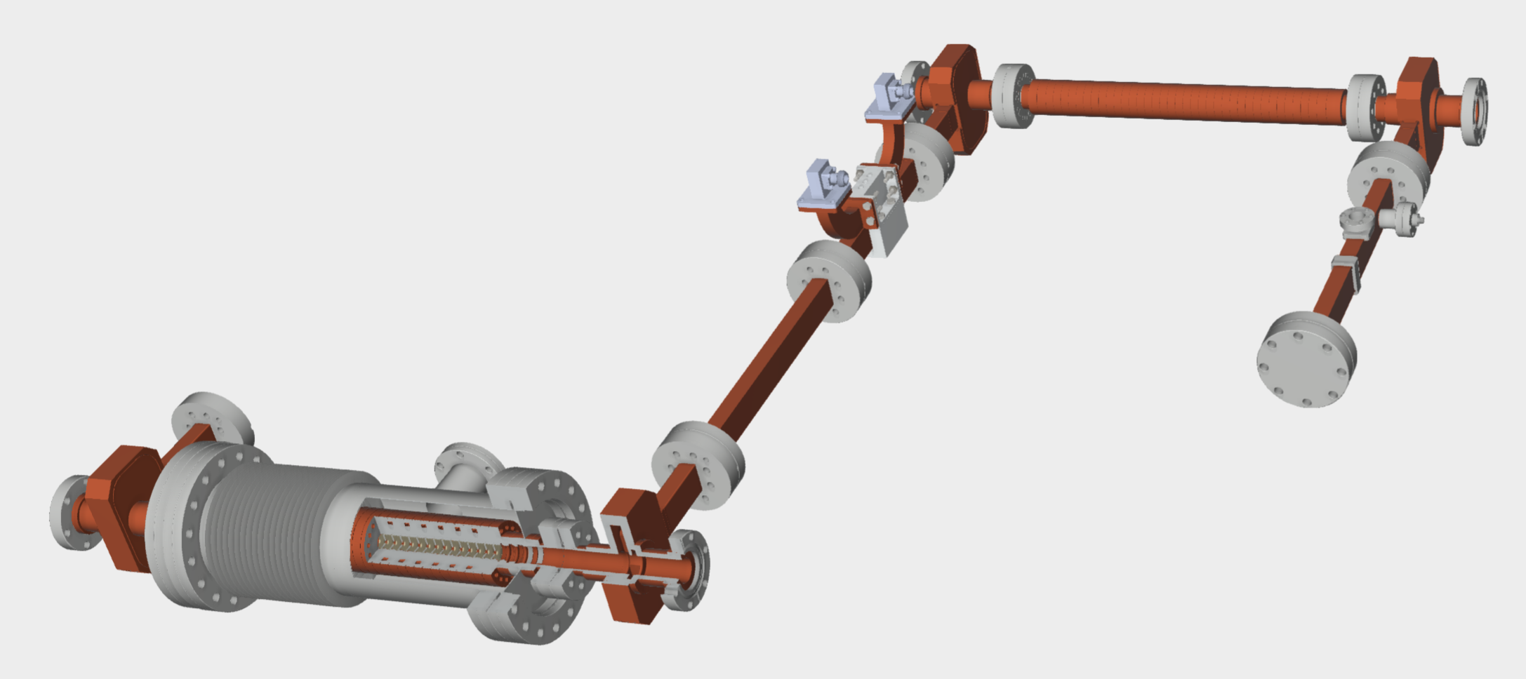
Two beam acceleration (TBA)
Simulated RF pulse
A single TBA module
Drive beamline:
Principle: coherent stacking of wakefield pulse produced by each bunch within a train.
At AWA, we are interested in the short-pulse operation, for a metallic corrugated PETS:
  8-bunch drive beam of 400 nC
  RF pulse: ~400 MW, 9 ns
drive bunch train
PETS
LINAC or gun
RF pulse
Main beamline:
main beam
Structures (LINAC or gun) is powered by short RF pulses extracted from the PETS.

Slide 5
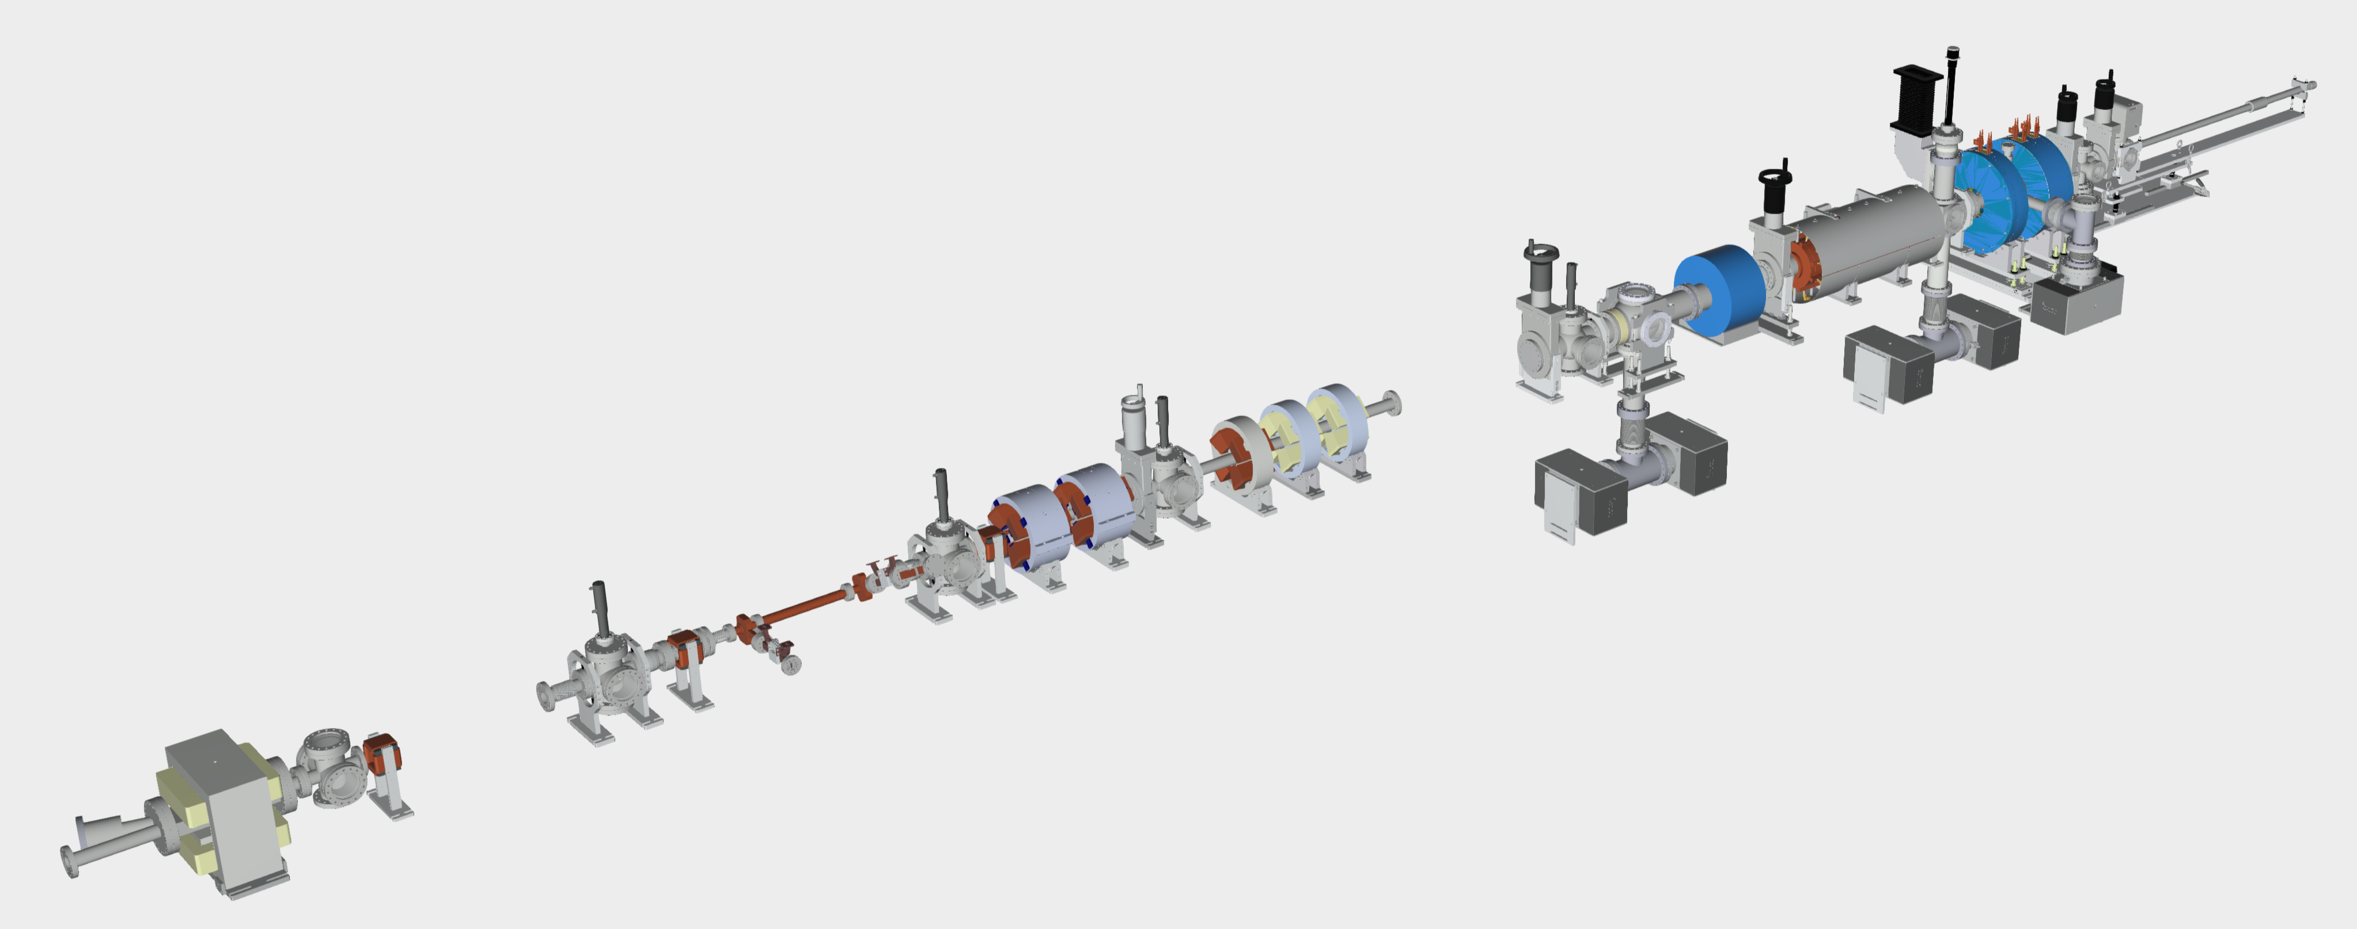
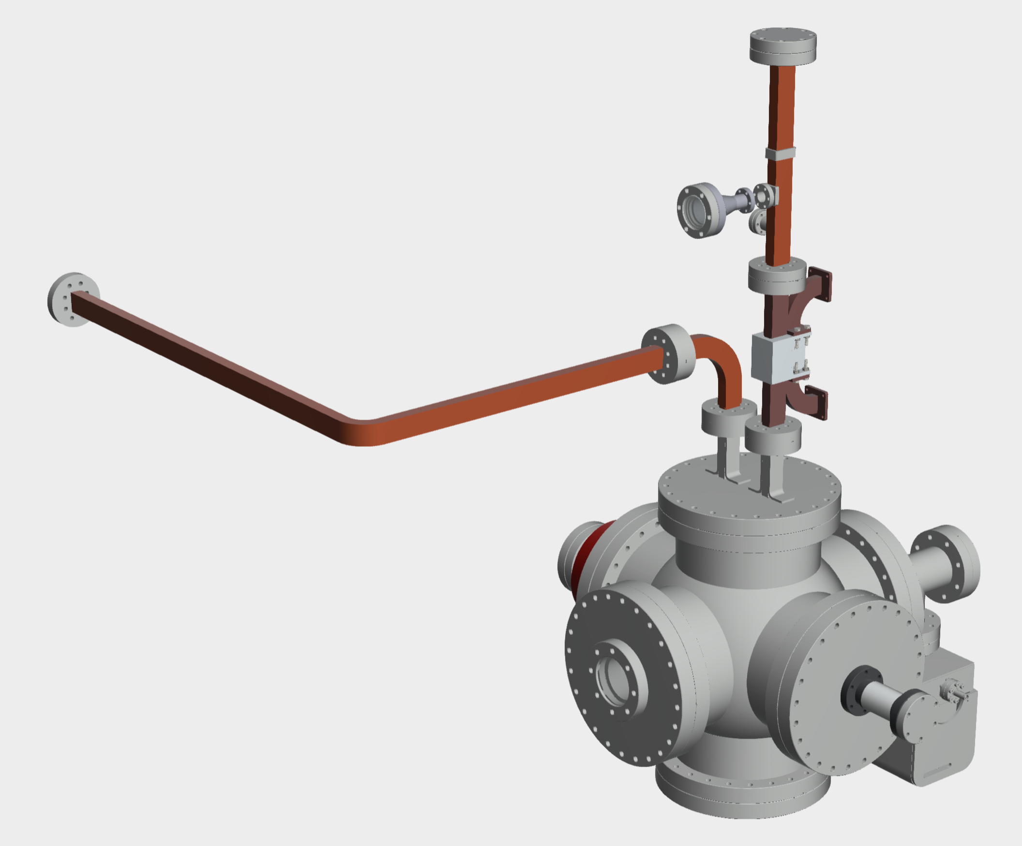
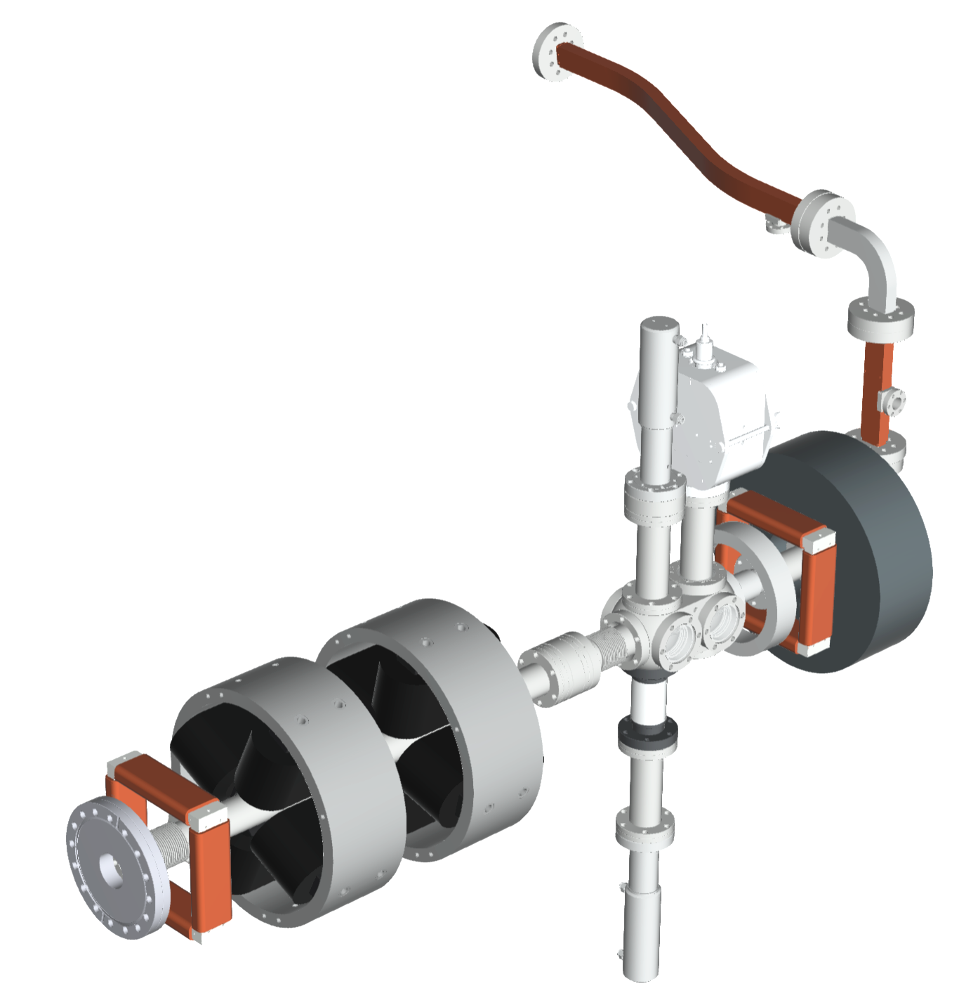
AWA test facilities
TBA testbed
Drive beamline:
Beam energy: ~63 MeV
Single bunch: ~50 nC
8-bunch train total charge: >400 nC
…
Power Extraction & Transfer Structure (PETS)
Example#1 of TBA
…
short RF pulse
High-power test stand:
Powered by the PETS with short RF pulses (9 ns).
Dedicated to structure high power conditioning
…
Example#2 of TBA
Main (“Xgun”) beamline:
Powered by the PETS with short RF pulses (9 ns).
Flexible beamline for R&D
…

Slide 6
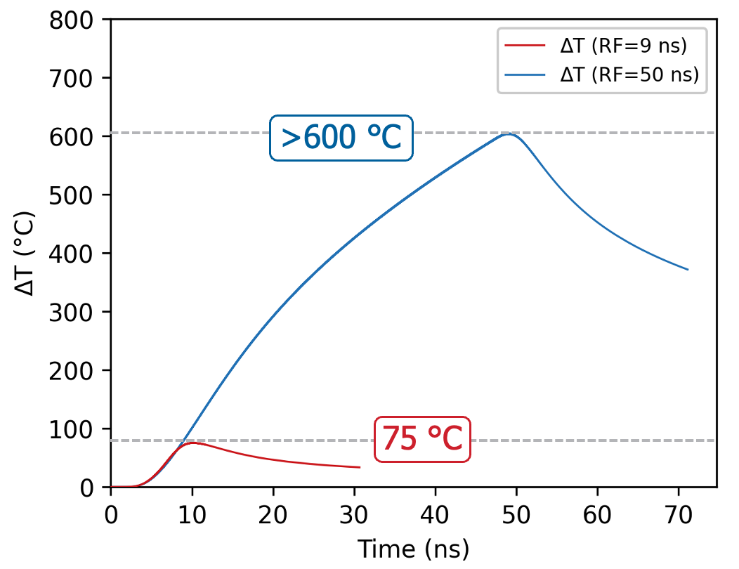
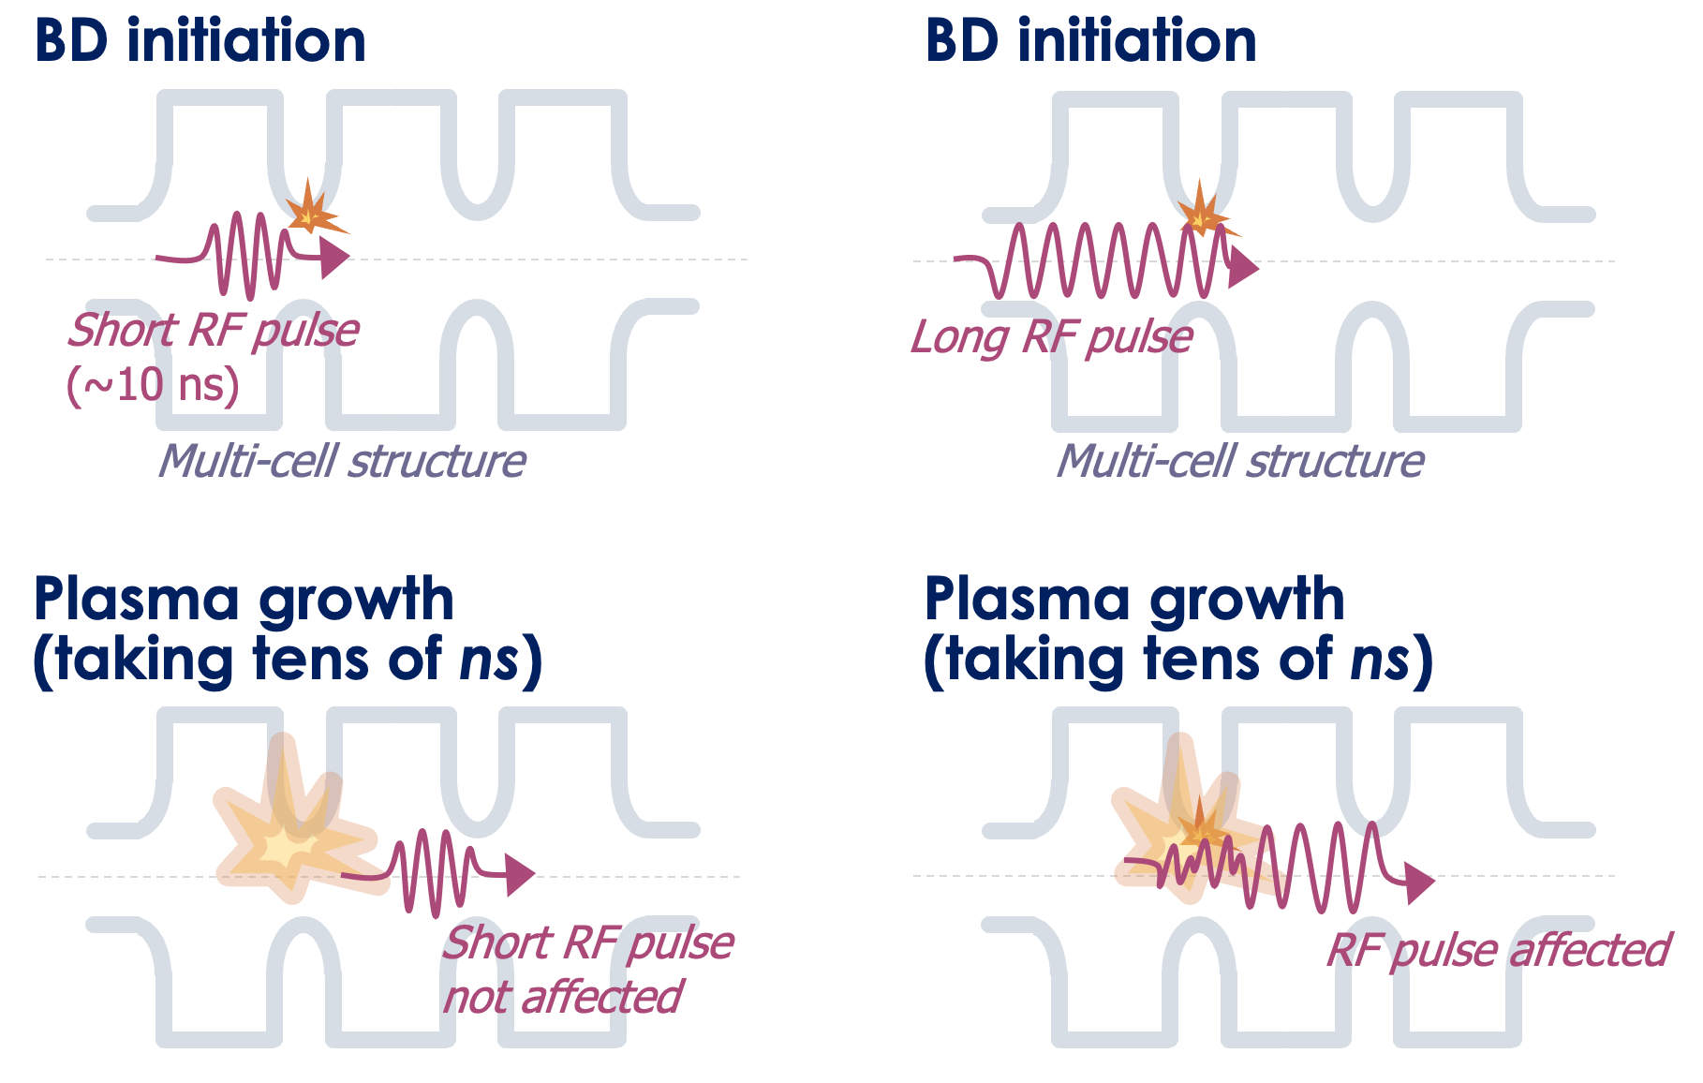
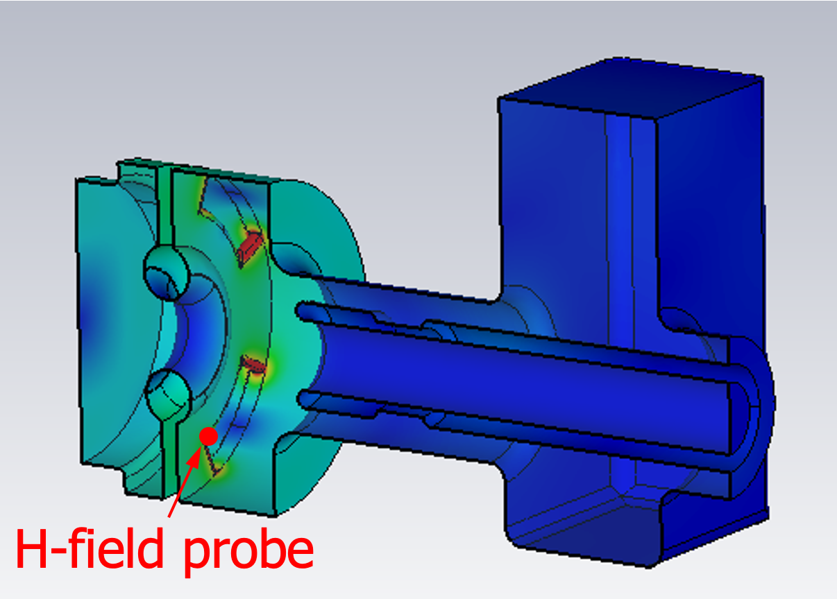
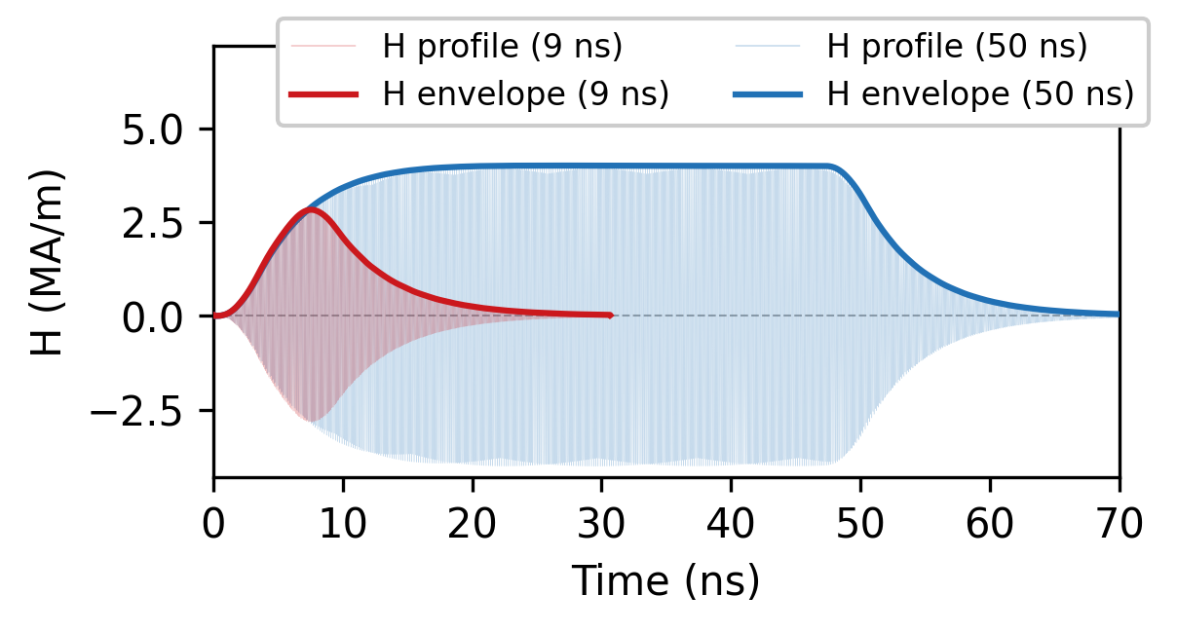
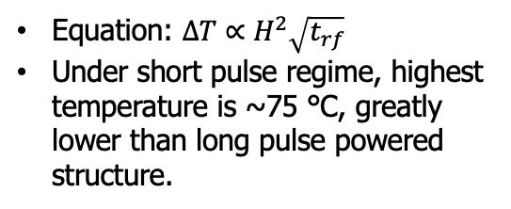
Why Short-pulse?
Motivation
Achieved >400 MV/m in an X-band photogun with a low breakdown rate under short-pulse operation.
Breakdown insensitive acc. regime (hypothesis):
Pulsed heating: high H-field induced temperature rise
Short Pulse vs. Long Pulse
Monitor local H-field
evolution
Equation: $∆T∝H^{2}\sqrt{t_{rf}}$
Under short pulse regime, highest temperature is ~75 °C, greatly lower than long pulse powered structure.
If BD initiates plasma, the short RF pulse may transmit through the structure and remain largely unaffected [1, 2]
[1] J. Shao et al., IPAC2022, doi: 10.18429/JACOW-IPAC2022-FROXSP2.
[2] D. Merenich et al., Phys. Rev. Accel. Beams, vol. 27, no. 4, p. 041301, Apr. 2024

Slide 7
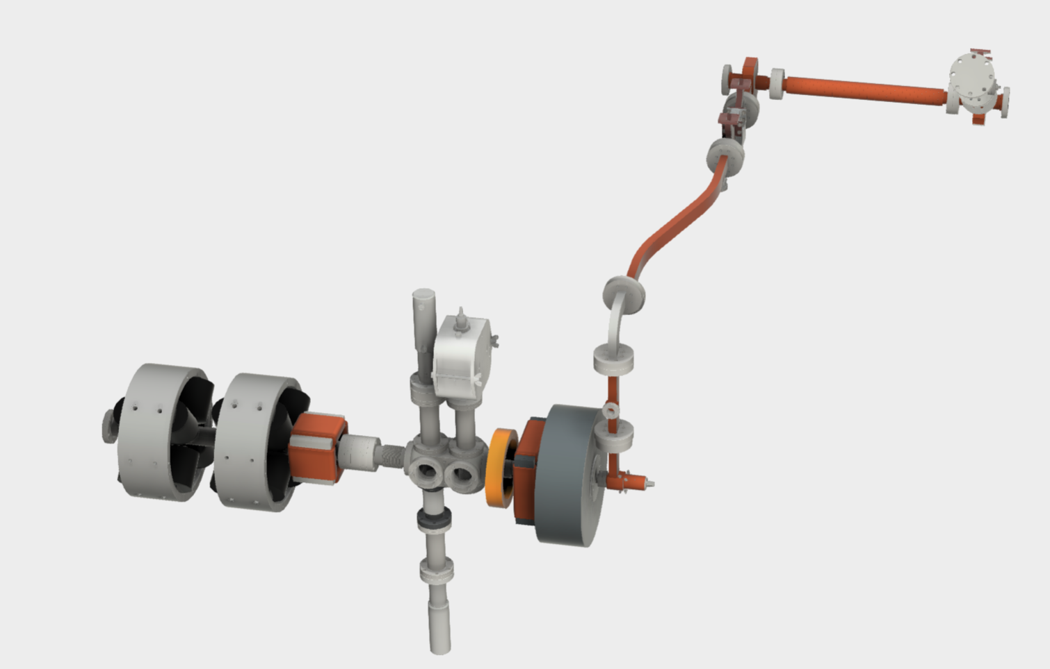
Selected highlight i:
phase scans at different gradients
Measured phase scans (charge vs. Xgun launching phase) @ different gradients: 60 MV/m to 320 MV/m
Simulation benchmarking
Drive bunch train
…
X-band photogun

Slide 8
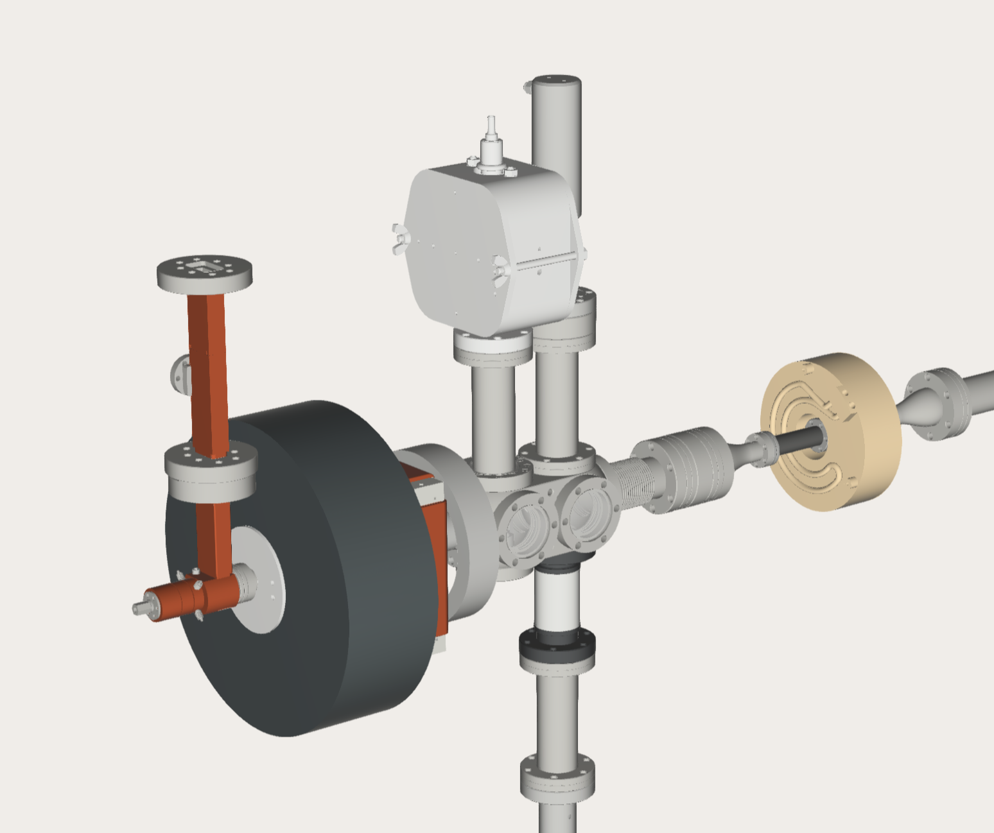
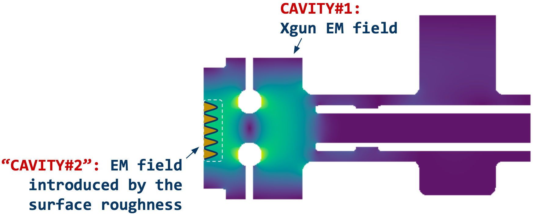
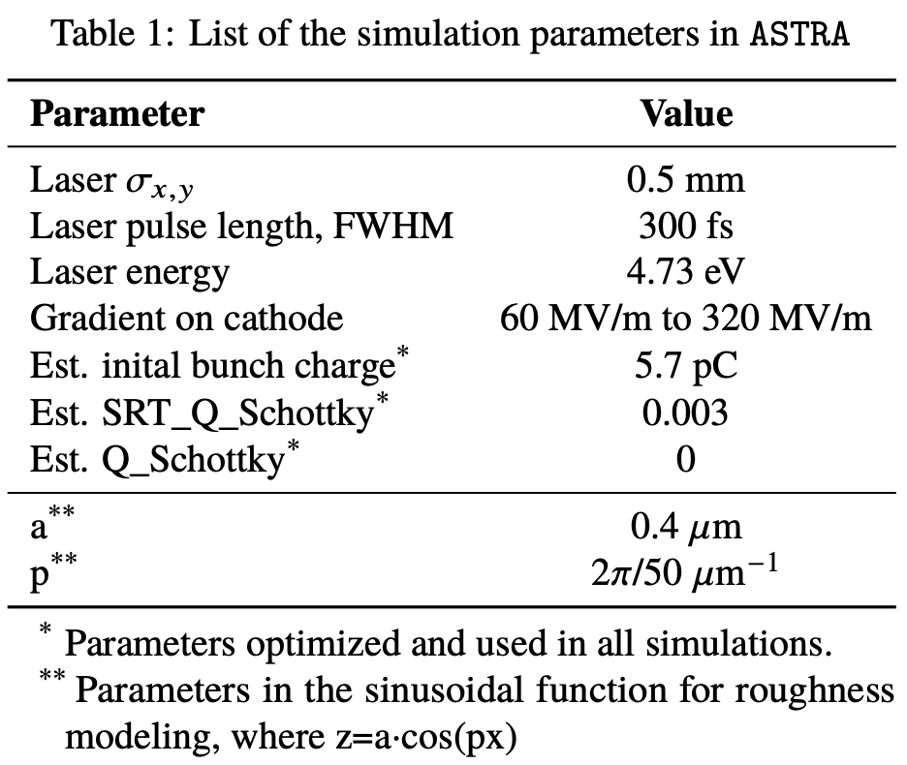

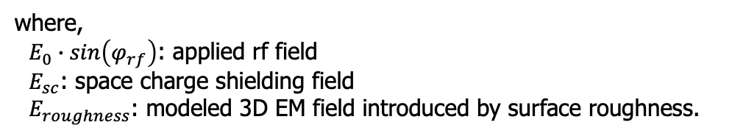
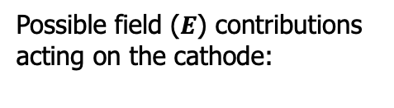
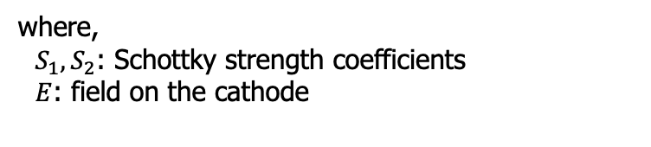
photoemission studies
Phase scans (or Schottky studies)
Simulation setup
main sol.
BPM
In ASTRA, bunch charge is evaluated as follows,
$Q=Q_{0}+S_{1}∙\sqrt{E}+S_{2}∙E$
where,
$S_{1}, S_{2}$: Schottky strength coefficients
$E$: field on the cathode
Laser cross
$E_{total}= E_{0}∙sin\left(φ_{rf}\right)+E_{sc} + { E}_{roughness}$
Xgun
ICT
Possible field ($E$) contributions acting on the cathode:
Modeled separately using a sinusoidal surface [1-2]
Both included in ASTRA
where,
$E_{0}∙sin\left(φ_{rf}\right)$: applied rf field
$E_{sc}$: space charge shielding field
$E_{roughness}$: modeled 3D EM field introduced by surface roughness.
[1] D. J. Bradley, et al., J. Phys. D: Appl. Phys., Vol. 10, (1977).
[2] G. S. Gevorkyan, et al., Phys. Rev. Accel. Beams 21, 093401 (2018).

Slide 9
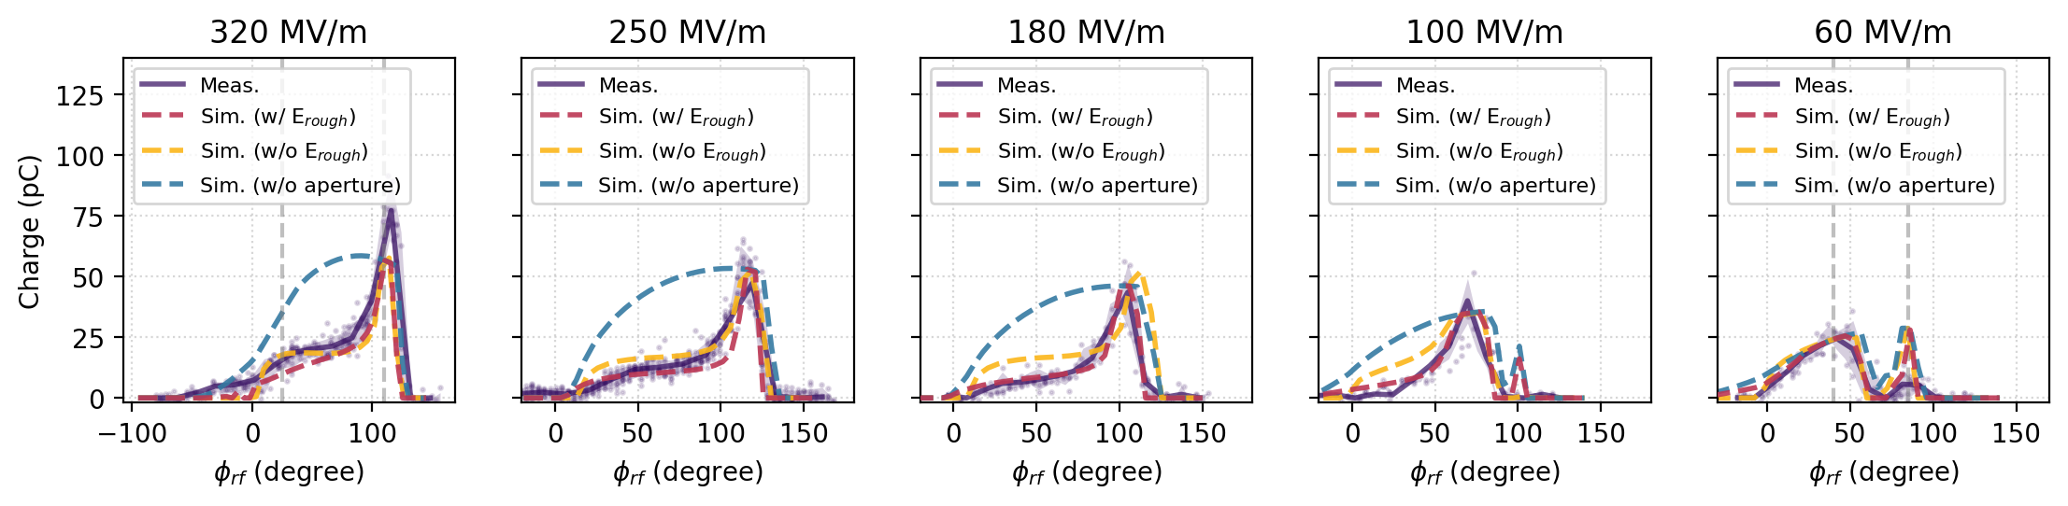
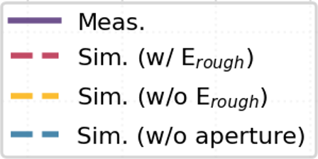

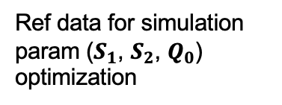
Schottky scans
In ASTRA, bunch charge is evaluated as follows,
$Q=Q_{0}+S_{1}∙\sqrt{E}+S_{2}∙E$
@ 60, 100, 180, 250, 320 MV/m
Ref data for simulation param ($S_{1}$, $S_{2}$, $Q_{0}$) optimization
Peak charge discrepancy only at high gradient.
Other emission mechanism involved (i.e. photo-assisted field emission)?
At all gradients, simulations include the ${ E}_{roughness}$ shows a better agreement with the measurements.
Revealed a beam clipping issue at the Xgun exit.
Photo-assisted field emission might happen at high gradient.

Slide 10
Selected highlight iI:
Operate the Xgun in Transient Regime
Understand the RF buildup process during the short pulse filling
Potential effects on the beam performance
Drive bunch train
…
X-band photogun

Slide 11
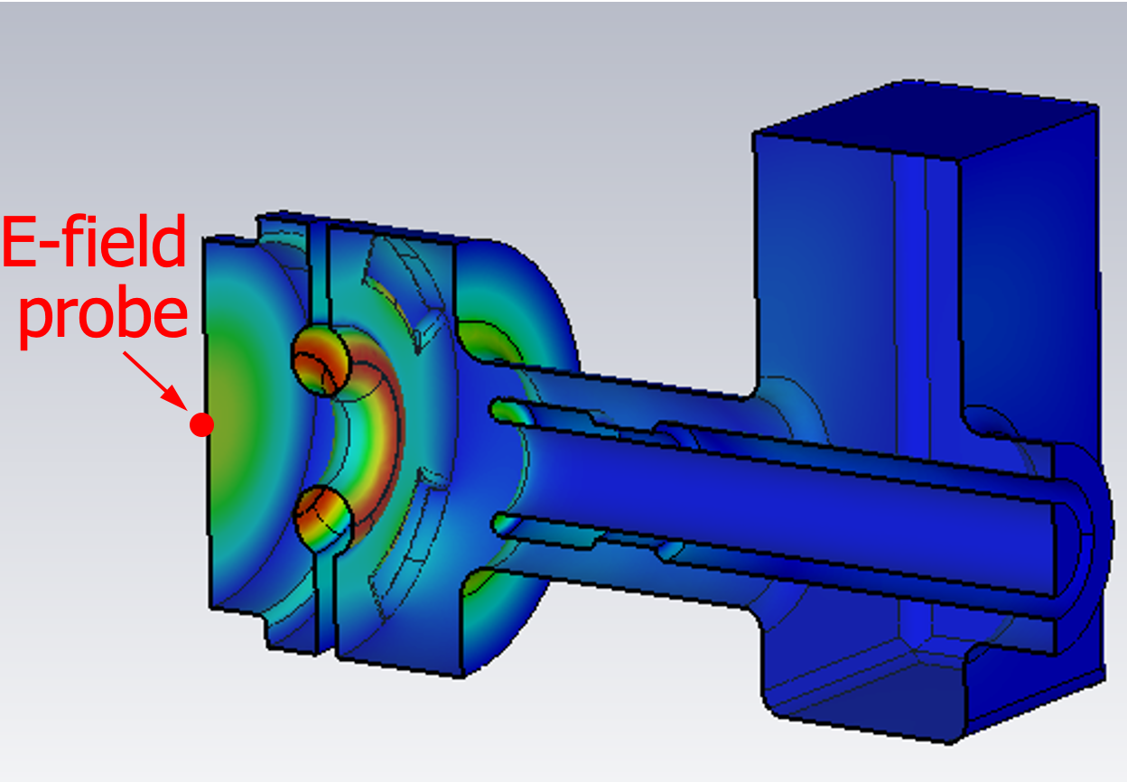
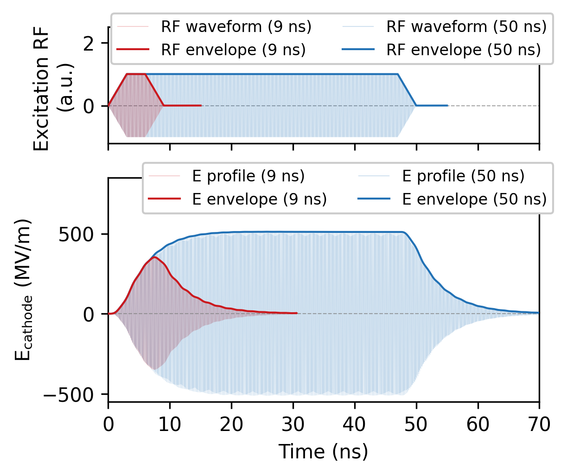
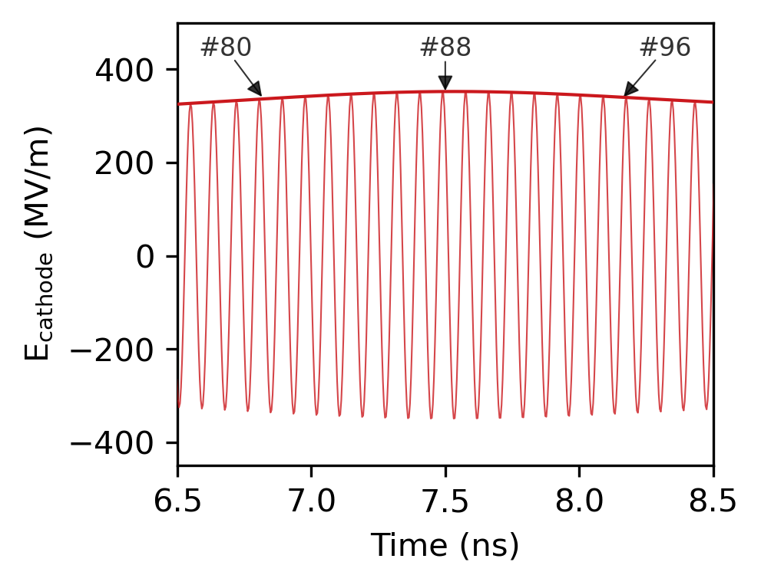
RF build up process
E-field on cathode: 9 ns vs. “long” 50 ns
Zoom-in
around the mostly filled region
(peak)
350 MV/m @ ~7.6 ns
If driven by 9 ns pulse, Xgun is under-filled and staying in the transient state during the full RF duration.
E-field on cathode is changing cycle by cycle.
Broad high-gradient operational window.
Zoom here
G. Chen, et al., arXiv: arXiv:2503.09575. doi: 10.48550/arXiv.2503.09575.

Slide 12
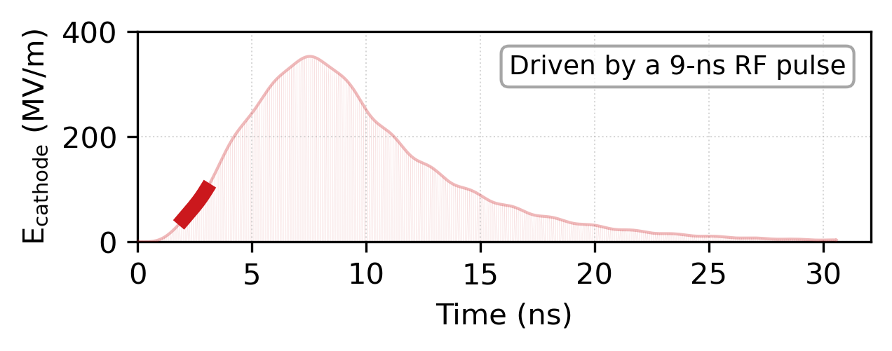
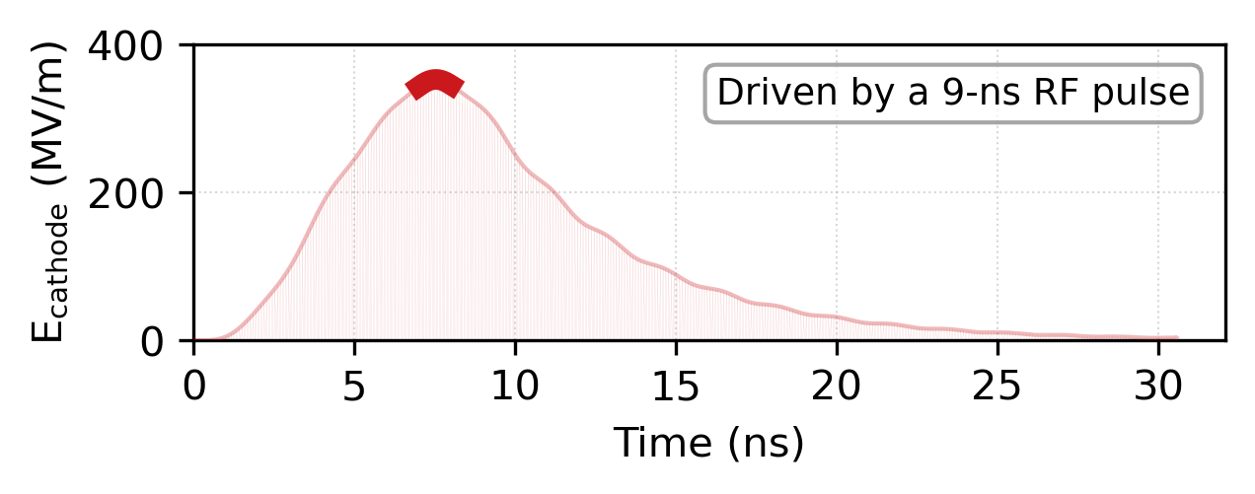
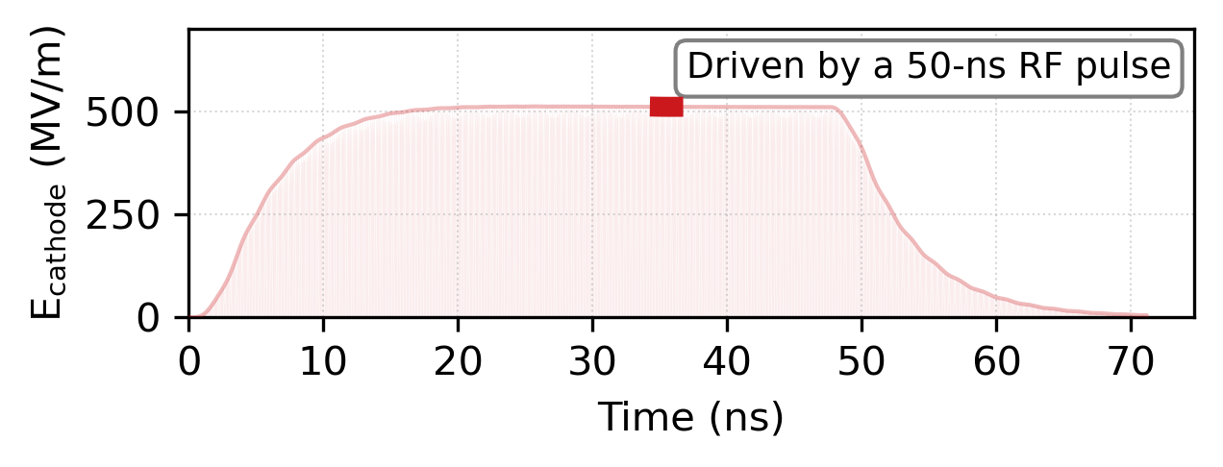
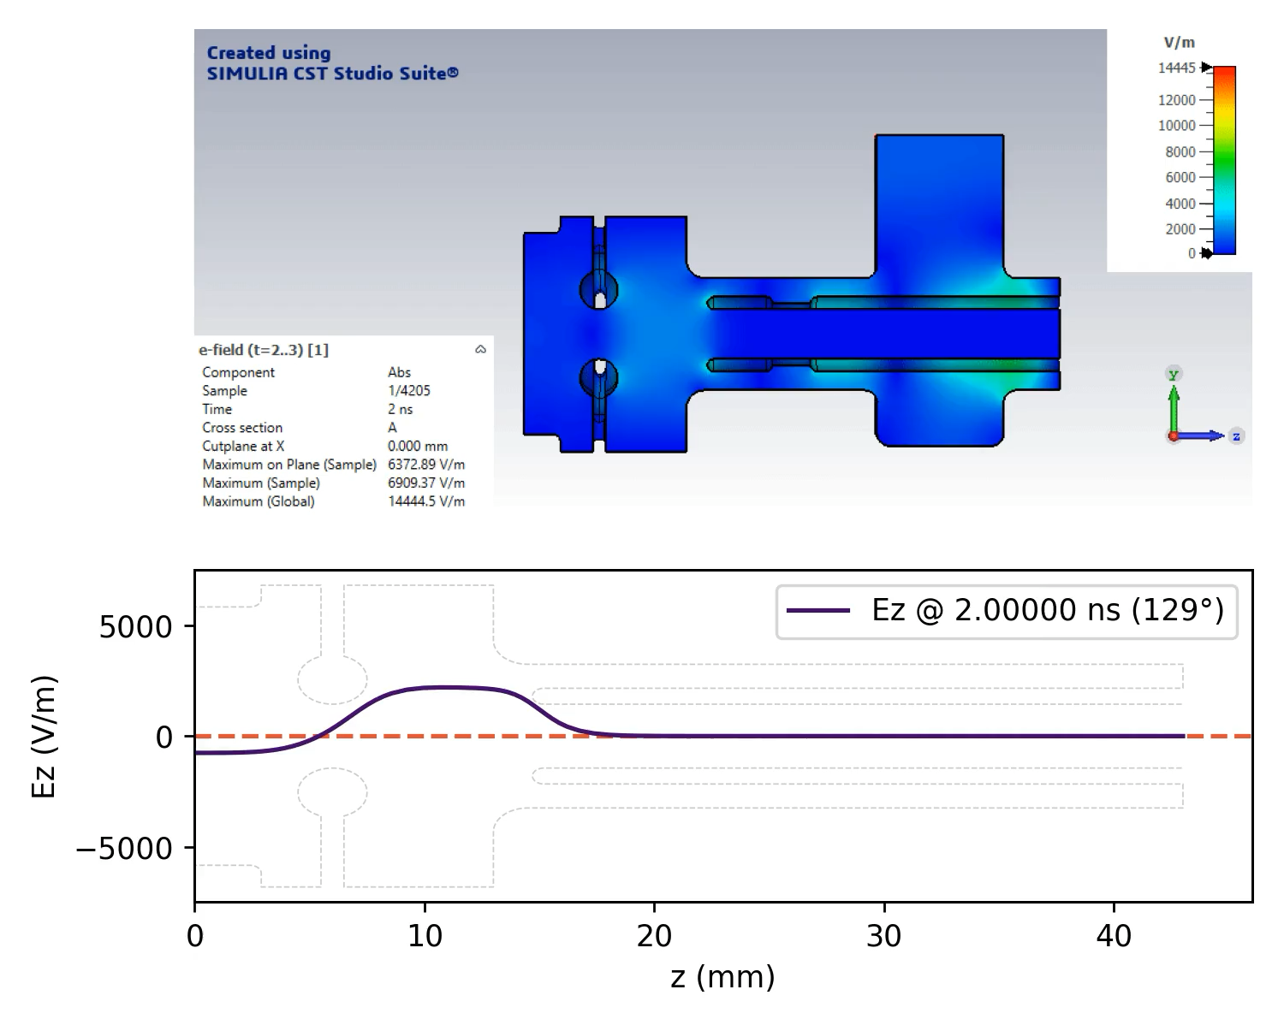

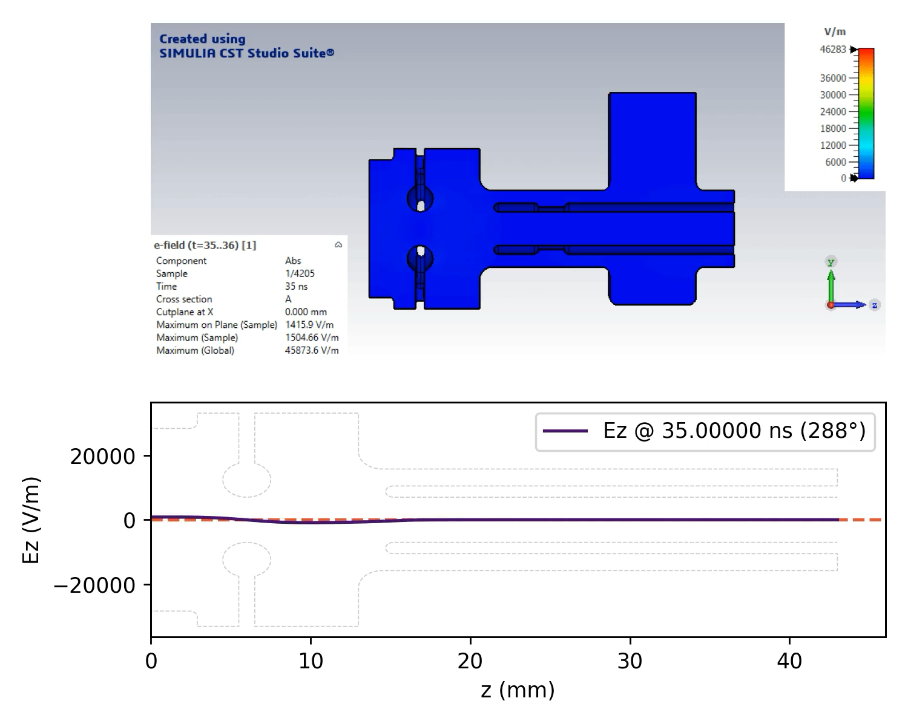
RF build up process
Spatial evolution of E-field: 9 ns vs. “long” 50 ns
E_cathode (2 ns to 3 ns)
E_cathode (7 ns to 8 ns)
E_cathode (35 ns to 36 ns)
On-axis Ez (2 ns to 3 ns)
On-axis Ez (7 ns to 8 ns)
On-axis Ez (35 ns to 36 ns)
RF
RF
RF

Slide 13
Recent work:
Longitudinal phase space (LPS)
Measured bunch lengths
Projected emittance, slice emittance
Drive bunch train
…
X-band photogun

Slide 14
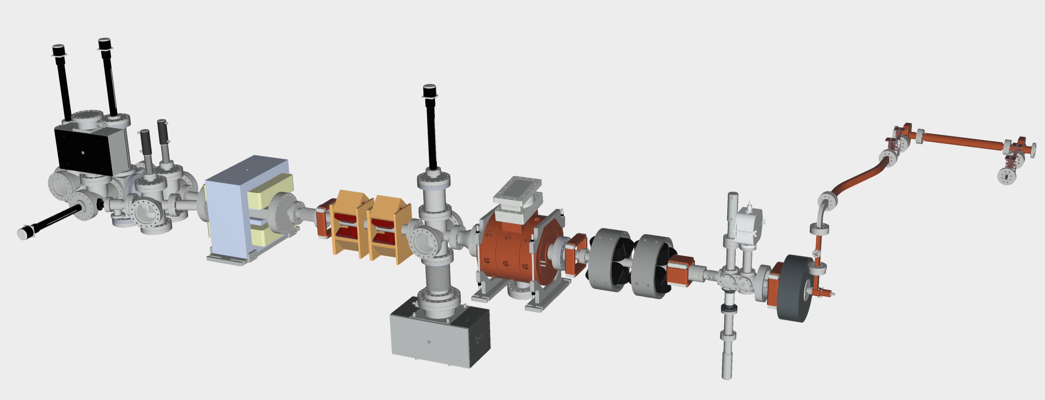
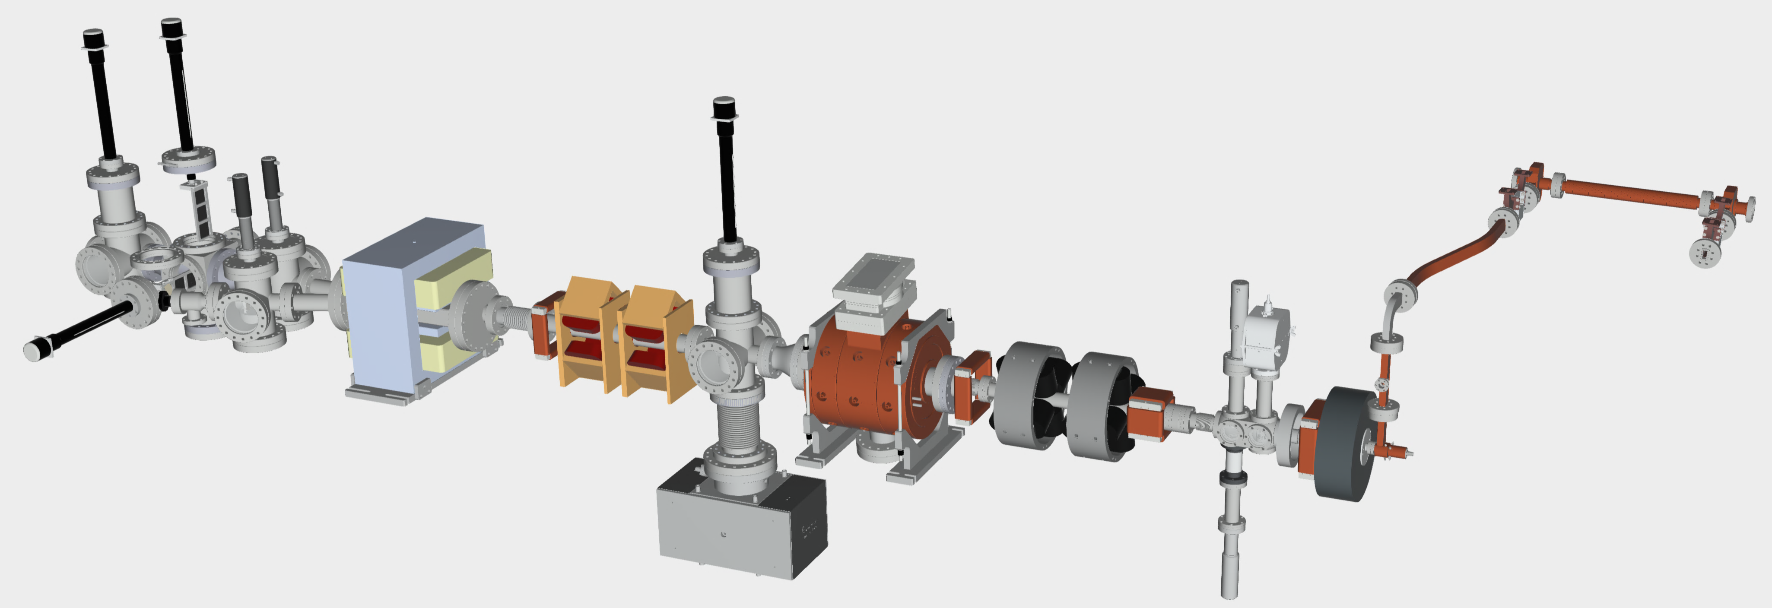
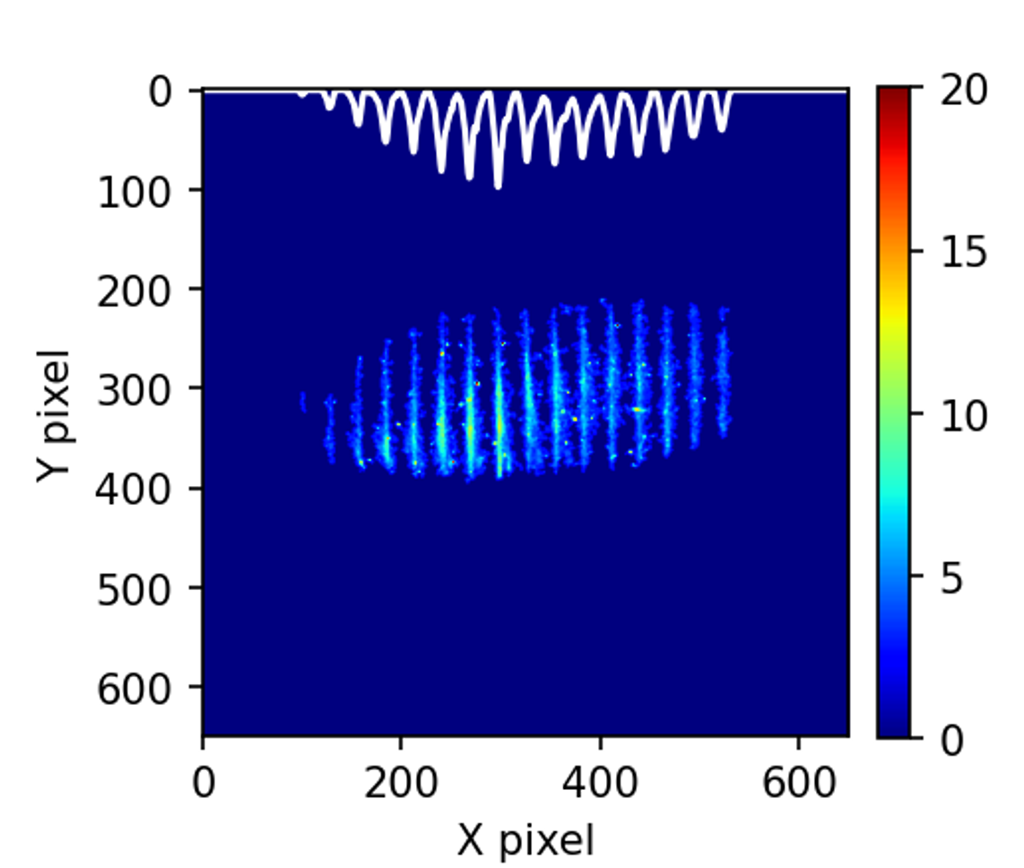
Recent beam test
Beamline in 2025
Drive bunch train
PETS
YAG
TDC
Quads
YAG &
Multi-slit plates
Spectrometer
dipole
Quads
X-band photogun
BPM
ICT
main solenoid
Given the current resources, a deflecting cavity (TDC) was installed into the beamline. We try to characterize the longitudinal phase space (LPS):
  Bunch lengths at different injection phases
  Slice emittance measurement
ε measured w/ multi-slit (2025 data)

Slide 15
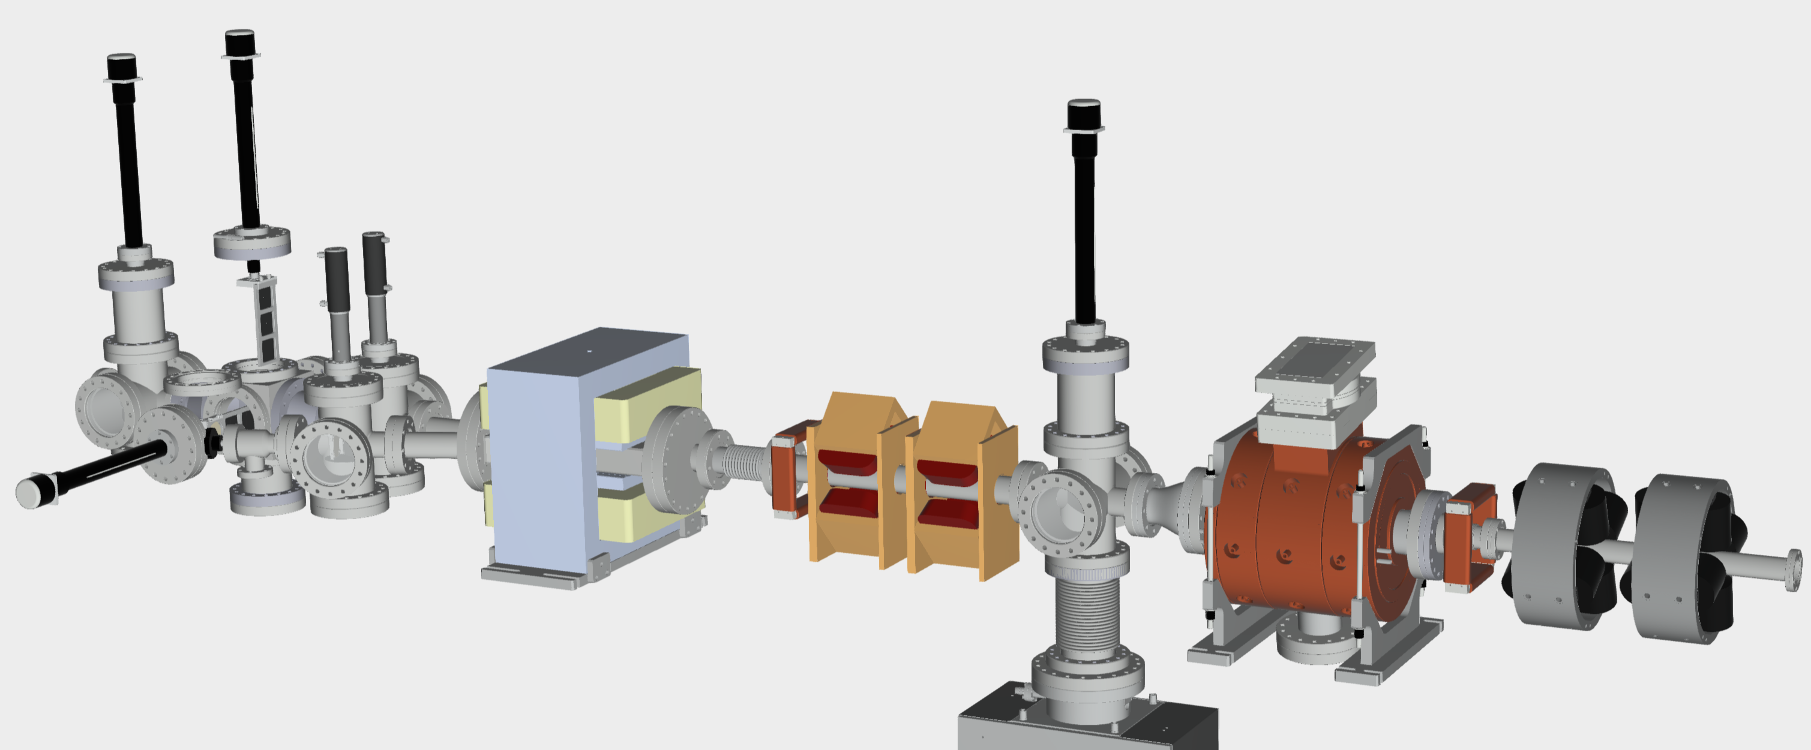
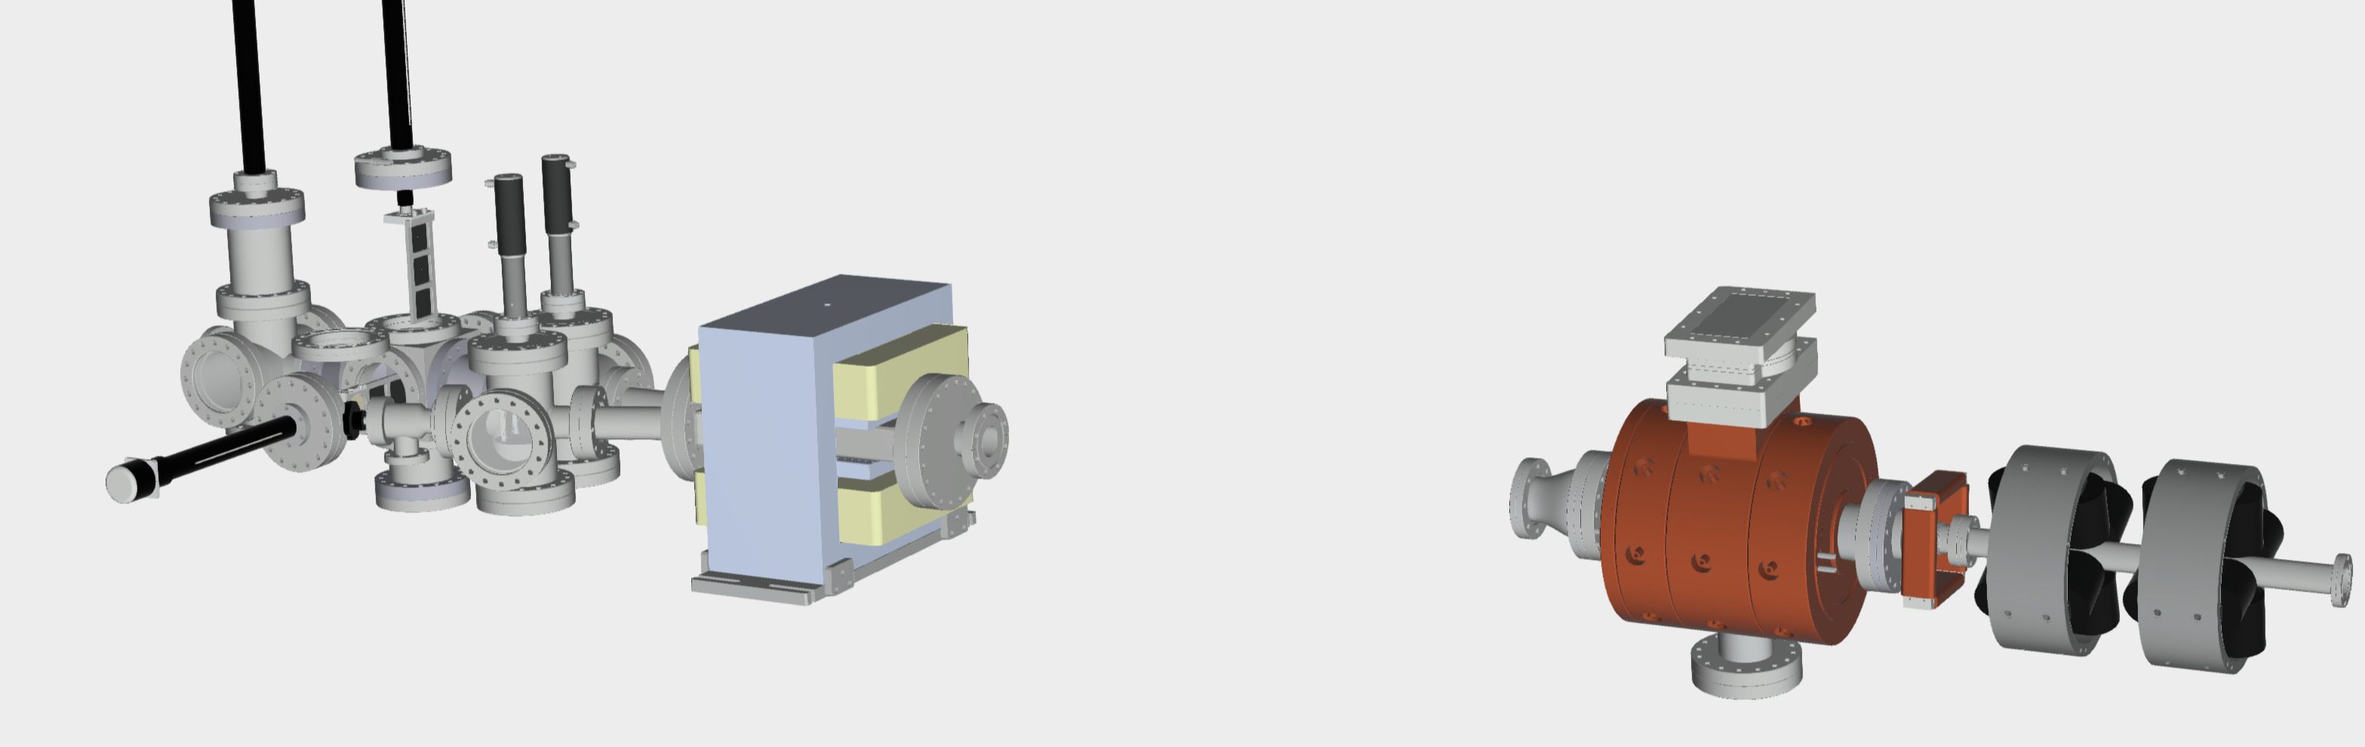
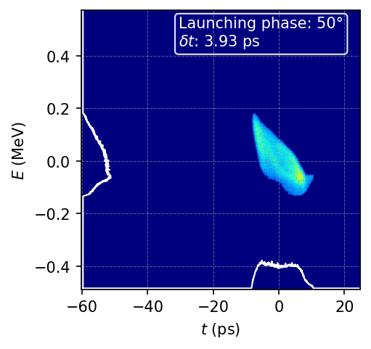
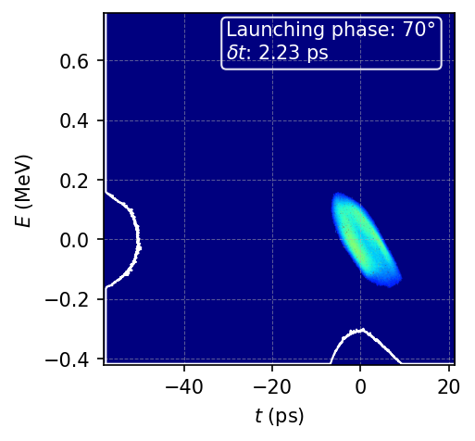
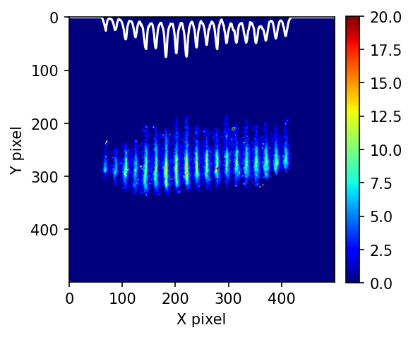
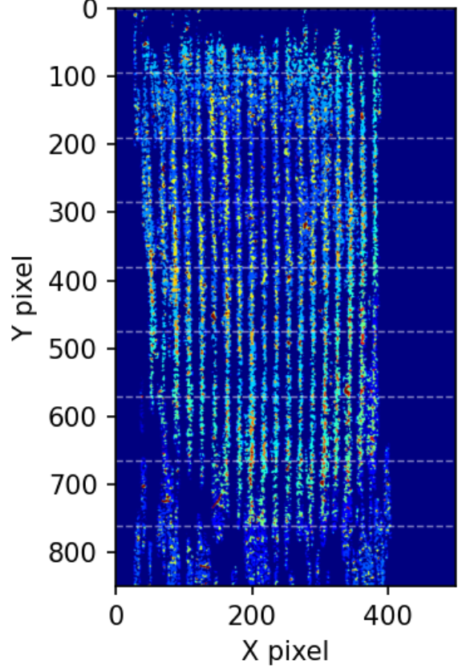
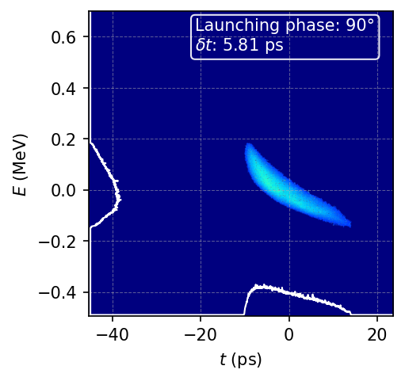
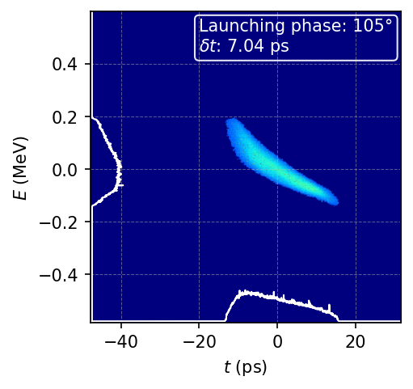
LPS phase space measurement
Preliminary σ_{z} and ε
Spectrometer
dipole
TDC
LPS and σ_{z} @ different phases:
Quads
beam
Multi-slit plates
YAG
Projected ε and slice ε:
Projected ε
sliced ε
Analysis ongoing…

Slide 16
future work: New LINAc development
Introduction to the design concept
Preliminary design

Slide 17
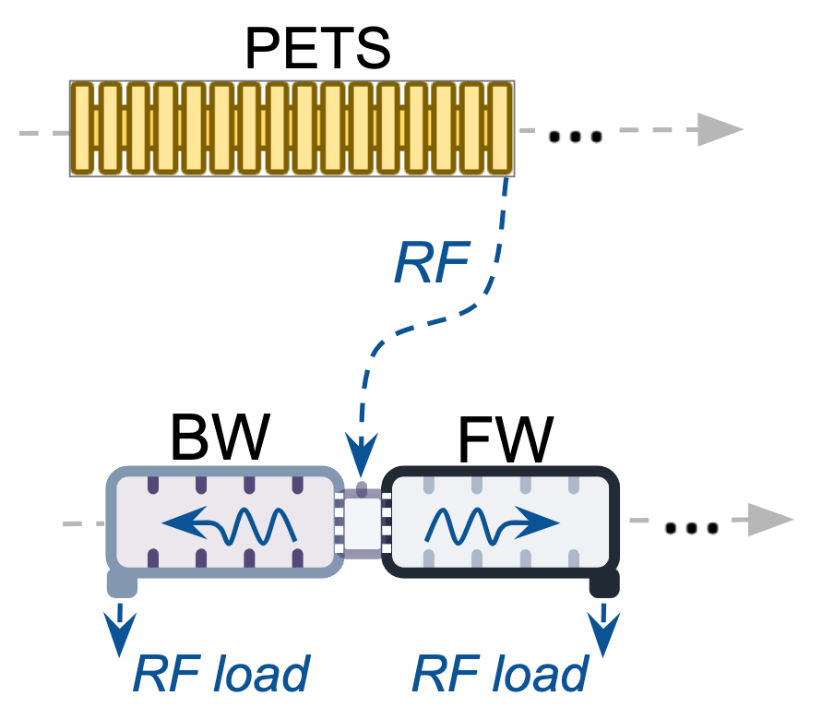
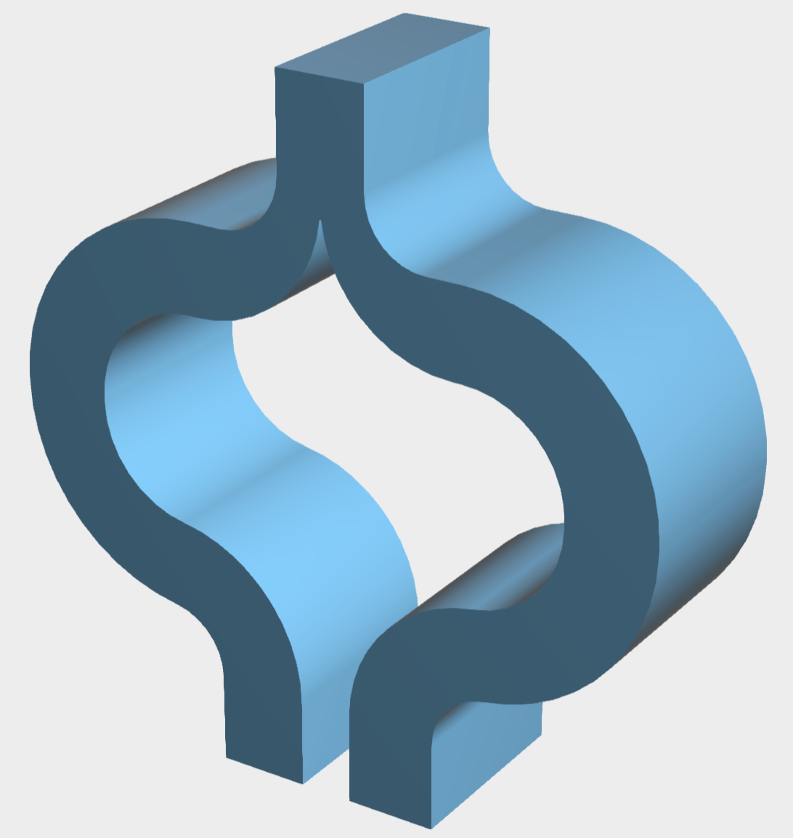
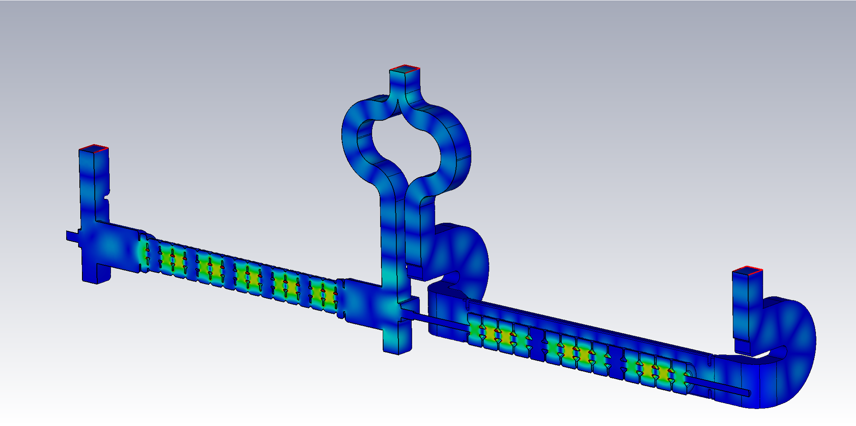
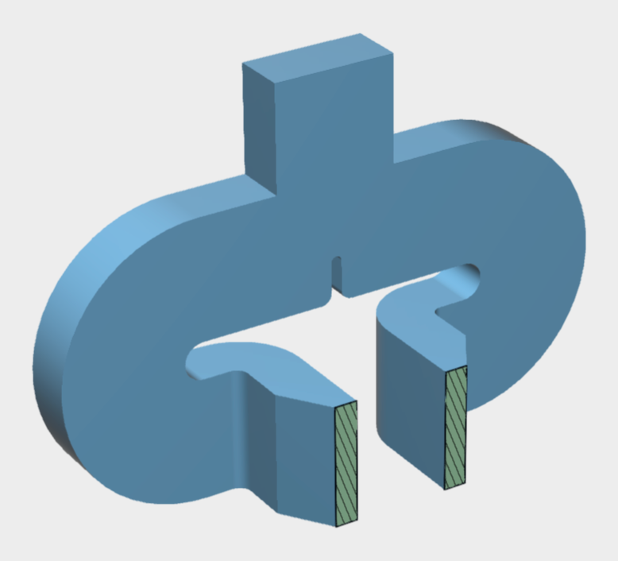
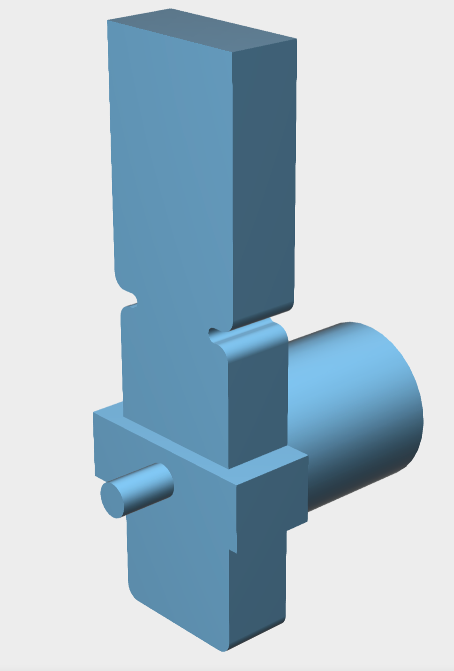
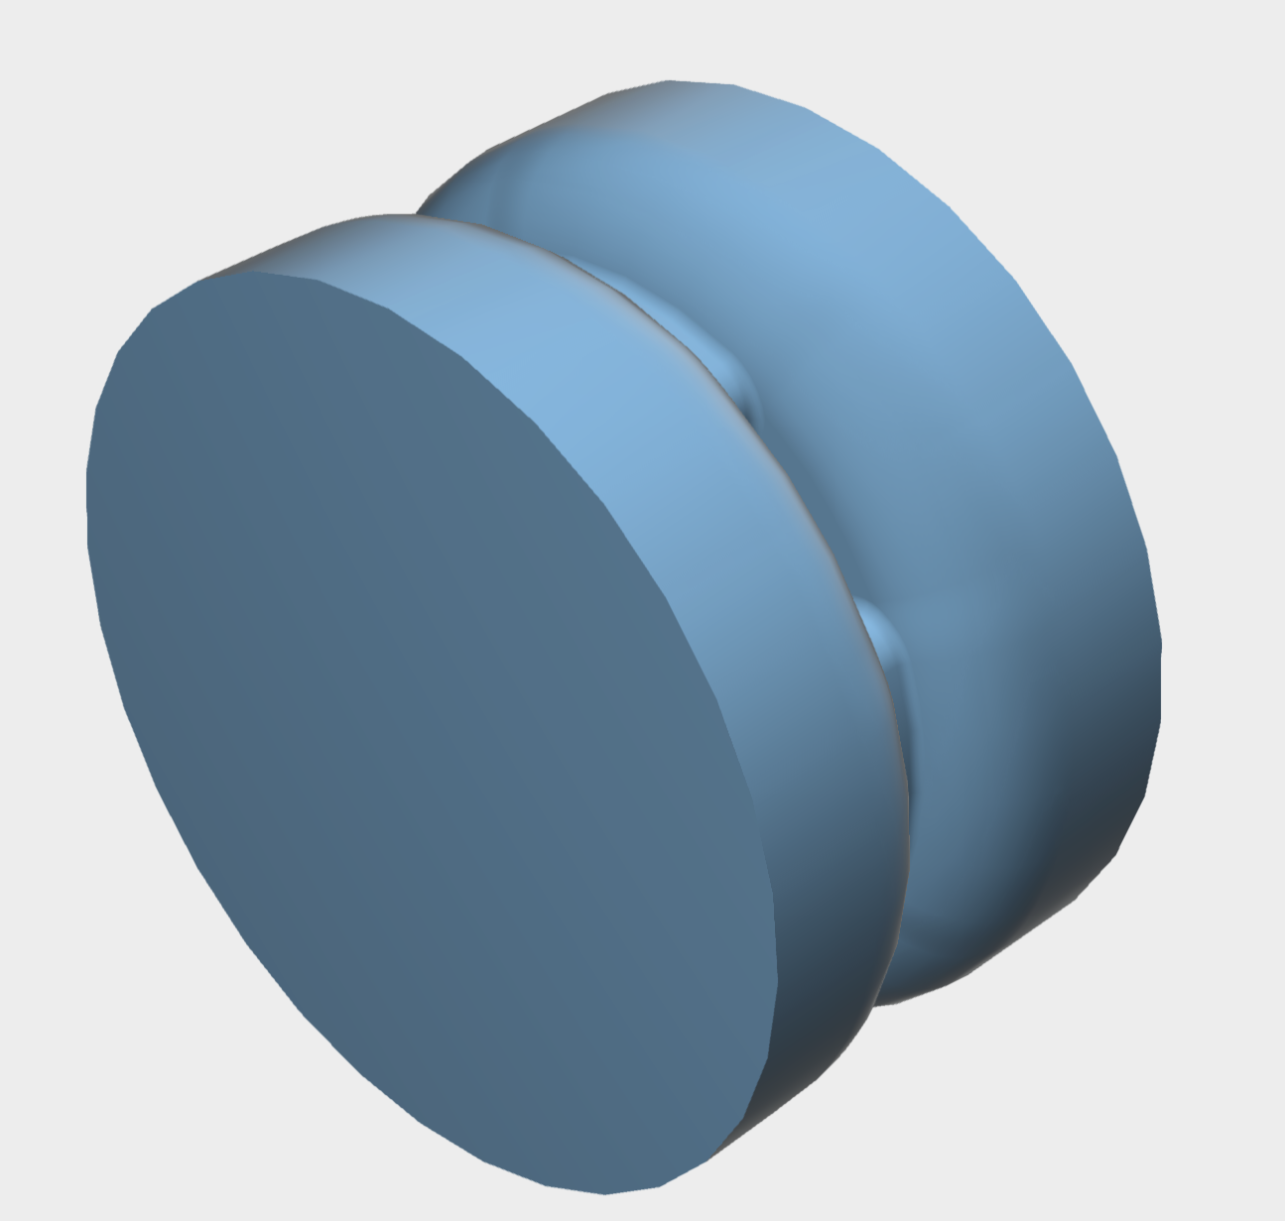
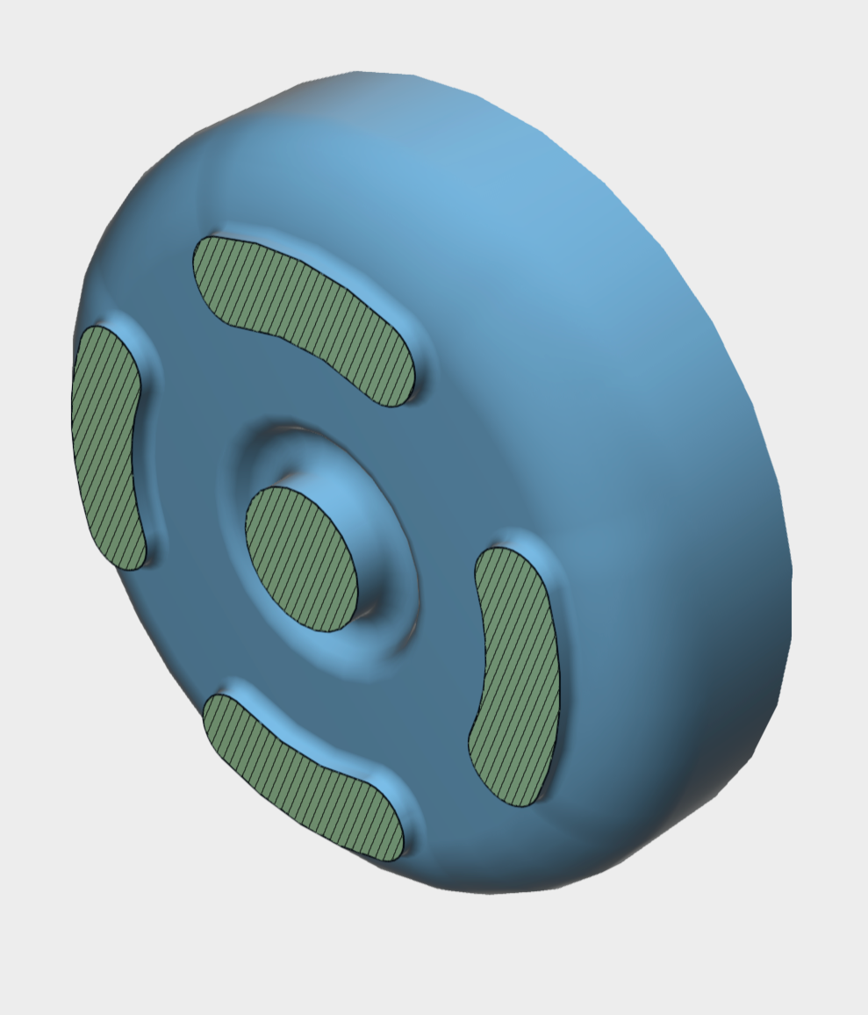



Short-pulse powered LINAC
Concept
On-going effort
Design concept:
To maximize the energy gain, a compact LINAC with longer accelerating length is needed.
We proposed a two-half BW-FW structure to extend the structure length, with each section optimized for high v_{g} and high r.
(f)
Short RF pulse
(e)
(d)
(a)
(b)
Backward wave (BW) single cell
Forward wave (FW) single cell
BW matching cell
Rectangular-to-circular adapter
H-plane power divider & FW matching slots
E-plane power divider
(c)
Beam direction
[1] G. Chen, et al., Proceedings of IPAC’26, 2026. doi: 10.18429/JACoW-IPAC2026-TUV3301.

Slide 18



future work and Conclusion
Xgun upgrade
Xgun (3 MeV) $⇒$10 MeV $⇒$ 50 MeV
Short-pulse operation is promising, with gradients >350 MV/m demonstrated in the X-gun.
Short-pulse operation also introduce challenges, such as rapid filling time, and potential transient effects in underfilled structures.
The ultimate goal is 100 pC with 100 nm emittance.
Phase shifter
Power splitter
LINAC
Xgun
New photogun and solenoid design.
Near term (3 MeV$⇒$10 MeV): Add an in-house conventional linac to reach 10 MeV, and quantify beam performance. With one PETS powering both the X-gun and linac.
Long term ($⇒$50 MeV): Add a second “PETS-linac” module for further energy scaling.
Thank you!

Slide 19
backup

Slide 20

Phase scan + beam trajectory

Slide 21




Closer look on Ez (on-axis)
Early filled stage (~2.5 ns)
Selected snapshots
Standing wave (SW) cavity:
$E=E_{0}∙cos⁡(ωt+φ)$
Clear Deviation from the pure SW Cavity.
RF
“0-mode” like distribution
Clear Deviation from the pure SW Cavity.
Before reaching to steady states, different coupling between sections causes non-uniform RF power flow, making some sections respond to the RF faster while others lag, showing a delayed or “0-mode”-like field patterns.
G. Chen, et al., arXiv: arXiv:2503.09575. doi: 10.48550/arXiv.2503.09575.

Slide 22




Closer look on Ez (on-axis)
Mostly filled stage (~7.5 ns)
Ez phases 88°–96°
RF buckets #80, #88, #96, & steady-state
Selected snapshots from #88 RF bucket
RF
When the Xgun is under-filled in the transient states, the EM field distribution varies cycle-by-cycle. This transient behavior is different from pure SW cavity.
This transient effect needs to be considered in beam simulations.

Slide 23

Beam simulation workflow
Include the transient field map
Dynamic field mapping method, simulation setup:
  Update field map every ~0.2 ps (1° at X-band).
  Use 3D field map
  Zero thermal emittance; no solenoid; ignore space charge
In the following work, we focus on characterizing beam properties (kinetic energy, transverse emittance, and bunch length) with the influence only from transient RF field.

Slide 24

An example of beam tracking
With dynamic field mapping
Launch the beam from #88 bucket at the launching phase of 185°.
Update field map every 0.2 ps. On-axis Ez (red curve) plotted for reference.
Track the bunch to the gun exit, and record the results (i.e. kinetic energy in this example).
Then repeat this process for launching phase 0° to 360° → next slide
kinetic energy

Slide 25



Beam performance summary
Kinetic energy, emittance, bunch length
kinetic energy vs. launching phase
emittance vs. launching phase
bunch length vs. launching phase
Small effect.
The value of the min emittance is similar as SW cavity (nearly no change). However, the phase is different.
Very small effect.
G. Chen, et al., arXiv: arXiv:2503.09575. doi: 10.48550/arXiv.2503.09575.

Slide 26


Lps data calibration
E and time calibration
Notes:
ICT4 gate: 190, 210 nC
XICT gate: 30, 135 pC

