Slide 1
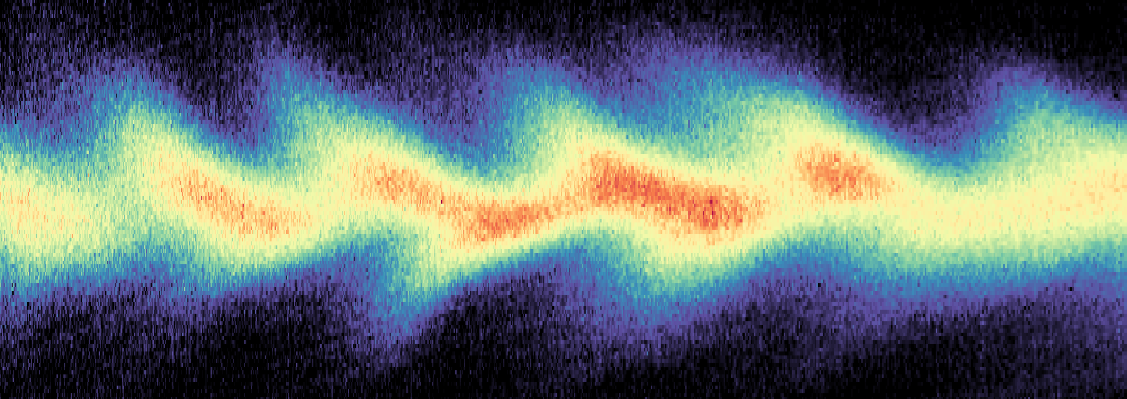
Single-Shot Reconstruction of Electron Beam Longitudinal Phase Space
Yong Ma
University of Michigan
2026 Advanced Accelerator Concepts , July 27-31, Los Angeles, CA

Slide 2





















Collaborators
M.J.V. Streeter, F. Albert, N. Bourgeois, S. Cipiccia, J.M. Cole, S.J.D. Dann, K. Falk, E. Gerstmayr, I.Gallardo. Gonzalez, A. Higginbotham, A.E. Hussein, D.A. Jaroszynski, A. S. Joglekar, B. Kettle, K. Krushelnick, N. Lemos, N.C. Lopes, C. Lumsden, O. Lundh, S.P.D. Mangles, S. T. McLoughlin, K. Miller, W. Mori, Z. Najmudin, Q. Qian, P.P. Rajeev, J. P. Palastro, M. Shahzad, M. Smid, D. Seipt, R. Spesyvtsev, D.R. Symes, G. Vieux, L. Willingale, J. C. Wood and A.G.R. Thomas

Slide 3
Acknowledgment
Partially supported by:
EuPRAXIA (Grant No. 653782),
LASERLAB-EUROPE (Grant No. 654148),
UK EPSRC Grant No. EP/J018171/1, EP/J500094/1 and EP/N028694/1),
Royal Society URF-R1221874,
EuCARD-2 (Grant No. 312453),
Swedish Research Council (VR 2019-04784, 2024-05698)
the Knut and Alice Wallenberg Foundation (KAW 2019.0318, 2020.0111)
the Extreme Light Infrastructure (ELI) European Project,
Natural Science and Engineering Research Council of Canada,
FCT Portugal under the contract POCI/FIS/59574/2004
US Department of Energy by Lawrence Livermore National Laboratory under the contract DE-AC52- 07NA27344; Lawrence Livermore National Security, LLC; DOE Early Career Research Prog. SCW1575/1.
US Department of Energy DE-NA0004144 and DE-SC0021057
Work supported by:
US National Science Foundation under grant No. 1804463, 2126181
UK STFC core grants ST/P002056/1 (Cockcroft Institute), ST/P000835/1 (John Adams Institute),
United States Department of Energy Grant No. DE- NA0002372, DE-SC0022109, DE-SC0016804.

Slide 4
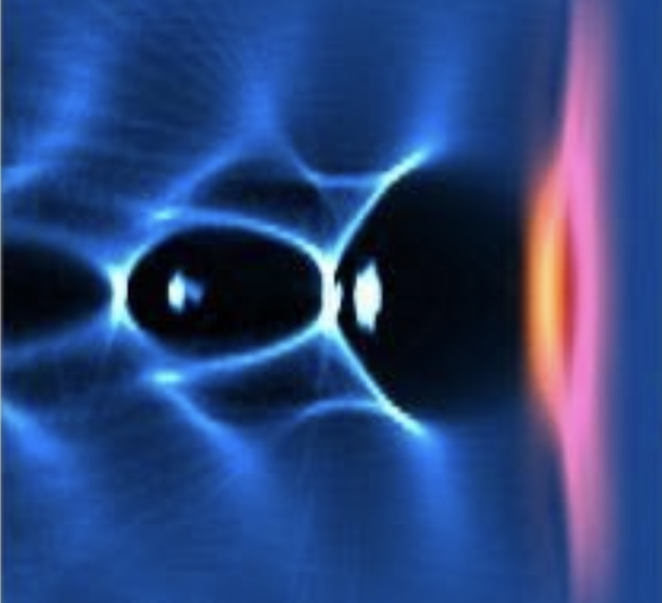
Laser / plasma wakefield acceleration
Lu, W., et al., Phys. Rev. ST Accel. Beams (2007)
High acceleration gradients ~100 GeV/m
1000X than conventional RF accelerators
~10 GeV, um source size, fs pulse duration, kA current.
LWFA and PWFA are the most promising and successful advanced acceleration concepts
Plasma
Electron
beam
Driver:
Laser or particle beam
T. Tajima and J. M. Dawson, Phys. Rev. Lett. 43, 267 (1979)
P. Chen et al., Phys. Rev. Lett. 54, 693 (1985)

Slide 5
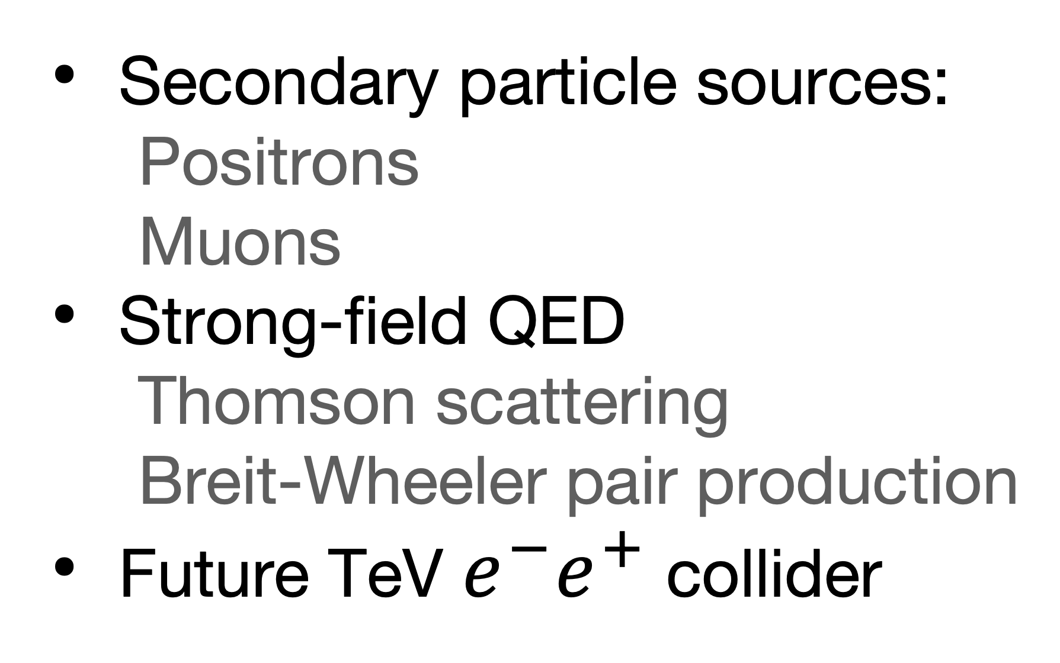
Applications
Secondary radiation sources:
    Betatron X-ray,
    Inverse Compton scattering,
    XUV (Photon acceleration),
    Mid-IR,
    ThZ (CTR),
    Free electron laser
    Synchrotron source injector
Secondary particle sources:
    Positrons
    Muons
Strong-field QED
    Thomson scattering
    Breit-Wheeler pair production
Future TeV $e^{−}e^{+}$ collider
Applications — Beam properties — Diagnostics

Slide 6



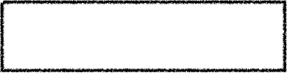




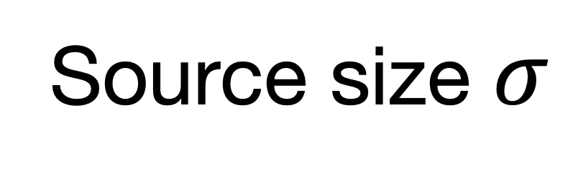



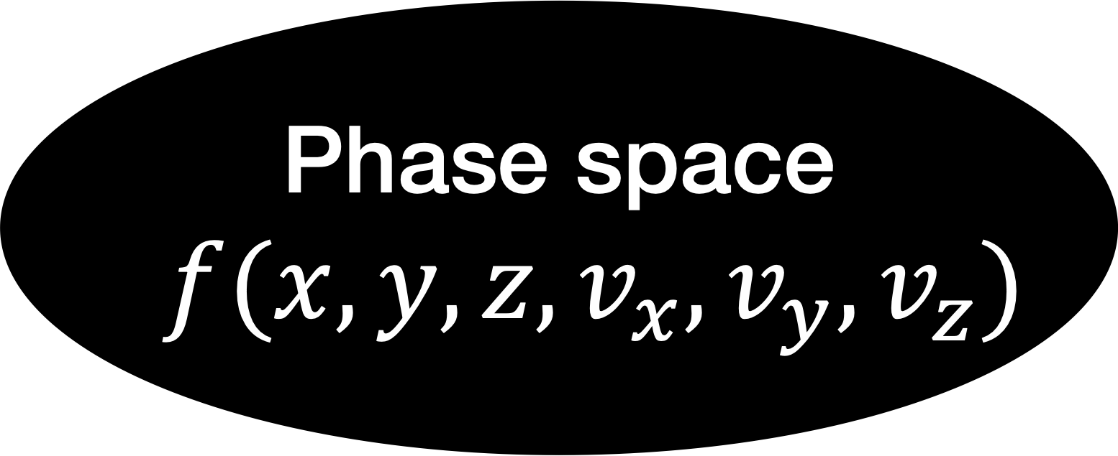




Diagnostics
Charge $Q$
Pulse duration $τ$
Energy spread $ΔE$
Phase space
$$f(x,y,z,v_{x},v_{y},v_{z})$$
Peak current $I_{A}$
Energy $E$
Divergence $Δθ$
etc.
Emittance $ε$
Source size $σ$
Single-shot

Slide 7

Phase space diagnostics
3D Real space
See also:
Downer et al.: Diagnostics for plasma-based electron accelerators,
Rev. Mod. Phys., 90. 3, 2018.
Coherent Transition Radiation & ElectroOptical sampling
M. LaBerge et al., Nature Photonics 18, 952–959 (2024)
K. Huang et al., Light: Science & Applications 13:84 (2024)
CTR for temporal characterization
J. van Tilborg et al., PRL. 96, 014801 (2006).
Y. Glinec, et al., PRL. 98, 194801 (2007)
O. Lundh et al., Nat. Phys. 7, 219 (2011).
O. Lundh et al., PRL. 110, 065005 (2013).
Indirect Single Shot X-Ray Spectroscopy
Transverse phase space
Betatron radiation
Quadrupole scan
G. R. Plateau, PRL 109, 064802 (2012)
S. Kneip, PRST-AB15, 021302 (2012)
A. Curcio, PRAB 20, 012801 (2017)
Pepper-pot mask
Multi-shot
Single shot 4D phase space
Inverse Compton scattering
R. Weingartner, PRST-AB 15, 111302 (2012)
S. K. Barber, PRL. 119, 104801 (2017)
V. Shpakov, PRAB 24, 051301 (2021)
C. A. Lindstrøm, PRAB 23, 052802 (2020)
C. A. Lindstrøm, Nat. Comms 15, 6097 (2024)
S. Fritzler et al., PRL. 92, 165006 (2004)
C. M. S. Sears et al., PRST-AB 13, 092803 (2010)
E. Brunetti et al., PRL 105, 215007 (2010)
W. P. Leemans, PRL 77, 4182 (1996)
G. Golovin,Sci. Rep 6, 24622 (2016)
J. M. Kr¨amer, Sci. Rep 8, 1398 (2018)

Slide 8
Longitudinal phase space f(z, pz)
Free electron lasers using LWFA / PWFA
LWFA
PWFA
@ SPARC_LAB, INFN, Italy
First free-electron lasing with LWFA
@SIOM
First free-electron lasing with PWFA
W. T. Wang et al., Nature 595, 516–520 (2021)
SASE FEL
First seeded FEL
@HZDR, DRACO laser
R. Pompili et al., Nature 605, 659 (2022).
M. Labat, et al., Nat. Photon. 17, 150–156. (2023)
M. Labat, et al., PRL. 136, 245001 (2026) (high-gain)
Seeded FEL
Galletti, M, et al., Phys. Rev. Lett. 129, 234801. (2022)
High Reliability, high-gain FEL
@LBNL BELLA, HTU
S. K. Barber et al., Phys. Rev. Lett. 135, 055001 (2025).
There are only ~10 major RF accelerator based FEL facilities worldwide:
LCLS/LCLS-II, European XFEL, SACLA, SwissFEL, PAL-XFEL, Shanghai Soft X-ray FEL, FLASH, FERMI, DCLS, etc.
New results in Japan
@SPring-8
Z. Jin et al, Phys. Rev. Res. 8, 013207 (2026)

Slide 9
Longitudinal phase space f(z, pz)
Free electron lasers using LWFA / PWFA
Percentage level relative energy spread
FELs | FEL wavelength (nm) | Electron energy (MeV) | Electron energy spread
SIOM | 27 | 490 | 0.2-1.2%
HZDR | 270 | 188 | 6.3%
LBNL | 420 | 100 | 2%
Spring-8 | 43 | 400 | 0.7%
INFN | 830 | 94 | 0.3%

Slide 10

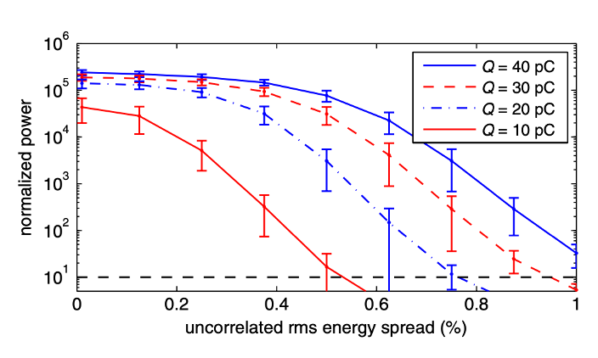
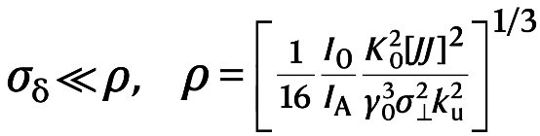
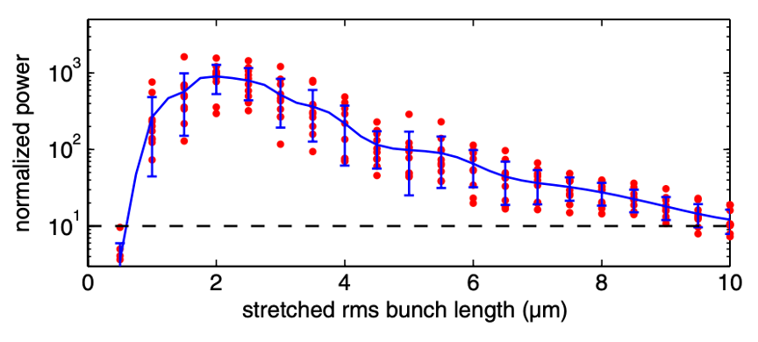
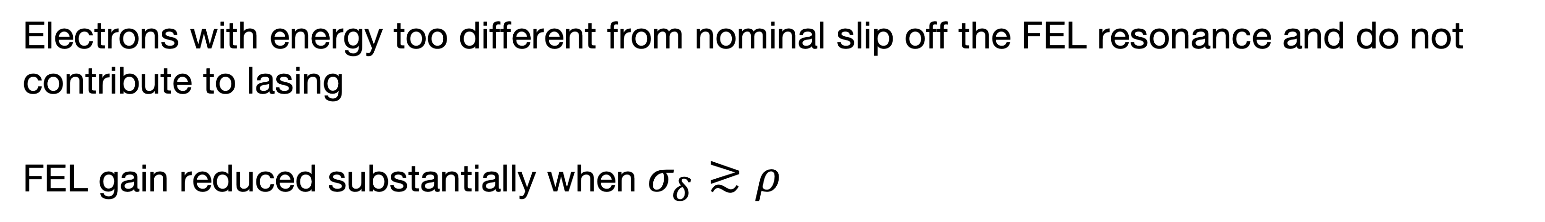
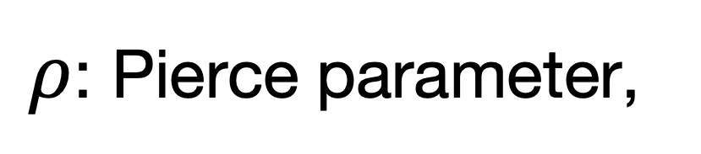
Longitudinal phase space f(z, pz)
Slice energy spread for FEL
FEL power VS slice energy spread
$ρ$: Pierce parameter,
Relativistic electrons,
High-gain FEL,
~0.1%
Maier et al., PRX 2, 031019 (2012)
Electrons with energy too different from nominal slip off the FEL resonance and do not contribute to lasing
FEL gain reduced substantially when $σ_{δ}≳ρ$

Slide 11
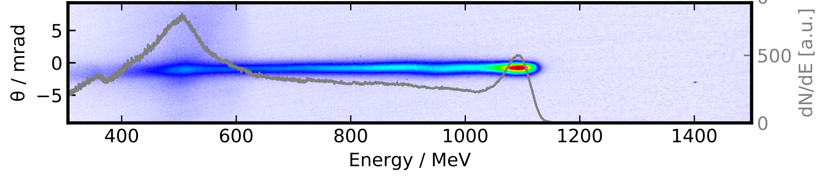
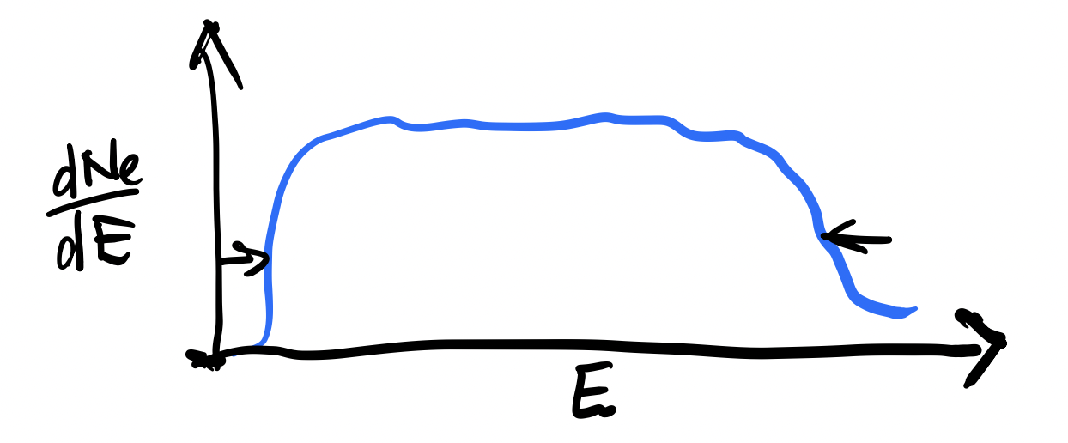
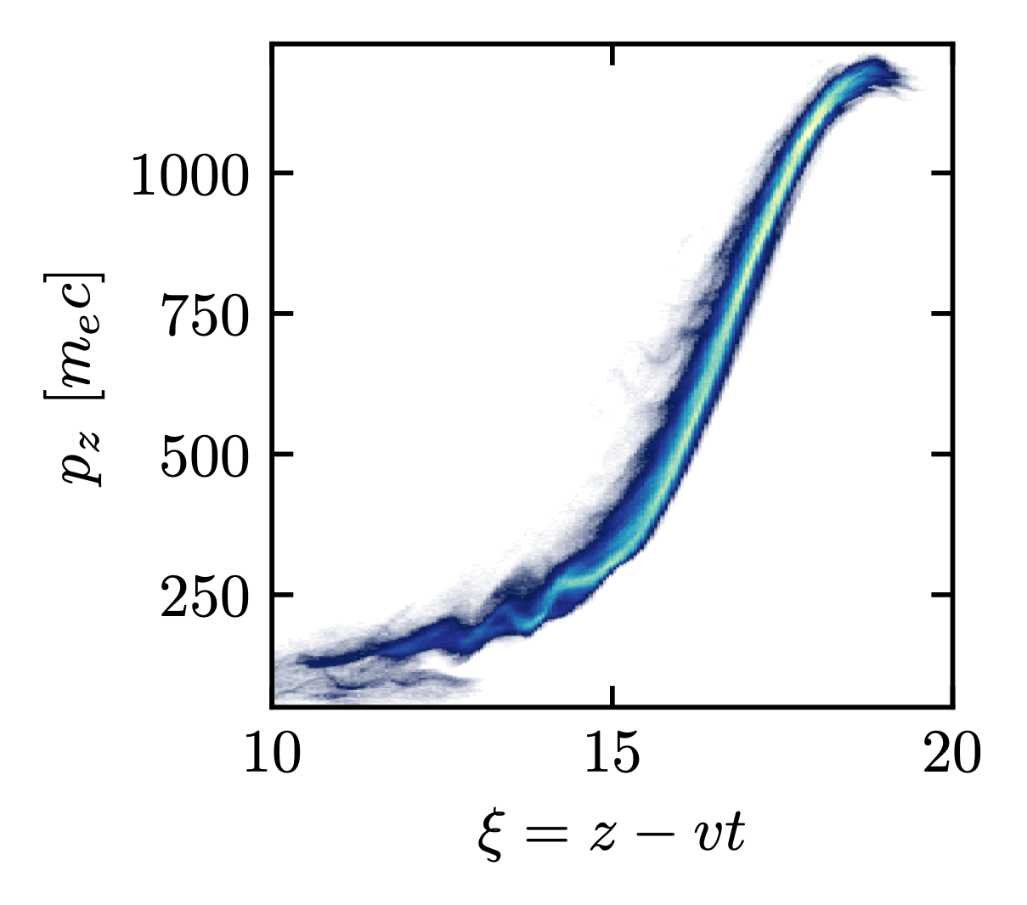
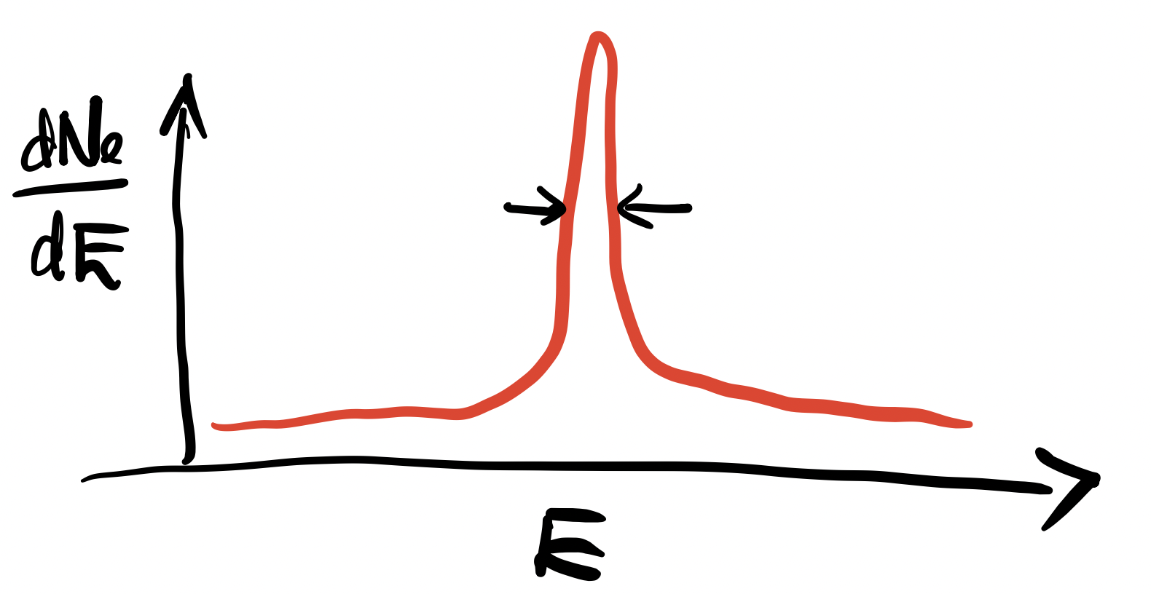
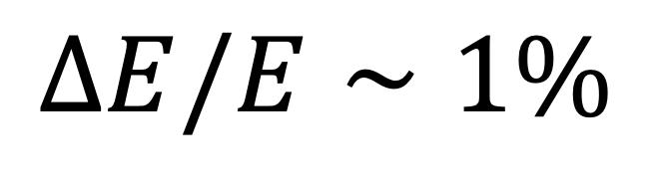
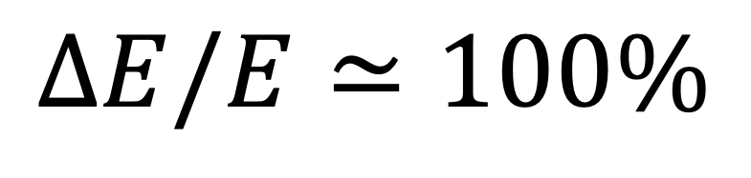
Slice energy spread
A typical electron spectrum
A. Hussein et al., Scientific Reports (2019) 9:3249;
Correlated energy spread
Longitudinal phase space (PIC simulation)
Chirp
$$ΔE/E≃100\%$$
Slice (uncorrelated) energy spread
$$ΔE/E∼1\%$$

Slide 12
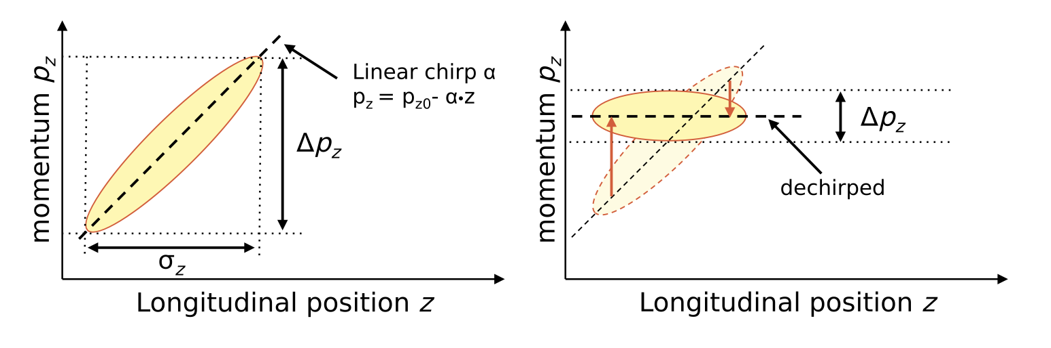
De-chirping
Longitudinal phase-space rotation
Plasma dechirper
Longitudinal density tailoring
Döpp et al., PRL 121, 074802 (2018)
S. Jalas et al., PRL 126, 104801 (2021)
Self-wake of the beam (Linac source)
Y. P. Wu, et al., PRL 122, 204804 (2019)
RF cavity dechirper
LWFA source, magnet chicane stretcher, RF dechirper
P. Winkler, et al., Nature 640, 907 (2025).

Slide 13
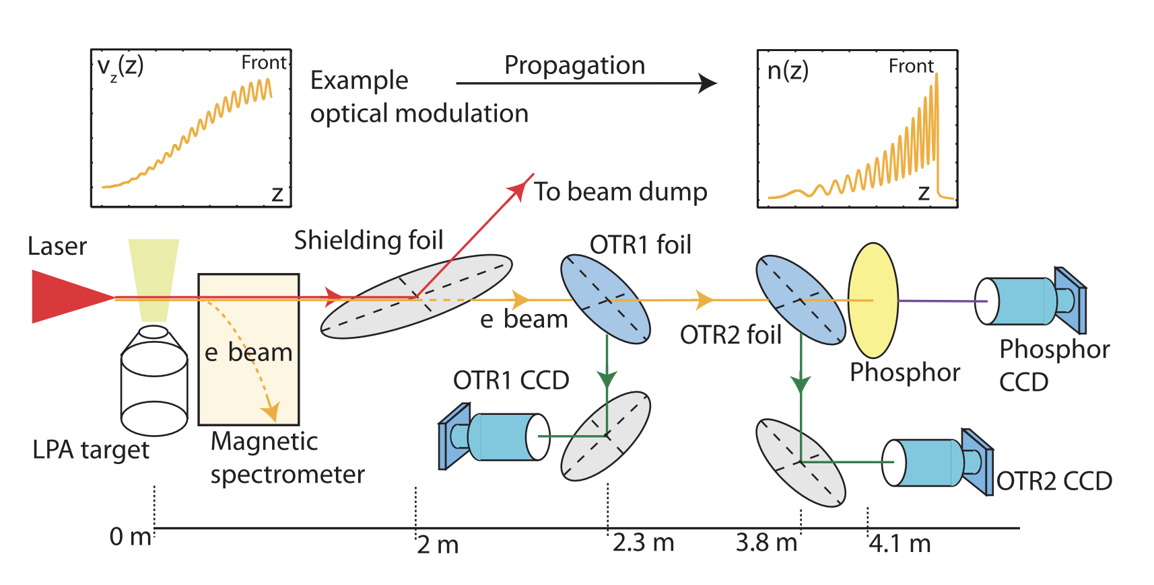
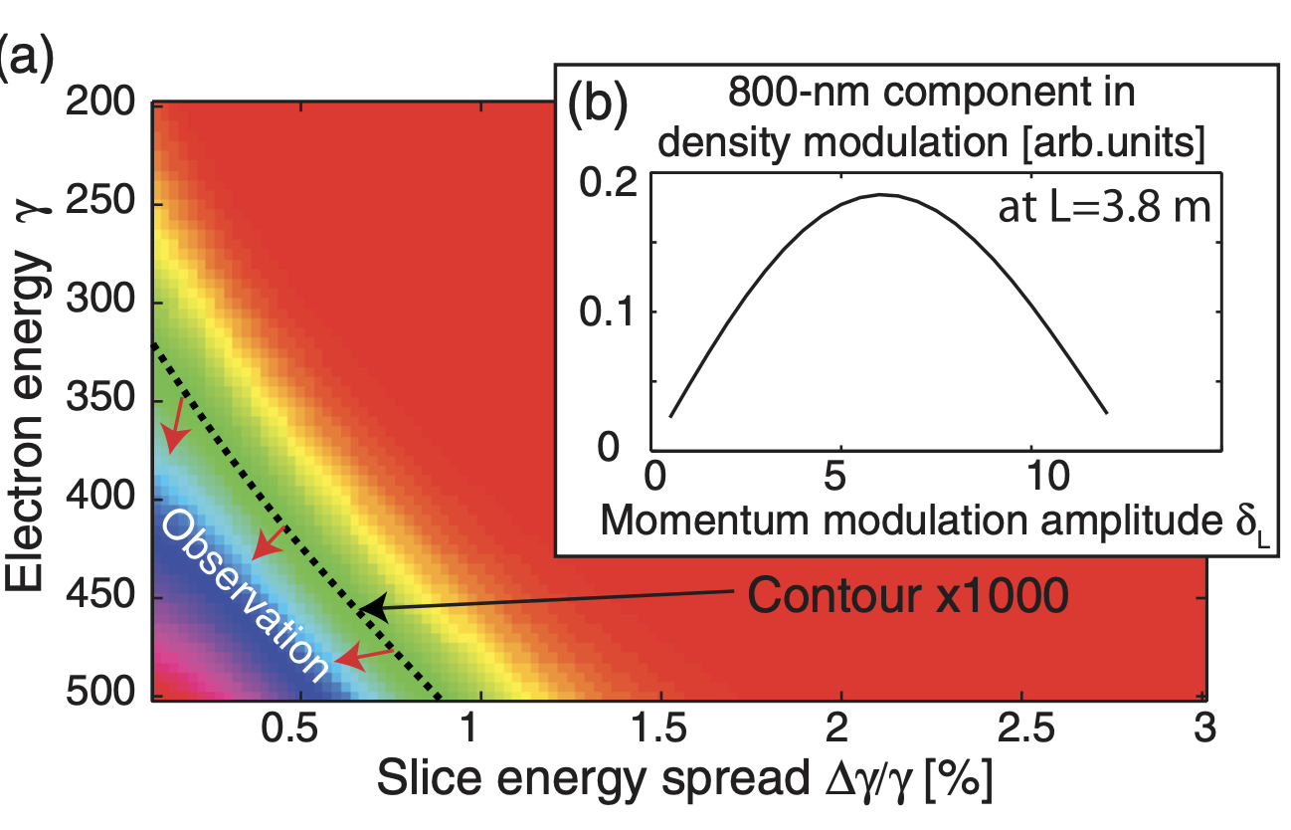
Longitudinal phase space
There is so far no direct measurement of longitudinal phase space in LWFA
Indirect slice energy spread measurement using CTR
Density modulation & small slice energy spread —> CTR enhancement
Fitting upper limit: 0.5% slice energy spread
C. Lin et al., Phys. Rev. Lett. 108, 094801 (2012)

Slide 14
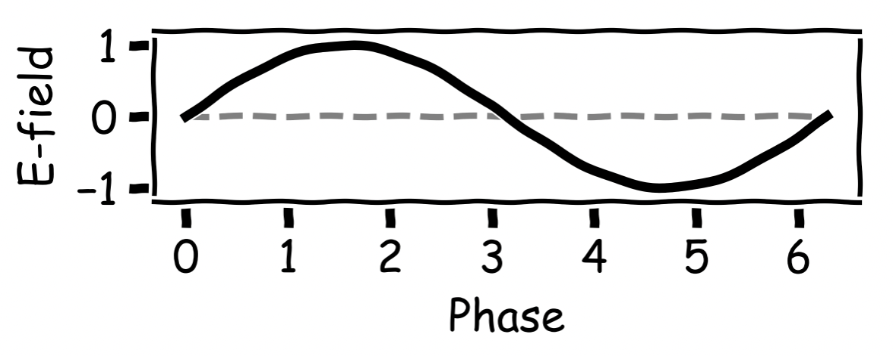
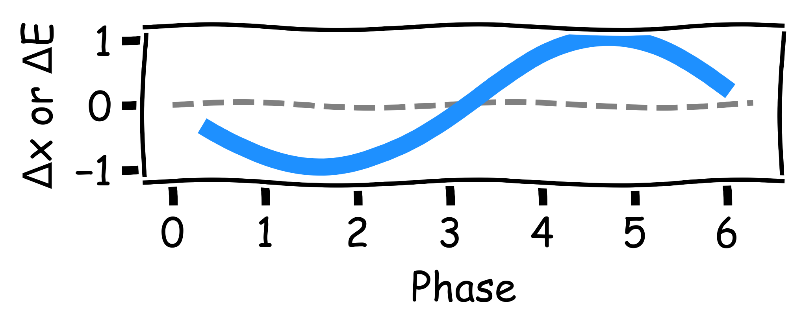
Temporal characterization
Interaction with varying fields, e.g., RF field, THz, etc.
Electron bunch
Temporal to spatial, and energy

Slide 15
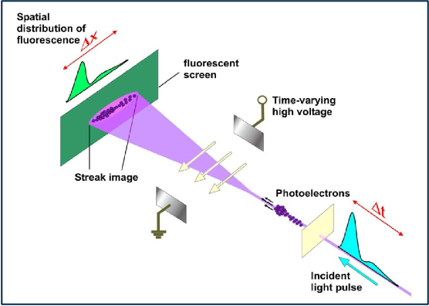
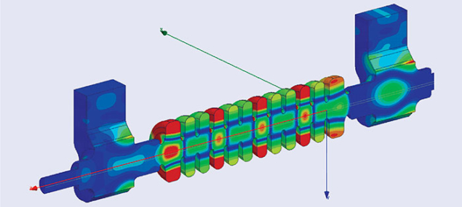
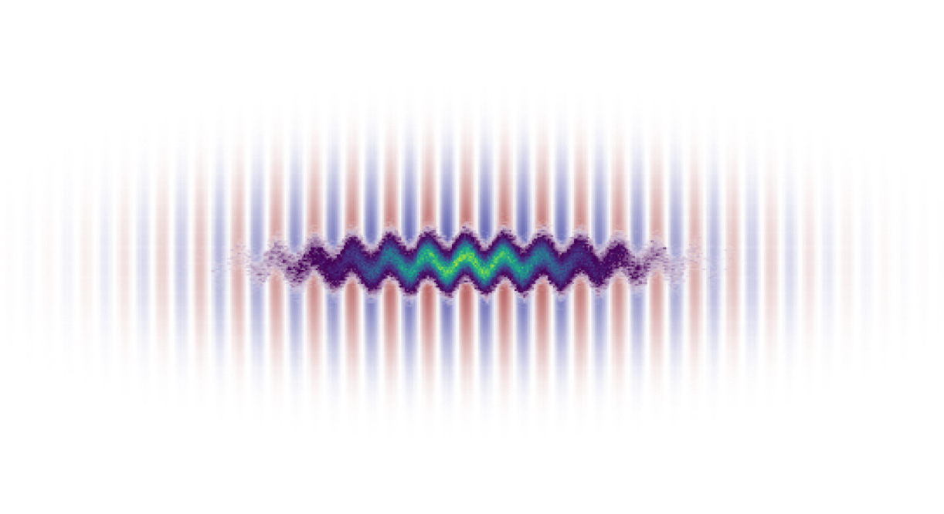
Temporal characterization
Interaction with varying fields, e.g., RF field, THz, etc.
Streak camera
X-band RF deflector
Laser deflector
Electron beam
Laser
100s um
~few - 100s fs resolution
~um
Sub-fs resolution
PHz
800 nm laser
~mm
ps resolution
GHz
THz

Slide 16
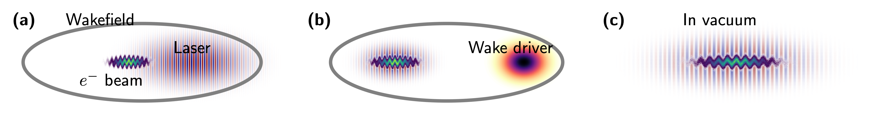
Laser deflector
Active deflector in LWFA / PWFA
The wakefield driver can be either a particle beam or a laser pulse;
Independent laser pulse as the deflector
Direct laser-electron interaction in vacuum
Requires the violation of the assumptions of the Lawson-Woodward theorem
Inherent (passive) deflector in LWFA
The LWFA driver is also the deflector
The reconstruction method / algorithm is the same for all cases.

Slide 17
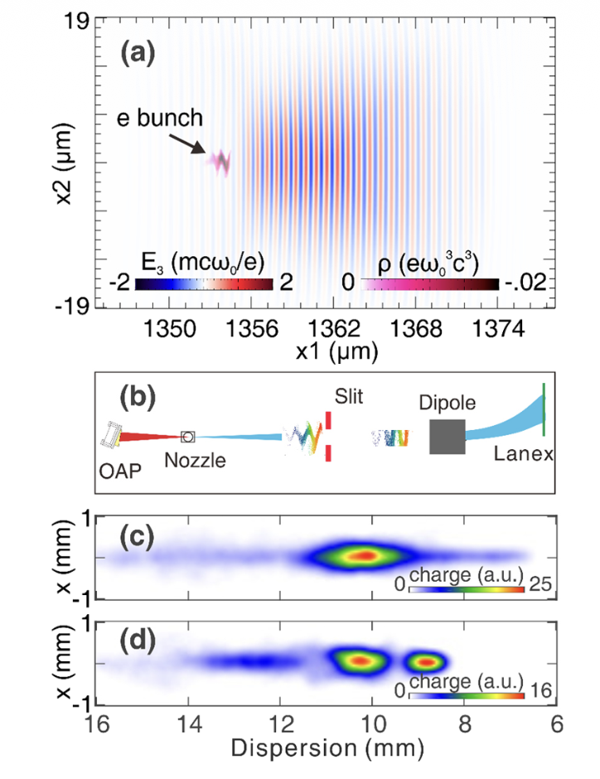
Inherent laser deflector in LWFA
Temporal profile reconstruction with a laser deflector
Y. Ma et al., Phys. Rev. X15, 031062 (2025)
Longitudinal temporal profile:
    pulse duration, beam current
Longitudinal phase space:
    chirp, slice energy spread
Potentially 6D phase space reconstruction in single-shot
C.J. Zhang et al., PRAB 19, 062802 (2016)

Slide 18
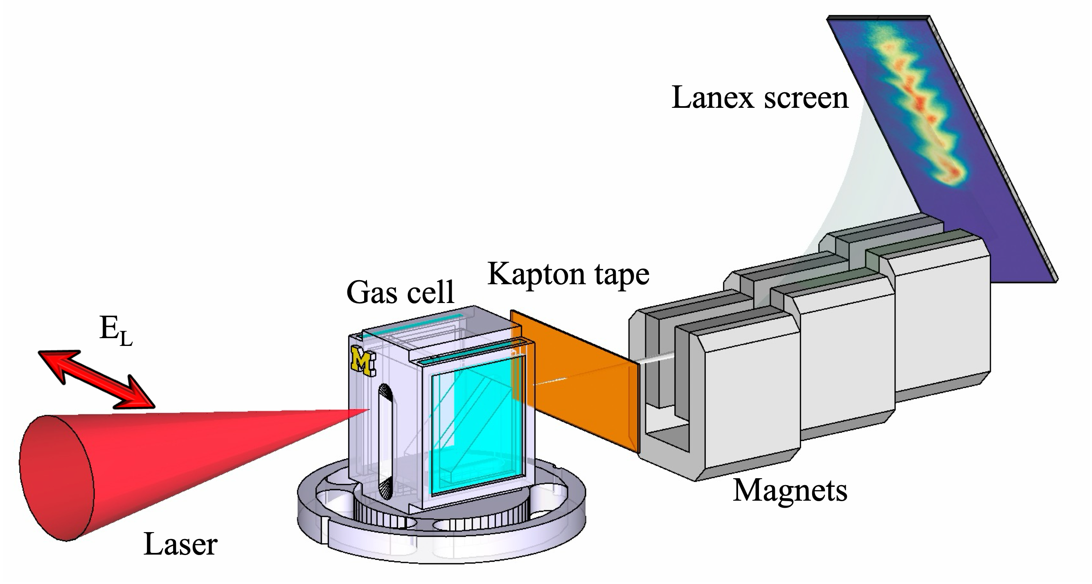
A typical LWFA setup
Gemini TA3 at RAL, CLF (UK)
All we need is an electron spectrometer which is available in all LWFA or PWFA experiments
E: 6.3 ± 0.6J
Pulse duration: 45±4 fs
Spot size: 40(±2) x 50(±2) um
I0 = 4.6(±0.8) x10¹⁸ W/cm²
a0 = 1.46 ± 0.12
See also:
M. Streeter et al., PRAB 25, 101302 (2022) ;
A. Hussein et al., Scientific Reports (2019) 9:3249;
B. Kettle et al., PRL 123, 254801 (2019);
R. Spesyvtsev et al.,Proc. SPIE 11036 2019
Y. Ma et al., Phys. Rev. X15, 031062 (2025)

Slide 19
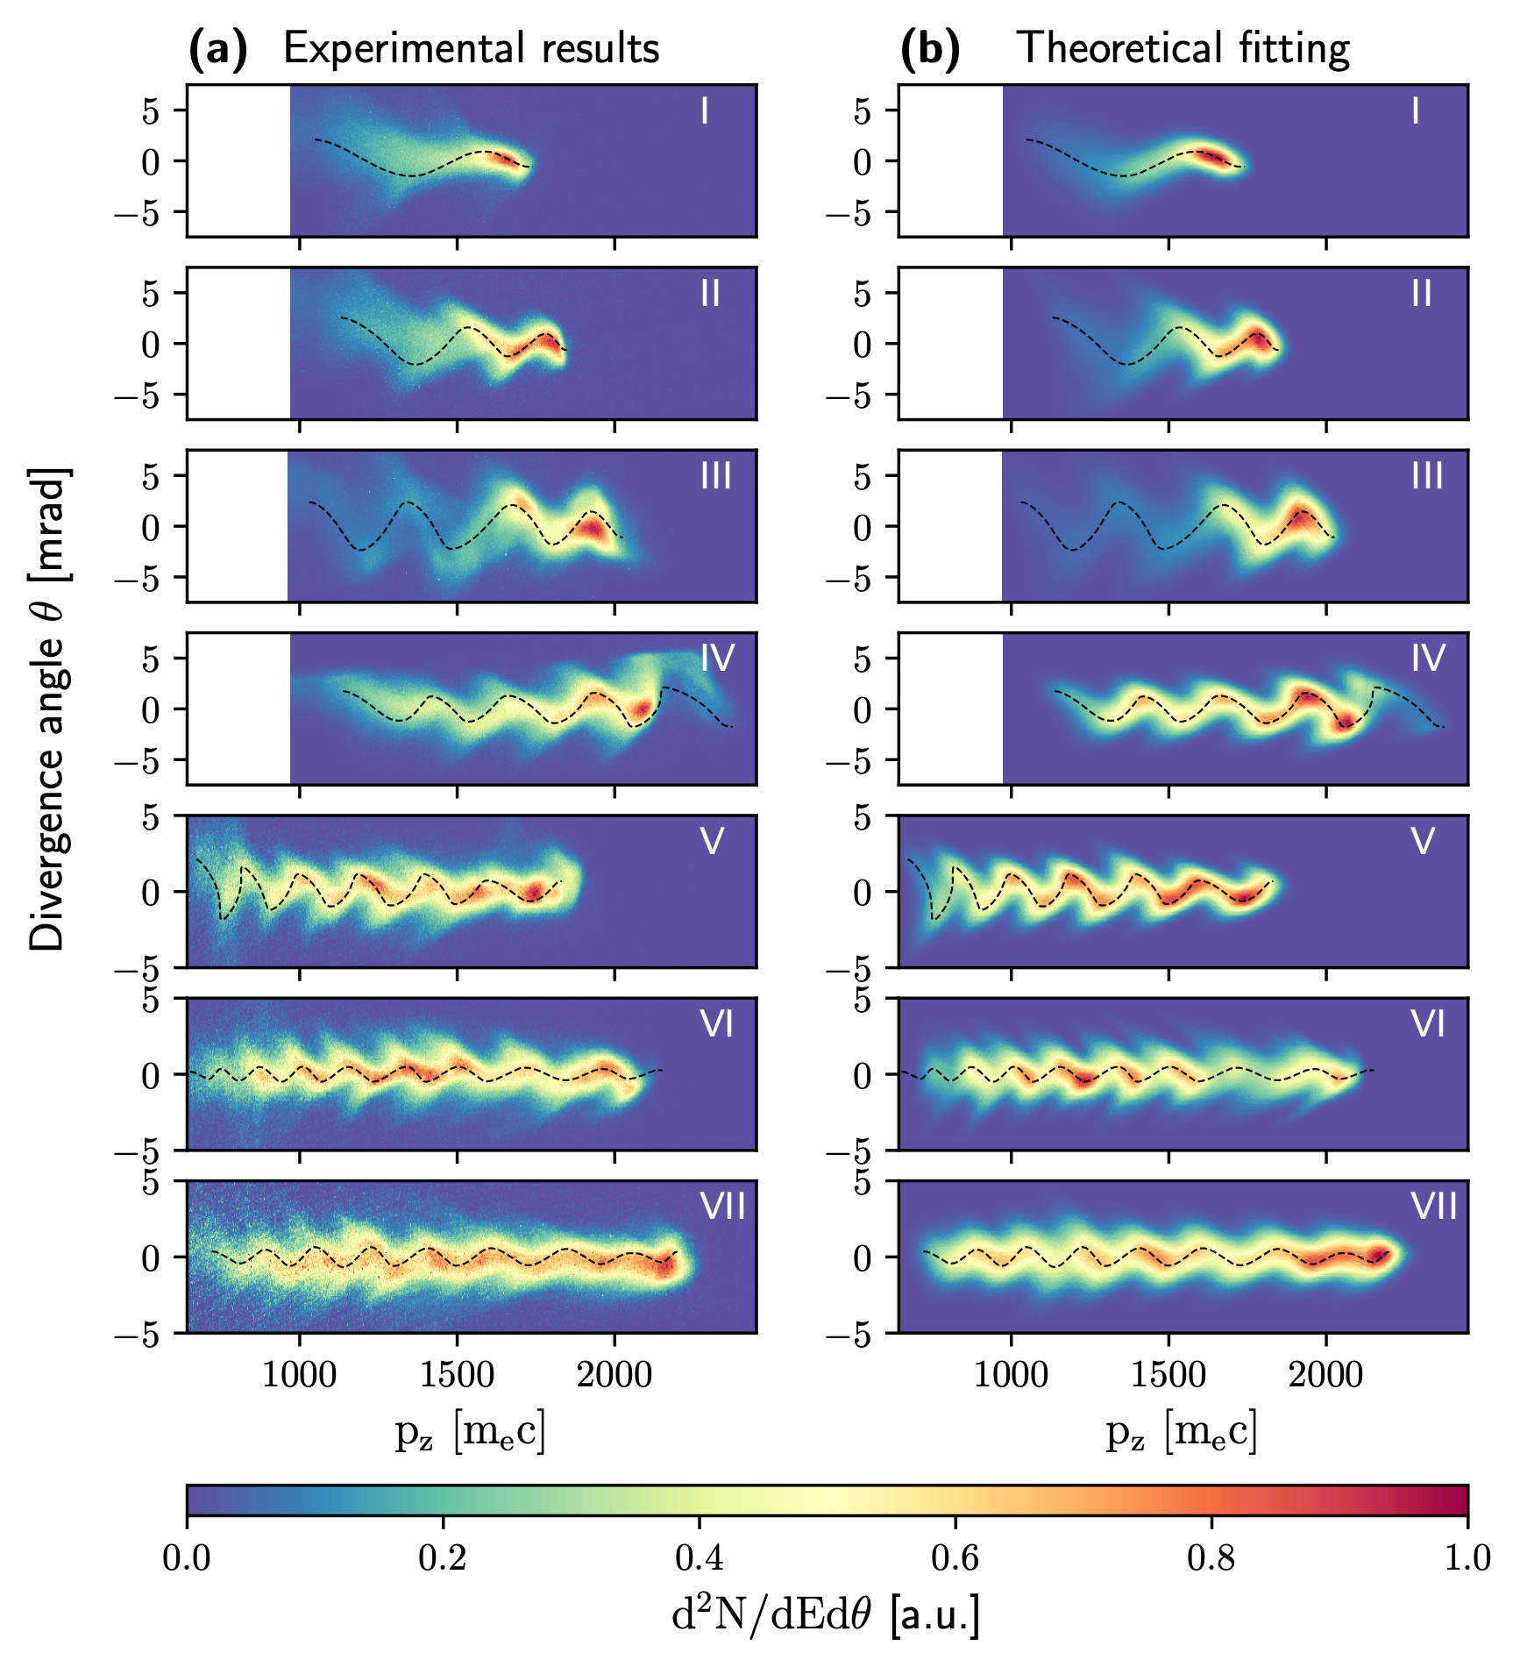
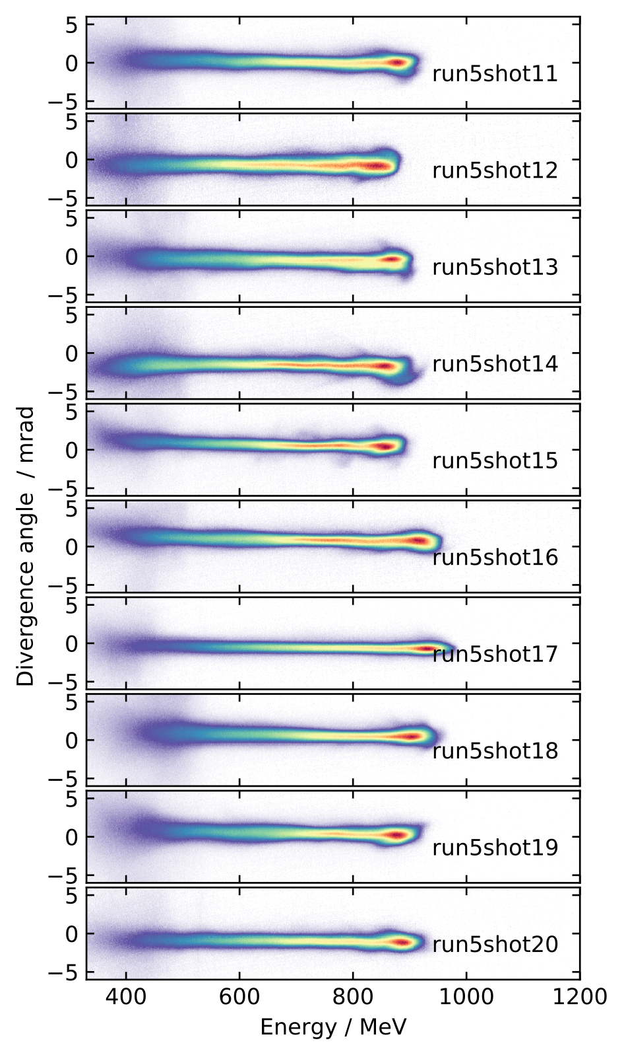
“Herringbone”
Typical spectra without modulations
Fitted with theoretical model with some guessed parameters which can tell a lot!
Y. Ma et al., Phys. Rev. X15, 031062 (2025)

Slide 20
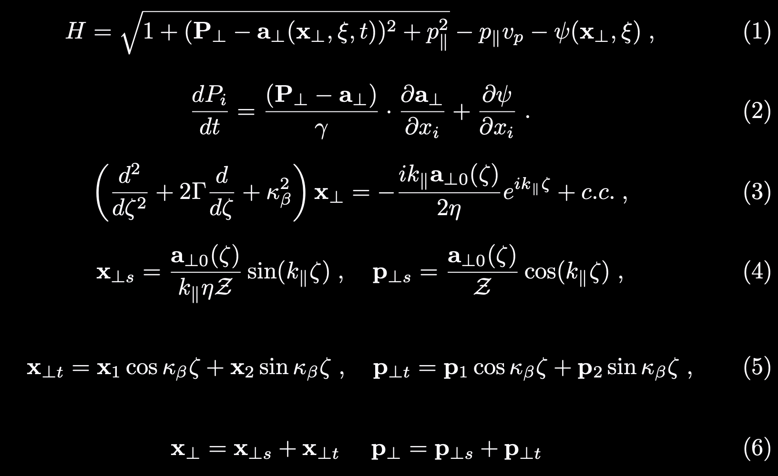
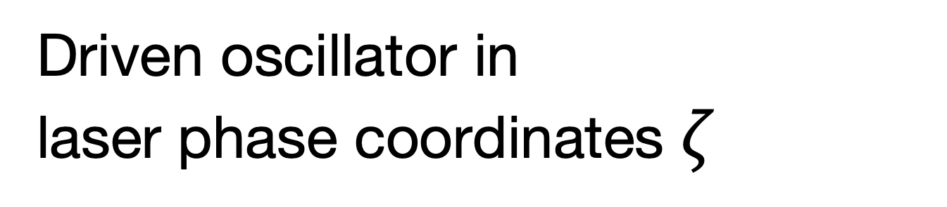
Theoretical model
Laser deflector in plasmas: Coupled motion of electrons in plasma wakefields and oscillations in the laser fields
Hamiltonian in wake coordinates
Transverse
Driven oscillator in
laser phase coordinates $ζ$
Steady state solutions
Laser
Transient solutions
Wakefield
General solutions
Laser
&
Wakefield
Y. Ma et al., Phys. Rev. X15, 031062 (2025)

Slide 21
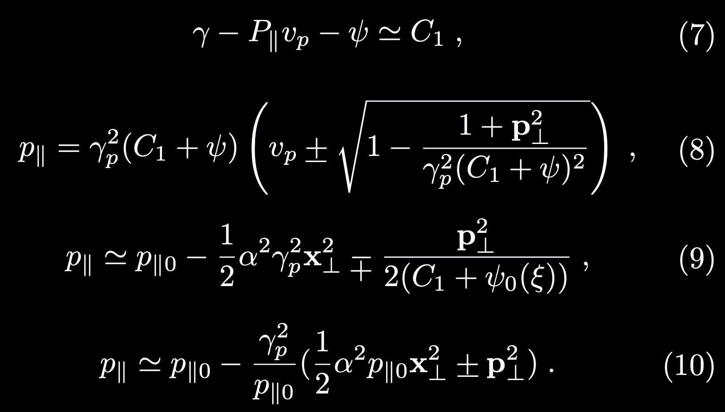
Theoretical model
Laser deflector in plasmas: Coupled motion of electrons in plasma wakefields and oscillations in the laser fields
Conservation of Hamiltonian (not explicitly time dependent)
Longitudinal
Longitudinal momentum modulation
(Can be measured in experiments)
Wakefield acceleration
Transverse modulation
Y. Ma et al., Phys. Rev. X15, 031062 (2025)

Slide 22
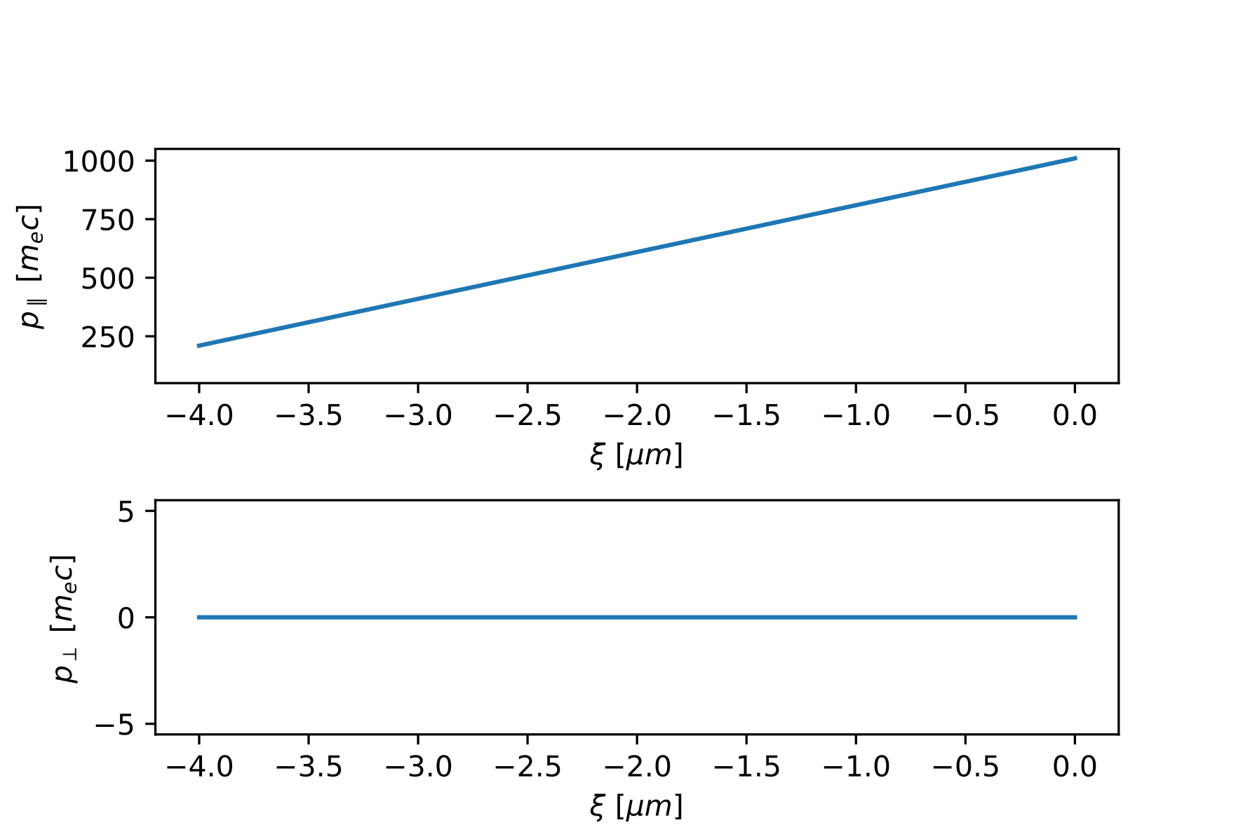
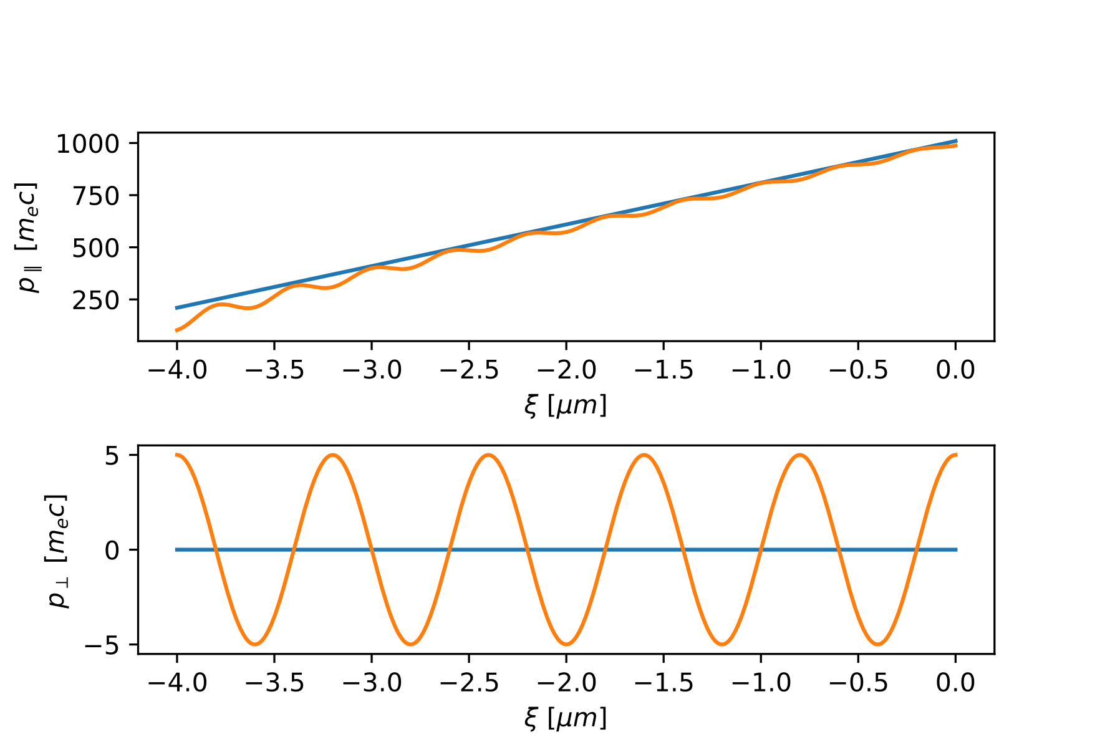
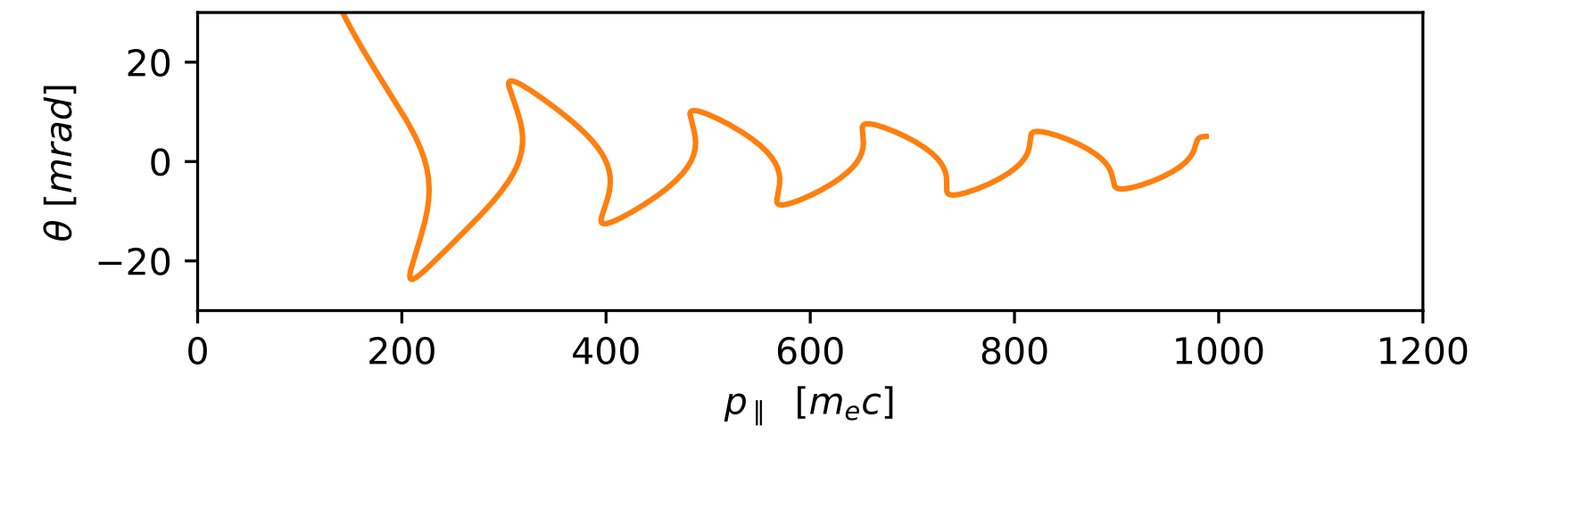
Theoretical model
Steady-state trajectory
“Herringbone”
Angular energy spectrum
Y. Ma et al., Phys. Rev. X15, 031062 (2025)

Slide 23

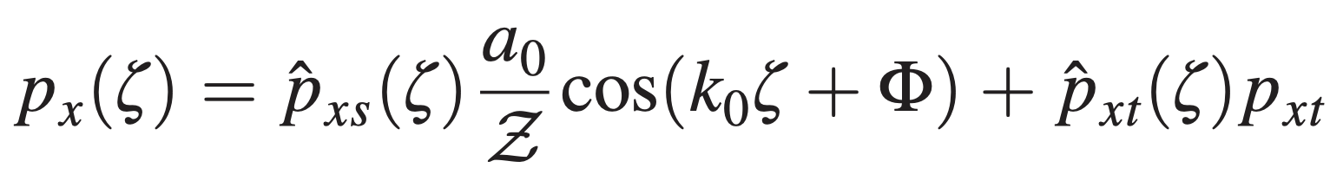
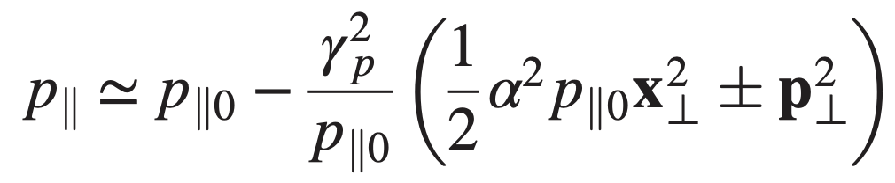
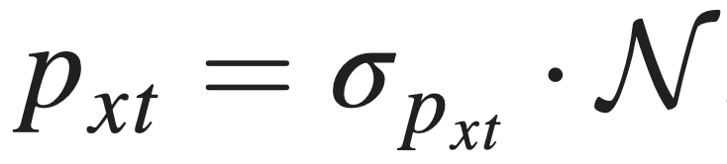

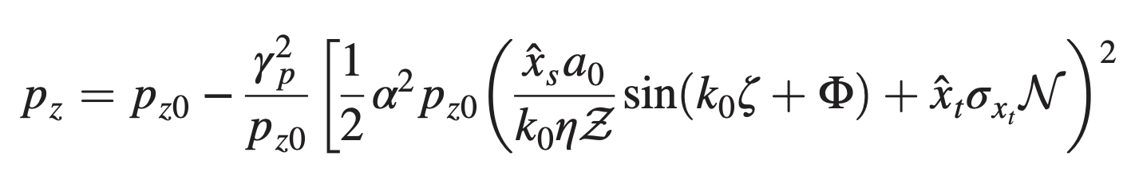
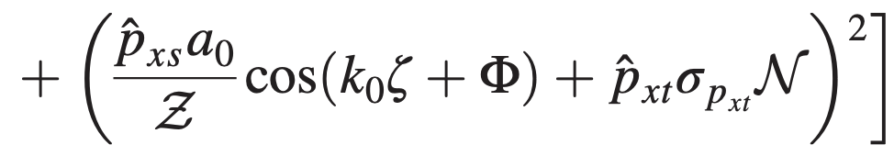
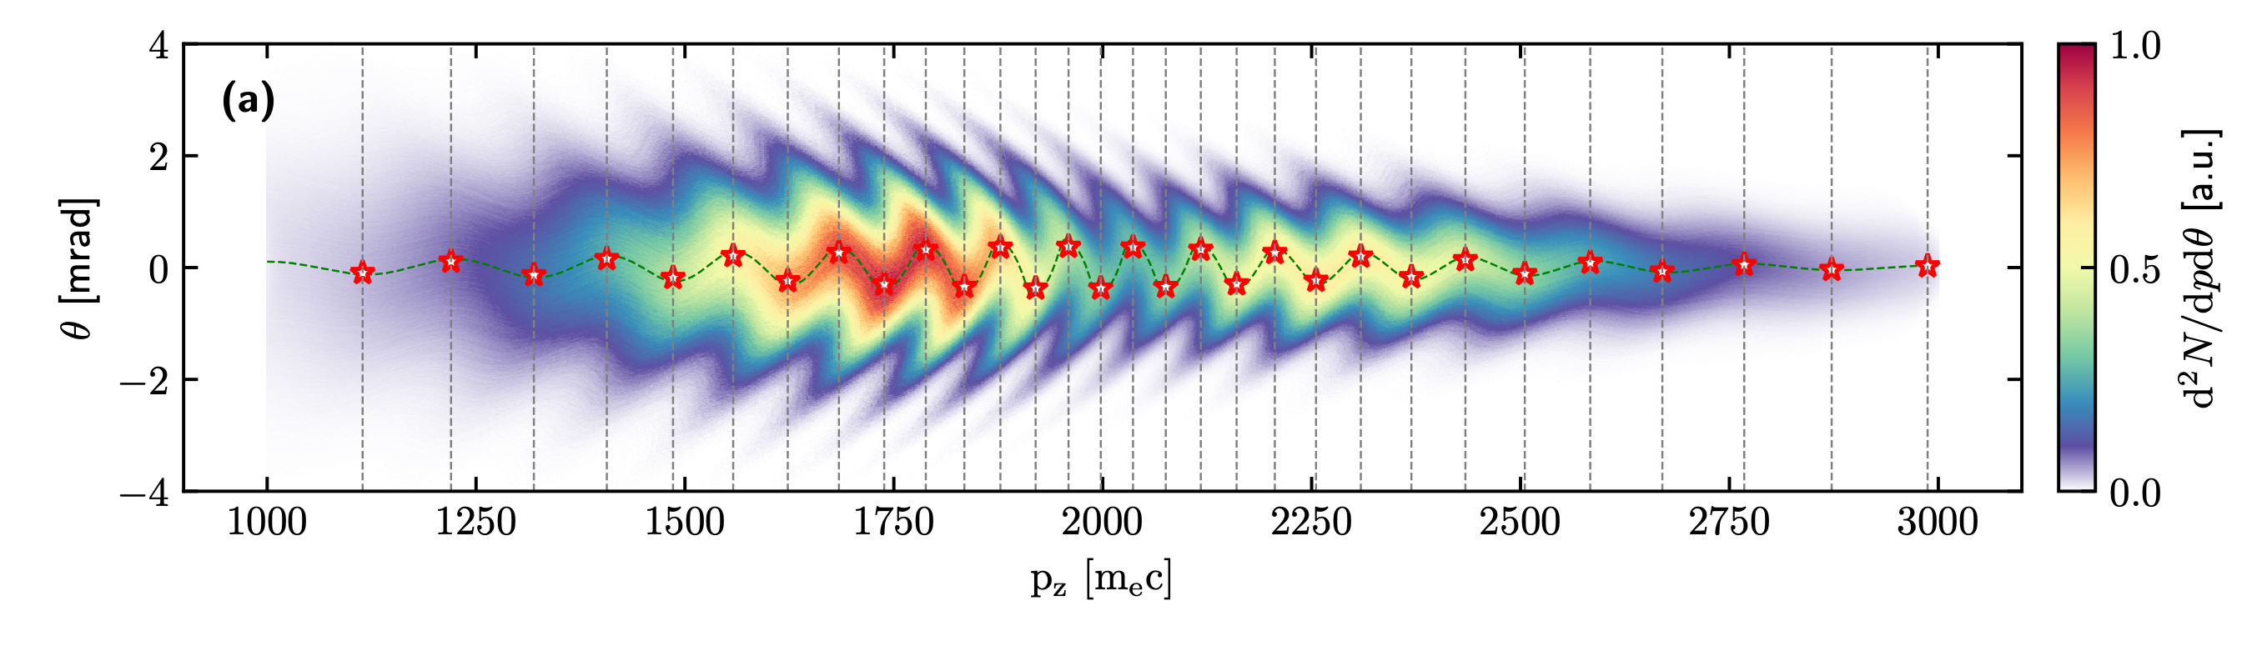
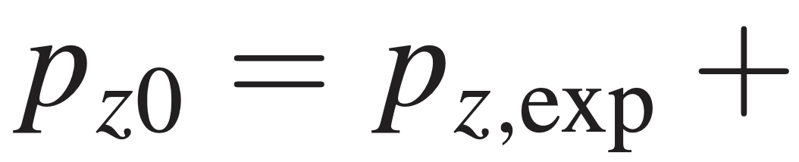
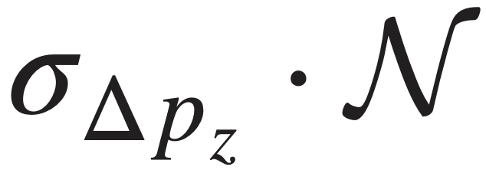

Spectral reconstruction
transient solutions represented by standard normal distributions N
1. Extracted from measurement
Longitudinal energy distribution (chirp)
Temporal beam charge profile
Transverse momentum envelope (steady state)
Transverse spectral width (transient)
2. Guessed parameters (all single value):
𝛄p (plasma density), 𝛼 (wake strength), a0 (laser intensity *) 𝞼pxt Transient momentum 𝞼xt Transient real space 𝛀 Phase 𝞼Δpz Slice energy spread
* (eta, Z are not independent parameter)
Y. Ma et al., Phys. Rev. X15, 031062 (2025); Physics of Plasmas (under review)

Slide 24
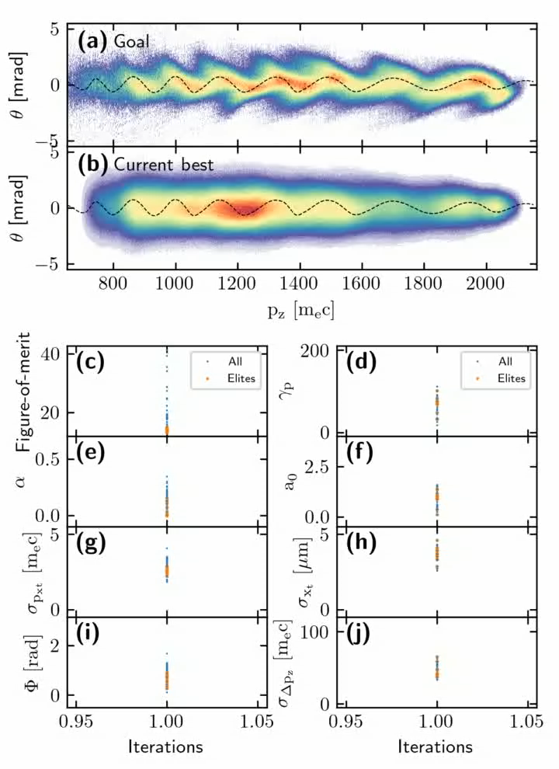
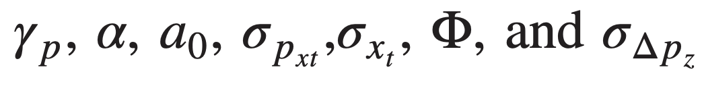
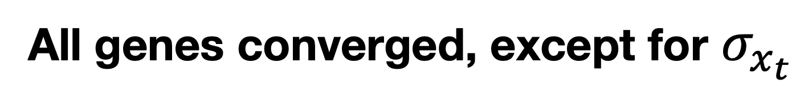
Multi-parameter optimization
Genetic algorithm
Goal:
experimental spectrum
Genes:
(With extracted longitudinal & transverse momentum and temporal charge profile)
Figure-of-merit:
Difference between “guessed spectrum” and experimental spectrum
Each iteration:
20 Parents-> select 5 best children as new parents to pass genes
All genes converged, except for $σ_{x_{t}}$
Y. Ma et al., Phys. Rev. X15, 031062 (2025)

Slide 25
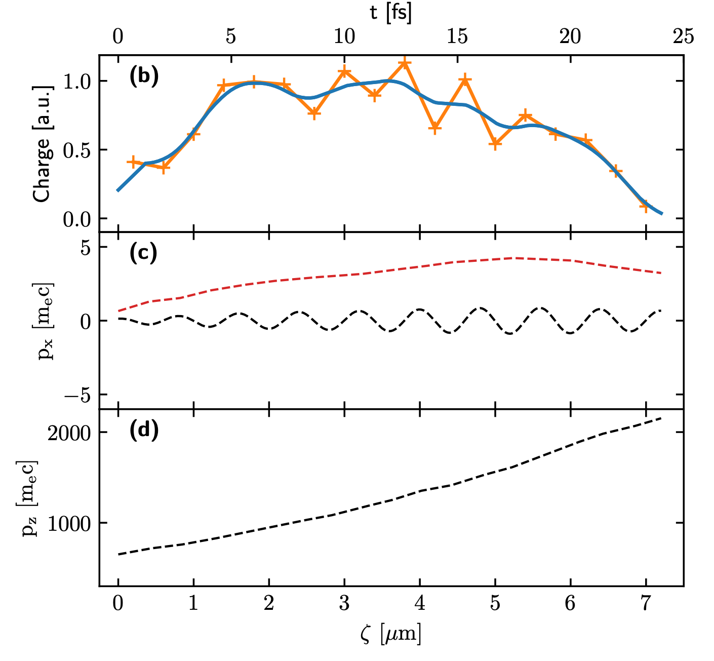
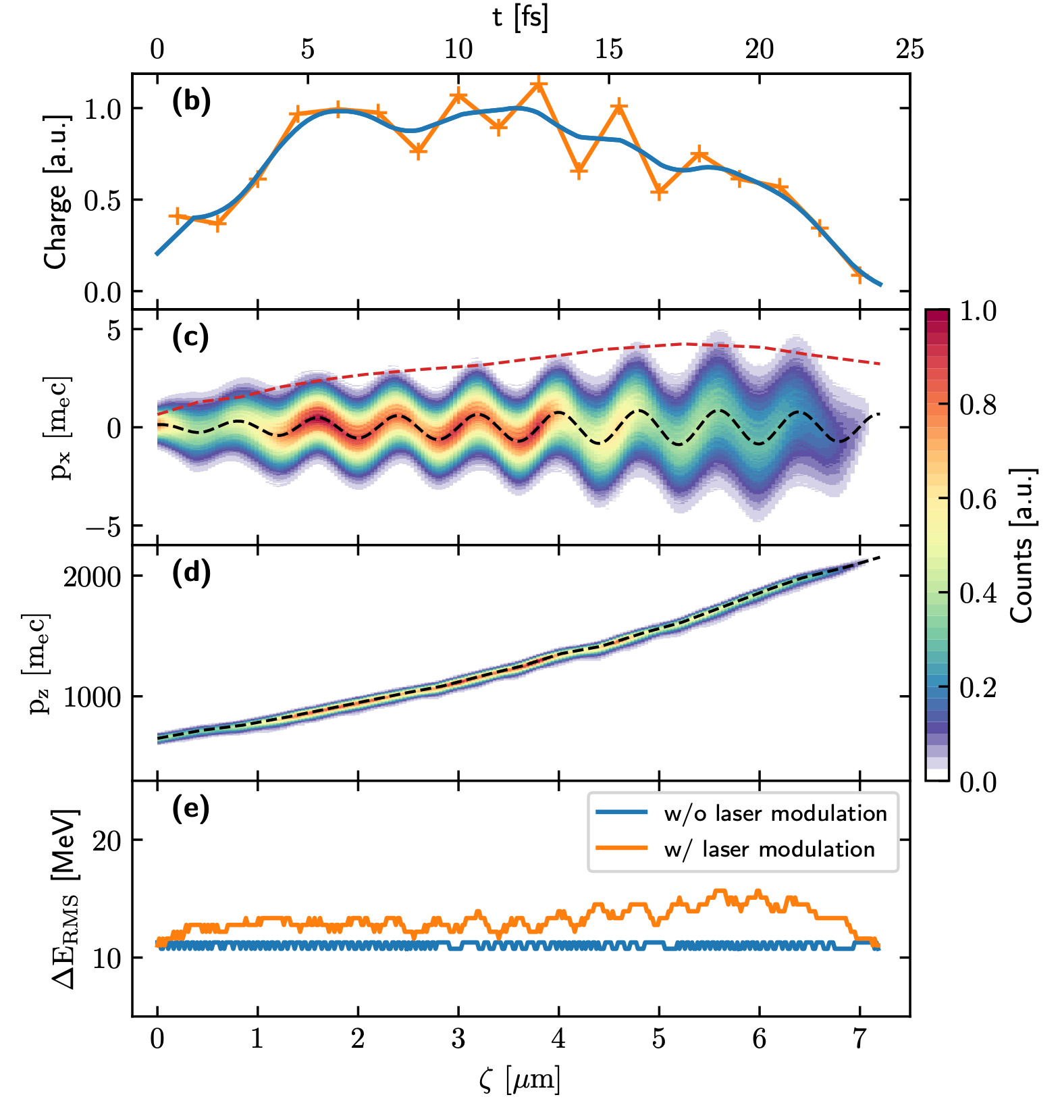

Longitudinal phase space
Temporal profile
Transverse momentum
Longitudinal phase space
Temporal profile
Transverse momentum
Longitudinal momentum
Slice energy spread
Experiment
Fitting
Y. Ma et al., Phys. Rev. X15, 031062 (2025)
~10 MeV slice energy spread, ~1% relative energy spread

Slide 26

PIC simulation
Ionization injection
at t = 110 ps
Y. Ma et al., Phys. Rev. X15, 031062 (2025)

Slide 27








6D Phase space
Fitting parameters:
$$γ_{p}=56.0,α=0.1,a_{0}=3.0,σ_{p_{xt}}=3.0m_{e}c,σ_{x_{t}}=0.5μm,Φ=π,σ_{Δp_{z}}=16m_{e}c.$$
$\overline{Δ}p_{z,rec}=46.0,$ vs $\overline{Δ}p_{z,sim}=40.2,$
$τ_{rec}=12.12fs,$ vs $τ_{sim}=12.06fs$
Transverse real space
Transverse momentum space
Y. Ma et al., Phys. Rev. X15, 031062 (2025)
Transverse phase space

Slide 28
Active Laser deflector
Active deflector in LWFA / PWFA
The wakefield driver can be either a particle beam or a laser pulse;
Independent laser pulse as the deflector
Direct laser-electron interaction in vacuum
Requires the violation of the assumptions of the Lawson-Woodward theorem
Y. Ma et al., Physics of Plasmas (under review)

Slide 29

Active laser deflector in PWFA
Two-bunch setup
Driver:
  10GeV,
  0.1% energy spread,
  1.3 nC charge
Witness:
  10GeV,
  0.1% energy spread,
  0.1 nC charge
Deflector laser:
  a0 = 0.5 -1.
Two-beam separation: 65 um
  Witness in acceleration phase
  Plasma chirper (inspired by K. Swanson’s talk at AAC24)*
Y. Ma et al., Physics of Plasmas (under review)
*K. Swanson et al., PRAB 29, 052802 (2026)

Slide 30

Active laser deflector in PWFA
Reconstruction of longitudinal phase space
Y. Ma et al., Physics of Plasmas (under review)

Slide 31

Active laser deflector in vacuum
Direct laser-electron interaction in vacuum
Requires the violation of the assumptions of the Lawson-Woodward theorem
Truncating laser pulse with plasma mirror
Net gain due to broken symmetry
Y. Ma et al., Physics of Plasmas (under review)

Slide 32

Active laser deflector in vacuum
Reconstruction of longitudinal phase space
Y. Ma et al., Physics of Plasmas (under review)

Slide 33
Summary
A laser deflector in LWFA can retrieve electron’s longitudinal phase spaces distribution with ~fs temporal resolution
Measurements confirmed the predicted small slice energy spread, ~1% level, from an LWFA
Active laser deflector can be realized in vacuum and in LWFA/PWFA.
Y. Ma et al., Phys. Rev. X 15, 031062 (2025)
Y. Ma et al., Physics of Plasmas (under review)
Thank you for your attention

