Slide 1
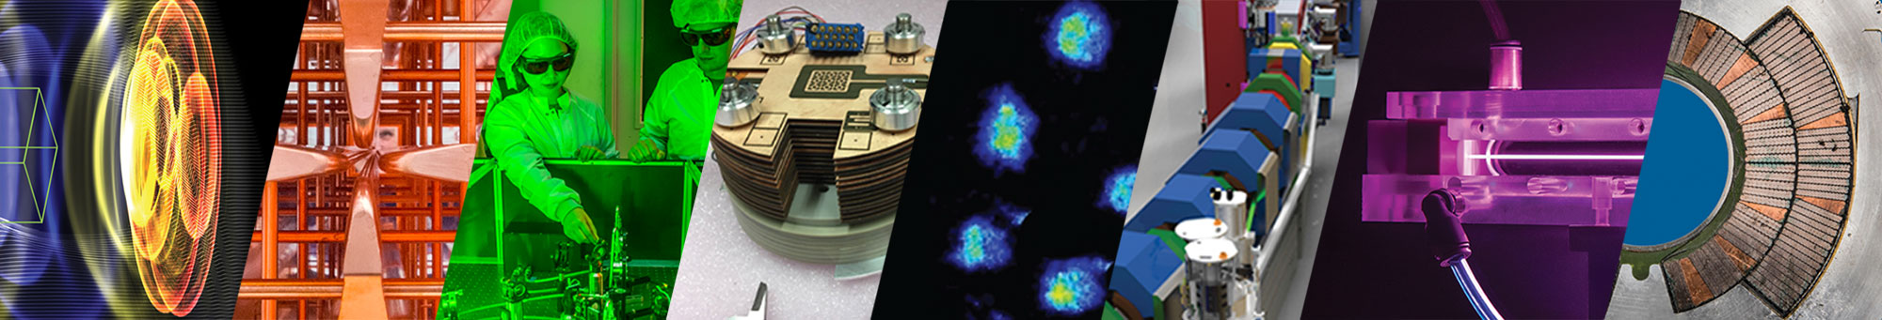
Radiation Generation and Applications from
Laser-Plasma Accelerators (LPAs)
Jeroen van Tilborg, BELLA Center – LBNL
+ large team of contributors at LBNL and partner institutions
Advanced Accelerator Concepts 2026
University of California Los Angeles, July 27th 2026
This work was supported by the Office of Science of High Energy Physics (HEP) and Basic Energy Sciences (BES) under Contract No. DE-AC02-05CH11231, by the Defense Advanced Research Projects Agency (DARPA), by the U.S. DOE National Nuclear Security Administration Defense Nuclear Nonproliferation R&D (NA-22), and through a collaborative grant from TAU Systems Inc.
1

Slide 2
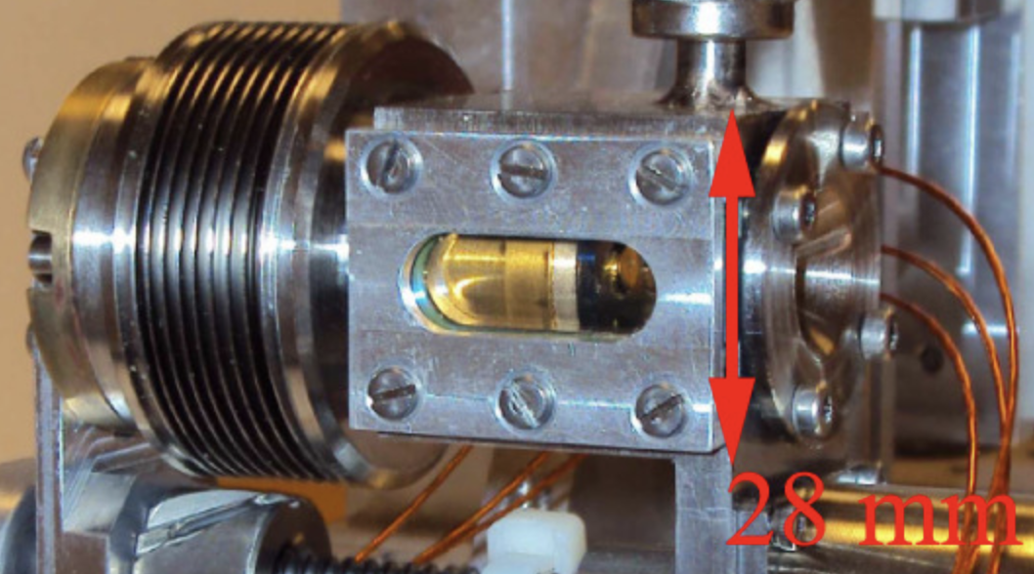
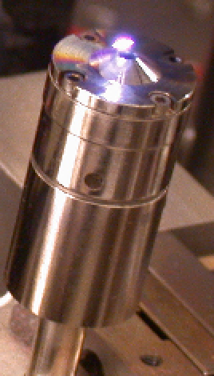
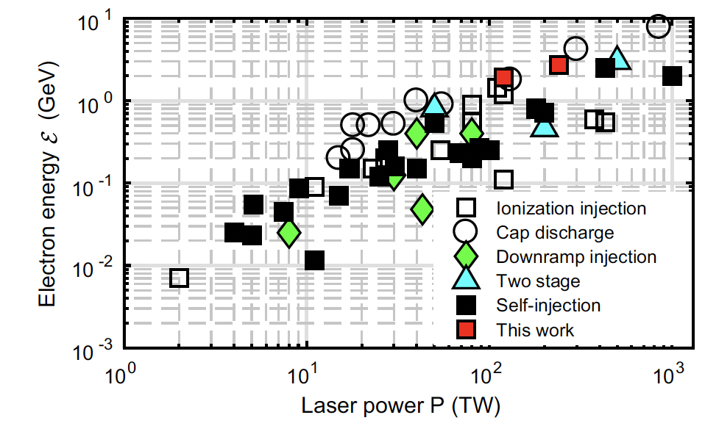
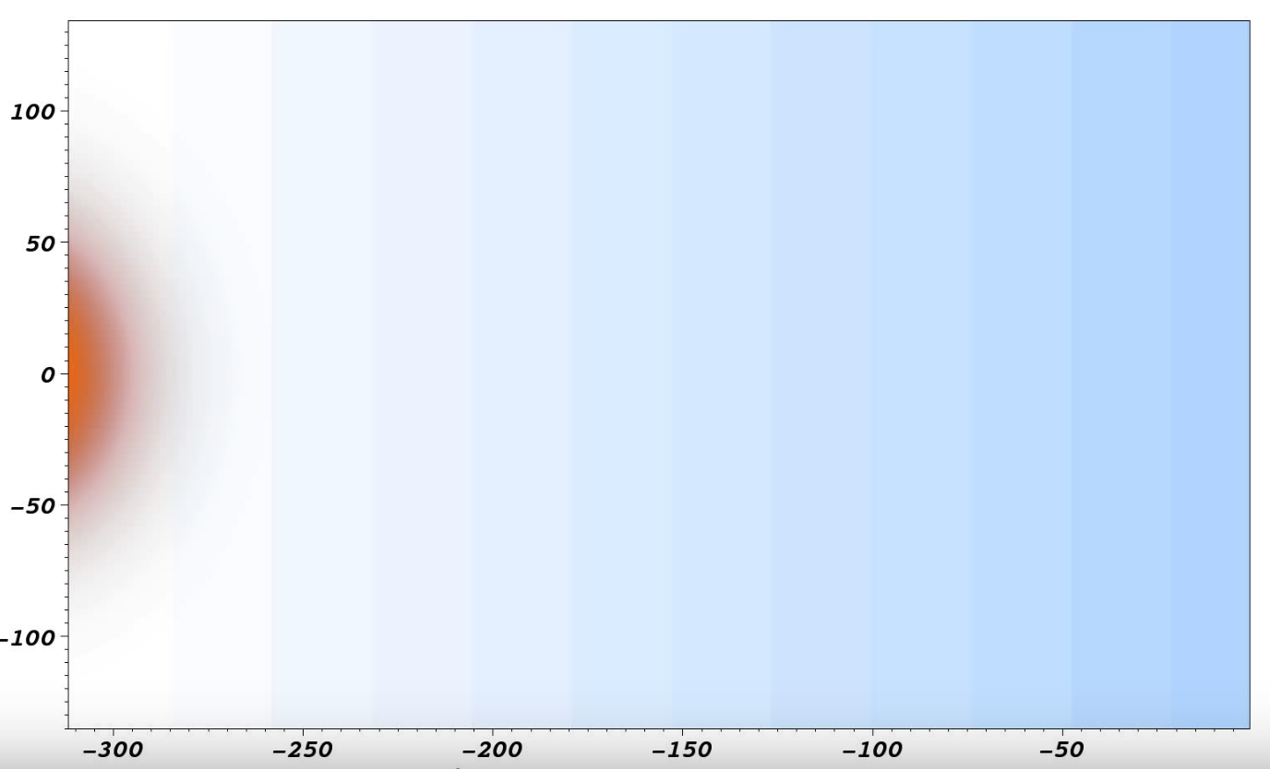
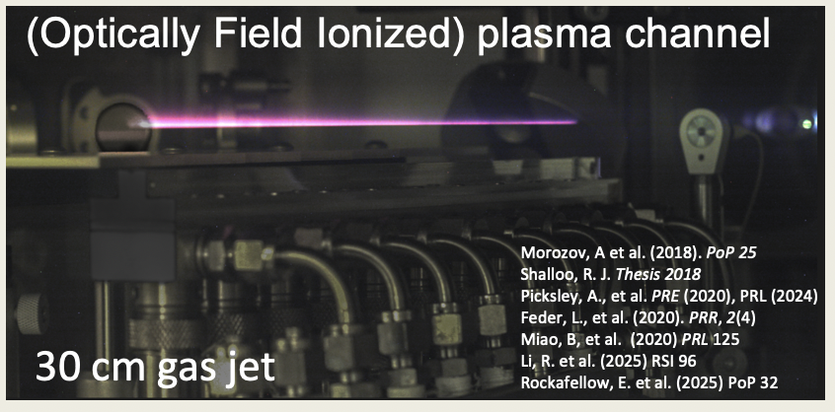
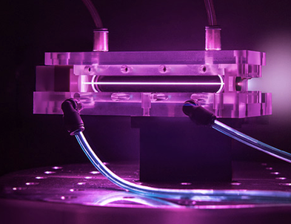
100s MeV with (sub)100 TW systems and >5 GeV with PW-class systems are maturing fast & plentiful → global pursuit of repetition rate increases & applications
LPA unique as core accelerator technology
High-gradient → compact “deployable” systems
High-energy → deep penetration
Point-source & low divergence → excellent resolution
Strong peak current → high peak flux
Control knobs → AI/ML optimization, active stabilization
20 GeV from 10 PW
Gas cell
10 GeV from 0.5 PW
Underdense plasma
Gas jet
Laser
μm
Discharged capillary
S. Mangles “An Overview of Recent Progress in Laser Wakefield Accel. Experiments“, Proc. CAS-CERN Accel. School (2014);
K. Poder Phys. Rev. Lett. 132, 195001 (2024)
Notes:
Accelerator technology is basis for applications. Applications mature accelerator technology

Slide 3
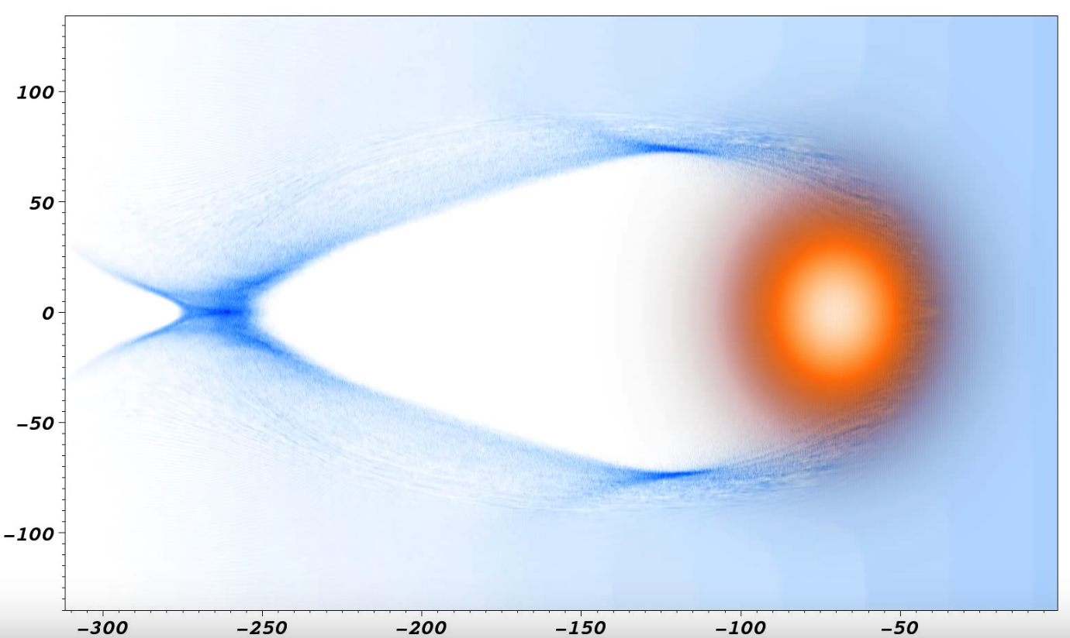

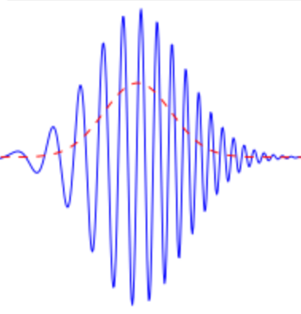
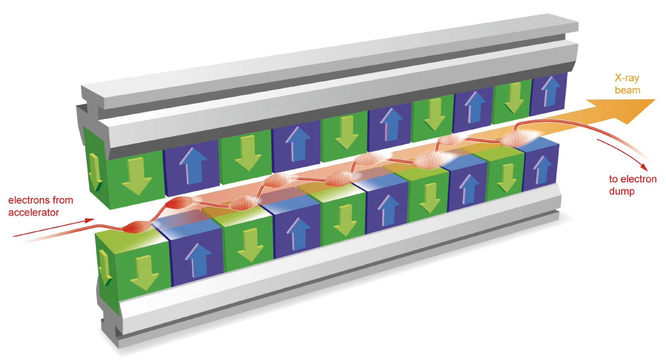
Laser
Outline
Intro: direct LPA e-beam applications, Bremsstrahlung gammas → neutrons, isotopes, muons
Plasma betatron radiation
Inverse-Compton-Scattered gammas
Active stabilization & Free-electron lasing (FEL)
E-beam
E-beam
Electrons
Laser
Scatter laser
E-beam
Isotopes
E-beam
Electron beam
Muons
Brems
gammas
Neutrons
Inverse Compton Scattered gamma ray photons
Undulator / FEL radiation
Plasma focusing force
Laser
Magnetic undulator
Plasma-betatron X-rays
Electron beam
Notes:
Take you through a experimental tour. By no means a comprehensive review, nor catching all LPA applications. Try to reference to follow-up presentation this conference. That’s what makes it exciting, lots of innovation and robustness of LPAs is inviting cross-community connections.

Slide 4
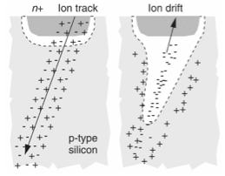
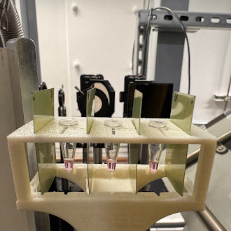
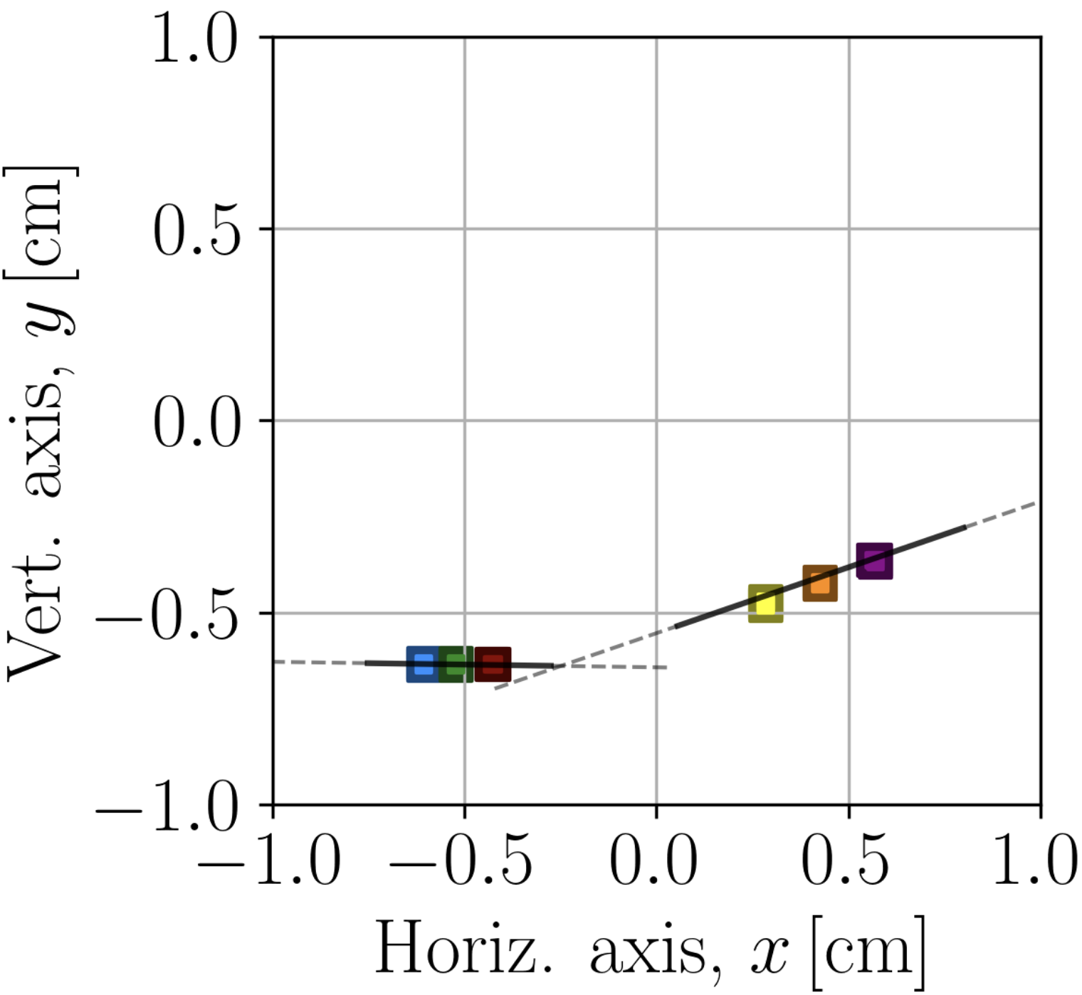

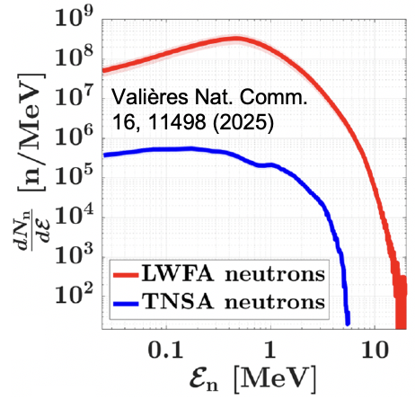
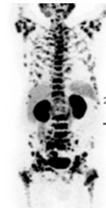
Low-emittance electrons, at high-energy, and compatible with a compact footprint, are of interest as source for SEE, VHEE, neutron, isotope and muography
Electrons directly:
Single-Event Effect (SEE) studies as proxy for heavy ions
  WG5 Tuesday: Kulkarni talk 1:30pm, Schröder talk 3:10pm
VHEE (50-300 MeV) electrons for flash radiation therapy
Obst-Huebl talk (WG6, Tuesday 2:10pm)
Laser
E-beam
E-beam
Electrons
sub-ps μm
electron beam as proxy for single ion
^{e-beam}
VHEE rad-bio
Gamma photons from Bremsstrahlung
High-flux neutron beams (imaging)
Larger selection of medical isotope production channels
Highly-directional, deeply penetrating, high-flux muography
Laser
Isotopes
E-beam
E-beam
Muons
Brems
gammas
Neutrons
Muon
vector tracking
Medical isotopes
WG6 Thursday: Terzani talk 2:30pm, Pöder talk 2:50pm

Slide 5
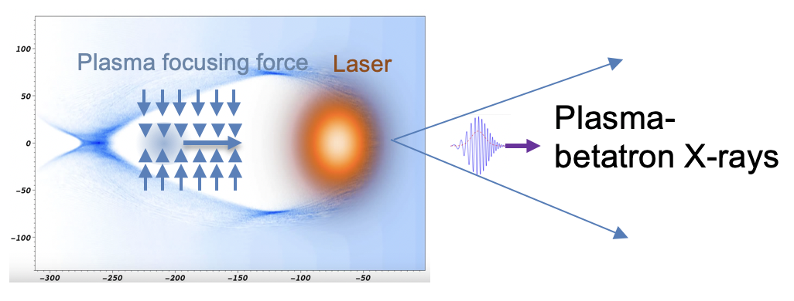
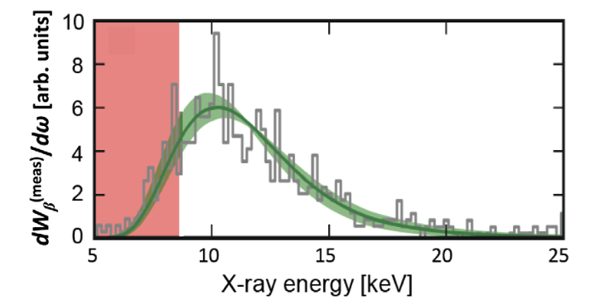
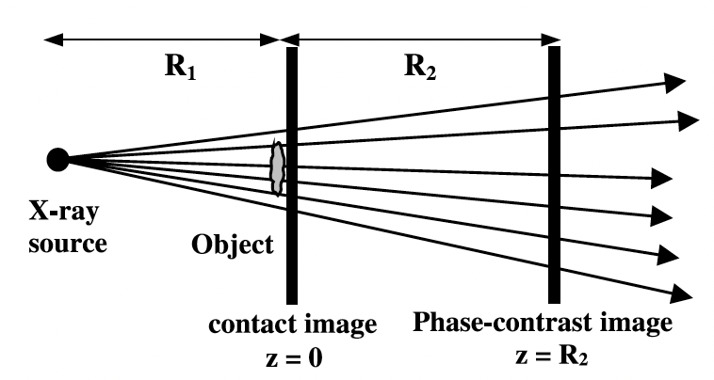
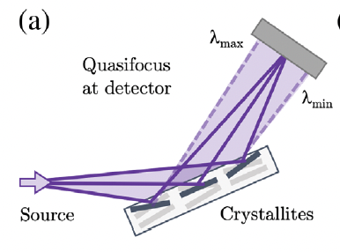
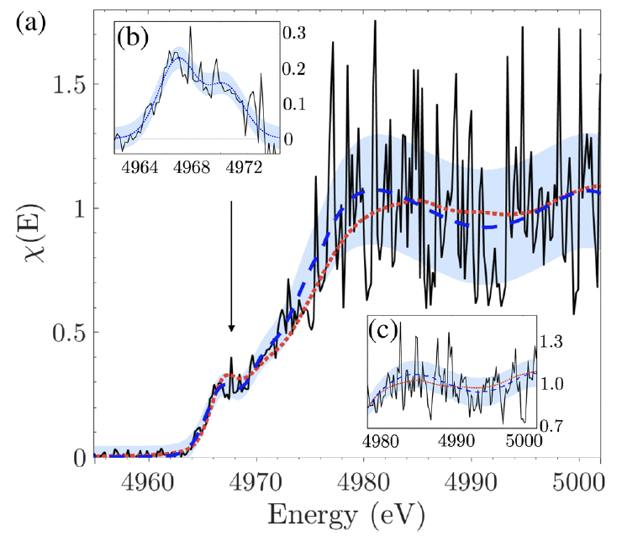
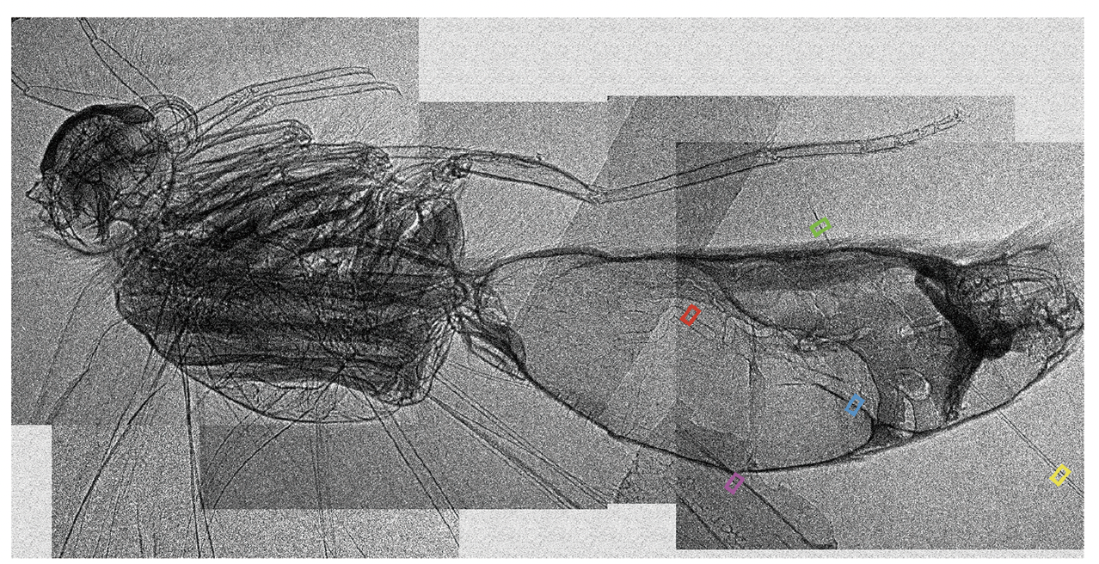
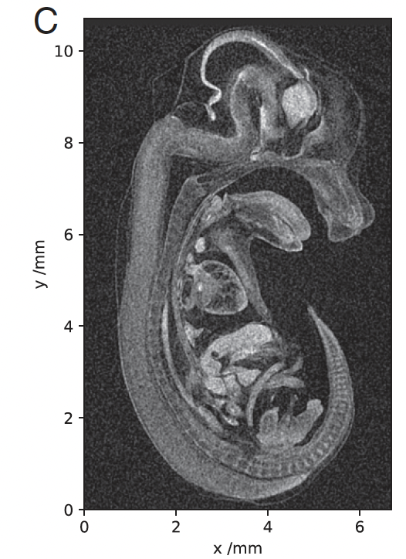
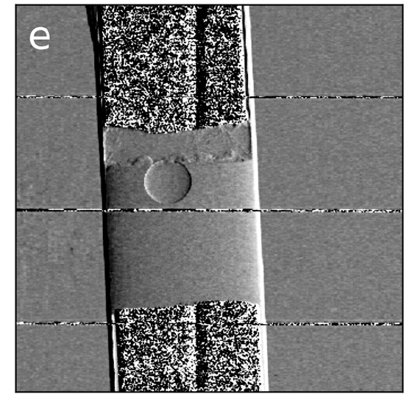
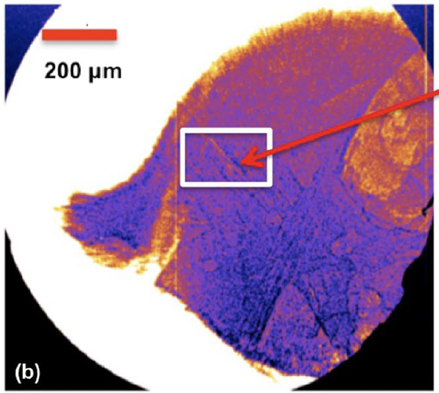

Betatron X-rays from Laser Plasma Accelerators are unique due their micron source size and femtosecond duration → high-resolution spectroscopy & lens-less imaging
M. Downer et al. Rev. Mod. Phys 2018
LPA betatron talks
(WG6 Thursday afternoon)
$$Φ\left(x,y\right)$$
$E_{crit}$ ~ plasma density, electron energy, injection source size
High-resolution, lens-less imaging
High-resolution, single-shot, broad-band spectroscopy
Kettle, PRL 2019;
Mahieu, Nat. Comm. 2018
Guo, Sci. Rep. 2019
Cole, PNAS 2018
Doherty, Comm. Phys. 2023
Hussain, Sci. Rep. 2019
Notes:
d is the separation between two features → d=5 micron. First-phase maxima for lambda < 0.5d^2/z. z=16cm, therefore lambda<0.3nm (>3.8 keV)
source-to-object distance R0 = 16 cm, object-to-detector distance R1 = 580 cm,

Slide 6
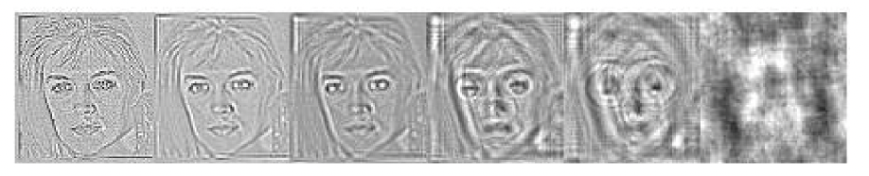
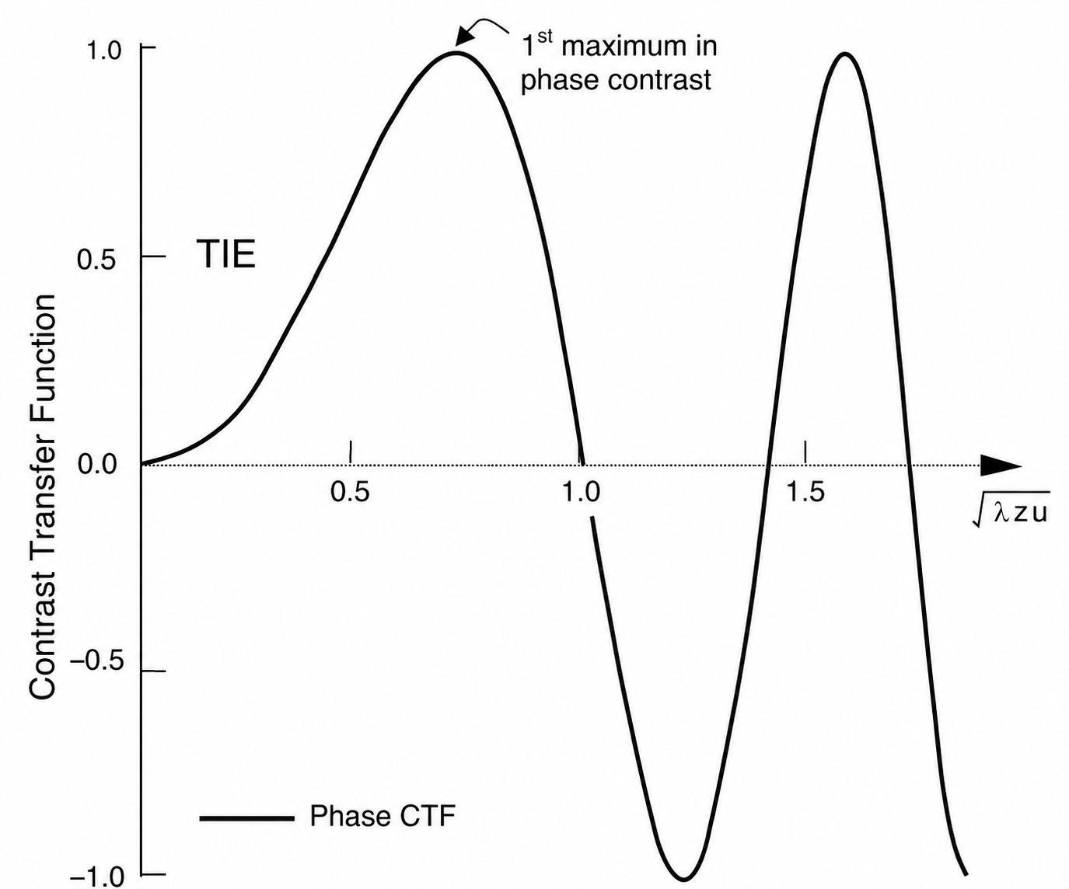







Absorption typically too weak, but phase perturbation turns into a measurable I(x,y) upon (normalized) propagation: keep $χ<π, ideally \sim π/2$
$$ℱ$$
$Φ\left(x,y\right)$ → $Φ\left(u,v\right)$
For weak (thin) objects
“Simple phase contrast” imaging regime
$$I_{z}\left(u,v\right)=2Φ\left(u,v\right)\sin\left(χ\right)$$
Phase object
Transfer function
Complex holography
$$χ=π/2$$
$$\sqrt{χ/π}$$
with
$$χ=πλz(u^{2}+v^{2})$$
X-ray wavelength
Object’s spatial frequency
Propagation
S. Mayo et al. J. Microscopy 207, 79 (2002)
Notes:
d is the separation between two features → d=5 micron. First-phase maxima for lambda < 0.5d^2/z. z=16cm, therefore lambda<0.3nm (>3.8 keV)
source-to-object distance R0 = 16 cm, object-to-detector distance R1 = 580 cm,

Slide 7
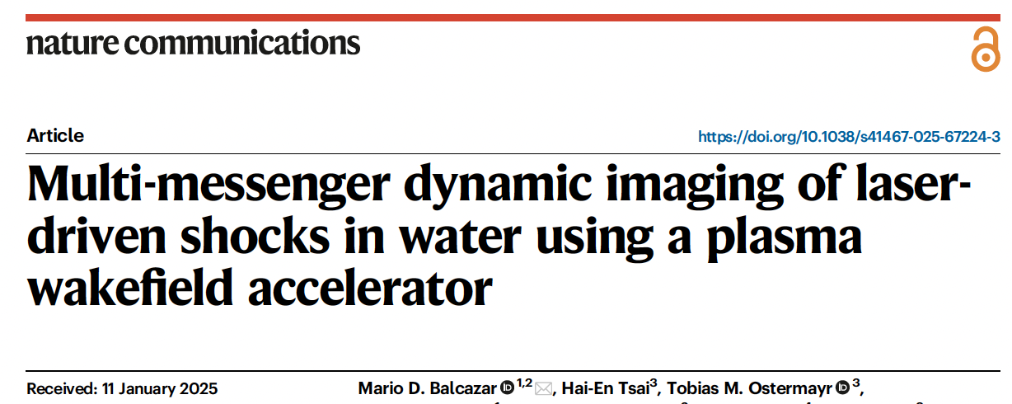
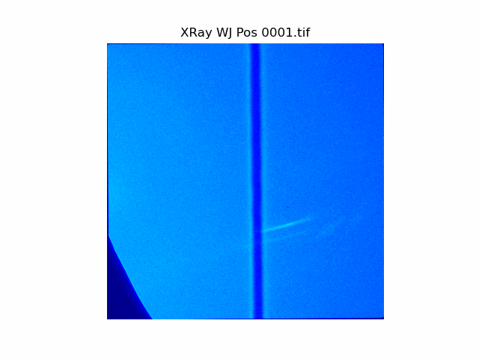

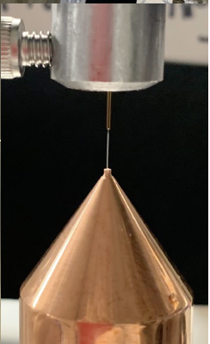
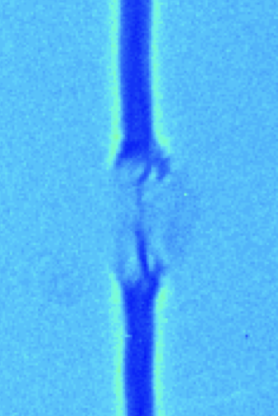
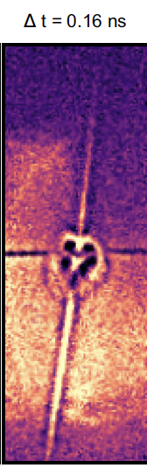

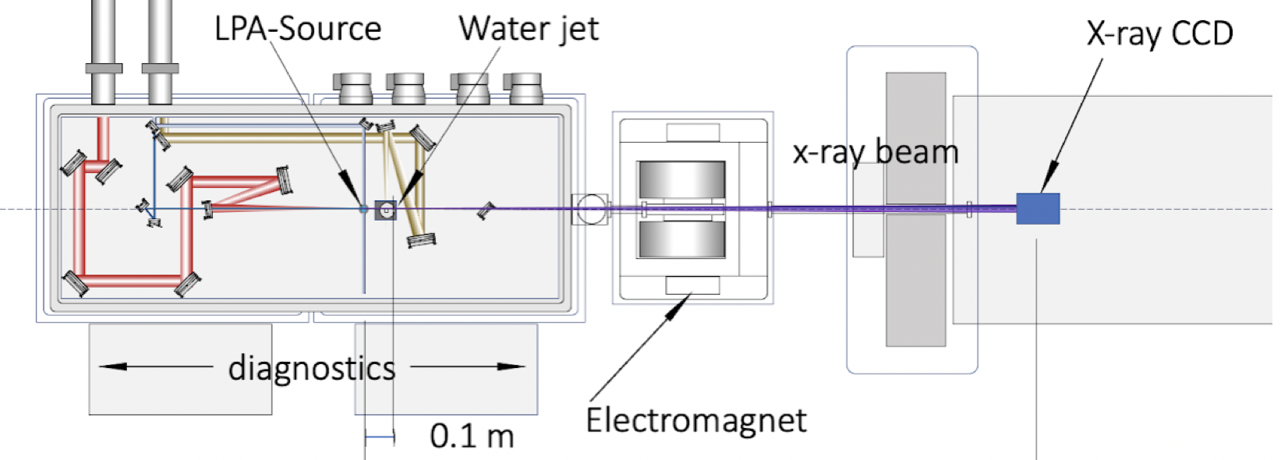
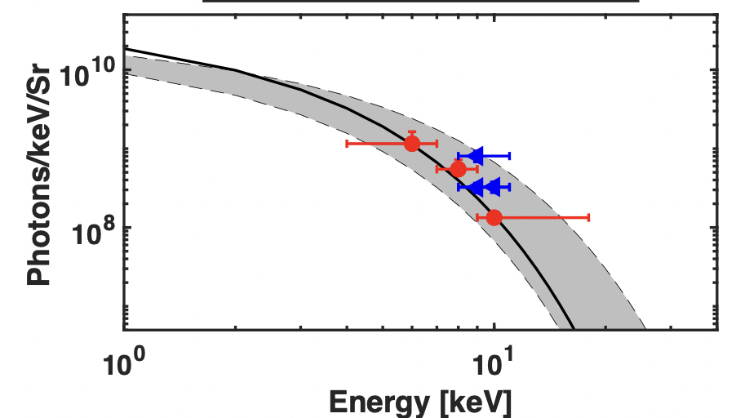




Phase-Contrast imaging inside 30 micron “laser-shocked” water jet at BELLA HTT;
e-beam deflectometry as ”2nd messenger” supplemented physics analysis
LaserNetUS Experiment at BELLA;
M. Balcazar, C. Kuranz, et al. (U Mich), Nat. Comm. 17, 529 (2025)
X-rays
E-beam
Cartoon: Mangles et al. Plasma Phys. Control. Fusion 56 (2014) 084015
$χ<π/2$ for >4 keV
Simple phase contrast
for few-μm features
Notes:
d is the separation between two features → d=5 micron. First-phase maxima for lambda < 0.5d^2/z. z=16cm, therefore lambda<0.3nm (>3.8 keV)
source-to-object distance R0 = 16 cm, object-to-detector distance R1 = 580 cm,

Slide 8
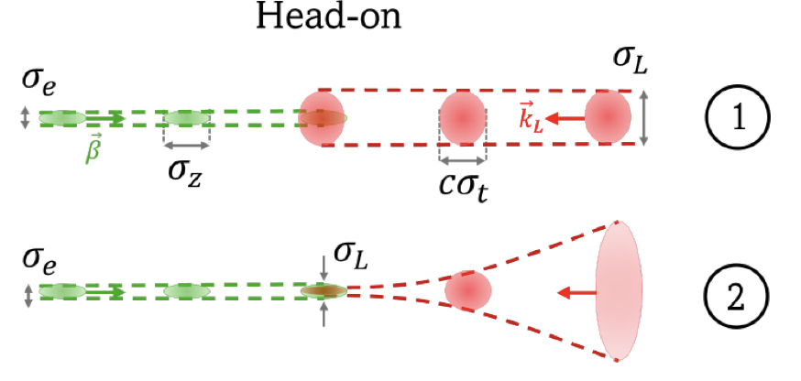
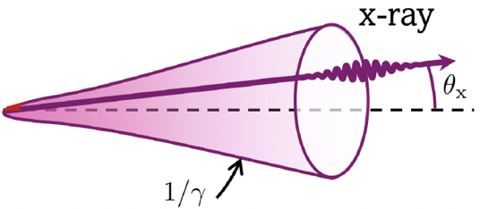
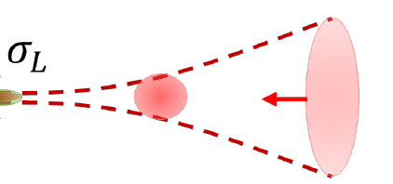

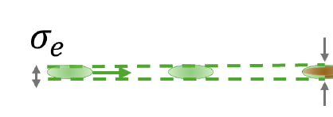
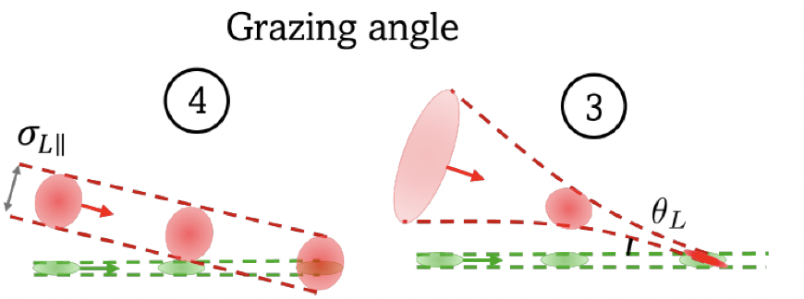








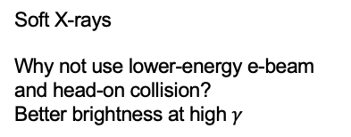
Inverse Compton/Thomson Scattering from low-energy-spread LPA e-beams yields attractive X-ray and gamma-ray beams
C. Sweers and J. Luiten, ArXiv (2026); https://arxiv.org/abs/2512.20356v1
$$ω_{x}≃ω_{L}\frac{{4γ}^{2}}{1+γ^{2}θ_{x}^{2}}$$
$$θ_{x}$$
$$θ_{L}=π$$
Nearly head-on
$$ω_{x}≃ω_{L}\frac{{2γ}^{2}(1−\cos{θ_{L}})}{1+γ^{2}θ_{x}^{2}}$$
$$θ_{L}$$
Grazing angle ICS: B. Schaap talk (WG6 Thursday 4:40pm)
LPA ICS session (WG6 Thursday afternoon)
Soft X-rays
Why not use lower-energy e-beam and head-on collision?
Better brightness at high $γ$
$$ω_{x}≃ω_{L}\frac{{1+γ}^{2}θ_{L}^{2}}{1+γ^{2}θ_{x}^{2}}$$
$$θ_{L}≪1$$
Brilliance

Slide 9
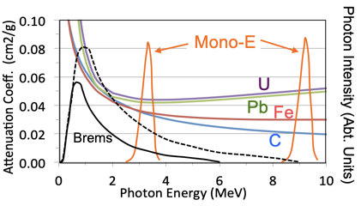
Inverse Compton/Thomson Scattering from low-energy-spread LPA e-beams yields attractive X-ray and gamma-ray beams
C. Sweers and J. Luiten, ArXiv (2026); https://arxiv.org/abs/2512.20356v1
Hard X-rays (gamma rays)
MeV photons are deeply penetrating (~10cm)
Require >100 MeV electrons
Small ICS bandwidth possible (few%-10%)
Tunable photon energy
Radiography, Nuclear Resonance Fluorescence, Photo-fission signatures with precision excitation (strongly reducing dose needed) and material specificity
$$ω_{x}≃ω_{L}\frac{{4γ}^{2}}{1+γ^{2}θ_{x}^{2}}$$
$$θ_{x}$$
$$θ_{L}=π$$
Nearly head-on
$$ω_{x}≃ω_{L}\frac{{2γ}^{2}(1−\cos{θ_{L}})}{1+γ^{2}θ_{x}^{2}}$$
$$θ_{L}$$

Slide 10
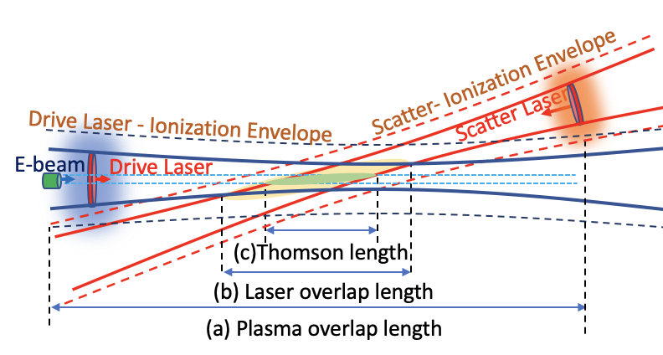
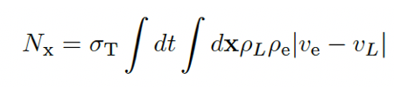
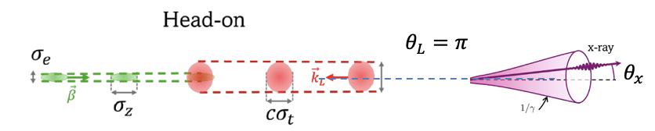
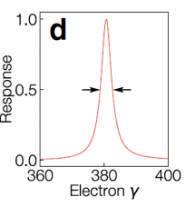
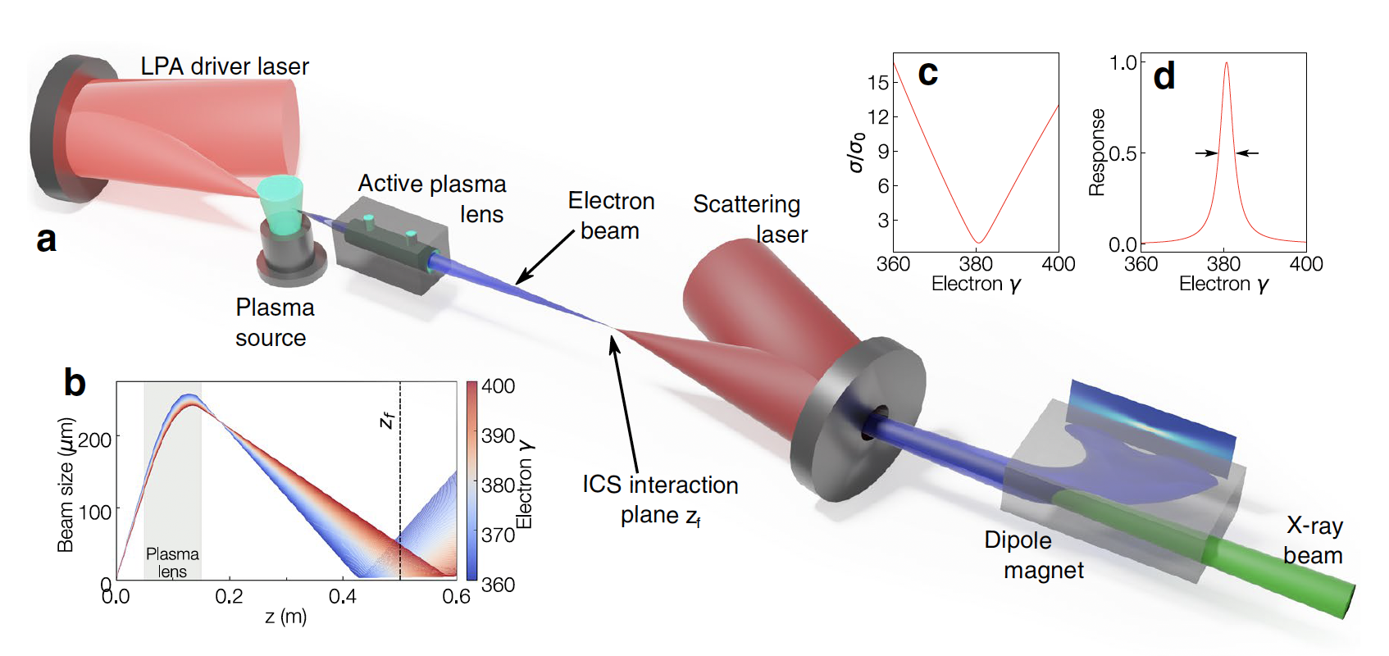
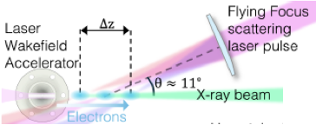

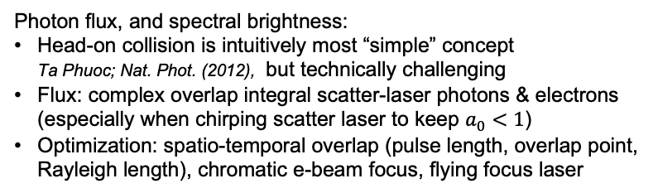
Flux of gamma beam is defined by spatio-temporal overlap of electron beam and drive laser; quickly get complex with role for optimization schemes
Number of X-ray photons ~ spatio-temporal overlap integral
Nearly head-on
Photon flux, and spectral brightness:
Head-on collision is intuitively most “simple” concept
Ta Phuoc; Nat. Phot. (2012), but technically challenging
Flux: complex overlap integral scatter-laser photons & electrons
(especially when chirping scatter laser to keep $a_{0}<1$)
Optimization: spatio-temporal overlap (pulse length, overlap point, Rayleigh length), chromatic e-beam focus, flying focus laser
H.-E. Tsai et al. “Stable and tunable MeV $γ$-ray generation via dual-laser inverse Thomson scattering from a laser-plasma accelerator”
Sci. Reports. in press (2026); https://doi.org/10.1038/s41598-026-56639-7
Flying Focus ICS: See Gerstmayr talk (Plenary Thursday 9:15am)
Bandwidth reduction:
Match e-beam chromatic focus with laser’s chromatic focus
Brümmer et al. Sci. Reports. 12, 16017 (2025)
E. Gerstmayr et al. https://arxiv.org/abs/2607.15805

Slide 11
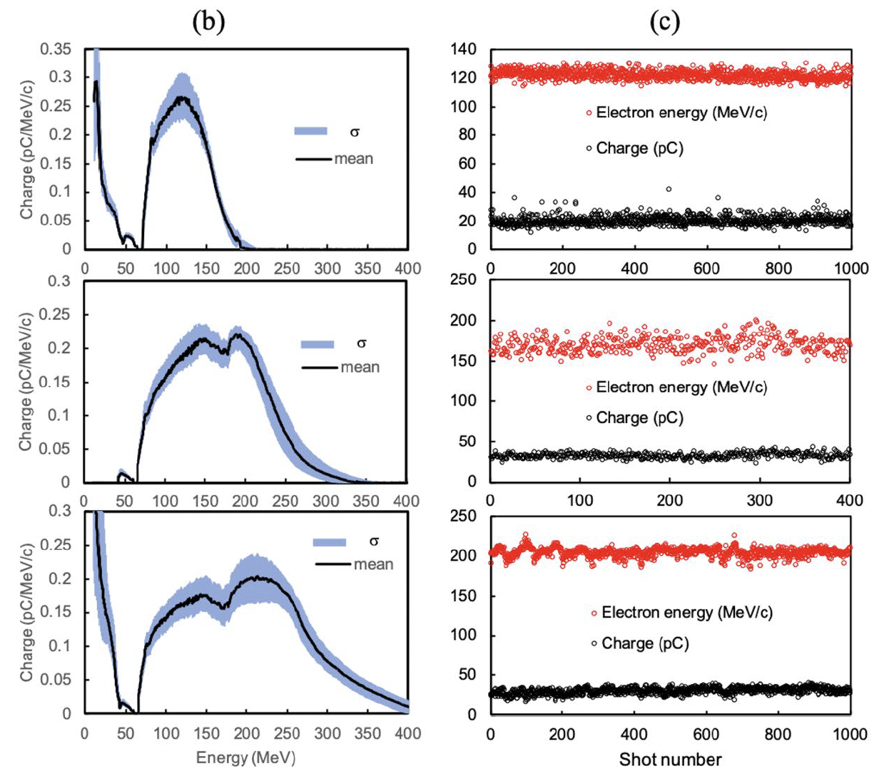
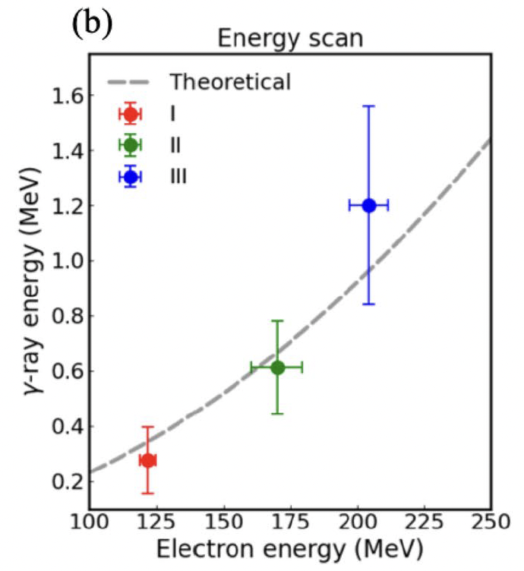
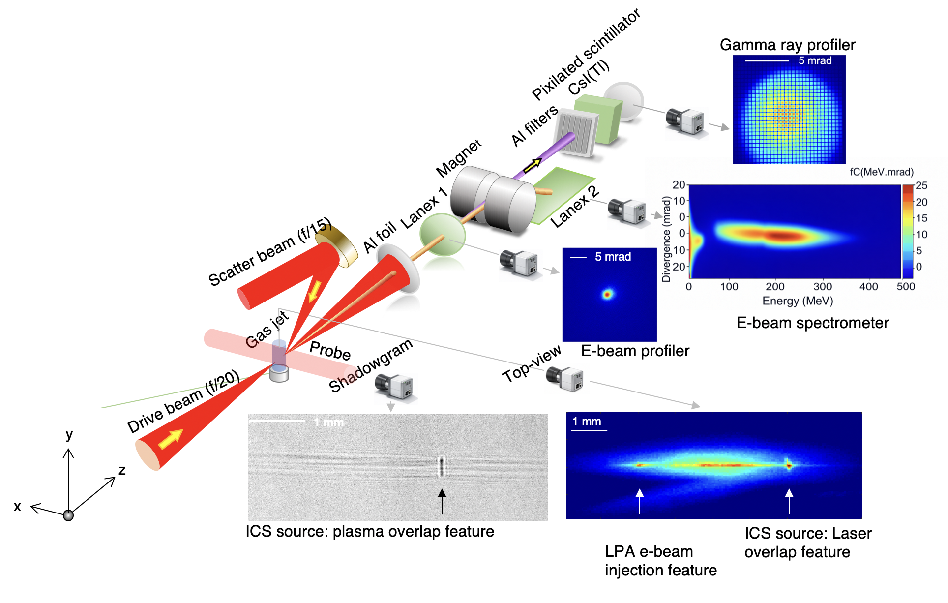
Experiments on BELLA HTT conducted over a series of campaigns, with emphasis on diagnostics for Thomson source optimization
400nm filter
“Stable and tunable MeV $γ$-ray generation via dual-laser inverse Thomson scattering from a laser–plasma accelerator”,
H.-E. Tsai et al. in press (2026); https://doi.org/10.1038/s41598-026-56639-7

Slide 12




Plasma, optical, and gamma diagnostics assist in source optimization (temporal overlap & flux increase) → foundation for applications in next slide
Plasma density boost when overlapped
400nm emission from plasma
(lasers beating)
Gamma emission
Model
Model
Experiment
H.-E. Tsai, T. M. Ostermayr, R. Jacob et al. “Stable and tunable MeV $γ$-ray generation via dual-laser inverse Thomson scattering from a laser–plasma accelerator”, Sci. Reports. in press (2026); https://doi.org/10.1038/s41598-026-56639-7

Slide 13











Several key applications demonstrated: high-resolution lens-less imaging (radiography), multi-shot 3D tomography, and LIDAR time-of-flight characterization
Test object (Inconel alloy)
Measured with BELLA HTT gamma ray source
100 TW “HTT – Thomson”
C. Thornton et al.,
arxiv.org/html/2404.09270v1
Multi-shot, multi-angle tomographic imaging
(takes advantage of shot-to-shot source stability)
LIDAR (timing-based spatial reconstruction)
< 0.1 mm Resolution!
H.-E. Tsai, T. M. Ostermayr, R. Jacob et al.
“Stable and tunable MeV $γ$-ray generation via dual-laser inverse Thomson scattering from a laser–plasma accelerator”
Sci. Reports. in press (2026);
https://doi.org/10.1038/s41598-026-56639-7
Scattered photons
Incoming gammas
R. Heller et al. (collaboration LBNL, INL, UTK);
https://doi.org/10.21955/nuclscitechnolopenres.1115144.1
Notes:
H.-E.

Slide 14








FELs driven by LPAs represent validation of electron beam brightness (beam quality) and stability… strong international & industrial interest
Electrons oscillate in periodic B-field
Incoherent & coherent (FEL) undulator radiation is emitted
eV – keV
Electron
beam
Z. Jin (Japan) Phys. Rev. Res. 8, 013207 (2026) @ 40nm
Labat et al Nat. Phot 2022; PRL 136, 245001 (2026)
Wang et al Nature 2021
LPA FEL at HDZR: See Schöbel talk (WG6 Thursday 3:10pm)
S. Barber (BELLA) Phys. Rev. Lett. 135, 055001 (2025)

Slide 15




100 TW “HTU – undulator” system is developed for precision delivery of high-quality electron beams to transport line (quadrupoles, chicane) and undulator
gas jet
e-beam diagnostic & application
Magnetic
spectrometer #2
triplet
Jeroen van Tilborg
VISA undulator
LPA
FEL pulse
Spectrometer
EM-Triplet
Chicane
UCLA collaboration, Rosenzweig,
Majernik et al. [PRAB 22, 032401 (2019)]
room148
Magnetic
spectrometer #1
OAP
chamber
LPA target chamber

Slide 16







Accurate non-perturbative high-power laser focus monitoring system developed:
key to active stabilization of laser on target & e-beam production
Robustness gas jet + shock plasma profile: S. Barber, unpublished
Active stabilization longitudinal laser focus position
--> e-beam stabilization: K. Jensen et al. PRAB 28, 092802 (2025)
Density down-ramp
Laser “witness” stabilization → stabilizes electron beam centroid
off
off
off
Stabilization on
on
on
on
Active stabilization transverse laser pointing
Non-perturbative high-power laser diagnostic: Isono et al. HPLSE 8, e25 (2021)
Active stabilization: Berger et al, NIM-A 1078, 170561 (2025); Amadio et al, HPLSE. 13, e35 (2025)
--> e-beam stabilization: Berger et al, PRAB 26, 032801 (2023)

Slide 17







E-beam matching into strong-focusing undulator results in observation of FEL gain
Excellent LPA and e-beam stability enables demonstration of >100x gain
E-beam
Coherent gain
Incoherent emission
FEL gain over 8+ hours
See Kohrell talk (WG6 Monday 5:00pm)
S. Barber et al. Phys. Rev. Lett. 135, 055001 (2025);
F. Kohrell et al. Phys. Rev. AB 29, 041301 (2026)

Slide 18

LPAs: compact drivers of high-energy electron beams & secondary radiation
              Point source → high-res imaging, low $ε_{n}$ → coherent radiation
              High-energy → deep penetration
              Highly directional → stand-off interrogation
              Femtosecond duration → blur-free dynamics studies
Higher repetition rates (WG1 afternoon session) & active stabilization → exciting application opportunities ahead
Laser
E-beam
E-beam
Electrons
Laser
Scatter laser
E-beam
Isotopes
E-beam
Electron beam
Muons
Brems
gammas
Neutrons
Inverse Thomson Scattered gamma ray photons
Undulator / FEL radiation
Plasma focusing force
Laser
Magnetic undulator
Plasma-betatron X-rays
Electron beam
Notes:
Take you through a tour. By no means a comprehensive review, nor catching all LPA applications. That’s what makes it exciting.
Scientist for application community are getting confident in LPA reliability to make these cross-community connections.

