Slide 1





Recent R&D on RF systems for
muon collider ionization cooling complex
Alexej Grudiev (CERN)
On behalf of the International Muon Collider Collaboration
Advanced Accelerator Concepts, 2026
Funded by the European Union (EU). Views and opinions expressed are however those of the author(s) only and do not necessarily reflect those of the EU or European Research Executive Agency (REA). Neither the EU nor the REA can be held responsible for them.

Slide 2
Outline
Introduction
  IMCC
  ESPPU 2026
  MC R&D program
High Gradient RF in strong Magnetic field
  Reminder of the State-of-the-Art from US MAP
  Some new ideas on the breakdown model
  Recent plans on the RF test stands in strong magnetic field
Design of RF cavities for Muon Cooling
  Comparison of Be-window and Dielectric-loaded cavities for 6D-cooling
  Very low frequency Dielectric-loaded cavities for the Final cooling
Conclusions and Outlook

Slide 3
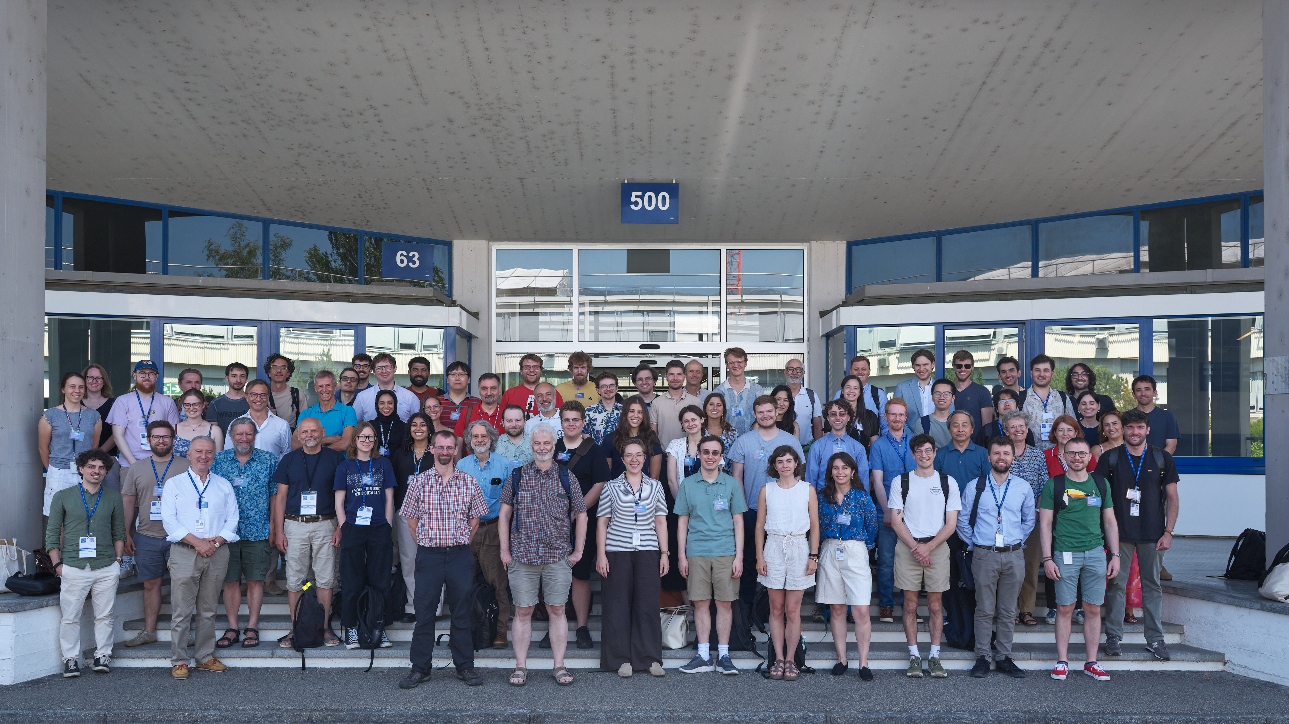

International Muon Collider Collaboration (IMCC)
IMCC and MuCol Annual Meeting 2026 (22-25 June 2026), CERN
IMCC:
68 institutes
from
18 countries
+
30 partners
from
4 countries
199 participants

Slide 4
European Strategy Particle Physics Update (ESPPU) 2026 Recommendation
The full exploitation of the physics potential of the LHC and the HL-LHC [..] remain the highest priorities of European particle physics.
The electron–positron Future Circular Collider (FCC-ee) is recommended as the preferred option for the next flagship collider at CERN.
A descoped FCC-ee is the preferred alternative option for the next flagship collider at CERN.
The longer-term development of advanced technologies, such as high-gradient wakefield acceleration and those underpinning bright muon beams, should be supported at an appropriate level. Synergies with the US initiative on muon collider R&D should be exploited.
Note: CERN wants a go/no-go decision on FCC-ee
Documentation on LEP3 and LCF380 will also be provided
D. Schulte, CERN

Slide 5
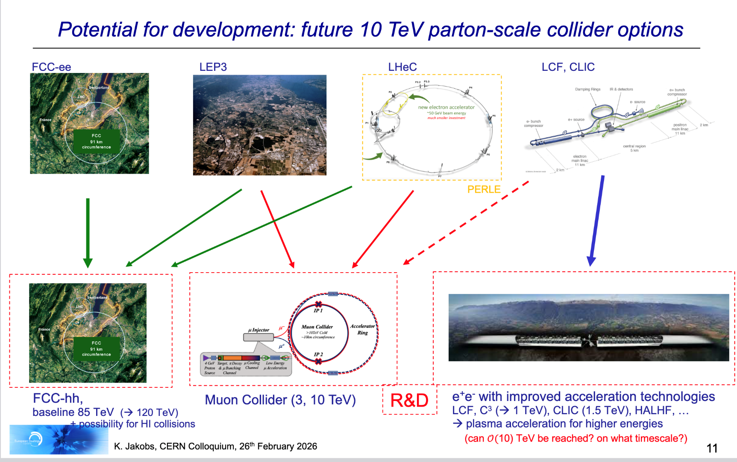
Collider landscape in Europe. ESPPU view
~2045
~2065

Slide 6
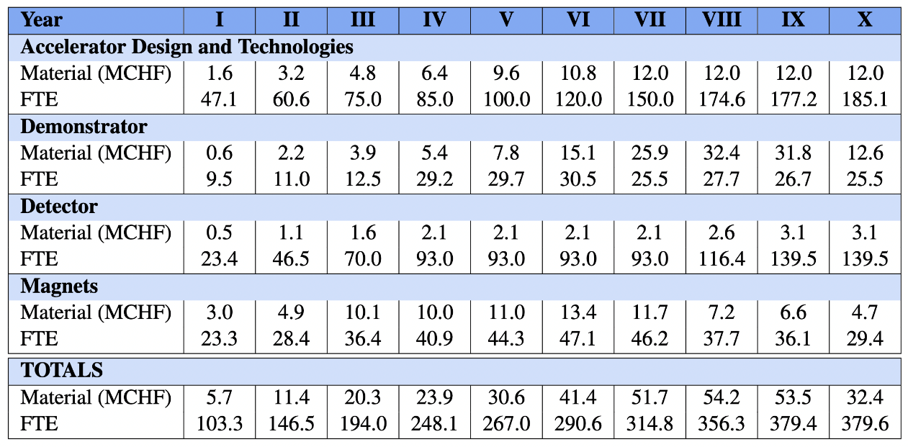
IMCC R&D Program
Accelerator design
Complete start-to-end design
Muon cooling technology
Staged implementation
  RF test stands
  Cooling cell prototype
  Demonstrator
Detector
Strong potential for further improve physics potential with technologies, AI and ML
Magnet programme
Have conceptual designs, need hardware
HTS solenoids have important synergy with society (also power converter)
  Industry is ready to invest
  Must not miss the opportunity
ESPPU: Accelerator WG2a concluded on the muon collider:
[…] the Muon Collider (MC), together with the FCC-hh, promises a potentially energy-efficient path toward high-luminosity collisions at a parton centre-of-momentum energy of 10 TeV. However, the MC has not yet reached the level of maturity of the other proposals discussed here. [..]
RF
Detailed R&D program proposal towards CDR with deliverables defined
D. Schulte, CERN

Slide 7
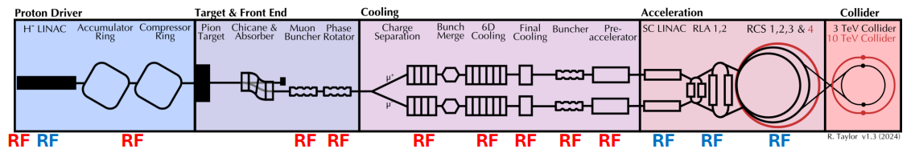
MC RF systems R&D Program
Detailed R&D program for MC RF systems
Task force on R&D for MC RF systems:
S. Belomestnykh (FNAL),
G. Burt (ULAN), R. Calaga (CERN),
D. Giove (INFN), A. Grudiev (CERN),
T. Luo (LBNL),
E. Nanni (SLAC),
J. Plouin (CEA), U. van Rienen (UROS),
I. Syratchev (CERN)
Moun cooling complex RF systems
Detailed R&D program partially funded
Collaborators \ Tasks | 1 | 2 | 3 | 4
CERN, CH
INFN, IT
University of Rostock, DE
University of Lancaster, UK
CEA, FR
LBNL, USA
FNAL, USA
SLAC, USA
University of Helsinki, FI
 | Tasks |  | year | 1 | 2 | 3 | 4 | 5 | 6 | 7 | 8 | 9 | 10 |  | All
1 | Muon Cooling Design Effort
 | Staff | FTE/y | FTE/y | 1 | 1 | 1 | 1 | 1 | 2 | 2 | 2 | 2 | 2 |  | 15 | FTE
 | Postdoc/Student | FTE/y | FTE/y | 4 | 4 | 4 | 4 | 4 | 8 | 8 | 8 | 8 | 8 |  | 60 | FTE
 | Material | MCHF | MCHF | 0.1 | 0.1 | 0.1 | 0.1 | 0.1 | 0.2 | 0.2 | 0.2 | 0.2 | 0.2 |  | 1.5
2 | Muon Cooling RF Tests & Theory
 | Staff | FTE/y | FTE/y | 3 | 3.5 | 5.3 | 4.5 | 4 | 0 | 0 | 0 | 0 | 0 |  | 20 | FTE
 | Postdoc/Student | FTE/y | FTE/y | 3.5 | 5 | 6 | 5 | 5 | 0 | 0 | 0 | 0 | 0 |  | 25 | FTE
 | Material | MCHF | MCHF | 0.2 | 0.4 | 0.8 | 0.2 | 0.5 | 0 | 0 | 0 | 0 | 0 |  | 2.2
3 | RF systems for Accelerators
 | Staff | FTE/y | FTE/y | 0.3 | 0.3 | 0.3 | 0.8 | 1 | 5.5 | 5.5 | 5.5 | 4.5 | 3.5 |  | 27 | FTE
 | Postdoc/Student | FTE/y | FTE/y | 2 | 2 | 2 | 2 | 3 | 5 | 5 | 5 | 5 | 4 |  | 35 | FTE
 | Material | MCHF | MCHF | 0 | 0 | 0 | 0.3 | 0.5 | 0.6 | 0.6 | 0.8 | 0.5 | 0.4 |  | 3.7
4 | RF power sources
 | Staff | FTE/y | 0.25 | 0.3 | 0.3 | 3.05 | 3.05 | 2.7 | 0.45 | 0.45 | 3 | 3 | 2.5 |  | 19 | FTE
 | Postdoc/Student | FTE/y | 1.1 | 1.1 | 2.2 | 3.6 | 4.1 | 4 | 2.1 | 3.1 | 4 | 4 | 3 |  | 31 | FTE
 | Material | MCHF | 0.01 | 0 | 0.02 | 1.8 | 0.8 | 0.4 | 0.03 | 0.03 | 0.8 | 0.8 | 0.4 |  | 5.1
Tot | Staff | FTE/y | 4.5 | 4.5 | 5.1 | 9.6 | 9.3 | 8.7 | 8 | 8 | 10.5 | 9.5 | 8 |  | 81 | FTE
 | Postdoc/Student | FTE/y | 10.6 | 11 | 13.2 | 15.6 | 15.1 | 16 | 15.1 | 16.1 | 17 | 17 | 15 |  | 151 | FTE
 | Material | MCHF | 286 | 0.3 | 0.53 | 2.7 | 1.4 | 1.5 | 0.83 | 0.83 | 1.8 | 1.5 | 1 |  | 12.4

Slide 8
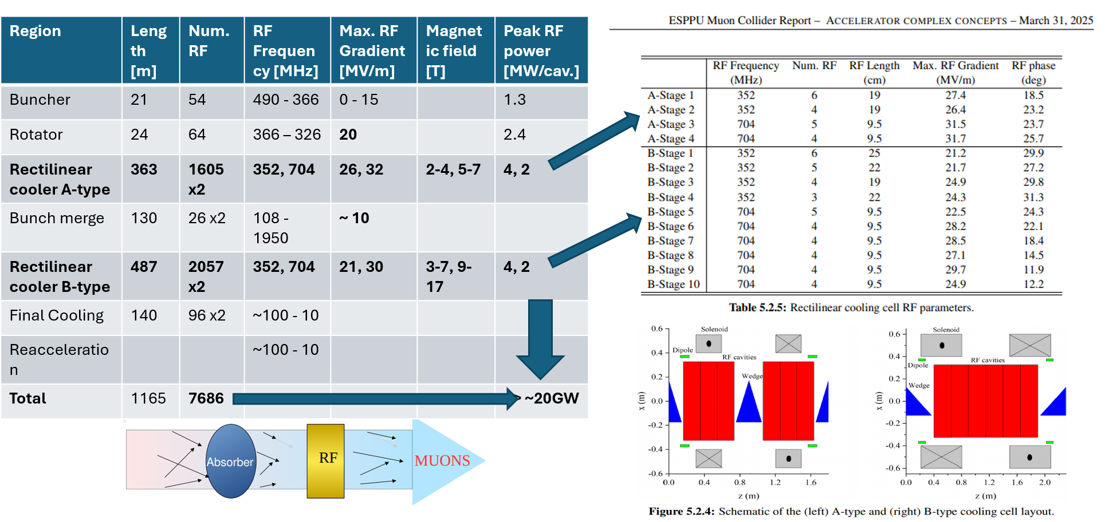
RF system for muon cooling

Slide 9
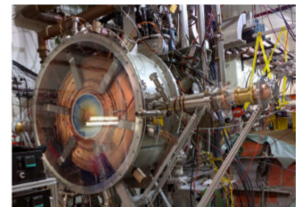
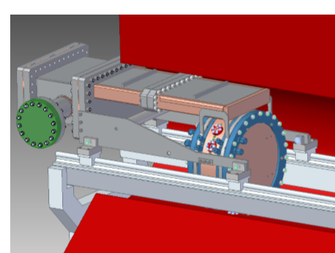
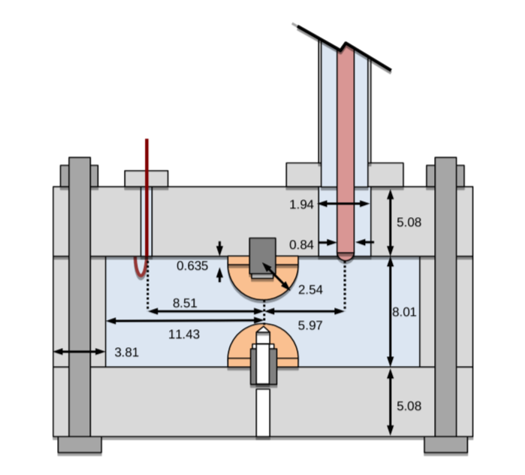
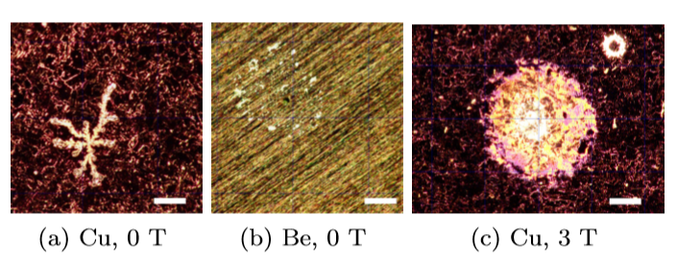
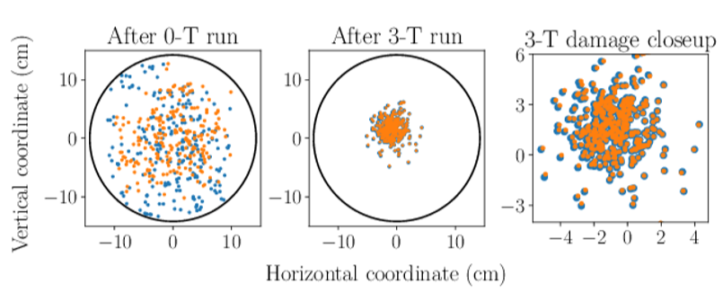
RF cavities for muon cooling from US MAP
Challenges:
High Gradient
High magnetic field
High radiation
No synergy with other projects
---------------------
State of the art (not complete):
MICE 200 MHz RF module prototype: 4T, 10 MV/m, 1ms@1Hz
800 MHz beryllium cavity:
3T, 50 MV/m, 30us@10Hz
Gas filled RF cavity:
Small gap, 800 MHz, >50 MV/m
US MAP

Slide 10
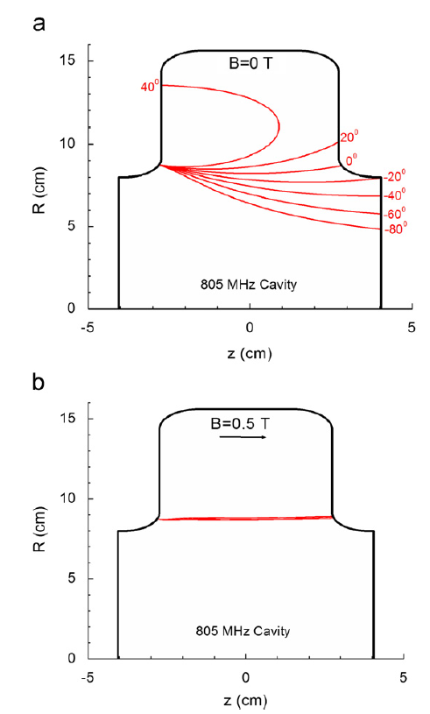
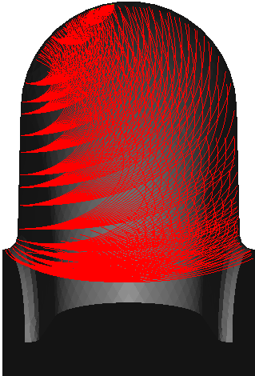
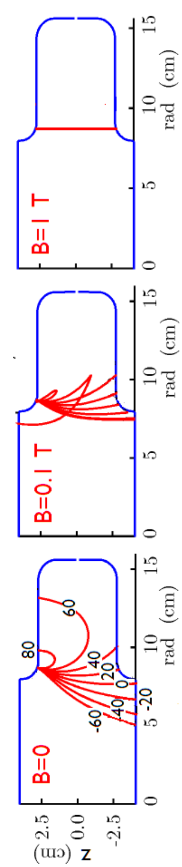
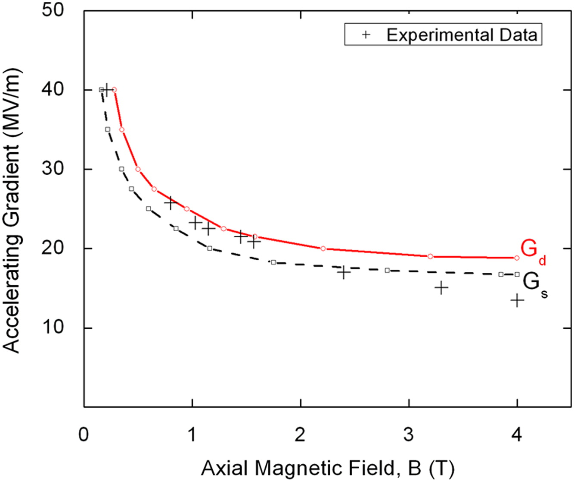
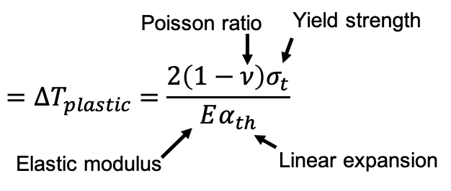
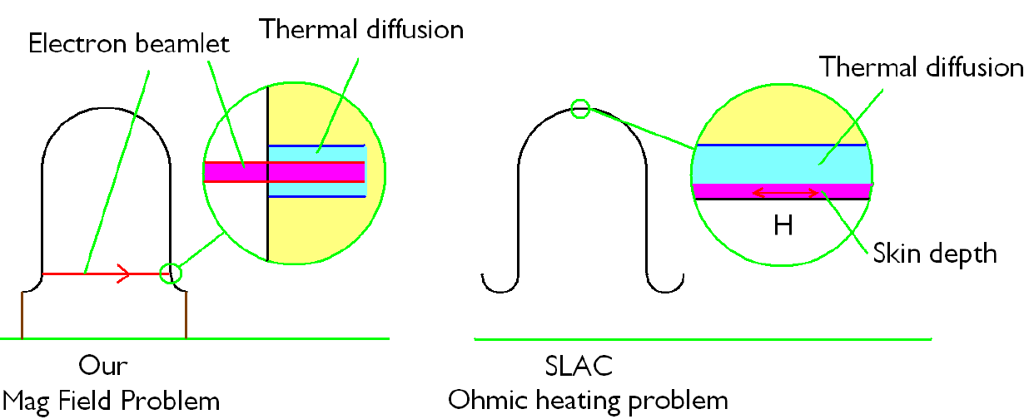
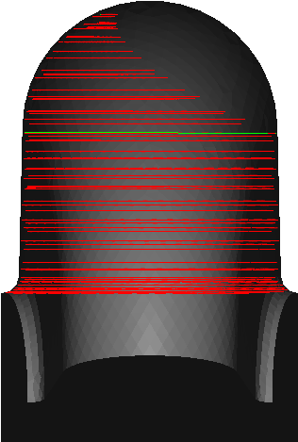
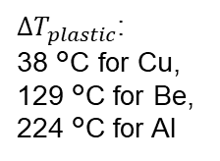
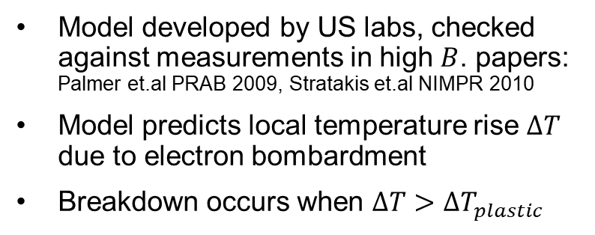
Breakdown model: beamlet focused by magnetic field
Numerical simulations showed trajectories of beamlets in the presence of the 805 MHz pillbox cavity
Model developed by US labs, checked against measurements in high $B$. papers: Palmer et.al PRAB 2009, Stratakis et.al NIMPR 2010
Model predicts local temperature rise $∆T$ due to electron bombardment
Breakdown occurs when $∆T>∆T_{plastic}$
US MAP
Electron beamlet
Thermal diffusion
$∆T_{plastic}$:
38 °C for Cu,
129 °C for Be,
224 °C for Al
Heating due to electron bombardment

Slide 11


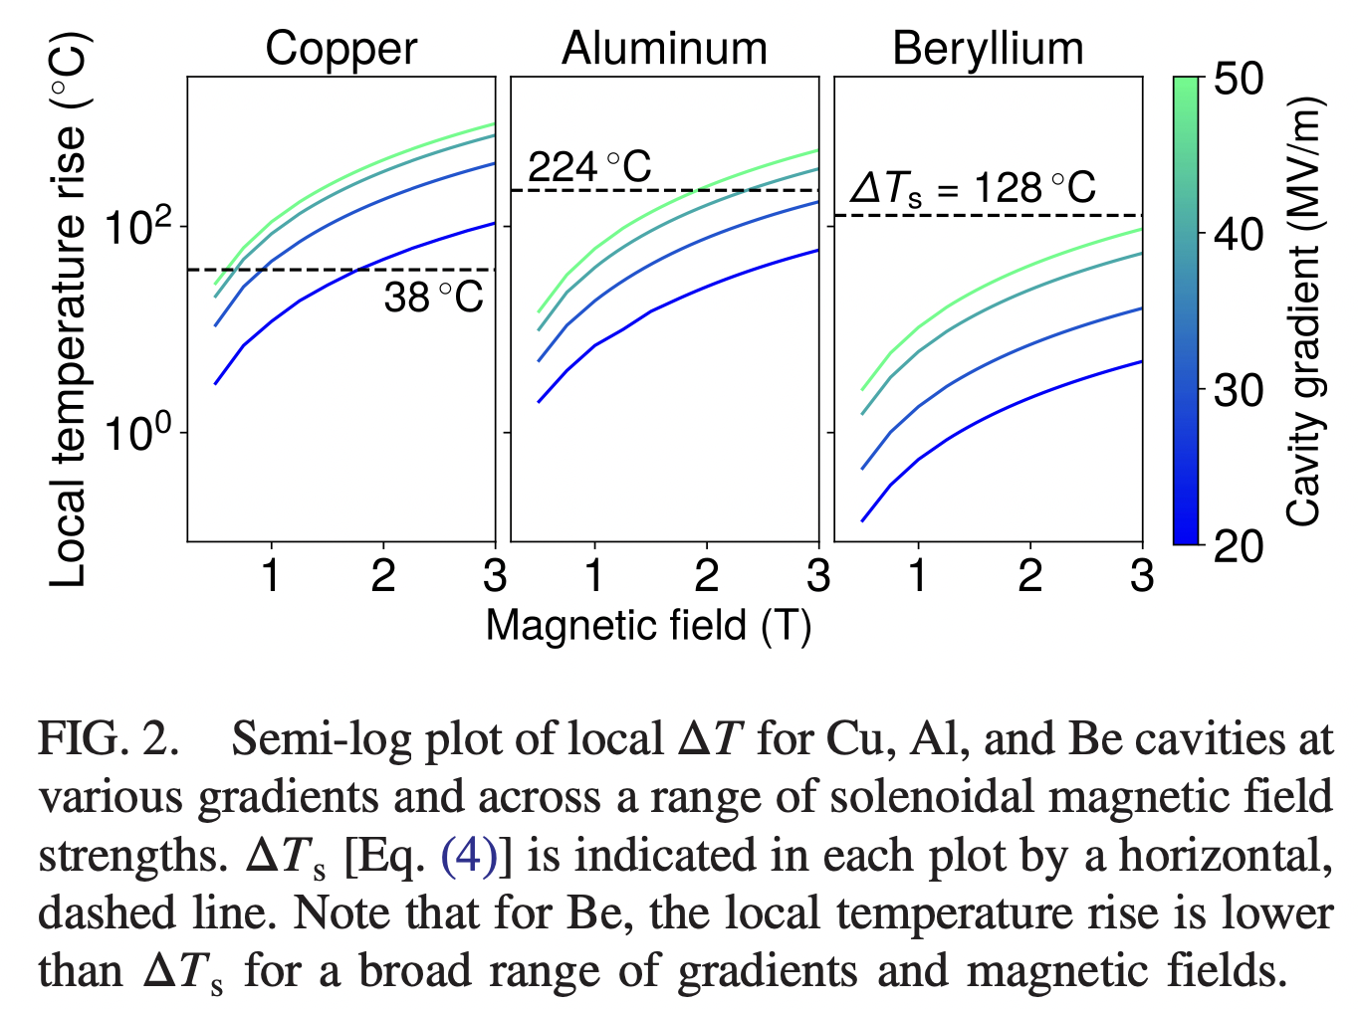
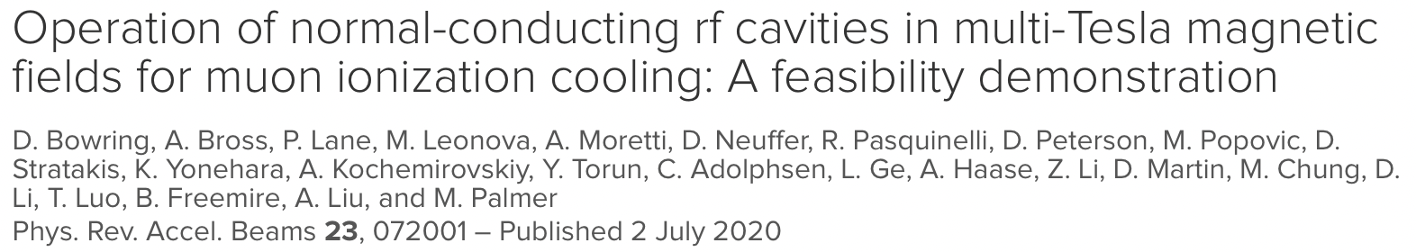
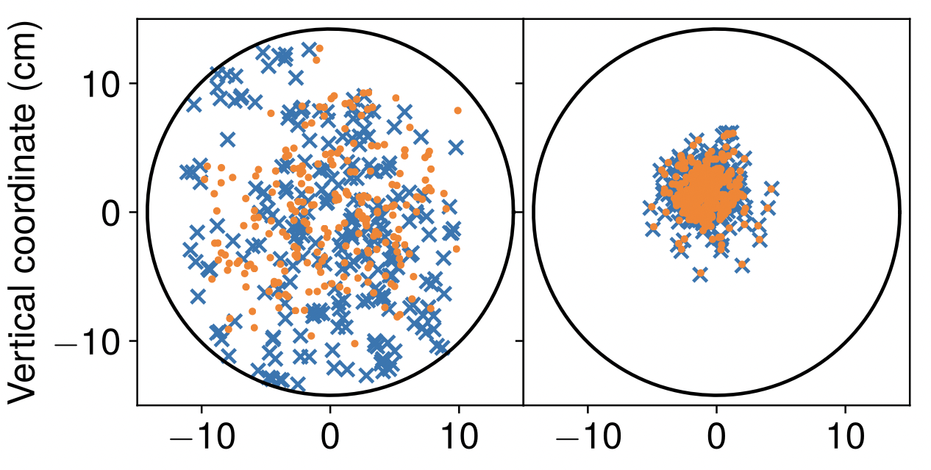
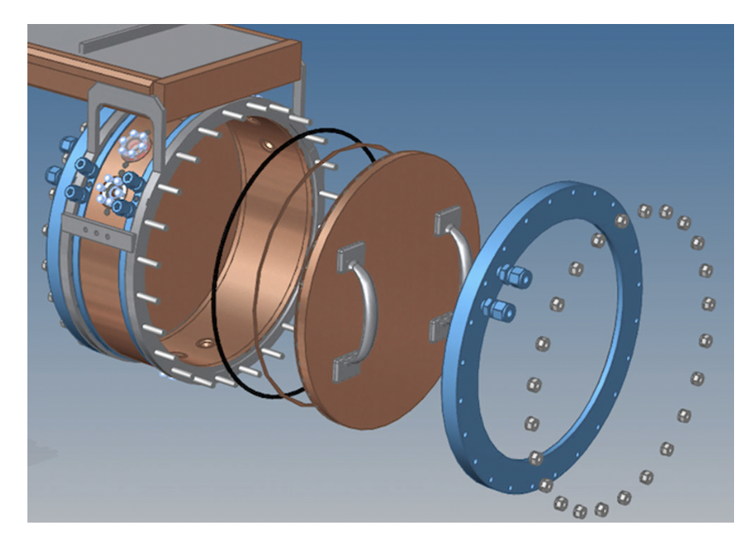
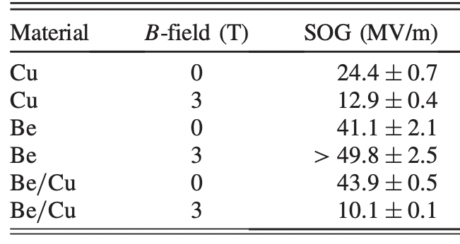
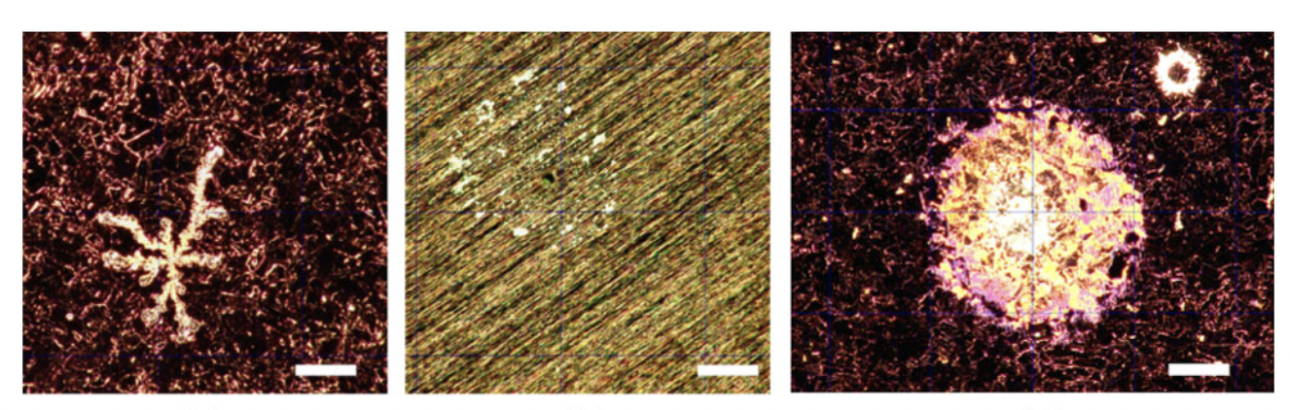
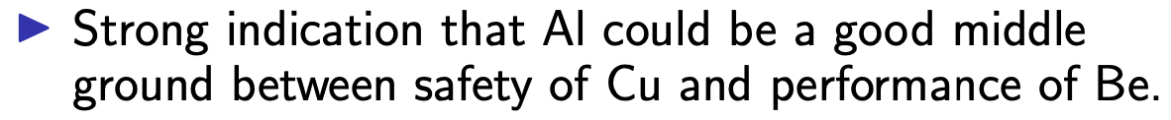
MuCool 805 MHz cavity with modular plates
US MAP
modular plate
Cu: 0 T
Cu: 3 T
Be: 0 & 3 T

Slide 12
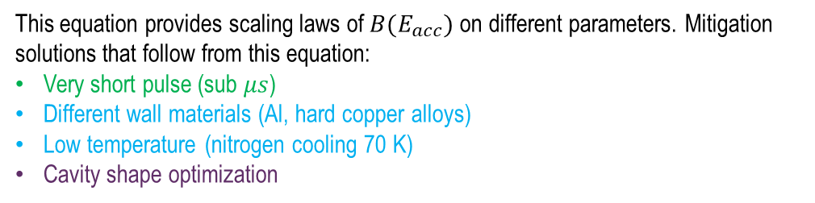



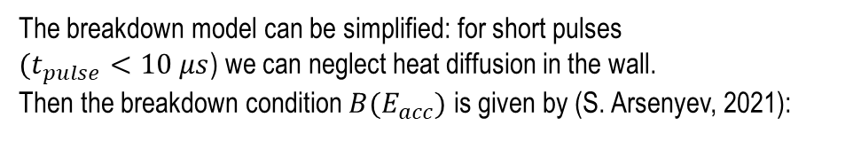
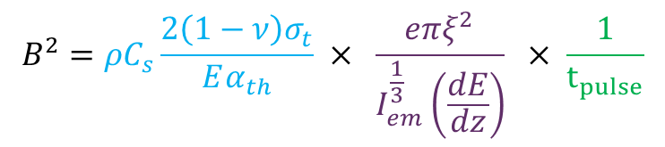

Scaling using no-diffusion beamlet model
The breakdown model can be simplified: for short pulses
$(t_{pulse}<10 μs$) we can neglect heat diffusion in the wall.
Then the breakdown condition $B(E_{acc})$ is given by (S. Arsenyev, 2021):
$$ΔT$$
Diffusion
ΔT_{plastic}
Cavity-dependent constant
$$B^{2}=ρC_{s}\frac{2\left(1−ν\right)σ_{t}}{Eα_{th}} × \frac{eπξ^{2}}{I_{em}^{\frac{1}{3}}\left(\frac{dE}{dz}\right)} × \frac{1}{t_{pulse}}$$
No diffusion
Pulse length
Magnetic field at breakdown
Wall material properties
$$\sim 10 μs$$
$$t_{pulse}$$
Electron energy loss
Field Emission current $I(E_{acc})$
This equation provides scaling laws of $B(E_{acc})$ on different parameters. Mitigation solutions that follow from this equation:
Very short pulse (sub $μs$)
Different wall materials (Al, hard copper alloys)
Low temperature (nitrogen cooling 70 K)
Cavity shape optimization
When combined, benefits from different solutions would multiply

Slide 13
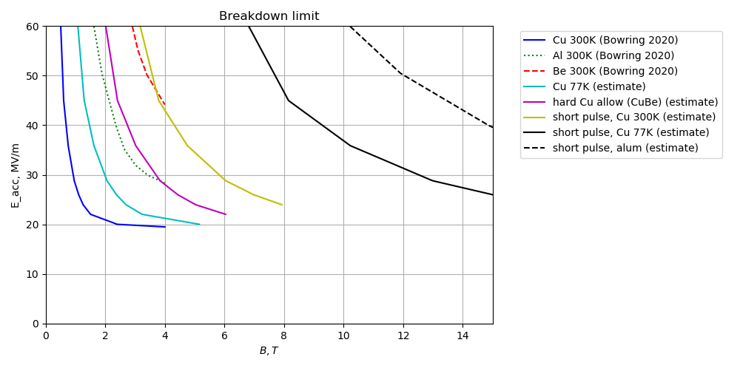
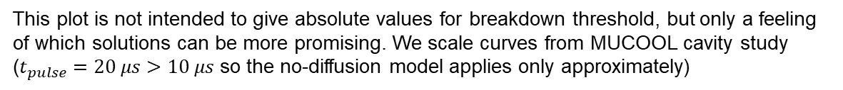
Comparing breakdown mitigation ideas
This plot is not intended to give absolute values for breakdown threshold, but only a feeling of which solutions can be more promising. We scale curves from MUCOOL cavity study ($t_{pulse}=20 μs$ $>10 μs$ so the no-diffusion model applies only approximately)
Scaled from the first 3 curves using the scaling model (previous slide)
Copper at short pulse and low temperature looks better
Aluminum cavity with a short pulse looks very promising
Benefits of short pulse and aluminum multiply
S. Arsenyev, 2021

Slide 14
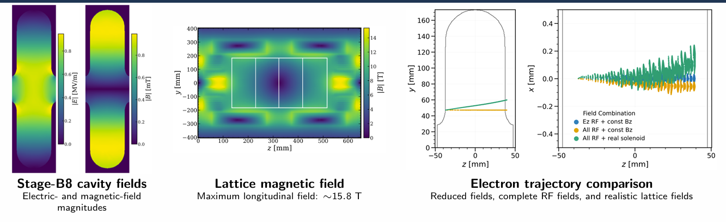
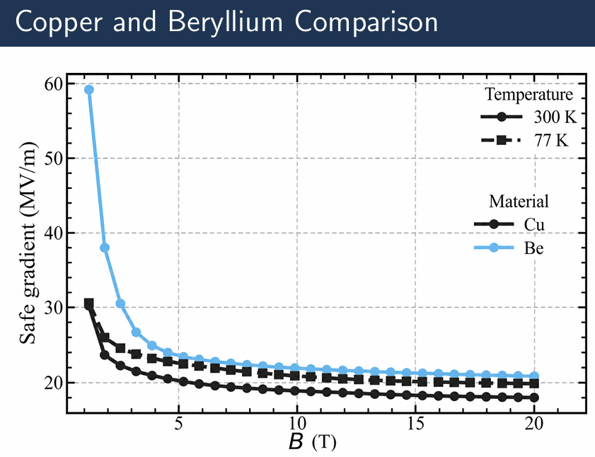
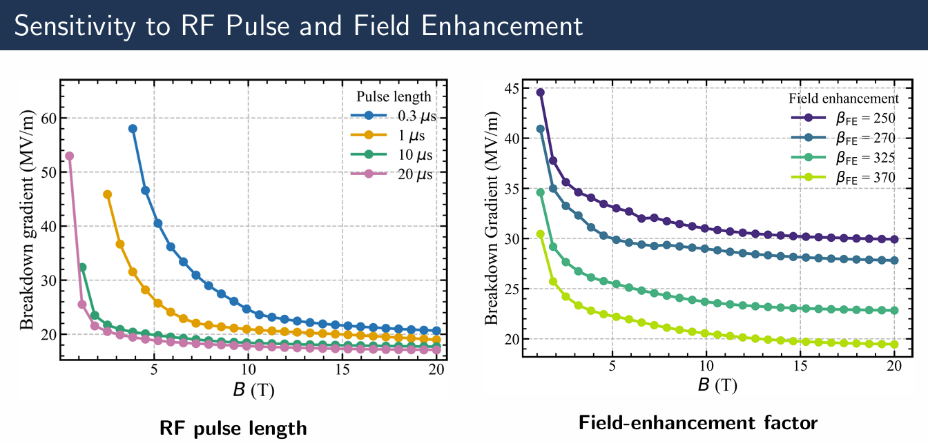
Breakdown Model in a Magnetic Field
Realistic field maps used for “RF-track”ing
See talk on Tue
D. Merenich, NIU
Low temperature
Short pulse
Different materials

Slide 15
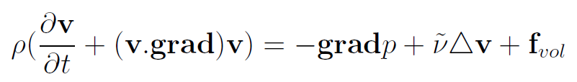
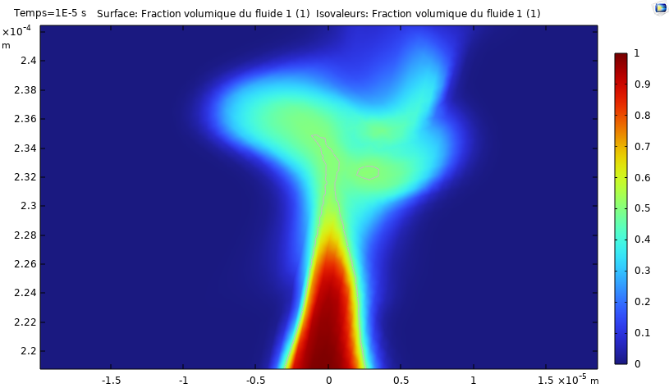
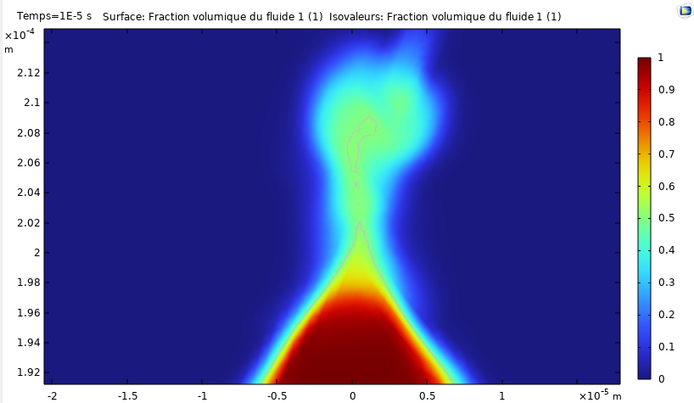
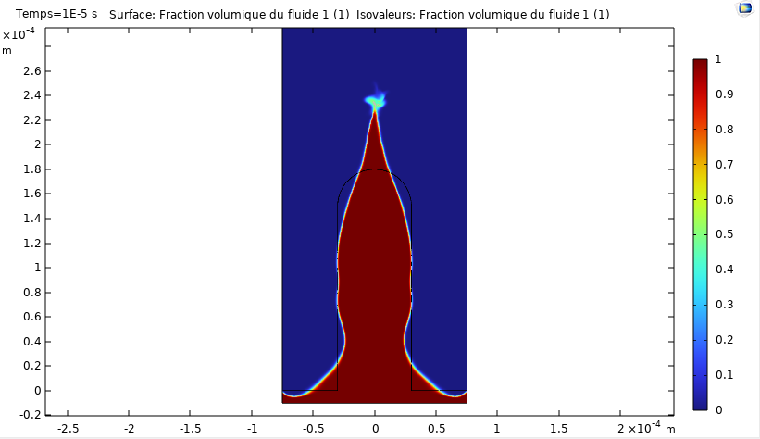
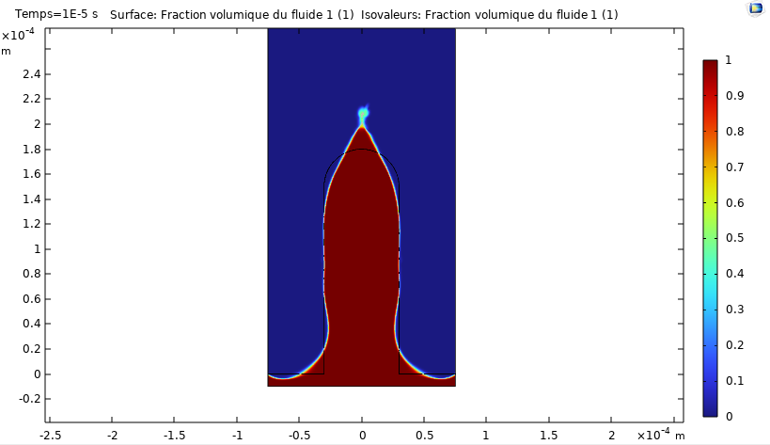




Magneto-hydrodynamic model of breakdown
Navier Stokes equation
$$P_{ts}= \frac{γ}{{2R}_{c}}$$
$$P_{rad}=\frac{1}{4}ε_{0}E^{2}$$
Without $\overset{⃑}{B_{DC}}$
$$\overset{⃑}{B_{DC}}=30 T$$
$\overset{⃑}{B_{DC}}$ will probably affect the amount and dynamics of copper detached
To this point : no evidence of breakdown increase due to B field
J. Plouin, CEA

Slide 16
R&D directions for cavity tests in high B field
  Strong need of high gradient RF test stand(s) with strong B-field
  Frequency: ideally 300 to 700 MHz range, but
  RF tests at higher RF frequency in L, S, C and X-bands as well as DC tests are very useful in studying and understanding the RF breakdown phenomena in strong magnetic field. They provides important insights on the achievable gradients and its dependence on the material, cavity geometry, RF pulse length, among others.
  Gradients from 25 to 50 MV/m
  Magnetic field: ~10T, different field configurations
  Short RF pulses (~10μs)
  Different materials and Coatings: Cu, Be, Al, Cu-alloys, HTS(REBCO)…
  Different temperatures: 300K -> 70K ->…
  Dielectric-loaded cavities

Slide 17
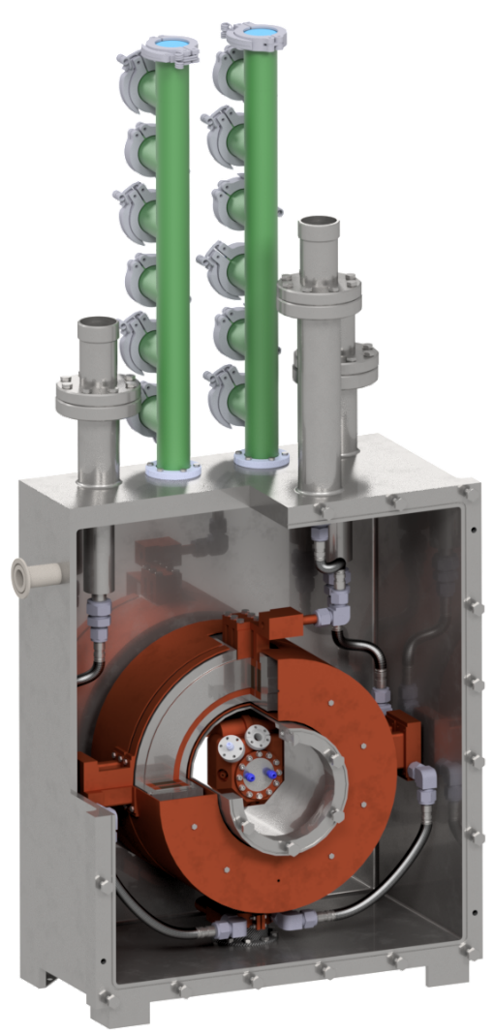
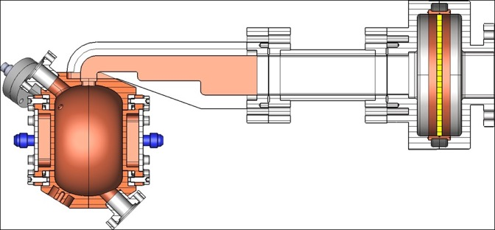
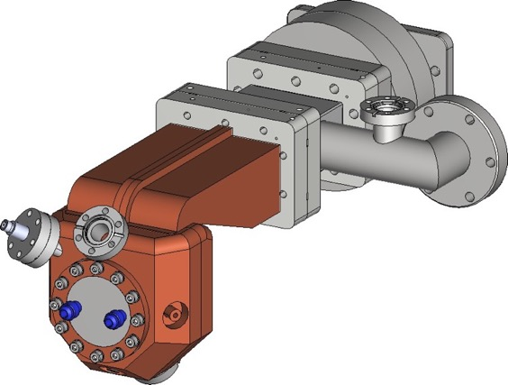
INFN LASA RF in Magnetic Field Test Facility
RFMFTF
HTS split coils,
250 mm coil aperture,
170 mm room temperature free bore
Axial B-field configuration: homogeneus + + or gradient + -
Bz= 7 T to 10 T
Gz = 68 T/m to 97 T/m
S-band RF
364 mm
170 mm
68 mm
Courtesy M. Statera and E. De Matteis
D. Giove, INFN

Slide 18
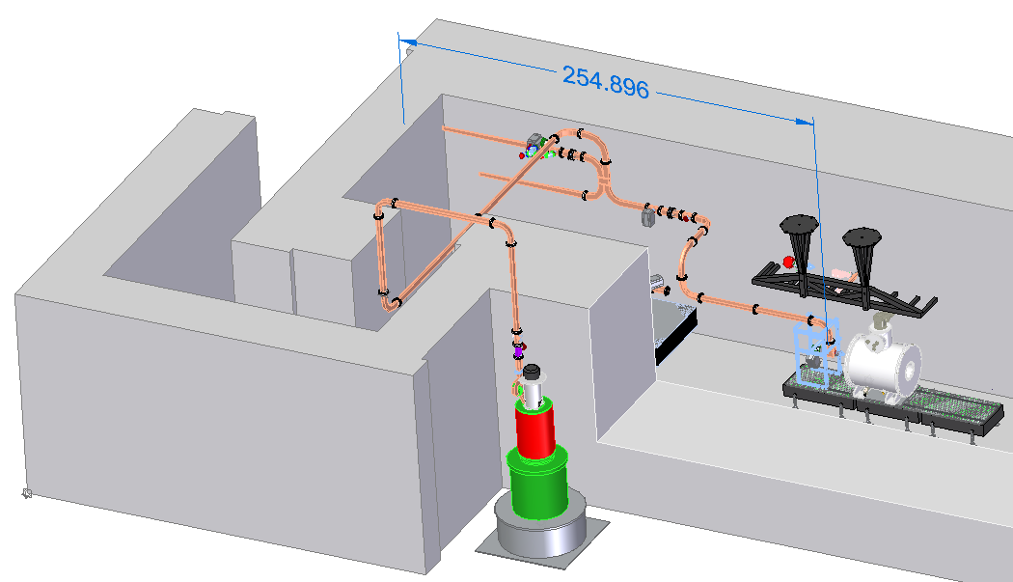
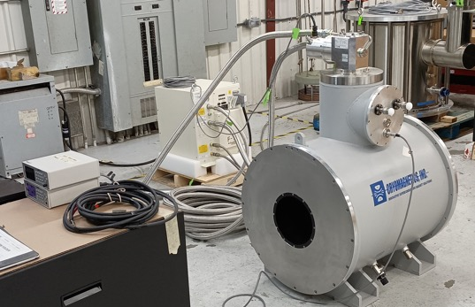
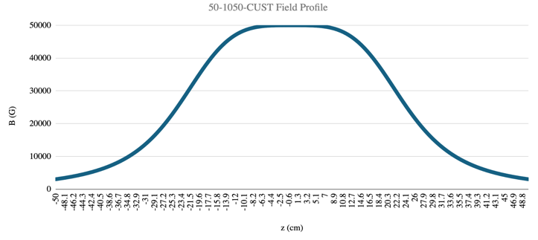
NLCTA-SLAC Test Facility
5 T Solenoid from Cryomagnetics with 9.5” diameter horizontal bore at room temperature
First measurements planned with a single-cell S-band cavity in the fringe field
Benchmark high gradient results for frequency scaling with measurements at S-band and L-band
S-Band Klystron
E. Nanni, SLAC

Slide 19
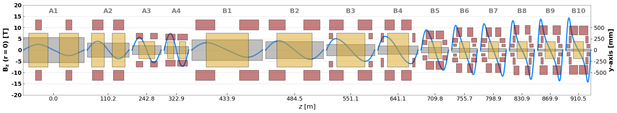
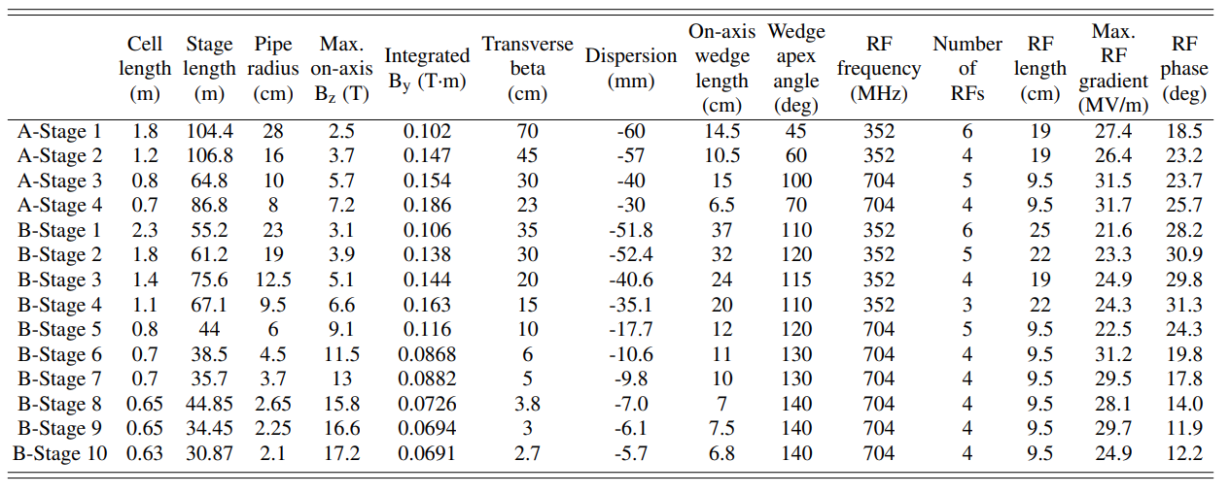
RF cavities for 6D-cooling
Cortesy Giuseppe Scarantino
Several cavity designs. Different parameters for each stage
High gradient in strong B-field. Current baseline is Be-window closing each RF cell
RF cavities are inside solenoids. Strong motivation for compact cavities
R. Zhu, https://doi.org/10.1103/PhysRevAccelBeams.28.041003

Slide 20
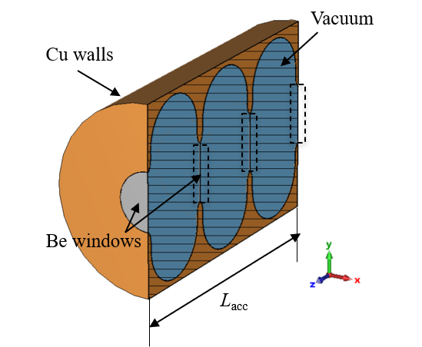
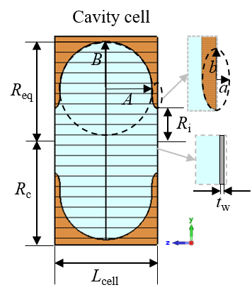
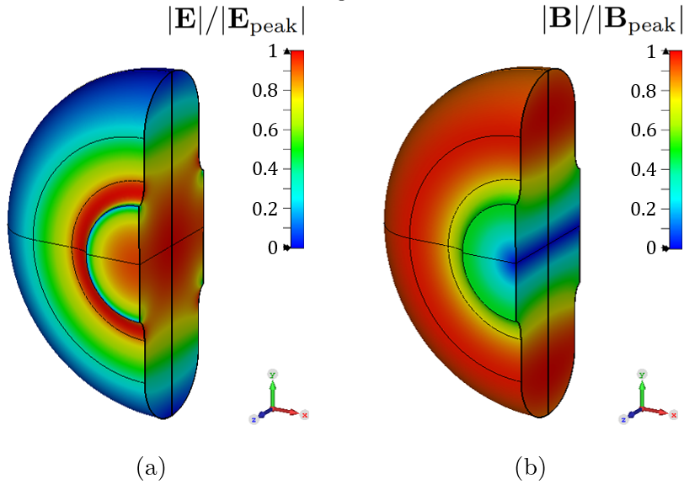







Comparison of different cavities: FM
Parameter | Unit | Cavity with windows | Cavity without windows | Dielectric cavity
f₀ | MHz | 704 | 704 | 704
L_{acc} | mm | 567.86 | 551.07 | 567.79
R_{i} | mm | 60 | 60 | 60
R_{c} | mm | 192.63 | 195.59 | 103.53
β | - | 0.8889 | 0.8889 | 0.8889
t_{w} | um | 30 | - | -
t_{d} | mm | - | - | 36.28
E_{nom} | MV/m | 22.50 | 22.50 | 22.50
Cavity radius
Parameter | Unit | Cavity with windows | Cavity without windows | Dielectric cavity
Q₀ | - | 3.84E+04 | 3.92E+04 | 6.98E+03
t_{f} | us | 19.63 | 20.02 | 3.57
DF | - | 7.41E-05 | 7.57E-05 | 1.39E-05
TTF | - | 0.65 | 0.68 | 0.60
R/Q (β) | Ω | 478.00 | 294.42 | 113.97
P_{diss} | MW | 3.76 | 6.14 | 73
P_{diss,Be/Diel} | MW | 0.08 | - | 43.87
E_{peak}/E_{acc} | - | 1.63 | 3.82 | 2.34
E_{peak,Cu} | MV/m | 23.80 | 58.34 | 7.10
E_{peak,Be/Diel} | MV/m | 20.79 | - | 31.44
Q-factor
Peak power
Parameter | Unit | Cavity with windows | Cavity without windows | Dielectric cavity
P_{g} | MW | 4.51 | 7.37 | 87.60
DFg | - | 9.88E-05 | 1.01E-04 | 1.84E-05
P_{ave,g} | W | 445.99 | 740.50 | 2297.29
P_{plug,} = P_{ave,g}/ƞ_{G}ƞ_{M} | W | 707.92 | 1175.40 | 2552.54
E-fields
Peak power
Average power
C. Barbagallo, CERN

Slide 21









Comparison of different cavities: Wakefields
5-cell cavity with Be windows
Short-range wake
Long-range wake
Be-windowed design: Exhibits the highest mode excitation. This is due to the high field confinement introduced by Be windows
Windowless design: Shows reduced wakefield excitation compared to the Be-windowed version, as the open iris allows a large fraction of long-range wakefields to escape the cavity
Dielectric cavities: Achieves the lowest overall wakefield due to the lowest R/Q
Total longitudinal wake potential (CST wakefield solver)*
Finite-beam eigenmode wake potential (CST eigenmode solver)
Transverse form factor
Normalized transverse charge density
C. Barbagallo, CERN

Slide 22




Integration study for 6D-cooling demonstrator
704 MHz 3-cell
RF cavity with Be- or Al-windows
L. Rossi, Uni. Milan & INFN

Slide 23



The ultimate cavity for 6D-cooling
70K
Sapphire(tanD=1e-8): 4 kW
Copper walls: 10 MW
HTS walls: ~1 MW
Sapphire-loaded cavity with HTS walls in common cryostat with HTS solenoid
Copper
300K
Sapphire
10GHz
300K ->70K
x100
1GHz <- 10GHz
x10
300K
Peak power loss: 73 MW
-------------------------------------
Al2O3(tanD=1e-4): 44 MW
Copper walls: 29 MW

Slide 24


RF cavities for Final Cooling
Very long bunches result in the use of very low RF frequencies
Cortesy R.Taylor
Cortesy R.Zhu

Slide 25







“Compact” cavities for final cooling at 100, 30 and 10 MHz, Rcav<1m
Parameter | Unit | 100 MHz Reentrant - Cu | 30 MHz AL₂O₃ insert - Cu Reentrant - water | 10 MHz Al₂O₃ 2.5cm ring /water loaded Reentrant | Description
R_{cav} | [mm] | 880.00 | 880.00 | 889.7 | Cavity radius
R_{cav}
Parameter | Unit | 100 MHz | 30 MHz | 10 MHz
E_{nom} | [MV/m] | 10 | 6.4 | 3.71
E_{acc} | [MV/m] | 9.7 | 6.4 | 3.71
V_{acc} | [MV] | 2.42 | 1.6 | 0.927
Parameter | Unit | 100 MHz | 30 MHz | 10 MHz
R_{cav} | [mm] | 880.00 | 880.00 | 889.7
Q₀ | [-] | 4.09e4 | 7293 | 1742
tf | [µs] | 147.12 | 87.40 | 62.64
DF | [-] | 55.30e-5 | 32.87e-5 | 23.58e-5
TTF | [-] | 0.970 | 0.999 | 0.999
R/Q | [Ω] | 111.78 | 36.47 | 13.13
P_{diss,tot} | [MW] | 1.29 | 9.6 | 37.3
P_{ave,tot} | [W] | 713 | 3146 | 8798
P_{loss%dielectric} | [-] | [-] | 68% | 87%
Very high peak power
due to loss in dielectric
Reentrant geometry
Vacuum at 100MHz
AL₂O₃ Reentrant
30MHz
AL₂O₃ ring + water loaded + reentrant at 10 MHz
Pg | MW | 1.55 | 11.52 | 44.76
DFg | - | 7.36e-4 | 4.37e-4 | 3.13e-4
Pave,g | kW | 1.14 | 5.03 | 14.0
Vacuum
Water
Water
Alumina ring holding water
Al₂O₃
Vacuum
E. Mortreuil, CERN

Slide 26
Conclusions and Outlook
The MC promises a potentially energy-efficient path toward high-luminosity collisions at a parton centre-of-momentum energy of 10 TeV
10-year resource loaded R&D plan towards CDR developed by IMCC
High gradient RF in strong magnetic field test stand are extremely important to understand the limitations and develop RF technology for muon cooling
Dielectric-loaded RF cavities for muon cooling offer several advantages: compactness, no Beryllium, high gradient potential
Low loss dielectric materials and low temperature operation are promising directions to mitigate the high peak power required by dielectric loaded cavities
R&D on high gradient RF and dielectric cavities has synergies between MC and AA communities

Slide 27
Thank you
for your attention
Funded by the European Union (EU). Views and opinions expressed are however those of the author(s) only and do not necessarily reflect those of the EU or European Research Executive Agency (REA). Neither the EU nor the REA can be held responsible for them.

