Slide 1
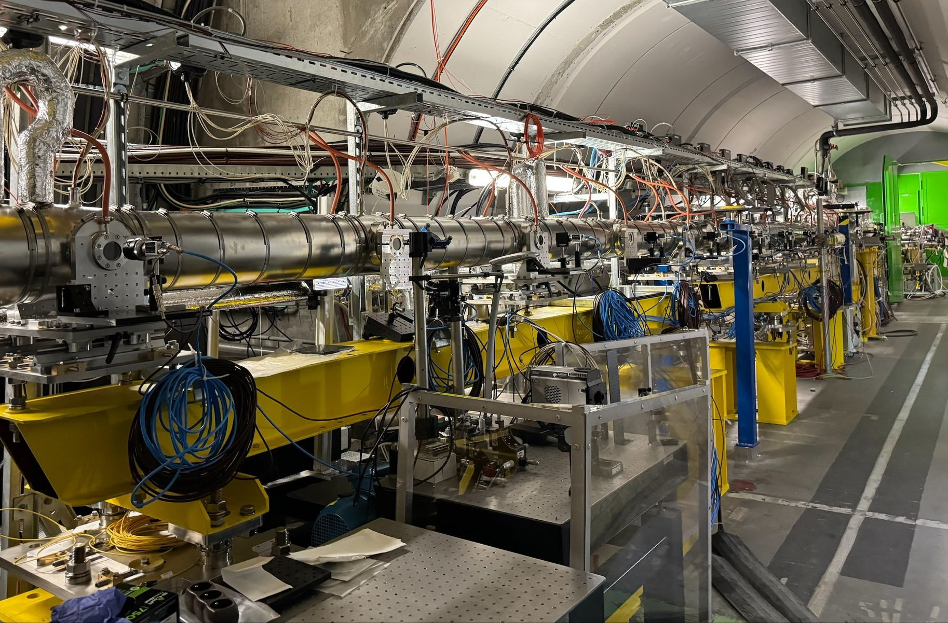
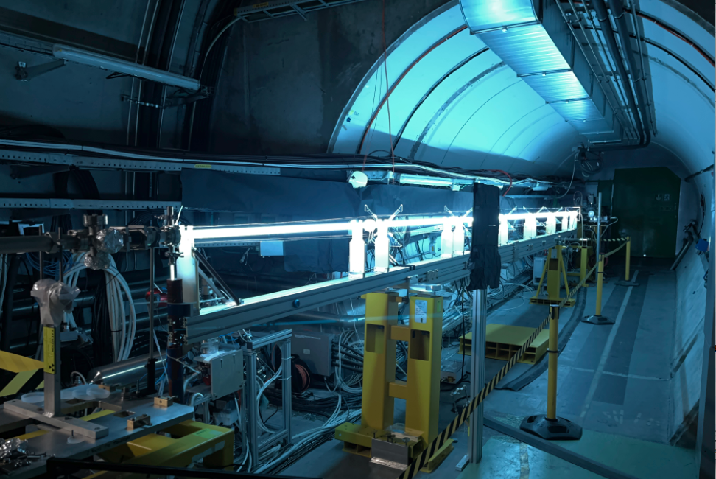
AWAKE: proton-driven plasma wakefield acceleration for particle physics applications
A. CLAIREMBAUD, Max Planck Institute for Physics
Advanced Accelerator Concepts, UCLA, 28/07/26
Arthur Clairembaud (AWAKE Collaboration)
1/26

Slide 2
Outline
Introduction to the AWAKE Experiment at CERN
Demonstration of Amplitude-Reproducible Self-Modulation by Seeding
Measurement of the Saturation Length of the Self-Modulation Instability
Moving forward…
Advanced Accelerator Concepts, UCLA, 28/07/26
Arthur Clairembaud (AWAKE Collaboration)
2/26

Slide 3
Outline
Introduction to the AWAKE Experiment at CERN
Demonstration of Amplitude-Reproducible Self-Modulation by Seeding
Measurement of the Saturation Length of the Self-Modulation Instability
Moving forward…
Advanced Accelerator Concepts, UCLA, 28/07/26
Arthur Clairembaud (AWAKE Collaboration)
2/26

Slide 4
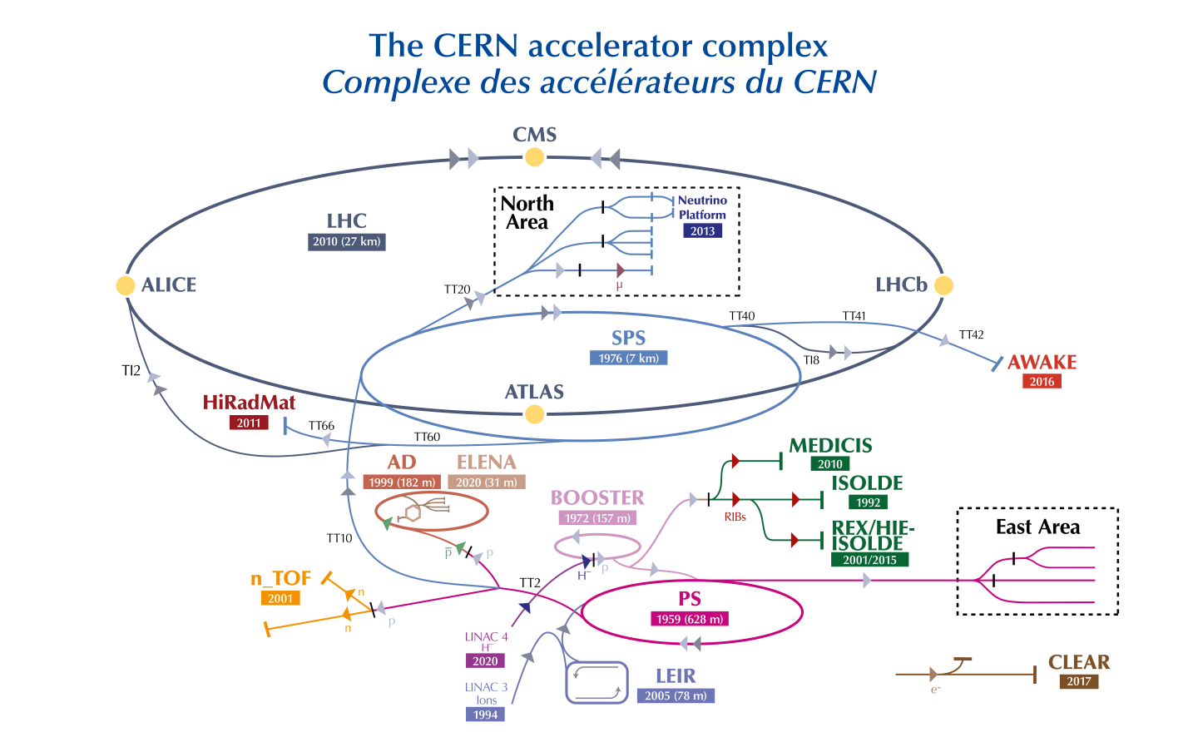
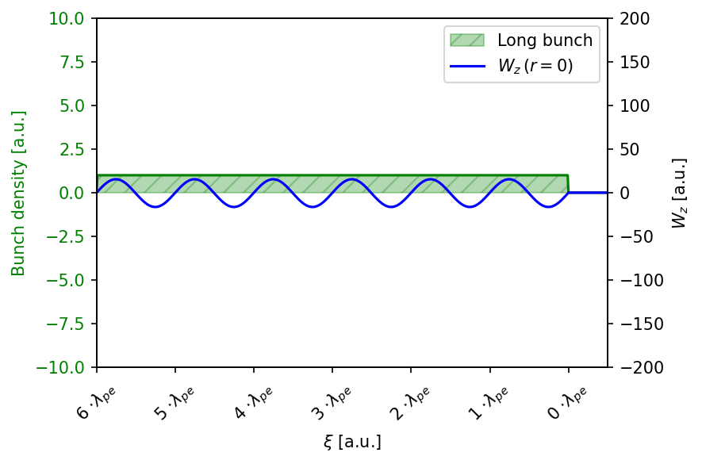
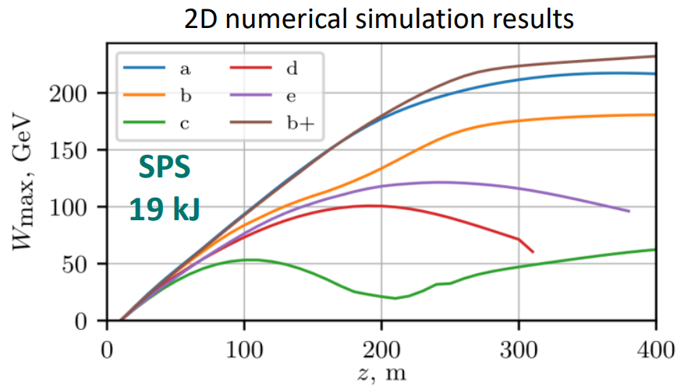
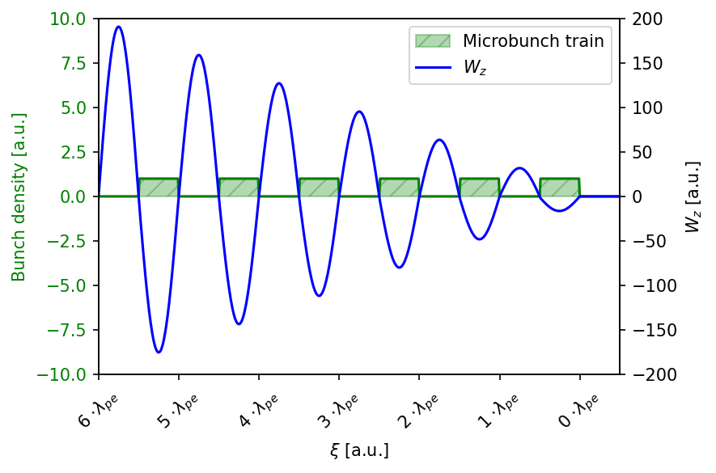


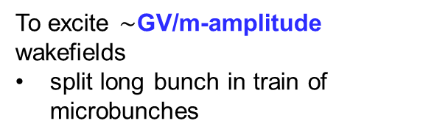
The AWAKE experiment at CERN
Proton-driven PWFA
High-energy drivers
Resonant wakefield excitation
p+ bunches from the
CERN SPS are delivered to the AWAKE facility
driver parameters:
19kJ: high energy per bunch
400GeV: high energy per particle
enables GV/m-amplitude wakefields for 10s-100s of meters in a single plasma
$n_{pe}=1−7×{10}^{14}$/cc
$τ_{pe}∼4−11$ps
long bunch $σ_{t}=170$ ps >> $τ_{pe}$
beam density $n_{b}={10}^{13}cm^{−3}$
To excite $∼$GV/m-amplitude wakefields
split long bunch in train of microbunches
$$σ_{t}≫τ_{pe}$$
K. V. Lotov & P. V. Tuev, Plasma Phys. and Control. Fusion, 63, 125027 (2021)
Small wakefields
Microbunch train
to excite wakefields in a (currently) 10m-long plasma
Large wakefields
Advanced Accelerator Concepts, UCLA, 28/07/26
Arthur Clairembaud (AWAKE Collaboration)
3/26
Notes:
Before getting started a quick reminder on what AWAKE is about.
First, AWAKE is a beam-driven plasma wakefield experiment and the drivers are proton bunches from the CERN SPS (that is the injector for the LHC). Wakefields, for now, are driven over 10m of plasma.
Proton drivers are exciting because they carry a large amount of energy per bunch and per particle, in our case ~20kJ and 400 GeV and therefore have the potential of energy gains of hundreds of GeV in a single plasma stage.
These bunches are however very long such that they can't drive high-amplitude fields as is.
To excite GV/m-like amplitude wakefields, these bunches must be first split in a train of microbunches that resonantly excite wakefields to large amplitudes.
In AWAKE, we do this splitting through the self-modulation process.
So the big challenge for AWAKE is to understand and control self-modulation, which is an instability, so it can be used as part of the accelerator. Since I will discuss about self-modulation for the rest of this talk, let me first remind you a couple of things concerning SM.

Slide 5
The AWAKE experiment at CERN
Proton-driven PWFA
High-energy drivers
Resonant wakefield excitation
p+ bunches from the
CERN SPS are delivered to the AWAKE facility
driver parameters:
19kJ: high energy per bunch
400GeV: high energy per particle
enables GV/m-amplitude wakefields for 10s-100s of meters in a single plasma
$n_{pe}=1−7×{10}^{14}$/cc
$τ_{pe}∼4−11$ps
long bunch $σ_{t}=170$ ps >> $τ_{pe}$
beam density $n_{b}={10}^{13}cm^{−3}$
To excite $∼$GV/m-amplitude wakefields
split long bunch in train of microbunches
$$σ_{t}≫τ_{pe}$$
$$σ_{t}≫τ_{pe}$$
K. V. Lotov & P. V. Tuev, Plasma Phys. and Control. Fusion, 63, 125027 (2021)
Small wakefields
Small wakefields
Microbunch train
to excite wakefields in a (currently) 10m-long plasma
Large wakefields
Advanced Accelerator Concepts, UCLA, 28/07/26
Arthur Clairembaud (AWAKE Collaboration)
3/26

Slide 6
The AWAKE experiment at CERN
Proton-driven PWFA
High-energy drivers
Resonant wakefield excitation
p+ bunches from the
CERN SPS are delivered to the AWAKE facility
driver parameters:
19kJ: high energy per bunch
400GeV: high energy per particle
enables GV/m-amplitude wakefields for 10s-100s of meters in a single plasma
$n_{pe}=1−7×{10}^{14}$/cc
$τ_{pe}∼4−11$ps
long bunch $σ_{t}=170$ ps >> $τ_{pe}$
beam density $n_{b}={10}^{13}cm^{−3}$
To excite $∼$GV/m-amplitude wakefields
split long bunch in train of microbunches
$$σ_{t}≫τ_{pe}$$
K. V. Lotov & P. V. Tuev, Plasma Phys. and Control. Fusion, 63, 125027 (2021)
Small wakefields
Microbunch train
to excite wakefields in a (currently) 10m-long plasma
Large wakefields
Advanced Accelerator Concepts, UCLA, 28/07/26
Arthur Clairembaud (AWAKE Collaboration)
3/26

Slide 7
The AWAKE experiment at CERN
Proton-driven PWFA
High-energy drivers
Resonant wakefield excitation
p+ bunches from the
CERN SPS are delivered to the AWAKE facility
driver parameters:
19kJ: high energy per bunch
400GeV: high energy per particle
enables GV/m-amplitude wakefields for 10s-100s of meters in a single plasma
$n_{pe}=1−7×{10}^{14}$/cc
$τ_{pe}∼4−11$ps
long bunch $σ_{t}=170$ ps >> $τ_{pe}$
beam density $n_{b}={10}^{13}cm^{−3}$
To excite $∼$GV/m-amplitude wakefields
split long bunch in train of microbunches
$$σ_{t}≫τ_{pe}$$
K. V. Lotov & P. V. Tuev, Plasma Phys. and Control. Fusion, 63, 125027 (2021)
Small wakefields
Microbunch train
to excite wakefields in a (currently) 10m-long plasma
Large wakefields
Advanced Accelerator Concepts, UCLA, 28/07/26
Arthur Clairembaud (AWAKE Collaboration)
3/26

Slide 8
The AWAKE experiment at CERN
Proton-driven PWFA
High-energy drivers
Resonant wakefield excitation
p+ bunches from the
CERN SPS are delivered to the AWAKE facility
driver parameters:
19kJ: high energy per bunch
400GeV: high energy per particle
enables GV/m-amplitude wakefields for 10s-100s of meters in a single plasma
$n_{pe}=1−7×{10}^{14}$/cc
$τ_{pe}∼4−11$ps
long bunch $σ_{t}=170$ ps >> $τ_{pe}$
beam density $n_{b}={10}^{13}cm^{−3}$
To excite $∼$GV/m-amplitude wakefields
split long bunch in train of microbunches
$$σ_{t}≫τ_{pe}$$
K. V. Lotov & P. V. Tuev, Plasma Phys. and Control. Fusion, 63, 125027 (2021)
Small wakefields
Self-modulation
Kumar, N. and al., PRL, 2010
Microbunch train
to excite wakefields in a (currently) 10m-long plasma
Large wakefields
Advanced Accelerator Concepts, UCLA, 28/07/26
Arthur Clairembaud (AWAKE Collaboration)
3/26

Slide 9
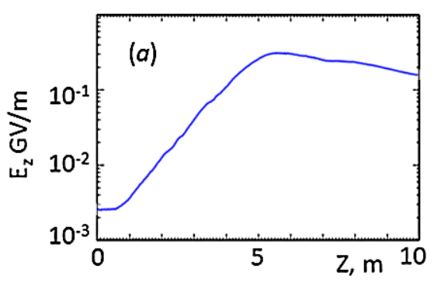
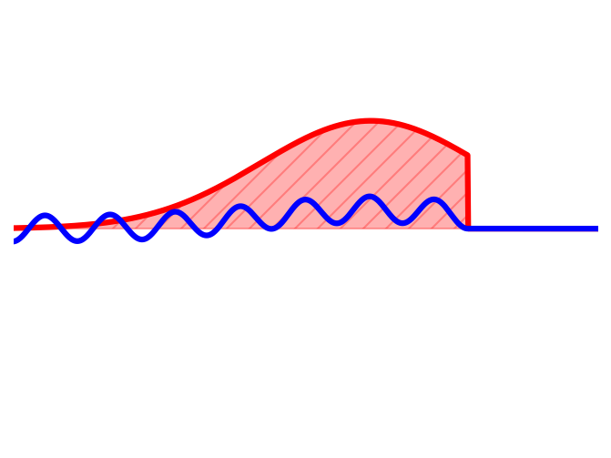
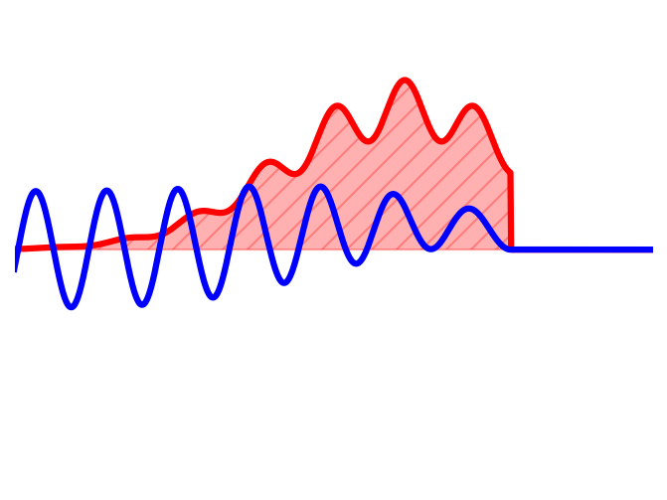
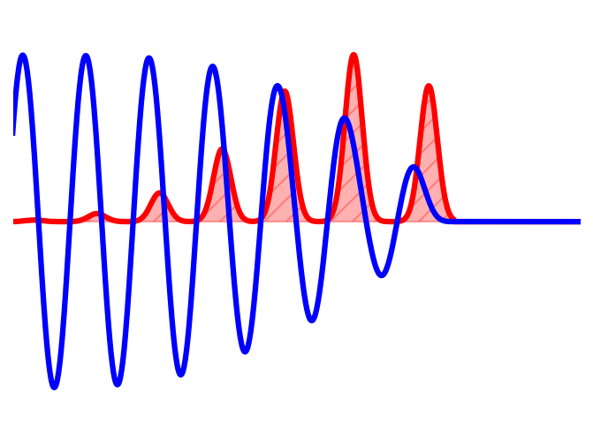
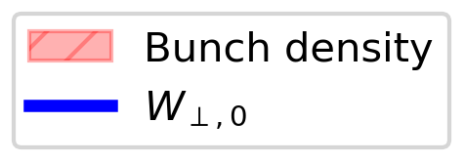


Self-modulation instability
bunch duration : $σ_{t}≫τ_{pe}$ : plasma period
$$170ps≫4−11ps$$
Bunch density modulation
Periodically focusing/ defocusing
Wakefield amplitude increase
Bunch fully modulated,
SM saturates
Initial wakefields
Pukhov, PRL 107 145003 (2011)
Advanced Accelerator Concepts, UCLA, 28/07/26
Arthur Clairembaud (AWAKE Collaboration)
4/26

Slide 10
Self-modulation instability
bunch duration : $σ_{t}≫τ_{pe}$ : plasma period
$$170ps≫4−11ps$$
Bunch density modulation
Periodically focusing/ defocusing
Wakefield amplitude increase
Bunch fully modulated,
SM saturates
Initial wakefields
Seed
Pukhov, PRL 107 145003 (2011)
Advanced Accelerator Concepts, UCLA, 28/07/26
Arthur Clairembaud (AWAKE Collaboration)
4/26
Notes:
Capital always

Slide 11
Self-modulation instability
bunch duration : $σ_{t}≫τ_{pe}$ : plasma period
$$170ps≫4−11ps$$
Bunch density modulation
Periodically focusing/ defocusing
Wakefield amplitude increase
Growth
Bunch fully modulated,
SM saturates
Initial wakefields
$$∝e^{Γz}$$
Seed
Pukhov, PRL 107 145003 (2011)
$$e^{Γz}$$
Advanced Accelerator Concepts, UCLA, 28/07/26
Arthur Clairembaud (AWAKE Collaboration)
4/26

Slide 12
Self-modulation instability
bunch duration : $σ_{t}≫τ_{pe}$ : plasma period
Saturation
$$170ps≫4−11ps$$
Bunch density modulation
Periodically focusing/ defocusing
Wakefield amplitude increase
Growth
Bunch fully modulated,
SM saturates
Initial wakefields
$$∝e^{Γz}$$
Seed
Pukhov, PRL 107 145003 (2011)
$$e^{Γz}$$
Advanced Accelerator Concepts, UCLA, 28/07/26
Arthur Clairembaud (AWAKE Collaboration)
4/26
Notes:
At some point, the bunch is fully modulated: there are no more particles to defocus in between microbunches.
The modulated bunch now drive large-amplitude wakefields suitable for high-gradient acceleration.

Slide 13
Self-modulation instability
bunch duration : $σ_{t}≫τ_{pe}$ : plasma period
Saturation
$$170ps≫4−11ps$$
Bunch density modulation
Periodically focusing/ defocusing
Wakefield amplitude increase
Growth
Bunch fully modulated,
SM saturates
Initial wakefields
$$∝e^{Γz}$$
Seed
Pukhov, PRL 107 145003 (2011)
$$e^{Γz}$$
Acceleration must occur after saturation of SM
Large wakefields after saturation
Event-to-event variations are typically smaller after saturation than during exponential growth
Advanced Accelerator Concepts, UCLA, 28/07/26
Arthur Clairembaud (AWAKE Collaboration)
4/26
Notes:
At some point, the bunch is fully modulated: there are no more particles to defocus in between microbunches.
The modulated bunch now drive large-amplitude wakefields suitable for high-gradient acceleration.

Slide 14
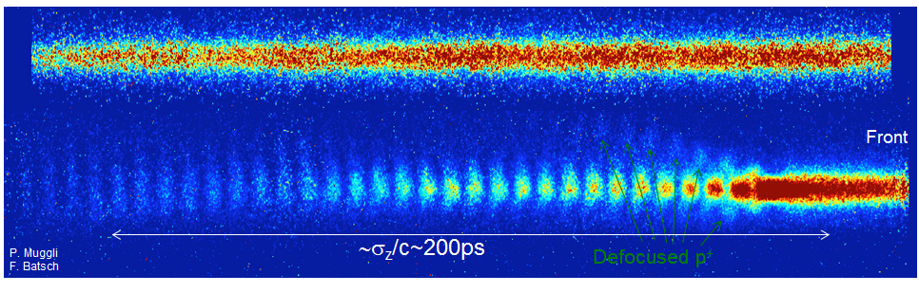
Self-modulation in AWAKE
plasma off:
plasma on:
Advanced Accelerator Concepts, UCLA, 28/07/26
Arthur Clairembaud (AWAKE Collaboration)
5/26
Notes:
Proton bunch self modulation was demonstrated at AWAKE.
On this plot you can see two time-resolved images of the proton bunch when the plasma is off, or after propagation in 10m of plasma.
On the "plasma on" measurement we can clearly see the formed bunch train, separated by the defocused protons.
These defocused protons can also be observed in the time-integrated transverse bunch profile (shown here in logarithmic scale), where we can observe a halo of defocused protons surrounding the bunch train, and that are located in between microbunches in the time-resolved images.
These profiles show that the modulation of the bunch occurs at the plasma frequency, and that each microbunch resonantly excites wakefields.
This resonant excitation can be seen on the defocused protons, here, where they transverse reach increases along the bunch. This shows that the transverse defocusing fields increase along the bunch.

Slide 15
Self-modulation in AWAKE
plasma off:
plasma on:
plasma
vapor
Bunch is self-modulated after 10m of plasma
Train of microbunches separated by defocused protons
Advanced Accelerator Concepts, UCLA, 28/07/26
Arthur Clairembaud (AWAKE Collaboration)
5/26
Notes:
Add rif

Slide 16
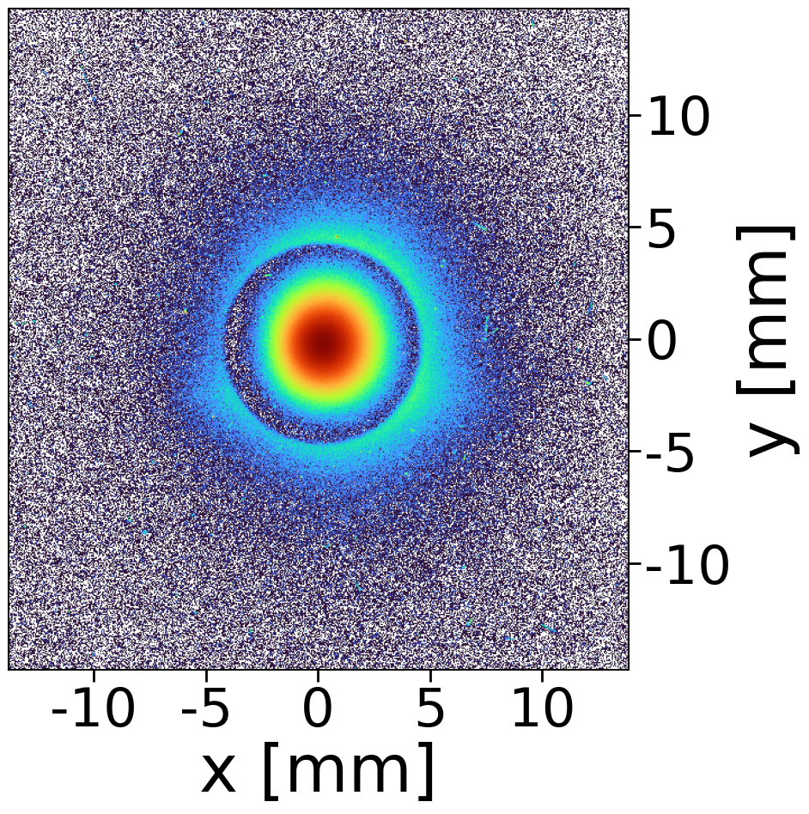
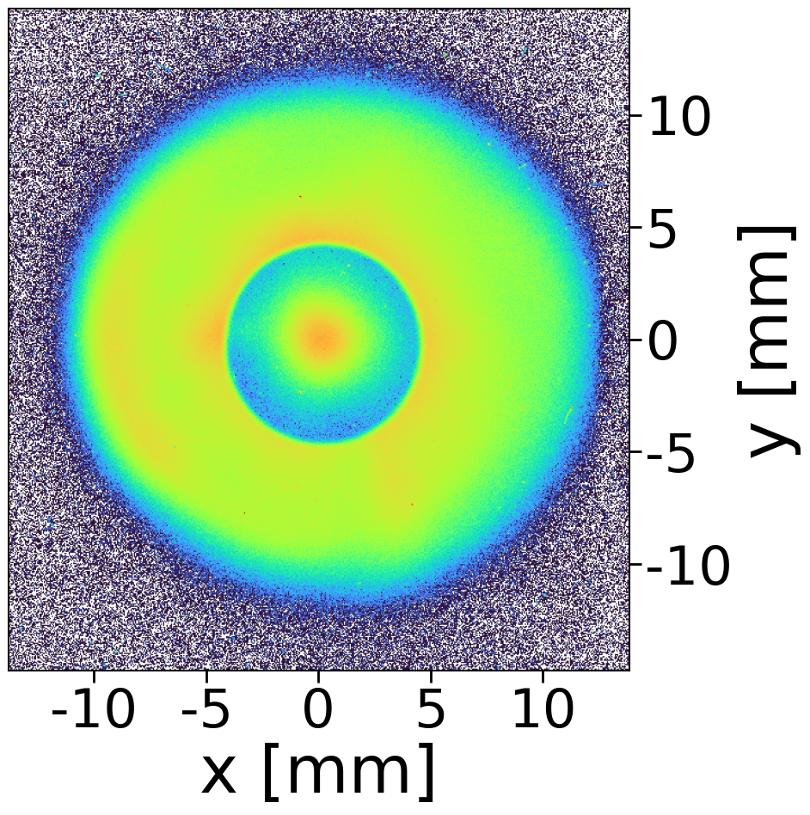
Self-modulation in AWAKE
plasma off:
attenuating mask
plasma on:
halo
plasma
vapor
core
Bunch is self-modulated after 10m of plasma
Train of microbunches separated by defocused protons
Advanced Accelerator Concepts, UCLA, 28/07/26
Arthur Clairembaud (AWAKE Collaboration)
5/26
Notes:
Proton bunch self modulation was demonstrated at AWAKE.
On this plot you can see two time-resolved images of the proton bunch when the plasma is off, or after propagation in 10m of plasma.
On the "plasma on" measurement we can clearly see the formed bunch train, separated by the defocused protons.
These defocused protons can also be observed in the time-integrated transverse bunch profile (shown here in logarithmic scale), where we can observe a halo of defocused protons surrounding the bunch train, and that are located in between microbunches in the time-resolved images.
These profiles show that the modulation of the bunch occurs at the plasma frequency, and that each microbunch resonantly excites wakefields.
This resonant excitation can be seen on the defocused protons, here, where they transverse reach increases along the bunch. This shows that the transverse defocusing fields increase along the bunch.

Slide 17
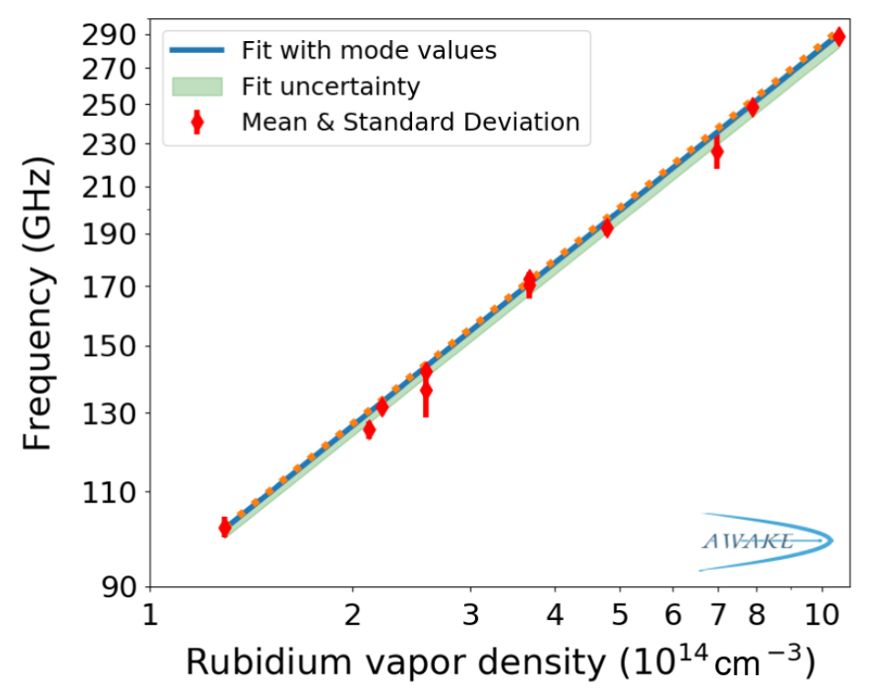


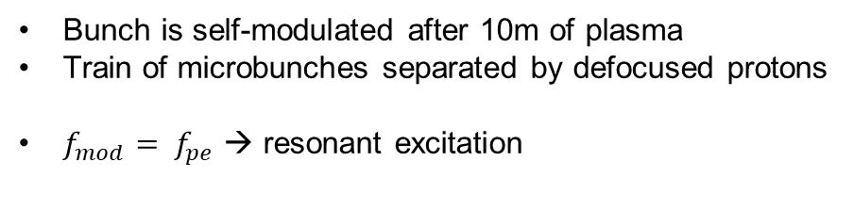
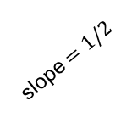
Self-modulation in AWAKE
plasma off:
attenuating mask
$$τ_{pe}$$
plasma on:
halo
plasma
vapor
core
Bunch is self-modulated after 10m of plasma
Train of microbunches separated by defocused protons
$f_{mod}= f_{pe}$ → resonant excitation
$$f_{mod}=f_{pe}∝n_{pe}^{1/2}$$
slope $=1/2$
AWAKE, PRL 122, 054802 (2019)
Advanced Accelerator Concepts, UCLA, 28/07/26
Arthur Clairembaud (AWAKE Collaboration)
5/26
Notes:
Proton bunch self modulation was demonstrated at AWAKE.
On this plot you can see two time-resolved images of the proton bunch when the plasma is off, or after propagation in 10m of plasma.
On the "plasma on" measurement we can clearly see the formed bunch train, separated by the defocused protons.
These defocused protons can also be observed in the time-integrated transverse bunch profile (shown here in logarithmic scale), where we can observe a halo of defocused protons surrounding the bunch train, and that are located in between microbunches in the time-resolved images.
These profiles show that the modulation of the bunch occurs at the plasma frequency, and that each microbunch resonantly excites wakefields.
This resonant excitation can be seen on the defocused protons, here, where they transverse reach increases along the bunch. This shows that the transverse defocusing fields increase along the bunch.

Slide 18
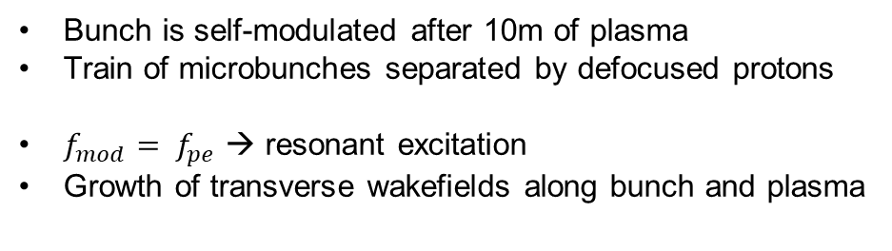
Self-modulation in AWAKE
plasma off:
attenuating mask
M. Turner, (AWAKE coll.), PRL 122, 054801 (2019)
$$τ_{pe}$$
growth
plasma on:
halo
plasma
vapor
core
Bunch is self-modulated after 10m of plasma
Train of microbunches separated by defocused protons
$f_{mod}= f_{pe}$ → resonant excitation
Growth of transverse wakefields along bunch and plasma
$$f_{mod}=f_{pe}∝n_{pe}^{1/2}$$
slope $=1/2$
AWAKE, PRL 122, 054802 (2019)
Advanced Accelerator Concepts, UCLA, 28/07/26
Arthur Clairembaud (AWAKE Collaboration)
5/26
Notes:
Growth of SM by marlene
Jan name also

Slide 19
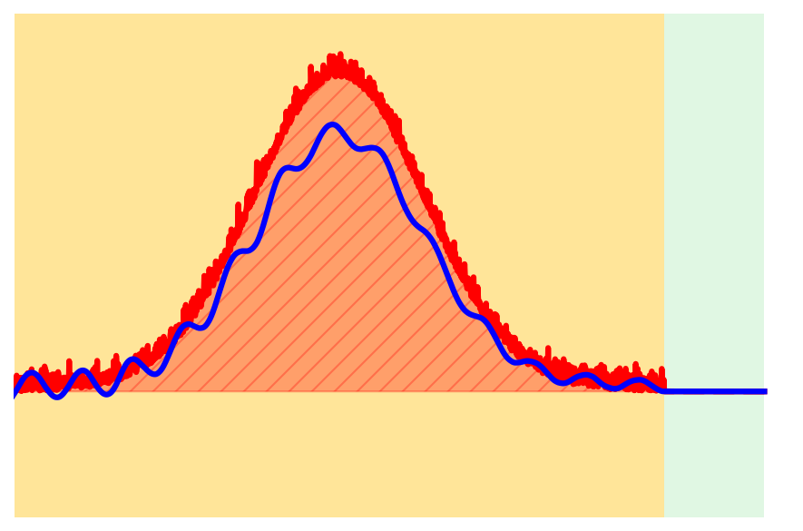
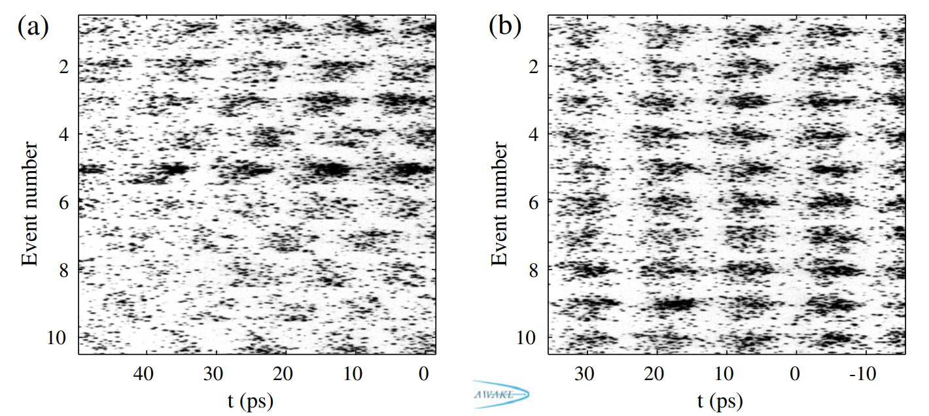

Seeding of SM
plasma off:
SM is an instability – process must be reproducible for accelerator
plasma on:
plasma
vapor
Unseeded
$$Δφ/2π∼29\%$$
F. Batsch (AWAKE coll.), PRL 126 (2021)
Advanced Accelerator Concepts, UCLA, 28/07/26
Arthur Clairembaud (AWAKE Collaboration)
6/26
Notes:
Proton bunch self modulation was demonstrated at AWAKE.
On this plot you can see two time-resolved images of the proton bunch when the plasma is off, or after propagation in 10m of plasma.
On the "plasma on" measurement we can clearly see the formed bunch train, separated by the defocused protons.
These defocused protons can also be observed in the time-integrated transverse bunch profile (shown here in logarithmic scale), where we can observe a halo of defocused protons surrounding the bunch train, and that are located in between microbunches in the time-resolved images.
These profiles show that the modulation of the bunch occurs at the plasma frequency, and that each microbunch resonantly excites wakefields.
This resonant excitation can be seen on the defocused protons, here, where they transverse reach increases along the bunch. This shows that the transverse defocusing fields increase along the bunch.

Slide 20
Seeding of SM
plasma off:
SM is an instability – process must be reproducible for accelerator
plasma on:
plasma
vapor
Unseeded
$$Δφ/2π∼29\%$$
e-
F. Batsch (AWAKE coll.), PRL 126 (2021)
Advanced Accelerator Concepts, UCLA, 28/07/26
Arthur Clairembaud (AWAKE Collaboration)
6/26
Notes:
Proton bunch self modulation was demonstrated at AWAKE.
On this plot you can see two time-resolved images of the proton bunch when the plasma is off, or after propagation in 10m of plasma.
On the "plasma on" measurement we can clearly see the formed bunch train, separated by the defocused protons.
These defocused protons can also be observed in the time-integrated transverse bunch profile (shown here in logarithmic scale), where we can observe a halo of defocused protons surrounding the bunch train, and that are located in between microbunches in the time-resolved images.
These profiles show that the modulation of the bunch occurs at the plasma frequency, and that each microbunch resonantly excites wakefields.
This resonant excitation can be seen on the defocused protons, here, where they transverse reach increases along the bunch. This shows that the transverse defocusing fields increase along the bunch.

Slide 21
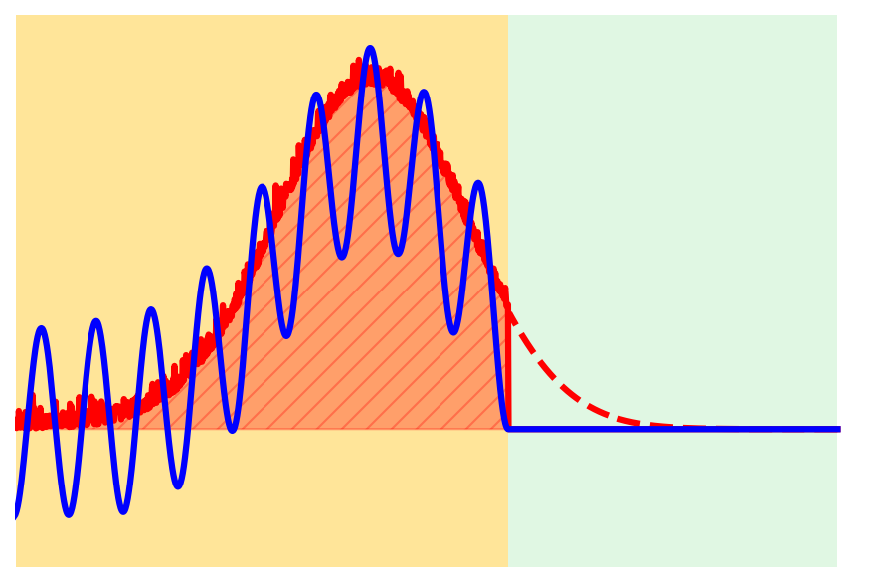


Seeding of SM
plasma off:
SM is an instability – process must be reproducible for accelerator
SM can be seeded
Generating plasma along bunch creates beam-plasma density onset
plasma on:
$$t_{RIF}$$
plasma
vapor
Results in initial wakefields
Relativistic Ionization Front (RIF)
Unseeded
$$W_{⊥,0}∝n_{b}\left(t=t_{RIF}\right)$$
$$Δφ/2π∼29\%$$
plasma
vapor
e-
F. Batsch (AWAKE coll.), PRL 126 (2021)
Advanced Accelerator Concepts, UCLA, 28/07/26
Arthur Clairembaud (AWAKE Collaboration)
6/26
Notes:
Proton bunch self modulation was demonstrated at AWAKE.
On this plot you can see two time-resolved images of the proton bunch when the plasma is off, or after propagation in 10m of plasma.
On the "plasma on" measurement we can clearly see the formed bunch train, separated by the defocused protons.
These defocused protons can also be observed in the time-integrated transverse bunch profile (shown here in logarithmic scale), where we can observe a halo of defocused protons surrounding the bunch train, and that are located in between microbunches in the time-resolved images.
These profiles show that the modulation of the bunch occurs at the plasma frequency, and that each microbunch resonantly excites wakefields.
This resonant excitation can be seen on the defocused protons, here, where they transverse reach increases along the bunch. This shows that the transverse defocusing fields increase along the bunch.

Slide 22

Seeding of SM
plasma off:
SM is an instability – process must be reproducible for accelerator
SM can be seeded
Generating plasma along bunch creates beam-plasma density onset
plasma on:
$$t_{RIF}$$
plasma
vapor
Results in initial wakefields
Relativistic Ionization Front (RIF)
Unseeded
Seeded
$$W_{⊥,0}∝n_{b}\left(t=t_{RIF}\right)$$
$$Δφ/2π∼29\%$$
$$Δφ/2π∼6\%$$
plasma
vapor
Wakefield phase reproducible from event to event
plasma
vapor
e-
F. Batsch (AWAKE coll.), PRL 126 (2021)
Advanced Accelerator Concepts, UCLA, 28/07/26
Arthur Clairembaud (AWAKE Collaboration)
6/26
Notes:
Make this slide from left to right

Slide 23
Seeding of SM
plasma off:
SM is an instability – process must be reproducible for accelerator
SM can be seeded
Generating plasma along bunch creates beam-plasma density onset
plasma on:
$$t_{RIF}$$
plasma
vapor
Results in initial wakefields
Relativistic Ionization Front (RIF)
Unseeded
Seeded
$$W_{⊥,0}∝n_{b}\left(t=t_{RIF}\right)$$
$$Δφ/2π∼29\%$$
$$Δφ/2π∼6\%$$
plasma
vapor
Deterministic, external injection of witness bunch can occur
Wakefield phase reproducible from event to event
plasma
vapor
e-
e-
F. Batsch (AWAKE coll.), PRL 126 (2021)
Advanced Accelerator Concepts, UCLA, 28/07/26
Arthur Clairembaud (AWAKE Collaboration)
6/26
Notes:
Proton bunch self modulation was demonstrated at AWAKE.
On this plot you can see two time-resolved images of the proton bunch when the plasma is off, or after propagation in 10m of plasma.
On the "plasma on" measurement we can clearly see the formed bunch train, separated by the defocused protons.
These defocused protons can also be observed in the time-integrated transverse bunch profile (shown here in logarithmic scale), where we can observe a halo of defocused protons surrounding the bunch train, and that are located in between microbunches in the time-resolved images.
These profiles show that the modulation of the bunch occurs at the plasma frequency, and that each microbunch resonantly excites wakefields.
This resonant excitation can be seen on the defocused protons, here, where they transverse reach increases along the bunch. This shows that the transverse defocusing fields increase along the bunch.

Slide 24
Seeding of SM
plasma off:
SM is an instability – process must be reproducible for accelerator
SM can be seeded
Generating plasma along bunch creates beam-plasma density onset
plasma on:
$$t_{RIF}$$
plasma
vapor
Results in initial wakefields
Relativistic Ionization Front (RIF)
Unseeded
Seeded
$$W_{⊥,0}∝n_{b}\left(t=t_{RIF}\right)$$
$$Δφ/2π∼29\%$$
$$Δφ/2π∼6\%$$
plasma
vapor
Wakefield phase reproducible from event to event
Deterministic, external injection of witness bunch can occur
Reproducible amplitude of the wakefields ?
plasma
vapor
e-
e-
F. Batsch (AWAKE coll.), PRL 126 (2021)
Advanced Accelerator Concepts, UCLA, 28/07/26
Arthur Clairembaud (AWAKE Collaboration)
6/26
Notes:
Proton bunch self modulation was demonstrated at AWAKE.
On this plot you can see two time-resolved images of the proton bunch when the plasma is off, or after propagation in 10m of plasma.
On the "plasma on" measurement we can clearly see the formed bunch train, separated by the defocused protons.
These defocused protons can also be observed in the time-integrated transverse bunch profile (shown here in logarithmic scale), where we can observe a halo of defocused protons surrounding the bunch train, and that are located in between microbunches in the time-resolved images.
These profiles show that the modulation of the bunch occurs at the plasma frequency, and that each microbunch resonantly excites wakefields.
This resonant excitation can be seen on the defocused protons, here, where they transverse reach increases along the bunch. This shows that the transverse defocusing fields increase along the bunch.

Slide 25
Outline
Introduction to the AWAKE Experiment at CERN
Demonstration of Amplitude-Reproducible Self-Modulation by Seeding
Measurement of the Saturation Length of the Self-Modulation Instability
Moving forward…
Advanced Accelerator Concepts, UCLA, 28/07/26
Arthur Clairembaud (AWAKE Collaboration)
7/26

Slide 26
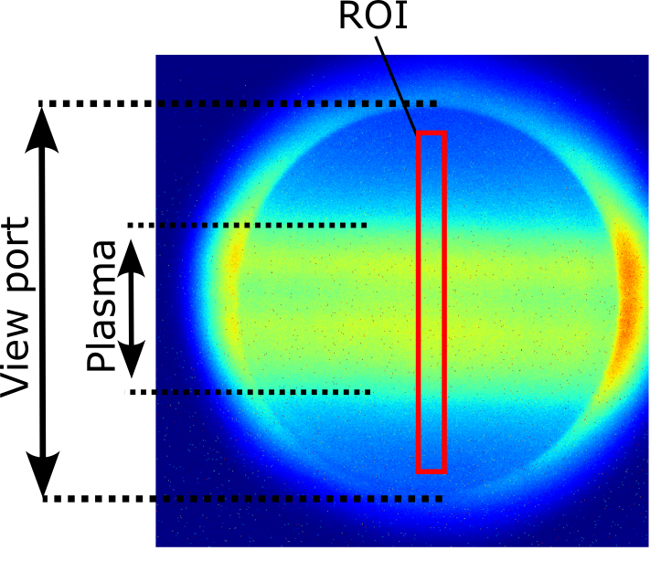
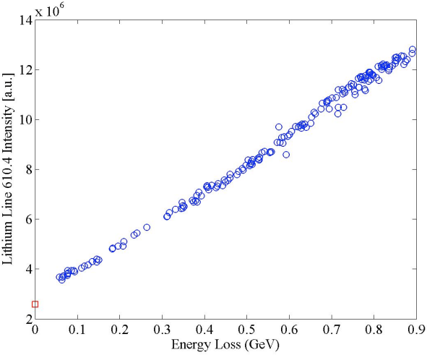
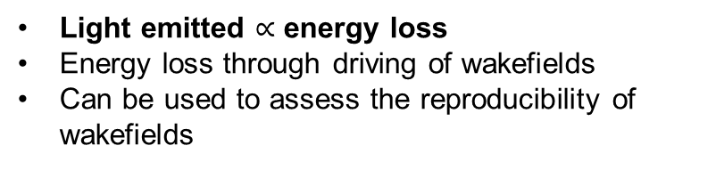
Amplitude reproducibility
J.Mezger and al, NIMA 2025
SLAC 2004
Camera
10.3 m
Mask
Screen
10 m
E. Oz et al.
Wakefield amplitudes are difficult to measure directly
Light emitted $∝$ energy loss
Energy loss through driving of wakefields
Can be used to assess the reproducibility of wakefields
Pukhov, PRL 107 145003 (2011)
Advanced Accelerator Concepts, UCLA, 28/07/26
Arthur Clairembaud (AWAKE Collaboration)
8/26
Notes:
Measuring the wf is difficult but what was shown at SLAC
Based on that
we installed 10 cameras

Slide 27
Amplitude reproducibility
J.Mezger and al, NIMA 2025
SLAC 2004
Camera
10.3 m
Mask
Screen
10 m
E. Oz et al.
Wakefield amplitudes are difficult to measure directly
Light diagnostic:
  10 cameras recording the light emitted by the plasma
  → energy deposited by the bunch
Light emitted $∝$ energy loss
Energy loss through driving of wakefields
Can be used to assess the reproducibility of wakefields
Advanced Accelerator Concepts, UCLA, 28/07/26
Arthur Clairembaud (AWAKE Collaboration)
8/26
Notes:
Measuring the wf is difficult but what was shown at SLAC
Based on that
we installed 10 cameras

Slide 28

Amplitude reproducibility
SLAC 2004
$$L_{sat}$$
Pukhov, PRL 107 145003 (2011)
E. Oz et al.
Expect to observe growth, saturation and decay of the signal along z
Light emitted $∝$ energy loss
Energy loss through driving of wakefields
Can be used to assess the reproducibility of wakefields
Advanced Accelerator Concepts, UCLA, 28/07/26
Arthur Clairembaud (AWAKE Collaboration)
8/26
Notes:
Measuring the wf is difficult but what was shown at SLAC
Based on that
we installed 10 cameras

Slide 29
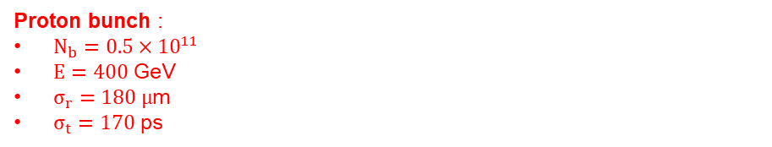
Light emission
Proton bunch :
$N_{b}=0.5×{10}^{11}$
$E=400$ GeV
$σ_{r}=180 μ$m
$σ_{t}=170$ ps
SM is not seeded
when it grows from noise
when timing of microbunches vary randomly from event to event
Pukhov, PRL 107 145003 (2011)
Advanced Accelerator Concepts, UCLA, 28/07/26
Arthur Clairembaud (AWAKE Collaboration)
9/26

Slide 30
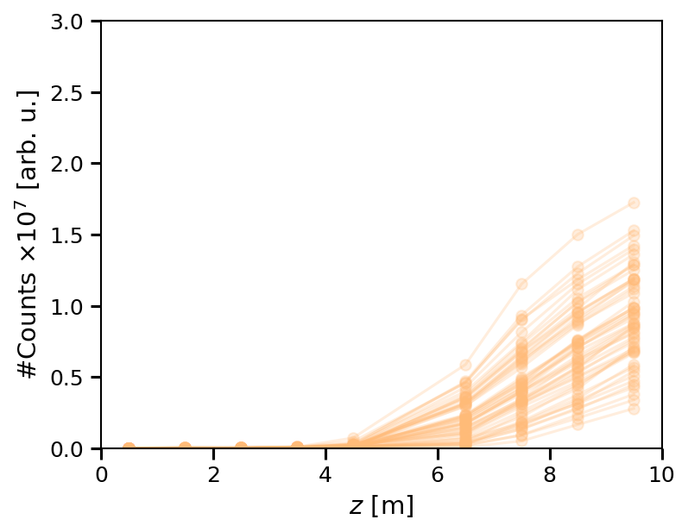
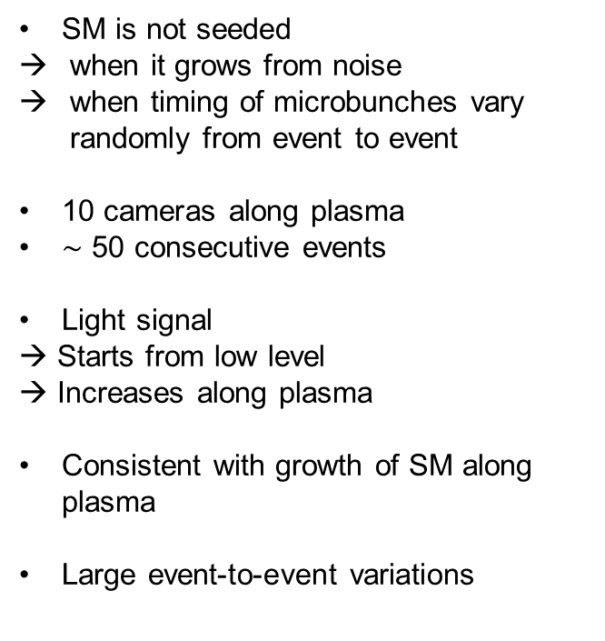
Light emission
Proton bunch :
$N_{b}=0.5×{10}^{11}$
$E=400$ GeV
$σ_{r}=180 μ$m
$σ_{t}=170$ ps
SM is not seeded
when it grows from noise
when timing of microbunches vary randomly from event to event
10 cameras along plasma
$∼$ 50 consecutive events
Light signal
→ Starts from low level
→ Increases along plasma
Consistent with growth of SM along plasma
Large event-to-event variations
preliminary
Pukhov, PRL 107 145003 (2011)
Advanced Accelerator Concepts, UCLA, 28/07/26
Arthur Clairembaud (AWAKE Collaboration)
9/26
Notes:
Add pukhov plot and say we observe this part

Slide 31

Light emission
preliminary
Unseeded
$t_{RIF}=650$ ps
Random phase (SM is unseeded)
SM grows from noise or features in the bunch
→ Initial conditions vary from event to event
Proton bunch :
$N_{b}=0.5×{10}^{11}$
$E=400$ GeV
$σ_{r}=180 μ$m
$σ_{t}=170$ ps
Advanced Accelerator Concepts, UCLA, 28/07/26
Arthur Clairembaud (AWAKE Collaboration)
10/26

Slide 32

Light emission
preliminary
$$W_{⊥,0}∝n_{b}(t=t_{RIF})$$
Unseeded
$t_{RIF}=650$ ps
Random phase (SM is unseeded)
SM grows from noise or features in the bunch
→ Initial conditions vary from event to event
Proton bunch :
$N_{b}=0.5×{10}^{11}$
$E=400$ GeV
$σ_{r}=180 μ$m
$σ_{t}=170$ ps
Advanced Accelerator Concepts, UCLA, 28/07/26
Arthur Clairembaud (AWAKE Collaboration)
10/26

Slide 33
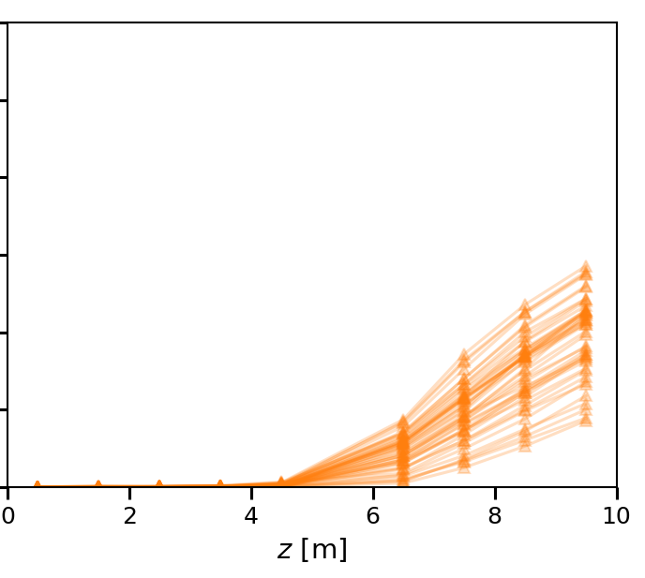
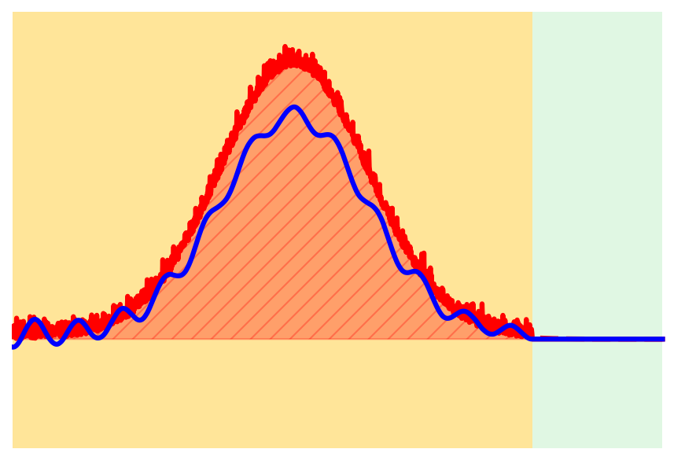

Light emission
preliminary
$$W_{⊥,0}∝n_{b}(t=t_{RIF})$$
Unseeded
$t_{RIF}=650$ ps
$t_{RIF}=550$ ps
Random phase (SM is unseeded)
SM grows from noise or features in the bunch
→ Initial conditions vary from event to event
Proton bunch :
$N_{b}=0.5×{10}^{11}$
$E=400$ GeV
$σ_{r}=180 μ$m
$σ_{t}=170$ ps
Advanced Accelerator Concepts, UCLA, 28/07/26
Arthur Clairembaud (AWAKE Collaboration)
10/26

Slide 34
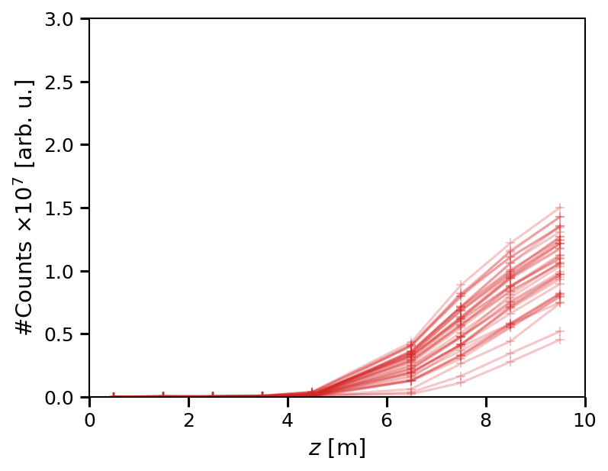
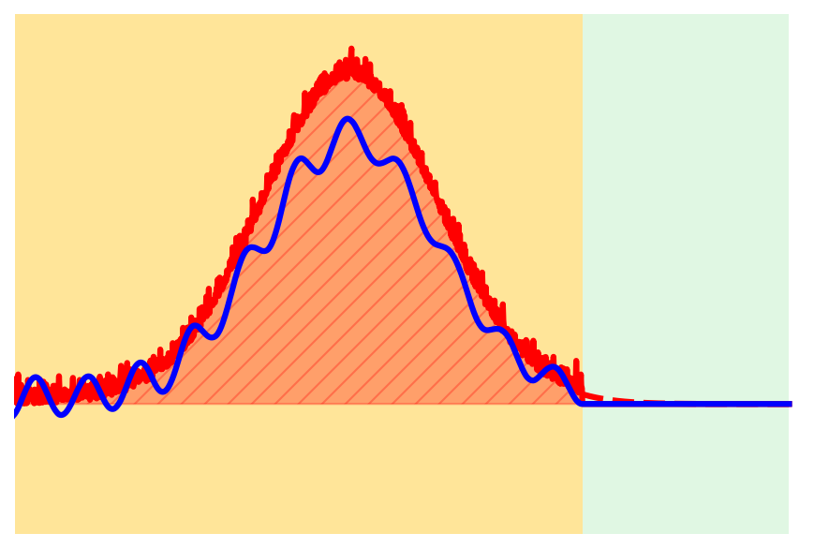

Light emission
preliminary
$$W_{⊥,0}∝n_{b}(t=t_{RIF})$$
Unseeded
$t_{RIF}=650$ ps
$t_{RIF}=550$ ps
$t_{RIF}=450$ ps
Random phase (SM is unseeded)
SM grows from noise or features in the bunch
→ Initial conditions vary from event to event
Proton bunch :
$N_{b}=0.5×{10}^{11}$
$E=400$ GeV
$σ_{r}=180 μ$m
$σ_{t}=170$ ps
Advanced Accelerator Concepts, UCLA, 28/07/26
Arthur Clairembaud (AWAKE Collaboration)
10/26

Slide 35
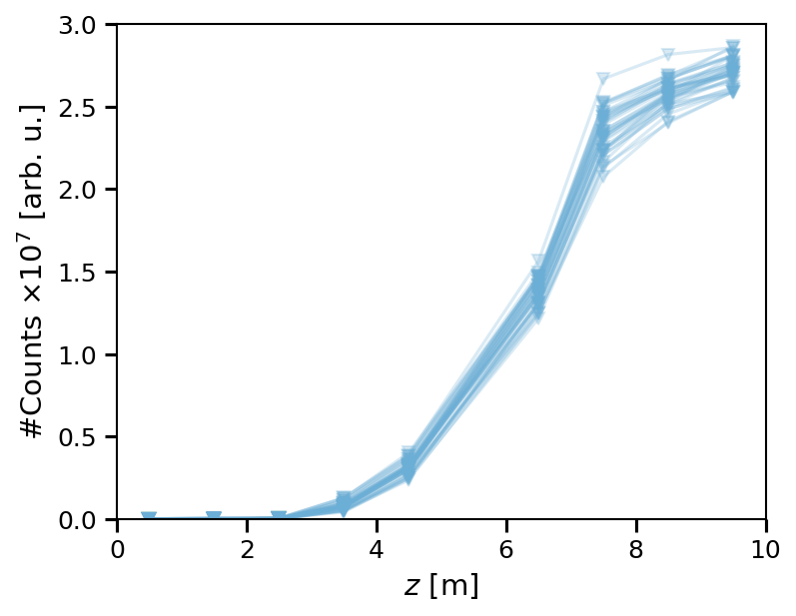
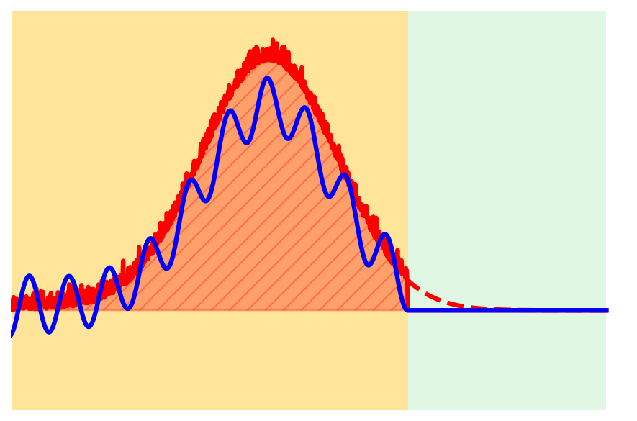

Light emission
preliminary
$$W_{⊥,0}∝n_{b}(t=t_{RIF})$$
Unseeded
Seeded
$t_{RIF}=650$ ps
$t_{RIF}=550$ ps
$t_{RIF}=450$ ps
$t_{RIF}=350$ ps
Random phase (SM is unseeded)
SM grows from noise or features in the bunch
→ Initial conditions vary from event to event
Phase reproducible (SM is seeded)
SM grows from controlled initial conditions
Proton bunch :
$N_{b}=0.5×{10}^{11}$
$E=400$ GeV
$σ_{r}=180 μ$m
$σ_{t}=170$ ps
Advanced Accelerator Concepts, UCLA, 28/07/26
Arthur Clairembaud (AWAKE Collaboration)
10/26

Slide 36
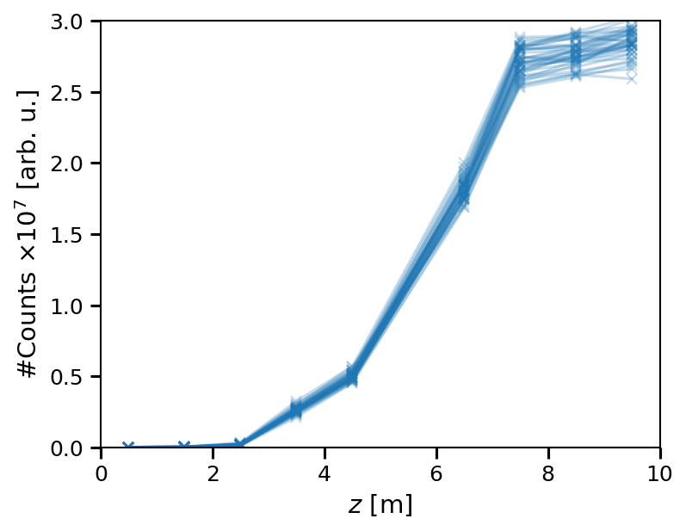


Light emission
preliminary
$$W_{⊥,0}∝n_{b}(t=t_{RIF})$$
Unseeded
Seeded
$t_{RIF}=650$ ps
$t_{RIF}=550$ ps
$t_{RIF}=450$ ps
$t_{RIF}=350$ ps
$t_{RIF}=250$ ps
Random phase (SM is unseeded)
SM grows from noise or features in the bunch
→ Initial conditions vary from event to event
Late growth
SM does not saturate within 10m
Phase reproducible (SM is seeded)
SM grows from controlled initial conditions
Earlier growth
SM saturates at z$∼$8m
Proton bunch :
$N_{b}=0.5×{10}^{11}$
$E=400$ GeV
$σ_{r}=180 μ$m
$σ_{t}=170$ ps
Advanced Accelerator Concepts, UCLA, 28/07/26
Arthur Clairembaud (AWAKE Collaboration)
10/26

Slide 37

Light emission
preliminary
$$W_{⊥,0}∝n_{b}(t=t_{RIF})$$
Unseeded
Seeded
$t_{RIF}=650$ ps
$t_{RIF}=550$ ps
$t_{RIF}=450$ ps
$t_{RIF}=350$ ps
$t_{RIF}=250$ ps
Random phase (SM is unseeded)
SM grows from noise or features in the bunch
→ Initial conditions vary from event to event
Late growth
SM does not saturate within 10m
Large variations from event to event
Phase reproducible (SM is seeded)
SM grows from controlled initial conditions
Earlier growth
SM saturates at z$∼$8m
Smaller variations from event to event
Proton bunch :
$N_{b}=0.5×{10}^{11}$
$E=400$ GeV
$σ_{r}=180 μ$m
$σ_{t}=170$ ps
Advanced Accelerator Concepts, UCLA, 28/07/26
Arthur Clairembaud (AWAKE Collaboration)
10/26

Slide 38

Light emission
preliminary
$$W_{⊥,0}∝n_{b}(t=t_{RIF})$$
Unseeded
Seeded
$t_{RIF}=650$ ps
$t_{RIF}=550$ ps
$t_{RIF}=450$ ps
$t_{RIF}=350$ ps
$t_{RIF}=250$ ps
Random phase (SM is unseeded)
SM grows from noise or features in the bunch
→ Initial conditions vary from event to event
Late growth
SM does not saturate within 10m
Large variations from event to event
  at same signal level
Phase reproducible (SM is seeded)
SM grows from controlled initial conditions
Earlier growth
SM saturates at z$∼$8m
Smaller variations from event to event
  at same signal level
Proton bunch :
$N_{b}=0.5×{10}^{11}$
$E=400$ GeV
$σ_{r}=180 μ$m
$σ_{t}=170$ ps
Advanced Accelerator Concepts, UCLA, 28/07/26
Arthur Clairembaud (AWAKE Collaboration)
10/26

Slide 39

Light emission
preliminary
$$W_{⊥,0}∝n_{b}(t=t_{RIF})$$
Unseeded
Seeded
$t_{RIF}=650$ ps
$t_{RIF}=550$ ps
$t_{RIF}=450$ ps
$t_{RIF}=350$ ps
$t_{RIF}=250$ ps
Random phase (SM is unseeded)
SM grows from noise or features in the bunch
→ Initial conditions vary from event to event
Late growth
SM does not saturate within 10m
Large variations from event to event
  at same signal level
  at same location along plasma
Phase reproducible (SM is seeded)
SM grows from controlled initial conditions
Earlier growth
SM saturates at z$∼$8m
Smaller variations from event to event
  at same signal level
  at same location along plasma
Proton bunch :
$N_{b}=0.5×{10}^{11}$
$E=400$ GeV
$σ_{r}=180 μ$m
$σ_{t}=170$ ps
Advanced Accelerator Concepts, UCLA, 28/07/26
Arthur Clairembaud (AWAKE Collaboration)
10/26
Notes:
Add colors ? To make it consistent with the profiles

Slide 40
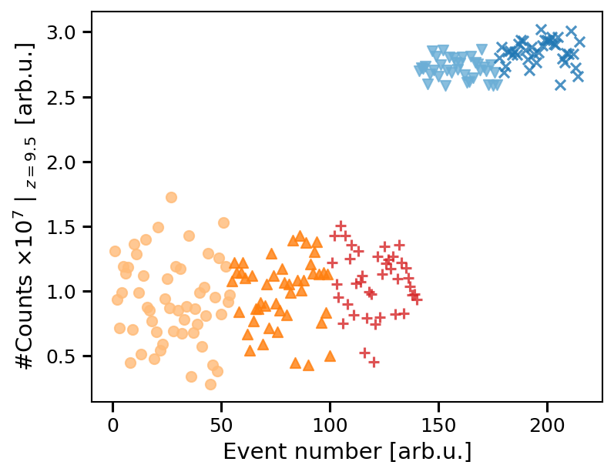
Light emission
Sum of signal from 10 cameras
total energy deposited by the bunch
More light when seeded
Higher initial wakefields
Earlier growth
Controlled initial conditions
absolute variations are smaller when seeded than when not
Unseeded
Seeded
preliminary
Advanced Accelerator Concepts, UCLA, 28/07/26
Arthur Clairembaud (AWAKE Collaboration)
11/26

Slide 41
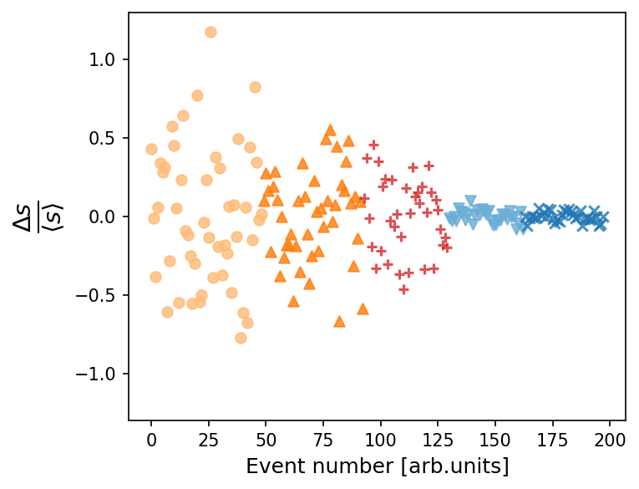
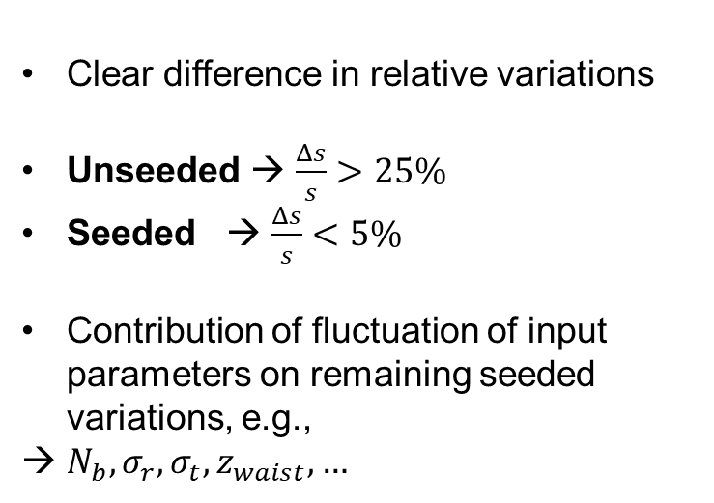
Light emission
Clear difference in relative variations
Unseeded → $\frac{Δs}{s}>25\%$
Seeded → $\frac{Δs}{s}<5\%$
Contribution of fluctuation of input parameters on remaining seeded variations, e.g.,
$N_{b}, σ_{r}, σ_{t}, z_{waist},…$
> 25%
< 5%
Unseeded
Seeded
preliminary
Advanced Accelerator Concepts, UCLA, 28/07/26
Arthur Clairembaud (AWAKE Collaboration)
11/26

Slide 42
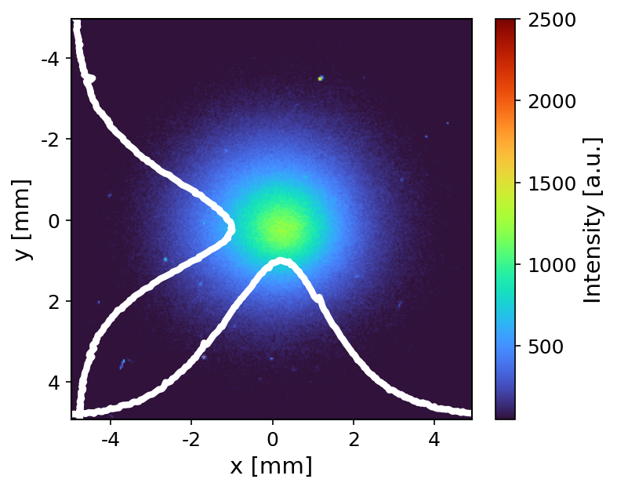


Amplitude reproducibility
Camera
10.3 m
Mask
Screen
10 m
Larger transverse wakefields
→ More defocusing
→ Larger transverse size at screen
Light measurement is non-destructive
Transverse bunch profile can be observed for the same events
SM is a transverse process
→ Shows cumulative effect of transverse wakefields over 10m of plasma
Proton bunch :
$N_{b}=0.5×{10}^{11}$
$E=400$ GeV
$σ_{r}=180 μ$m
$σ_{t}=170$ ps
$$r∝p_{⊥}∝\int_{0}^{z}{W_{⊥}\left(z\right)dz}$$
Advanced Accelerator Concepts, UCLA, 28/07/26
Arthur Clairembaud (AWAKE Collaboration)
12/26
Notes:
add for the same event

Slide 43
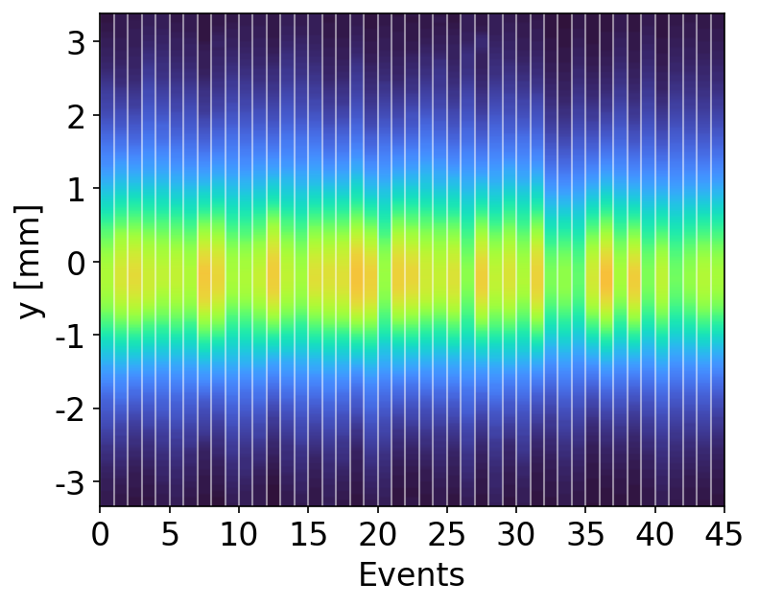
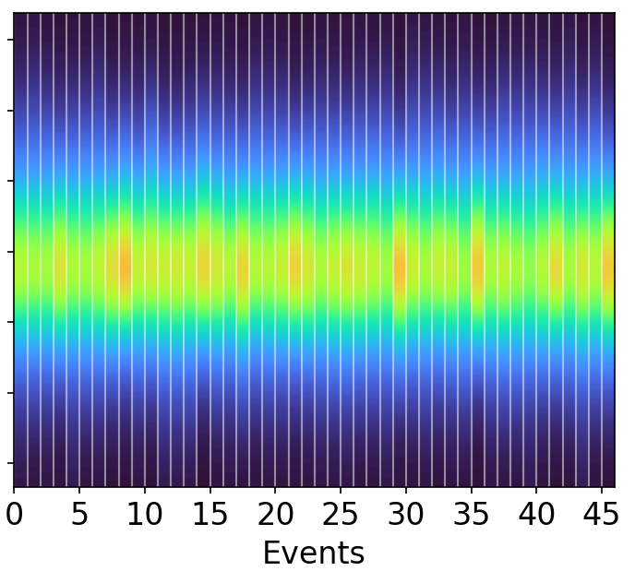
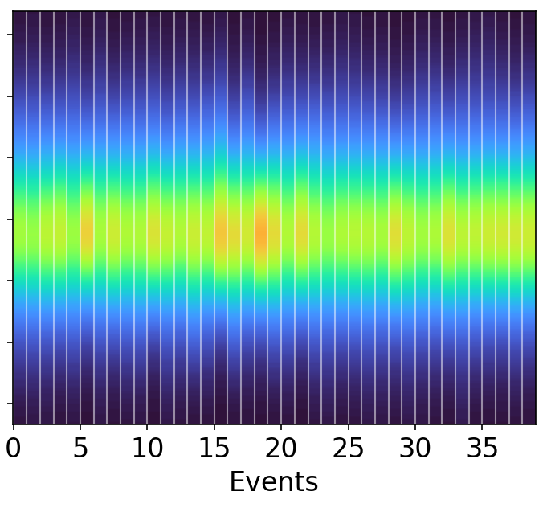
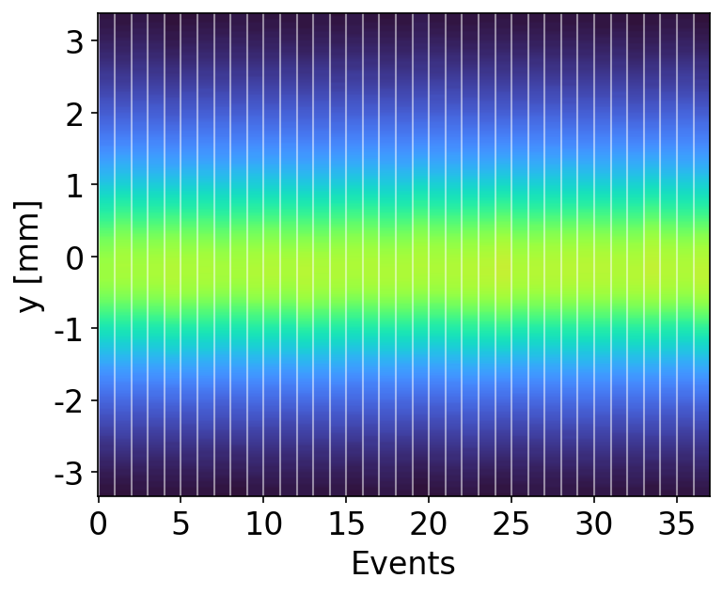
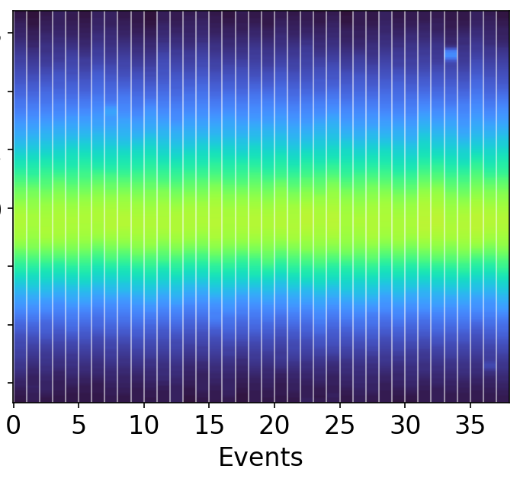





Effect of transverse wakefields
preliminary
$$W_{⊥,0}∝n_{b}(t=t_{RIF})$$
Unseeded
Seeded
$t_{RIF}=650$ ps
$t_{RIF}=550$ ps
$t_{RIF}=450$ ps
$t_{RIF}=350$ ps
$t_{RIF}=250$ ps
Waterfall plot of corresponding transverse bunch profiles
Shows cumulative effect of transverse wakefields on the bunch over 10m of plasma
More reproducible when seeded
Advanced Accelerator Concepts, UCLA, 28/07/26
Arthur Clairembaud (AWAKE Collaboration)
13/26
Notes:
Add t_rif
And it looks like it is larger

Slide 44
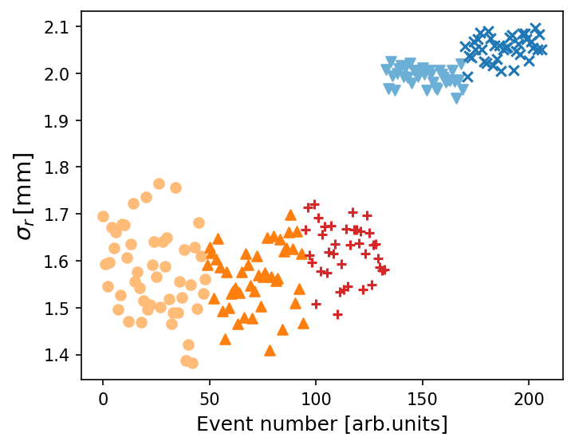

Effect of transverse wakefields
preliminary
$$W_{⊥,0}∝n_{b}(t=t_{RIF})$$
Unseeded
Seeded
$t_{RIF}=650$ ps
$t_{RIF}=550$ ps
$t_{RIF}=450$ ps
$t_{RIF}=350$ ps
$t_{RIF}=250$ ps
Unseeded
Seeding leads to larger wakefields
Larger transverse size at the screen
More reproducible when seeded
Seeded
$$σ$$
Advanced Accelerator Concepts, UCLA, 28/07/26
Arthur Clairembaud (AWAKE Collaboration)
13/26

Slide 45

Two independent diagnostics
preliminary
Seeded
Clear correlation between light and transverse size
Larger wakefields
More energy deposited
More defocusing
Two independent diagnostic show consistent event to event information
Unseeded
Advanced Accelerator Concepts, UCLA, 28/07/26
Arthur Clairembaud (AWAKE Collaboration)
14/26

Slide 46


Relative variations along z
preliminary
Relative variations decrease along plasma
Larger during growth than at saturation
$t_{RIF}=350$ ps
$t_{RIF}=250$ ps
$t_{RIF}=250$ ps
Advanced Accelerator Concepts, UCLA, 28/07/26
Arthur Clairembaud (AWAKE Collaboration)
15/26
Notes:
t_rif again

Slide 47
Relative variations along z
preliminary
Relative variations decrease along plasma
Larger during growth than at saturation
$t_{RIF}=350$ ps
$t_{RIF}=250$ ps
$t_{RIF}=250$ ps
Advanced Accelerator Concepts, UCLA, 28/07/26
Arthur Clairembaud (AWAKE Collaboration)
15/26
Notes:
t_rif again

Slide 48



Relative variations along z
preliminary
Relative variations decrease along plasma
Larger during growth than at saturation
Influence of fluctuations of input parameters decreases after saturation
Acceleration of witness bunch must occur after saturation of SM
$t_{RIF}=350$ ps
$t_{RIF}=250$ ps
M. Moreira and al,
PRAB, 2019
$t_{RIF}=250$ ps
Advanced Accelerator Concepts, UCLA, 28/07/26
Arthur Clairembaud (AWAKE Collaboration)
15/26
Notes:
Because it is seeded, these variations are assigned to fluctuations of input params
Some of it can be assigned to the input parameters fluctuations

Slide 49
Relative variations along z
preliminary
Relative variations decrease along plasma
Larger during growth than at saturation
Influence of fluctuations of input parameters decrease after saturation
Acceleration of witness bunch must occur after saturation of SM
$t_{RIF}=350$ ps
$t_{RIF}=250$ ps
M. Moreira and al,
PRAB, 2019
$t_{RIF}=250$ ps
Advanced Accelerator Concepts, UCLA, 28/07/26
Arthur Clairembaud (AWAKE Collaboration)
15/26
Notes:
Because it is seeded, these variations are assigned to fluctuations of input params
Some of it can be assigned to the input parameters fluctuations

Slide 50




High bunch population
preliminary
$$N_{b}=0.5×{10}^{11}$$
$N_{b}=0.5×{10}^{11}$ → $N_{b}=3×{10}^{11}$
At high bunch population
Signal along z doesn't look like expected growth and saturation
Energy flows along plasma
Need another diagnostic for saturation length of SM for high bunch population
Sum of signal still shows transition in reproduciblity
Proton bunch :
$E=400$ GeV
$σ_{r}=180 μ$m
$σ_{t}=170$ ps
Seeded
Unseeded
$$N_{b}=3×{10}^{11}$$
Advanced Accelerator Concepts, UCLA, 28/07/26
Arthur Clairembaud (AWAKE Collaboration)
16/26
Notes:
Now if we increase the bunch population
While at low bunch population, the light signal looks what is expected from the growth, at high bunch pop it doesnt

Slide 51
Outline
Introduction to the AWAKE Experiment at CERN
Demonstration of Amplitude-Reproducible Self-Modulation by Seeding
Measurement of the Saturation Length of the Self-Modulation Instability
Moving forward…
Advanced Accelerator Concepts, UCLA, 28/07/26
Arthur Clairembaud (AWAKE Collaboration)
17/26
Notes:
Now I am going to show you our determination of the sat length of SM using the halo of defocused protons

Slide 52

Saturation length of SM
$$L_{sat}$$
Modulation of bunch leads to growth of wakefields
Zeroth order expectation: wakefields saturates when modulation stops
Modulation = transverse process
Stops when halo is fully formed and defocused protons drift ballistically
Pukhov, PRL 107 145003 (2011)
Modulation
Defocusing
Advanced Accelerator Concepts, UCLA, 28/07/26
Arthur Clairembaud (AWAKE Collaboration)
18/26
Notes:
We are going to see whether

Slide 53

Saturation length of SM
$$L_{sat}$$
Modulation of bunch leads to growth of wakefields
Zeroth order expectation: wakefields saturates when modulation stops
Modulation = transverse process
Stops when halo is fully formed and defocused protons drift ballistically
Halo stops forming along z at $L_{sat}$ ?
Pukhov, PRL 107 145003 (2011)
Modulation
Defocusing
Advanced Accelerator Concepts, UCLA, 28/07/26
Arthur Clairembaud (AWAKE Collaboration)
18/26

Slide 54



Halo formation along the plasma
Camera
10.3 m
Laser blockers
$$L_{sat}$$
Mask
Rb vapor
Screen
10 m
Proton bunch :
$N_{b}=3×{10}^{11}$
$E=400$ GeV
$σ_{r}=180 μ$m
$σ_{t}=170$ ps
$t_{RIF}=100$ ps
Goal: Determine location along the plasma where halo stops forming
Plasma is a "black box", we see:
what goes in
Advanced Accelerator Concepts, UCLA, 28/07/26
Arthur Clairembaud (AWAKE Collaboration)
19/26
Notes:
Again, the previous experiments at AWAKE had shown the transverse profile of the bunch after propagating in vacuum, or 10m of plasma.
The plungers now allow to fill the gaps in between.

Slide 55
Halo formation along the plasma
Camera
10.3 m
Laser blockers
$$L_{sat}$$
Mask
Screen
10 m
Proton bunch :
$N_{b}=3×{10}^{11}$
$E=400$ GeV
$σ_{r}=180 μ$m
$σ_{t}=170$ ps
$t_{RIF}=100$ ps
Goal: Determine location along the plasma where halo stops forming
Plasma is a "black box", we see:
what goes in
what comes out
Advanced Accelerator Concepts, UCLA, 28/07/26
Arthur Clairembaud (AWAKE Collaboration)
19/26
Notes:
Again, the previous experiments at AWAKE had shown the transverse profile of the bunch after propagating in vacuum, or 10m of plasma.
The plungers now allow to fill the gaps in between.

Slide 56
Halo formation along the plasma
Camera
10.3 m
Laser blockers
$$L_{sat}$$
?
Mask
Screen
10 m
Proton bunch :
$N_{b}=3×{10}^{11}$
$E=400$ GeV
$σ_{r}=180 μ$m
$σ_{t}=170$ ps
$t_{RIF}=100$ ps
?
Goal: Determine location along the plasma where halo stops forming
Plasma is a "black box", we see:
what goes in
what comes out
Advanced Accelerator Concepts, UCLA, 28/07/26
Arthur Clairembaud (AWAKE Collaboration)
19/26
Notes:
In addition to the laser blockers, now we've added laser blockers, that allow

Slide 57

Halo formation along the plasma
Camera
10.3 m
Laser blockers
Mask
Plasma generated by ionizing laser pulse
Vary plasma length ($L_{p}$) by blocking laser pulse at different locations
$L_{p}=\left[0.5, 1.5, 2.5,…, 9.5\right]$ m
SM develops over different distances
Process is seeded (reproducible)
varying $L_{p}$ ⬄ observing state of bunch at different z on single event
Screen
10 m
Proton bunch :
$N_{b}=3×{10}^{11}$
$E=400$ GeV
$σ_{r}=180 μ$m
$σ_{t}=170$ ps
$t_{RIF}=100$ ps
?
Advanced Accelerator Concepts, UCLA, 28/07/26
Arthur Clairembaud (AWAKE Collaboration)
19/26
Notes:
Again, the previous experiments at AWAKE had shown the transverse profile of the bunch after propagating in vacuum, or 10m of plasma.
The plungers now allow to fill the gaps in between.

Slide 58
Halo formation along the plasma
Camera
10.3 m
Laser blockers
Mask
Plasma generated by ionizing laser pulse
Vary plasma length ($L_{p}$) by blocking laser pulse at different locations
$L_{p}=\left[0.5, 1.5, 2.5,…, 9.5\right]$ m
SM develops over different distances
Process is seeded (reproducible)
varying $L_{p}$ ⬄ observing state of bunch at different z on single event
Rb vapor
Screen
10 m
Proton bunch :
$N_{b}=3×{10}^{11}$
$E=400$ GeV
$σ_{r}=180 μ$m
$σ_{t}=170$ ps
$t_{RIF}=100$ ps
Advanced Accelerator Concepts, UCLA, 28/07/26
Arthur Clairembaud (AWAKE Collaboration)
19/26
Notes:
Again, the previous experiments at AWAKE had shown the transverse profile of the bunch after propagating in vacuum, or 10m of plasma.
The plungers now allow to fill the gaps in between.

Slide 59
Halo formation along the plasma
Camera
10.3 m
Laser blockers
Mask
Plasma generated by ionizing laser pulse
Vary plasma length ($L_{p}$) by blocking laser pulse at different locations
$L_{p}=\left[0.5, 1.5, 2.5,…, 9.5\right]$ m
SM develops over different distances
Process is seeded (reproducible)
varying $L_{p}$ ⬄ observing state of bunch at different z on single event
Rb vapor
Screen
10 m
Proton bunch :
$N_{b}=3×{10}^{11}$
$E=400$ GeV
$σ_{r}=180 μ$m
$σ_{t}=170$ ps
$t_{RIF}=100$ ps
Advanced Accelerator Concepts, UCLA, 28/07/26
Arthur Clairembaud (AWAKE Collaboration)
19/26
Notes:
Again, the previous experiments at AWAKE had shown the transverse profile of the bunch after propagating in vacuum, or 10m of plasma.
The plungers now allow to fill the gaps in between.

Slide 60
Halo formation along the plasma
Camera
10.3 m
Laser blockers
Mask
Plasma generated by ionizing laser pulse
Vary plasma length ($L_{p}$) by blocking laser pulse at different locations
$L_{p}=\left[0.5, 1.5, 2.5,…, 9.5\right]$ m
SM develops over different distances
Process is seeded (reproducible)
varying $L_{p}$ ⬄ observing state of bunch at different z on single event
Rb vapor
Screen
10 m
Proton bunch :
$N_{b}=3×{10}^{11}$
$E=400$ GeV
$σ_{r}=180 μ$m
$σ_{t}=170$ ps
$t_{RIF}=100$ ps
Advanced Accelerator Concepts, UCLA, 28/07/26
Arthur Clairembaud (AWAKE Collaboration)
19/26
Notes:
Again, the previous experiments at AWAKE had shown the transverse profile of the bunch after propagating in vacuum, or 10m of plasma.
The plungers now allow to fill the gaps in between.

Slide 61
Halo formation along the plasma
Camera
10.3 m
Laser blockers
Mask
Plasma generated by ionizing laser pulse
Vary plasma length ($L_{p}$) by blocking laser pulse at different locations
$L_{p}=\left[0.5, 1.5, 2.5,…, 9.5\right]$ m
SM develops over different distances
Process is seeded (reproducible)
varying $L_{p}$ ⬄ observing state of bunch at different z on single event
Rb vapor
Screen
10 m
Proton bunch :
$N_{b}=3×{10}^{11}$
$E=400$ GeV
$σ_{r}=180 μ$m
$σ_{t}=170$ ps
$t_{RIF}=100$ ps
Advanced Accelerator Concepts, UCLA, 28/07/26
Arthur Clairembaud (AWAKE Collaboration)
19/26
Notes:
Again, the previous experiments at AWAKE had shown the transverse profile of the bunch after propagating in vacuum, or 10m of plasma.
The plungers now allow to fill the gaps in between.

Slide 62
Halo formation along the plasma
Camera
10.3 m
Laser blockers
Mask
Plasma generated by ionizing laser pulse
Vary plasma length ($L_{p}$) by blocking laser pulse at different locations
$L_{p}=\left[0.5, 1.5, 2.5,…, 9.5\right]$ m
SM develops over different distances
Process is seeded (reproducible)
varying $L_{p}$ ⬄ observing state of bunch at different z on single event
Rb vapor
Screen
10 m
Proton bunch :
$N_{b}=3×{10}^{11}$
$E=400$ GeV
$σ_{r}=180 μ$m
$σ_{t}=170$ ps
$t_{RIF}=100$ ps
Advanced Accelerator Concepts, UCLA, 28/07/26
Arthur Clairembaud (AWAKE Collaboration)
19/26
Notes:
Again, the previous experiments at AWAKE had shown the transverse profile of the bunch after propagating in vacuum, or 10m of plasma.
The plungers now allow to fill the gaps in between.

Slide 63
Halo formation along the plasma
Camera
10.3 m
Laser blockers
Mask
Plasma generated by ionizing laser pulse
Vary plasma length ($L_{p}$) by blocking laser pulse at different locations
$L_{p}=\left[0.5, 1.5, 2.5,…, 9.5\right]$ m
SM develops over different distances
Process is seeded (reproducible)
varying $L_{p}$ ⬄ observing state of bunch at different z on single event
Rb vapor
Screen
10 m
Proton bunch :
$N_{b}=3×{10}^{11}$
$E=400$ GeV
$σ_{r}=180 μ$m
$σ_{t}=170$ ps
$t_{RIF}=100$ ps
Advanced Accelerator Concepts, UCLA, 28/07/26
Arthur Clairembaud (AWAKE Collaboration)
19/26
Notes:
Again, the previous experiments at AWAKE had shown the transverse profile of the bunch after propagating in vacuum, or 10m of plasma.
The plungers now allow to fill the gaps in between.

Slide 64
Halo formation along the plasma
Camera
10.3 m
Laser blockers
Mask
Plasma generated by ionizing laser pulse
Vary plasma length ($L_{p}$) by blocking laser pulse at different locations
$L_{p}=\left[0.5, 1.5, 2.5,…, 9.5\right]$ m
SM develops over different distances
Process is seeded (reproducible)
varying $L_{p}$ ⬄ observing state of bunch at different z on single event
Screen
10 m
Proton bunch :
$N_{b}=3×{10}^{11}$
$E=400$ GeV
$σ_{r}=180 μ$m
$σ_{t}=170$ ps
$t_{RIF}=100$ ps
Advanced Accelerator Concepts, UCLA, 28/07/26
Arthur Clairembaud (AWAKE Collaboration)
19/26
Notes:
Again, the previous experiments at AWAKE had shown the transverse profile of the bunch after propagating in vacuum, or 10m of plasma.
The plungers now allow to fill the gaps in between.

Slide 65
Halo formation along the plasma
Camera
10.3 m
Laser blockers
Mask
Plasma generated by ionizing laser pulse
Vary plasma length ($L_{p}$) by blocking laser pulse at different locations
$L_{p}=\left[0.5, 1.5, 2.5,…, 9.5\right]$ m
SM develops over different distances
Process is seeded (reproducible)
varying $L_{p}$ ⬄ observing state of bunch at different z on single event
Screen
10 m
Proton bunch :
$N_{b}=3×{10}^{11}$
$E=400$ GeV
$σ_{r}=180 μ$m
$σ_{t}=170$ ps
$t_{RIF}=100$ ps
Advanced Accelerator Concepts, UCLA, 28/07/26
Arthur Clairembaud (AWAKE Collaboration)
19/26
Notes:
Again, the previous experiments at AWAKE had shown the transverse profile of the bunch after propagating in vacuum, or 10m of plasma.
The plungers now allow to fill the gaps in between.

Slide 66
Halo formation along the plasma
Camera
10.3 m
Laser blockers
Mask
Plasma generated by ionizing laser pulse
Vary plasma length ($L_{p}$) by blocking laser pulse at different locations
$L_{p}=\left[0.5, 1.5, 2.5,…, 9.5\right]$ m
SM develops over different distances
Process is seeded (reproducible)
varying $L_{p}$ ⬄ observing state of bunch at different z on single event
Screen
10 m
Proton bunch :
$N_{b}=3×{10}^{11}$
$E=400$ GeV
$σ_{r}=180 μ$m
$σ_{t}=170$ ps
$t_{RIF}=100$ ps
Advanced Accelerator Concepts, UCLA, 28/07/26
Arthur Clairembaud (AWAKE Collaboration)
19/26
Notes:
Again, the previous experiments at AWAKE had shown the transverse profile of the bunch after propagating in vacuum, or 10m of plasma.
The plungers now allow to fill the gaps in between.

Slide 67

Halo formation along the plasma
10 events
$$n_{pe}=1×{10}^{14}/cc$$
Advanced Accelerator Concepts, UCLA, 28/07/26
Arthur Clairembaud (AWAKE Collaboration)
20/26
Notes:
Arrow that says 10 events each

Slide 68

Halo formation along the plasma
10 events
$$n_{pe}=1×{10}^{14}/cc$$
Advanced Accelerator Concepts, UCLA, 28/07/26
Arthur Clairembaud (AWAKE Collaboration)
20/26
Notes:
Average halo radius

Slide 69

Halo formation along the plasma
Evolution in three phases:
10 events
$$n_{pe}=1×{10}^{14}/cc$$
1) $L_{p}=0 to≅1.5 m$:
Little evolution of bunch
Wakefields:
  Small amplitude
  Predominantly focusing
2) $L_{p}≅1.5 to≅5.5 m$:
Halo forms:
  Charge redistributes transversely
  Halo radius increases
SM grows:
  Wakefields acquire defocusing regions
  Wakefields increase in amplitude
3) $L_{p}≅5.5 to≅9.5 m$:
Halo radius stops increasing
Distribution essentially unchanged
Signature expected from SM saturation
Pukhov, PRL 107 145003 (2011)
Advanced Accelerator Concepts, UCLA, 28/07/26
Arthur Clairembaud (AWAKE Collaboration)
20/26
Notes:
At this plasma density
Three phases from pukhov

Slide 70

Halo formation along the plasma
Evolution in three phases:
10 events
$$n_{pe}=1×{10}^{14}/cc$$
1) $L_{p}=0 to≅1.5 m$:
Little evolution of bunch
Wakefields:
  Small amplitude
  Predominantly focusing
2) $L_{p}≅1.5 to≅5.5 m$:
Halo forms:
  Charge redistributes transversely
  Halo radius increases
SM grows:
  Wakefields acquire defocusing regions
  Wakefields increase in amplitude
3) $L_{p}≅5.5 to≅9.5 m$:
Halo radius stops increasing
Distribution essentially unchanged
Signature expected from SM saturation
Pukhov, PRL 107 145003 (2011)
Advanced Accelerator Concepts, UCLA, 28/07/26
Arthur Clairembaud (AWAKE Collaboration)
20/26
Notes:
At this plasma density

Slide 71

Halo formation along the plasma
Evolution in three phases:
10 events
$$n_{pe}=1×{10}^{14}/cc$$
1) $L_{p}=0 to≅1.5 m$:
Little evolution of bunch
Wakefields:
  Small amplitude
  Predominantly focusing
2) $L_{p}≅1.5 to≅5.5 m$:
Halo forms:
  Charge redistributes transversely
  Halo radius increases
SM grows:
  Wakefields acquire defocusing regions
  Wakefields increase in amplitude
3) $L_{p}≅5.5 to≅9.5 m$:
Halo radius stops increasing
Distribution essentially unchanged
Signature expected from SM saturation
Pukhov, PRL 107 145003 (2011)
Advanced Accelerator Concepts, UCLA, 28/07/26
Arthur Clairembaud (AWAKE Collaboration)
20/26

Slide 72











Halo formation along the plasma
For all $n_{pe}$
  Similar development
Larger $n_{pe}$ ➔ halo forms earlier
Saturates earlier (90% $r_{h,max}$)
Proton bunch :
$N_{b}=3×{10}^{11}$
$E=400$ GeV
$σ_{r}=180 μ$m
$σ_{t}=170$ ps
$t_{RIF}=100$ ps
Camera
Screen
Mask
10 m
$$n_{pe}=1×{10}^{14}/cc$$
$$n_{pe}=2×{10}^{14}/cc$$
$$n_{pe}=3.9×{10}^{14}/cc$$
$$n_{pe}=7.4×{10}^{14}/cc$$
10.3 m
Laser blockers
Advanced Accelerator Concepts, UCLA, 28/07/26
Arthur Clairembaud (AWAKE Collaboration)
21/26

Slide 73

Halo formation along the plasma
For all $n_{pe}$
  Similar development
Larger $n_{pe}$ ➔ halo forms earlier
Saturates earlier (90% $r_{h,max}$)
Proton bunch :
$N_{b}=3×{10}^{11}$
$E=400$ GeV
$σ_{r}=180 μ$m
$σ_{t}=170$ ps
$t_{RIF}=100$ ps
Camera
Screen
$$Γ∝n_{pe}^{1/6}$$
Mask
10 m
Kumar, N. and al., PRL, 2010
$$n_{pe}=1×{10}^{14}/cc$$
$$n_{pe}=2×{10}^{14}/cc$$
$$n_{pe}=3.9×{10}^{14}/cc$$
$$n_{pe}=7.4×{10}^{14}/cc$$
Schroeder, C. B. and al., PRL, 2011
Pukhov, A. and al., PRL, 2011
10.3 m
Laser blockers
Advanced Accelerator Concepts, UCLA, 28/07/26
Arthur Clairembaud (AWAKE Collaboration)
21/26

Slide 74


Halo formation along the plasma
For all $n_{pe}$
  Similar development
Larger $n_{pe}$ ➔ halo forms earlier
Saturates earlier (90% $r_{h,max}$)
Proton bunch :
$N_{b}=3×{10}^{11}$
$E=400$ GeV
$σ_{r}=180 μ$m
$σ_{t}=170$ ps
$t_{RIF}=100$ ps
Camera
Screen
$$Γ∝n_{pe}^{1/6}$$
Mask
10 m
Kumar, N. and al., PRL, 2010
$$n_{pe}=1×{10}^{14}/cc$$
$$n_{pe}=2×{10}^{14}/cc$$
$$n_{pe}=3.9×{10}^{14}/cc$$
$$n_{pe}=7.4×{10}^{14}/cc$$
Schroeder, C. B. and al., PRL, 2011
Pukhov, A. and al., PRL, 2011
$$r_{h,max}$$
10.3 m
Laser blockers
$$L_{sat,r_{h}}=L_{p}(r_{h}=0,9 r_{h,max })$$
Advanced Accelerator Concepts, UCLA, 28/07/26
Arthur Clairembaud (AWAKE Collaboration)
21/26

Slide 75
Halo formation along the plasma
For all $n_{pe}$
  Similar development
Larger $n_{pe}$ ➔ halo forms earlier
Saturates earlier (90% $r_{h,max}$)
Proton bunch :
$N_{b}=3×{10}^{11}$
$E=400$ GeV
$σ_{r}=180 μ$m
$σ_{t}=170$ ps
$t_{RIF}=100$ ps
Camera
Screen
$$Γ∝n_{pe}^{1/6}$$
Mask
10 m
Kumar, N. and al., PRL, 2010
$$n_{pe}=1×{10}^{14}/cc$$
$$n_{pe}=2×{10}^{14}/cc$$
$$n_{pe}=3.9×{10}^{14}/cc$$
$$n_{pe}=7.4×{10}^{14}/cc$$
Schroeder, C. B. and al., PRL, 2011
Pukhov, A. and al., PRL, 2011
$$r_{h,max}$$
10.3 m
Laser blockers
$$L_{sat,r_{h}}=L_{p}(r_{h}=0,9 r_{h,max })$$
Advanced Accelerator Concepts, UCLA, 28/07/26
Arthur Clairembaud (AWAKE Collaboration)
21/26
Notes:
We define the saturation length of the halo radius as the location where it reaches 90% of its maximum value.
This is shown by the pink diamonds on the figure.

Slide 76


Comparison with simulation results
Saturation length of halo radius
Zeroth order expectation ➔ Saturation of the wakefields
Need to show it…
$$r_{h,exp}$$
Advanced Accelerator Concepts, UCLA, 28/07/26
Arthur Clairembaud (AWAKE Collaboration)
22/26
Notes:
Radius at saturation

Slide 77



Comparison with simulation results
Saturation length of halo radius
Zeroth order expectation ➔ Saturation of the wakefields
Need to show it…
Good agreement between exp. and sim. results
LCODE (2D axisymmetric)
$$r_{h,exp}$$
$$r_{h,sims}$$
Advanced Accelerator Concepts, UCLA, 28/07/26
Arthur Clairembaud (AWAKE Collaboration)
22/26

Slide 78







Comparison with simulation results
$$r_{h,exp}$$
$$r_{h,sims}$$
$$1.0×{10}^{14}$$
$$2.0×{10}^{14}$$
$$3.9×{10}^{14}$$
$$7.4×{10}^{14}$$
Normalized transverse field amplitude along z
Maximum field along the bunch ($t_{rif}>ξ>{−σ}_{t}$)
Grows, saturate and decay
$L_{sat}$→ 90% maximum
Saturates earlier for larger $n_{pe}$
Advanced Accelerator Concepts, UCLA, 28/07/26
Arthur Clairembaud (AWAKE Collaboration)
22/26

Slide 79
Comparison with simulation results
$$r_{h,exp}$$
$$r_{h,sims}$$
$$1.0×{10}^{14}$$
$$2.0×{10}^{14}$$
$$3.9×{10}^{14}$$
$$7.4×{10}^{14}$$
Normalized transverse field amplitude along z
Maximum field along the bunch ($t_{rif}>ξ>{−σ}_{t}$)
Grows, saturate and decay
$L_{sat}$→ 90% maximum
Saturates earlier for larger $n_{pe}$
Advanced Accelerator Concepts, UCLA, 28/07/26
Arthur Clairembaud (AWAKE Collaboration)
22/26

Slide 80




Comparison with simulation results
$$r_{h,exp}$$
$$r_{h,sims}$$
$$1.0×{10}^{14}$$
$$2.0×{10}^{14}$$
$$3.9×{10}^{14}$$
$$W_{⊥,sims}$$
$$7.4×{10}^{14}$$
$$W_{z,sims}$$
Normalized transverse field amplitude along z
Maximum field along the bunch ($t_{rif}>ξ>{−σ}_{t}$)
Grows, saturate and decay
$L_{sat}$→ 90% maximum
Saturates earlier for larger $n_{pe}$
Fields saturate earlier than halo
Good estimate for the saturation of the fields ($ΔL_{sat}<1$m)
Advanced Accelerator Concepts, UCLA, 28/07/26
Arthur Clairembaud (AWAKE Collaboration)
22/26

Slide 81



Seeded vs Unseeded
20 events
Reproducible
Earlier saturation
Seeded
Unseeded
Not reproducible
Later saturation
Seeded $W_{⊥,0}$ > Unseeded $W_{⊥,0}$
→ $L_{sat}$ decreases with initial wakefield amplitude
Consistent with light measurements !
Advanced Accelerator Concepts, UCLA, 28/07/26
Arthur Clairembaud (AWAKE Collaboration)
23/26

Slide 82
Outline
Introduction to the AWAKE Experiment at CERN
Demonstration of Amplitude-Reproducible Self-Modulation by Seeding
Measurement of the Saturation Length of the Self-Modulation Instability
Moving forward…
Advanced Accelerator Concepts, UCLA, 28/07/26
Arthur Clairembaud (AWAKE Collaboration)
24/26
Notes:
Moving forward

Slide 83


Moving forward
Demonstration of SM of proton bunch at AWAKE
  Modulation
  Growth of wakefields
Advanced Accelerator Concepts, UCLA, 28/07/26
Arthur Clairembaud (AWAKE Collaboration)
25/26

Slide 84
Moving forward
Demonstration of SM of proton bunch at AWAKE
  Modulation
  Growth of wakefields
Control of the process: reproducible in timing
Advanced Accelerator Concepts, UCLA, 28/07/26
Arthur Clairembaud (AWAKE Collaboration)
25/26

Slide 85
Moving forward
Demonstration of SM of proton bunch at AWAKE
  Modulation
  Growth of wakefields
Control of the process: reproducible in timing
Reproducible in amplitude
Advanced Accelerator Concepts, UCLA, 28/07/26
Arthur Clairembaud (AWAKE Collaboration)
25/26

Slide 86
Moving forward
Demonstration of SM of proton bunch at AWAKE
  Modulation
  Growth of wakefields
Control of the process: reproducible in timing
Reproducible in amplitude
Saturates within 10m → ready for acceleration of witness after that
Advanced Accelerator Concepts, UCLA, 28/07/26
Arthur Clairembaud (AWAKE Collaboration)
25/26

Slide 87


Moving forward
Demonstration of SM of proton bunch at AWAKE
  Modulation
  Growth of wakefields
Control of the process: reproducible in timing
Reproducible in amplitude
Saturates within 10m → ready for acceleration of witness after that
Acceleration of witness (side injection, not optimal)
AWAKE Collab. Nature 561, 363–367 (2018)
Energy gain of 2 GeV
Up to 2.8 GeV now with a density step !
Advanced Accelerator Concepts, UCLA, 28/07/26
Arthur Clairembaud (AWAKE Collaboration)
25/26

Slide 88
Moving forward
Demonstration of SM of proton bunch at AWAKE
  Modulation
  Growth of wakefields
Control of the process: reproducible in timing
Reproducible in amplitude
Saturates within 10m → ready for acceleration of witness after that
Acceleration of witness (side injection, not optimal)
AWAKE Collab. Nature 561, 363–367 (2018)
Energy gain of 2 GeV
Up to 2.8 GeV now with a density step !
Next step ?
Advanced Accelerator Concepts, UCLA, 28/07/26
Arthur Clairembaud (AWAKE Collaboration)
25/26

Slide 89

Moving forward
Demonstration of SM of proton bunch at AWAKE
  Modulation
  Growth of wakefields
Control of the process: reproducible in timing
Reproducible in amplitude
Saturates within 10m → ready for acceleration of witness after that
Acceleration of witness (side injection, not optimal)
Next step ?
Beam quality and scalability !
Advanced Accelerator Concepts, UCLA, 28/07/26
Arthur Clairembaud (AWAKE Collaboration)
25/26

Slide 90

Moving forward
Demonstration of SM of proton bunch at AWAKE
  Modulation
  Growth of wakefields
Control of the process: reproducible in timing
Reproducible in amplitude
Saturates within 10m → ready for acceleration of witness after that
Acceleration of witness (side injection, not optimal)
Injection of electrons after saturation of SM
1 plasma for self-modulation (10m>$L_{sat}$)
+1 for acceleration
+ on-axis injection
+ beam loading
Next step ?
Beam quality and scalability !
Advanced Accelerator Concepts, UCLA, 28/07/26
Arthur Clairembaud (AWAKE Collaboration)
25/26

Slide 91

Moving forward
Demonstration of SM of proton bunch at AWAKE
  Modulation
  Growth of wakefields
Control of the process: reproducible in timing
Reproducible in amplitude
Saturates within 10m → ready for acceleration of witness after that
Acceleration of witness (side injection, not optimal)
C. Amoedo, A.Sublet and al.
Scalable plasma source
Next step ?
Beam quality and scalability !
Advanced Accelerator Concepts, UCLA, 28/07/26
Arthur Clairembaud (AWAKE Collaboration)
25/26

Slide 92
Conclusion
AWAKE :
AWAKE aims to be a proton-driven PWFA for particle physics applications
SPS bunches allow for GV/m-amplitude wakefields for 10s to 100s of meters in a single plasma
SPS bunches are long, first need to be self-modulated
Previous results :
Seeding SM makes phase of wakefields more reproducible
New results:
Seeding SM makes the amplitude of the wakefields more reproducible
Variations decrease at saturation
SM saturates in less than 10m
Next:
On-axis, external injection of witness bunch in second plasma
  After saturation, with reproducible wakefields both in phase and amplitude
Scalable plasma for the accelerator, 10s to 100s of meters
K. V. Lotov & P. V. Tuev, Plasma Phys. and Control. Fusion, 63, 125027 (2021)
Advanced Accelerator Concepts, UCLA, 28/07/26
Arthur Clairembaud (AWAKE Collaboration)
26/26

Slide 93
Thank you for your attention !
Advanced Accelerator Concepts, UCLA, 28/07/26
Arthur Clairembaud (AWAKE Collaboration)
26/26

Slide 94

Backup: reproducibility
Seeded
Unseeded

Slide 95

Backup: density step

Slide 96

Backup: effect of the step
preliminary
F. Pannell

Slide 97

Backup: witness bunch params.

Slide 98

Backup: run 2c goals

Slide 99

Backup: density step on halo

Slide 100


Backup: theory scaling
Same nb of exponentiations ?
Expected scaling $∝n_{pe}^{−1/4}$

