Slide 1

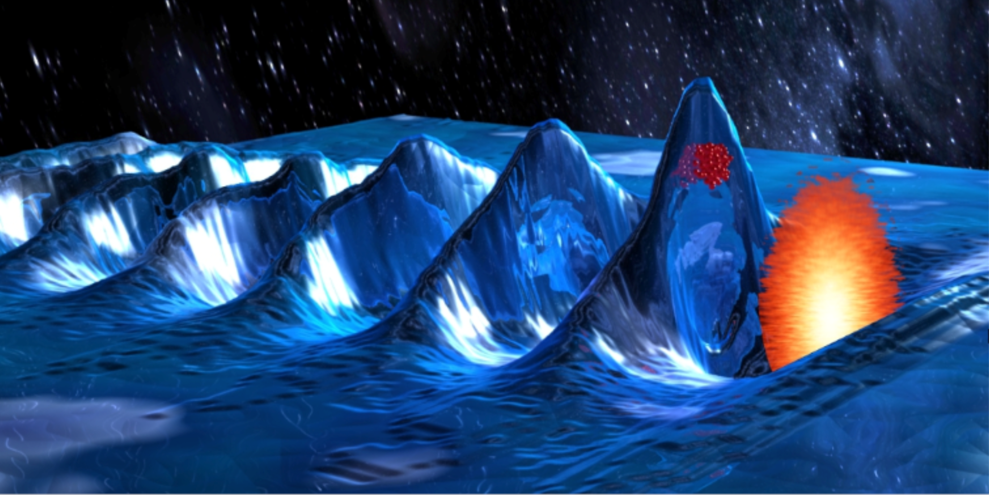
Towards Dephasingless LWFA
AAC 2026
Aaron Liberman
Anton Golovanov, Slava Smartsev, Anda-Maria Talposi, Sheroy Tata, Ronan Lahaye, Igor Andriyash, Eitan Levine, Salome Benracassa, Eyal Kroupp, Cedric Thaury, and Victor Malka
1

Slide 2
The Need for High Energy Electron Beams
The Dephasing Limit
Near-Field: Spatio-Temporal Couplings (STCs)
Far Field: Axiparabola
Axiparabola Velocity Measurement
Femtosecond Relativistic Electron Microscopy (FREM)
First Electrons + Partial Mitigation of Dephasing
AAC 2026
2

Slide 3
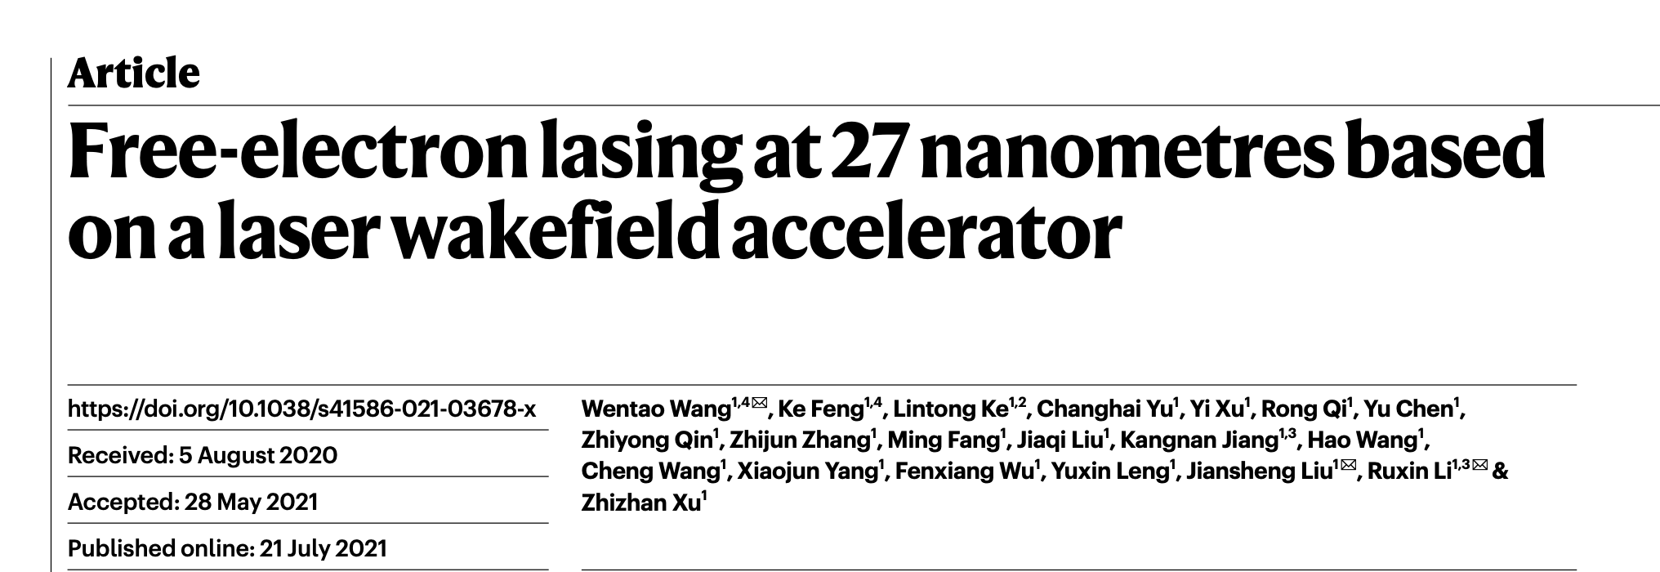
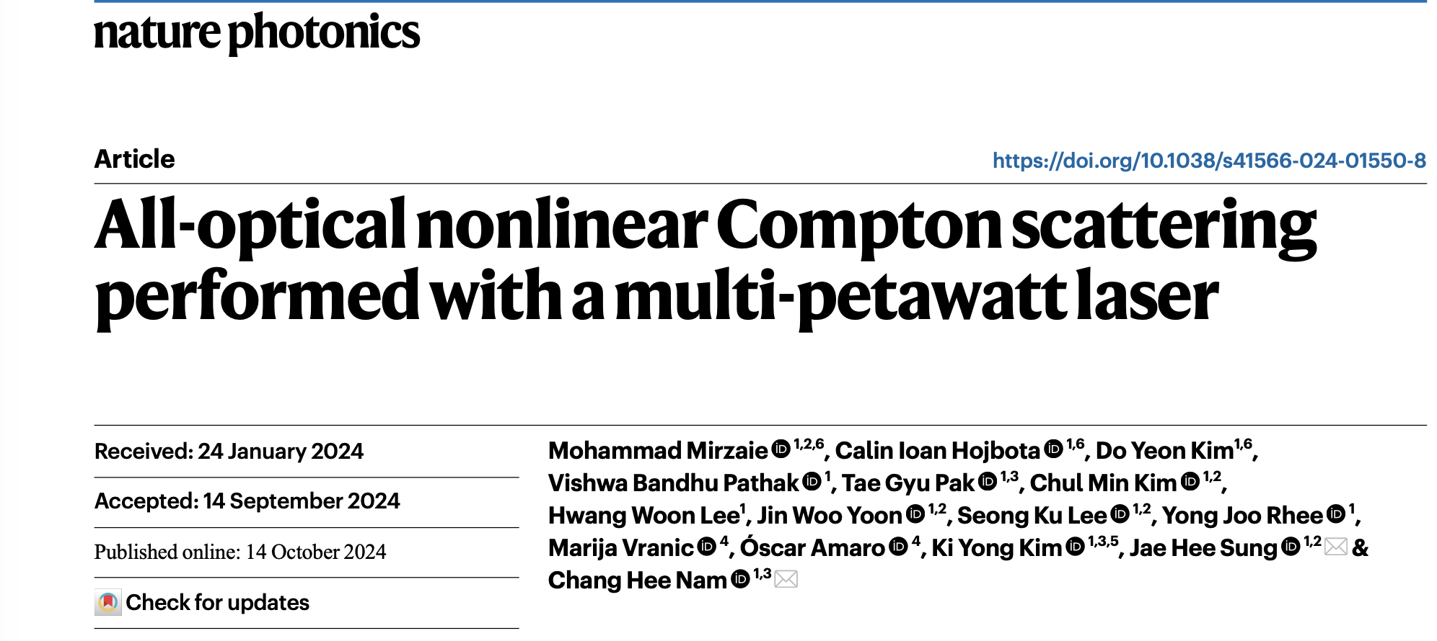
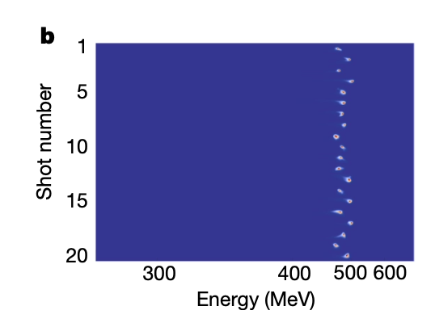
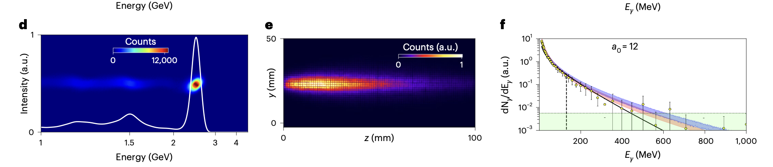

The Breakdown Issue
The Need for High Energy Electron Beams
FEL Wavelength: $λ=\left(1+\frac{K}{2}\right)/2γ^{2}$
Quantum Nonlinearity: $χ∼\frac{γ^{2}I_{0}}{I_{s}}$
$$χ≈0.32$$
AAC 2026
3

Slide 4
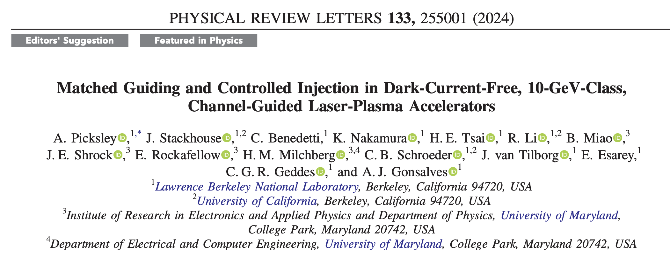
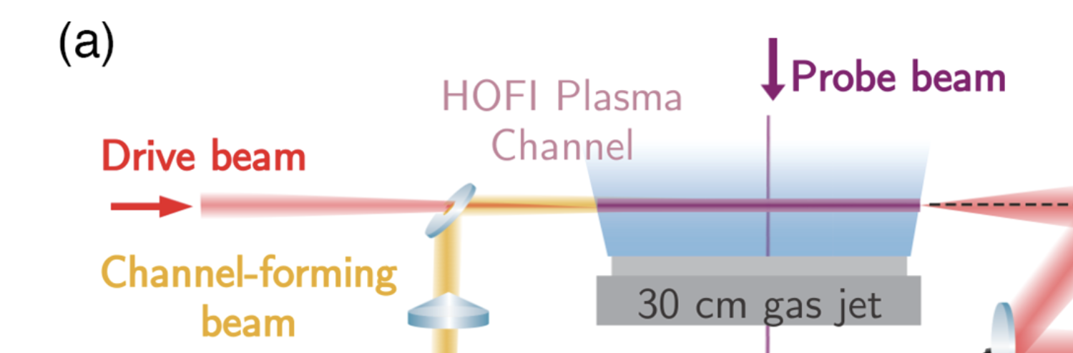
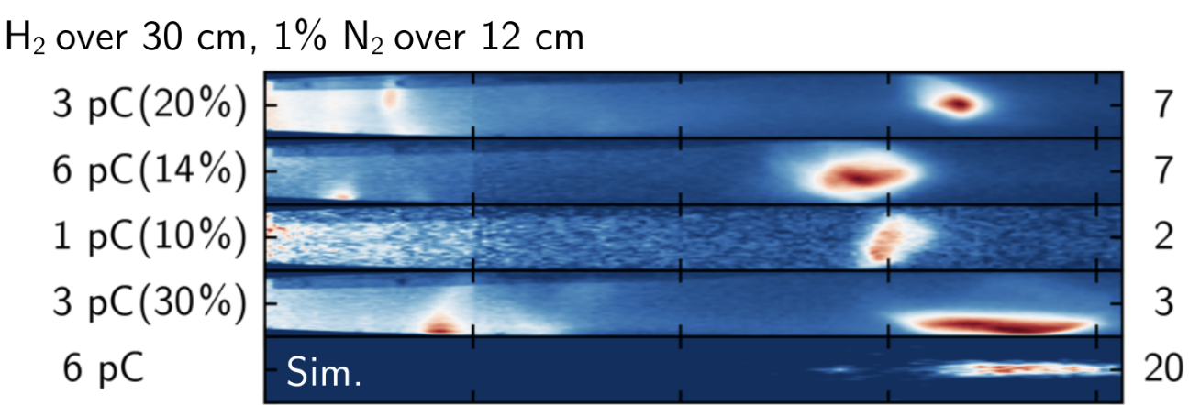
The Breakdown Issue
State of the Art – Guiding in HOFI Channel
AAC 2026
4

Slide 5
The Need for High Energy Electron Beams
The Dephasing Limit
Near-Field: Spatio-Temporal Couplings (STCs)
Far Field: Axiparabola
Axiparabola Velocity Measurement
Femtosecond Relativistic Electron Microscopy (FREM)
First Electrons + Partial Mitigation of Dephasing
AAC 2026
5

Slide 6

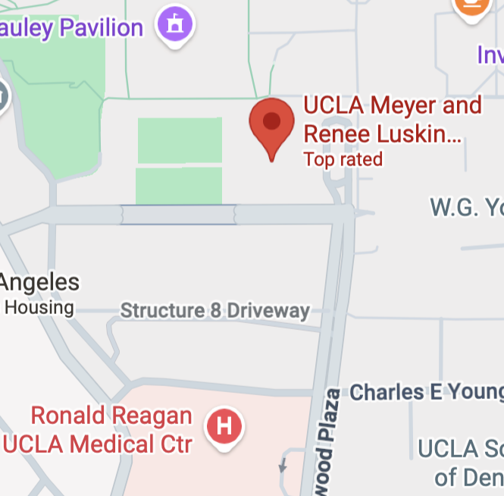

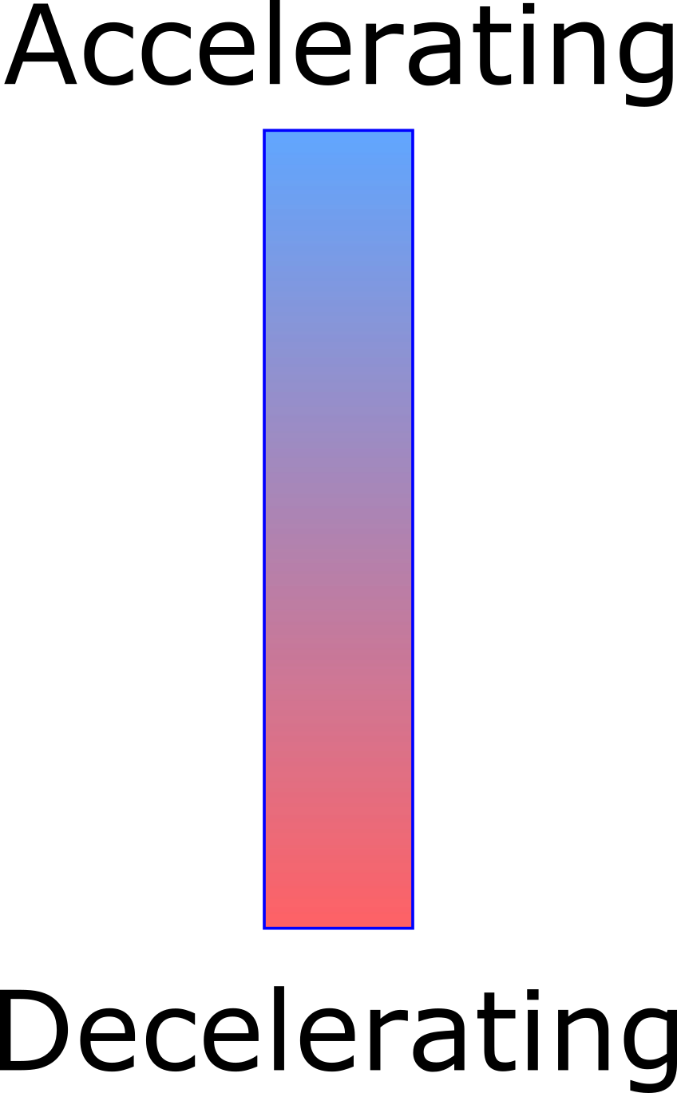
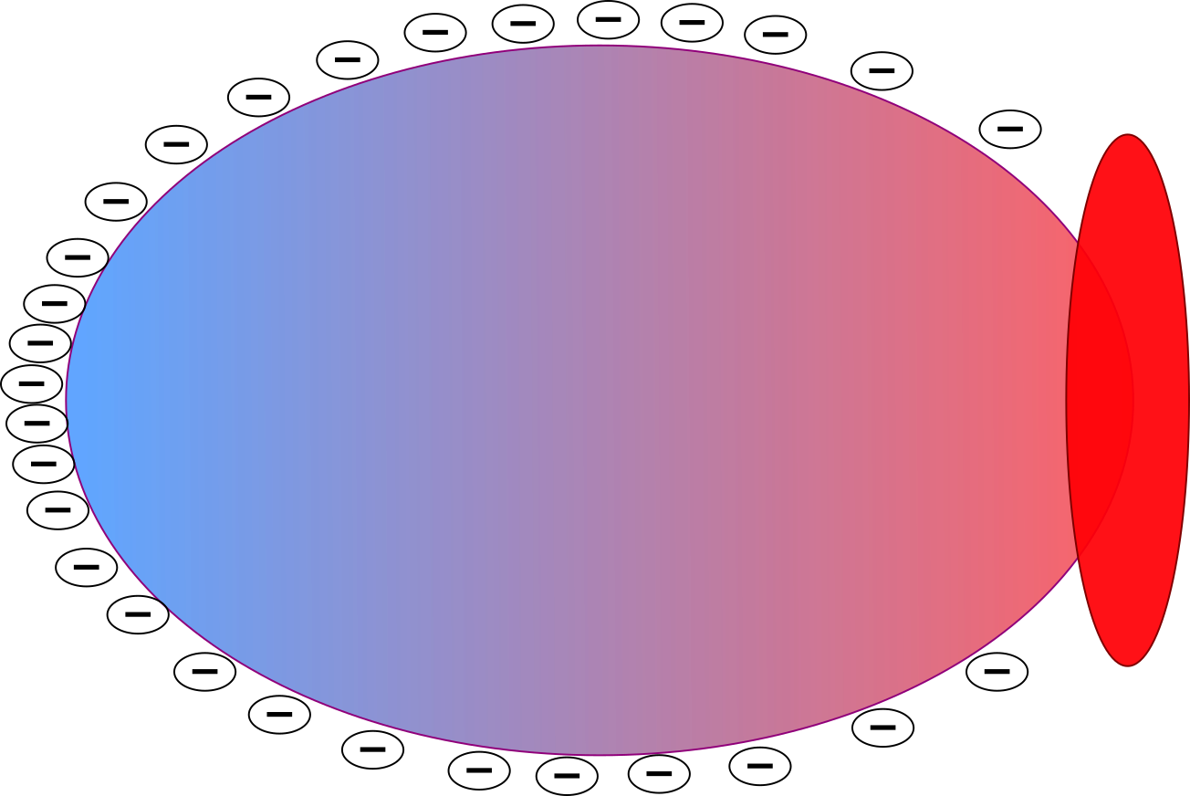
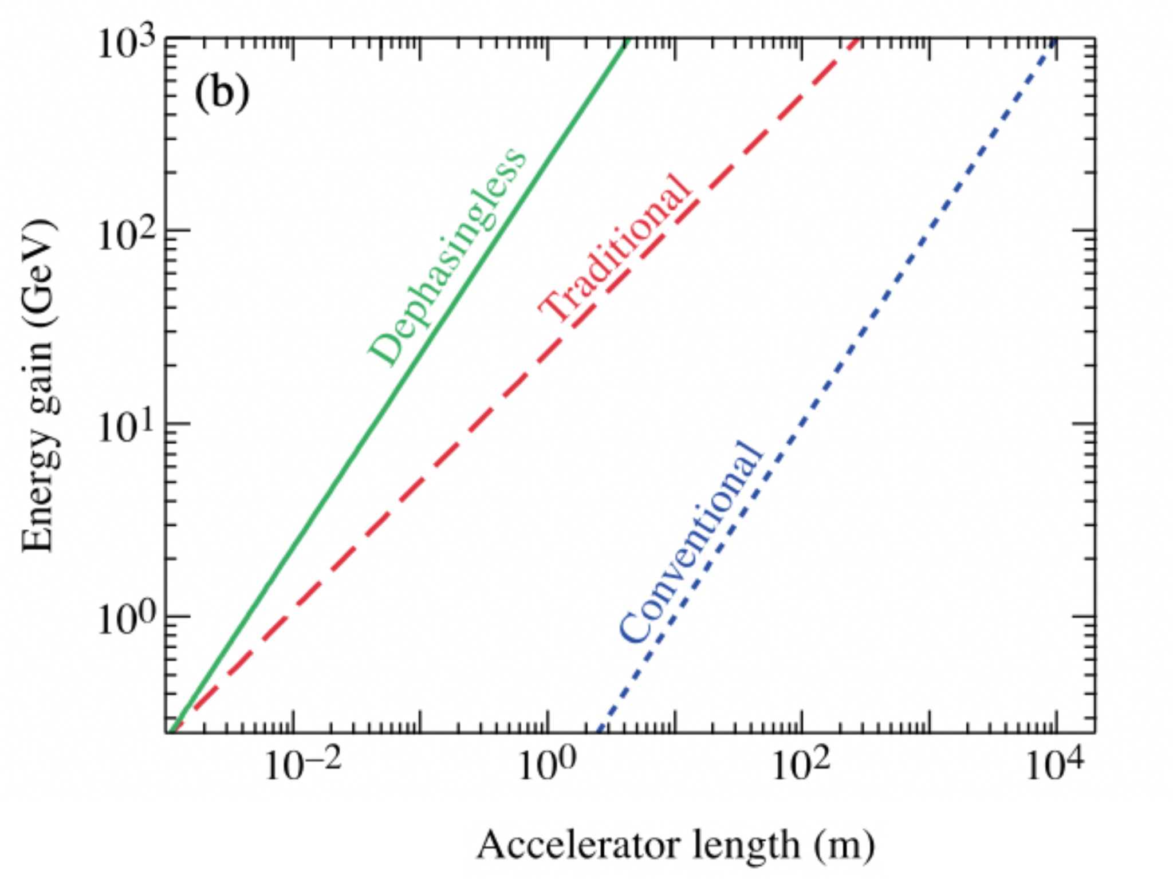

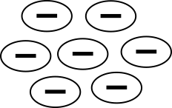
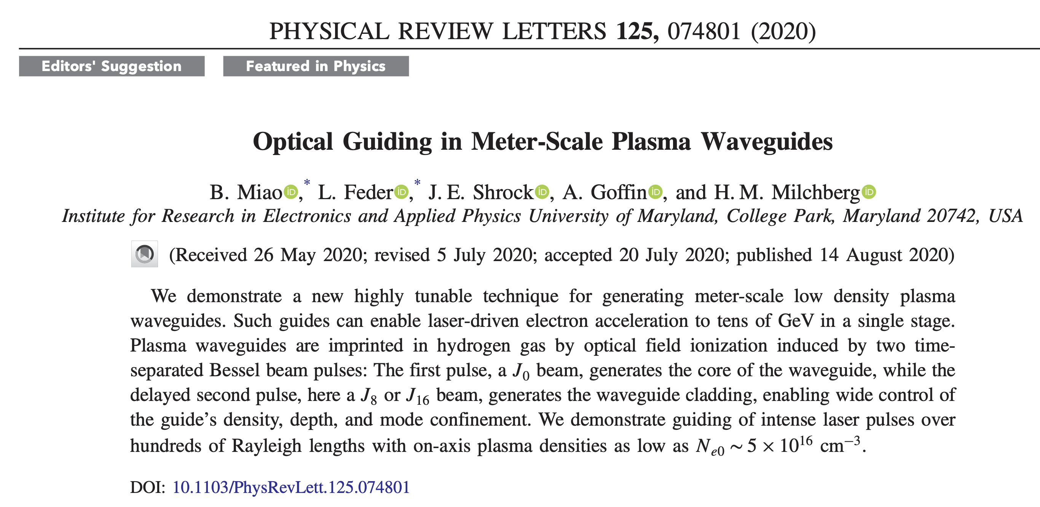
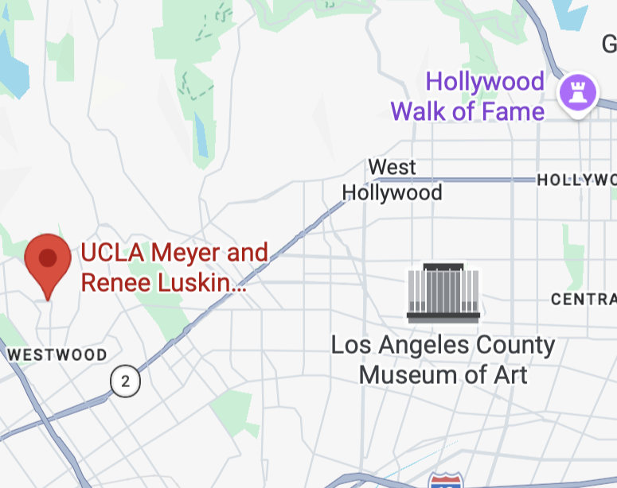
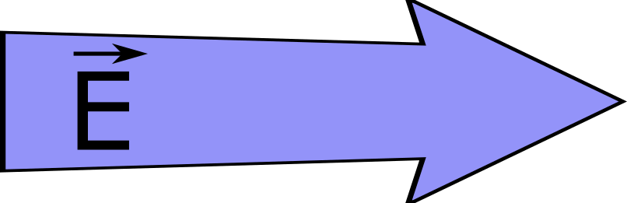
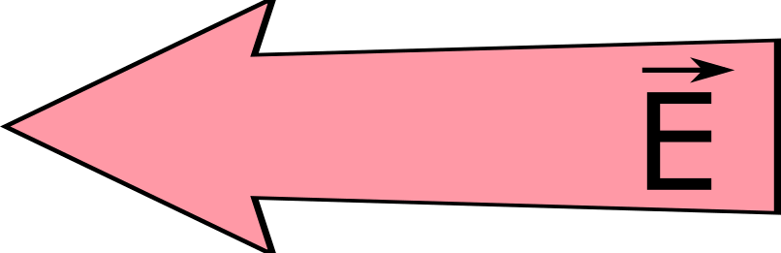
The Dephasing Limit
Problem: Relativistic electrons outpace laser in plasma
4 m
200 m
10,000 m
Solution: Need to speed up the bubble (and therefore the laser driver)
J. P. Palastro et al., 2020.
AAC 2026

Slide 7
The Need for High Energy Electron Beams
The Dephasing Limit
Near-Field: Spatio-Temporal Couplings (STCs)
Far Field: Axiparabola
Axiparabola Velocity Measurement
Femtosecond Relativistic Electron Microscopy (FREM)
First Electrons + Partial Mitigation of Dephasing
AAC 2026
7

Slide 8
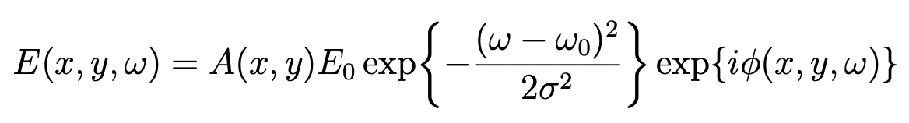


Spatio-Temporal Couplings (STCs)
-
Spatio-Temporal couplings spatially-dependent chromatic effects
For Gaussian:
wavefront
pulse front
$$x$$
$$x_{0}$$
PFC – Pulse Front Curvature
8
AAC 2026

Slide 9
The Need for High Energy Electron Beams
The Dephasing Limit
Near-Field: Spatio-Temporal Couplings (STCs)
Far Field: Axiparabola
Axiparabola Velocity Measurement
Femtosecond Relativistic Electron Microscopy (FREM)
First Electrons + Partial Mitigation of Dephasing
AAC 2026
9

Slide 10
The Axiparabola
parabola
axiparabola
f
δ
f
Smartsev et. al., Opt. Lett. 44, 14 (2019)
AAC 2026

Slide 11
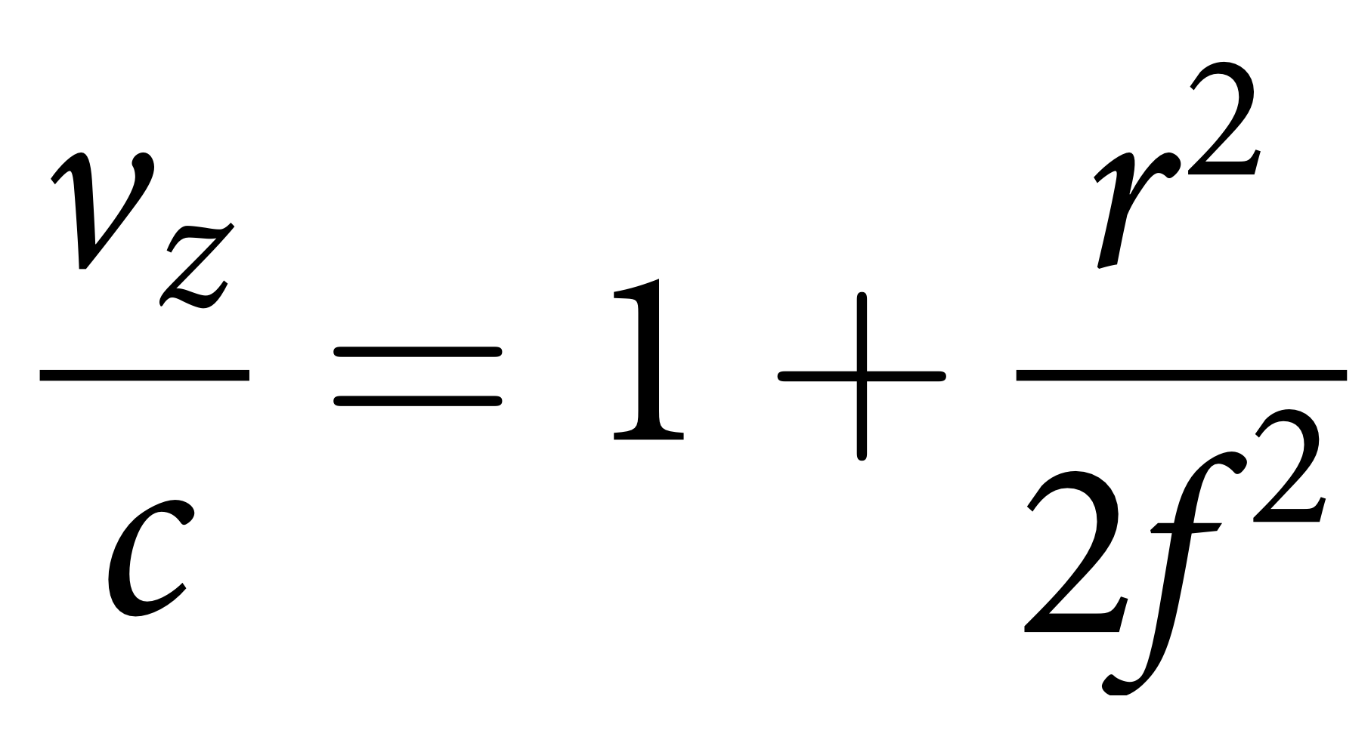
Intensity Propagation Dynamics
“Appearance” velocity is superluminal
axiparabola
Caizergues et. al., Nat. Phot. 14, 475–479 (2020)
AAC 2026

Slide 12
Axiparabola + STCs
t₀ t₁ t₂
Caizergues et. al., Nat. Phot. 14, 475–479 (2020)
AAC 2026
12

Slide 13
The Need for High Energy Electron Beams
The Dephasing Limit
Near-Field: Spatio-Temporal Couplings (STCs)
Far Field: Axiparabola
Axiparabola Velocity Measurement
Femtosecond Relativistic Electron Microscopy (FREM)
First Electrons + Partial Mitigation of Dephasing
AAC 2026
13

Slide 14
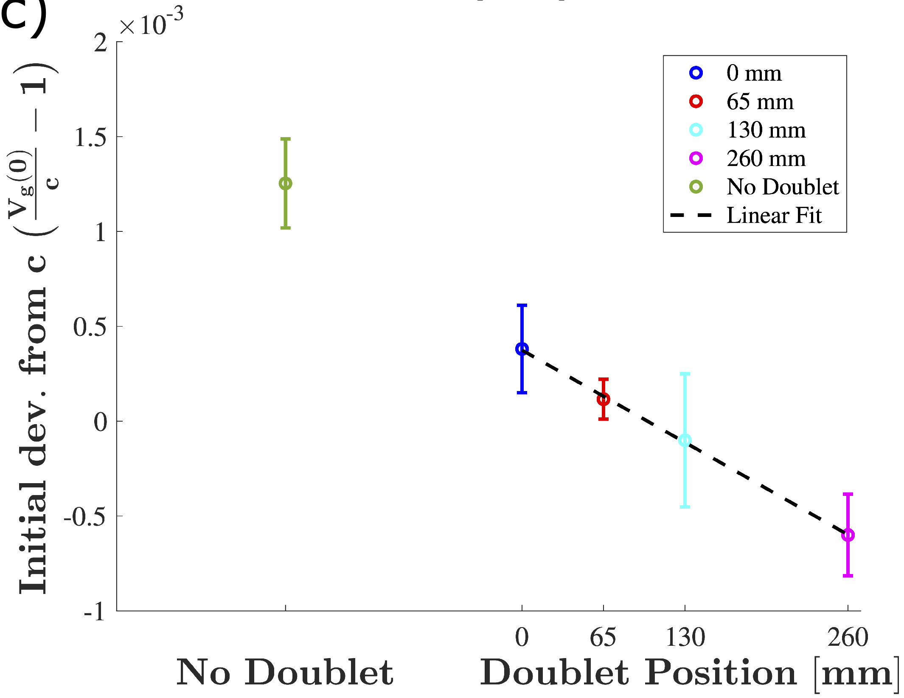

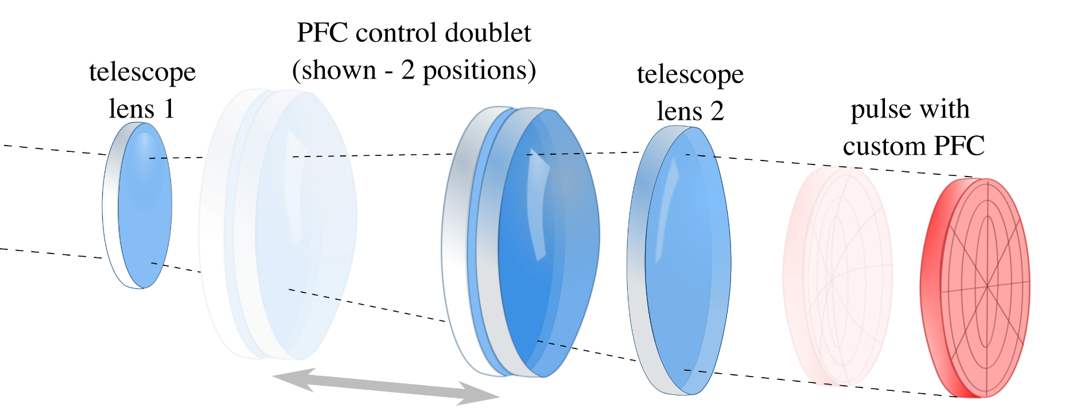
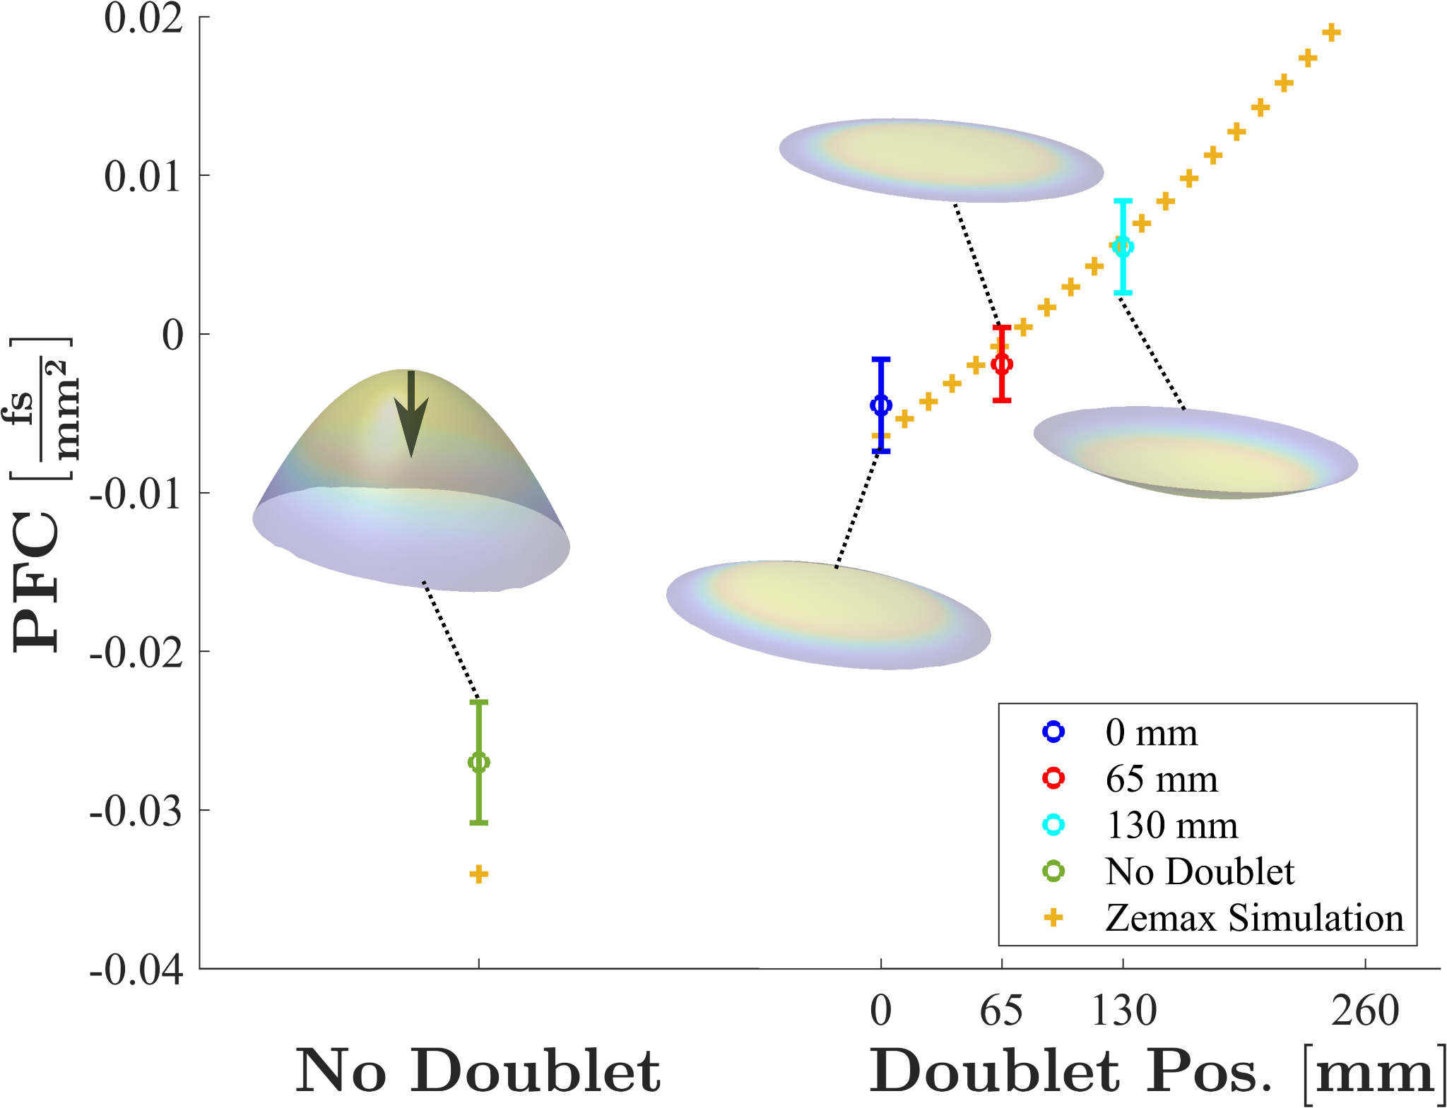
Axiparabola Velocity Measurement
\
Measurement: Smartsev et al., J. Opt. 24 115503 (202 2)
Liberman et al., Opt. Let. 49 (2024)
One Shot: S. Smartsev*, A. Liberman* et al., Opt. Lett. 49 (2024)
A. Liberman and S. Smartsev, OPN Optics in 2024
Doublet + Axiparabola – Tunable Velocity
See also: Pigeon et al. Opt. Exp. 32 (2024)
Refractive doublet for PFC Control:
PFC Values
Liberman et al., Opt. Let. 49 (2024)
AAC 2026
14

Slide 15
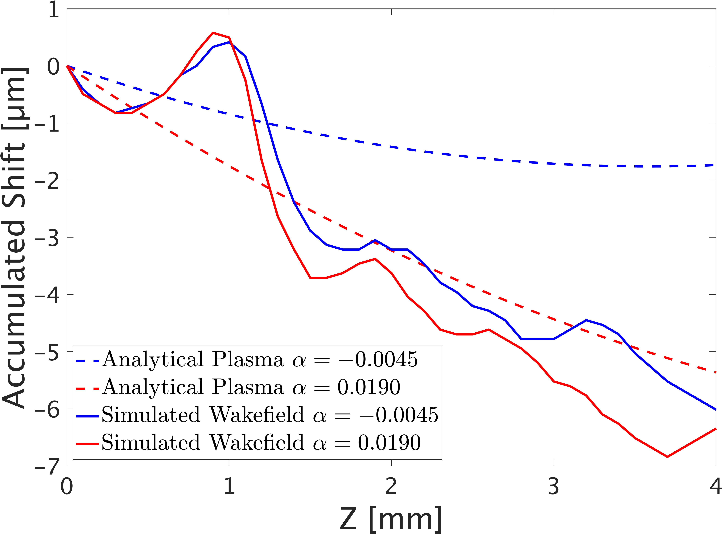
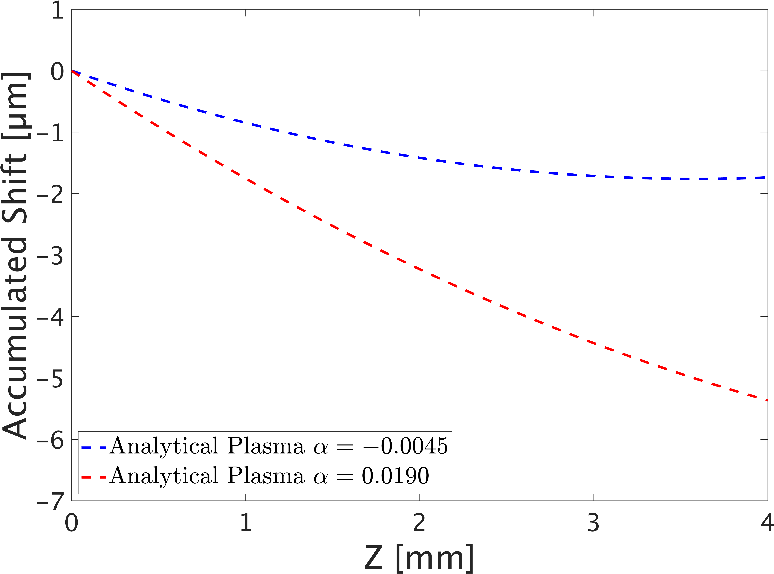
Velocity Measurement – The Challenge
Liberman et al., “First Electron Acceleration in a Tunable-Velocity Laser Wakefield,” Phys. Rev. Res. 8(2) L022001 (2026)
Liberman et al, “Electron Acceleration in a Flying-Focus Generated Laser Wakefield Accelerator,” (under review)
AAC 2026

Slide 16
The Need for High Energy Electron Beams
The Dephasing Limit
Near-Field: Spatio-Temporal Couplings (STCs)
Far Field: Axiparabola
Axiparabola Velocity Measurement
Femtosecond Relativistic Electron Microscopy (FREM)
First Electrons + Partial Mitigation of Dephasing
AAC 2026
16

Slide 17
Femtosecond Relativistic Electron Microscopy
AAC 2026

Slide 18
Femtosecond Relativistic Electron Microscopy
V-Shape
Structure
Data
Sim.
Offset Wakes
Wakefield
Shrinking Wake
Liberman et al., “Direct Observation of a wakefield generated with structured light,” Nature Comm. 16, 10957 (2025)
Liberman et al., “Probing Flying-Focus Wakefields,” Reports on Progress in Physics 89(3) 038501 (2026)
AAC 2026

Slide 19
FREM PFC Comparison
PFC = -0.0019 fs/mm²
PFC = 0.02 fs/mm²
Liberman et al., “Direct Observation of a wakefield generated with structured light,” Nature Comm. 16, 10957 (2025)
Liberman et al., “Probing Flying-Focus Wakefields,” Reports on Progress in Physics 89(3) 038501 (2026)
AAC 2026

Slide 20
FREM Linear and Nonlinear Fields
Liberman et al., “Direct Observation of a wakefield generated with structured light,” Nature Comm. 16, 10957 (2025)
Liberman et al., “Probing Flying-Focus Wakefields,” Reports on Progress in Physics 89(3) 038501 (2026)
AAC 2026

Slide 21
FREM Comparison to Parabola
Parabolic
Axiparabolic
Liberman et al., “Direct Observation of a wakefield generated with structured light,” Nature Comm. 16, 10957 (2025)
Liberman et al., “Probing Flying-Focus Wakefields,” Reports on Progress in Physics 89(3) 038501 (2026)
AAC 2026

Slide 22
The Need for High Energy Electron Beams
The Dephasing Limit
Near-Field: Spatio-Temporal Couplings (STCs)
Far Field: Axiparabola
Axiparabola Velocity Measurement
Femtosecond Relativistic Electron Microscopy (FREM)
First Electrons + Partial Mitigation of Dephasing
AAC 2026
22

Slide 23
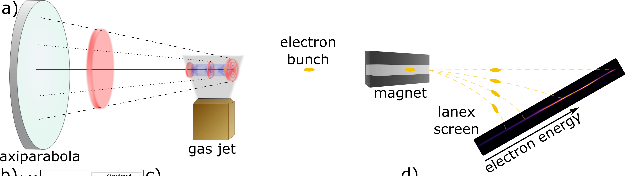
Electron Acceleration - Setup
Liberman et al., “First Electron Acceleration in a Tunable-Velocity Laser Wakefield,” Phys. Rev. Res. 8(2) L022001 (2026)
Liberman et al, “Electron Acceleration in a Flying-Focus Generated Laser Wakefield Accelerator,” (under review)
AAC 2026

Slide 24
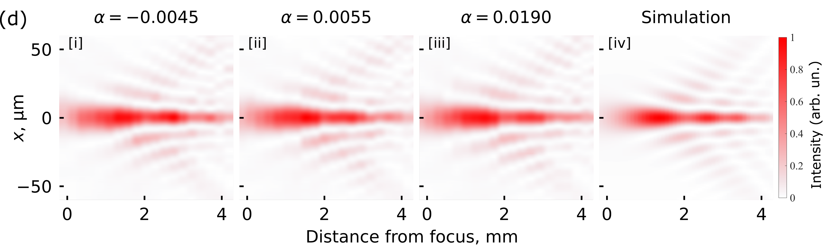
Electron Acceleration – Laser Params
Liberman et al., “First Electron Acceleration in a Tunable-Velocity Laser Wakefield,” Phys. Rev. Res. 8(2) L022001 (2026)
Liberman et al, “Electron Acceleration in a Flying-Focus Generated Laser Wakefield Accelerator,” (under review)
AAC 2026

Slide 25
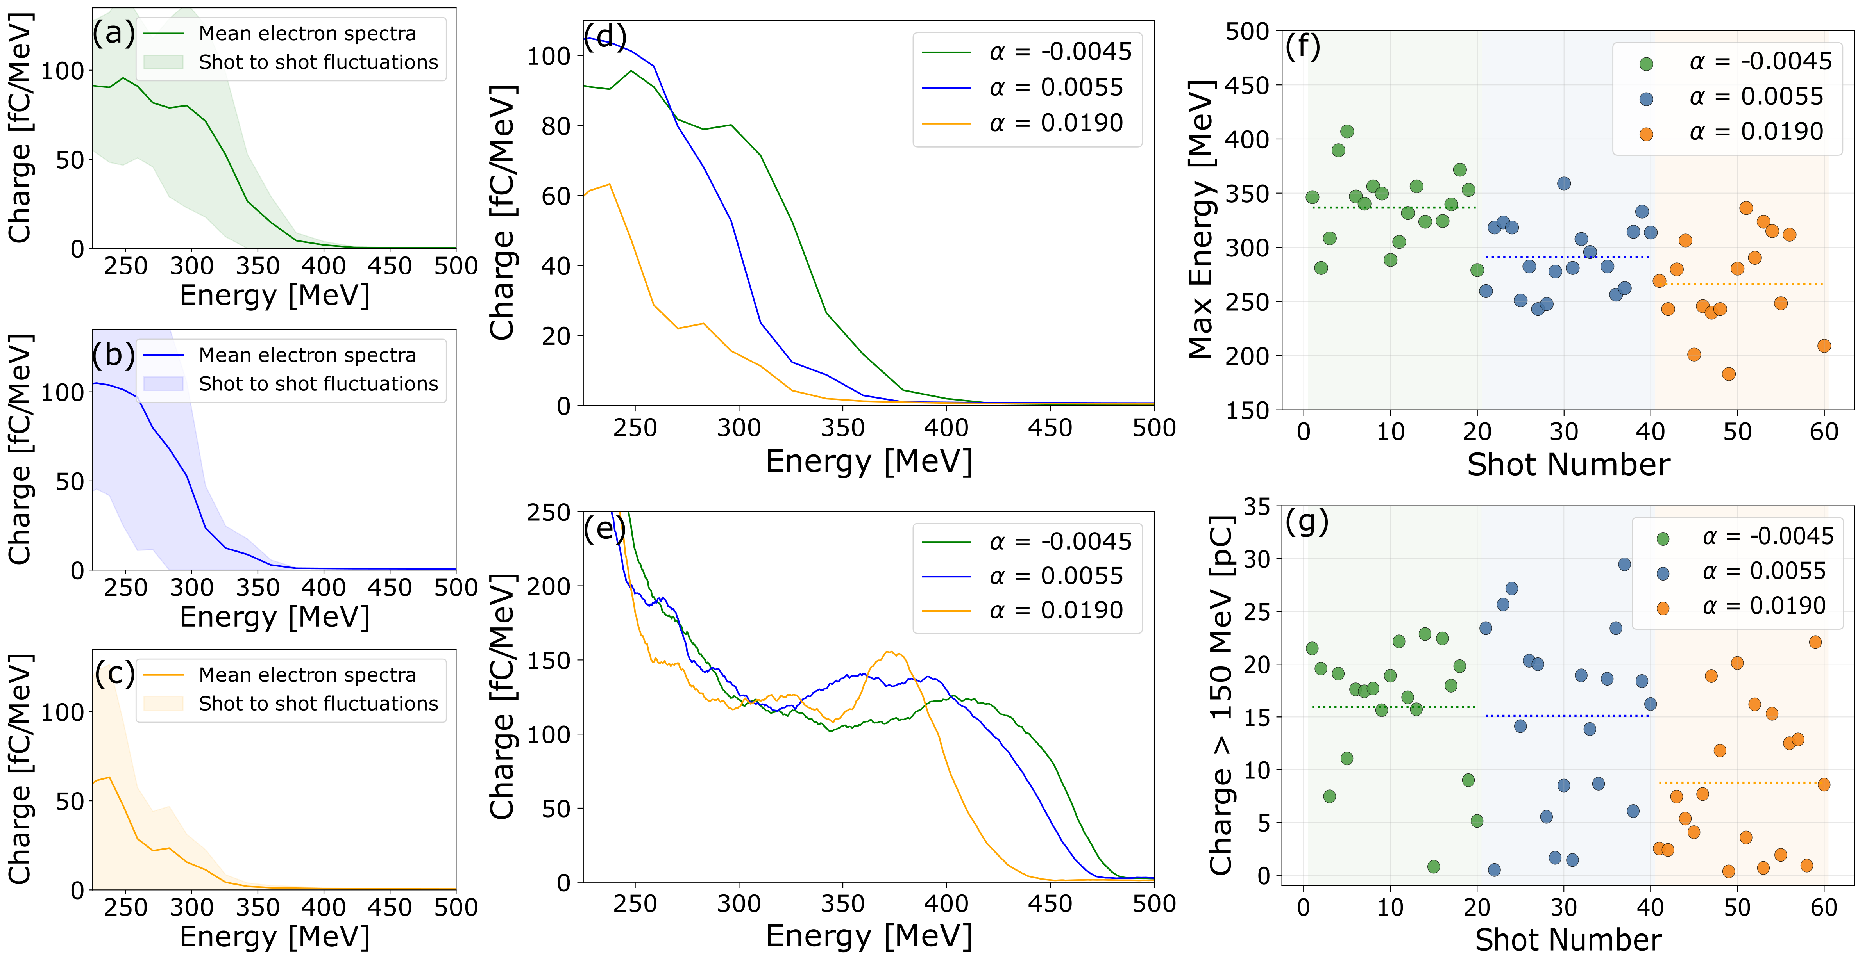
First Acceleration of Electrons!
x
α = -0.0045
Cutoff energy dependent on
wakefield velocity!
x
α = 0.0055
x
α = 0.0190
Energy dependence reconstructed!
Liberman et al., “First Electron Acceleration in a Tunable-Velocity Laser Wakefield,” Phys. Rev. Res. 8(2) L022001 (2026)
Liberman et al, “Electron Acceleration in a Flying-Focus Generated Laser Wakefield Accelerator,” (under review)
AAC 2026

Slide 26
Partial Mitigation of Dephasing
--- Dephased Electron --- Zero-point E-Field
--- Laser Centroid
See also: Arrowsmith et al. Nat. Phys. (2026)
Liberman et al., “First Electron Acceleration in a Tunable-Velocity Laser Wakefield,” Phys. Rev. Res. 8(2) L022001 (2026)
Liberman et al, “Electron Acceleration in a Flying-Focus Generated Laser Wakefield Accelerator,” (under review)
AAC 2026

Slide 27
Summary
Dephasing limits the achievable electron energy – hurts potential applications
Structuring light using STCs and an axiparabola – possible solution
Experimentally demonstrated ability to tune propagation velocity
Used FREM to probe the structure of this novel wakefield
Experimentally demonstrated electron acceleration
Experimentally demonstrated electron energy dependence on wakefield velocity
AAC 2026

Slide 28
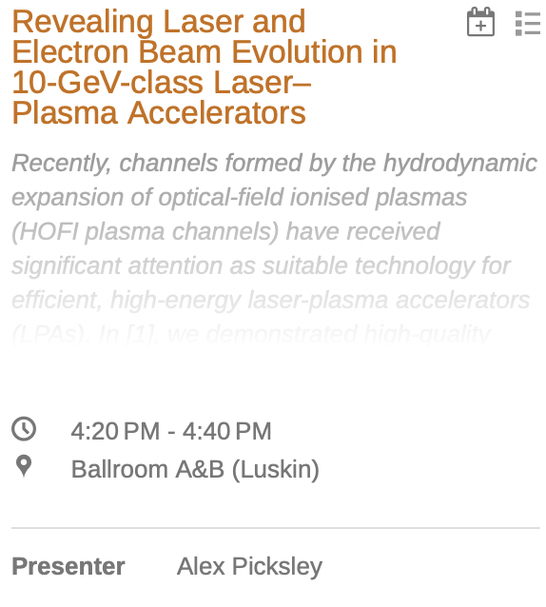
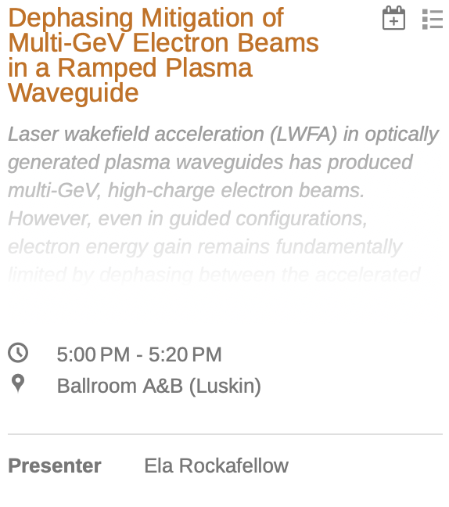
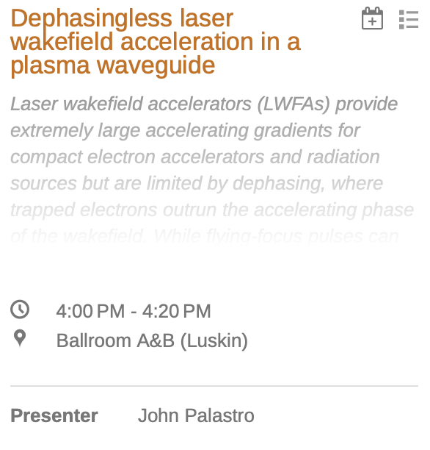
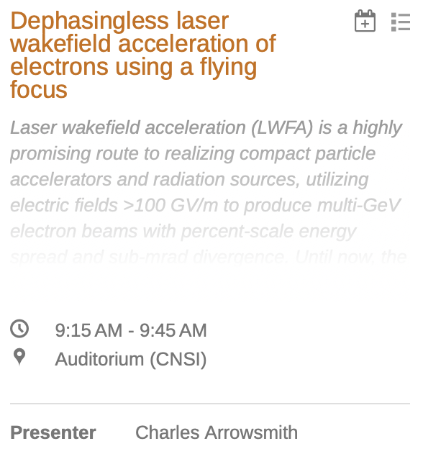
Related Talks to Check Out
Today
Tuesday
Friday
AAC 2026

Slide 29









Thank You
Anton Golovanov
Anda-Maria Talposi
Sheroy Tata
Eitan Levine
Salome Benracassa
Eyal Kroupp
Victor Malka
Slava Smartsev
Igor Andriyash
Ronan Lahaye
Cedric Thaury
Jerome Faure
ExCoMet
WIS-CNRS (IPR LAMA)

