Slide 1


Advanced Accelerator Concepts (AAC)
Jul 26 – 31, 2026
Very high energy electrons from multi-Petawatt LWFA in a transitional regime
On behalf of E50122 beamtime / collaboration
Calin ioan hojbota
Principal Investigator & Research Associate,
The University of Texas at Austin
26/07/2026

Slide 2
Contents
Introduction
Setup and conditions
Results
Discussion
Conclusions

Slide 3
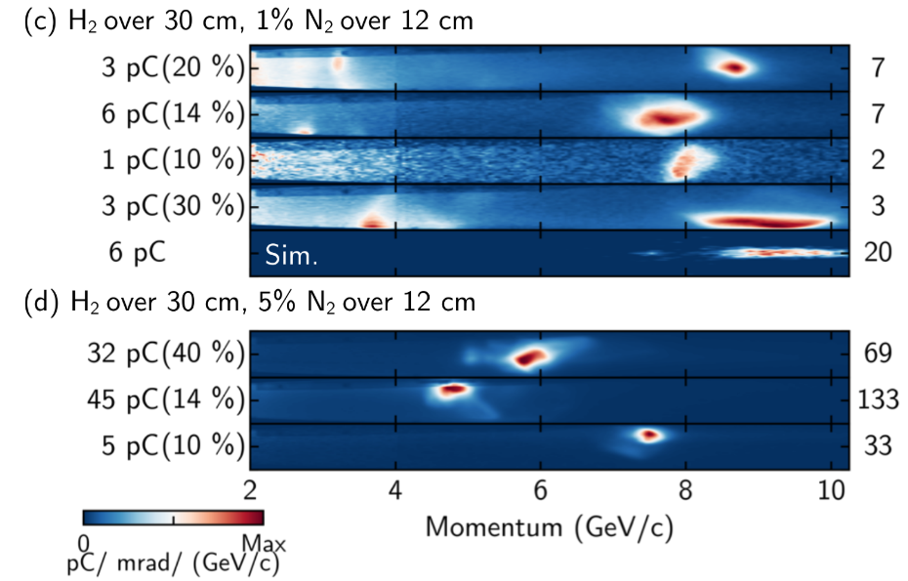
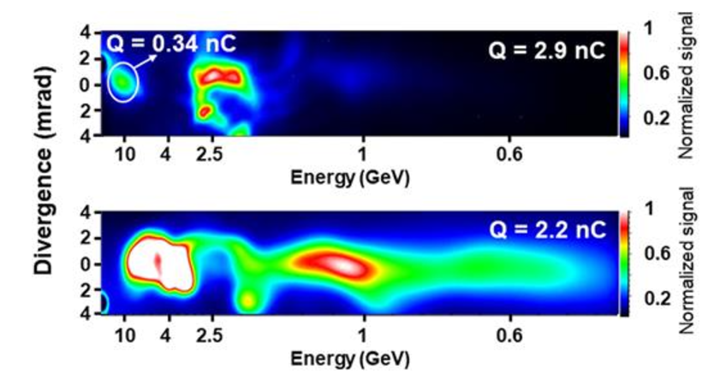
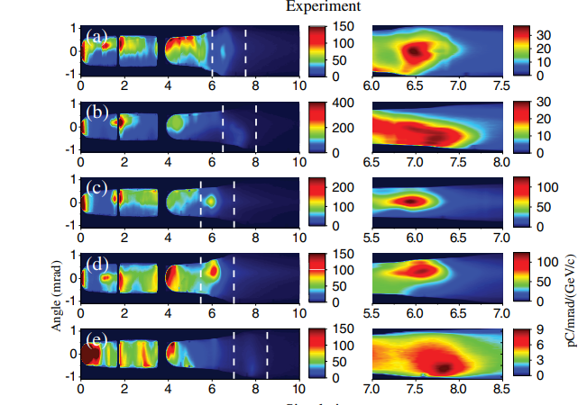
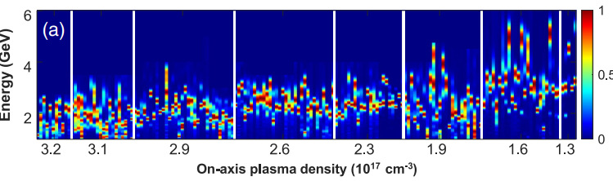
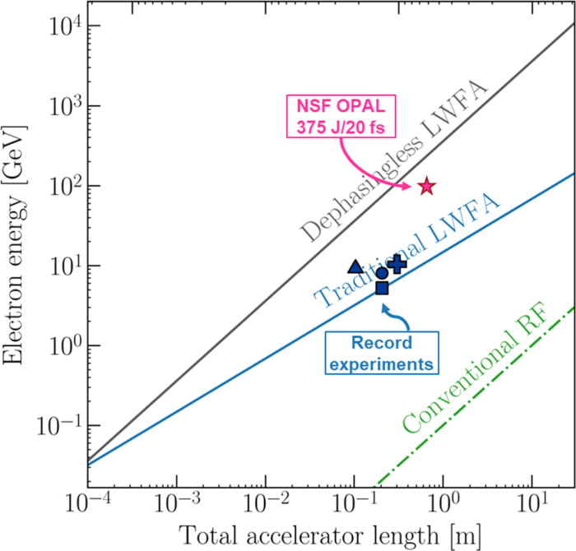
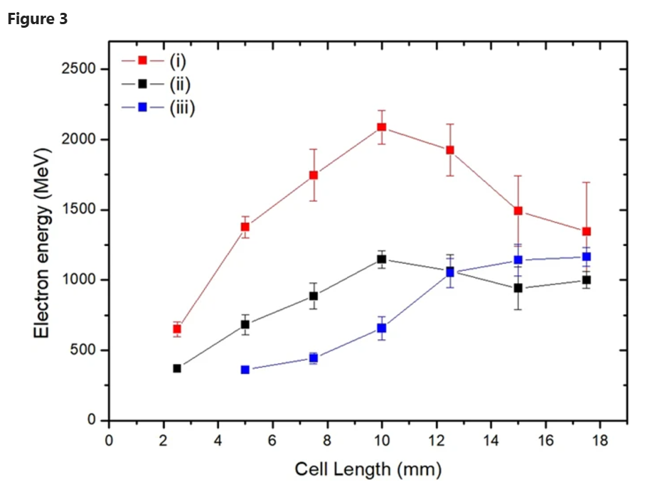
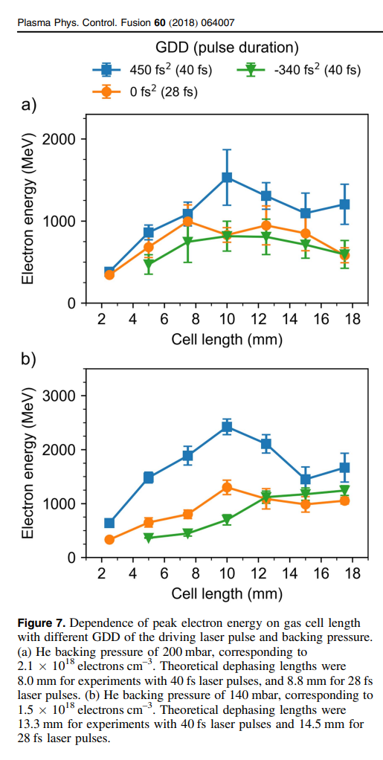
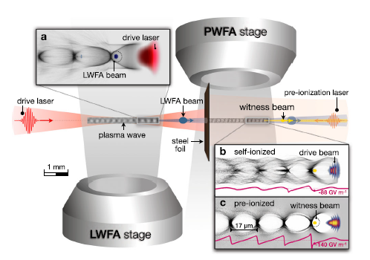
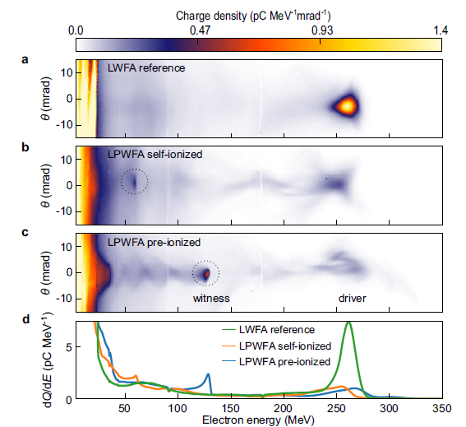
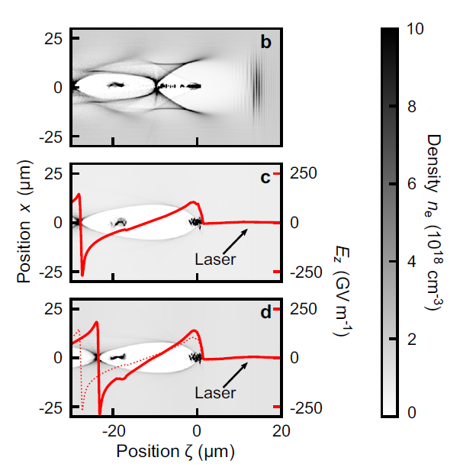
1.1 Introduction - experiment overview and motivation
C. Aniculaesei et al., Matter Rad. Extremes 9, 014001 (2024)
J.E. Shrock et al., Phys. Rev. Lett. 133, 045002 (2024)
A.J. Gonsalves et al., Phys. Rev. Lett. 122, 084801 (2019)
A. Picksley et al., Phys. Rev. Lett. Phys. Rev. Lett. 133, 255001 (2024)
8-10 GeV electron beam energies have been obtained – but the 10 GeV milestone is hard to surpass.
Requirements: guiding, beam shaping, nanoparticles.
What happens if we just use the available laser energy for LWFA?
There were some clues …
J. Shaw et al., Phys. Plasmas 32, 083107 (2025)
T. Kurz et al., Nat. Comm. 12, 2895 (2021)
J.H. Shin et al., Plasma Phys. Control. Fusion 60 (6), 064007 (2018)
H.T. Kim et al., Sci. Rep. 7 (1), 10203 (2017)

Slide 4
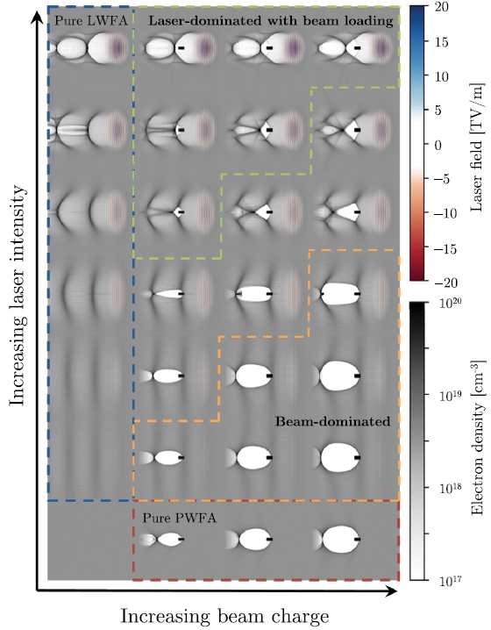
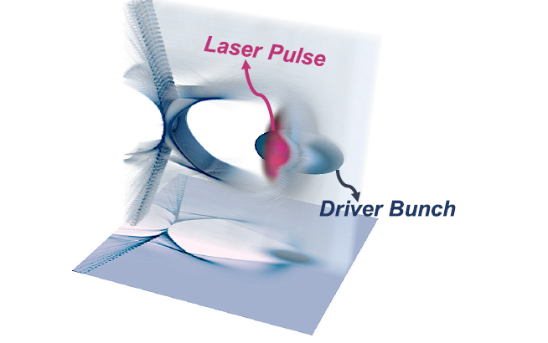
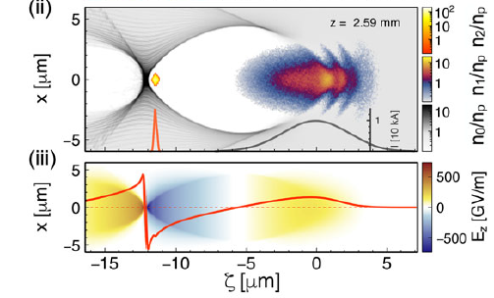
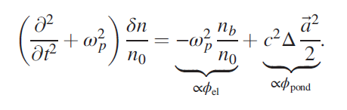


1.2 Introduction - experiment overview and motivation
Dephasing length
Pump depletion length
Maximum energy gain:
Motivation
1) LWFA scaling expectations
  ΔE = 10-14 GeV
  L_{dp} = 262 mm
  L_{pd} = 92 mm
  Q_{max}= ~1 - 3 nC
[n_{e} = 2x10¹⁷/cc, P~4 PW]
Maximum charge:
e-
$$N≈ \left(\frac{8/15}{k_{0}r_{e}}\right){\left(\frac{P}{m_{e}^{2}c^{5}/e^{2}}\right)}^{1/2}≈ 2.5×{10}^{9}\frac{λ_{0}[μm]}{0.8}{\left(\frac{P\left[TW\right]}{100}\right)}^{1/2}$$
W. Lu et al., Phys. Rev. ST Accel. Beams 10, 061301 (2007)
Laser pulse
2) PWFA
  $\tilde{Q}=\frac{N_{b}k_{p}^{3}}{n_{e}}$ > 1 (equivalent of a₀)
3) PWFA + LWFA = LEPA
Martinez de la Ossa et al.,
Trans. R. Soc. A 377, 20180175.(2019)
T. Wang et al.,
Phys. Rev. Accel. Beams 23, 111304 (2020)
J. Götzfried et al.,
Phys. Rev. X 10, 041015 (2020)

Slide 5





1.3 Introduction - collaboration
C. I. Hojbota (PI), O. Z. Labun, D. D. Phan, R. Sain, D. Stec, B.M. Hegelich
A. J. Franco-Altamirano, T. Araujo, R. Zgadzaj, M. C. Downer
B. Diaconescu (Co-PI/LER), L. Tudor, V. Nastasa, L. Neagu, S. Balascuta, K. Sphor, P.G. Bleotu, V. Phung Ling Jen, C. Ticos, S. Ter-Avetisyan, M. Patrascoiu, M. Gugiu, S. Popa, V. Popescu, D. Ursescu, A. Dumitru, L. Vasescu, A. Nazaru, D. Nistor, S. Rusnac, A. Lazar, R. Schmelz, I. Dancus, P. Ghenuche (Co-PI), V. Malka, C.A. Ur, et al.
B.Hidding, C. Aniculaesei, M. Cerchez, M. Osenberg, O. Bilen, T. Heinemann, E. Hartmann, N. Thomas, T. Wilson, A. Pukhov
P. Franke, T. Ha, E. McCary, S. Milton, L. Labun, J. Paye, C. Neacsu, G. Tiwari, G. Plateau, H. Smith
V. Winter
Funding: UT Austin - TAU Systems, Inc. SRA; UT Austin, Center for High Energy Density Science (CHEDS);
EURO-LABS Transnational Access Funding (EURO-LABS-IFIN-HH-035);

Slide 6

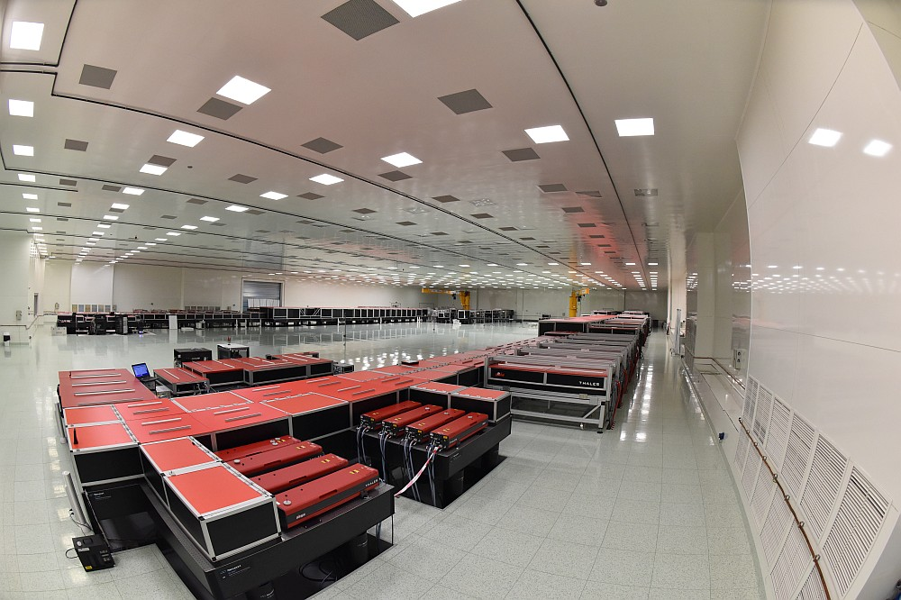
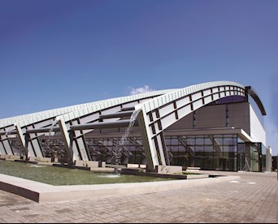
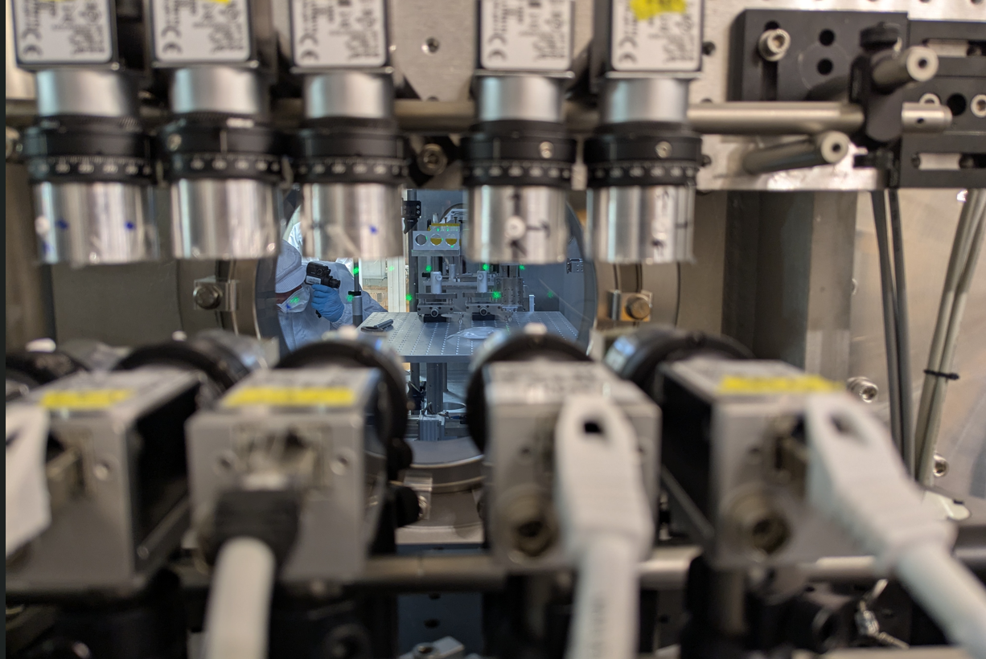
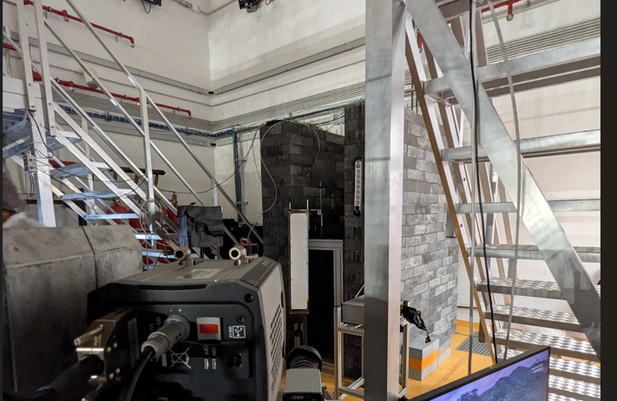
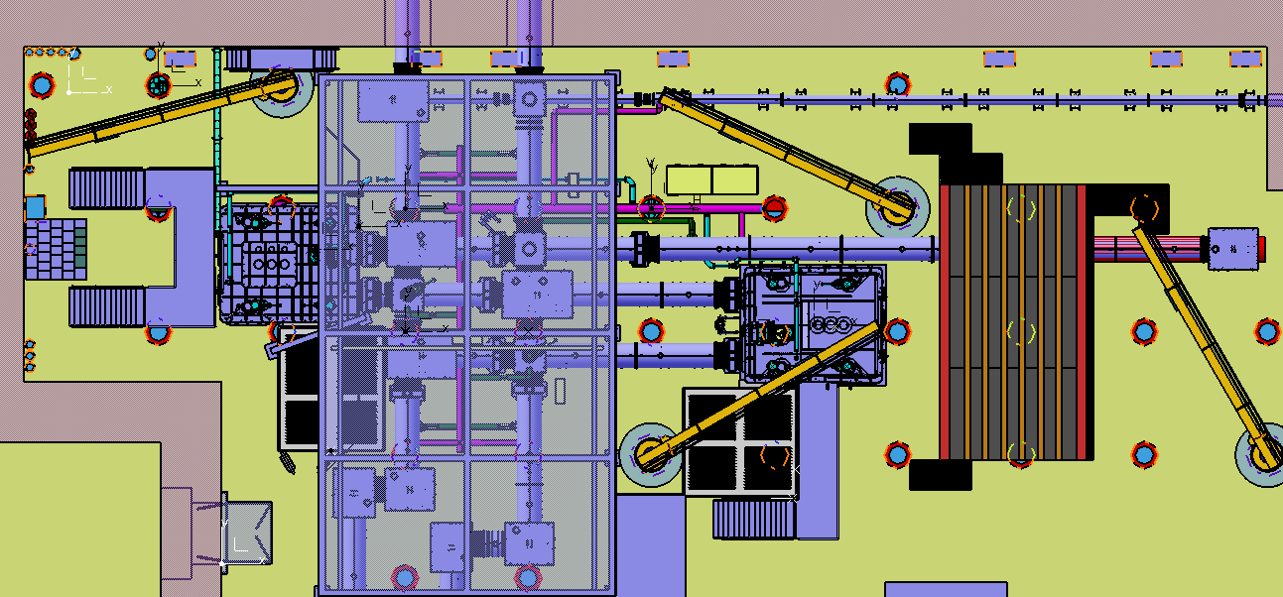
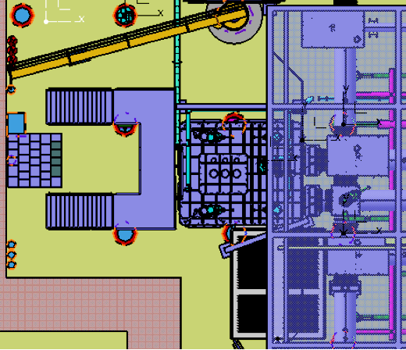
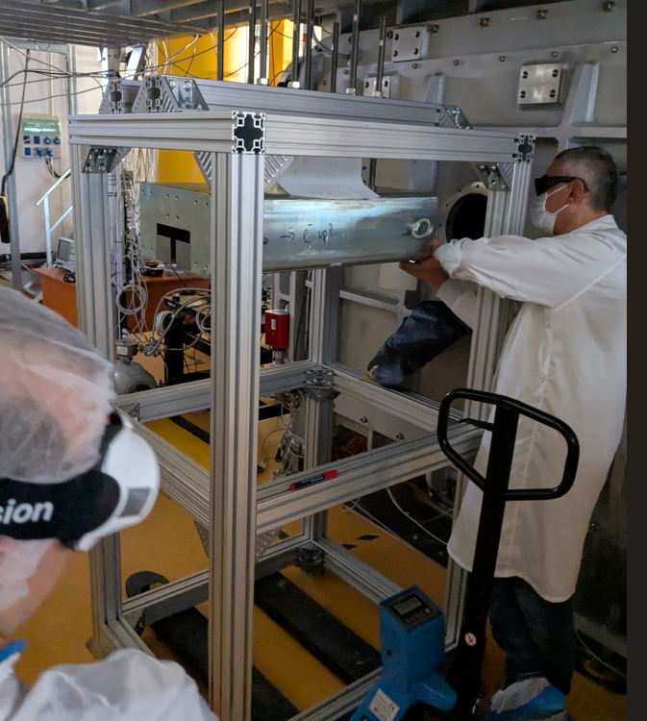
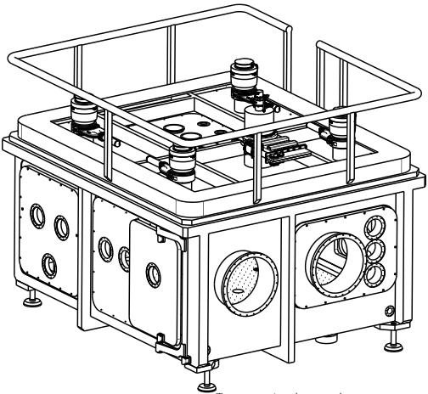
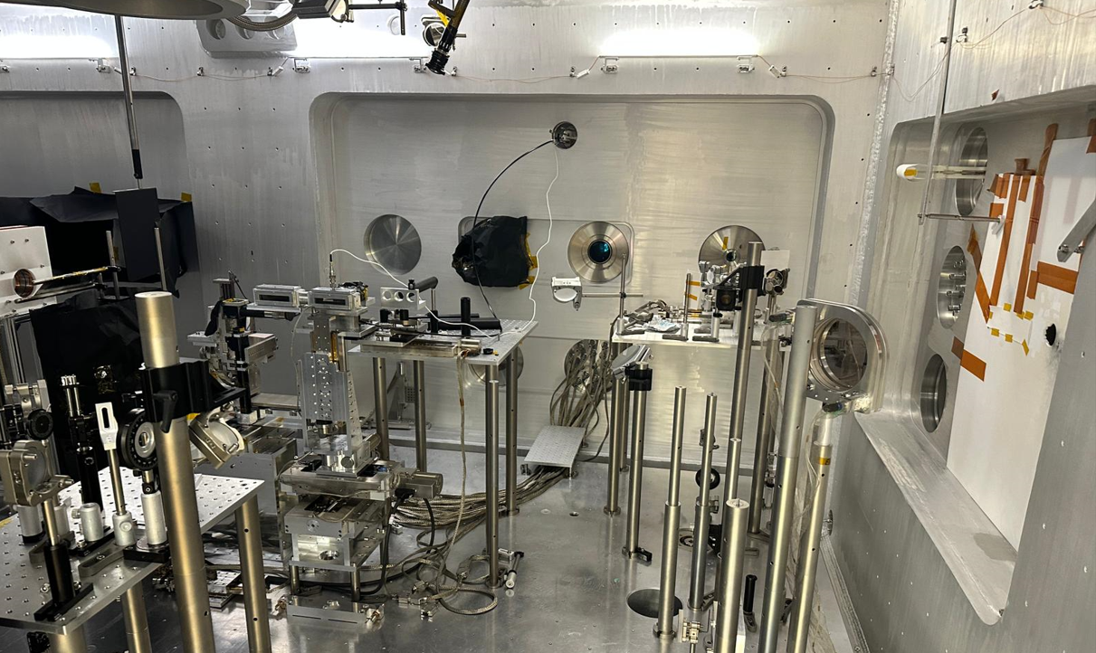
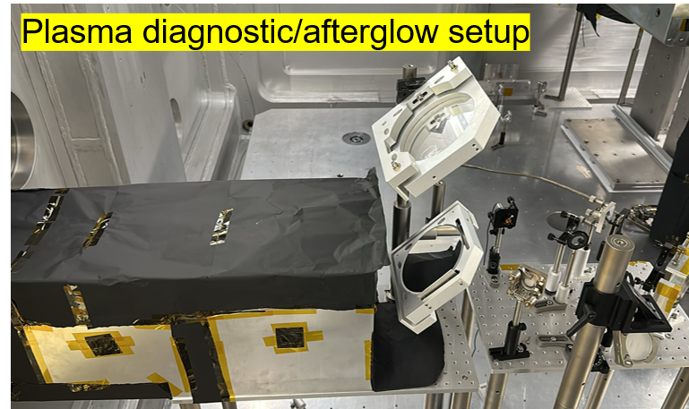
2.1 Setup and conditions – target area (1)
10 PW
Experimental area
Probe beam setup
Additional detection (calorimetry, x/gamma-ray, irradiation)
30 m
Focusing mirror
Electron diagnostic
Experimental chamber

Slide 7
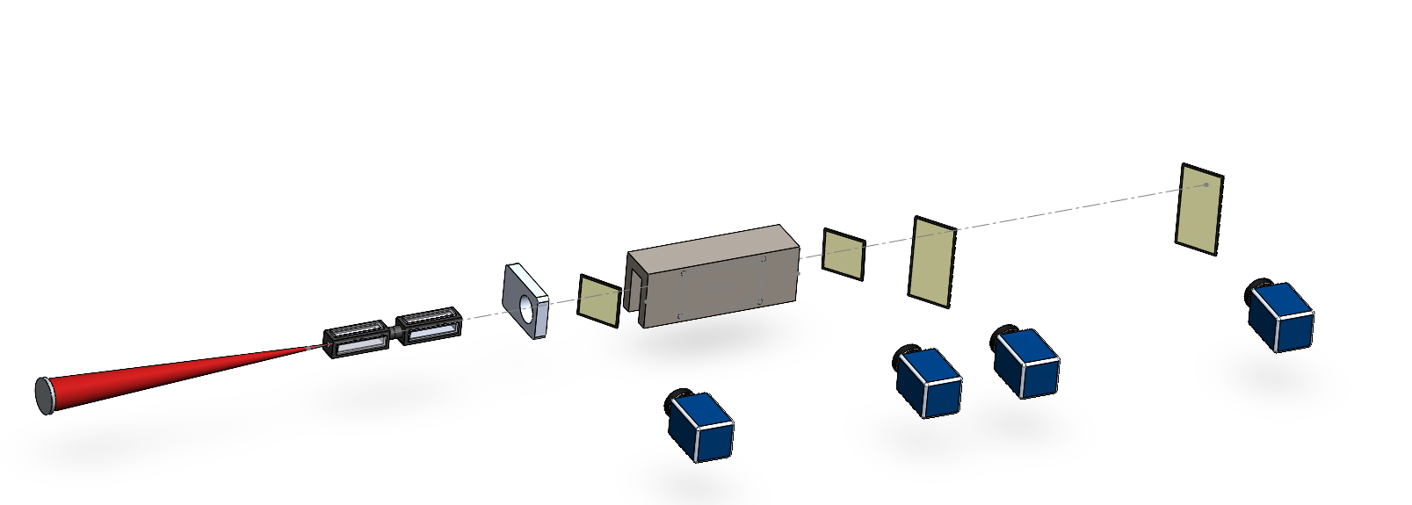
2.2 Setup and conditions – target area (2)
640.8 cm
295.8 cm
Secondary detection area
(calorimetry, x-rays, etc)
245.8 cm
131 cm
114.2 cm
S3
Vacuum chamber
Magnet
(0.8m, 1T)
S2b
ICT
S1
electrons
Gas cell
S2
Laser beam
28 cm
80 cm
F/60, f = 30 m
T = 25 - 35 fs
E = 240 - 300 J
P_{target} = 4-6 PW

Slide 8
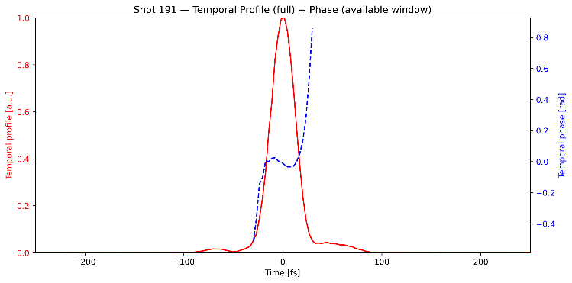
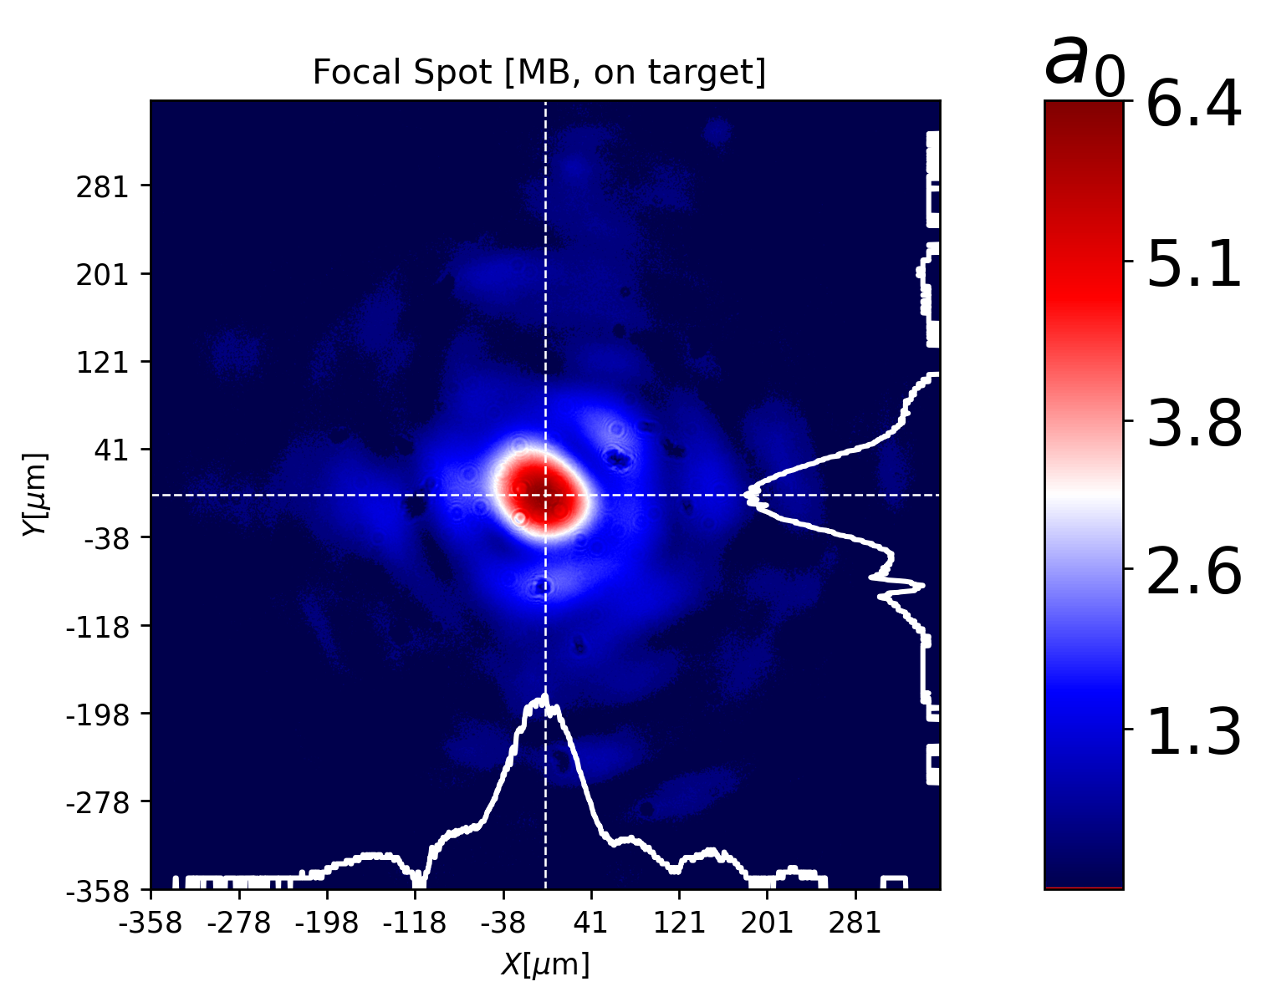
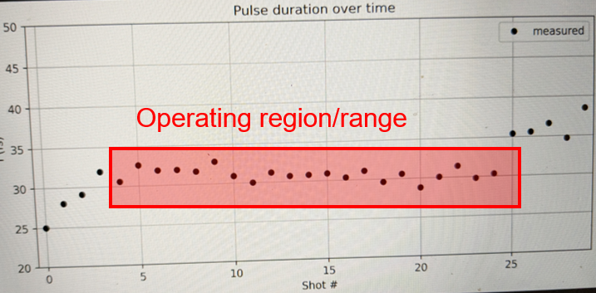
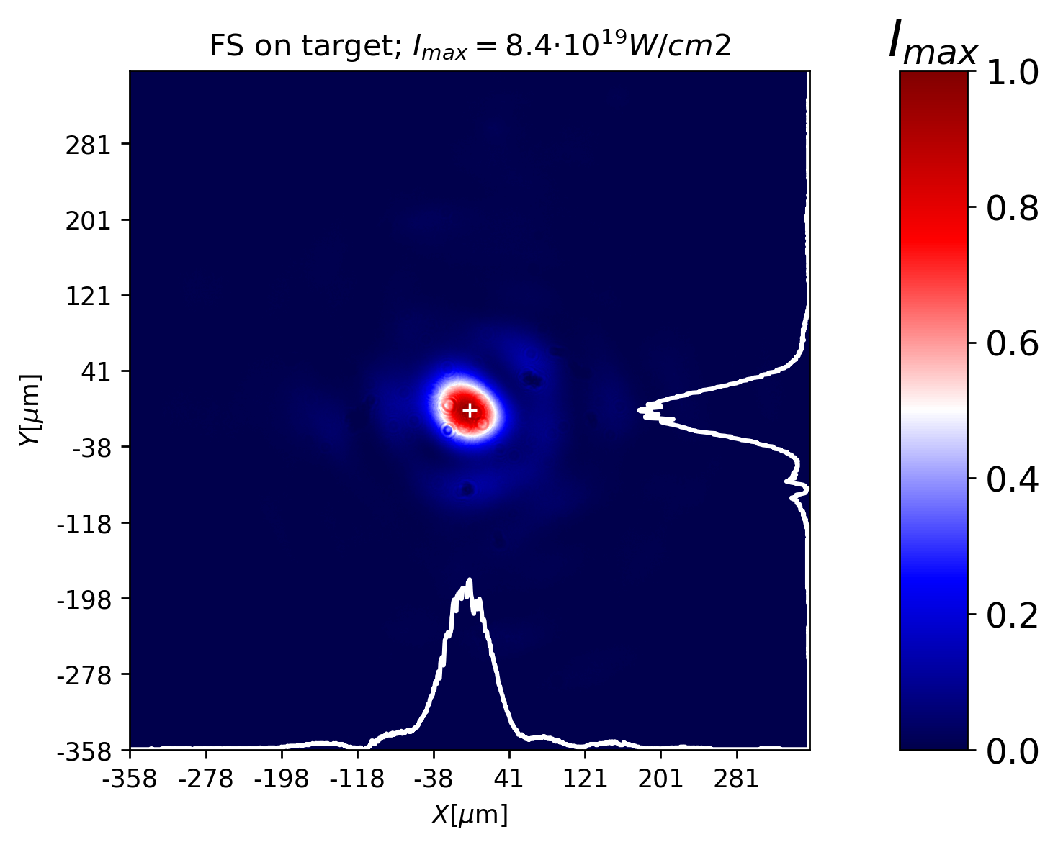
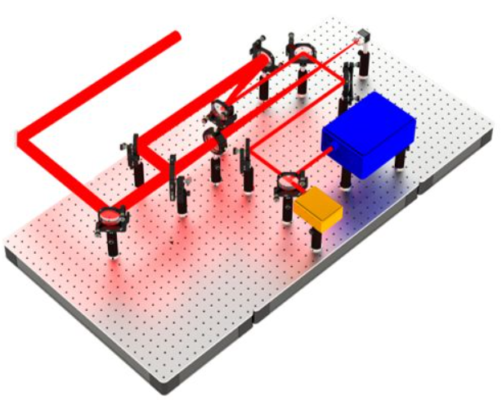
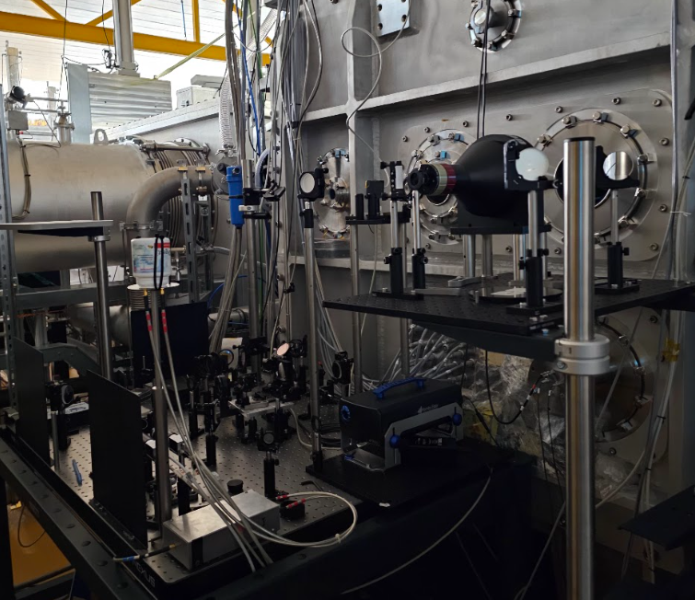
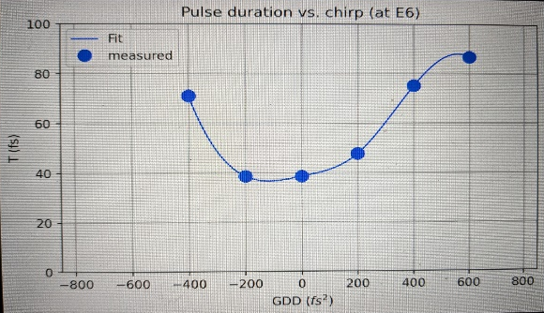

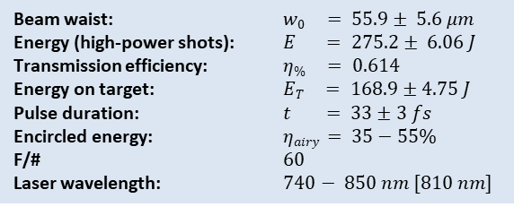
2.3 Setup and conditions - laser status
Operating regime:
$a0 \sim 4−7$
Beam waist: $w0 = 55.9± 5.6 μm$
Energy (high-power shots): $E = 275.2± 6.06 J$
Transmission efficiency: $η\% = 0.614$
Energy on target: $ET = 168.9±4.75 J$
Pulse duration: $t = 33±3 fs$
Encircled energy: $ηairy = 35−55\%$
F/# $60$
Laser wavelength: $740− 850 nm [810 nm]$
On-shot monitoring (pick-up):
Temporal profile
Spectral phase
Energy
Pointing
Transverse profile
Online laser diagnostic setup

Slide 9
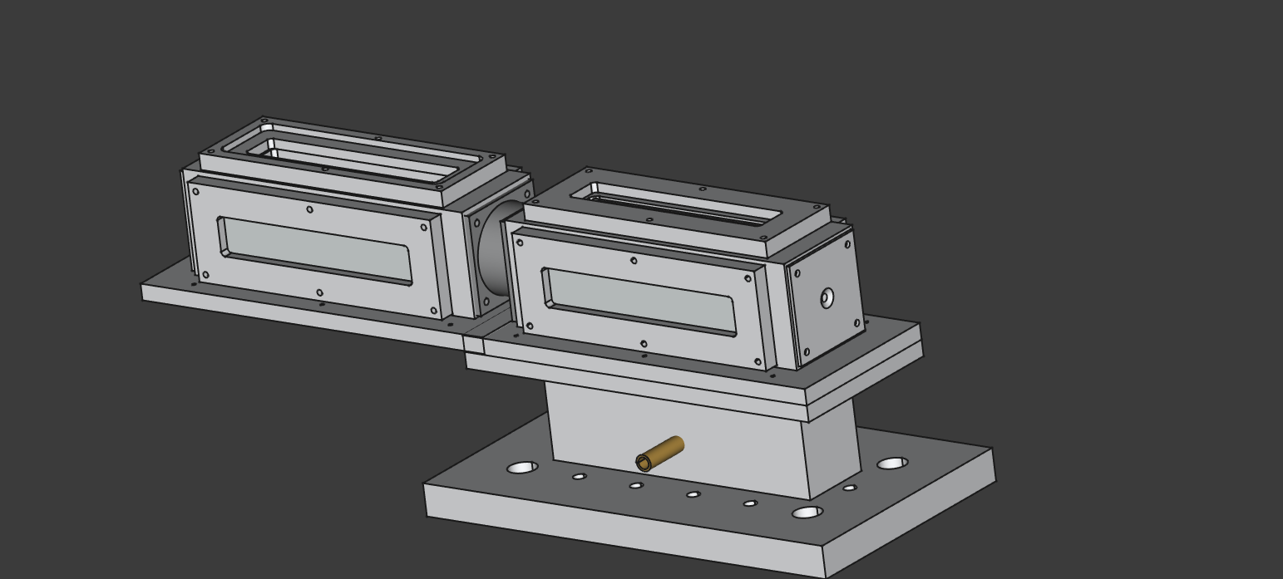
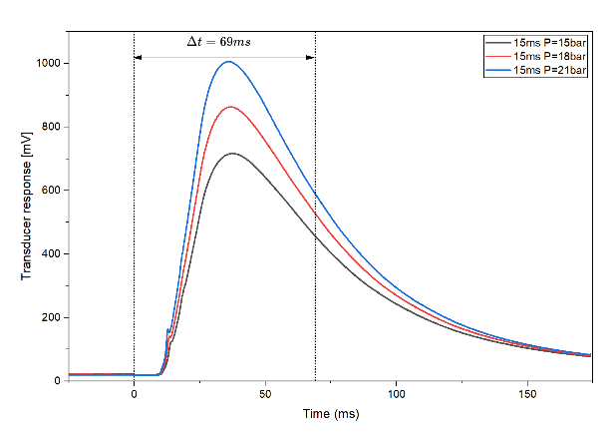
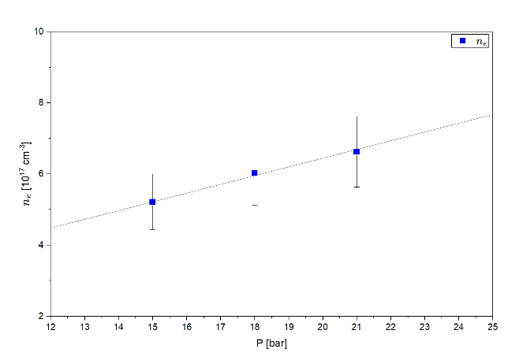
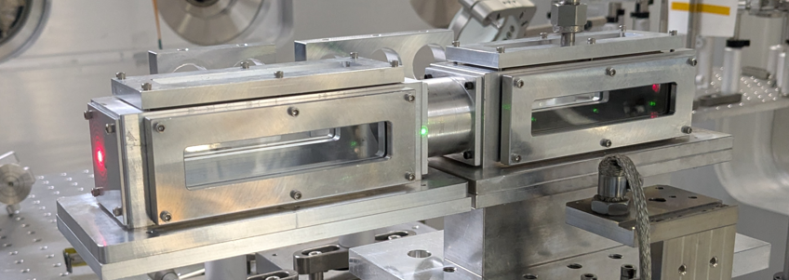
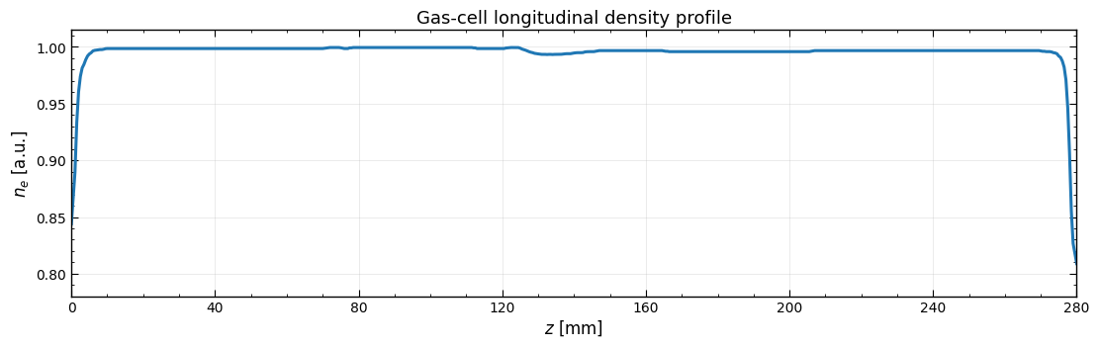
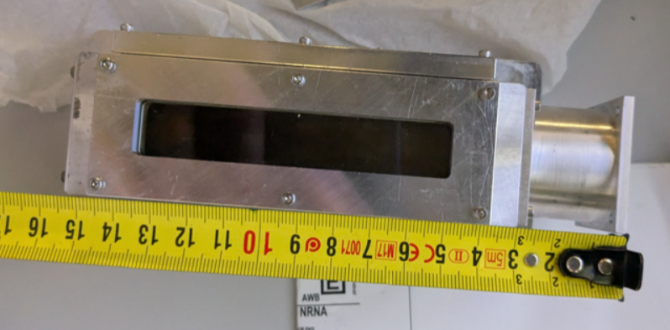
2.4 Setup and conditions - target
28 cm
Gas medium
He 100%
He 99% / N₂ 1%
He 97% / N₂ 3%
He 95% / N₂ 5%
He 97% / Ne 3%
Laser beam
Gas flow timing
Density measurements
Double gas cell: 28 cm (2x12.5 cm + 3cm separator)
Single cell configuration
15.5 cm
(12.5 cm + 3cm extension)
Ansys FLUENT simulations

Slide 10
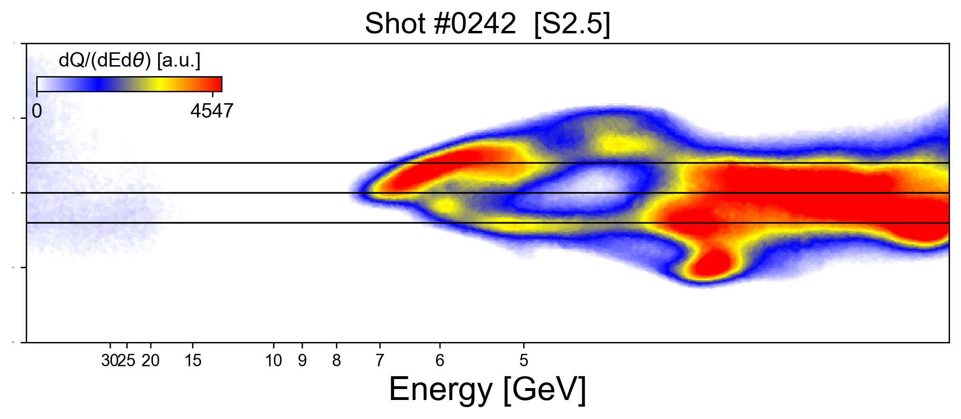
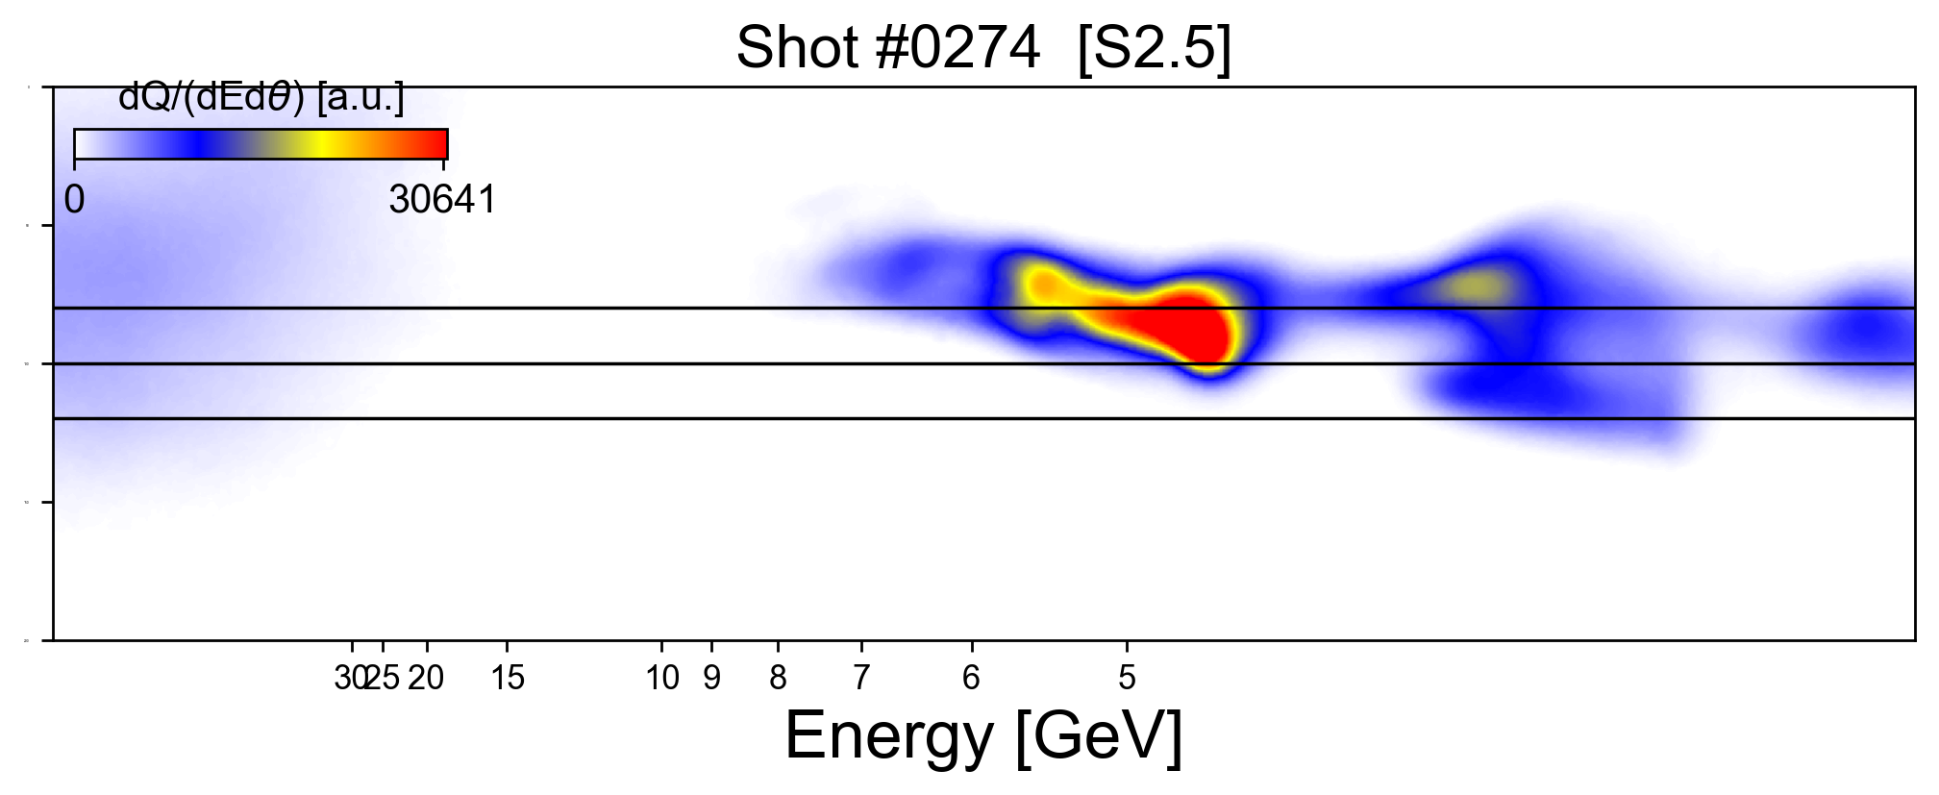
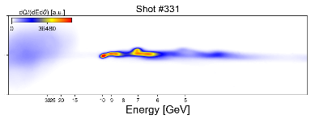
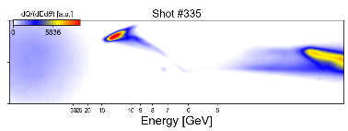
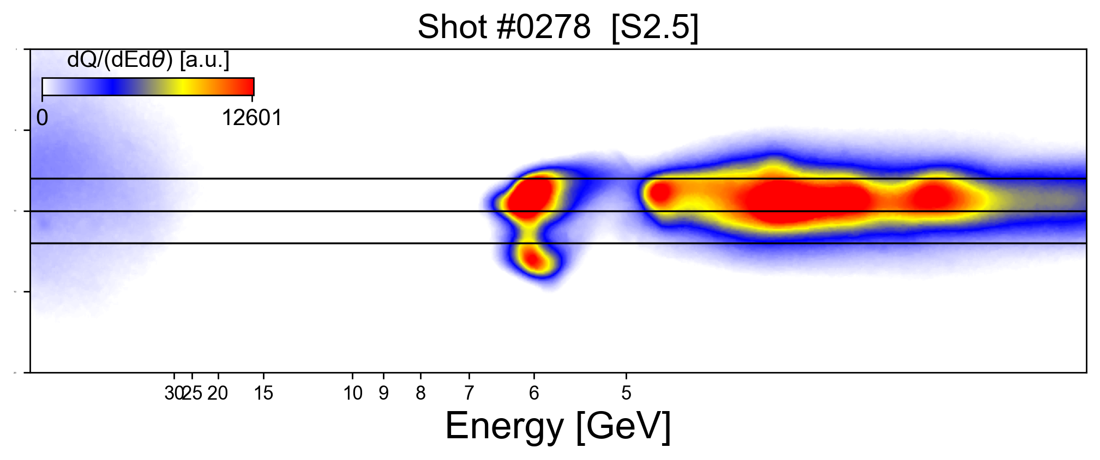
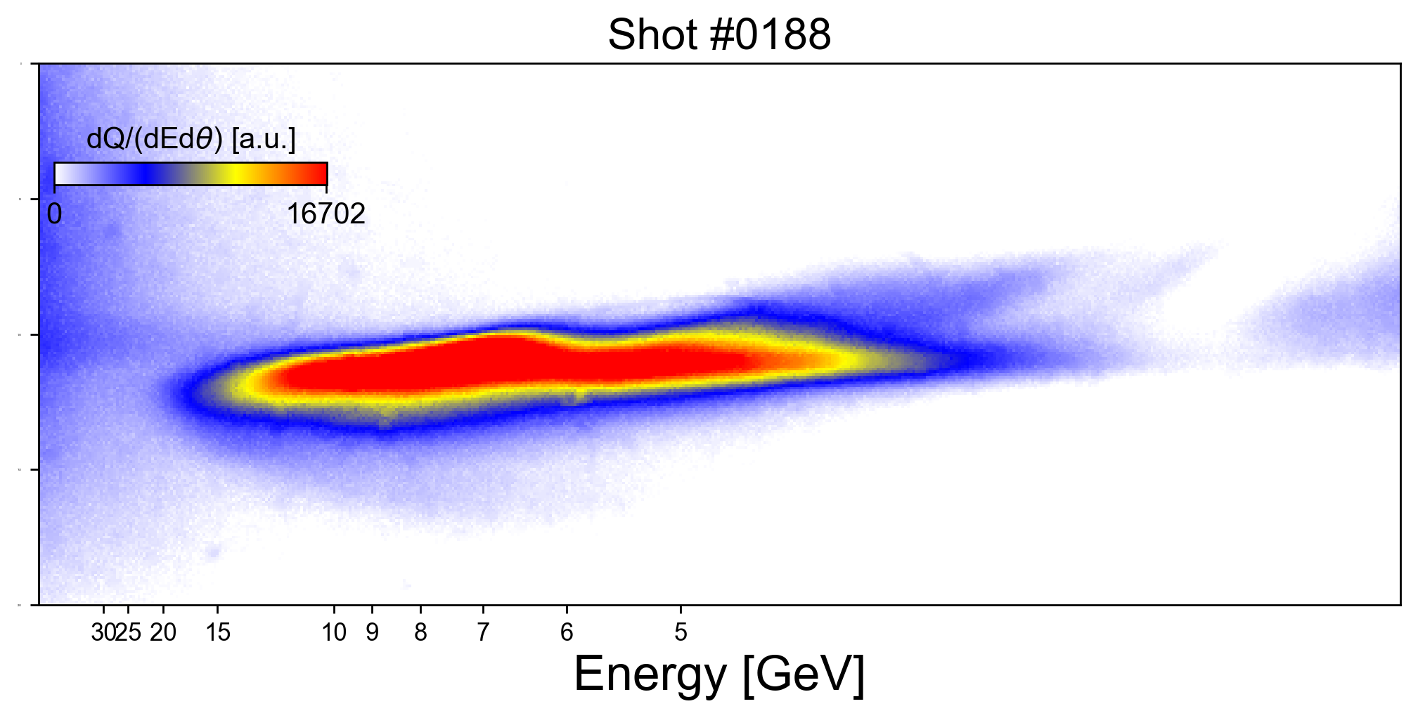
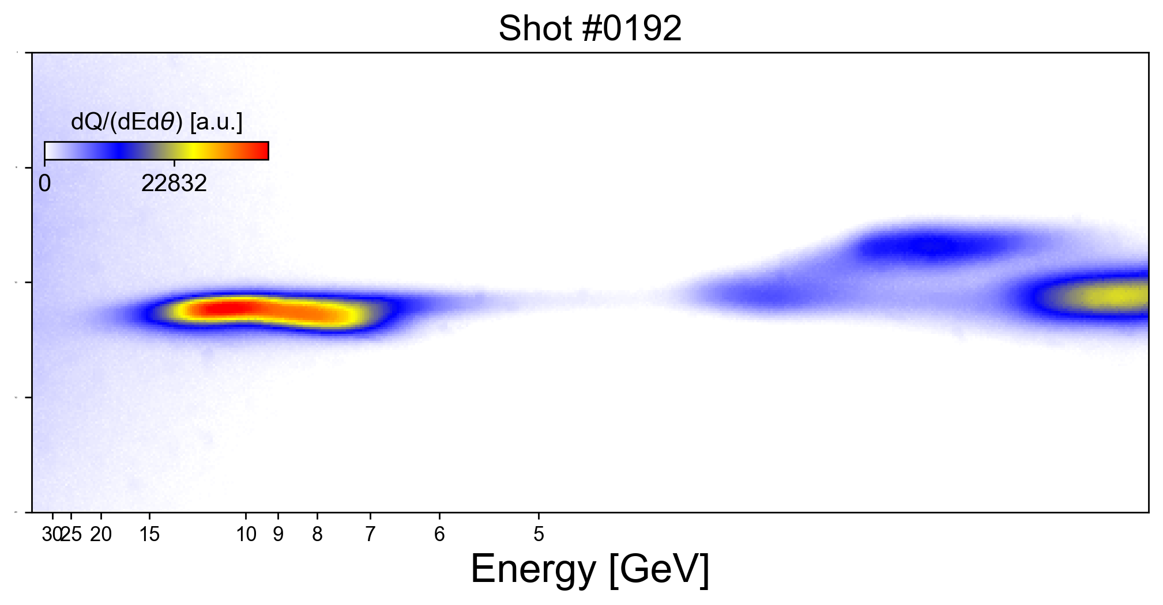
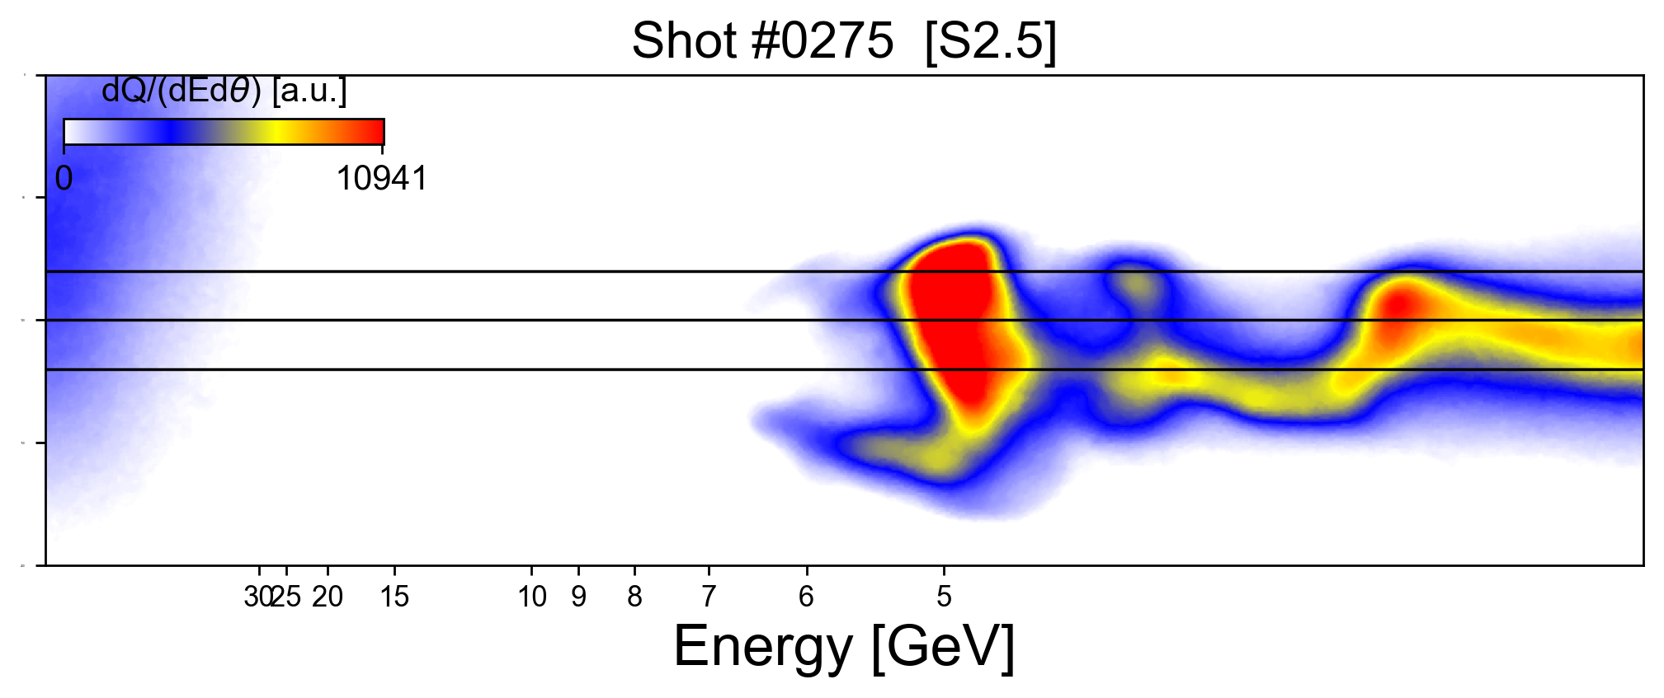
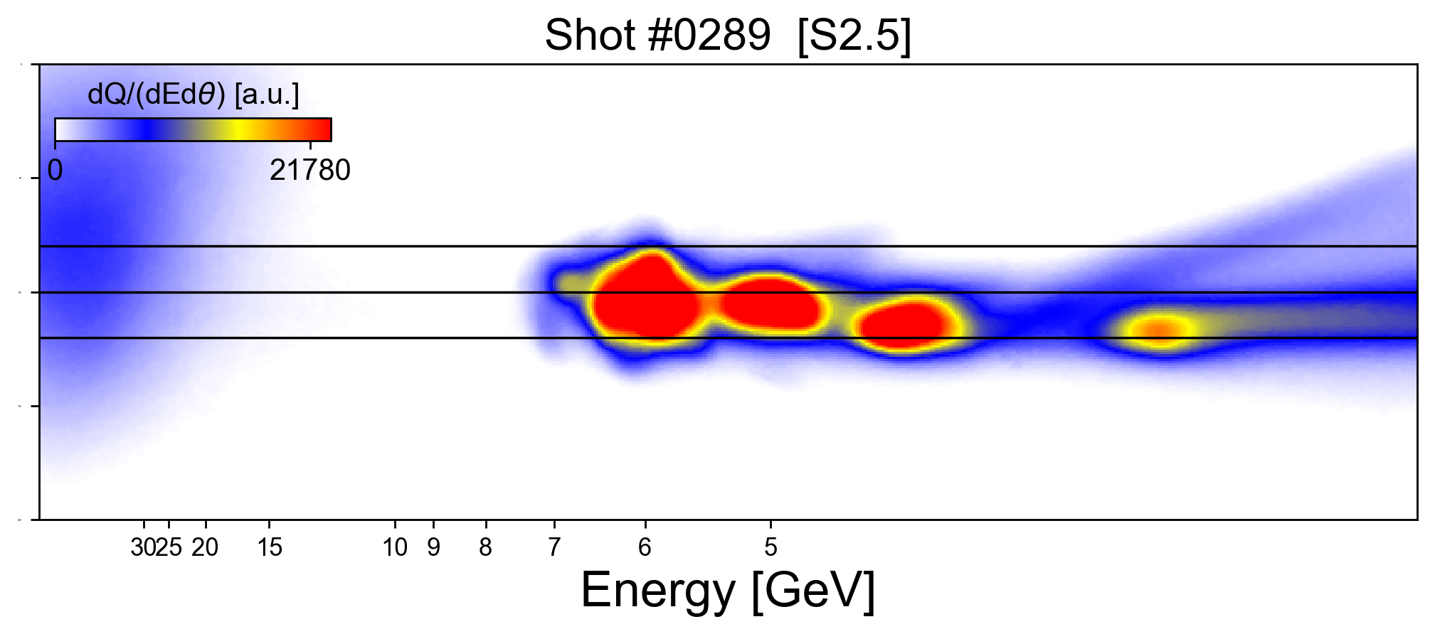
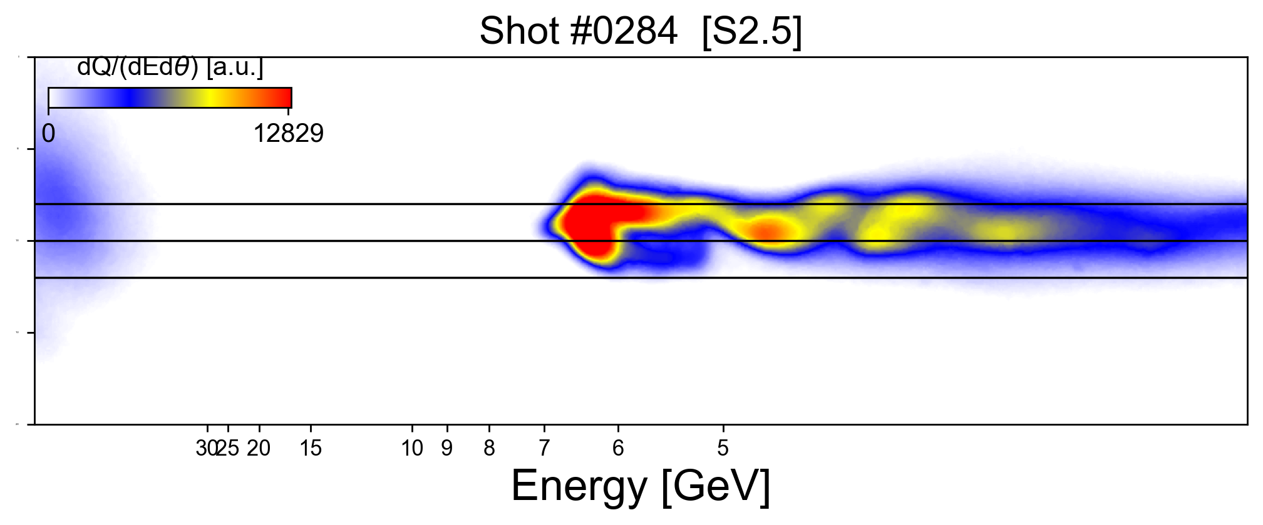
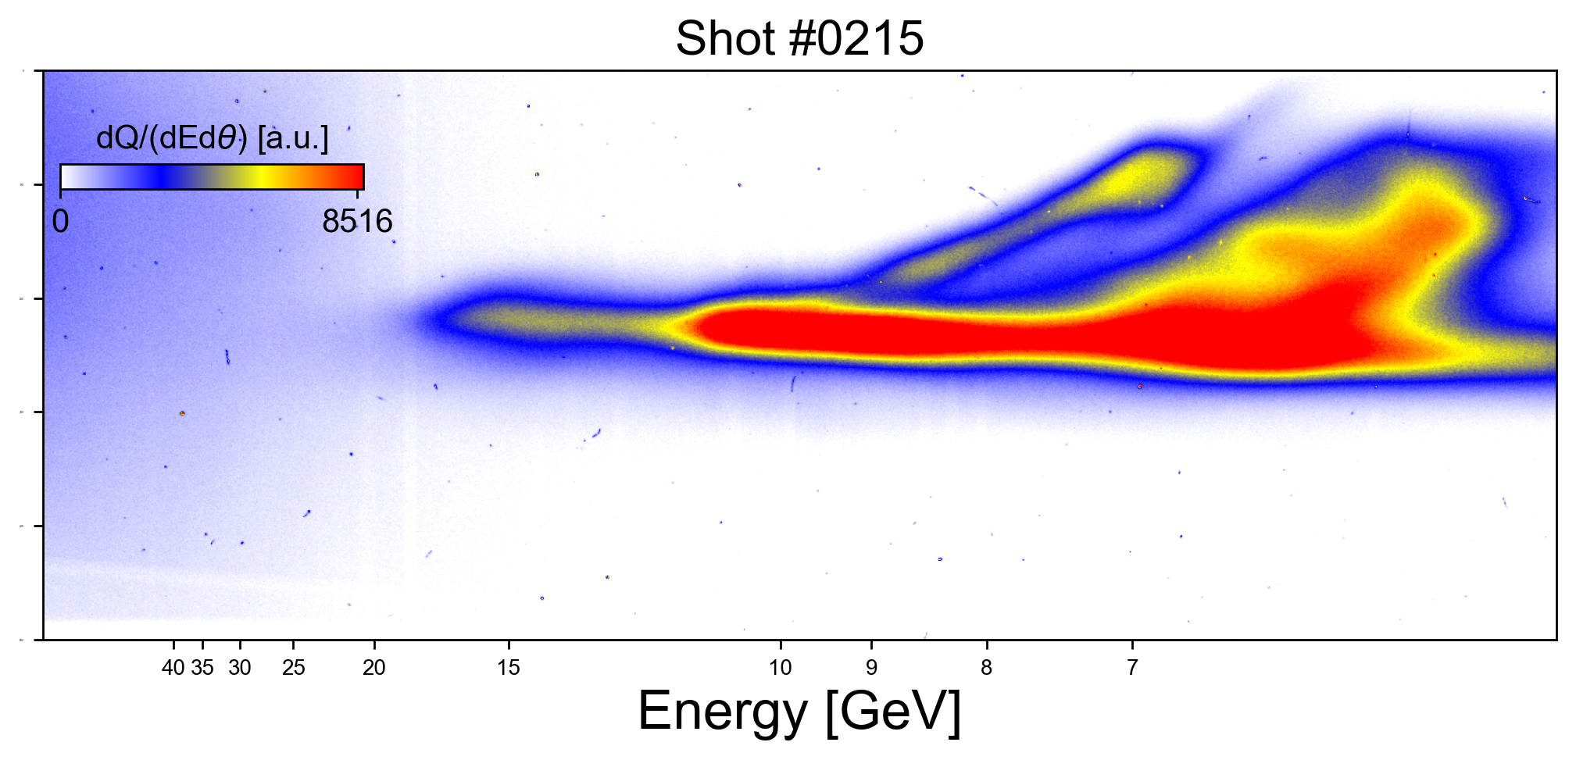









3.1 Results - overview
L_{acc} = 15.5 cm
L_{acc} = 28.0 cm
At 15.5 cm we regularly obtained 5-10 GeV
Very hard to go beyond 10 GeV …
When switching to L_{acc} = 28 cm, electron beam structure becomes more complex and the energies go beyond 10 GeV, surpassing 15 GeV multiple times

Slide 11












3.2 Results - experimental highlight: beyond 10 GeV
Dispersion (cm)
Driver bunch
Witness bunch
$$Qtotal ≈0.8−0.9 nC$$
Low pointing offset!
Beam profile at S1
Peak
$$Epeak ≈17.1±2 GeV$$
$$θfwhm ≈3.8 mrad$$
$$Qpeak ≈22.1 pC$$
$$θy ≈0.8 mrad$$
$$σ_{E}$$
$$θpeak ≈0.6 mrad$$
Detection limit
Blumenfeld et al., Nature 445, 741 (2007)
Highest energy shot – peaking at ~17 GeV with electron energy extending beyond 20 GeV
Feature comparison with a previous PWFA demonstration!

Slide 12



3.3 Results – boosting electron beam energy
Maximum energy vs. acceleration distance
15.5 cm
The energy is basically doubled when the 2nd cell is used
28.0 cm
This is consistent with the following model:
Stage1:
Acceleration (LWFA)
Stage2:
Self-Boosting (PWFA)
Magnetic spectrometer
B = 0.9 – 1.0 T
L = 0.8 m
See reports of 8 GeV measurements on
D. Catana et al., Plasma Physics and Controlled Fusion 68 (4), 045001 (2026)

Slide 13



3.4 Results – charge enhancement
L_{acc} = 15.5 cm
L_{acc} = 28 cm
Charge injected for the two stages:
Single gas cell:
$\left\langle Q\right\rangle ≈0.65 nC$
$$Q_{max}≈1.6 nC$$
Double gas cell:
$\left\langle Q\right\rangle ≈0.8 nC$
$$Q_{max}≈3 nC$$
Measurement range
Indication that charge injection still occurs after 15.5. cm! (i.e. in the second stage)
Likeliest scenario:
An additional witness beam gets injected into the wake and accelerated by the driver

Slide 14



3.5 Results – gas species’ effect on beam charge
Gas species have a clear effect on charge (3% N₂ produces highest charge)
Scaling law is exceeded by measurements (instead of acting like an upper bound)
“tail”

Slide 15



3.6 Results – scaling laws
L= 28 cm / 15.5 cm
L= 28 cm / 15.5 cm
The plot shifts here if we use $P_{airy}$
Final details of the analysis are in progress but conclusions will remain unchanged.
Maximum achieved energy goes beyond the typical LWFA scaling
Indication of a hybrid LWFA -> PWFA (HLPWFA) mechanism!

Slide 16





3.7 Results - calorimetric detection (electrons)
Magnet
Electrons
Energy [GeV]
20
e⁻
10
Electron beam
5 cm
Calorimeter
5
2
Fiber optic calorimeter stack
A. J. Franco-Altamirano

Slide 17






3.8 Results - plasma afterglow and neutrons
Plasma afterglow – a useful tool for diagnosing channel properties
Extracting pointing fluctuations of the plasma channel on-shot
Ongoing analysis
O. Bilen et al.
Observing spallation neutrons >100 MeV
Ongoing analysis
P. Bleotu, K. Spohr

Slide 18






4.1 Discussion – Similar experiments
Dispersion (cm)
Driver bunch
Witness bunch
$$Qtotal ≈0.8−0.9 nC$$
B. Hidding et al., Phys. Rev. Lett. 104, 195002 (2010)
Masson-Laborde, P E et al., Phys. Plasmas 21, 123113 (2014)
Self-mode transition:
K.H. Pae et al., Phys. Plasmas, 17, 123104 (2010)
T. Kurtz et al., Nat. Comm. 12, Article number: 2895 (2021)
C. A. Lindstrøm et al.,
Phys. Rev. Lett. 126, 014801 (2021)
F. M. Foerster et al., arXiv:2602.24107v1 (2026)
Reviews of (H)LPWFA:
First demonstration of PWFA:
J.B. Rosenzweig et al., Phys. Rev. Lett. 61(1), 98 (1988)
Recent PWFA overview:
C. A. Lindstrømet al., arXiv:2504.05558v1 (2025)
B. Hidding et al., Appl. Sci., 9(13), 2626, (2019)
B. Hidding et al., Photonics, 10(2), 99 (2023)

Slide 19










4.2 Discussion – Measurement considerations
Magnetic spectrometer
70 mm
30 mm
Acceptance angle $±$14.5 mrad - Necessary!
Small acceptance angle would not distinguish PWFA features of the driver beam (beam breaking up, transverse divergence growth).
We use multiple screens after magnetic dispersion, and an entrance screen for pointing correction …
B. B. Pollock et al., Proceedings of PAC09, 3035–3037 (2009)
H.J. Cha et al., Rev. Sci. Instrum. 83, 063301 (2012)
C.I. Hojbota et al., AIP Advances 9 (8), 085229 (2019)
$$\frac{σ_{E}}{E}≈\frac{θ\sqrt{\left(L_{1}^{2}+L_{2}^{2}\right)}E}{\left(L_{1}+L_{2}\right)eBc L_{m}}×100 [\%]$$
Error: $\frac{ΔE}{E}=±2−15\%$
D. Catana et al., Plasma Phys. Control. Fusion 68 045001(2026)
M.V. Ambat et al., Rev. Sci. Instrum. 96, 123303 (2025)

Slide 20




















4.3 Discussion – future work
What should we do with these beams?
Generate muons! (for radiography and beyond)
Diagnose them in compact setups!
Strong-Field QED
Smith-Purcell radiation
D. Terzani et al., PRAB 28 (2025)
Photoproduction: $γZ→π^{±}X→μ^{±}+ν_{μ}+X$
Bethe–Heitler: $γZ→μ^{+}μ^{−}Z$
L. Calvin et al., PPCF 68, 035015 (2026)
S. Ikram et al., arXiv:2605.13118 (2026)
K. Zhu et al., arXiv:2607.12984 (2026)
E. Los et al., Nat. Commun. 17, 1157 (2026)
A. I. Titov, B. Kämpfer and H. Takabe, PRSTAB 12, 111301 (2009).
F. Zhang et al., Nat. Phys. 21, 1050 (2025)
Upcoming work…
M. Mirzaie, C.I. Hojbota, D.Y.Kim et al., Nat. Photonics 18, 1212 (2024)
R. Rudzinsky et al., Optica 13, 5 (2026)
Fiducial wires
X. Hu et al., Nat. Photonics (2026)
X. Wang et al., Nat. Commun. 4, 1988 (2013)

Slide 21

5. Conclusions
We observed electrons with peak energy of $17.1 ±2.0$GeV, extending beyond $20$ GeV
Beams of up to Q = 3 nC were produced, with a clear gas species dependence
We have strong evidence of a transitional (hybrid) regime:
  (H)LPWFA = (1)LWFA + (2)PWFA
The evidence is backed by:
  electron spectra features
  injection and acceleration in the 2nd stage
  departure from classical LWFA scaling
We conducted plasma afterglow and neutron measurements
Although not perfect (yet), the beam produced here can readily be used in:
  Beam-target experiments (e.g. $μ^{+}μ^{−}$ production)
  Laser-electron collisions (SFQED)
  Measurement of electron bunch characteristics

Slide 22


☺ Food for thought ☺
Today
Today
R. W. Aßmann & J. Grebenyuk, Proc. IPAC'14, 961–964 (2014).
doi:10.18429/JACoW-IPAC2014-TUOBB01
Peak LWFA electron energy has doubled approximately every 4-4.5 years.
This trend has persisted for more than two decades.
A. Cakir and O. Guzel arXiv:1908.07207v4 (2020)
We should expect 100 GeV from (some form of) LWFA within 10-15 years!

