Slide 1
Congratulations for 70th Anniversary of
Turkish Physical Society and
Korean Physical Society

Slide 2
We enjoyed 2002 World Cup Semi-final Match
(Turkiye 3 : 2 Korea)
And
Korea thanks Turkish Army for one of 16-UN Forces
during Korean Conflict in 1950-1953

Slide 3
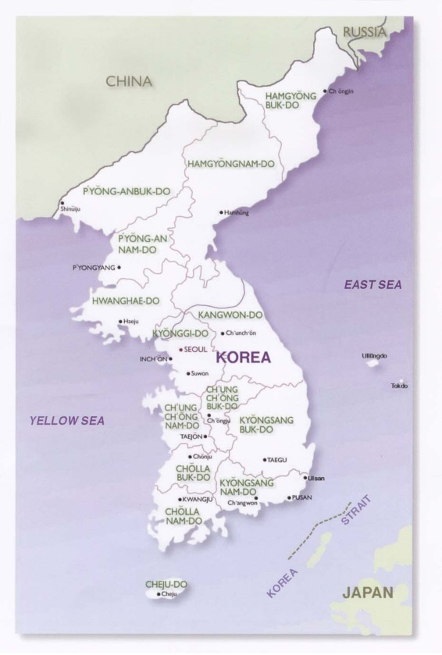
Brief Facts about Korea
People & Language: Korean (~4,500 yrs in the area)
Area (South): ~100,000 km² (~38,000 sq. mi.)
Population (South): 52 million
Recent History:
1945: Divided into North and South
1950~1953: Korean Conflict
1960~1970: Modernization (Migration to cities)
1970~1980: Industrialization (Heavy Industries)
1990~2022: High-tech oriented
Leading Industries:
Electronics, Automobile, Ship-building,
Steel, Chemicals, Construction
Economy: GDP = 1.8 T$ and 35.4 k$/capita in 2021
Religion: Christian (~30%), Buddhism (~30%)
Education: > 80% high-school seniors go to college
Seoul
Daejeon
Pohang
Busan

Slide 4
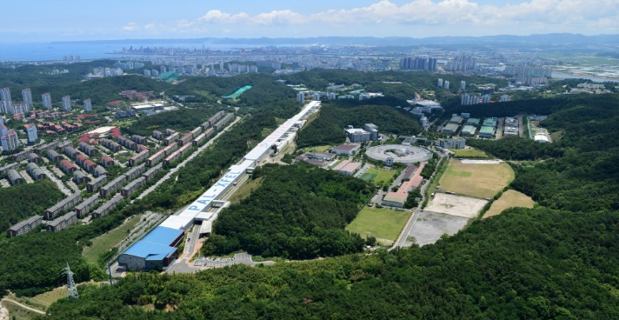
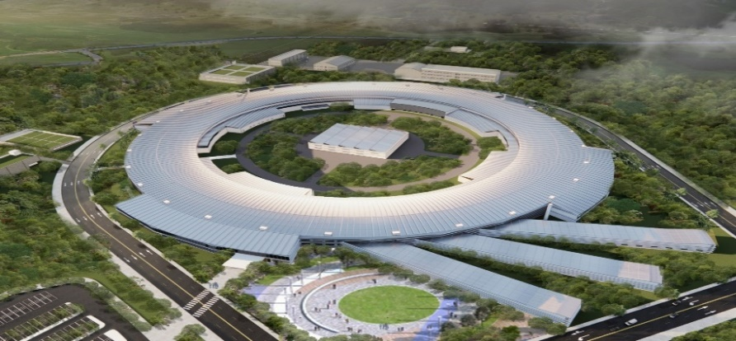
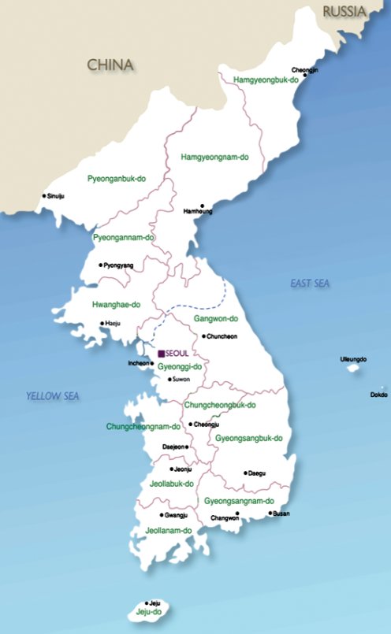
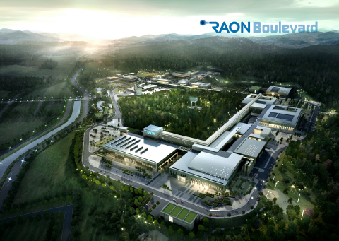
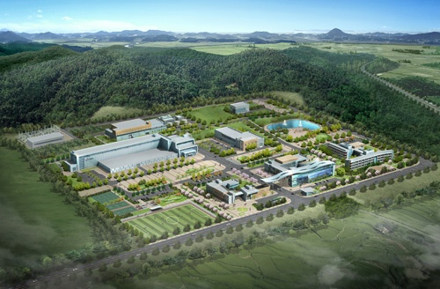
Accelerator Facilities in Korea (2022)
4GSR Project (KPS)
(Under construction)
PAL-XFEL (10.0 GeV) and
PLS-II (3.0 GeV Light Source)
Rare Isotope Science Project (RISP)
(Under construction)
KOMAC (100-MeV Proton Linac)

Slide 5
Status and Prospects of
Pohang Accelerator Laboratory (PAL)
UPHUK-VIII
Bodrum, Turkiye
September 5-7, 2022
Won Namkung
PAL, POSTECH

Slide 6
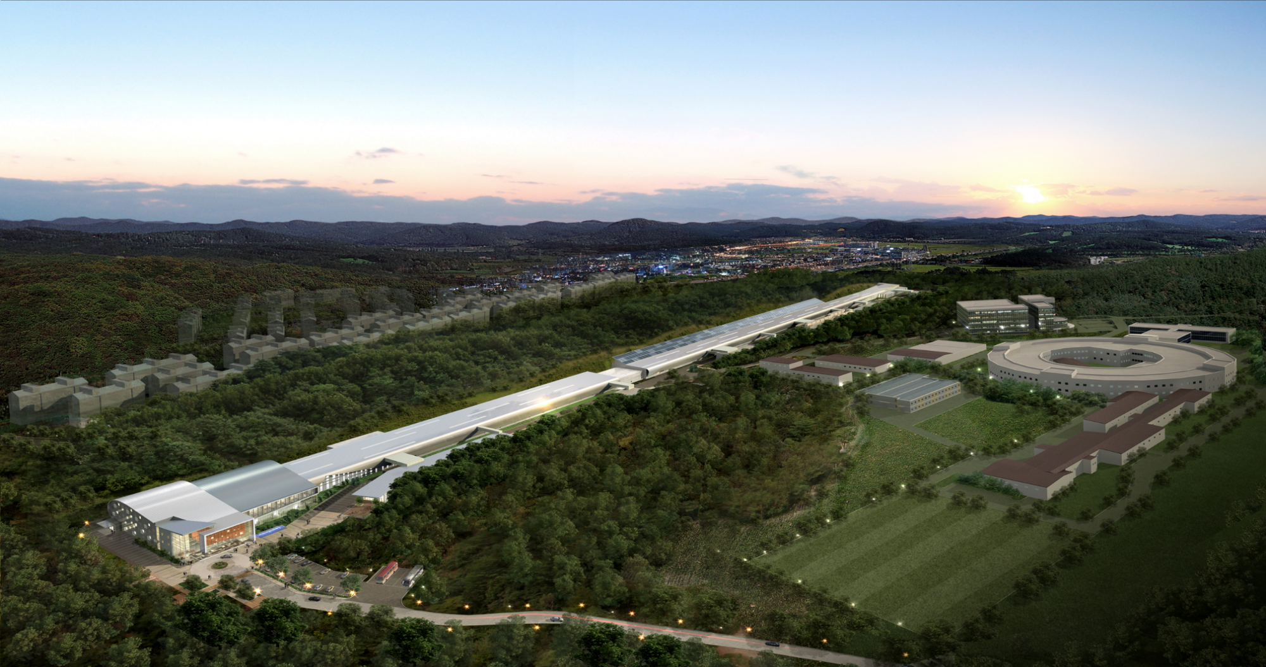
Aerial View of PAL
PLS-II
(3GeV/400mA)
PAL-XFEL (10.0 GeV)
280 m
1.1 km
170 m
3rd Generation Light
Source

Slide 7
Pohang Accelerator Laboratory Overview
POSTECH, a newly established university, proposed to construct
a synchrotron light source on its campus in 1988
PLS is a 3rd generation synchrotron radiation source:
- 2 GeV injector linac and storage ring with upgrade option to 2.5-GeV
- Construction Project: April 1988 ~ December 1994
- Funded by POSCO (60%) & Government (40%)
Upgraded to 3.0 GeV in 2011 (PLS-II)
PAL-XFEL (X-ray Free Electron Laser) was constructed in 2015
- World 3rd after SLAC (US) and SACLA (Japan)
PAL is donated to Government in 2018
KPS Project (4.0 GeV, 4GSR) is started with KBSI in Chung-ju (2021-2027)

Slide 8
PAL-XFEL
Initial proposal was to use existing PLS linac
to be a leading group member in 2003
Revised proposal in 2010 for 10 GeV XFEL

Slide 9
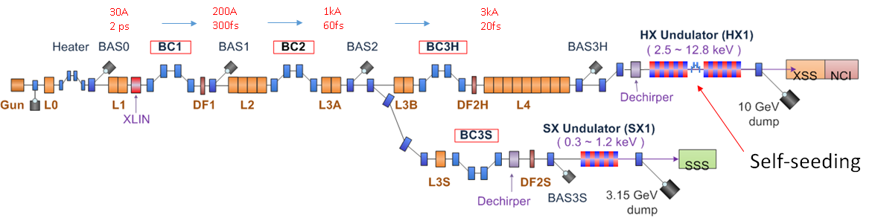
PAL-XFEL Layout and Parameters
  Main parameters
  e⁻ Energy 10 GeV
  e⁻ Bunch charge 20-200 pC
  Slice emittance < 0.4 mm mrad
  Repetition rate 60 Hz
  Bunch length 5 fs – 50 fs
  Peak current 3 kA
  SX line switching Kicker Magnet
Undulator Line | HX | SX
Photon energy [keV] | 2.4 ~ 15 | 0.28 ~ 1.0
Beam Energy [GeV] | 4 ~ 11 | 3.0
Wavelength Tuning | Energy | Gap
Undulator Type | Planar | Planar
Undulator Period / Gap [mm] | 26 / 8.3 | 35 / 9.0

Slide 10
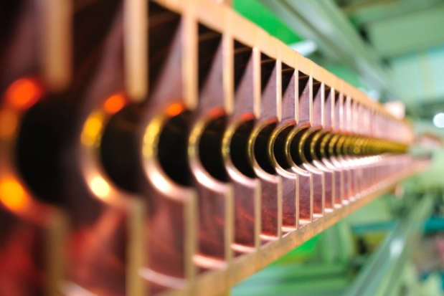
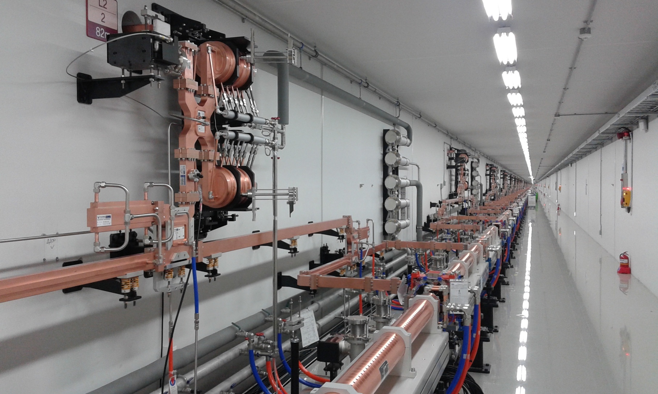
Linac Tunnel
Cross Section of Acceleration. Column
Parameter | Unit | Value
Energy | GeV | 10
Charge | pC | 200
No. of SLED |  | 42
No. of Acc. Column |  | 173

Slide 11
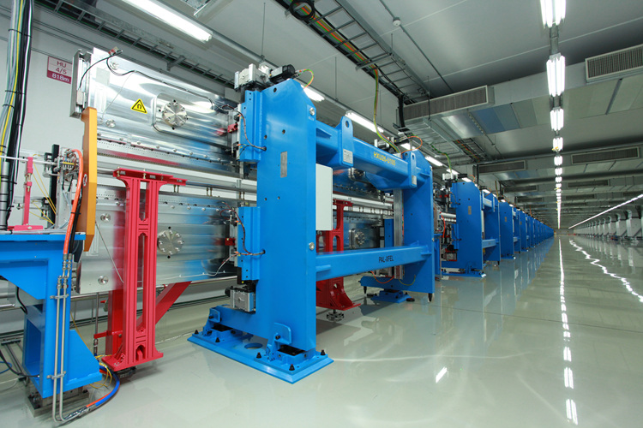
Undulator Hall
Parameter | Unit | Value
No. of Undulator |  | 21
Length | m | 5
Period | mm | 26.0
Gap | mm | 8.3
Wavelength | nm | 0.1
Magnetic field | Tesla | 0.8124
K |  | 1.9727

Slide 12
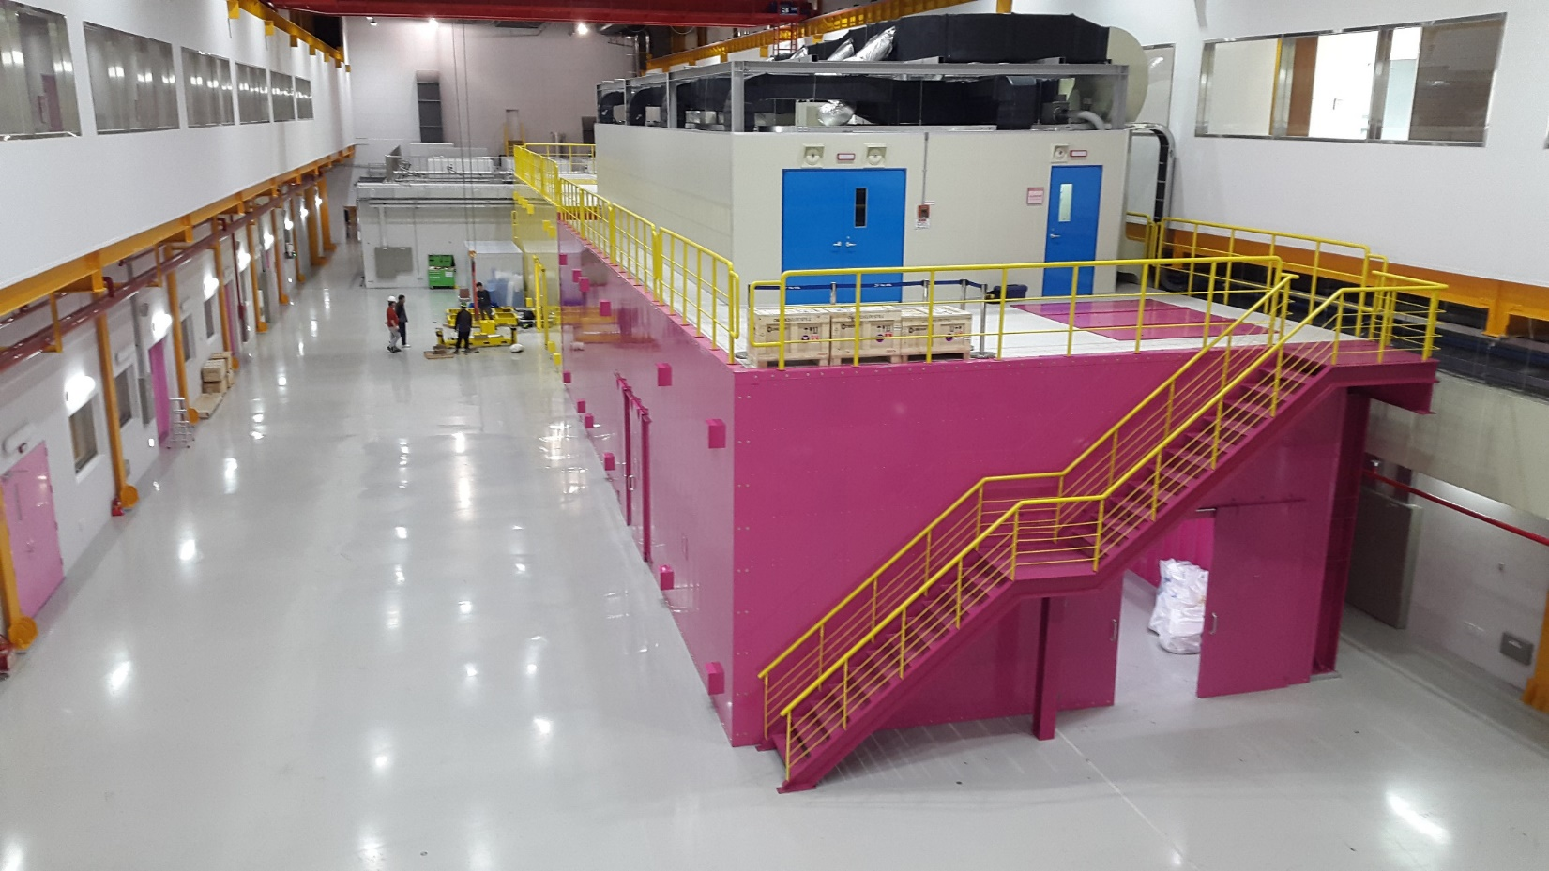
Hard X-ray Experiment Hutches

Slide 13
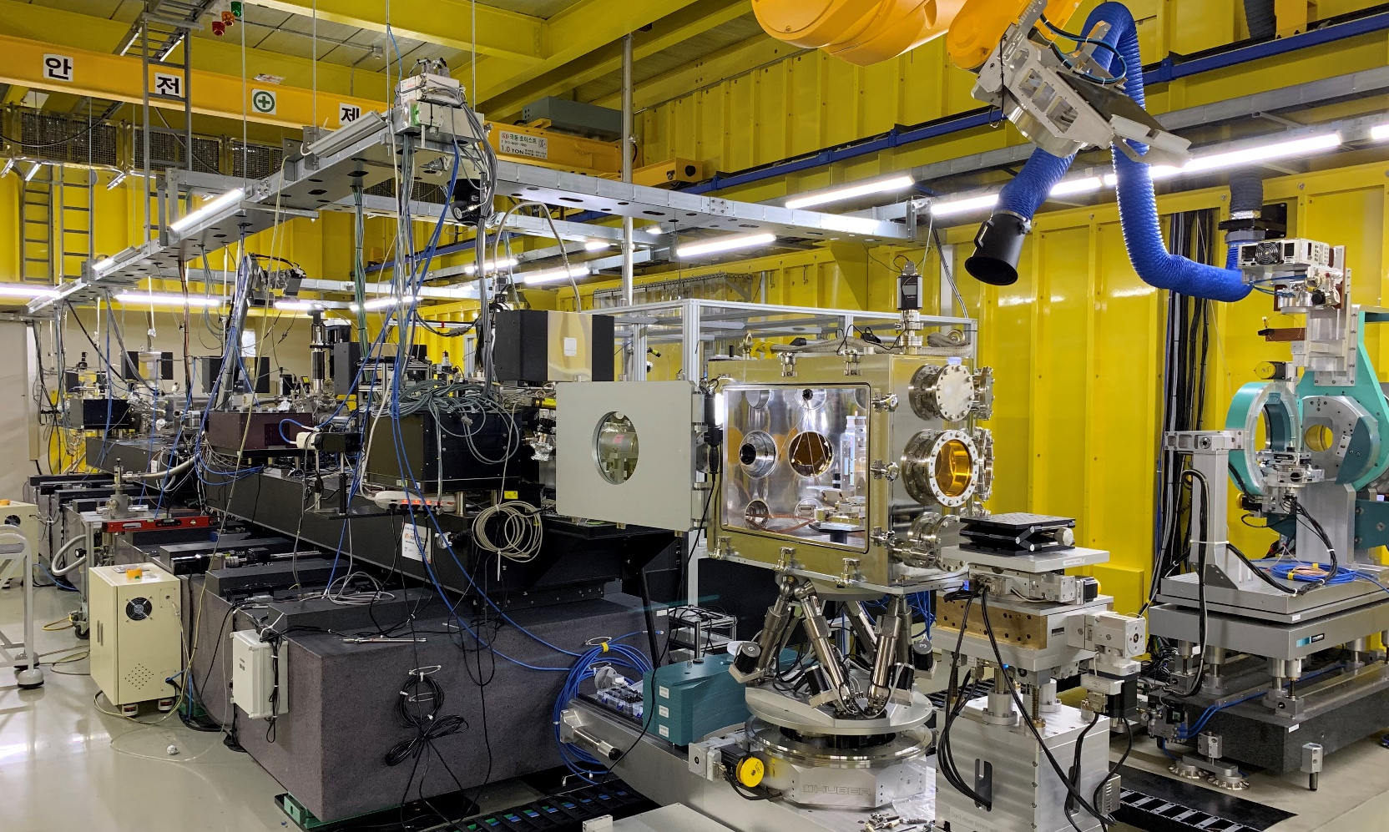
Hard X-ray Experiment Station

Slide 14
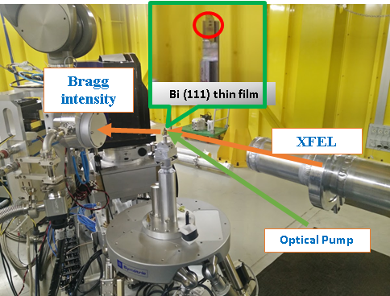
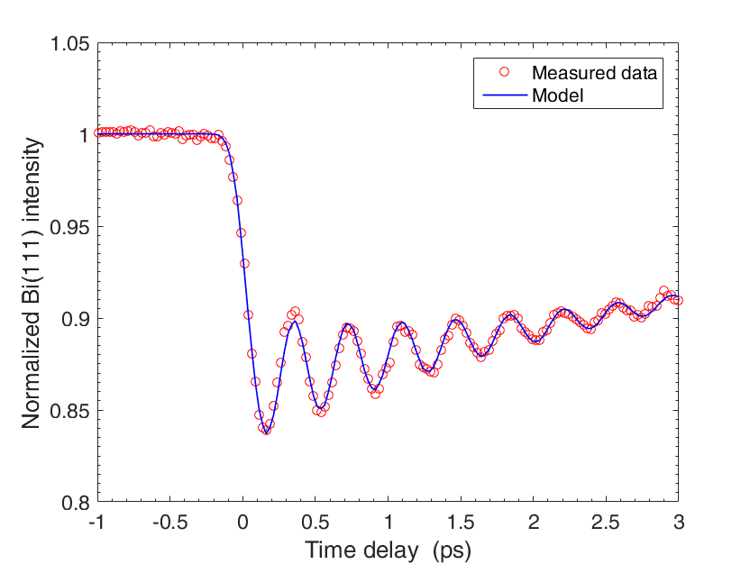
Hard X-ray FEL with Femtosecond Timing Jitter
- No timing jitter correction
- averaged by 50 trials of the time delay scan and normalized by GaSb(111) Bragg peak intensity
- Only slow time-drift correction
- Vibration Frequency : 2.7 THz
- Instrument Response: 137 fs (FWHM)
Bi(111) thin film (50 nm) on GaSb(111)/Si(111)
X-ray: 6 keV
X-ray size: ~ 60 x 60 um²
Laser: 800 nm, 100 fs
Detector: MPCCD 0.5M

Slide 15
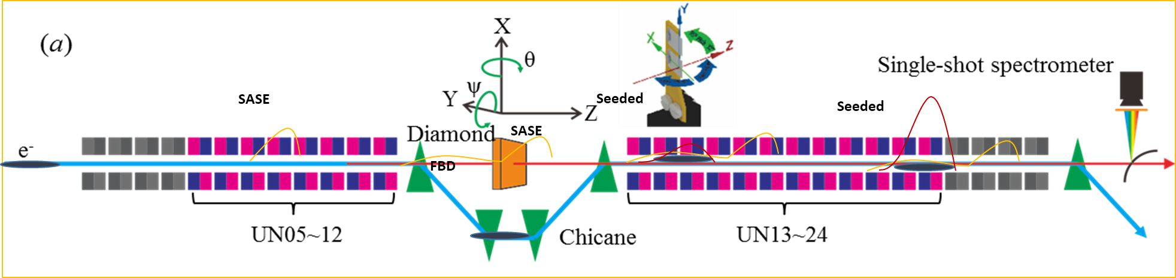
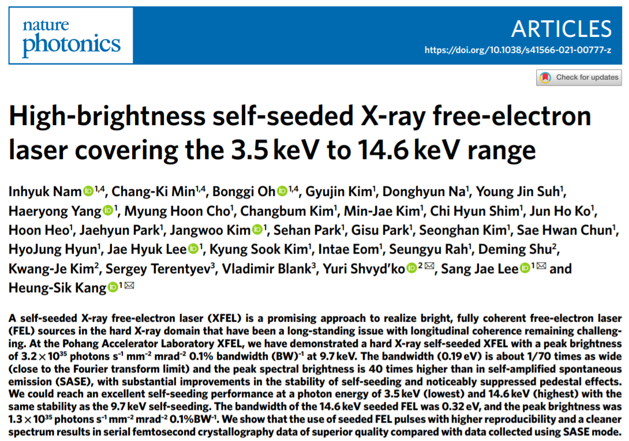
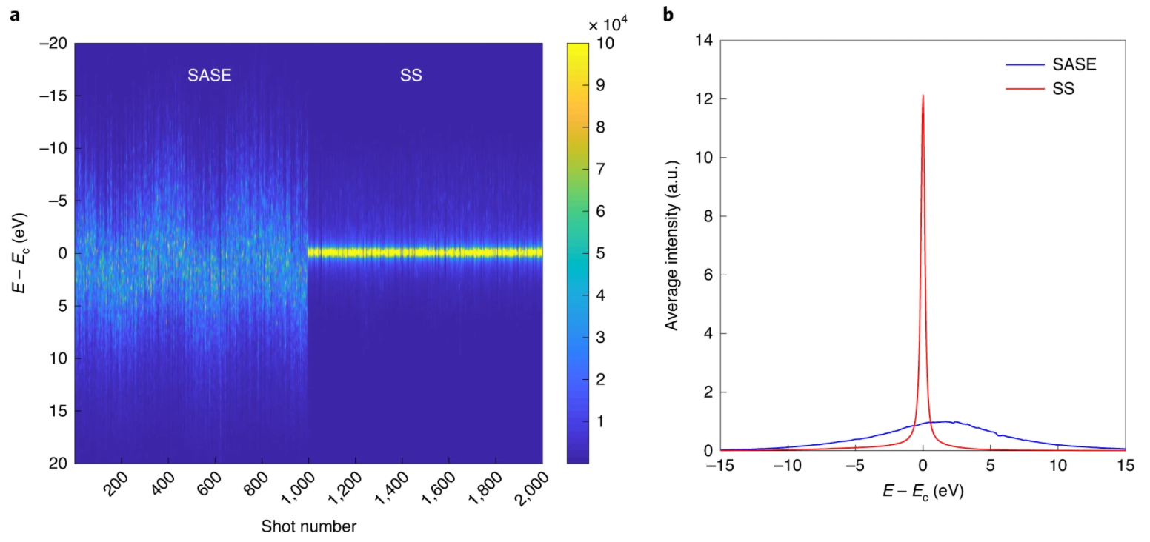
Hard X-ray self seeding
Ec = 9.7 keV
SASE bandwidth (FWHM) = 27 eV
Self-seeding bandwidth (FWHM) = 0.22 eV
Averaged pulse energy: ~850 μJ
FEL Pulse duration = ~ 20 fs
Nat. Photon. 15, 435 (2021)

Slide 16
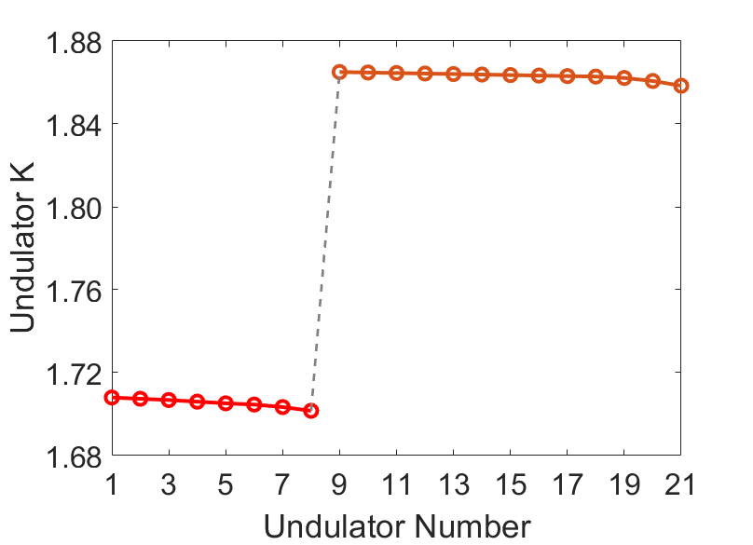
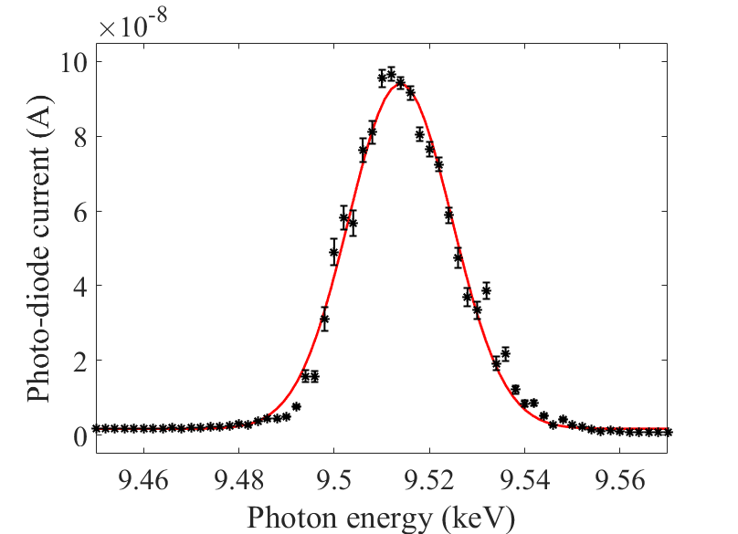
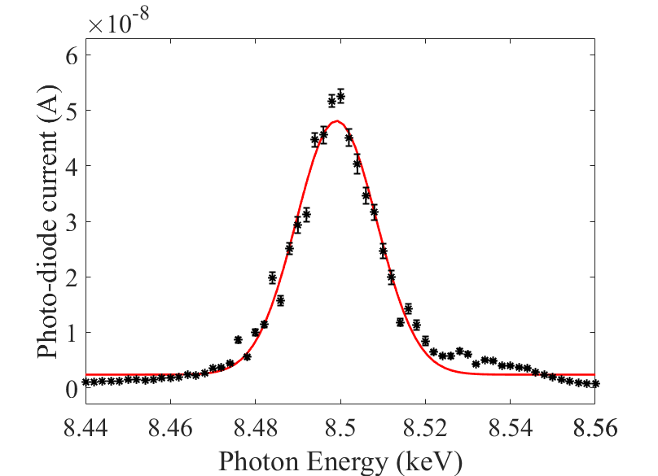
Two-color HX FEL pulse generation
undulator section for lasing pump pulse
(8 undulators)
undulator section for lasing probe pulse
(13 undulators)
magnetic chicane
(delay control)
e-beam
pump X-ray
probe X-ray
delay
e-beam
pump X-ray (SASE)
probe X-ray (SASE)
e-beam delay
Undulator section
for lasing probe pulse
(8.5 keV)
Pump (9.5 keV)
~224 μJ
BW ~10.9 eV (rms)
Probe (8.5 keV)
~257 μJ
BW ~9.5 eV (rms)
Undulator section
for lasing pump pulse
(9.5 keV)
Machine study results (2022. 01. 15)

Slide 17
PAL-XFEL Machine Performance
FEL position stability: < 10 % of beam size
FEL power stability: < 5 % rms
E-beam energy jitter: < 0.015 %
E-beam arrival time jitter: < 15 fs
FEL pulse energy: > 3.18 mJ at 7.13 keV
FEL beam pulse duration: 20 ~ 30 fs (FWHM)
Saturated FEL: up to 20.0 keV
Lattice design used three bunch compressor configuration
Machine stability is outstanding
Self-seeding and two-color generation are very promising

Slide 18
PAL-XFEL Statistics
Annual Plan of Operation (Days)
User Service
 | 2017 | 2018 | 2019 | 2020 | 2021 | 2022
User Beam-time | 120 | 140 | 160 | 170 | 180 | 190
Turn-on & Tuning | 123 | 110 | 73 | 67 | 70 | 57
Machine Study |  |  | 21 | 21 | 10 | 10
Maintenance | 109 | 102 | 98 | 97 | 92 | 95
 | Applied | Approved | Days of Service
2017 | 82 | 26 | 120
2018 | 84 | 45 | 140
2019 | 140 | 49 | 160
2020 | 118 | 51 | 170
2021 | 132 | 47 | 180
2022 | 131 | 53 | 190

Slide 19
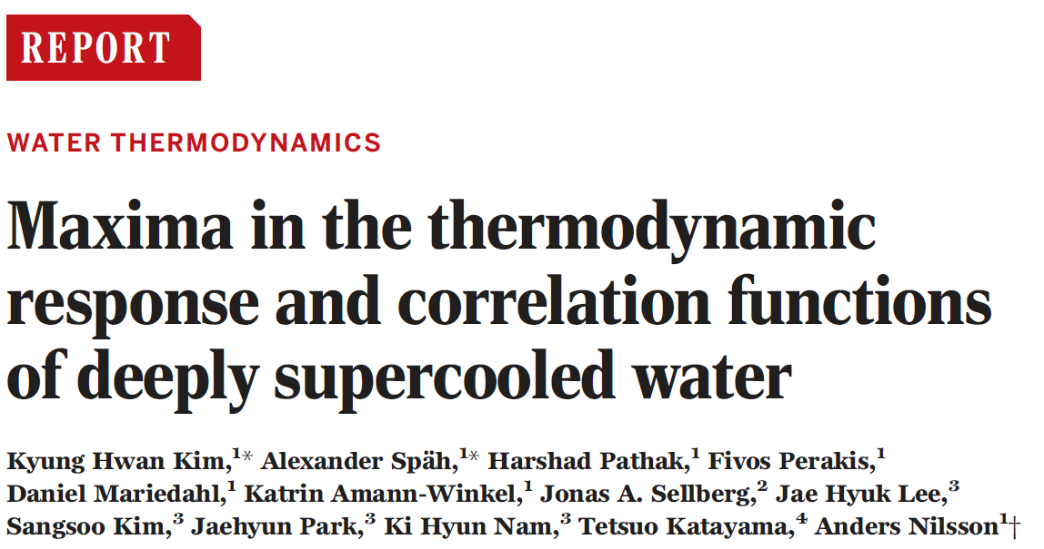
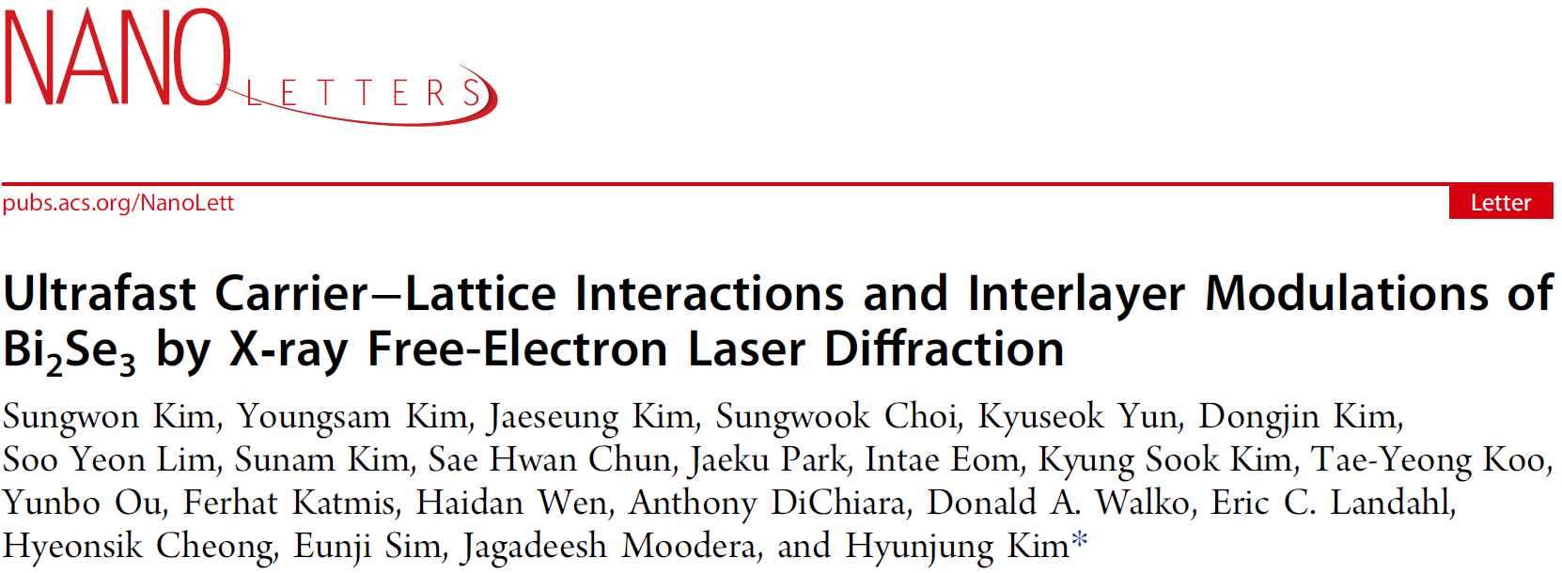
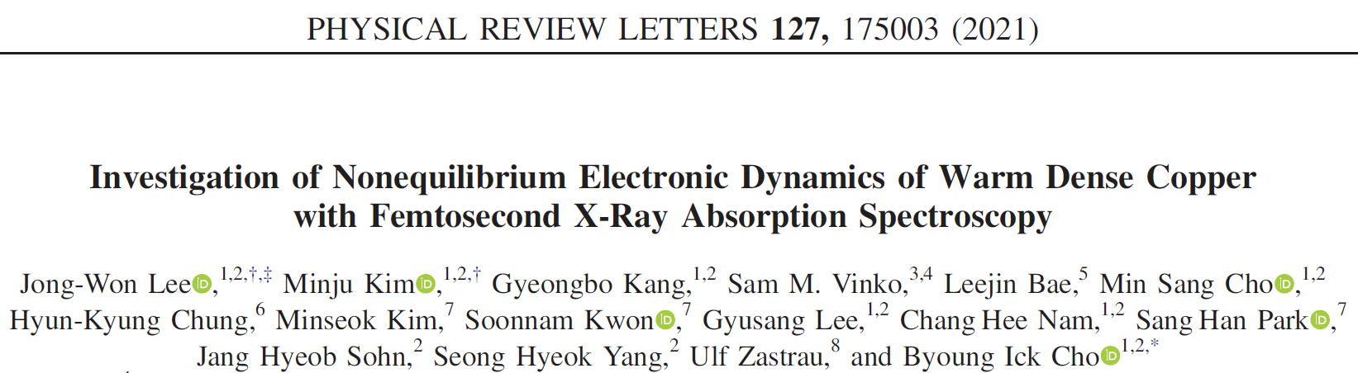
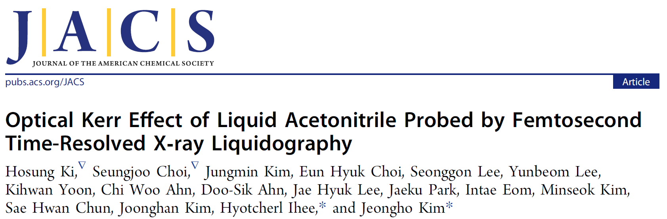
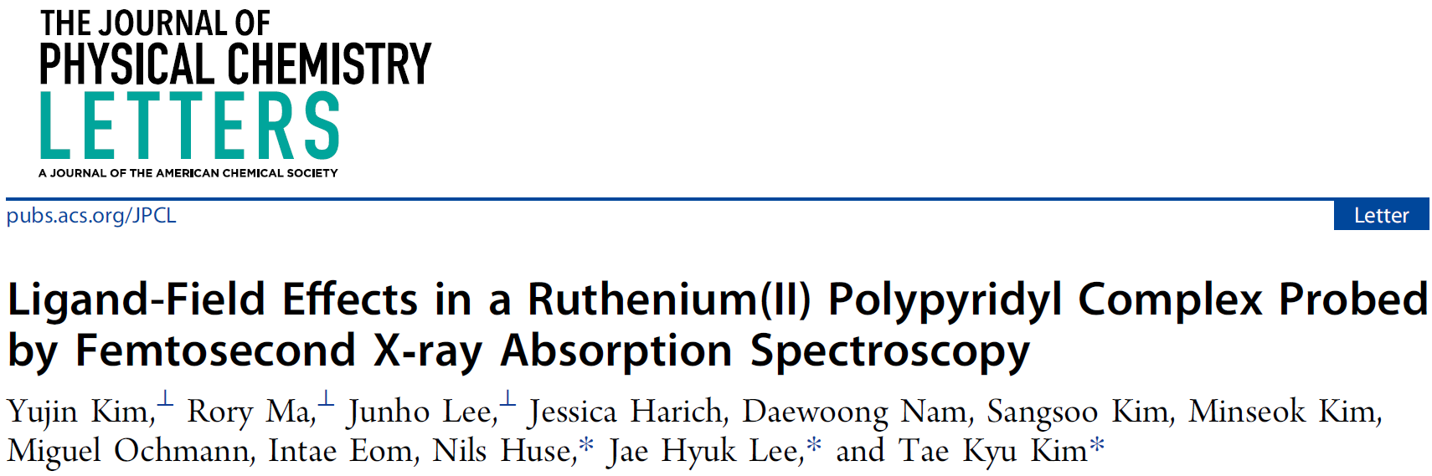
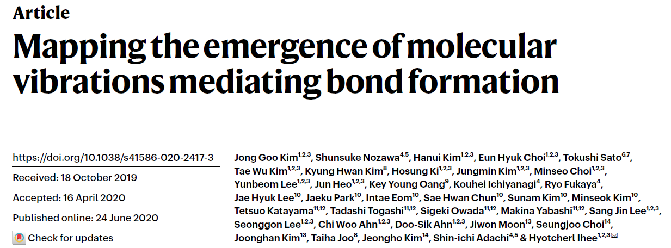
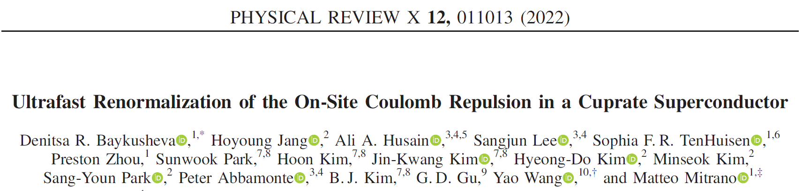

Slide 20
PLS-II
Energy upgrade: 2.5 => 3.0 GeV
Top-up operation
Normal conducting RF => Super conducting RF
One year for user beam-time interruption

Slide 21
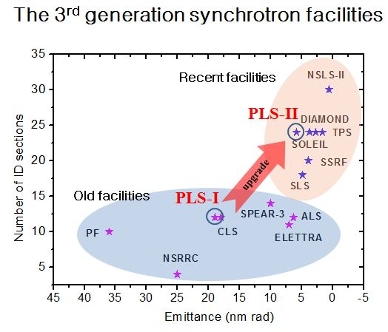
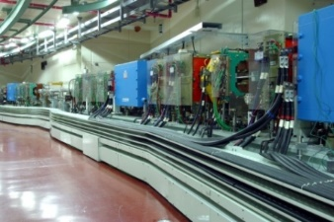
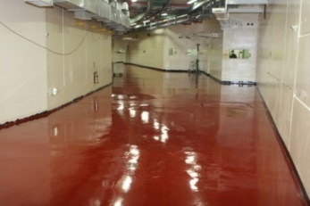
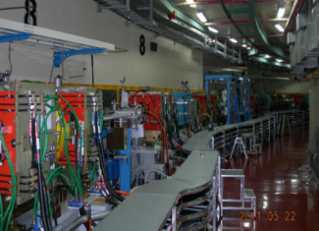
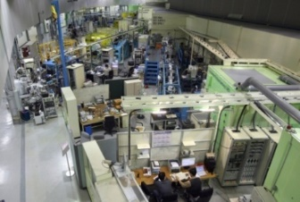
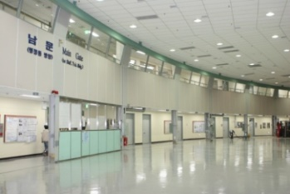
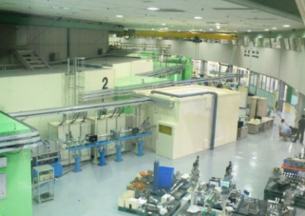
PLS-II Upgrade Storage Ring
○ Main goals
- Beam energy : 2.5 → 3.0 GeV
- Current : 200 → 400 mA
- Storage Ring Emittance : 18.9 → 5.8 nm
- Top-up Operation mode
- No. of Insertion Device : 10 → 20
- Superconducting RF cavities
PLS
Dismantling
Re-installation
PLS-II
DEC. ‘10
JAN. ‘11
PLS
PLS-II

Slide 22
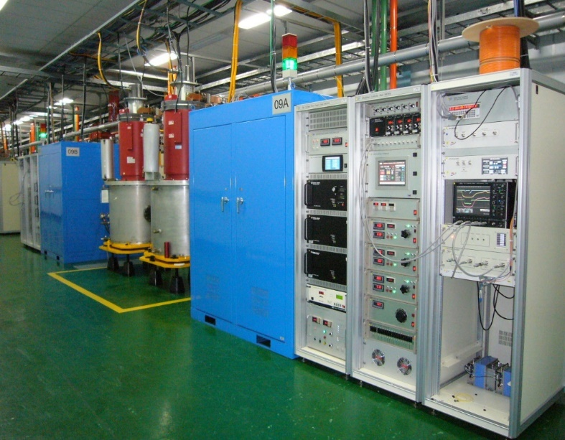
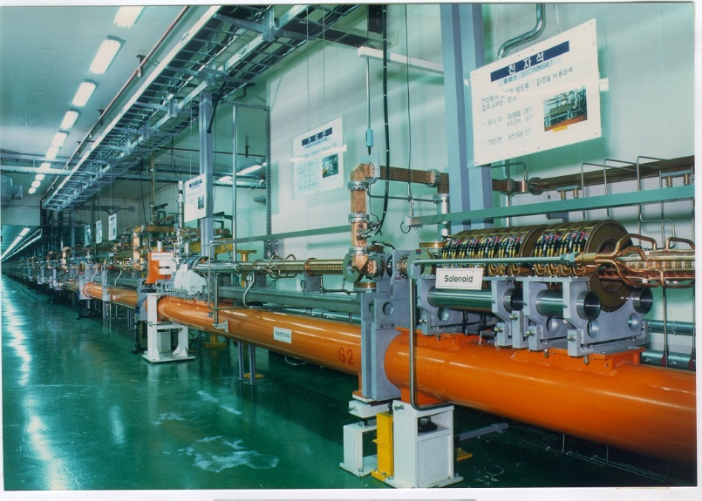
PLS-II Linac
Injector LINAC
Length = 170m
3.0 GeV, full energy injection
2,856 MHz (S-band)
10 Hz, 1.5 ns, 1Å pulsed beam
Norm. emmittance: 150 µmrad
Gallery
Thermionic Electron Gun
17 Pulse Modulators (200MW, 7.5µs)
17 Klystrons (80 MW, 4µs)
16 Energy Doublers (gain=1.5)
46 Accelerating Sections
Tunnel

Slide 23
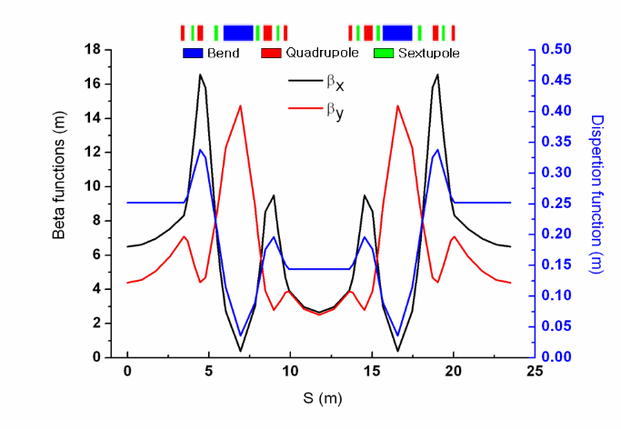
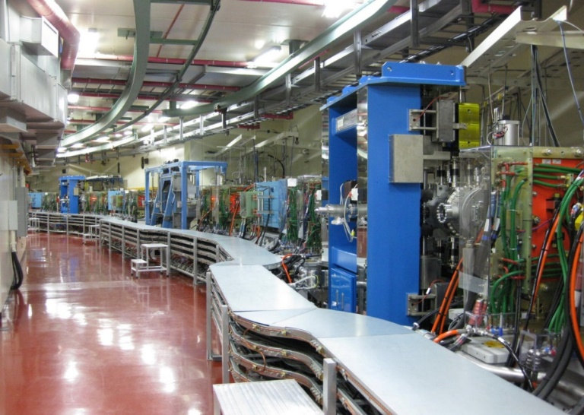
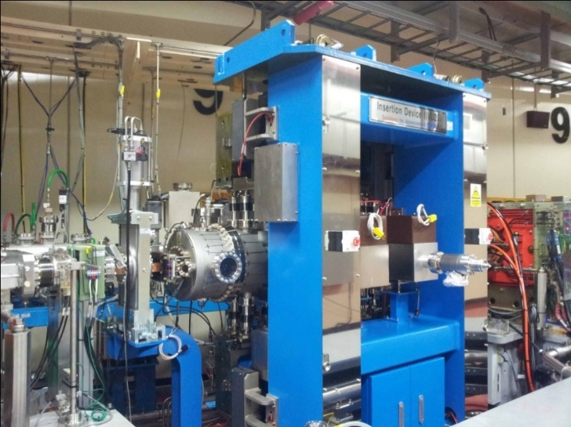
PLS-II Parameters
Beam Energy 3.0 GeV
Beam Current 400 mA
Lattice DBA
Superperiods 12
Emittance 5.8 nm∙rad
Tune 15.37 / 9.15
SRF Frequency 499.97 MHz
Circumference 280 m

Slide 24
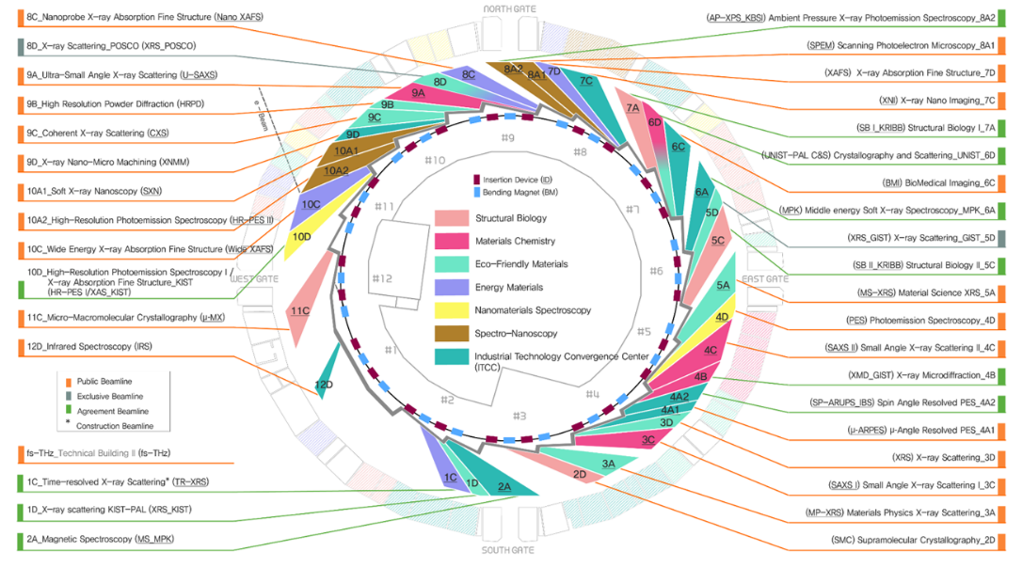
36 Beam-lines at PLS-II

Slide 25
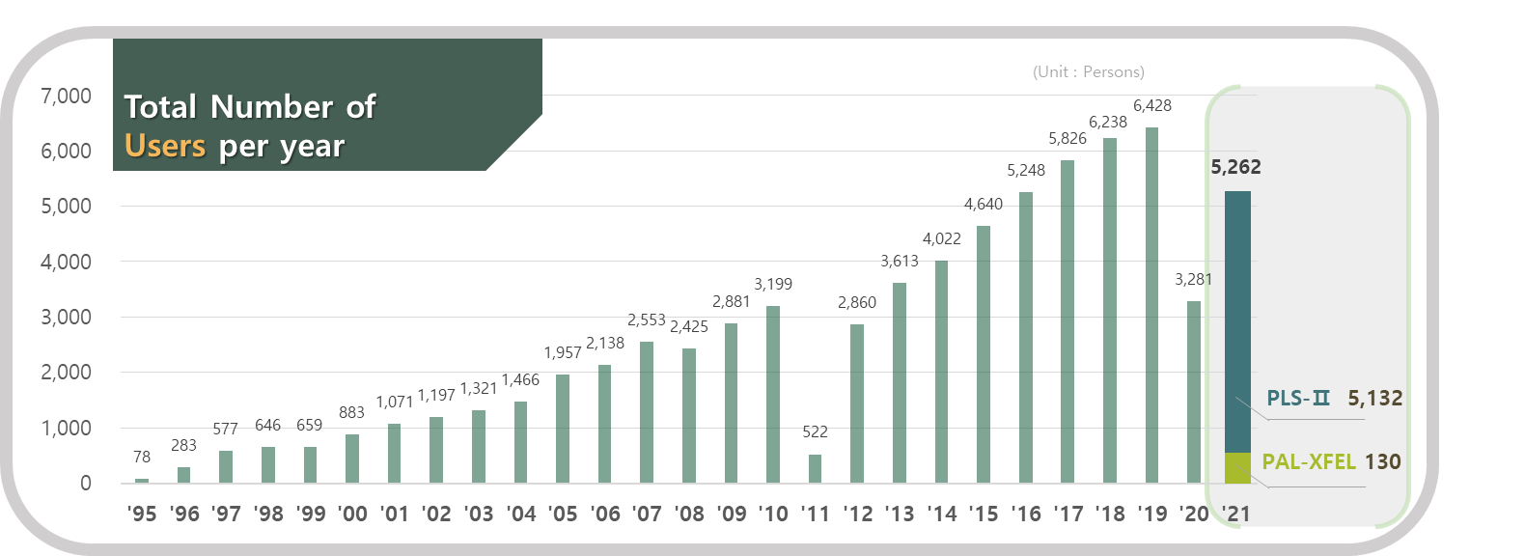
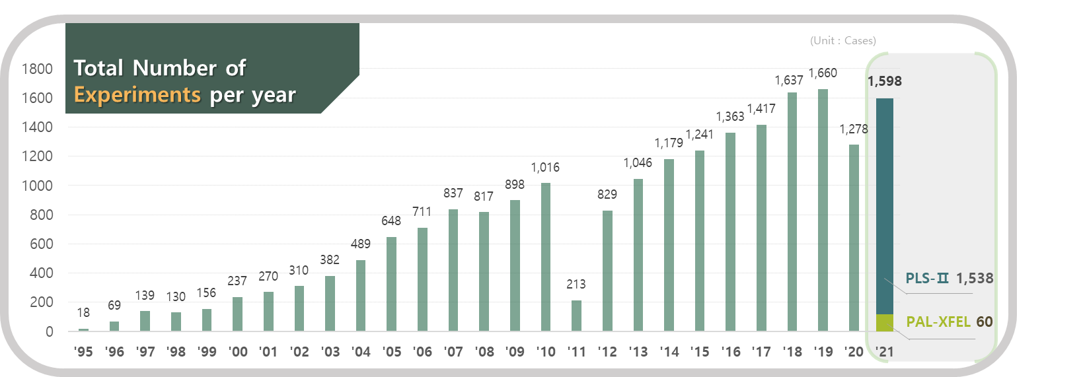
Number of Experiments and Users per Year

Slide 26
User Sciences in PLS-II

Slide 27
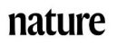
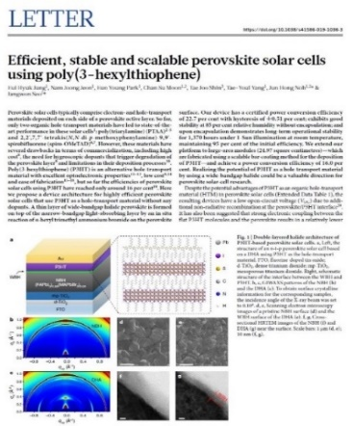
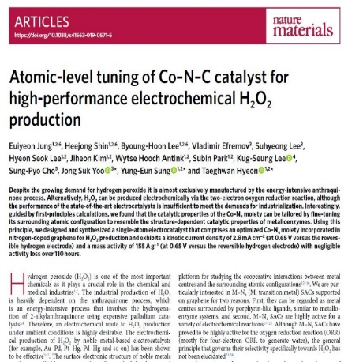
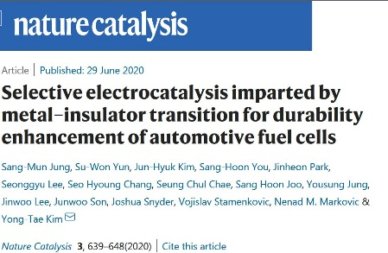
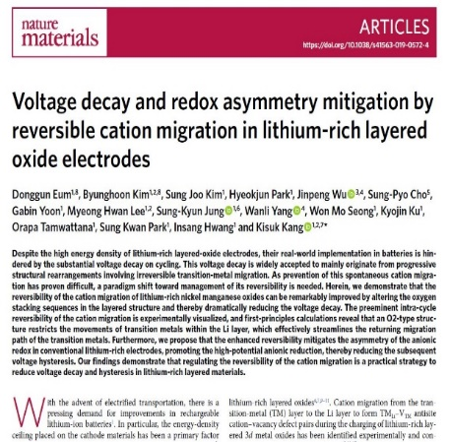

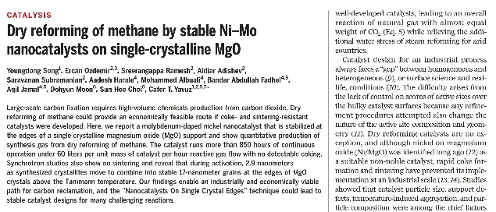
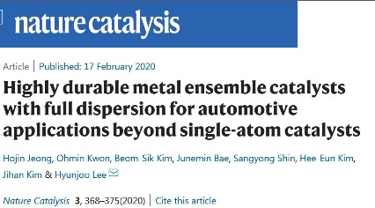









2020-2021 User Scientific Representative Achievements-I
Focused on Energy conversion and storage Materials
and
Nanochemistry
Solar cell
Electrocatalyst
Li-ion Battery
Nanochemistry & Catalyst
Electrocatalyst
Electrocatalyst
Solar cell
Nanochemistry
Electrocatalyst
Semiconductor
Memory device
Catalyst

Slide 28


2022 User Scientific General Achievements-II
An increasing trend of Impact factor
Constant SCI Publications

Slide 29
KPS (Korea Photon Source)
Users are increasing
Available Beam-lines are limited at 36
High-performance beams are in demand
There is no space left at PAL

Slide 30

3rd and 4th Generation Light Sources
Off-axis injection
KPS
(Korean 4GSR)

Slide 31


3GSR vs. 4GSR (with challenging technology)

Slide 32



Korea Photon Source (KPS) Project
- Preliminary study by PAL: 2017 ~ 2019
- CDR project: 2020
- Project start: 2021. 7 ~ 2027. 12
- Building by KBSI / Machine by PAL
Parameter | Units | PLS-II | Korean 4GSR
Electron energy | GeV | 3 | 4
Horiz. Emittance | pm | 5,800 | 58 (RB: 39 )
Vert. Emittance | pm | ~ 58 | ~ 5.8 (RB: 39 )
Bunch length (rms) | ps | 20 | 13 (50 with HC)
Circumference | m | 280 | 800
Harmonic # |  | 470 | 1332
RF frequency | MHz | 500 | 500
Beam stability @ ID (x/y) | $μm$ | < 4 / 2 | < 2.5 / 0.45
Injection mode |  | Top-up | Top-up

Slide 33

Major Parameters for KPS

Slide 34



SR Lattice Structure (linear)
Natural evolution of ESRF-EBS and APS-U
ESRF-EBS type
- Dispersion bump w/sextupoles.
- Longitudinal gradient dipoles.
- Phase advance of Δφ_{x} ~ 3π and Δφ_{y} ~ π between corresponding sextupole
APS-U type: Reverse bends in Q4, Q5, and Q8.
Massive use of combined function magnets
6.5 m straight section and 2 T center-bend (E_{c}=21 keV)
Minimum emittance @ 4 GeV

Slide 35



Hybrid 7-bend Achromat

Slide 36



Longitudinal Gradient Bending Magnet (LGBM)
Dipole and higher order multipole along the orbit.
EM version is selected for construction costs and total cost of operation during the lifetime.
3D field map with 1mm step size is calculated, and the multipole along the orbit is calculated.
Except the quadrupole component which comes from the edge focusing, higher order was negligible.
To match the design field, reluctance gap at the return yoke is implemented for each magnet section

Slide 37
Design Features
High photon beam performance from storage ring.
- The best performance in the range of 10 ~ 40 keV.
- Capability to generate photon beam up to 100 keV.
Considering well demonstrated technologies for the design.
- Off axis injection with conventional injection scheme
- General technologies for magnet and vacuum systems.
Synergy with PLS-II and PAL-XFEL.
- Supporting full range of synchrotron radiation application.

Slide 38
Initial Beam-lines (10 units)
Beam-line | Beam Energy | Resolution | Source | Experimental Technique
① BioPharma-BioSAXS | 5~20 keV | SAXS: < 1 Å ΔE/E < 10⁻⁴ | IVU | ① Bio-SAXS
② Material Structure Analysis | 5~40 keV | ΔE/E < 10⁻⁴ | Undulator | ① XRD ② XAFS
③ Soft X-ray Nano-probe | 0.1~5.0 keV | sub-micro beam ΔE/E>1.5×10⁻⁴@1keV | EPU | ① XAS ② XPS
④ Nanoscale Angle-resolved Photoemission | 0.1~2 keV | < 100 nm ΔE/E < 10⁻⁴ | Undulator | ① Nano-ARPES
⑤ Coherent X-ray Diffraction | 3~30 keV | sub-micro beam | Undulator | ① XRD ② CDI
⑥ Coherent Small-angle X-ray Scattering | 4~40 keV | few nm ~ few μm ΔE/E < 2×10⁻⁴ | IVU | ① SAXS/WAXS ② XPCS
⑦ Real-time X-ray Absorption Fine Structure | 5~40 keV | Few μm | Undulator | ① XAFS
⑧ Bio Nano crystallography | 5~20 keV | < 1 Å | IVU | ① MX
⑨ High Energy Microscopy | 5 ~ 100 keV | resolution 0.1μm | Superbend | ① Projection imaging
⑩ Nano-probe | 5~25 keV | < 50nm 1~10 μm | IVU | ① Ptychography/XRF ② XRS

Slide 39



Site Arrangement (Plan)

Slide 40
Summary
A few visionary people initiated light source facility in Korea in late 1980s.
Successful constructions and user services at PAL have been recognized
There are more accelerator projects being undertaken recently.
The users’ quality is continuously improved, and we expect more impact results.
We need more technological development for effective domestic maintenance capability, for example, high-power klystrons, superconducting cavities, and cryogenic facilities.

Slide 41
Acknowledgements
Thanks to
C. B. Kim: PAL-XFEL
I. T. Uom: PAL-XFEL
S. H. Shin: PLS-II
M. K. Kim: PLS-II
K. W. Kim: PAL
I. S. Ko: KPS
for their contribution

Slide 42


Slide 43
First Publication by First User
Confirmation of the Existence of the Widom Line !
Science (Dec. 21, 2017)

