Slide 1
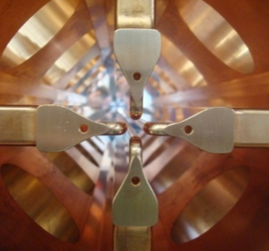
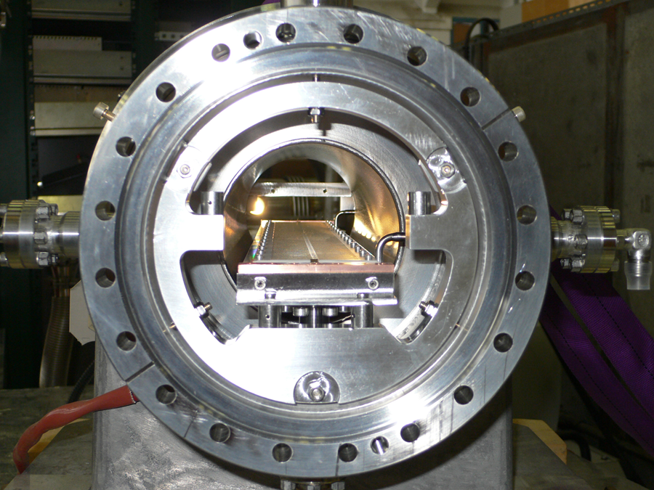
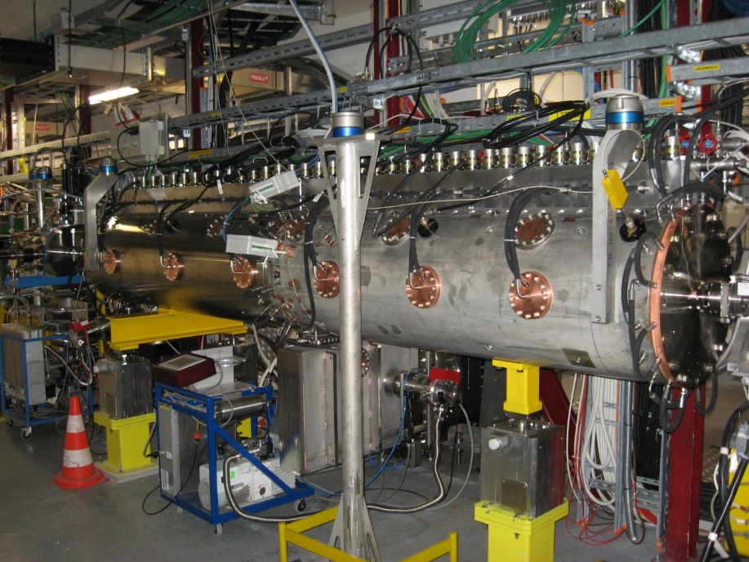
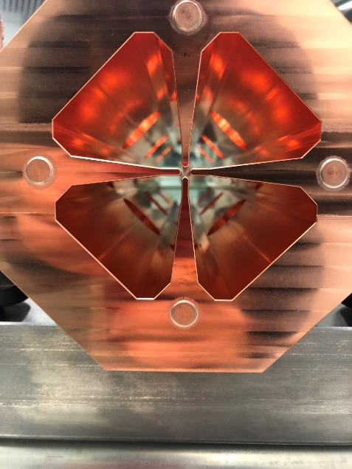
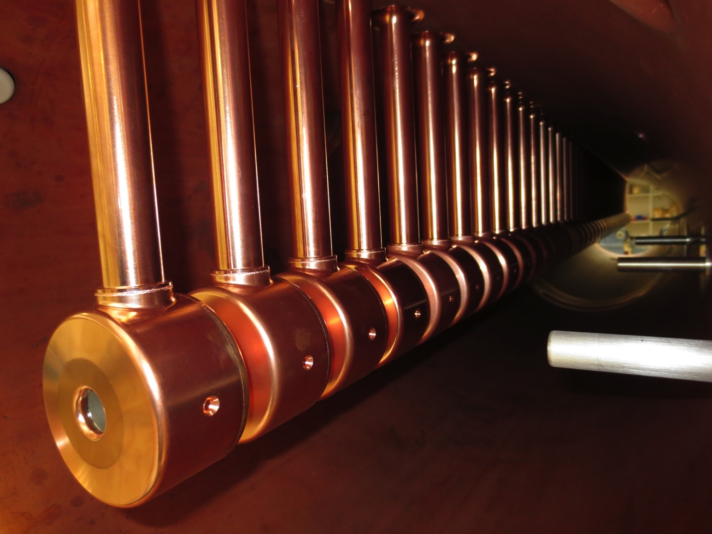
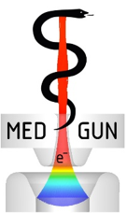
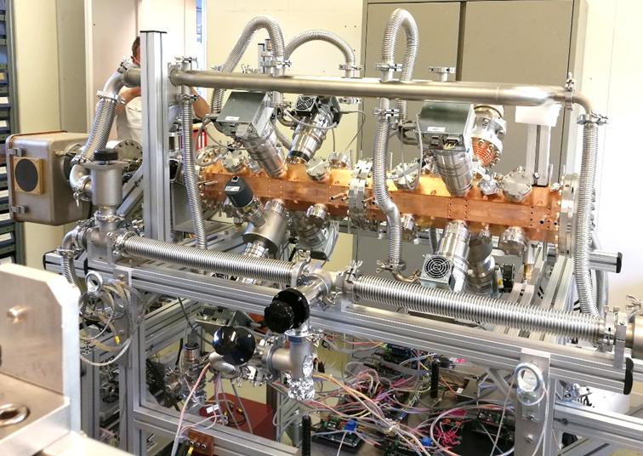
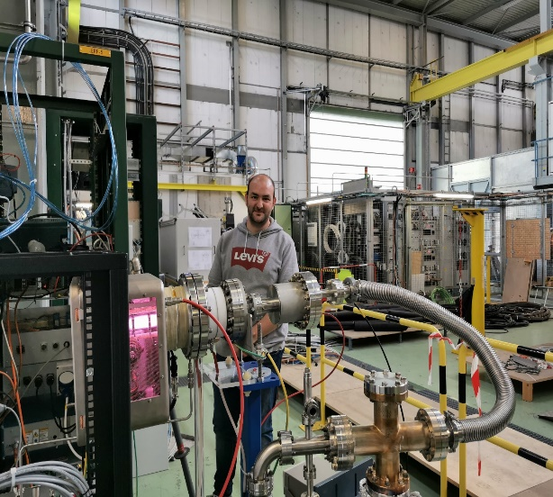
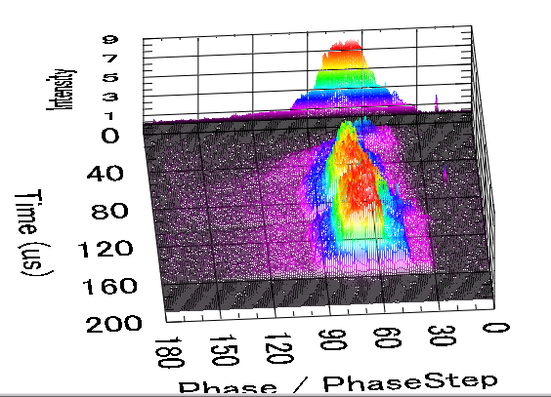

LINAC proton activities at CERN
Alessandra M Lombardi (BE-ABP-HSL)

Slide 2

Outline
Highlight of Linac 4 (2006-2020)
R&D on LINAC4 was applied in medical and societal projects
LIGHT : 750MHz RFQ for medical protons (2015-2017)
ELISA-MACHINA : 750 MHZ RFQ for societal use (2017-2022)
Name-to-be found : 750 MHZ RFQ for carbon ion (2020-under construction)

Slide 3
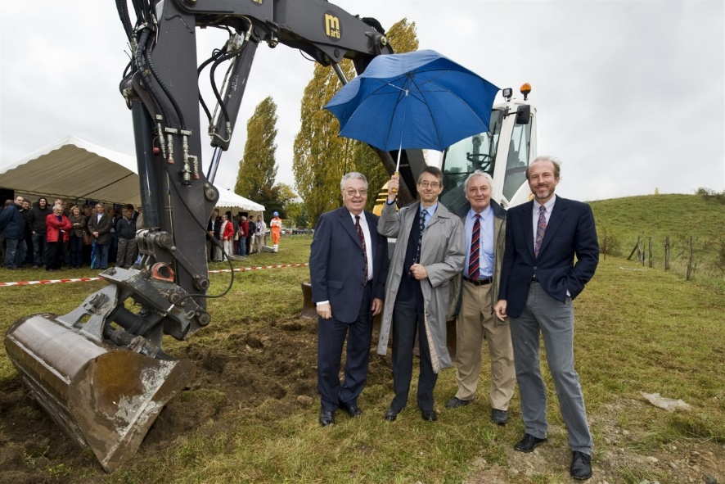
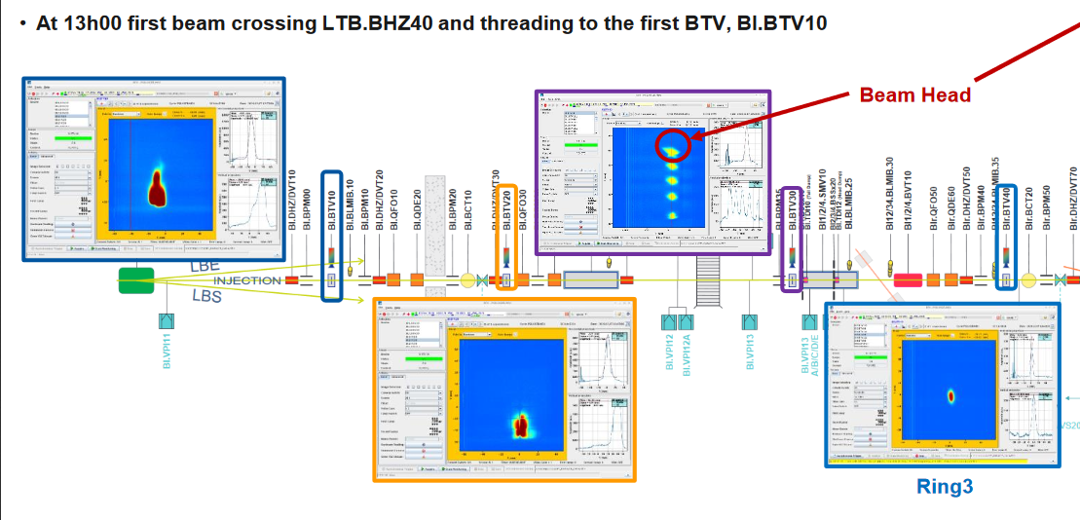

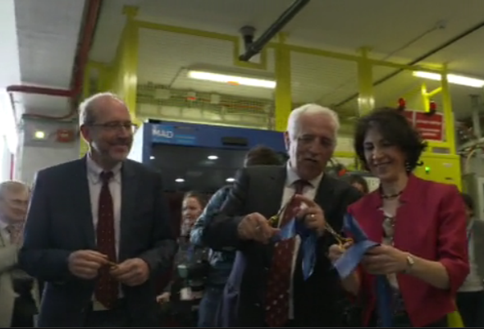
Proposals (1996-2006)
Decision in 2007 R. Aymar director general
Ground Breaking ceremony : 16 October 2008
Injection in PSB : 7 December2020
Inauguration : 9 May 2017
In its June 2007 session the CERN Council has approved the White Paper "Scientific Activities and Budget Estimates for 2007 and Provisional Projections for the Years 2008-2010 and Perspectives for Long-Term", which includes construction of a 160 MeV H- linear accelerator called LINAC4, and the study of a 5GeV, high beam power, superconducting proton Linac (SPL).

Slide 4
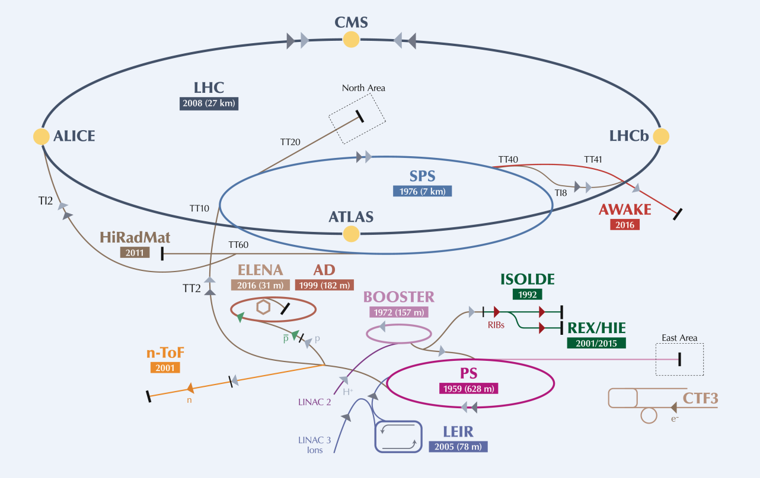
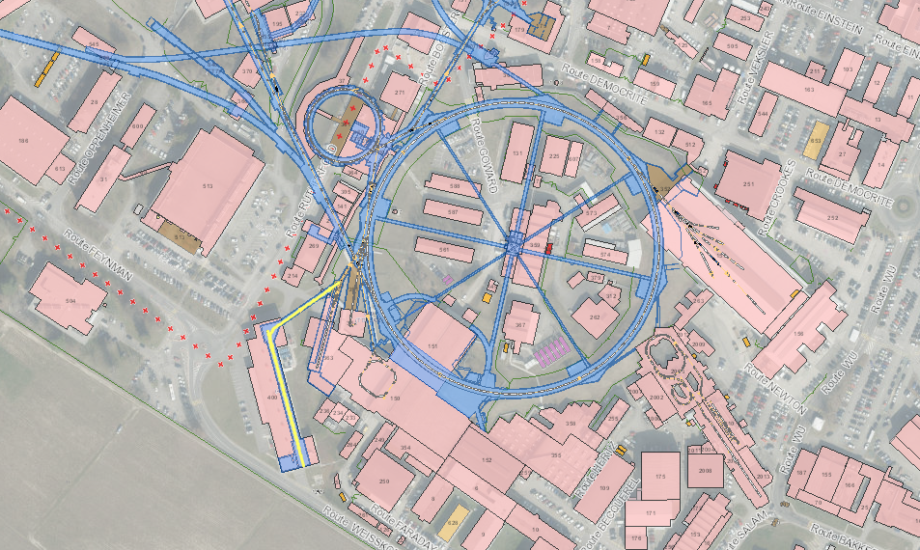
Frequency : 352 MHz
Duty cycle for PSB : 0.06 %
Max duty cycle : 5%
Located 12m underground
Notes:
Add lines to indicate the PSB and the PS

Slide 5
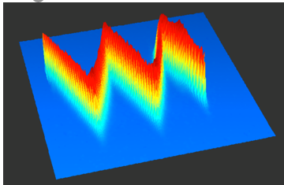
Baseline beam parameters
LINAC4 – CDR -2006 | LINAC4 – achieved (2016) and perfected 2016-2019
H- | Stripping and more tested in Half Sector Test
70mA peak at the source 65 ma peak at 3 MeV 40 mA after chopping | 50mA peak (in twice the acceptance of the RFQ) 30 mA peak at 3 MeV (record) 20 mA after chopping | Peak current from the source Average beam current after chopping (LEBT and RFQ transmission and chopping factor)
160 MeV | 160.48 MeV | All RF structures performing to specs
0.4 π mm mrad | 0.3 π mm mrad (at 160MeV) | Smaller emittance , allows for more turns injected
400 µsec 1Hz (4 rings) | Up to 600 µsec 1Hz | Longer injection in the PSB (100-150turns)
Fast Chopping at 3 MeV | Demonstrated , including transmitted beam quality | Unprecedented flexibility: Beam from 1µsec to 150µsec
Energy painting with the last accelerating modules | proof of principle of energy painting
Measured phase variation for 100 μs long pulse when a energy variation is programmed along the pulse –

Slide 6
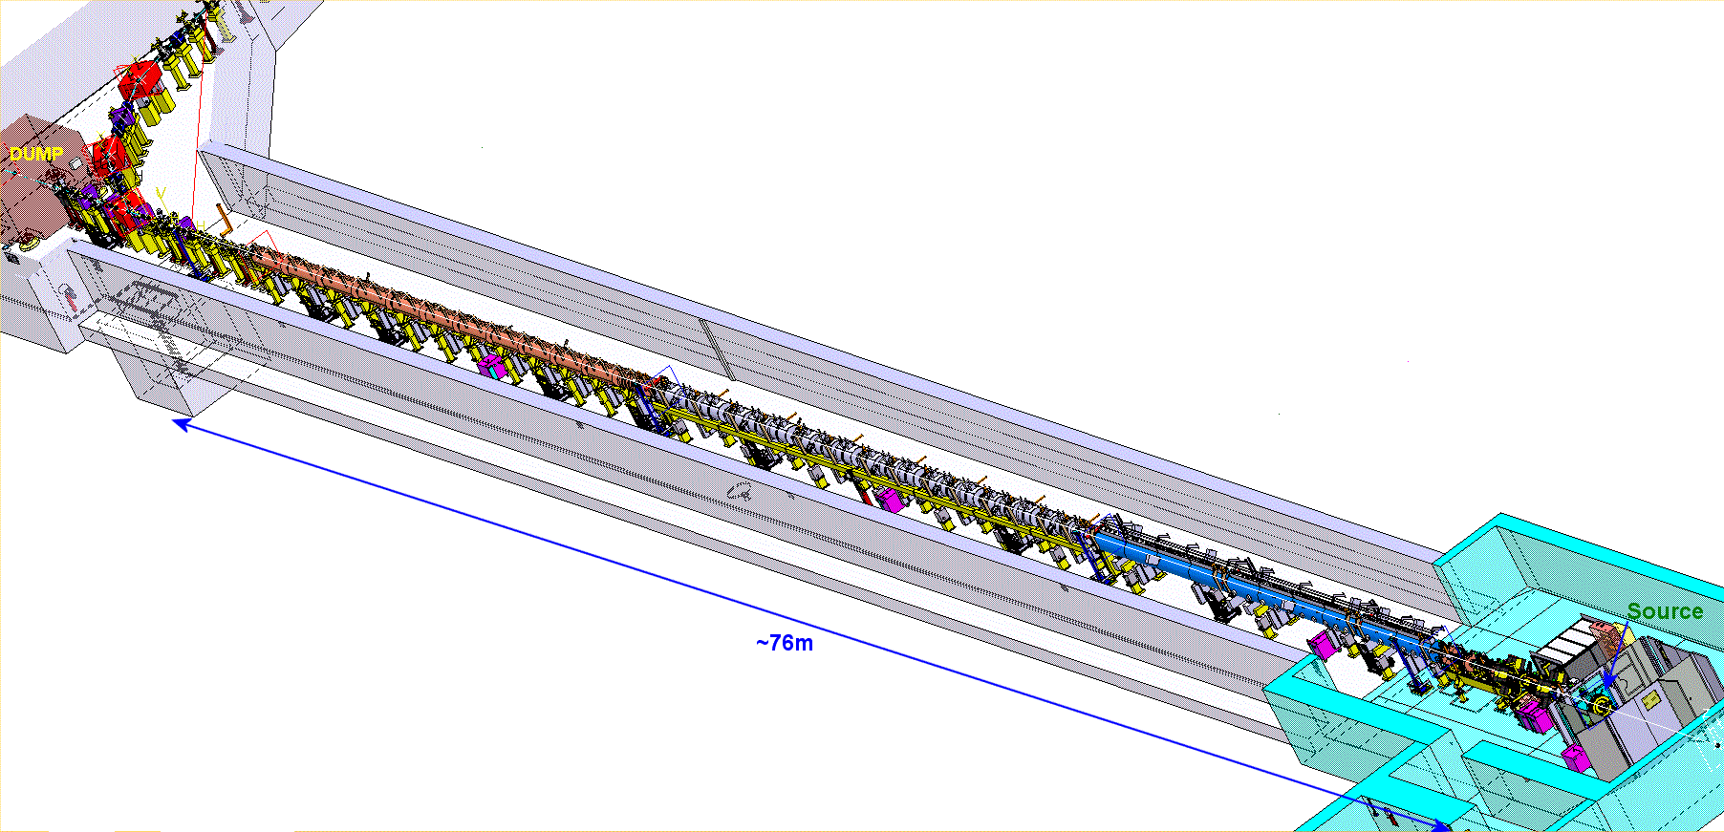

Commissioning in stages of increased energy
Oct 2013
3MeV
30 mA
Nov 2016
160 MeV 18mA
Jun 2016
105 MeV 20mA
Nov 2015
50 MeV
20 mA
Safely on the dump.
It has been stripped.
It has been delivered to the Half Sector Test.
Aug 2014
12 MeV
20 mA
45 keV
50 mA

Slide 7
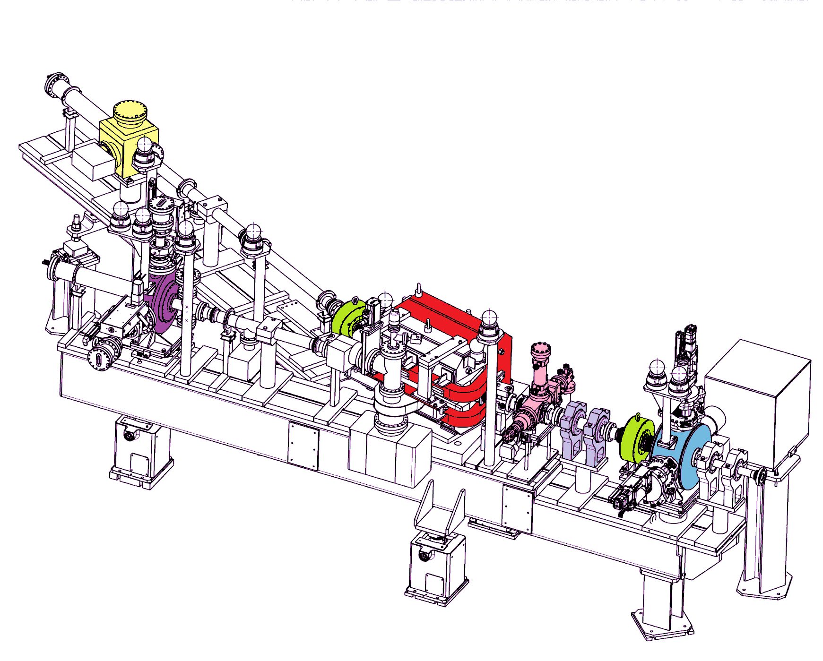
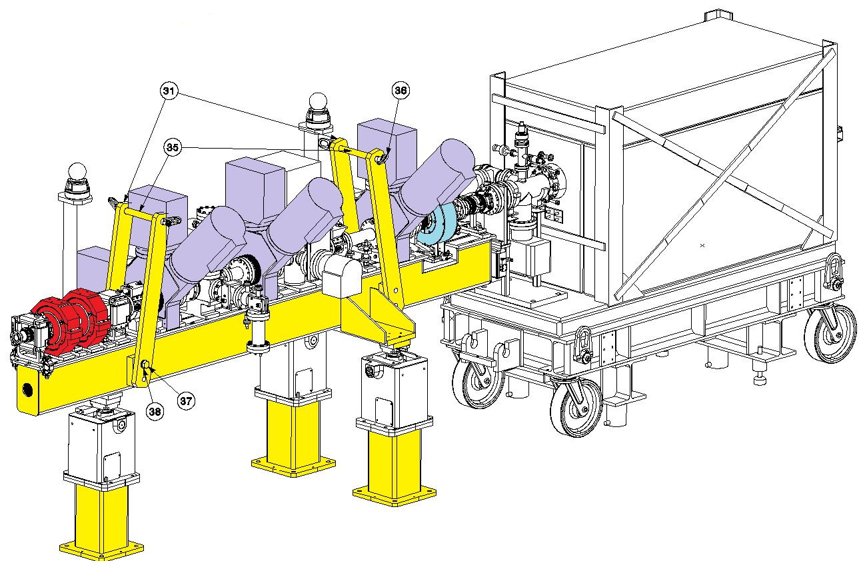
Temporary measurement benches
Low energy test bench at 3 and 12 MeV
Direct measurements:
Transverse emittance with slit-grid.
Energy – Energy spread with a spectrometer.
Taking data for preparing and gaining confidence in higher energies commissioning strategy.
High energy test bench at 50 and 107 MeV
Indirect measurements:
Transverse emittance with 3 profile monitors.
Longitudinal emittance with bunch shape monitor.
Energy with Time of Flight.
Permanent measurement line in the transfer line for 160 MeV
4 profile monitors, beam current transformer and BPMs.

Slide 8
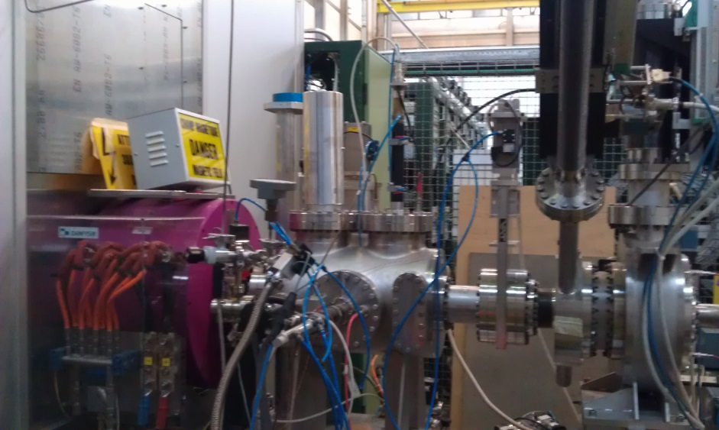
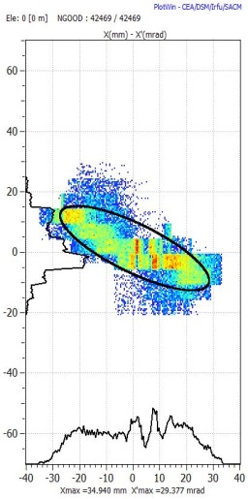
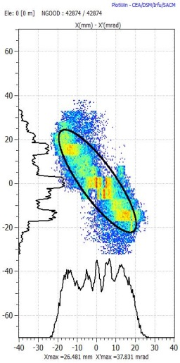
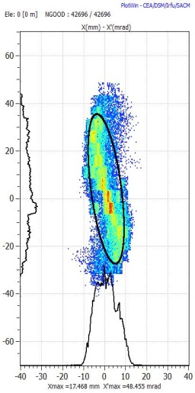
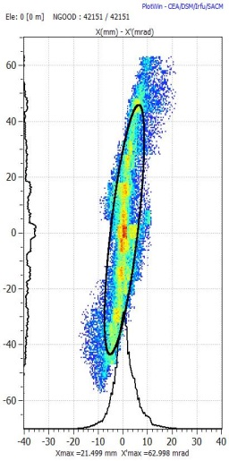
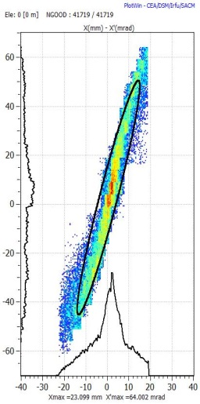
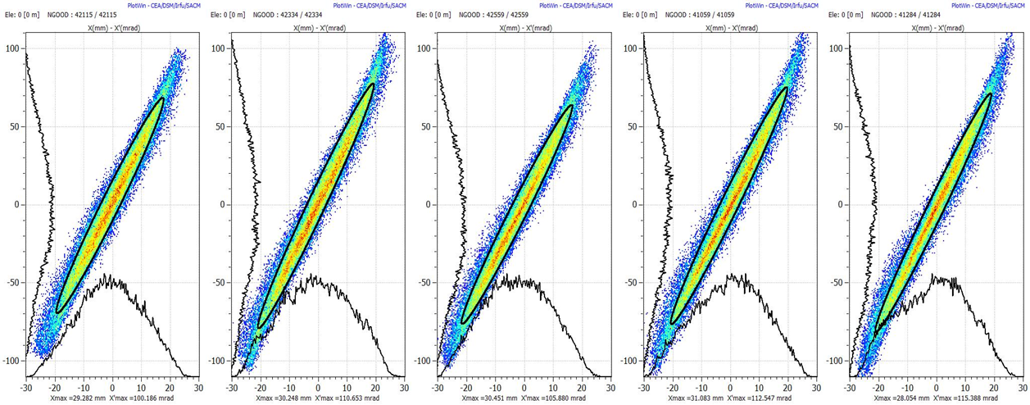
Extensive measurements at 45 keV
This turned out to be a CRUCIAL STEP-see next slide
1- take measurements varying solenoidal field and generate in tracking code
source
Solenoid
Emittance metre
2 – back-trace to source out
3 - Result : we have an empirical input beam distribution that very well represents the dynamics in the LEBT and the rest of the accelerator.

Slide 9
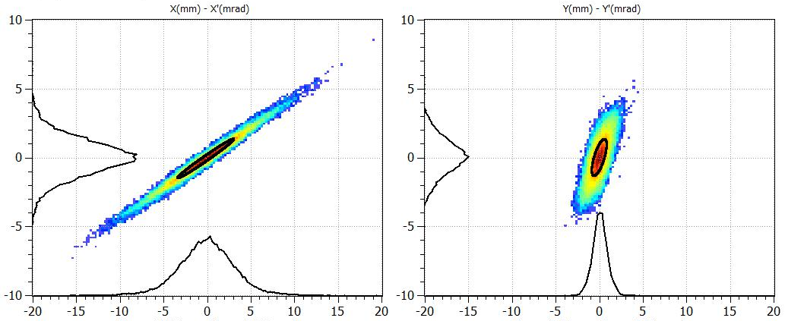
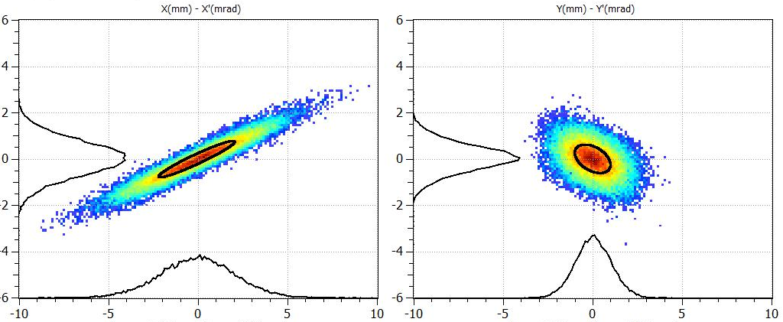
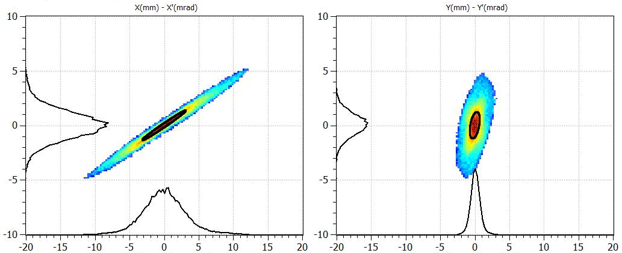
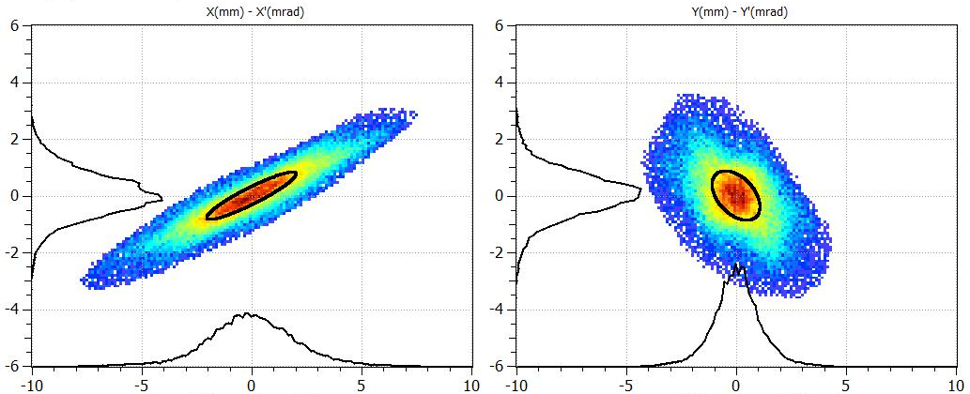
Transverse emittance at higher energies
@ 50 MeV
@ 107 MeV
Expected from simulations
Transverse emittances were indirectly measured with:
the “Forward method”
the “Hybrid Tomographic method”
Both based on: The 3 profiles method – Including the space charge forces with multi-particle simulation codes.
Measured

Slide 10
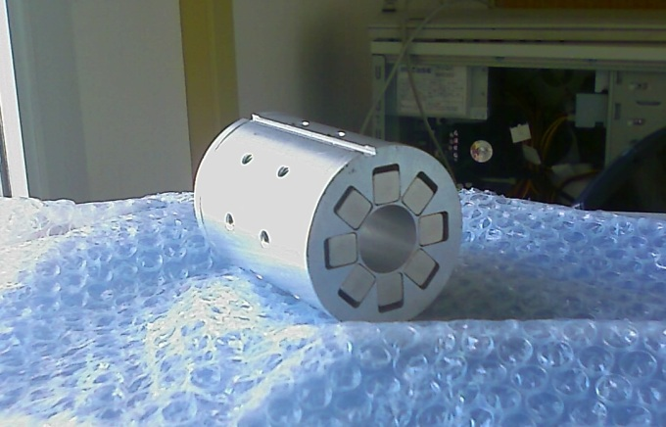
Innovations in LINAC4
PMQ for tank2 , 60 mm in diameter and 80 mm in length
Produced in European industry for the first time
3 MeV/ 352 MHz/ 3 m long RFQ
Commissioned with beam 2013
Fast chopper, validated 2013
Risetime<10nsec/ extinguish factor 100%

Slide 11
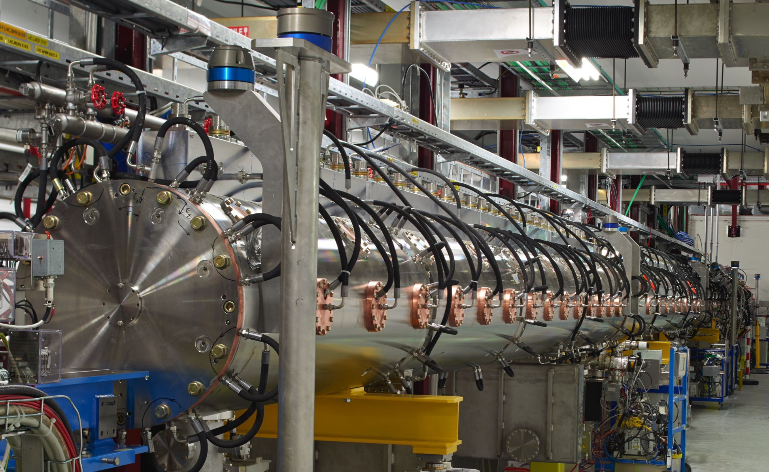
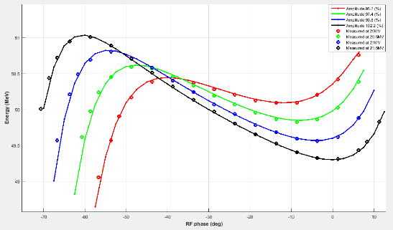
Drift Tube Linac : 3-50 MeV
(3-12-30-50 MeV, commissioned in 2 stages Aug 14 and Nov 15)
3 tanks
DTL3

Slide 12
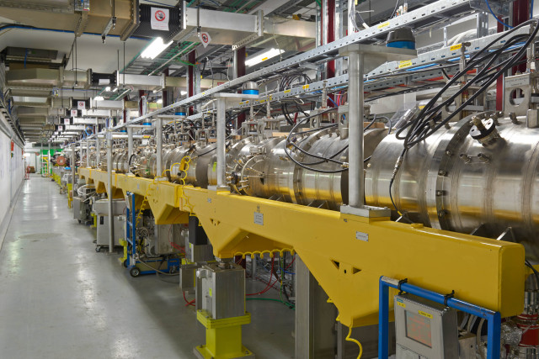
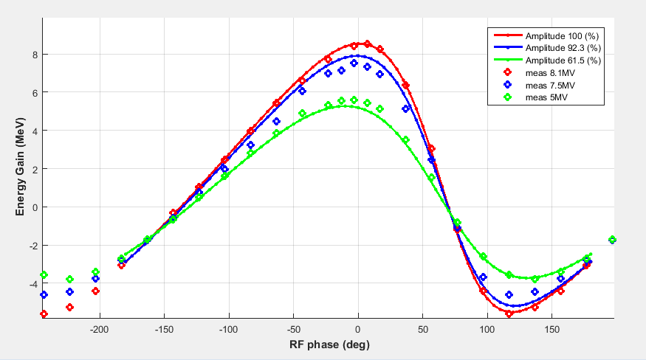
Cell Coupled Drift Tube LINAC : 50-100MeV
(commissioned June 16)
7 modules of 3 accelerating cavities (3 gaps each) and 2 coupling cells,
quadrupoles outside of RF structure,
first-ever CCDTL in a working machine!
Average energy vs cavity phase for CCDTL module 3
measured June 2016 with Time-of-Flight

Slide 13
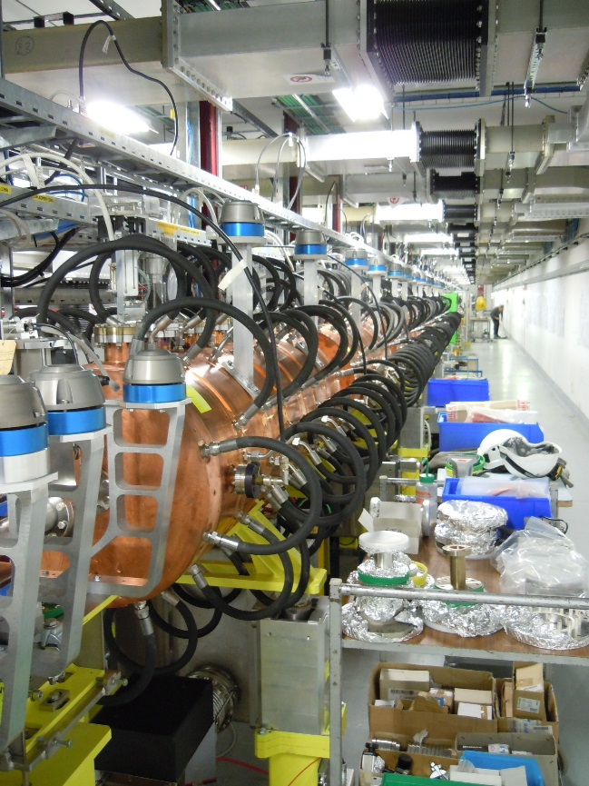
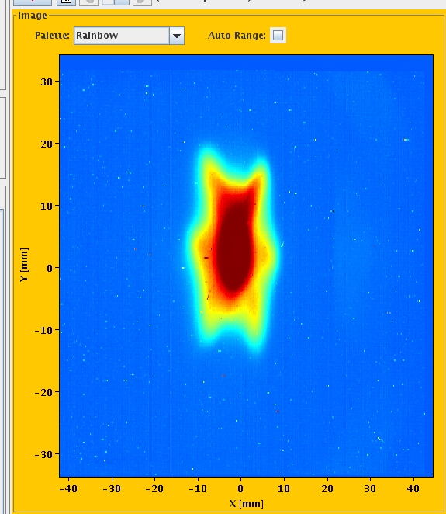
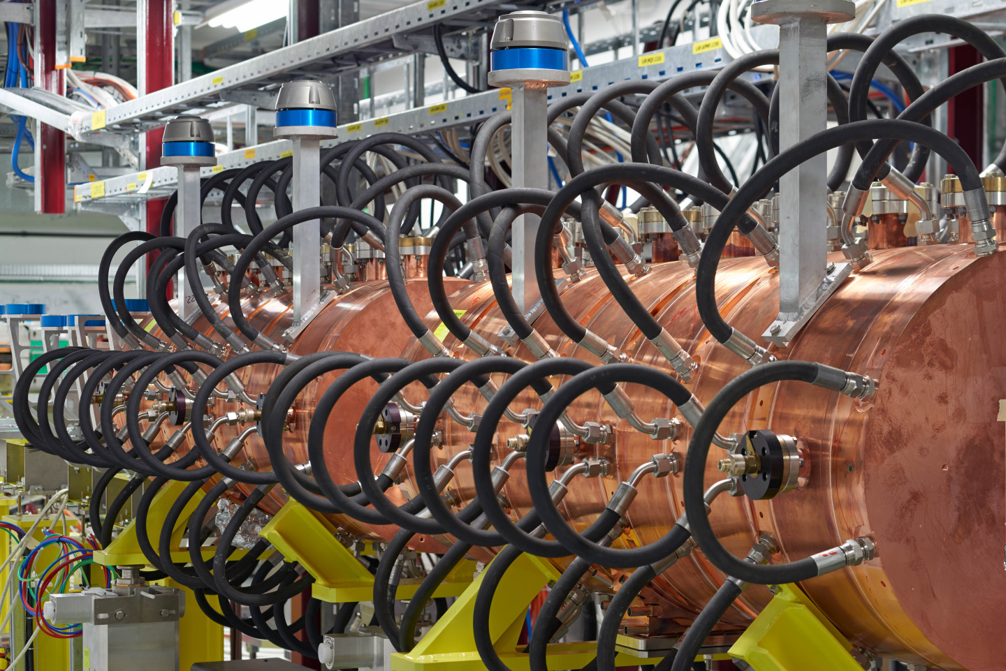
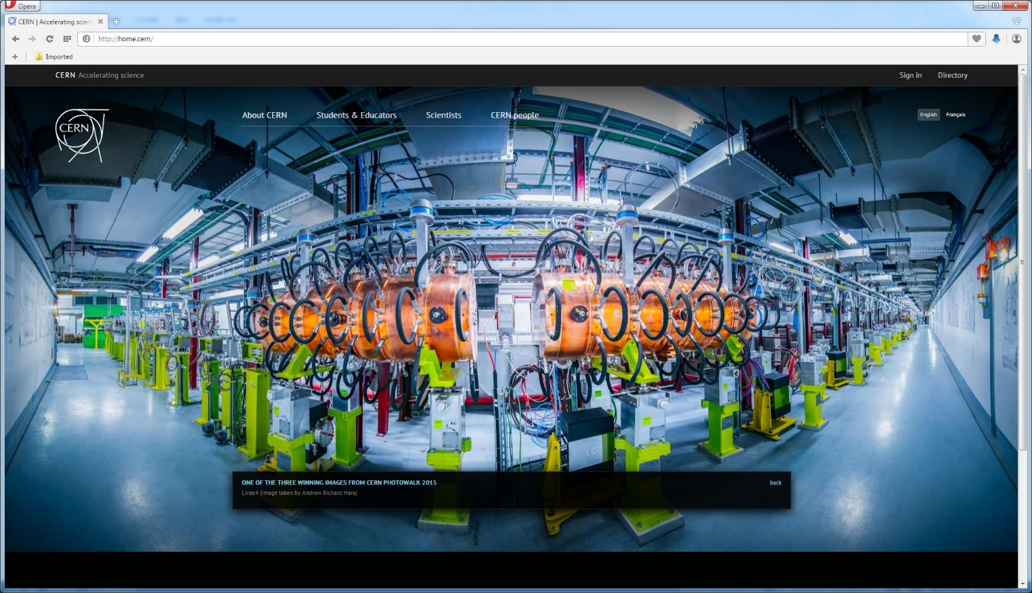
Pi-mode structure : 100-160 MeV
(commissioned Oct 16)
Beam transverse footprint – stripped – 160 MeV at BTV1077 ,
Mar 2017

Slide 14
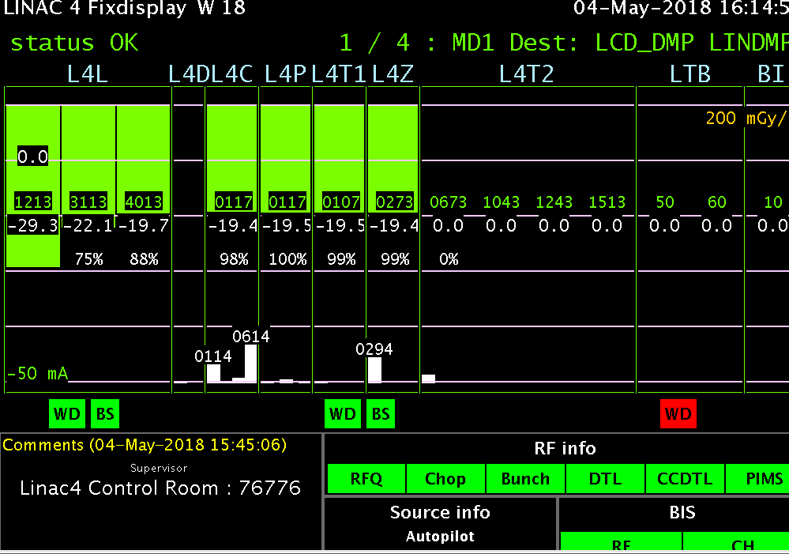
Reliability run
Insure a smooth transition from commissioning to operation: train operators, necessary software development, learn to deal with the increased flexibility.
Find any weak points and mend them in time for the connection
Achieve a beam-availability for the PSB as high as possible and possibly above 90% : importance of the fault tracking system
From 2016 it was all about intensity and reliability : 160 MeV on the dump
Criterium for LINAC4 availability: Current in BCT before the dump
LINAC4 run 24/7 in parallel to normal operation on best-effort basis with:
  Operators deal with issues where possible
  Expert availability and interventions only during working hours
  Faults are fully tracked (Accelerator Fault Tracker AFT)
  Stop AFT Clock during off-hours when fault needs expert intervention & during MDs
Thorough logbook verification w/ Timber/LASER information

Slide 15
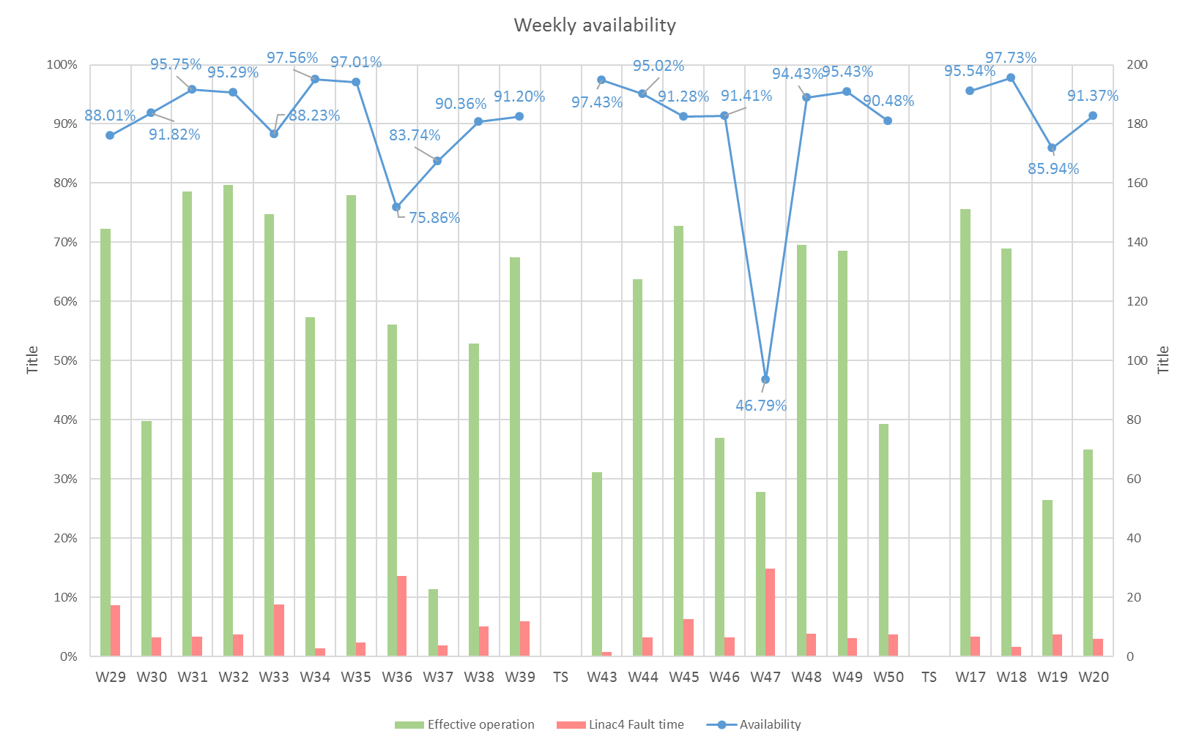
First availability run
Period: 13/07/2017 – 15/05/2018
Last update: 05/06/2018
Availability | Fault Count | Operation | Suspended OP | Effective Operation | Fault Mean Time to Repair
91.5% | 449 | 23 weeks | ~ 8 weeks | ~15 weeks | ~29 min
Average 91.5 %
Week 47: Anode module change 2x, Pre-Chopper connector to feedthrough to vacuum

Slide 16
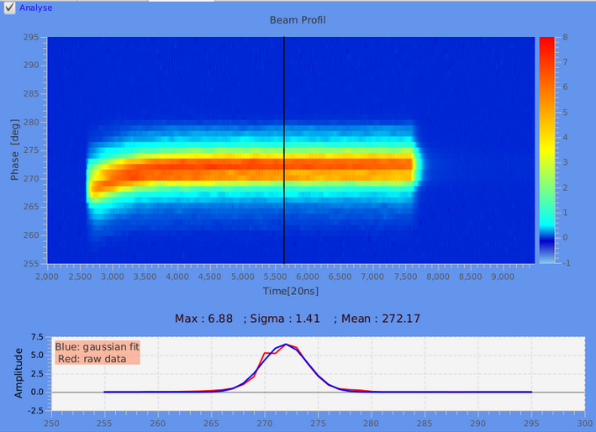
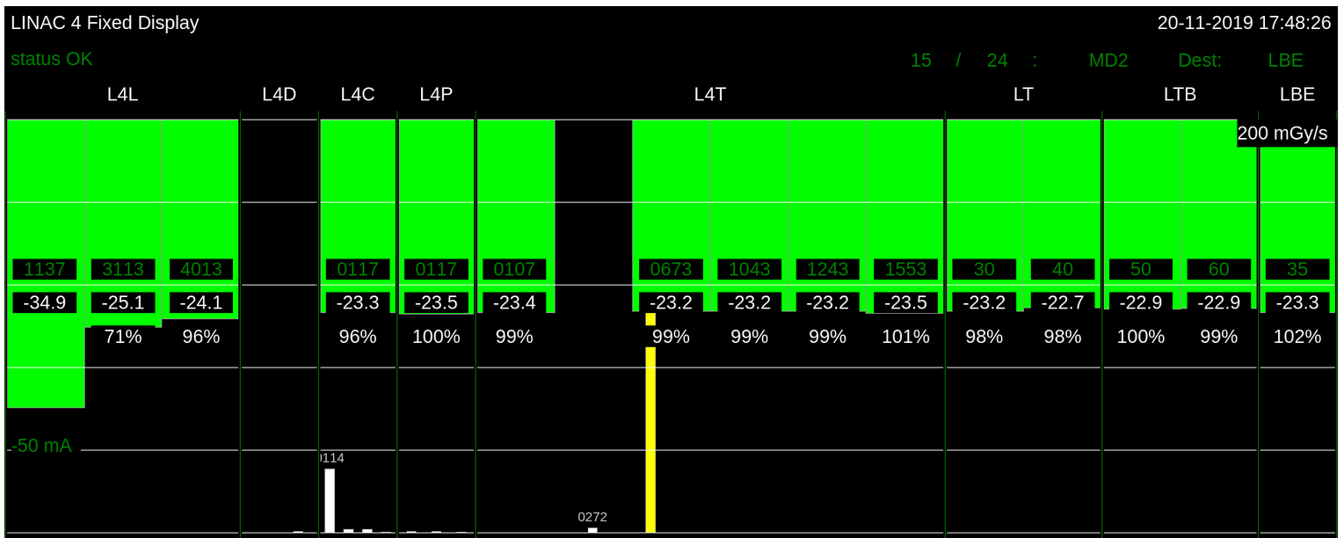
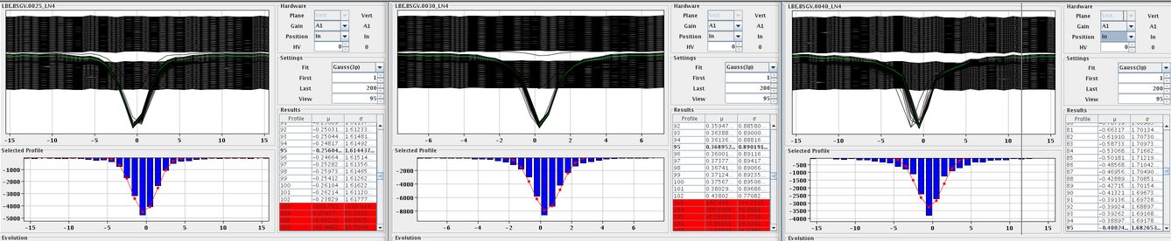
2019 : Beam to the LBE !
LBE
Availability
93.9%
Excellent transmission from 3 MeV to the LBE
Routinely 23mA (un-chopped) that allows the production of all the pre-LS2 beams
The devil is in the pre-injector
Beam phase spread at 160 MeV – in specs.
Pre-injector
Accelerator
Transfer Lines
96% transmission from 3 MeV to the LBE – 23mA suitable for all pre-LS2 beams
Emittance measurements in LBE – as expected

Slide 17
LINAC4: measured beam characteristics
Parameter | Measurement
Peak intensity at 160 MeV | 25 mA
Emittance rms normalized | 0.3 π mm mrad
Max usable pulse length | 600 μs
Stability shot-to-shot | 2%
Pulse flatness | 2% for 160μs pulse 5% fpr 600μs pulse
Beam position jitter along the pulse at the linac dump | +/- 1mm
Fast Chopping at 3 MeV | Rise time < 10ns Extinction factor close to 100% Unprecedented flexibility: beam 1- 600 μs
AVALIABILTY 2021 : 99%

Slide 18
LIGHT pre-injector
Wednesday
2014
S. Myers : head of office for medical applications
Study efficient accelerator in the energy range few keV to 5 MeV for a LINAC-based hadron-therapy facility (3GHz)
2015-16
2015 Construction and assembly at CERN
2016 installation at SA2 includes a commercial proton source
2017
First beam in February
Validation of the beam dynamics
2017 - present
Used by ADAM/AVO at CERN as a pre-injector for a hadron based facility (tests up to 70MeV)
CERN was granted a patent

Slide 19
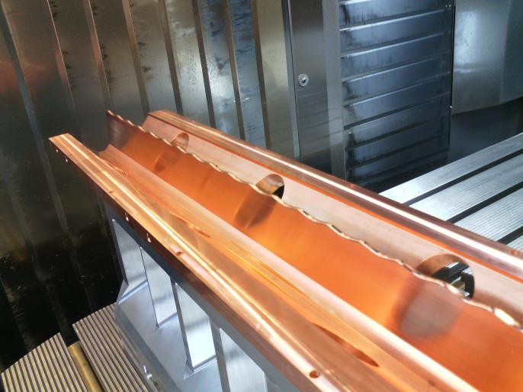
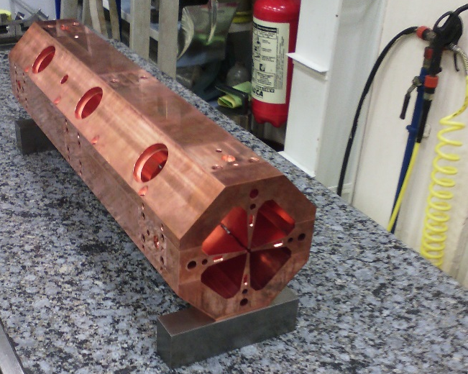
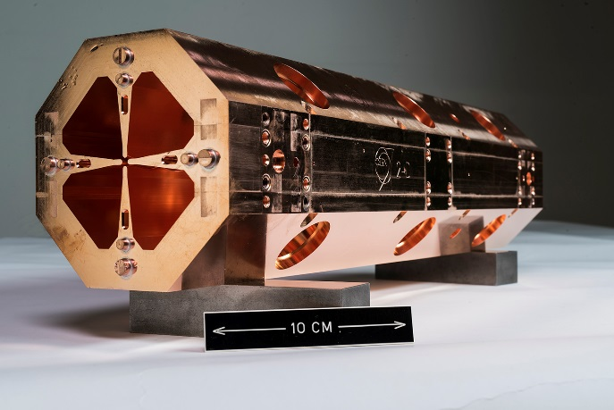
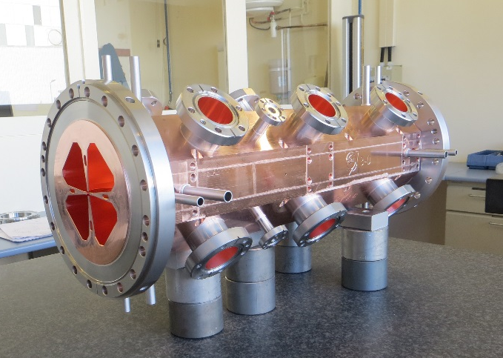
2015 - CONSTRUCTION
March 15 -Machining (±10 µm) | May 15- Assembling (±15 µm )
June 15 - First brazing | October 15 – Second brazing
Source and RFQ parameters
RF Frequency | 750 MHz
Input | 40 keV
Output Energy | 5 MeV
Length | 2m
Vane voltage | 65kV
Peak RF power | 400kW
Duty cycle / max | 0.4% /(5%max)
Input/Output Pulse Current in 3GHz acceptance | 100/30 µA
Transv. emittance 90% | 0.1 pi mm mrad
Average aperture (r0) | 2mm
Maximum modulation | 3

Slide 20



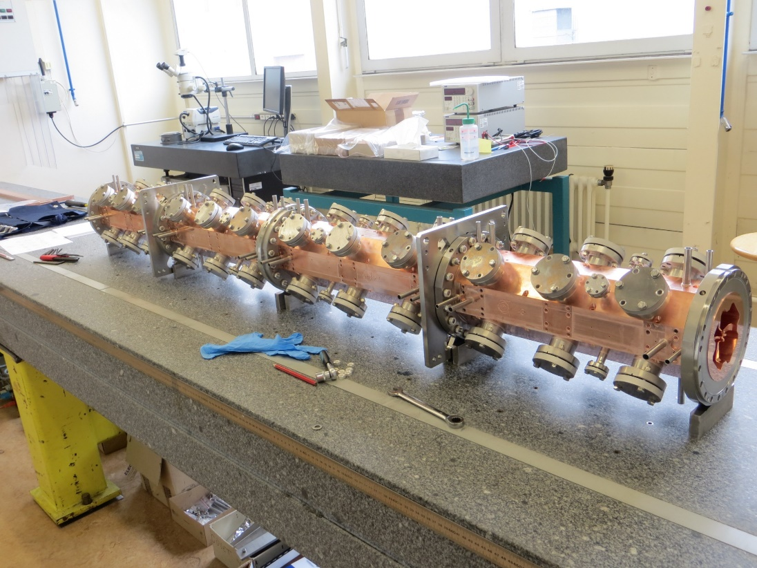
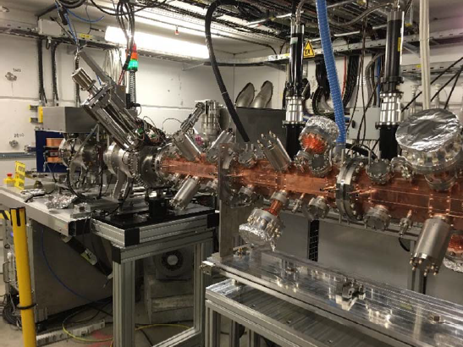
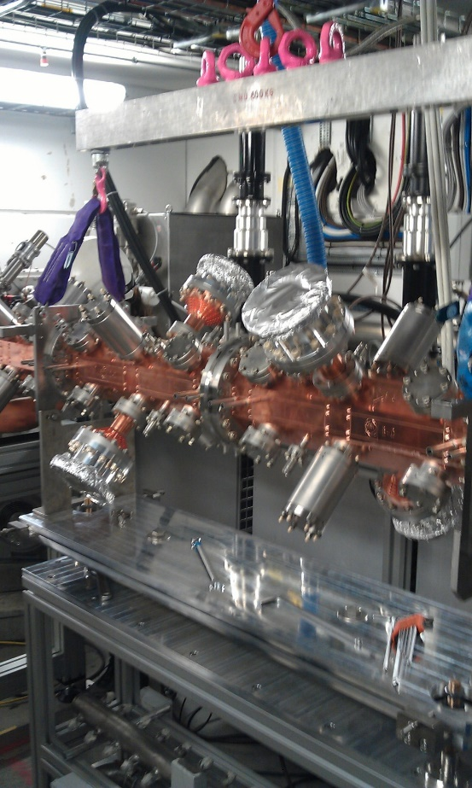
2016 : assembly, tuning and high power RF
One word on beam dynamics
RF measurements
Ready for beam tests

Slide 21


2017 : proton beam at SA2
LOW ENERGY PRE-INJECTOR for ADAM/AVO test facility at SA2
Radically new design from the beam dynamics point of view- validated by beam measurements. It build on the experience of the LINAC4 RFQ for RF design and mechanical design.
Built in the CERN workshop : less than 2 years from start of construction to installation, this included RF tuning.
A copy is built in industry.

Slide 22









Foundation for 4 other RFQs
Redesigned for portability :
ELISA (2022 science gateway)
MACHINA (in Florence)
Copy for medical facility:
Built in Italian industry,
First beam July21
Redesigned for Carbon6+ :
Built (1 out of 4 modules) in Spanish industry collaboration agreement with CIEMAT, due in 2022
Test at CERN ideally in SA2

Slide 23

MACHINA
Source and RFQ parameters
RF Frequency | 750 MHz
Input | 20 keV
Output Energy | 2 MeV
Length | 1m
Vane voltage | 35kV
Peak RF power | 100kW
Duty cycle / max | 0.4% /(5%max)
Input/Output Pulse Current in 3GHz acceptance | 100/30 µA
Transv. emittance 90% | 0.1 pi mm mrad
Average aperture (r0) | 1.4 mm
Maximum modulation | 2.8
Light from the Bragg peak at 2 MeV.

Slide 24







ELISA
Experimental Linac for Surface Analysis
A miniature proton accelerator for Science Gateway
READY DOR PUBLIC OPENING June2023
Demonstration / Experience in public with the beam

Slide 25








NEXT challenge : accelerate Carbon in a LINAC
1- Source of fully stripped carbon ion with sufficient quality for use in a medical facility
RFQ and IH
2- An efficient and easy to use pre-injector
3- LINAC with a “hospital-friendly” footprint , adaptable to existing buildings and allowing intermediate station for e.g.
Radioisotope production
Notes:
This is the collaboration of CERN // note that we can do radioisotopes after the fixed energy part

Slide 26
Sources
LINAC is designed for q/m =1/2
  Helium and fully stripped carbon ions
  Works for protons by reducing Magnetic and Electric field to ½
Ultimate source is a EBIS (tests ongoing at MedEGUN) delivering Carbon ions – not yet up to specs
A Helium source allows to validate all the aspects of the pre-injector (mechanics, RF and beam dynamics) without compromise : Helium source (destined to Sarajevo University) shall be ordered within 2022 , ready to use end 2023
A proton source allows to validate beam dynamics but not RF (voltage holding capabilities, stability at high field etc) : proton source ELISA-like with the extraction designed in ABP is ordered with the aim of extracting protons as early as June 2023

Slide 27




Collaboration CERN-CIEMAT-CDTI-Spanish Industry – RadioFrequencyQuadrupole
1-Drawings
2-Precision machings
3-Assembly and brazing
2.0 m long
750 MHz
Will deliver Carbon (or Helium) at 5 MeV (total energy)
Designed at CERN built in Spanish Industry
2/4 section completed – complete delivery june 2023
4-First (of 4) section completed

Slide 28
Somehow during 2023 we will have
A proton source designed to inject DIRECTLY into the RFQ – very little room for regulation
A helium source + a Low Energy Beam Transport designed to match a helium beam to the RFQ acceptance
A 750 MHz RFQ designed to accelerate from 15keV/ to 2.5 MeV/u particles with q/m =1/2

Slide 29
Plans 2023 and beyond
2022 : beam at 2 MeV from ELISA RFQ
2023 : spare of the LINAC4 RFQ ready
Characterize the proton and helium sources for use with the Carbon RFQ (2023)
Accelerate the beam through the Carbon RFQ (2023-2024)
Validate (hopefully ) the 750 MHz RFQ design and proceed to the construction of the second RFQ to bring the beam to 5MeV/u
Test direct injection from the source into an RFQ (and feed back to LINAC4?)

Slide 30




Milestones in the development of RFQ at CERN.
1990 RFQ2 200 MHz 0.5 MeV /m Power/m 244kW/m P/MeV 670kW/MeV Weight :1200kg/m Ext. diametre : ~45 cm 200mA proton | 2007 LINAC4 RFQ 352 MHz 1MeV/m Power/m 133 kW/m P/MeV 135kW/MeV Weight : 400kg/m Ext. diametre : 29 cm 40 mA H- | 2014 HF RFQ 750MHz 2.5MeV/m Power/m 200kW/m P/MeV 80 kW/MeV Weight : 100 kg/m Ext. diametre : 13 cm 0.1 mA proton | 2019 MACHINA / ELISA 750MHz 2.0MeV/m Power/ m 80kW/m P/MeV 40kW/MeV Weight : 100 kg/m Ext. diametre : 13 cm 0.1 mA proton Portable | 2020 Name_to_ be_ found 750MHz 1.0MeV/m (q/m=1/2) Power/ m 100kW/m P/MeV 80 kW/MeV Weight : 100 kg/m Ext. diametre : 13 cm 0.1 mA carbon ions

