Slide 1
Muon Collider
Status and Plans
UPHUK8 Bodrum, 5th September 2022
Christian Carli on behalf of the International Muon Collider Collaboration (IMCC)
Present status of ideas on muon colliders based on several studies in the past and, in particular, the MAP study. Many of the images taken from MAP publications.

Slide 2
Content
Introduction
Design baseline overview
Muon production and capture
Muon cooling
Acceleration
Muon collider ring
Neutrino radiation issue
Tentative Timeline
Summary

Slide 3
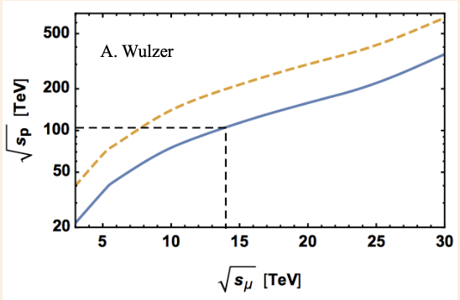
Introduction
High energy lepton colliders precision
and discovery machines
  Given physics reach with at lower
  energies than for proton colliders
Electron-positron colliders limited
by low particle mass
  Energy loss from synchrotron radiation for circular colliders
  Length for linear colliders
Collide muons – leptons with mass ~105 MeV
    Feasible lepton circular collider
    Same (higher) physics reach at lower beam energy than hadron collider
  Drawbacks and limitations
    Effort to generate useful muon beams, still resulting in large emittance
    Low life-time of ~2.2 us in muon rest frame
    => Fast (ionization) cooling and acceleration (e.g., by pulsed synchrotrons)

Slide 4
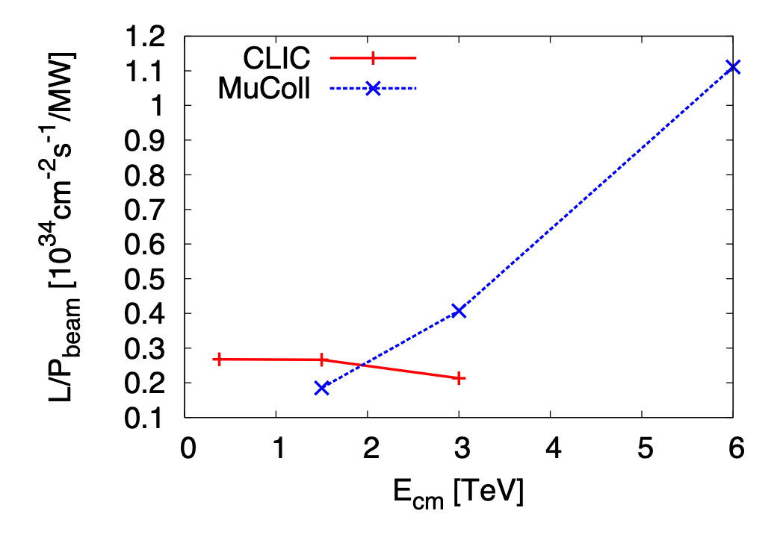
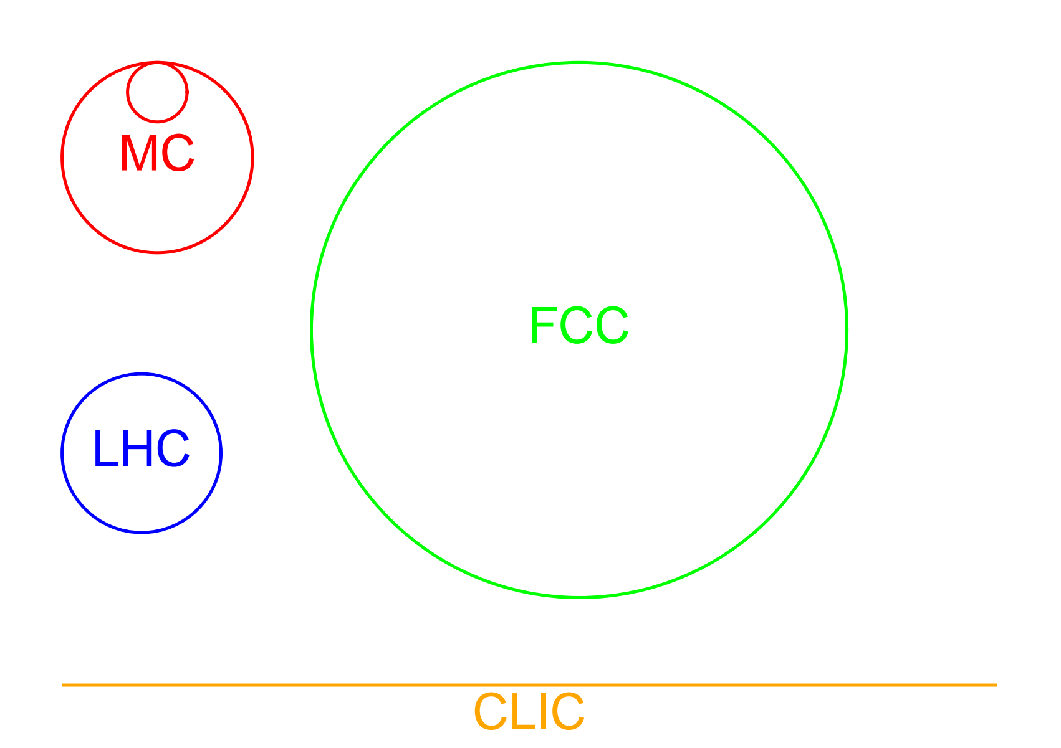
Introduction
Facility footprints for different high energy physics projects
10 TeV muon collider
  Footprint comparable to 3 TeV CLIC …
  … with physics potential comparable to FCC-pp
Luminosity per beam power as function of beam energy
  Ratio of luminosity to beam power increases with beam energy
  Muon collider attractive in particular for high energies

Slide 5
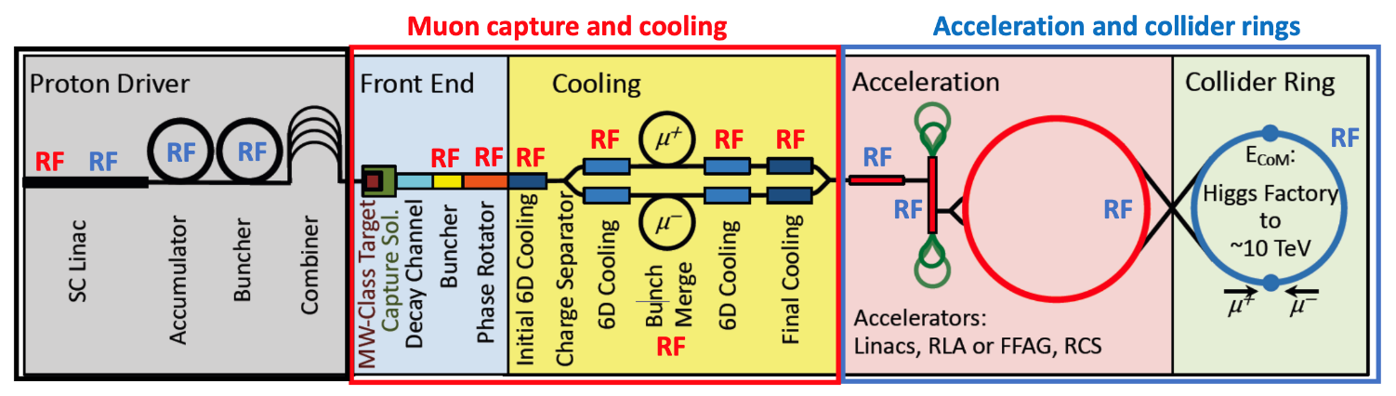
Introduction
Muon collider studies exist since decades
  First proposal about 50 years ago, concepts with ionization cooling in the 80ies
  Studies in US and Russia in the 90ies, later at CERN
Muon Accelerator program
  US initiative launched in 2011
International Muon Collider Collaboration IMCC working
on 10+ TeV scheme
From MAP study

Slide 6
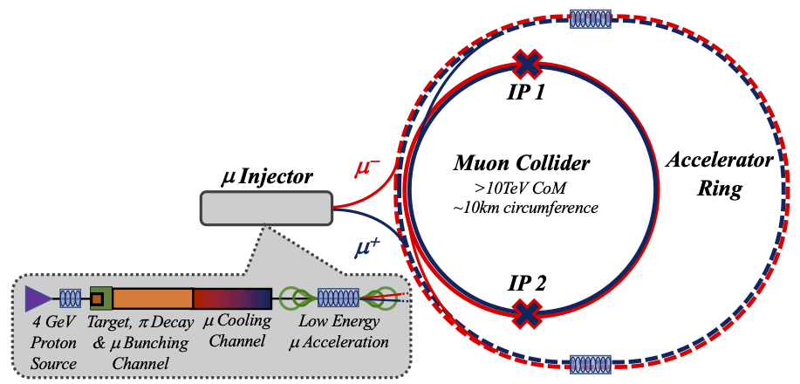
Design Baseline Overview
Short beam life-time:
=> Ionization cooling, fast acceleration,
high RF gradients and high field magnets!
Acceleration in a sequence of
pulsed synchrotrons
(last one larger than collider)
Collider: tightly packed high field
magnets to minimize circumference
and maximize luminosity
Few MW production beam:
short intense bunches
on target generating
πs decaying into μs.
Target and capture
channel: large energy
μ beam transformed
to sequence of bunches
Cooling stages and
merging of μ bunches
into one bunch
Low energy acceleration
In recirculating Linacs

Slide 7
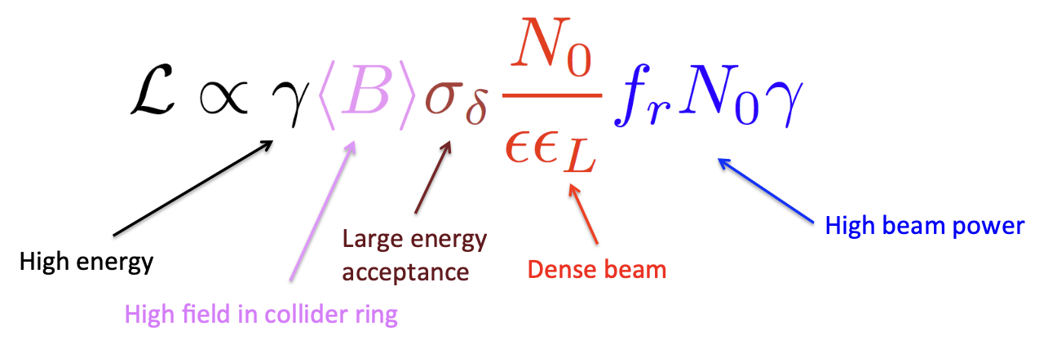
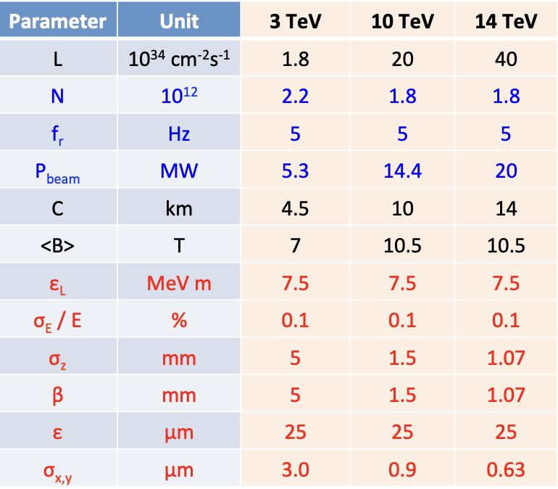
Design Baseline Overview tentative parameter list for IMCC study
High (average)
magnetic field
Relative energy spread
kept constant at 10⁻³
Bunch length and β*
decreasing with beam energy

Slide 8
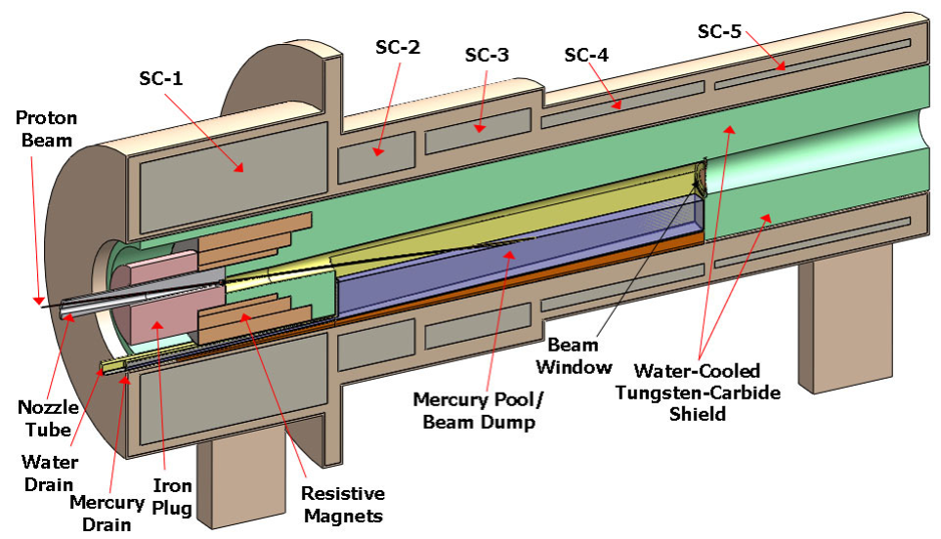
Muon Production and Capture
Production beam
  A few (1-4) MW proton beam with a few GeV beam energy
  Short bunch length of a few ns!
  Could be a SC linac followed by accumulator and compressor rings
Target
  Options: graphite, liquid metal jet (mercury tested with MERIT experiment or powder) …
  P+ N -> π + X followed by decay with charged πs decaying into μs
  Large energy distribution of muons
Magnetic field taper
  Aim: collection of muons in
  range 50 MeV to 400 MeV
  Target in high field ~20 T
  to minimize transverse emittance
  Reduction to ~2 T over ~10m
  length a compromise between
  transverse and long. blow-up
From MAP study

Slide 9
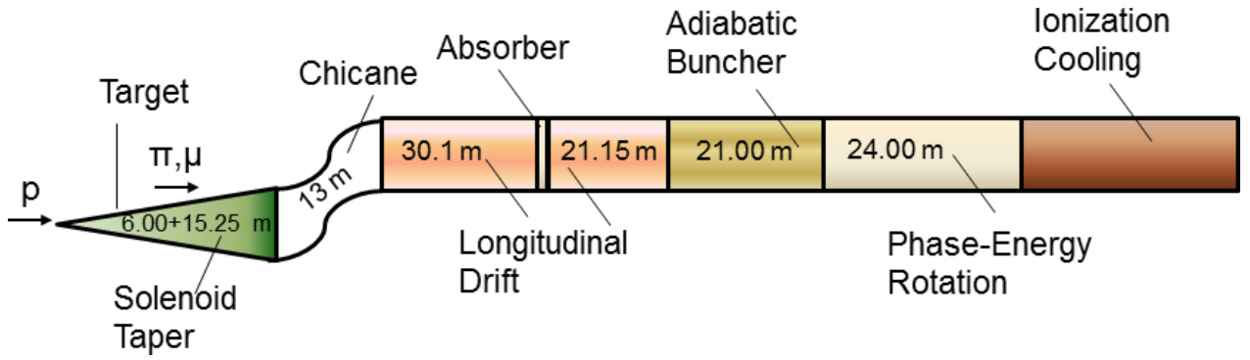
Muon Production and Capture
Transformation of large energy spread muon beam into sequence of bunches
  Target and drift followed by chicane to remove most unwanted particle
  Be absorbed stopping protons in momentum range of selected muons
  Drift: generation of correlation between energy and longitudinal position
  RF cavity section to create longitudinal structure (bunches)
    Muon distribution still becoming longer => RF frequency decreasing over buncher section
  Phase-energy rotation: accelerate low energy bunches coming late, decelerate high energy bunches coming early
    Appropriate choice of RF frequency and phase
    Again frequency varying over over phase-energy rotation section
  Result: train of bunches with about equal energy suitable for ionization cooling
From MAP study

Slide 10
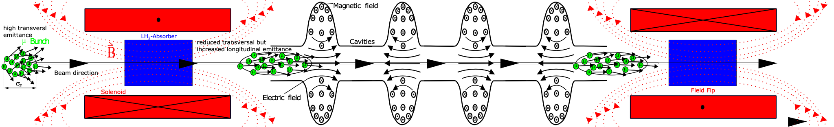
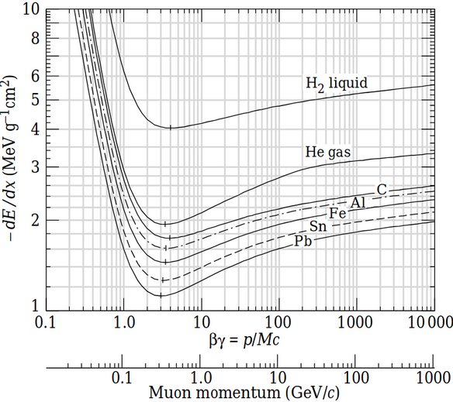
Muon Cooling
Principle
Principle of (transverse) ionization cooling
  Absorber: reduction of both the longitudinal and transverse momentum
  Cavities: acceleration, i.e., increase of only longitudinal momentum
  Net effect: reduction of transverse momentum and, thus, beam cooling
  Scattering leads to beam blow-up – need for
  strong focusing solenoids and low Z absorbers
Longitudinal cooling (or heating)
  Dependence of energy loss on energy
  Dispersion and wedge shaped absorber
Bending
generating
dispersion
Absorber slowing
down high (low)
momenta more (less)

Slide 11
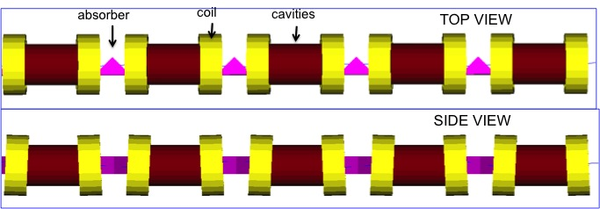
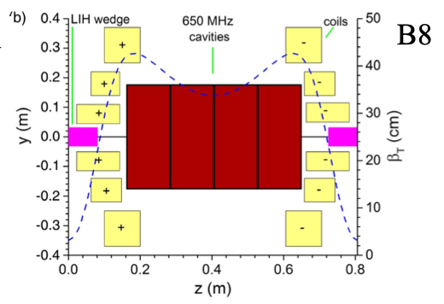
Muon Cooling
6D Cooling Channels
First 6D cooling channel
suitable for neutrino factory
High field solenoids for focusing
  Minimum Twiss betatron function
  β_{T} at absorber location
  Tilting of solenoids
  Solenoid polarity reversals
    Dispersion from vertical magnetic
    field for longitudinal cooling
Low Z absorbers: Liquid H₂ and LiH
Cavities in high magnetic field region
6D cooling
  Between muon capture and bunch merging
    Interleaved with separation of μ⁺ and μ⁻
  Between bunch merging and final cooling
From MAP study
Last section of 6D cooling
after bunch merge

Slide 12
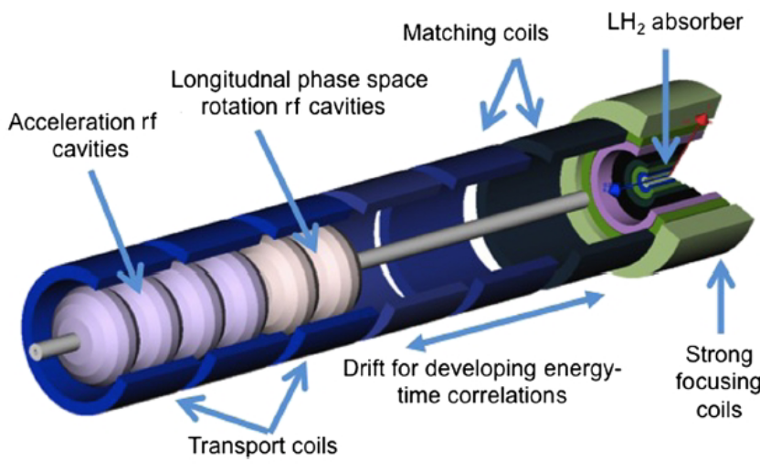
Muon Cooling
Bunch merging and final cooling
Bunch merging – transformation of train of 21 bunches into one bunch
  Longitudinal gymnastics combining three bunches, resulting in 7 bunches
  Transverse merging
Followed by another 6D cooling channel
  Equilibrium transverse emittances too large, small longitudinal emittance
Final cooling channel
  Gradually decreasing energy to reach smaller transverse emittances
  Absorber liquid H₂
  No longitudinal cooling
  resulting in significant
  blow-up
  High magnetic field (~30T)
  at absorber location
From MAP study

Slide 13
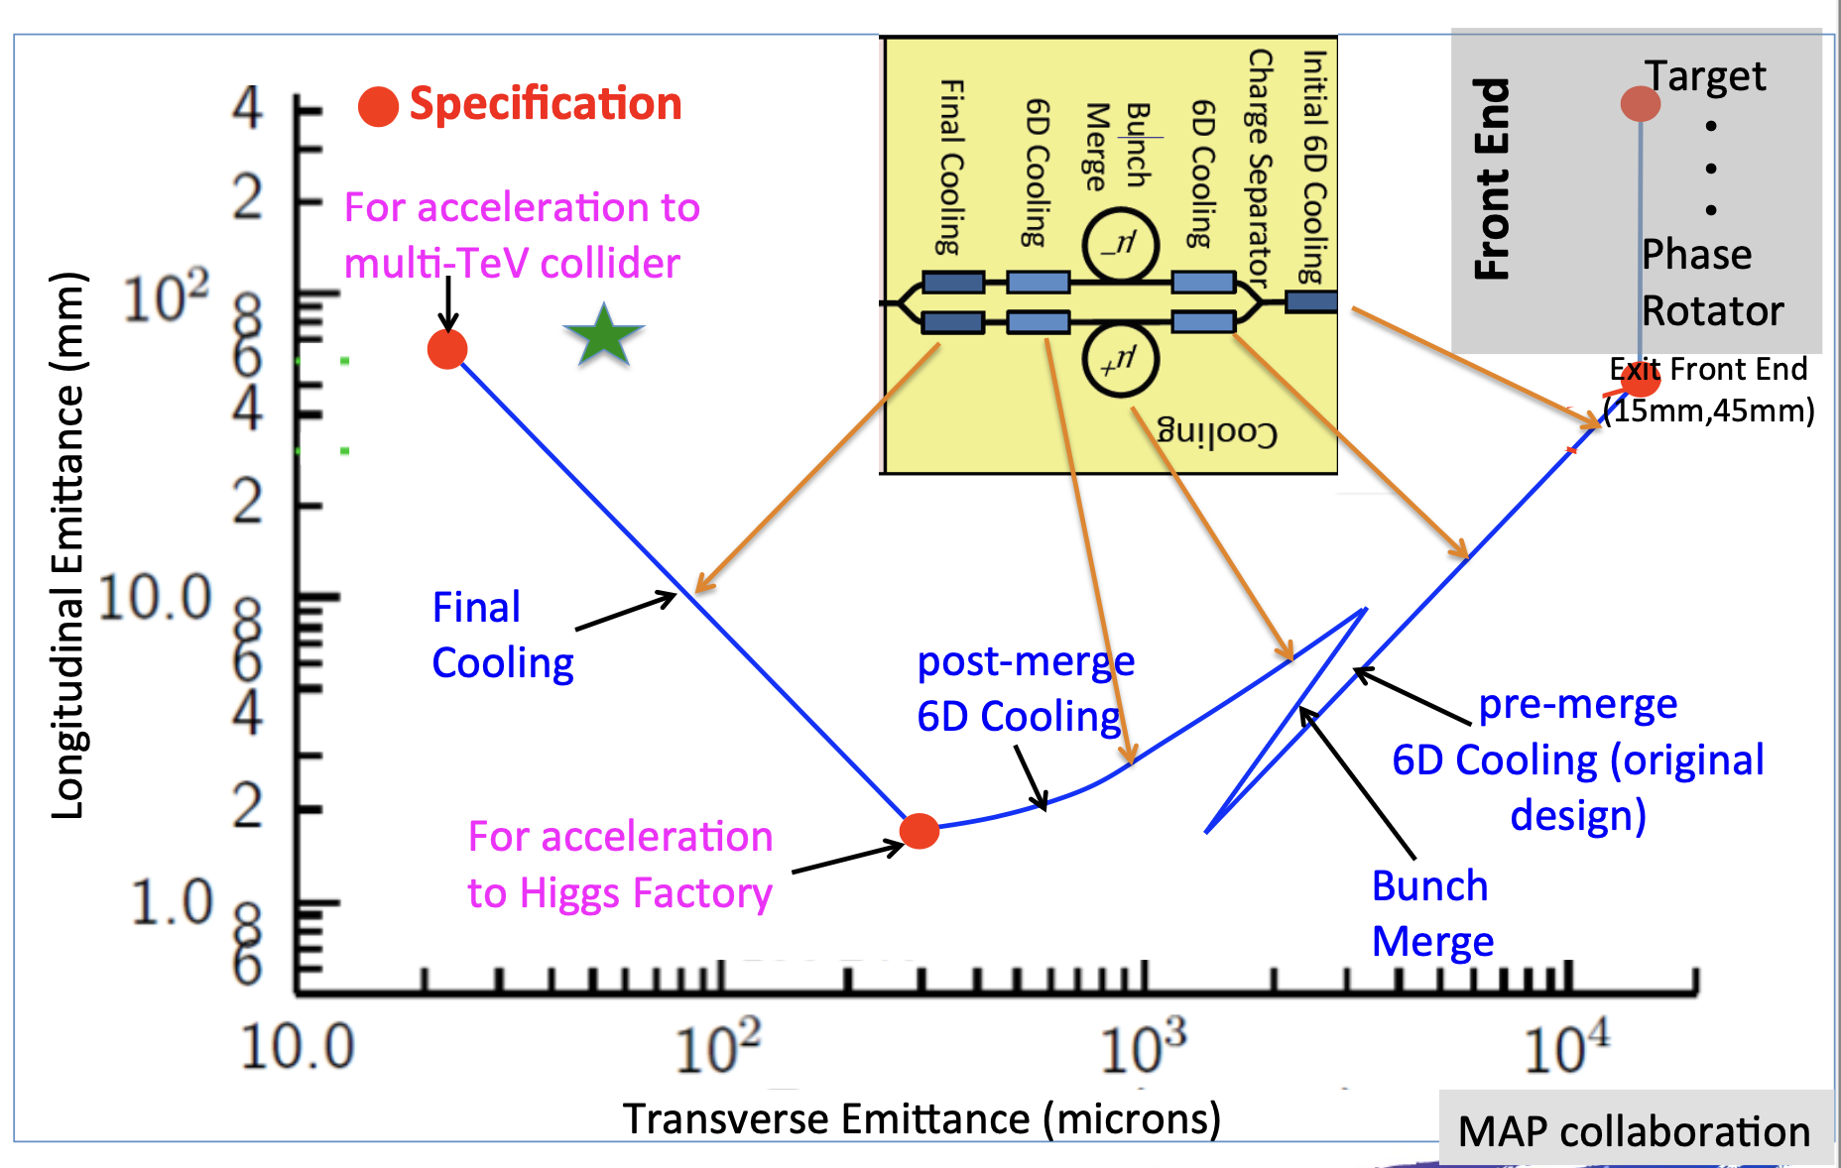
Muon Cooling
Emittance evolution
Missing factor 2 between emittances
obtained in simulations and expected for collider
to be gained by optimized final cooling design
From MAP study

Slide 14
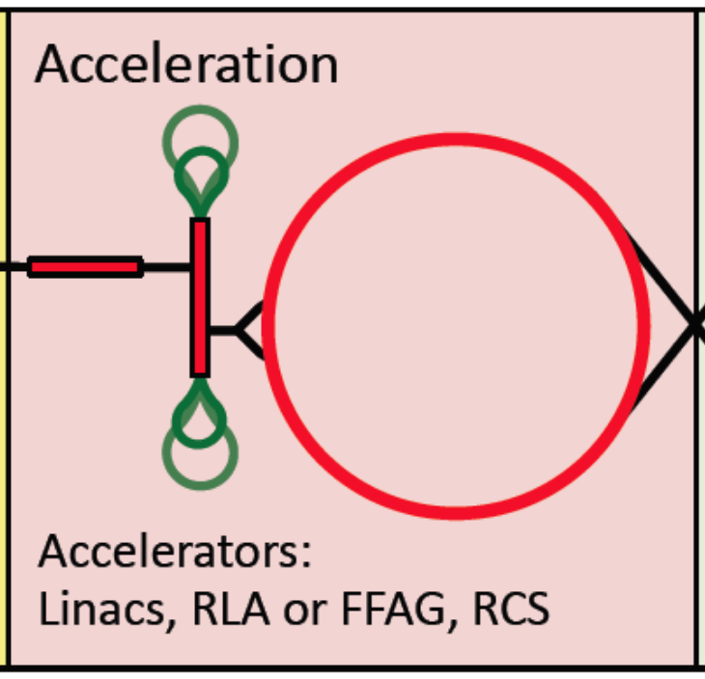
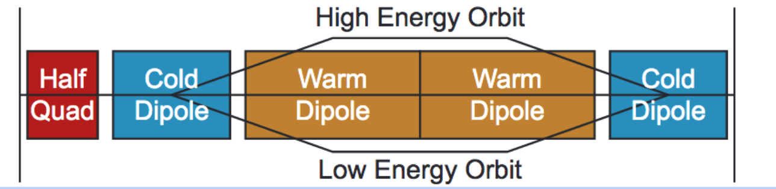
Acceleration
Fast acceleration and high (average) RF gradients
needed to avoid muon losses due to decay
Starting with (re-circulating) Linacs
Followed by “pulsed synchrotrons”
  Acceleration within few tens of turns!
  Combination of static SC bends and pulsed
  conventional bends (changing polarity)
  Ongoing work:
    Orbit excursions – minimization of resulting circumference variation for RF
    Magnet powering and Eddy currents a challenge, in particular, for lower energy rings
  FFAs a possible alternative

Slide 15
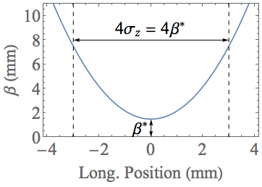
Muon Collider Ring
Assumptions and parameters
  Lattice study concentrating on 10 TeV com collider => beam E = 5000 MeV
    Increase in energy compared to previous studies
  High magnetic fields and ≈10 km circumference for high luminosity
  Longitudinal (rms) emittance ε_{L} = 7.5 MeV m, transv. emittance ε_{T} = 25 μm
  Maximum acceptable rms momentum spread σ_{δ} R = ≈ 10⁻³
    Gives bunch length σ_{z} = ε_{l}/(σ_{δ} E) = 1.5 mm
    => Challenging, short bunch length needed over ≈1000 turns
    => linear and non-linear momentum compaction, path length increase due to divergence
  Twiss beta function at IR β^{* =} σ_{z} = ε_{l}/(σ_{δ} E) = 1.5 mm
    “Hour glass” effect f_{hg} describes luminosity reduction
    if bunch length is not negligible (collisions at different
    longitudinal positions with different Twiss β)
    For β^{* =} σ_{z} one gets f_{hg} (β* = σ_{z}) ≈ 0.76,
    little gain by going to β^{* =}smaller than σ_{z}
    Energy increase results in higher beam rigidity,
    but unchanged divergence at IP
    Larger maximum Twiss β–functions around IP
Challenging conditions for collider lattice design!

Slide 16
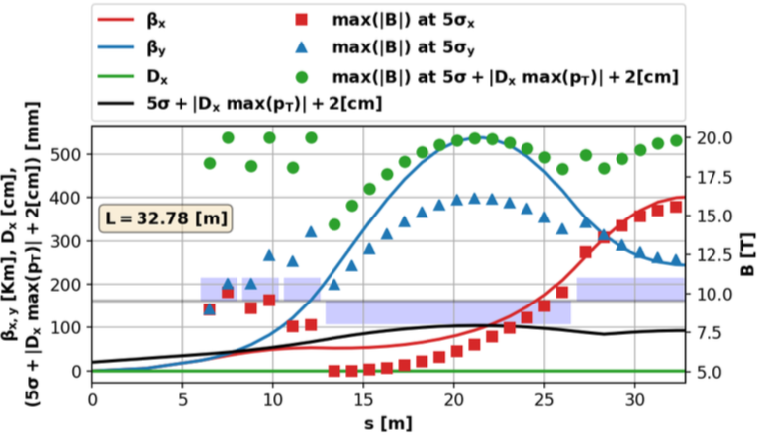
Muon Collider Ring
Interaction region
  Small β* and high beam rigidity (energy)
    Lead to long quadrupole triplet and large maximum β
    Despite large maximum magnetic field (or quadrupole gradient) assumed
    Different versions without or with dipolar (bending) field components to remove decay products
    Version here without dipolar fields
From K. Skoufaris

Slide 17
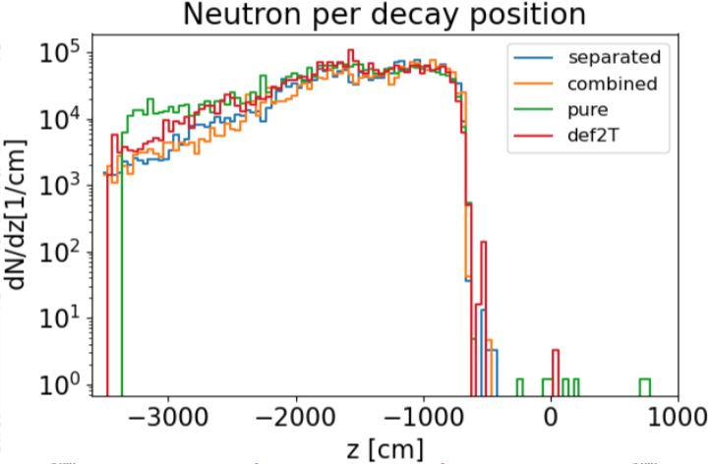
Muon Collider Ring
Interaction region
  Beam Induced Background (BIB): particles from decays seen by detector and perturbing data taking an issue
  MAP study (lower energy) concluded that dipolar fields mitigate
  Similar shape of particle flux versus decay position for different species
  Only week reduction of BIB seen for 10 TeV lattice with FLUKA
From D. Calzolari,
A. Lechner et al.

Slide 18
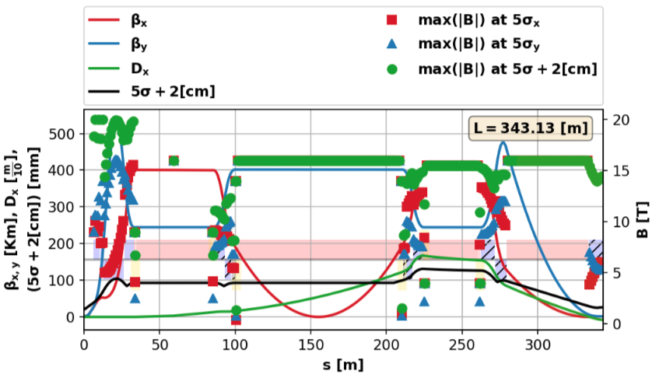
Muon Collider Ring
Local chromaticity correction
  Quadrupole strength depending on momentum
  Needed due to strong inner triplet, large maximum Twiss β and large energy spread
  Sextupoles in regions with dispersion to correct chromaticity …
  … introduce non-linearities, which make the design tricky
From
K. Skoufaris
Inner
triplet
Bending
magnets
Sextupole
+ bending

Slide 19
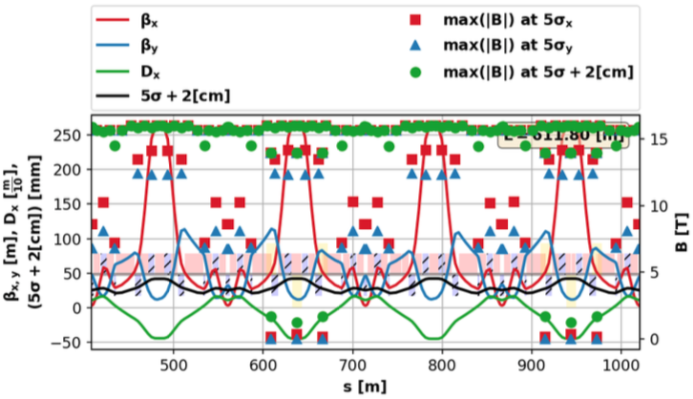
Muon Collider Ring
Flexible Momentum Compaction cells for arc
  To keep short bunch length with large momentum spread
  Good control of path length for off-momentum particles δ = Δp/p
  Each cells with regions with
    positive (longer path for δ>0) and
    negative dispersion (shortcut for δ>0) regions
  In average, path shorter for
  δ>0 to compensate for other
  parts of machine
dispersion
From
K. Skoufaris

Slide 20
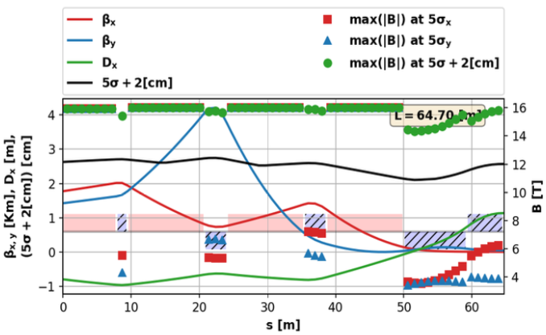
Muon Collider Ring
Matching section
  Linking chromatic
  compensation section
  to arc
Status
  Full linear lattice section available and looking reasonable
    IR, chromatic compensation, matching and arc cells
  Study ongoing to understand and cure too small dynamic aperture – improvements expected using octupoles
  Work in progress!

Slide 21
Neutrino Radiation Issue
Radiation due to showers generated by
neutrinos reaching the earth surface
  Matter in front (“shielding”) does not
  help but makes situation even worse
  Narrow radiation “cone” for a short piece
  of the machine with length
Strong increase with muon energy
  Cross sections about proportional to energy
  Typical energy per interaction of neutrino
  with matter proportional to muon energy
  Opening of radiation inversely proportional
  to muon energy
Radiation cone
Collider
ring
21
21

Slide 22
Neutrino Radiation Issue
From analytical estimates
  Narrow cone spread in horizontal plane by bendings
Mitigation
  No long straight sections other than the IR
    Maximum straight between magnets say 0.3 m
    Dipolar fields added to quadrupoles and sextupoles
  Localize neutrino radiation from straight with IR in inhabited area (sea, steep mountain ..)
  Installation deep underground
  For high energies (say >3TeV) wobbling of collider
    Periodic deformation of machine out of horizontal plane
    In amplitude and phase
    Precise movement system and horizontal B needed
    Delicate for beam optics (vertical dispersion)
Dose per muon decay

Slide 23
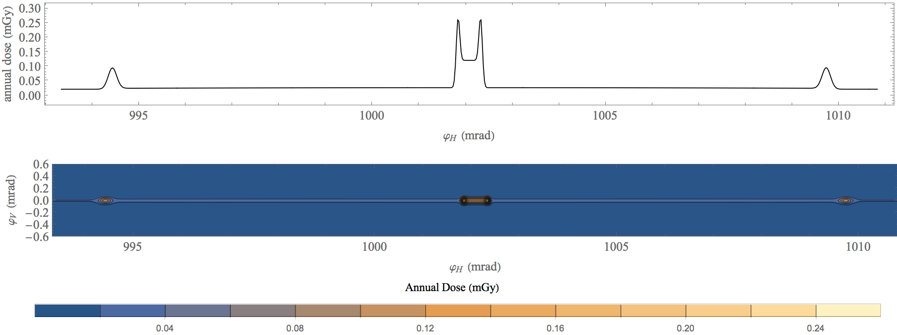
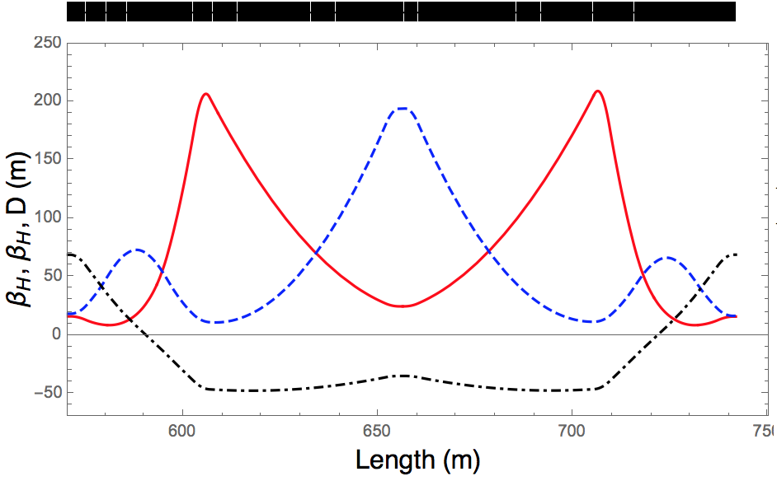
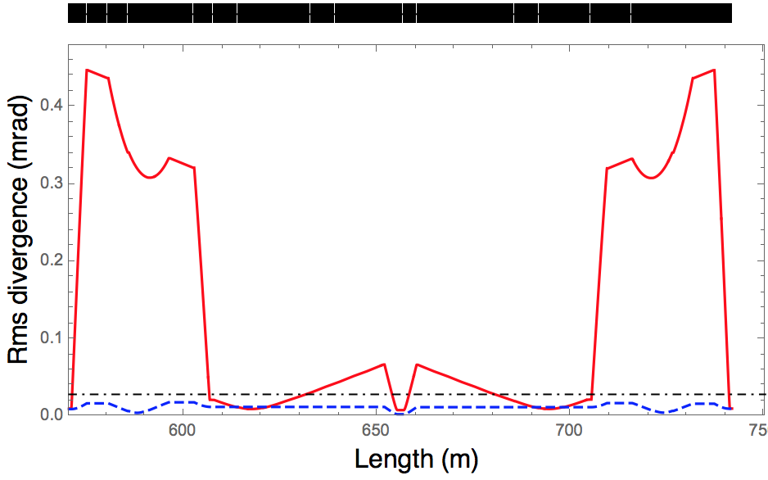
Neutrino Radiation Issue
Some Evaluations with realistic Lattice for 3 TeV
Radiation at earth surface due to neutrinos for 3 TeV collider arc cell 100 m underground
5000 h operation
Plans:
Use FLUKA simulation results to improve precision
Evaluation for 10 TeV collider (with wobbling)

Slide 24
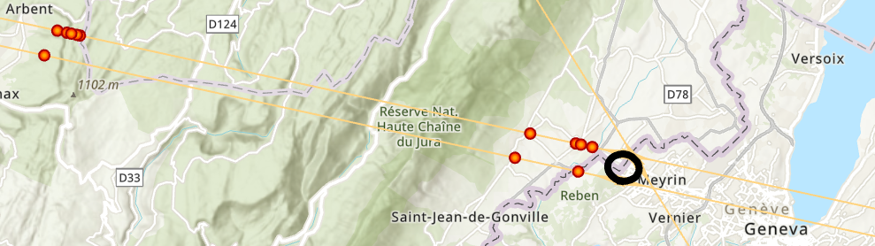
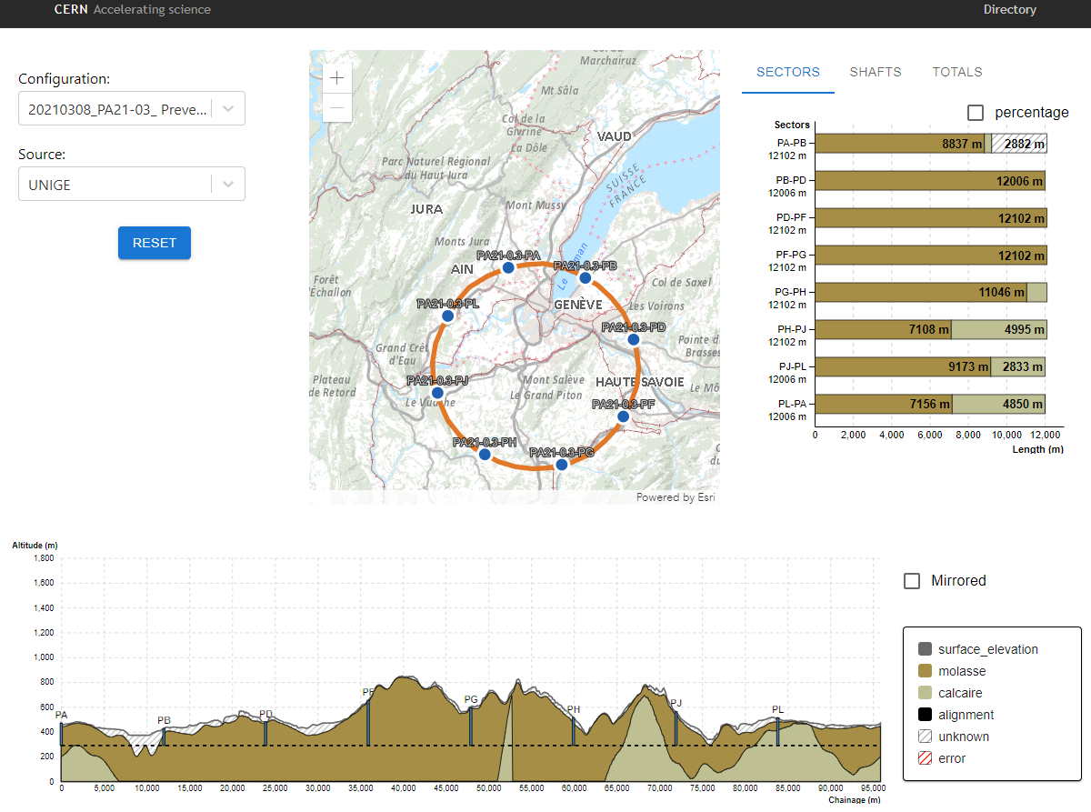
Neutrino Radiation Issue
Geoprofiler tool for suitable collider positioning
* Unrealistic positioning, for illustrative purposes only!
Geoprofiler Application – currently focused on geological analysis
Edit and reposition the ring
Detailed knowledge of shape of earth surface
Recalculation of the geology along the tunnel
Positions where tangential to ring reaches earth surface
Information about impacted areas (rights, urbanization …)
* Prototype, for illustrative purposes only!
From
G. Lacerda et al.

Slide 25
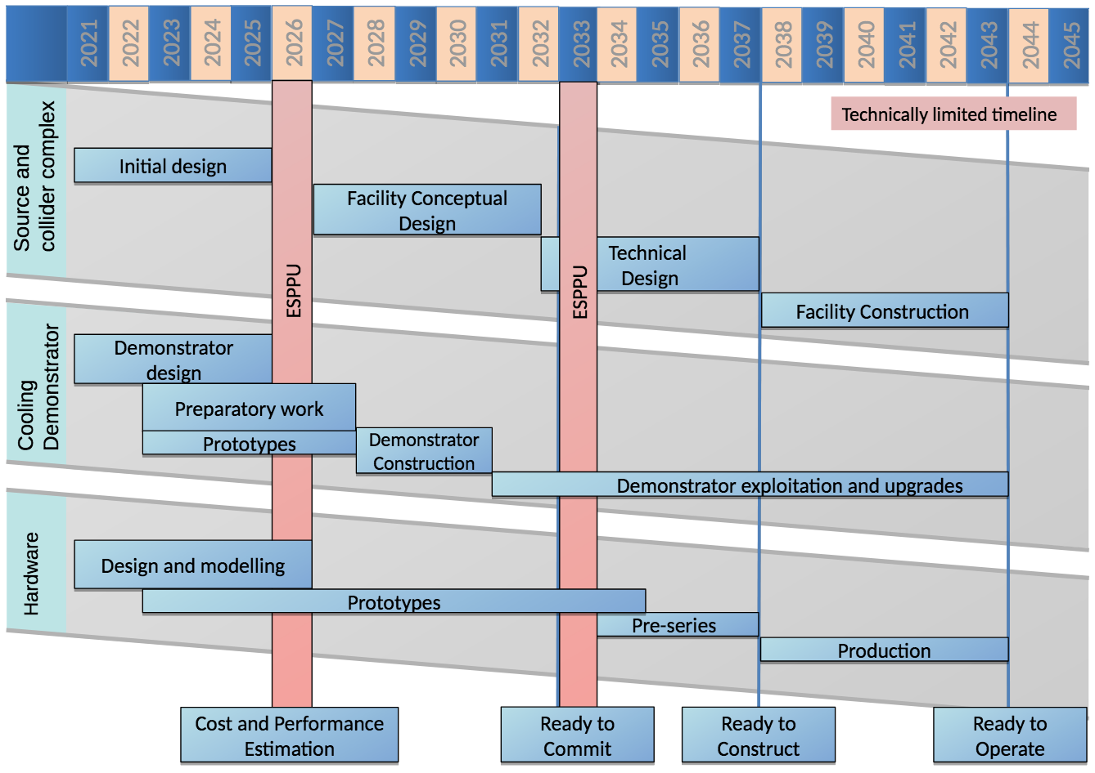
Tentative Timeline
(technically limited)

Slide 26
Summary
Muon Collider considered as future high energy project
  Circular lepton collider not limited by beam energy loss due to synchrotron radiation
  Very attractive option for high energy physcis
    High precision and discovery machine equivalent to hadron collider with higher energy
  Challenges mainly related to effort to generate muon beams and short life-time
Not as mature as other projects as CLIC, ILC, FCC
  Still feasibility to be shown and many R&D topics to be addressed
    Ionization cooling to nominal emittances
    Target, activation and damage of components, neutrino radiation, heat load
    Fast acceleration, high field magnets, RF systems ….
    Collider ring providing sufficient luminosity (small β* …)
IMCC aiming at a conceptual design
of 10+ TeV com. muon collider
  Based on several studies made over
  several decades and, in particular, MAP
The talk used materiel from several sources and, in particular, MAP
Special thanks to D. Schulte and E. Fol for helping with the preparation of the talk

