Slide 1








The e⁻e⁺ Future Circular Collider FCC-ee
Frank Zimmermann, CERN
Thanks to Michael BENEDIKT, Ilkay TÜRK ÇAKIR, Orhan ÇAKIR, Haluk DENIZLI, Kenan Abbas ÇİFTÇİ, Rena ÇİFTÇİ, Özgür ETIŞKEN, Salim OĞUR, Gokhan UNEL, Saleh SULTANSOY, Fatih YAMAN
UPHUK8, Bodrum, 5 September 2022
on behalf of the FCC collaboration and FCCIS DS team
LHC
PS
SPS
FCC
http://cern.ch/fcc
Work supported by the European Commission under the HORIZON 2020 projects EuroCirCol, grant agreement 654305; EASITrain, grant agreement no. 764879; iFAST, grant agreement no. 101004730, FCCIS, grant agreement 951754, and E-JADE, contract no. 645479
photo: J. Wenninger

Slide 2

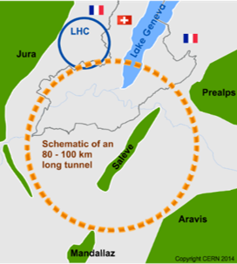
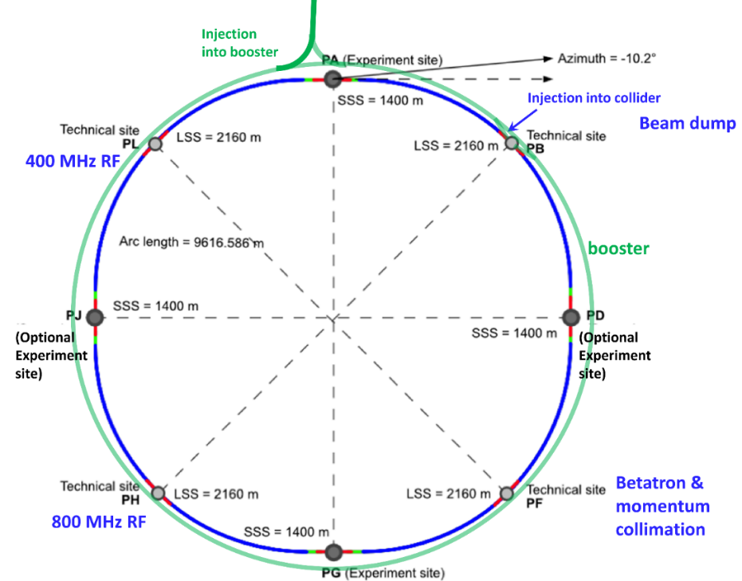
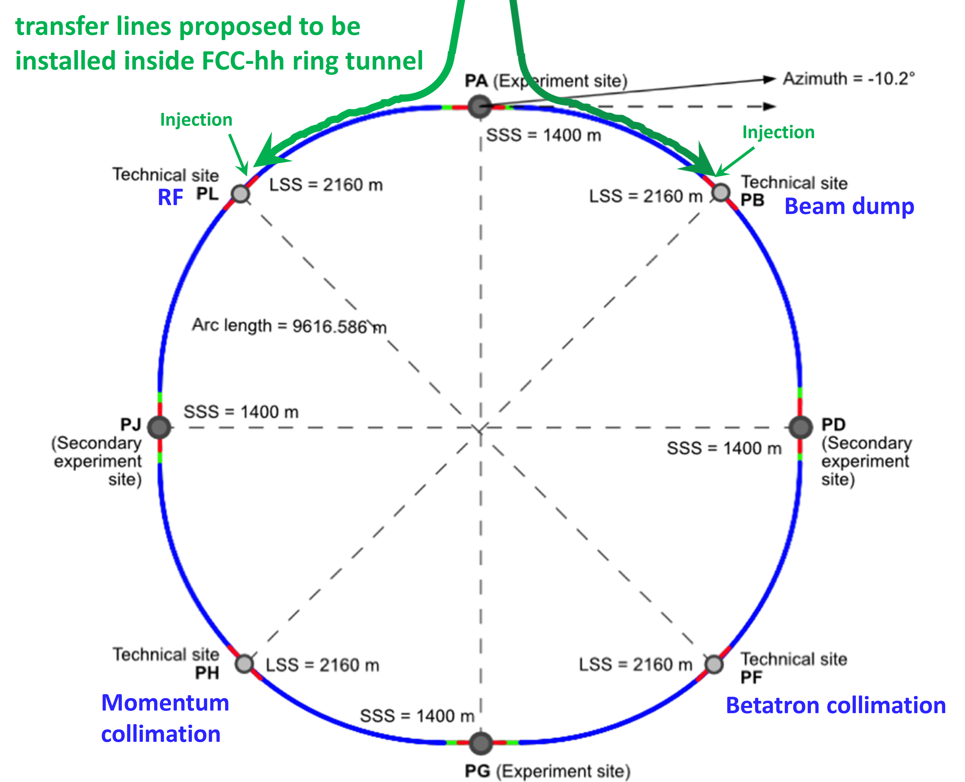
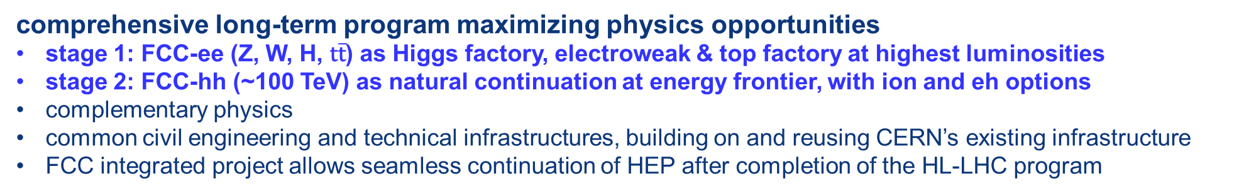
The FCC integrated program
inspired by successful LEP – LHC programs at CERN
comprehensive long-term program maximizing physics opportunities
stage 1: FCC-ee (Z, W, H, $\text{t}\overline{\text{t}}$) as Higgs factory, electroweak & top factory at highest luminosities
stage 2: FCC-hh (~100 TeV) as natural continuation at energy frontier, with ion and eh options
complementary physics
common civil engineering and technical infrastructures, building on and reusing CERN’s existing infrastructure
FCC integrated project allows seamless continuation of HEP after completion of the HL-LHC program
FCC-ee
FCC-hh
2020 - 2040
2045 - 2060
2065 - 2090
a similar two-stage project CEPC/SPPC is under study in China

Slide 3
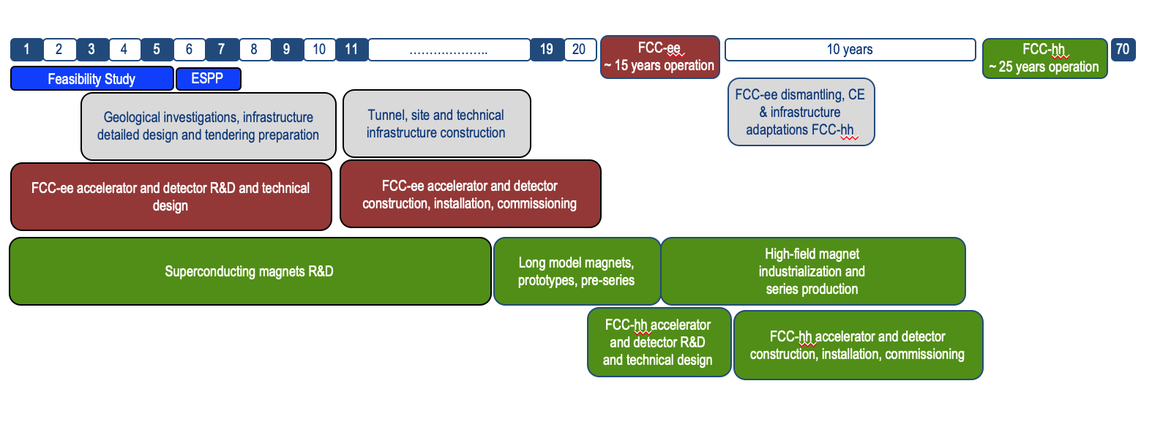
technical timeline of FCC integrated programme
Feasibility Study: 2021-2025
If project approved before end of
decade → construction can start
beginning 2030s
FCC-ee operation ~2045-2060
FCC-hh operation 2070-2090++
F. Gianotti

Slide 4
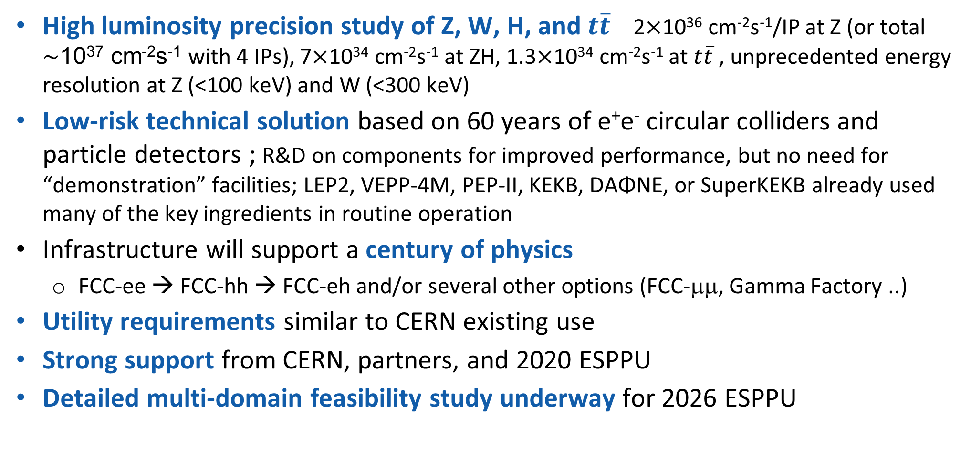
FCC-ee in a nutshell
High luminosity precision study of Z, W, H, and $t\overline{t}$ 2$×$10³⁶ cm⁻²s⁻¹/IP at Z (or total $\sim$10³⁷ cm⁻²s⁻¹ with 4 IPs), 7$×$10³⁴ cm⁻²s⁻¹ at ZH, 1.3$×$10³⁴ cm⁻²s⁻¹ at $t\overline{t}$, unprecedented energy resolution at Z (<100 keV) and W (<300 keV)
Low-risk technical solution based on 60 years of e⁺e⁻ circular colliders and particle detectors ; R&D on components for improved performance, but no need for “demonstration” facilities; LEP2, VEPP-4M, PEP-II, KEKB, DAΦNE, or SuperKEKB already used many of the key ingredients in routine operation
Infrastructure will support a century of physics
  FCC-ee → FCC-hh → FCC-eh and/or several other options (FCC-μμ, Gamma Factory ..)
Utility requirements similar to CERN existing use
Strong support from CERN, partners, and 2020 ESPPU
Detailed multi-domain feasibility study underway for 2026 ESPPU

Slide 5
FCC-ee parameters
Parameter [4 IPs, 91.1 km,T_{rev}=0.3 ms] | Z | WW | H (ZH) | ttbar
beam energy [GeV] | 45.6 | 80 | 120 | 182.5
beam current [mA] | 1400 | 135 | 26.7 | 5.0
number bunches/beam | 8800 | 1120 | 336 | 42
bunch intensity [10¹¹] | 2.76 | 2.29 | 1.51 | 2.26
SR energy loss / turn [GeV] | 0.0391 | 0.37 | 1.869 | 10.0
total RF voltage 400/800 MHz [GV] | 0.120/0 | 1.0/0 | 2.1/0 | 2.5/8.8
long. damping time [turns] | 1170 | 216 | 64.5 | 18.5
horizontal beta* [m] | 0.15 | 0.2 | 0.3 | 1
vertical beta* [mm] | 0.8 | 1 | 1 | 1.6
horizontal geometric emittance [nm] | 0.71 | 2.17 | 0.64 | 1.49
vertical geom. emittance [pm] | 1.42 | 4.34 | 1.29 | 2.98
horizontal rms IP spot size [μm] | 10 | 21 | 14 | 39
vertical rms IP spot size [nm] | 34 | 66 | 36 | 69
beam-beam parameter ξ_{x} / ξ_{y} | 0.004/ 0.159 | 0.011/0.111 | 0.0187/0.129 | 0.096/0.138
rms bunch length with SR / BS [mm] | 4.32 / 15.2 | 3.55 / 7.02 | 2.5 / 4.45 | 1.67 / 2.54
luminosity per IP [10³⁴ cm⁻²s⁻¹] | 181 | 17.3 | 7.2 | 1.25
tot. integr. luminosity / yr [ab⁻¹/yr] | 86 | 8 | 3.4 | 0.6
beam lifetime rad Bhabha / BS [min] | 19 / ? | 20 / ? | 10 / 19 | 12 / 46

Slide 6

FCC-ee Design Outline
C=91.1 km
Double ring e⁺e⁻ collider
Common footprint with FCC-hh
Asymmetric IR layout and optics to limit SR towards the detector
Large crossing angle 30 mrad, “virtual” crab-waist collision, four-fold superperiodicity: 2 or 4 IPs
SR power 50 MW/beam
Top-up injection requires booster synchrotron in collider tunnel

Slide 7
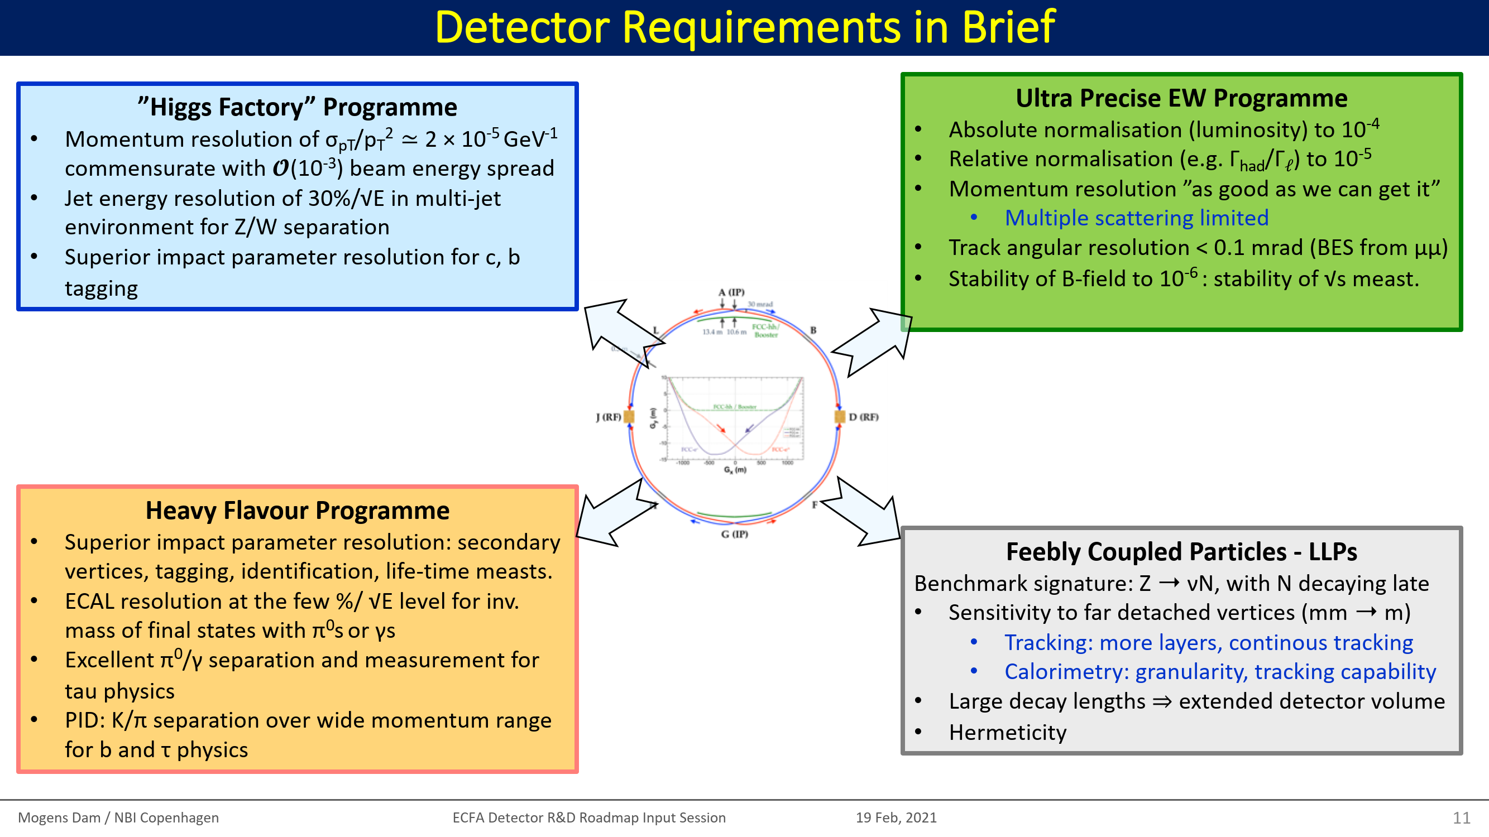
a case for four IPs & experiments
Four different FCC-ee detectors to optimally address:
(1) Higgs factory program; (2) Ultraprecise electroweak & QCD physics; (3) Heavy Flavour physics; (4) Search for feebly coupled particles
For FCC-hh, two high-luminosity general-purpose experiments and two specialized experiments are foreseen, similar to
present LHC detectors
FCC-ee & hh would share the 4 experimental caverns
M. Dam, ECFA Det. R&D Roadmap, 2021, https://indico.cern.ch/event/994685/

Slide 8

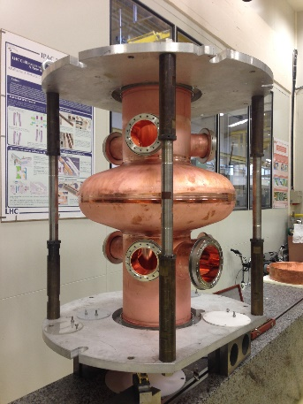
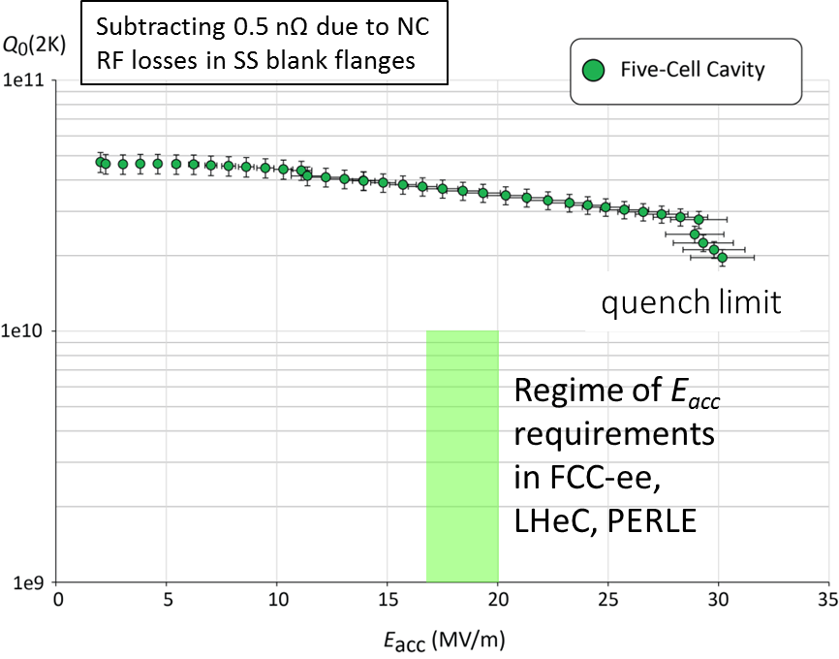
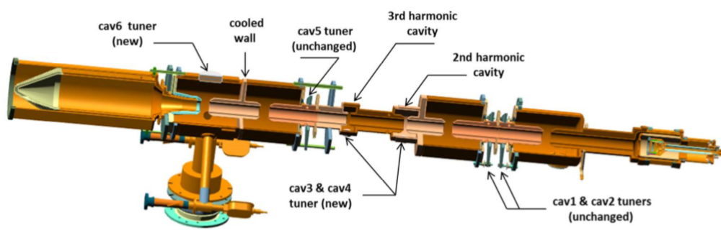
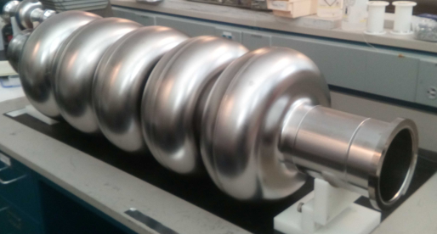
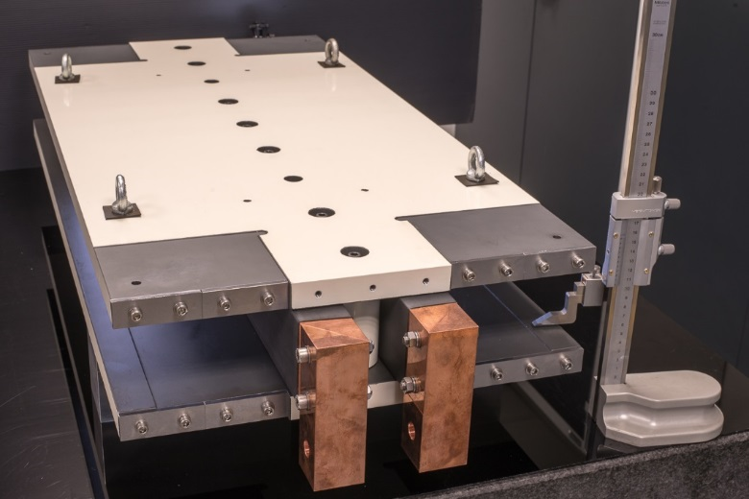
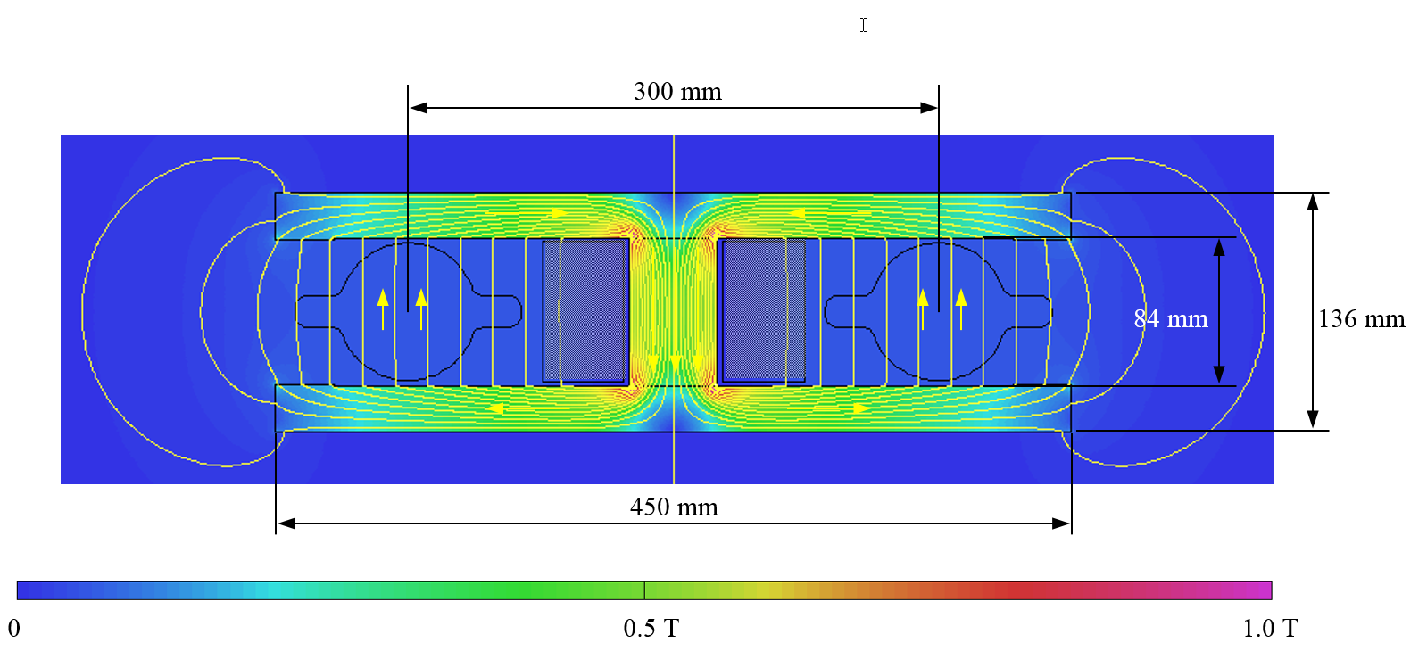

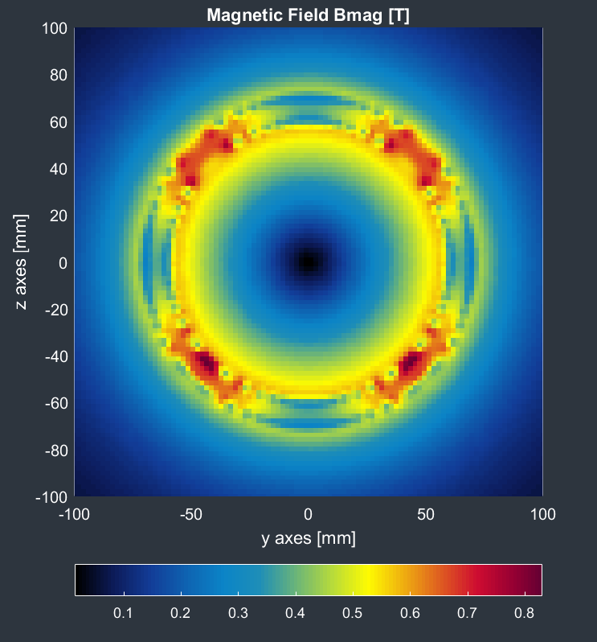
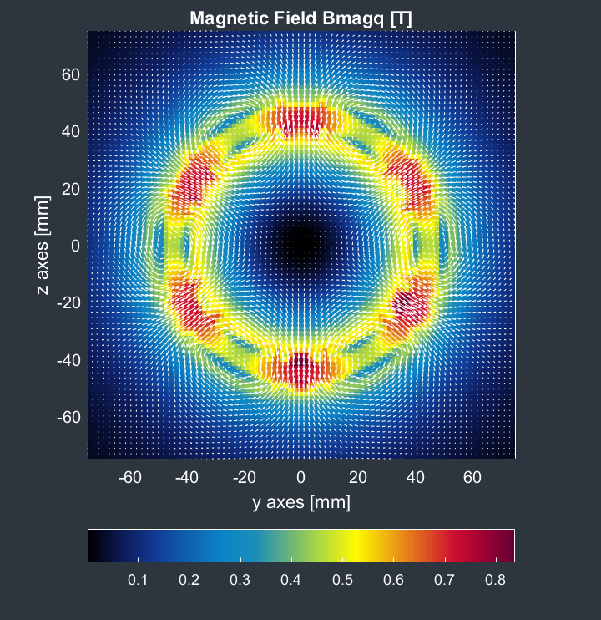
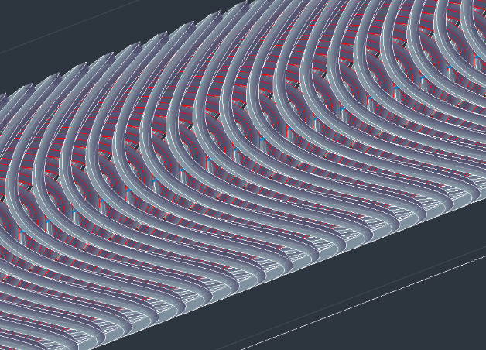

accelerator R&D examples
efficient RF power sources
(400 & 800 MHz)
efficient SC cavities
I. Syratchev
400 MHz 1-,2- & 4-cell Nb/Cu , 4.5 K
F. Marhauser
800 MHz 5-cell Nb
prototype / JLAB, 2 K
FPC & HOM coupler, cryomodule, thin-film coatings…
energy efficient twin aperture arc dipoles
under study: CCT HTS quad’s & sext’s for arcs
A. Milanese
M. Koratzinos

Slide 9
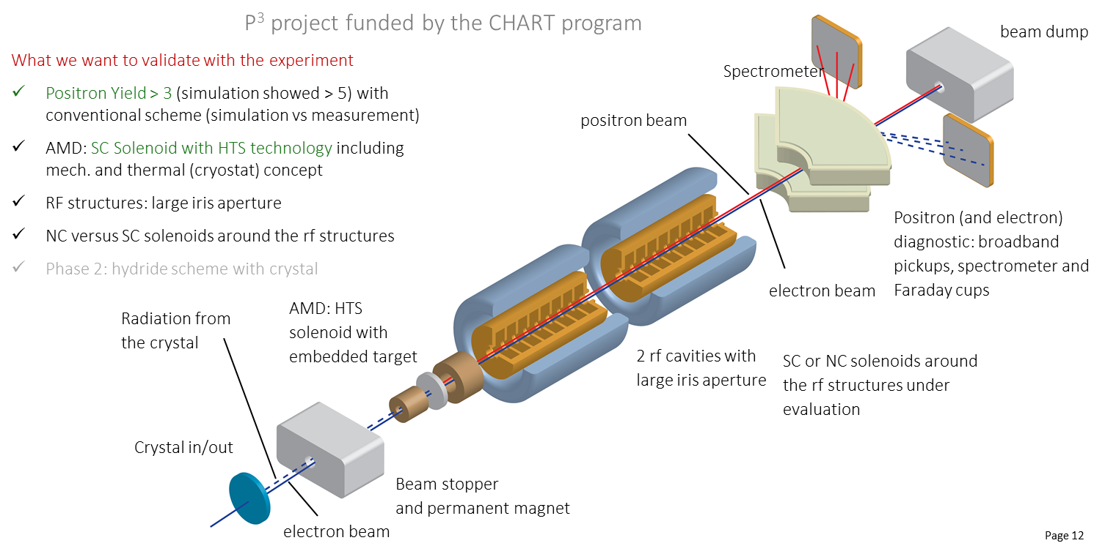
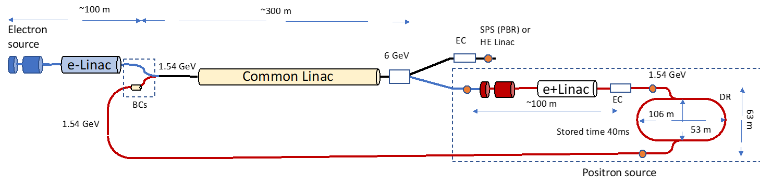
FCC-ee Pre-Injector - Swiss CHART 2 program
Collaboration between PSI and CERN with external partners: CNRS-IJCLab (Orsay), INFN-LNF (Frascati), KEK/SuperKEKB as observer, INFN-Ferrara – radiation from crystal
P³: PSI e⁺ production experiment with HTS solenoid at SwissFEL
planned for 2024/25
Latest FCC-ee pre-injector layout
location? transfer lines?
P. Craievich et al.

Slide 10


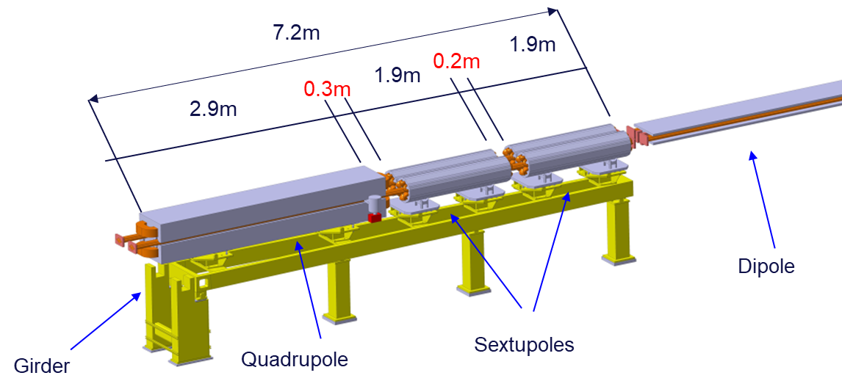
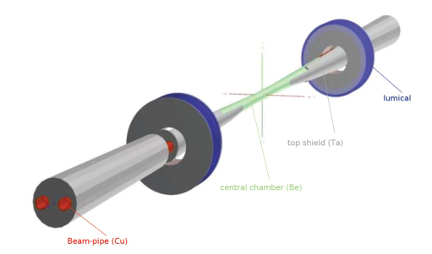


FCC-ee mock-ups for arcs and IR
Arc half-cell mock-up
F. Carra et al.
Arc half-cell: most recurrent assembly of mechanical hardware in the accelerator (~1500 similar FODO)
Mock-up → Functional prototype(s) → Pre-series → Series
Building a mock-up allows optimizing and testing fabrication, integration, installation, assembly, transport, maintenance
Working with structures of equivalent volumes, weights, stiffness
IR mock-up
Step 1: Central IP vacuum chamber (test the cooling system and the vacuum system), AlBeMet162 & steel transition (study the shape of the transition, EBW process), Bellows (vacuum and thermal tests), Welding (EBW for elliptical geometry)
Step 2: Trapezoidal vacuum chamber with remote vacuum connection, first quadrupole QC1, cryostat, beam pipe and quadrupole and cryostat support, vibration & alignment sensors
M. Boscolo et al.

Slide 11



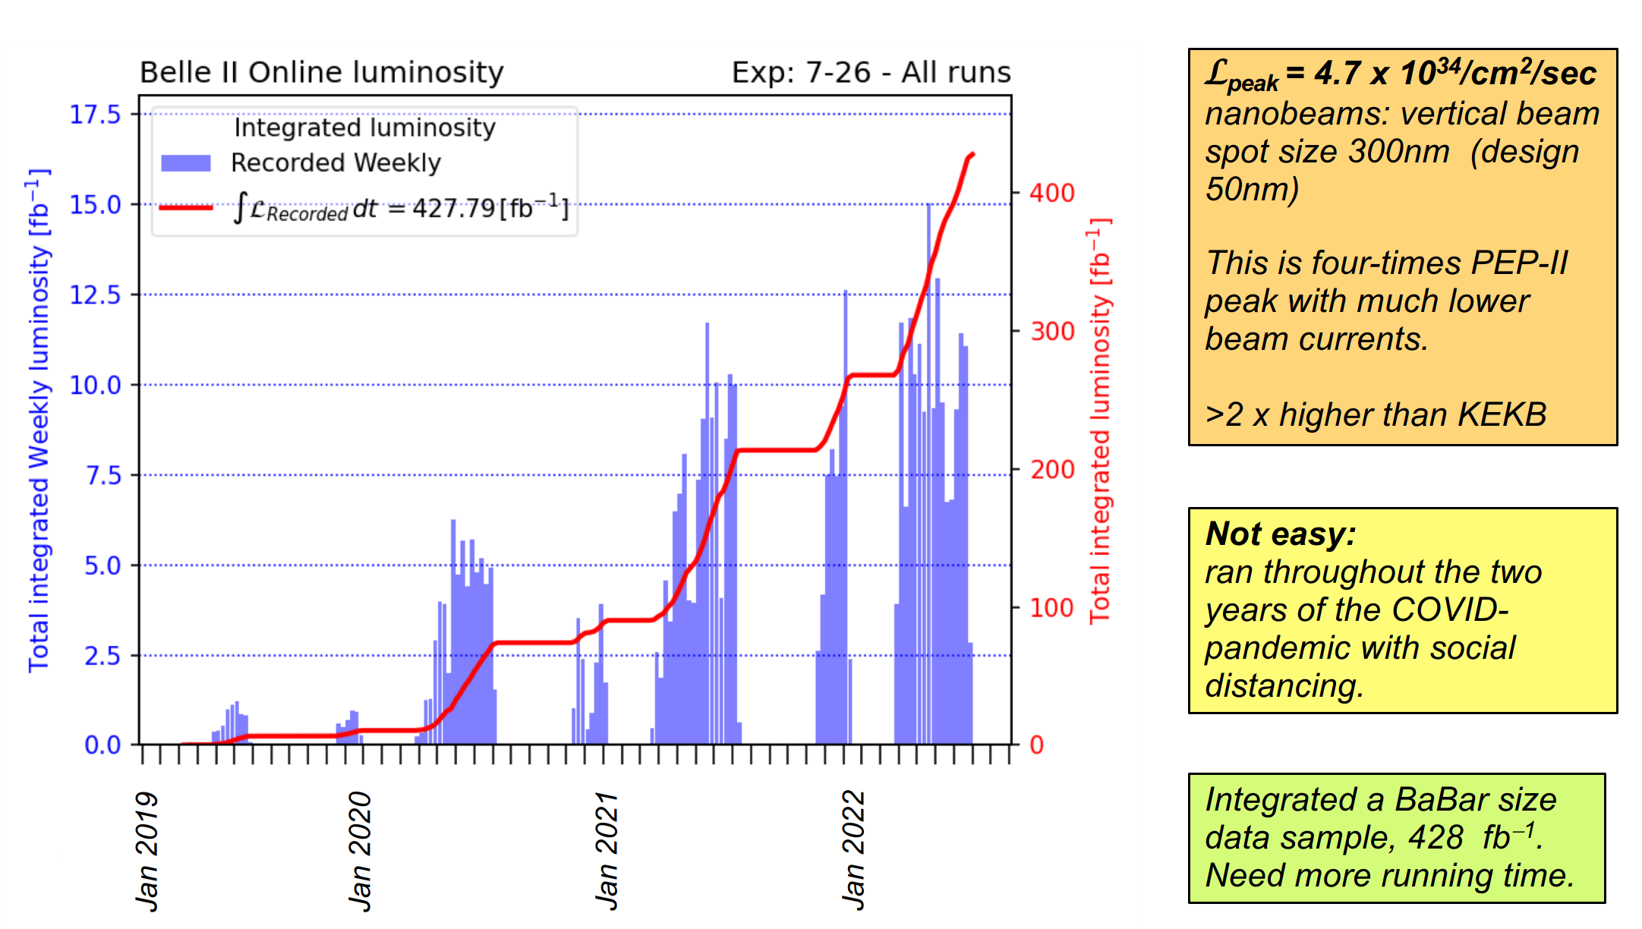
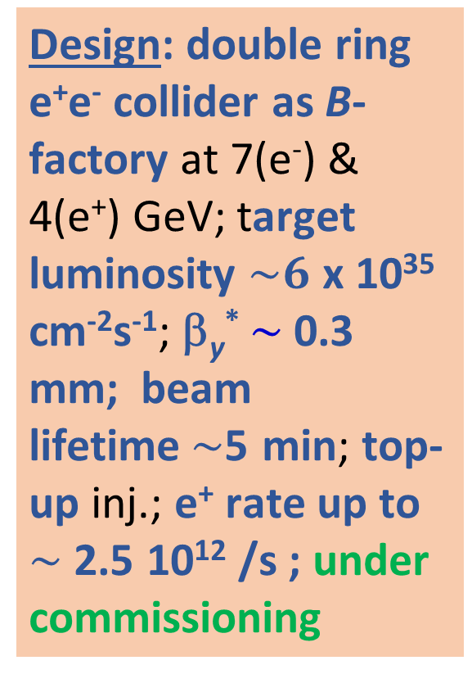
SuperKEKB / Belle II
Design: double ring e⁺e⁻ collider as B-factory at 7(e⁻) & 4(e⁺) GeV; target luminosity $\sim 6$ x 10³⁵ cm⁻²s⁻¹; β_{y}* $\sim$0.3 mm; beam lifetime$\sim$5 min; top-up inj.; e⁺ rate up to $\sim$ 2.5 10¹² /s ; under commissioning
T. Browder et al., U. Hawaii, BNL, etc.
world record luminosity of 4.71x10³⁴ cm⁻²s⁻¹ on 22 June 2022, β_{y}* = 1.0 mm in routine operation, also β_{y}* = 0.8 mm demonstrated in both rings – with FCC-ee-style “virtual” crab-waist collision scheme originally developed for FCC-ee (K. Oide)

Slide 12
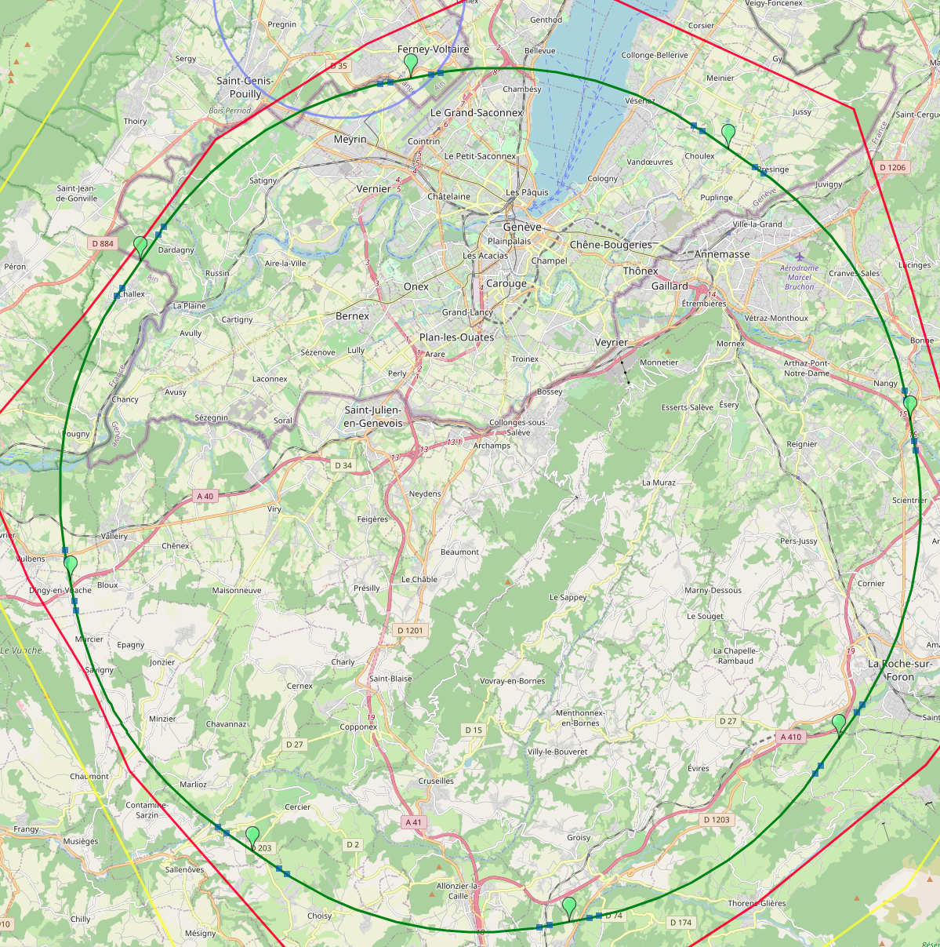
8-site baseline “PA31”
optimized placement and layout
PA: Experiment
Number of surface sites | 8
LSS@IP (PA, PD, PG, PJ) | 1400 m
LSS@TECH (PB, PF, PH, PL) | 2143 m
Arc length | 9.6 km
Sum of arc lengths | 76.9 m
Total length | 91.1 km
PB: technical
PL: technical
PD: experiment
8 sites – less use of land, <40 ha instead 62 ha
Possibility for 4 experiment sites in FCC-ee
All sites close to road infrastructures (< 5 km of new road constructions for all sites)
Vicinity of several sites to 400 kV grid lines
Good road connection of PD, PF, PG, PH suggest operation pole around Annecy/LAPP
PJ: experiment
PF: technical
PH: technical
PG: experiment
J. Gutleber

Slide 13
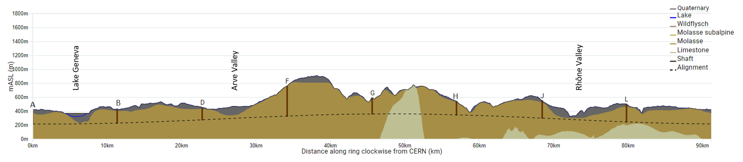
FCC Long Section – PA31-1.0
FCC inclined at 0.5% gradient to minimise depth of point F
Limestone unavoidable between G-H
FCC passes below Lake Geneva moraines
FCC passes above limestone
Shaft depth:
A: 202 m
B: 200 m
D: 177 m
F: 399 m
G: 228 m
H: 139 m
J: 251 m
L: 253 m
John Osborne

Slide 14
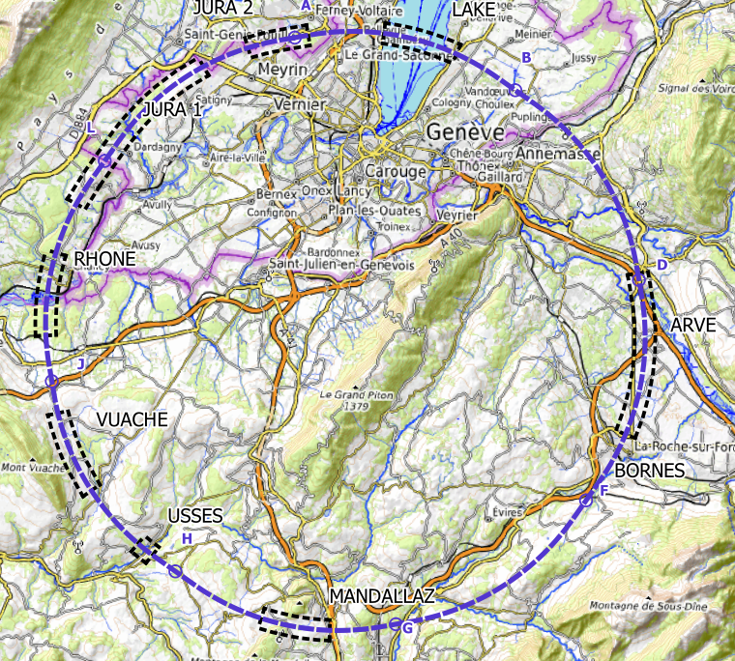
plans for high-risk area site investigations
  Jura, Vuache (3 Areas)
  Top of limestone
  Karstification and filling-in at the tunnel depth
  Water pressure
  Lake, Rhône, Arve and Usses Valley (4 Areas)
  Top of the molasse
  Quaternary soft grounds, water bearing layers
  Mandallaz (1 Areas)
  Water pressure at the tunnel level
  Karstification
  Bornes (1 Area)
  High overburden molasse properties
  Thrust zones
  Site investigations planned for 2024 – 2025:
  ~40-50 drillings, some 100 km of seismic lines

Slide 15
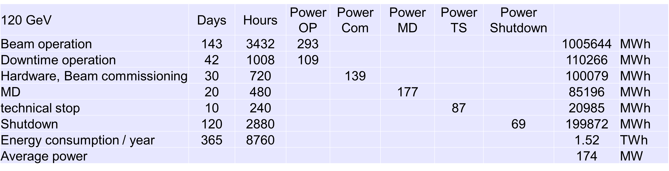
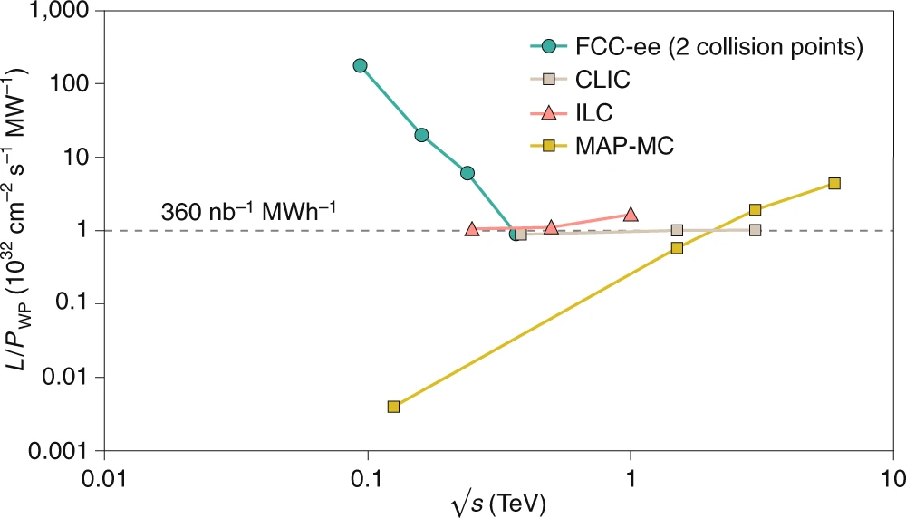
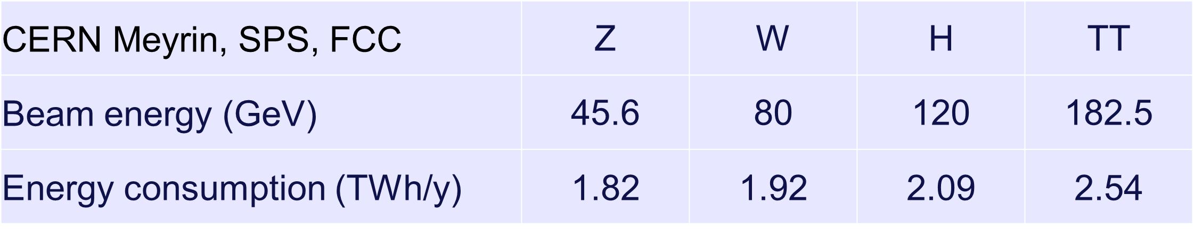
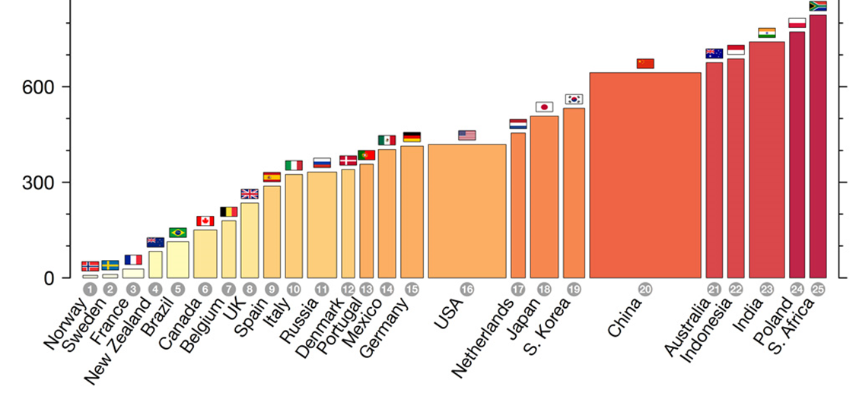


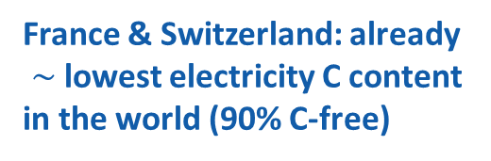
sustainability and carbon footprint studies
highly sustainable Higgs factory
FCC-ee annual energy consumption $\sim$ LHC/HL-LHC
luminosity vs. electricity consumption
J.-P. Burnet, FCC Week 2022
incl. CERN site & SPS
powered by mix of renewable & other C-free sources
France & Switzerland: already
$\sim$lowest electricity C content
in the world (90% C-free)
Thanks to twin-aperture magnets, thin-film SRF, efficient RF power sources, top-up injection
optimum usage of excavation material
int’l competition “mining the future®”
https://indico.cern.ch/event/1001465/
https://www.carbonbrief.org/

Slide 16
sustainability compared with other Higgs factories
TWh / year for the “Higgs factory” centre-of-mass energy
Patrick Janot
    √s = 240 GeV for CEPC/FCC-ee, 250 GeV for ILC/C³, 380 GeV for CLIC
https://indico.cern.ch/event/1178975/
CLIC | ILC | C³ | FCC-ee | CEPC
0.8 | 0.9 | 0.9 | 1.1 | 2.0
Energy consumption in MWh / Higgs
CLIC | ILC | C³ | CEPC | FCC-ee
30 | 20 | 21 | 10 | 3.3
      becomes 2 MWh / Higgs for FCC-ee with 4 IPs
Present carbon footprint for electrical energy in tons CO₂ / Higgs
CLIC@CERN | ILC@KEK | C³@FNAL | CEPC@China | FCC-ee@CERN
2.1 | 7.8 | 8.5 | 6.1 | 0.24
0.14 ton CO₂ / Higgs for FCC-ee with 4 IPs

Slide 17
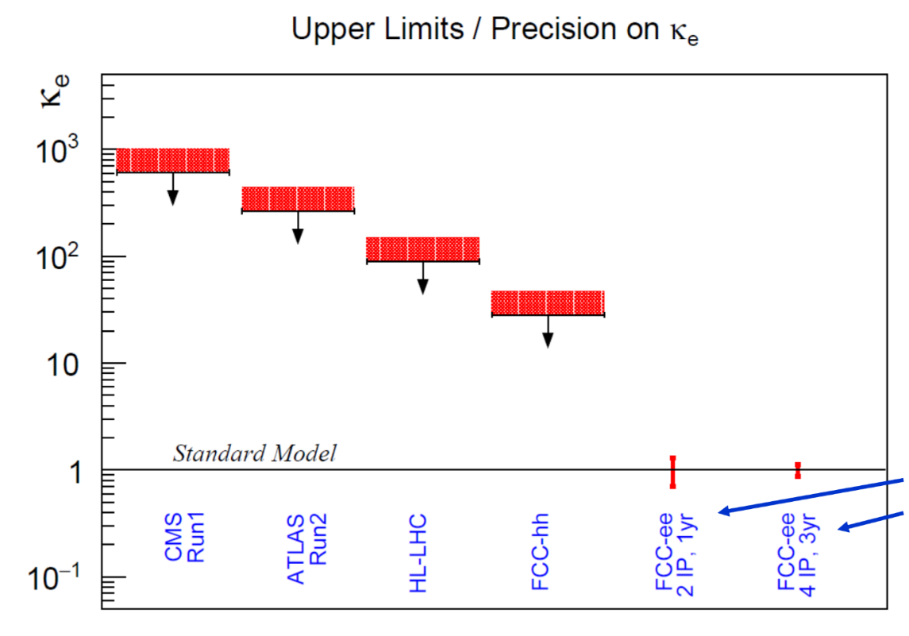
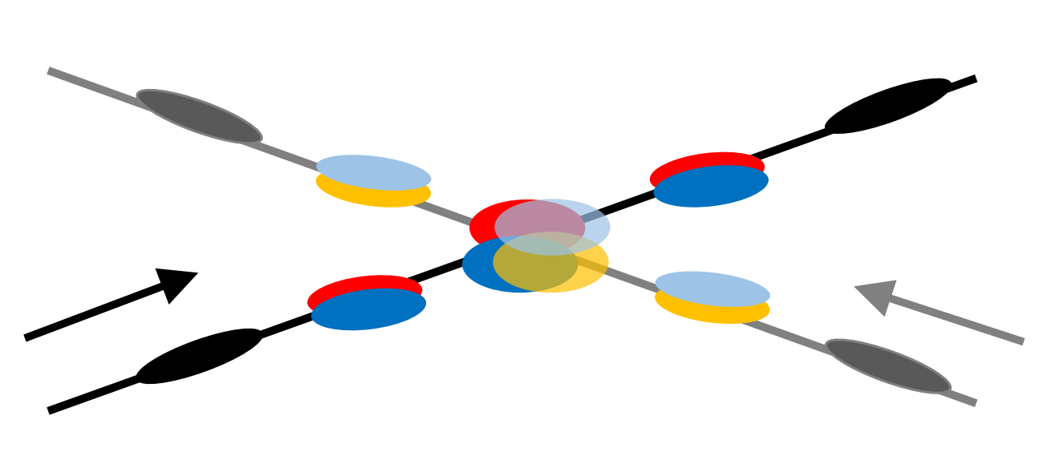
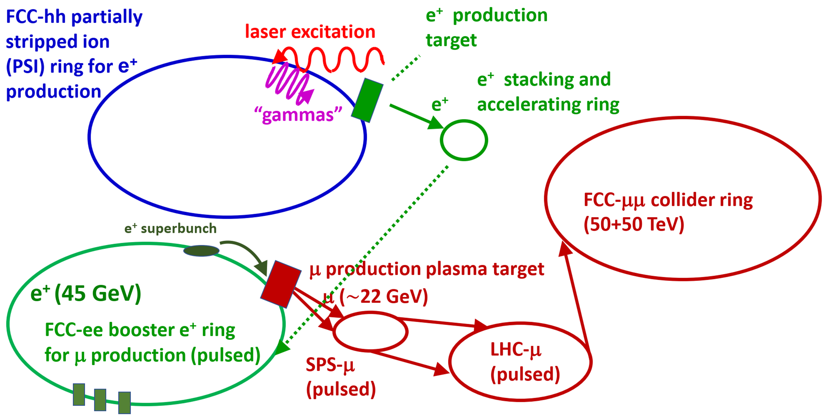
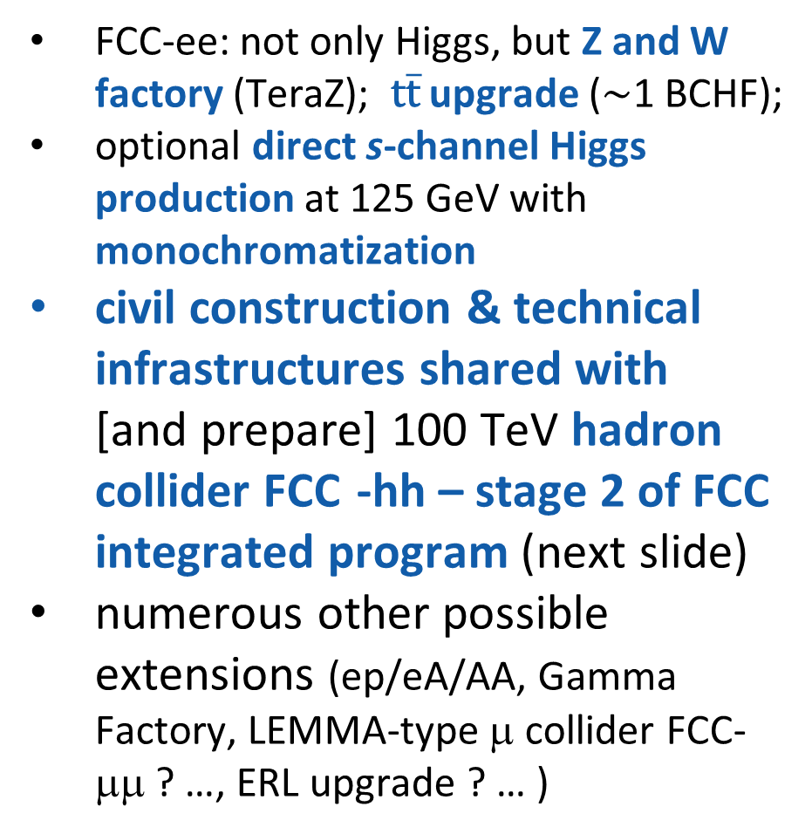

future upgrades and uses
FCC-ee: not only Higgs, but Z and W factory (TeraZ); $\text{t}\overline{\text{t}}$ upgrade ($\sim$1 BCHF);
optional direct s-channel Higgs
production at 125 GeV with monochromatization
civil construction & technical infrastructures shared with
[and prepare] 100 TeV hadron
collider FCC -hh – stage 2 of FCC integrated program (next slide)
numerous other possible extensions (ep/eA/AA, Gamma Factory, LEMMA-type μ collider FCC-μμ ? …, ERL upgrade ? … )
A. Faus-Golfe et al., Eur. Phys. J. Plus, 137 (2022) 31
$$D_{x}^{∗}≠0$$
e⁻ Yukawa coupling
F. Zimmermann et al., PAC’22, Bangkok, WEPOST009

Slide 18
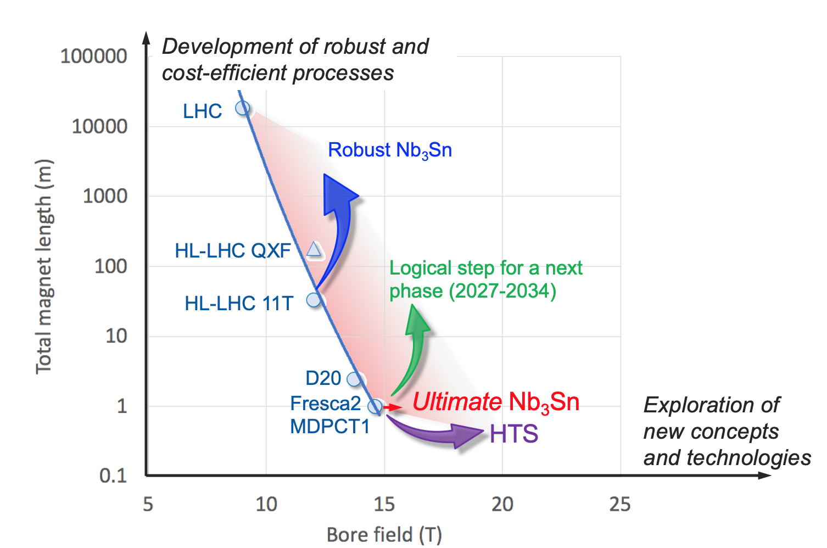
preparing for FCC stage 2 (FCC-hh)
In parallel to FCC studies,
High Field Magnet development program as long-term separate R&D project
CERN budget for high-field magnets doubled in 2020 Medium-Term Plan (~ 200 MCHF over ten years)
Main R&D activities:
materials: goal is ~16 T for Nb₃Sn, at least ~20 T for HTS inserts
magnet technology: engineering, mechanical robustness, insulating materials, field quality
production of models and prototypes: to demonstrate material, design and engineering choices,
industrialisation and costs
infrastructure and test stations: for tests up to ~ 20 T and 20-50 kA
Detailed deliverables and timescale being defined through Accelerator R&D roadmap under development
L. Bottura, F. Gianotti, A. Siemko

Slide 19

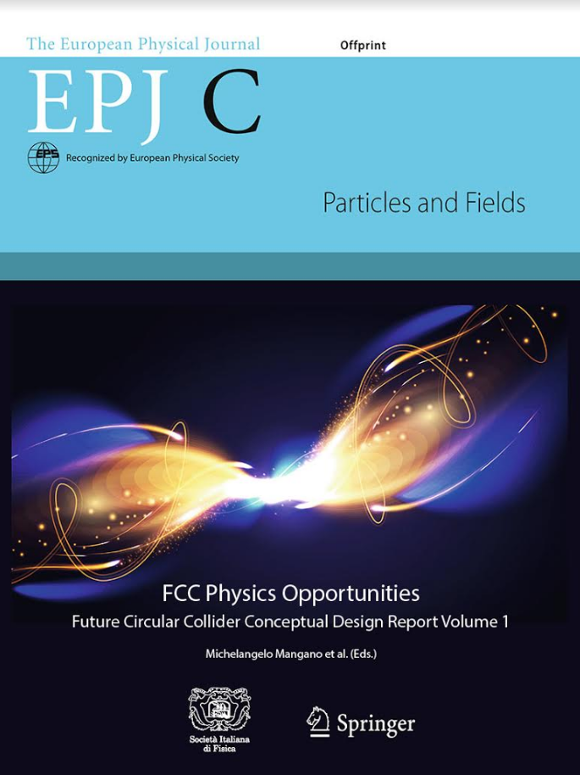
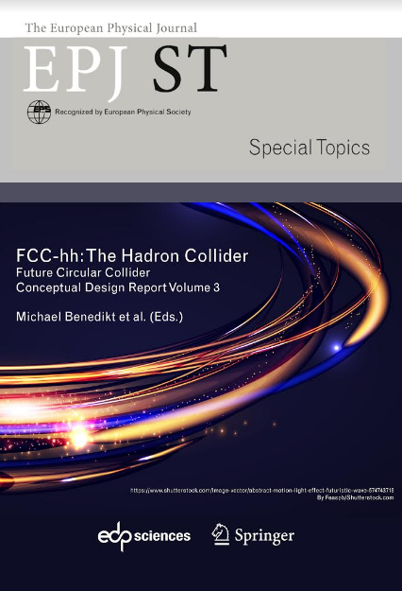
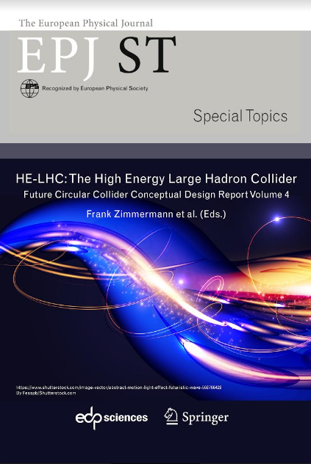
FCC CDR published in 2018/19
FCC-Conceptual Design Reports:
  Vol 1 Physics, Vol 2 FCC-ee, Vol 3 FCC-hh, Vol 4 HE-LHC
  CDRs published in European Physical Journal C (Vol 1) and ST (Vol 2 – 4) [Springer]
  EPJ C 79, 6 (2019) 474 , EPJ ST 228, 2 (2019) 261-623 ,
  EPJ ST 228, 4 (2019) 755-1107 , EPJ ST 228, 5 (2019) 1109-1382
EPJ is a merger and continuation of Acta Physica Hungarica, Anales de Fisica, Czechoslovak Journal of Physics, Fizika A, Il Nuovo Cimento, Journal de Physique, Portugaliae Physica and Zeitschrift für Physik. 25 European Physical Societies are represented in EPJ, including the DPG.
Summary documents provided to EPPSU SG
  FCC-integral, FCC-ee, FCC-hh, HE-LHC
  Accessible on http://fcc-cdr.web.cern.ch/
>1350 contributors 41 from Turkey!) and >350 institutes (19 institutes from Turkey!),
a truly global effort as suggested by EPPSU 2013

Slide 20
from ESPP Update 2020
      High-priority future initiatives:
      An electron-positron Higgs factory is the highest-priority next collider. For the longer term, the European particle physics community has the ambition to operate a proton-proton collider at the highest achievable energy. Accomplishing these compelling goals will require innovation and cutting-edge technology:
      “the particle physics community should ramp up its R&D effort focused on advanced accelerator technologies, in particular that for high-field superconducting magnets, incl. high-temperature superconductors”
      “Europe, together with its international partners, should investigate the technical and financial feasibility of a future hadron collider at CERN with a centre-of-mass energy of at least 100 TeV and with an electron-positron Higgs and electroweak factory as a possible first stage. Such a feasibility study of the colliders and related infrastructure should be established as a global endeavour and be completed on the timescale of the next Strategy update..”

Slide 21
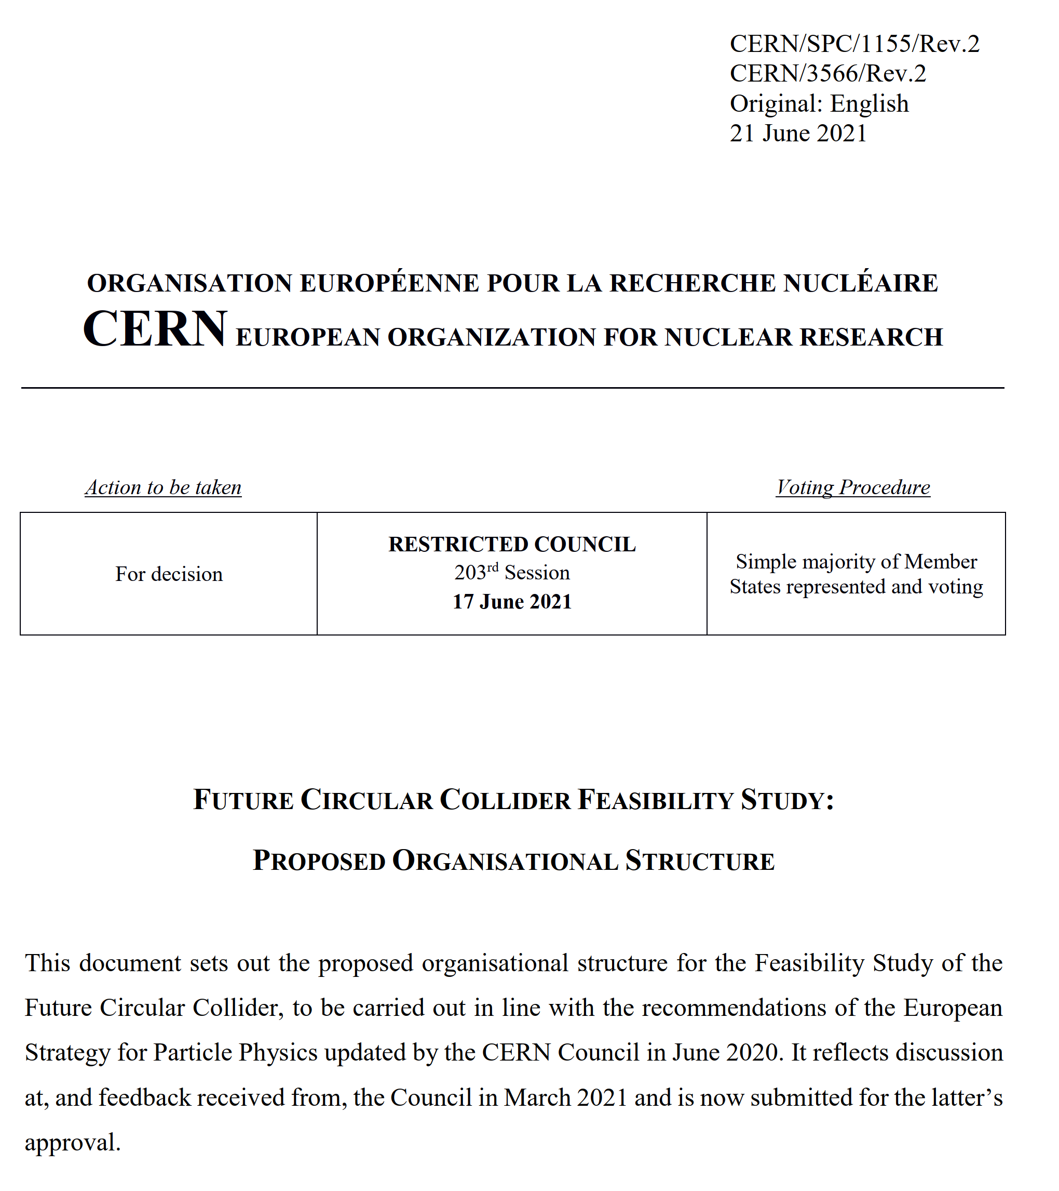
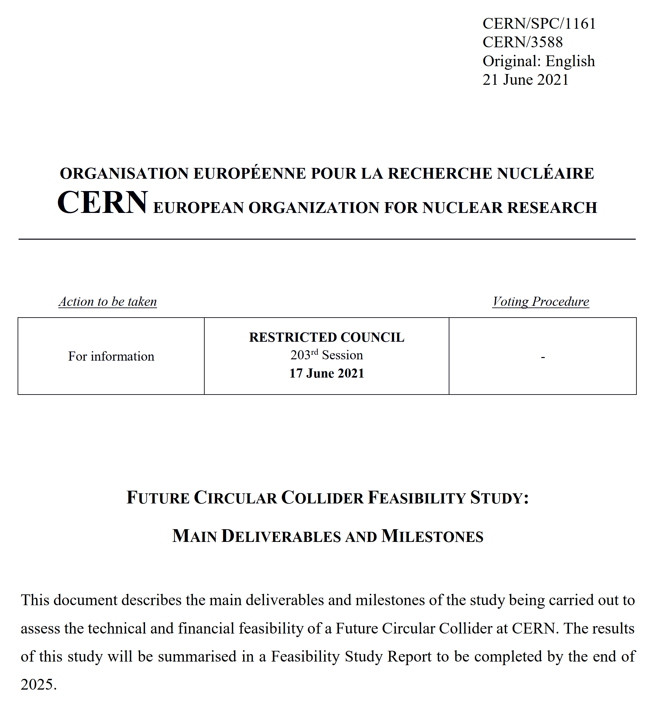
FCC Feasibility Study (FS)
Organisational Structure of the FCC Feasibility Study
http://cds.cern.ch/record/2774006/files/English.pdf
Main Deliverables and Timeline of the FCC Feasibility Study
http://cds.cern.ch/record/2774007/files/English.pdf
2013 ESPPU requested FCC Conceptual Design four-volume report → 4 volumes delivered in 2018/19, describing the physics cases, the design of the lepton and hadron colliders, and the underpinning technologies and infrastructures. Fol-
2020 ESPPU→ 2021 Launch of FCC Feasibility Study (FCC FS) by CERN Council
Feasibility Study Report (FSR) expected by the end of 2025 , not only the technical design, but also numerous other key feasibility aspects, including tunnel construction, financing, and environment
FSR will be an important input to the next ESPPU expected in 2026/27.
FCC FS is organized as international collaboration.
The FCC FS and a possible future project will profit from CERN’s decade-long experience with successful large international accelerator projects, e.g., the LHC and HL-LHC, and the associated global experiments, such as ATLAS and CMS.

Slide 22
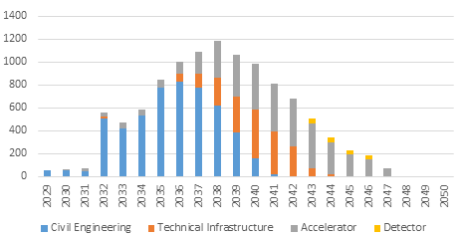
Post FS & ESPPU2027: Project Cost & Profile
Construction cost estimate for FCC-ee
(from CDR 2018, update in 2025)
Machine configurations for Z, W, H working points included
Baseline configuration with 2 detectors
CERN contribution to 2 experiments incl.
Spending profile for FCC-ee
CE construction 2032 - 2040
Technical infrastructure 2037 - 2043
Accelerator and experiment 2032 – 2045
Commissioning and operation start 2045 -2048.
cost category | [MCHF] | %
civil engineering | 5.400 | 50
technical infrastructure | 2.000 | 18
accelerator | 3.300 | 30
detector | 200 | 2
total cost (2018 prices) | 10.900 | 100

Slide 23
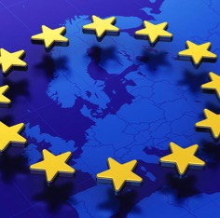
Status of Global FCC Collaboration
Increasing international collaboration as a prerequisite for success:
links with science, research & development and high-tech industry will be essential to further advance and prepare the implementation of FCC
147
Institutes
30
Companies
34
Countries
EC
H2020
FCC Feasibility Study: 58 fully-signed previous members, 17 new members, MoU renewal of remaining CDR participants in progress

Slide 24


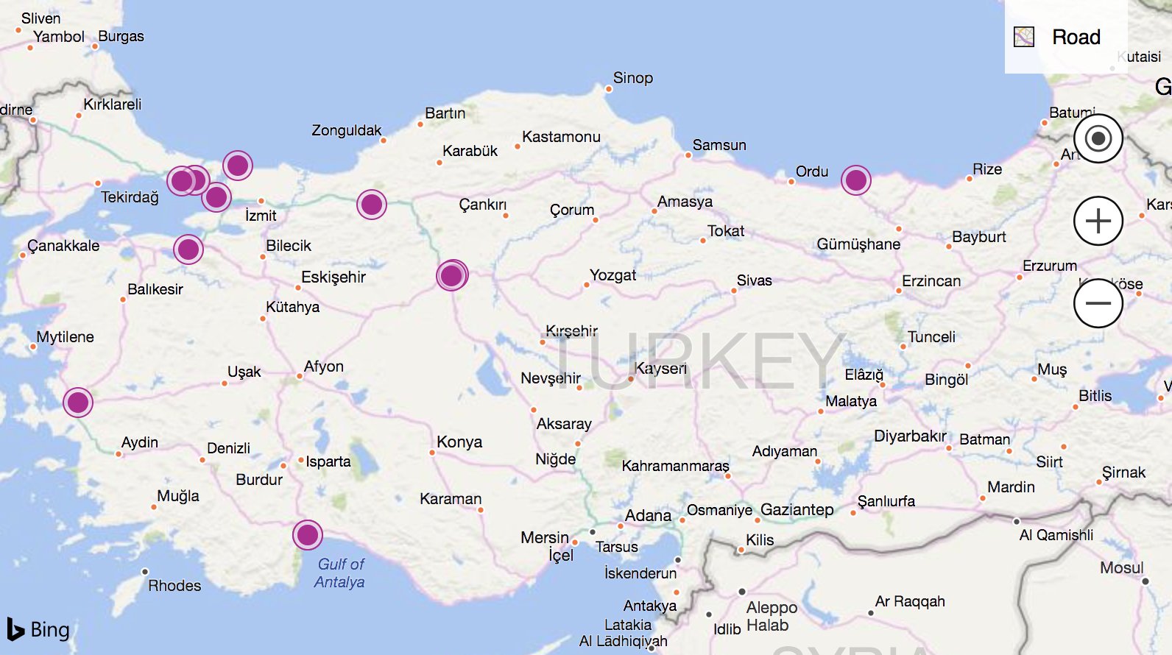
Turkish members of FCC collaboration
15 or 16 institutes from Turkey: AIBU, Bolu; Akdeniz U, Antalya; Ankara U, Tandogan/ Ankara; EgeU, Bornova-Izmir; Giresun U, Giresun; Isik U, Sile, Istanbul; Istanbul Aydin U, Istanbul; Istanbul U, Vezneciler-Istanbul;
Istinye U, Istanbul; IUE, Balcova-Izmir; IYTE, Urla-Izmir;
Kirrikale U; Okan U, Istanbul; PRU, Tuzla/Istanbul; TOBB ETU, Ankara; ULUDAG, Nilüfer-Bursa

Slide 25
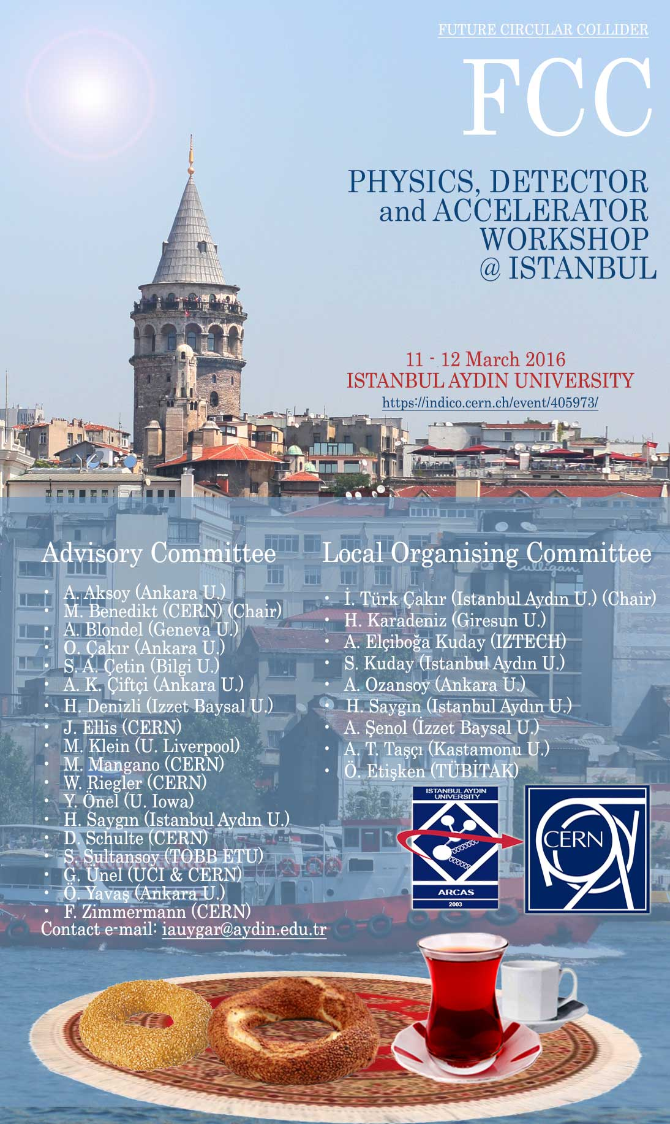


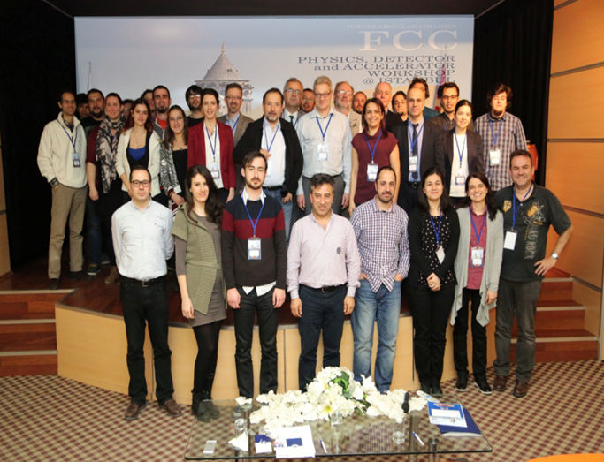
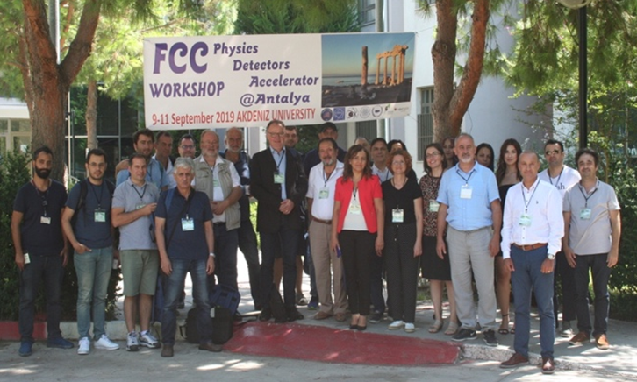
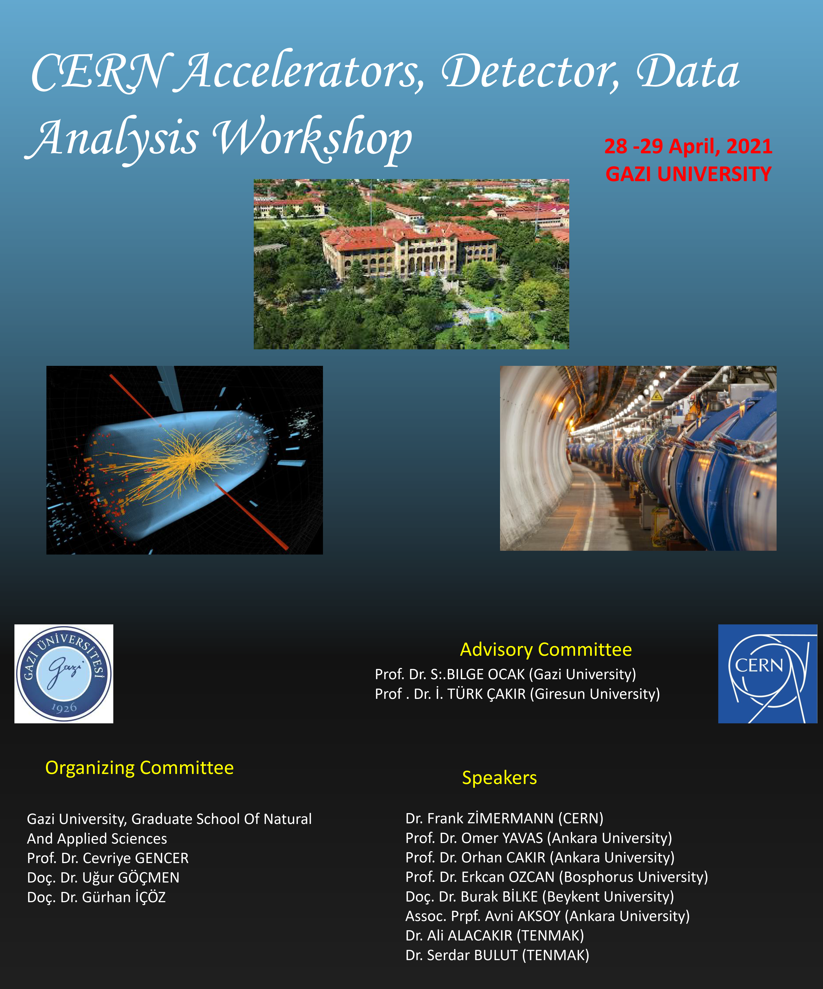
Istanbul 2016
Antalya 2019
https://indico.cern.ch/event/405973/
FCC workshops organized by
Turkish FCC community

Slide 26

Publications by FCC groups in Turkey FCC theses at Turkish universities
  The 28 GeV Dimuon Excess in Lepton Specific 2HDM, A. Cici, S. Khalil, B. Niş, C. S. Un, arXiv:1909.02588v1 [hep-ph]
  Study on Anomalous Neutral Triple Gauge Boson Couplings from Dimension-eight Operators at the HL-LHC, A. Senol, H. Denizli, A. Yilmaz, I. Turk Cakir, O. Cakir., arXiv:1906.04589 [hep-ph].
  Sensitivity on Anomalous Neutral Triple Gauge Couplings via ZZ Production at FCC-hh, A. Yilmaz, A. Senol, H. Denizli, I. Turk Cakir, O. Cakir., arXiv:1906.03911 [hep-ph].
  Top quark anomalous FCNC production via $tqg$ couplings at FCC-hh, K.Y. Oyulmaz, A. Senol, H. Denizli, O. Cakir, Phys.Rev. D99 (2019) no.11, 115023. 10.1103/PhysRevD.99.115023.
  Testing for observability of Higgs effective couplings in triphoton production at FCC-hh, H. Denizli, K.Y. Oyulmaz, A. Senol., arXiv:1901.04784 [hep-ph]
  Linac and Damping Ring Designs for the FCC-ee, S. Ogur et al., Proceedings of International Particle Accelerator Conference (IPAC 2019), pp. 420-423, 2019
  FCC-ee: The Lepton Collider : Future Circular Collider Conceptual Design Report Volume 2, FCC Collaboration (A. Abada et al.)., Eur.Phys.J.ST 228 (2019) no.2, 261-623, 10.1140/epjst/e2019-900045-4.
  FCC-hh: The Hadron Collider : Future Circular Collider Conceptual Design Report Volume 3, FCC Collaboration (A. Abada et al.)., Eur.Phys.J.ST 228 (2019) no.4, 755-1107, 10.1140/epjst/e2019-900087-0.
  HE-LHC: The High-Energy Large Hadron Collider, FCC Collaboration (A. Abada et al.)., Eur.Phys.J.ST 228 (2019) no.5, 1109-1382. 10.1140/epjst/e2019-900088-6.
  FCC Physics Opportunities : Future Circular Collider Conceptual Design Report Volume 1, FCC Collaboration (A. Abada et al.)., Eur.Phys.J. C79 (2019) no.6, 474. 10.1140/epjc/s10052-019-6904-3.
  Probing anomalous tq\gamma and tqg couplings via single top production in association with photon at FCC-hh, K.Y. Oyulmaz, A. Senol, H. Denizli, A. Yilmaz, I. Turk Cakir, O. Cakir., Eur.Phys.J. C79 (2019) no.1, 83. 10.1140/epjc/s10052-019-6593-y.
  Probing top quark FCNC tq\gamma and tqZ couplings at future electron-proton colliders, O. Cakir, A. Yilmaz, I. Turk Cakir, A. Senol, H. Denizli, Nucl.Phys. B944 (2019) 114640. ,10.1016/j.nuclphysb.2019.114640.
  Probing the Effects of Dimension-eight Operators Describing Anomalous Neutral Triple Gauge Boson Interactions at FCC-hh, A. Senol, H. Denizli, A. Yilmaz, I. Turk Cakir, K.Y. Oyulmaz, O. Karadeniz, O. Cakir., Nucl.Phys. B935 (2018) 365-376, 10.1016/j.nuclphysb.2018.08.018.
  Light stops and fine-tuning in MSSM, A. Çiçi, Z. Kırca, C. S. Ün; , Eur. Phys. J. C (2018) 78: 60. https://doi.org/10.1140/epjc/s10052-018-5549-y
  Probing the Anomalous FCNC Couplings at Large Hadron Electron Collider , I. Turk Cakir, A. Yilmaz, H. Denizli, A. Senol, H. Karadeniz, O. Cakir. Adv.High Energy Phys. 2017 (2017) 1572053.
15) Top quark FCNC couplings at future circular hadron electron colliders , H. Denizli, A. Senol, A. Yilmaz, I. Turk Cakir, H. Karadeniz, O. Cakir. Phys.Rev. D96 (2017) no.1, 015024.
16) Probing Charged Higgs Boson Couplings at the FCC-hh Collider , I.T. Cakir, S. Kuday, H. Saygin, A. Senol, O. Cakir. , Phys.Rev. D94 (2016) 015024.
17) Single production of the excited electrons in the future FCC-based lepton–hadron colliders, Abdullatif Caliskan, Seyit Okan Kara., Int.J.Mod.Phys. A33 (2018) no.24, 1850141.
18) Layout and Performance of the FCC-ee Pre-Injector Chain, Salim Ogur et al., DOI: 10.18429/JACoW-IPAC2018-MOPMF034.
Pre-Booster Ring Considerations for the FCC e⁺e⁻ Injector, Ozgur Etisken, Fanouria Antoniou, Abbas Çiftçi, Yannis Papaphilippou, DOI: 10.18429/JACoW-IPAC2018-MOPMF002.
20) Bunch Schedules for the FCC-ee Pre-injector, Salim Ogur, Katsunobu Oide, Yannis Papaphilippou, Dmitry Shatilov, Frank Zimmermann. DOI: 10.18429/JACoW-IPAC2018-MOPMF001.
21) First Look at the Physics Case of TLEP , TLEP Design Study Working Group (M. Bicer et al.). , JHEP 1401 (2014) 164.
22) Excited muon searches at the FCC based muon-hadron colliders , A. Caliskan, S.O. Kara, A. Ozansoy. arXiv:1701.03426 [hep-ph]. Adv.High Energy Phys. 2017 (2017) 1540243.
23) Azimuthal Angular Decorrelation of Jets at Future High Energy Colliders , I. Hos, H. Saygin, S. Kuday. arXiv:1809.01505 [hep-ph].
Projections for Neutral Di-Boson and Di-Higgs Interactions at FCC-he Collider , S. Kuday, H. Saygın, İ. Hoş, F. Çetin., Nucl.Phys. B932 (2018) 1-14. 10.1016/j.nuclphysb.2018.05.002.
25) FCC Based Lepton-Hadron and Photon-Hadron Colliders: Luminosity and Physics, Y. C. Acar, A. N. Akay, S. Beser, H. Karadeniz, U. Kaya, B. B. Oner, S. Sultanso, arXiv:1608.02190 [physics.acc-ph].
26) Color Octet Electron Search Potential of the FCC Based e-p Colliders , Y. C. Acar, U. Kaya, B. B. Oner, S. Sultansoy, J. Phys. G 44, no. 4, 045005 (2017).
27) Resonant production of leptogluons at the FCC based lepton-hadron colliders, Y. C. Acar, U. Kaya, B. B. Oner, S. Sultansoy, arXiv:1511.05814 [hep-ph].
I . Turk Cakir, A. Şenol, A. T. Tasci and O. Cakir. “Probing Anomalous WW γ and WWZ Couplings with Polarized Electron Beam at the LHeC and FCC-Ep Collider”. World Academy of Science, Engineering and Technology International Journal of Chemical, Molecular, Nuclear, Materials and Metallurgical Engineering (2015) Vol:9, No:1.
I. Turk Cakir, B. Hacisahinoglu, S. Kartal, A. Yilmaz, A. Yilmaz, Z. Uysal, O. Cakir, "Search for Flavour Changing Neutral Current Couplings of Higgs-up Sector Quarks at Future Circular Collider (FCC-eh)". World Academy of Science, Engineering and Technology, Open Science Index 132, International Journal of Physical and Mathematical Sciences (2017), 11(12), 525-529.
30) I. Turk Cakir, M. Altinli, Z. Uysal, A. Senol, O. Yalcinkaya, A. Yilmaz, "The Search of Anomalous Higgs Boson Couplings at the Large Hadron Electron Collider and Future Circular Electron Hadron Collider". World Academy of Science, Engineering and Technology, Open Science Index 132, International Journal of Physical and Mathematical Sciences (2017), 11(12), 519-524.
31 F. Yaman et al., “Mitigation of electron cloud effects in the FCC-ee collider”, EPJ Techniques and Instrumentation volume 9, Article number: 9 (2022)
PhD theses
Ozgur ETISKEN, Ankara University, “Pre-Booster Ring Design for FCC-e⁺e⁻ Injector complex”, CERN/Ankara
Umit KAYA, Ankara University, “Search for Color Octet Electron (e8) at TeV Energy Scale Colliders”
Kaan Yuksel OYULMAZ, Bolu Abant Izzet Baysal University, “Upgrade and performance studies of CMOS sensors for future colliders”
Salim OGUR, Bogazici University, “Linac and Damping Ring Designs of the future Circular e+e- Collider of CERN”, CERN/Bogazici PhD April 2019 – lzter CERN fellow
…
FCC-Turkey team extremely active and productive
MSc theses
Yunus Emre OKYAYLI, 2018, “Search for R-parity violation interactions of scalar leptons at future circular collider”, Istanbul U.
Gökhan HALİMOĞLU, 2018, “Measurement of lepton + jets at 100 TeV at future circular collider”, Istanbul U.
Rokia Omar Ali ALAMIN, 2017, “Anomalous heavy down type b' quark production at the future circular collider”, Kastamonu University
Burak HACIŞAHİNOĞLU, 2017, “Search for flavour changing neutral current couplings of higgs-up sector quarks at electron-proton colliders”, Istanbul U.
Murat ALTINLI, 2017, “Investigation of gauge boson anomalous couplings with higgs particle at electron-proton colliders”, Istanbul U.
Çağla ÇAĞLAR, 2019, “Search for quarkonium consists of E6 model predicted isosinglet quark at future colliders,”, Ege University
Alev Ezgi DEMİRCİ, 2017, “Production and decay channels of charged higgs boson at high energy hadron colliders”, Ankara U.

Slide 27


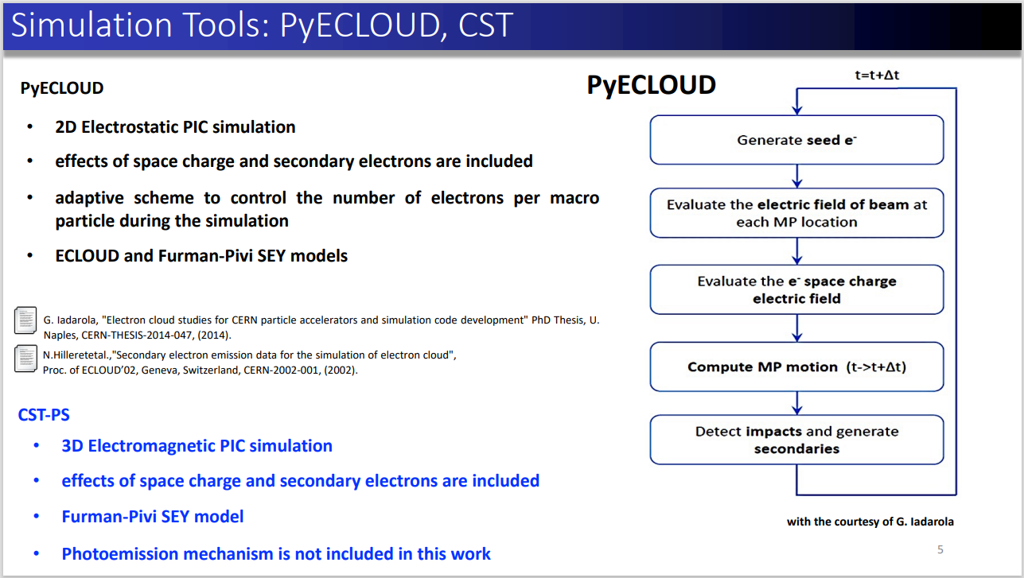
FCC-ee e-cloud build up studies
Fatih Yaman

Slide 28
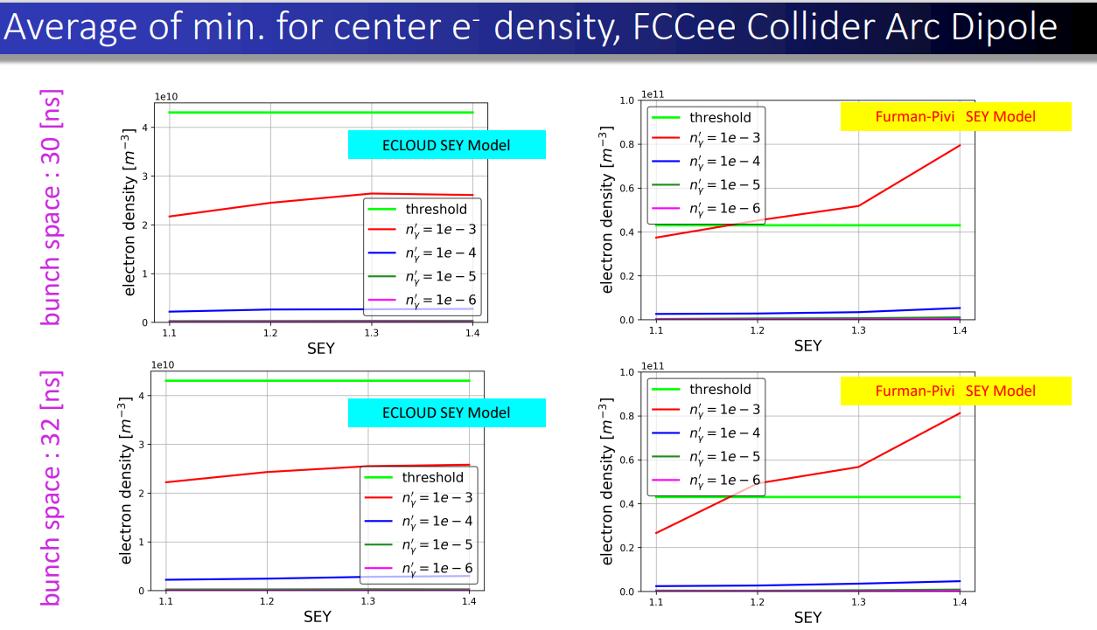
FCC-ee e-cloud build up studies
Fatih Yaman

Slide 29
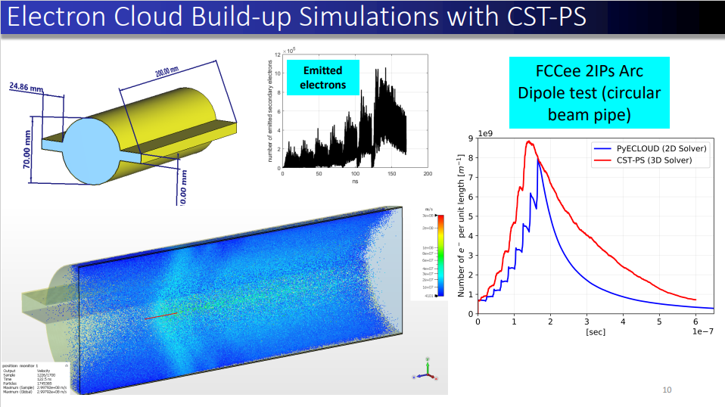
FCC-ee e-cloud build up studies
Fatih Yaman

Slide 30






linac and damping ring design
Salim Ogur
  S-Band structures.
  Results with misalignments and BPM errors.

Slide 31



pre-booster design: SPS & greenfield
Ozgur Etisken

Slide 32




injector & collider filling schemes
Salim Ogur

Slide 33















Physics Studies
teams in Turkey are extremely productive !

Slide 34
FCC opportunities for Turkey
ongoing collaborations
FCC-ee injector design (Ankara, Bogazici, IEU, Kirikkale.…)
FCC-ee beam dynamics studies (IYTE,…)
FCC detector studies (AIBU, Uludag, …)
FCC physics (Akdeniz, Ankara, Tandogan, EgeU, Giresun, Isik, Istanbul Aydin, Istanbul U, IEU, Okan, PRU, TOBB ETU, ULUDAG…)
potential further contributions
FCC civil engineering
FCC-ee vacuum system prototype (IEU proposal)
FCC-ee damping ring and booster designs (Ankara, Kirikkale, ...)

Slide 35
Summary and Outlook
The European Strategy Update 2020 has issued a high-priority request for a feasibility study of the FCC integrated programme, and suggestions for key technology R&D areas
Main activities of the FCC Feasibility Study: concrete local/regional implementation scenario in collaboration with host state authorities, accompanied by machine optimization, physics studies and technology R&D, performed via global collaboration and supported by EC H2020 Design Study FCCIS, to prove FCC feasibility by 2025/26
Long term goal: world-leading HEP infrastructure for 21st century to push the particle-physics precision and energy frontiers far beyond present limits.
Success of FCC relies on global participation
Strong participation from Turkey with many addt’l opportunities !
Teşekkür ederim !

Slide 36

FCC Week 2023
5 – 9 June
From 5 to 9 June 2023 in London

