Slide 1
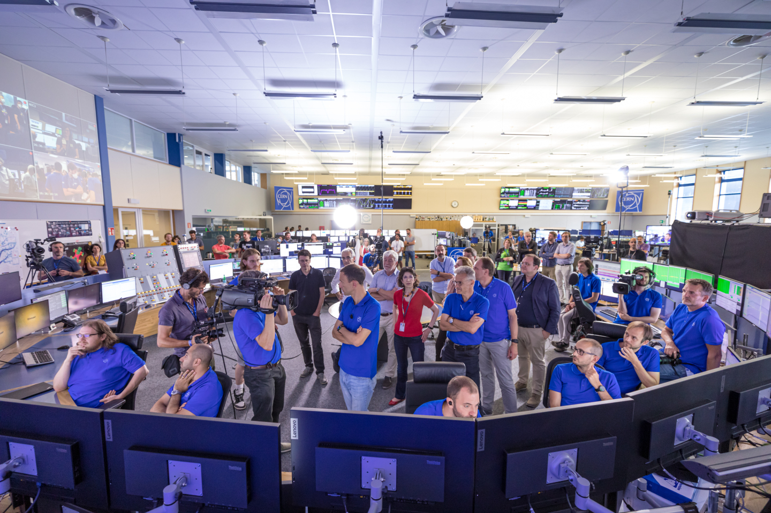

LHC Status
J. Wenninger – BE/OP/LHC
Acknowledgements: M. Solfaroli, M. Hostettler, S. Fartoukh, A. Lechner, G. Iadarola

Slide 2
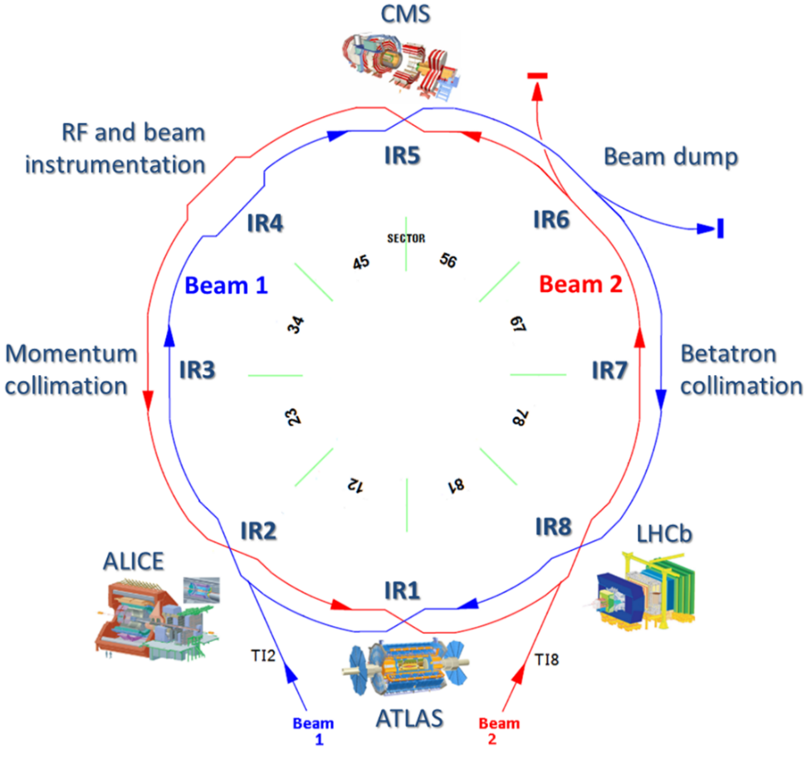
Outline
Introduction – LHC Run 3
Commissioning 2022
Performance limitations
Conclusions

Slide 3
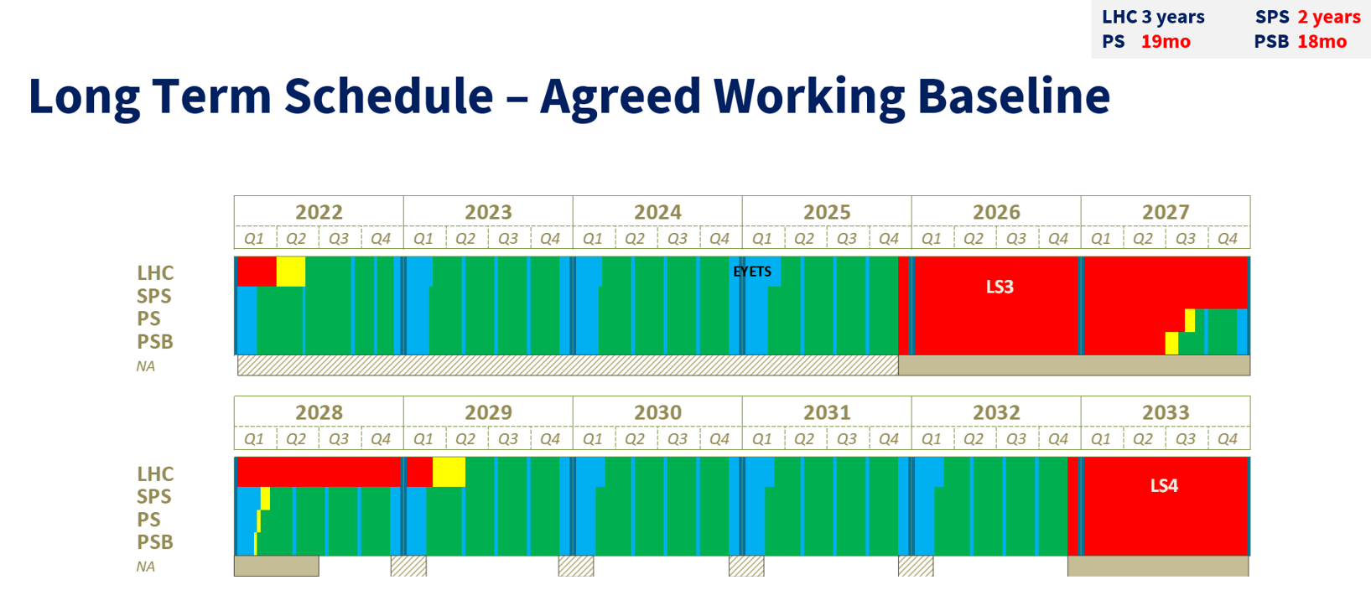
Long term CERN accelerator schedule
Long term operation plan of CERN – recent changes:
Extension of LHC Run 3 by one year until the end of 2025.
Extension of Long Shutdown 3 (LS3) to 3 years (for LHC).
Run 3
LHC → HL-LHC : HL-LHC beam commissioning in 2029

Slide 4
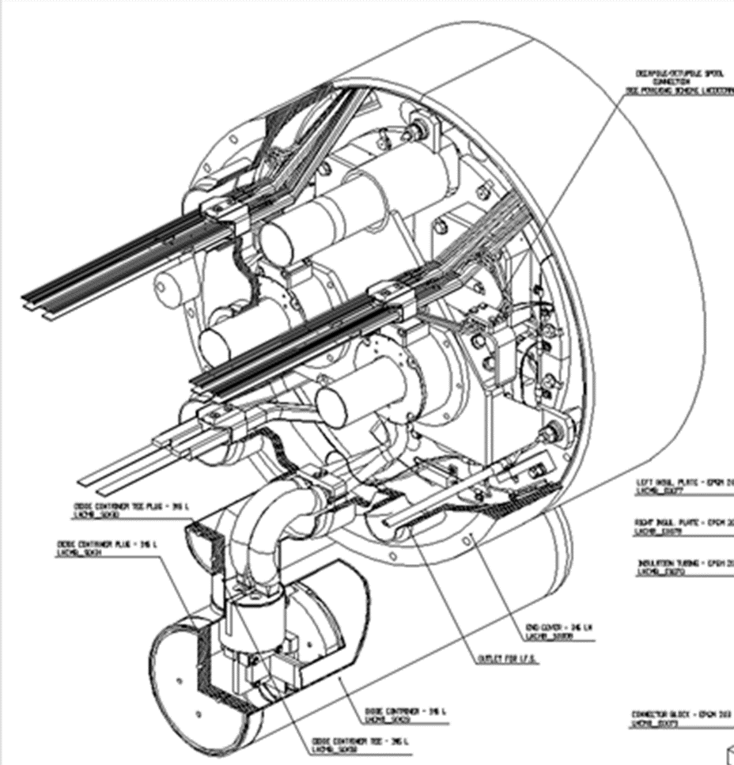
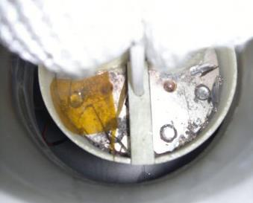
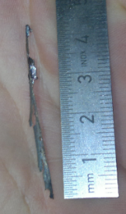
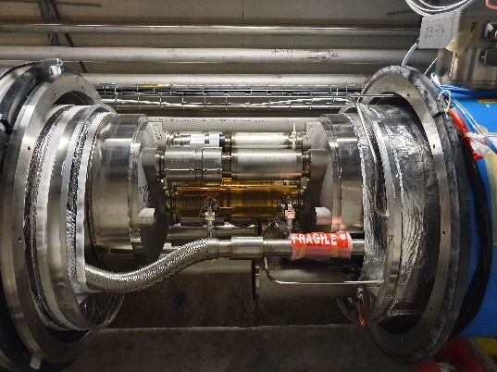
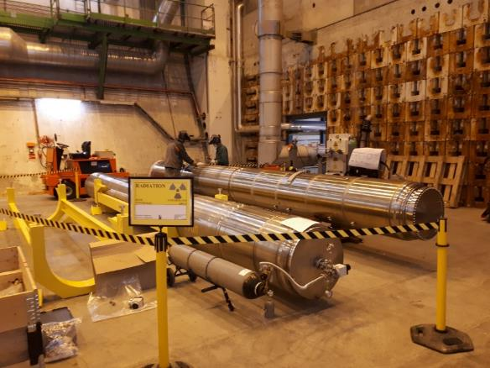
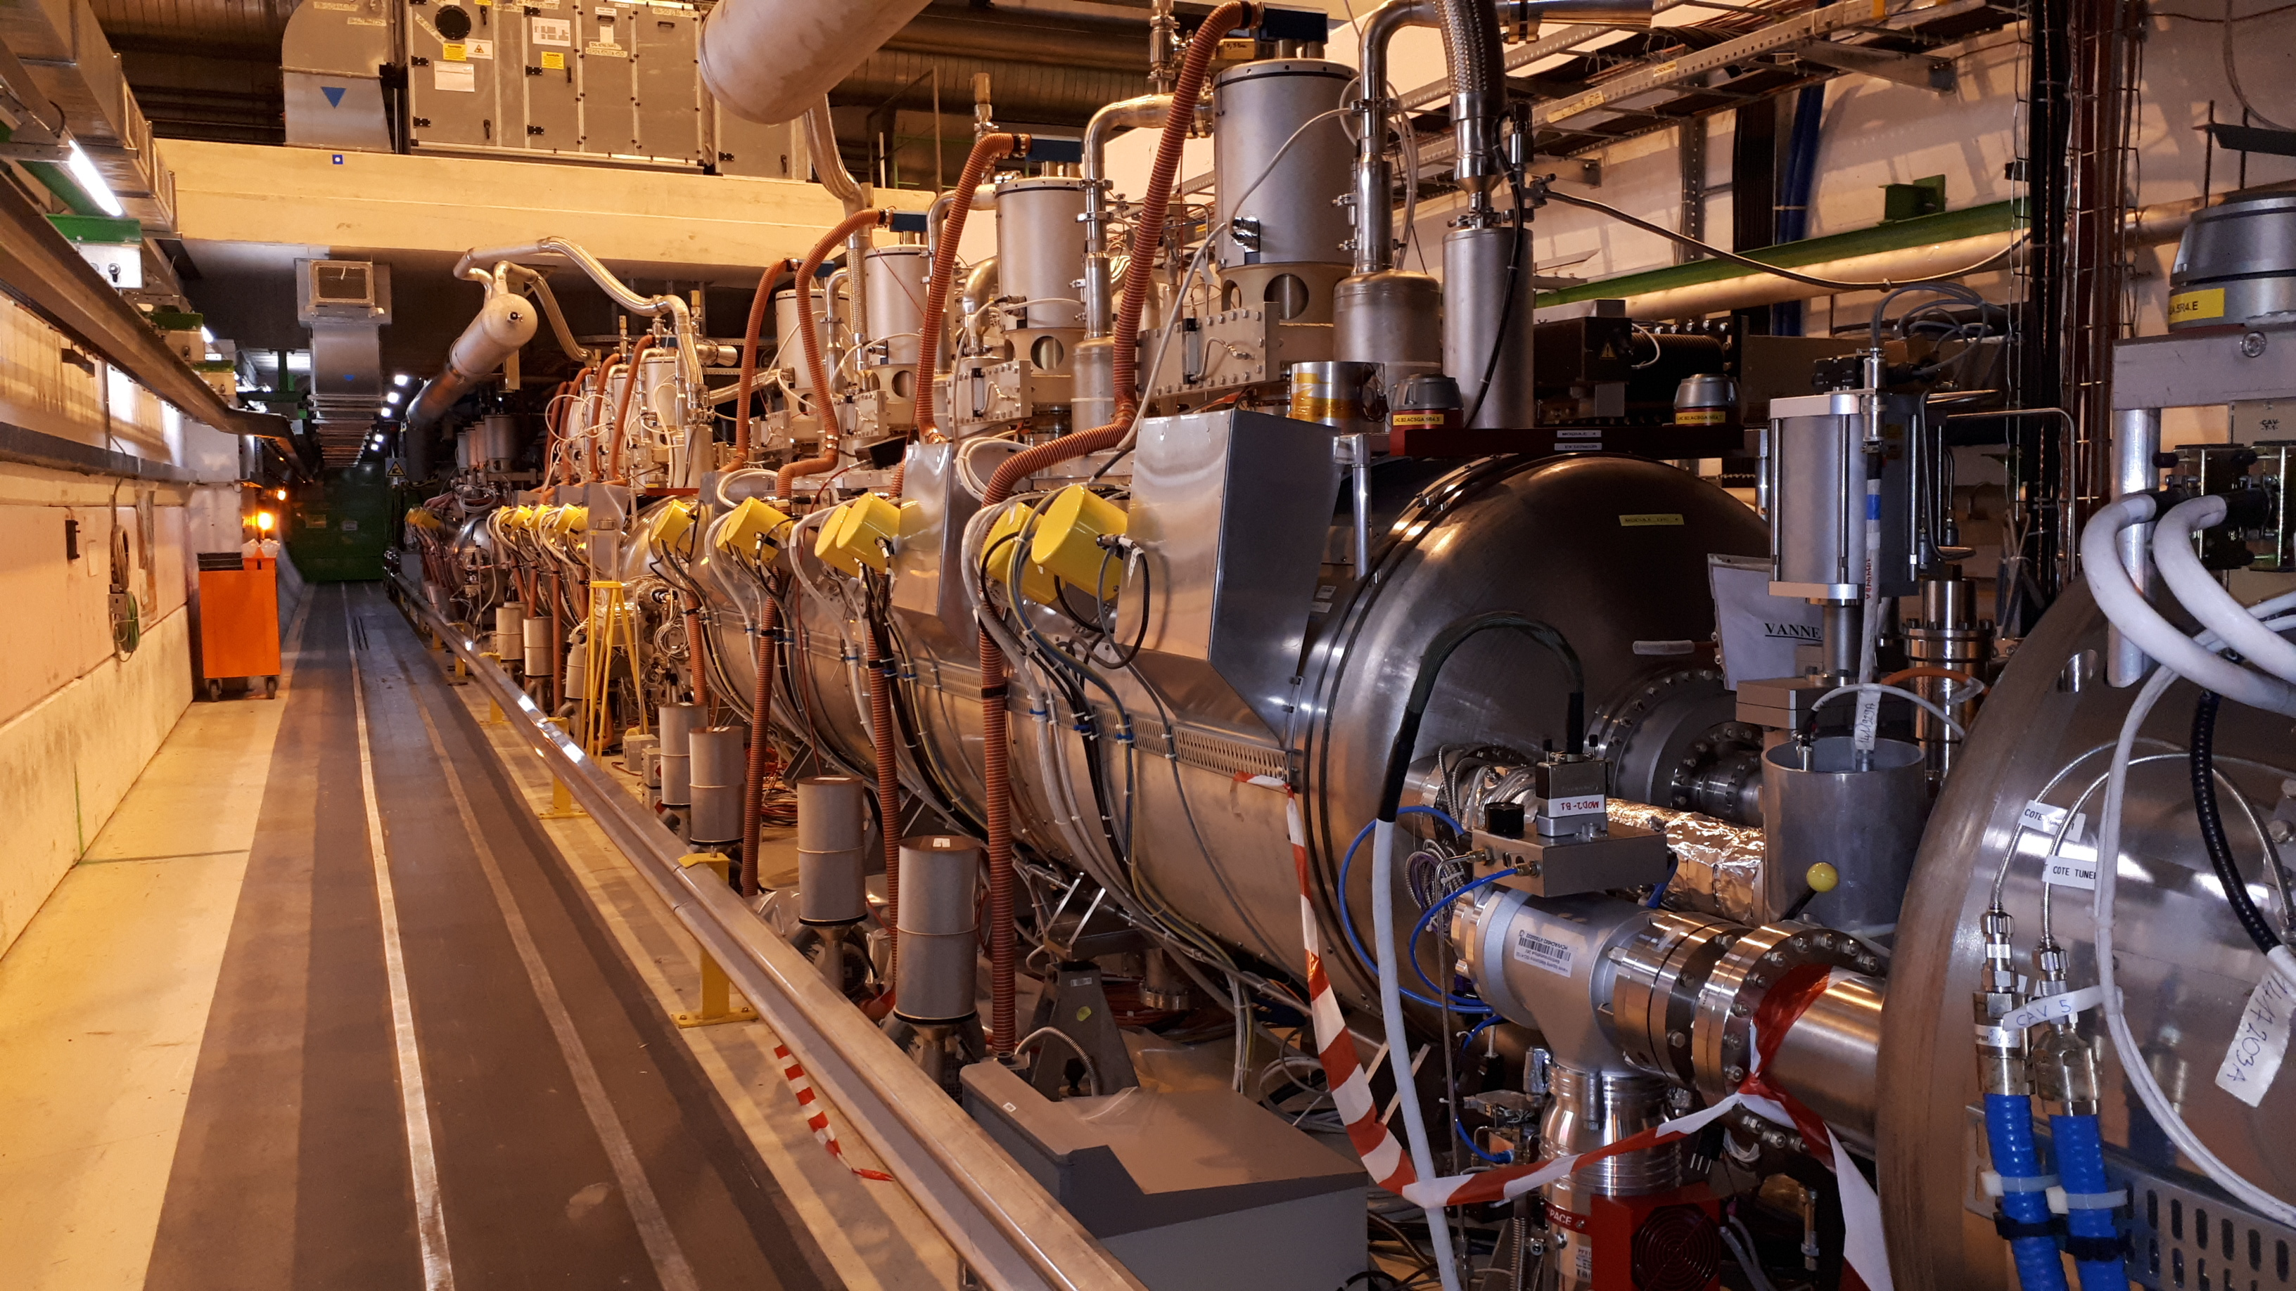
Long Shutdown 2 – 2019-2021
The main shutdown activities of LS2 :
Diode consolidation for all dipole magnets
Replacement of 24 magnets with non-conformities
RF module replacement
Realignment of the CMS beam line (~3mm shift)
Consolidation of LHC beam dumps
Maintenance of the major systems

Slide 5
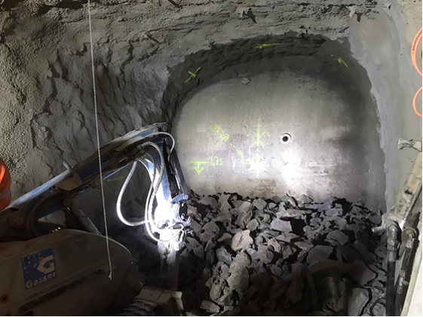
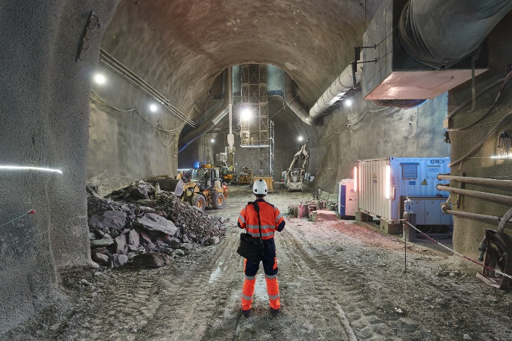
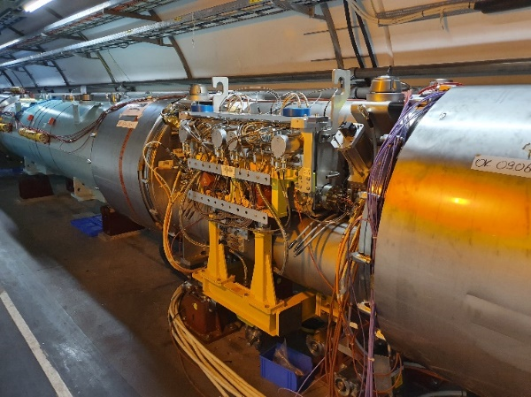
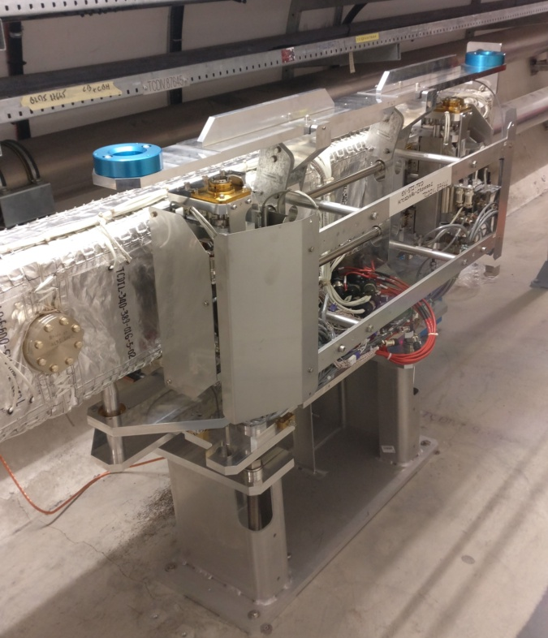
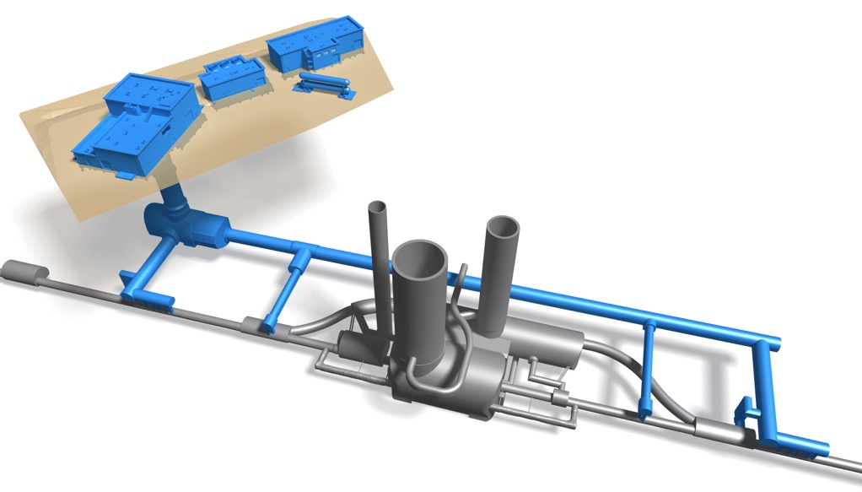
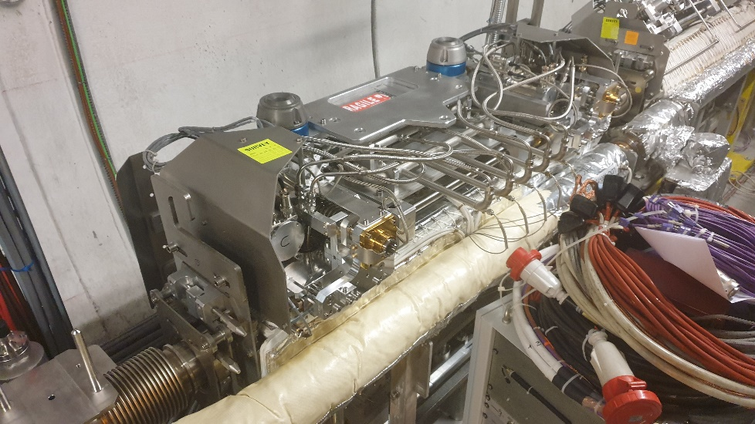
HL-LHC activities during Long Shutdown 2
Civil engineering of new HL underground caverns and connection to the LHC tunnel.
New collimators and injection protection devices.
No 11T dipole magnet installation.

Slide 6

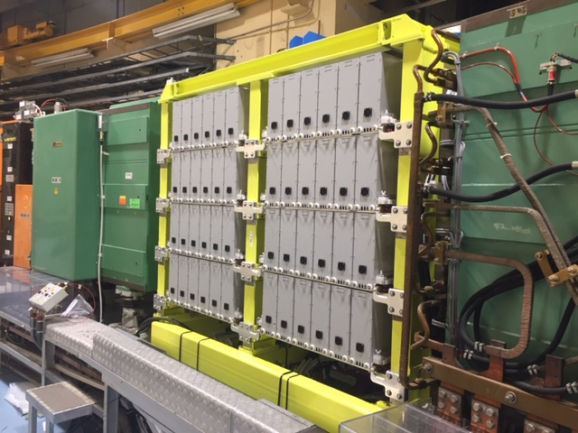
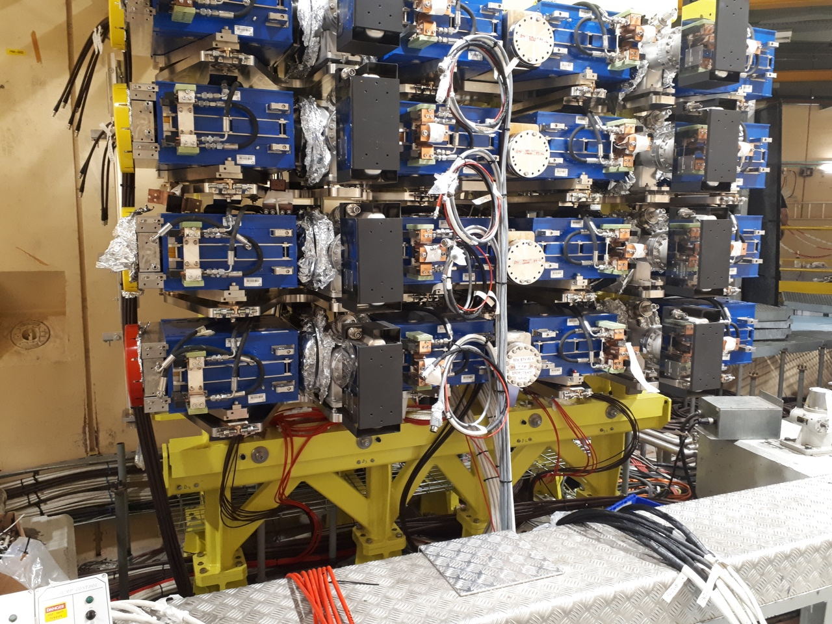
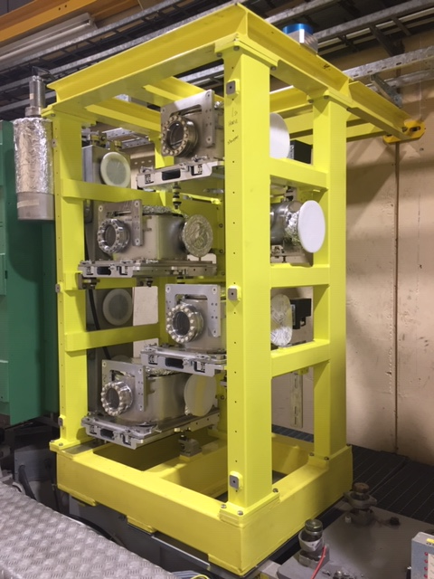
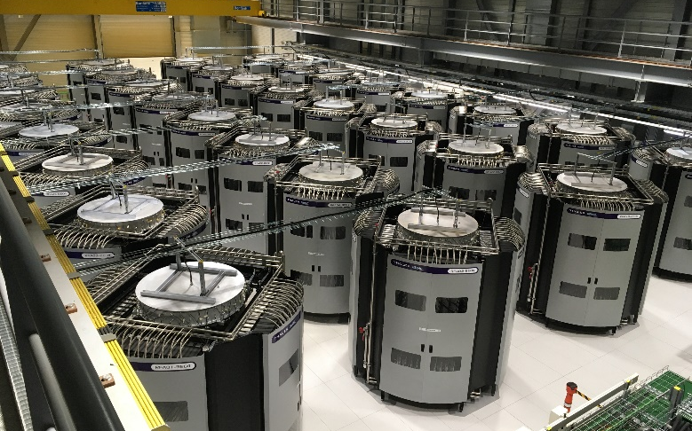
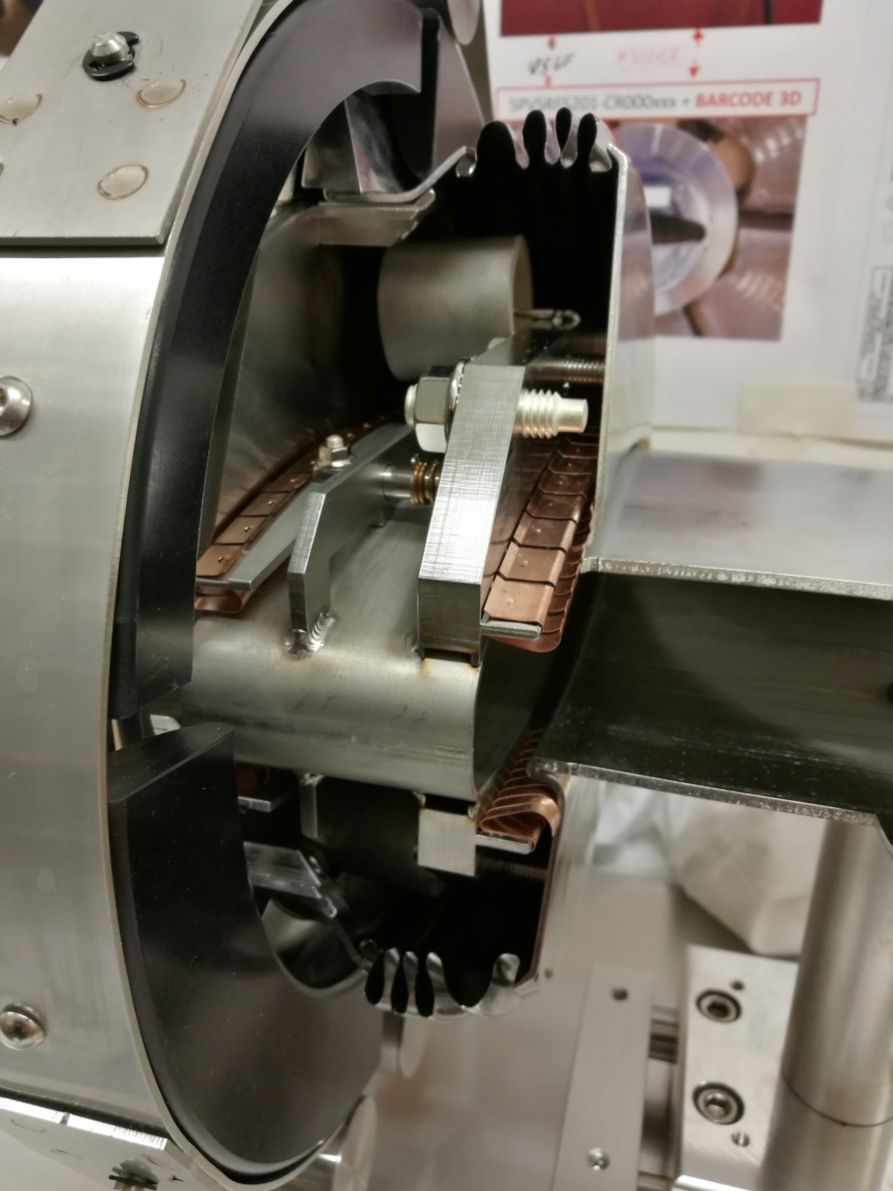
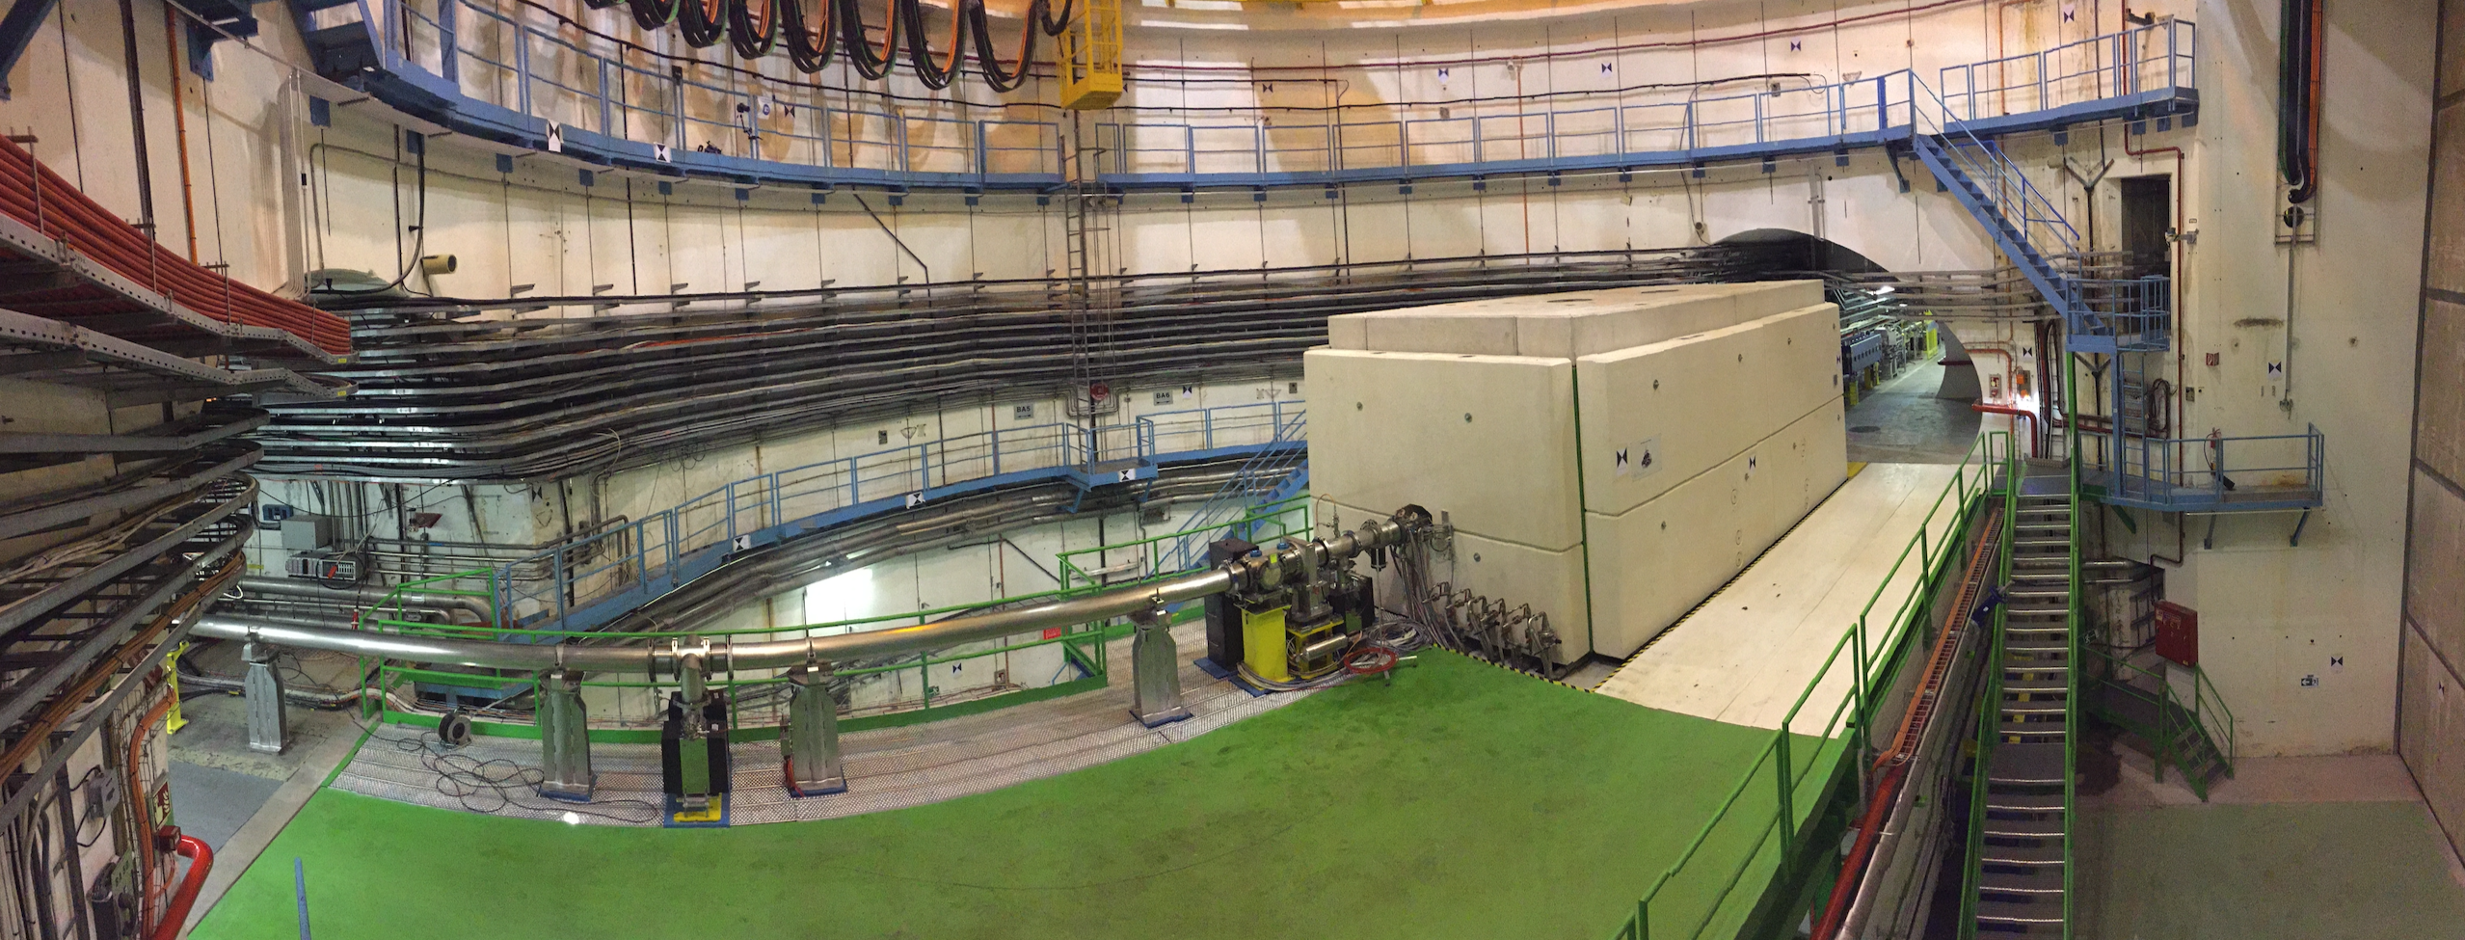
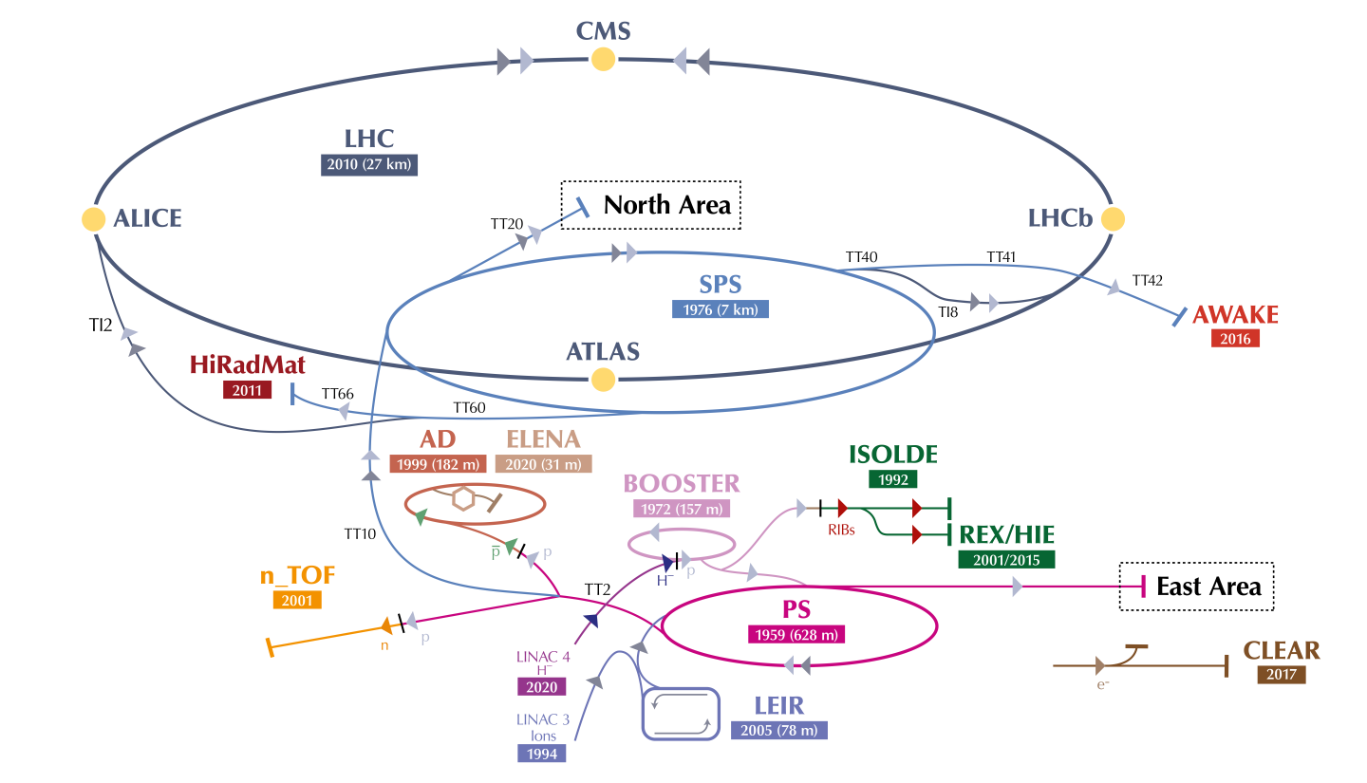
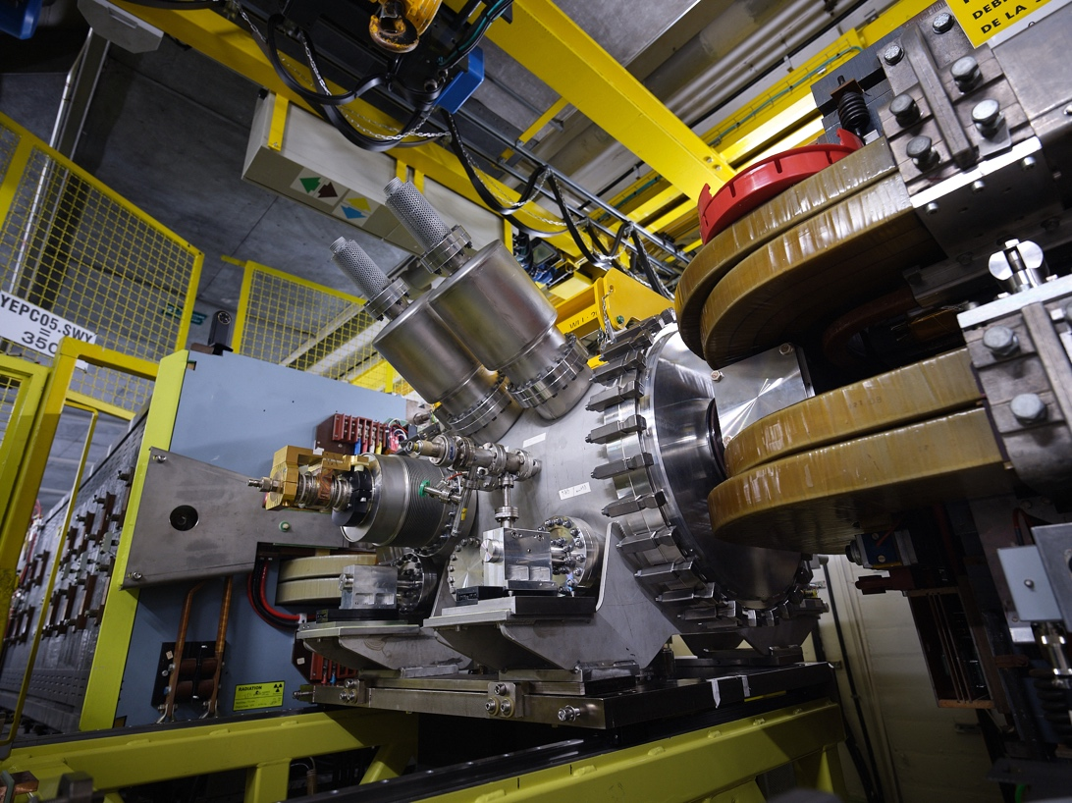
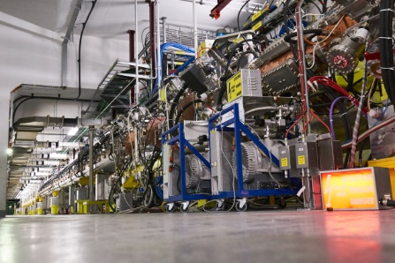
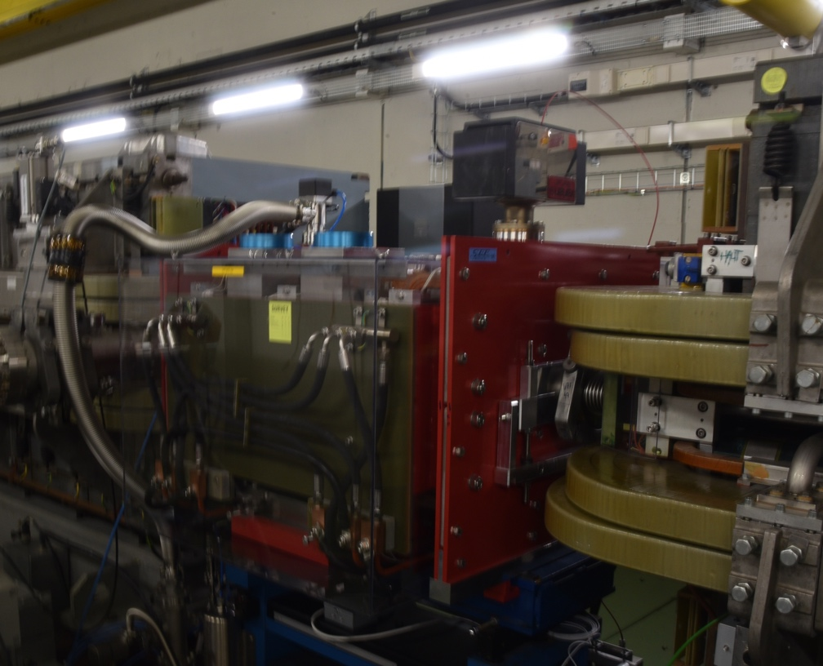
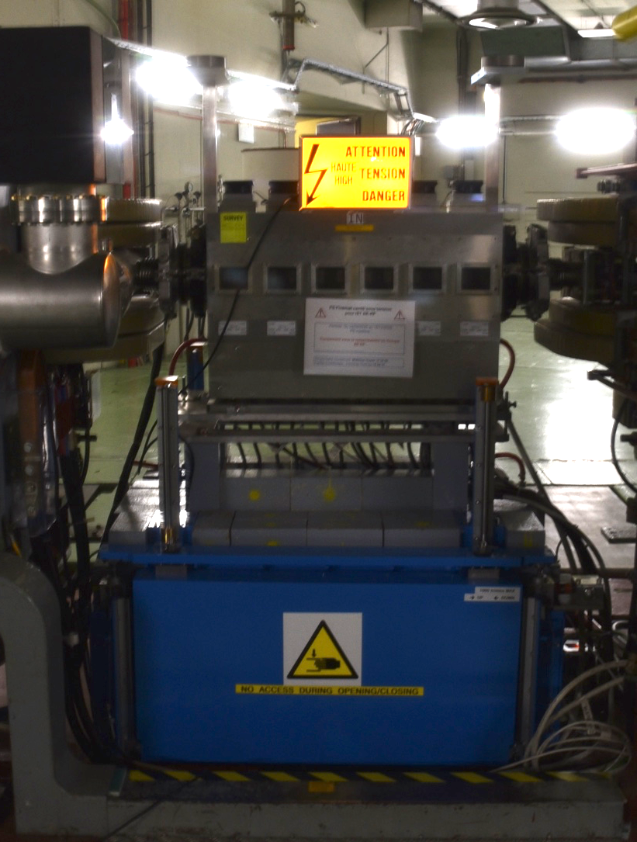
LHC Injectors Upgrade
PSB
160 MeV H⁻ injection
Acceleration to 2 GeV
SPS
RF system upgrade
Longitudinal impedance reduction
& partial a-C coating
New beam dump and protection devices
PS
2 GeV injection
6
Linac4
Acceleration of H⁻ to 160 MeV

Slide 7
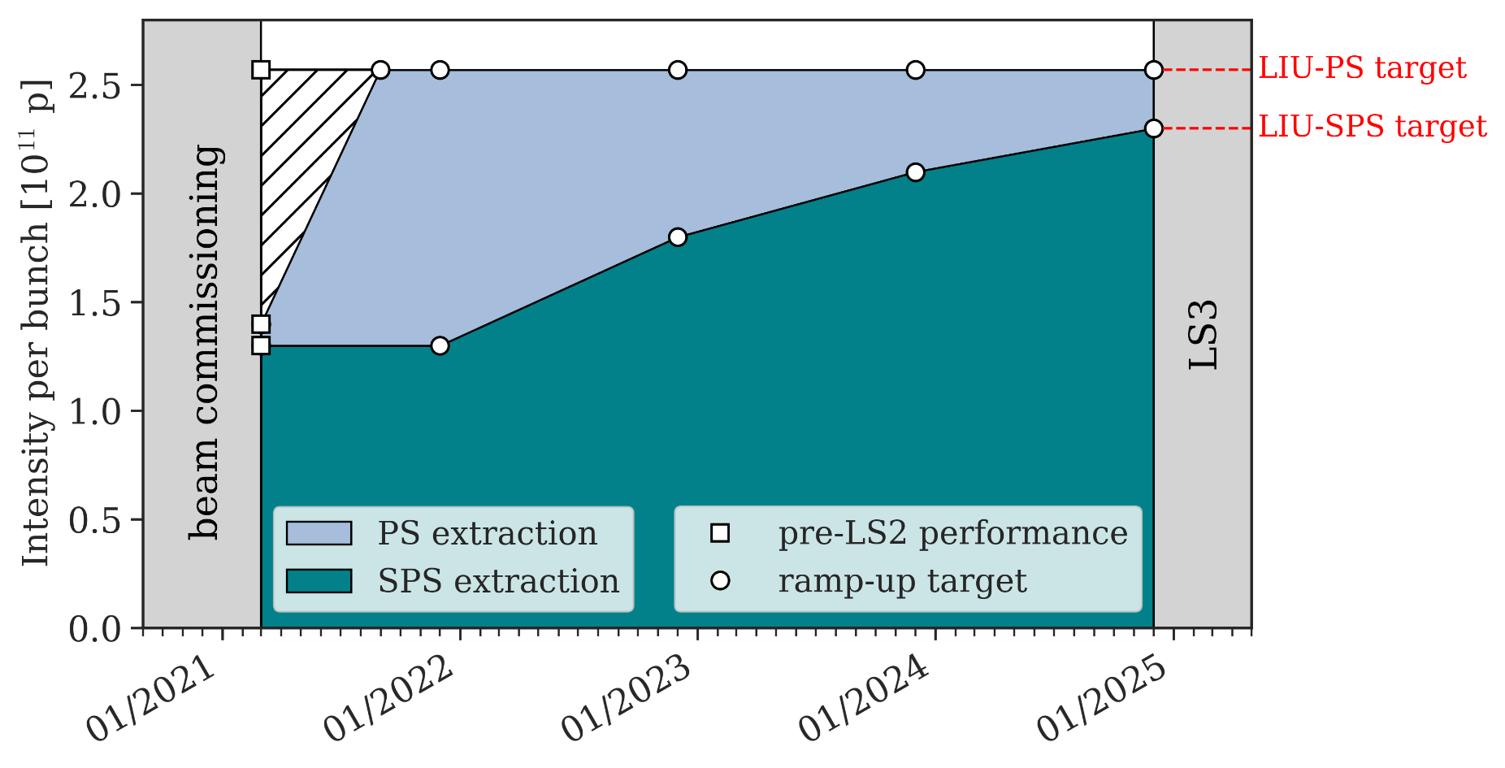
LHC injector intensity ramp up in Run 3
Year | Initial intensity [ppb] | Target intensity [ppb]
2022 | 1.4×10¹¹ | 1.8×10¹¹
2023 | 1.8×10¹¹ | 2.1×10¹¹
LHC baseline for 2023-2025
The target of 1.4×10¹¹ has been achieved.
The injectors are on track to provide trains with 1.8x10¹¹ ppb at SPS extraction for the end of 2022.
The injectors will push the intensity towards the HL target of 2.2×10¹¹ ppb at extraction from the SPS in 2023-2025 – but the LHC cannot ‘swallow’ such beams in pp production in Run 3.

Slide 8
LHC Run 3 performance projections
The performance and configuration of LHC for Run 3 was studied and optimized during LS2*.
Performance estimate assumptions:
LHC peak luminosity limited to ≈2×10³⁴ cm⁻²s⁻¹.
  Limited by the cryogenic cooling capacity of the inner triplets quadrupoles.
Maximum bunch currents of 1.8×10¹¹ ppb for ~2750 bunches (BCMS beam), limited by:
  the RF system,
  the beam dump core integrity – will be refined by observations during Run 3,
  the beam dump protection absorber integrity,
  heating of the injection kickers (soft limit).
While the limit on peak luminosity is well established (within a few %), the limit on the bunch intensity carries more uncertainty as system as pushed to their limits.
(*): S. Fartoukh et al, LHC configuration and operational scenario for Run 3, CERN-ACC-2021-0007

Slide 9
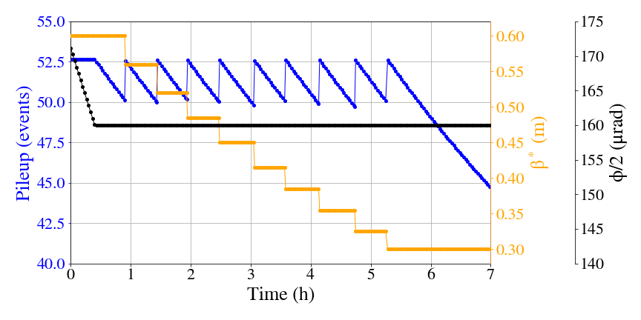
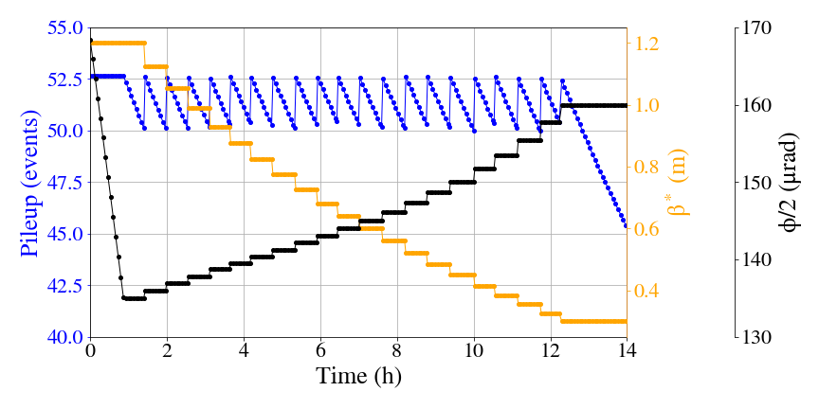
Performance projections
2022
1.4×10¹¹ ppb
For the available bunch intensities, the luminosity in ATLAS/CMS must be levelled at 2×10³⁴ m⁻²s⁻¹.
Levelling times of 6 – 12 hours (1.4 – 1.8×10¹¹ ppb) for good beam emittances, levelling by beam size (β* levelling).
Performance estimates:
Year | Efficiency* (%) | ∫L (fb⁻¹)
2022 | 25% | ≈30
2023-25 | 40% | 85-90
2023-2025
1.8×10¹¹ ppb
For a Run 2 efficiency of 49%: ∫L ~100 fb⁻¹/year in 2023-25
Run 3 is expected to integrate ~300 fb⁻¹ until the end of 2025
(*): fraction of time spent in stable beams
2023-2025: indicative, details may vary !

Slide 10
Outline
Introduction Run 3
Commissioning 2022
Performance limitations
Conclusions
45
56
34
67
23
78
12
81

Slide 11
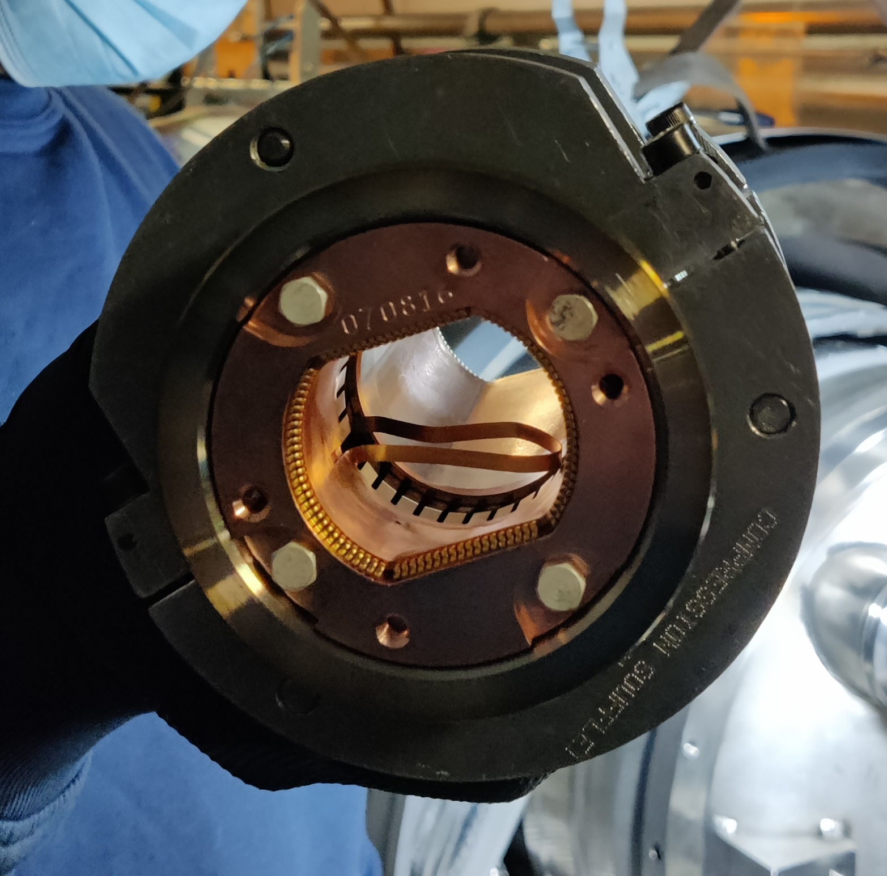
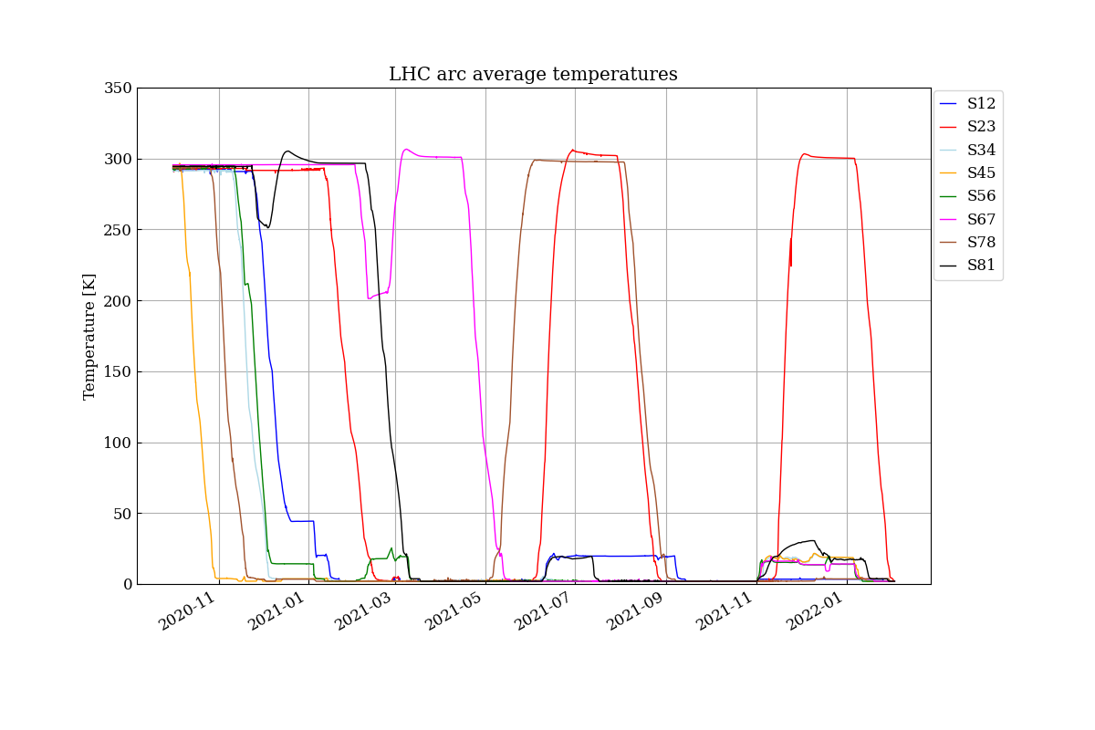
LHC cooldown
Warm up for repair
Short circuits during cool down
LHC cool downs started in 2020 to be ready for magnet powering tests in 2021.
Two failures during dipole magnet training to 7 TeV required warm up cycles of sectors 23 and 78.
This led to the decision to reduce the target energy for Run 3 to 6.8 TeV.
A third warm up cycle was required to repair a buckled RF finger in sector 23.
Discovered during the beam test in Oct 2021.
The LHC was eventually ready at 1.9K in February 2022.
2021 beam test

Slide 12
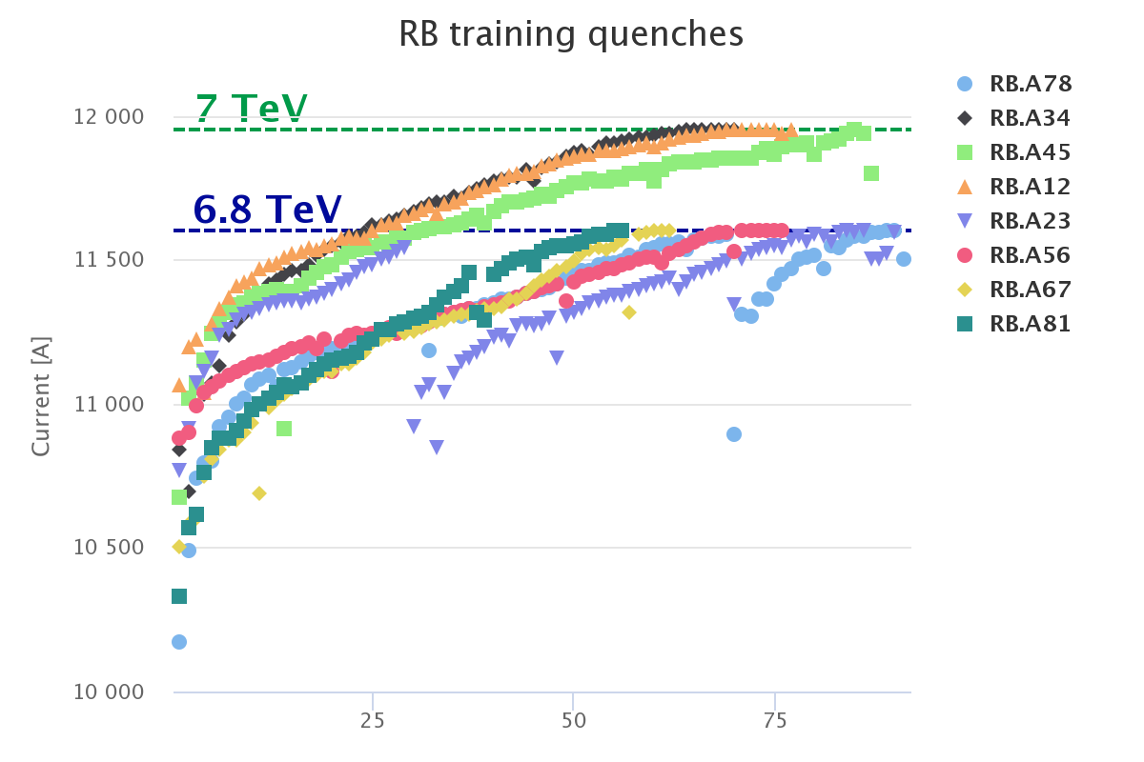
Dipole magnet training
During the magnet training campaign to 6.8 TeV over 600 primary training quenches were recorded on the dipole circuits.
3 sectors were trained to 7.0 TeV.
completed before decision to lower target energy.
5 sectors were trained to 6.8 TeV.
sectors 23 and 78 had to be trained twice due to the warm up cycles.
Since the start of beam operation 12 spontaneous training quenches have already occurred in sectors trained to 6.8 TeV – no training quenches on dipoles were observed at 6.5 TeV during Run 2.
45
56
34
67
23
78
12
81
# training quenches / sector

Slide 13
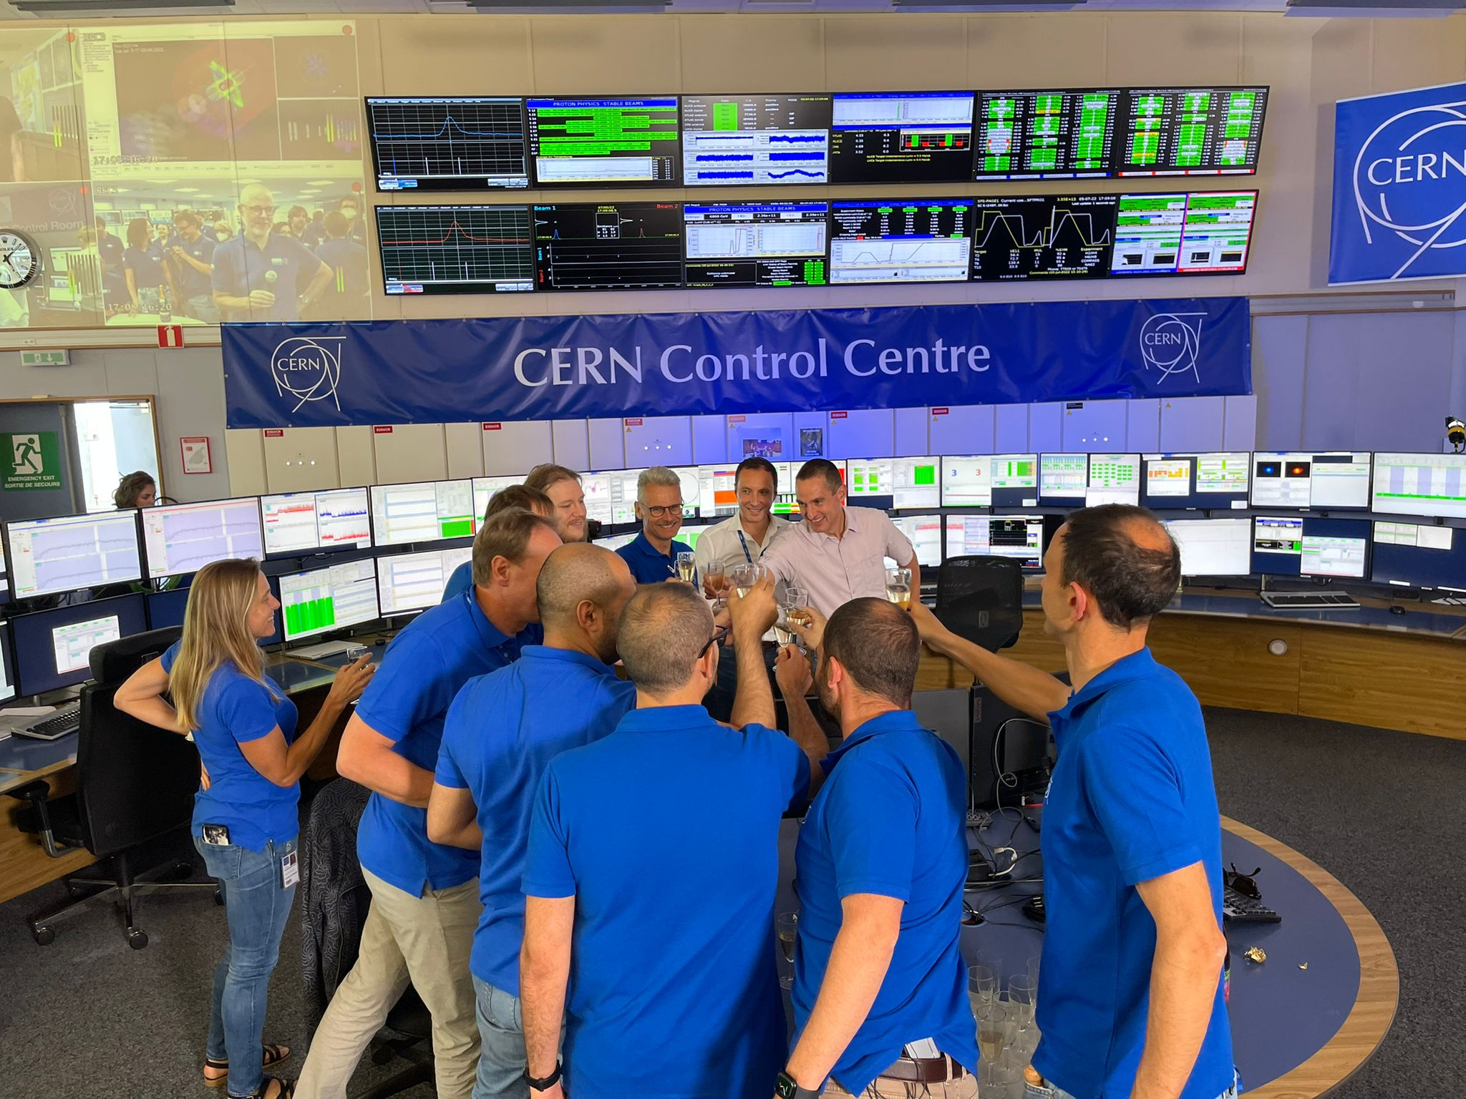
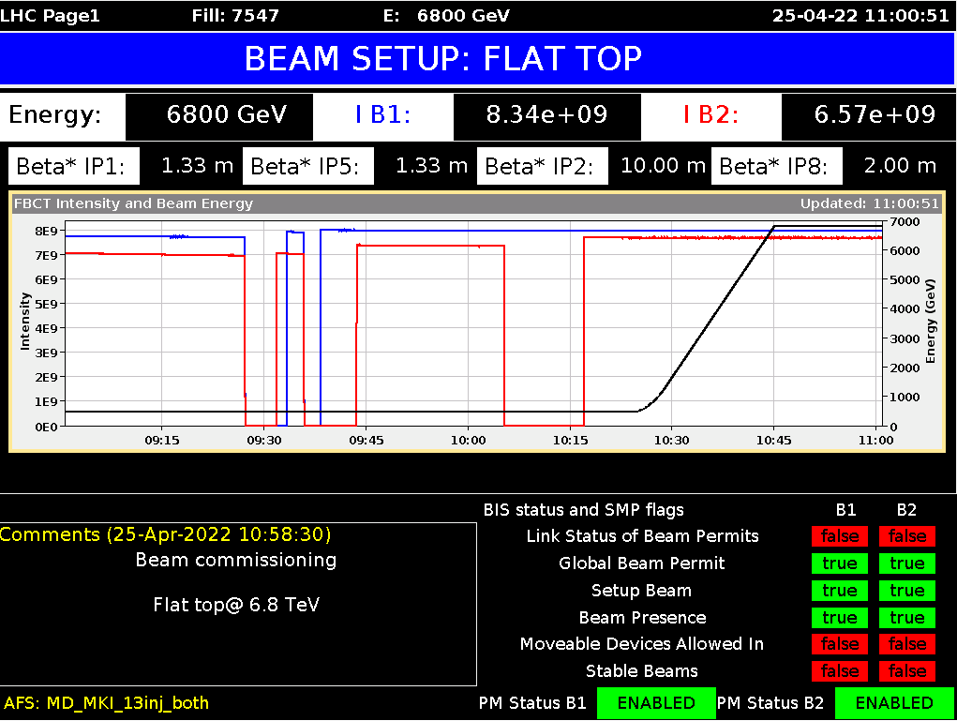
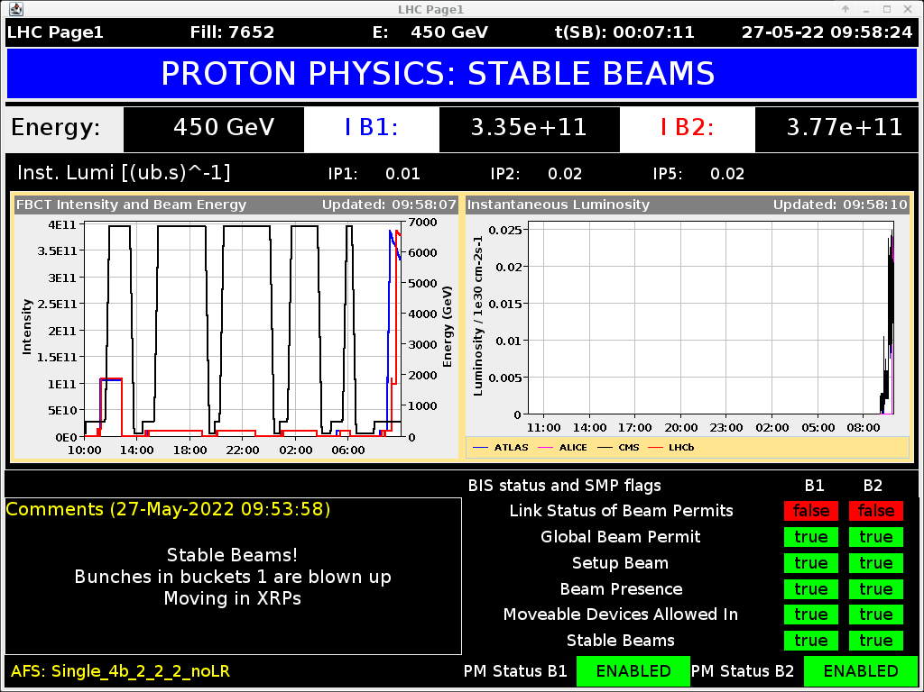
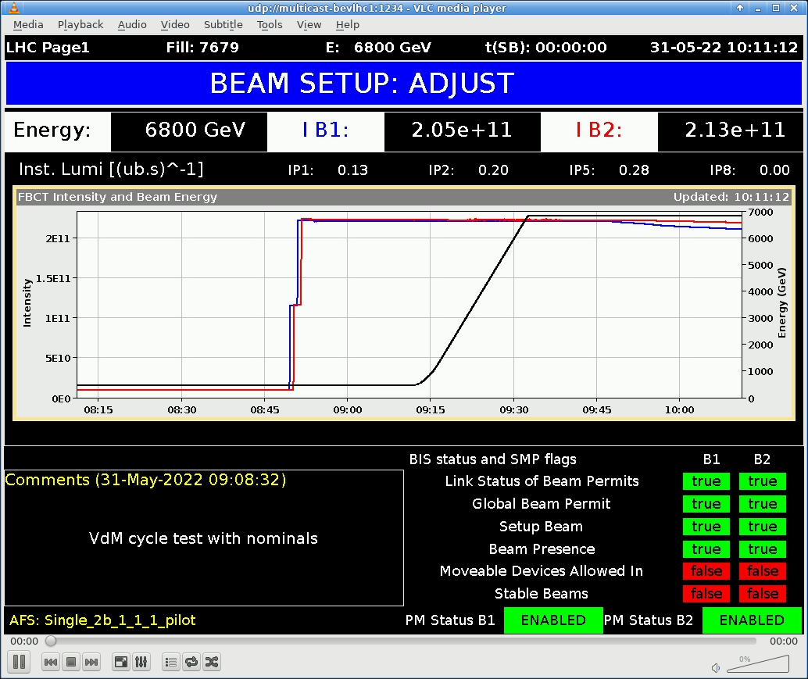
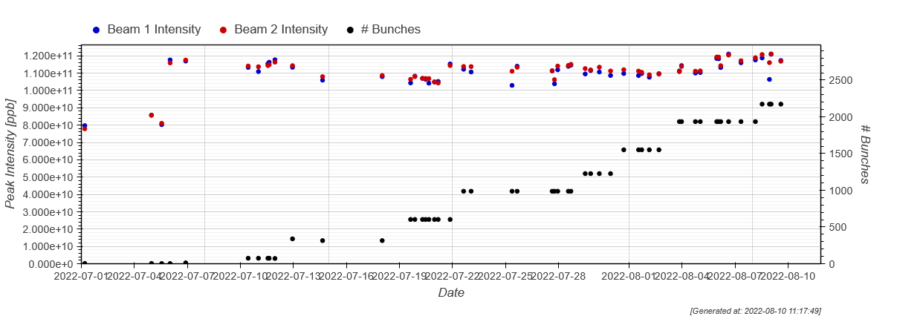
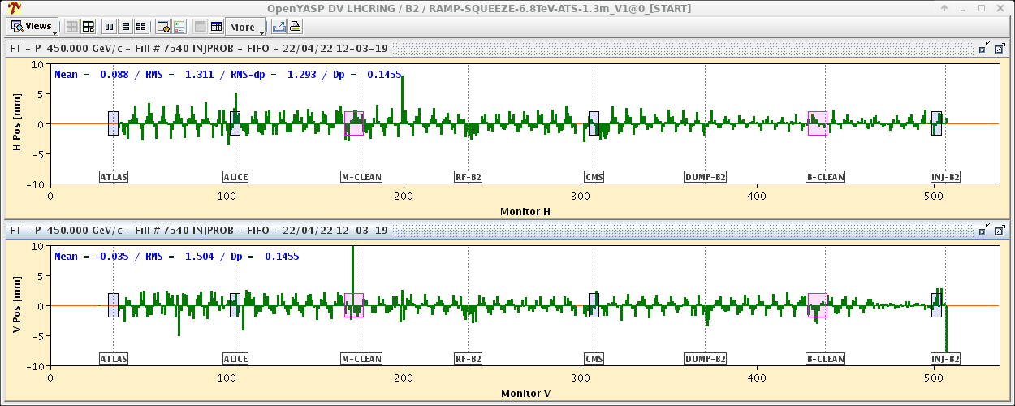
LHC restart in 2022
July 5th
Start of Run 3 physics
April 25th
First protons at 6.8 TeV
May 27th
Collisions at injection
August 23rd
Accidental cooling tower stop leads to Helium release from RF cavities – warm up and conditioning of RF cavities required – 4 week stop
April
May
June
July
August
September
52 days devoted to beam commissioning
June 1st
Collisions at 6.8 TeV
August 3rd
> 2000 bunches
April 22nd
First beam injection

Slide 14
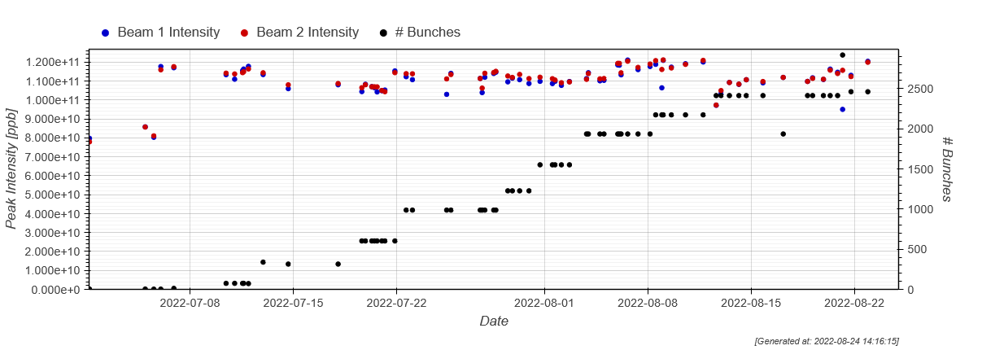
Intensity ramp up
The beam intensity ramp up was initially performed with trains of 48 bunches at a bunch intensity of ~1.1 – 1.2x10¹¹ ppb – as planned.
Due to electron cloud limitations (see later), the train length was reduced to 36 bunches just before the cooling tower incident interrupted the progress for 4 weeks.
2461 bunches
in trains
of 36 bunches
@ 1.2×10¹¹ ppb

Slide 15
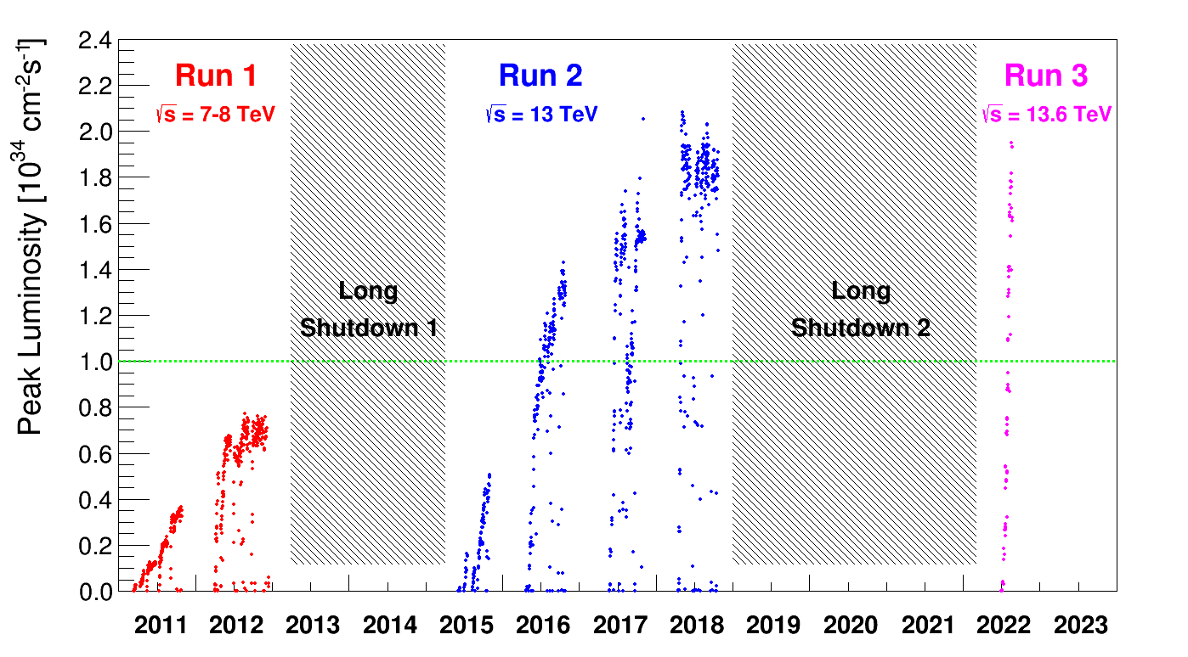
Performance 2022 status
With the experience of the previous two runs, the increase of peak luminosity over such a short time was very steep.
Reflects the excellent understanding of how to control and to operate LHC.
Peak luminosity almost within target.

Slide 16
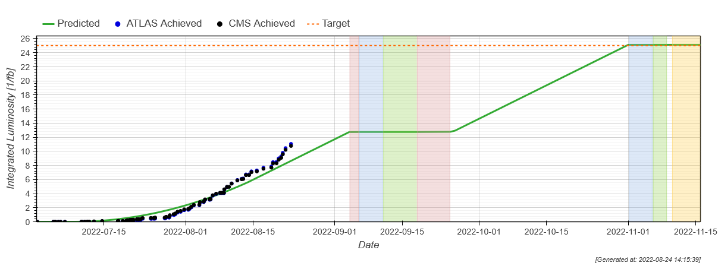
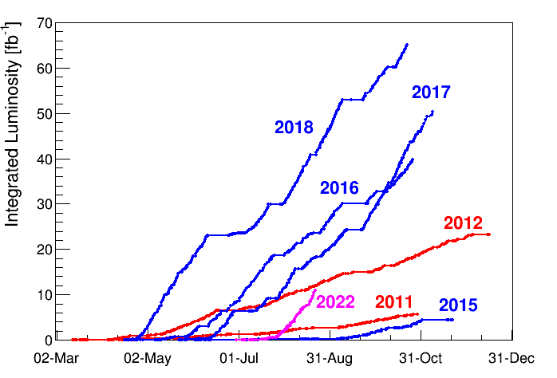
Performance 2022 status
RF system thermal cycle and conditioning
Luminosity Production started to exceed the (conservative) planning for this first run year before the beam stop.
Slope close to the best Run 2 periods.

Slide 17
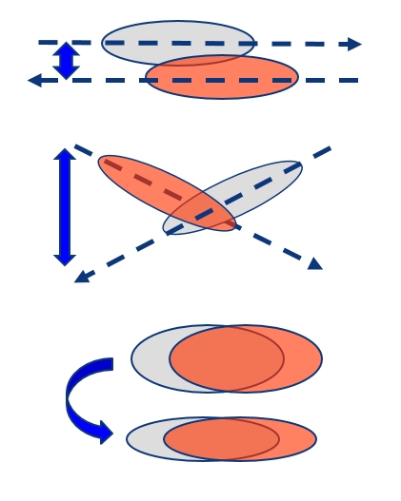
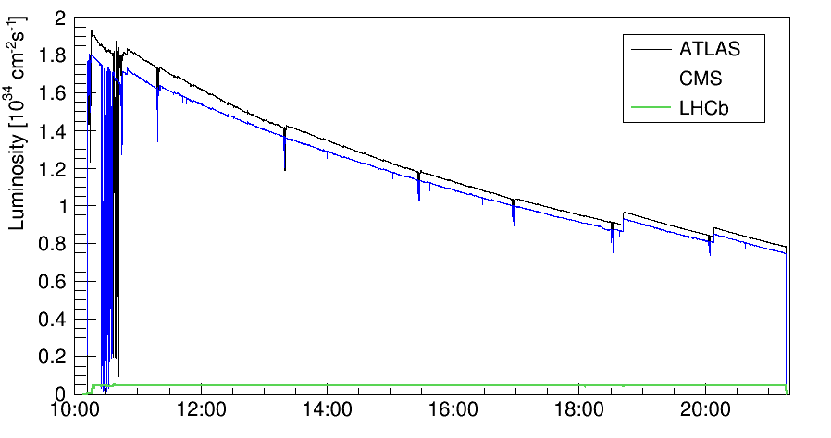
Luminosity levelling
3 levelling techniques to control luminosity are used in parallel in Run 3:
Offset levelling for ALICE and LHCb.
  Local to one IP, well established since Run 1.
Crossing angle (up or down) levelling for ATLAS and CMS.
  Local to one IP, well established since Run 2.
β* levelling for ATLAS and CMS – beam size change at IP(s).
  Beneficial/essential for beam stability, tested at the end of Run 2.
  Key ingredient of Run 2 and HL-LHC operation.
2018 fill with all levelling techniques in action in ATLAS, CMS and LHCb
(ALICE luminosity not visible on this scale)
Smooth crossing angle levelling
(not visible due to luminosity decay)
β* levelling
Offset levelling

Slide 18
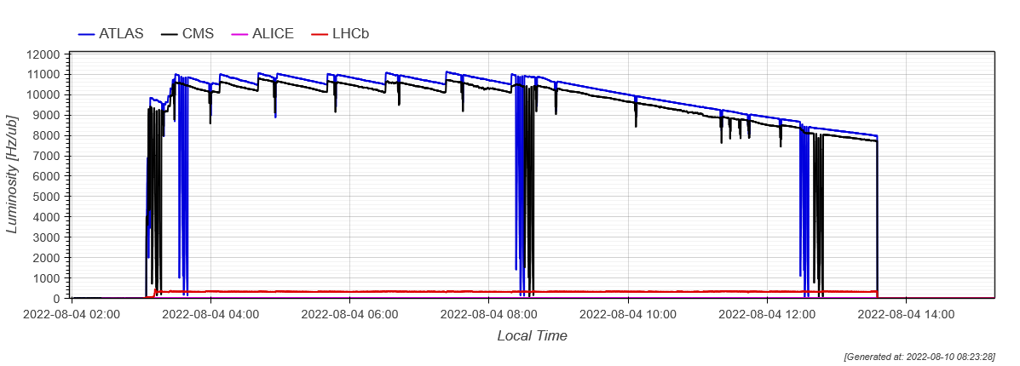
Beta* levelling in 2022
Luminosity levelling of ATLAS and CMS is performed in 10 steps in β* / beam size to limit the luminosity jumps to ≤ ~ 5%.
β* range of 60 cm to 30 cm.
Already achieved fully automated execution based on target luminosity or pile-up.
CMS & ATLAS are fully coupled, i.e. β* changes occur at the same time at both IPs.
Achieved a major milestone for LHC Run 2 and for HL-LHC !
β* levelling
Example of a 2022 fill
(ALICE luminosity not visible on this scale)
β* levelling step

Slide 19
Outline
Introduction Run 3
Commissioning 2022
Performance limitations
Conclusions

Slide 20
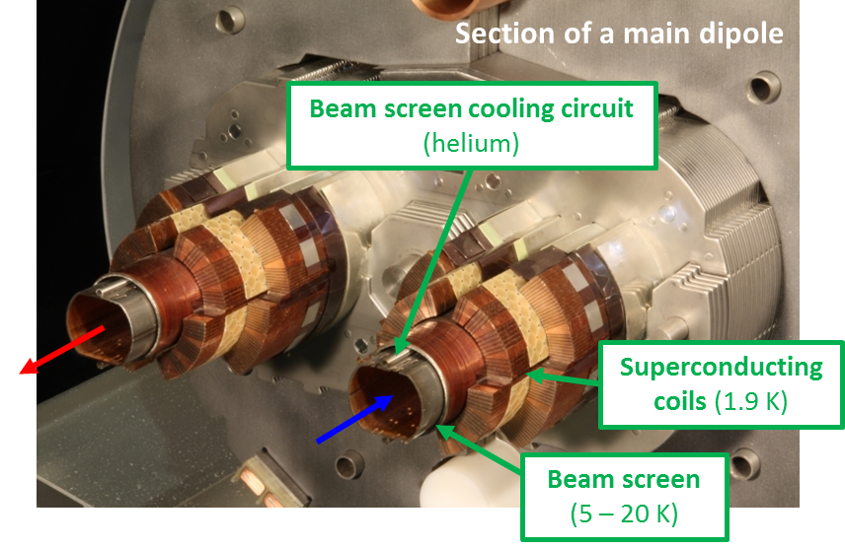
Electron clouds
Bunch N
liberates e-
Bunch N+1 accelerates e-,
multiplication at impact
Process repeats for Bunch N+2 …
Electron clouds can affect all accelerators with high currents of positive charge (p, ions, e+). Impact :
Vacuum pressure rise.
Degraded beam quality (emittance, instabilities, losses).
Energy deposition on the vacuum chamber (~20K at LHC) → heat load for the cryogenic system.
e-
e-
++++++
++++++
++++++
N+1
N+2
N
e-
If the probably of emitting a secondary electron (SEY) is above threshold ➔ avalanche effect (multipacting) which depends on bunch spacing and population
Remedies:
Conditioning by beam-induced electron bombardment (“scrubbing”) leading to a progressive reduction of SEY.
Holes in bunch filling pattern to break up cloud build-up → lower luminosity.
Surface treatment of vacuum chamber (coatings..)

Slide 21
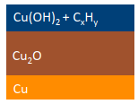
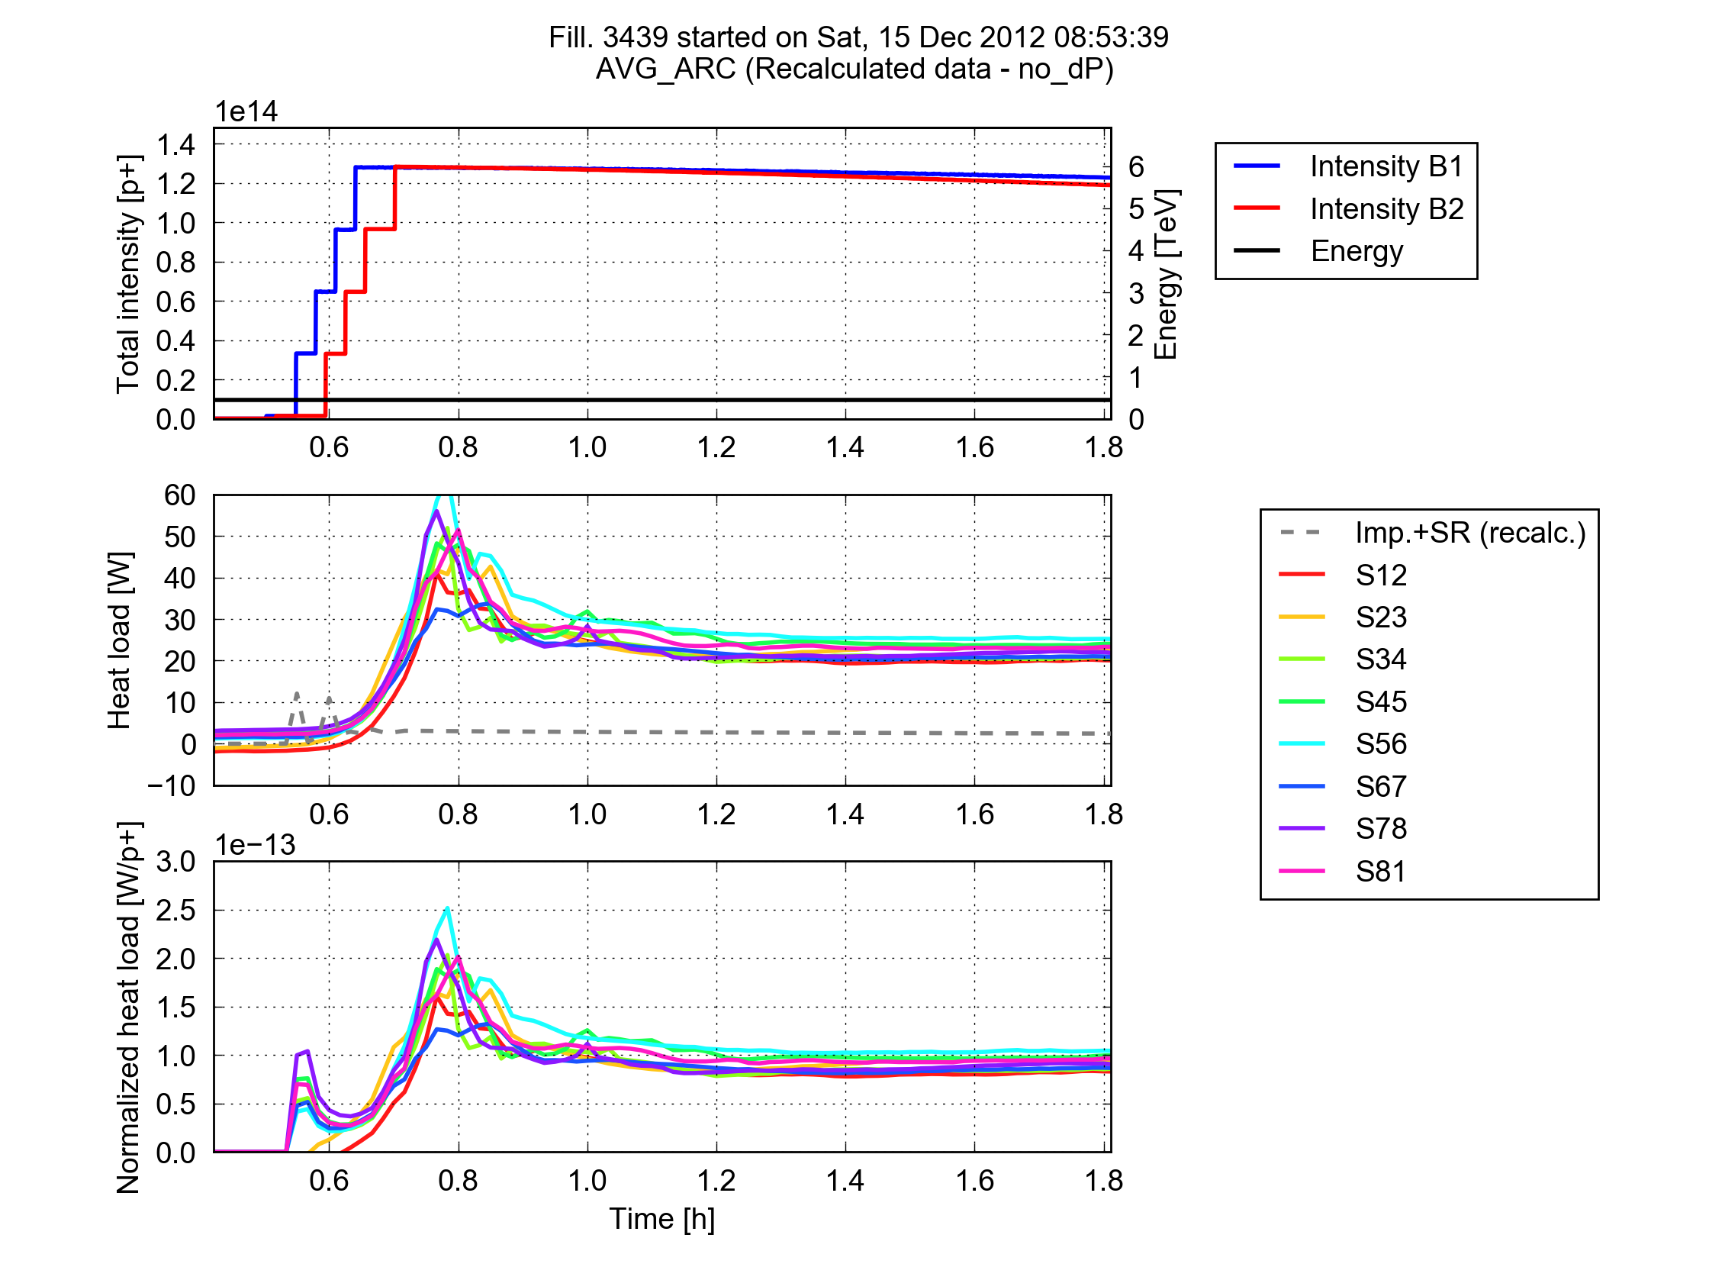
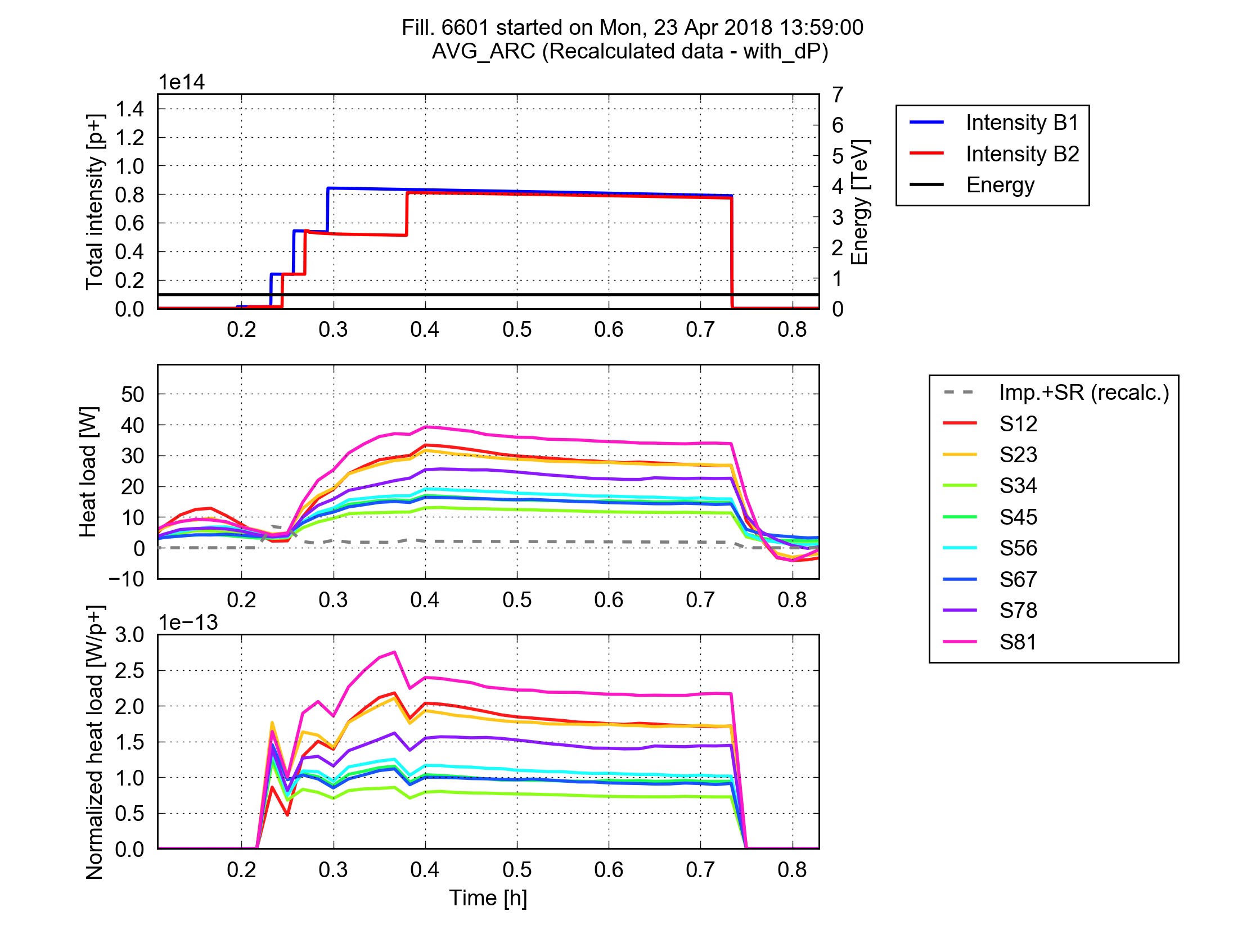
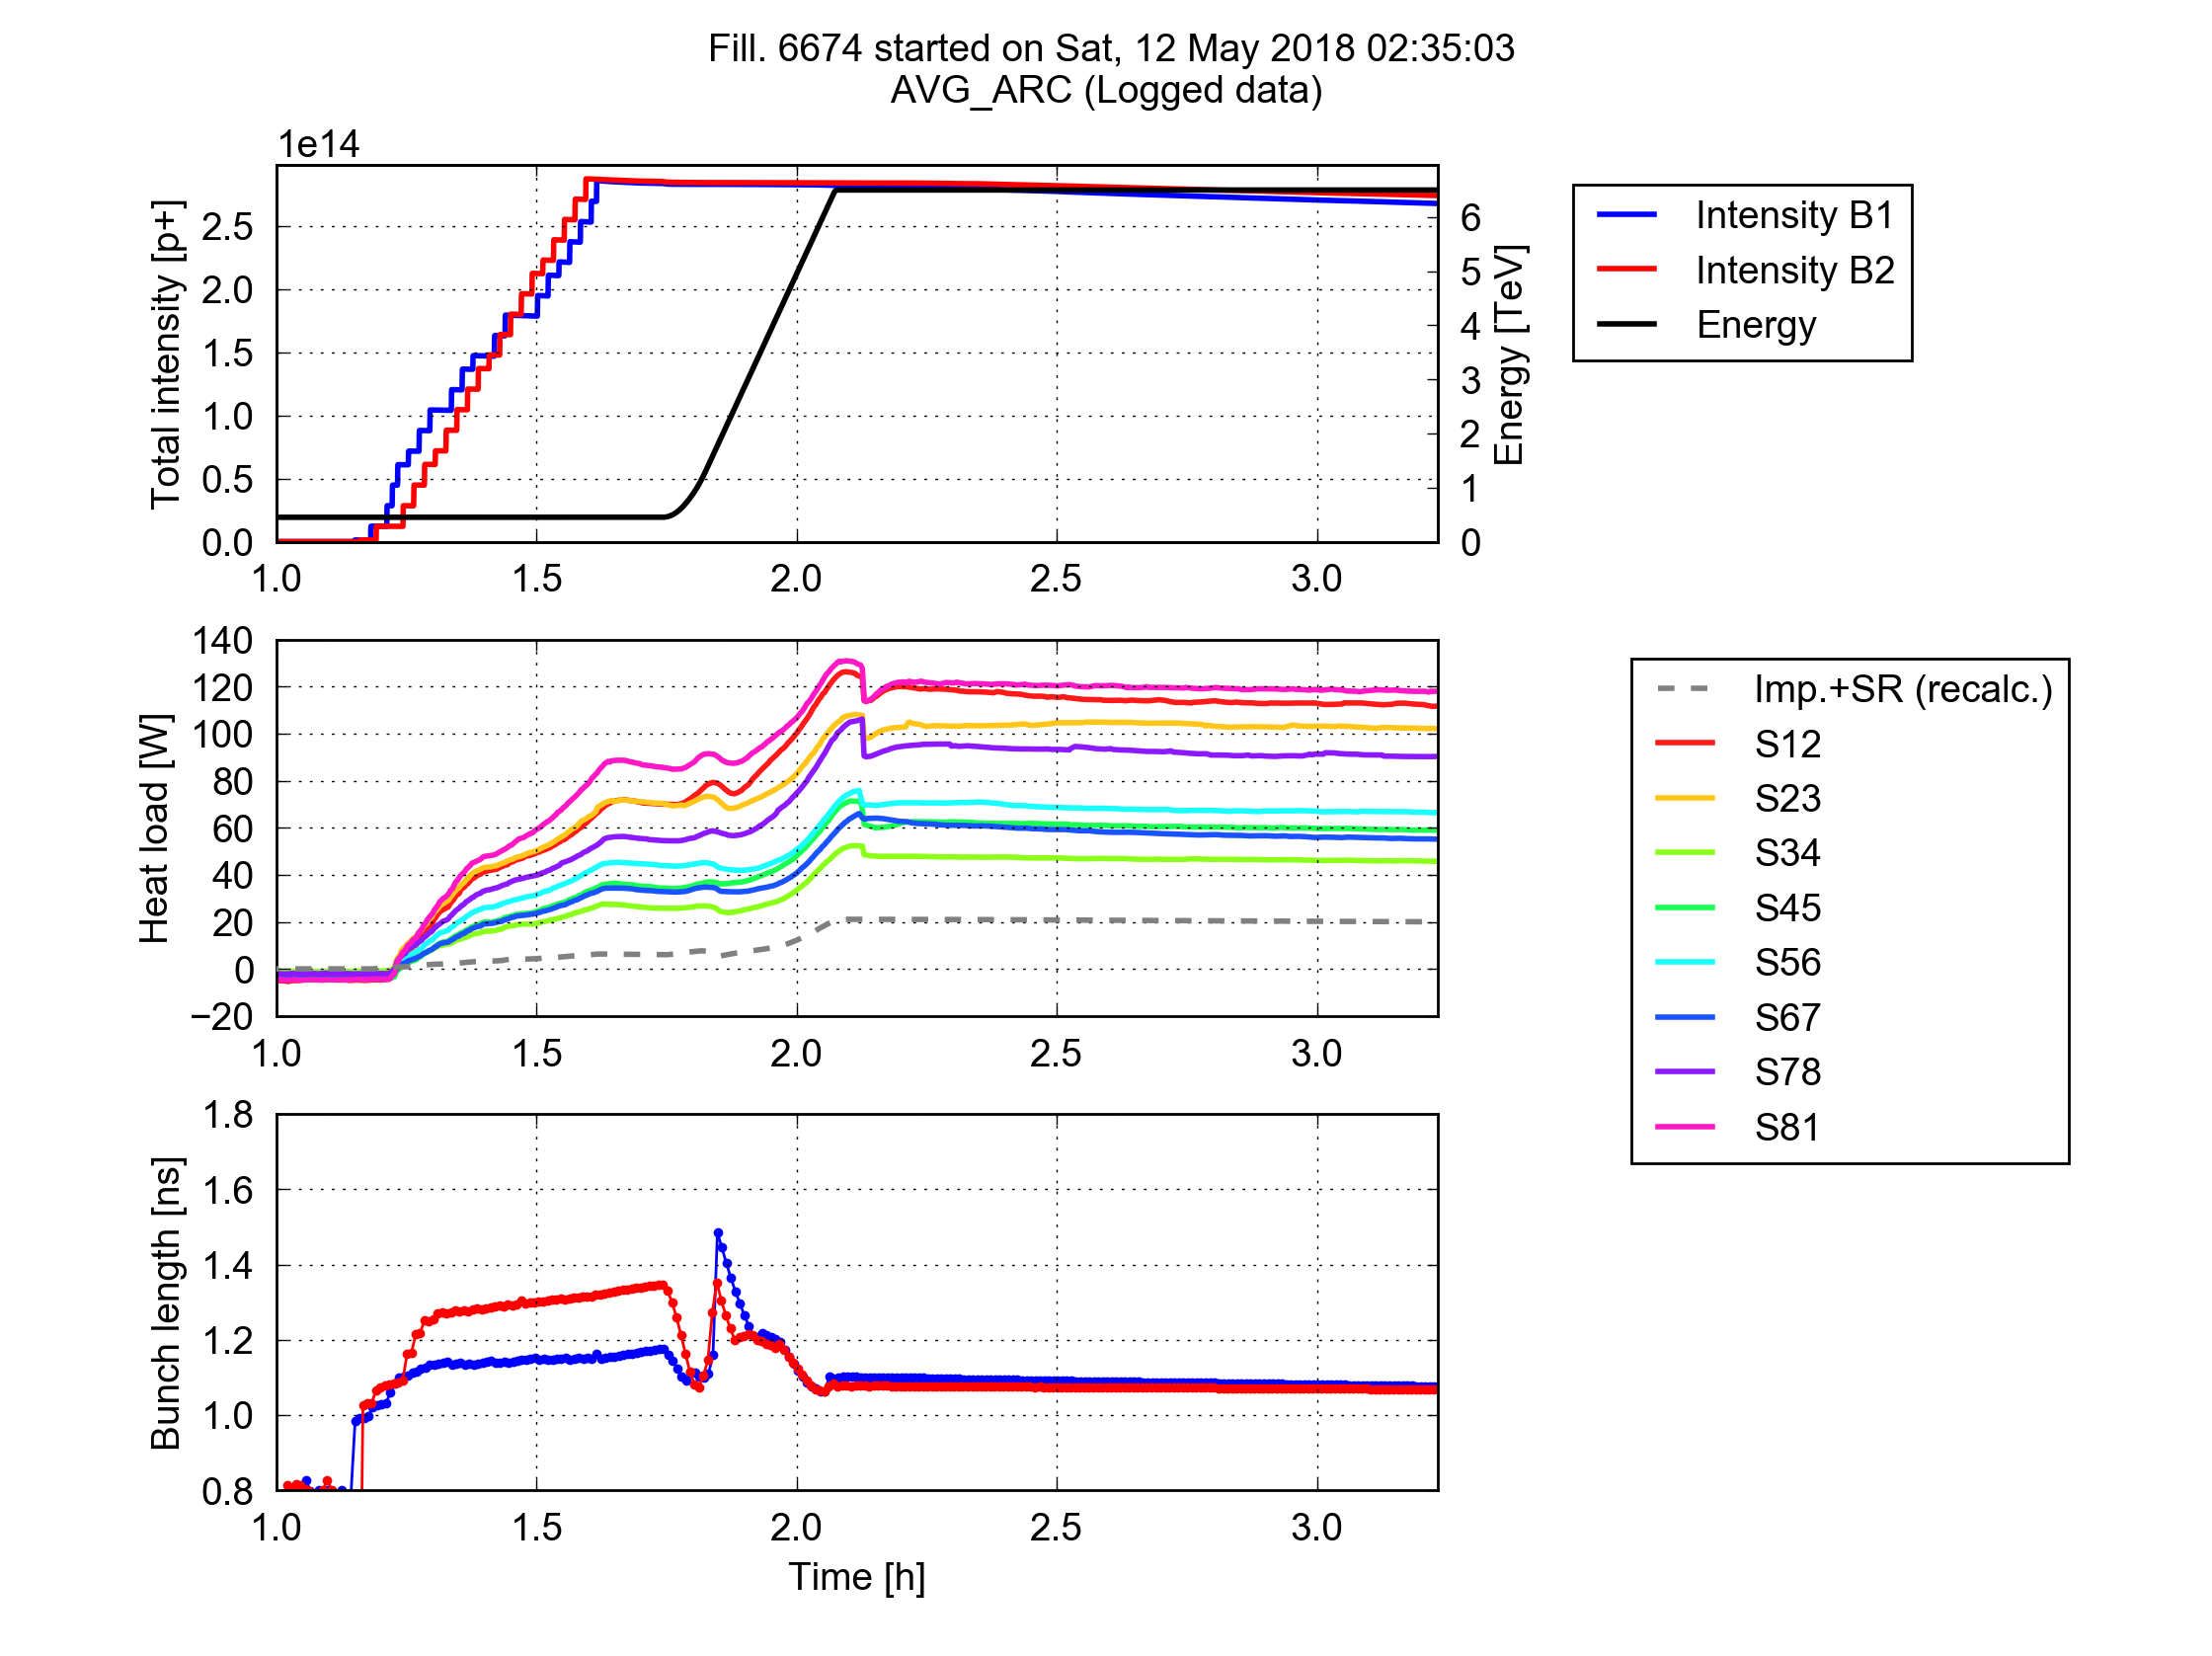

Electron cloud activity - Run 2
After Long Shutdown 1 a large increase in residual e-cloud activity was observed.
Conditioning saturated, e-cloud contributing to an excess in heat load for the cryogenic system.
Strongly sector dependent, in “bad” sectors the heat load is a factor ~2 higher than in good sectors.
Heat load by sector AFTER conditioning by e-cloud scrubbing
2012 (25 ns test, end of Run 1)
2018 (25 ns, during scrubbing)
SEY ~ 2
Trains of 288b
Trains of 288b
Conditioning (scrubbing with beam ~ e- bombardment)
Average per half cell
SEY ~ 1.1
Degradation
SEY = Secondary Emission Yield (of electrons)

Slide 22



Origin of high heat loads
Xray Electron Spectroscopy
Vacuum chamber samples were analysed to identify differences in surface properties between high and low load magnets.
High heat load sector are characterized by:
Large concentrations of CuO,
Low Carbon content.
Laboratory tests show much slower conditioning of the high heat load surface samples under e- bombardment.
More work to understand the surface alteration in progress at a new cryogenic laboratory.
In-situ treatments of the vacuum chamber during a future long shutdown are under evaluation.

Slide 23

From Run 3 electron cloud forecast…
Simulations forecast a mild increase in heat load between 1.2×10¹¹ and 1.8×10¹¹ ppb for a conditioned machine.
No performance limitations in Run 3 if:
  No further degradation of the high-load sectors.
  The surface model used in simulations is accurate enough.
If heat load limitations are encountered, mitigation measures have to be applied, typically by introducing empty bunches slots in the bunch trains.
Suppresses e-cloud growth along the bunch train.
At the cost of fewer bunches !
Forecast for conditioned machine, bad sector
e-cloud in dipoles
Impedance
e-cloud in quadrup.
Synch. rad.
e-cloud in drifts
Optimized configuration
Run 3 goal
10 kW/arc (~200 W/hcell)
7 TeV, 5 x 48 b
48 bunches
classical 48 bunch train
8 bunches
4 holes
8b4e bunch train – same length

Slide 24

… to e-cloud observations in 2022
Unfortunately the heat load of some sectors has degraded further.
The worst sector is no longer sector 81, but sector 78.
LHC is currently operating at the cryogenic cooling limit of the vacuum chamber.
Conditioning seems to be saturating, or to be very slow – more run time required for conformation.
Cooling capacity limit

Slide 25
The way forward
Options to push the beam intensity towards the Run 3 target:
Operate with 8b4e bunch trains only which limits the number of bunches to ~1900 (compared to 2750 bunches forecast for Run 3).
  Secondary benefit: the electricity consumption of the cryogenic system can be lowered by ~20% - this may become important with rising electricity prices.
Mix 8b4e trains with classical trains in the filling scheme and operate at the cooling limit.
  The exact number of bunches will depend on the bunch intensity.
Work-around’s are under discussion to push the beam intensity further in a few weeks.
Nota-bene: 8b4e beams have not yet been prepared in the injector chain.

Slide 26



Run 3 - UFOs
(Charged) dust particles falling into the beam – nicknamed UFOs – were expected to become more critical at 6.8 TeV: showers are more energetic and quench thresholds are reduced.
Reduction of the margins by ~30% wrt 6.5 TeV.
UFO events can trigger beam dumps when the interaction rates are to high (to high losses).
The UFO rates condition during runs, but a rate reset was observed after long shutdown 1.
Vacuum chamber
reset

Slide 27

UFOs in 2022
This year we have observed a similar “reset”, with UFOs predominantly originating in regions where magnets were exchanged during the shutdown.
The rate drops rapidly, but UFOs already triggered 23 beam dumps.
Important impact on availability this year, but the worst should be over by the end of 2022 !

Slide 28
Summary
The LHC injector chain is in excellent shape, good progress with the high intensity LHC beams for Run 3.
The LHC commissioning followed the planning, Run 3 started on July 5th.
Intensity and luminosity followed a steep curve despite the fight against UFOs and electron cloud.
The complex luminosity levelling mix of Run 3 (and HL-LHC) was implemented in a record time – now fully operational.
The beam intensity is currently limited by electron cloud, work-around’s are under discussion, in particular bunch trains with holes (8b4e).

