Slide 1




Axion Phenomenology: from String Theory to the Lab
David J. E. Marsh,
Gravitational Probes of the Early Universe, KCL 2025

Slide 2
Gravitation and the Early Universe
String theory: amazing playground for differential geometry.
Opportunity to probe quantum gravity: compactifications are falsifiable using axions.
“Axion stars”: novel GW signals and multimessenger.
String axion models prefer low temperature reheating and low scale inflation.
“Haloscopes” are also high frequency GW detectors.
Axion quasiparticles as analogue simulators.

Slide 3
QCD axion searches
QCD axion
“Post-inflation”: miniclusters
QCD axion in string theory
String Axiverse
Heavy axions:
Decays, overproduction, constraints on cosmology
Ultralight axions:
structure formation
Axions in string theory
Hubble scale
~ (size of Universe)⁻¹
Planck scale (quantum gravity)

Slide 4
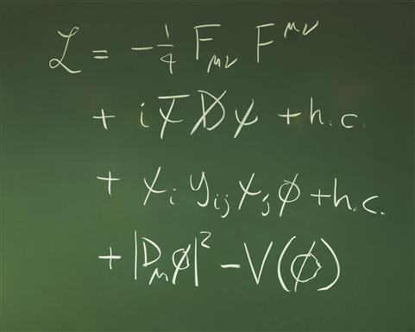
Axions
101

Slide 5
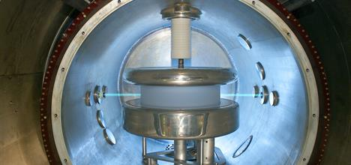
Axion Theories
Neutron observed to have EDM ~0. This can be explained by the QCD axion.
Extra dims. of string theory wrapped by gauge fields → axion-like particles.
Number of axions given by topological invariants.
Masses spread over log scale: “the string axiverse”.
One parameter DM model valid since 1980’s.
High scale SSB → low mass particle.

Slide 6
Axion Relic Density
Relic density from solving the Klein-Gordon equation for a massive scalar field:
Damped SHM with time dependent “friction”. Oscillates and decays when H<m.
H~1/t → ρ ~ a⁻³. Harmonically oscillating scalar behaves like pressureless dust.

Slide 7
Axion Dark Matter
Axions can be modeled as an oscillating classical field:
From galactic rotation curve
Local DM density: harmonic oscillator:
Axions interact with electromagnetism via:
=0.3-0.4 GeV cm⁻³

Slide 8

String theory progress
Specifically, type IIB on CY3’s.
Demirtas, Rios-Tascon, McAllister

Slide 9
10D SUGRA has p-form fluxes. Consider IIB 4-form, C₄:
V from “triple intersections” = topological
SUSY → τ = Kähler modulus.
Eigenvalues of K give kinetic term → “decay constant”. Parametrically:
Decompose field into harmonic forms:
Basis of harmonic forms given by closed 4-cycles (divisors) in X:
Axion potential generated by ED3 instantons wrapping D:
# basis elements given by h11 Hodge number = topological
Q = instanton charge = topological
Compactify → massless fields in 4D:
→ massive “closed string” axions from gravity sector unavoidable.

Slide 10
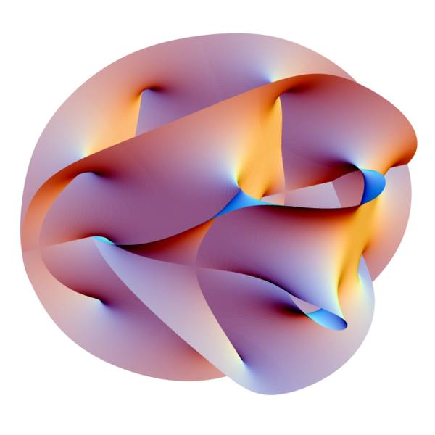
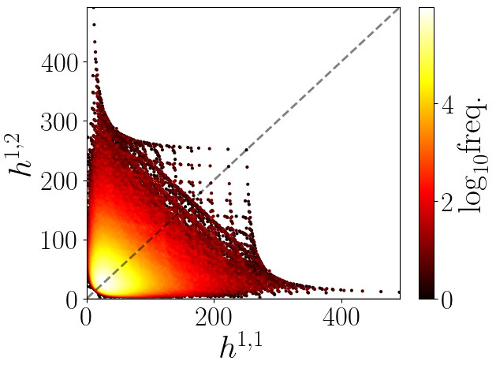
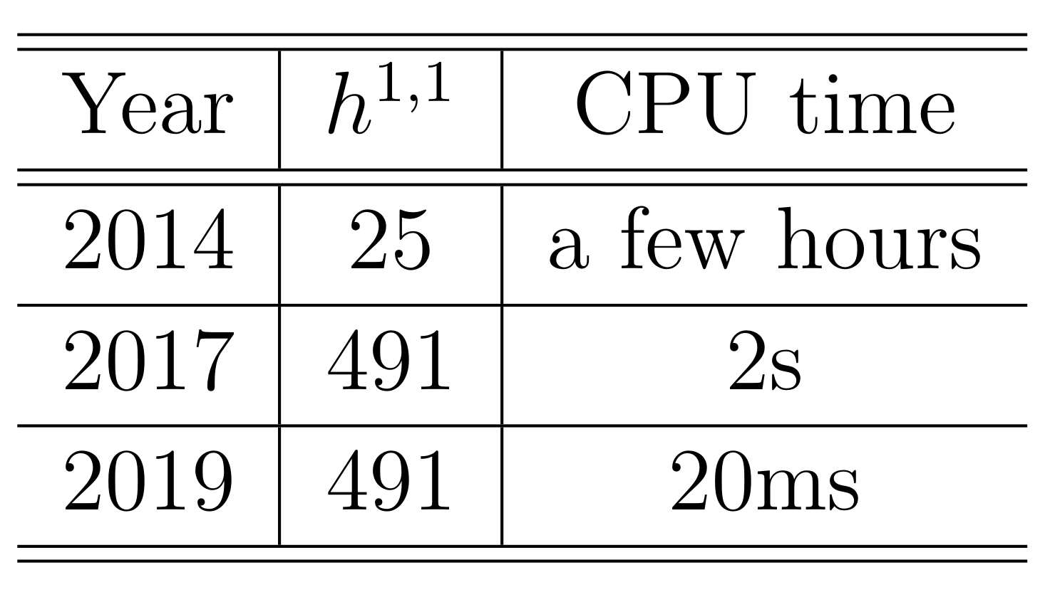
Calabi-Yau Manifolds
h11=27: most polytopes
h11=491: most CYs <10⁴²⁸
Fermat quintic. Section of polynomial in CP4.
→ A hypersurface in a “toric variety”.
Fast and automated with CYTools.
Batyrev: toric varieties from “polytopes”.
Kreuzer & Skarke: all 4x10⁸ polytopes.

Slide 11
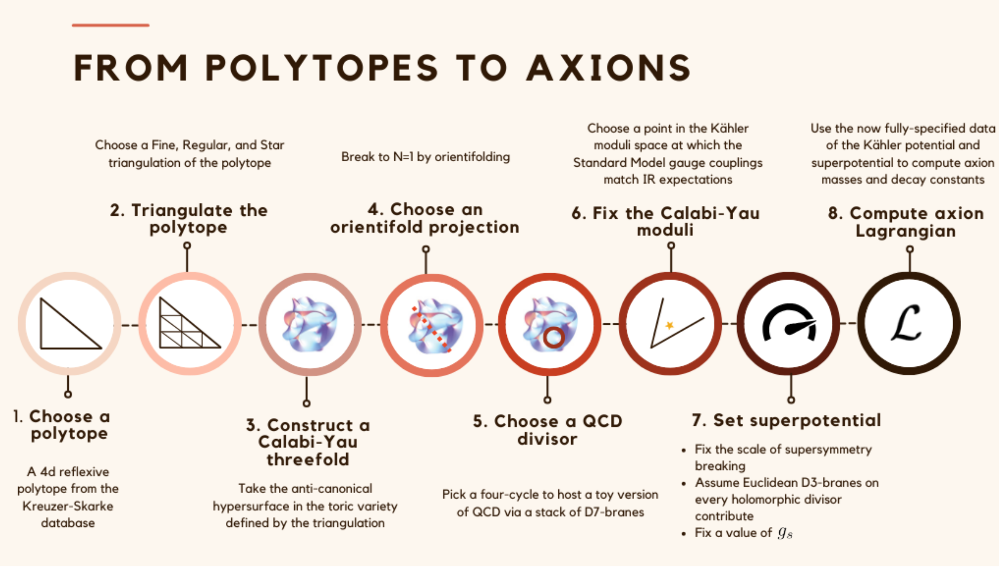
Sheridan, DJEM et al (2024)

Slide 12
Axion Spectra from KS
Mehta, DJEM et al (2021)
superradiance bands
Not shown: ~70% of m<H₀ masses..
Find vacua of V in fundamental domain. Expand to quartic order → masses +couplings (“f_{pert}” decay constant).
Hodge Number h11
Mass spectrum “blue tilted”.
Decay constants log-normal, becoming smaller at large h11.

Slide 13
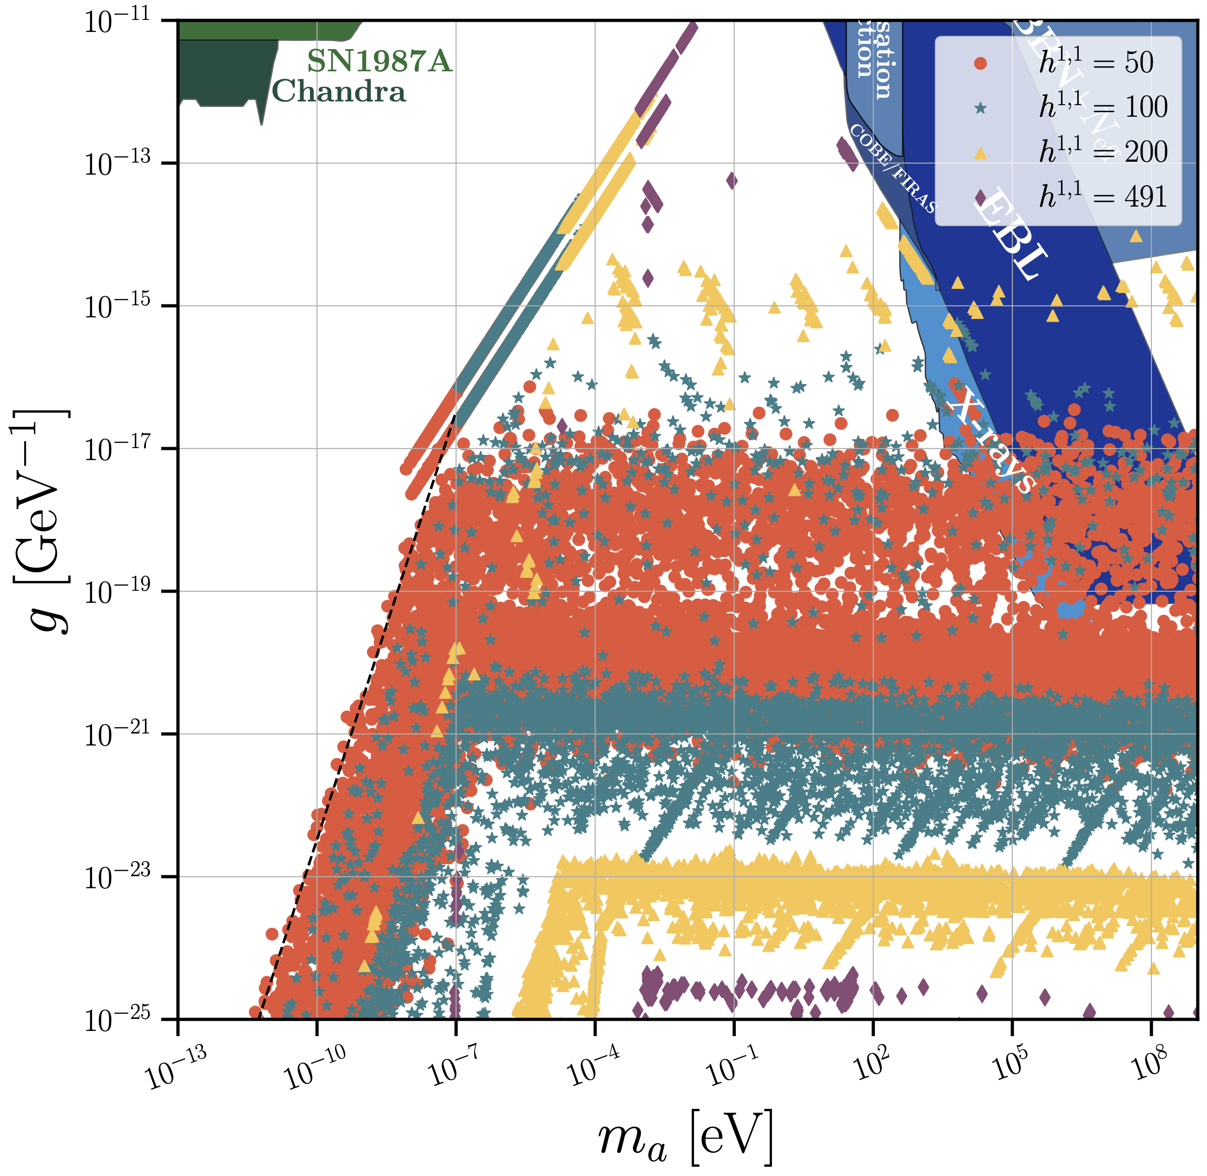
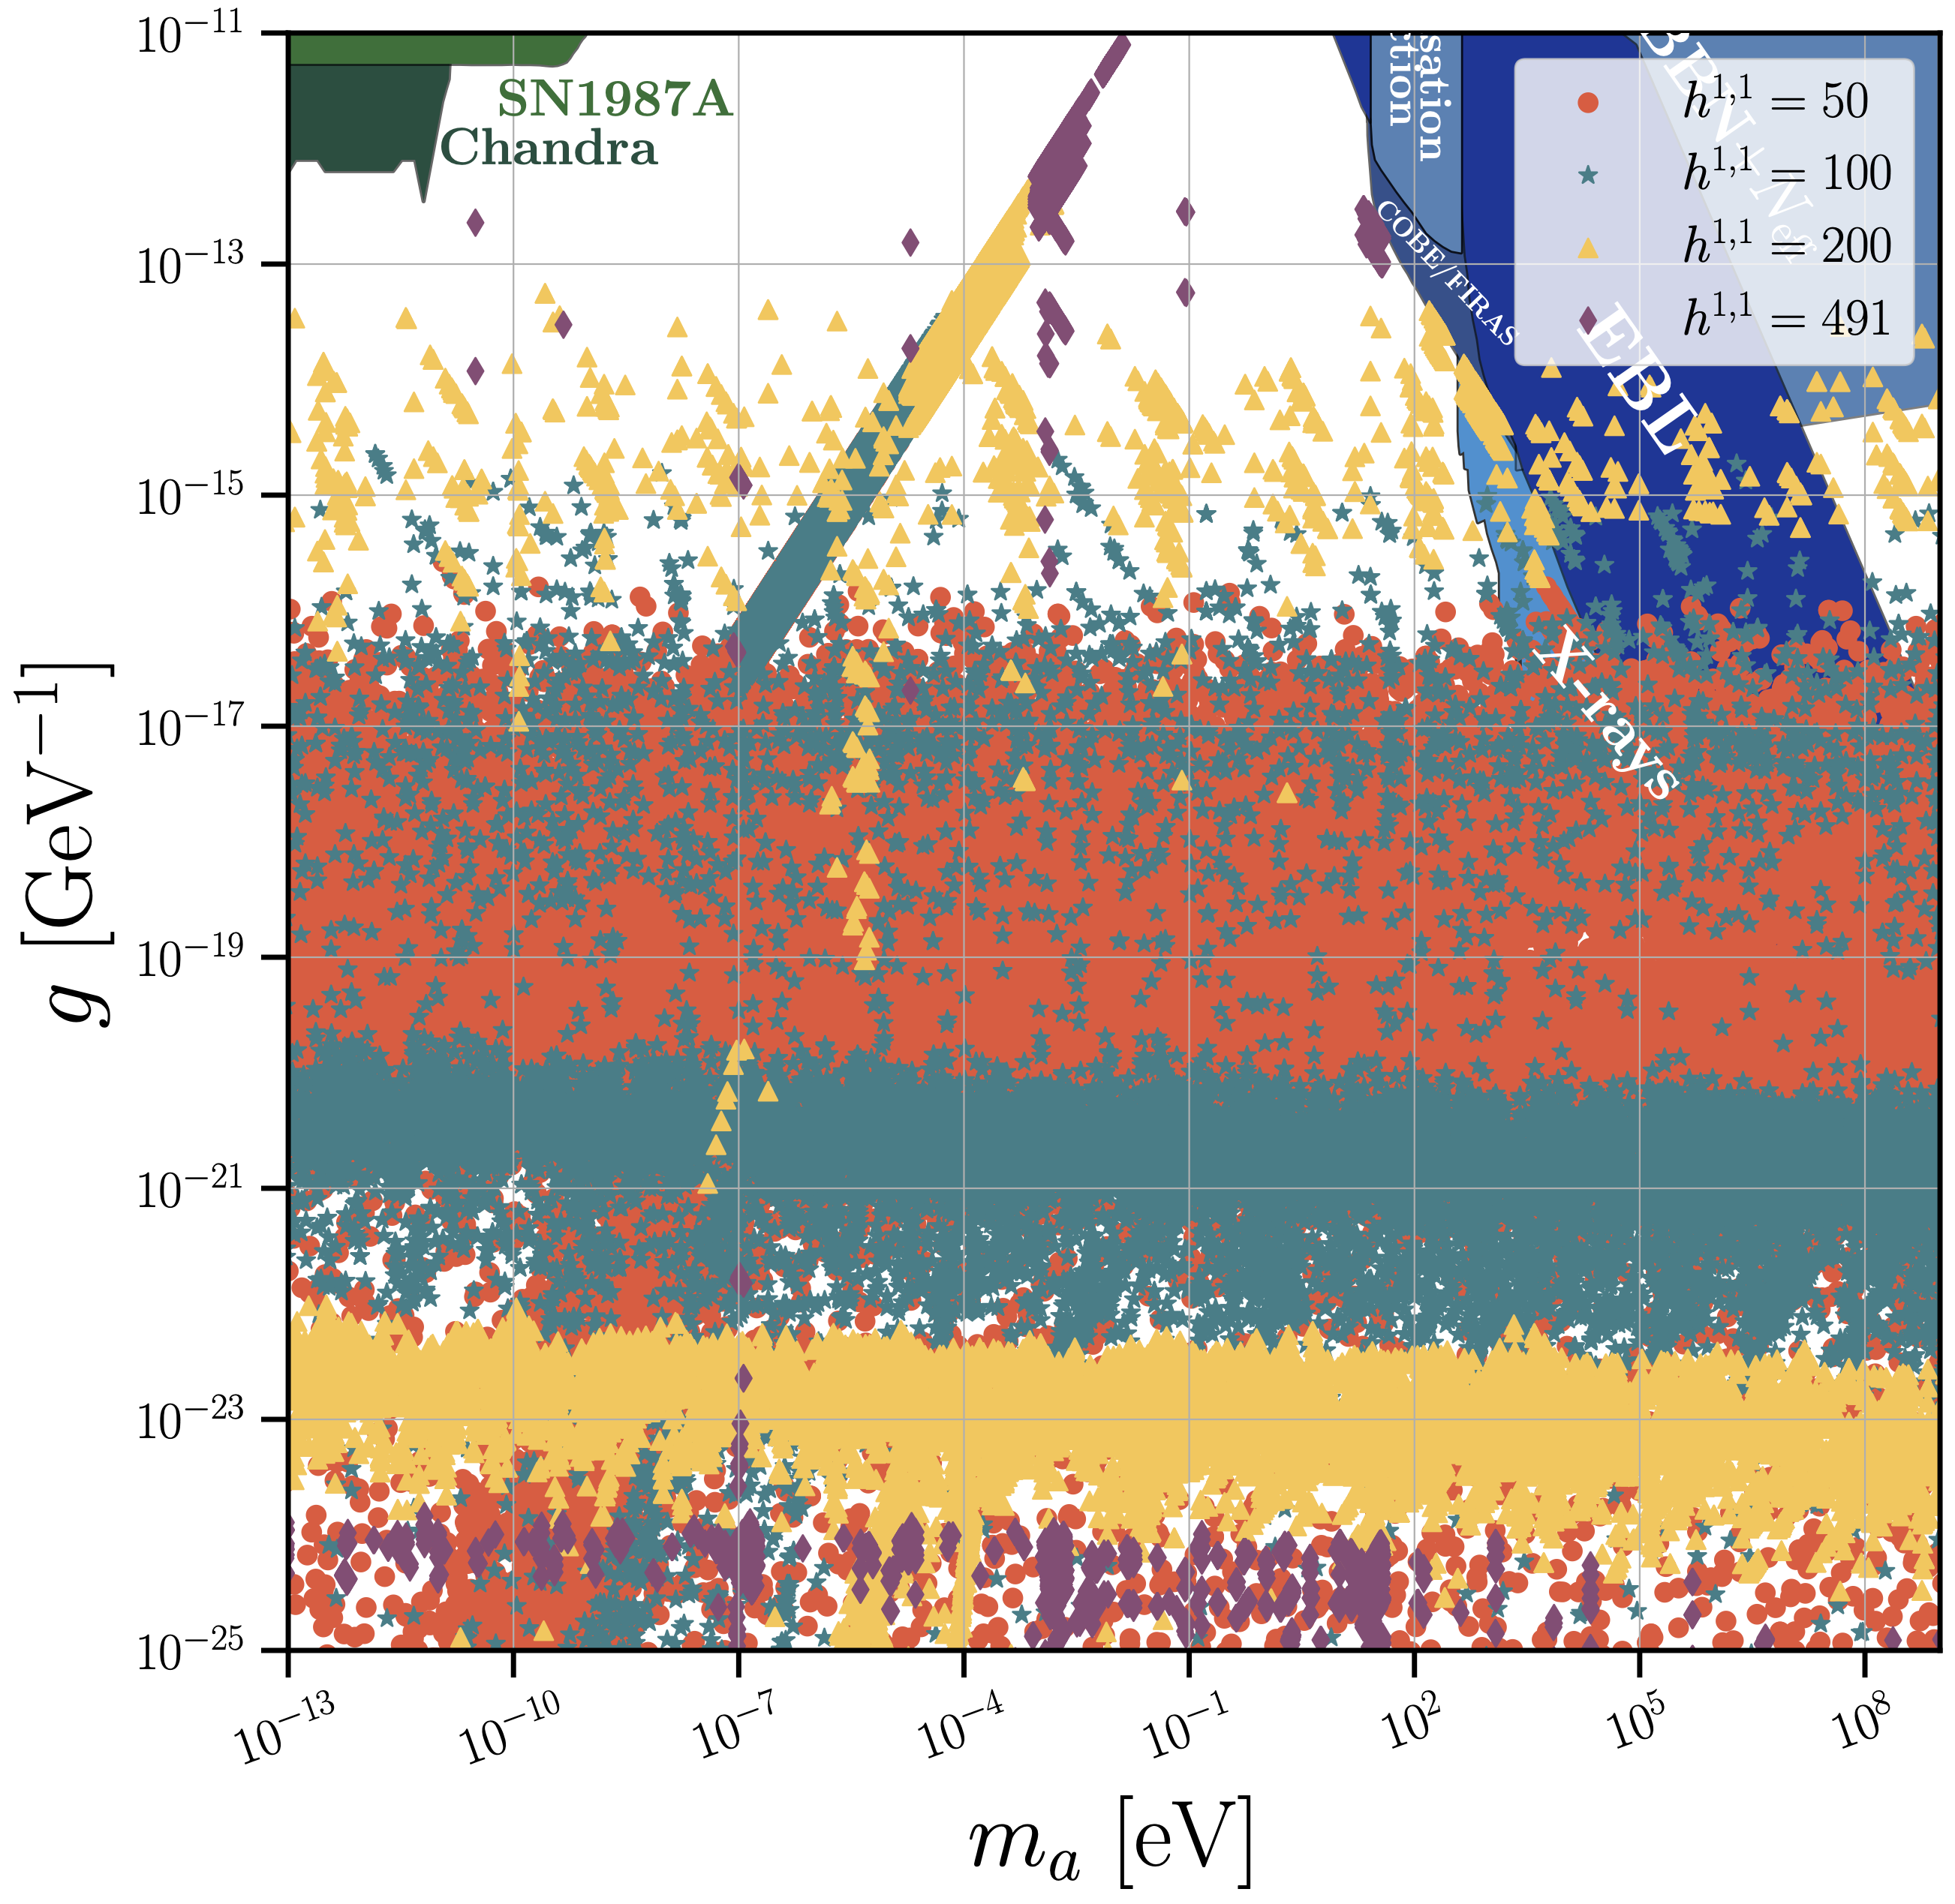
Axion-Photon Couplings
Gendler, DJEM et al (2023)
Not all axions couple to photons, but some do. Max coupling increases with h11.
GUT: QCD axion sets the “light threshold”. No axions above the QCD line.
Non-GUTs: (almost) anything goes, for a subset of axions.

Slide 14
Ultralight axions: fuzzy dark matter

Slide 15
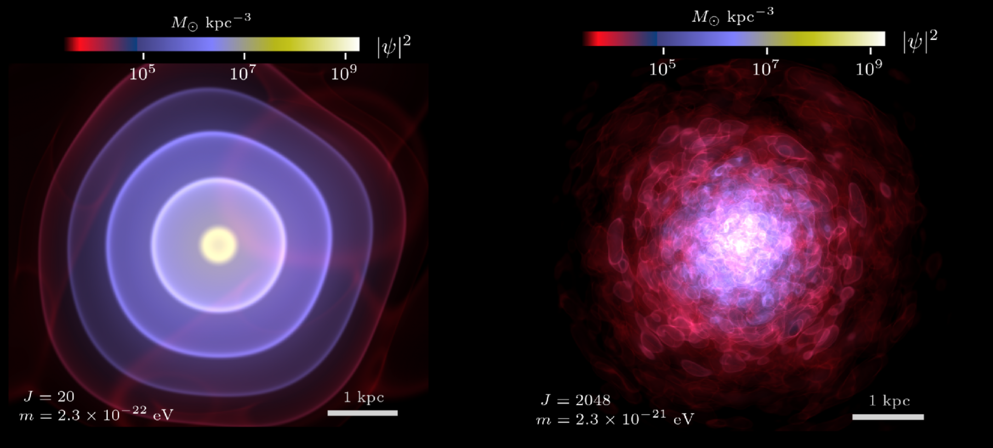
DM lower limit: 2.10⁻²¹ eV
Zimmermann, DJEM et al (PRL)
Folk wisdom: de Broglie wavelength must be smaller than dwarf galaxy radius.
“Bosonic Tremaine-Gunn bound”. Extremely difficult to compute precisely.
Leo-II is cuspy. Waves give cores. Compare self-consistent wavefunction to model-independent reconstruction of density + rigorous stats → strong limit.

Slide 16
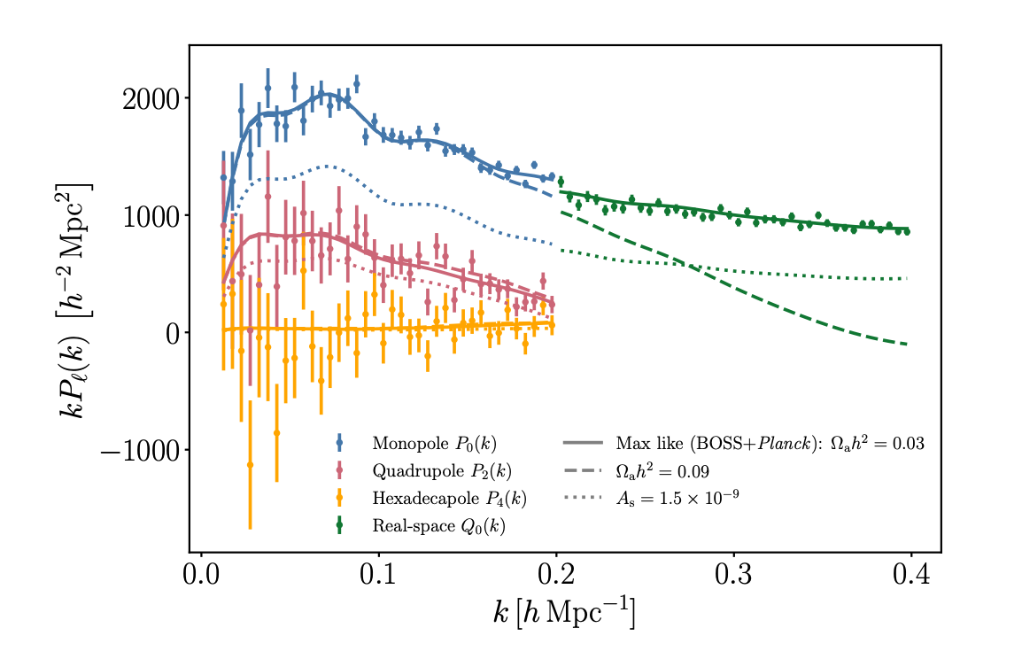
Structure Formation
Fig: Rogers, DJEM et al (2023)
Wave effects suppress clustering in the galaxy power spectrum.
Galaxy clustering
Wavenumber, k [h Mpc⁻¹]
Advances in quasi- and non-linear modelling (halo model, EFTofLSS, emulators) allow precision limits from many scales → probe many masses and sub fractions of DM.

Slide 17
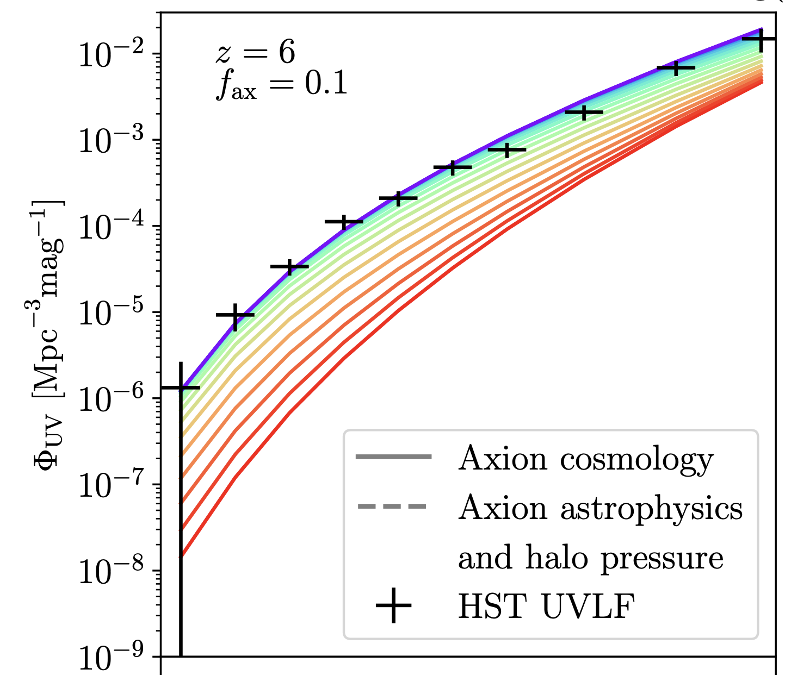
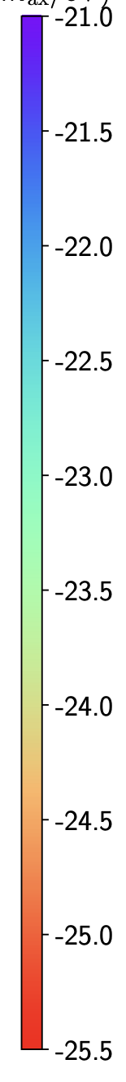
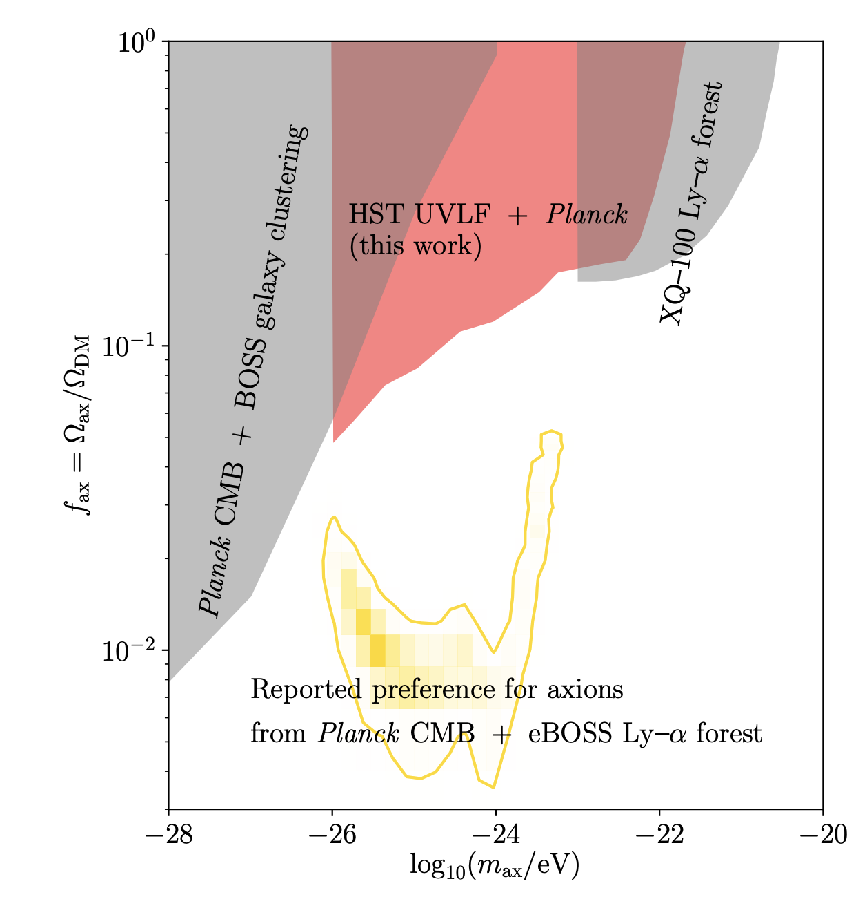
High-z Galaxies
DJEM & Silk (2013);
Winch DJEM et al (2024)
Suppressed DM clustering → fewer galaxies at high-z.
Reshift z=6
10% axion DM
log₁₀ (m/eV)
Dark matter fraction
Luminosity function from P(k) + halo model
Magnitude
Bright
Faint
Axion mass

Slide 18
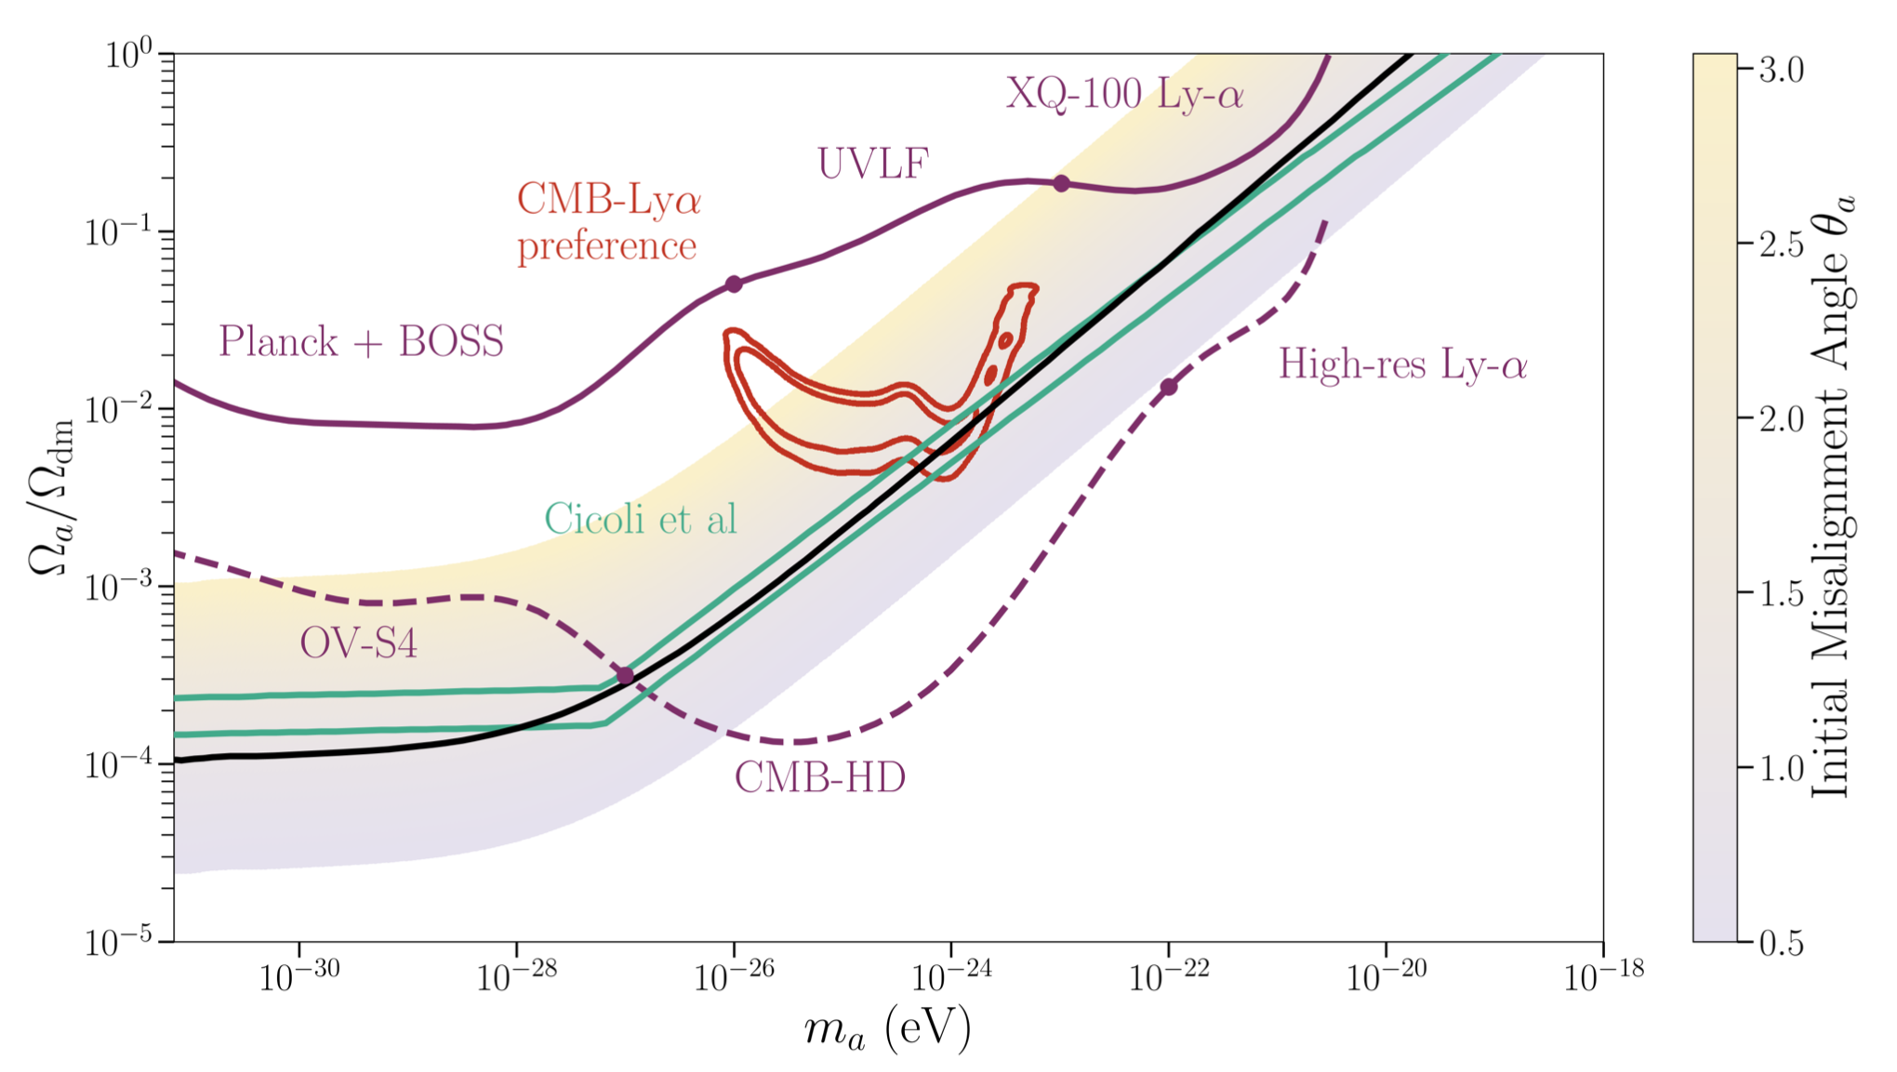
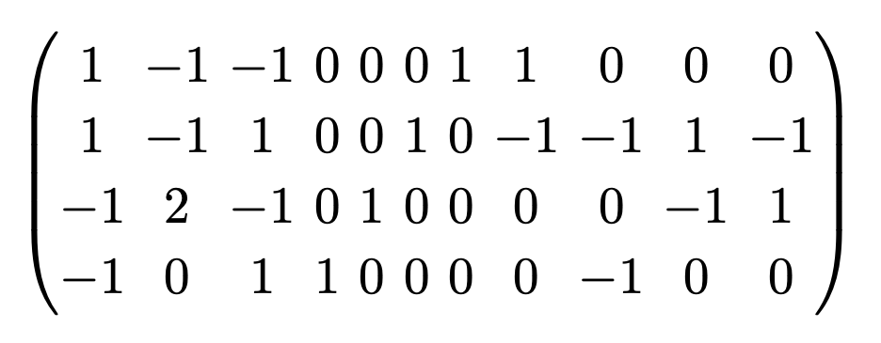
An explicit “fuzzy” axion
Sheridan, DJEM et al (2024)
Triangulate this polytope:
→ 7 axions. Mass 10¹⁴ GeV to 10⁻²⁰ eV with f~10¹⁶ GeV.
Vary the Calabi-Yau volume→ vary the axion mass.
DM density set by angle θi.
Large ensemble of ~10⁶ similar models constructed.
Solid: limits
Dashed: forecasts
Axion P(k) suppression can explain Ly-α amplitude tension with CMB. Testable with more data!

Slide 19
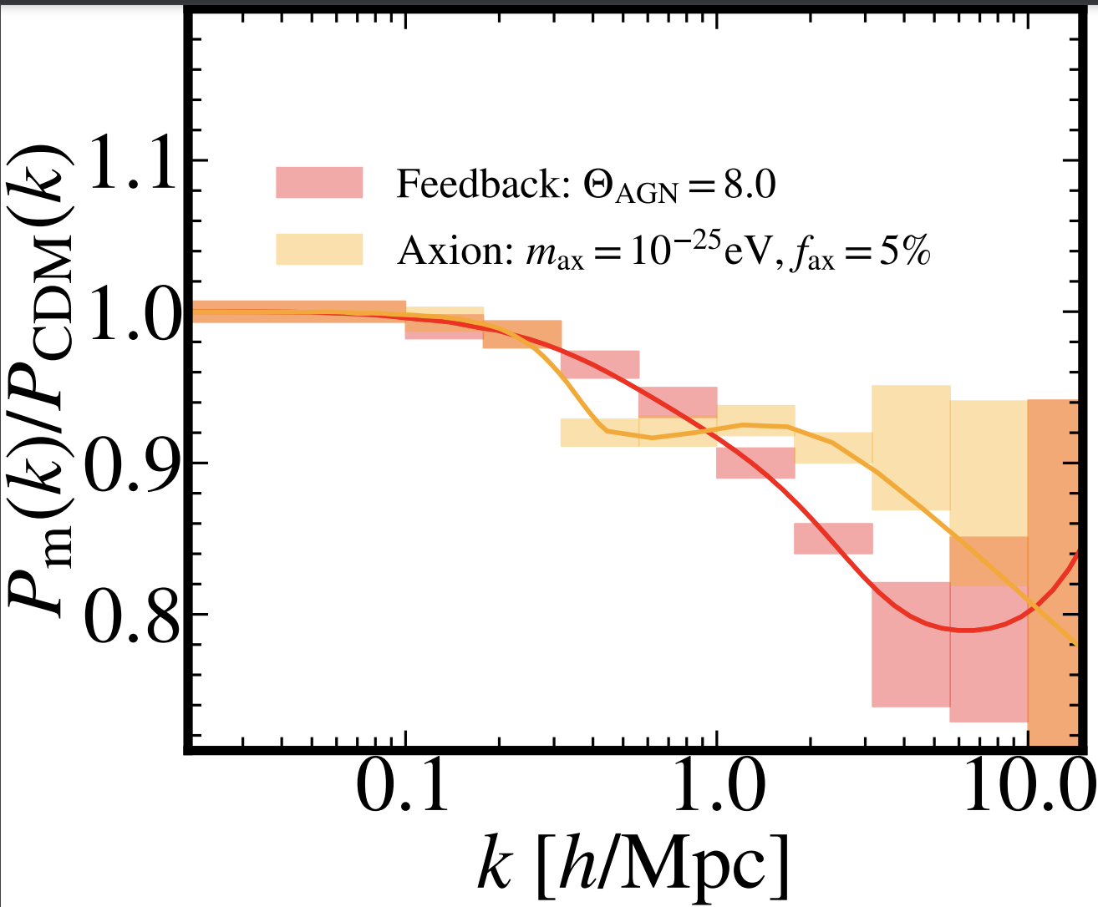
Modeling of ULA effects on structure is good, but it needs to be better…
Lägue, DJEM et al (2024),
see also Dome, DJEM et al (2024)
Preston, Rogers, Amon & Efstathiou (2025)

Slide 20
Axion stars

Slide 21
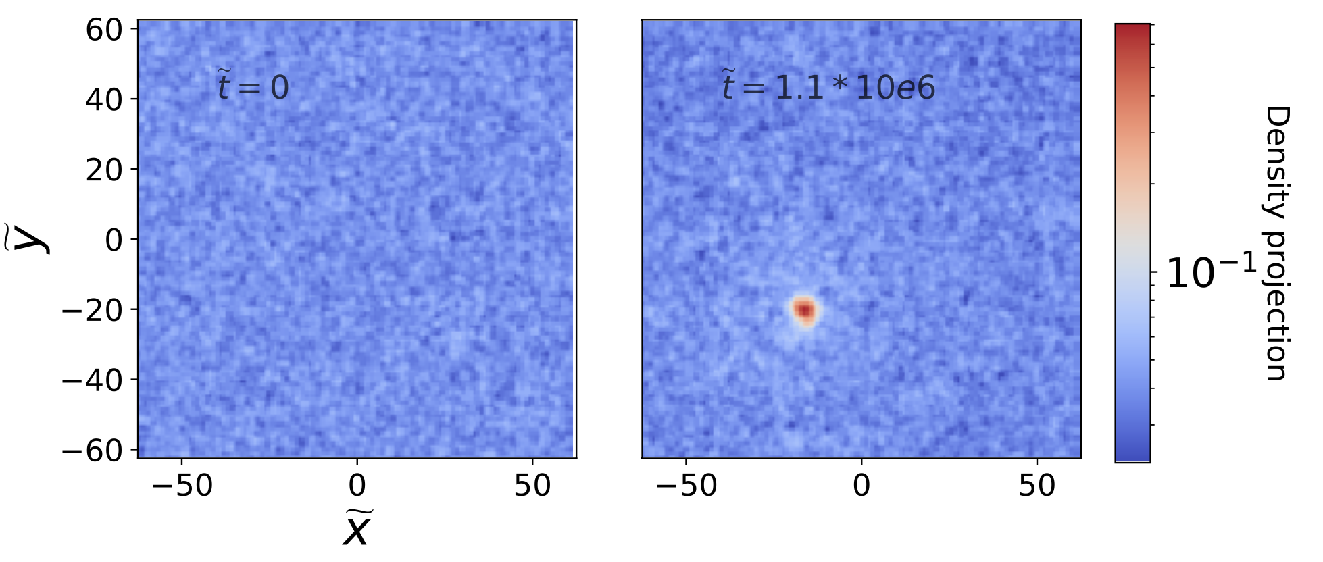
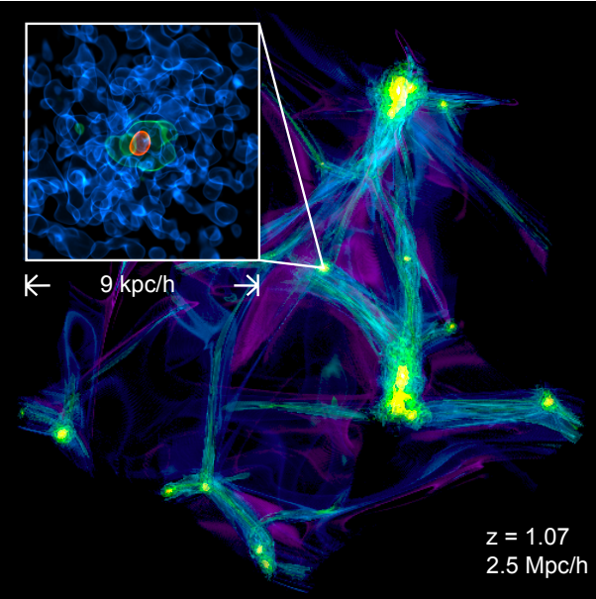
Soliton Formation
Schive et al (2014); Levkov et al (2018); Chen, DJEM et al (2020); Veltmaat et al (2018)
Soliton cores of DM halos form during “violent relaxation” from initial coherence.
Second formation mechanism: gravitational BEC in “kinetic regime”.
Gravitationally stable box: condensation and growth from scattering theory.
Cosmological box: halos and cores from hierarchical structure formation.

Slide 22
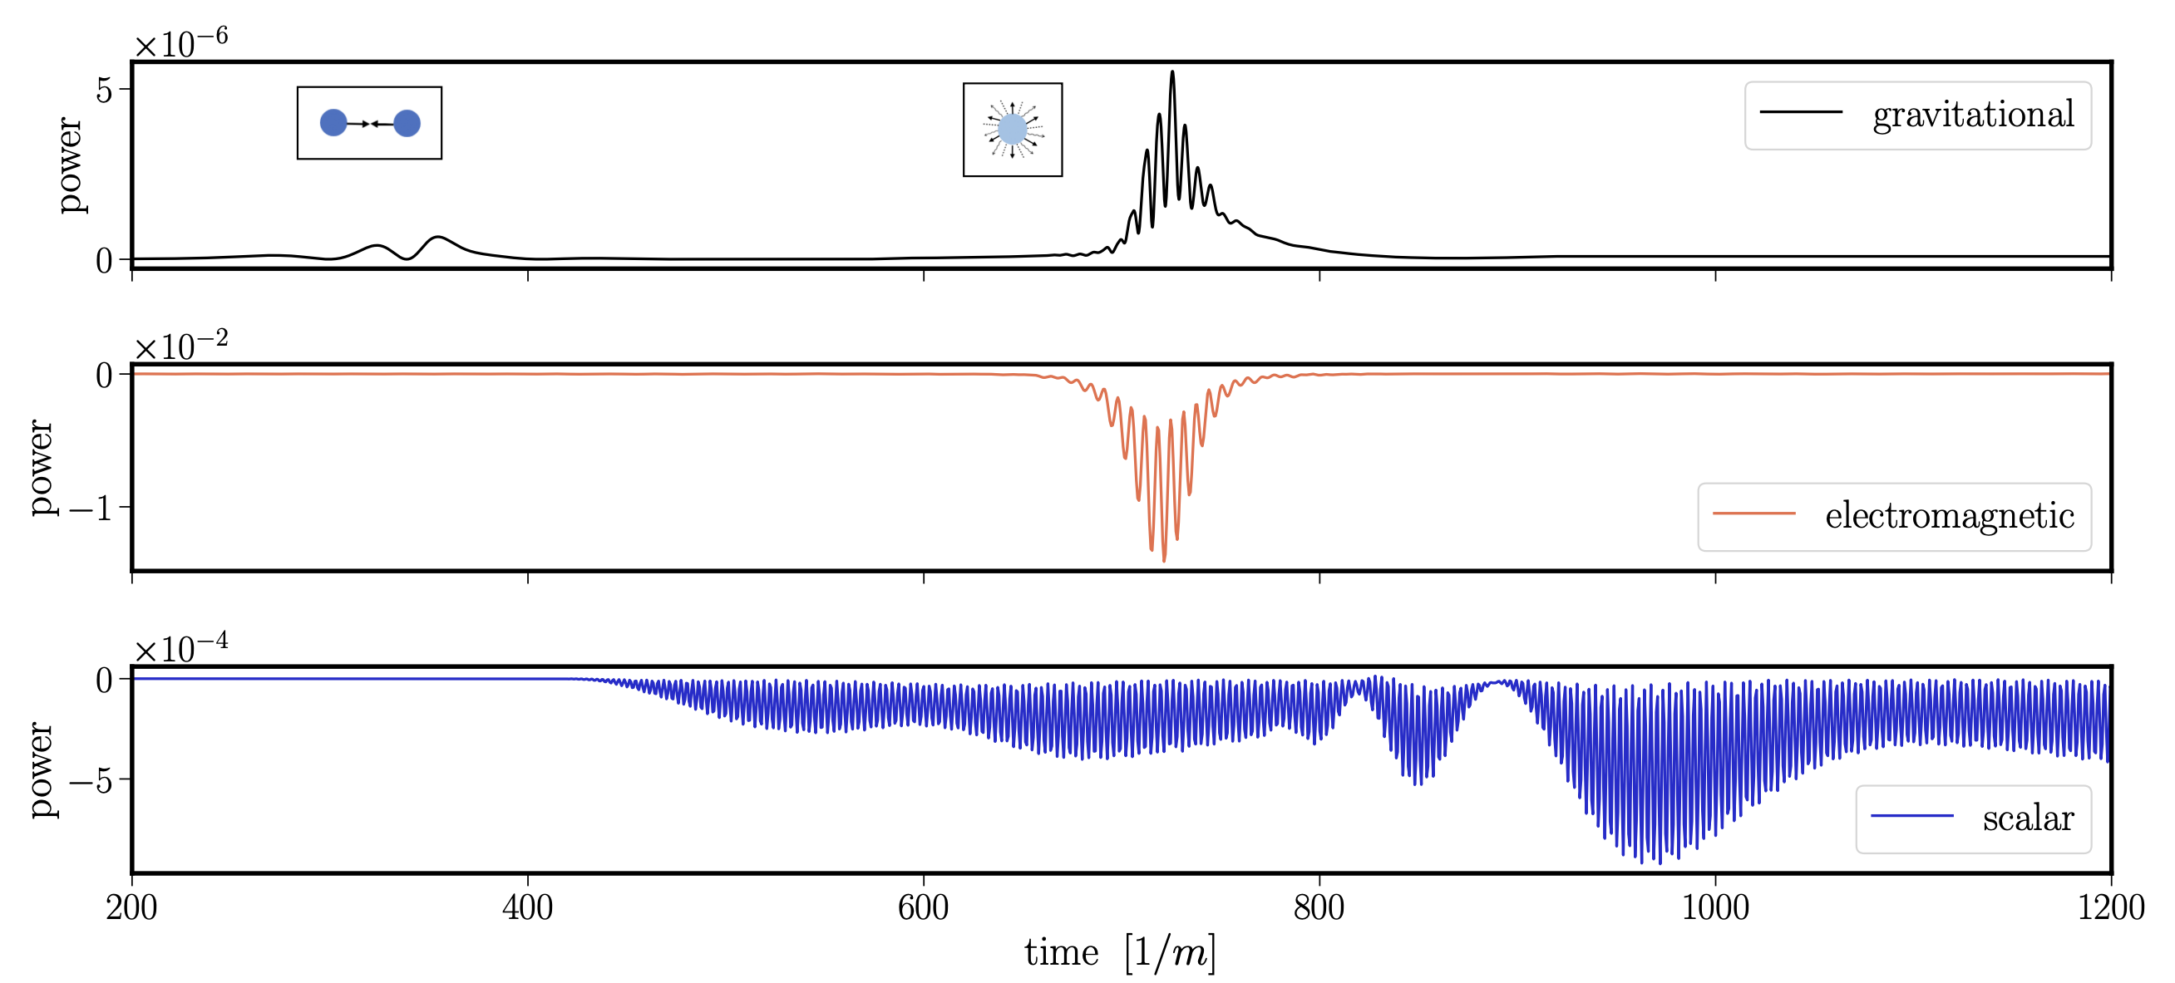
Axion Star Explosions
Simulate in (3+1) GR with GRChombo.
Chung-Jukko, DJEM+(2023,2024)
Solitons above a critical mass will explode to axions + photons + GWs.
GW burst v. distinct from merger+ringdown. In LIGO window for m~10⁻¹¹ eV
Caveat: formation mechanism for compact objects is exotic (a la PBHs).

Slide 23
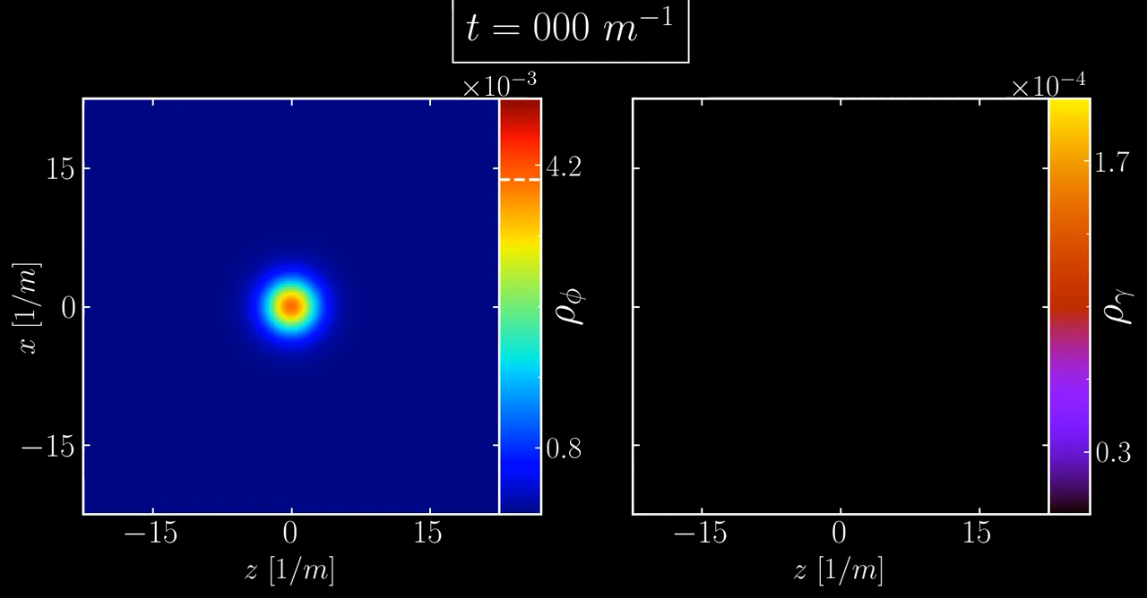

Slide 24
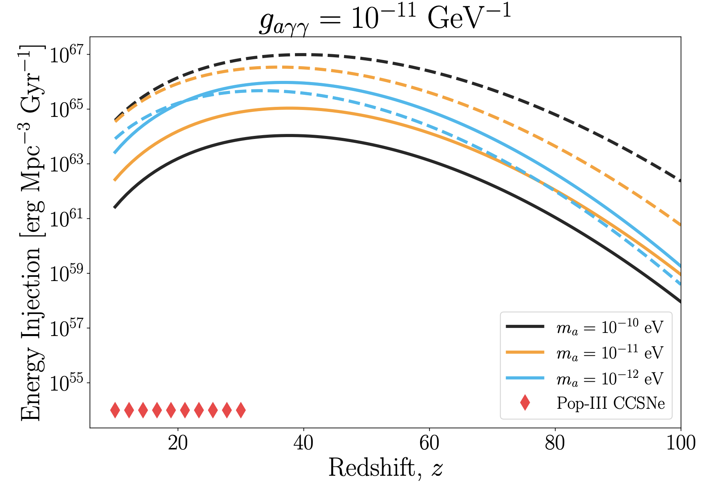
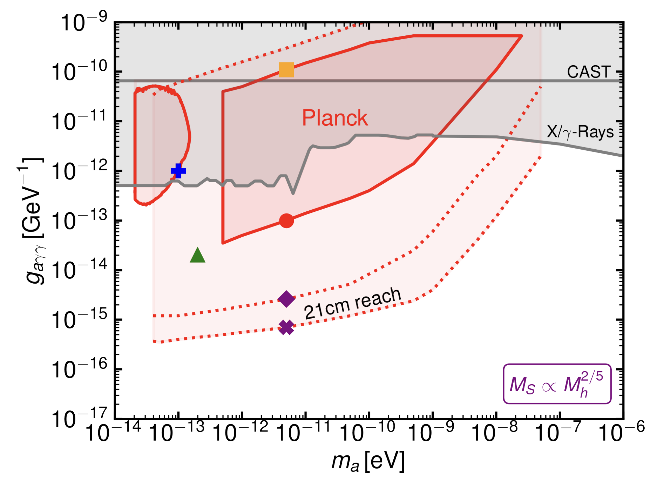
Axion Star Explosions 2
Du, DJEM et al (2023)
Escudero, DJEM et al (2023)
Merger rate from halo model → photons heat IGM → change CMB optical depth.
Future opportunity for 21cm. This model: suppressed quartics. Other models?
Di et al (2024)

Slide 25
Heavy axions

Slide 26
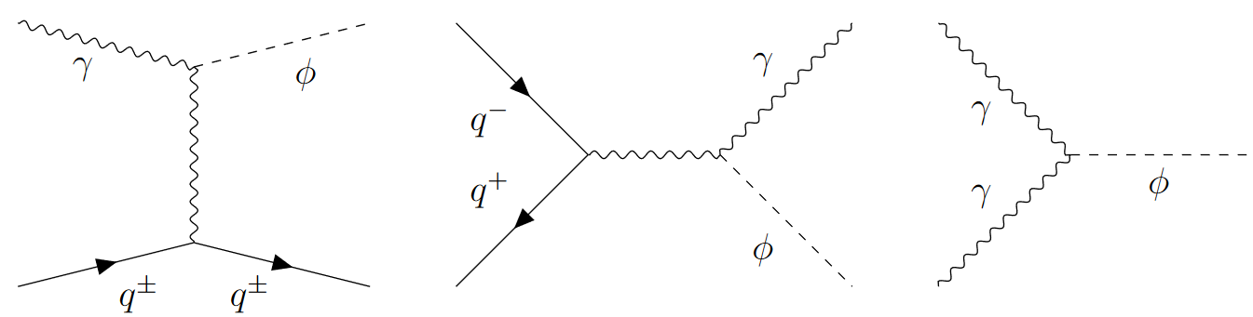
Heavy Axions Overproduce DM
Misalignment: anything much heavier than QCD axion → way too much DM. Free parameter → Fine tuning penalty?
Freeze-in: production from SM plasma via g. Same coupling → decaying DM.
Fractional Abundance
Jain, DJEM et al (2024)
Abundance depends on reheat temperature: disfavour high T?

Slide 27
Constraining the Early Universe
Need to get rid of these problematic axions.
Use modified reheating epoch (w<0) and lower temperature TR<<GUT.
Isocurvature constraints also favour low-scale inflation H<10¹⁰ GeV.
The “cosmological moduli problem”:
Moduli axion partners → matter dom. epoch, followed by low temp reheating.
Getting BBN correct → m_{SUSY} > 100 TeV.
If axions → max allowed TR, does this give an upper limit on the SUSY scale?

Slide 28
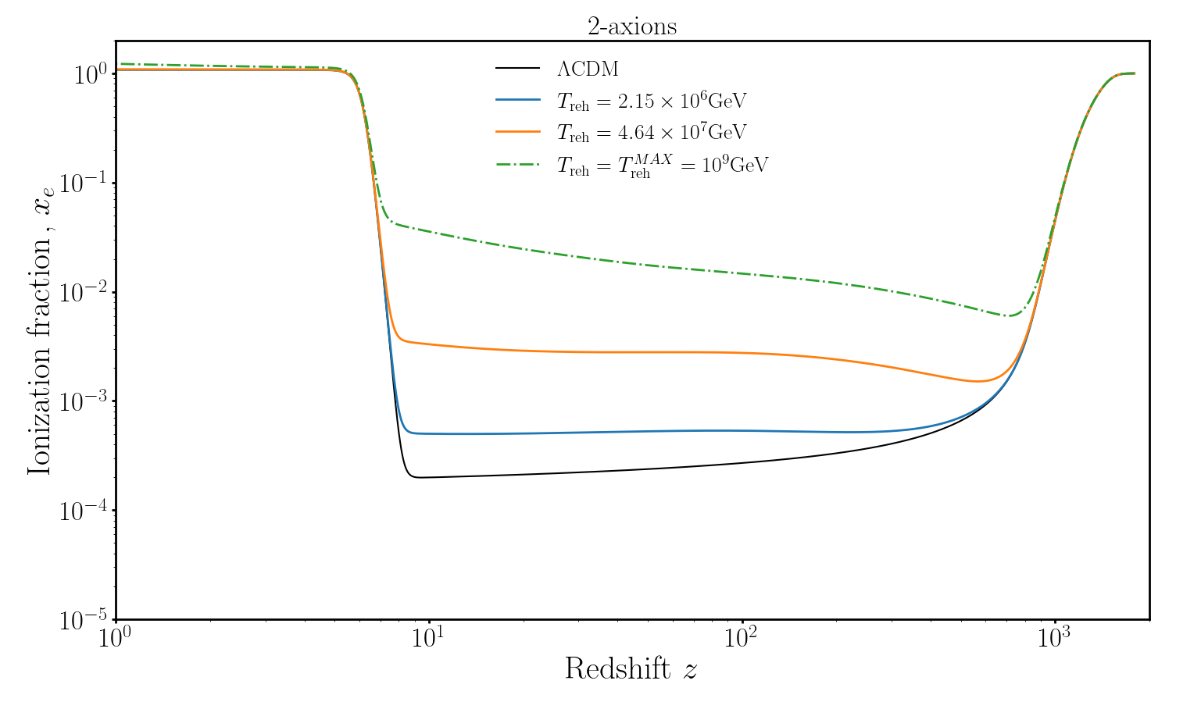
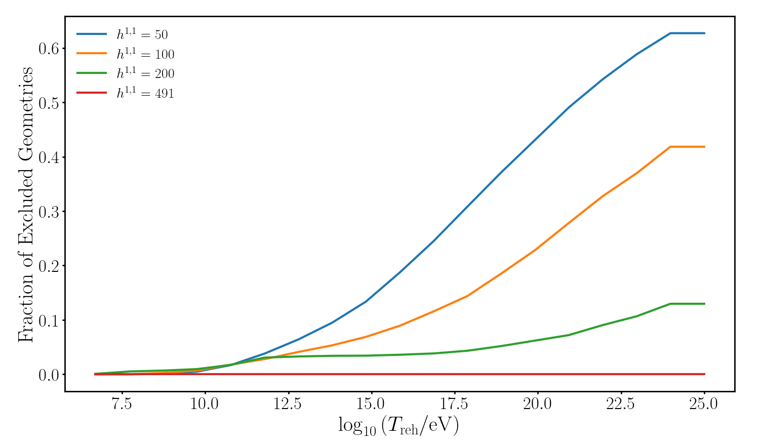
Example: freeze-in and decay of heavy axions. h11>50 → f<10¹² GeV.
Compute full reionization history from decaying axion DM for any (g,m,TR) and up to ten decaying axions.
Compare optical depth to measured value in CMB → exclude models at large TR.
Yin, DJEM et al (in prep); Gendler, DJEM et al (2023)

Slide 29
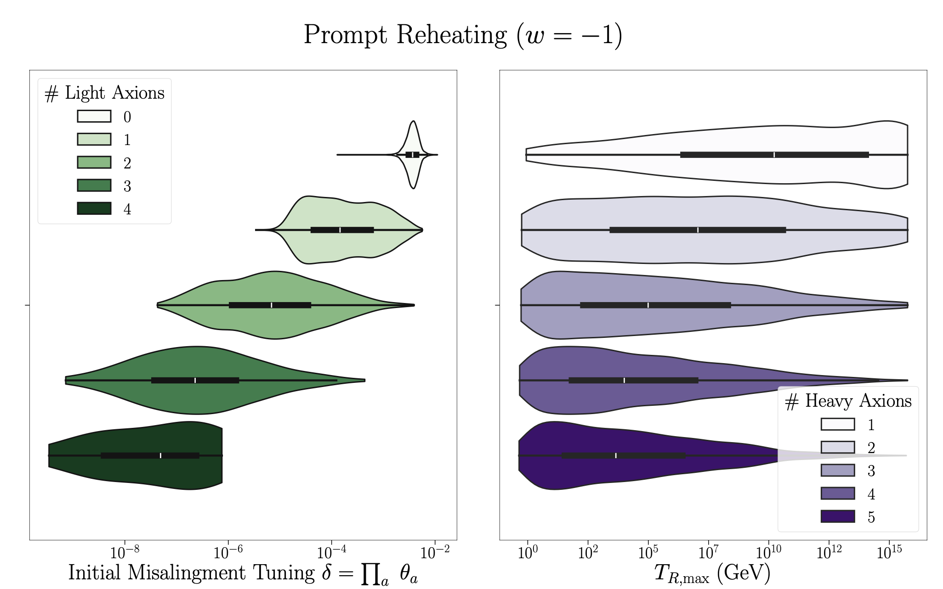
Example: misalignment abundance of complete ensemble at h11<8 → f~10¹⁶ GeV.
Sheridan, DJEM et al (2024)
“Light” axions roll after BBN → cannot be diluted → must be tuned.
“Heavy” axions removed with “prompt reheating”, need low TR and low HI.

Slide 30
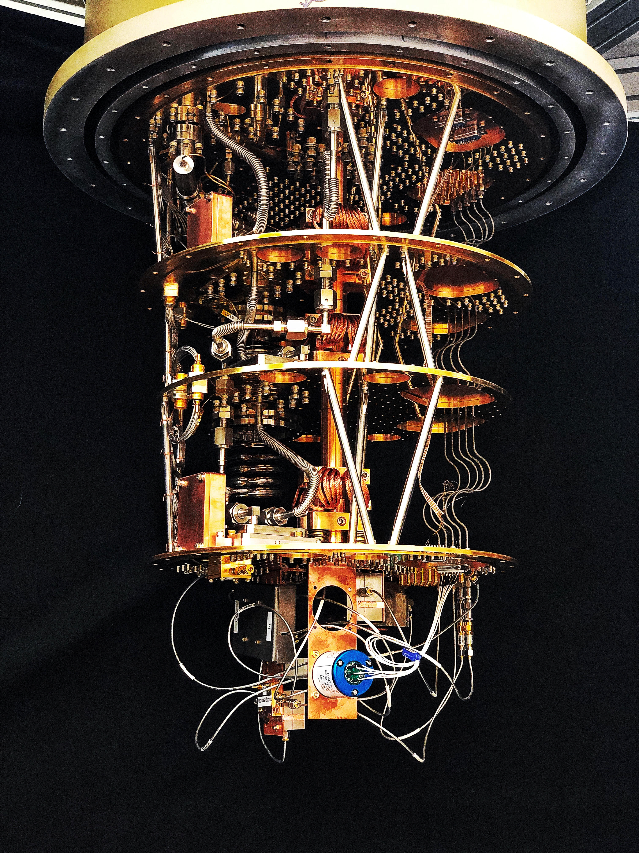
Direct detection:
“Haloscopes”

Slide 31
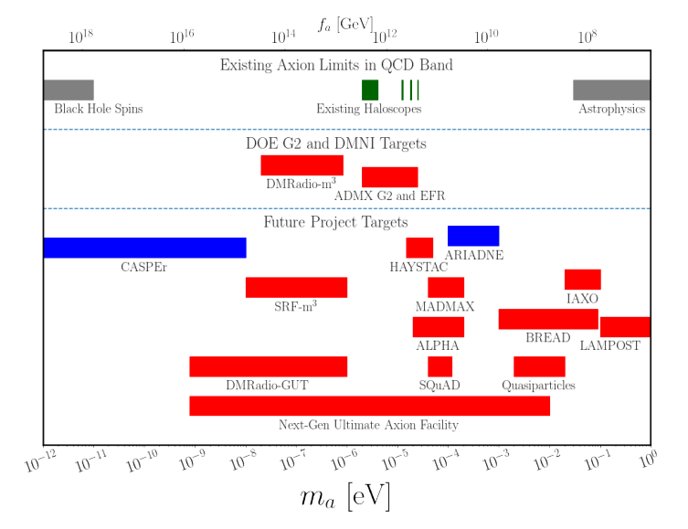
The QCD axion will be found
QCD axion mass:
kHz
THz
Bounded from above by SN1987A ν burst duration. Bounded from below by black hole superradiance.
Axion DM is an oscillating classical field in kHz to THz.
Snowmass “Axion Dark Matter” (inc DJEM)

Slide 32
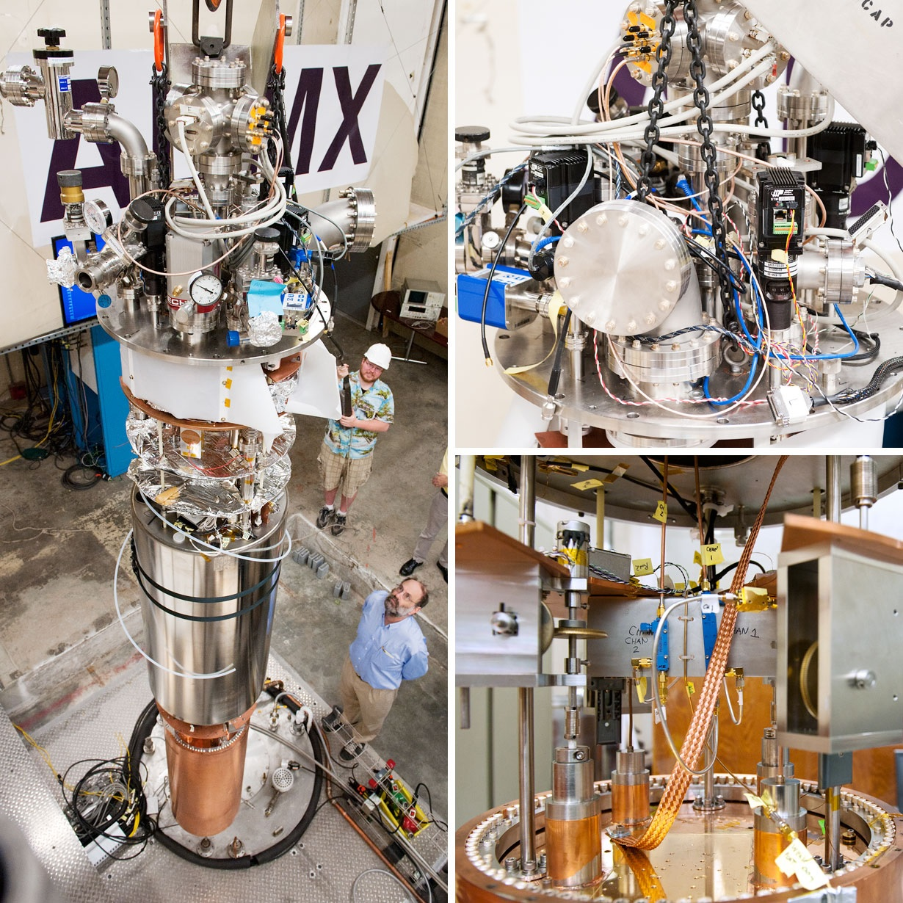
Resonant Cavities
Sikivie (1983); ADMX collab.
“Dark Matter” (DJEM et al)
Axions interact with electromagnetism via:
→ axions source Maxwell’s equations:
B source → linearise for E wave equation:
→ resonance via boundary conditions.
Power 10⁻²² W in typical experiment

Slide 33
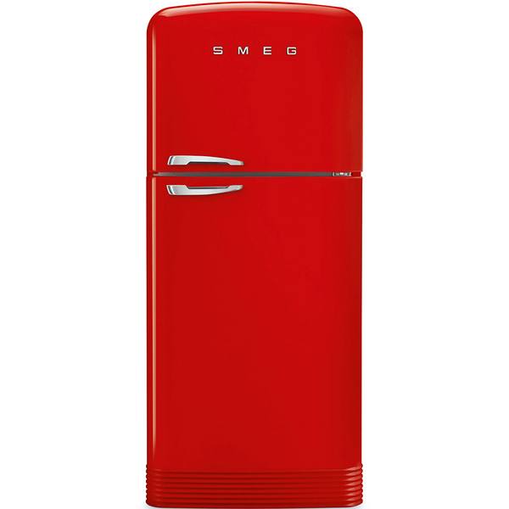
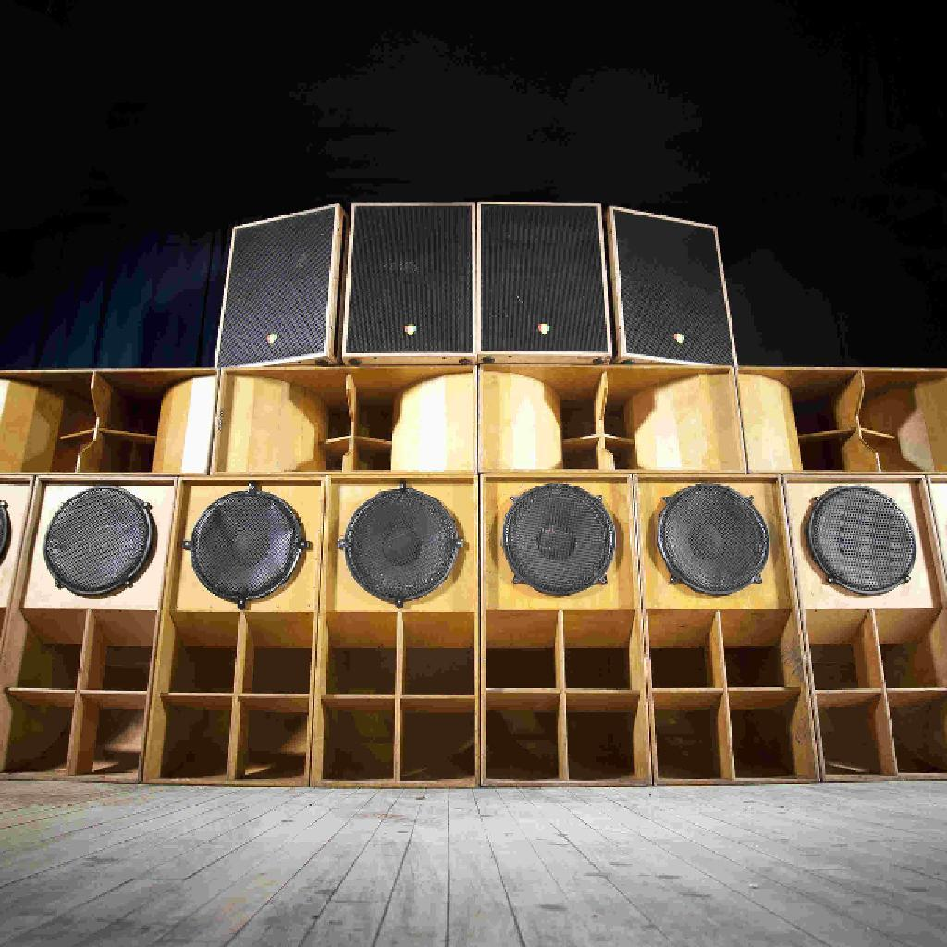
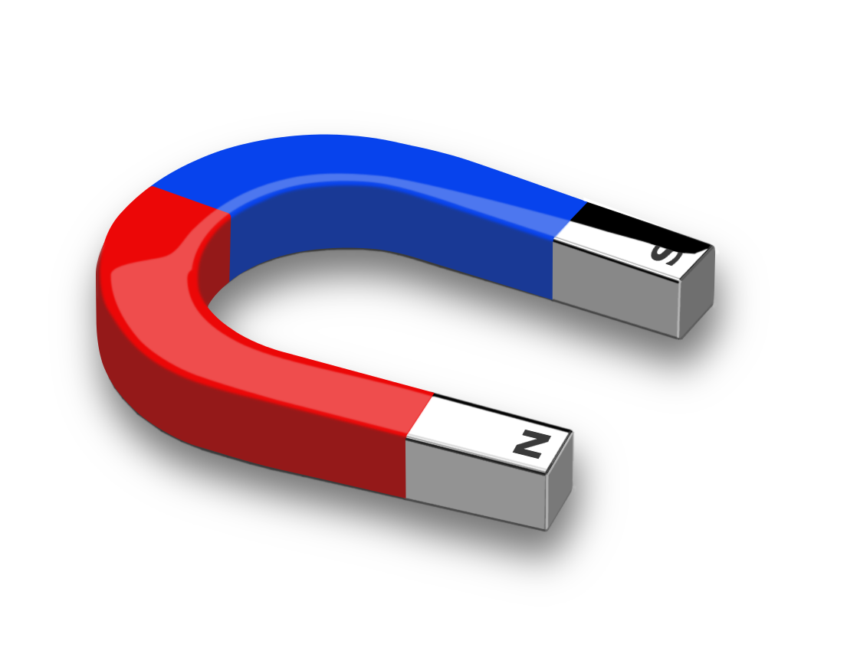
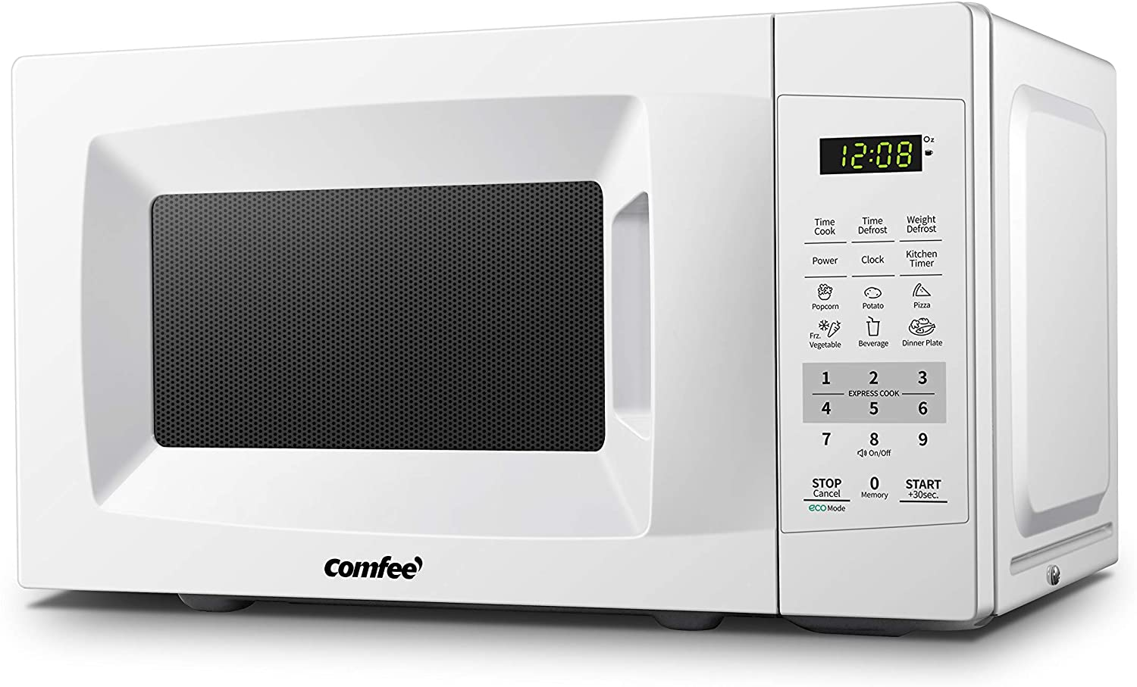
How to Detect Axions

Slide 34
Haloscopes beyond GHz
Cavity tech doesn’t scale well.
Many new ideas since ~2012.
Low frequency: DMRadio/ ABRA resonant circuits.
Mid: MADMAX dielectrics, ALPHA wire metamaterial.
High: BREAD dish antenna, quasiparticle magnetic res.
Haloscopes are also high frequency GW detectors.
Ciaran O’Hare AxionLimits Github

Slide 35
CY topology in the lab
Gendler & DJEM (2024)
Cycle vols >1 (control EFT) → overall volume grows with topology.
QCD axion mass correlated to topology. Higher h11 → higher ma .
Different haloscopes are sensitive to different topologies → test string theory.

Slide 36
Discovery of the axion quasiparticle
Qiu, DJEM et al, Nature (2025)

Slide 37

Axion Quasiparticles
Review: Sekine & Nomura (2021)
New insight: in-plane B tilts spins → order parameter fluctuation.
This can be achieved in more well understood “axion insulator” MnBi₂Te₄.
Fluctuating antiferromagnetic order can couple to E.B →axion quasiparticle.
Axion ~ magnetoelectric coupling α_{ii}. Static value π in topological insulators.
Until now, candidate materials included Mn₂Bi₂Te₅ using antiferromagnetic amplitude mode. Difficult to excite, materials unstable.

Slide 38
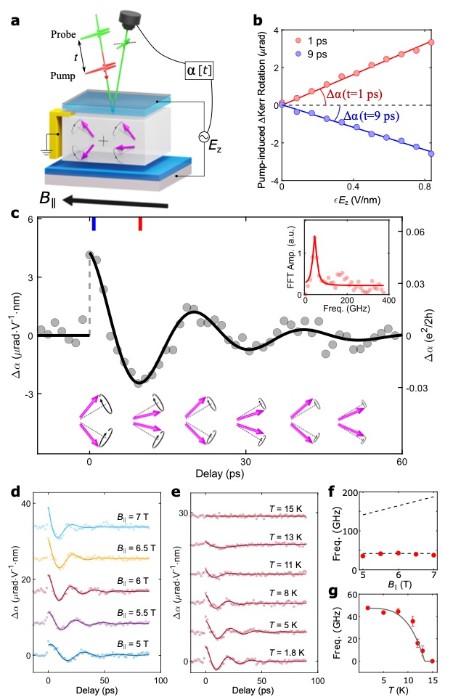
Measuring the Quasiparticle
Qiu, DJEM et al (2025)
Axion-photon coupling causes probe laser polarization angle to oscillate at frequency ~ axion mass (birefringence). Measured frequency 44 GHz.

Slide 39
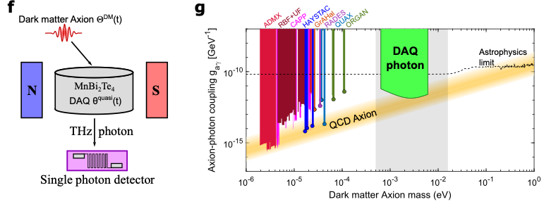
Measured quaisparticle frequency 44 GHz → axion mass m_{Θ} =0.2 meV.
New DFT calculations → f_{Θ} = 80 eV, conductive losses Γ/ω ~ 10⁻⁴.
Exciting laboratories for analogue physics, e.g. gravitational Chern-Simons.
Axion quasiparticle polaritons provide a tunable axion DM detector in difficult THz.
Sample size ~ (20cm)² *mm
Integration ~ 3 years
Dark count 10⁻⁵ s⁻¹
DJEM et al (2019); Schütte-Engel, DJEM et al (2021); Qiu, DJEM et al (2025)

Slide 40
Axion quasiparticles are sensitive to the QCD axion at upper limit of its allowed mass, and thus to Calabi-Yaus with large Hodge number that dominate the landscape.
QCD axion searches
QCD axion
“Post-inflation”: miniclusters
QCD axion in string theory
String Axiverse
Heavy axions:
Decays, overproduction, constraints on cosmology
Ultralight axions:
structure formation
Axions in string theory
Hubble scale
~ (size of Universe)⁻¹
Planck scale (quantum gravity)

Slide 41
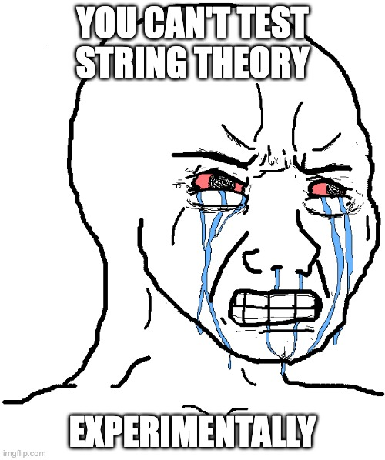
ALGEBRAIC GEOMETRY
AXIONS
BAYESIAN STATISTICS (*)

Slide 42
Backup slides

Slide 43
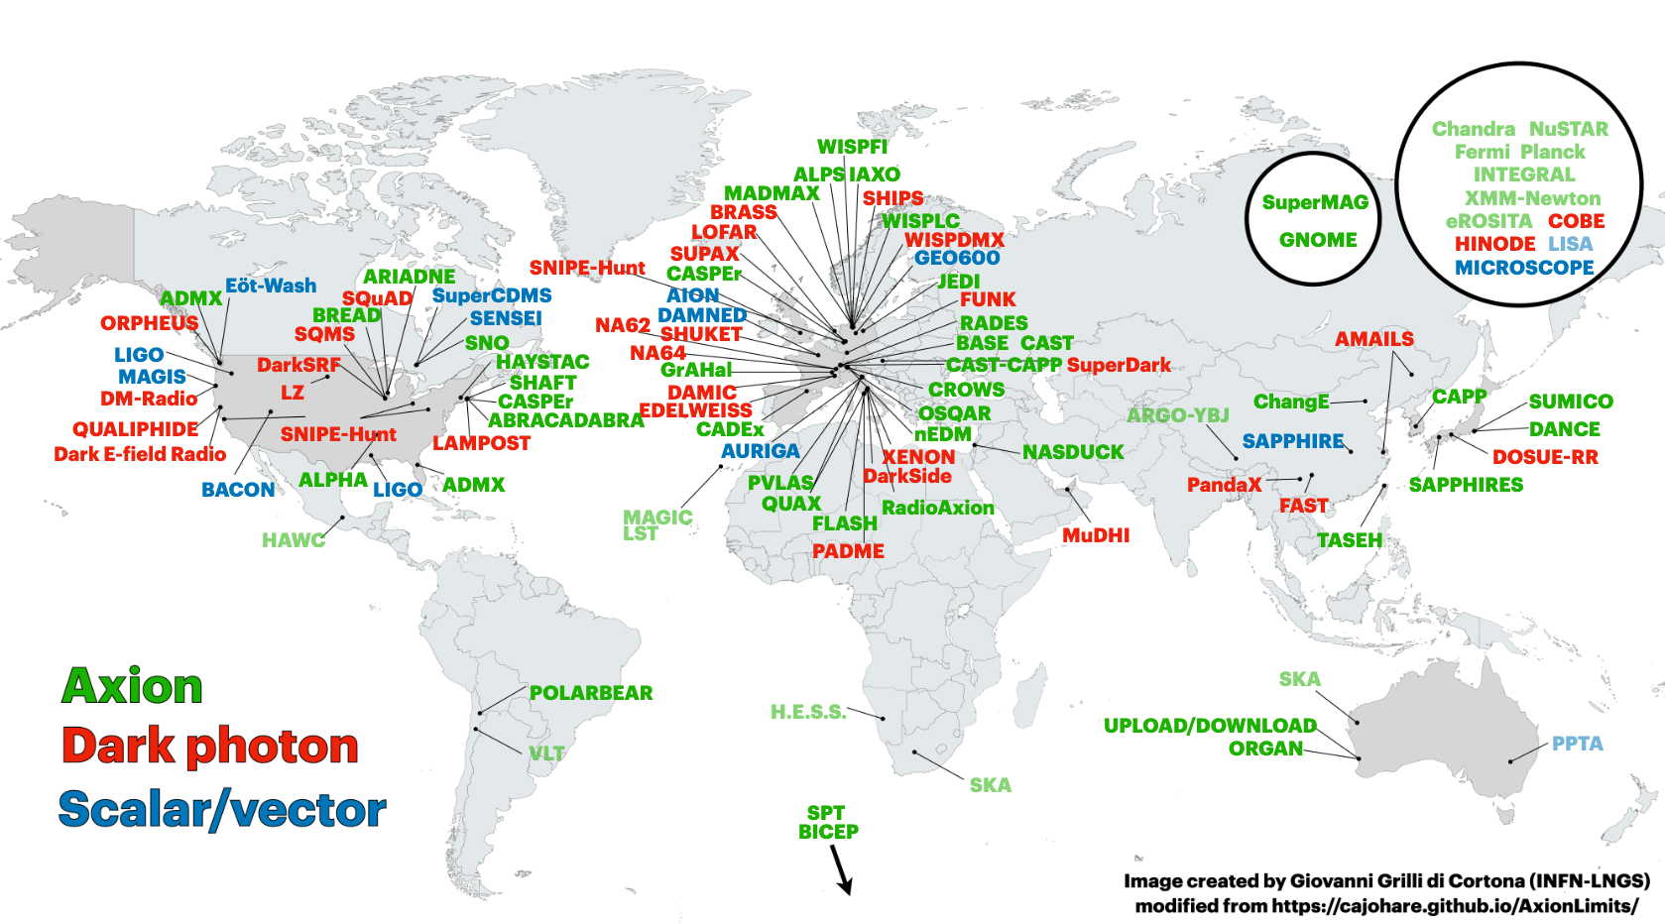
Haloscopes around the world

Slide 44
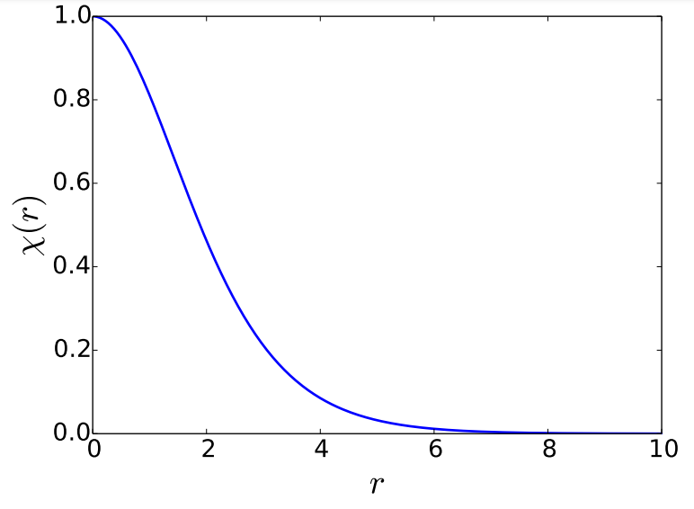
Solitons from Schrödinger
Ground state solutions of self-gravitating wave equation (non-relativistic limit).
In full GR: “oscillatons”. Also called boson stars or axion stars.
In physical units: Increase boson mass → smaller soliton.
Increase soliton mass → smaller soliton.
Radius ~ de Borlgie
Ansatz
Dimensionless variables with χ(0)=1.
→ Boundary value problem with eigenvalue γ. Solved for:
Zero oscillation, lowest energy solution.

Slide 45
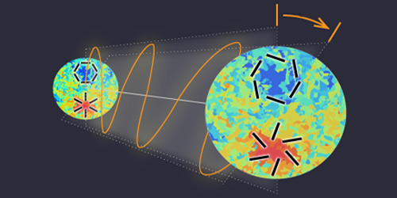
Birefringence
E→B rotation
β
E, B are CMB polarization states (Stokes)
Required mass range:
Minami & Komatsu (2020)
Planck collab. (2022)
H₀
H_{CMB}
Isotropic birefringence can be caused by an ultralight axion via:
Naturally get the measured value (!)

Slide 46
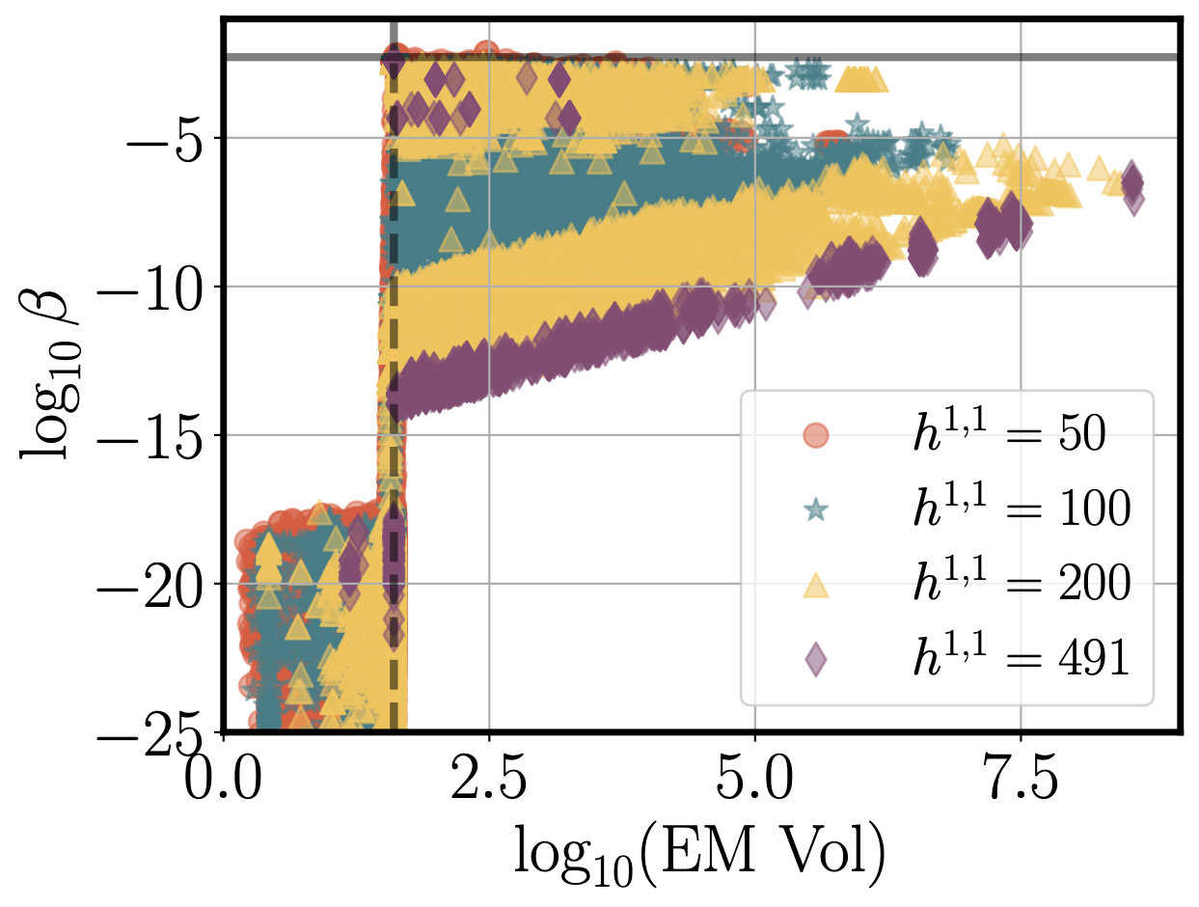
Birefringence …in string theory
… and in the lab (see later)
Need ”light threshold” at H-CMB~10⁻²⁸ eV. Happens if EW coupling at KK scale ~1/40.
“Axion quasiparticles” rotate the polarization of a probe laser.

Slide 47
Astrophysics: miniclusters

Slide 48
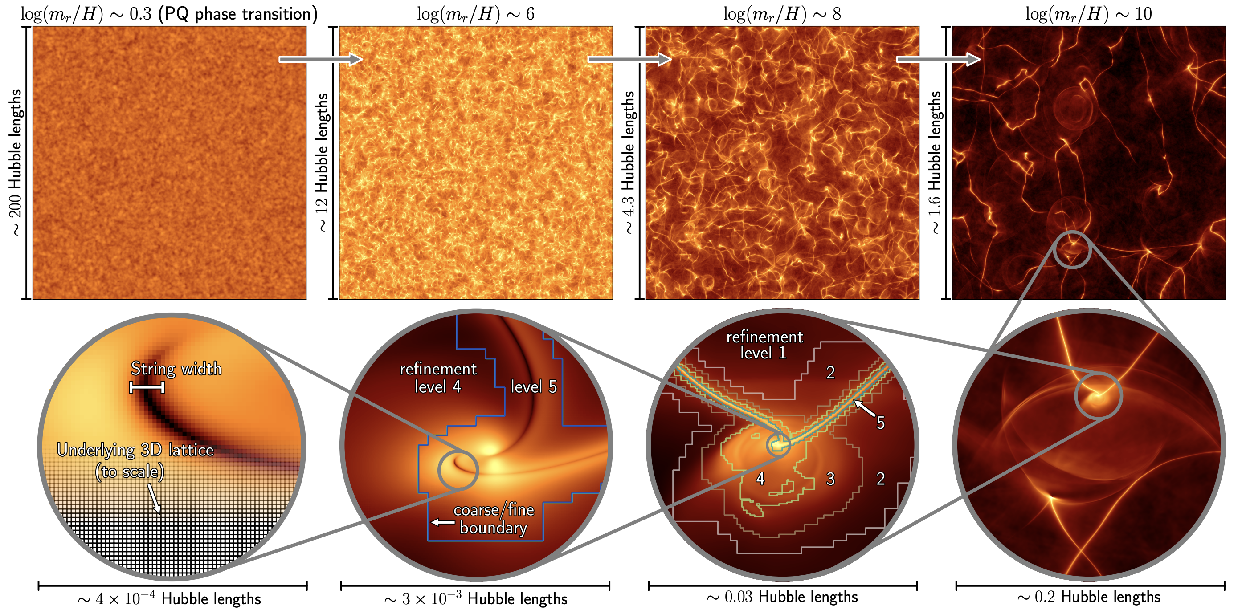
SSB After Inflation
Fig: Buschmann et al (2024)
* Not true for closed string axions in IIB
In ordinary QFT* the QCD axion is the phase of a complex field → SSB after inflation forms a network of topological defects that later decay → DM abundance.

Slide 49
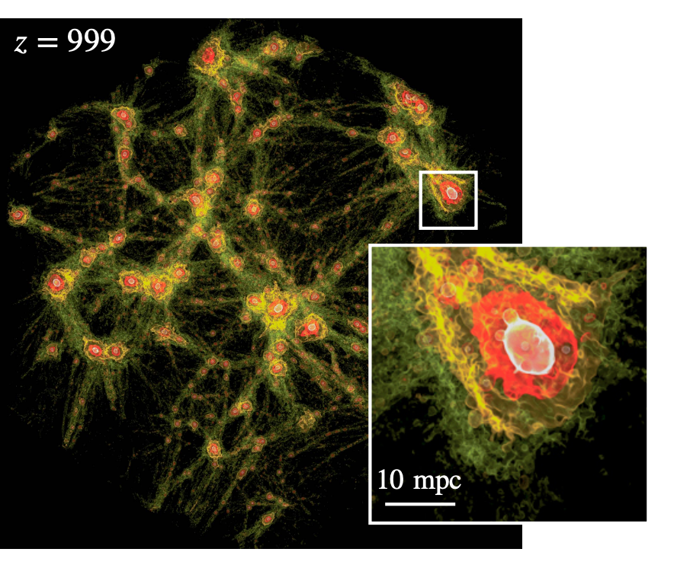
L=0.2 pc
Ellis, DJEM et al (2020)
Eggemeier et al (2022)
Seed overdensities from strings collapse to dense halos “miniclusters”. Simulate using N-body methods → mass function O(10⁻¹²) solar mass and density profiles.

Slide 50
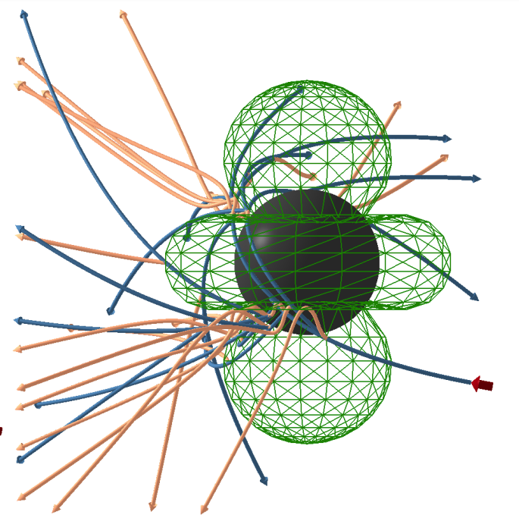
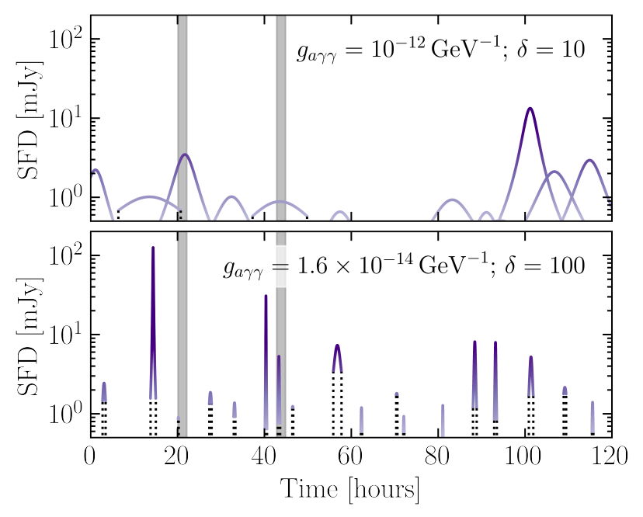
Neutron star magnetospheres high B and plasma frequency → convert axions to radio (~GHz) photons.
Minicluster-NS collision → bright radio transient to look for. Need dense DM environment + lots of NSs.
MacDonald et al (2023)
Walters, DJEM et al (2024)

Slide 51
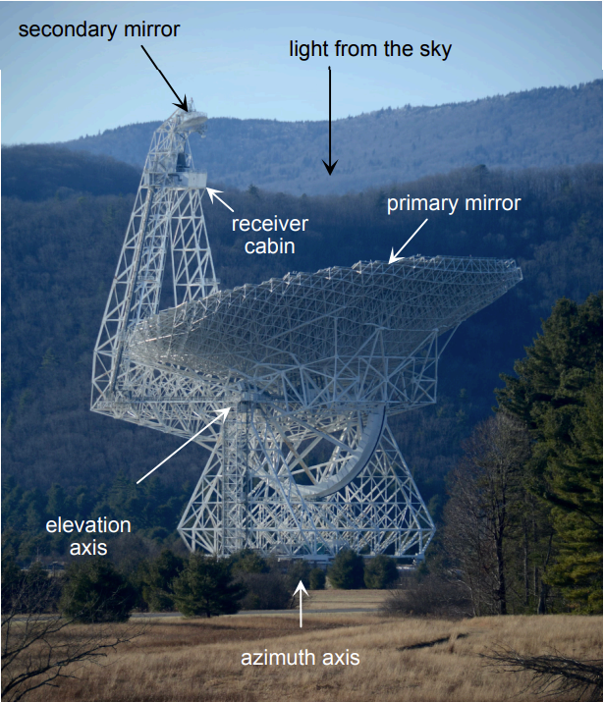
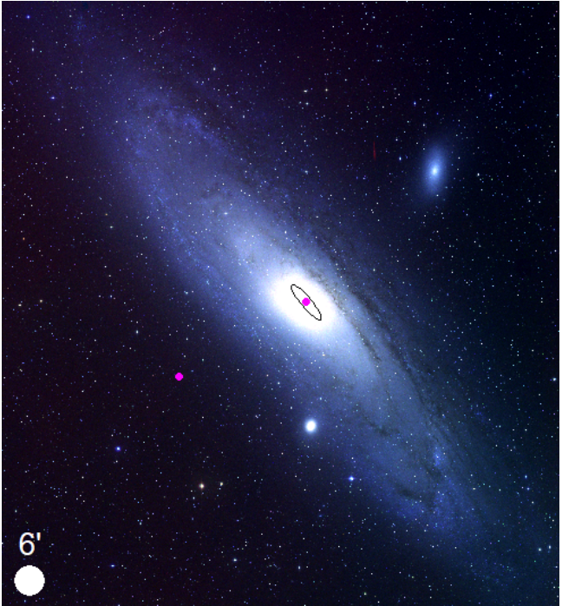
Let’s look and see… few hours observation of Andromeda with GBT. No signal, but not expected in such a short period.
Walters, DJEM et al (2024)

Slide 52
If you build it, they will come…
Why wait for SKA? Make progress with a cheap dedicated telescope.
Sky location of NS population simulated with PsrPoPy.
Fan Mountain Observatory. L-band telescope funded. Others in prep.
Johnson, Bhura, DJEM et al (in prep)

Slide 53
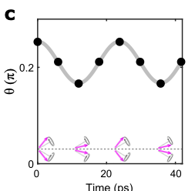
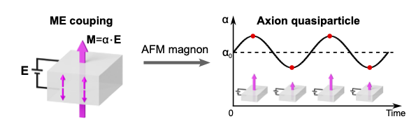
Axion Quasiparticles in Axion Insulators
Qiu, DJEM et al (2025)
Insight : in-plane B tilts spins, out-of-phase magnon → order parameter fluctuation.
This can be achieved in more well understood “axion insulator” MnBi₂Te₄.

Slide 54
Axion-Photon Couplings
Recipe:
Consequences:
Choose a CY.
Choose a divisor to host QCD.
Dilate divisor to Vol=40 → QCD (gauge coupling)⁻¹ in UV.
Pick a divisor for QED. Same → GUT. Intersecting → non-GUT.
EW divisor → linear combination of axions coupling to EM.
Diagonalise matrices and compute couplings of eigenstates.
“Kinetic isolation”: K matrices are sparse → suppressed kinetic mixing of all axions into EM linear comb.
“Light threshold”: mass scale generated by ED3 branes on EW divisor → hierarchically suppressed coupling of axions lighter than this.
c.f. similar effect in GUTs found by Agrawal et al.
Not all axions couple with O(1) strength to photons, but some do.
Gendler, DJEM et al (2023)

Slide 55
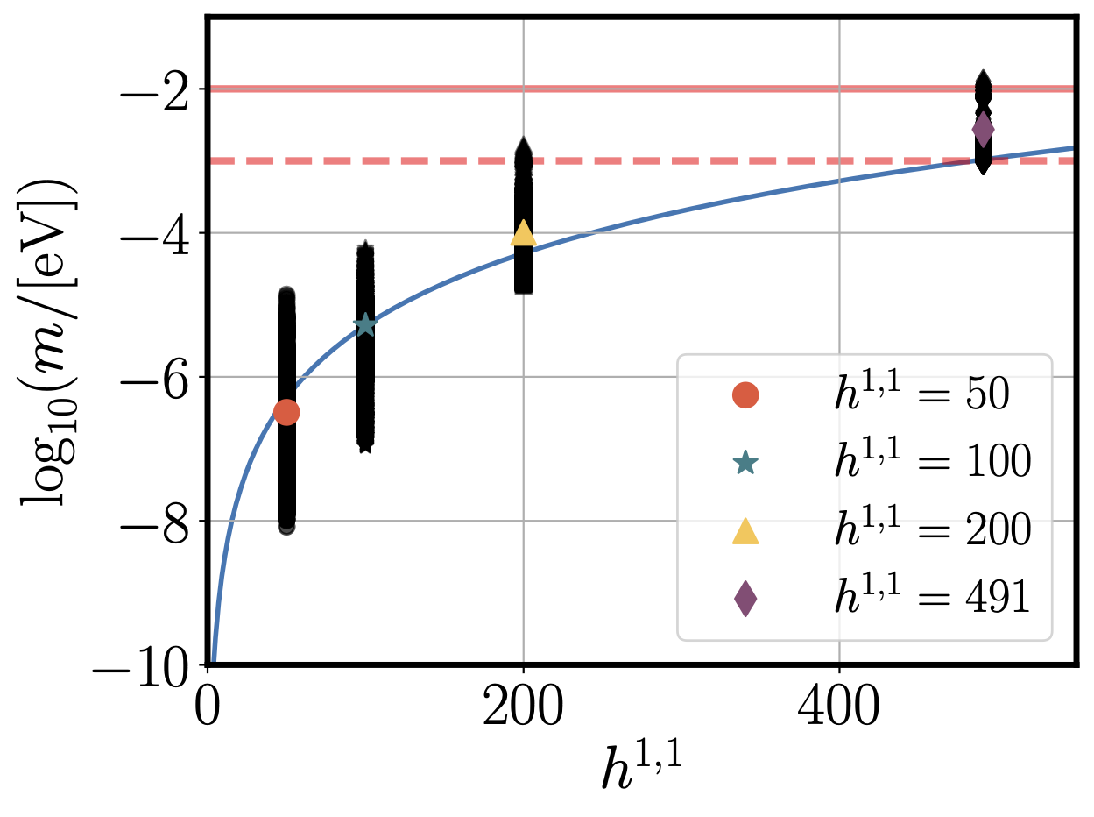
QCD Axion & string theory
All volumes >1 (control of EFT) → some volumes large.
Gendler, DJEM et al (2023)

Slide 56
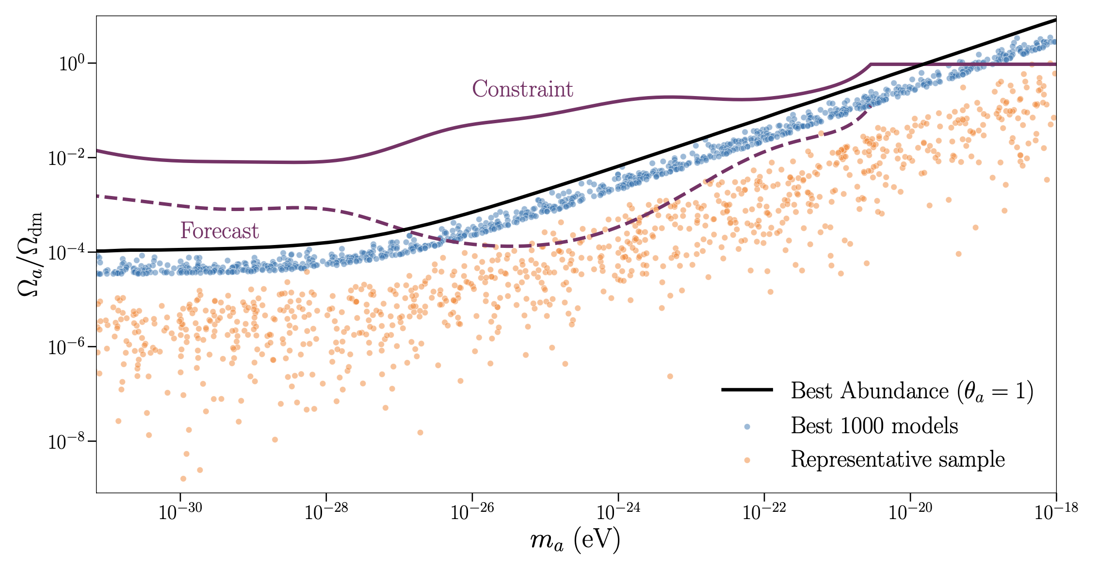
Ultralight Axion Statistics
Sheridan, DJEM et al (2024)
Topologically exhaustive construction explicit orientifolds in KS with 1<h11<8. Moduli chosen to get QCD gauge coupling + fuzzy axion → 1.8 million models.
Difficult to get detectable models at larger h11 → “cohomologies from cosmology”.

Slide 57

From Sheridan, DJEM et al

