Slide 1
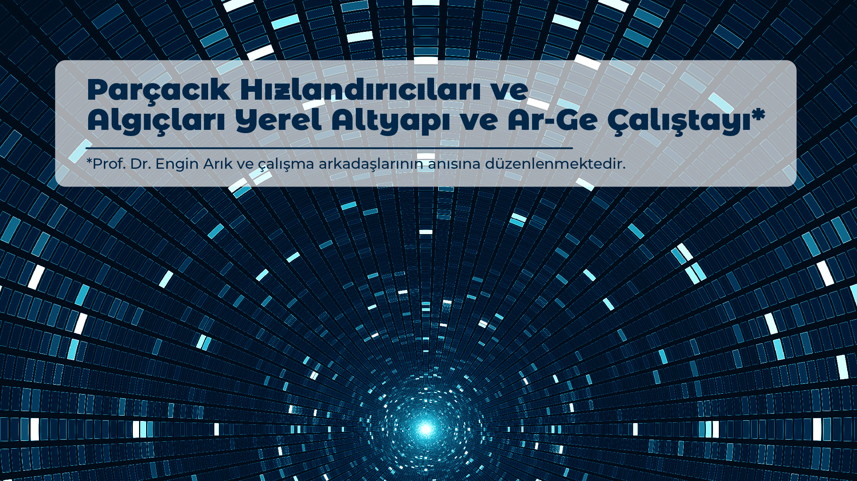

PANEL

Slide 2

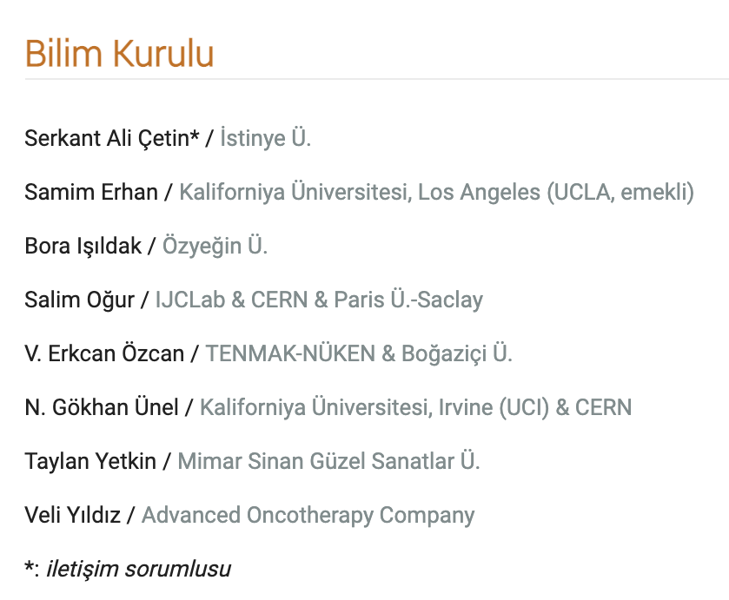
PANELİSTLER:
PANEL
Parçacık Hızlandırıcıları ve Algıçları Yerel Altyapı ve Ar-Ge Çalıştayı
Bilim Kurulu üyelerinin panelist olarak yer aldığı bu panelde genel değerlendirme ve 2020 çalıştayı ile karşılaştırma yapılması hedeflenmektedir.

Slide 3
Sayılarla 2020 ile 2021 karşılaştırması
PANEL
Parçacık Hızlandırıcıları ve Algıçları Yerel Altyapı ve Ar-Ge Çalıştayı
 | 2020 | 2021
Toplam başvuru sayısı | 33 | 19
Programa alınan başvuru sayısı | 25 | 16
Algıç | 6 | 10
Hızlandırıcı | 14 | 5
Hızlandırıcı & Algıç | 5 | 1
İllere göre dağılım | 11x Ankara 9x İstanbul 1x Muş 1x Eskşehir 1x Gaziantep 1x Kütahya | 3x Ankara 10x İstanbul 1x Muş 1x Kayseri 1x Niğde

Slide 4
Çalıştay Sunumları Hakkında Değerlendirme
PANEL
Parçacık Hızlandırıcıları ve Algıçları Yerel Altyapı ve Ar-Ge Çalıştayı

Slide 5
TÜRKİYE DENESYEL PARÇACIK FİZİĞİ CAMİASI ADINA CERN GÖREV GÜCÜNE SUNULAN ULUSAL SWOT ANALİZİ / Mart’20
GÜÇLÜ YÖNLER
High quality of the educational system .
Large body of academics.
~40 physics departments.
Participation in a wide spectrum of CERN programs.
50% of “Research Universities” collaborate in CERN programmes.
Wide spectrum of Detector and Accelerator R&D.
High performance even with limited resources.
Efficient interaction between industry and university research groups.
Thematic clusters between institutes.
Productive theory community.
Strong CERN-TR ILO.
ZAYIF YÖNLER
No active national roadmap.
Lack of national structure for governing research in high energy physics.
Unrecognized self organization of the EPP research community
Limitted resources for GRID computing and similar technologies.
Lack of project grants with personnel positions and infrastructure budgets; only travel money.
Undiscussed limitations on number of physicists with PhD by state bodies.
No support for participating in EPP programs other than CERN.
Corporate and sustainable support structure missing.
Lack of centralized support for teaching and outreach activities.
Missing financial measures to ensure the industry to become more active.
FIRSATLAR:
Developing high-tech skills.
Potential leading role in the region .
Investing more on Acc. & Det. R&D hence improving industrial return from CERN.
Potential to construct a facility for worldclass physics.
The nuclear plant gives an option to implement PP experiments.
The interdisciplinary ecosystem requiring cutting-edge technologies is a perfect opportunity to increase quantity and quality of experts.
A push to Turkish industry to use and produce advanced technologies which will result in a stronger economic competitive power.
Knowhow transfer from CERN to flourish infrastructures and laboratories.
More disciplines to benefit from distributed computing technologies .
Enhance the awareness and impact of fundamental research and the spin-offs in the society
TEHDİTLER
Insufficient and unstructured support mechanisms resulting in low gain from CERN could be read by authorities “CERN associate membership does not help”.
Hard conditions to enlarge teams; even the risk of getting smaller and less diverse and/or inefficient.
Without the funding for postdocs, engineers and support staff, commitments cannot be made for upgrades.
Sustainability, reliability and visibility of the Turkish teams within the experimental collaborations at risk.
Risk of retention of high quality researchers.
Less involvement in global collaborations and scientific activities; less diverse and limited contributions.
Imbalanced distribution of national resources among basic sciences, hence not easy to advance in cutting edge technologies and sciences.

Slide 6
Tartışma Önerileri
PANEL
Parçacık Hızlandırıcıları ve Algıçları Yerel Altyapı ve Ar-Ge Çalıştayı
Ulusal potansiyelin yansıtılması
Ulusal ihtiyacın yansıtılması/desteklenmesi
Ulusal işbirliklerinin teşviki, farklı ekiplerin birlikte çalışmaları
Uluslararası işbirliklerindeki deneysel tecrübe ile Ulusal Altyapı/AR-Ge potansiyelinin ilişkisinin irdelenmesi
Akademi/Endüstri işbirliği kadar Akademi/Kamu Kurumları işbirliği
…

Slide 7
Çalıştaya katkı ve katılımınız için teşekkürler!

