Slide 1



Born-Oppenheimer Effective Theory
for multiquark states
42nd International Symposium on Lattice Field Theory (Lattice 2025)
Tata institute of Fundamental Research
Nov 5, 2025
Abhishek Mohapatra (TU Munich)
Phys. Rev. D 110, 094040 (2024) (Editors Suggestion), Phys. Rev. Lett 135, 121902 (2025),
arXiv 2508.13050 (accepted in Physical Review D)

Slide 2
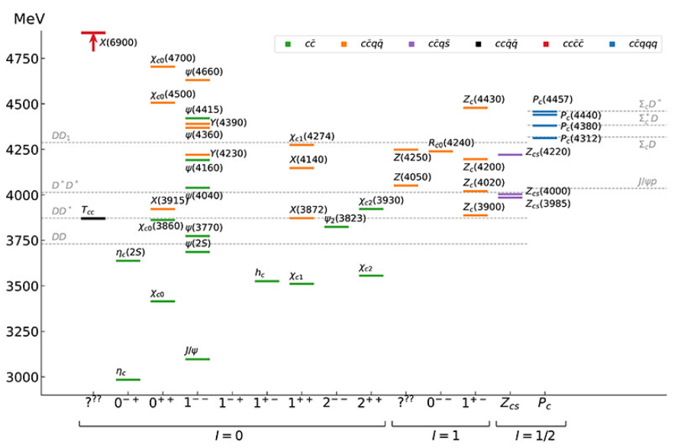
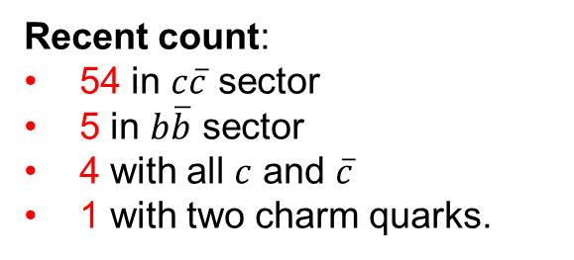
Exotic mesons
Recent count:
54 in $c\overline{c}$ sector
5 in $b\overline{b}$ sector
4 with all $c$ and $\overline{c}$
1 with two charm quarks.
JPAC, PPNP 127 (2022) 103981
Lebed 2024, PDG 2025
XYZ hadrons: QCD bound states of at least two heavy quarks (charm or bottom).

Slide 3
Born-Oppenheimer EFT

Slide 4
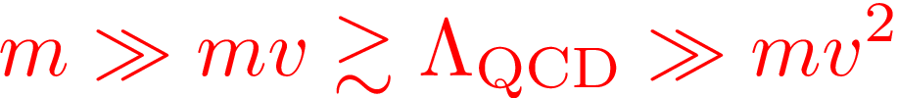






Exotic Hadron
Exotic hadron $(Q\overline{Q}X,QQX, …..)$, $X$: any combination of light quark and gluons (LDF) for color singlet.
Multiple scales in Exotics:
LDF
Mass of heavy quark: $m$
Energy scale for LDF: ${\text{Λ}}_{\text{QCD}}$
$$\overline{Q}$$
$$r∼1/mv$$
$$Q$$
Relative momentum between heavy quarks: $mv ∼1/r$
Heavy Quark kinetic energy scale: $mv^{2}$
Heavy quarks static with
respect to light quarks or gluons
Time-scale for dynamics of $\text{Q}\overline{\text{Q}}:∼\frac{\text{1}}{\text{m}{\text{v}}^{\text{2}}}\text{≫ }\frac{1}{{\text{Λ}}_{\text{QCD}}}$
Born-Oppenheimer (BO) Approximation
Braaten, Langmack, Smith Phys. Rev. D. 90, 014044 (2014)
Juge, Kuti, Morningstar, Phys. Rev. Lett. 90, 161601 (2003)
Bound-state dynamics at energy scale $mv^{2}$ ! Integrate out all energy scales above $mv^{2}$.
Notes:
A complete understanding of exotic quarkonia in terms of these pictures has not yet been obtained

Slide 5
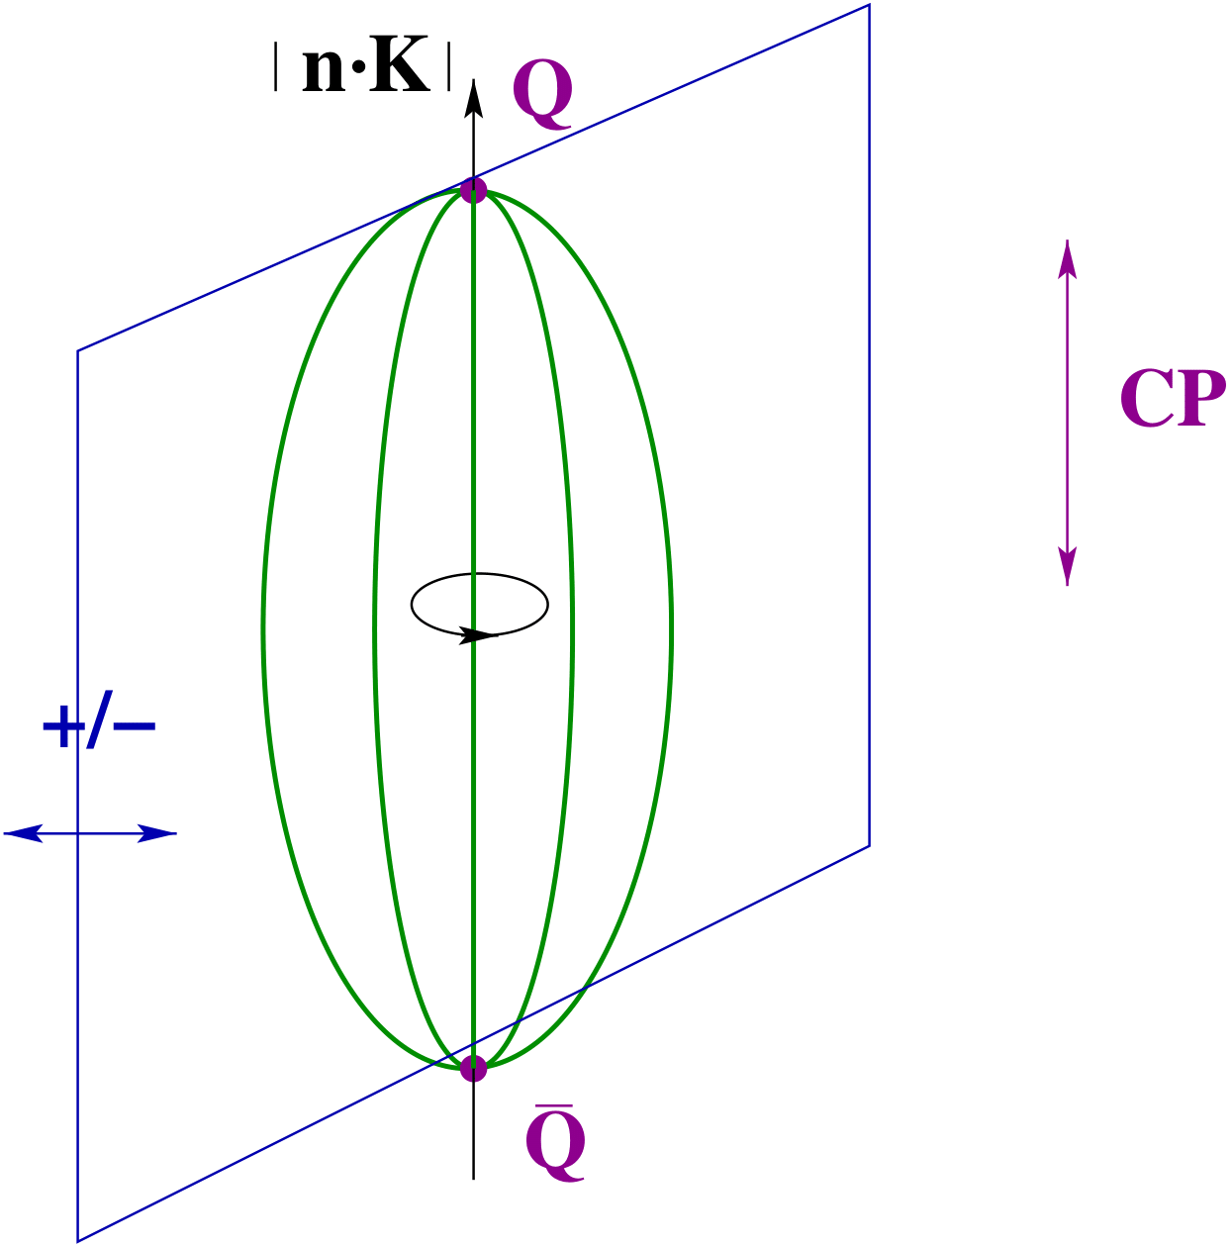


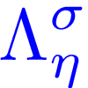

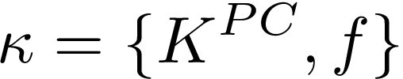





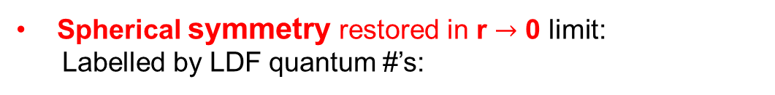







BOEFT: Quantum #’s
BO-quantum number ($\text{r}≠\text{0}$): heavy quarks static, Cylindrical symmetry group $D_{∞h}$
Labelling LDF static energies:
Absolute value of component of LDF angular momentum $K$
$$\left|r⋅K\right|≡Λ=0, 1, 2,…….. (or Σ, Π, Δ, Φ,…..)$$
CP
Product of charge conjugation and parity ($CP$):
$η=+1 \left(g\right),$ $−1 \left(u\right)$
$σ$: Eigenvalue of reflection about a plane containing static sources.
$$σ=P {\left(−1\right)}^{K_{light}}=±1$$
Born, Oppenheimer, Annalen der Physik 389 (1927)
Landau, Lifshitz & Pitaevskii, QM book
Examples:
$$K^{PC}$$
$$Λ_{η}^{σ}$$
Spherical symmetry restored in $\text{r}→\text{0}$ limit:
Labelled by LDF quantum #’s:
$$0^{++}$$
$$Σ_{g}^{+}$$
$$0^{+ −}$$
$$Σ_{u}^{+}$$
$$1^{+ −}$$
$${\{ Σ}_{u}^{−}, Π_{u} \}$$
$$2^{−−}$$
$$\{ Σ_{g}^{−}, Π_{g}, Δ_{g} \}$$
Notes:
D_{infinity}h-→cylindrical symmetry group. O(3)*C: spherical symmetry group. In the centreof-mass system gluonic excitations between static quarks are, therefore, classified according to representations of O(3)× C, which we summarize by L, the angular momentum, CP and reflection with respect a plane passing through the quark-antiquark axes5x

Slide 6














Exotic Hadron
Berwein, Brambilla, AM, Vairo, Phys. Rev. D. 110, (2024), 094040
$$Q\overline{Q}X$$
$$QQX$$
$Q$
$\overline{Q}$
$Q$
$Q$
r
r
color:
color:
X = gluon $→$ Hybrid
X = $q_{3}$ $→$ Double heavy baryon
X = ${\left(q\overline{q}\right)}_{8}→$ Tetraquark
X= ${\left(\overline{q}\overline{q}\right)}_{3} /{ \left(\overline{q}\overline{q}\right)}_{\overline{6}}→$ Tetraquark
X = ${\left(qqq\right)}_{8}→$ Pentaquark
X= ${\left(qq\overline{q}\right)}_{3} /{ \left(qq\overline{q}\right)}_{6}→$ Pentaquark
and so on
and so on
X₈ : Adjoint hadrons (gluelump, adjoint meson, adjoint baryon….)
X_{3 / 6} : Triplet or sextet hadrons (meson, baryon….)
BOEFT can address all these states with required inputs from Lattice QCD !!
Notes:
Non-relativistic because v~alpha<<1. This can be seen from the virial theorem.
Top quark mass ~ 180 GeV. Top quark unstable and short-lived and decays into bottom quark + W-boson.

Slide 7



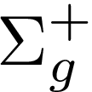


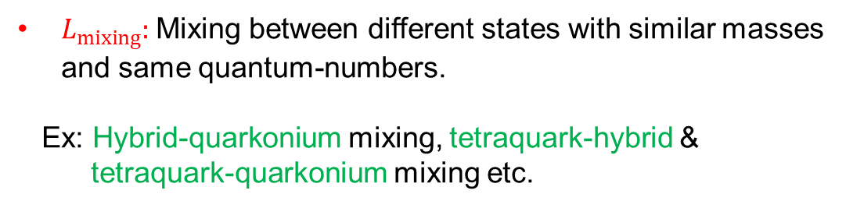
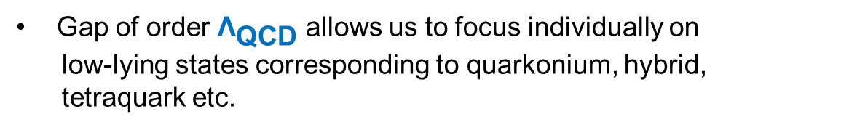

BOEFT
BOEFT Lagrangian:
Berwein, Brambilla, AM, Vairo, Phys. Rev. D. 110, (2024), 094040
Soto & Castella Phys. Rev. D. 102, (2020), 014012
Gap of order ${\text{Λ}}_{\text{QCD}}$ allows us to focus individually on
low-lying states corresponding to quarkonium, hybrid,
tetraquark etc.
$L_{mixing}:$ Mixing between different states with similar masses and same quantum-numbers.
Ex: Hybrid-quarkonium mixing, tetraquark-hybrid &
tetraquark-quarkonium mixing etc.
$$Δ∼Λ_{QCD}$$
$$E∼mv^{2}$$
R. Oncala, J. Soto, Phys. Rev. D96 014004 (2017)
$Σ_{g}^{+}$, $Σ_{u}^{−}$, $Π_{u}$: represent different potentials between heavy quark-antiquark
Notes:
In the static limit, quarkonium (the lowest potential ) and heavy hybrids (the remaining potentials) do not mix by construction (they are built as orthogonal states). Hence, the mixing must be due to 1/m corrections to the Born-Oppenheimer approximation

Slide 8
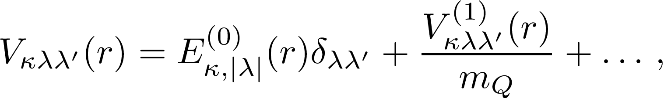
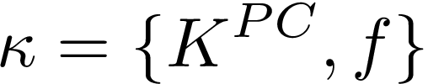
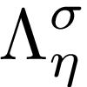

BOEFT
Berwein, Brambilla, AM, Vairo, Phys. Rev. D. 110, (2024), 094040
BO potentials: Potential between heavy quark pair due to LDF (light quarks, gluons).
v
LDF-quantum #:
v
Born-Oppenheimer (BO)
potential:
BO-quantum #:
Static Energy
Spin-dependent
potentials
Brambilla, Lai, Segovia, Castellà, Phys. Rev. D. 101, (2020)
Castellà , Soto
Phys. Rev. D. 102, (2020)
Soto, Valls,
Phys. Rev. D 108 (2023)
Radial Schrödinger equation:
Mixing term $M_{λ^{′}λ}$: Mixing static potentials with different BO-quantum numbers $Λ_{η}^{σ}$
corresponding to same LDF-quantum # $κ$
BO potentials are inputs into Schroedinger equations.
Notes:
In the static limit, quarkonium (the lowest potential ) and heavy hybrids (the remaining potentials) do not mix by construction (they are built as orthogonal states). Hence, the mixing must be due to 1/m corrections to the Born-Oppenheimer approximation

Slide 9







BOEFT
Berwein, Brambilla, AM, Vairo, Phys. Rev. D. 110, (2024), 094040
NRQCD operator (gauge invariant) for exotic hadron $Q\overline{Q}X$ or $QQX$ :
: LDF (gluon or light-quarks) operator characterizing X based on quantum # $κ$ (isospin, color etc..)
: Projection vectors for projecting onto cyclindrical symmetry $D_{∞h}$ representations.
$${(x}_{1}, −T/2)$$
$${(x}_{1}, T/2)$$
$${(x}_{1}, −T/2)$$
$${(x}_{1}, T/2)$$
$$H(0,−T/2)$$
$$H(0,T/2)$$
$${(x}_{2}, −T/2)$$
(a)
$${(x}_{2}, T/2)$$
$${(x}_{2}, −T/2)$$
(b)
$${(x}_{2}, T/2)$$
Quarkonium
Wilson loop for exotics
Notes:
Non-relativistic because v~alpha<<1. This can be seen from the virial theorem.
Top quark mass ~ 180 GeV. Top quark unstable and short-lived and decays into bottom quark + W-boson.

Slide 10
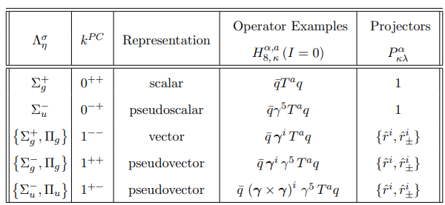
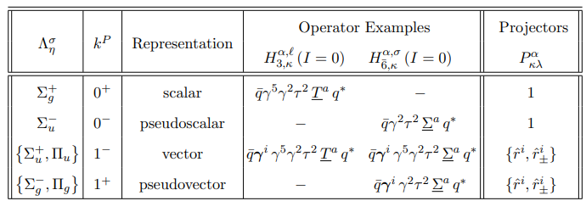

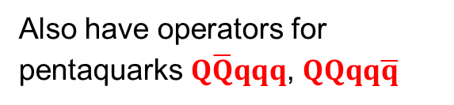

Examples of
Quarkonium tetraquarks $Q\overline{Q}q\overline{q}$ (I=0)
Doubly heavy tetraquarks $QQ\overline{q}\overline{q}$ (I=0)
I=1 operator: Insert $e_{I_{3}}⋅τ$ between light quarks
Good diquark
Also have operators for
pentaquarks $Q\overline{Q}qqq$, $QQqq\overline{q}$
Berwein, Brambilla, AM, Vairo, Phys. Rev. D. 110, (2024), 094040
Notes:
Non-relativistic because v~alpha<<1. This can be seen from the virial theorem.
Top quark mass ~ 180 GeV. Top quark unstable and short-lived and decays into bottom quark + W-boson.

Slide 11
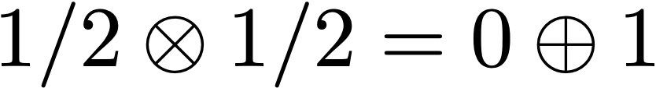


BOEFT: Potentials
Berwein, Brambilla, AM, Vairo, Phys. Rev. D. 110, (2024), 094040
Exotic hadron $(Q\overline{Q}X,QQX, …..)$, $X$ is light d.o.f.
:
spin:
$Q$
$\overline{Q}$
r
color:
EFT matching for operators characterizing $Q\overline{Q}X$:
NRQCD
Multipole expansion
BOEFT
${\text{O}}^{\text{a}}$: Octet field
Only short-distance matching
$(r→0)$
Notes:
Non-relativistic because v~alpha<<1. This can be seen from the virial theorem.
Top quark mass ~ 180 GeV. Top quark unstable and short-lived and decays into bottom quark + W-boson.

Slide 12
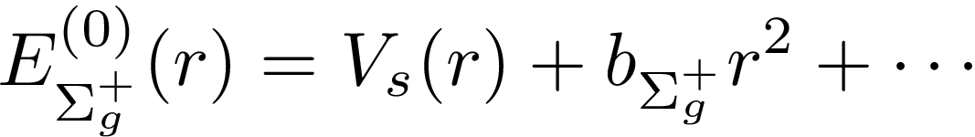
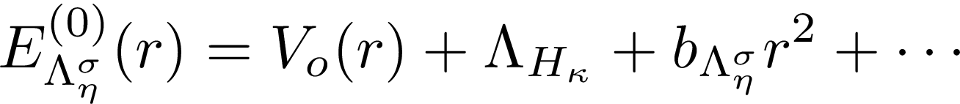

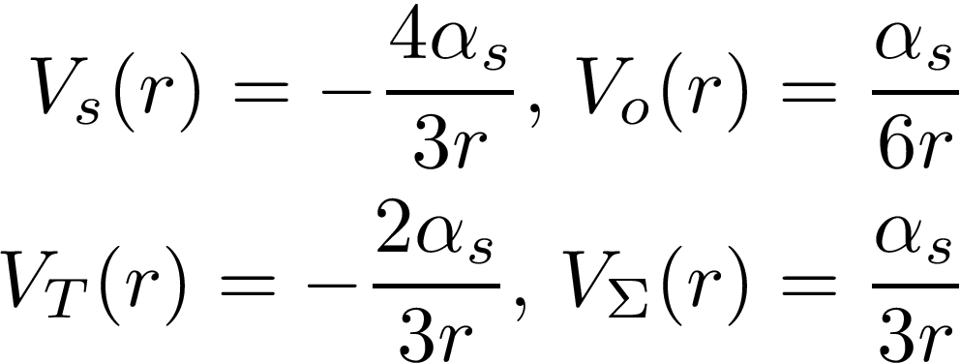







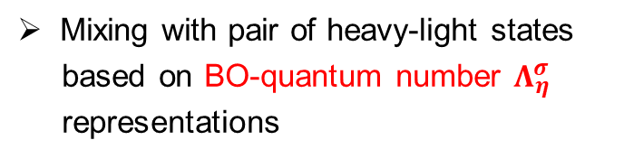



BOEFT: Potentials
Berwein, Brambilla, AM, Vairo, Phys. Rev. D. 110, (2024), 094040
LDF-quantum #:
BO-quantum #:
$$Q$$
r
$\overline{Q}$
$$Q$$
$\overline{Q}$
r
Short-distance $(r→0)$
Large-distance $(r→∞)$
$Q\overline{Q}$:
String behavior (pure SU(3) gauge)
$$Q\overline{Q}X:$$
K. Juge, J. Kuti, C. Morningstar, Phys. Rev. Lett. 90 (2003)
$$QQX:$$
Mixing with pair of heavy-light states
based on BO-quantum number $Λ_{η}^{σ}$
representations

Slide 13
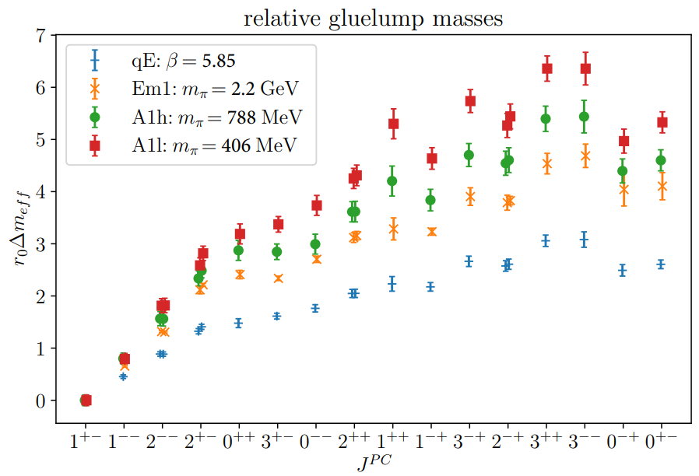
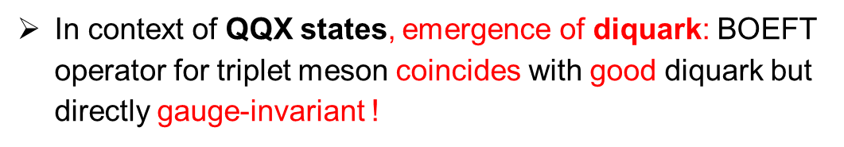

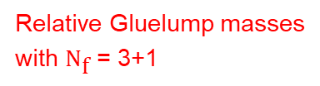
BOEFT: Potentials
Berwein, Brambilla, AM, Vairo, Phys. Rev. D. 110, (2024), 094040
Foster, Michael (UKQCD) Phys. Rev. D 59 (1999)
Campbell, Jorysz, Michael Phys. Lett. B 167 (1986)
Gluelump / adjoint meson or baryon mass for $\text{Q}\overline{\text{Q}}\text{X}$ states
Triplet meson or baryon / Sextet meson or baryon mass for $\text{QQ}\text{X}$ states
Adjoint meson ($1^{−−}$ & $0^{− +}$) : quenched with valence quarks
Foster, Michael (UKQCD) Phys. Rev. D 59 (1999)
New results on isospin=1 adjoint mesons: See Sipaz Sharma talk on
Wed at 11:30 !
Relative Gluelump masses
with ${\text{N}}_{\text{f}}$ = 3+1
In context of $\text{QQ}\text{X}$ states, emergence of diquark: BOEFT operator for triplet meson coincides with good diquark but directly gauge-invariant !
Höllwieser, Knechtli, Korzec, Peardon, Struckmeier, Andres Urea-Nino PoS LATTICE2024 (2025) 102
Notes:
Adjoint meson masses obtained in chiral extrapolation.
Marsh and Lewis pion mass 3.5 times the actual value.

Slide 14
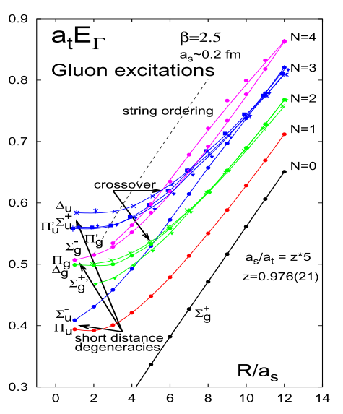
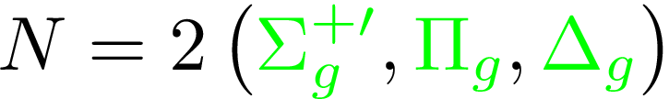

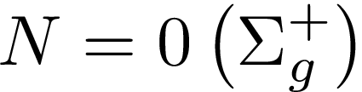
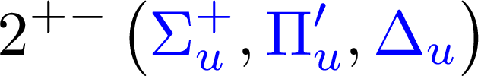
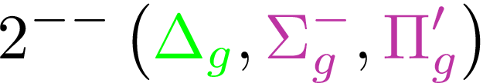
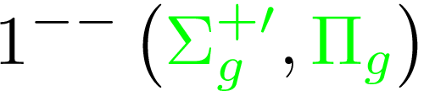
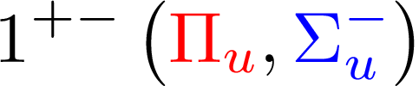

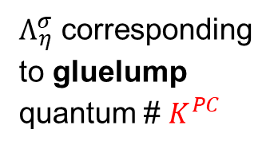

BO potential: Quenched
$Λ_{η}^{σ}$ corresponding to gluelump quantum # $K^{PC}$
Observation:
BO-quantum # $Λ_{η}^{σ}$ conserved
at all values of r
K. Juge, J. Kuti, C. Morningstar,
Phys. Rev. Lett. 90 (2003)
$0$ $∞$
$$r$$

Slide 15
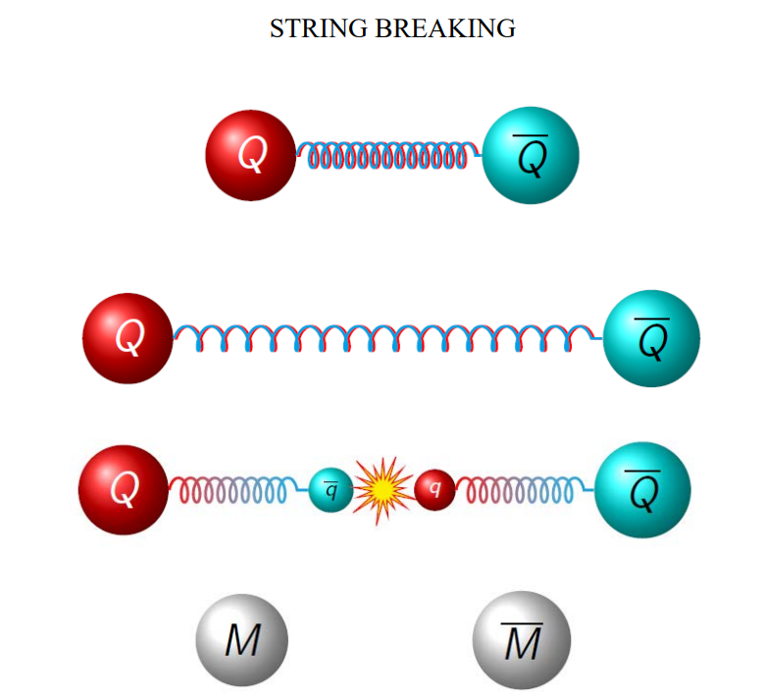
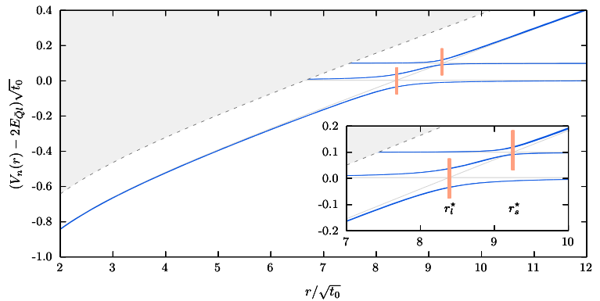
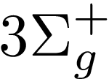
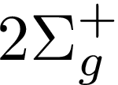
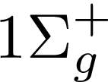

BO potential: Unquenched
String breaking: quarkonium & meson-antimeson
Bulava, Hoerz, Knechtli, Koch, Moir,
Morningstar, Peardon, Phys. Lett. B. 793 (2019)
Bulava, Knechtli, Koch,
Morningstar, Peardon, Phys. Lett. B. 854 (2024)
Ground state + Pions
Figure from R. Bruschini talk
String breaking radius $≈$ 1.22 fm
Avoided crossing between degenerate static potentials with same BO-quantum # $Σ_{g}^{+}$
Notes:
Lattice spacing: 0.063 fm

Slide 16
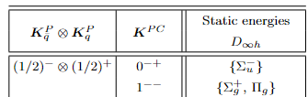
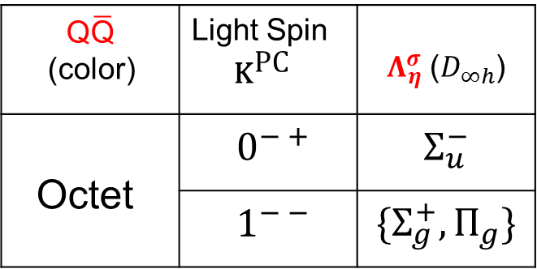




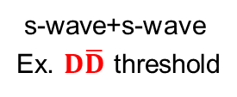



BO potentials: Tetraquarks
LDF
$$Q$$
$$r$$
$$Q$$
$$\overline{Q}$$
$$\overline{Q}$$
As $r→∞$
2- meson state
Consider $\text{Q}\overline{\text{Q}}\text{q}\overline{\text{q}}$ system:
BO-quantum # $Λ_{η}^{σ}$ as $r→0$:
BO-quantum # $Λ_{η}^{σ}$ for meson-antimeson as $r→∞$
$$\text{Q}\overline{\text{Q}}$$ (color) | Light Spin ${\text{K}}^{\text{PC}}$ | $Λ_{η}^{σ}$ ($D_{∞h}$)
Octet | $0^{− +}$ | $$Σ_{u}^{−}$$
 | $1^{− −}$ | $$\{Σ_{g}^{+}, Π_{g}\}$$
s-wave+s-wave
Ex. $D\overline{D}$ threshold
Meson-antimeson threshold have same BO-quantum # $Λ_{η}^{σ}$ !!!
Berwein, Brambilla, AM, Vairo, Phys. Rev. D. 110, (2024), 094040
Braaten, Bruschini Phys. Lett. B 863 (2025) 139386

Slide 17
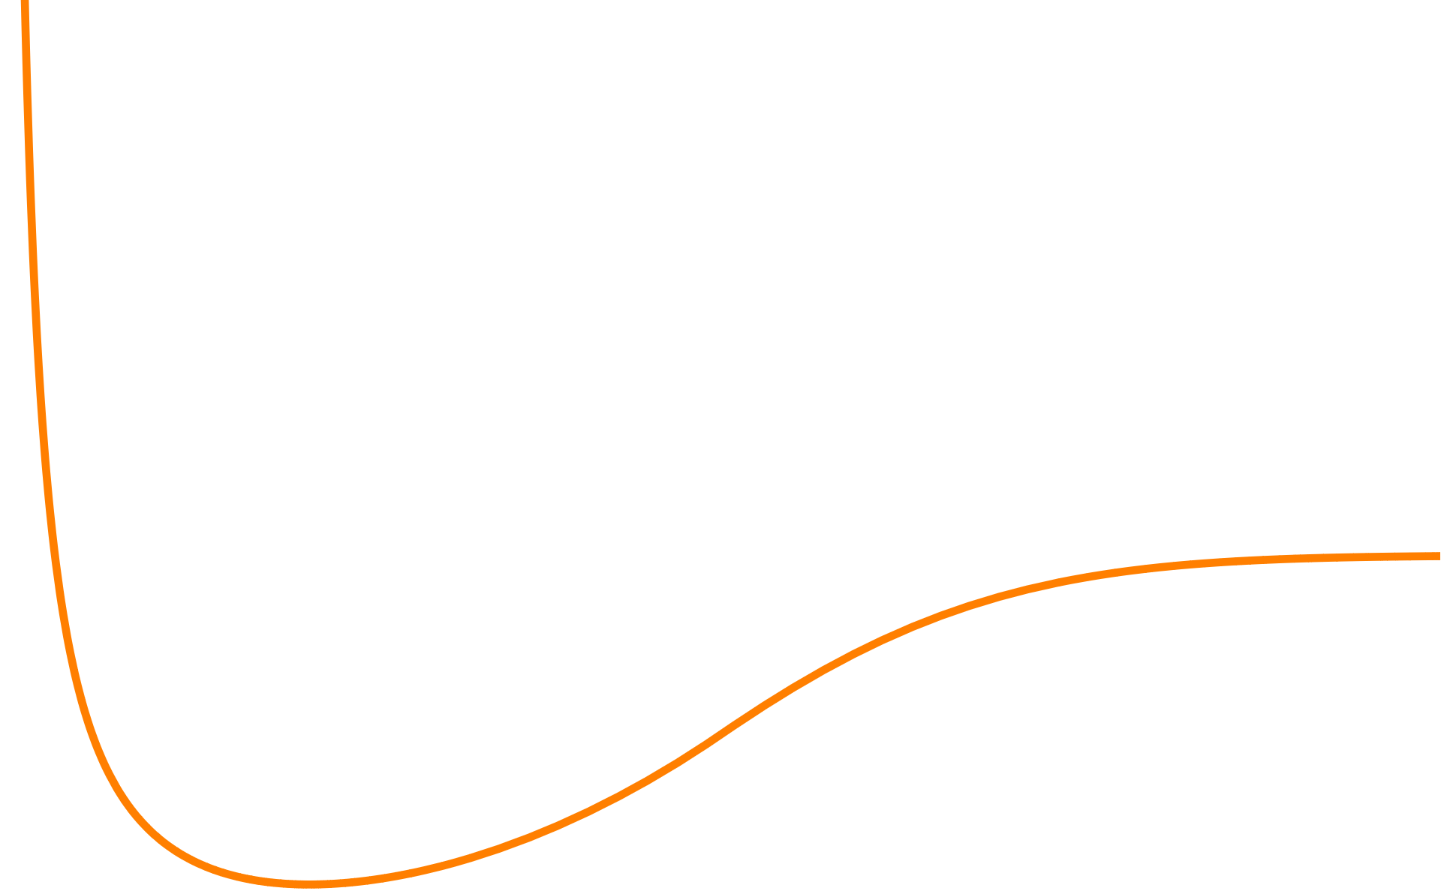

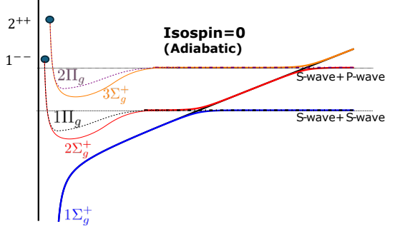
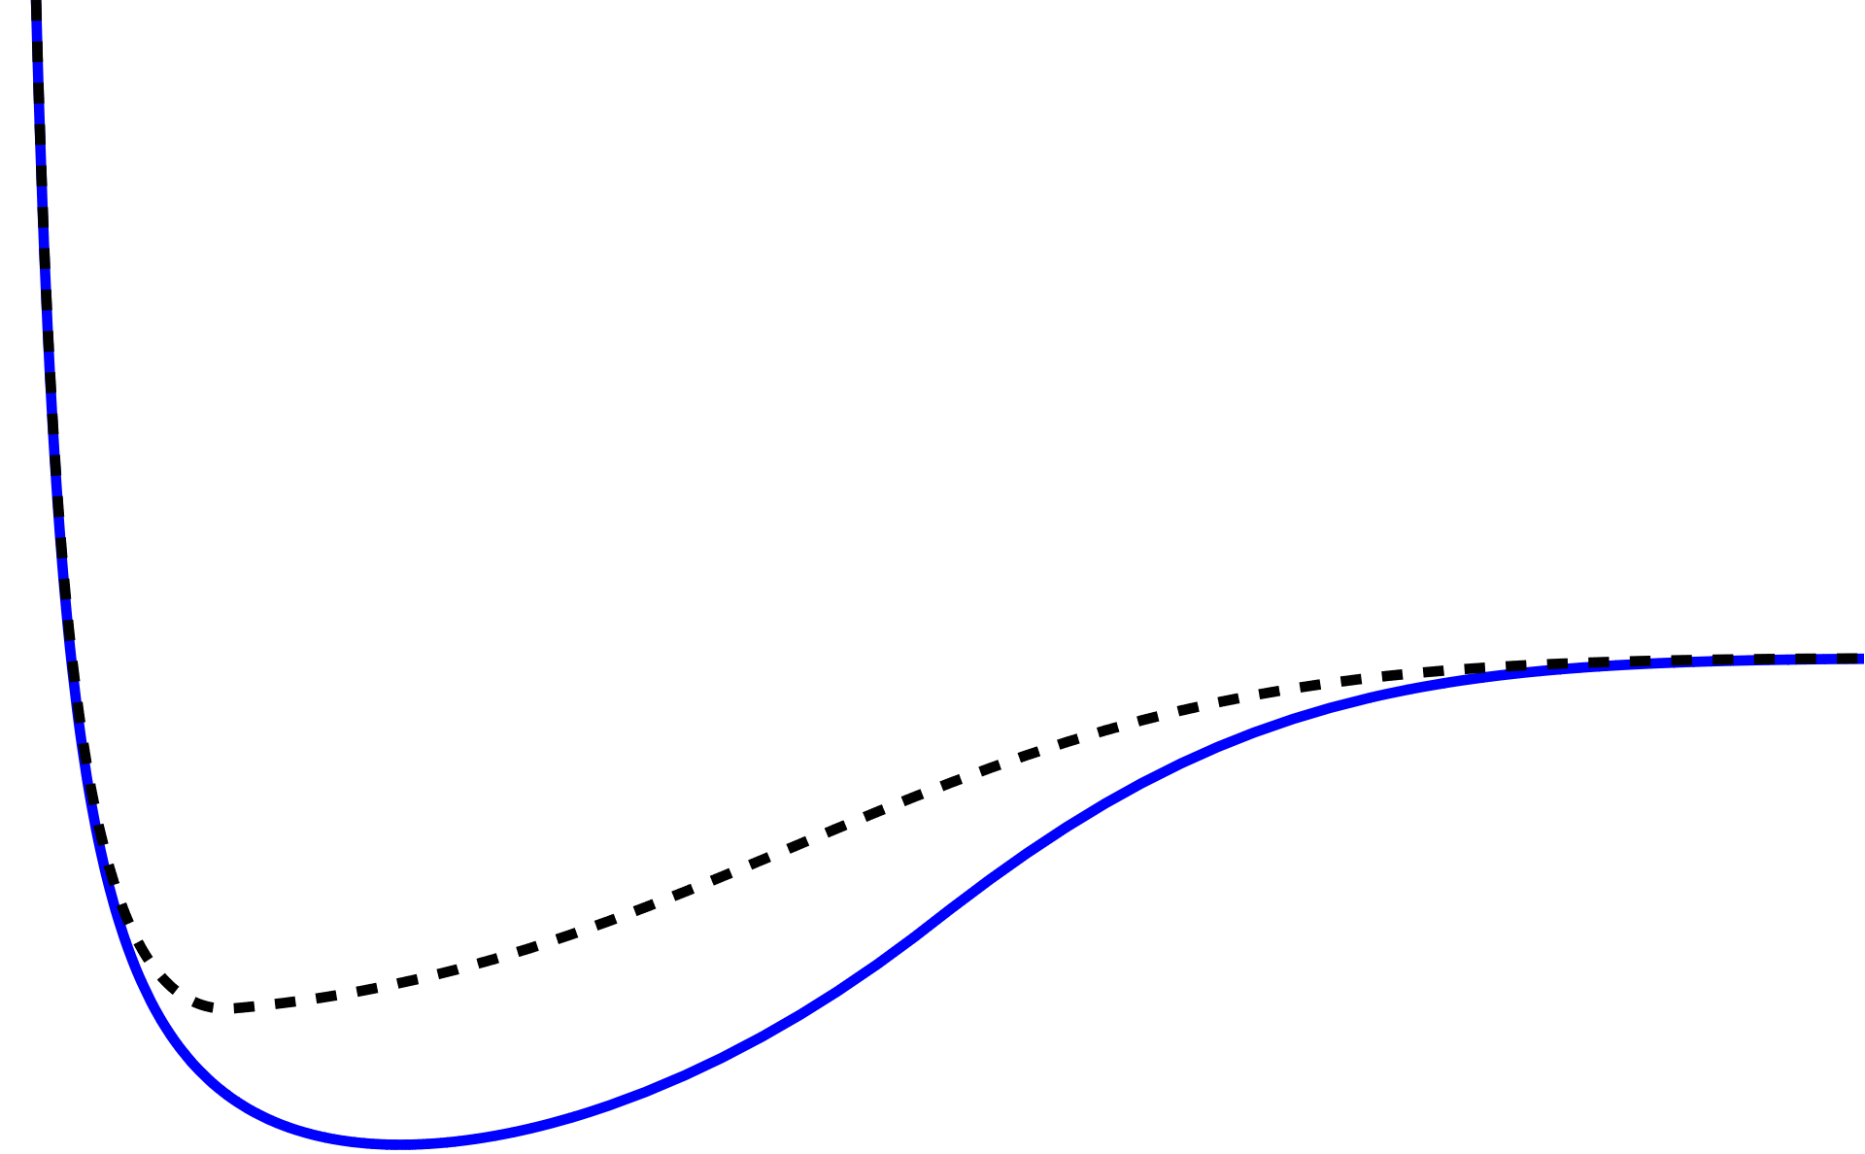

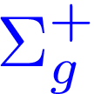


BO potentials: Tetraquarks
$$0^{− +}$$
Isospin=1
Key Takeaways: Tetraquark static potential behavior
Repulsive behavior at small r ($r→0$)
S-wave +S-wave
Heavy meson pair threshold at large r ($r→∞$)
Avoided crossing with quarkonium static energy (Isopsin=0)
$$1^{−−}$$
Isospin=1
S-wave +S-wave
Berwein, Brambilla, AM, Vairo, Phys. Rev. D. 110, (2024), 094040
For preliminary results
see Sipaz Sharma talk on Wed 11:30 !
Braaten, Bruschini Phys. Lett. B 863 (2025) 139386

Slide 18
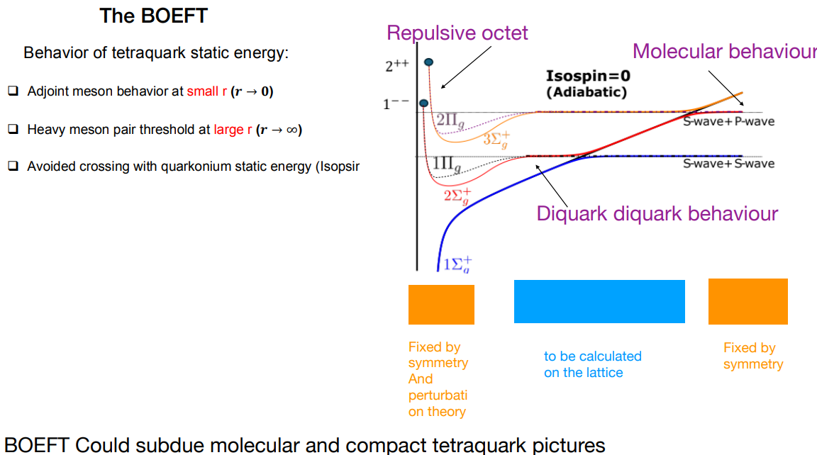
BO potentials
Berwein, Brambilla, AM, Vairo, Phys. Rev. D. 110, (2024), 094040

Slide 19
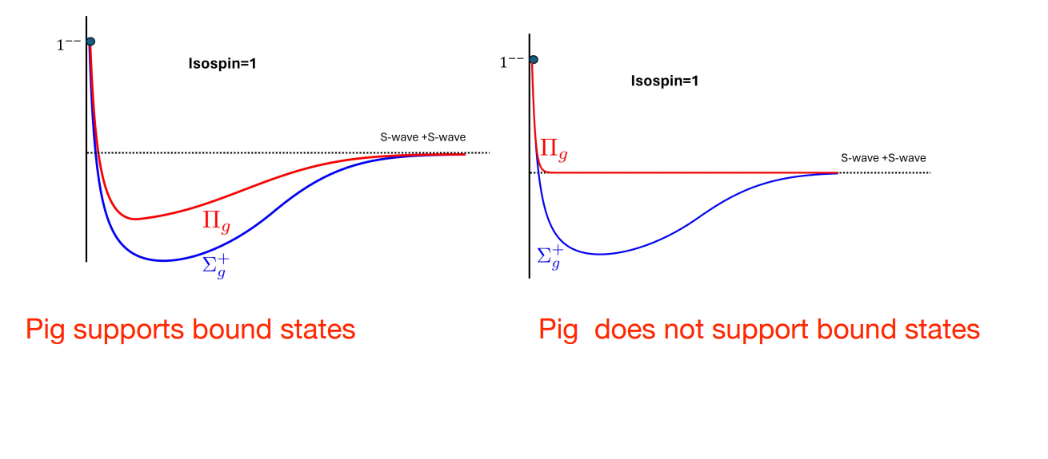
Need lattice evaluation of static potentials:
Intermediate region dictates if bound states are supported.

Slide 20
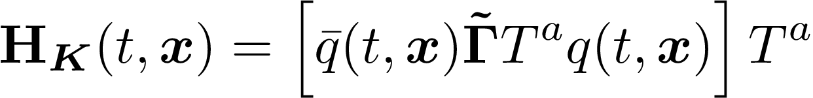
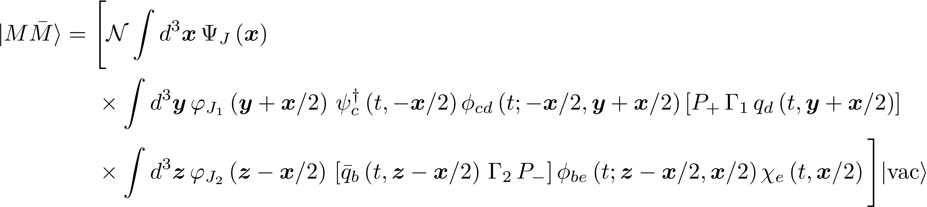
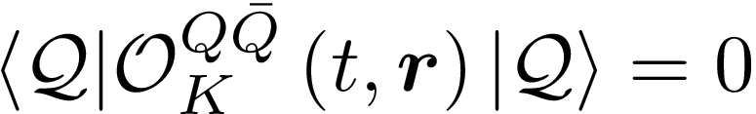
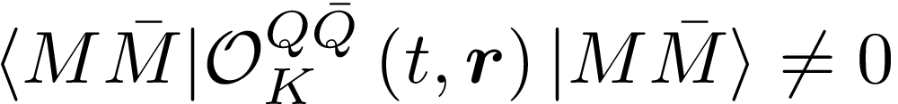
$\text{Q}\overline{\text{Q}}\text{q}\overline{\text{q}}$ : Operator Overlap
Berwein, Brambilla, AM, Vairo, Phys. Rev. D. 110, (2024), 094040
NRQCD operator (gauge invariant) for exotic hadron: $Q\overline{Q}$ pair in octet color
$\tilde{Γ}$: Dirac matrices based
on quantum #’s
Quarkonium + Pions
Meson-antimeson
Quarkonium state:
Meson-antimeson state:
Overlap of adjoint operator on quarkonium + pion:
Overlap of our operator on meson-antimeson:
(at leading order in multipole expansion)
Adjoint operators could be good operators for lattice computation for $\text{Q}\overline{\text{Q}}\text{q}\overline{\text{q}}$ potentials
Notes:
Non-relativistic because v~alpha<<1. This can be seen from the virial theorem.
Top quark mass ~ 180 GeV. Top quark unstable and short-lived and decays into bottom quark + W-boson.

Slide 21

$χ_{c1}\left(3872\right)$ & $T_{cc}^{+} (3875)$

Slide 22





BOEFT: $\text{Q}\overline{\text{Q}}\text{q}\overline{\text{q}}$ multiplets
$$q\overline{q}$$
Isospin-1 channel: $Z_{c} \left(3900\right),Z_{c} \left(4200\right), Z_{b}\left(10610\right), Z_{b}\left(10650\right)$
Mixing b/w adjoint mesons $0^{− +}$ and $1^{− −}$
Voloshin, Phys. Rev. D. 93, 074011 (2016)
Braaten, Bruschini Phys. Lett. B 863 (2025) 139386
See Sipaz Sharma talk on Wed at 11:30 !
Berwein, Brambilla, AM, Vairo, Phys. Rev. D. 110, (2024), 094040
Isospin-0 channel:
$χ_{c1}\left(3872\right),$ $X_{b}$
Brambilla, AM, Scirpa, Vairo
Phys. Rev. Lett. 135 (2025), 131902
Notes:
tti

Slide 23







BOEFT: $\text{Q}\overline{\text{Q}}\text{q}\overline{\text{q}}$ multiplets
Berwein, Brambilla, AM, Vairo, Phys. Rev. D. 110, (2024), 094040
Isospin-0
$$q\overline{q}$$
Lowest multiplet with $χ_{c1}(3872)$ J^{PC}=1⁺⁺
$1^{−−}$ Adjoint meson mass unknown.
Fix it to reproduce $χ_{c1}(3872)$.
Coupled-channel Equations:
Brambilla, AM, Scirpa, Vairo
Phys. Rev. Lett. 135 (2025), 131902

Slide 24








Adiabatic potentials
Berwein, Brambilla, AM, Vairo, Phys. Rev. D. 110, (2024), 094040
Brambilla, AM, Scirpa, Vairo
Phys. Rev. Lett. 135 (2025), 131902
Coupled-channel Equations:
$$∝Λ_{a}^{1^{−−}}$$
$$l=1$$
Bulava et al Phys. Lett. B. 854 (2024)
Results:
Adjoint ${\left(q\overline{q}\right)}_{8}$ : $Λ_{a}^{1^{−−}}≈914$ MeV (pole mass scheme)
2P Quarkonium percentage:${\left|ψ_{Σ}\right|}^{2}≈ 8 \%$
Tetraquark percentage: ${\left|ψ_{Σ^{′}}\right|}^{2}≈ 38 \%$, ${\left|ψ_{Π}\right|}^{2}≈ 54 \%$
Radius $∼15$ fm.
Deeper state in bottom sector: 15 MeV below spin-isospin averaged $B\overline{B}$ threshold.
$$g(GeV)$$
Mixing potential g(r)
Adjoint ${\left(q\overline{q}\right)}_{8}$ energy$Λ_{a}^{1^{−−}}$can be confirmed by lattice QCD !!
r (fm)

Slide 25






BOEFT: $\text{QQ}\overline{\text{q}}\overline{\text{q}}$ multiplets
Berwein, Brambilla, AM, Vairo, Phys. Rev. D. 110, (2024), 094040
Defines the Born-Oppenheimer
static potentials $Σ_{g}^{+}, \{Σ_{g}^{−}, Π_{g}\}$
“Bad diquark”
“Good diquark”
Bad diquark – Good diquark
$≈$ 200 MeV
$J^{P}$ for $T_{cc}^{+}$

Slide 26






Berwein, Brambilla, AM, Vairo, Phys. Rev. D. 110, (2024), 094040
Brambilla, AM, Scirpa, Vairo Phys. Rev. Lett. 135 (2025), 131902
Schrödinger Equation:
$$l=0$$
Results:
${\text{T}}_{\text{cc}}$ state : $320$ keV below DD threshold
Radius $∼8$ fm or larger.
Deeper bound state in bb sector: $T_{bb}$ 116 MeV below BB threshold.
Deeper bound state in bc sector: $T_{bc}$ 25 MeV below DB threshold.
Good diquark : $Λ_{t}^{0^{+}}≈664$ MeV (pole mass scheme)
Lyu, Aoki, Doi, Hatsuda, Ikeda, Meng, Phys. Rev. Lett. 131, 161901 (2023)
Bicudo, Marinkovic, Mueller, Wagner, arXiv 2409.10786
Good diquark energy $Λ_{t}^{0^{+}}$ can be confirmed by lattice QCD !!
Notes:
Lattice data pion mass around 200 MeV

Slide 27








$T_{bb}$ & $T_{bc}$
Brambilla, AM, Scirpa, Vairo 2411.14306
$T_{bc}$ binding energy comparison:
$T_{bb}$ binding energy comparison:
$$J^{P}=1^{+}$$
2411.14306
2411.14306
2503.09760
EFT and heavy-quark-diquark symmetry prediction
for $T_{bb}$: $133±25$ MeV
Our result 25 MeV for both $J^{P}=\{0^{+}, 1^{+}\}$
Braaten, He, AM, Phys. Rev. D. 103, 016001 (2021)
Figures from Randy Lewis talk: LepageFest 2024

Slide 28
Pentaquarks

Slide 29



Pentaquark
Observed states
4 states with isospin $I=1/2$:
$P_{c\overline{c}}{\left(4312\right)}^{+}$, $P_{c\overline{c}}{\left(4380\right)}^{+}$, $P_{c\overline{c}}{\left(4440\right)}^{+}$, $P_{c\overline{c}}{\left(4457\right)}^{+}$
$J^{P}$ quantum numbers not established
All pentaquark states seen by LHCb experiment
PDG 2025
LHCb, Phys. Rev. Lett. 122, (2019), 222001
Notes:
GlueX aims to study pentaquark states through s-wave channel photoproduction.

Slide 30



Brambilla, AM, Vairo, arXiv 2508.13050
Pentaquark
Berwein, Brambilla, AM, Vairo, Phys. Rev. D. 110, (2024), 094040
Lowest pentaquark multiplets:
No lattice QCD results on
adjoint baryon mass: $Λ_{({1/{2)}}^{+}}$ and $Λ_{({3/{2)}}^{+}}$
Treat $Λ_{({1/{2)}}^{+}}$ and $Λ_{({3/{2)}}^{+}}$ as
free parameter to fix on $P_{c\overline{c}}$ spectrum.
Coupled-channel Equations $k^{P}=({1/{2)}}^{+}$:
Coupled-channel Equations $k^{P}=({3/{2)}}^{+}$:
$$l=1/2$$
$$l=3/2$$

Slide 31







Brambilla, AM, Vairo, arXiv 2508.13050
Pentaquark: $P_{c\overline{c}}$
Spin-splitting in meson - baryon :
$$∝Λ_{{\left(3/2\right)}^{+}}^{b}$$
First-order perturbation theory in Vss:
$$∝Λ_{{\left(1/2\right)}^{+}}^{b}$$
Adjoint baryon ${\left(qqq\right)}_{8}$ energy:
$Λ_{{\left(1/2\right)}^{+}}^{b}≈1125$ MeV, $Λ_{{\left(3/2\right)}^{+}}^{b}≈1152$ MeV
Compact pentaquark model: 10 states (some with parity = +)
Molecular model: 7 states

Slide 32



Brambilla, AM, Vairo, arXiv 2508.13050
Pentaquark: $P_{b\overline{b}}$
Spin-splitting in meson - baryon :
$$∝Λ_{{\left(3/2\right)}^{+}}^{b}$$
First-order perturbation theory in Vss:
$$∝Λ_{{\left(1/2\right)}^{+}}^{b}$$
Adjoint baryon ${\left(qqq\right)}_{8}$ energy:
$Λ_{{\left(1/2\right)}^{+}}^{b}≈1125$ MeV, $Λ_{{\left(3/2\right)}^{+}}^{b}≈1152$ MeV

Slide 33








Pentaquark: Decays
Ratio of decays to $Λ_{c}−\overline{D}$ and $Λ_{c}−\overline{D^{∗}}$: $\frac{Γ(P_{c\overline{c}}→Λ_{c}−\overline{D})}{Γ(P_{c\overline{c}}→Λ_{c}−\overline{D^{∗}})}$
Decay happens through transition amplitude $g_{(1/2)}^{Σ−Λ}$
$g_{(1/2)}^{Σ−Λ}$ currently unknown can be determined by lattice QCD
decays to $Λ_{c}−\overline{D}$ and $Λ_{c}−\overline{D^{∗}}$ in d-wave !!!

Slide 34
Summary
Born-Oppenheimer EFT (BOEFT):
Theoretical framework based on scale separation, symmetries with some inputs from lattice QCD.
Quarkonium and Exotic XYZ mesons can be described in the same framework.
Tetraquark / pentaquark static potentials features based on BOEFT:
$\text{Q}\overline{\text{Q}}$ systems: Repulsive at small r ($r→0$). Avoided crossing quarkonium static energy (isospin=0).
$\text{QQ}$ systems: Attractive (Triplet) or repulsive (sextet) at small r ($r→0$).
Heavy meson pair or heavy meson baryon threshold at large r ($r→∞$).
$\text{Q}\overline{\text{Q}}$ systems: Avoided crossing between tetraquark and quarkonium static energy (Isospin=0).
Inputs required from lattice QCD: adjoint meson or baryon spectrum, triplet & sextet meson or baryon
spectrum, tetraquark & pentaquark static potentials.
Exotic dynamics governed by Schrödinger equations. Universal non-perturbative parameters same for both charm and bottom.
BOEFT + lattice QCD, enable quantitative predictions of spectra, decays, and even production rates of exotics, offering key insights into their underlying nature.

Slide 35

What is an XYZ Meson ???
X Y Z
Figure from Eric Braaten talk: Charm 2020 conference and chatgpt
Thank you!!
Perhaps Born-Oppenheimer EFT + Lattice QCD is the key to unlock !!!

Slide 36
Backup Slides

Slide 37

BOEFT
Berwein, Brambilla, AM, Vairo, Phys. Rev. D. 110, (2024), 094040
Coupled Equations for lowest Hybrids ($\text{Q}\overline{\text{Q}}g$) and Tetraquarks ($\text{QQ}\overline{\text{qq}}$ or $\text{Q}\overline{\text{Q}}\text{q}\overline{\text{q}}$):
LDF quantum # K=1
Berwein, Brambilla, Castellà , Vairo Phys. Rev. D. 92 (2015)
LDF quantum # K=2

Slide 38


BOEFT
Berwein, Brambilla, AM, Vairo, Phys. Rev. D. 110, (2024), 094040
Coupled Equations (spin-averaged) for Doubly Heavy Baryons ($\text{QQ}\text{q}$) & Pentaquarks ($\text{QQ}\overline{\text{q}}\text{qq}$ or $\text{Q}\overline{\text{Q}}\text{qqq}$):
LDF quantum # K=1/2
LDF quantum # K=3/2
parity $σ_{P}$:
Opposite
parity $−σ_{P}$ :

Slide 39








BO potentials
$$I=0, Σ_{g}^{+}$$
$$I=1, Σ_{g}^{−}$$
$$I=1, Π_{g}$$
Isospin=1
Mueller et al, PoS LATTICE2023, 64 (2024)
Prelovsek, Bahtiyar, Petkovic, Phys. Lett. B. 805, (2020)
Bicudo, Cichy, Peters, Wagner, Phys. Rev. D. 93, (2016)
Tetraquark / pentaquark BO potentials:
Quark configurations can be rearranged to have two hadron state.
Similarity with molecular physics. Molecules going to constituent atoms when internuclear
separation very large.
Notes:
Sasa lattice data at r/a=1, lattice sapcing is not fine enough to get to small distance.

Slide 40






Brambilla, AM, Scirpa, Vairo
Phys. Rev. Lett. 135 (2025), 131902
Results:
Using lattice QCD spin-splitting
results for hybrids ($Q\overline{Q}g$)
Quarkonium percentage: ${\left|ψ_{Σ}\right|}^{2}≈ 8 \%$
Tetraquark percentage: ${\left|ψ_{Σ^{′}}\right|}^{2}≈ 38 \%$, ${\left|ψ_{Π}\right|}^{2}≈ 54 \%$
Radius $∼15$ fm.
Adjoint ${\left(q\overline{q}\right)}_{8}$ energy: $Λ_{a}^{1^{−−}}≈−228$ MeV:
No bound states in higher
multiplets $T_{2}^{1},T_{3}^{1}$, $T_{4}^{1}$ ….
$1^{+ +}$ state: Identified with $χ_{c1}(3872)$
$1^{+ −}$ state: Mass around 3.957 (11) GeV. Identified with X(3940) ?
Multiplet $T_{1}^{1}$: {$1^{+ −}, {\left( 0, 1, 2\right)}^{+ +}$}
$2^{+ +}$ state: Mass around 4.004 (14) GeV.
$0^{+ +}$ state: Mass around 3.846 (11) GeV. Also indicated in the lattice calculations: Prelovsek et al JHEP 06 (2021) 035.

Slide 41









Brambilla, AM, Scirpa, Vairo
Phys. Rev. Lett. 135 (2025), 131902
Using lattice QCD spin-splitting
results for hybrids ($Q\overline{Q}g$)
Results with
adjoint meson energy $≈−228$ MeV
Quarkonium percentage: ${\left|ψ_{Σ}\right|}^{2}≈1.5 \%$
Tetraquark percentage:
${\left|ψ_{Σ^{′}}\right|}^{2}≈45.4 \%$, ${\left|ψ_{Π}\right|}^{2}≈ 53.1 \%$
$$2^{++}$$
$1^{+ +}$: identified with $X_{b}$: Mass around 10.595 GeV
$1^{+ −}$ state: Mass around 10.612 GeV.
Multiplet $T_{1}^{1}$: {$1^{+ −}, {\left( 0, 1, 2\right)}^{+ +}$}
$2^{+ +}$ state: Mass around 10.635 GeV.
$0^{+ +}$ state: Mass around 10.576 GeV.

Slide 42







Brambilla, AM, Scirpa, Vairo 2411.14306
We naturally get $8−13 \%$ quarkonium component
in $χ_{c1}(3872)$ due to avoided level crossing
Quarkonium percentage: ${\left|ψ_{Σ}\right|}^{2}≈ 8−13 \%$
Tetraquark percentage: ${\left|ψ_{Σ^{′}}\right|}^{2}≈ 38 \%$, ${\left|ψ_{Π}\right|}^{2}≈ 54 \%$
Radius $>15$ fm.
Radiative decays:
Our estimate: $R_{γψ}=2.99±2.36$ (assuming only through $χ_{c1}\left(2P\right)$ component)
LHCb: $R_{γψ}=1.67±0.25$
Aaij et al arXiv: 2406.17006
Compositeness:
BES III: $Z={0.18}_{−0.23}^{+0.20}$
EMPPR: $\text{0.052 < }\text{Z}\text{ < 0.14}$
Agreement with our $8−13 \%$ quarkonium (compact) component
Ablikim et al. Phys. Rev. Lett 132, 151903 (2024)
Esposito, Maiani, Pilloni, Polosa, Riquer
Phys. Rev. D 105, L031503 (2022)
Lattice QCD:
$c\overline{c}$ operator along with $D{\overline{D}}^{∗}$ relevant for $χ_{c1}(3872)$ signal
Padmanath, Lang, Prelovsek Phys. Rev. D 92, 034501 (2015)
Prelovsek and Leskovec Phys. Rev. Lett 111, 192001 (2013)

Slide 43





Brambilla, AM, Vairo, arXiv 2508.13050
Pentaquark: Decays
Semi-inclusive decays:
$Q_{n}$: low-lying quarkonium Y: light hadrons
$ΔE$: Large energy difference $⇒ΔE≡ E_{P_{c\overline{c}}} −E_{n}≿$ 1 GeV.
Hierarchy of scales: $\text{∆}\text{E}\text{ ≫ }{\text{Λ}}_{\text{QCD}}≫mv^{2}$
Constituent LDF of the exotic is a spectator.
Perturbative computation
Reported in PDG 2024:
Semi-inclusive decays:
$P_{c\overline{c}}$ | $Γ$ (total width)
$P_{c\overline{c}}(4312)$ | $10±5$ MeV
$$P_{c\overline{c}}(4380)$$ | $210±90$ MeV
$$P_{c\overline{c}}(4440)$$ | ${21}_{−11}^{+10}$ MeV
$$P_{c\overline{c}}(4457)$$ | ${6.4}_{−2.8}^{+6}$ MeV
$P_{c\overline{c}}$ | $J^{P}$ | $Γ$ ($P_{c\overline{c}}→J/ψ+⋯$)
$P_{c\overline{c}}(4312)$ | ${\left(1/2\right)}^{−}$ | $2_{−1 −1}^{+1 +1}$ MeV
$$P_{c\overline{c}}(4457)$$ | $${\left(1/2\right)}^{−}$$ | $1_{−0.3 −0.3}^{+0.5 +0.4}$ MeV
$$P_{c\overline{c}}(4380)$$ | $${\left(3/2\right)}^{−}$$ | ${14}_{−3 −4}^{+6 +5}$ MeV
$$P_{c\overline{c}}(4440)$$ | $${\left(3/2\right)}^{−}$$ | ${20}_{−5 −6}^{+9 +8}$ MeV
only decays to $η_{c}$ !!!

