Slide 1
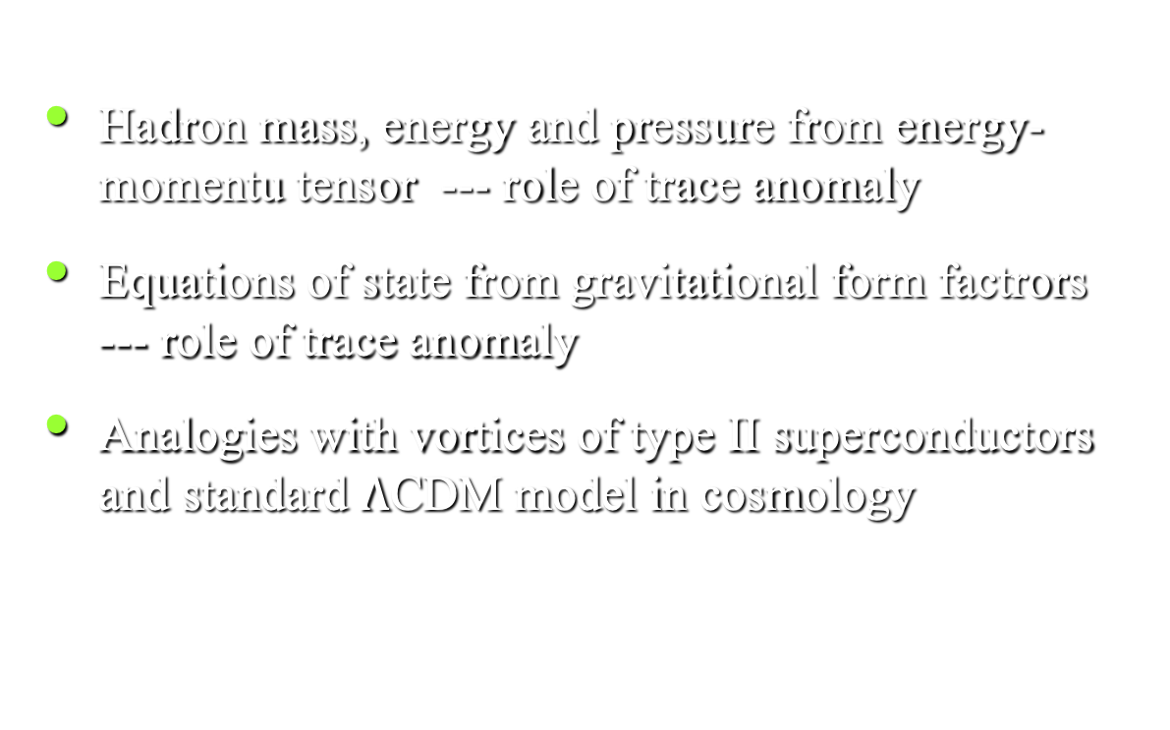
Pressure-Energy Equations of State of Hadrons
Hadron mass, energy and pressure from energy-momentu tensor --- role of trace anomaly
Equations of state from gravitational form factrors --- role of trace anomaly
Analogies with vortices of type II superconductors and standard $Λ$CDM model in cosmology
PRD 104,076010 (2021) [arXiv:2103.15768],
PLB 849, 138418 (2023) [arXiv:2302.11600]
Lattice 2025, Mumbai, Nov.6, 2025

Slide 2
Mass, Energy, and Pressure of Hadrons – Energy Momentum Tensor
Energy momentum tensor
Mass from trace of EMT – scalar, frame independent, scale invariant
Chanowitz, Ellis, Crewther, Collin, Duncan, Joglekar
91% of nucleon mass

Slide 3
Rest Energy Decomposition from Hamiltonian
Separate the EMT into traceless part and trace part
Hamiltonian --
Rest energy --
(Ji, 1995)
Quark energy
(scale dependent)
Glue field energy
(scale dependent)
Caracciolo:1989pt, Makino:2014taa,
DallaBrida:2020gux
<x> - momentum fraction
experimentally measurable
3

Slide 4
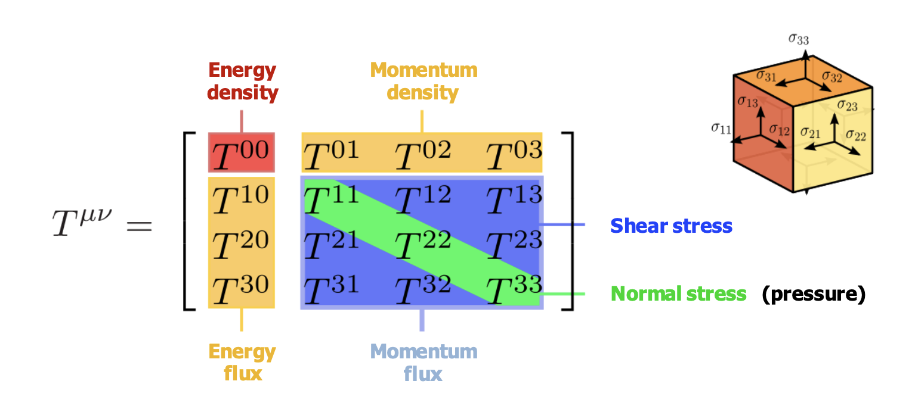
Rest Energy/Mass from Gravitational FF
Gravitational Form factors from the EMT matrix elements
  A(0) and A(0)+ B(0) : momentum and angular momentum -
  D(q²): pressure distrituton - [Polyakov]
  C-bar term: pressure-volume work - [Lorce, Liu]
[Ji]

Slide 5
Pressure and T^{ii}
Thermodynamic pressure
Hydrodymic pressure = normal stress
Are they the samein QCD? (true for fluid, general relativity, quantum many-body physics).
Euclidean path-integral formalism = classical statistical mechanics with a partition function. Lattice QCD phase structure in thermodynamical variables, e.g. T, E, P in grand canonical ensemble.
Proof for QCD with renormalization group and trace anomaly taken into account – Drummond, Horgan, and Landshoff, hep-th/9905207.
Finite density, e.g., one baryon is formulated in terms of the canonical ensemble (KFL, hep-lat/0202026)

Slide 6
Pressure and T^{ii}
However, there is an issue with bound states – energy does not depend on volume, therefore P = 0 and V in the PV work is ill-defined.
On the other hand, the pressure is a local observable. In neutron stars, the thermodynamic definition of pressure is valid (each fluid element can still be compressed and expanded) – Ferrer and Hackebill (1903.08224). This implies that
The spatial distribution of T^{ii} (r) can be obtained from the gravitational form factor for off-forward matrix elements.

Slide 7
Graviational FF (off-forward)
Breit frame
Trace FF:
Energy FF:
Pressure FF:
Mass FF:
Note:
Equation of state:
Polyakov, Lorce
Ignore B
KFL, PLB 849, 138418 (2023) [arXiv:2302.11600

Slide 8

Trace Anomaly and Gluon Condensate
Where are and coming from?
Picture: Nucleon is a bubble in the sea of gluon condensate, where
Pressure
(stactic pressure )
Trace anomaly gives a negative constant
pressure confinement
Many facets of color confinement
  Dual superconductor
  Magnetic monopole
  Center vortices
Same as in
charmonium
Bali (‘97), Baker (‘18)
R.H. Rothe, 9504012
String tension from the lattice calculation of the trace anomaly in charmonium is consistent with that the potential model. 2103.15768

Slide 9
Spatial Distributions from Graviational FF
Fourier Transform to obtain spatial distributions
Eqations of state:
Static pressure from the trace part is from the condensate.
Dynamic pressure of the traceless part is due to quarks and gluons
Total pressure distribution
D. Pefkou
D term:
Caveat: 3D instant form is questionable
(G. Miller, R. Jaffe); 2D in light front or
infinite momentum frames is OK.
Shanahan and Detmold 1810.07589
D. Pefkou
Forward M.E.
PV_{eff} =0

Slide 10


Energetics and Equilibrium
Normal Phase
Type II superconductor
Variational model (J.R. Clem, Jour. Low Temp. Phys. 18, 5/6 (1975))
Superconducting Phase
Equation of state

Slide 11
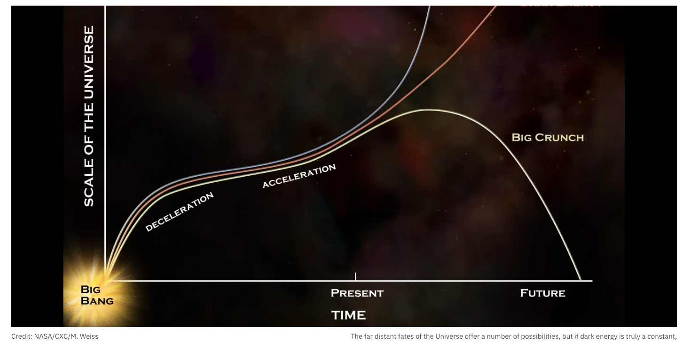
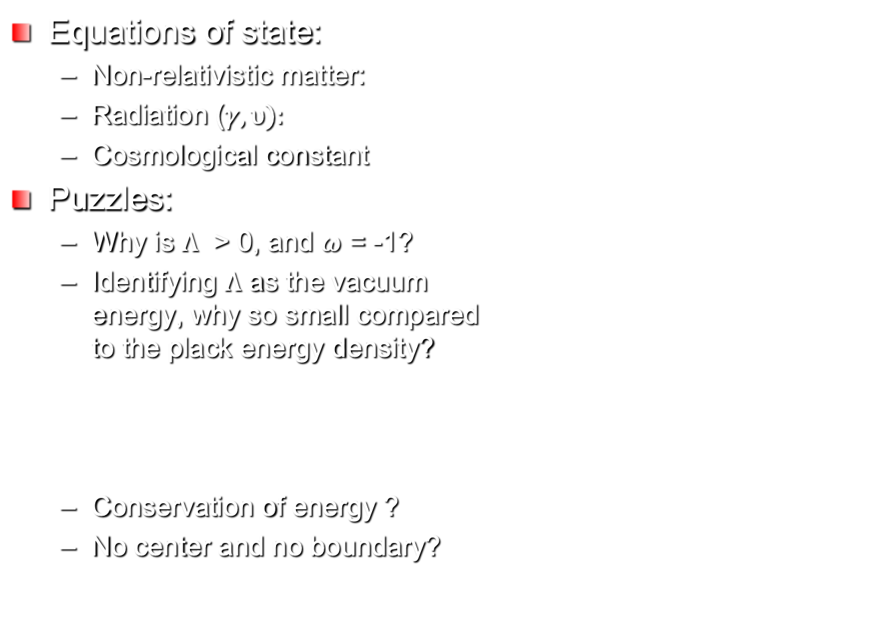

Standard Model of Cosmology - $Λ$CDM
Equations of state:
  Non-relativistic matter:
  Radiation ($γ,υ):$
  Cosmological constant
Puzzles:
  Why is $Λ$ > 0, and $ω$ = -1?
  Identifying $Λ$ as the vacuum energy, why so small compared to the plack energy density?
  Conservation of energy ?
  No center and no boundary?
N.B. in the GR equation
- a salient feature

Slide 12
Exploring the Possible Origin of Cosmological Constant
How does come about?
  By fiat (Einstein)
  Condensate
Cosmos – by analogy with QCD and superconductivity, there could be a conformal symmetry breaking in quantum gravity, leading to a trace anomaly and, thus, a condensate
Universe emerges from the true vacuum.
Small cosmological constant ?
Energy is conserved.
Boundary – lattice example
S.K. Blau, E.I.Guendelman, A.H. Guth, PRD 035, 1747 (1987)

Slide 13
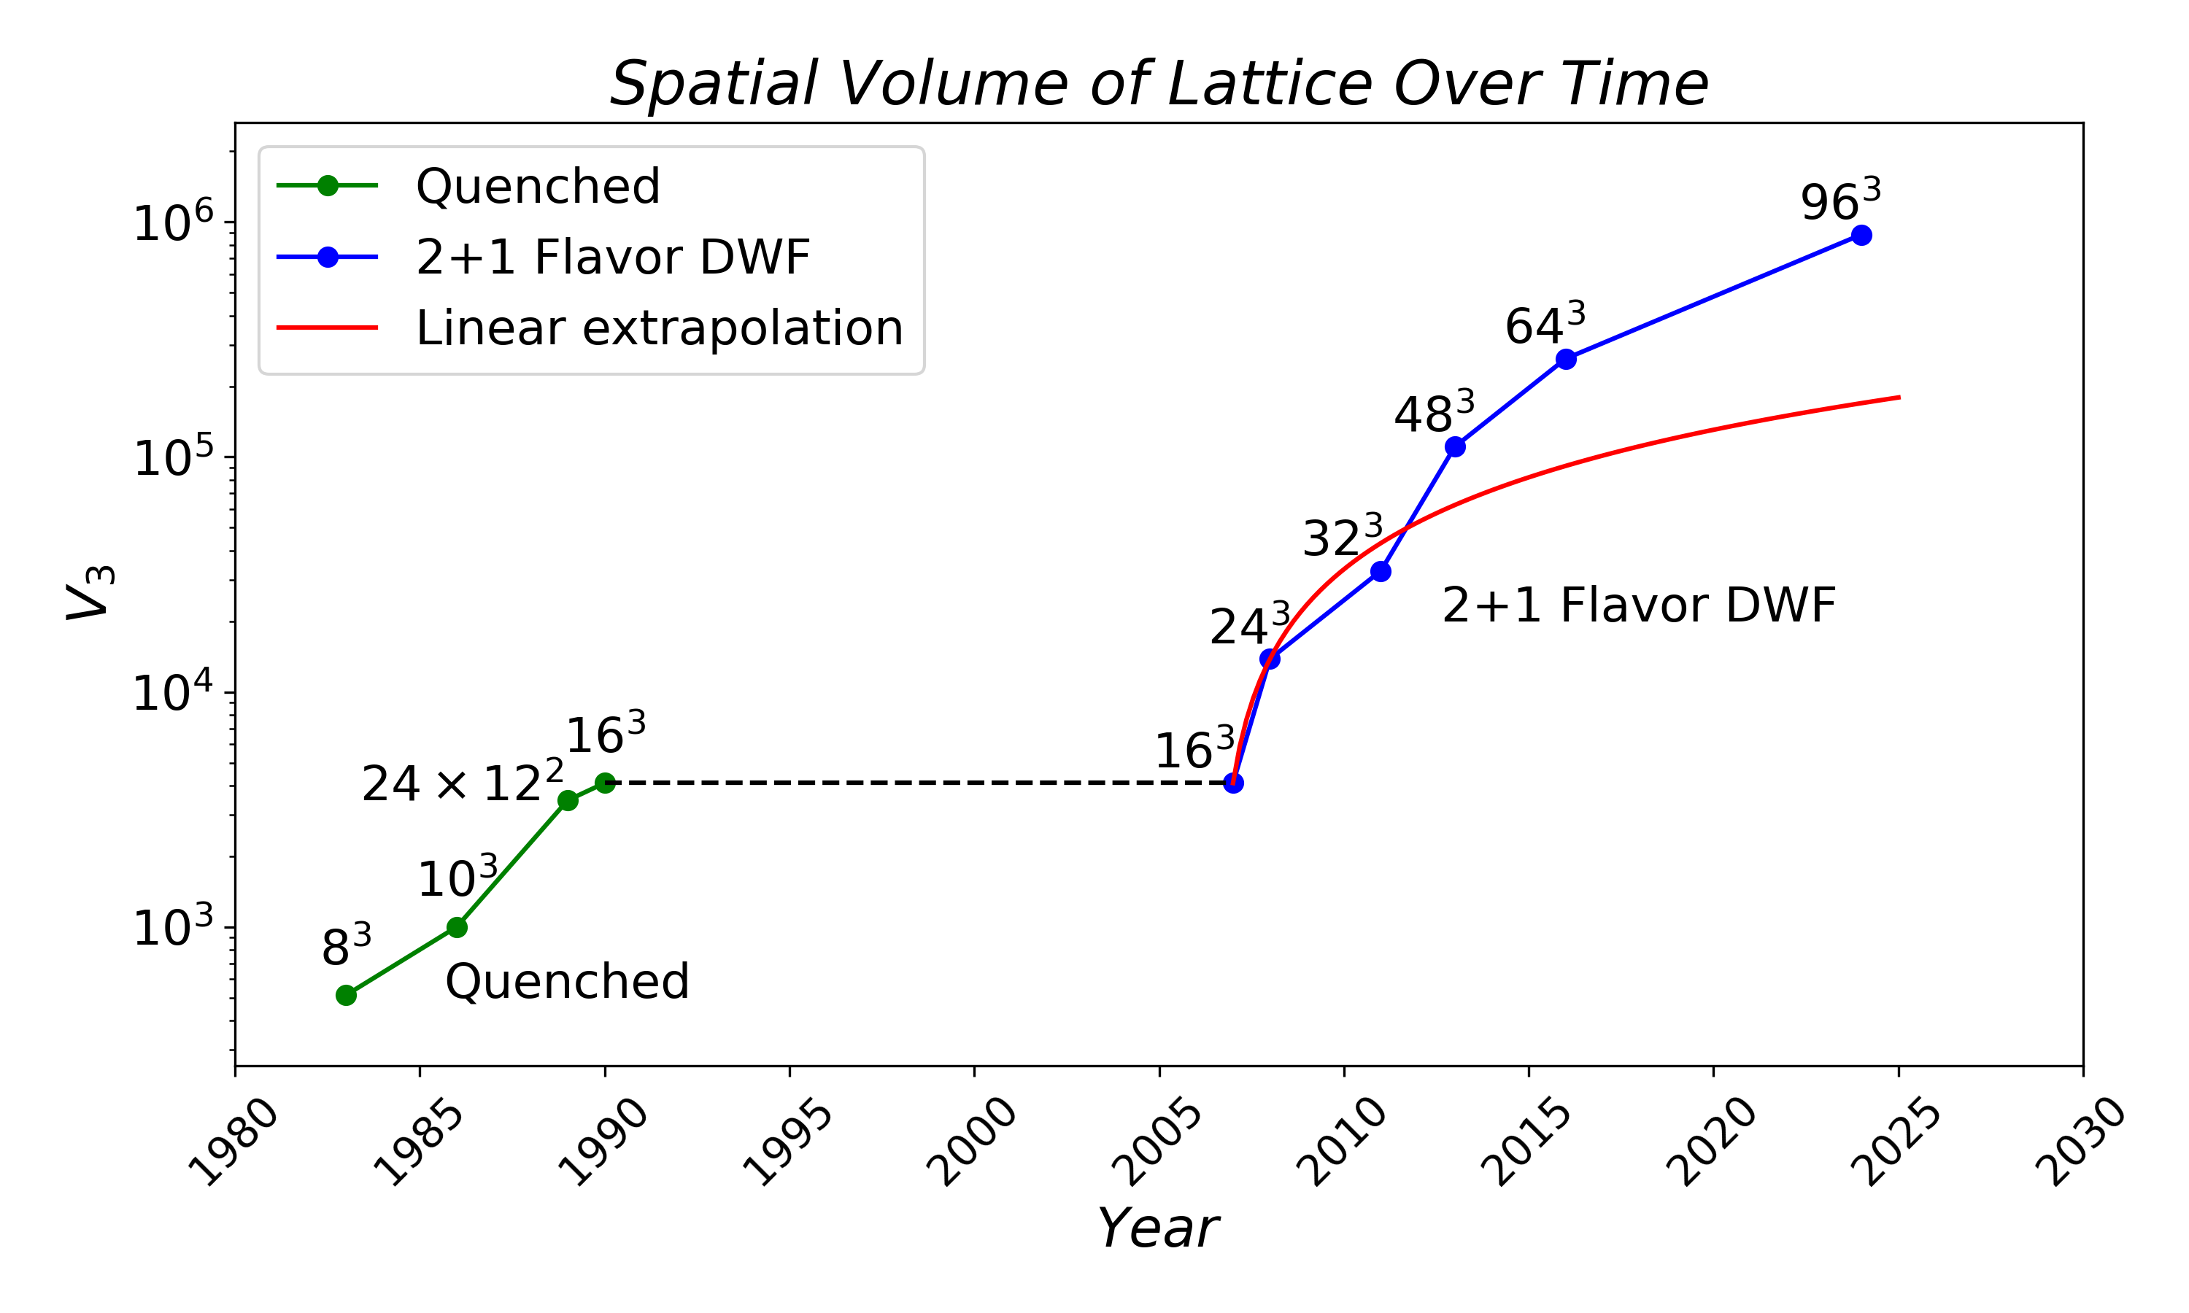
Lattice Universe

Slide 14
To see a World in a Grain of Sand and a Heaven in a Wild Flower, Hold Infinity in the palm of your hand and Eternity in an hour. -- William Blake
In a drop of water, all the oceans are reflected. In a speck of dust, infinite worlds.
-- Zen teaching

Slide 16

Mass and Rest Energy
E = m c² m increases with E?
E₀ = m c² (Einstein 1905, m² = E² – p²)
e⁺ e⁻ $→$ $γγ$ (m$γγ$= 2m_{e})
Mass is a scalar and E is a component of the four vector. E and p are additive, not mass. Converting mass to energy?
In general relativity, the gravitational field is coupled to the EMT.
In non-relativistic limit, Newton’s law of force and universal gravitational involves E₀ or mass.
Inertial mass and gravitational mass are the same mass.
Relativistic mass in a misnomer, rest mass is redundant.
-- L.B. Okun doi:10.1134/1.1358478
cou

Slide 17
Graviational FF (off-forward)
Mass FF:
Energy FF:
Pressure FF:
Note: Pressure-energy relations
Equation of state:

Slide 18
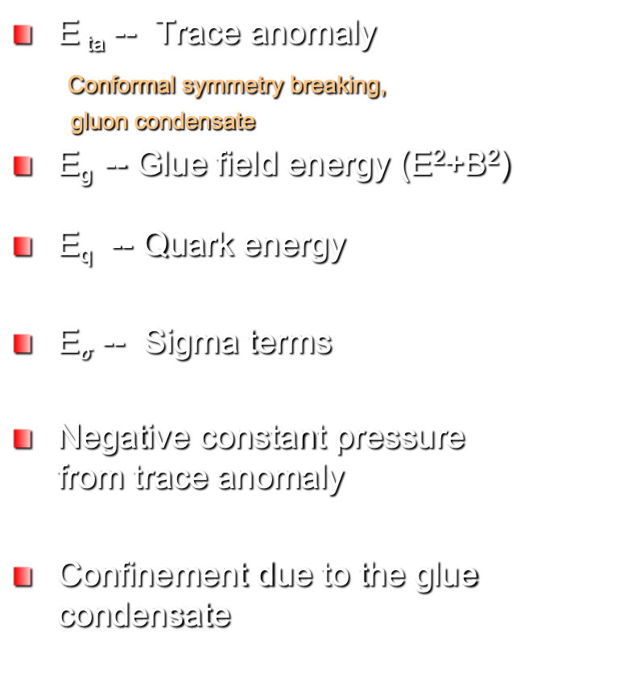
Superconductor Vortex
Hadron
F_{S} – Cost of compensation energy
Gauge smmerty breaking,
Cooper pair condensate
F_{B} -- Magnetic field energy
F_{SC} -- Supercurrent energy
Total Electron mass
Negative constant pressure from F_{S}
Confinement due to the superconducting condensate
E _{ta} -- Trace anomaly
Conformal symmetry breaking,
gluon condensate
E_{g} -- Glue field energy (E²+B²)
E_{q} -- Quark energy
E$σ$ -- Sigma terms
Negative constant pressure from trace anomaly
Confinement due to the glue condensate

