Slide 1
Precision Scale Setting in Lattice QCD Using Baryon Spectra and Decay Constants
Jun-Sik Yoo
Department of Physics
Korea University
South Korea
with T. Bhattacharya, J. Ee, R. Gupta, S. Park in progress

Slide 2
Collaboration
NME Collaboration: 2+1-flavor clover ensembles = clover-on-clover formulation
Members of NME
Tanmoy Bhattacharya (LANL)
Vincenzo Cirigliano (INT)
Rajan Gupta (LANL)
Yong-Chull Jang
Balint Joo (NVIDIA)
Emanuele Mereghetti (LANL)
Santanu Mondal
Sungwoo Park (LLNL)
Huey-Wen Lin (MSU)
Frank Winter (JLab)
Jun-Sik Yoo (Korea University)
Boram Yoon (NVIDIA)
Acknowledgement
LANL NME 2+1 flavor clover ensembles
Travel support from NRF, South Korea, via Professor Alexander Rothkopf in Korea University
Supported by BrainPool program RS2528521
CHROMA software package
Computing Resources:
INCITE award HEP133 on Frontier @ OLCF
ALCC award HEP145 on Frontier @ OLCF
ERCAP Awards on Perlmutter @ NERSC
LANL Institutional Computing
USQCD Allocations

Slide 3
Outline
Motivation
Methodology
Result
Summary

Slide 4

Motivation
Lattice scale propagates to every dimensionful observables as
At sub-percent precision, scale error dominates systematics
Example)
dipole estimate of nucleon charge radius r_{E}²
0.586(17)(13) fm²
PNDME, 2020, PRD 101, 014507
– Nucleon charge radius r_{E}² has units of fm² → 2× sensitivity to a.
– Due to precision determination, error from scale setting is small
– Precision tests demand sub-percent control.
For Clover-on-Clover, such determination is called for!

Slide 5
Lattice Details
2+1 flavor Wilson clover ensemble
tree-level tadpole improved symanzik gauge action
Sheikholeslami-Wohlert coefficient tuned to 1/u₀³
Quark mass aimed to have (2𝑀_{𝐾+}² − 𝑀_{𝜋+}² )/𝑀_{Ω−} = 0.1678 but it varies from 0.17 to 0.20
Lattice ensembles by many collaboration well summarized in Aoki, arXiv:2502.08303
Read also JHEP 05 (2023) 035 by G. Bali et al.

Slide 6
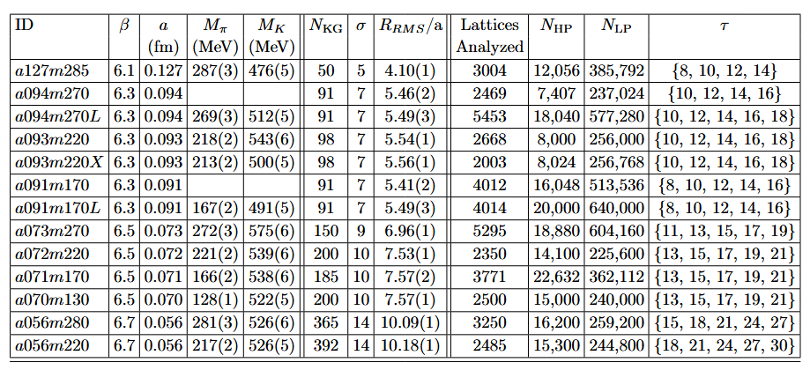
Lattice Details
Multiple lattice Ensemble used:

Slide 7


Gradient flow observables
Gradient flow smoothes field toward static point in Lattice action
Energy density at specific flow time, serves as a reference point
Lattice Measurement gives t₀/a²
Multiply by t₀/a² to certain power to keep observable dimensionless
t₀ will be matched to t₀^{phys} at the physical point when extrapolating

Slide 8
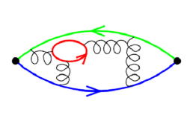
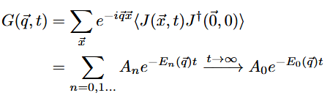
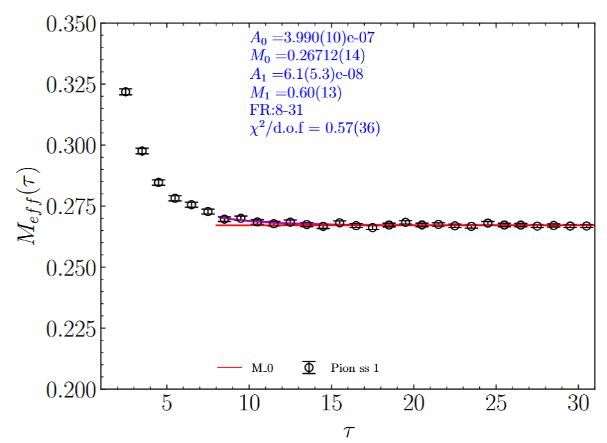

Spectrum on the lattice
Euclidean two-point correlation function gives:
where

Slide 9
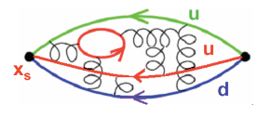
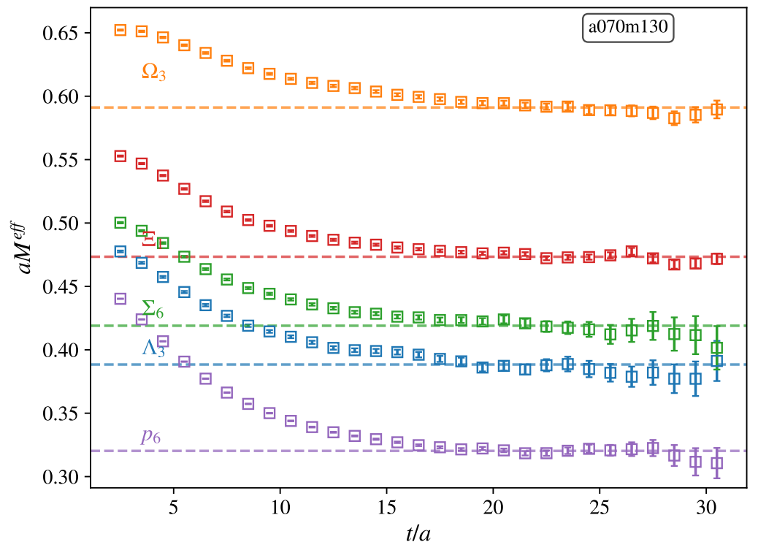

Spectrum on the lattice
Euclidean two-point correlation function gives:
where

Slide 10


Analysis from Octet Baryon Masses
Chiral model separated from lattice discretization effect
lattice discretization modeled in three different shape
LO, NLO, NNLO term is fit as LEC
At physical point, we solve for t₀^{phys}

Slide 11
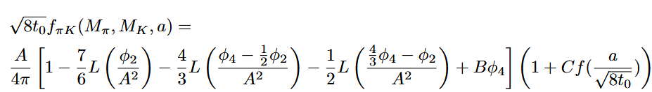
Analysis from Decay constants
Chiral and discretization dependence modeled
B. Strassberger, POS Lattice 2021
Lattice discretization modeled in three different form
Additional chiral dependence tested (Cont.)

Slide 12
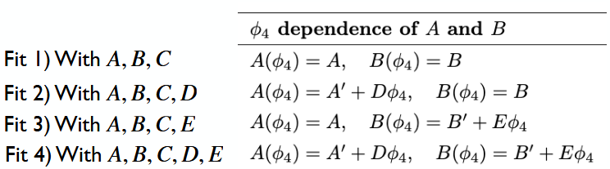
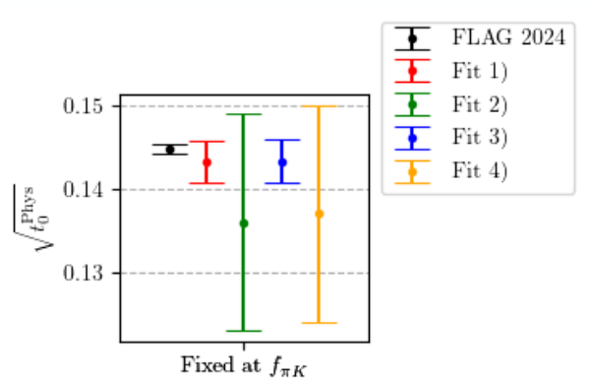
Analysis from Decay constants

Slide 13
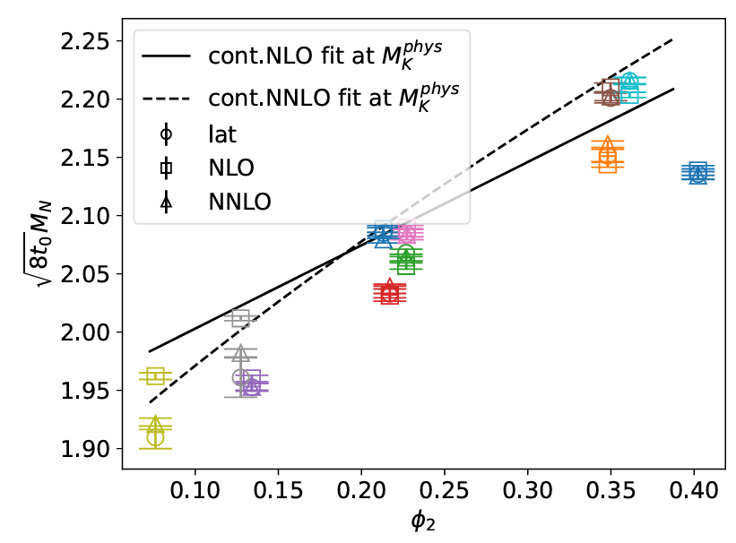
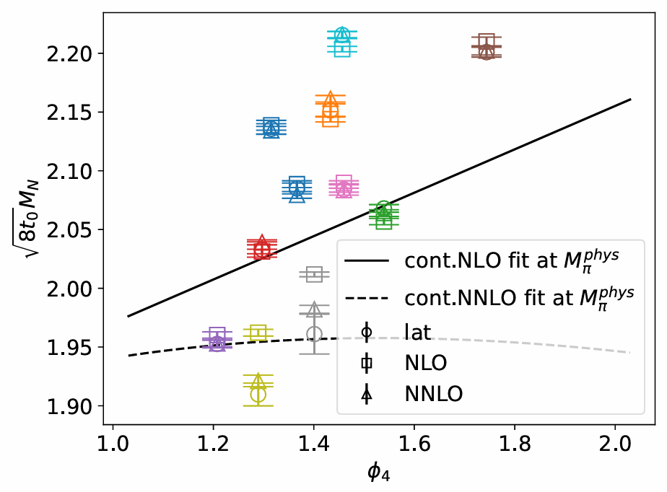
Analysis from Octet Baryon Masses
Chiral and discretization dependence modeled

Slide 14
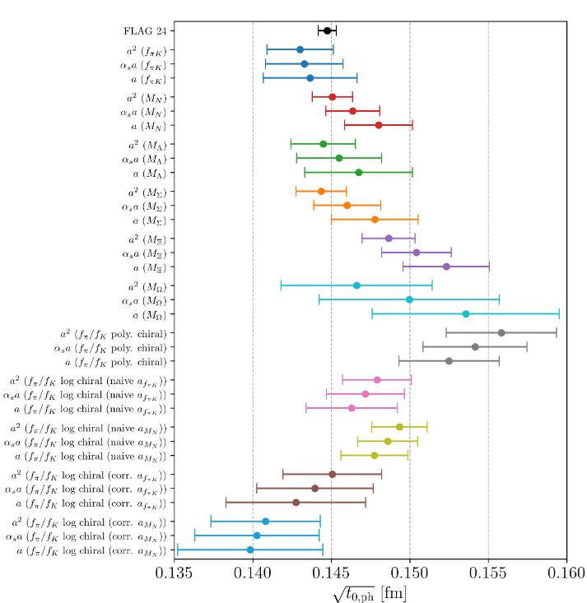
Analysis from Both

Slide 15
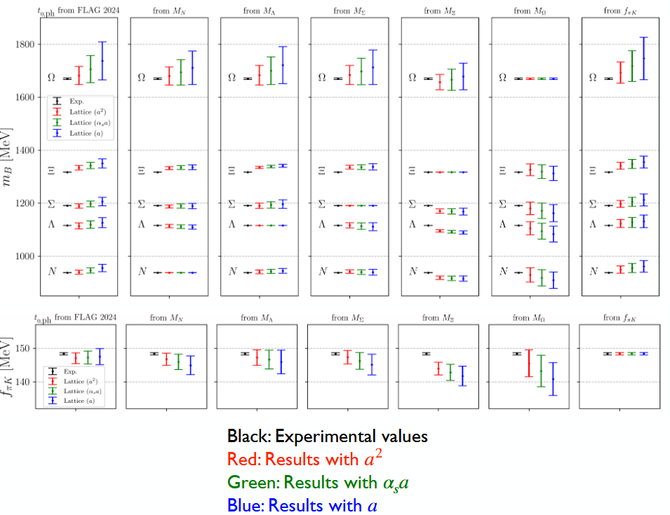
Final Result

Slide 16
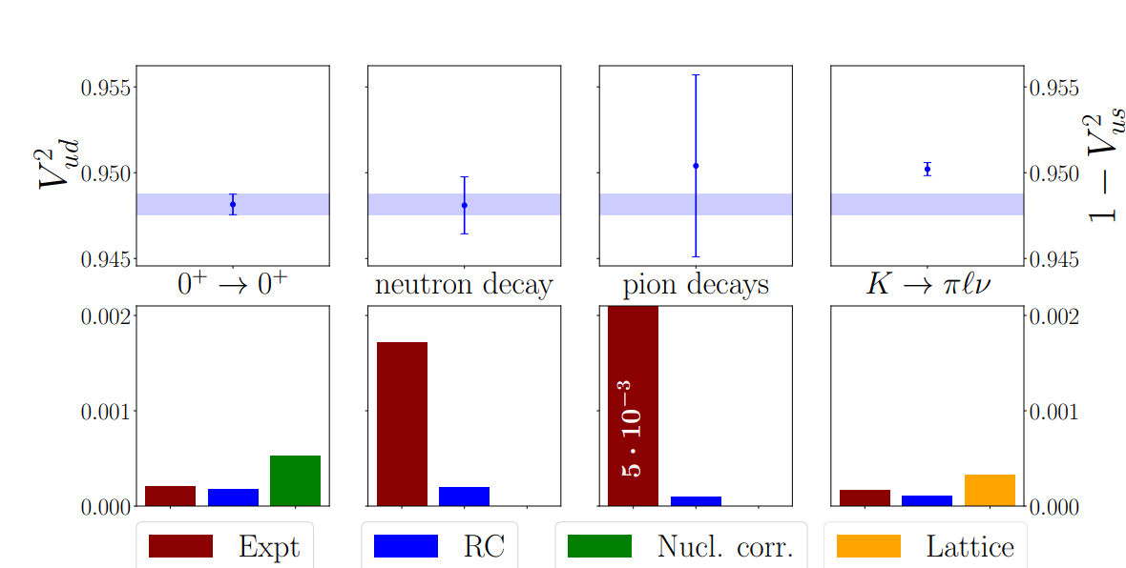
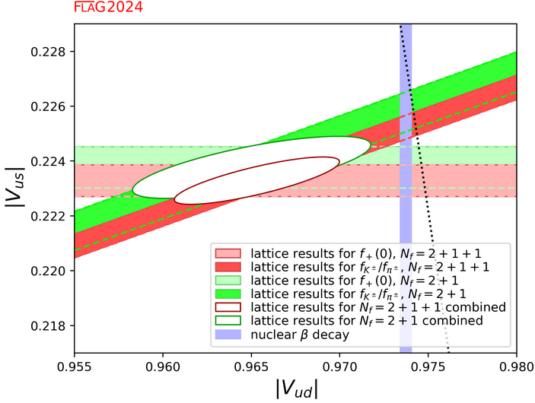
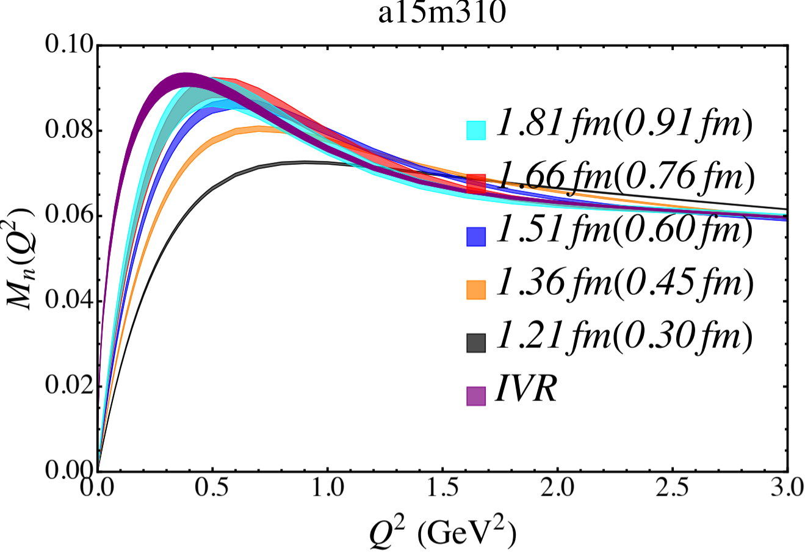
Other ongoing projects.. (LANL)
K → μν/π → μν
K → πℓν
2+1+1 HISQ ensemble w/ Clover fermion
Unitarity
|V_{ud}|² + |V_{us}|² + |V_{ub}|² = 1
With upcoming UCNA measurements, 1st row unitarity of CKM matrix will again put to test.
Radiative correction with small error bar needed!

Slide 17
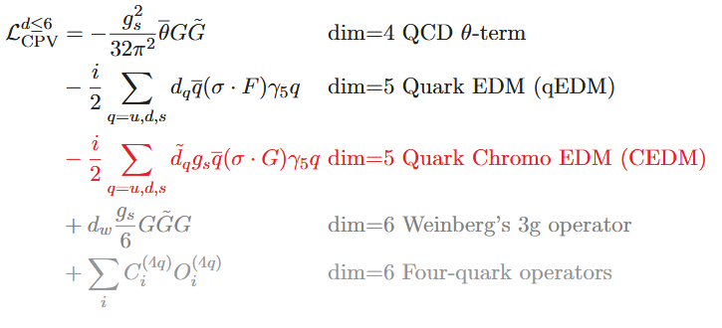
Other ongoing projects.. (LANL)
CEDM operator has power divergent mixing with pseudoscalar operators
Gradient flowed operators for quark bilinears ready
→ renormalization & chiral behavior better under control

Slide 18
Summary
Flow time observable t0 and w0 is measured on Clover ensemble
Meson and Baryon spectrum measured in precision
Thank you for your attention
Decay constants measured
Small numbers of ensemble limits analysis
Scale setting as well as sigma term can be measured

