Slide 1

Axial Charges in Hilbert Space and Their Role in Chiral Gauge Theories
Based on : JHEP10(2025)102
Tatsuya Yamaoka
Department of Physics, The University of Osaka
Lattice 2025 @Mumbai
Nov. 2 2025

Slide 2
Our Work
We reconstructed 1+1 D staggered fermion system using the fermion basis
that diagonalizes the chiral charge defined by [Chatterjee, D. Pace, Shao (2024)]
As a result, we identified a new basis
in which the chiral charge becomes manifest in real space.
Applying this framework,
one can construct scenarios to realize chiral theories on the lattice,
such as the 3-4-5-0 model, via the SMG mechanism.
Our 3-4-5-0 scenario corresponds to a reconstruction of the one discovered
by [Wang, Wen(2013)] within the Hilbert space.
This talk focuses on the 1+1 D Hamiltonian.
A detailed discussion on its implementation on quantum computers is left for future work.

Slide 3

Nielsen-Ninomiya’s theorem in Hamiltonian formalism
[Nielsen, Ninomiya (1981)]
[D. Friedan (1982)]
Non-existence of an axial charge $Q_{A}$
for lattice fermion without doublers,
(i) has quantized (= integer) eigenvalues,
that
(ii) commutes with the vector U(1) symmetry.
Formulating chiral gauge theories on the lattice remains an open problem.

Slide 4
Symmetric Mass Generation
[Kikukawa (2017)]
[S. Razamat, D. Tong (2020)]
[Catterall (2021)]
[J. Wang, You (2022)] etc.
SMG :
Mechanism in which interactions gap out a system without introducing any fermion bilinear terms, while preserving all underlying symmetries.
Strategy to realizing a chiral gauge theory
1. Starting with some vector theory.
2. Adding precise interactions which can gap out the Weyl fermions to be gap.
= Mirror sectors
whose chirality are defined at each site.
3. The mirror sector can be gapped out.
4. The remaining theory becomes a chiral theory.

Slide 5
Staggered fermion in 1+1 dimensions

Slide 6
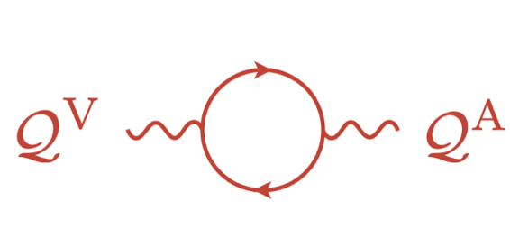
Quantized axial charge on the lattice
[H. B. Thacker (1995)]
[Chatterjee, D. Pace, Shao (2024)]
In the Hamiltonian of staggered fermion,
where
there are two conserved lattice charge operators,
,
has integer eigenvalues since it is unitarily equivalent to .
The non-commutativity implies the chiral anomaly.
Continuum limit

Slide 7

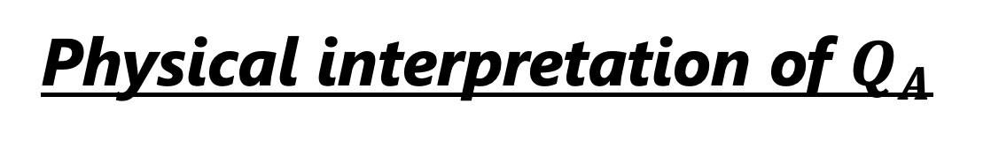




Physical interpretation of $Q_{A}$
[Chatterjee, D. Pace, Shao (2024)]
In the momentum space,
$$ψ_{R}$$
$$ψ_{L}$$
$$ψ_{R}$$
.
$$H=$$
For finite $k$ and N$→∞$ ,
.
gives a well-defined chirality to the zero mode of the staggered fermion.

Slide 8
SMG of staggered fermion in the Hamiltonian formalism
Chatterjee, D. Pace and Shao said
‘’It would also be natural to analyze chiral global symmetries
in other models, such as the 3450 model.’’
[Chatterjee, D. Pace, Shao (2024)]
However, it was later found that
the conventional staggered fermion system cannot implement
the SMG mechanism to realize chiral gauge theories on the lattice.
[Ling-Xiao Xu (2025)]
This is because the chirality of fermions depends on their momentum,
interaction terms that gap out fermions cannot respect the underlying symmetries throughout the entire momentum space.
We want to propose the correct approach.

Slide 9
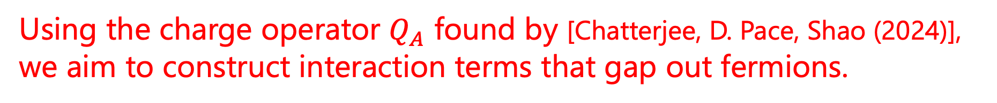
Our Goal
This talk focuses on the 1+1 D Hamiltonian formalism.
A detailed discussion on its implementation on quantum computers is left for future work..
Using the charge operator $Q_{A}$ found by [Chatterjee, D. Pace, Shao (2024)],
we aim to construct interaction terms that gap out fermions.

Slide 10
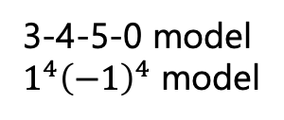
Our Strategy
 | chiral symmetry | Weyl fermion | SMG
Lagrangian Formalism 2 D | Ginsparg Wilson relation | Overlap fermion | [Kikukawa(2017)] etc.
 | Site parity | Staggered fermion | [Catterall(2021)]
Hamiltonian Formalism 1+1 D | Ordinal U(1) (On site) symmetry | Edge mode of 2+1 D Chern insulator | [Wang, Wen(2013)]
 | Quantized Axial charge operator with integer eigenvalues. [H. B. Thacker (1995)] [Chatterjee, D. Pace, Shao (2024)] | Staggered fermion with momentum dependent chirality | ❌[Ling-Xiao Xu (2025)]
Eigne state of s.t.
3-4-5-0 model
$1^{4}{\left(−1\right)}^{4}$ model
OUR WORK

Slide 11
Our Work
1. Axial charge basis
2. Application to SMG

Slide 12

Eigenstate of the axial charge and the Hamiltonian
We aim to construct fermions satisfying the following conditions:
They can be expressed as local linear combinations of the original fermions
up to nearest neighbors.
2) They obey the canonical anticommutation relations.
3) They are eigenstates of $Q_{A}$.
4) In the continuum limit, they coincide with Weyl fermions.
We find that fermions satisfying all four conditions are uniquely determined.
The result is shown on the next page.

Slide 13
Eigenstate of the axial charge and the Hamiltonian
We construct the chiral fermions satisfying all four conditions as follows,
satisfying
The Hamiltonian can be rewritten locally as
KS

Slide 14
Conserved lattice charges
The vector and axial charge operator are rewritten as
By constructions,
KS
KS
There exist both vector and axial charge which commute with the Hamiltonian.

Slide 15
Conserved lattice charges
Taking the limit N → ∞ at ﬁnite momentum, we obtain
which conﬁrms that, as expected,
the charge operator ﬂows to the charge operator of the vector symmetry
in the continuum limit.

Slide 16
Our Work
1. Axial charge basis
2. Application to SMG

Slide 17

Symmetric Mass Generation (SMG)
This Hamiltonian provides a framework for lattice chiral theories
such as 3-4-5-0 model (and $1^{4} {\left(−1\right)}^{4}$ model).

Slide 18
Symmetric Mass Generation (SMG)
Eg. 3-4-5-0 model
in the continuum
[J. Wang and X.-G. Wen (2013)]
This model, when gapped via SMG, preserves $U{\left(1\right)}_{1} × U{\left(1\right)}_{2}$ symmetry.
The fermion multi-interaction term introduced for SMG
must commute with both symmetry generators, $Q_{1}$ and $Q_{2}$.
Interaction terms:
s.t.

Slide 19
Symmetric Mass Generation (SMG)
Eg. 3-4-5-0 model
on the Lattice
This model, when gapped via SMG, preserves $U{\left(1\right)}_{1} × U{\left(1\right)}_{2}$ symmetry.
The fermion multi-interaction term introduced for SMG must commute with both symmetry generators, $Q_{1}$ and $Q_{2}$.
Staggered fermion system
Our system
[Ling-Xiao Xu (2025)]
Interaction term :
Conserved generator :
Commutation relation :

Slide 20
Summary
 | chiral symmetry | Weyl fermion | SMG
Lagrangian Formalism 2 D | Ginsparg Wilson relation | Overlap fermion | [Kikukawa(2017)] etc.
 | Site parity | Staggered fermion | [Catterall(2021)]
Hamiltonian Formalism 1+1 D | Ordinal U(1) (On site) symmetry | Edge mode of 2+1 D Chern insulator | [Wang, Wen(2013)]
 | Quantized Axial charge operator with integer eigenvalues. [H. B. Thacker (1995)] [Chatterjee, D. Pace, Shao (2024)] | Staggered fermion with momentum dependent chirality | ❌[Ling-Xiao Xu (2025)]
Eigne state of s.t.
3-4-5-0 model
$1^{4}{\left(−1\right)}^{4}$ model
OUR WORK

Slide 21
Summary
Our Goal :
Using the charge operator $Q_{A}$ found by [Chatterjee, D. Pace, Shao (2024)],
we aim to construct interaction terms that gap out fermions.
It is essential to have Weyl fermions
with well-defined chirality across the entire momentum space.
・We define chiral fermions as eigenstates of the axial charge operator with definite chirality, and construct the Hamiltonian (in this work, without gauge fields )
of an axial $U{\left(1\right)}_{A}$ theory using these chiral fermions.
・SMG scenario of 3-4-5-0 model and $1^{4} {\left(−1\right)}^{4}$ model is consistently realized on the lattice using our Hamiltonian
although further numerical studies are required to verify the SMG mechanism in interacting models.
c.f. Tetsuya Onogi, TY extended the discussion on conserved charges to a 3+1-d system.
Talk by T. Onogi on 4.11

