Slide 1




Lattice Calculation of Neutron
Electric Dipole Moment
CP violation operators and lattice methodology
Recent lattice results from the $θ$ term and error reduction
Topological charge, overlap fermion
CP-violating $π$NN coupling
Weinberg operator and Quark Chromoelectric Dipole Moment
Lattice 2025, Mumbai, Nov. 5, 2025

Slide 2
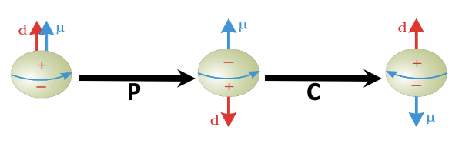
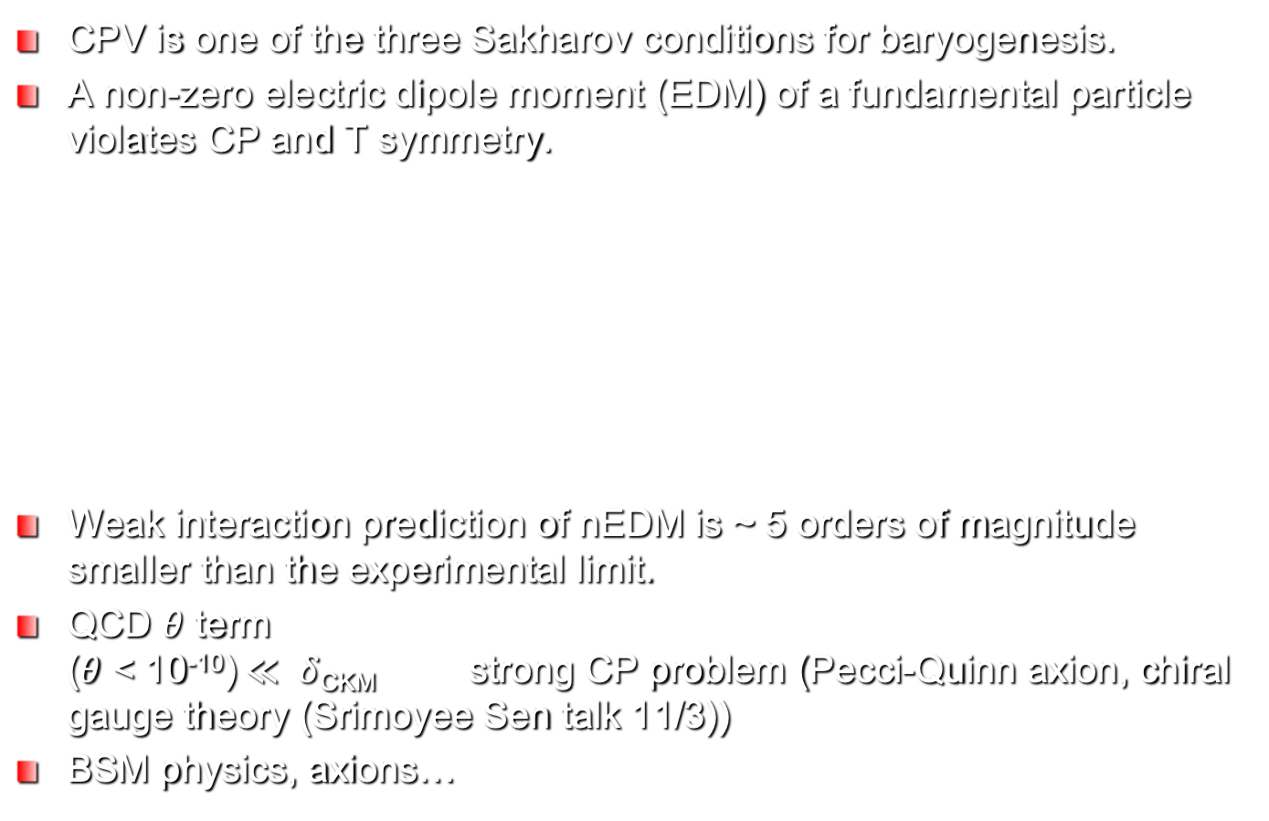
CP Violation and nEDM
CPV is one of the three Sakharov conditions for baryogenesis.
A non-zero electric dipole moment (EDM) of a fundamental particle violates CP and T symmetry.
Weak interaction prediction of nEDM is ~ 5 orders of magnitude smaller than the experimental limit.
QCD $θ$ term ($θ$ < 10⁻¹⁰)$≪ δ$_{CKM} strong CP problem (Pecci-Quinn axion, chiral gauge theory (Srimoyee Sen talk 11/3))
BSM physics, axions…

Slide 3
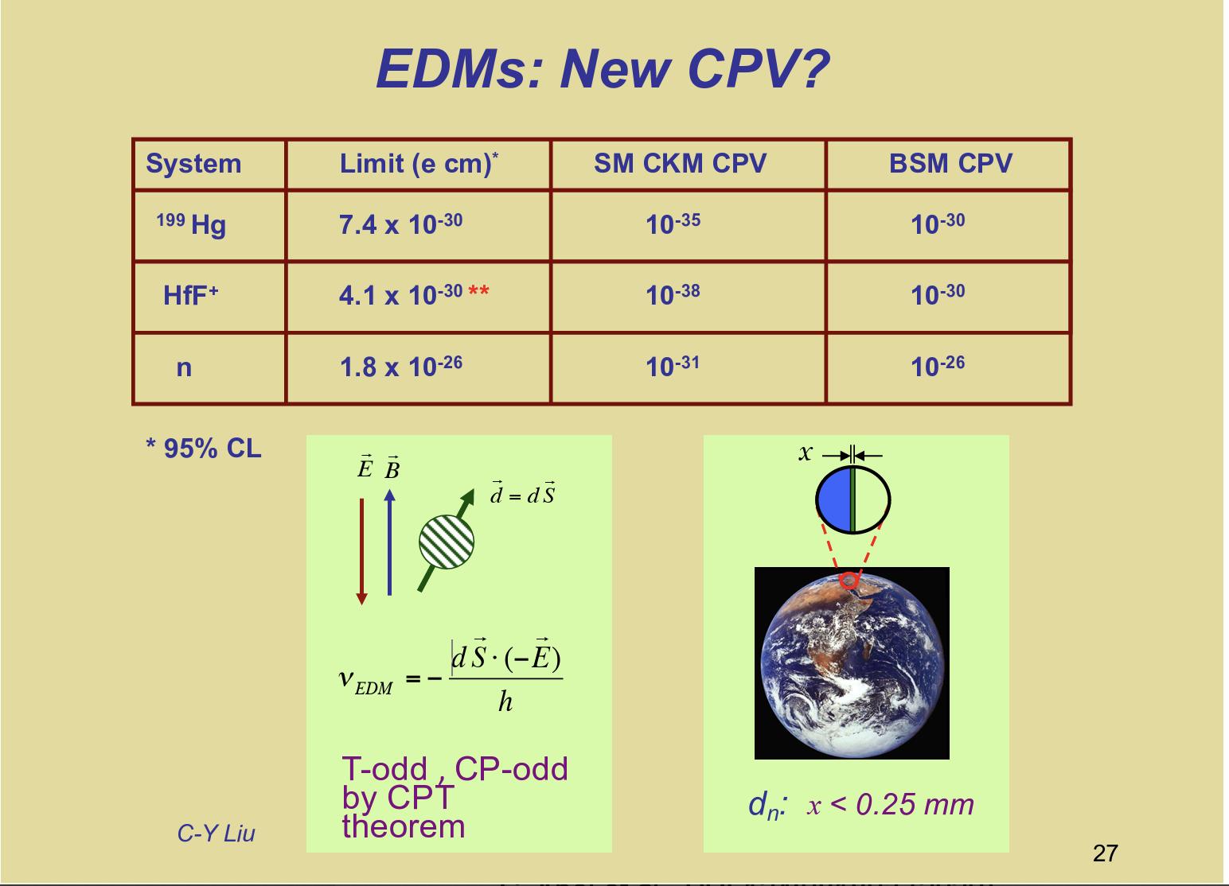
Experimental Status
d_{n} = 0.0(1.1)(0.2) x 10⁻²⁶ e.fm
C. Abel et al., PRL124:081803 (2020)

Slide 4
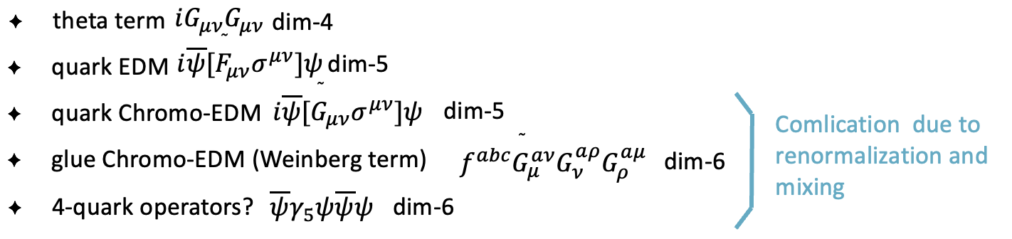

CPV operators and Lattice Methodology
CPV operators from the low-energy effective theory at the hadronic scale
Lattice methods
  Nucleon CPV electromagntic FF F₃ with Q and q(x)
  Neutron energy shift with background electric field
  MC simulation with imaginary $θ$ term
R. Gupta, arXiv:1904.00323

Slide 5
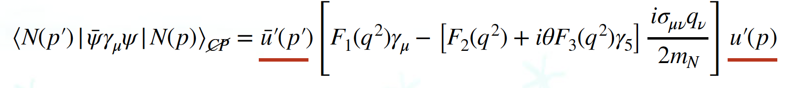
Nucleon EM form factors
Nucleon EM form factor with CPV
Real part of the previously defined F’₃ and imaginary part of F₂ transform like an axial-vector
This has rendered previous lattice calculations to zero within one sigma.
Abramczyk et al., PRD96:014501 (2017)

Slide 6
Cluster Decomposition Error Reduction (CDER)
large fluctuation
Consider , partial sum of local charge in t reduces error.
Cluster decomposition:
For disonncected insertion, the variance has a vacuum insertion signal falls with relative coordinate r, but noise remains.
CDER: cut off in relative coordinate beyond correlation length which redcudes the error by -- Liu, Liang and Yang, PRD97:034507 (2018)

Slide 7
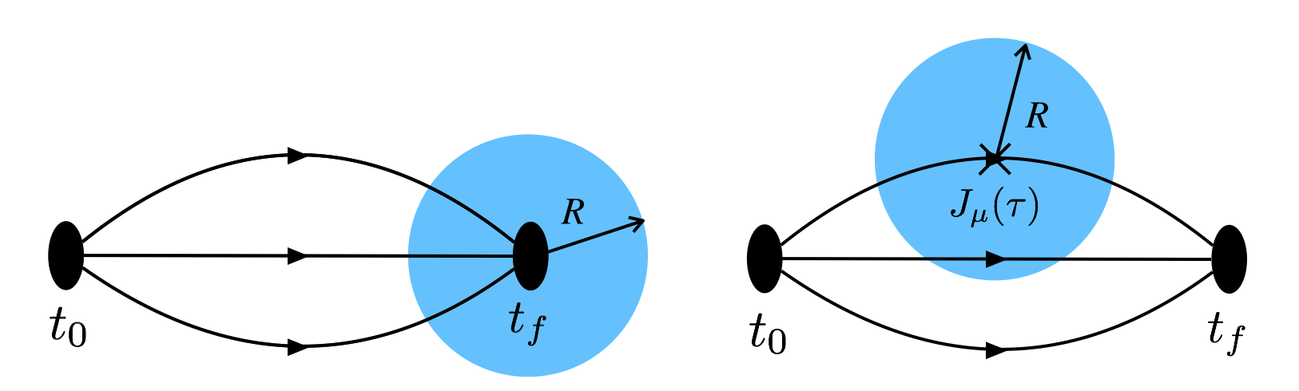
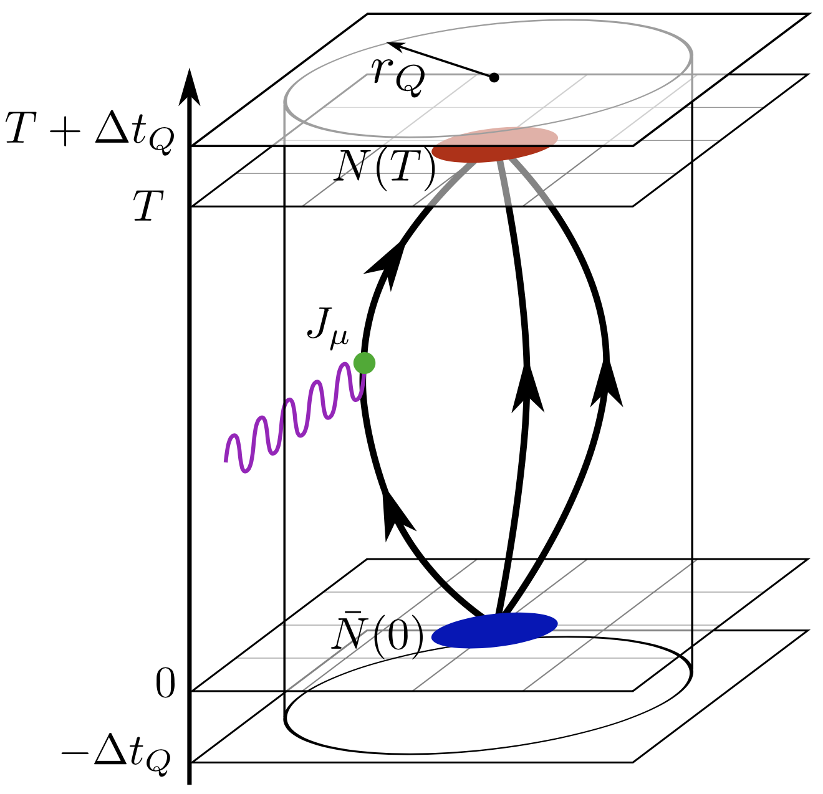
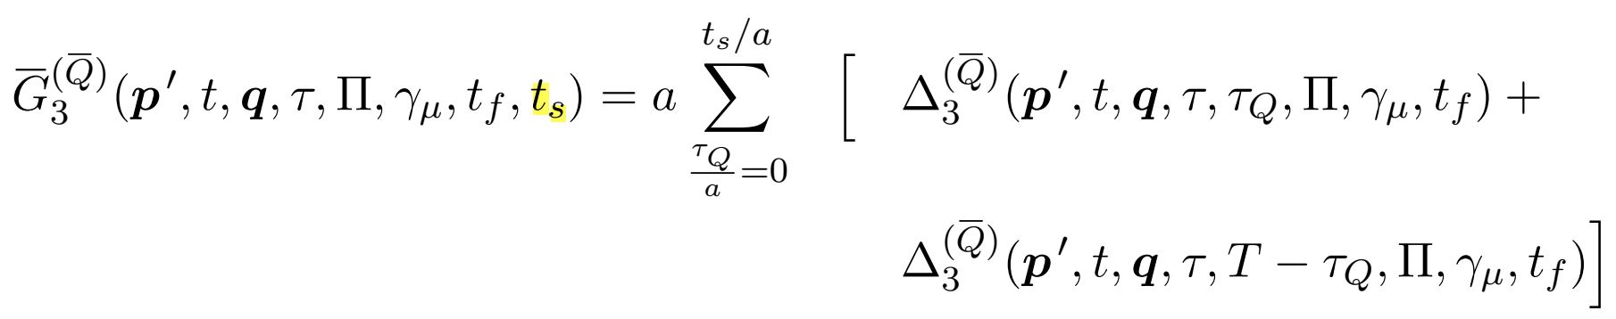

Error reduction
The cluster decomposition error reduction (CDER):
Liu, Liang and Yang, PRD97:034507 (2018)
$(χ$QCD)
FFT -- V log V
Cylinder shape
Truncation in t-direction
J. Dragos et al., arXiv:1902.03254
T. Izubuchi, H. Ohki and S. Syritsyn, arXiv:2004.10449

Slide 8
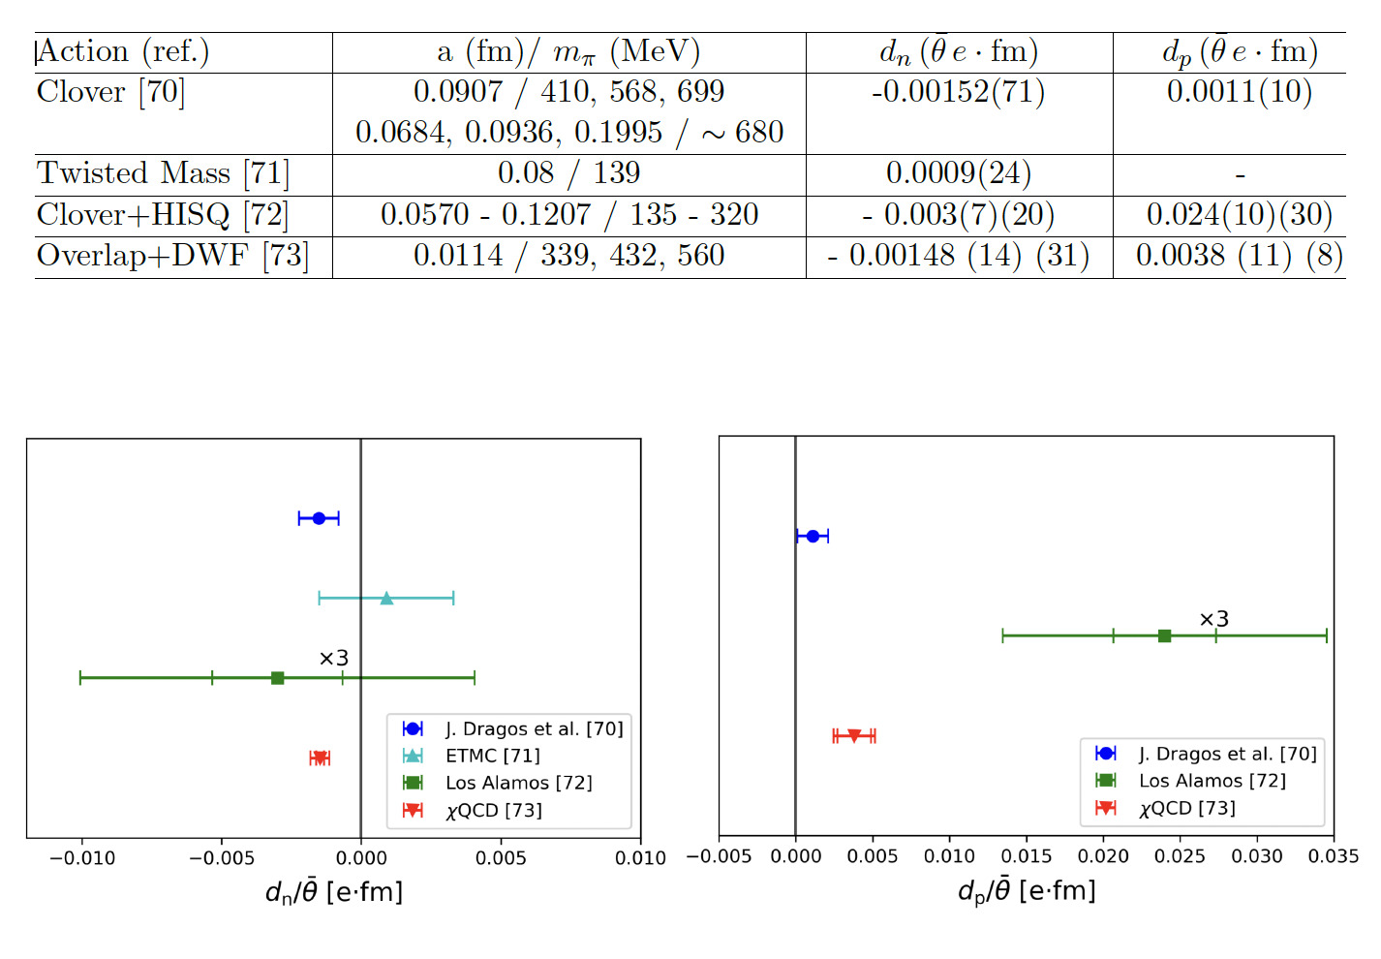

Slide 9
Overlap Fermion
Chiral symmetry – Ginsparg-Wilson relation
Topology – Atiya-Singer theorem:
Anomalous WI – P. Hasenfratz et al., hep-lat/0205010
EDM →0 when m → 0 -- Baluni V. Phys. Rev. D 1, 2227 (1979)
Effective propagator:
local charge

Slide 10
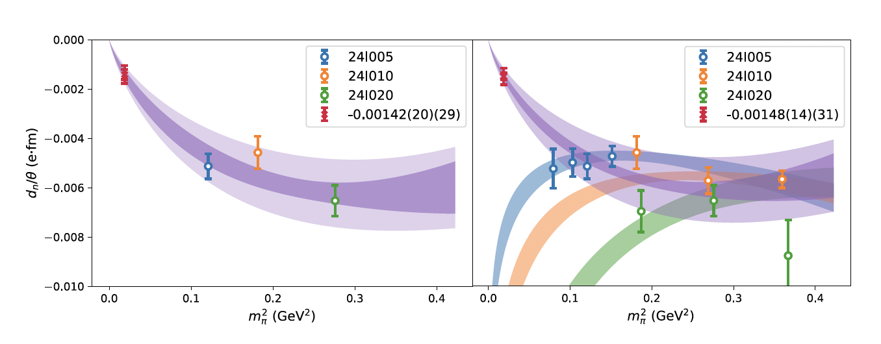
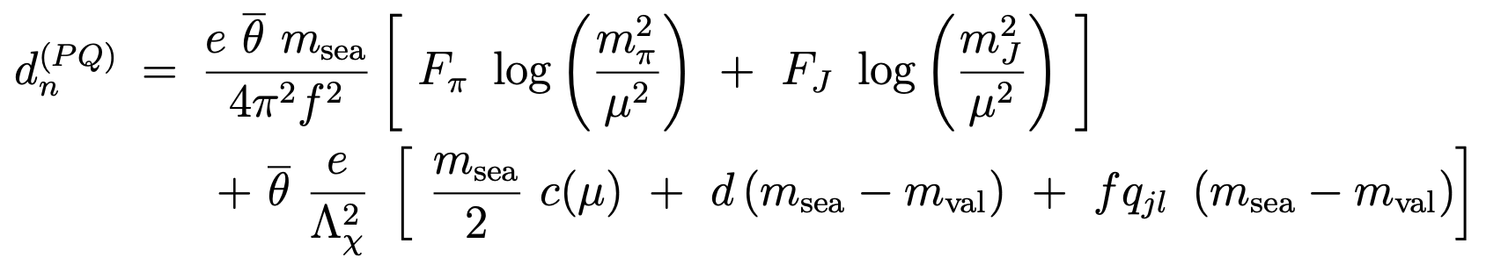



nEDM with Overlap fermion on
DWF configurations
24³ x 64 DWF
a = 0.114 fm
m$π$ = 339,431,
560 MeV
Partially quenched $χ$PT
$$c_{0}m_{π,s}^{2}\log\left(\frac{m_{π,v}^{2}}{m_{N}^{2}}\right)+c_{1}m_{π,s}^{2}+c_{2}\left(m_{π,s}^{2}−m_{π,v}^{2}\right)$$
D.O’Connell and M. J. Savage, PLB633:319 (2006)
J. Liang et al., 2301.04331

Slide 11
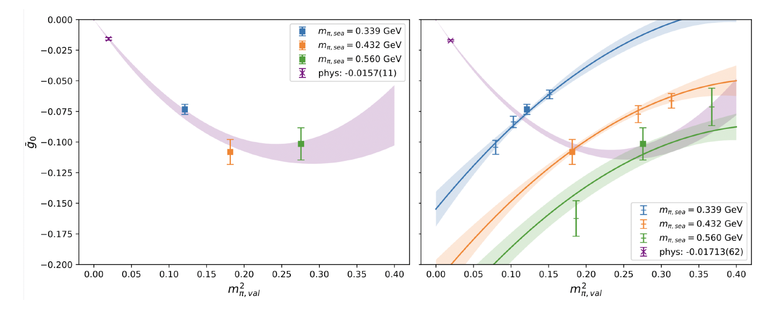



CPV $π$NN Coupling
($χ$QCD)
Baryon mass splitting and $χ$PT,
J. de Vries et al., 1506.06247

Slide 12
Weinberg Operator (dim 6)
RI/MOM renormalization scheme [V. Ciriglina, et al., 2004.03576]
  mixing many lower-dimension and same dimension operators
  power divergences that interfere with continuum limit.
Small flow time expansion (SFTE) of gradient flow
One-loop mixing between and gradient flow: [O.L. Crosas et al., 2308.16221]
Matching onto the theta term

Slide 13
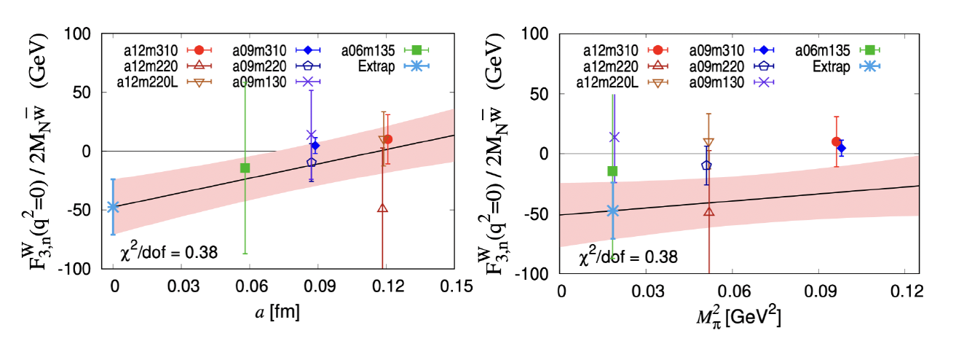

Neutron F₃ with Gradient Flow
T. Bhattacharya et al., (Los Alamos), 2203.03746
Clover fermion on HISQ ensembles – multiple lattice spacings and quark masses for extrapolation.
Signals better than the $θ$ term.
Need SFTE for lower and same dimension operators.

Slide 14
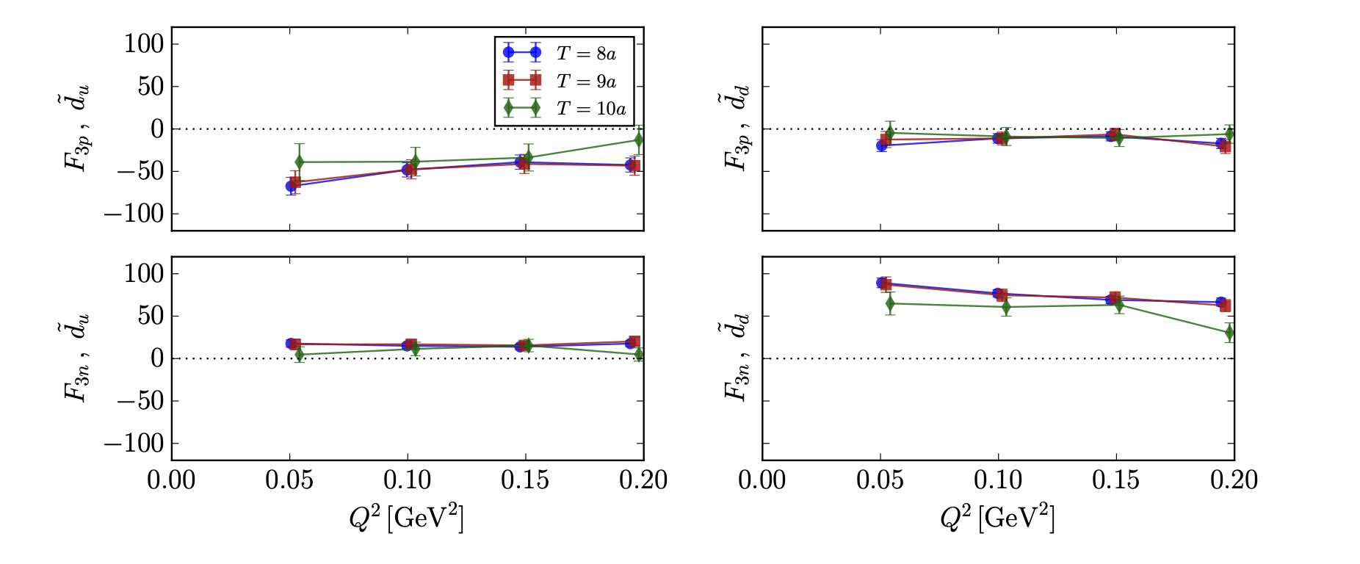
Chromoelectric Dipole Moment (dim 5)
qEDM
qcEDM
S. Syritsyn et al., (Stony Brook and BNL), 1901.05455
-- u and d quark F₃ for neutron and proton
-- DWF at physical pion mass and a = 0.01141(3) fm

Slide 15
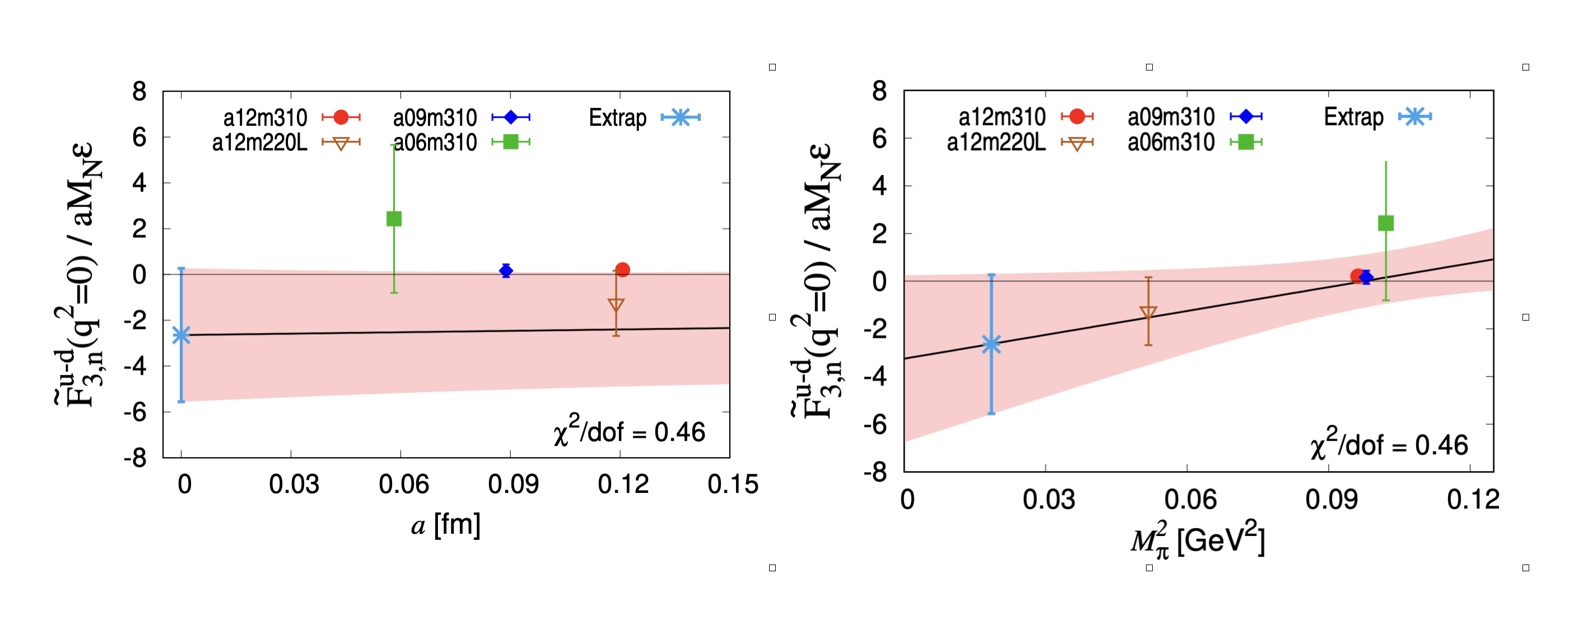
T. Bhattacharya et al. (Los Alamos), 2304.09929
-- neutron u – d F₃
-- Schwinger source method
-- Clover on HISQ with continuum and chiral extrapolation
Need renormalization and mixing with lower dimensional operators.
Leading order perturbative calculation in SFTE, 2005.04199

Slide 16
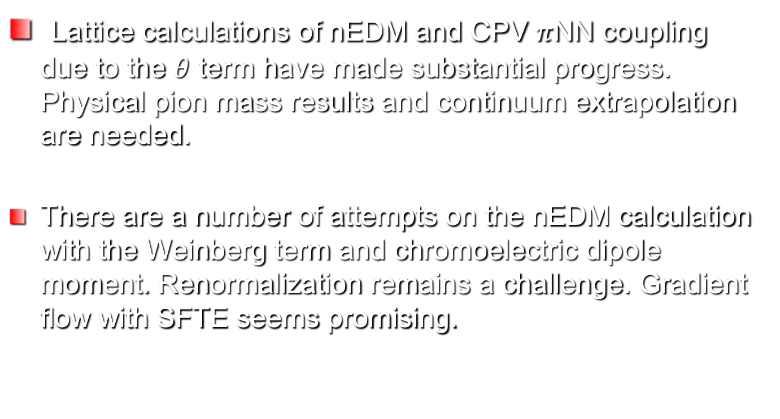
Summary
Lattice calculations of nEDM and CPV $π$NN coupling due to the $θ$ term have made substantial progress. Physical pion mass results and continuum extrapolation are needed.
There are a number of attempts on the nEDM calculation with the Weinberg term and chromoelectric dipole moment. Renormalization remains a challenge. Gradient flow with SFTE seems promising.

