Slide 1
TCAD simulation I
E. Giulio Villani
Instrumentation Training Lectures, Oxford 03/06/2025

Slide 2
Overview
Introduction, needs for TCAD simulations
Transport regimes and related equations
Discretization techniques: meshing
Discretization of semiconductor equations: Scharfetter-Gummel technique
Examples
Instrumentation Training Lectures, Oxford 03/06/2025

Slide 3




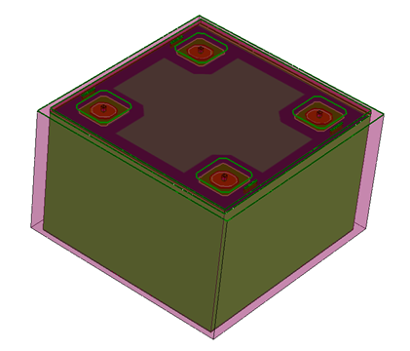
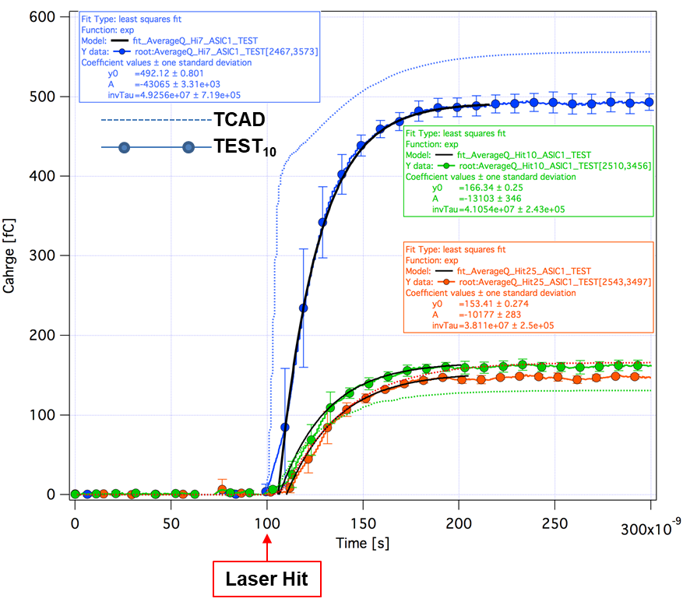
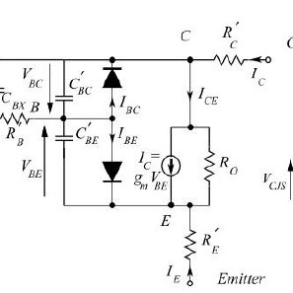
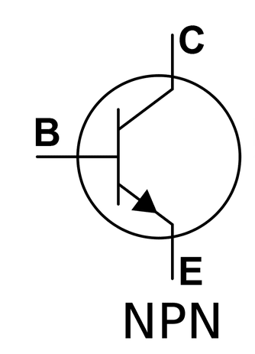

Introduction
Epitax growth
SiO₂ etch
N⁺⁺ implant
P⁺⁺ implant
TCAD (Technology Computer Aided Design) divides into three groups:
  Process simulation, i.e. simulation of fabrication process steps (oxidation, implantation, diffusion…)
  Device simulation, i.e. simulation of the thermal/electrical/optical behavior of electronic devices,(IV,CV, frequency response…)
  Device modeling, i.e. creating compact behavioral models for devices for circuit simulation (SPICE, Cadence…)
1
Instrumentation Training Lectures, Oxford 03/06/2025

Slide 4
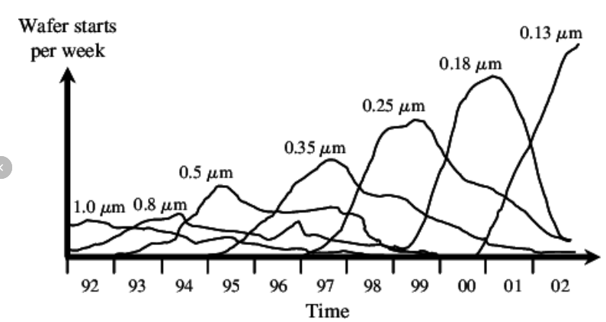
Introduction
  Reasons why TCAD simulations are needed:
    Market demands cycle of design to production of 18 months or less. Typically 2-3 months required for wafer tape out implies short time for development
    Reduce cost to run experiments on new devices and circuits
Shrinking product life cycles in semiconductor industry over time
Hochbaum, Dorit S. et al., Rating Customers According to Their Promptness to Adopt
New Products., Operations Research, vol. 59, no. 5, p. 1171–83, 2011.
2
Instrumentation Training Lectures, Oxford 03/06/2025

Slide 5
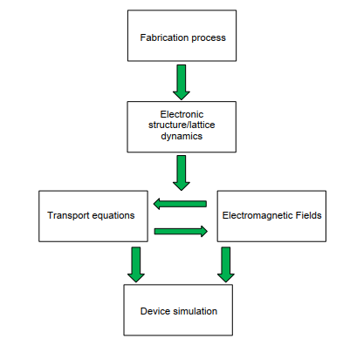
Introduction
  Main components of semiconductor device simulation include fabrication process, description of electronic structure, driving forces and transport phenomena
  The two kernels of semiconductor transport equations and fields that drive charge flow are coupled to each other and needs solving self-consistently
3
Instrumentation Training Lectures, Oxford 03/06/2025

Slide 6
Transport regimes
Usually only the quasi-static electric fields from the solution of Poisson’s equation are necessary
Transport regime in semiconductors depends on length scale
Modern Silicon technology already requires tools to describe transport in quantum regime [D. K. Ferry and S. M. Goodnick, Transport in Nanostructures, 1997]
L: device length
l_{e-e}: electron-electron scattering length
l_{e-ph}: electron-phonon scattering length
λ: electron wavelength
D. Vasileska, et al., Computational Electronics: Semiclassical and Quantum Device Modelling and Simulation, RC press, 2010,ISBN-13: 978-1-4200-6484-1.
4
Instrumentation Training Lectures, Oxford 03/06/2025

Slide 7
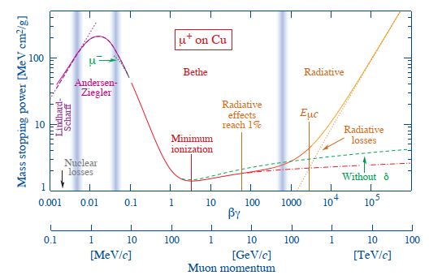
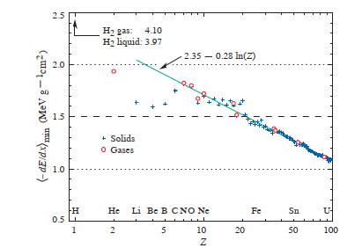
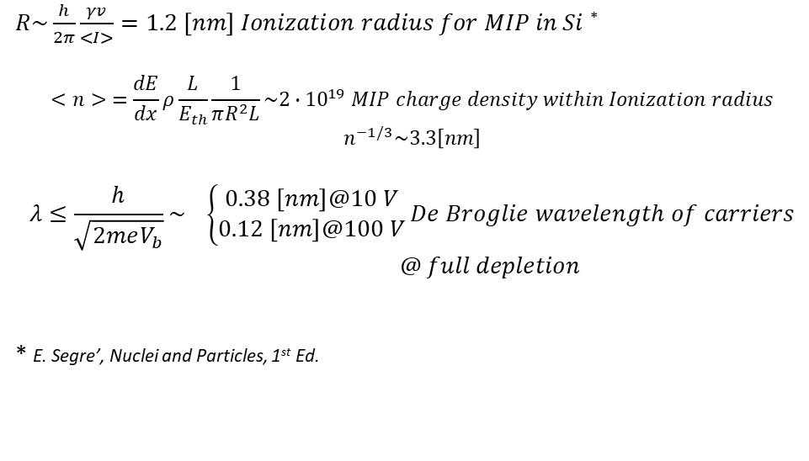
Transport regimes
Charge carrier dynamics in Si detectors usually does not require QM
Semiclassical laws of motions apply
Drift-diffusion (DD) equations are often valid, i.e. provided the electron gas is in thermal equilibrium with lattice temperature (T_{n} = T_{L})
Mass stopping power (= −dE/dx) for positive muons in copper as a function of βγ = p/Mc
Mass stopping power at minimum ionization for the chemical elements.
$R\sim \frac{h}{2π}\frac{γv}{<I>}=1.2 \left[nm\right] Ionization radius for MIP in Si$ *
$$<n> =\frac{dE}{dx}ρ\frac{L}{E_{th}}\frac{1}{πR^{2}L}\sim 2∙{10}^{19} MIP charge density within Ionization radius$$
$$n^{−1/3}\sim 3.3\left[nm\right]$$
$$λ≤\frac{h}{\sqrt{2meV_{b}}}\sim \left\{\begin{aligned}0.38 \left[nm\right]@10 V \\ 0.12 \left[nm\right]@100 V\end{aligned}\right.De Broglie wavelength of carriers$$
$@ full depletion$
* E. Segre’, Nuclei and Particles, 1st Ed.
5
Instrumentation Training Lectures, Oxford 03/06/2025

Slide 8



Drift diffusion model
The semiconductor equations derived from 1st moment of Boltzmann's Transport Equation (BTE) are referred to as Drift Diffusion (DD) model
The model consists of Poisson's equation and PDE for the continuity and current density equations for electrons and holes
The DD expresses charge and momentum conservation
Their self-consistent solutions are obtained via discretization, using finite element methods FEM
6
Instrumentation Training Lectures, Oxford 03/06/2025

Slide 9
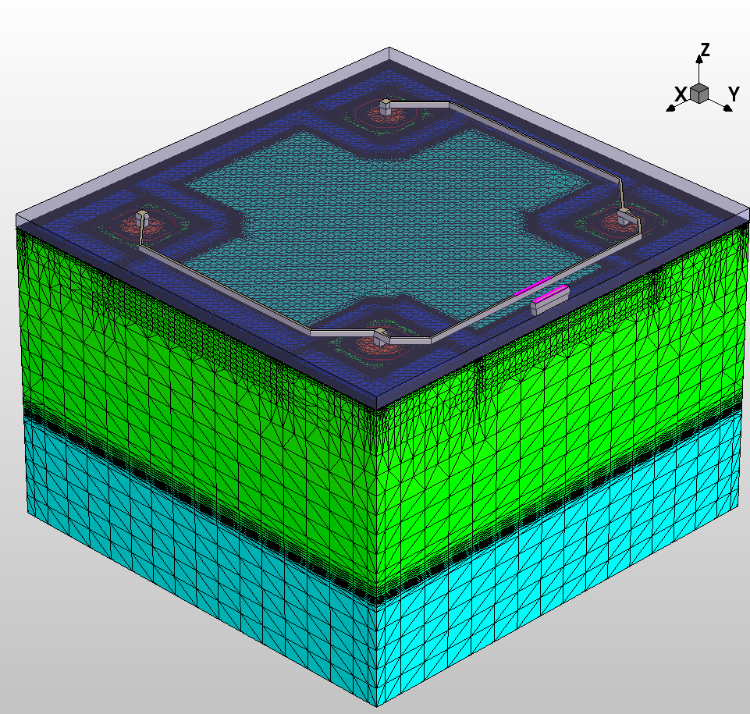
Discretization and meshing
The device simulations process consists of two steps:
The test volume is obtained through grid generation (‘mesh generation’ )
Solving the discretized differential equations using Finite-Boxes method (box integration method) . This method integrates PDEs over a test volume
7
Instrumentation Training Lectures, Oxford 03/06/2025

Slide 10
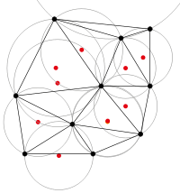
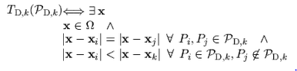
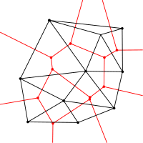
Discretization and meshing
The Delaunay triangulation with all the circumcircles and their centres
The meshing used in most finite elements methods (FEM) relies on Delaunay triangulations:
the interior of the circumsphere of each element contains no mesh vertices.
The Delaunay triangulation of a discrete point set P in general corresponds to the dual graph of the Voronoi diagram for P
the set of all locations x closest to P_{i} than to any other point of the grid
P_{i}
Connecting the centres of the circumcircles produces the Voronoi diagram (in red).
8
Instrumentation Training Lectures, Oxford 03/06/2025

Slide 11
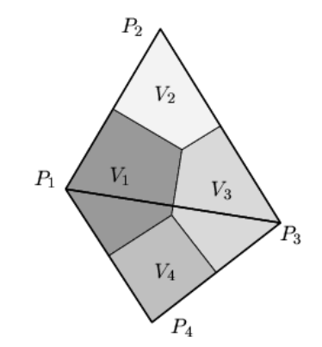
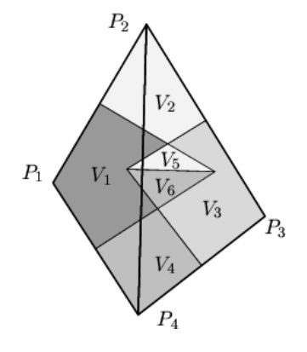
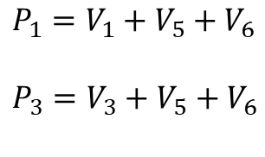

Discretization and meshing
Voronoi boxes do not overlap (each circumcircle does not include a point of another triangle). Each can be uniquely assigned to its corresponding grid points.
$$P_{i}=V_{i}$$
Correct Delaunay triangulation* guarantees element-volume conservation, important in many problems (diffusion, charge generation, et cetera)
Delaunay triangulation maximizes the minimum angle of the triangle
*A. Okabe, B. Boots, and K. Sugihara, Spatial Tessellations, John Wiley and Sons Ltd, 1992.
Voronoi boxes do overlap (each circumcircle does include a point of another triangle). Each cannot be uniquely assigned to its corresponding grid points. Wrong volumes calculated
$P_{1}=V_{1}+$ $V_{5}+V_{6}$
$P_{3}=V_{3}+$ $V_{5}+V_{6}$
9
Instrumentation Training Lectures, Oxford 03/06/2025

Slide 12
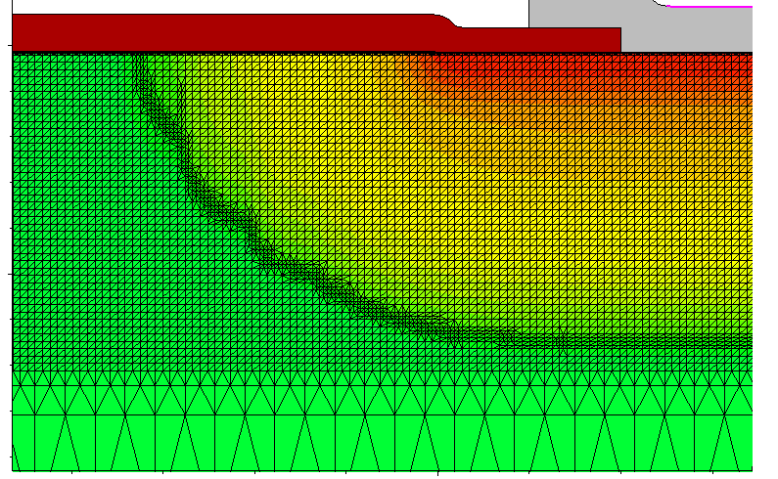

Discretization and meshing
nwell
HR p
Discretization of equations imposes some constraints on spatial and temporal mesh size
Mesh size should be smaller than Debye length (i.e. the characteristic length for screening of field by charges) where charge variations in space have to be resolved
$$L_{D}=\sqrt{\frac{{ε_{s}k}_{B}T}{e^{2}N}} Debye length$$
$$N={10}^{13}{[cm}^{−3}]:L_{D}≈1.3 \left[um\right]@T=300 \left[K\right] \\ N={10}^{17}{[cm}^{−3}]:L_{D}≈13 \left[nm\right]@T=300 \left[K\right] \\ N={10}^{19}{[cm}^{−3}]:L_{D}≈1.3 \left[nm\right]@T=300 [K]$$
10
Instrumentation Training Lectures, Oxford 03/06/2025

Slide 13

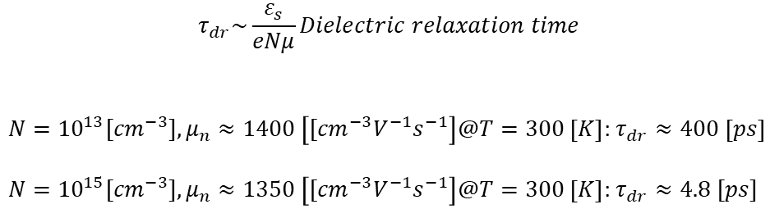
Discretization and meshing
$$τ_{dr}\sim \frac{ε_{s}}{eNμ}Dielectric relaxation time$$
$N={10}^{13}{[cm}^{−3}],μ_{n}≈1400 \left[{[cm}^{−3}V^{−1}s^{−1}\right]@T=300 \left[K\right]$: $τ_{dr}≈400 \left[ps\right]$
$N={10}^{15}{[cm}^{−3}],μ_{n}≈1350 \left[{[cm}^{−3}V^{−1}s^{−1}\right]@T=300 \left[K\right]$: $τ_{dr}≈4.8 [ps]$
Also temporal ‘mesh’ size should be smaller than the dielectric relaxation time t_{dr} (i.e. time it takes to charge fluctuations to decay under the field they produce, essentially the RC of the bulk)
Time interval smaller than t_{dr} might give unrealistic transient results (‘oscillations’ in estimated transient currents)
$$\frac{∂Δn}{∂t} =−\frac{Δn(t=0)}{t_{dr}}$$
$$Δn \left(Δt\right)=Δn \left(0\right)−Δt\frac{Δn(0)}{t_{dr}}$$
11
Instrumentation Training Lectures, Oxford 03/06/2025

Slide 14
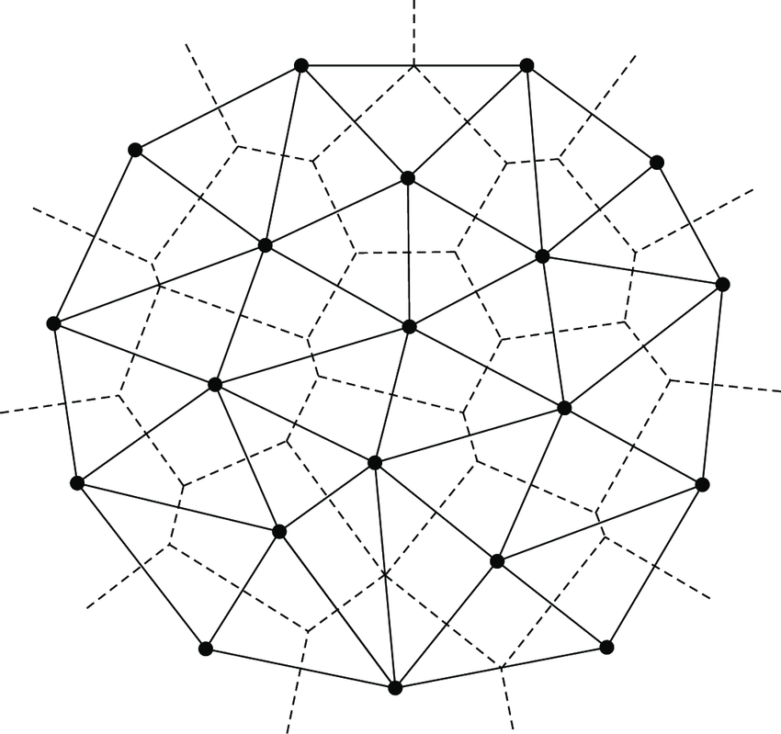






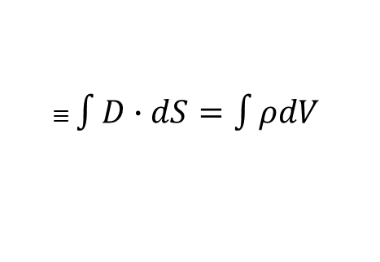
Box integration method
$$k$$
$$j$$
Discretization of Poisson’s and continuity equations is done via Box Integration method
The LHS of equations is transformed via Gauss’ theorem and integrated over a Voronoi box Ω_{k} of point P_{k}
$$i$$
$$∇∙ε_{S}∇φ=e(n−p−N_{D}+N_{A})$$
$≡$ $\int{D∙dS=\int{ρdV}}$
$$∇∙J_{n} −q\frac{∂n}{∂t}=qR$$
$$∇∙J_{p}+q\frac{∂p}{∂t}=−qR$$
12
Instrumentation Training Lectures, Oxford 03/06/2025

Slide 15















Box integration method
$$k$$
$$L_{j}$$
$$L_{i}$$
Example of Poisson’s equation discretization
Assume that the electric potential is linearly varying over each elementary domain
$$d_{j}$$
$$d_{i}$$
$$d_{k}$$
$$i$$
$$L_{k}$$
$$j$$
$$≡\int{D∙dS=\int{ρdV}}$$
$$∇∙ε_{S}∇φ=e(n−p−N_{D}+N_{A})$$
$$i,j,k:nodal indices$$
$L_{i},L_{j}$, $L_{k}:side vectors$
$L_{i},L_{j}$, $L_{k}:magnitude side vectors$
$$u≔\frac{e}{k_{B}T}φ:normalized potential$$
13
Instrumentation Training Lectures, Oxford 03/06/2025

Slide 16


Box integration method
$$k$$
$$L_{j}$$
$$L_{i}$$
Components of D vector along sides L_{i,j,k}
Flux of D vector associated to node k:
Discretization of RHS is obtained by multiplying the node value of charge by the area of the portion of the Voronoi box
$$d_{j}$$
$$d_{i}$$
$$d_{k}$$
$$i$$
$$L_{k}$$
$$j$$
$$\frac{k_{B}T}{e}ε_{s}\frac{1}{L_{i}}\left(u_{j}−u_{k}\right) \\ \frac{k_{B}T}{e}ε_{s}\frac{1}{L_{j}}\left(u_{k}−u_{i}\right) \\ \frac{k_{B}T}{e}ε_{s}\frac{1}{L_{k}}(u_{i}−u_{j})$$
$\frac{k_{B}T}{e}ε_{s}[\frac{d_{i}}{L_{i}}\left(u_{j}−u_{k}\right)$+ $\frac{d_{j}}{L_{j}}\left(u_{i}−u_{k}\right)$] $Flux of D$
14
Instrumentation Training Lectures, Oxford 03/06/2025

Slide 17
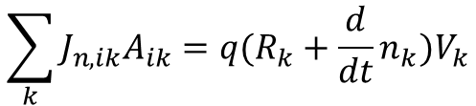




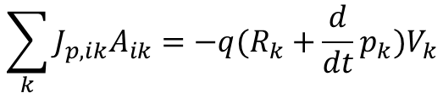

Box integration method
$$k$$
$$j$$
$$i$$
Summing over all points P_{k} of Voronoi boxes
Same approach to discretize the continuity equations for electrons and holes
$$\sum_{k}{D_{ik}A_{ik}=ρ_{k}V_{k}}$$
$$A_{ik}:area of K −Vbox \\ D_{ik}:projection along grid line$$
$$\sum_{k}{J_{n,ik}A_{ik}=q(R_{k}+\frac{d}{dt}n_{k})V_{k}}$$
$$\sum_{k}{J_{p,ik}A_{ik}=−q(R_{k}+\frac{d}{dt}p_{k})V_{k}}$$
15
Instrumentation Training Lectures, Oxford 03/06/2025

Slide 18
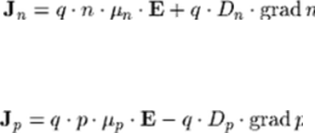














$$k$$
Scharfetter-Gummel discretization
$$L_{j}$$
$$L_{i}$$
$$d_{j}$$
$$d_{i}$$
$$d_{k}$$
In case of no strong generation-recombination the current density varies little within each domain
Even so, this implies an exponential dependence of electron / hole density n/p with position along grid’s edge
Using previous discretization method would require very dense mesh: the Scharfetter-Gummel technique* includes such dependence, requiring less grid points
*D. L. Scharfetter and H. K. Gummel, “Large-signal analysis of a silicon read diode oscillator,” IEEE Trans. Electron Devices, vol. ED-16, pp. 64–77, Jan. 1969
$$i$$
$$L_{k}$$
$$j$$
$$u≔\frac{e}{k_{B}T}φ$$
$$D_{n}≔\frac{k_{B}T}{e}μ_{n}$$
$$J_{n}≔qD_{n}[∇n−n∇u]$$
from $J_{n}$
$projection along L_{k}\sim constant$
$$J_{nk}≔qD_{n}[\frac{dn}{dl_{k}}−n\frac{du}{dl_{k}}]$$
16
Instrumentation Training Lectures, Oxford 03/06/2025

Slide 19




$$k$$
Scharfetter-Gummel discretization
$$L_{j}$$
$$L_{i}$$
$$d_{j}$$
$$d_{i}$$
$$d_{k}$$
Assume u varies linearly along the edge and current density $J_{n}$ ≃ constant over the domain
Define the reduced current $j_{nk}$ and assume an average diffusion $D_{nk}$along the edge
Obtain first order equation in n along the edge
$$i$$
$$L_{k}$$
$$j$$
$$u=\frac{u_{j}−u_{i}}{L_{k}}l_{k}+u_{i}=a_{k}l_{k}+u_{i}$$
$j_{nk}:=\frac{J_{nk}}{{qD}_{nk}},{ D}_{nk}≔<D_{ni},$ $D_{nj}>$
$$j_{nk}= \frac{dn}{dl_{k}}−na_{k}$$
17
Instrumentation Training Lectures, Oxford 03/06/2025

Slide 20

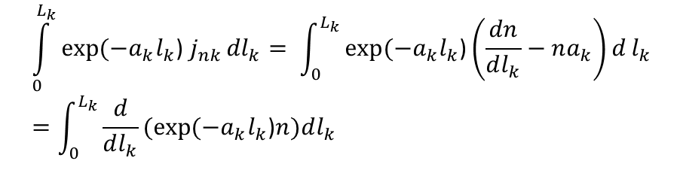

$$k$$
Scharfetter-Gummel discretization
$$L_{j}$$
$$L_{i}$$
$$d_{j}$$
$$d_{i}$$
$$d_{k}$$
Integrate from node i to node j, i.e. for l_{k}=[0, L_{k}]
Obtain expression relating potential and carriers concentration
$$i$$
$$L_{k}$$
$$j$$
$$\int_{0}^{L_{k}}{exp⁡(−a_{k}l_{k}\text{) }j_{nk}}{dl}_{k}= \int_{0}^{L_{k}}{exp⁡(−a_{k}l_{k}\text{)}\left(\frac{dn}{dl_{k}}−na_{k}\right)d}l_{k}=\int_{0}^{L_{k}}{\frac{d}{dl_{k}}(exp⁡(−a_{k}l_{k}\text{)}n)dl_{k}}$$
$j_{nk}\frac{1}{a_{k}}(1−exp(⁡−u_{ji}\text{)}=$ $exp⁡(−u_{ji}\text{)}n_{j}−n_{i}$
$$j_{nk}=a_{k}(\frac{n_{j}}{exp⁡(u_{ji}\text{)}\text{−1}}+\frac{n_{i}}{exp⁡(−u_{ji}\text{)−1}})$$
18
Instrumentation Training Lectures, Oxford 03/06/2025

Slide 21



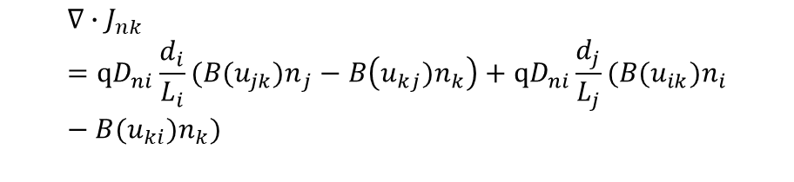
$$k$$
Scharfetter-Gummel discretization
$$L_{j}$$
$$L_{i}$$
$$d_{j}$$
$$d_{i}$$
$$d_{k}$$
Obtain the flux of current density relative to node k
Scharfetter –Gummel discretization requires less fine mesh as the exponential dependence of carriers concentration is included in the discretization scheme
It also depends on boundary values, i.e. 2D and 3D cases can be reduced to local 1D cases
$$i$$
$$L_{k}$$
$$j$$
$$j_{nk}=\frac{1}{L_{k}}(\frac{{u_{ji}n}_{j}}{exp⁡(u_{ji}\text{)}\text{−1}}−\frac{u_{ij}n_{i}}{exp⁡(u_{ij}\text{)−1}})$$
$$j_{nk}=\frac{1}{L_{k}}(B({u_{ji})n}_{j}−B({u_{ij})n}_{i})$$
$$Bernoulli function B\left(x\right)=\frac{x}{\exp\left(x\right)−1}$$
$$∇∙J_{nk}=qD_{ni}\frac{d_{i}}{L_{i}}(B({u_{jk})n}_{j}−B\left({u_{kj})n}_{k}\right)+qD_{ni}\frac{d_{j}}{L_{j}}(B({u_{ik})n}_{i}−B({u_{ki})n}_{k})$$
19
Instrumentation Training Lectures, Oxford 03/06/2025

Slide 22
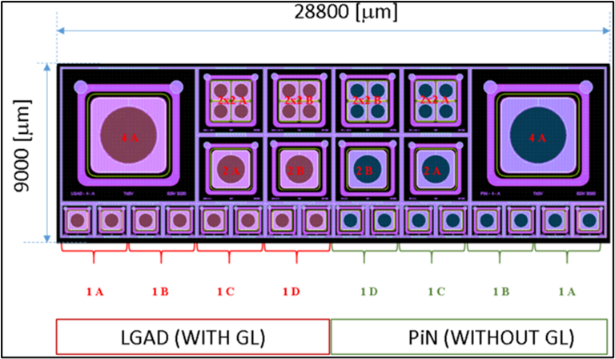
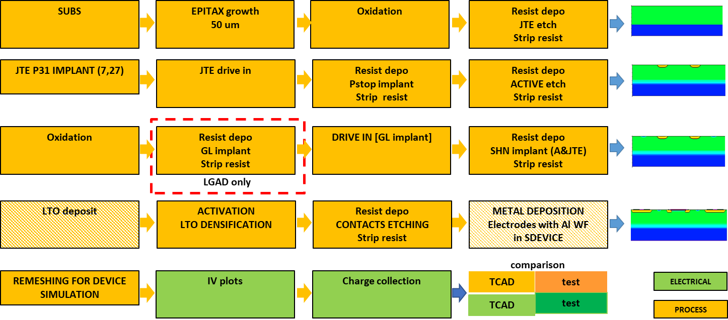
Simulation examples
Examples from Synopsys TCAD (more on this from N. Owen lectures)
Beside electrical simulation, process simulation is possible
Most of the typical steps of fabrication process can be simulated
Simulated process steps for LGAD fabrication
Nwell-GR
Nwell
P-epi
p⁺⁺
20
Instrumentation Training Lectures, Oxford 03/06/2025

Slide 23
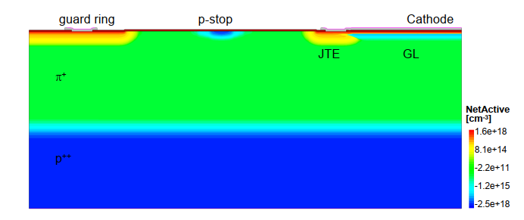
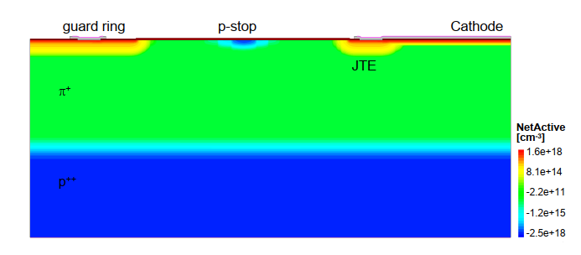
Simulation examples
Fabrication process and Electrical performances simulation of a Low Gain Avalanche Detector (LGAD*) sensor
The simulation of the fabrication included photolithography, etching, implantation, diffusion, deposition
The electrical simulations included charge collection and gain due to impact ionisation w.r.t to a PIN diode
*G. Pellegrini, et al., Technology developments and first measurements of low gain avalanche detectors (LGAD) for high energy physics applications, Nuclear Instruments and Methods in Physics Research Section A: Accelerators, Spectrometers, Detectors and Associated Equipment, vol. 765, p. 12 – 16, 2014.
Cross section of simulated LGAD (top) and PIN diode (bottom)
21
Instrumentation Training Lectures, Oxford 03/06/2025

Slide 24
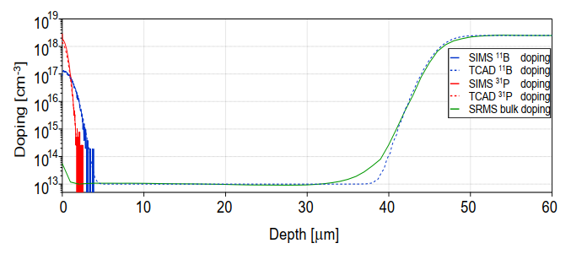
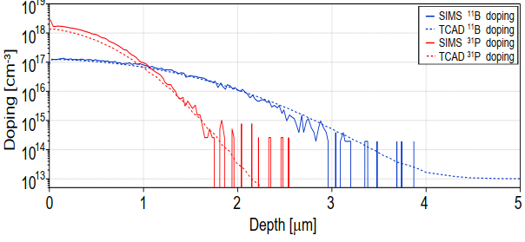
Simulation examples
High energy implants of ions were simulated, both analytically or through Monte Carlo
Results compared with Secondary Ion Mass Spectrometry (SIMS): Accuracy ≃ 10% or better
Full doping profile TCAD (dotted line) and SIMS/SRMS (thick line) comparison for LGAD.
An expanded view of GL doping. SIMS (thick line) and TCAD (dotted line) results are shown for comparison
22
Instrumentation Training Lectures, Oxford 03/06/2025

Slide 25
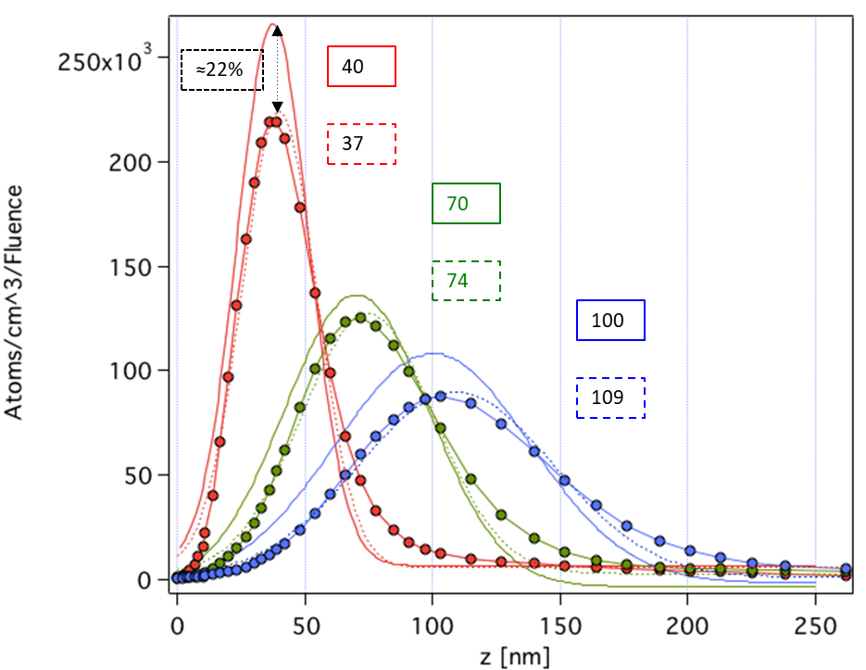
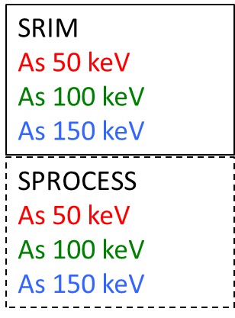
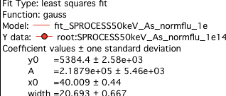
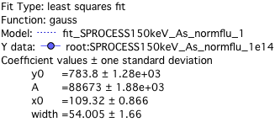
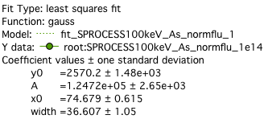
Simulation examples
A note on ion implantation:
  At least with As, MC (SRIM) and SPROCESS predictions on doping seem to agree within ≈ 20%
  SRIM assumes amorphous Si, <100> used for SPROCESS, channeling suppressed
23
Instrumentation Training Lectures, Oxford 03/06/2025

Slide 26
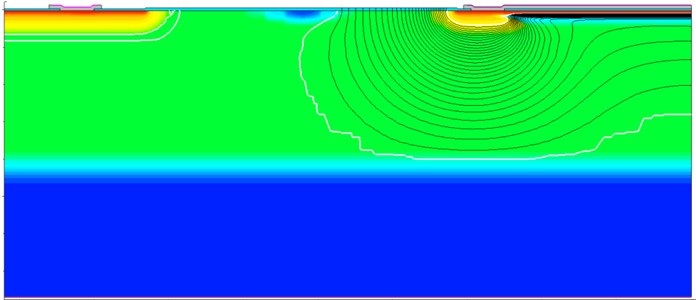
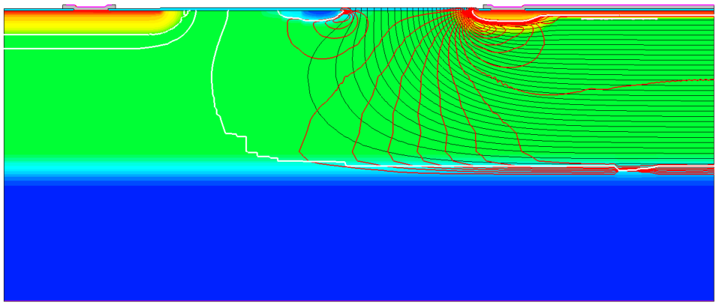
Guard ring
P-stop
Cathode
Simulation examples
Internal field configuration vs. bias and temperature
DC and AC characteristics can be obtained from the simulated model
LGAD electrical simulation, showing the extension of depletion region (white line) and equipotential lines (black lines)
PIN electrical simulation, showing the extension of depletion region (white line), equipotential lines (black lines) and vertical electrical field (red lines)
24
Instrumentation Training Lectures, Oxford 03/06/2025

Slide 27
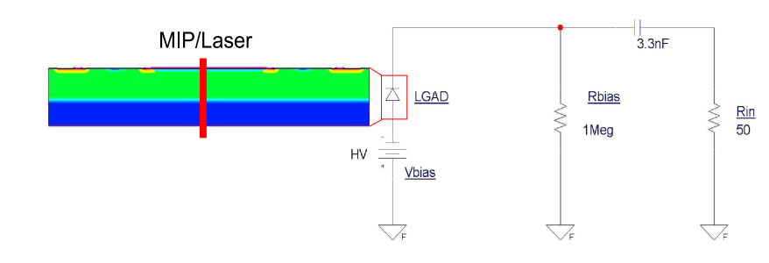
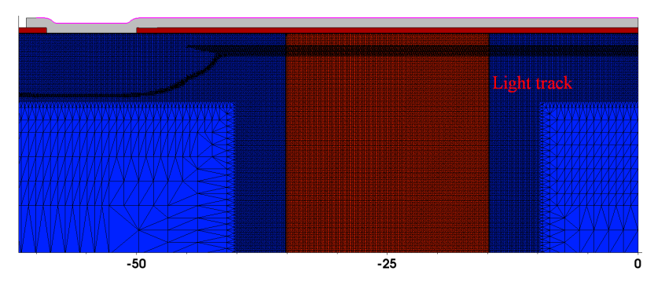
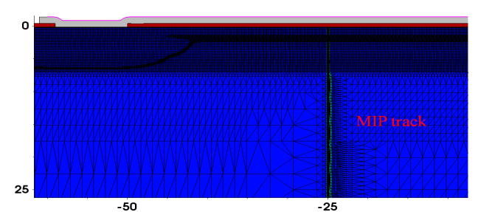
Simulation examples
Charge collection is simulated using laser light and MIP injection
Spatio-temporal meshing different for Light an MIP injection
Device meshing for an optical charge injection in the PIN diode. The same meshing resolution was used for LGAD devices. Values in µm.
Device meshing for MIP charge injection. A meshing resolution of up to 0.3 nm was used in the radial direction along the MIP track. Values in µm.
25
Instrumentation Training Lectures, Oxford 03/06/2025

Slide 28
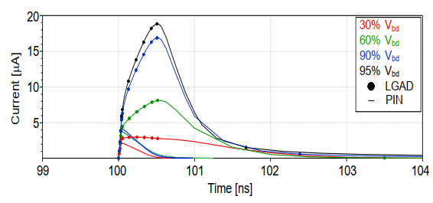
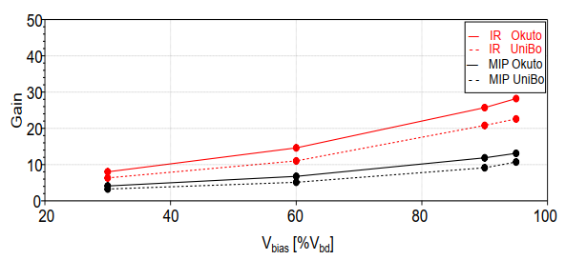
Simulation examples
The gain of the LGAD is defined as the ratio of collected charge w.r.t. the charge collected by a PIN diode, under the same biasing condition
The gain depends on the bias voltage applied, as this affect the impact ionization, leading to charge multiplication
Different impact ionisation models predict different gain
The transient current from optical charge injection in a PIN diode (line) and an LGAD (line with markers) at different percentage of breakdown voltage V_{bd}. The simulation uses the Okuto impact ionisation model with default values and T = 21 °C.
The simulation results of gain normalized to the percentage of V_{bd} using MIP and IR charge injection for an LGAD.
26
Instrumentation Training Lectures, Oxford 03/06/2025

Slide 29
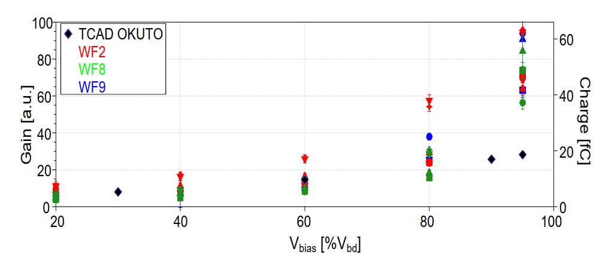
Simulation examples
The TCAD simulations using the Okuto-Crowell model* for impact ionisation match the measured LGAD gain up to values of the bias voltage of approximately 80% of the breakdown.
Additional corrections to the modelling are needed to improve the accuracy of prediction
Due to the exponential dependence of impact ionisation on field / doping / parameters the task of LGAD modelling presents interesting challenges
Laser gain and charge collected of five LGAD devices vs. bias normalized to breakdown. The TCAD gain obtained from a laser injection, when the bias voltage is normalized to the breakdown voltage, matches the results up to approximately 80% of the breakdown.
*Y. Okuto and C. R. Crowell, Threshold Energy Effect on Avalanche Breakdown Voltage in Semiconductor Junctions, Solid-State Electronics, vol. 18, no. 2, p. 161–168, 1975.
27
Instrumentation Training Lectures, Oxford 03/06/2025

Slide 30
TCAD and simulation I
Introduction to simulation
Needs and transport regimes
Meshing and discretization. Intro to DD model discretization. SG method
Some examples of TCAD simulations: process and electrical device simulations, charge collection
    Thank you
    giulio.villani@stfc.ac.uk
28
Instrumentation Training Lectures, Oxford 03/06/2025

