Slide 1
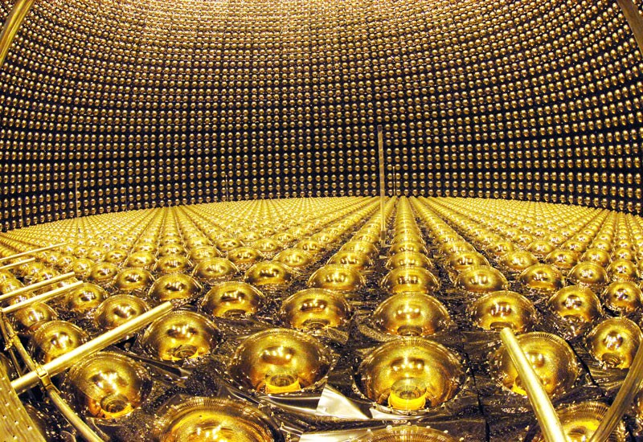
Credit: The Asahi Shimbun/Getty
Photonics
Peter R Hobson
Professor of Physics
School of Physical & Chemical Sciences
UK Advanced Instrumentation Training: June 3 2025

Slide 2
Photonics in Particle Physics
“The technology of generating and harnessing light and other forms of radiant energy whose quantum unit is the photon” (from Photonics Spectra magazine)
In our context it is
  The detection of light generated by some process related to the measurement of some property of particles (e.g. Energy or velocity).
  The transmission and reception of analogue & digital information connected with the electrical signals from particle detectors.

Slide 3
What systems are used in Particle Physics?
Calorimeters (which measure energy and position)
  Scintillation light
  Cherenkov light
Time-of-flight
  Fast scintillators used to determine the speed of a particle
Fibre Trackers
Readout of electronics particularly in large hermetic detectors. (I will not cover this aspect)
Fibre backbone for Local and Wide Area Networks (I will not cover this aspect)

Slide 4
What devices are discussed in this lecture?
Solid-state (silicon)
  Photodiodes (including avalanche)
  SiPM (“Geiger-mode” devices)
  Imaging SiPM arrays
Photomultipliers (external photoelectric effect)
  Devices for low magnetic fields (high gain)
  Devices for high magnetic fields (low gain)
Hybrid devices

Slide 5
What devices are discussed in this lecture?
Photodetectors
Gas
External photoeffect
Vacuum
External photoeffect
Solid state
Internal photoeffect
TMAE MWPC
TEA + GEM
CsI …
Avalanche gain
Process
Dynodes → PhotoMultiplier Tubes
Continuous dynode
Channeltron, MicroChannel Plate
Multi-Anode devices
Other gain process
= Hybrid tubes
Silicon Luminescent
anodes
HPD SMART/Quasar
HAPD X-HPD
G-APD-HPD
PIN-diode
APD
GM-APD
SiPM
CMOS
CCD
AIDAinnova 2nd Annual meeting Introduction to photodetectors and their applications in HEP 24-04-2023 Sune Jacobson

Slide 6
The human eye (historic!)
Detection of α particles by Geiger & Marsden (1909) using ZnS(Ag) scintillator screens
  Visual detection of scintillation light
  Rate limited to about 60 s⁻¹
  Each detected flash contained around 300 photons entering the observer’s eye
Last important visual experiment was the disintegration of Li nuclei by protons (Cockcroft & Walton (1932))
  Used a human coincidence counter technique

Slide 7
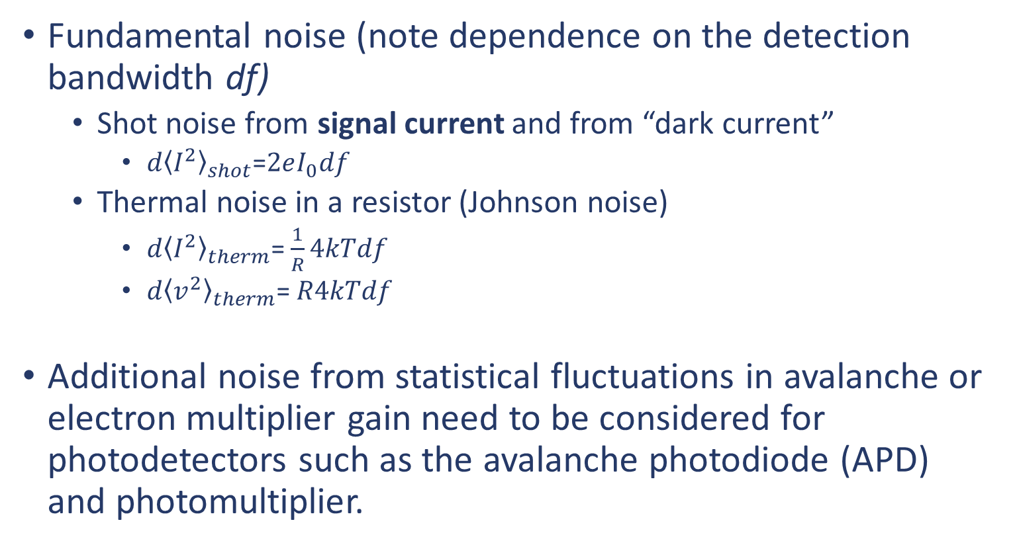
Noise in photodetection
Fundamental noise (note dependence on the detection bandwidth df)
  Shot noise from signal current and from “dark current”
    $d{\left\langle I^{2}\right\rangle }_{shot}$=$2eI_{0}df$
  Thermal noise in a resistor (Johnson noise)
    $d{\left\langle I^{2}\right\rangle }_{therm}$=$\frac{1}{R}4kTdf$
    $d{\left\langle v^{2}\right\rangle }_{therm}$= $R4kTdf$
Additional noise from statistical fluctuations in avalanche or electron multiplier gain need to be considered for photodetectors such as the avalanche photodiode (APD) and photomultiplier.

Slide 8
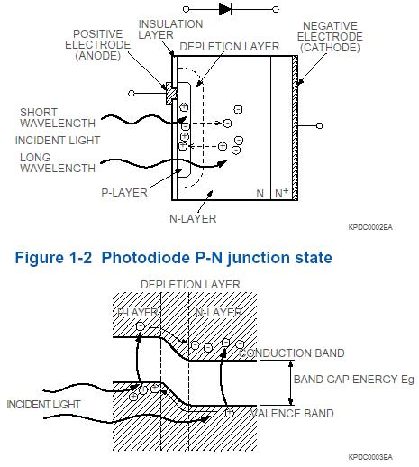
Junction photodetectors
These use the internal photoelectric effect
A photon with energy larger than the bandgap of the material generates an electron-hole pair (eh-pair) with some probability < 100%
The eh-pair is separated by an internal field (e.g. a junction inside a diode)

Slide 9
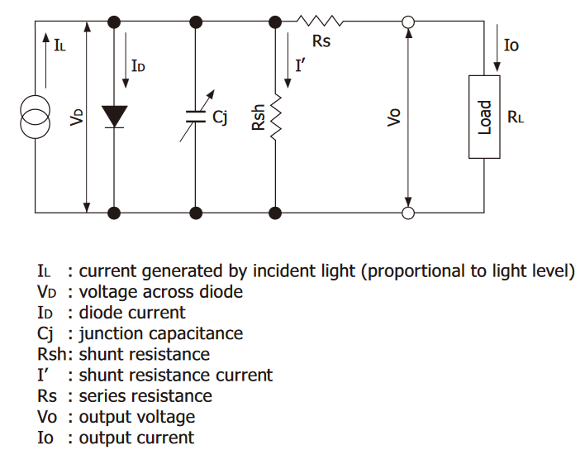

Junction photodetectors
Equivalent electrical circuit:
Capacitance is a function of reverse bias (until full-depletion)
Thermal noise I’ arises from the shunt resistance Rsh

Slide 10
Silicon photodiodes
Silicon is the primary material since in general we are detecting fast scintillation or Cherenkov light (UV and visible). SiC useful for a UV only response and for high temperature operation.
Silicon diode technology is well advanced and the peak quantum efficiency (QE) is high (around 80%)
Silicon devices are tolerant to quite high radiation levels, although there are problems with hadrons.
Silicon photodiodes are linear over many orders of magnitude.
Small devices can have cut-off frequencies ~ 1 GHz
Remember that they make good ionising radiation sensors too! This can be a problem when you have a mixed light/ionising radiation environment.

Slide 11


Absorption of Light
In ideal (non scattering) materials the absorption of light is governed by the Beer-Lambert law. This relates transmittance, T, to absorbance, A, and optical depth τ, by the fundamental relationship
$$T=e^{−τ}={10}^{−A}$$
If the attenuation coefficient μ is given and the physical depth l, then
$$T=e^{−μl}$$
For some actual values for real semiconductors see this site: http://www.ioffe.ru/SVA/NSM/Semicond/

Slide 12


Ideal behaviour
Photocurrent is proportional to the optical (signal) power
How large is the responsivity R (in A/W) and how does it vary with wavelength for an ideal photodetector?
In an ideal photodiode with unity gain (i.e. a pn or pin structure or a Schottky device) one gets one e/h pair per absorbed photon with energy > band-gap. This has the largest value when the photon energy is the smallest allowed, i.e. just above the band gap. Numerically, for wavelengths in nm:
$$R=\frac{q}{E_{ph}}$$
$$R≈\frac{λ\left[nm\right]}{1240}$$

Slide 13
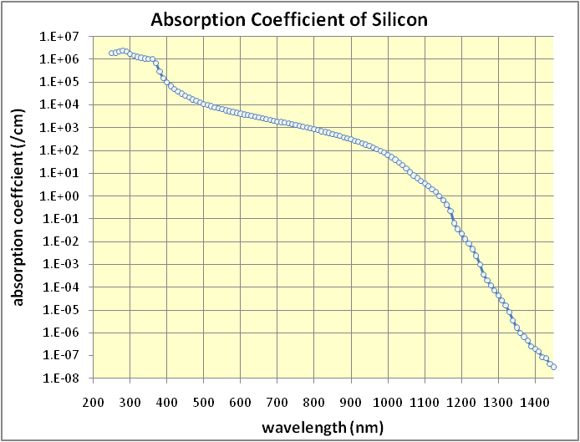
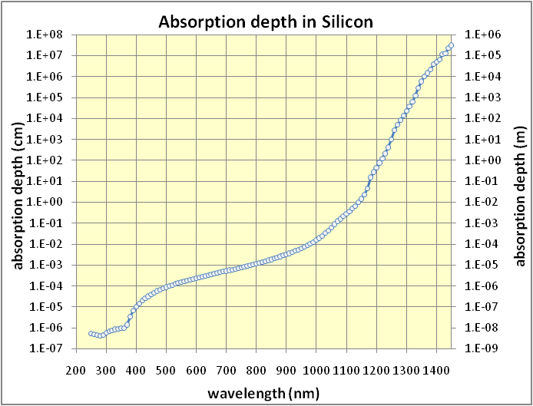
Intrinsic silicon
Note that silicon is an indirect bandgap semiconductor so it has quite a complicated absorption spectrum. Red lines are for 1 µm and 100 µm thickness.
M. A. Green and Keevers, M. J., “Optical properties of intrinsic silicon at 300 K”, Progress in Photovoltaics: Research and Applications, vol. 3, pp. 189 - 192, 1995.
2. M. A. Green, “Self-consistent optical parameters of intrinsic silicon at 300 K including temperature coefficients”, Solar Energy Materials and Solar Cells, vol. 92, pp. 1305–1310, 2008.

Slide 14
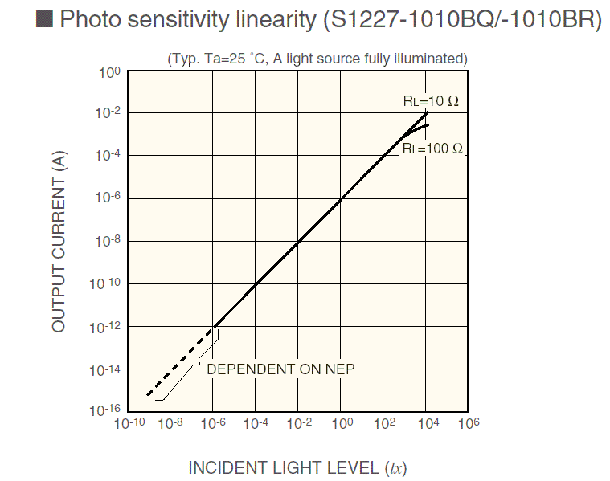
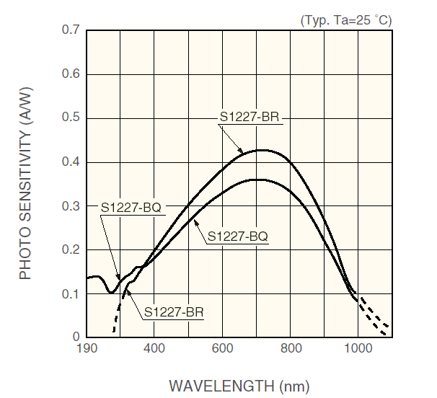
A commercial large area (10×10 mm²) PIN diode
Note 8 to 10 decades of
linear response
Data from Hamamatsu Photonics

Slide 15
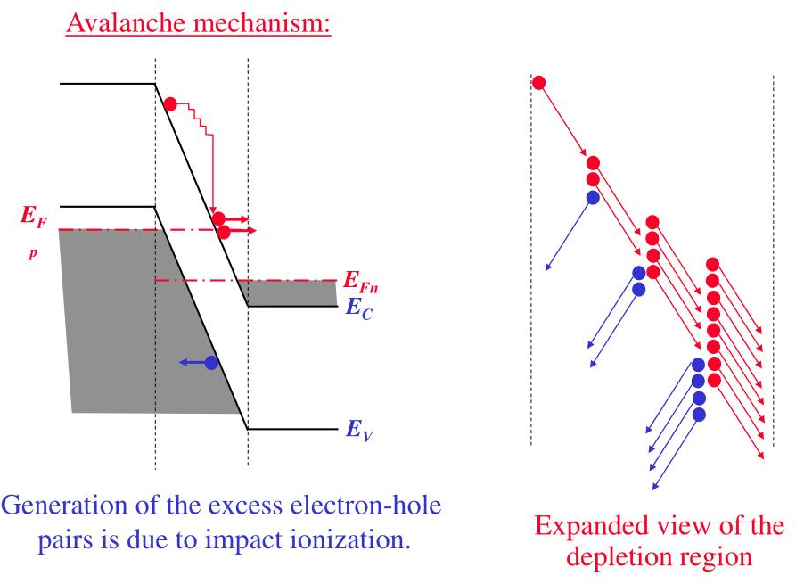
Avalanche Photodiode (APD) – a diode with gain
A junction photodetector with internal gain
Uses impact ionisation that occurs at very high internal electric fields.
The avalanche process is an additional source of noise (excess noise factor F)
Use the majority carrier to minimise the excess noise
  Use an n⁺-p-π-p⁺ structure for silicon

Slide 16
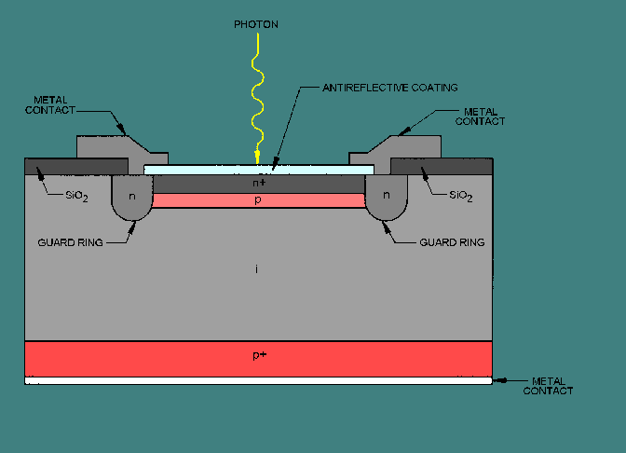
Silicon “Reach-through” APD
Silicon RAPD structure, electrons are the carriers multiplied here.
Figure from http://www.tpub.com/neets/tm/111-4.htm

Slide 17
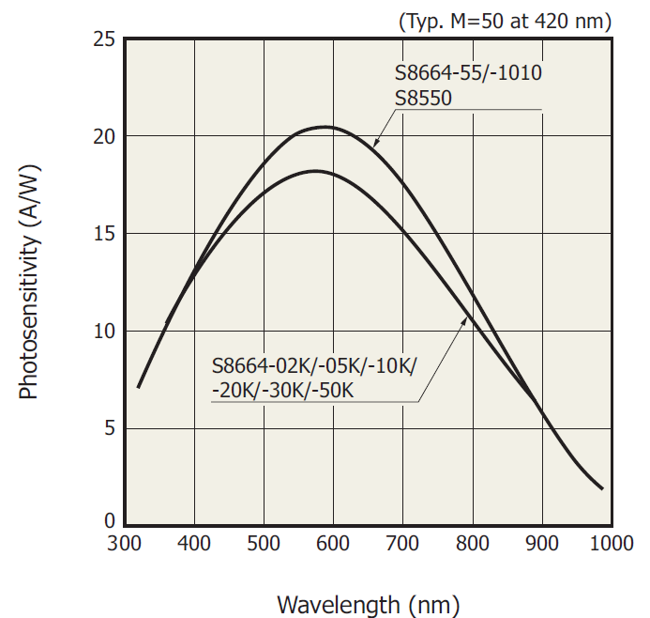
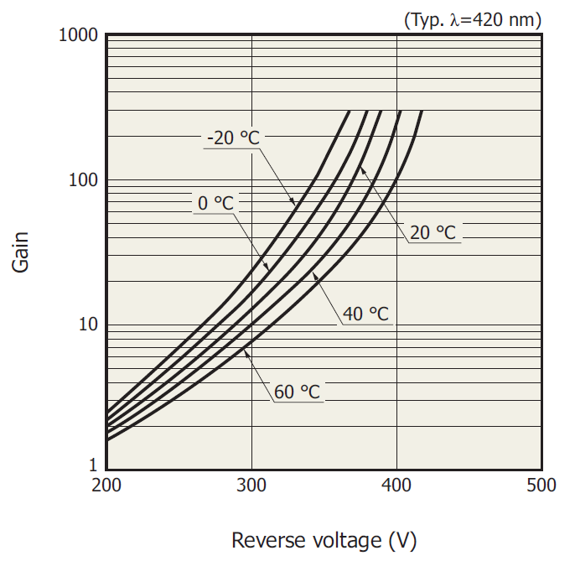
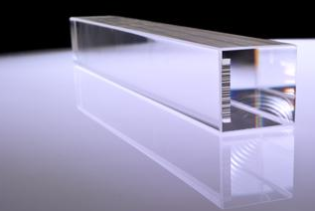
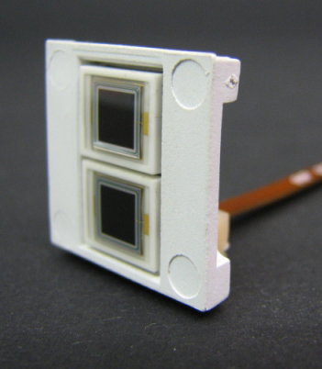
A commercial large area (5×5 mm²) APD
CMS barrel ECAL crystal (PbWO₄) and associated APD readout.
Data from Hamamatsu Photonics

Slide 18
Silicon photomultiplier (SiPM)
Take an APD, increase the reverse bias to get a very high gain (Geiger mode) .
PROBLEM! The first photon detected will generate a huge avalanche in the high field region which could be destructive.
SOLUTION: limit current with external quench resistor.
Clever idea: couple together lots of tiny APD (cells) in parallel to make a moderate area device (several square millimetres), then can get a quantised output (up to ~ the number of cells) which allows photon counting.
Geiger mode also produces a fast rise-time signal so get good timing information (Time-of-Flight applications for example).

Slide 19
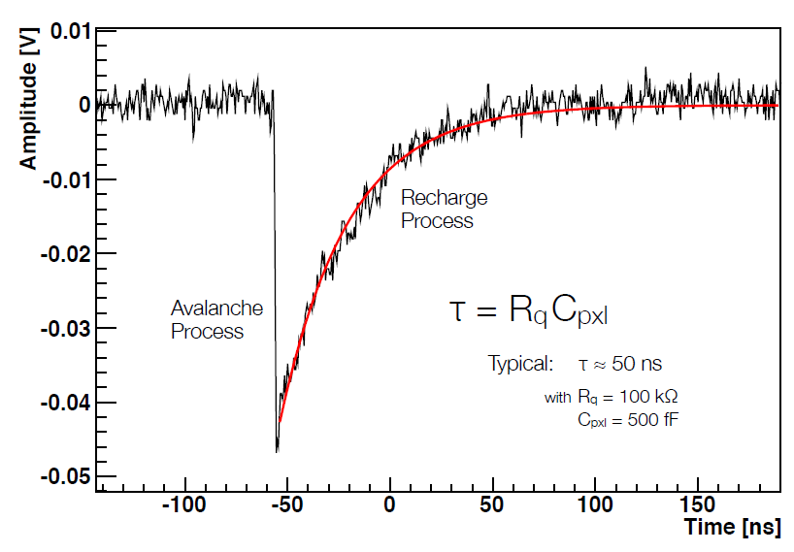
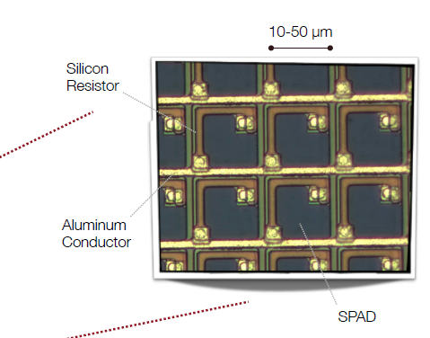
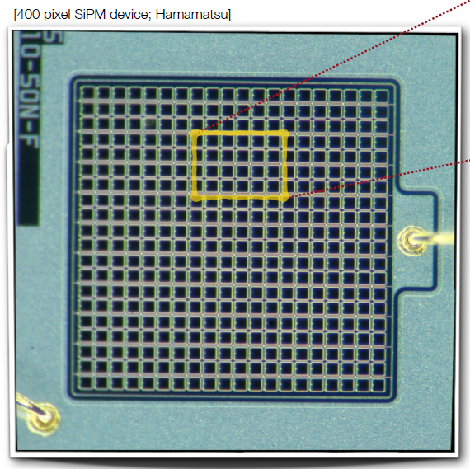
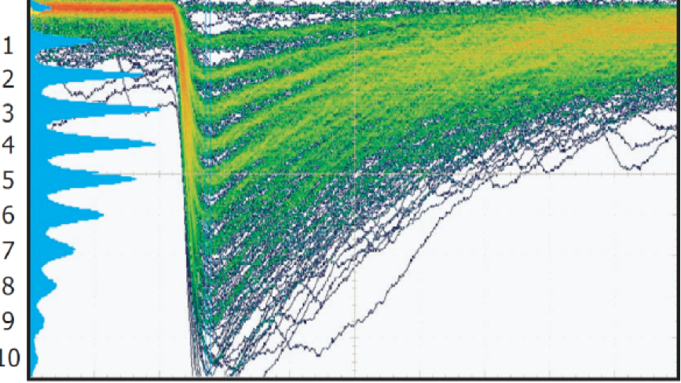
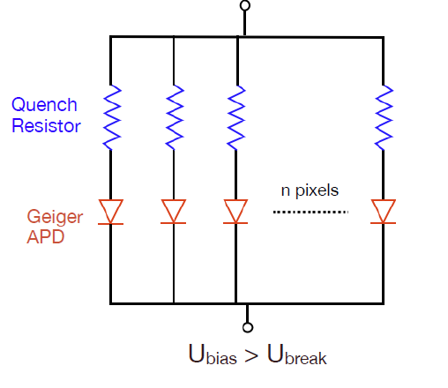
SiPM
# of photons in each event

Slide 20
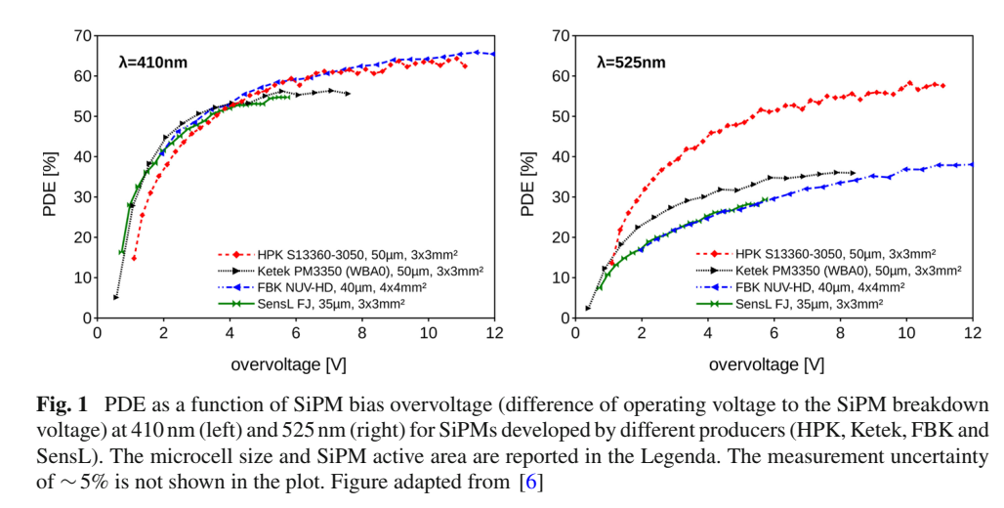

SiPM – photon detection efficiency (PDE)

Slide 21
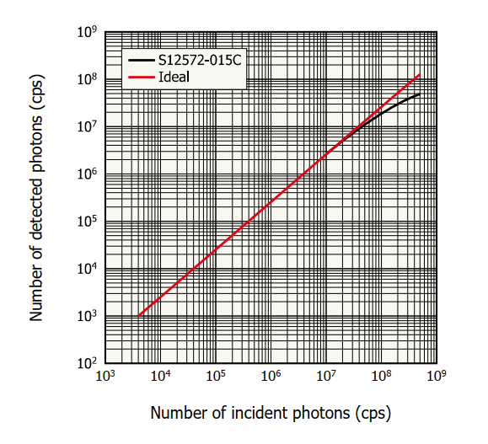
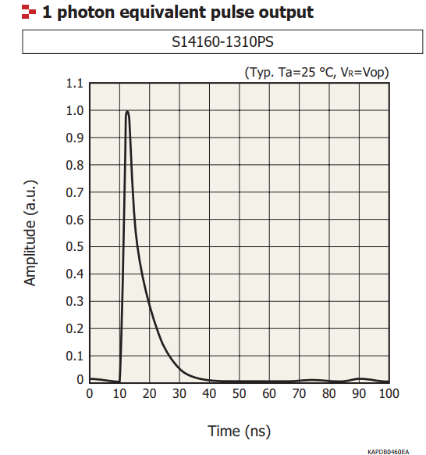
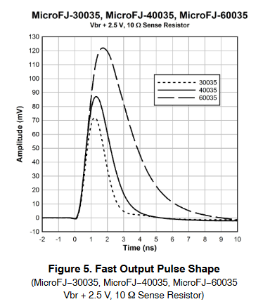
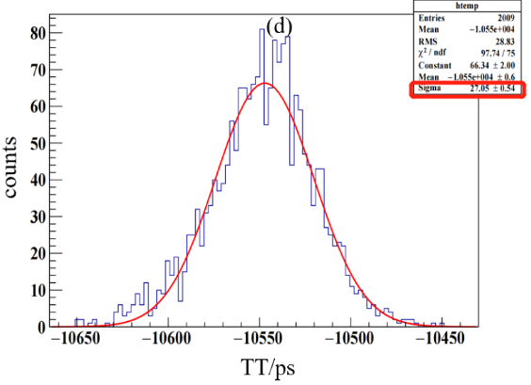
SiPM – linearity, timing
Pulse output for Hamamatsu S14160-1310PS
Fast pulse output for onsemi J-series SiPM
Transit-time spread (TTS) of 28 ps for the onsemi J-30035 SiPM.
IEEE TRANSACTIONS ON NUCLEAR SCIENCE, 68 (2021) 2096
Linearity for Hamamatsu S12572-015C

Slide 22
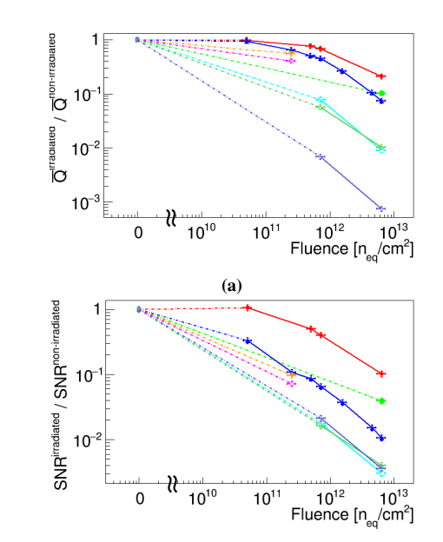
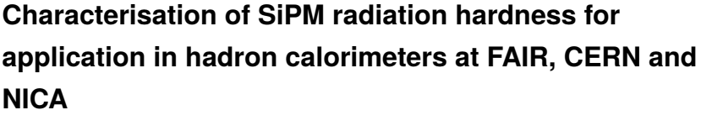
SiPM – radiation tolerance
Degradation becomes evident at neutron fluences above 10¹¹ n/cm² even for the best devices studied here.

Slide 23
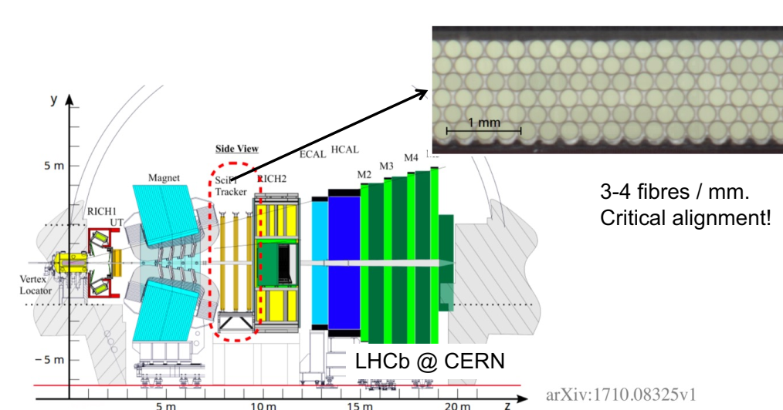
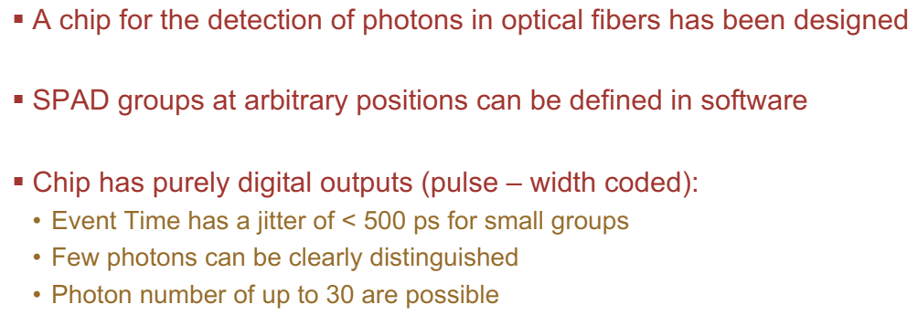
SiPM – imaging devices
Tracking detector using scintillating fibres in LHCb
SPAD = “Single Photon Avalanche Diode”

Slide 24
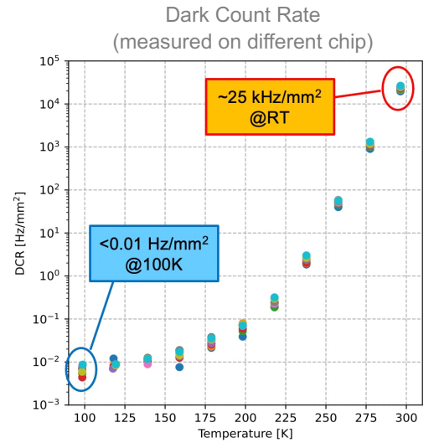
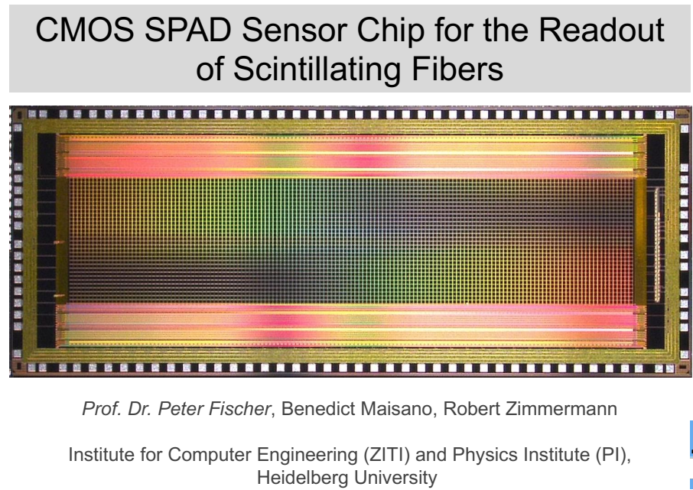
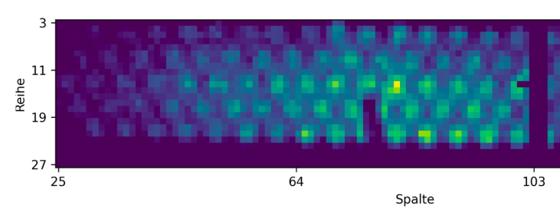
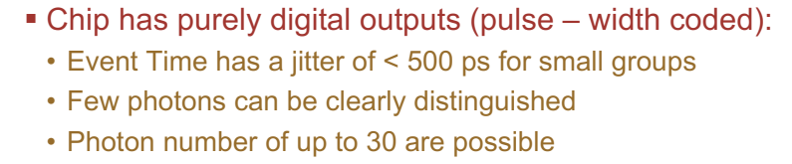
SiPM – imaging devices

Slide 25
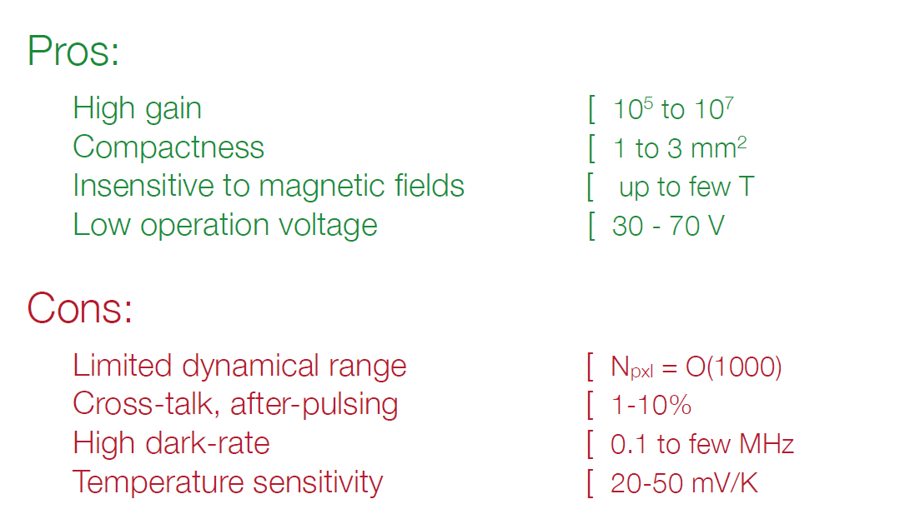
SiPM summary
These parameters are being improved with the latest devices

Slide 26
Photodetectors – the photomultiplier tube (PMT)
A free electron is liberated from a photocathode (photoelectric effect) into a vacuum under an electric field
  The free electron is accelerated to a few hundred volts and hits a dynode
  Low energy (~ 1eV each ) secondary electrons are liberated from the dynode (4 to 10 depending on electron energy and material of dynode)
  Each secondary electron is accelerated and hits the next dynode
  And so on …
A typical tube used in HEP has 10 to 14 dynodes
Thus a high gain is achieved (10⁵ to ~ 10⁷)
A very special amplifier, with a simultaneous high gain (~ 10⁶) and high bandwidth (~1GHz).
Large photosensitive areas (up to hundreds of cm²) are possible, but low QE compared to silicon devices
Most PMT are very sensitive to magnetic fields

Slide 27
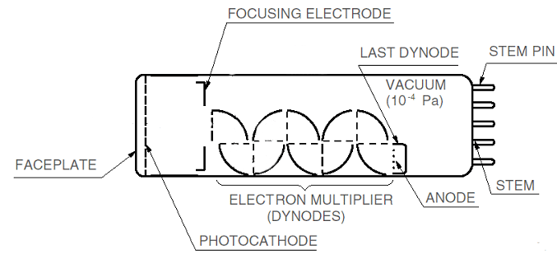
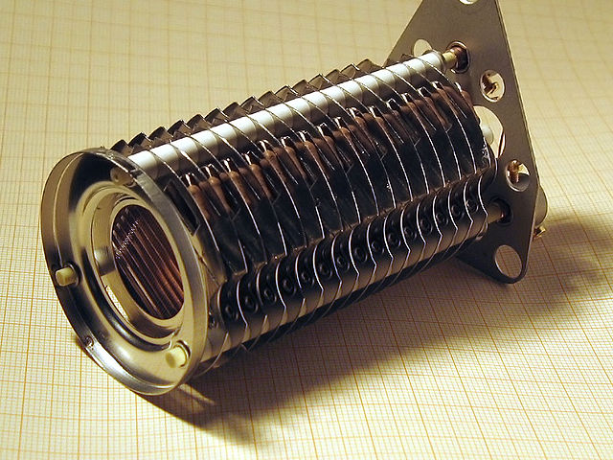
Title
Typical dynode gain is about 4 (for BeCu dynodes) and a typical PMT has 10-12 dynodes. Current gain is therefore of order 4¹⁰ ~ 1000000.
Michael Schmid / CC BY-SA (http://creativecommons.org/licenses/by-sa/3.0/)

Slide 28
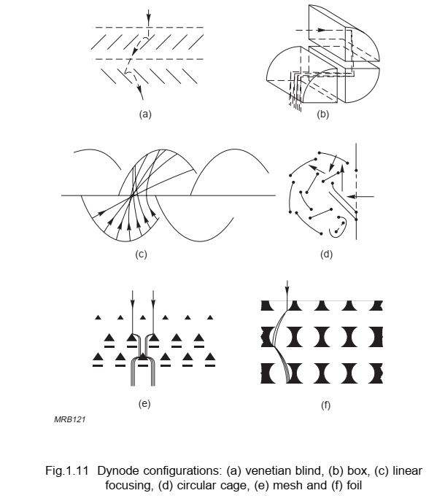
Dynode geometries
Different types of electron multiplier have different characteristics regarding linearity, minimising pulse distortion, sensitivity to external magnetic field etc.

Slide 29
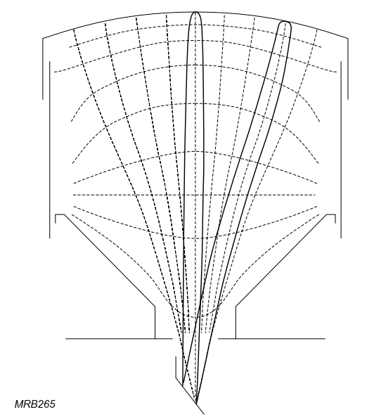
Fast large area PMT
Photocathode
Use electrostatic focussing to minimise the time differences from a large photocathode focussing onto a small area electron multiplier. Note use of a variety of electrodes. This type of PMT is very sensitive to external magnetic fields.
Increasingly positive Equipotentials

Slide 30
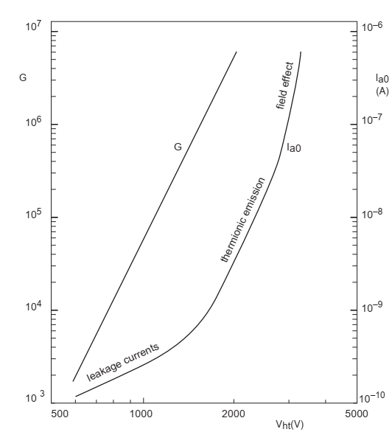
Gain and noise
G = gain
I_{a0} = anode dark current (= noise!)
1 nA

Slide 31
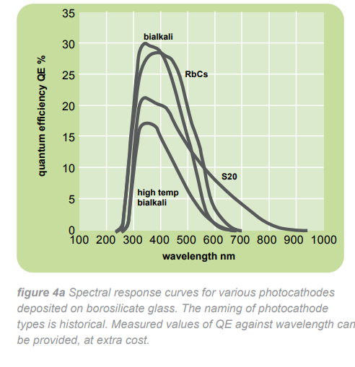
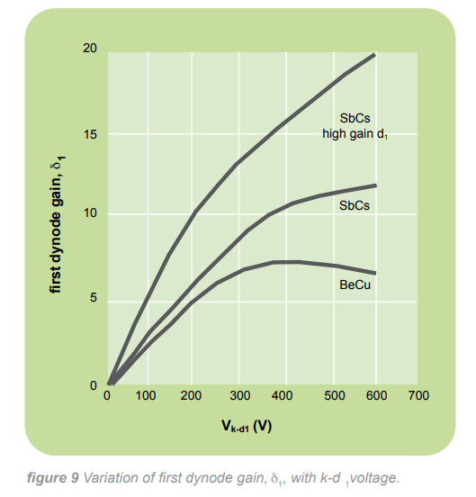
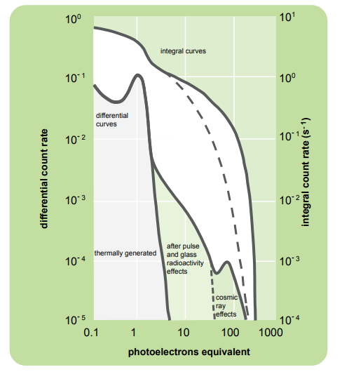
Spectral response, dynode gain, noise
Plots from ET Enterprises Limited, Uxbridge, UK

Slide 32
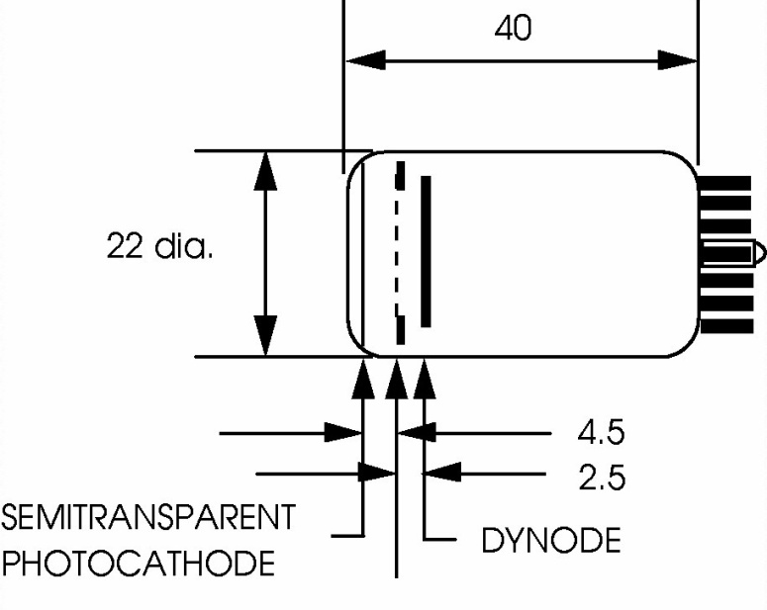
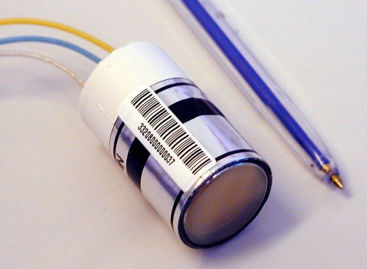
Photomultipliers for high magnetic fields
Fine mesh dynode approach – gains of thousands, fields up to ~ 1T
Fine mesh anode – gain ~ 10 but operating at fields up to at least 4T
Vacuum Phototriodes (VPT)
B-field orientation in end caps favourable for VPTs
(Tube axes 0º < |θ| < 40º with respect to field)
Vacuum devices offer greater radiation hardness than Si diodes
Gain 8 - 10 at B = 4 T
Q.E. ~ 20% at 420 nm
Insensitive to ionising particles
UV glass window - much less expensive than quartz and much more radiation resistant than borosilicate glass
Used in the current CMS endcap calorimeter at the LHC.
φ = 26.5 mm
MESH ANODE

Slide 33
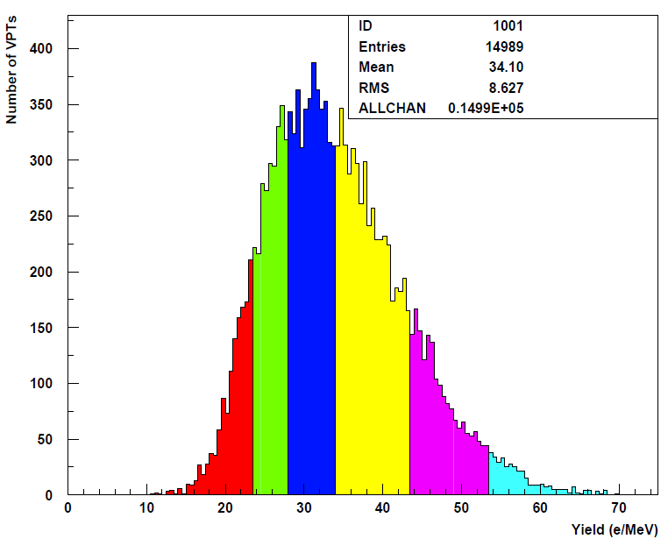
Photomultipliers – VPT used in CMS
Measured at 1.8 T
Only 8% loss of transparency in the glass faceplate after 19 kGy radiation dose (equivalent to 10 years operation at LHC)
Violet box shows the extent of the PbWO₄ scintillation spectrum which peaks at 430 nm.
Variation in gain*QE

Slide 34
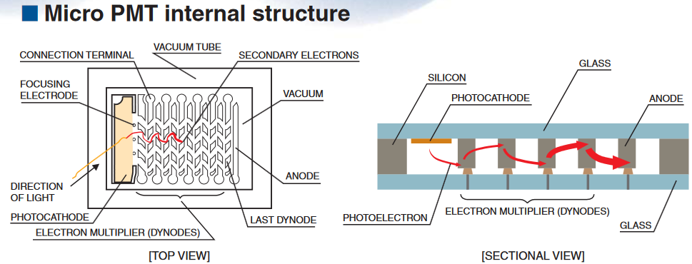
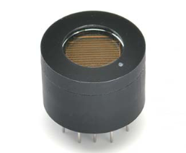
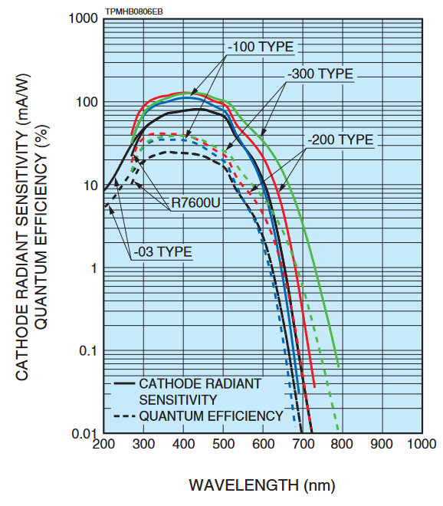
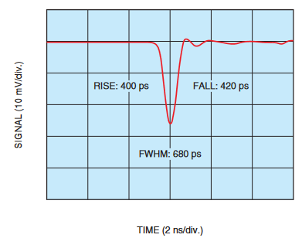
Photomultipliers are still being improved
Ultra-compact PMT from Hamamatsu High QE photocathodes
Gain ~ 10⁶, rise time of anode pulse ~ 0.5 ns, active area 3 mm²

Slide 35
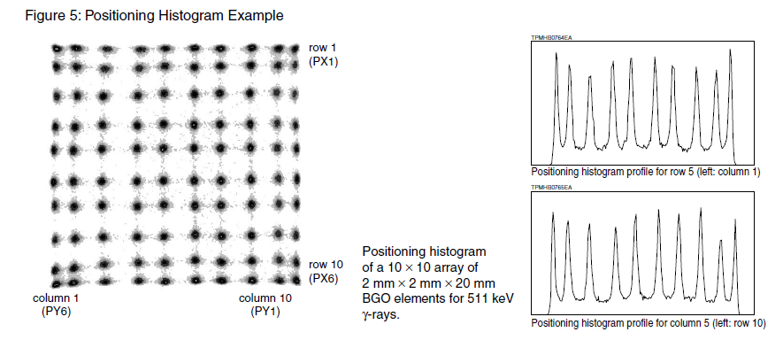

Photomultipliers for many channels
Using proximity focus, and semi-transparent dynodes you can transfer, with gain, the localised photon signal on the photocathode to an array of anodes.
Hamamatsu have also developed a very compact “metal channel dynode” design that enables multi-anode capability. This is very useful for reading out small area scintillating crystals used in PET scanners for medicine.
Hamamatsu R8900 6×6 anode PMT. Gain ~ 700000 @ 1kV

Slide 36
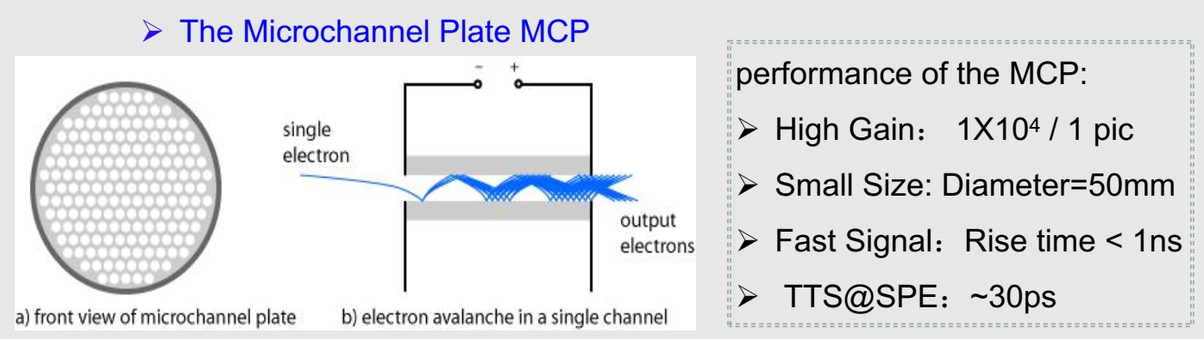



Micro Channel Plate (MCP)
Built for LHAASO expt.
Concept for 4π detection!
Sen Quian at TF-4 Community Meeting, 16/5/2023

Slide 37
Photomultiplier Producers
Hamamatsu
https://www.hamamatsu.com/eu/en/product/optical-sensors/pmt/index.html
ET Enterprises Ltd
http://et-enterprises.com/products/photomultipliers
Electron
    http://www.niielectron.ru/en/main/
Photek https://www.photek.com/photomultipliers/ (MCP based)

Slide 38
Hybrid photodetector
Generate free photoelectrons in a vacuum (like a photomultiplier tube)
Accelerate photoelectrons to a high (10 to 20 kV) energy
Use a silicon sensor as a particle (electron) detector. Get approximately 2500 eh-pairs for each photoelectron accelerated to 10 kV
Large photocathode plus small area diode (low capacitance, thus fast)
Use a pixel detector (CMOS) or microchannel plate (MCP), to provide a position sensitive photon counter.

Slide 39



Hybrid photodetector
Note the resolution of 1,2,3,… photons. <n> = 5.4
Used in the RICH of LHCb
C. Joram, CERN, Large Area Hybrid Photodiodes
6th International conference on advanced technology and particle physics, Como, Italy, October 5-9, 1998

Slide 40



Hybrid photodetector
The LAPPDTM for large area, fast timing and good spatial resolution.
Upgrade II of LHCb RICH
QE ~20%
Gain ~ 10⁷
1mm resolution
60 ps timing
Figure from INCOM, USA
Used today with APD for ultrafast single-photon timing applications
Beckler & Hickl device with 6 mm diameter photocathode

Slide 41

Advantages and disadvantages of PMT
High gain and large electrical bandwidth at the same time is possible.
Large photocathode areas are available.
Insensitive to ionising radiation generating a signal (but Cherenkov in faceplate).
Very low dark count obtainable even at 293 K.
Very well understood technology.
Low noise at high(ish) temperatures (up to 200 °C for oil-well applications)
Very few manufacturers available (effectively two).
Low peak QE (~ 25%) compared to silicon devices (but improving).
Poor (and noisy) photocathode response in the red/near-IR
Very sensitive to magnetic fields
Susceptible to gamma radiation induced darkening of faceplate (except quartz)
Sensitive to helium ingress – after-pulsing issues.
Handcrafted aspect for some tubes = £££/$$$/€€€
Uses high voltage (1 to 2 kV).
Hamamatsu R12860, 508 mm diameter PMT

