Slide 1

Device Fabrication
(or how the detectors for your experiment get made)
Dr Richard Bates
Richard.Bates@Glasgow.ac.uk
(Original slides from Andy Blue, andrew.blue@glasgow.ac.uk)
UK Instrumentation Lectures

Slide 2

Outline of Lectures
(today)
Brief look at why Silicon detectors* are used
Outline of the steps used to fabricate a microstrip detector
  PhotoLithography
  E-beam Lithography
  Resists
  Applications of E-beam lithography
  Additive/Subtractive Processes
    Lift Off
  Etching
    Wet
    Dry (Plasma & ICP)
    FIB
  Doping
Cleanrooms and Specifications
New Detector geometries (3D, edgeless, TSV)
* Other semiconductors are available

Slide 3
Semiconductor Materials
 | Material | Bandgap (eV) | Uses
Ge | Germanium | 0.66 | Gamma @ low temperature
Si | Silicon | 1.11 | Particle, X-ray
GaAs | Gallium Arsenide | 1.43 | Particle, X-ray
CdZnTe | Cadmium Zinc Telluride | 1.4-2.2 | X-Ray
SiC | Silicon Carbide | 2.86 | UV/Rad Hard
GaN | Gallium Nitride | 3.4 | UV/Rad Hard
C | Diamond | 5.5 | UV/Rad Hard
Issues
  Growth – How easy to make?
  Defects – How many?
  Material science – contact formation, pasivation etc

Slide 4
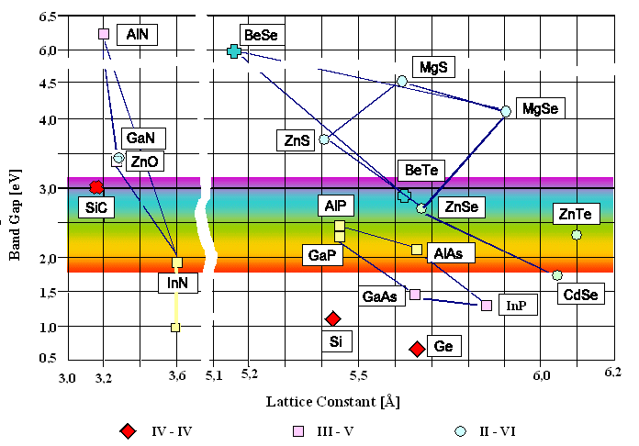
Semiconductor Materials
http://www.tf.uni-kiel.de/matwis/amat/semitech_en/kap_2/illustr/materials.gif

Slide 5
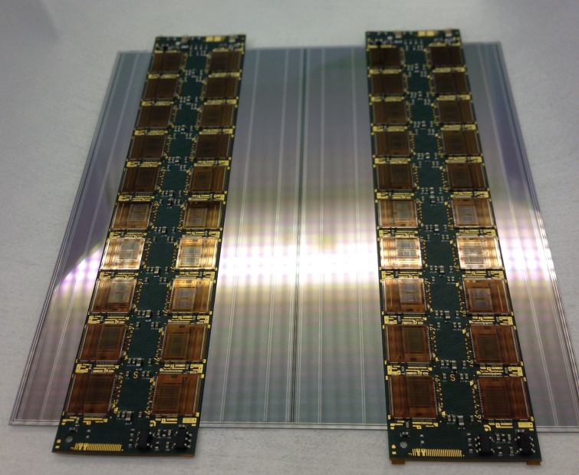
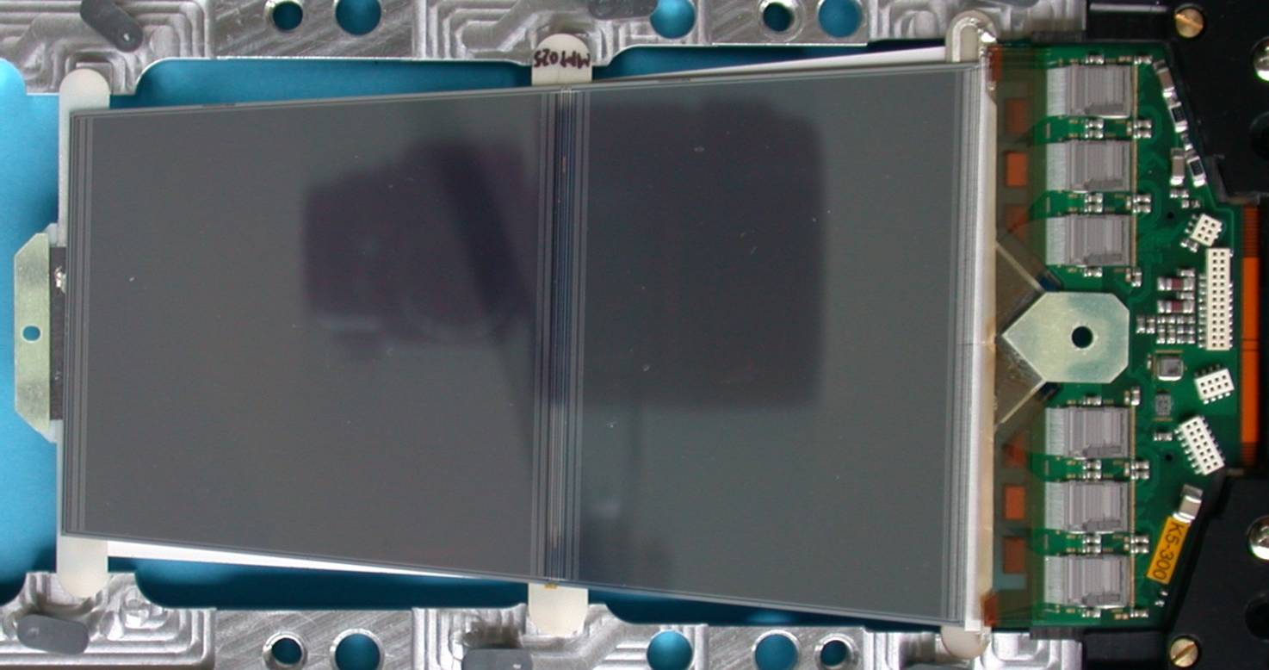
Why Silicon?
Material is well known
  Very high purity material is commonly available
  Higher purity material reduces leakage current and noise
Fabrication processes are very well developed
  Technology doesn’t have to be developed. It already exists, reducing the production time by several years

Slide 6
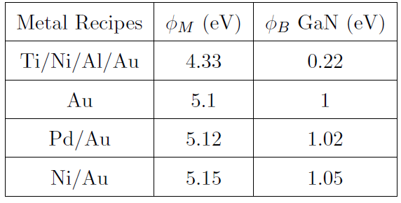
Contact formations
Non Si based Semiconductors can have ‘non trivial’ Metal contact schemes
Example: Gallium Nitride (GaN)
Work Functions and associated Schottky barrier heights for various metal contact
schemes on GaN

Slide 7
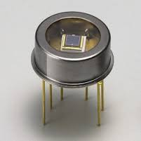
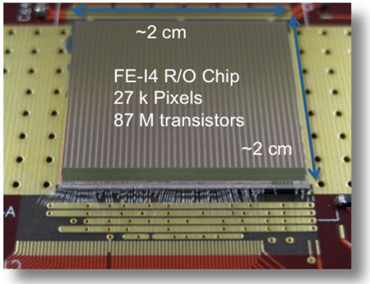
Semiconductor Detectors
The main semiconductor detectors used in physics are
  Single Segment
    Large or small ‘1D’ detectors (energy and timing Information)
    Eg Si Photo Diodes
  Multi Segmented
    2D detectors (Position, energy and timing information)
  You can use lots of single segmented detectors in array to get position information
  Or can you can use fabrication techniques to create ‘sub cell’ information
    Pixel Detectors
    Strip Detectors
So how do we decide on what to make?
  Physics needs, cost, complexity, yield…
‘Single Segment’ Photodiode
‘Multi Segmented ’ Pixel Detector

Slide 8
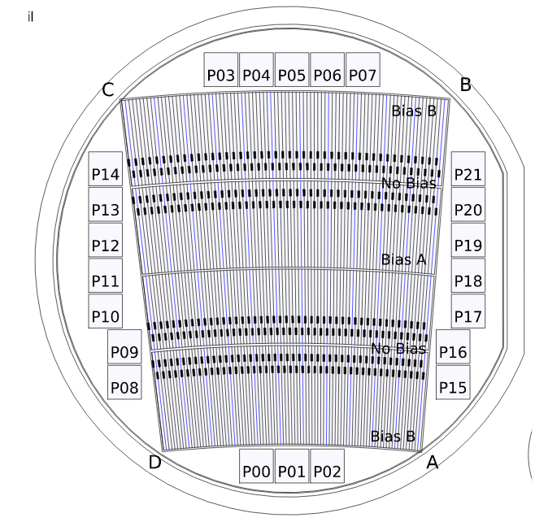
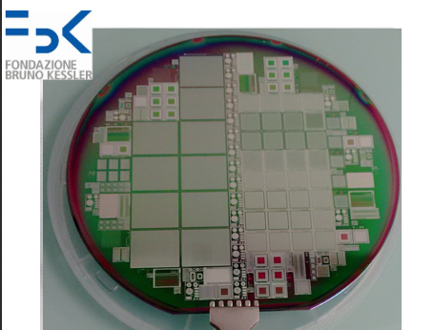
Semiconductor Detectors: Wafer Scale
Wafer Size (inches) | Wafer Size (mm) | Thickness (um)
2 | 51 | 275
3 | 76 | 375
4 | 100 | 525
5 | 130 | 625
6 (5.9) | 150 | 675
8 (7.9) | 200 | 725
12 (11.8) | 300 | 775

Slide 9
Stages in Creating A Si Microstrip Detector
oxide for capacitive coupling
passivation oxide layer
n⁺ doped
p⁺ doped
n- bulk Si
aluminium contacts

Slide 10
Starting Material
High purity, high resistivity Si n_{eff} ~10¹³ cm⁻³
Used because it reduces:
  Depletion voltage
  Leakage current
  Defect concentrations
Together these mean lower noise and more efficient operation

Slide 11

So..
How do we start to “build” our layers of design on to the bulk material?

Slide 12
Lithography
Lithography:
The process of transferring a pattern to a material using an intermediate medium
Two common types
  Electron beam lithography
  Photolithography
This is the process which allows the others to be carried out.

Slide 13
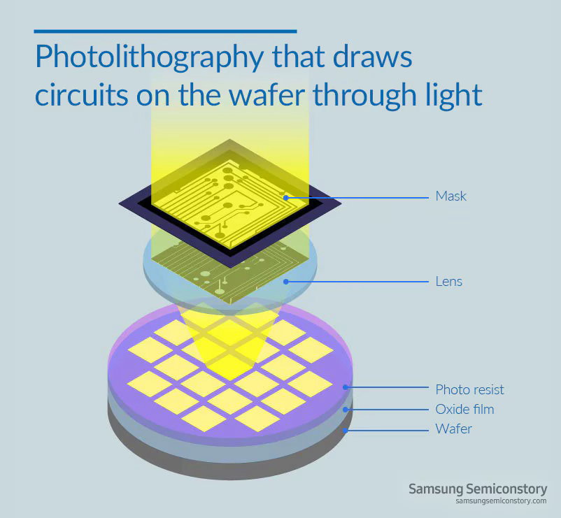
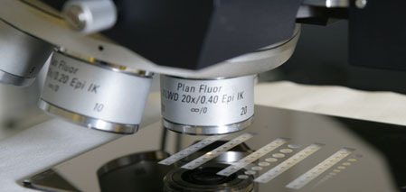
Photolithography
Transfers the pattern using UV light via photoresist
Areas exposed to light will wash away in solvent due to chain scission
Masks used are written using e-beam
Chlorobenzene can be used to enhance metal lift-off

Slide 14
Lithography
Photolithography
UV light
Post-Bake
Mask
resist
Pre-Bake
substrate

Slide 15
Lithography
Photolithography
Developer to remove exposed resist
Hard bake (optional)
resist
substrate

Slide 16
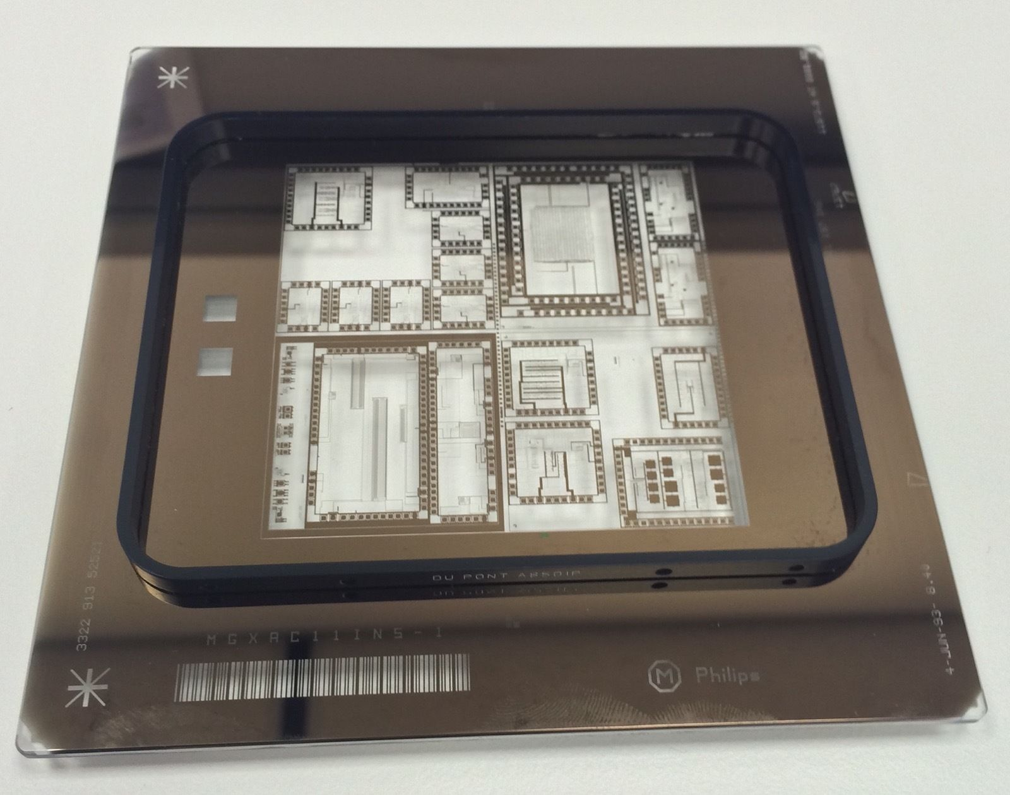
Photolithographic Mask

Slide 17
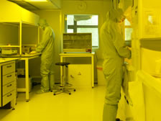
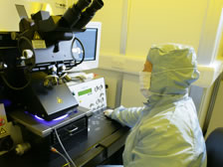
Photo Resists
Resist chosen depends on
  Selectivity - Amount of light needed to create chemical change in the resist
  Resolution – Determines the minimum feature size that can be transferred onto the resist
  Thickness – Amount of resist that can be used as an etch mask
There are 8 photoresists used in the Glasgow Engineering Dept, all with a range of alignment, development times
However, these times will also change depending on the feature size of the pattern

Slide 18
Lithography
Photolithography: The good
Quick relatively simple process
  Printing process entire wafer exposed at once
The resist compounds are very robust
  Patterns produced are suitable for a large number of subsequent processes

Slide 19
Lithography
Photolithography: The bad
Resolution limited
  Minimum feature size ~1 μm for manual photolithography
  Industrial best ~ 0.15 μm, Pentium chips
Possible contamination
  The use of a physical mask can introduce contaminants

Slide 20
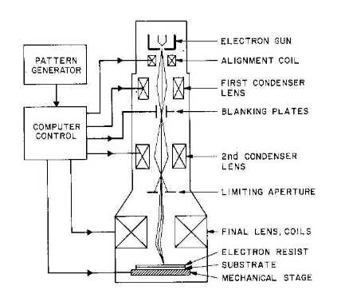
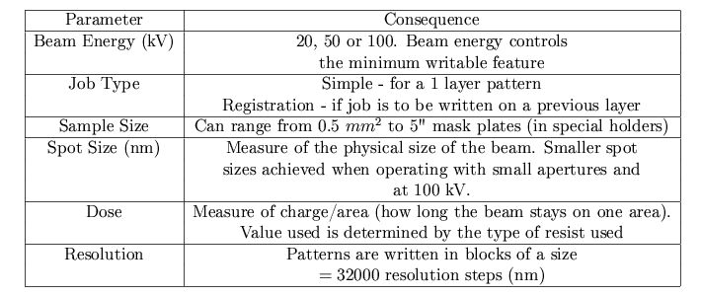
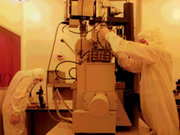
Electron Beam Lithography
Electrons are generated by an electron gun
Condenser lens focus the beam to a set diameter
Banking plates switch the beam on/off
Aperture controls the current density of the beam

Slide 21
Lithography
Electron beam lithography
Electron beam
Electron beam
resist
substrate

Slide 22
Lithography
Electron beam lithography
resist
substrate

Slide 23
E-Beam Mask?
There isn’t one
Pattern is made by as CAD file (gds)
  Translated into movements of the electron beam

Slide 24
Lithography
Electron beam lithography: For
Resist much thinner
  ~100 nm thicknesses available
Resolution down to ~10 nm
  Limited by Gaussian spread of the electron beam
Less contamination
  No mask, direct write

Slide 25
Lithography
Electron beam lithography: Against
Slow and expensive
  Vector scan technique writes the pattern sequentially
Resist compounds not as robust
  Limits possible processes for patterned substrates

Slide 26
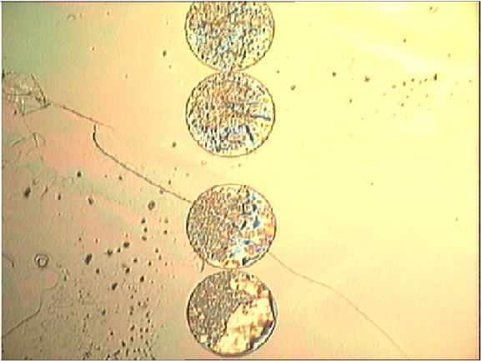
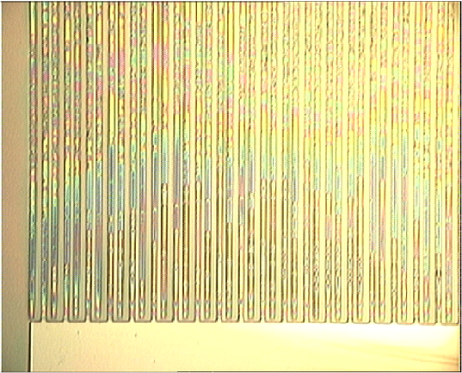
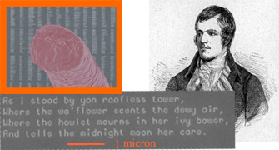
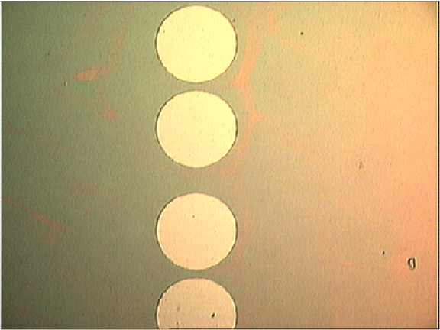
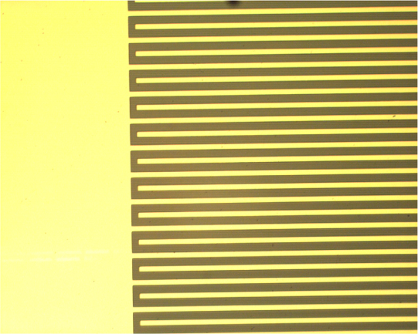
E-beam – Good + Bad
A book of the Complete Works of Robert Burns, Scotland’s National Bard, has approximately 480 pages. To publicise the capability of the new Vistec VB6 UHR EWF electron beam lithography tool at the JWNC, we used it to write the Complete Works of Robert Burns on a small piece of silicon. Ten copies would fit on the head of a pin and this is likely to be the world's smallest copy of the works of Burns. The image shows pages of text alongside a human hair plus detailed text from the song “As I stood by yon roofless tower”. Each character is approximately 150 nm
Dose tests : (Top left) under exposure (Top right) over exposure
(Bottom) – Correct exposure

Slide 27
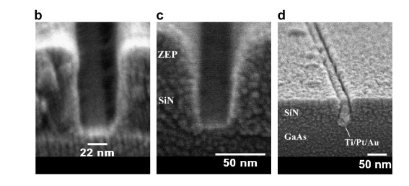
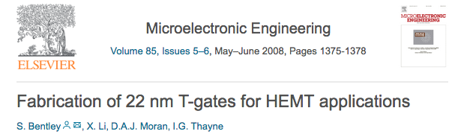
E-Beam: 22nm Gates

Slide 28
CMOS
As well as for fabrication of semiconductor detectors, lithography (e-beam) is essential for the production of CMOS devices
Used mostly in particle physics for readout
  Can be used for data processing, multiplexing etc
Advantages to going to smaller technology
  Cost, power, integration of Digital and Analog, chip size…

Slide 29
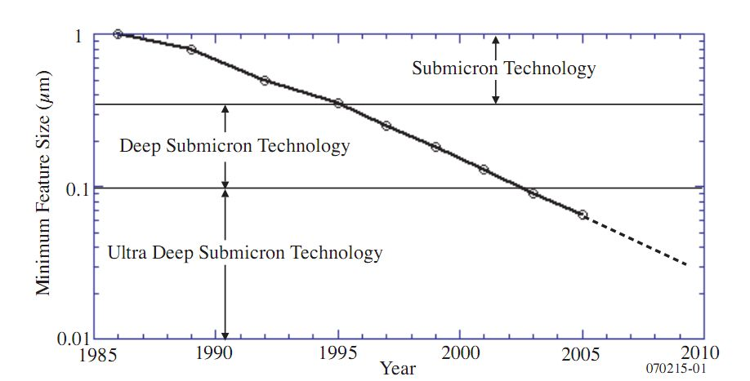
CMOS technology

Slide 30
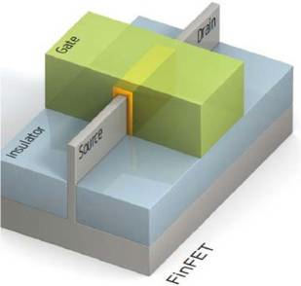
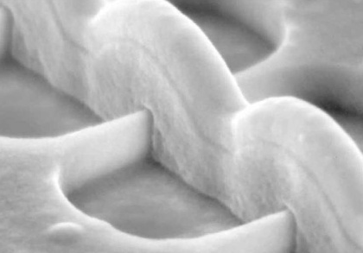
State of the art 2013: 16 nm FINFET
16 nm
Source: TSMC

Slide 31
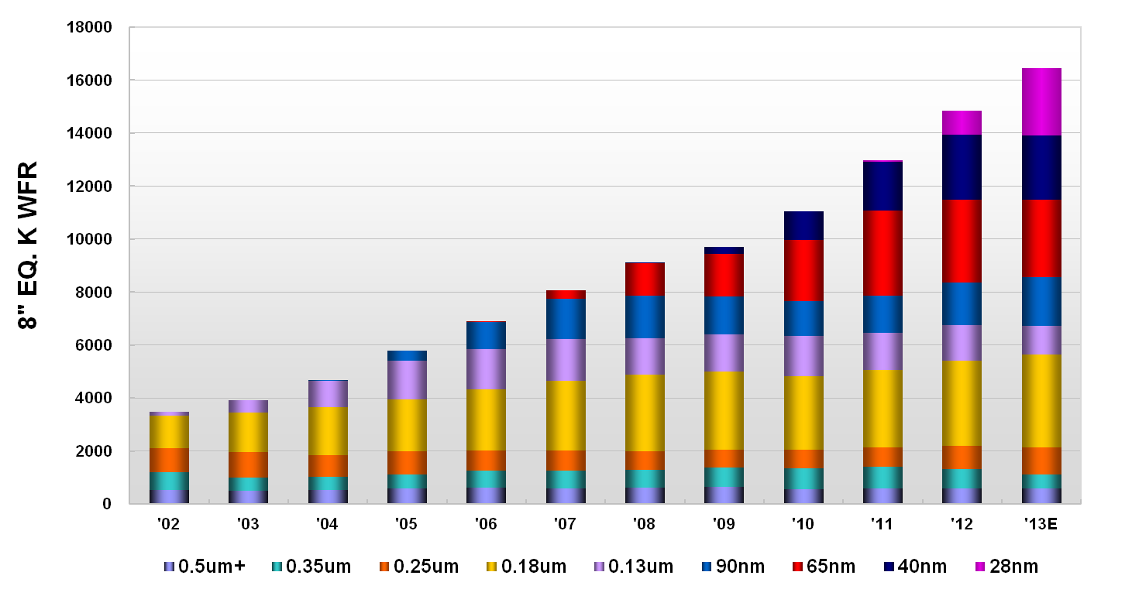
Installed Capacity by Technology
_____________
Source: TSMC

Slide 32
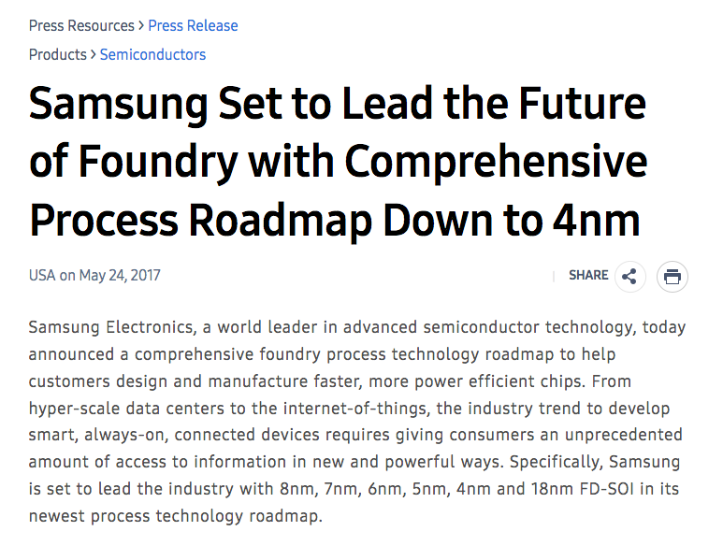

Slide 33
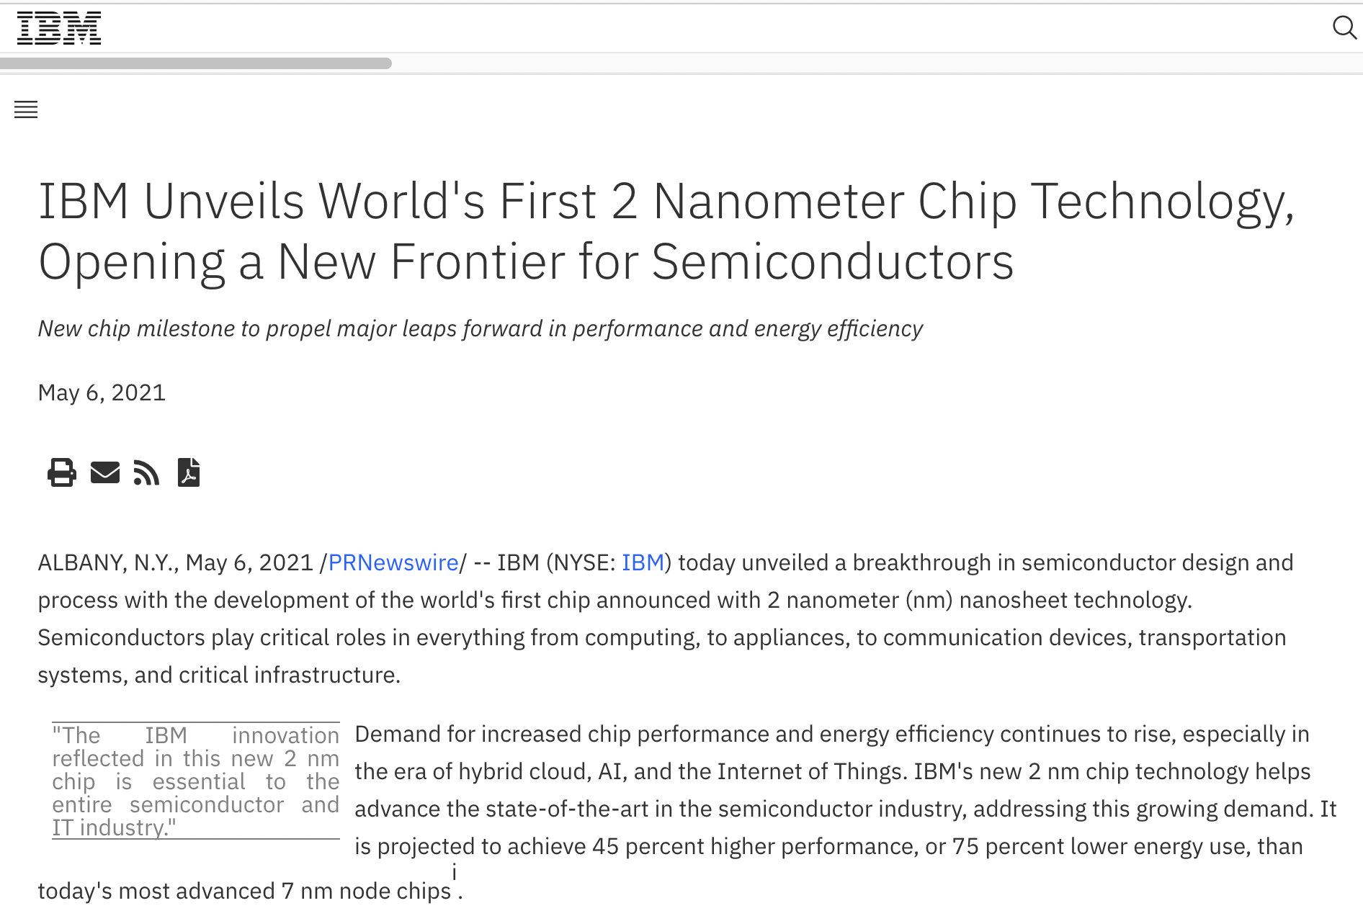
https://newsroom.ibm.com/2021-05-06-IBM-Unveils-Worlds-First-2-Nanometer-Chip-Technology,-Opening-a-New-Frontier-for-Semiconductors

Slide 34
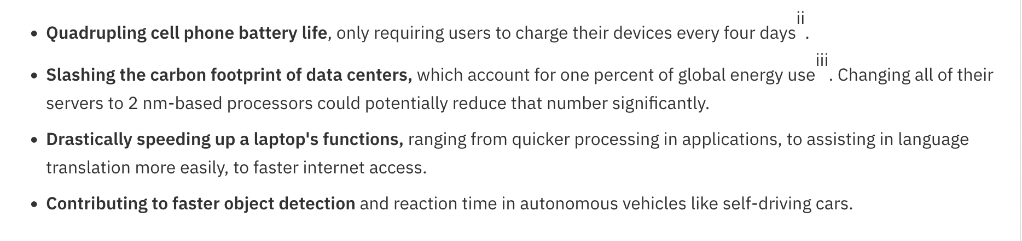
https://newsroom.ibm.com/2021-05-06-IBM-Unveils-Worlds-First-2-Nanometer-Chip-Technology,-Opening-a-New-Frontier-for-Semiconductors

Slide 35
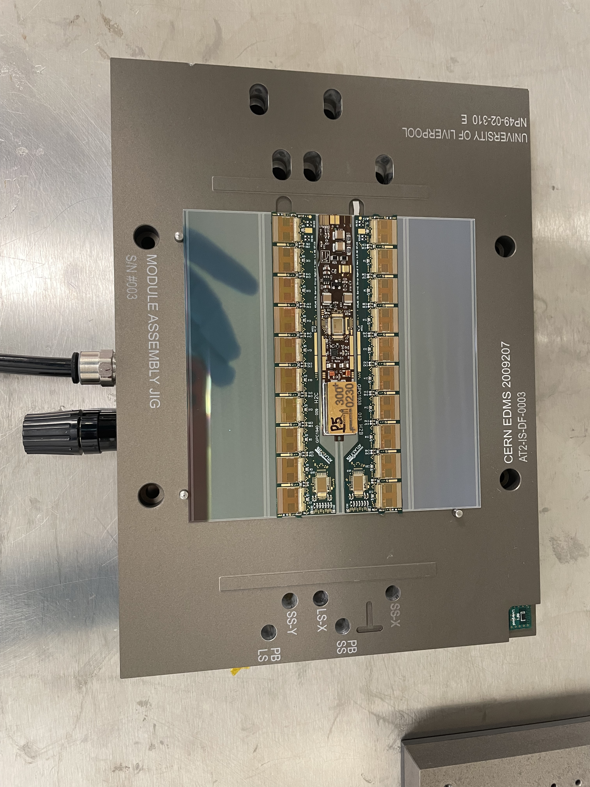
CMOS Improvements – Closer to Home
ATLAS ITk Strip Module - 250nm Chip set
ATLAS ITk Strip Module – 130nm Chip set
2013
2023

Slide 36
Summary
Lecture 1
Brief look at why Silicon detectors* are used
Outline of the steps used to fabricate a microstrip detector
  PhotoLithography
  E-beam Lithography
  Resists
  Applications of E-beam lithography
  Additive/Subtractive Processes
    Lift Off
  Etching
    Wet
    Dry (Plasma & ICP)
    FIB
  Doping
Cleanrooms and Specifications
New Detector geometries (3D, edgeless, TSV)
* Other semiconductors are available

