Slide 1

Device Fabrication
(or how the detectors for your experiment get made) - Part 2
Dr Richard Bates
Richard.Bates@Glasgow.ac.uk
(Original slides from Andy Blue, andrew.blue@glasgow.ac.uk)
UK Instrumentation Lectures

Slide 2

Outline of Lectures
Lecture 2
Brief look at why Silicon detectors* are used
Outline of the steps used to fabricate a microstrip detector
  Photo Lithography
  E-beam Lithography
  Resists
  Applications of E-beam lithography
  Additive/Subtractive Processes
    Lift Off
  Etching
    Wet
    Dry (Plasma & ICP)
    FIB
  Doping
Cleanrooms and Specifications
New Detector geometries (3D, edgeless, TSV)
* Other semiconductors are available

Slide 3
What Now?
Two types of process are possible after a lithography step
Additive
  Putting down metals
  Adding to the surface of a material in any way
Subtractive
  Removal of metals or dielectric layers from exposed/unmasked areas

Slide 4
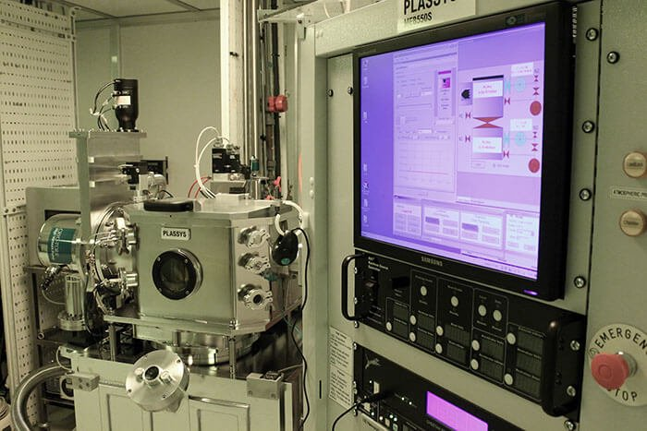
Metal Deposition
The first task of the processing is to deposit metal on the surface of your sample
There are a range of systems that can do this:
load-locked electron beam evaporation tools
multi-target sputtering systems
Common metals deposited by evaporation include Au, Ti, Pd, Pt, Al, Ge, Ni and NiCr.
Can deposit ~10nm-150nm of metal

Slide 5
Metal Deposition - Preparation
Before depositing or ‘flashing’ any metal on to a surface, the surface itself must be very clean
Example, Si will naturally form an oxide layer on top over time, which would be a barrier to the conducting material deposited on top
We need to clean (etch) the surface of the material before deposition
Usually, for Si we use HF – Hydrofluoric Acid,
  or Ammonium Floride (NH4F)
  Or can use a reductive hydrogen plasma treatment
Need to be careful to avoid subsequent oxide growth

Slide 6
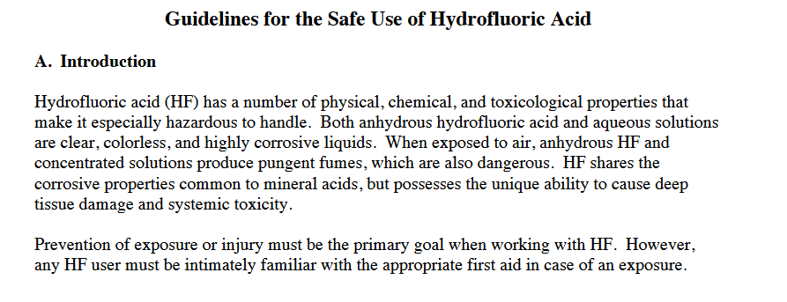
HF – An Aside
HF (Hydrofluoric Acid is a particularly nasty chemical
  Used for wet etch on Si
  But often used in samples to prepare/clean surface before metal deposition
Exposure requires
  removal of clothing,
  immediate flushing with lukewarm water,
  application of 0.13% benzalkonium chloride (Zephiran®) solution or 2.5% calcium, gluconate gel
  hospitalization

Slide 7
Lesson?
As ‘boring’ as it may seem, aways pay attention to safety, and hazard issues in cleanrooms
Control of Substances Hazardous to Health (COSHH)
  COSHH is the law that requires employers to control substances that are hazardous to health. You can prevent or reduce workers exposure to hazardous substances by:
  finding out what the health hazards are;
  deciding how to prevent harm to health (risk assessment);
  providing control measures to reduce harm to health;
  making sure they are used ;
  keeping all control measures in good working order;
  providing information, instruction and training for employees and others;
  providing monitoring and health surveillance in appropriate cases;
  planning for emergencies.

Slide 8
Additive Processes
The most common additive process is lift-off
Developed
resist
substrate

Slide 9
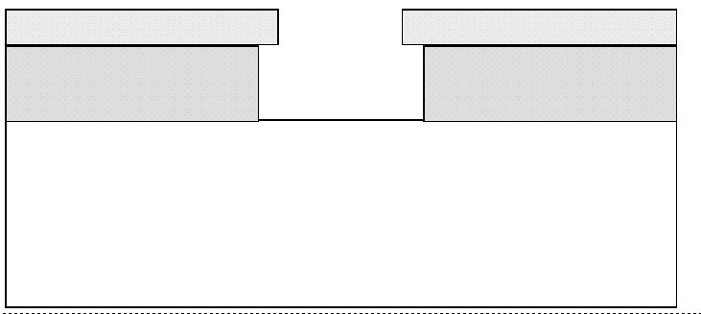
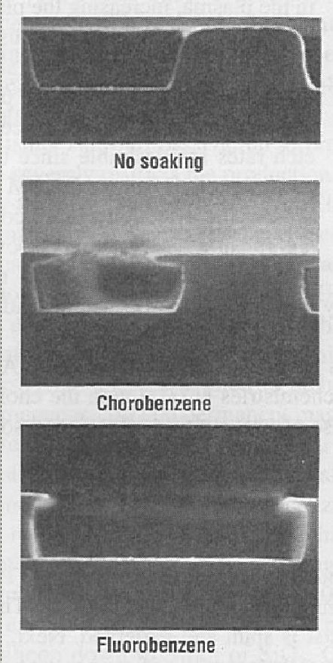
Additive Processes
Above: bi-layer of resist for e-beam resist
Right : Effect of chemical soaks on photoresist

Slide 10
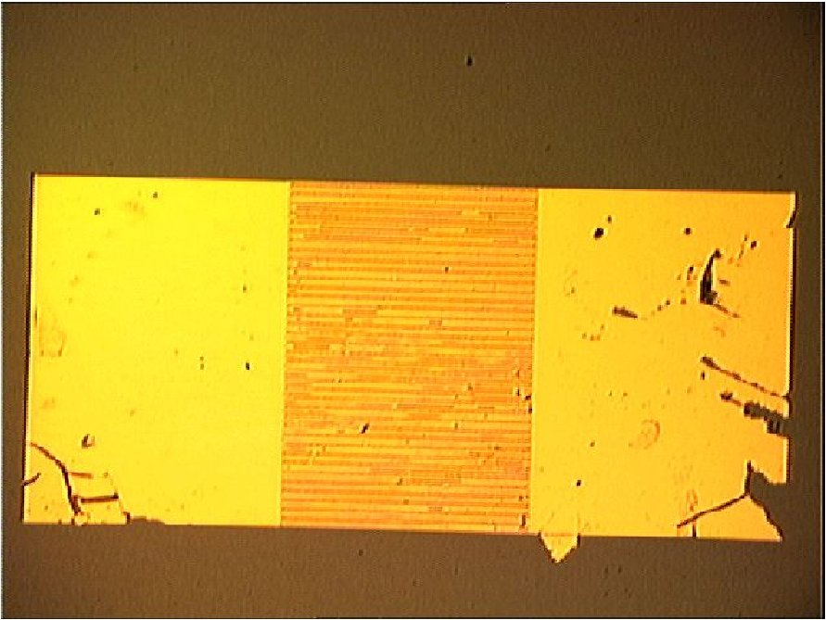
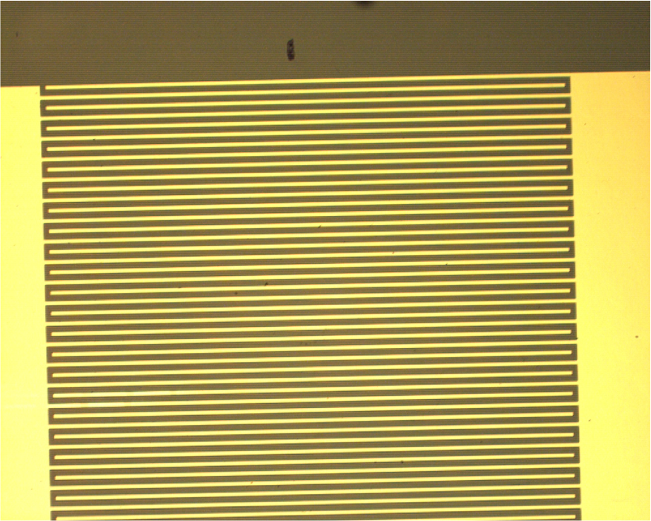
Lift off – Good + Bad
Improvement in lift-off using (right) bi-layer resist

Slide 11
Additive Processes
Lift off is mostly used for defining metal layers.
Advantages
  No strong/ corrosive chemicals
  Accurate edge definition
Disadvantages
  Significant failure rate
    There are ways to improve the repeatability

Slide 12
Subtractive Processes
Etching using wet or dry chemistries
resist
SiO₂
substrate

Slide 13
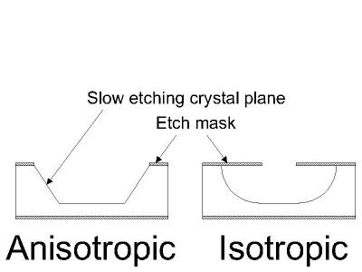
Subtractive Processes
Can be used to pattern most materials
  Metals, di-electrics, semiconductor materials
Two separate processes are used
Wet chemical etch (isotropic) or Dry plasma etch (anisotropic)

Slide 14
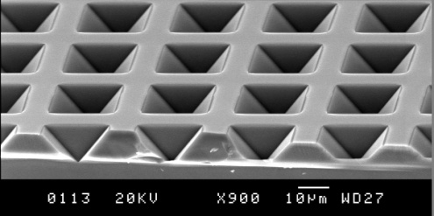
Wet Etching
Wet etching: uses liquid chemicals to transfer pattern
  Acid or alkaline solutions used depend on material being patterned:
    HF for SiO₂, KOH for Si, any alkali for Al etc
Fast process with very well-known chemical processes available for most materials
Wet etching is isotropic
  Etches at the same rate in all directions, unsuitable for very small features
Not all materials have a suitable wet etch chemistry available
HCl wet etch

Slide 15
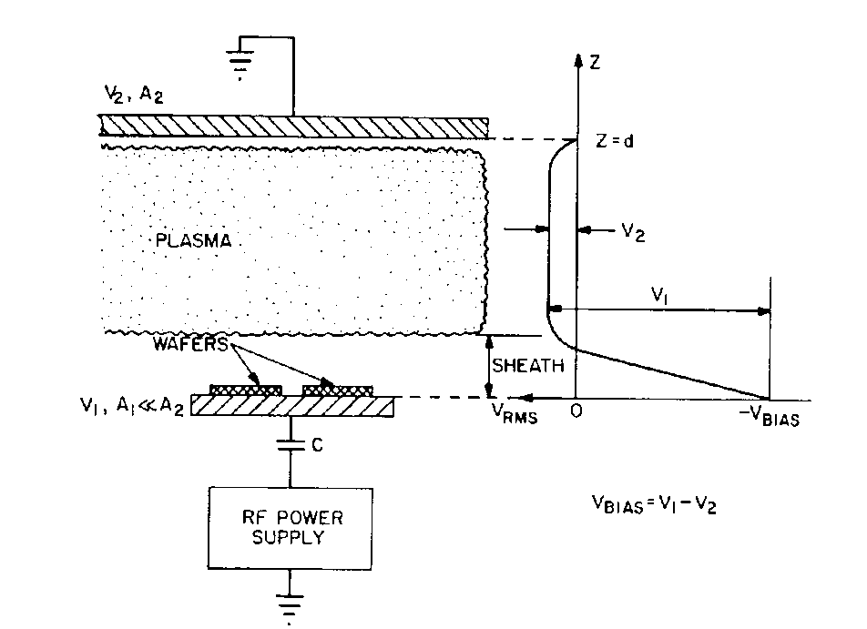
Dry Etching
Dry etching: uses a ‘dry’ plasma to remove unwanted material
  An RF discharge is used to crack a pressurised gas into a number of reactive and neutral species
  The electrical field accelerates the ions toward the sample material, causing physical sputtering and chemical removal
Schematic of reactive ion etching (RIE) plasma reactor

Slide 16
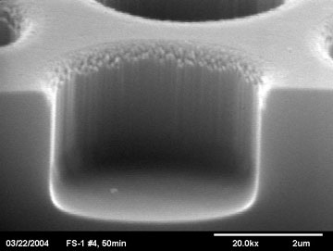
Dry Etching
Process is anisotropic
  Suitable for small or densely packed features
Everything can be etched using plasma
  Even if it is sometimes very slow
Process is very hard on masks

Slide 17
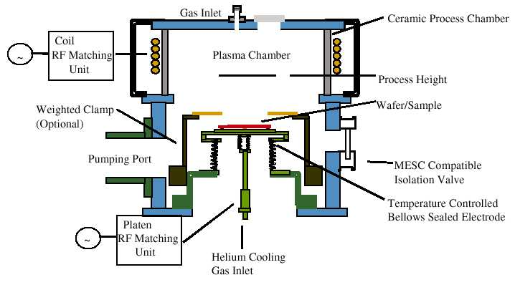
ICP Etching
Inductively Coupled Plasma
  High density plasma source for deep reactive ion etching of materials
Bosch Process
  Use of alternative gases for cycles of passivation and etching
ICP used to produce denser plasma and faster etching
  Uses 2 RF discharges, one to excite the plasma & one to accelerate the ions
Faster etch rates
Tougher on mask material
  Don’t use a resist rather a hard mask like Al₂O₃

Slide 18
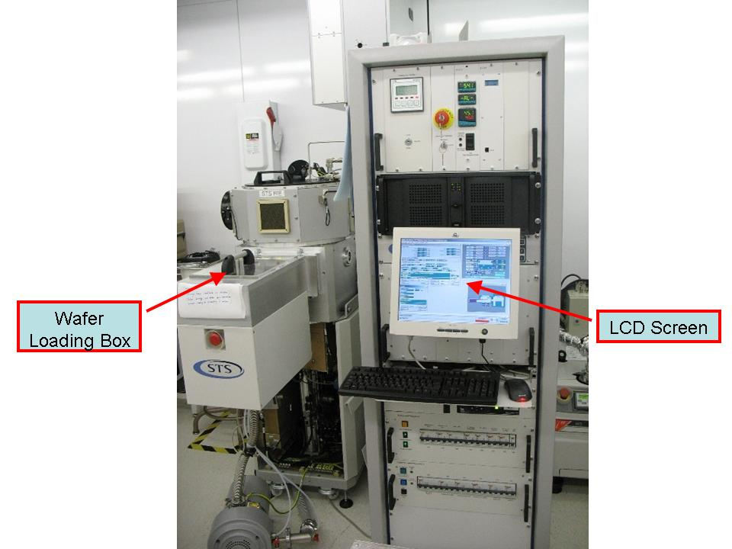
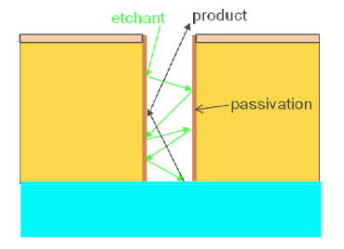
BOSCH Inductively Coupled Plasma
These machines have 1 major advantage
They can operate in a ‘switched’ mode
  1 Cycle etches the surface
  1 Cycle passivates the sidewalls
Typical Etch mechanisms:
For the etch
sulfur-hexafluoride (SF6) or the combination of tetrafluoromethane (CF4) mixed with oxygen (O2).
For the passivation
followed by fluorocarbon plasma (e.g. c-C4F8)

Slide 19
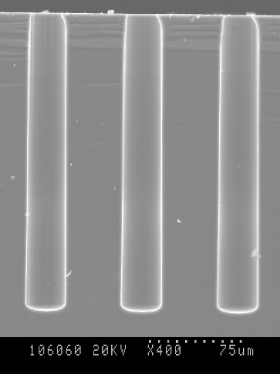
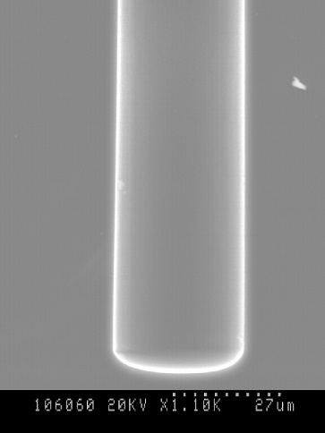
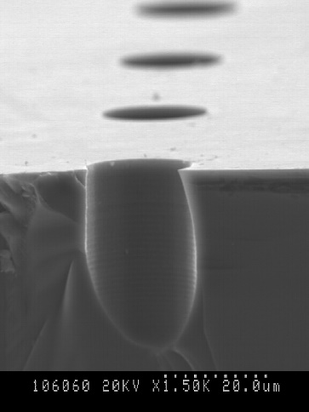
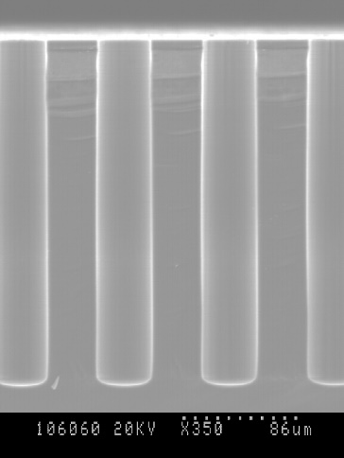
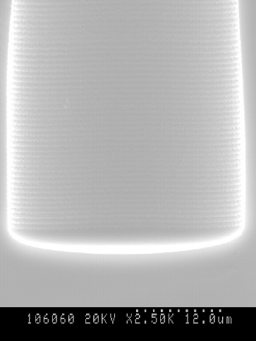
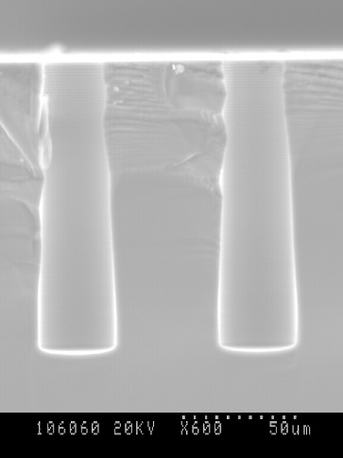
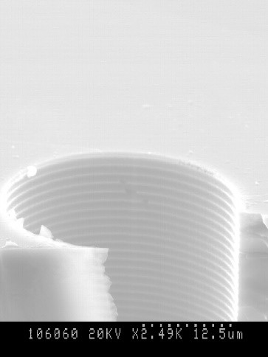
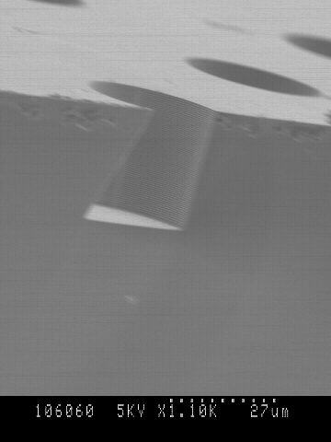
ICP Etching
Scalloping (ripples)

Slide 20
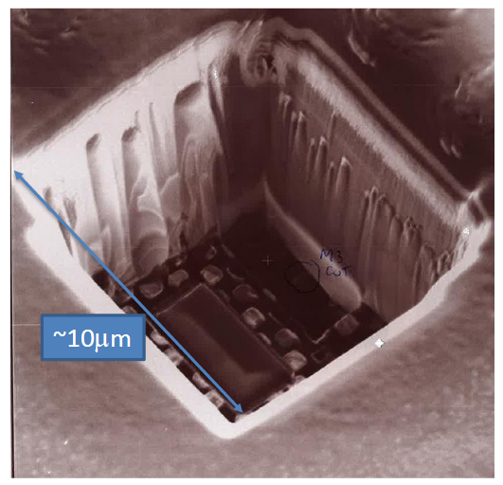
Focus Ion Beam (FIB)
FIB: uses Focused Ion beam (Ar) to remove (with precision) areas of a sample
  Most commonly ASICs
  An example below is a CMOS chip where the wrong connect made in one of the metal layers below the oxide layer
    Remove oxide layer
    ‘Cut’ metal track

Slide 21
Next Step
How do reduce our leakage current and noise sourced from our surfaces?
How do we isolate our doped areas?
Introduce an insulator
SiO₂

Slide 22
SiO₂ layers
Thermal growth
  Increases thickness of natural oxide
  Can be dry (O₂) atmosphere
    Slower, high-quality oxide with little dislocations
  or wet (H₂O) atmosphere
    Faster, lower density oxide with more Si-SiO₂ interface states
Deposition
  Uses a chemical process to produce thick layers of SiO₂
  Chemical vapour deposition (CVD) is often used where a gas deposits the Silicon oxide on the wafer
    Gases include SiH₄ with O₂ or tetraethoxysilane (TEOS)

Slide 23
Final Stage
We’ve made our metal contacts
We’ve made out oxide regions
We’ve etched out bulk silicon
What’s left?
Doping

Slide 24
Doping Silicon
Heavily doped p⁺ layer
~10¹⁸ cm⁻³ concentration of boron (B)
n⁺ doped
p⁺ doped
n- bulk Si
phosphorous (P) doped to produce n⁺ region

Slide 25
Doping Silicon
Three main methods
Gas diffusion
Diffusion from a solid
Ion implantation

Slide 26
Doping Silicon
Ion implantation
B
Magnetic field causes
ion trajectories to bend
Electric field accelerates ions
E
Dopant
Mass
separator
Heavy impurities
Light impurities
Ion source creates +ve charged ions

Slide 27
Doping Silicon
Implants are produced using ion implantation
Implant geometry is very precise
  In all three dimensions
Dopant element is uncontaminated
  Single chosen element due to mass separation
Higher concentrations are possible than other methods of doping
  Infinite source and no reliance on thermal processes to move dopant into Si
After doping the silicon is annealed to remove damage and activate the dopant
  This cases the dopant to diffuse into the silicon

Slide 28
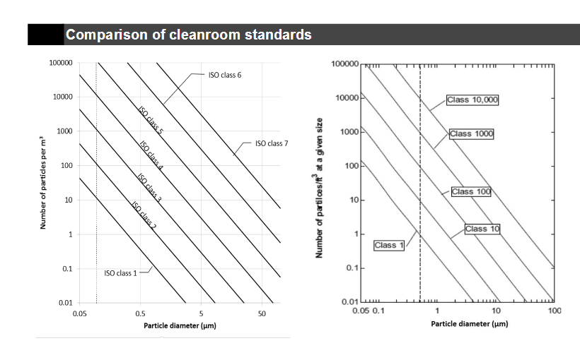
Were does this all happen?
In very, very, clean rooms
  Appropriately called ‘cleanrooms’
How clean?

Slide 29
Cleanrooms
Class 10 000 area (Bio, Photochemical, MEMS, Photolith cabinets)

Slide 30
New Geometries
Several new types of detectors are under research for their use as particle detectors
  All utilise fabrication techniques
3D Detectors
Edgeless Detectors
Thru Silicon Vias (TSV)

Slide 31
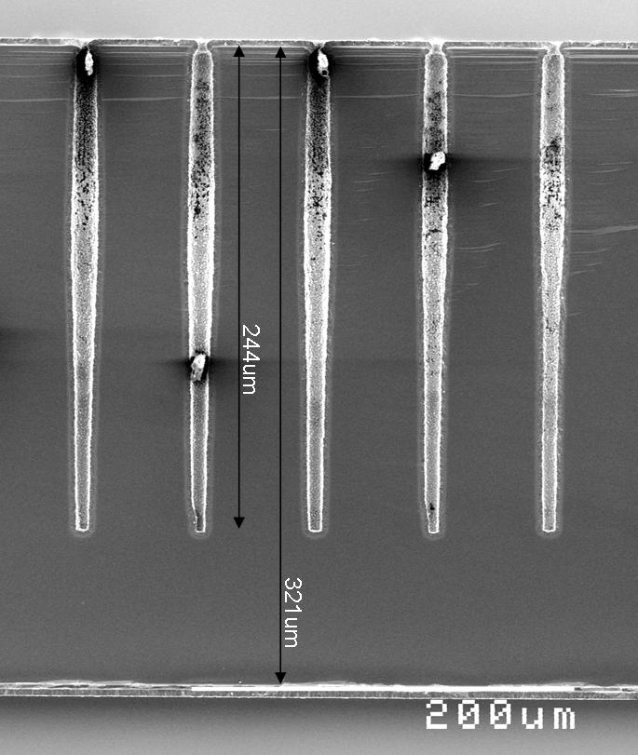
3D Detectors
A 3D detector is a photodiode with closely-spaced electrode columns. This leads to very fast charge collection and low depletion voltages.
Due to their high radiation tolerance, 3D detectors are used as pixel detectors for the HL-LHC.
Different 3D structures are being designed in collaboration with other institutions, simulated, and tested with LHC-speed readout electronics

Slide 32
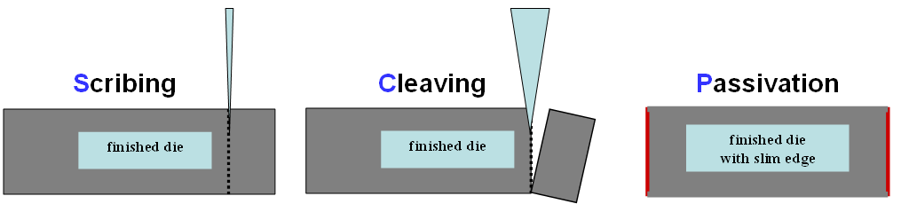
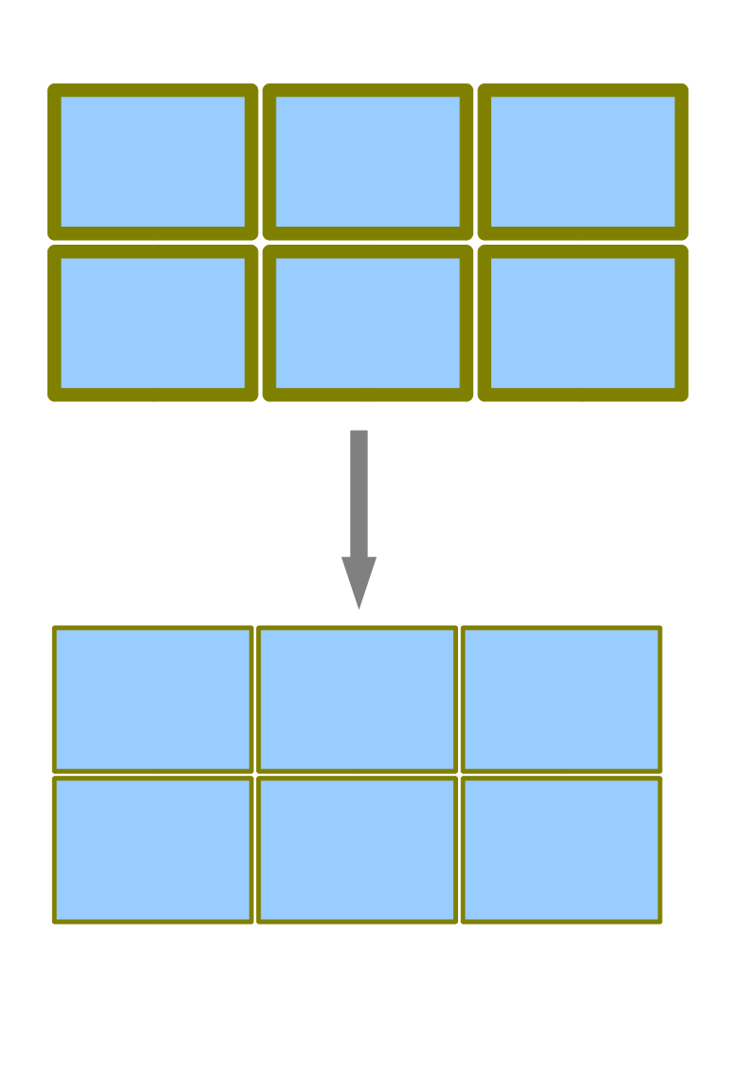
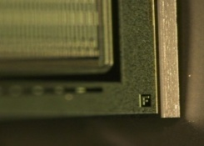
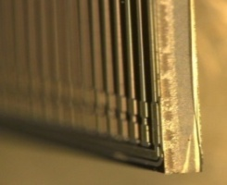
Edgeless Detectors
To minimize the dead areas between the end of the detecting area and the cut edge, the dead areas is “Scribed”, then “Cleaved”, then “Passivated” to reduce edge effects

Slide 33
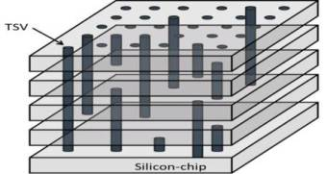
TSV (Thru Silicon Vias)
A through-silicon via (TSV) is a vertical electrical connection (via)(Vertical Interconnect Access) passing completely through a silicon wafer or die.
TSVs are a used to create 3D packages and 3D integrated circuits

Slide 34
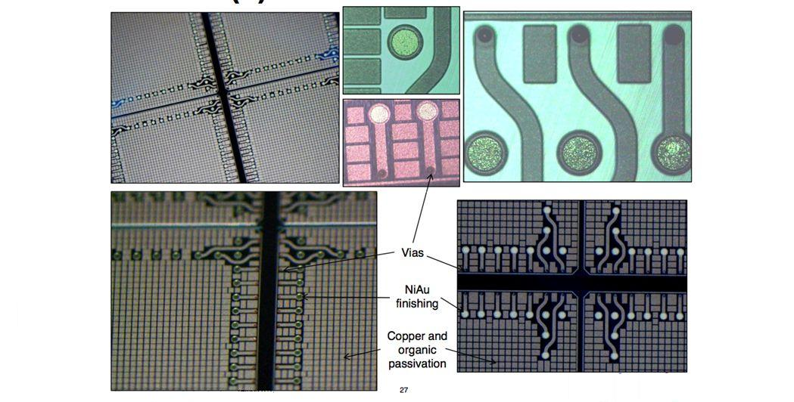
HDI Example: TSV

Slide 35
All Together Now..
All ofthese processes are carried out for every single detector.
  Each wafer will go through multiple lithography/ metal and SiO₂ deposition steps.
  Multiple etching steps are also used
A wafer will go through over 100 individual steps before it is complete

Slide 36
All Together Now..
One single failure at any stage can cause a wafer to be discarded.
  A single grain of dust can destroy an entire wafer

Slide 37
In Conclusion
Most of you won’t be doing any fabrication
  This is an attempt to make you appreciate it
You will all probably be analysing data gathered using detectors fabricated this way
  That bit is your problem ;)

Slide 38
BOSCH Process Overview
Etching Step:
  A fluorine-based plasma (e.g., SF6) is used to etch the silicon, removing material from the bottom of the feature.
Sidewall Passivation:
  A fluorocarbon plasma (e.g., c-C4F8) is then used to deposit a protective layer on the sidewalls of the etched feature.
Cycle Repetition:
  The etching and passivation steps are repeated multiple times to achieve the desired depth and verticality of the etched features.
Key aspects:
Anisotropy:
  The alternating etching and deposition steps result in anisotropic etching.
High Selectivity:
  The fluorocarbon layer provides good selectivity between the etch mask and the silicon, preventing the etch mask from being etched while silicon is being removed.
Deep and Vertical Features:
  The Bosch process is well-suited for creating deep, vertical features, used in MEMS and TSV (Through-Silicon Via) fabrication.
Complex Process:
  Bosch process is complex with numerous parameters to control, including gas flows, RF power, and switching times.
Potential Challenges and Solutions:
Scalloping:
  Scallops, or ripples, can form on the sidewalls due to the isotropic nature of the etching within each cycle.
  Solutions: Faster gas switching and sidewall smoothing processes can help reduce or eliminate scalloping.
Mask Selectivity:
  The process can be demanding on mask selectivity due to the long etching times.
  Solution: Al₂O₃ hard mask offers higher selectivity compared to conventional masks.

