Slide 1
Process fabrication III
E. Giulio Villani
Instrumentation Training Lectures, Oxford 13/05/2025

Slide 2
Overview
Semiconductor technology
    Introduction
    Moore’s Law
    Dennard’s Law
Semiconductor fabrication process I
  Silicon crystal growth
  Fabrication process flow
  Oxidation
  Resist deposition
  Photolithography
Instrumentation Training Lectures, Oxford 13/05/2025

Slide 3
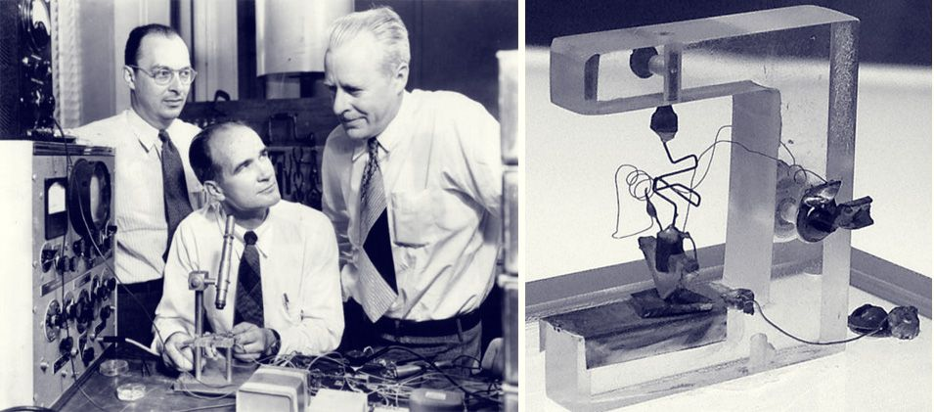
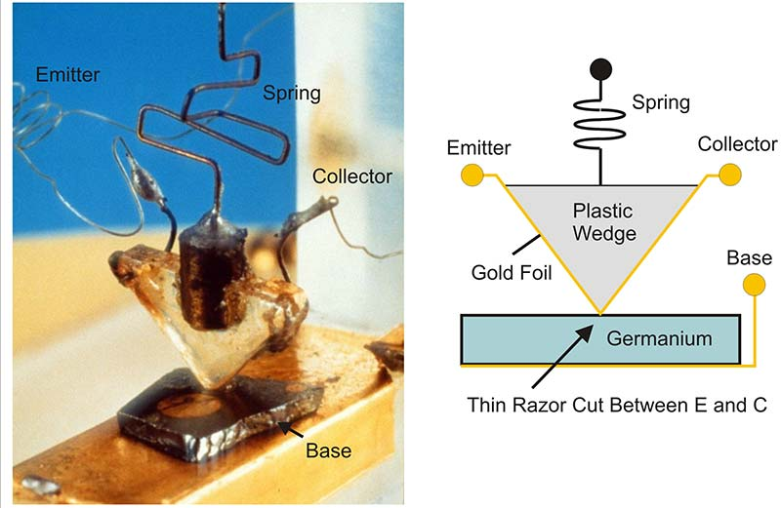

Introduction
First bipolar (PNP Ge) transistor invented in 1947 (US patent 2569347A, 1948)
Research on solid state devices to replace vacuum tubes
Resulted from failed attempts to build a field-effect transistor (FET)
1
Instrumentation Training Lectures, Oxford 13/05/2025

Slide 4
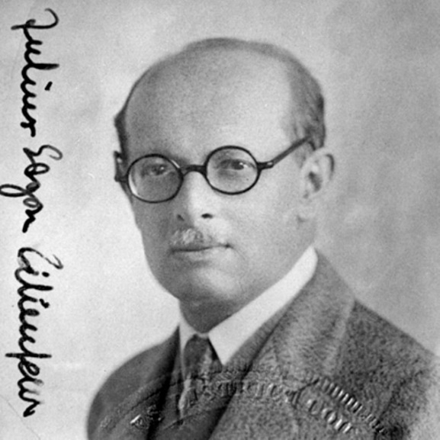
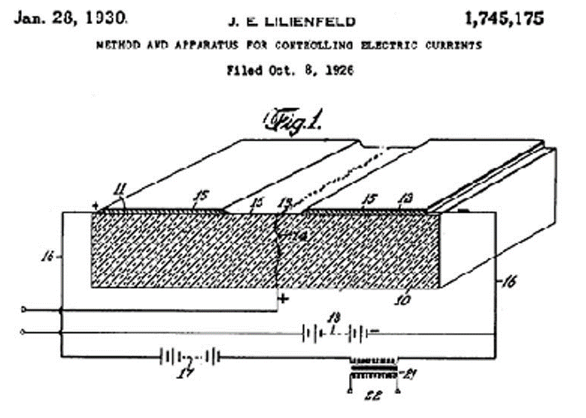
Introduction
First FET (Field Effect Transistor) patented filed in 1926 (US patent 1745175A,1930)
Serious problems with surface states/ dielectric defects prevented the devices from working
First practical working device invented in 1959, using SiO₂ as dielectric (MOSFET, Metal Oxide Silicon Field Effect Transistor)
2
Instrumentation Training Lectures, Oxford 13/05/2025

Slide 5
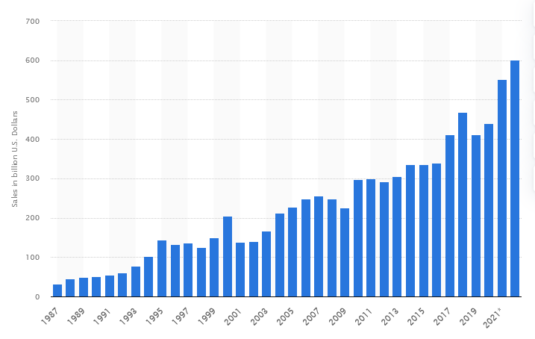
Introduction
MOSFETs by far the most widely used (99%) transistor device
Estimated > 10²² devices produced since 1960 (> 10⁹ produced / sec)
Sales of semiconductors in 2022 ≃ 574 10⁹ USD
Semiconductor market size worldwide from 1987 to 2022
3
Instrumentation Training Lectures, Oxford 13/05/2025

Slide 6
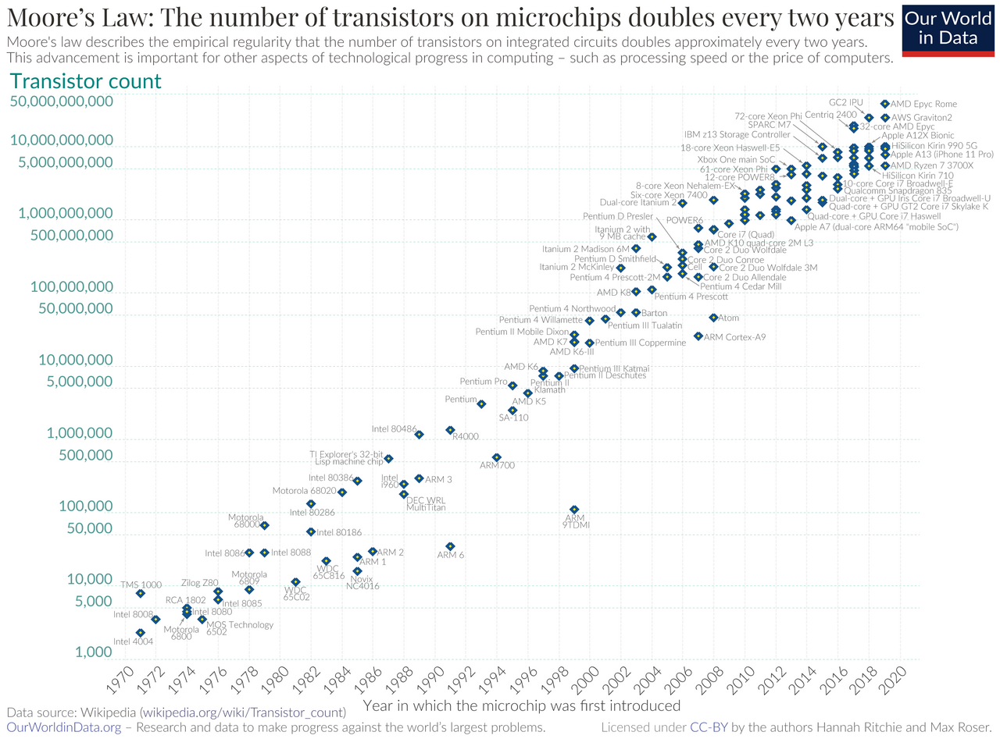
Moore’s Law
Planar semiconductor industry started around 1960 (First hybrid circuit:, Kilby, Jack S. "Miniaturized Electronic Circuits", U.S. Patent 3,138,743, February 1959)
In 1965 G. Moore predicted a doubling number of integrated components every year, to promote the idea of integrating devices. From mid ‘70s the trend is around doubling every ~2 years
Such trend has been maintained for almost 60 years, leading to ~2^{60/2} ~ 10⁹ transistors count on chip
Moore, G. "Cramming More Components onto Integrated Circuits," Electronics Magazine Vol. 38, No. 8 (April 19, 1965)
4
Instrumentation Training Lectures, Oxford 13/05/2025

Slide 7
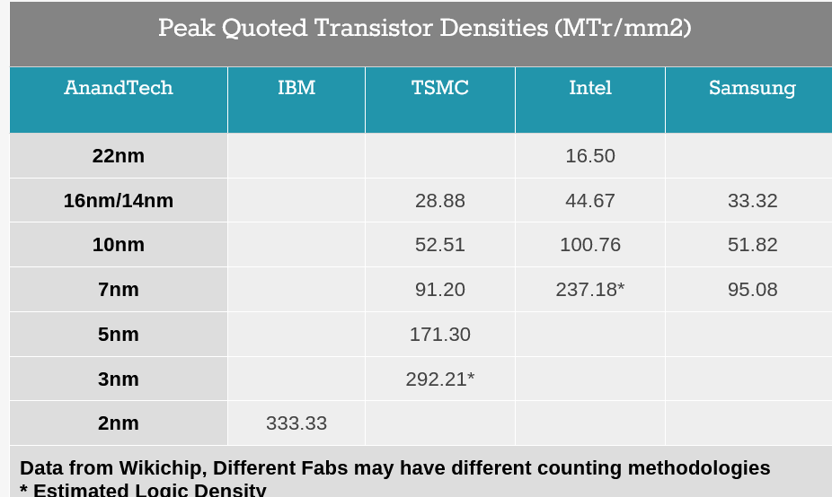
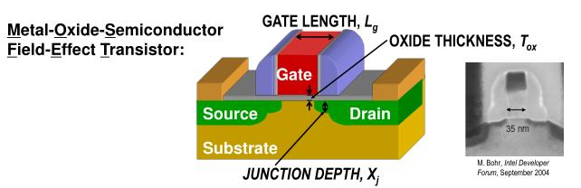
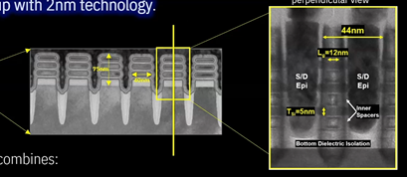
Moore’s Law
For planar technology, the size (used to) refers to the actual minimum MOS transistor gate length
Since the advent of 3D structures the name of nodes means an equivalent gate length size of a planar device
Reducing the size of the devices requires considerable technological efforts and investments
Current production state-of-the-art
https://www.anandtech.com/show/16823/intel-accelerated-offensive-process-roadmap-updates-to-10nm-7nm-4nm-3nm-20a-18a-packaging-foundry-emib-foveros
5
Instrumentation Training Lectures, Oxford 13/05/2025

Slide 8
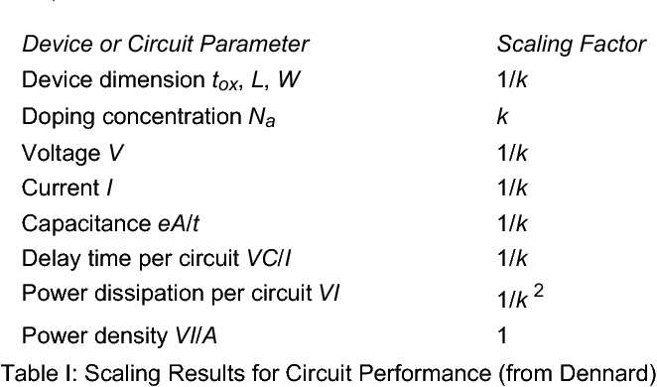
Dennard’s Law of scaling
From Dennard’s 1974 paper: smaller feature size can only bring benefits
Smaller -> Faster, Less power dissipation; Power density remains the same!
R. H. Dennard et al., "Design of ion-implanted MOSFET's with very small physical dimensions," Oct. 1974, doi: 10.1109/JSSC.1974.1050511
6
Instrumentation Training Lectures, Oxford 13/05/2025

Slide 9
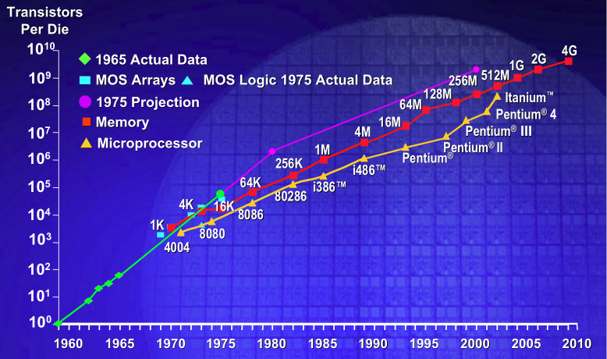
Dennard’s and Moore’s Law
By keeping the cost/area of chip constant:
  More powerful chip for the same price
  Same chip for a lower price: the scaling down of transistor area reduces the cost of a transistors by ∼30%/year.
  This trend has continued for around 20-25 years (1975-2000)
7
Instrumentation Training Lectures, Oxford 13/05/2025

Slide 10
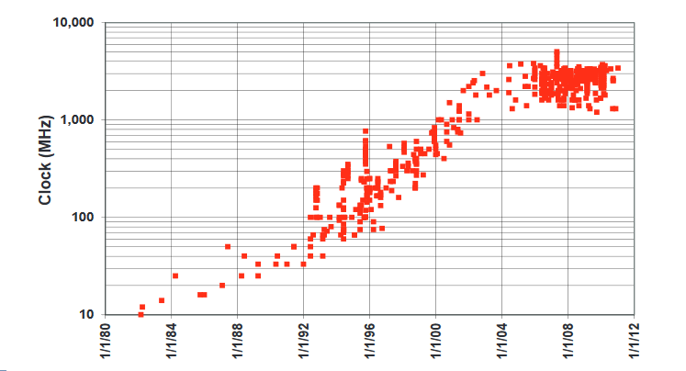
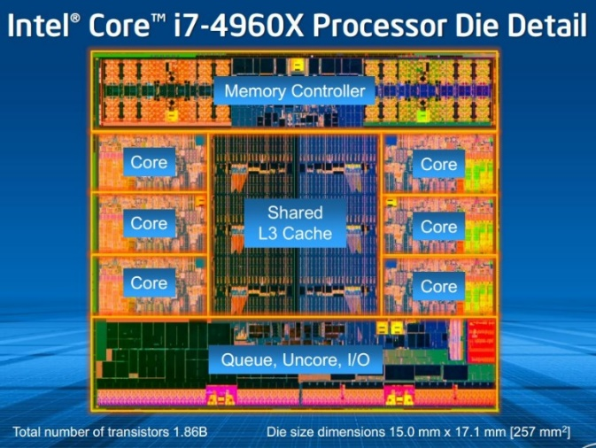
Dennard’s Law of scaling
This scaling ignores quantum tunnelling and noise, i.e. leakage current, which leads to power dissipation, and threshold voltage which do not scale with size (~1/√k)
Power wall, limiting the frequency of processors to around 4 GHz since 2006
8
Instrumentation Training Lectures, Oxford 13/05/2025

Slide 11
Dennard’s and Moore’s Law
  Moore’s law is not a physics law per se: keeping the cost/area the same (for example increasing the wafer size) despite rising cost of fabrication is the result of continuous human efforts.
  Dennard’s law is based on physics, but it does not completely justify anymore the continuous trend in size reduction.
  Nowadays the main benefit in reducing the size of transistor is to reduce cost/function
9
Instrumentation Training Lectures, Oxford 13/05/2025

Slide 12
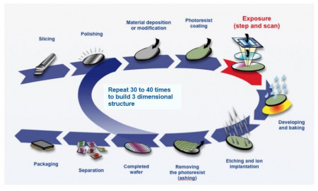
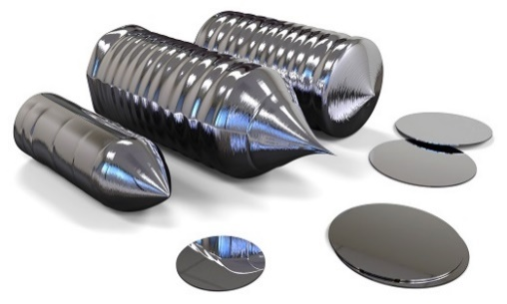
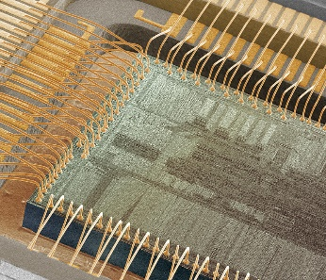
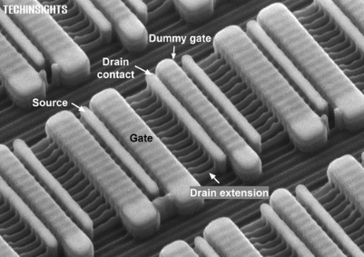
Semiconductor fabrication process
The fabrication of semiconductor devices is a rather complex process
Many intermediate steps and manufacturing precision at atomic level
It starts with the growth of high purity Si crystals
11
Instrumentation Training Lectures, Oxford 13/05/2025

Slide 13
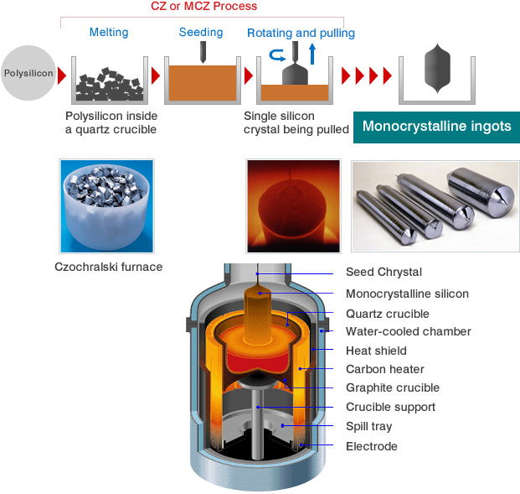
Silicon crystal growth Czochralski
The majority of ICs are made on single-crystal Si wafers grown in large ingots using CZ (Czochralski, 1915 ^{[1]} ) method
  High purity polysilicon (99.9999999% or 9N) crushed into powder, put into a quartz crucible and heated until it melts
  A seed crystal is dipped into liquid silicon. As the stick is rotated and slowly pulled up, an ingot of monocrystalline silicon is formed that has the same atomic arrangement as the seed crystal
For detector grade Si, the smallest concentration of contaminants is required. The Floating- Zone (FZ ^{[2]}) process is usually employed for this
¹ Development of Crystal Growth Technique of Silicon by the Czochralski Method, Vol. 124 ACTA PHYSICA POLONICA, 2013
² T.F. Ciszek, T.H. Wang, Silicon defect and impurity studies using float-zone crystal
growth as a tool, Journal of Crystal Growth, 237, p. 1685-1691, 2002
  * Oxygen Impurities might be introduced from the quartz crucible into the ingot
  * Czochralski discovered this by accident: instead of dipping his pen into his inkwell, he dipped it in molten tin, and drew a tin filament, which later proved to be a single crystal
12
Instrumentation Training Lectures, Oxford 13/05/2025

Slide 14
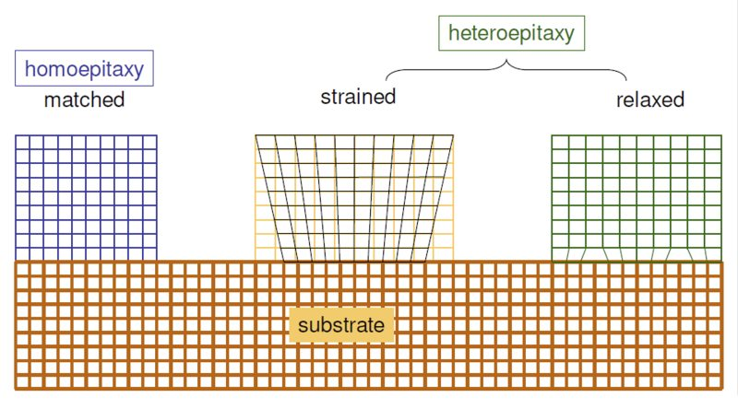
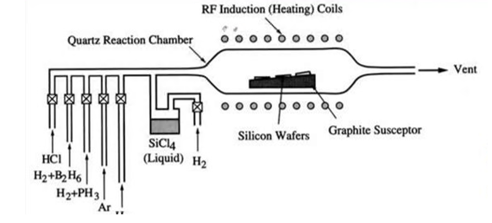
Silicon crystal growth
Epitaxy
Arrangement of atoms over existing planes of crystalline substrate, to form an extended crystal
The deposited layer can have very different doping of the substrate, allowing doping profiles unattainable with implantation.
Different materials can be grown (heteroepitaxy)
The epitaxially grown layer can be oxygen free
SiCl₄ [gas] + 2H₂ [gas] = Si [solid] + 4HCl [gas]
  Chemical Vapour Deposition (CVD) is the formation of solid films on a substrate by exploiting a chemical reaction of reactants in vapour phase.
  Reactants introduced in reaction chamber decompose and react with the heated
  ^{surface to form the film}
13
Instrumentation Training Lectures, Oxford 13/05/2025

Slide 15
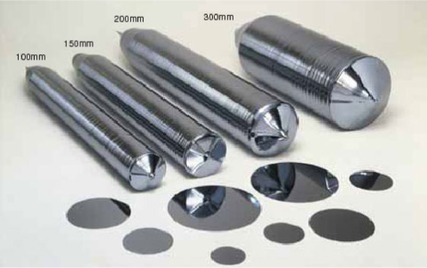
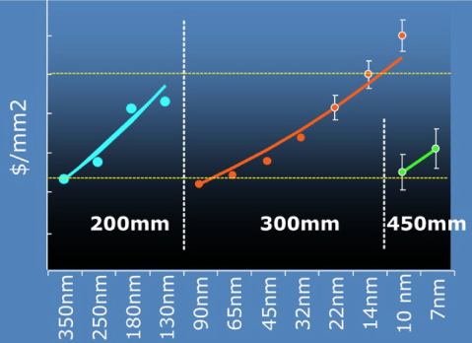
Silicon crystal
The cylindrical ingot is sliced into thin circular wafers, polished, etched, and cleaned until their surface is almost roughness free (<< 1 nm)
The diameter of Si ingots grew over the years: currently 300 mm diameter, driven by keeping the cost/area constant
As per 2023, worldwide Si wafer area around 5e6 m² , for an approximate 1.15x10¹² semiconductor chips produced (i.e. around 150 chips/person on Earth)
14
Instrumentation Training Lectures, Oxford 13/05/2025

Slide 16
Silicon process fabrication example
Wafer substrate
Start with Si wafer cleaned and polished
The wafer top is covered by insulating layer, SiO₂
Light-sensitive layer (photoresist) deposited
A photomask with the desired pattern is aligned with the wafer
Oxidation
Resist depo
Masks alignment/ exposure
15
Instrumentation Training Lectures, Oxford 13/05/2025

Slide 17
Silicon process fabrication example
Exposure/Develop
Exposure to UV light makes the photoresist not covered by masks easily removable
Once the developed resist is removed, the unprotected SiO₂ is etched away, using chemical process. Remaining resist is stripped off
The exposed areas of silicon are then doped, e.g. to obtain PN junctions
Metallization followed by a similar photolithographic process to obtain a final device
Etching
Implantation/ Annealing
Metallization
16
Instrumentation Training Lectures, Oxford 13/05/2025

Slide 18
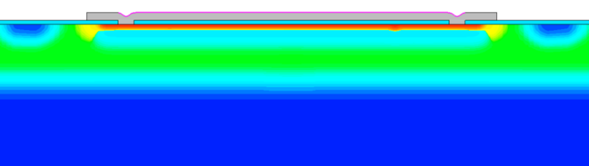
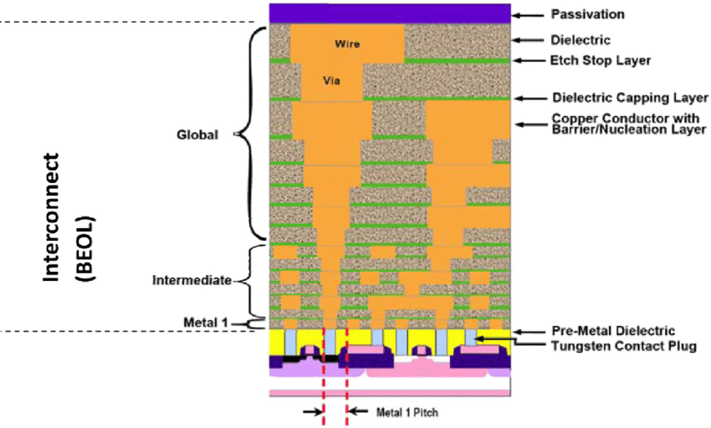
Silicon process fabrication example
Additional layers of conducting or insulating materials can be added, to obtain multilayers structures
10s of layers in modern submicron CMOS process
  LGAD cross section example – 1 layer
Diagram of a cross-section of a VLSI circuit
from ITRS 2005, http://www.itrs.net/Links/2005itrs/ home2005.htm. 58
17
Instrumentation Training Lectures, Oxford 13/05/2025

Slide 19
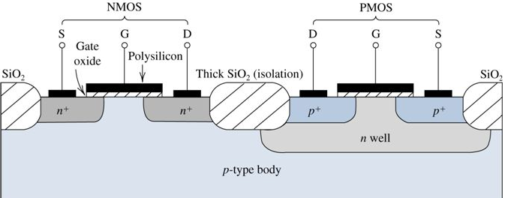
Oxidation process
_{Ions implanted}
SiO₂
The purpose of oxidation is essentially to provide isolation:
Barrier against dopants diffusion/implantation
Electrical insulator between devices (critical field ~ 10⁷ V/cm)
Si
Parasitic MOS
18
Instrumentation Training Lectures, Oxford 13/05/2025

Slide 20
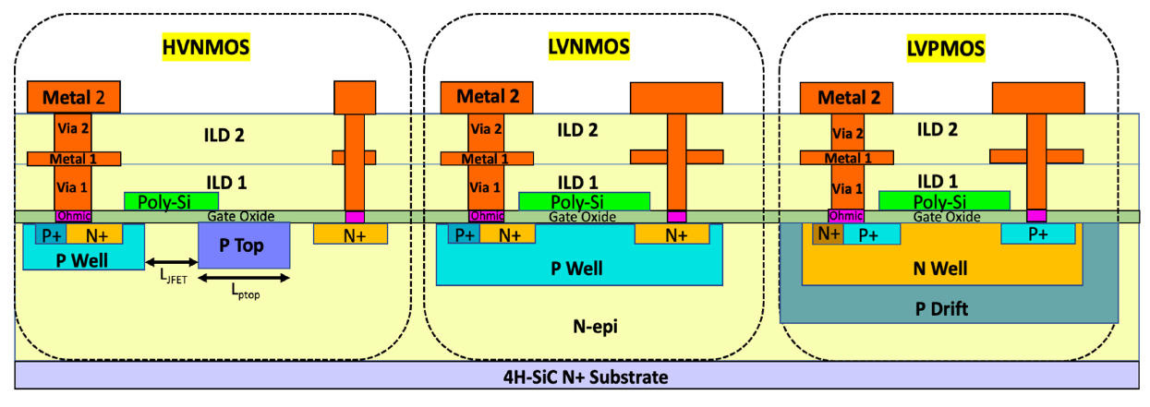
Oxidation process
Two deposition methods:
  Thermal growth
    Dry: best quality, slow growth rate: used for gate oxide
    Wet: lower quality, faster growth rate: used for field oxide (isolation)
  Chemical vapor deposition ^{[3]} (lower quality, fast)
    Used when no Si is available for oxidation (Interlayer Layer Dielectric, ILD)
  ^{[3]} J. K. Wang, D. R. Denison, Advanced techniques for interlayer dielectric
  deposition and planarization, Proc. SPIE 2090, https://doi.org/10.1117/12.156535, 1993.
19
Instrumentation Training Lectures, Oxford 13/05/2025

Slide 21
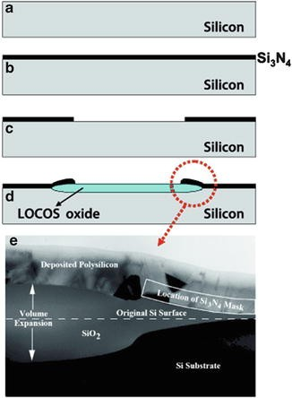
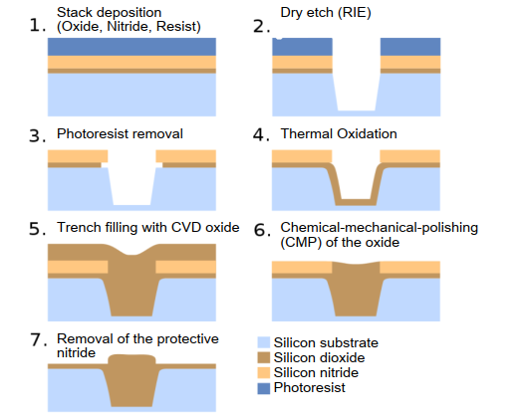
Oxidation process
LOCOS (local Oxidation of Si) process:
Thermal oxide is grown in etched region: bird’s beak means Si area loss
STI process
STI (Shallow Trench Isolation) process: (<250 nm)
CVD oxide is deposited in the etched region: reduced Si area loss
LOCOS process
STI fabrication process of modern integrated circuits in cross-sections (from Wikipedia)
20
Instrumentation Training Lectures, Oxford 13/05/2025

Slide 22
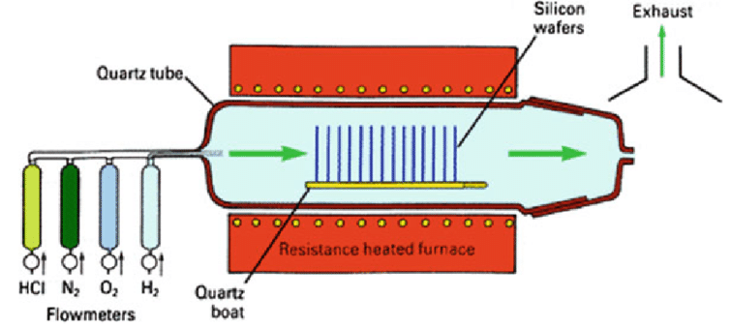
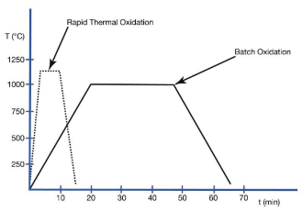
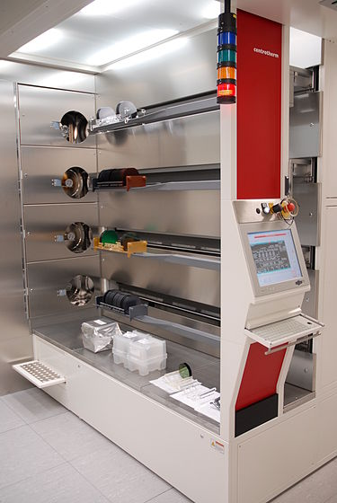


Oxidation process tools
Thermal oxidation:
  oxide is grown at high temperature (~ 1000° C) by supplying oxygen that reacts with silicon wafer to form SiO₂ at the surface
Wafers inserted on a suspended boat into a tubular reactor of quartz, heated by resistance
Dry oxidation: best quality, slow (10 nm/hr)
Wet oxidation: lower quality, faster (>x10)
Wet oxidation is faster because H₂O molecules smaller than O₂ leading to faster diffusion through SiO₂
21
Instrumentation Training Lectures, Oxford 13/05/2025

Slide 23
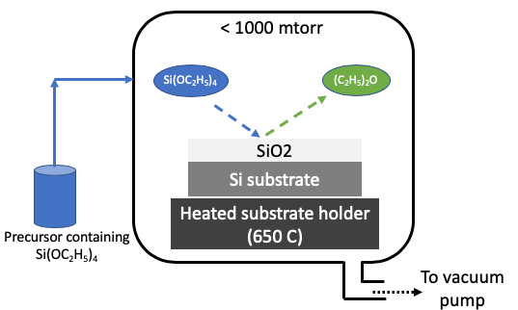
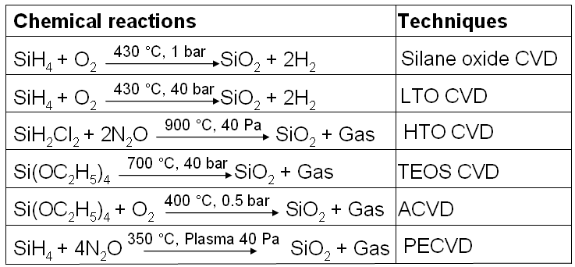
Oxidation process tools
Chemical Vapor Deposition (CVD) :
reaction of vapor phase chemicals containing the material to deposit form the solid film on substrate. Reactant gases decompose and form the film.
  SiO₂ growth rate >x10 compared to thermal oxide, but lower quality
  CVD is also used for growing dielectric materials of different electrical permittivity (high k/low k material)
22
Instrumentation Training Lectures, Oxford 13/05/2025

Slide 24
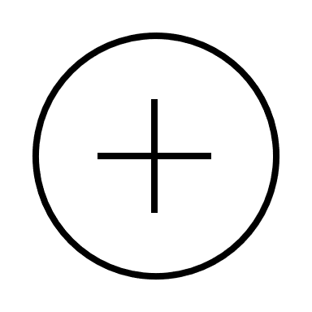
Oxide quality
SiO₂
mobile charges
Na⁺,K⁺
Mobile charges (contamination - make insulator conductive)
Fixed charges (incompletely oxidized Si - create an extra electric field affecting the devices in Si)
Oxide trapped charge (broken Si-O bonds, due to radiation)
Interface trapped charges (dangling bonds – affect mobility and increase noise)
Oxide trapped charges (+), (-)
Fixed charges (+)
interface trapped charges (+)
Si sub
23
Instrumentation Training Lectures, Oxford 13/05/2025

Slide 25
Resist deposition
_{Coat with photoresist}
SiO₂
The purpose of photoresist deposition is to prepare the wafer for the next step of lithography
The pattern needs to be reproduced on the photoresist, using a special camera that projects the image of the photomask onto the photoresist
Photoresist must allow to form a high-res image of the pattern (photo) and be able to stop etching (resist) to transfer the pattern onto the wafer
Si
_{Align and expose}
mask
_{Develop}
24
Instrumentation Training Lectures, Oxford 13/05/2025

Slide 26
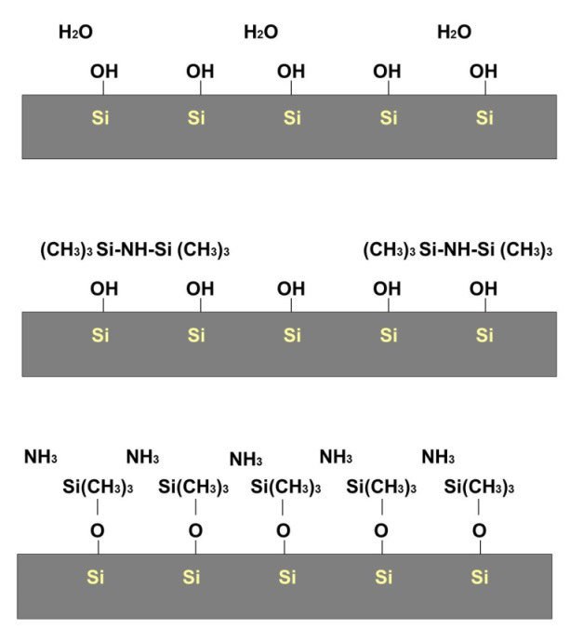
Resist deposition
The wafer must be prepared to improve the adhesion of the photoresist, which is hydrophobic
Water adheres to the dangling Si bonds at the top of the wafer
An initial bake to dehydrate the wafer surface is usually performed
To avoid prompt oxidation, adhesion promoter are often deposited onto the wafer top (HMDS, HexaMethylDiSilazane)
Pics from Dhima, Khalid. (2014). Hybrid lithography −The combination of T-NIL & UV-L.
25
Instrumentation Training Lectures, Oxford 13/05/2025

Slide 27
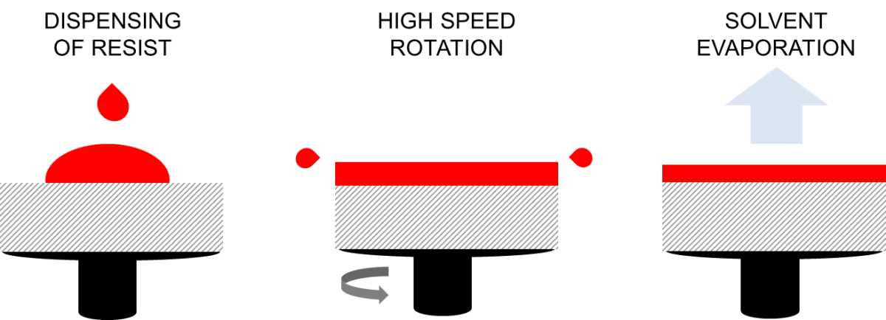
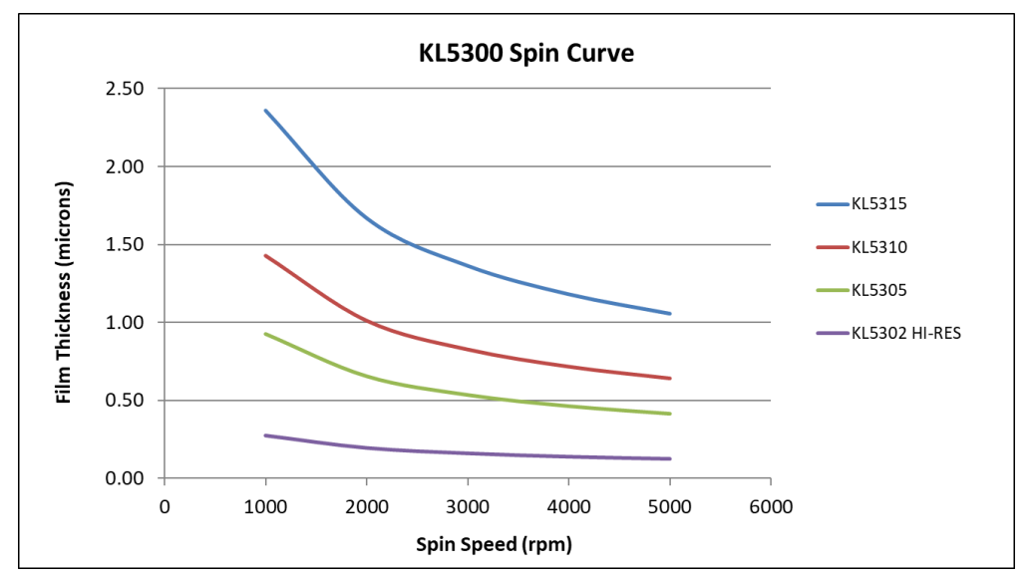

Resist deposition
A small amount ( ~ml ) of photoresist, with its solvent, is poured onto the wafer surface
The wafer is spun at high speeds, the resist spreads out. The air flow increases the viscosity of the photoresists, by evaporating the solvent, which leads to a very uniform photoresist layer spread over the surface
A post-apply bake is usually performed to further stabilize the film before lithography
The obtained uniformity is of the order of < 1nm over the entire wafer surface
From KemLab website, https://www.kemlab.com/
Resist thickness $\sim \frac{1}{\sqrt{ω}}$
26
Instrumentation Training Lectures, Oxford 13/05/2025

Slide 28
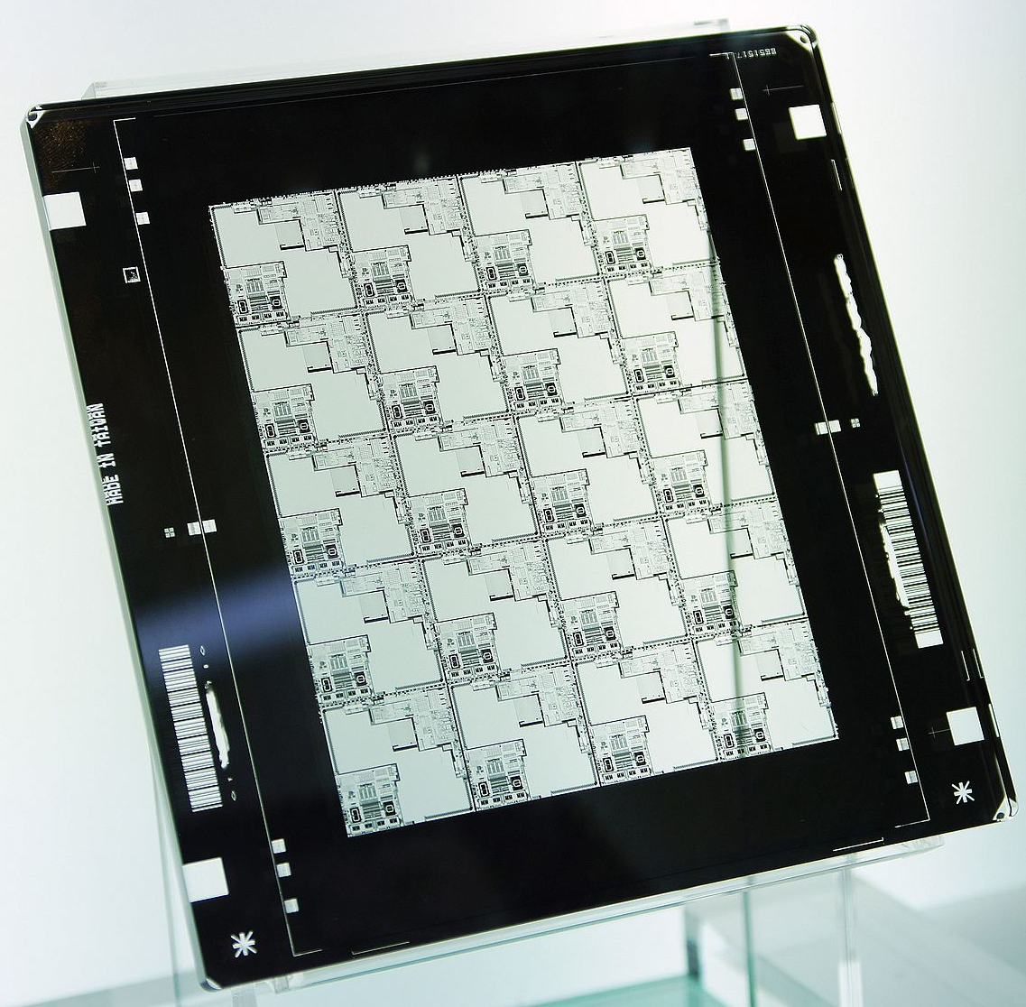
Mask/photolithography
_{Align and expose}
photomask
The photomask, usually made of chrome on quartz substrate, around 5 mm thick, includes the pattern to be reproduced onto the wafer. It can be put in direct contact (contact litho), kept at small distance (proximity litho) or projected onto the wafer (projection litho)
The photomask is typically bigger (x4-x5) than the wafer pattern
resist
From Wikipedia
The photomask itself is an example of high-resolution photolithography, usually obtained by electron beams to expose a photoresist
27
Instrumentation Training Lectures, Oxford 13/05/2025

Slide 29

Mask/photolithography
_{Contact lithography}
Contact printing provides a resolution near the wavelength λ of light used, but every contact damages the mask, that can be used only for a number of times
Proximity printing keeps mask and wafer separated, around 10 um to avoid cumulative defectiveness, but resolution is about $\sqrt{λd}$
The modern lithography process makes use of projection printing, where the mask is illuminated by UV light and the image is projected on the wafer
_{Proximity lithography}
_{Gap d}
_{Projection lithography}
_{Lens}
28
Instrumentation Training Lectures, Oxford 13/05/2025

Slide 30
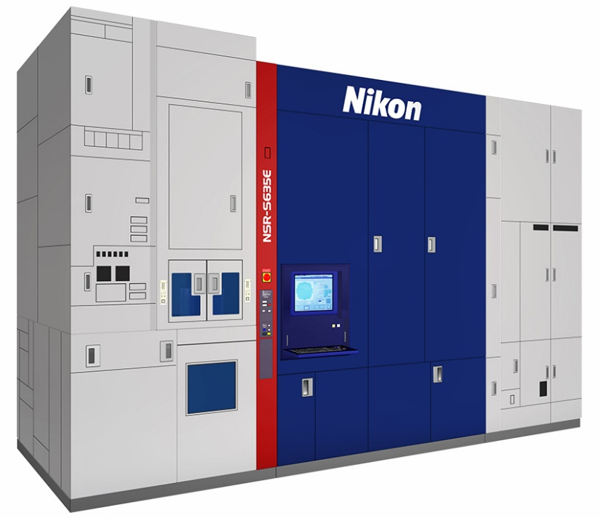
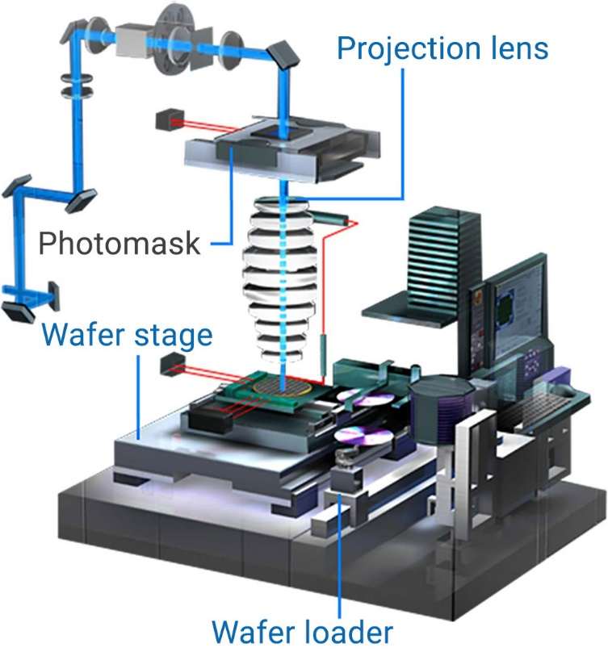
Mask/photolithography
The cost of lithography process is around 30 % - 50 % of the entire fabrication process and bound to increase for the most modern technology nodes
Lithography is a gating technology, which leads the advancement in semiconductor industry
From Nikon website
29
Instrumentation Training Lectures, Oxford 13/05/2025

Slide 31
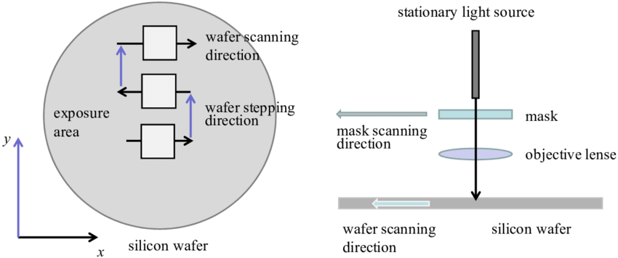
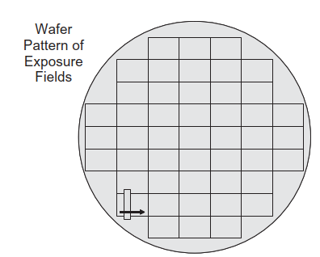
Mask/photolithography
The patterning of the image is done using a step and scan procedure
The light goes through a slit and the mask and wafer are scanned across the length of a field (mask pattern)
Once a field is scanned, the wafer/mask are stepped along the orthogonal direction and the scanning is repeated
Field size typically 26 x 33 mm², slit 25 x 8 mm²
30
Instrumentation Training Lectures, Oxford 13/05/2025

Slide 32
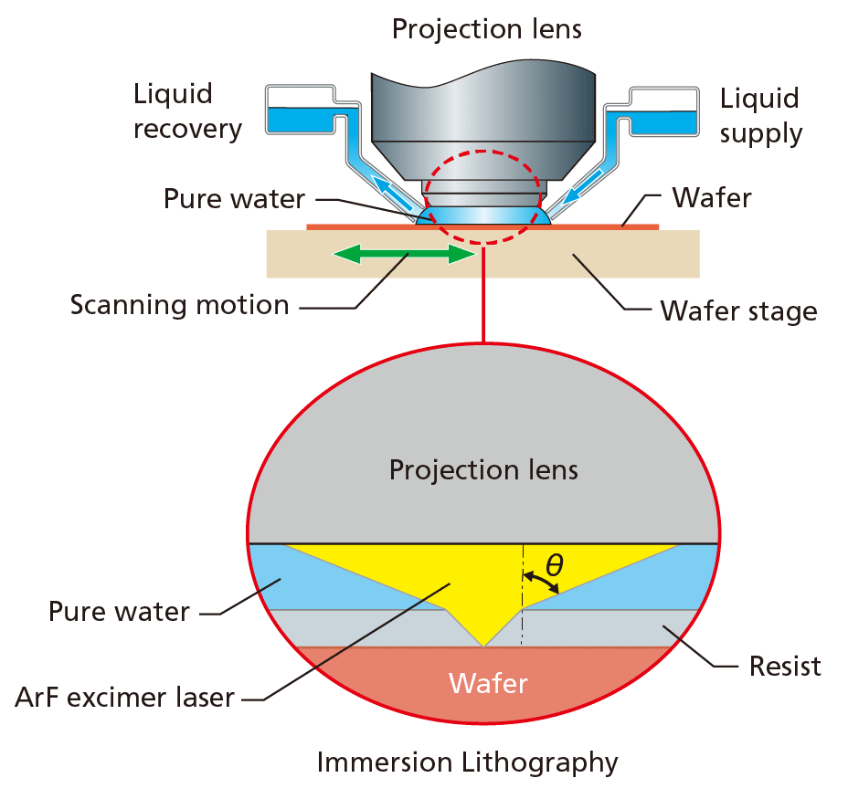

_{Light source}
Mask/photolithography
_{Focusing lens}
The projection method used by modern processes consist of a light source and a lens system
Currently state-of-the-art photolithography ^{[4]} uses Deep Ultraviolet (DUV) light λ = 193 nm from an ArF excimer Laser
The printing of nanometers feature size is possible using immersion lithography, where a media of higher refractive index n (DI) is used between the lens and the wafer surface
^{[4]} B. Lin, Optical lithography—present and future challenges, C. R. Physique 7 (2006) 858–874
_{Photomask}
_{Objective lens}
_{resist}
_{wafer}
$$NA=n sin(θ)$$
31
Instrumentation Training Lectures, Oxford 13/05/2025

Slide 33
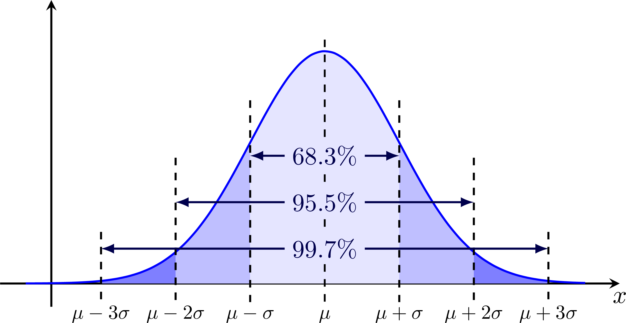



Mask/photolithography
_{Light source}
Monochromatic light using a condenser lens is focused onto the mask
In passing through the mask the light is diffracted (in the far field one gets the Fourier transform of the mask function)
The objective lens produces the Fourier transform of the diffraction pattern entering it
The Fourier transform of the Fourier transform gives back the ‘original’ image, i.e. the mask pattern, which is projected onto the wafer
Due to the practical limitations in the size (hence numerical aperture NA) of the objective lens, higher frequencies modes of the initial diffraction pattern are cut – off ( low pass filter), degrading the final reconstructed pattern on the wafer (resist)
_{Condenser lens}
T$m=ℱ(mask)$
_{Objective lens}
E$(\overline{r})=ℱ^{−1}(T_{L}ℱ\left(mask\right))$
$$I_{w}={\left|\text{E}(\overline{r})\right|}^{2}$$
32
Instrumentation Training Lectures, Oxford 13/05/2025

Slide 34
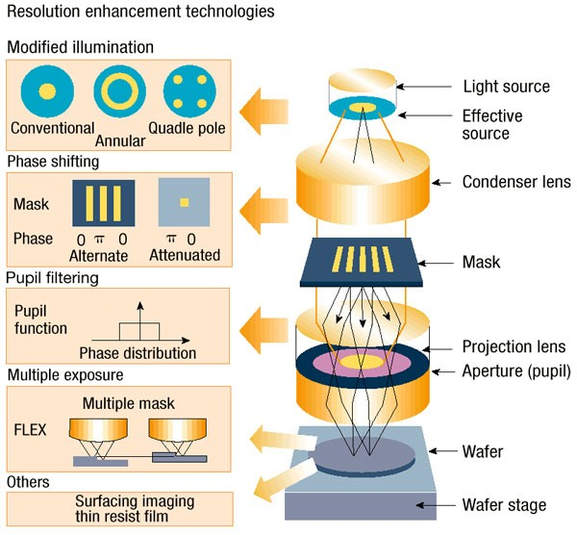
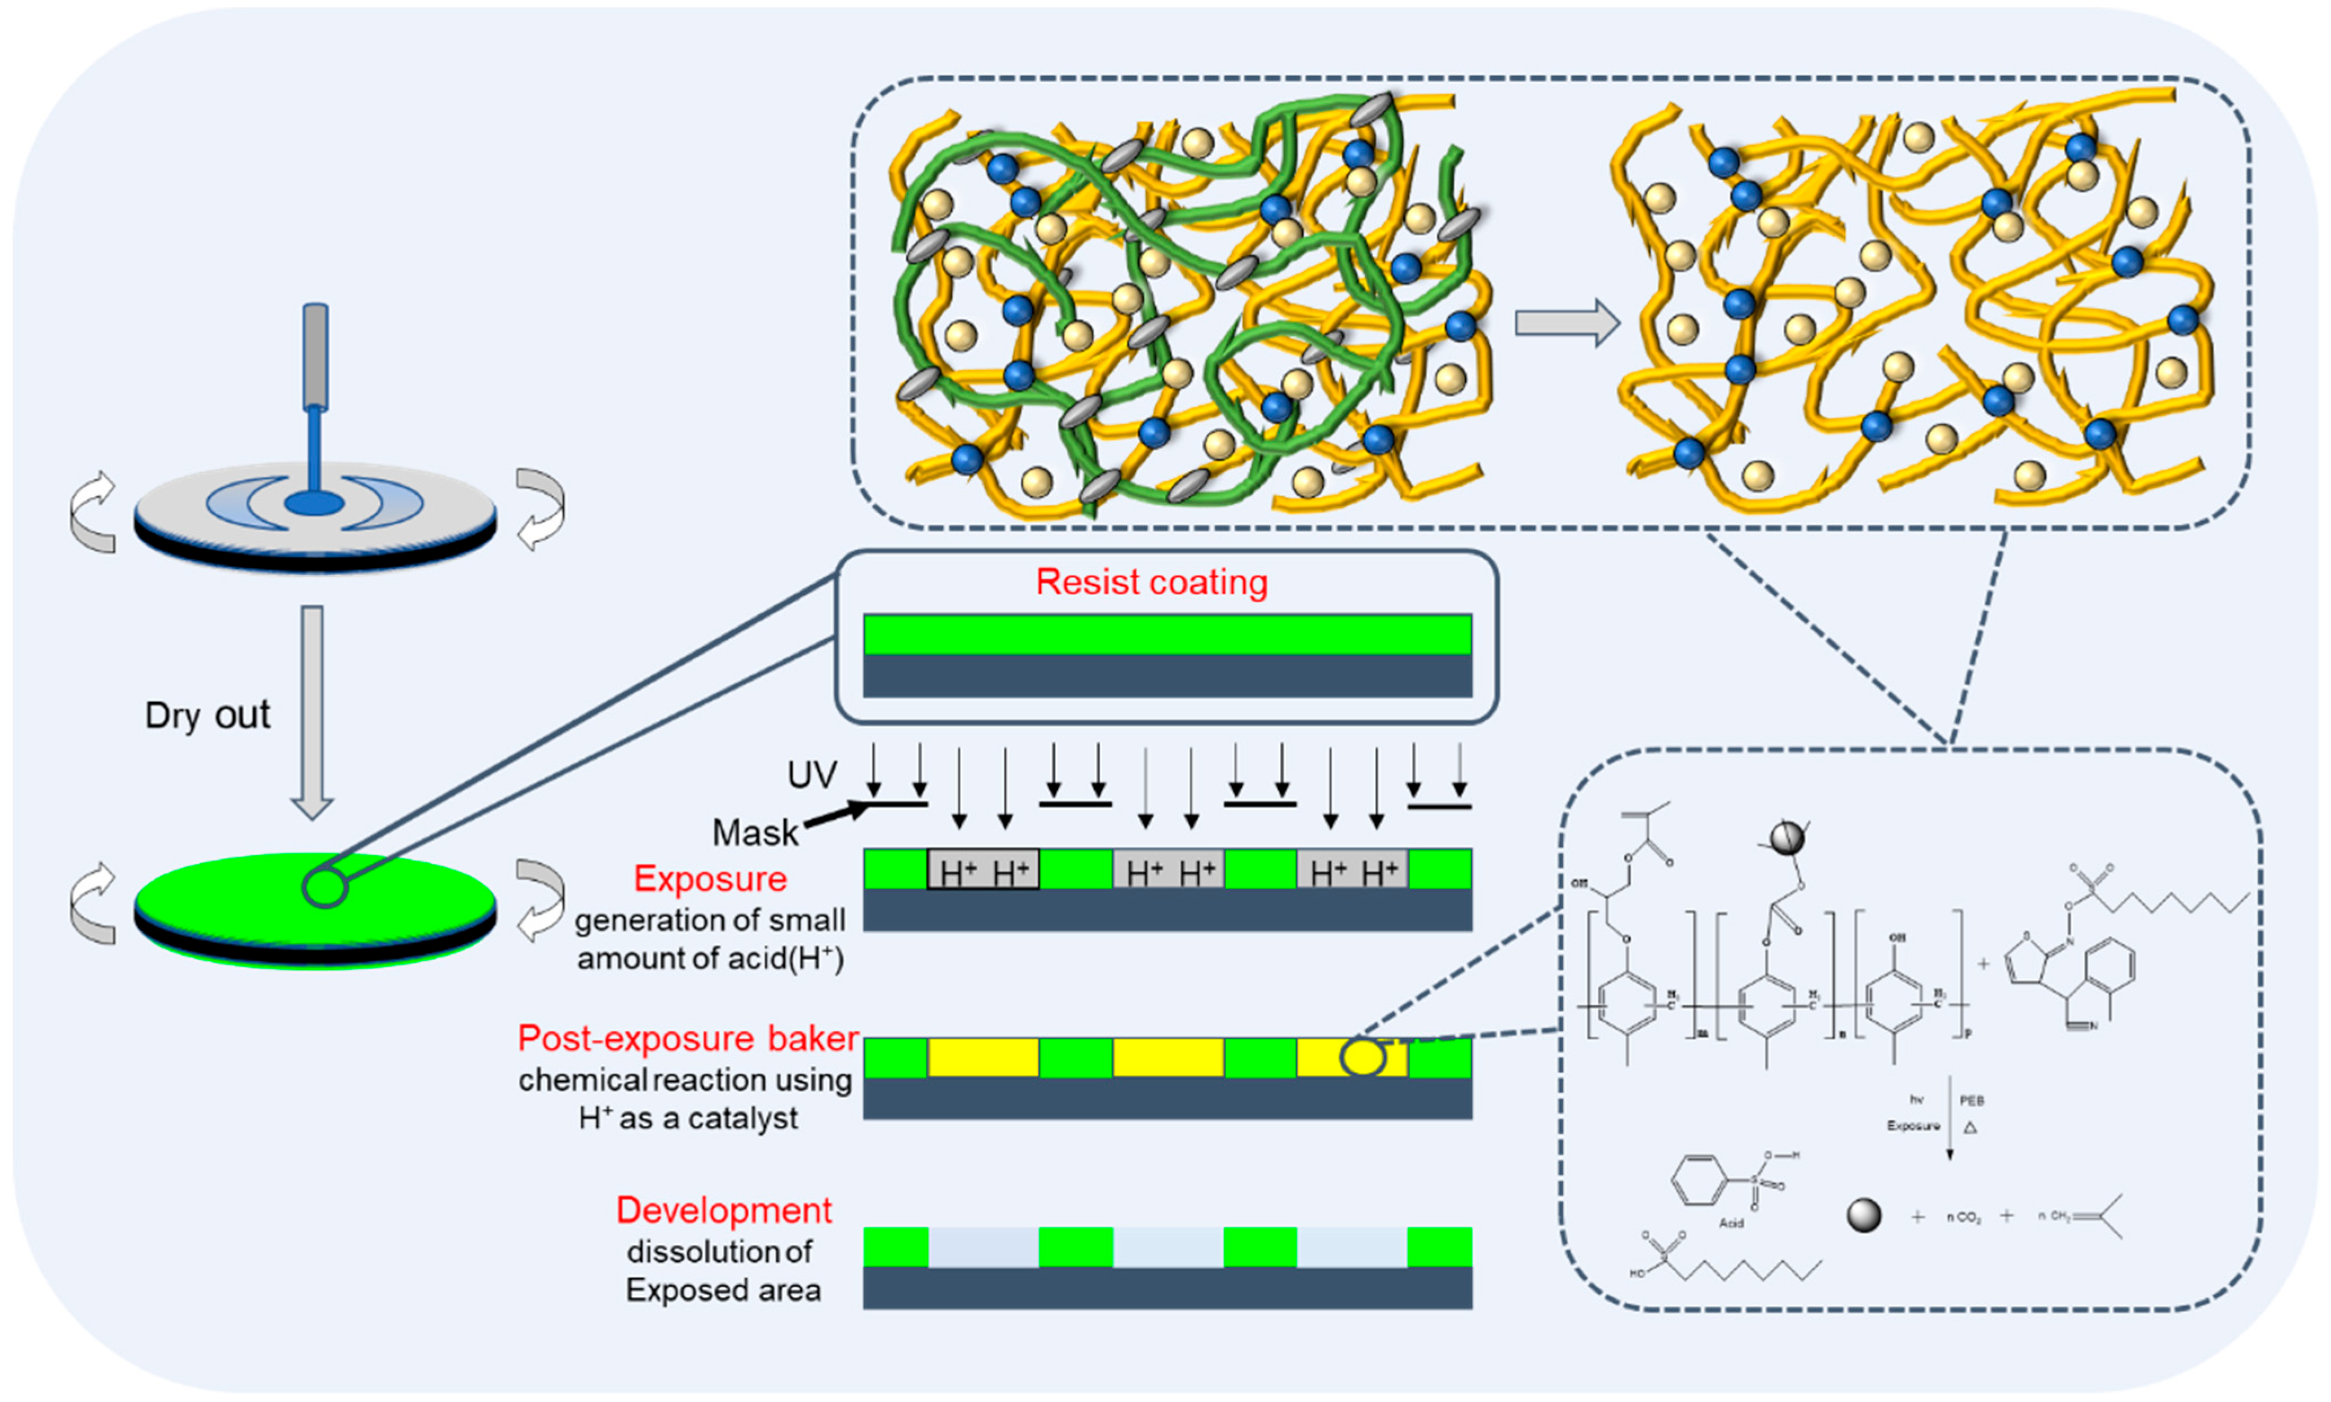

Mask/photolithography
Rayleigh resolution criterion
$$R=k\frac{λ}{NA}$$
Minimum feature size (Critical Dimension, CD) depends on various factors
The technology factor k can be lowered by
  Using ‘chemically amplified’ photoresist that increases the response to exposure
  Using different RTE (resolution enhancement techniques : two beams imaging, off-axis illumination, phase-shifting masks, techniques)
  Theoretical lowest limit is 0.25
R = smallest half pitch
k = technology factor
= wavelength
NA = numerical aperture
T. Ito, S. Okazaki, Pushing the limits of lithography – Nature 406,1027-1031 (2000)
Liu, J.; Kang, W. New Chemically Amplified Positive Photoresist with Phenolic Resin Modified by GMA and BOC Protection. Polymers 2023, 15, 1598. https://doi.org/10.3390/polym15071598
33
Instrumentation Training Lectures, Oxford 13/05/2025

Slide 35
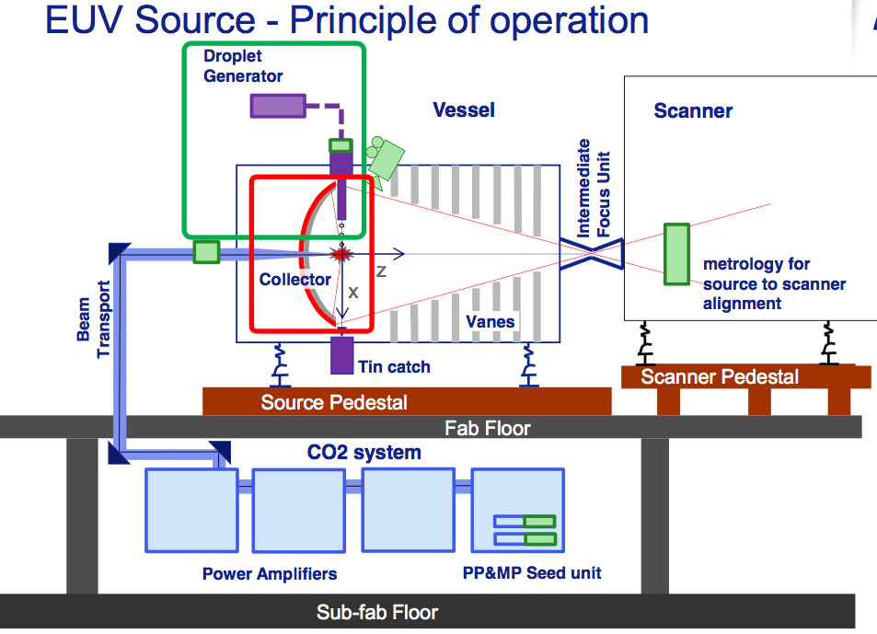
Mask/photolithography
Rayleigh resolution criterion
$$R=k\frac{λ}{NA}$$
The wavelength λ can be lowered by using UV/extreme UV laser sources
Currently there is only one company (ASML) in the world producing EUV systems operating at 13.5 nm, for 3-5 nm nodes
EUV emitted power around 100 W, too low for wafer production
EUV is absorbed by air and glass, glass mask would not work. Photomasks work by Bragg reflection, i.e. they consists of multilayers of MoSi (Molybdenum and Silicon). Special photoresist is also needed
R = smallest half pitch
k = technology factor
= wavelength
NA = numerical aperture
Sn droplets 25 um size are dropped 50,000 / sec in a vacuum chamber
A powerful Laser (10’s kW) hits twice the droplet, creating a plasma, which emits at 13.5 nm
A multi-layer mirror collects and focuses the UV into the scanner
Source: ASML (Advanced Semiconductor Materials Lithography)
34
Instrumentation Training Lectures, Oxford 13/05/2025

Slide 36
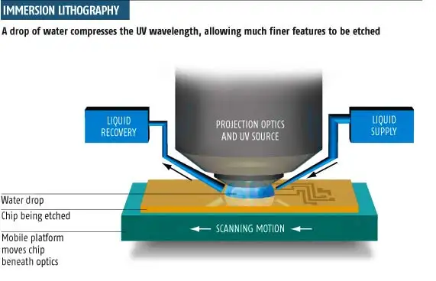
Mask/photolithography
Rayleigh resolution criterion
$$R=k\frac{λ}{NA}$$
The numerical aperture NA can be increased using immersion lithography
Typical NA ≃ 0.9 with biggest lenses
Using water with λ = 193 nm n = 1.43 increases NA
The increased NA also helps increase the depth of focus (DOF), i.e. distance over which all the diffraction orders are in phase
R = smallest half pitch
k = technology factor
= wavelength
NA = numerical aperture
Source: New Scientist
35
Instrumentation Training Lectures, Oxford 13/05/2025

Slide 37
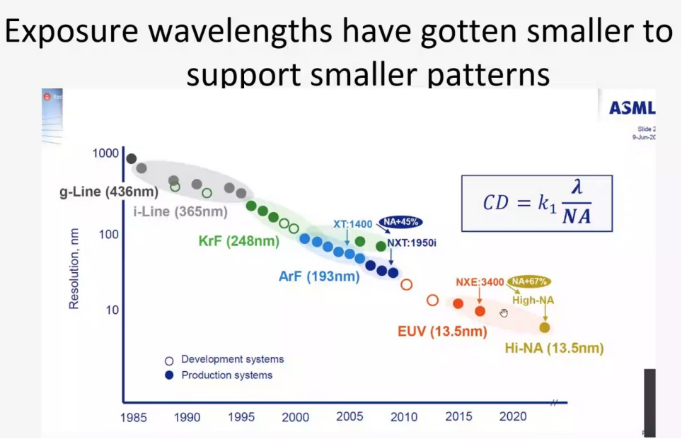


Mask/photolithography
The various historical trend for the CD coefficients are shown
Despite having decreased the wavelength, it seems that the bigger improvement in resolution comes from k1 and NA
However, k1 is close to its limit and so is NA. Reduction in wavelength seems the likely future direction for conventional lithography
Recent developments on metamaterials might provide new solutions
Source: ASML
Source: Mentor Graphics
J. Hu, Z. Li, Z. Hu, J. Wu, J. Wang, Achieving super resolution lithography based on bulk plasmon polaritons of hyperbolic metamaterials, Optical Materials, Volume 130,2022,112536,
ISSN 0925-3467, 2022
36
Instrumentation Training Lectures, Oxford 13/05/2025

Slide 38
  Introduction to Semiconductor technology
  Differences between Moore’s (economic) and Dennard’s (physics) law, miniaturization and Power wall
  Process fabrication I, Introduction and typical process flow
  Silicon wafer production
  Oxidation
  Resist deposition
  Photolithography
  [Deal-Groove model]
Process fabrication I Summary
    Thank you
    giulio.villani@stfc.ac.uk
37
Instrumentation Training Lectures, Oxford 13/05/2025

Slide 39


Appendix :The Deal-Grove oxidation model
The Deal Grove Model is a simple kinetic model for oxide thermal growth, wet and dry
Developed by Andy Grove (Intel’s CEO) and Bruce Deal in the 60’s
  B. E. DEAL AND A. S. GROVE General Relationship for the Thermal Oxidation of Silicon, JOURNAL OF APPLIED PHYSICS VOLUME 36. NUMBER 12 DECEMBER 1965
38
Instrumentation Training Lectures, Oxford 13/05/2025

Slide 40
The Deal-Grove oxidation model
C_{G}
1
2
3
C_{s}
SiO₂
Si
1: Oxygen diffuses from bulk (C_{G})to wafer surface (C_{S} )
2: Oxygen diffuses from wafer surface (C_{O}) to Si surface (C_{i})
3: Oxygen reacts with Si at interface to form SiO₂
C₀
C_{i}
T_{ox}
F₁
F₂
F₃
Gas flux
Diffusion flux
Reaction flux
39
Instrumentation Training Lectures, Oxford 13/05/2025

Slide 41










The Deal-Grove oxidation model
Oxygen diffusion through gas: Fick’s 1st Law approximated as linear equation
Adsorbed concentration C_{o} on surface $∝$ partial pressure (Henry’s Law)
Oxygen diffusion through SiO₂ Fick’s 1st Law approximated as linear equation
1st order reaction at Si interface
$1: F_{1}=D\frac{dC}{dx}≈\frac{D_{g}}{δ}\left(C_{g}− C_{s}\right)=h_{g}(C_{g}−$ $C_{s})$
$$C_{o}=HP_{s}=HC_{s}kT$$
$2: F_{2}=D\frac{dC}{dx}≈\frac{D_{ox}}{t_{ox}}(C_{o}−$ $C_{i})$
$$C_{g}=\frac{P_{g}}{kT}$$
Reactant concentration
H
Henry’s gas law coefficient
$$3: F_{3}=k_{s}C_{i}$$
$$t_{ox}$$
SiO2 thickness
$$D_{ox}$$
Oxygen diffusivity in SiO2
$$h_{g}$$
Mass transfer coefficient
40
Instrumentation Training Lectures, Oxford 13/05/2025

Slide 42





The Deal-Grove oxidation model
Steady state: all fluxes are equal (Si interface reaction is the rate-limiting step)
$$F_{1}={ F}_{2}=F_{3}=F_{OX}$$
$F_{OX}=\frac{Hk_{s}P_{g}}{1+\frac{k_{s}}{h}+\frac{k_{s}t_{ox}}{D_{ox}}}$ = $\frac{dt_{ox}}{dt}N_{ox}$
; h$=\frac{h_{g}}{HkT}$
Oxygen flux $F_{OX}$= v_{ox} N_{ox}
$$\frac{dt_{ox}}{dt}=\frac{Hk_{s}P_{g}}{1+\frac{k_{s}}{h}+\frac{k_{s}t_{ox}}{D_{ox}}}\frac{1}{N_{ox}}$$
41
Instrumentation Training Lectures, Oxford 13/05/2025

Slide 43






The Deal-Grove oxidation model
$$t_{ox}^{2}+At_{ox}=B\left(t+τ\right)$$
$$A=2D_{ox}\left(\frac{1}{h}+\frac{1}{k_{s}}\right)$$
Integrating over t gives the expression for oxide thickness $t_{ox}$ vs. time t
$$B=\left(\frac{2D_{ox}HP_{g}}{N_{ox}}\right)$$
$$τ=\left(\frac{t_{0}^{2}+At_{0}}{B}\right)$$
The model requires coefficients adjustments for different crystal orientations
<111> Si
42
Instrumentation Training Lectures, Oxford 13/05/2025

Slide 44

The Deal-Grove oxidation model
Comparison of Deal-Grove model with measured oxide thickness (Dry oxide)
Deal Grove
Measured
With the correct coefficients (P,T, crystal ) the Deal-Grove model works nicely for single crystal silicon (~%’s accuracy). Model extensions to 3D exist
Additional tweaking needed for high Si doping
The model fails for Polysilicon
* Self-limiting growth of native oxide saturates at around 2-3 nm
‘Growth of native oxide on a silicon surface’ Journal of Applied Physics, Volume 68, Issue 3, August 1, 1990, pp.1272-1281
43
Instrumentation Training Lectures, Oxford 13/05/2025

Slide 45

The Deal-Grove oxidation model
SiO₂
X_{Ox}
The oxide grows at the expense of Silicon: during oxidation around half of Silicon is consumed
Si
Si
X_{Si}
$X_{Si} N_{Si}=$ $X_{Ox} N_{Ox}→$ $X_{Si}$=$\frac{{ X}_{Ox} N_{Ox}}{ N_{Si}}≡{ X}_{Ox}\frac{2.3 {10}^{22}}{5 {10}^{22}}={ X}_{Ox} 0.46$
$$N_{Ox}=molecular density SiO_{2}$$
$$N_{Si}=atomic density Si$$
44
Instrumentation Training Lectures, Oxford 13/05/2025

