Slide 1
Process fabrication IIII
E. Giulio Villani
Instrumentation Training Lectures, Oxford 16/05/2025

Slide 2
Overview
Semiconductor fabrication process IIII
  Resist development
  Etching
  Implantation
  Metallization
Instrumentation Training Lectures, Oxford 16/05/2025

Slide 3
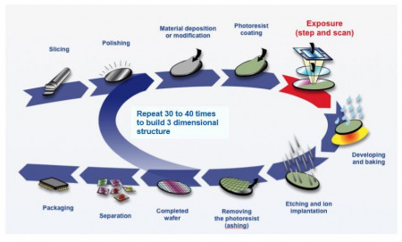
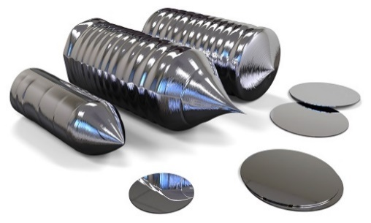
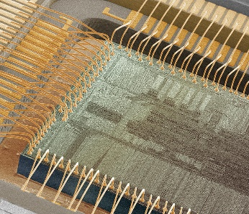
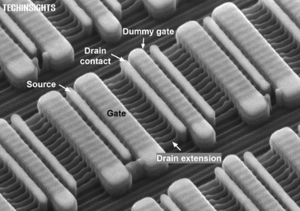

Semiconductor fabrication process
The fabrication of semiconductor devices is a rather complex process
Many intermediate steps and manufacturing precision at atomic level
It starts with the growth of high purity Si crystals
0
Instrumentation Training Lectures, Oxford 13/05/2025

Slide 4
Resist development
_{Coating with photoresist}
SiO₂
After photoresist deposition the mask is aligned and the process of exposure takes place
The lithography process is what leads the development. Currently state-of-the-art photolithography uses Deep Ultraviolet (DUV) light λ = 193 nm ArF excimer Laser. Shorter wavelengths (13.5 nm) still not widely used.
After the UV exposure, a post-bake to stabilize the film is performed , before the development
Si
_{Align and expose}
mask
_{Develop}
1
Instrumentation Training Lectures, Oxford 16/05/2025

Slide 5
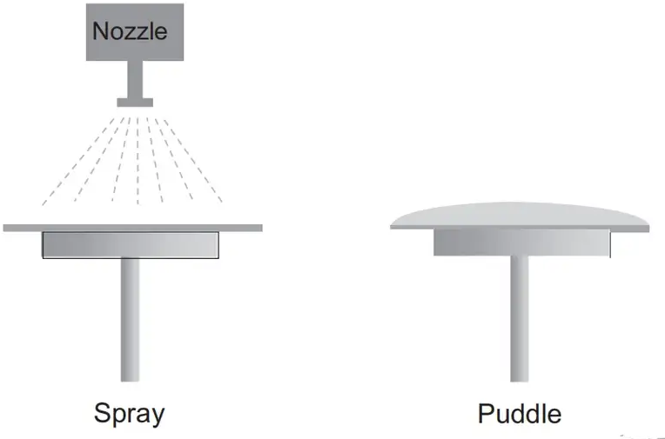
Resist development
A developer is poured/sprayed onto a slowly spinning wafer
For positive tone resist the developer removes the UV exposed parts
For negative tone resist the developer removes the unexposed parts
For more info: https://www.microchemicals.com/
mask
resist
oxide
_{Develop}
_{Positive resist}
_{Negative resist}
2
Instrumentation Training Lectures, Oxford 16/05/2025

Slide 6
Etching
oxide
After lithography, the process of etching usually follows
Its purpose is to transfer a pattern onto the wafer, by removing material from some areas
Either ‘wet’ or ‘dry’ etching is used
Selectivity: etch rate ratio, e.g. s=etch_{SiO2}/etch_{res} (>= 4-5)
Anisotropy: A= 1 – e_{h}/e_{v}
Also high etch rates is required, 1 – 10 nm/s
Si
Good selectivity: only the material to be etched is removed
Poor selectivity: the material to be etched and the material below are etched
Good anisotropy: vertical sidewalls
Poor anisotropy: round sidewalls
3
Instrumentation Training Lectures, Oxford 16/05/2025

Slide 7

Etching
Wet etching example: Buffered HF etching of SiO₂
$${SiO}_{2}+6HF→H_{2}SiF_{6}+{2H}_{2}O$$
Wet etching uses chemistry and might provide very high selectivity
Plasma etching also uses reactive free radicals that chemically reacts with the material
Usually poor anisotropy A= 1 – e_{h}/e_{v}
Cheap and good selectivity but not suitable for precision etching, i.e. nanostructures
F displaces O atoms and dissolves oxide, no effect on Si: very high selectivity
After resist development
Wet etching
After resist stripping
4
Instrumentation Training Lectures, Oxford 16/05/2025

Slide 8
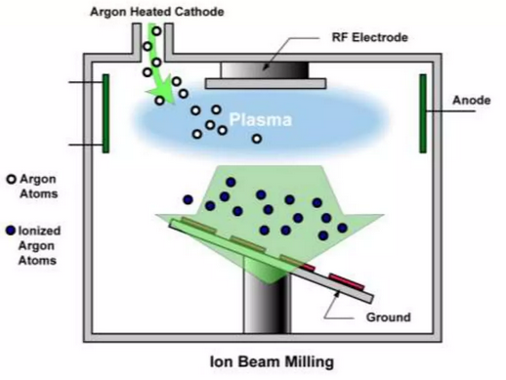
Etching
Sputter etching is a purely ‘physical’ process, i.e. no chemical reaction involved
Anisotropy very high but poor selectivity
The wafer is bombarded with chemically inert ions e.g. Ar⁺
Possible damage to the crystal (similar to ion implantation)
Plasma generates ion beam (Ar+) which are extracted and accelerated towards the sample
The ions sputter off atoms of the target
Low pressure (1e-4 Torr) to increase mean free path and provide line of sight travel to increase anisotropy
5
Instrumentation Training Lectures, Oxford 16/05/2025

Slide 9
Etching
Ideally one wants to combine selectivity using chemical reactions (like in wet etching) and anisotropy (like in sputter etching)
Using Reactive Ion Etching (RIE) it is possible to achieve both high selectivity and anisotropy
RIE uses ions bombardment to enhance the chemical process
Chemical etching happens where the ions strike, leading to high selectivity and anisotropy
 | High selectivity | Low selectivity
High anisotropy | Reactive Ion etch (RIE) | Sputter etch
Low anisotropy | Wet/plasma etch
6
Instrumentation Training Lectures, Oxford 16/05/2025

Slide 10
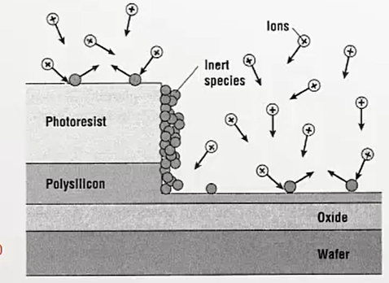
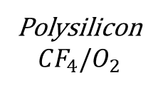
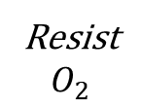
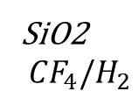
Etching
Reactive-ion etching (RIE) uses chemistry and ions to simultaneously provide high selectivity and anisotropy
The wafer is negatively biased
Positive ions are accelerated towards its surface
A plasma creates reactive species which diffuse towards the wafer
The exposed parts of the wafer react and are etched
Etch byproducts may deposit onto the surface and provide sidewall passivation as they do not react with the reactive species
Unique RIE recipe for a specific etching process
Polysilicon
$${CF}_{4}{/O}_{2}$$
SiO2
$${CF}_{4}{/H}_{2}$$
Resist
$$O_{2}$$
7
Instrumentation Training Lectures, Oxford 16/05/2025

Slide 11
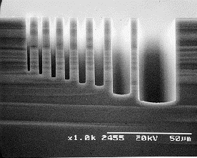
Etching
Issues with RIE etching:
  Ion damage to wafer
  Etch loading (the etch rate changes depending on the mask pattern, i.e. Si with narrow trenches etch more slowly than wider ones)
A wide trench allows fluorine radicals to reach the bottom more easily, hence fast etch rate compared to the narrow trench
Source: https://www.samcointl.com/opto/
8
Instrumentation Training Lectures, Oxford 16/05/2025

Slide 12
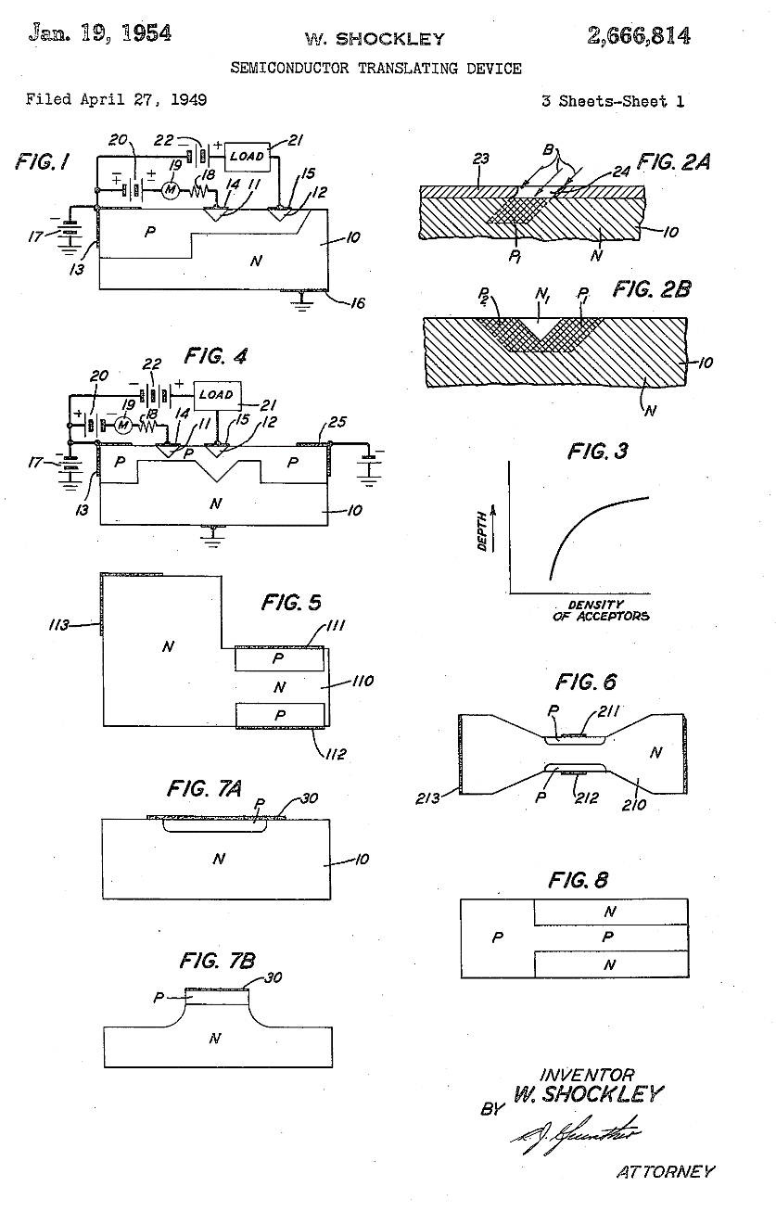
Ion Implantation
…the layer is formed by bombardment of one face of the N-type body with nuclear particles and the N-type zones in the layer are produced by masking the surface areas of the layer from the bombarding particles.
Technique to introduce atoms of dopants into a semiconductor material and create regions of different electrical characteristics
Historically proposed by Shockley in 1949, became common in the 70’s
Ionized gas ions are accelerated by strong electric field and injected into a target wafer ( a few nm to a few µm depth). Ion implanters spin-off from particle accelerator technology
9
Instrumentation Training Lectures, Oxford 16/05/2025

Slide 13
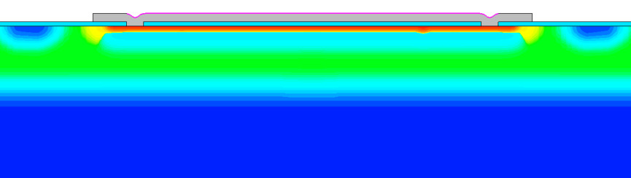
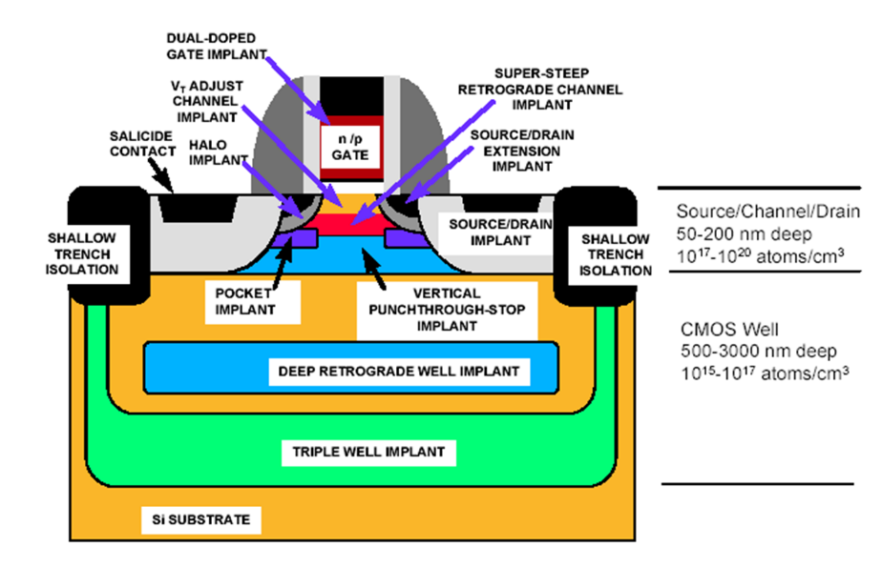
Ion Implantation
B⁺
P⁺
B⁺
Pros
Precise control of dose and depth profile, complex profiles
RT process (can use photoresist as mask)
Wide selection of masking materials e.g. photoresist, oxide, poly-Si, metal
Excellent dose uniformity across wafers
Little lateral dopant diffusion, important for small devices
P-epi
4 implantations process, 1 metal layer
>10 implantations process
10
Instrumentation Training Lectures, Oxford 16/05/2025

Slide 14
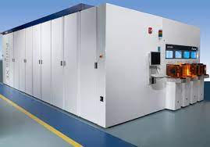
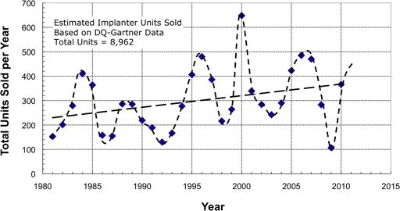
Ion Implantation
Cons
Equipment big and expensive (> 1M$)
Radiation damage: reticle damage due to implantation not always possible to correct
Difficult to obtain very shallow and very deep doping
Masks material can be scattered into the wafer, creating impurities and defects
Estimates of the number of commercial ion implanters sold per year, mainly for IC fabrication, showing the ‘5 year cycle’
11
Instrumentation Training Lectures, Oxford 16/05/2025

Slide 15
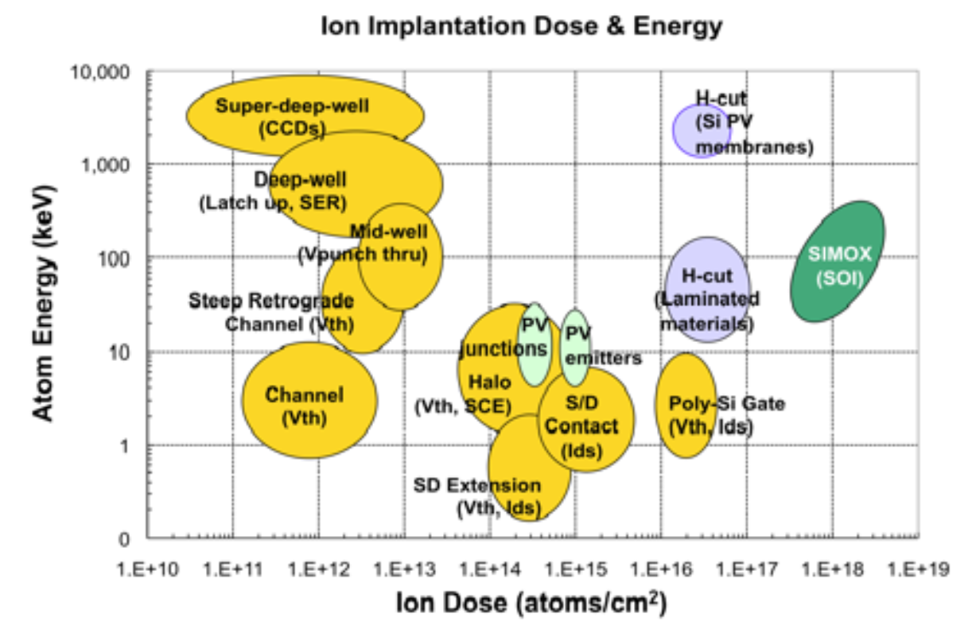
Ion Implantation
Ions used: As, B, P, In, O, Ar
Energy: 1 - ∼1000’s keV
Flux: 10¹² – 10¹⁴ cm⁻² s⁻¹
Dose: 10¹¹ – 10¹⁸ cm⁻²
Uniformity: ± 1% across 12’’ wafers
Absolute dose accuracy: ± 10 -15 %
Temperature: RT
Dose and atom energy regions for CMOS transistor doping (gold), high dose hydrogen implants for Si layer splitting (lavender), and direct implantation of oxygen to form Silicon-on-Insulator (SOI) wafers (green).
12
Instrumentation Training Lectures, Oxford 16/05/2025

Slide 16
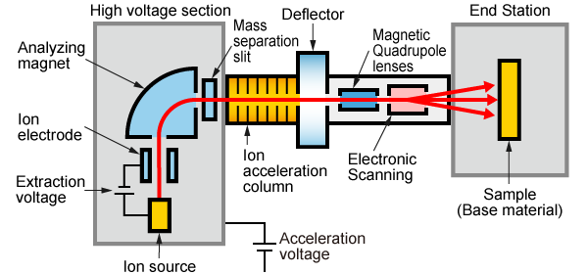
Ion Implantation tools
Typical ion implanter for semiconductor process consists of several elements
1: Ion source
2: Analyzing Magnetic
3: Ion Accelerator
4: Beam manipulating system
5: End station
13
Instrumentation Training Lectures, Oxford 16/05/2025

Slide 17
Ion Implantation tools
Ion source:
  Filament emits thermionic electrons, accelerated to gain enough energy (20 – 30 kV)
  The electrons collide with the molecules or atoms (AsH₃, PH₃, BCl₃) and ionize them
  A negative bias to the end side of the chamber extracts the positive ions towards the magnetic analyzer
14
Instrumentation Training Lectures, Oxford 16/05/2025

Slide 18
Ion Implantation tools
  Magnetic analyzer
    Plasma provides positive ions, (B¹¹)⁺, BF₂⁺, (P³¹)⁺, (P³¹)⁺⁺
    The correct ions need to be separated to choose what to implant (e.g. acceptors B¹¹, or donors P³¹)
    A magnetic mass analyzer selects the desired species via a magnet (< 1 T) which bends the ion beam: only one mass with the correct radius of curvature goes through the slit (~ mm’s) and hits the wafer
15
Instrumentation Training Lectures, Oxford 16/05/2025

Slide 19
Ion Implantation tools
Accelerator
  n-sections LINAC, giving a total ×n acceleration at relatively low voltage: E ~ 1000’s keV, I ~ mA
  Single charge ion ⇒ E = e * HV
  n⁺ charge ion ⇒ E = n* e * HV
16
Instrumentation Training Lectures, Oxford 16/05/2025

Slide 20
Ion Implantation tools
Beam manipulating system
  After acceleration the ion beam is focused ( ~ few cm²)
  A small deflection via electrostatic means is applied to discard neutral components to a beam stop
  The ion beam passes through an electrostatic deflection system and scanned over the wafer (~ Ø 30 cm)
17
Instrumentation Training Lectures, Oxford 16/05/2025

Slide 21
Ion Implantation tools
End station
  Wafers mounted on rotating disc (15-25 wafers/disc) > 100 wafers/hr
  Dose measurement performed by integrating the ion current via a Faraday cup
  Complex design of the Faraday cup is needed for high current implanters
18
Instrumentation Training Lectures, Oxford 16/05/2025

Slide 22

Ion Implantation doping profile
Adiabatic approximation : Scattering of ions with target is described using two separate collision processes:
S_{n} collisions with nuclei (energy loss and geometry of trajectory)
S_{e} collisions with electrons (energy loss only).
S_{n} screened potential classical two-body scattering (Binary Collision Approximation BCA)
S_{e} interactions of ion with target electrons (Lindhard’s Bethe-Bloch)
19
Instrumentation Training Lectures, Oxford 16/05/2025

Slide 23
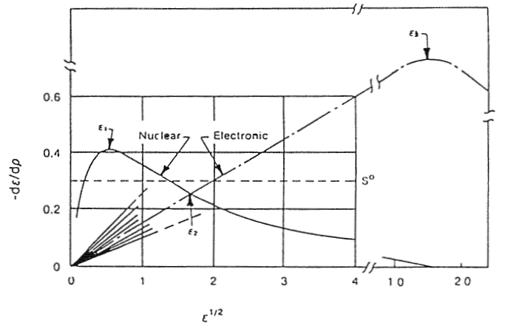
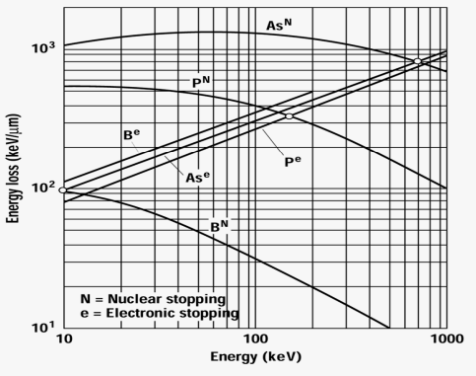
Ion Implantation doping profile
At low energy, nuclear collisions dominate: at the end of its range the ion has low energy, S_{n} dominates leading to more crystalline damage
At high energy, electronic collisions dominate, from scattering of electrons ~ Ohm’s law
Nuclear and electronic stopping powers versus energy in reduced units
E₂(As)=800 keV
E₂(B) = 16 keV
20
Instrumentation Training Lectures, Oxford 16/05/2025

Slide 24
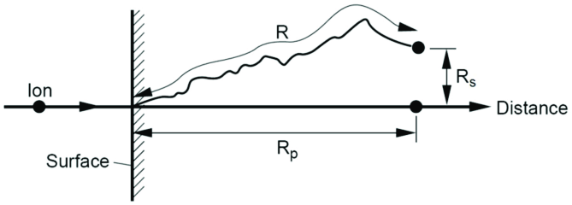

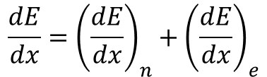

Ion Implantation doping profile
From $\frac{dE}{dx}$ ,the total stopping power, one can estimate the average ion range
R: range
R_{p}: projected range along axes of incident ion, with straggle (σ) ΔR_{p}
R_{s} perpendicular distance
∆R_{p}
$$\frac{dE}{dx}={\left(\frac{dE}{dx}\right)}_{n}+{\left(\frac{dE}{dx}\right)}_{e}$$
$$R=\int_{0}^{E}{\frac{dE}{−\frac{dE}{dx}}}$$
21
Instrumentation Training Lectures, Oxford 16/05/2025

Slide 25
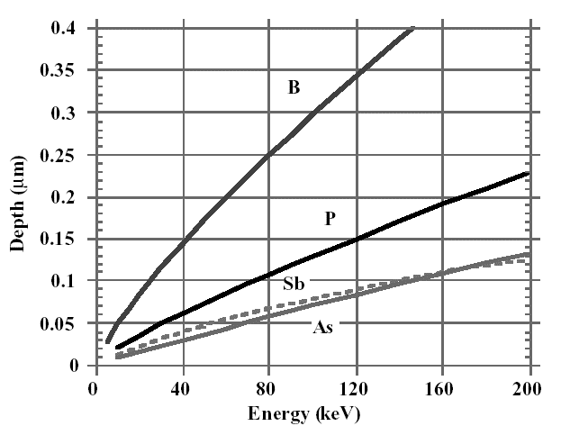
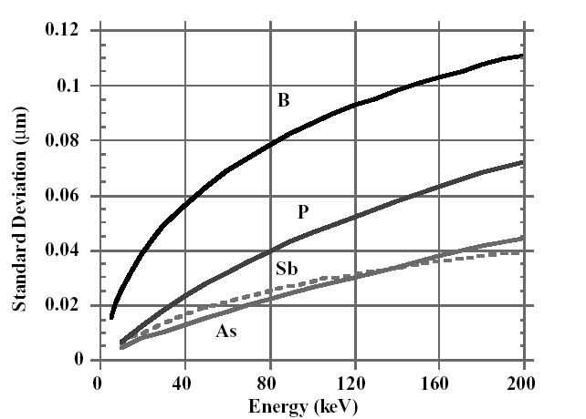

Ion Implantation doping profile
Projected range Rp and Straggle ΔRp for common dopants
Transverse spread increases with R_{p} ($Rs≃(1+M2/3M1)Rp$
limiting factor on lower limit of mask opening, which affects maximum device density
Projected range R_{p}
Straggle ΔR_{p}
22
Instrumentation Training Lectures, Oxford 16/05/2025

Slide 26
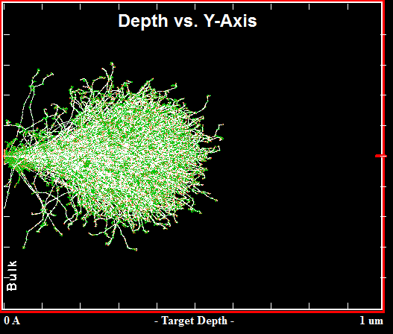
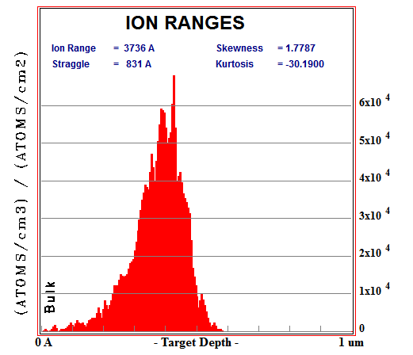
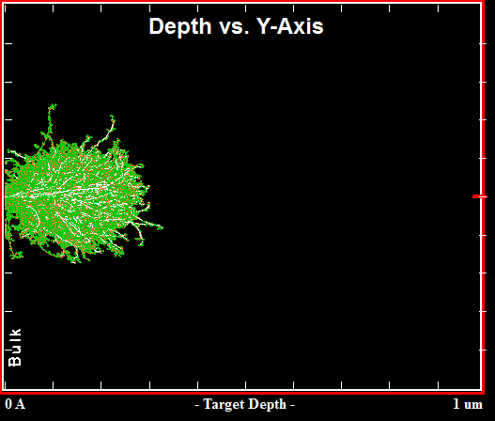
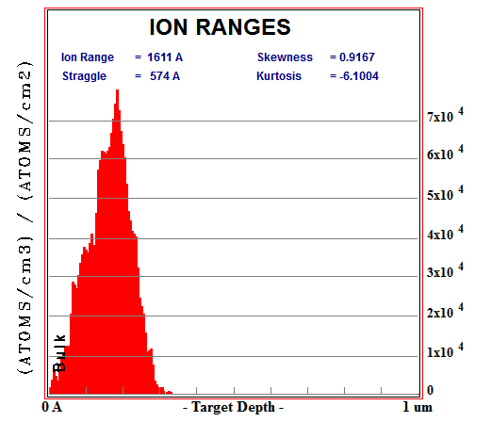
Ion Implantation doping profile
B¹¹(120keV) in Si
R_{p}
Example of MC (>5000 runs) ion range simulations (SRIM*) of B¹¹ and P³¹ implanted in amorphous Si
No annealing, i.e. no dopants activation, no thermal diffusion
P³¹(120keV) in Si
R_{p}
*http://srim.org/
23
Instrumentation Training Lectures, Oxford 16/05/2025

Slide 27
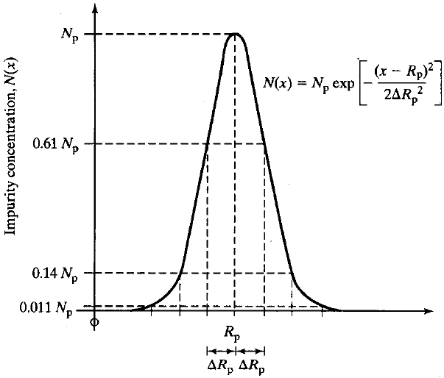
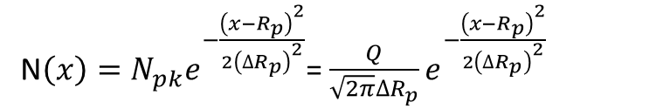
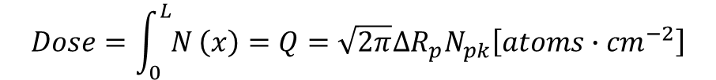
Ion Implantation doping profile
The range distribution of implanted impurities is described, as a first approximation, by a symmetrical Gaussian distribution ( 2 moments: R_{p} = projected range, ΔR_{p} = straggle)
N$\left(x\right)=N_{pk}e^{−\frac{{\left(x−R_{p}\right)}^{2}}{{2\left({∆R}_{p}\right)}^{2}}}$= $\frac{Q}{\sqrt{2π}{∆R}_{p}}e^{−\frac{{\left(x−R_{p}\right)}^{2}}{{2\left({∆R}_{p}\right)}^{2}}}$
$$Dose=\int_{0}^{L}{N}\left(x\right)=Q={\sqrt{2π}{∆R}_{p}N}_{pk}\left[atoms∙{cm}^{−2}\right]$$
24
Instrumentation Training Lectures, Oxford 16/05/2025

Slide 28
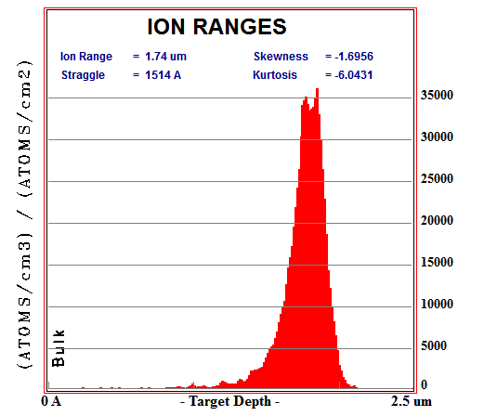
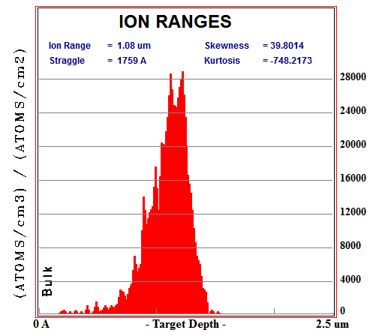





Ion Implantation doping profile
B(1000keV) in Si
$$Q=m_{0}=\int_{−∞}^{+∞}{N\left(x\right)dx}$$
$$R_{p}=m_{1}=\int_{−∞}^{+∞}{xN\left(x\right)dx}$$
Higher moments are needed to describe realistic profiles:
  skewness (γ), describing asymmetry of distribution
  kurtosis (β), describing peak sharpness of the profile
P(1000keV) in Si
$${∆R}_{p}=m_{2}=\int_{−∞}^{+∞}{{(x−R_{p})}^{2}N\left(x\right)dx}$$
$$γ=m_{3}=\frac{1}{{{∆R}_{p}}^{3}}\int_{−∞}^{+∞}{{(x−R_{p})}^{3}N\left(x\right)dx}$$
$$β=m_{4}=\frac{1}{{{∆R}_{p}}^{4}}\int_{−∞}^{+∞}{{(x−R_{p})}^{4}N\left(x\right)dx}$$
25
Instrumentation Training Lectures, Oxford 16/05/2025

Slide 29
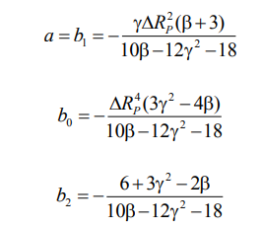


Ion Implantation doping profile
$$\frac{df}{dx}=\frac{\left(x−a\right)f}{b_{0}+b_{1}x+b_{2}x^{2}}$$
Pearson distribution function defined as DE solution
Analytical description of doping profiles can be obtained from Pearson distribution
Coefficients of Pearson’s equation are related to the four moments
Explicit formula for the implanted profile can be obtained
Generic profile formula from Pearson distribution
A. F. Tasch et al., “An Improved Approach to Accurately Model Shallow B and BF 2 Implants in Silicon,” Journal of the Electrochemical Society, vol. 136, no. 3, pp. 810–814, 1989,
26
Instrumentation Training Lectures, Oxford 16/05/2025

Slide 30
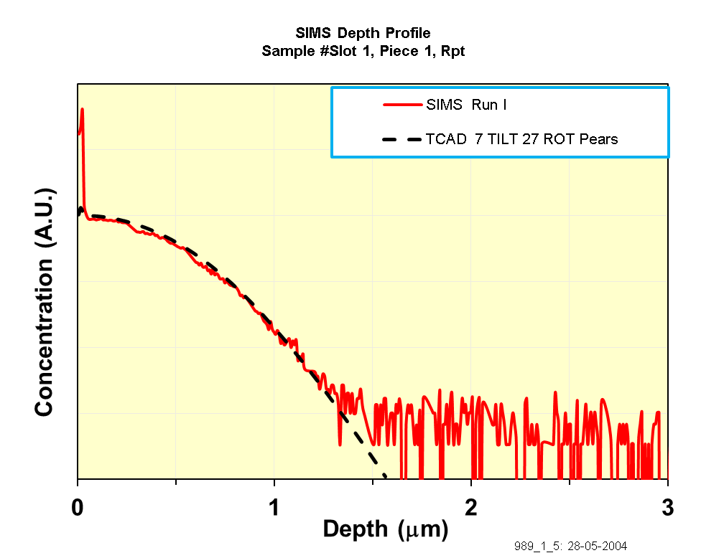
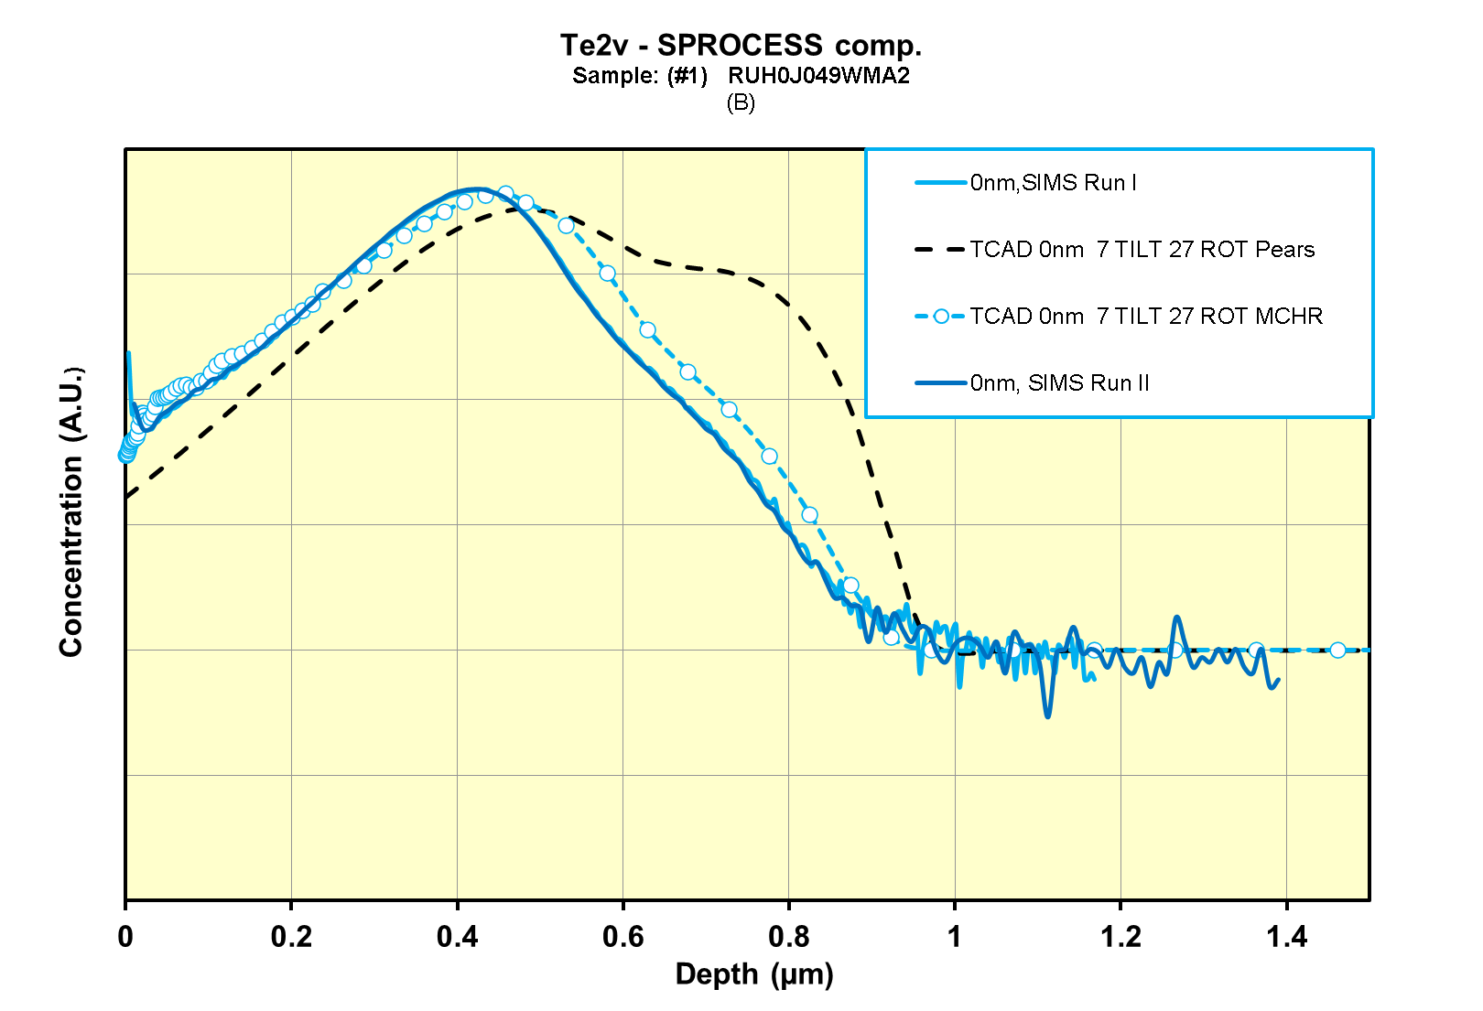
Ion Implantation doping profile
Analytical doping profiles description reasonably accurate for heavy ions
Lighter ions more accurately described using MC (crystal orientation depending)
SIMS and Pearson IV distribution – 31P on <100> Si
SIMS, Pearson IV distribution and MC run – 11B on <100> Si
27
Instrumentation Training Lectures, Oxford 16/05/2025

Slide 31
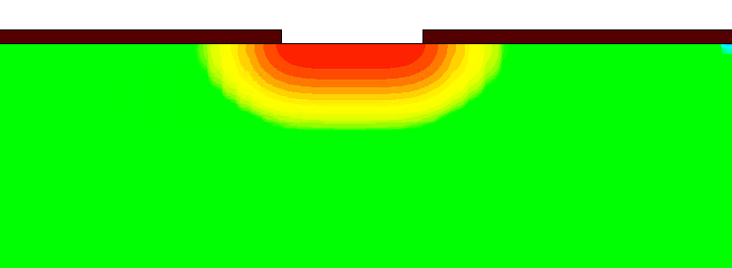
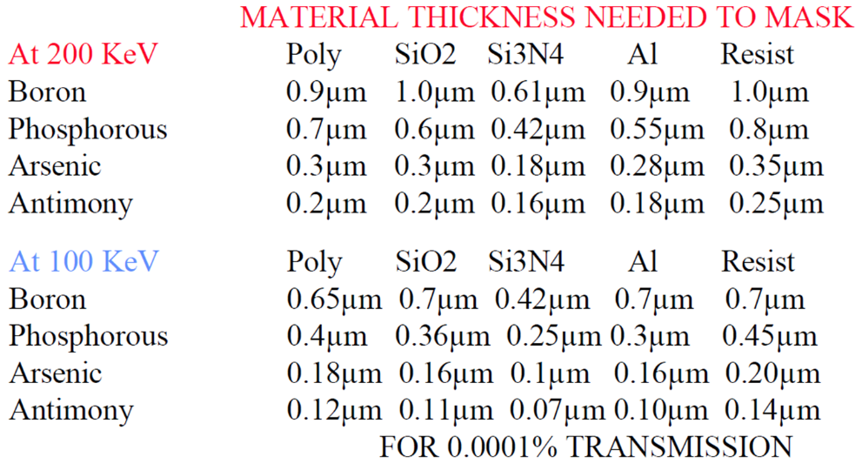
Ion Implantation masking
mask
Si
Lateral scatter around the impact point
Purpose of the mask is to implant only in certain parts of the wafer, using a suitably thick mask (i.e. that its R_{p} lies within the mask material)
The thickness of the mask should be large enough that the tail of the implant profile in the silicon should not significantly alter the doping concentration (C_{B})
The resist thickness cannot exceed a maximum value to avoid the UV light giving non uniform exposure
28
Instrumentation Training Lectures, Oxford 16/05/2025

Slide 32
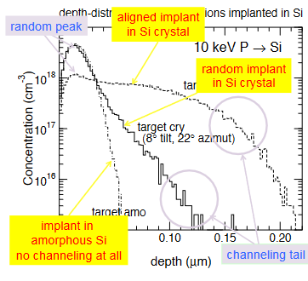
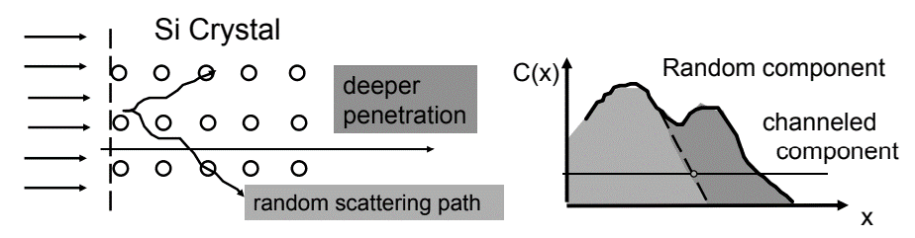
Ion Implantation channeling
During ions implantation in a periodic structure, directional effects due to nuclear scattering might confine the ions into regions minimizing interactions along the path.
Channelling: Average penetration depth is larger, affecting the final doping profile
29
Instrumentation Training Lectures, Oxford 16/05/2025

Slide 33
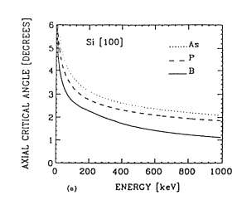
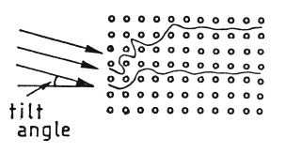
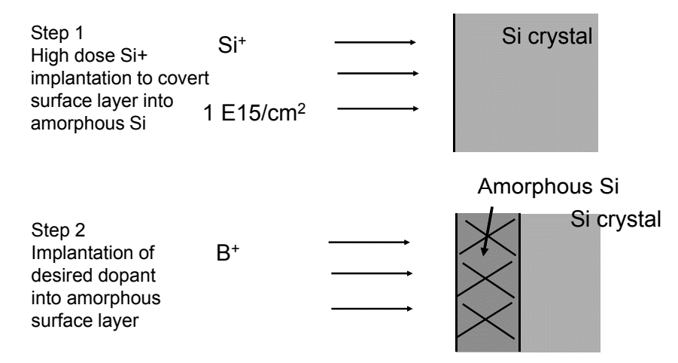
Ion Implantation channeling
To minimize channelling:
pre-amorphization of the wafer via implantation
the wafer is tilted by some degrees with respect to ion beam: the value of the critical angle below which there is channelling depends on crystal orientation and energy of the ion. In practice a tilting angle of 7 degrees is used
30
Instrumentation Training Lectures, Oxford 16/05/2025

Slide 34
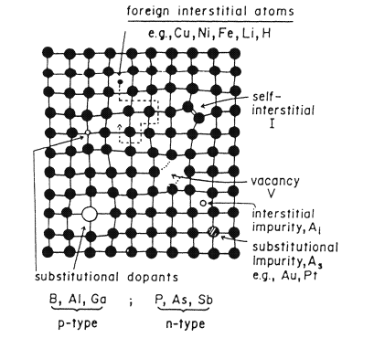
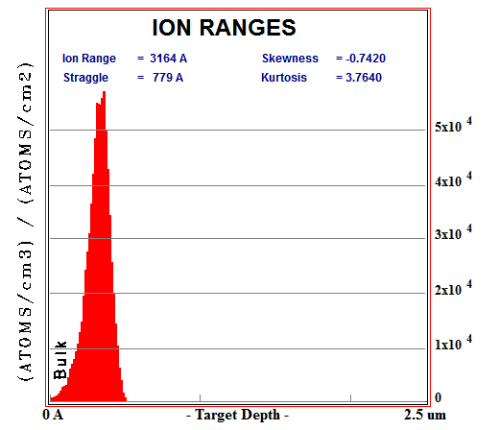
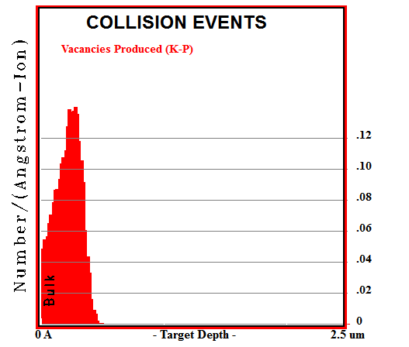
Ion Implantation damage and annealing
Ion implantation creates defects in the target crystal, by displacing atoms from their regular lattice sites (see radiation damage lectures)
The elementary radiation defect consists of Frenkel defect, i.e. displaced atom (interstitial) plus the related vacancy
More complex defects form as a result of accumulation and clustering of interstitials and vacancies (divacancies V-V, vacancy impurities, like V-O, As-I…)
31
Instrumentation Training Lectures, Oxford 16/05/2025

Slide 35
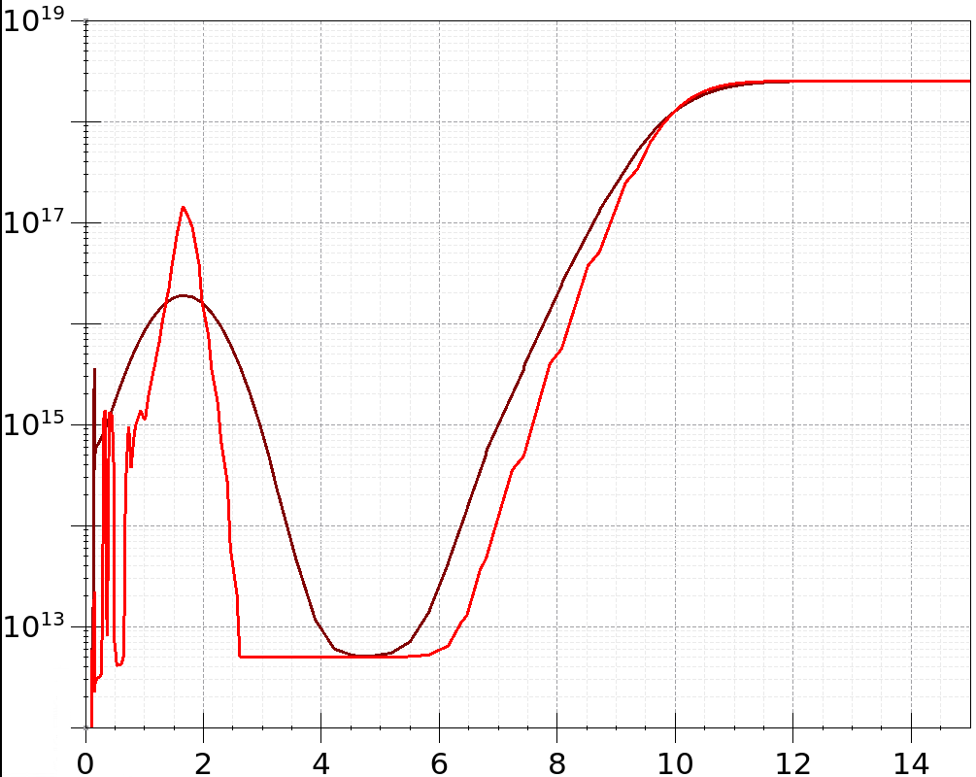

Ion Implantation damage and annealing
An example of doping profile from ¹¹B implantation in <100> Si, as implanted and after thermal annealing
After the implantation process, a thermal treatment is required to electrically activate the dopant (i.e. to have them moved to substitutional positions) and to restore the crystalline order of the semiconductor
Annealing at high temperature (~1000°C) could result in perfect crystal, but leads to dopant diffusion. Particularly serious issue in modern technologies, where very shallow junctions are used
As implanted
Thermally annealed
Isochronal annealing of boron. The ratio of the free-carrier to dose (fraction of boron atoms located in substitutional lattice points ) is plotted versus the anneal temperature for three doses of boron.
32
Instrumentation Training Lectures, Oxford 16/05/2025

Slide 36


Ion Implantation damage and annealing
Activation energy for removal of point defects (V and I) usually higher than that of impurity diffusion.
Different slopes in Arrhenius plots allow to use high temperature to enhance annealing and depress diffusivity:
Rapid Thermal Annealing (RTA)
Dislocation removal rate in As implanted Si and As diffusivity vs. 1/T
33
Instrumentation Training Lectures, Oxford 16/05/2025

Slide 37



Ion Implantation damage and annealing
Rapid thermal annealing of wafers (RTA) optimizes the defects suppression, whilst minimizing dopants diffusion
Wafers are rapidly heated by lamps (10’s kW) to 1000 C for 1 – 20 secs max
Various methods to measure the wafer temperature (optical, acoustic)
https://photonexport.com/rapid-thermal-processing/
34
Instrumentation Training Lectures, Oxford 16/05/2025

Slide 38


Schottky diode on P-type Si wafer
Metallization
Once devices have been fabricated in the wafer (Front End of Line), metal layers are deposited to form the conductive connections
Modern technologies moved from Al to Cu to reduce resistivity in interconnect in Back End of Line (BEOL). This is a more complex process (Dual Damascene process) than sputtering
Al guard ring
Al cathode
35
Instrumentation Training Lectures, Oxford 16/05/2025

Slide 39

Metallization
Sputtering (PVD, Physical Vapor Deposition) is one of the most common method to deposit thin film of metal
Good step coverage obtained by reducing the mean free path of sputtered atoms (increasing Ar ions, magnetron sputtering)
Sputtering also used to clean wafer before deposition, by Ar⁺ etching
Cathode (target -) is the material to deposit, generally cooled
An inert gas (Ar) is ionized, accelerated and collides with the target. Ejected atoms have energies ~ 10’s eV
Some atoms sputters off and, after scattered paths, land and deposit onto the wafer (+)
36
Instrumentation Training Lectures, Oxford 16/05/2025

Slide 40
Process fabrication IIII Summary
Resist development
Etching
  Wet and dry
Ion Implantation
  Characteristics, tools and equipment
  Ion interactions, masking and channeling, doping profiles
  Implantation damage and annealing required
Metallization
  Tools and equipment
    Thank you
    giulio.villani@stfc.ac.uk
37
Instrumentation Training Lectures, Oxford 16/05/2025

Slide 41



Example
Estimate the dose ϕ, energy E required for B11 to get an implanted depth x_{pk} = 0.3 µm with N_{Apk} = 5e16 cm⁻³ in a Silicon substrate of doping N_{abulk} = 1e14 cm⁻³
Assume both R_{p} and ∆R_{p} $∝ \sqrt{E}$
$R=4{∙10}^{−3}E−7.8{∙10}^{−6}E^{2}$
$∆R=1.4{∙10}^{−3}E−4.4{∙10}^{−6}E^{2}$
Parabola through 3 points for B11 range and straggle
N_{Apk}
N_{Abulk}
x_{j1}
x_{pk}
x_{j2}
38
Instrumentation Training Lectures, Oxford 16/05/2025

Slide 42




Example
$R=4{∙10}^{−3}E−7.8{∙10}^{−6}E^{2}$
$∆R=1.4{∙10}^{−3}E−4.4{∙10}^{−6}E^{2}$
<R>=294.8 nm
$∆R$=74.4 nm
$$Φ=\frac{{5∙10}^{16}}{{6∙10}^{4}}={0.83∙10}^{12}$$
From expression of R_{p} = 0.3 µm determine E required for 0.3 depth :
E = 92 keV, from which ∆ R_{p} = 0.0915 µm
Assuming Gaussian profile, the dose required is then:$\int_{0}^{L}{N}\left(x\right)=Q={\sqrt{2π}{∆R}_{p}N}_{pk}$≃ 2.5*0.0915*1e-4* 5e16=1.14e12 cm⁻²
10k runs SRIM B¹¹(92keV) in Si
39
Instrumentation Training Lectures, Oxford 16/05/2025

Slide 43

Appendix: Ion Implantation
The many-body problem of Ion-solid interaction where one ion (M₁, n₁ ≠ Z₁ ) interacts with all target atoms M₂ nuclei and electrons in a solid is practically intractable: some simplifying assumptions are introduced:
Classical mechanics used to describe the motion of ion and nuclei
Binary collision approximation (BCA) to calculate the ion trajectories
Adiabatic approximation : nuclear and electronic systems are treated separately
40
Instrumentation Training Lectures, Oxford 16/05/2025

Slide 44



Appendix: Ion Implantation
Classical mechanics : ions move as classical point-like particles: e.g. for lightest ion B¹¹ @ E =10 keV
Usually in implantation processes ion energy is not large enough to penetrate the coulomb barrier of the target nuclei, i.e. no nuclear reactions.
$λ=8.6∙{10}^{−5} \left[nm\right]≪0.54 [nm]$, Si lattice parameter
$$B11 @ 1MeV β=0.01$$
41
Instrumentation Training Lectures, Oxford 16/05/2025

Slide 45



Appendix: Ion Implantation
Binary collision approximation : ion movement is described as a series of successive elastic two-body Coulombic interactions, using a screened potential (i.e. negative charge of ion and target reduces the Coulomb potential strength)
potential energy [eV]
[Å]
42
Instrumentation Training Lectures, Oxford 16/05/2025

