Slide 1
What I will be talking about
Today and Friday: mechanical structures
  Session 1: Purpose of structures, track-based alignment, requirements for positioning and stability, loads (vibration, thermo-mechanical, etc.)
  Session 2: 1D oscillator, Miles' equation, vibration studies (base vibration and air flow), structure design examples
Friday this week and next: Thermal management
  Session 1: Silicon systems cooling requirements, sensor temperature and runaway, prediction methods, thermal path design, thermal conductivities of structural and interface materials, case studies
  Session 2: Cooling technologies (air, monophase, evaporative), evaporative cooling systems (emphasis on CO2), evaporator design (incl. microchannels), prediction methods and performance verification, engineering aspects
A lot of stuff is from a review article I wrote some time ago:
  G. Viehhauser 2015 JINST 10 P09001, doi:10.1088/1748-0221/10/09/P09001
  Also has lots of references

Slide 2

A shameless plug…
Tony Weidberg and I have written a textbook on detectors in particle physics
  Now in print
  Open access: https://www.taylorfrancis.com/books/oa-mono/10.1201/9781003287674/detectors-particle-physics-tony-weidberg-georg-viehhauser
Written for graduate students
Has of course a chapter on silicon detectors

Slide 3
Mechanical structures
Georg Viehhauser

Slide 4
Purpose of structures
Silicon detectors are typically segmented into modules
  The size of these modules is defined by wafer and/or chip sizes
Typically, a silicon detector system will consist of a few ten to several 1000 modules
Large coverage will usually require the spreading of these modules over a large volume
They need to be held in space by support structures
Tracking will usually require linking measured positions from several modules, which can be metres away from each other
  The relative positioning of these modules is called alignment
The support should not degrade the module-internal measurement accuracy
  This is typically at the level of µm
The support structure should achieve this with minimal material
Additional tasks:
  Support services (cables, fibres, cooling pipes, etc.)
  Sometimes part of the thermal management (conductive heat paths) – more on this next week
  Sometimes part of the grounding & shielding system – not part of this course

Slide 5
Material
CMS Tracker
ATLAS ID
Sensitive (aka silicon)
Active (aka silicon)
Tracker material dominated by non-sensor material
Material in cylindrical geometries grows with sin⁻¹θ
In particular material is a problem in front of endcaps (barrel services cross on the way out)

Slide 6
Alignment strategies
To be able to reconstruct a track in a several metre tracking system, the positions of the modules must be known
  This is known as alignment
Several strategies are conceivable
  Position modules accurately
    µm positioning accuracy on this scale is extremely challenging (aka impossible)
    In particular, because structures are deforming under static and dynamic loads
  Build system and survey after build
    Still suffers from deformations under dynamic loads
  Hardware alignment systems
    A system that measures in real-time the dimensions of the system, independent of the primary particle tracking function
    Examples for this later, but key difficulty here is that fiducial positions for such a system are usually weakly connected to module positions – extrapolation of module positions is challenging
  Track-based alignment (TBA) – aka software alignment
    Selected real tracks are used to find module positions
    This is nowadays the most powerful approach
    Even if this sounds like it does rely on data/software only, that’s not true. The support structure needs to support TBA to make it work

Slide 7
Track-based alignment
For TBA a subset of real data is used
  Typically well-constructed tracks with high momentum
  To get enough statistics need to accumulate data for finite alignment periods
    The length of these periods depend on the granularity of the alignment, and the rate of events (luminosity)
Then create a huge Χ² with all the tracks and as parameters the positions/orientations of the substructures
This is typically done in granularity hierarchies
  Sub-detectors (barrel, endcap, etc.)
  Large structures (cylinders, disks, etc.)
  Local supports (staves/ladders, petals, etc.)
  Individual modules
At the highest level TBA can be done at ATLAS/CMS daily (few hours at SLHC)
Deformations below the level of individual modules can also be reconstructed
  Example: CMS barrel pixels – calibration of module bows
  To keep parameters manageable requires realistic deformation models/parametrizations
Number of parameters can be reduced if positions of subgroups of modules can be mechanically constrained
  Either build with high accuracy, or survey after construction – must not deform under dynamic loads
Developed for reconstruction of ATLAS & CMS – now used for all particle physics silicon systems
More
parameters
More data
required
Length of alignment period
Time between alignments

Slide 8
Challenges for TBA
Weak modes
  These are certain classes of deformations with coherent degrees of freedom
  Not constrained by the global Χ² fit – the results for these parameters are arbitrary
    That means that even if the system is perfectly positioned an arbitrary deformation will be introduced
  Solutions:
    Cosmics
    Higher level physics analysis (reconstruct mass peaks and see that they are correct for all directions)
Position perpendicular to detector plane
  High-momentum tracks typically cross detector planes perpendicularly – low sensitivity to perpendicular plane displacement
  While this will have a small effect for the high-momentum tracks used for the alignment, this can be an issue for low-momentum tracks
  Solutions:
    Cosmics
    This is an example where other (mechanical) means of position control or knowledge can be helpful (at the level of <100 µm)
Tracks going through one sense element (pixel/strip)
Well defined in this direction
Poorly in this

Slide 9
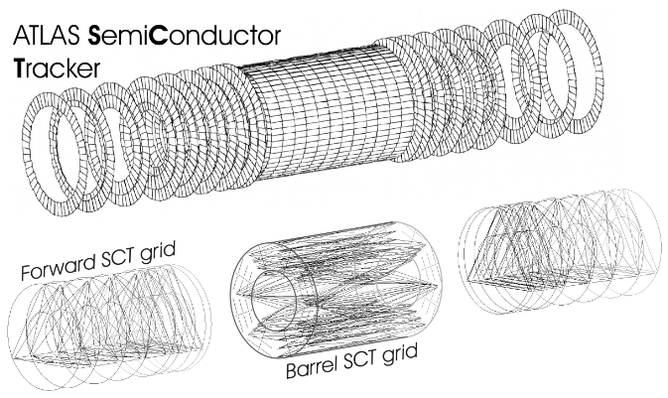
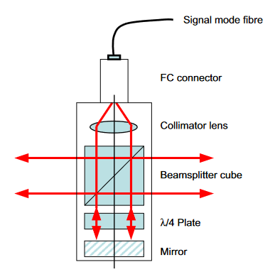
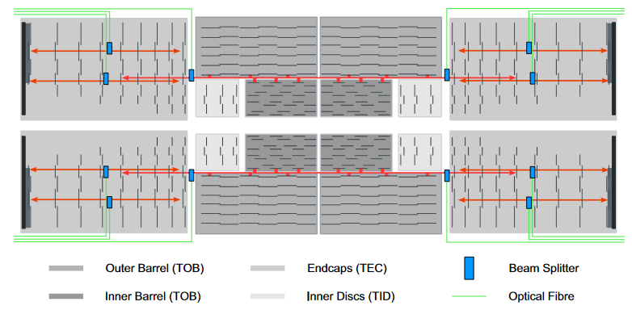
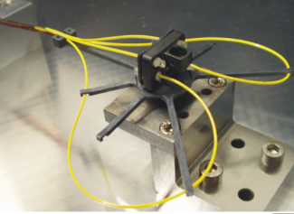
Hardware alignment
During planning for LHC experiments not full confidence that TBA will work
  Fall-back solution: hardware alignment system
  Based on light beams (represent infinite momentum tracks)
ATLAS
Frequency Scanning Interferometry (FSI)
Interferometric system for absolute length measurement with sub-µm precision
System consists of a beam splitter quill and a retroreflector per beam
These were mounted in a geodetic grid throughout the strip system
CMS
Silicon is semi-transparent to infrared, but CMS modules have opaque Al backplane
A small number of standard tracker sensors have been made with a hole in metallization
Laser beams are shone though this areas
Advantage is that you get position of modules (but only a small number)
Read out, but only used to identify seismic shocks to the system
Installed, but not read out

Slide 10
Requirements for structures
#1 requirement is stability of the module positions over the duration of an alignment period
  This does require identification of the loads that are relevant, and their time scales (will discuss later)
  Typically, stability must be comparable to module precision (~1 µm)
Module placement is secondary
  Everything needs to fit together
  Clearances (for installation or HV) need to be maintained
  Overlaps needed for tracking hermeticity and TBA must maintained
  All these are typically a very few 100 µm
A sociological observation: The TBA community and the mechanical community are very different
  Communication is very difficult – we are using different languages and there is a reluctance to engage with the tools of the other community
  But it can be extremely fruitful and is worth the effort
  In particular, necessary to understand the requirements for structures

Slide 11
Stiffness and strength
In structural mechanics there are two different properties – stiffness and strength
  Stiffness means small deformation under (limited) loads
  Strength is ability to maintain structural integrity under (high) loads
At low loads the two are somewhat correlated
However, in the high performance regime they become complementary
  A strong structure must be able to deform to absorb the energy imparted by the load
    Simple example (for a static load): A rope stretched between two points sags under gravity. To get it straight you would need to put on infinite tension – the rope would snap
In typical engineering applications the primary requirement is strength
  For example aircraft wings can take enormous forces, but deform by metres
Typical particle physics experiments (apart from space-based) are static and loads are tiny
  Our application is therefore (as often the case) non-mainstream, and this has implications for designs and materials
  Strength is usually only required to the level that it allows for handling during the construction of the experiment

Slide 12
Composite structures
The most efficient structural material are carbon fibre reinforced plastics (CFRPs)
  Efficiency here means stiffness/material
  CFRPs consist of a matrix of carbon fibre, embedded in a polymer
  The polymer is typically cured in an autoclave at elevated temperature (for polymerization) and pressure (for compaction) from a resin (which is tacky at room T)
    Typical cure temperatures are below 100°C (low T cure), around 125°C (medium cure T), or 170-200°C (high T cure) – dependent on resin
    The higher the T, the bigger the thermal stress is locked in; the lower it is the shorter the shelf life of the material is, and the lower the glass transition T
    Pressure is usually a few bar
Typical resin material is epoxy or cyanate ester
  We like the latter because it is very radiation hard and has a low CME (coefficient of moisture expansion)
  These can be procured already soaked into a prepreg, or on its own if needed as a glue or for wet lay-ups (where dry prepreg is used and the user infuses the resin)
Alternative fibre materials are glass fibre or synthetic fibres like Kevlar (Aramid)
  These usually have lower modulus, and are thus less useful for high stiffness applications (better for high strength)

Slide 13
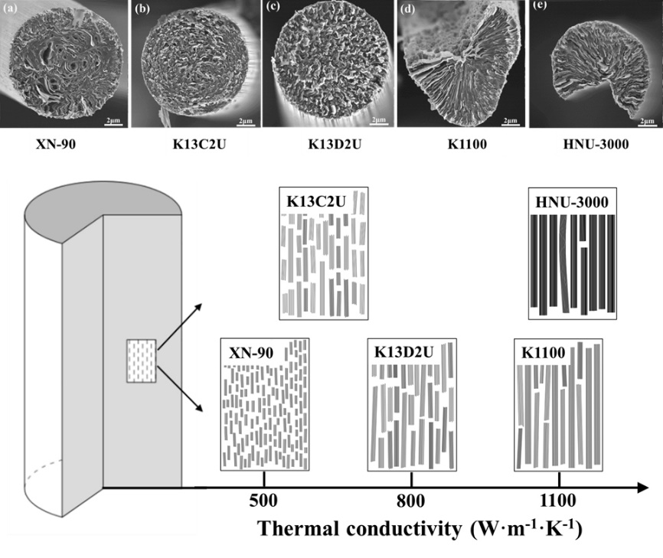
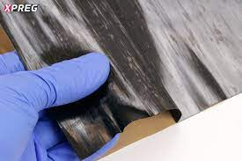
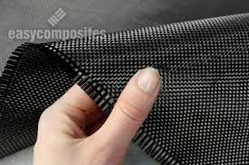
Carbon fibre - manufacture
Carbon fibres are fibres of about 5 to 10 µm diameter (1/10 of human hair)
Several 1000s of fibres (filaments) are spun into a tow
  Filament number (tow size) depends on brand
Start with a polymer such as polyacrylonitrile (PAN), rayon, or petroleum pitch
Then heated to drive off non-carbon atoms (carbonization)
The final production step is a coating to protect them from damage during winding or weaving
  This is called sizing - process and material is proprietary
The carbon fibres are then often prepared in woven or uni-directional pre-preg and impregnated with resin
Unidirectional
Weave

Slide 14
Carbon fibre - properties
Fibres can be classified according to their tensile modulus
  For us only high-end fibres are interesting: High modulus (HM, 400-700 GPa) or Ultra-high modulus (UHM, 700-1000 GPa)
  Widely used fibres in PP are K13C2U (900 GPa) or K13D2U (935 GPa)
  UHM fibre is ideal for high stiffness application, but useless for high strength (thus not common)
  Because of the high stiffness this fibre is brittle, and cannot be woven – only uni-directional
  If more strength is required a woven HM fibre like M55J or similar is useful
Density is mildly correlated with modulus - More important is prepreg fibre area density, which is a feature of manufacturing process (how many fibres per width or area)
A useful feature of carbon fibres is that longitudinal heat conduction is good, and correlated to modulus
  Cross-plane heat conductivity is usually poor (a factor 1000 smaller than along the fibre)
The coefficient of thermal expansion of a uni-directional layer is usually slightly positive across the fibre direction, but negative along the fibre (about -10⁻⁶ m/m°C)
  Therefore combinations of layer orientations can be found which have zero CTE in certain directions (those are not necessarily the lay-ups with the highest modulus)
Only defence

Slide 15

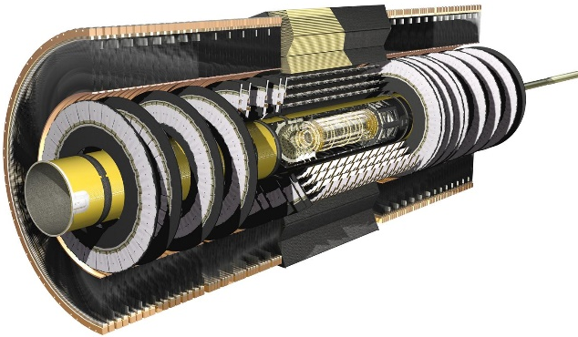
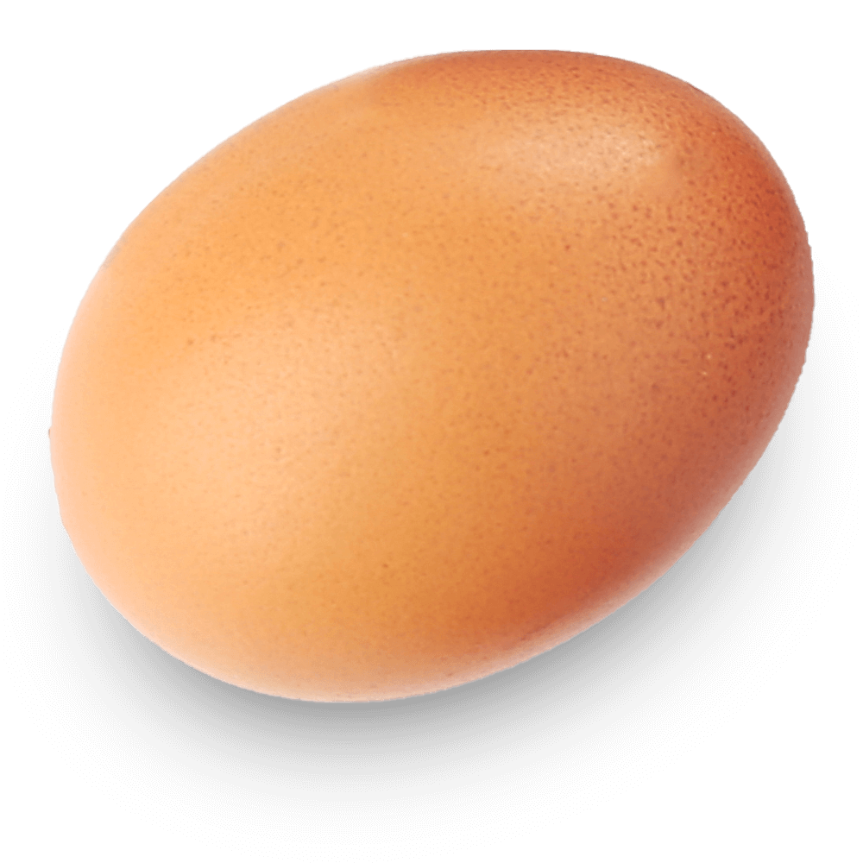
Composites design
Carbon fibre design is fundamentally different from machining metal
Design for metal structures involves removal of material (subtractive machining), and then usually connection by bolts
  Metal designs therefore often involve straight and square geometries
  Manufacture requires placement of the piece into a machine for the material removal
    This becomes more difficult and precision harder to achieve the larger the piece is
  Recently, additive metal manufacturing is changing this paradigm
Composites on the other hand comprise often sheets, which are appropriately shaped
  Structural performance is often achieved by shaping, and the design optimizes the shape according to the loads, which typically results in non-square forms
  Composites are anisotropic, so design is significantly more complex
  Shaping of composite structures in principle gives a lot of freedom for geometries
  In particle physics we are often not exploiting these possibilities (even if work with CF) – we tend to design in cylinders or disks
    Apart from being structurally inferior, this also is suboptimal in reducing tracker material
Joints are usually bonded
  Bolted connections are actually difficult and require inserts and local reinforcements
  Because carbon fibre is so structurally powerful, it often is actually the bonds, which limit the structural performance
Structural dimensional precision is best not achieved by machining of precision interfaces, but by gluing parts held in place by precision jigs
What we have now:
ATLAS ID
The most efficient tracker geometry:

Slide 16
Type of loads
In order of increasing time scales (relevant to correlate with duration of stability required)
Vibrations (timescale seconds)
  External (seismic and/or from other parts of experiment) or internal (typically flow of coolant)
Thermo-mechanical (seconds to hours)
  Structures and modules contain elements with different CTE, so temperature changes over time will lead to load changes
  This can also be due to changes in power consumption, because of thermal impedance of thermal path from heat source to local heat sink (coolant)
Seismic shocks (days to months)
  Significant perturbations or change of state, usually brief, but with significant times of stability between
  Examples are magnet ramp/quench, power or cooling system stoppage (planned and unplanned)
Long-term effects of static loads (months to years)
  For example creep or relaxation effects
  Humidity effects
  No defined time of change, but over long time scales
Relevant within TBA periods
Sets boundaries of TBA periods
Tracked by TBA

Slide 17
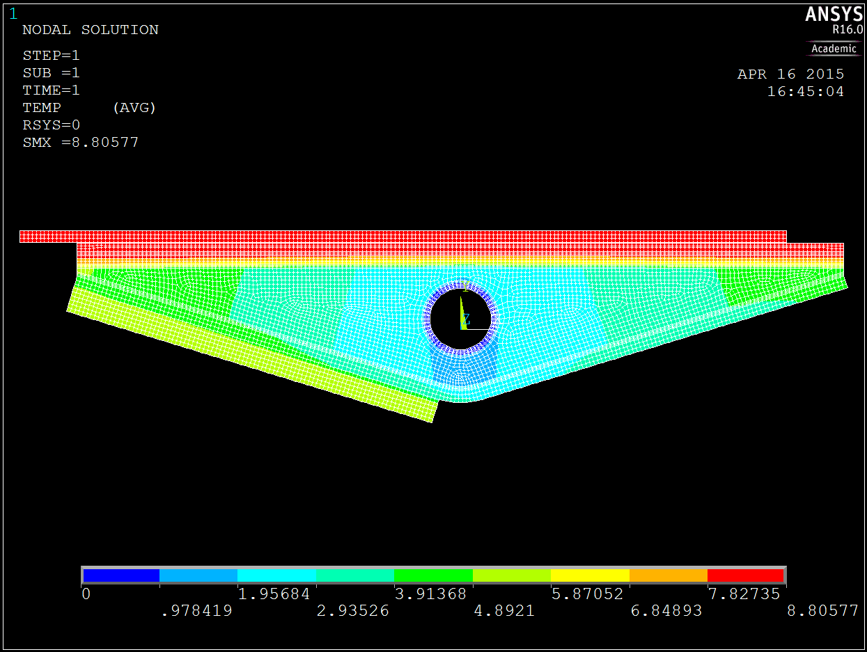
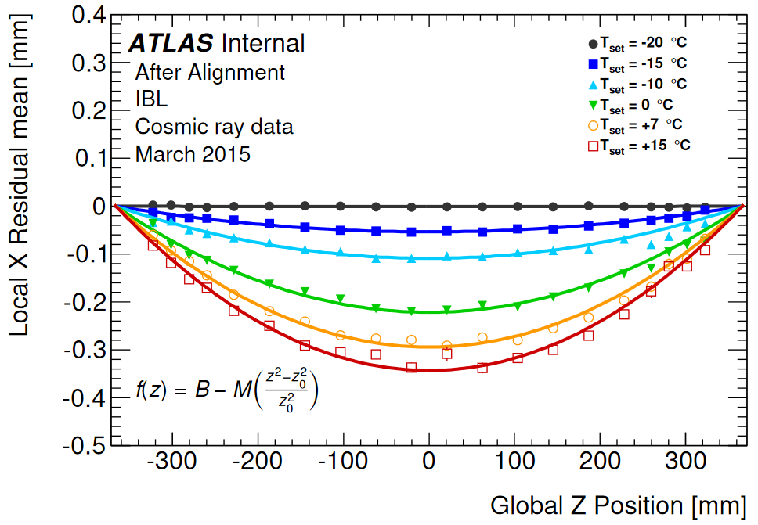
How to minimize thermo-mechanical effects
Large silicon detector systems are a complex mixture of different materials
  Generally, they will have different CTEs (coefficients of thermal expansion)
  Hence the structures will encounter temperature-dependent deformations (like a bi-metallic strip)
    These can also be power-dependent, because of temperature gradients along thermally resistive conduction paths from the heat source to the local heat sink (typically coolant)
  Often, but not only, this is to due trigger rate variations within a fill
What strategy?
  Equalize temperatures and power consumption (good number: ±0.5-1°C)
    This is an important requirement that needs to be made clear to the cooling and the electronics people in your collaboration from early on
  Design symmetric structures
    Thermal strains balance – minimize deformations
Example of what can go wrong: ATLAS IBL
  Electrical cable bonded to one side of local support only
  Does require temperature control at the level of 0.2 K and regular alignment correction in the offline reconstruction
Carbon Foam
CO₂ Cooling Pipe
Service Flex Bus
Pixel Module

Slide 18
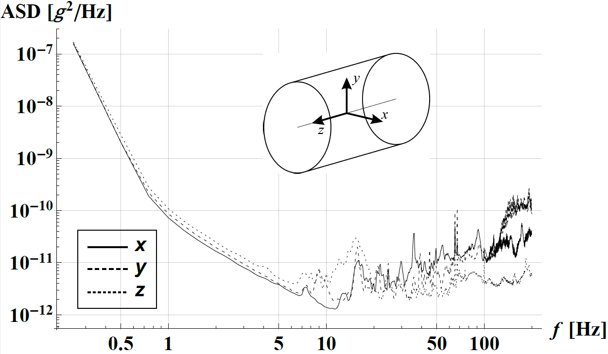
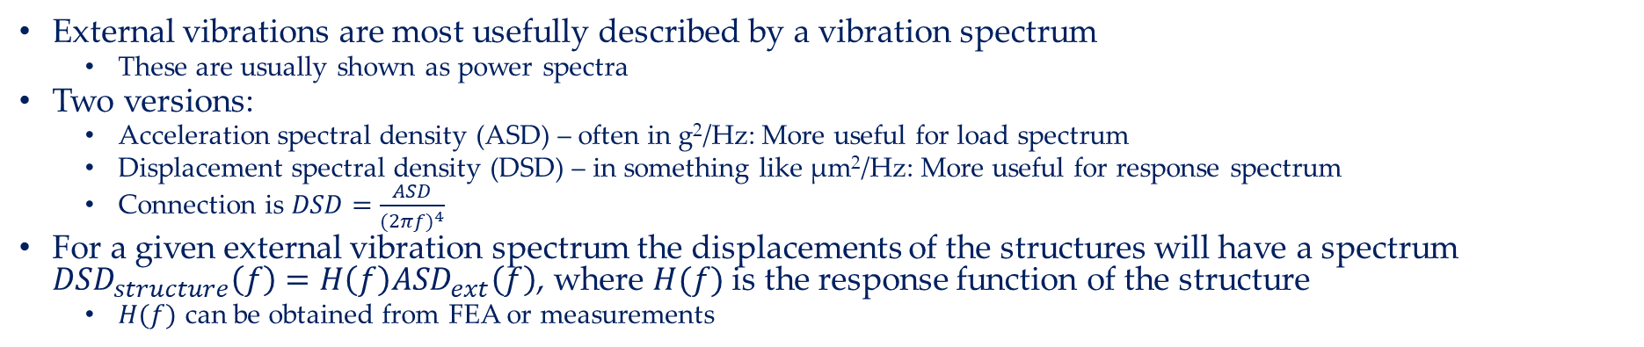
External vibrations
External vibrations are most usefully described by a vibration spectrum
  These are usually shown as power spectra
Two versions:
  Acceleration spectral density (ASD) – often in g²/Hz: More useful for load spectrum
  Displacement spectral density (DSD) – in something like µm²/Hz: More useful for response spectrum
  Connection is $DSD=\frac{ASD}{{(2πf)}^{4}}$
For a given external vibration spectrum the displacements of the structures will have a spectrum ${DSD}_{structure}\left(f\right)=H\left(f\right){ASD}_{ext}\left(f\right)$, where $H(f)$ is the response function of the structure
  $H(f)$ can be obtained from FEA or measurements
Typically, external vibration spectra in static particle physics experiments are low
  A common misconception is that they have some special feature at line frequency
The external vibration spectrum depends on your location and environment
  Ideally, they need to be measured for your specific experiment, but this is not always possible in advance
  I have seen spectra for a range of experiments, with one exception, they have all been (well) below 10⁻⁷ g²/Hz
As we will discuss more quantitatively in the next lecture, these vibration levels are very low, and displacements due to external vibrations easy to be controlled
  In fact, I have the suspicion that most silicon detector supports are over-designed
ATLAS ID – measured ASD spectrum
Long-term-average over several months

Slide 19
Summary
The most powerful method to align detector modules is track-based alignment
The mechanical design must enable, facilitate and support this
The prime requirement for the mechanical design is stability at O(1µm)
  For a definition of stability the specification of loads is required
  This also requires a specification of time scales
Typically, the relevant loads are
  Temperature variations
  Vibrations (internal and external)
Placement requirements are usually much more relaxed O(100µm)
The most capable material are carbon fibre composites
  Because our requirement is for stiffness, we typically use UHM carbon fibre, which not your standard CF
  Carbon fibre design relies on shapes – lots of opportunities to optimize structures and layouts

Slide 20
Mechanical structures II
Georg Viehhauser

Slide 21





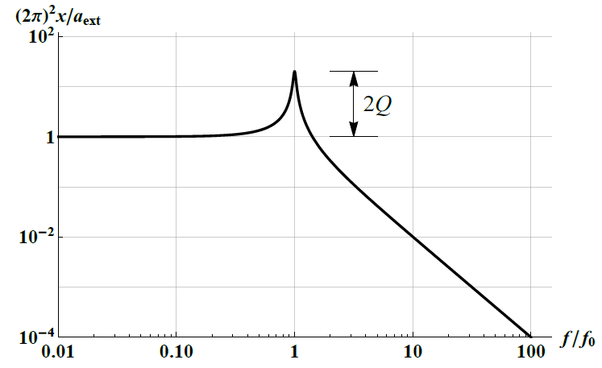
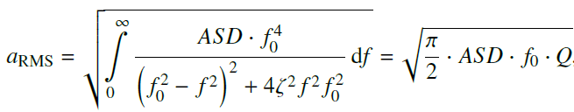



1D oscillator – Miles’ equation
To understand the response of a periodically excited object we start with a very simple model, a 1-D damped oscillator ($m\ddot{x}+c\dot{x}+kx=F_{ext}(t)$)
with
Integrate over all frequencies
Miles’ equation: a good estimator of the dynamic response of a mechanical system
John W. Miles

Slide 22


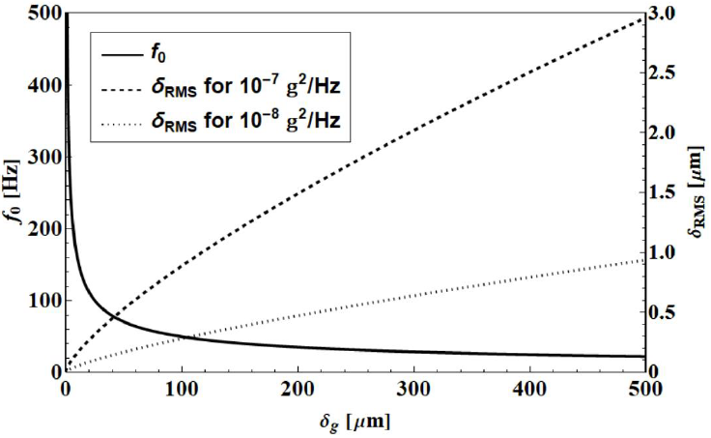
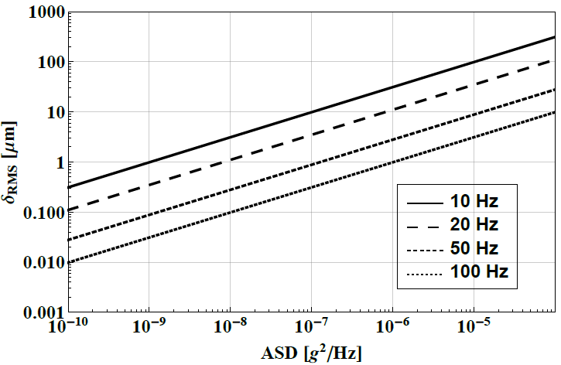


Milking Miles’ equation
If oscillator is loaded by external static force mg (gravity), $f_{0}$ can be expressed through the static deflection (sag) $δ_{g}$
and
$$f_{0}$$

Slide 23

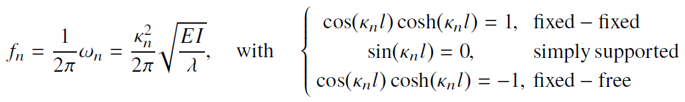



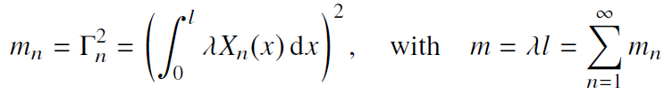
Simple beam theory
But structures are complex 3D-objects: they have a much richer resonance structure
Next level up: Bernoulli beam (essentially a 2D beam, with d << l)
  Characterized by bending stiffness EI, with E the Young’s modulus (material property), and I the (area) moment of inertia (beam geometry)
After separation and boundary conditions
  Resonance frequencies:
  Spatial part:
Combined frequency response
  Weighted with modal participation factors
  which relate to modal mass
Superposition of 1-D oscillator frequency responses
with

Slide 24
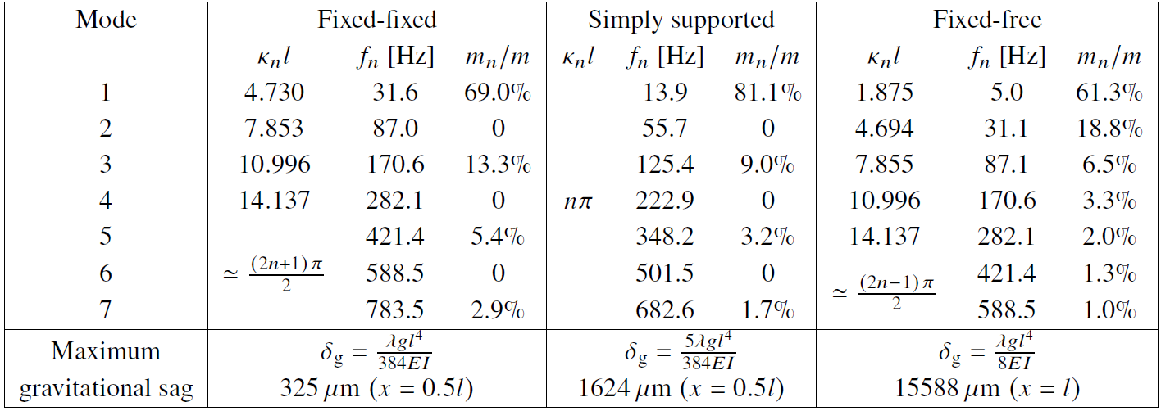
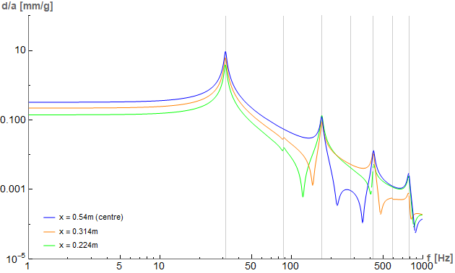
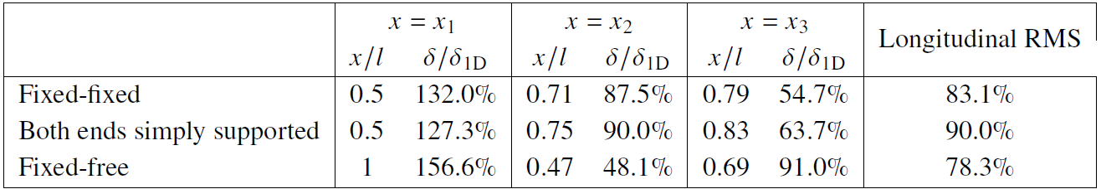
Bernoulli beam example
Beam length 1.08 m, EI = 32.92 kgm³/s², mass density 0.31 kg/m, ζ = 0.017
fixed-fixed
Even-n modes are not excited because of symmetry (would require rocking excitation)
1st mode max
2nd mode max
3rd mode max
Comparison to 1D oscillator
(use f1 as resonance frequency)
Note that higher modes do not contribute that much, because their resonance peak is already in the damping tail of the 1st mode $→$ Miles’ equation is still a good predictor

Slide 25
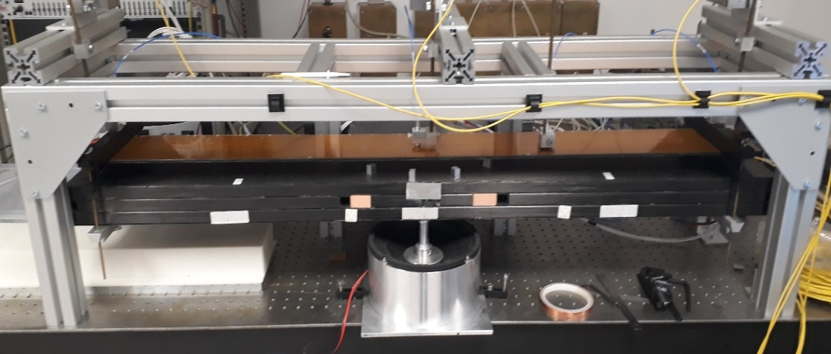
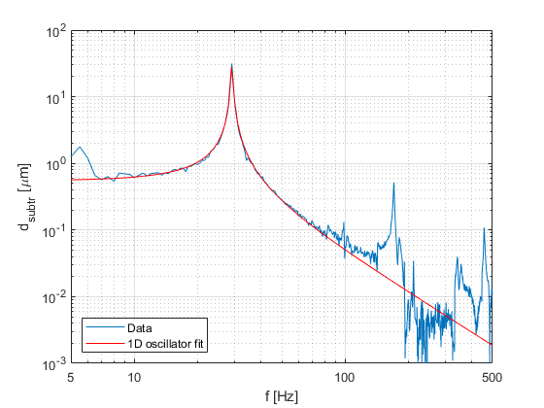
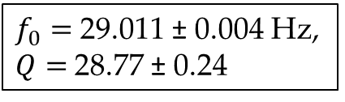
Vibration response – external vibrations
As usual, theoretical understanding needs to be backed up by experimental data
To systematically study the frequency response use a shaker table
Shaker tables are widely used in structural engineering (for example in space instrumentation)
  However, usually these are for high loads (> 1 g) – much more than typical for (non-space) particle physics experiments
  At Oxford we have built a low-acceleration shaker table (typically 1 mg)
  Challenge is that the displacement response is very small (a few nm at 500 Hz)
  Interesting instrumentation
Setup with ATLAS stave core prototype
$f_{0}=$ 29.011 ± 0.004 Hz, $Q=$28.77 ± 0.24

Slide 26

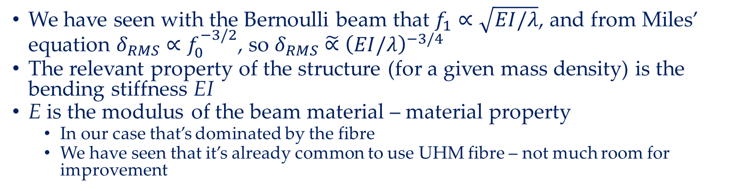
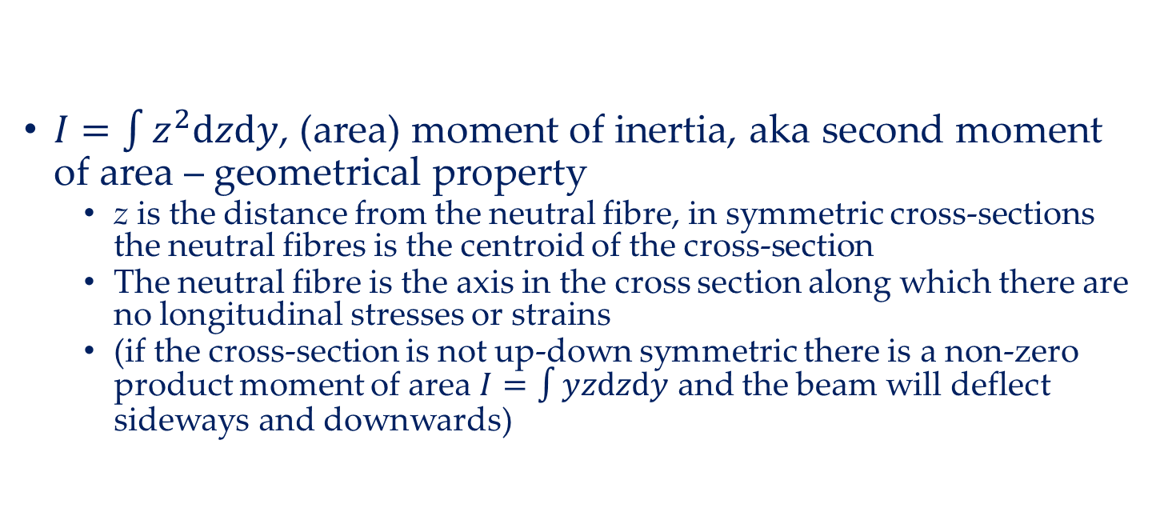
Bending stiffness
We have seen with the Bernoulli beam that $f_{1}∝\sqrt{EI/λ}$, and from Miles’ equation $δ_{RMS}∝f_{0}^{−3/2}$, so $δ_{RMS}\tilde{∝}$ ${\left(EI/λ\right)}^{−3/4}$
The relevant property of the structure (for a given mass density) is the bending stiffness EI
E is the modulus of the beam material – material property
  In our case that’s dominated by the fibre
  We have seen that it’s already common to use UHM fibre – not much room for improvement
$I=\int{z^{2}dzdy}$, (area) moment of inertia, aka second moment of area – geometrical property
  z is the distance from the neutral fibre, in symmetric cross-sections the neutral fibres is the centroid of the cross-section
  The neutral fibre is the axis in the cross section along which there are no longitudinal stresses or strains
  (if the cross-section is not up-down symmetric there is a non-zero product moment of area $I=\int{yzdzdy}$ and the beam will deflect sideways and downwards)
Example: square beam
$$I=\frac{bh^{3}}{12}$$
h
b

Slide 27
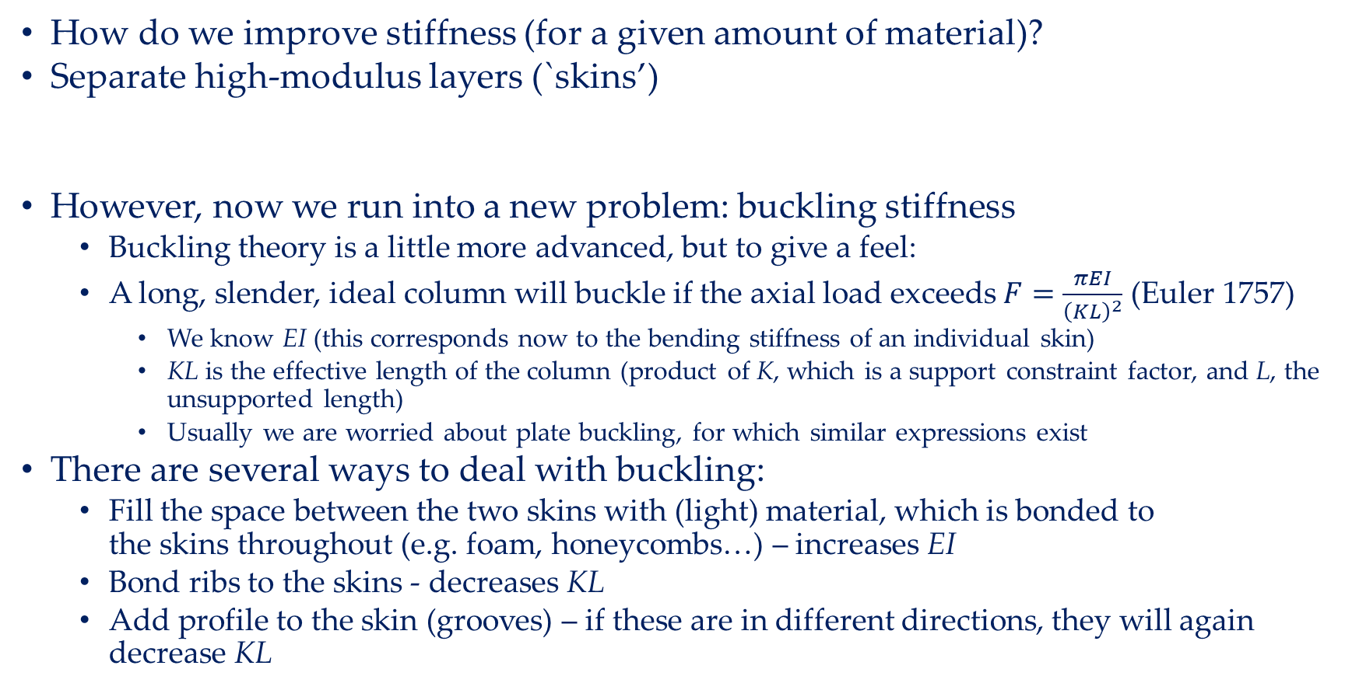
Buckling
How do we improve stiffness (for a given amount of material)?
Separate high-modulus layers (`skins’)
However, now we run into a new problem: buckling stiffness
  Buckling theory is a little more advanced, but to give a feel:
  A long, slender, ideal column will buckle if the axial load exceeds $F=\frac{πEI}{{\left(KL\right)}^{2}}$ (Euler 1757)
    We know EI (this corresponds now to the bending stiffness of an individual skin)
    KL is the effective length of the column (product of K, which is a support constraint factor, and L, the unsupported length)
    Usually we are worried about plate buckling, for which similar expressions exist
There are several ways to deal with buckling:
  Fill the space between the two skins with (light) material, which is bonded to the skins throughout (e.g. foam, honeycombs…) – increases EI
  Bond ribs to the skins - decreases KL
  Add profile to the skin (grooves) – if these are in different directions, they will again decrease KL

Slide 28
… and the mysterious Q factor…
The quality factor is a result of the damping of the system
I do not know of a simple way to predict this factor, yet it contributes as much to the displacement response as the ASD
In the study of a number of structures we have done it appears that bare mechanical structures have typically a Q value of a few 10
However, structures equipped with sensors (or sensor dummies) and services (or service dummies) tend to have lower Q values
  Which is what you would expect
I would be very interested if anybody has an idea to predict this…

Slide 29
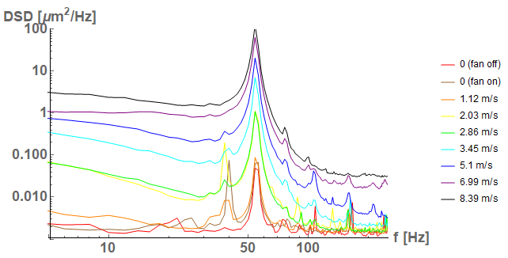
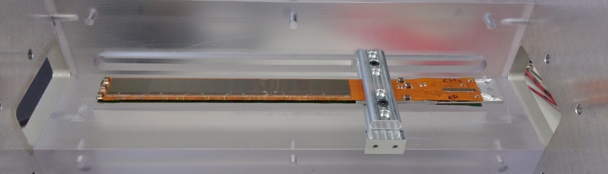
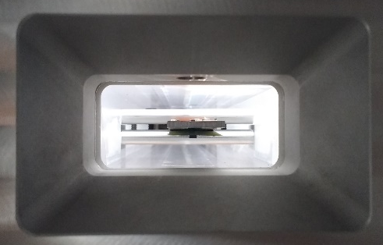
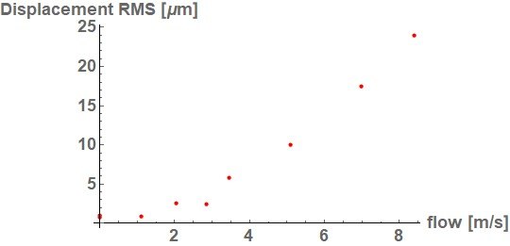
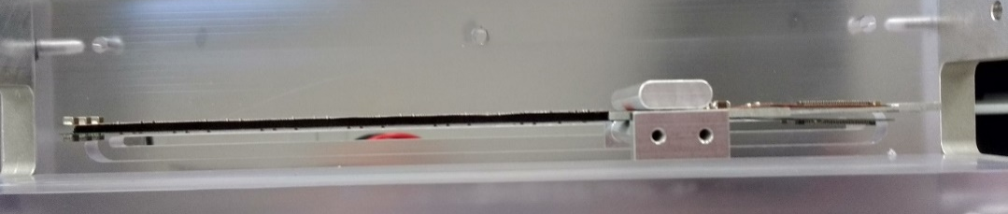
Vibration response – internal vibrations
The most important source of internal vibrations is the flow of coolant through the system
This is particularly a concern for air flow cooling, which is considered for future lepton colliders
The exact prediction of displacement response is difficult, as it does depend on the coupling of the flow to the structure, which is a 3D problem
  In particular if flow is turbulent
Peak at 1st mode frequency
However, because of the large modal mass, the structure will be dominantly excited in the first mode
Again, we have built an experimental setup for this at Oxford
Example: Study of Plume ladders (supplied by Bristol)
~ 10 cm
Unfortunately no
visualization of flow…

Slide 30
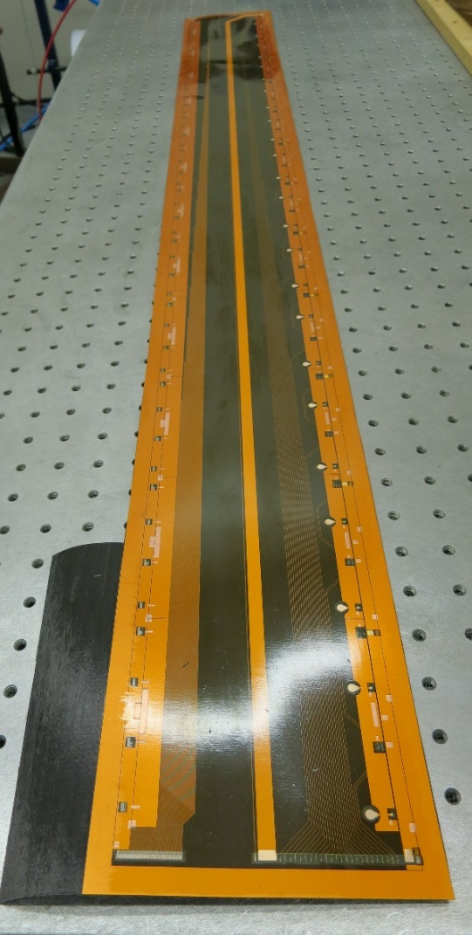
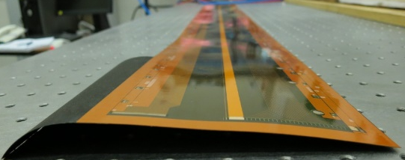
Service integration - electrical
A secondary function of the support structures is to provide support for services
  A simple approach is to provide support by clips or service channels
  A more aggressive approach is to bond the services to the/into the structures
  The key issue here is the management of coupling of forces (in particular thermo-mechanical) inside the services and the structure (see ATLAS IBL before)
Electrical
  Co-curing of Kapton/Cu or Kapton/Al flex circuits (for example ATLAS strips)
Optical
  No attempts known to me
  However, an interesting topic in structural engineering is strain and integrity monitoring using Fibre-Bragg interferometry in embedded optical fibres (used for example in monitoring concrete structures) – this might be useable as a hardware deformation tracking system?...
ATLAS Barrel strips
Kapton/Cu co-cured with 3 layers of
K13C2U/EX1515
1400 mm
100 mm

Slide 31
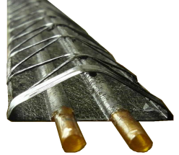
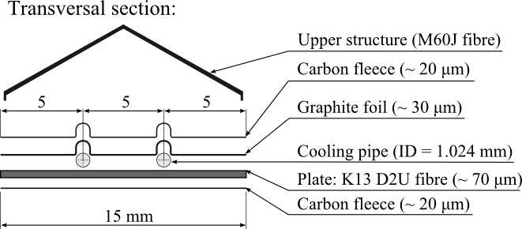
Service integration - cooling
In fluid forced flow cooling system standard is to use metal pipes
Additional benefit from bonding is that it provides a good conductive path for heat from the heat sources to the cooling pipe
Bonding these to the composite structures is challenging (CTE of metals and CF are significantly different)
Cooling pipes from carbon fibre have been studied, but two major issues
  CF cooling pipes are very stiff – need to be manufactured precisely to the right shape (metal pipe shapes can usually be adjusted in situ)
  CF cooling pipes are not leak tight for CO₂ (CO₂ is a good solvent, and attacks the resin)
A good compromise is to use a weak tube to co-cure with CF - Example: ALICE using Kapton tubes
Another idea is to run the cooling in channels inside the silicon itself – more on this next week
ALICE IB
Pipe burst pressure @ 51bar
Leak-less water cooling

Slide 32
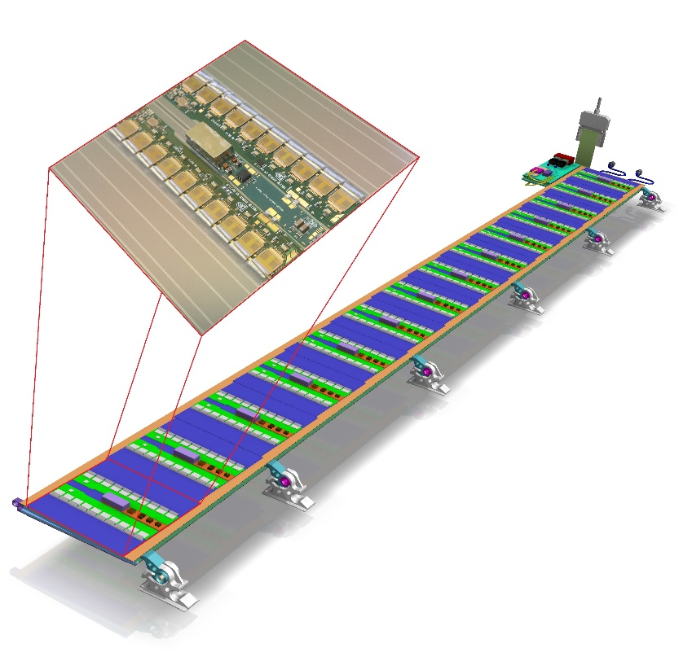
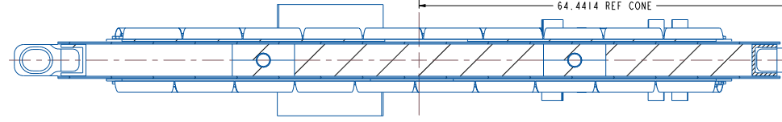
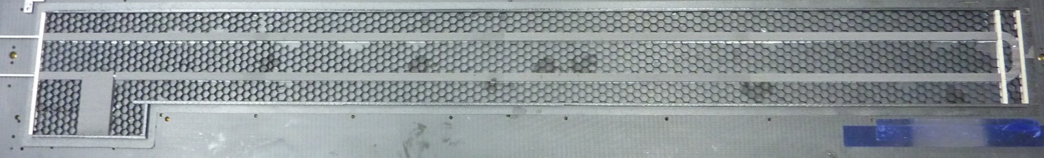
Case study: Plank structure (ATLAS barrel strip stave)
Silicon modules
Ti cooling pipe
Skins: K13C2U w/
co-cured Kapton/Cu
6 mm
Carbon honeycomb
Carbon foam
Good thermal connection from silicon to cooling pipe (embedded in carbon foam with high thermal conductivity) – short thermal path
High degree of symmetry to reduce thermo-mechanical deformation
High buckling stiffness
But stiffness-to-mass ratio not overwhelming (area moment of inertia limited)
Interesting detail: Ti cooling pipe is bonded into foam. Despite FEA predicting that foam should break during thermal cycling, this was never observed in built stave
  Shows the shortcomings of FEA, when modelling complex geometries

Slide 33
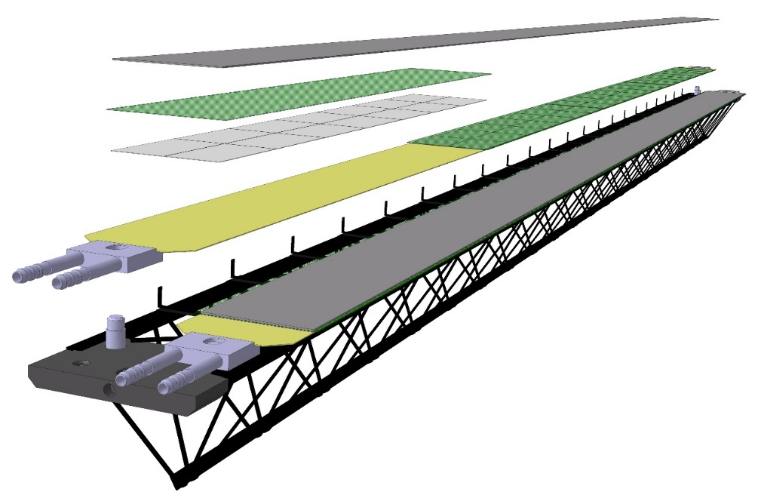
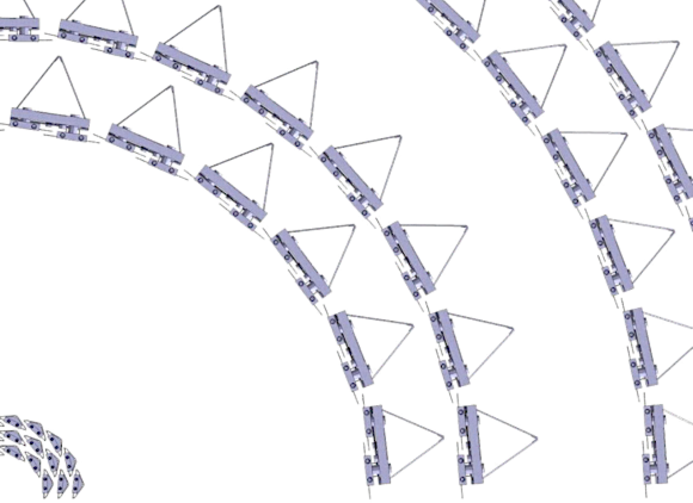
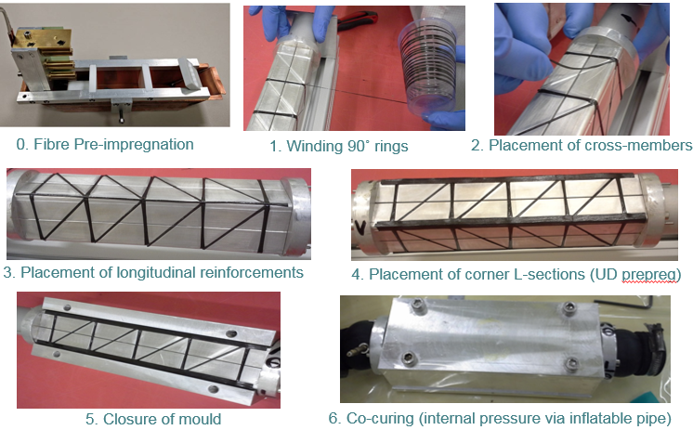
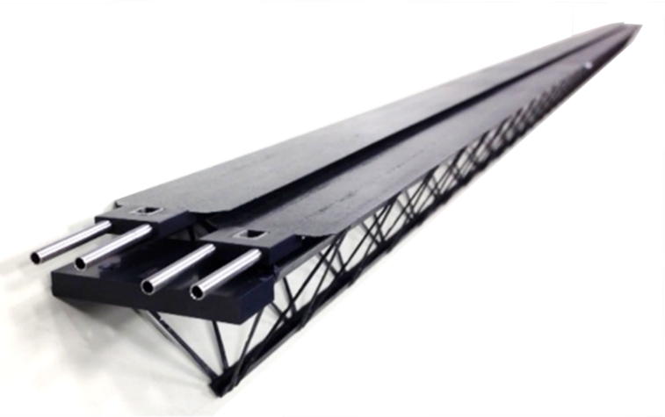
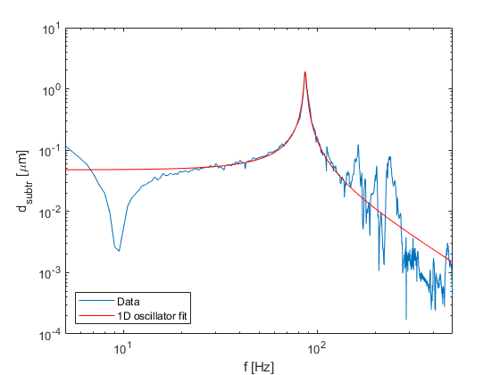
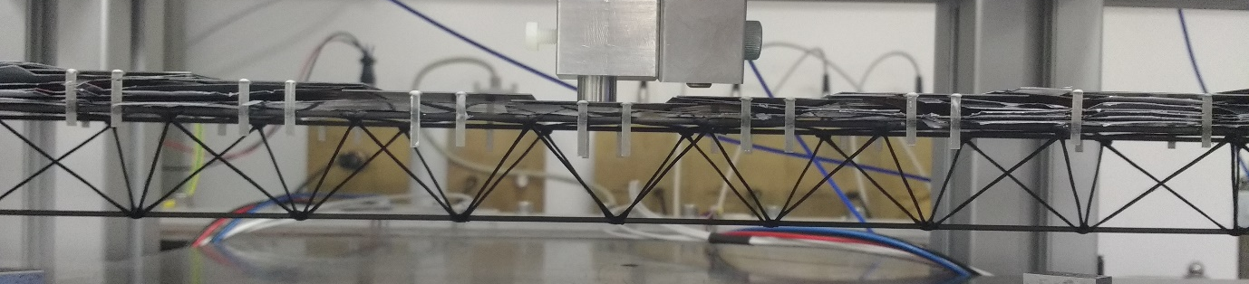
Case study: Truss structure (ALICE et al.)
Power bus
FPC
ALICE OB
2x7 sensors
Cold Plate
Space Frame
Truss structures from filaments, which get soaked in resin, and then wound on a template
Very high stiffness to mass ratio
Performance difficult to predict (buckling, joint-driven) and complex mode spectrum (not only bending modes, but also torsional modes)
CBM-STS (GSI)

Slide 34
Case study: Box channel (STAR PXL)
0.4%X₀/layer
Mechanics optimized for quick installation/de-installation
  Structure consists of cantilevered sector tubes
Air flow cooling through sector tube (9 m/s)
  Sector first mode: 230 Hz (measured)
  Sensor vibration at full flow: 5 μm RMS
  Sensor displacement at full flow: 25-30 μm
No TBA assumed for design
  All sensor positions surveyed on a half-detector
  But TBA was used in the analysis
Deformation under air flow
Sensor survey
7 layers of M55J

Slide 35
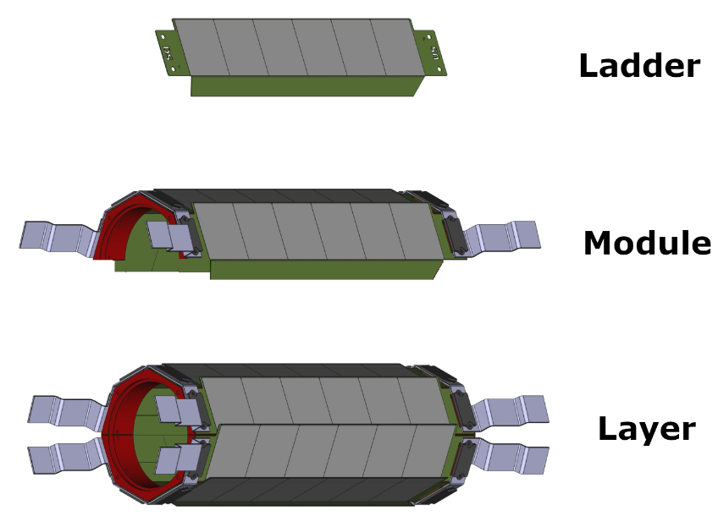
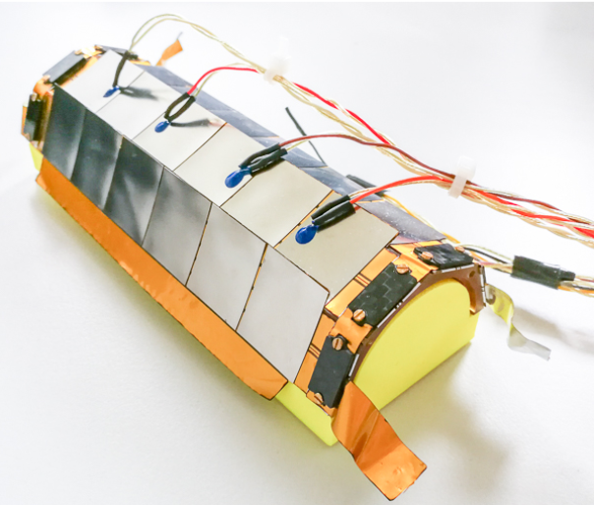

Case study: extremely low mass – Mu3e
Ultra–low mass (0.1%X₀/layer)
Support structure made from folded Kapton
  Structural stiffness achieved by linking adjacent ladders to modules, which increases area moment of inertia
Electrical connection: Kapton/Al High Density Interconnect with tab bonding
He gas flow cooling
Steel dummy modules

Slide 36
Summary
The displacement response to external vibration can be described reasonably well with a 1D oscillator with the same resonance frequency as the structure’s 1st mode
  This is because higher modes are usually in the damping tail of the first mode
  Numerically, this allows for the use of Miles’ equation to make a quick prediction
  This needs to be verified experimentally to capture the performance of joints and more complex mode structures due to the true 3D geometry
The critical parameter is the bending stiffness EI
  E is the modulus of the load-bearing elements (material property)
  I the area moment of inertia (geometry)
To increase the latter structure should open up
  Need to watch buckling stiffness
Modern structures integrate services for material-efficient systems
  Integration introduces thermo-mechanical challenges

Slide 37

Final thoughts – why we are often bad engineers
Courtesy Steve McMahon: Physicists are problem-solvers, not problem-avoiders
  We much rather get all excited when something does not work, and try to find a solution, than spend time in advance to make sure that the problem never shows up
  When a problem shows up during commissioning suddenly an army of headless chickens will have opinions and run around to find a solution – the same people would have done a much better job early on if they would have prepared properly
We get intoxicated by cool ideas
  Often we start with a cool solution, and use that to retro-actively justify the requirements
We do not like to follow boring procedural schemas
  Should be: requirements$→$ specifications $→$design$→$verification (hardware & software)$→$build$→$quality control
  Our sequence is: design $→$ some prototyping (cool) $→$wait a minute: we should write down requirements & specs (mix them, it’s too late anyway) $→$build (boring) - no time for quality control, because we are late
We intimidate our trained engineers and technicians
  They still believe we are smarter and know things they don’t know, and do not dare to tell us we are wrong (although privately they are appalled)
We don’t know the physics
  Engineering is nothing but applying basic physics (Mechanics, thermal physics, E&M), but we are too lazy/have forgotten too much/have never learned to apply what we learned in our first years at Uni
Mechanics is not considered sexy
  Too few are working on this – but we have tons of people working on sensors…

