Slide 1

Trigger and
Data-Acquisition: Part II
UK Advanced Instrumentation Course 2025
Andrew W. Rose, Imperial College London
awr01@imperial.ac.uk

Slide 2
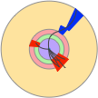
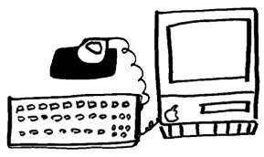
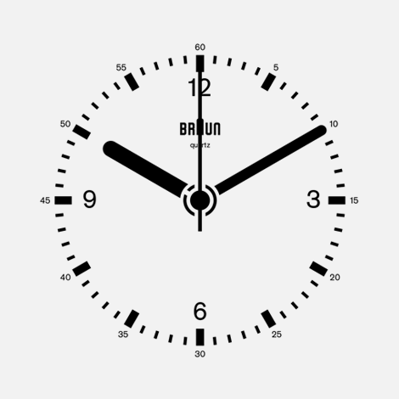
A Simple trigger system: Digital Triggers
Fast links
Digital Trigger system
  This is the fundamental design behind all modern collider
  trigger-systems
start
FE
FE
FE
FE
Front-Ends
ADCs
ReadOut
Digital delay
A PIPELINE
Mux

Slide 3
A trigger system: Multilayer Triggers
Fast links
Digital Trigger system
Digital Trigger system
Accept
Accept
FE
FE
FE
FE
Front-Ends
ADCs
ReadOut
Digital delay
A PIPELINE
Filter
Digital delay
A PIPELINE
Filter

Slide 4
Multilayer triggers
Each stage reduces the rate, so later stages have longer latency
Complexity of algorithms increases at each level
Dead-time is the sum of the trigger dead-time, summed over the trigger levels, and the readout dead-time
Pre-trigger: i=1

Slide 5


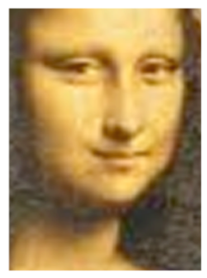
MultiLAYER triggers
Level-1
Level-2
Level-3
Analysis
Adopted in large experiments
  More and more complex algorithms are applied on lower and lower data rates
Efficiency for the desired physics must be kept high AT ALL LEVELS, since rejected events are lost for ever
Low latency
Full event rate
Small event fragment size
Lower algorithmic complexity
Access to coarse granularity information
Longer latency
Lower event rate
Larger event fragment size
Higher algorithmic complexity
Access to higher granularity information
LHC experiments @ Run1
Experiment | Number of Levels (excl. analysis)
ATLAS | 3
CMS | 2
LHCB | 3
ALICE | 4

Slide 6


A trigger system: Multilayer Triggers
Fast links
Digital Trigger system
Accept
Accept
FE
FE
FE
FE
Front-Ends
ADCs
ReadOut
Digital delay
A PIPELINE
Filter
RAM
Filter
If your input rate is low enough

Slide 7
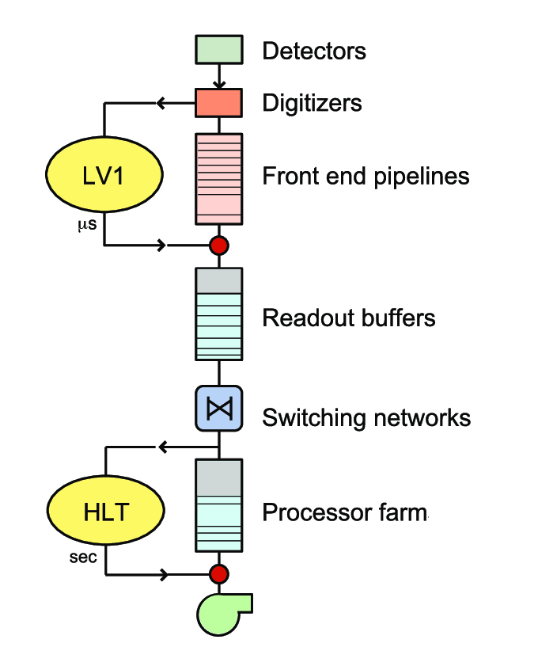
A trigger system: Multilayer Triggers
And this is exactly what the
CMS Trigger does
“Standard” figure for the CMS Trigger & DAQ

Slide 8
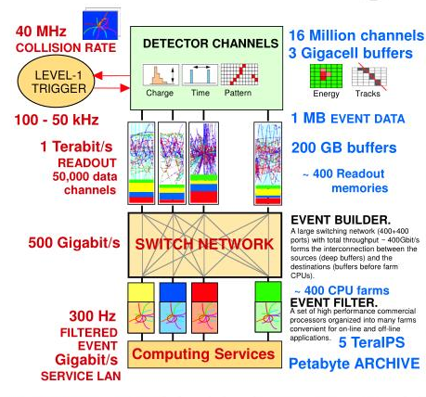
Of course, “Low enough” is relative…

Slide 9


Synchronous or asynchronous?
Synchronous: operates phase-locked with master clock
  Data move in lockstep with the clock through the trigger chain
  Fixed latency
  The data, held in storage pipelines, are either sent forward or discarded
  Used for L1 triggers in collider experiments, exploiting the accelerator bunch crossing clock
FE data
Local
trigger decision
  Pro’s: dead-time free (just few clock cycles to protect buffers)
  Con’s: cost (high frequency stable electronics, sometimes needs to be custom made); maintain synchronicity throughout the entire system, complicated alignment procedures if the system is large (software, hardware, human…)
T1
T2
T3
T4
Fixed time
FE buffers
Global trigger decision going back to FE
YES
to the DAQ
data

Slide 10
Synchronous or asynchronous?
Asynchronous: operations start at given conditions (when data ready or last processing is finished)
  Used for larger time windows
  Average latency (with large buffers to absorb fluctuations)
  If buffer size ≠ dead-time → lost events
  Used for HLT
FE data
Local trigger
decision+timestamp
Take data when ready
  Pro’s: more resilient to data burst; running on conventional CPUs
  Con’s: needs a timing signal synchronised to the FE to latch the data, needs time-marker stored in the data, data transfer protocol is more complex)
Average maximum time
FE buffers
Global trigger decision back to the FE
YES/NO
to DAQ or clear
data+timestamp

Slide 11
Synchronous or asynchronous?
Why not both?
Pseudo-synchronous: operates locally phase-locked
  Data move in lockstep through the trigger chain from a set of local clocks
  Buffering required whenever you move between clocks
  Clocks run slightly faster than source data to prevent overflow
  Realignment to global clock only after the final trigger stage
  Fixed latency
FE data
Local
trigger decision
  Pro’s: dead-time free (just few clock cycles to protect buffers), no need for expensive globally-distributed clock, simpler alignment procedure
  Con’s: must propagate timing info with data, buffering required to handle clock-domain change
T1
T2
T3
T4
Fixed time
FE buffers
Global trigger decision going back to FE
YES
to the DAQ
data

Slide 12
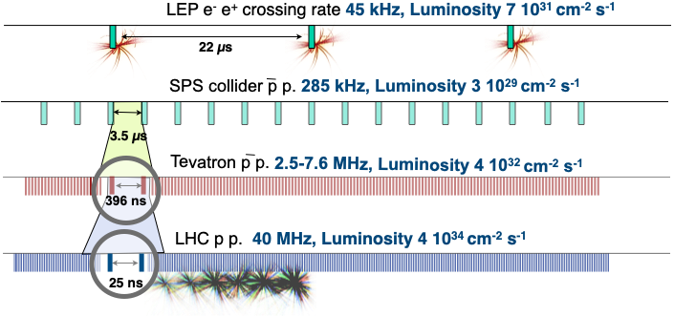
A Note on timescales
At LEP, BC interval 22 µs: complex trigger processing was possible between BXs

Slide 13
A Note on timescales
At LEP, BC interval 22 µs: complex trigger processing was possible between BXs
Modern colliders chasing statistics
  High Luminosity by high rate of BX
  BX spacing too short for final trigger decision!
  No mechanism to throttle data

Slide 14
A Note on timescales
At LEP, BC interval 22 µs: complex trigger processing was possible between BXs
Modern colliders chasing statistics
  High Luminosity by high rate of BX
  BX spacing too short for final trigger decision!
  No mechanism to throttle data
Trigger logic must be pipelined

Slide 15

Pipelined processing
6pm | 7pm | 8pm | 9pm | 10pm | 11pm | 12pm | 01am | 02am | 03am

Slide 16
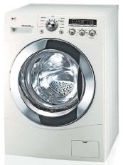
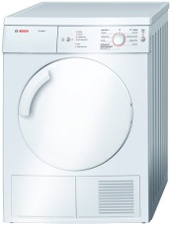

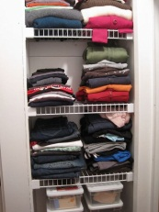
Pipelined processing
6pm | 7pm | 8pm | 9pm | 10pm | 11pm | 12pm | 01am | 02am | 03am

Slide 17

Pipelined processing
6pm | 7pm | 8pm | 9pm | 10pm | 11pm | 12pm | 01am | 02am | 03am
That would just be stupid

Slide 18
Pipelined processing
6pm | 7pm | 8pm | 9pm | 10pm | 11pm | 12pm | 01am | 02am | 03am

Slide 19
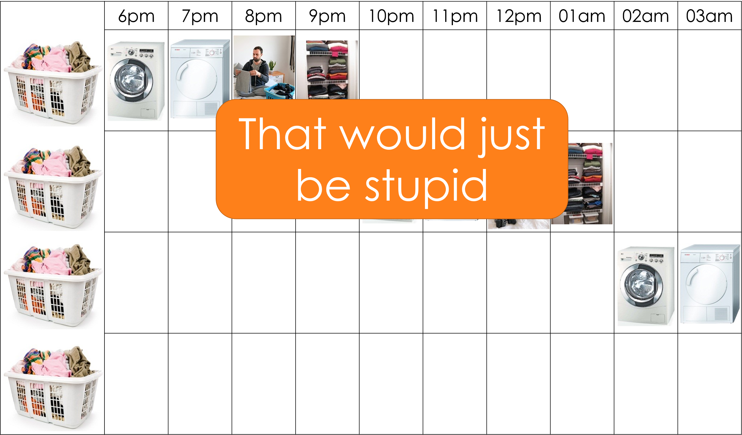
But this is precisely what a CPU does...
To first order, the ALU of a CPU handles one instruction at a time
Shameless advertising for my FPGA lecture

Slide 20
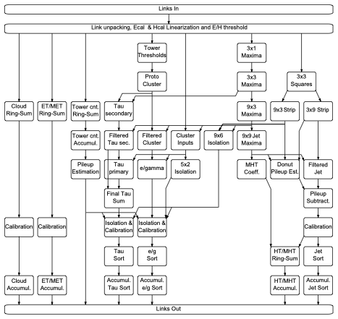
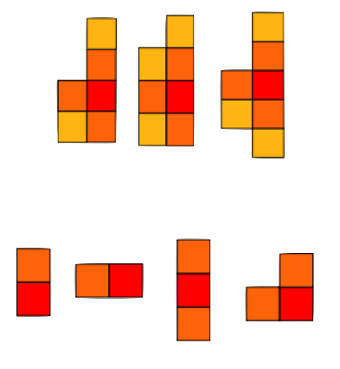
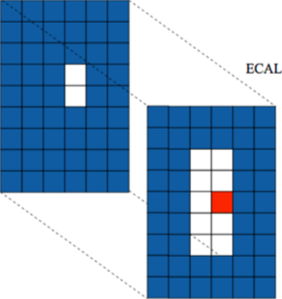
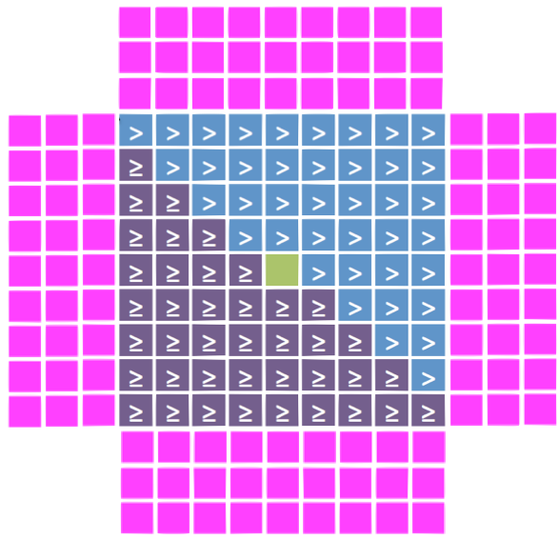
The CMS Calorimeter trigger
Inputs
Unpack & Linearisation
Dynamic clustering
Seeding & basic clustering
Clusters combination
Filtering Sums
Jet building with pileup subtraction
EG/TAU/Jets PileUp
Isolation&Calibration
Sort
Shape veto,
H/E, isolation, calibration
Cumulative sort
Outputs

Slide 21
The CMS Calorimeter trigger
Inputs
Unpack & Linearisation
Dynamic clustering
Seeding & basic clustering
Each box itself consists of a number of pipelined operations
Clusters combination
Filtering Sums
Jet building with pileup subtraction
EG/TAU/Jets PileUp
Isolation&Calibration
Sort
Shape veto,
H/E, isolation, calibration
Cumulative sort
Outputs

Slide 22
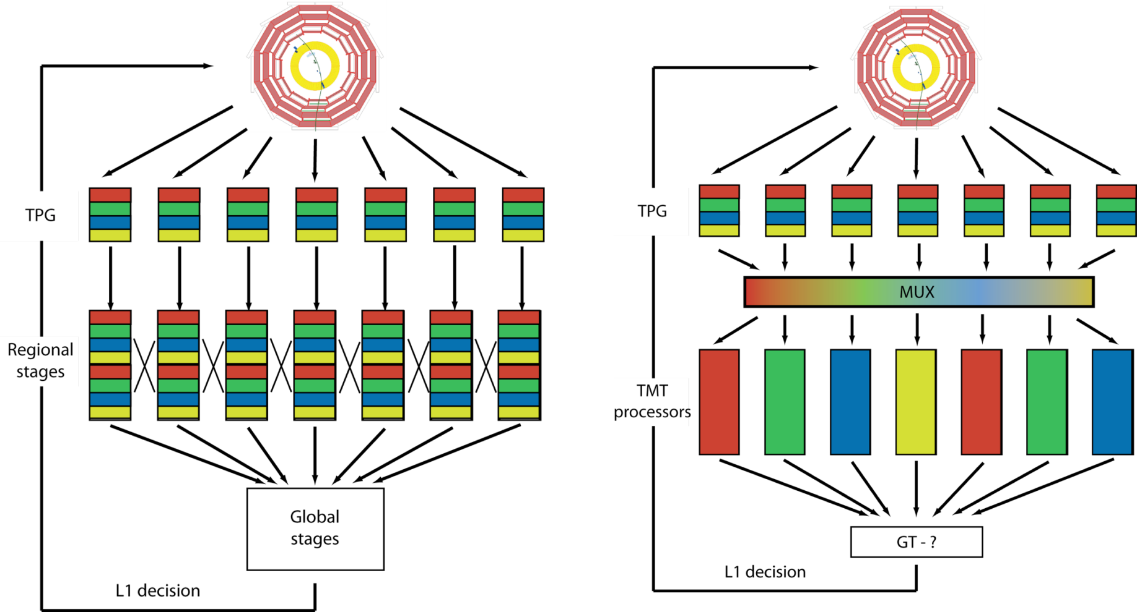
Conventional Architecture
Each subsystem is regionally segmented
Each region must talk to its neighbour
  This is the root cause of requiring specialized boards for a given task!
Each region of each processing layer compresses, suppresses, summarizes or otherwise reduces its data and passes it on to the next level which is less regionally segmented
Detector data ordering
Globally
laterally connected system
Many, many details on time-multiplexing and conventional architectures in sections 1-3 of https://cds.cern.ch/record/1421552/files/IN2011_022.pdf (although please note that the systems proposed in section 4-9 are very outdated and should be ignored)

Slide 23

Time-multiplexed Architecture
Buffer data and stream it out optimized for processing
Spread processing over time
  Stream-processing rather than combinatorial-logic
  Maximise reuse of logic resources
  Easiest for FPGA design tools to route and meet timing
Costs you latency, bought back by more efficient processing
Detector data ordering
Self-contained
event processing nodes
Many, many details on time-multiplexing and conventional architectures in sections 1-3 of https://cds.cern.ch/record/1421552/files/IN2011_022.pdf (although please note that the systems proposed in section 4-9 are very outdated and should be ignored)

Slide 24
High Level Trigger Architecture
LEP: 40 Mbyte/s
  VME bus sufficient for bandwidth needs
LHC: cutting-edge processors, high-speed network interfaces, high speed optical links
Different approaches possible
  Network-based event building (CMS)
  Seeded reconstruction (ATLAS)
 | Levels | L1 rate | Event size | Readout bandwidth | HLT rate
LEP | 2/3 | 1 kHz | 100 kB | few 100 kB/s | ~5 Hz
ATLAS | 2/3 | 100 kHz (L2: 10 kHz) | 1.5 MB | 30 GB/s (Incremental Event Building) | ~1 kHz
CMS | 2 | 100 kHz | 1.5 MB | 100 GB/s | ~1 kHz

Slide 25
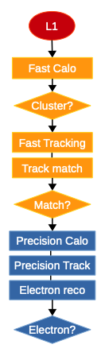
High Level Trigger design principles
Offline reconstruction too slow to be used directly
  Takes >10s per event
  HLT usually needs << 1s
Instead, step-wise processing with early rejection
  Stop processing as soon as one step fails
  Event accepted if any of the trigger passes
  Add a time-out to kill the Poisson tail!
Fast reconstruction & L1-guided regional reconstruction first
Precision reconstruction as full detector data becomes available

Slide 26
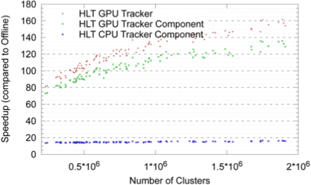
High Level Trigger design principles
Event-level parallelism
  Process more events in parallel
  Multi-processing or/and multi-threading
Algorithm-level parallelism
  GPUs effective whenever large amount of data
  can be processed concurrently (although
  bandwidth can be a limiting factor)
Algorithms developed and optimized offline
Common HLT-reconstruction software framework reduces maintenance and increases reliability

Slide 27
Example: CMS HLT
Approximately 38,000 cores
  An equal mix of Haswell, Broadwell and Skylake
Multithreading allowing the cores to share non-event data
  Reduced memory footprint → can process more events: ~20% higher performance
Upgrades to add a GPU in every filter farm node is ruled out by cost and power
  More likely a dedicated server sub-farm which does heavy tasks on demand
  FPGAs acceleration also a (possibly better) option
Boundary between trigger and DAQ is fuzzy, they are closely related
  At CMS the “High Level Trigger” is part of the DAQ

Slide 28
CMS - Event Building
At the detector readout, data is fragmented
  Readout PCs access data from some local detector region
  Each PC buffers data from multiple events
Software triggering & storage need all data for one event
High-throughput network to reorganize data
  Using standard networking technology as much as possible
Absolute numbers here are out of date!
J. Gutleber, Data Acquisition in High Energy Physics

Slide 29
Real-time Analysis / Scouting
We have discussed the typical trigger & DAQ paradigm
  Fast & coarse processing of raw data -> decide what events to keep -> store raw event data
In CMS we have “scouting” - today at HLT, at L1T also for Phase 2
  Same concepts exist at LHCb (Turbo Stream) and ATLAS (Trigger-object-level analysis)
Store objects computed by the trigger (L1T or HLT) for more events for later analysis
  More events, smaller event content (don’t keep raw detector data)
Trigger flow
Make trigger decision
Raw
data
Raw data
Compute ‘Physics objects’
Scouting flow
Loose trigger decision
Physics
objects

Slide 30
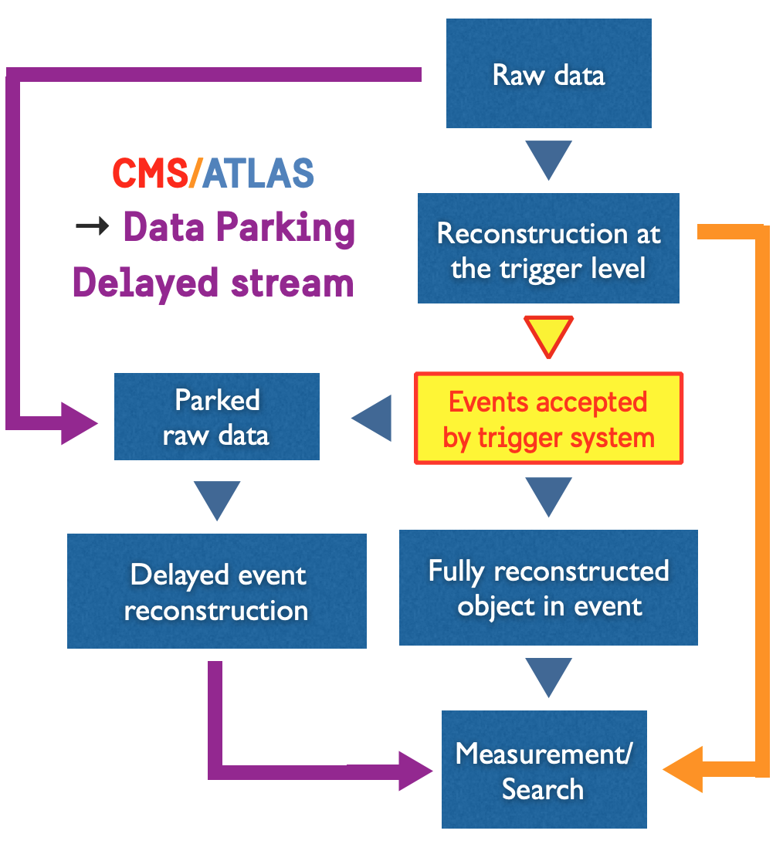
Data Parking
Based on the fact that HLT trigger rate was a bit lower than what the DAQ could handle
Add some new, loose, trigger paths for specific analyses
‘Park’ the raw data -
  Don’t run full reconstruction on accepted events immediately, store the raw data
  Process later when no triggers are arriving - e.g. in between runs
CMS, LHCb, ATLAS all use this
Right orange arrow is scouting
Talk on ‘real time analysis’ - C. Doglioni

Slide 31
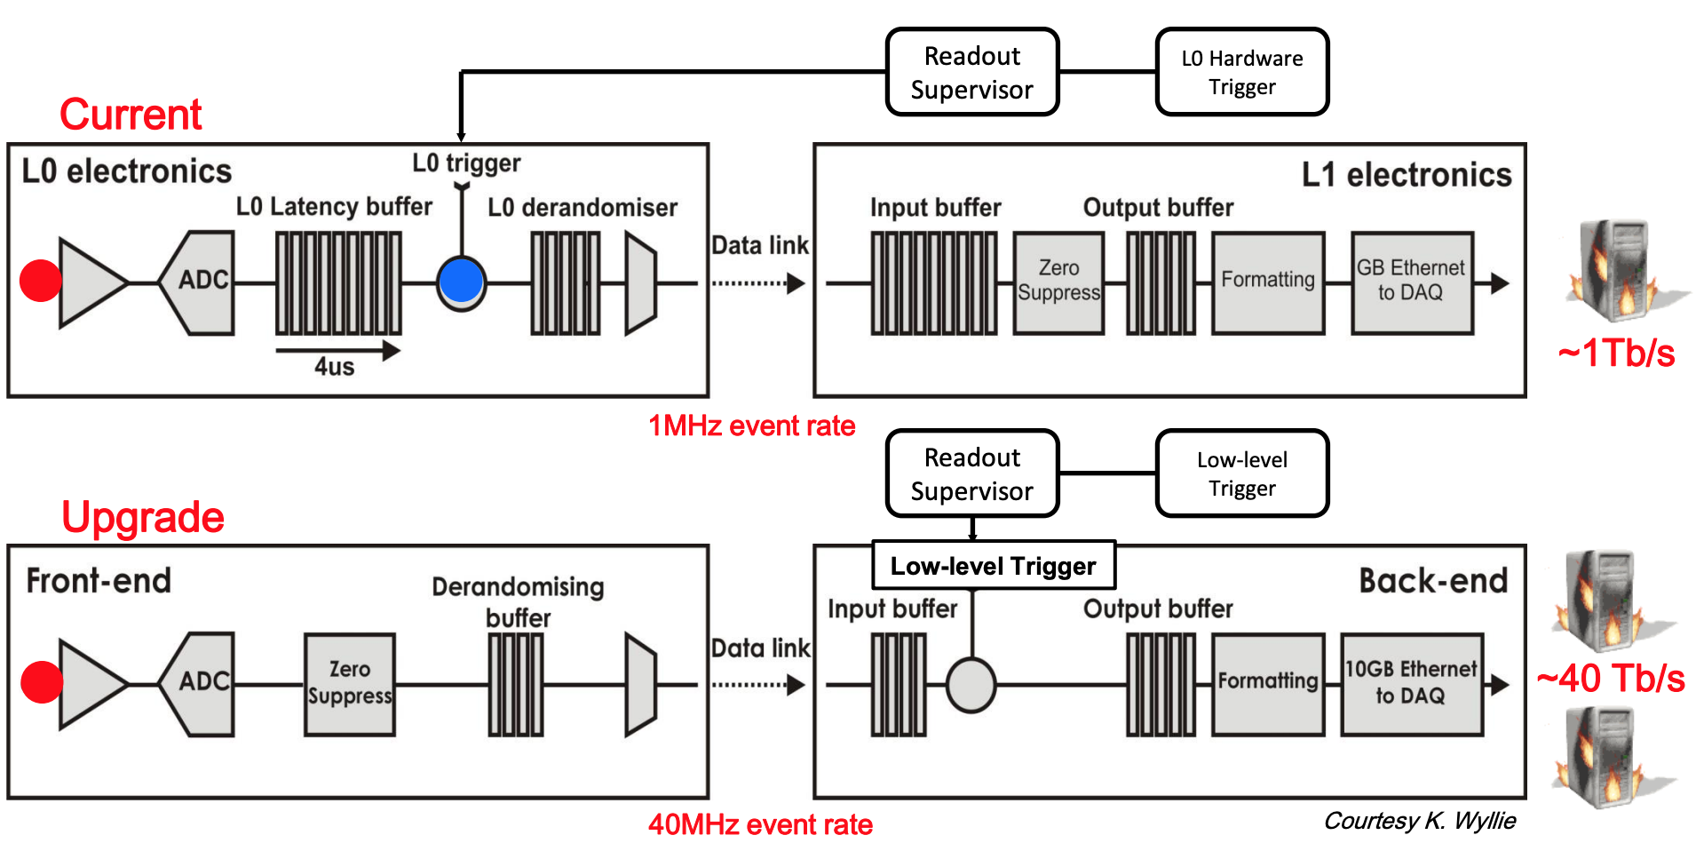
The future: Triggerless readout?
LHCb started with a hardware trigger
Then decided they could get rid of that step as L0 trigger was introducing bias
Back-end electronics and software filter see 40x higher rate

Slide 32
DAQ Mini-Summary
DAQ should aim to minimize dead time and keep up with incoming rate
Many choices when designing DAQ
  e.g. zero-suppression on or off detector? Simple front-end with high output rate, or complicated front-end with lower output rate?
Modern experiments are large detectors with many channels
  DAQ systems are complicated
  Many strategies for enhancing existing DAQ strategies - scouting, parking, etc.
Brute-force computing power can be the simplest and “cleanest” strategy

Slide 33
TRIGGERING: Practical advice
You might well have to design a trigger for some physics channel you are interested in
Not as unusual as you might imagine!
Some things to remember....

Slide 34
TRIGGERING: Practical advice
Keep it as simple as possible
  Easy to commission
  Easy to debug
  Easy to understand

Slide 35
TRIGGERING: Practical advice
Be as inclusive as possible
  One trigger for several similar analyses
  Your trigger should be able to discover the unexpected as well as the signal you intended it for!

Slide 36
TRIGGERING: Practical advice
Make sure your trigger is robust
  Triggers run tens of millions of times a second so ANY STRANGE CONDITION WILL OCCUR, make sure you are prepared for it
  Detectors don’t work perfectly EVER! Make sure your trigger is immune to detector problems
  Beam conditions change - be prepared

Slide 37
TRIGGERING: Practical advice
Build in redundancy
  Make sure your signal can be selected by more than one trigger
  Helps to understand biases and measure efficiencies
  Also for safety, if rates are too high or there’s some problem you still get your events

Slide 38
TRIGGERING: Practical advice
Finally…Taking your signal events is only part of the game
  You might well also need background samples
  You will need to measure the efficiency of your trigger using a redundant trigger path
  You will need to know if it works! Monitoring!

Slide 39
TRIGGERING: Practical advice
And remember…
The goal is not to perform the analysis online – it is just to
get the events written to tape at a manageable rate

Slide 40
TRIGGERING: Practical advice
Oh, and be very suspicious if your supervisor plies you with strong coffee and gets you to look for scintillation light

Slide 41
TRIGGERING: Conclusion
Triggers are not new
  but they are constantly evolving as the accelerators and detectors do
The design of how you structure the transfer of data around your system is the most important decision you will make
Heterogeneous computing farms look likely to feature at HL-LHC
  but it is a brave new world!

Slide 42
Thank you
Any questions?
Another shameless advert for my FPGA lecture on Friday!

