Slide 1

An Introduction to
Field Programmable Gate Arrays
UK Advanced Instrumentation Course 2025
Andrew W. Rose, Imperial College London
awr01@imperial.ac.uk

Slide 2
What this lecture is (and what it is not)
This lecture is a somewhat light-hearted introduction to what FPGAs are, and why they are both brilliant and horrible
Unfortunately, 1 hour does not give time to go into any depth – several months of hands-on work would be more realistic

Slide 3
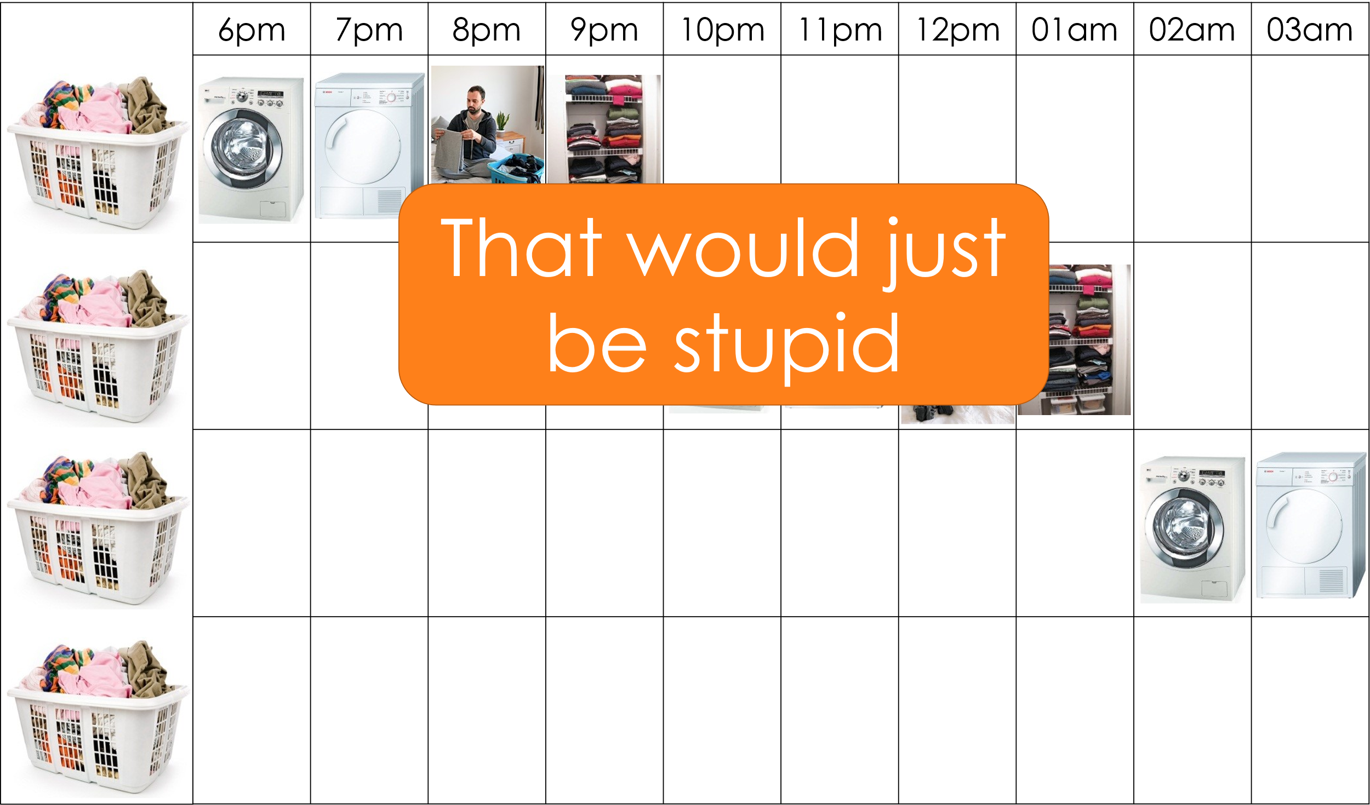
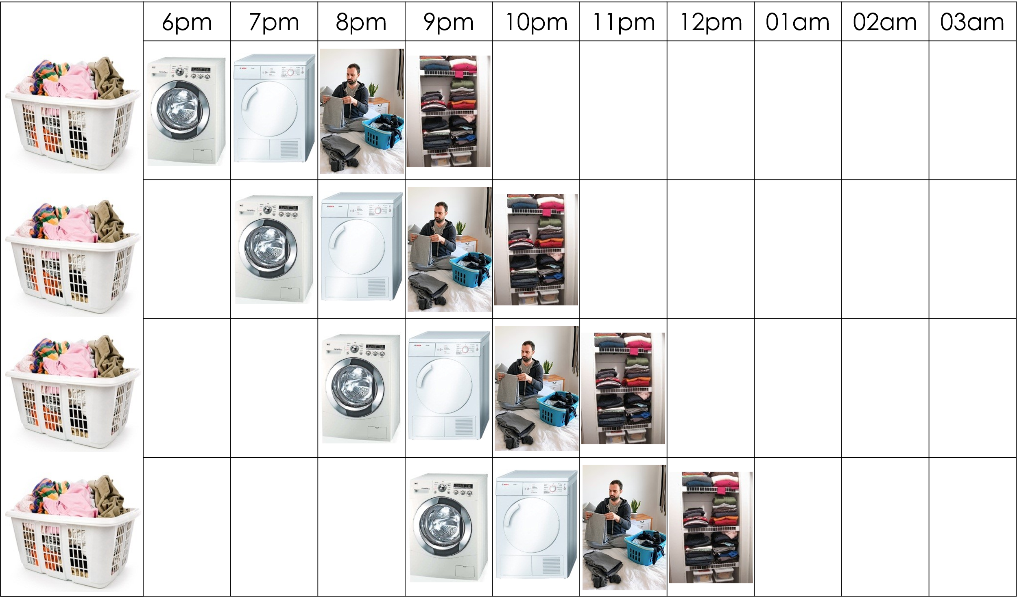
Recall From
Trigger & DAQ lectures
FPGA
CPU

Slide 4
Recall From
Trigger & DAQ lectures
FPGA
CPU
So… I should probably justify those statements…

Slide 5
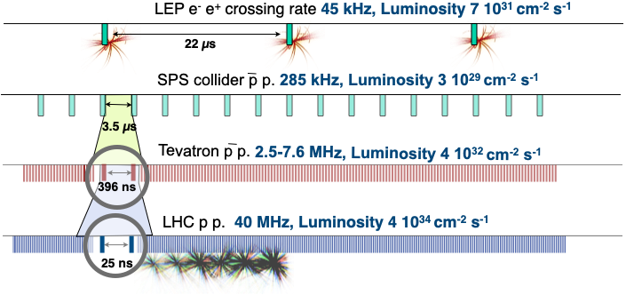
A Note on timescales
At 40MHz BX rate, a 4GHz CPU could perform 100 CPU operations (not enough to be useful) before having to pass to the next core
Compare that to the O(10M) detector channels
What technology can we use?

Slide 6
Programmable devices
Application-specific integrated circuits (ASICs): optimised for fast processing,
design encoded into silicon
“Programmable ASICS”:
Field-programmable gate arrays (FPGAs)

Slide 7
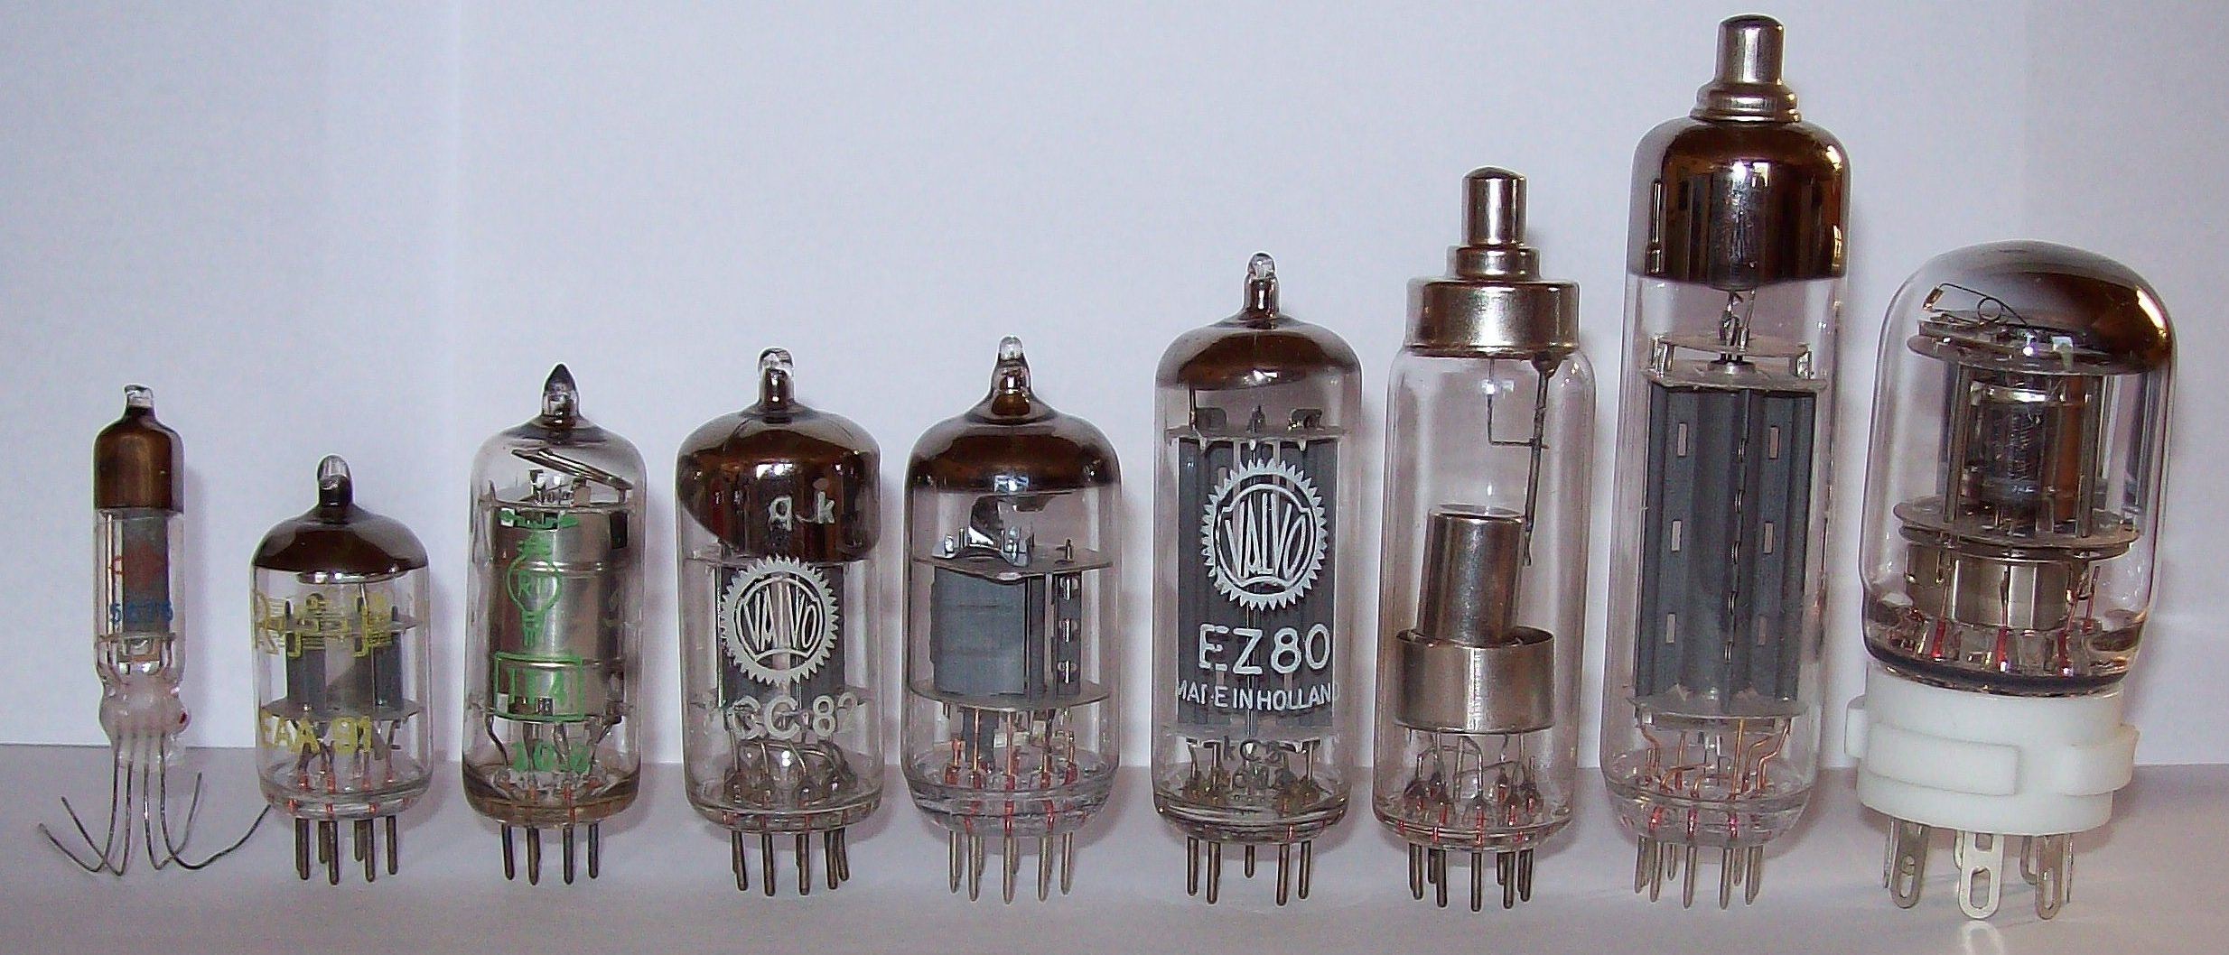
An aside: The history of electronics
Digital electronics really started with the advent of the thermionic valve (colloquially, the “vacuum tube”)

Slide 8
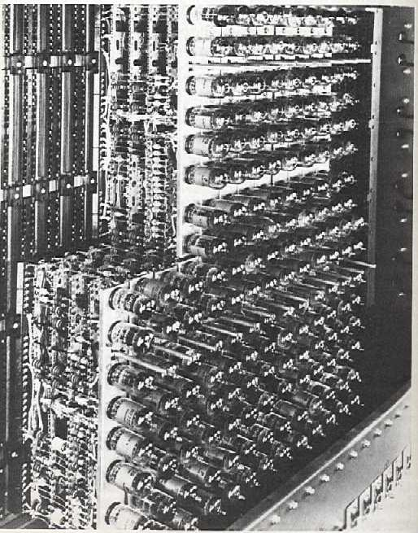
The history of electronics
Valve
transistors

Slide 9
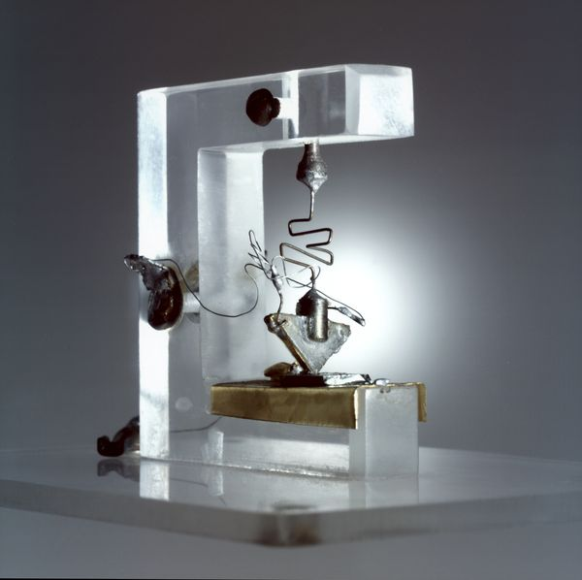
The history of electronics
First
solid-state
transistors
Valve
transistors
Notes:
Bardeen and Brattain, later much advanced by Shockley

Slide 10
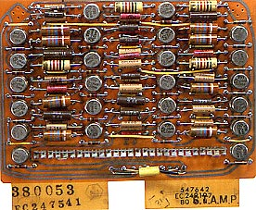
The history of electronics
First
solid-state
transistors
Valve
transistors
Solid-state
transistors

Slide 11
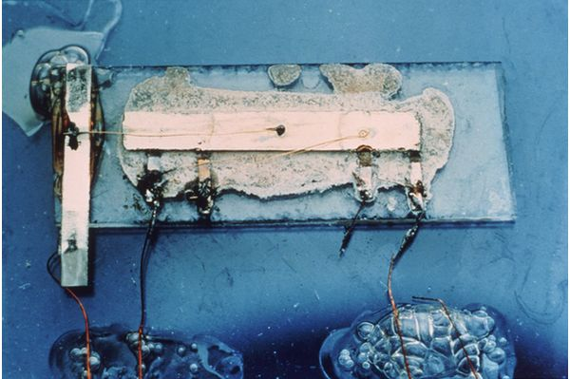
The history of electronics
First
multi-transistor
silicon
Notes:
Jack Kilby

Slide 12
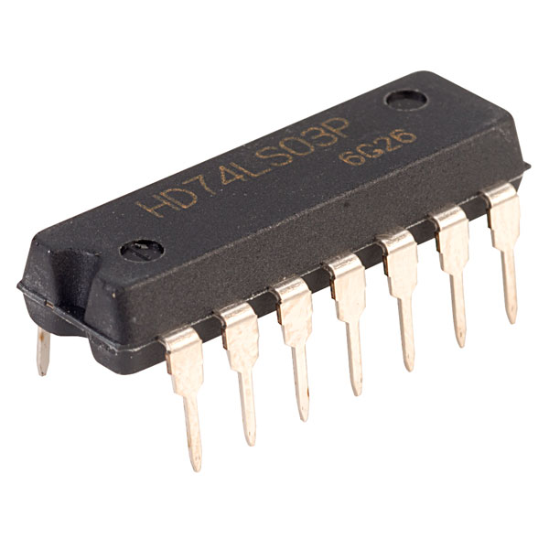
The history of electronics
First
multi-transistor
silicon
Packaged
Logic

Slide 13
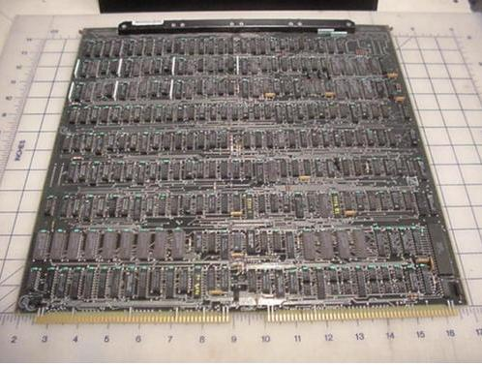
The history of electronics
First
multi-transistor
silicon
Packaged
Logic
“Mini” processor
board

Slide 14
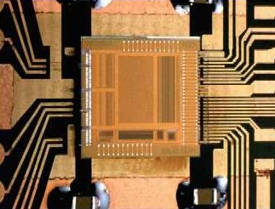
ASICs
APV25 - Imperial College, London
Application Specific Integrated Circuit (ASIC)

Slide 15
ASICs
APV25 - Imperial College, London
$
ASIC
Qty
Application Specific Integrated Circuit (ASIC)

Slide 16
ASICs
APV25 - Imperial College, London
$
Off-the-shelf
device
ASIC
Qty
Application Specific Integrated Circuit (ASIC)

Slide 17
Two philosophies: Space vs. Time
Have each operation performed by
dedicated logic
and
let signal propagate as a wave through the logic
Combinatorial

Slide 18
Two philosophies: Space vs. Time
Have each operation performed by
dedicated logic
and
let signal propagate as a wave through the logic
Fast, but messy, hard to understand, not scalable and low throughput
Combinatorial

Slide 19
Two philosophies: Space vs. Time
Have each operation performed by
dedicated logic
and
do that same operation
on every clock cycle
Slightly slower, but clean, easy to understand, scalable and high throughput
Pipelined/Parallel

Slide 20
Two philosophies: Space vs. Time
Have each operation performed by
dedicated logic
and
do that same operation
on every clock cycle
Have each operation performed by
the same logic
performing
a different operation
on every clock cycle
Pipelined/Parallel
Sequential

Slide 21
Two philosophies: Space vs. Time
Have each operation performed by
dedicated logic
and
do that same operation
on every clock cycle
Have each operation performed by
the same logic
performing
a different operation
on every clock cycle
Pipelined/Parallel
Sequential
A debate as old as electronic computing itself

Slide 22
Two philosophies: Space vs. Time
Have each operation performed by
dedicated logic
and
do that same operation
on every clock cycle
Have each operation performed by
the same logic
performing
a different operation
on every clock cycle
Pipelined/Parallel
Sequential
“The parallel approach to computing does require that some original thinking be done about numerical analysis and data management in order to secure efficient use.
In an environment which has represented the absence of the need to think as the highest virtue, this is a decided disadvantage”
Daniel Slotnick, 1967

Slide 23
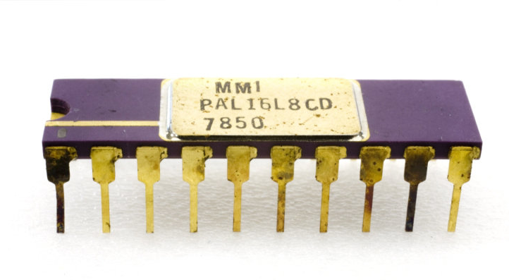
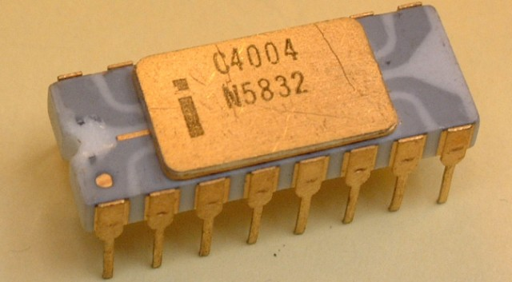
And the story diverges…
Pipelined/Parallel
Sequential
Programmable Array Logic
Microprocessor
Pack entire logic circuits in a chip
Perform all logical operations in one location, but sequentially

Slide 24
And the story diverges…
Pipelined/Parallel
Sequential
Programmable Array Logic
Limited further discussion of microprocessors
Microprocessor
Pack entire logic circuits in a chip
Perform all logical operations in one location, but sequentially

Slide 25
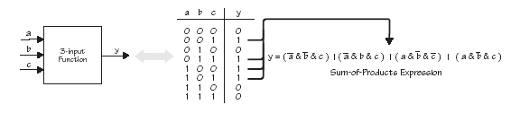

Sum-of-products theorem
Any Boolean operation may be expressed as
the OR of AND operations (Sum of products form)
Or
the AND of OR operations (Product of sums form)
Notes:
‘outline’ of coverage
time-plan
- What is an FPGA
- And why are they important for HEP
questions
- any time

Slide 26
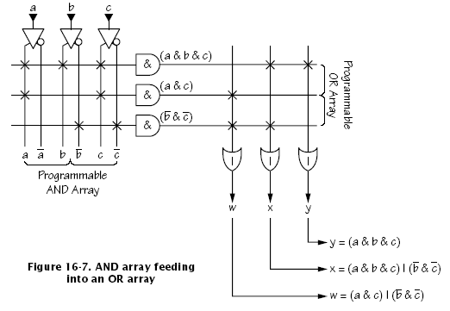
Programmable Logic Devices (PLDs)
?
?
?
?
?
?
?
?
?
?
?
?
?
?
?
?
?
?
?
?
?
?
?
?
?
?
?
Unprogrammed
Notes:
‘outline’ of coverage
time-plan
- What is an FPGA
- And why are they important for HEP
questions
- any time

Slide 27
Programmable Logic Devices (PLDs)
Programmed
Notes:
‘outline’ of coverage
time-plan
- What is an FPGA
- And why are they important for HEP
questions
- any time

Slide 28
Programmable Logic Devices (PLDs)
Originally one-time programmable
Later field reprogrammable
What did people do? Build boards with many PLDs…
Notes:
‘outline’ of coverage
time-plan
- What is an FPGA
- And why are they important for HEP
questions
- any time

Slide 29
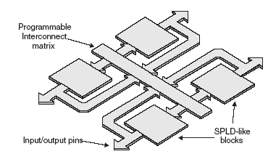
Complex PLDs (CPLDs)
Feedback
Feedback
Notes:
‘outline’ of coverage
time-plan
- What is an FPGA
- And why are they important for HEP
questions
- any time

Slide 30
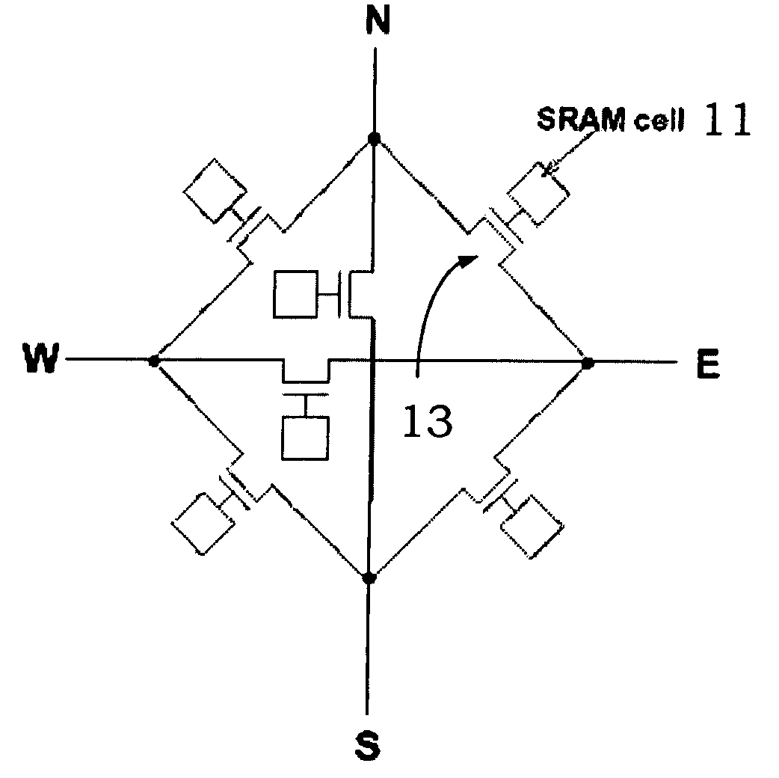
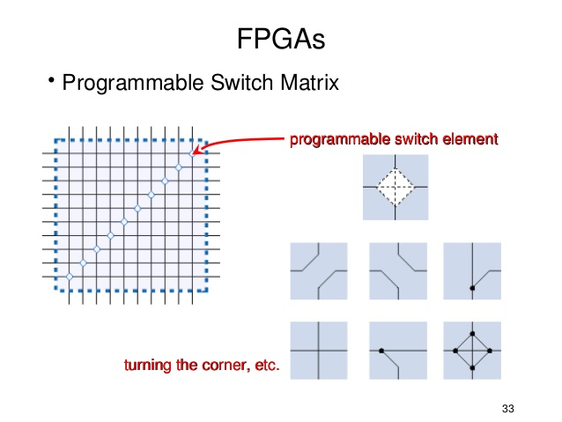
Programmable Interconnect matrix

Slide 31
An alternative approach
Why bother with the complexity of the PLD cell?
Replace the PLD cell with a simple SRAM:
  Data-in becomes the “address”
  Outputs the preloaded value for a given input

Slide 32
An alternative approach
Why bother with the complexity of the PLD cell?
Replace the PLD cell with a simple SRAM:
  Data-in becomes the “address”
  Outputs the preloaded value for a given input
The Field Programmable Gate Array
(FPGA)

Slide 33
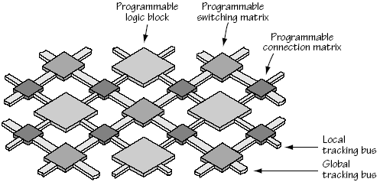
Field Programmable Gate Arrays (FPGAs)
‘Simple’ Programmable Logic Blocks
Massive Fabric of Programmable Interconnects
Notes:
A field-programmable gate array (FPGA) is a large-scale integrated circuit that can be programmed after it is manufactured rather than being limited to a predetermined, unchangeable hardware function. The term "field-programmable" refers to the ability to change the operation of the device "in the field," while "gate array" is a somewhat dated reference to the basic internal architecture that makes this after-the-fact reprogramming possible.

Slide 34
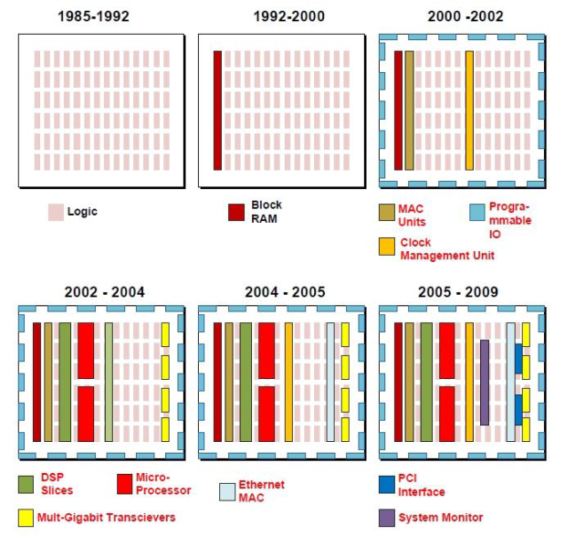
Evolution of features in FPGAs

Slide 35
Evolution of features in FPGAs
Who wants to waste all the LUTs as RAM?

Slide 36
Evolution of features in FPGAs
Who wants to waste all the LUTs for multiplication?
Big chips need dedicated clocking!

Slide 37
Evolution of features in FPGAs

Slide 38
Evolution of features in FPGAs
Who wants to waste LUTs AND re-invent industry-standard blocks?

Slide 39
Evolution of features in FPGAs
Who wants to waste LUTs AND re-invent industry-standard blocks?

Slide 40
A note on I/O
Traditionally, many hundreds of general-purpose pins (Gen I/O) up to a few hundred MHz
Latest generation Gen I/O up to 1.8Gbps
Programmable logic standards
Since 2002, FPGAs have been adding dedicated Multi-gigabit transceivers
Arms race - Ever more and ever faster

Slide 41
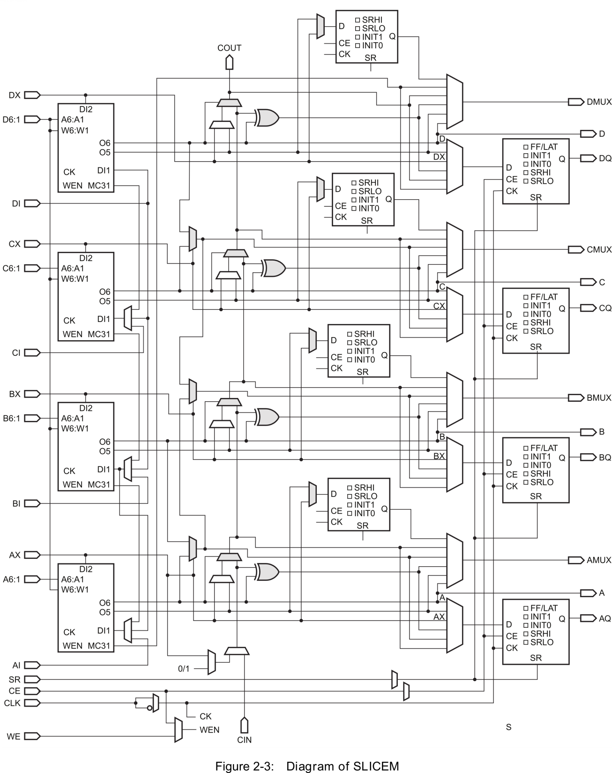
Combinatorial Logic Block

Slide 42
Combinatorial Logic Block
Registers on the output of every cell
Perfect for pipelined logic

Slide 43
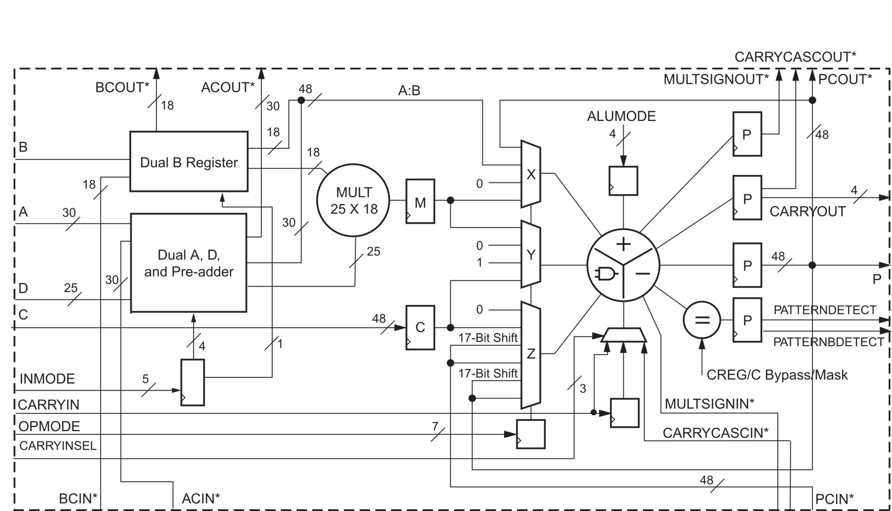
Integrated Digital Signal Processing

Slide 44
Integrated Digital Signal Processing
So many registers
Perfect for pipelined logic

Slide 45
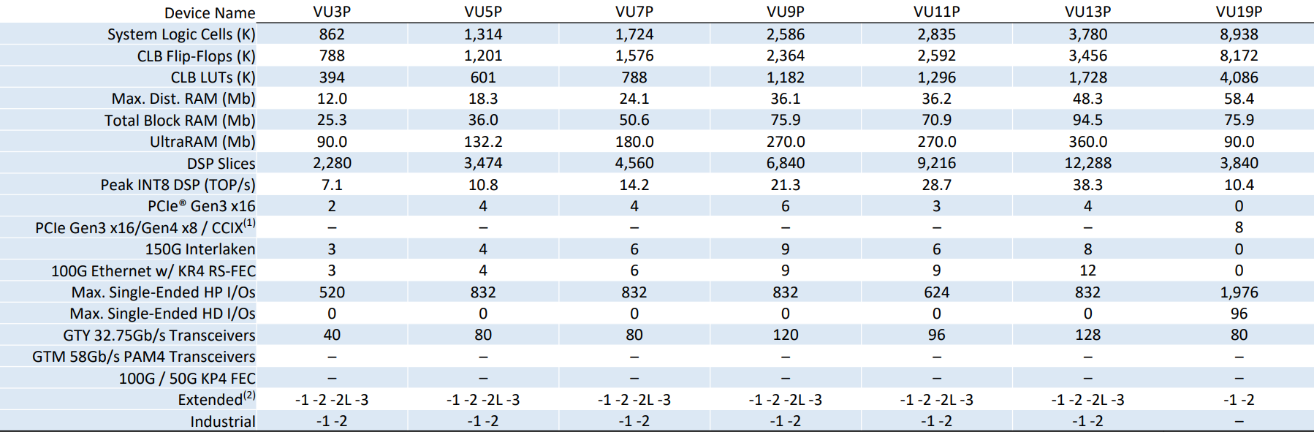
Biggest Xilinx “Ultrascale+” Devices
Upwards of 8.9 million logic cells
  All clocked at up to 500MHz
  Over O(10¹⁵) operations/second
    1 PetaBOp
Upwards of 12,000 DSPs
All pipelined
Fully programmable

Slide 46
Biggest Xilinx “Ultrascale+” Devices
Upwards of 8.9 million logic cells
  All clocked at up to 500MHz
  Over O(10¹⁵) operations/second
    1 PetaBOp
Upwards of 12,000 DSPs
All pipelined
Fully programmable
4.2 Tb/s!!!!

Slide 47
Biggest Xilinx “Ultrascale+” Devices
Upwards of 8.9 million logic cells
  All clocked at up to 500MHz
  Over O(10¹⁵) operations/second
    1 PetaBOp
Upwards of 12,000 DSPs
All pipelined
Fully programmable
So what is the catch?
4.2 Tb/s!!!!

Slide 48
FPGAs: What’s the Catch?
Incredibly hard to program efficiently
  Thinking in a parallel, pipelined-fashion is exceptionally difficult
  A handful of real experts in CMS
Efficient use depends on efficiently structured data

Slide 49
FPGAs: What’s the Catch?
Incredibly hard to program efficiently
  Thinking in a parallel, pipelined-fashion is exceptionally difficult
  A handful of real experts in CMS
Efficient use depends on efficiently structured data
“The parallel approach to computing does require that some original thinking be done about numerical analysis and data management in order to secure efficient use.
In an environment which has represented the absence of the need to think as the highest virtue, this is a decided disadvantage”
Daniel Slotnick, 1967
Recall:

Slide 50
FPGAs: What’s the Catch?
Incredibly hard to program efficiently
  Thinking in a parallel, pipelined-fashion is exceptionally difficult
  A handful of real experts in CMS
Efficient use depends on efficiently structured data
The chip is just the start – needs to be attached to something
You are also responsible for the infrastructure

Slide 51
How to preserve your sanity using FPGAs
Keep your data-flow fully flow-forwards
  No iterations
  or at least
  Flatten your loops

Slide 52
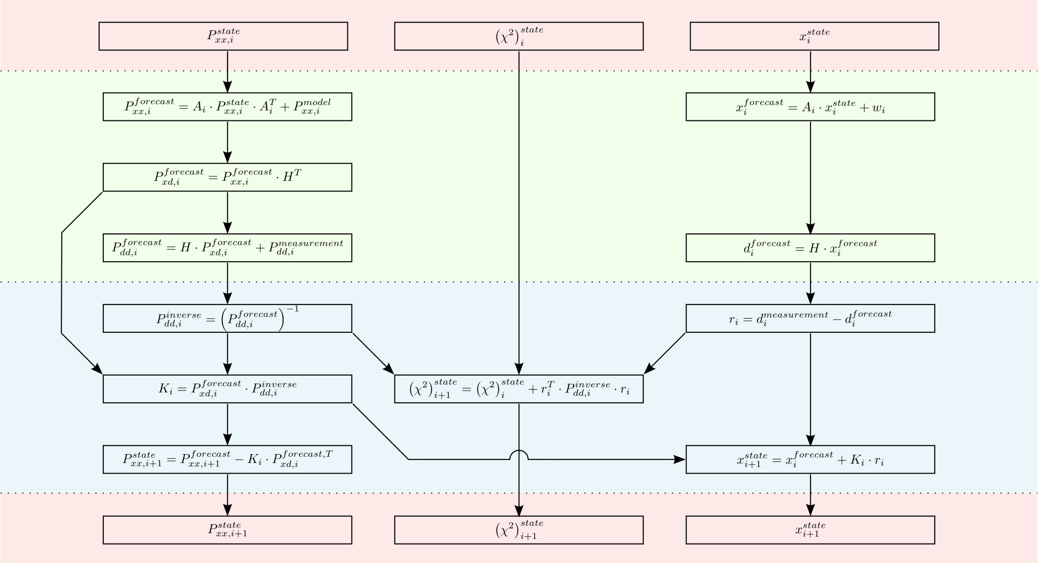
Prototype CMS Tracking Trigger:
Kalman Filter

Slide 53
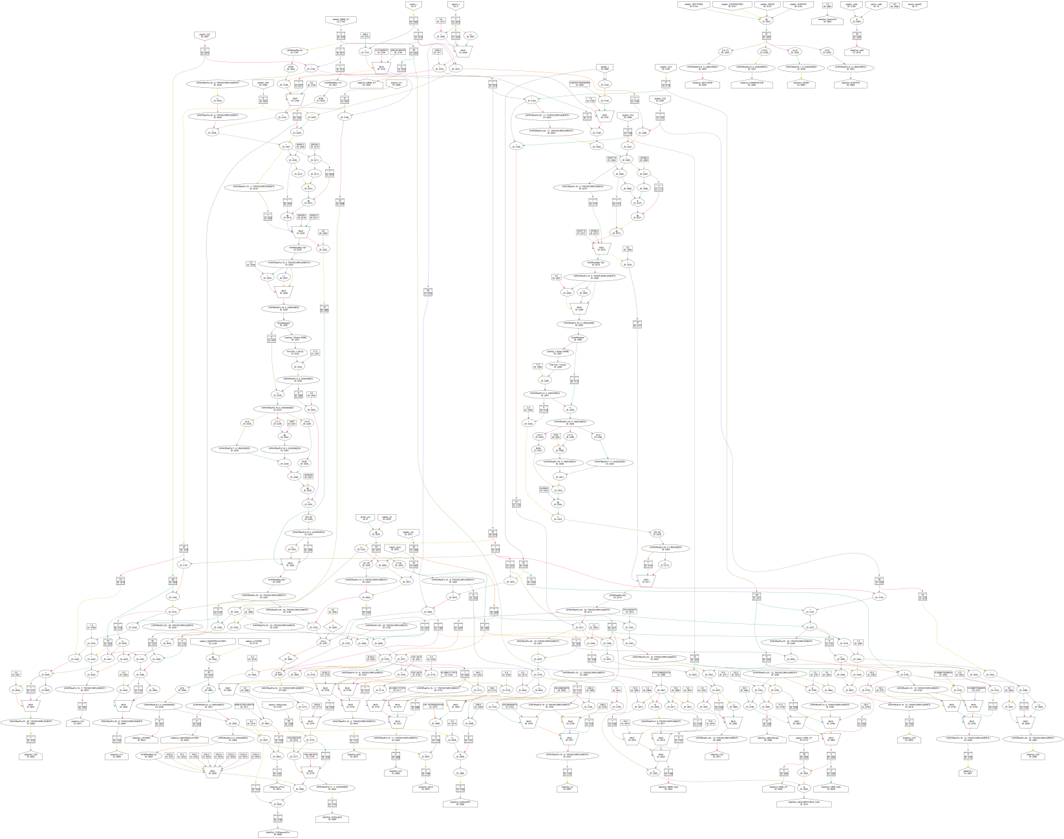
Prototype CMS
Tracking Trigger:
Kalman Filter

Slide 54
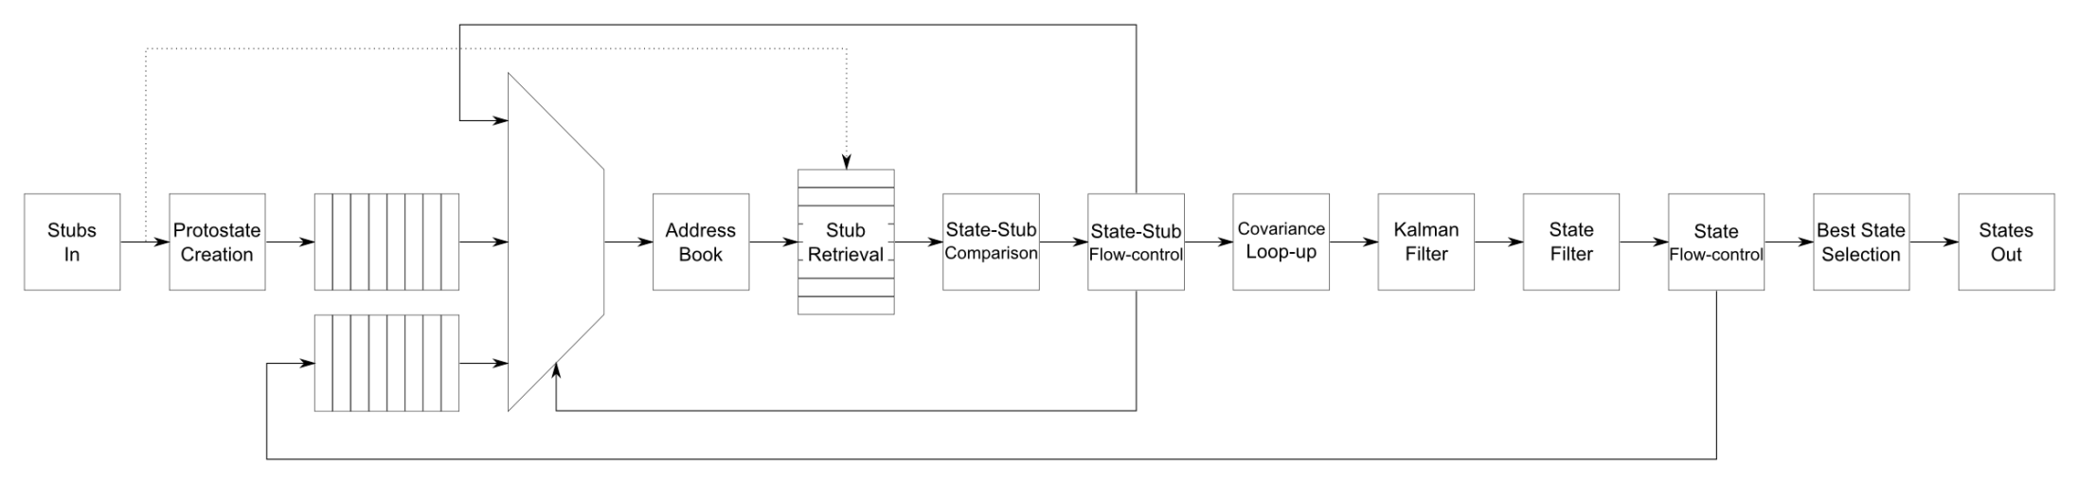
Prototype CMS Tracking Trigger:
Kalman Filter
The maths is a relatively simple part of a more complex whole

Slide 55
Prototype CMS Tracking Trigger:
Kalman Filter
Kalman Filter is iterative

Slide 56
Prototype CMS Tracking Trigger:
Kalman Filter
Kalman Filter must handle combinatorics

Slide 57
Prototype CMS Tracking Trigger:
Kalman Filter
Kalman Filter data-flow is data-dependent

Slide 58
An aside on High-Level Synthesis
Due to an arbitrary decision by DoE/DARPA/U.S. Govt, FPGA vendors moved C->FPGA compilers from a curiosity to a top-priority
Reinforced by push for heterogeneous, energy-efficient computing
Flattens loops, deals with pipelining for you
  Very simple to get started
  “Hurrah, we can get our software people writing firmware”
From practical experience
  We see very inefficient usage of resources
  Hard to understand “what the compiler has done”
  Requires many pre-processor directives to instruct code to do “what you want”
So, how do you program massively parallelized devices efficiently?

Slide 59
Hardware Description Languages
Need a language to describe hardware
Novelly – called a “Hardware Description Language” (HDL)
Also called FIRMWARE
Two popular languages are VHDL , VERILOG
Easy to start learning… Hard to master!
Notes:
‘outline’ of coverage
time-plan
- What is an FPGA
- And why are they important for HEP
questions
- any time

Slide 60
Hardware Description Languages
Describe Logic as collection of Processes operating in Parallel
Language Constructs for Synchronous Logic
Compiler (Synthesis) Tools recognise certain code constructs and generates appropriate logic
Not all constructs can be implemented in FPGA!
Notes:
‘outline’ of coverage
time-plan
- What is an FPGA
- And why are they important for HEP
questions
- any time

Slide 61
Example
library ieee;
use ieee.std_logic_1164.all;
entity test is
port(
x: in std_logic;
y: in std_logic;
F: out std_logic;
G: out std_logic);
end test;
architecture behavioural of test is
begin
process(x, y)
begin
-- compare to truth table
if ((x='1') and (y='1')) then
F <= '1’;
else
F <= '0’;
end if;
end process;
G <= x or y;
end behavioural;
Must write code with
understanding of how
it will be implemented.
Can also enter code via schematic entry:
  Easier to navigate, but not vendor independent
  Will there ever be a standard graphical programming language?

Slide 62
How to you know it works?
Simulate design extensively!
  Much quicker than debugging inside the FPGA

Slide 63
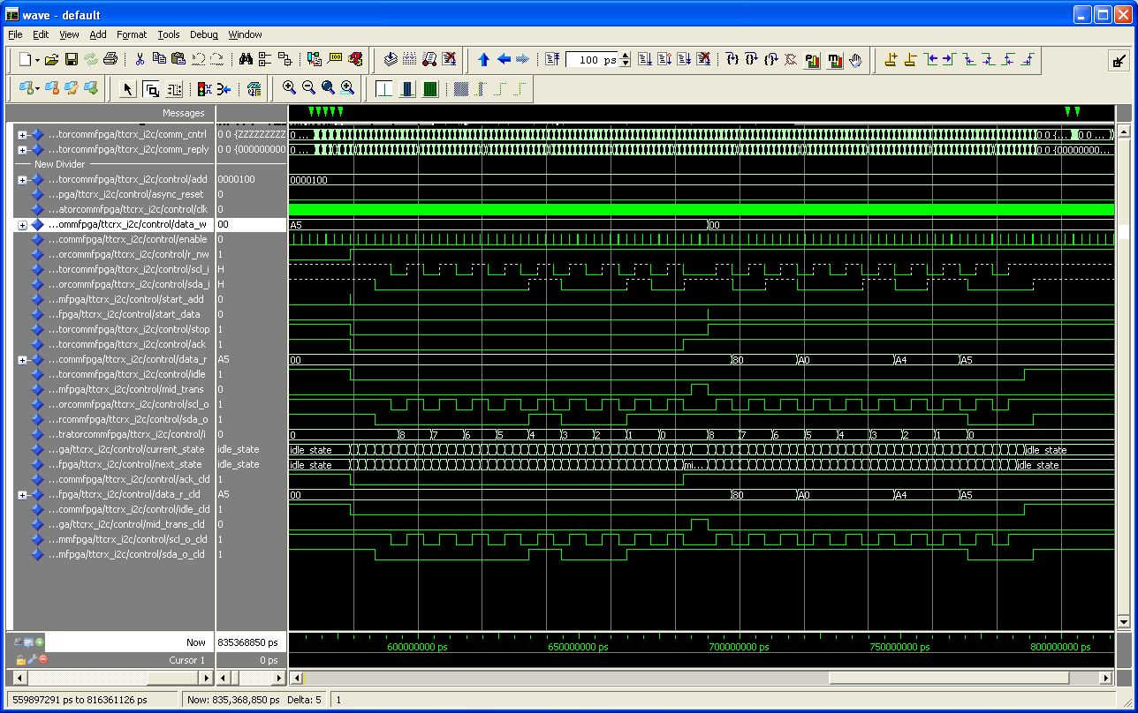

Slide 64
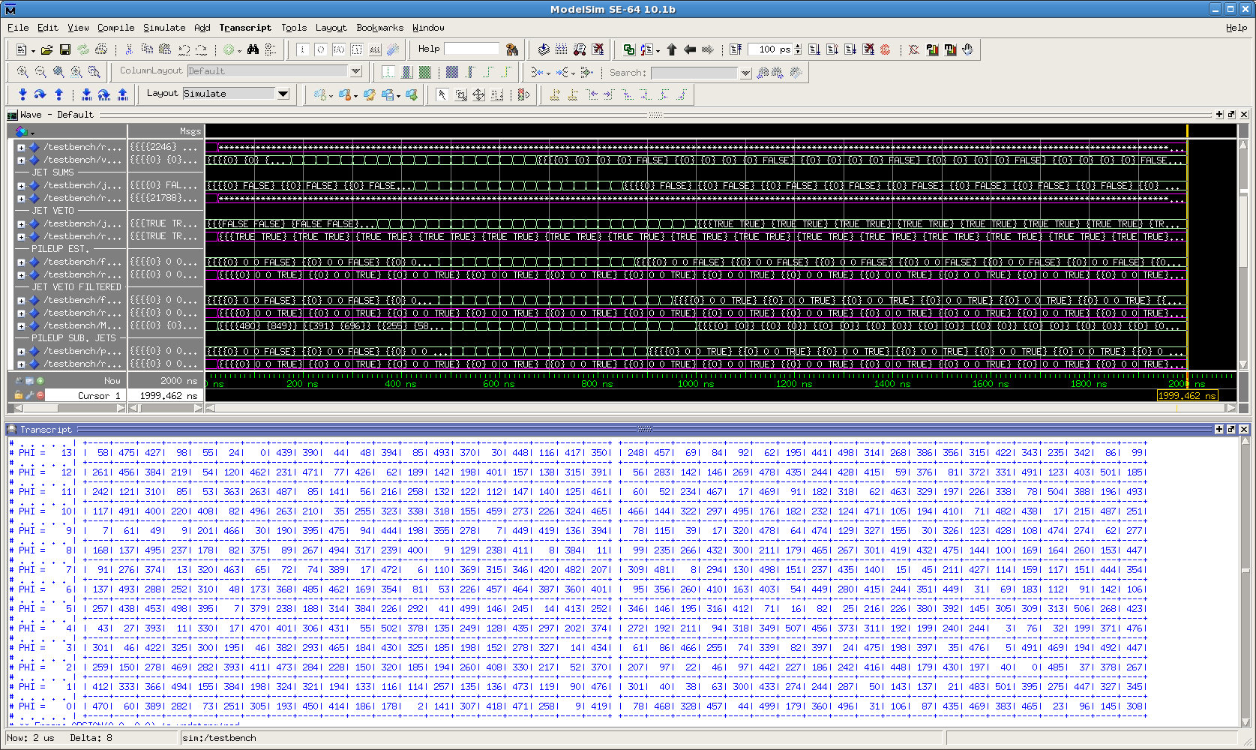
Testbench Suite
“Event display”

Slide 65
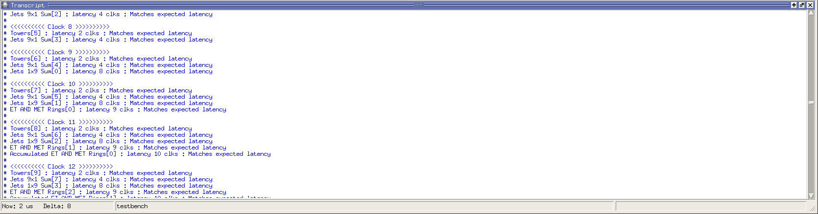
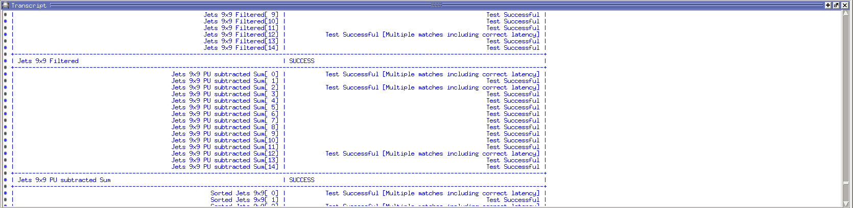
Testbench Suite
Clock-by-clock summary
End-of-event summary

Slide 66
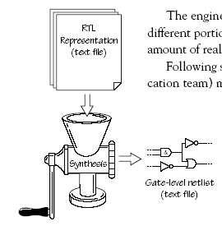
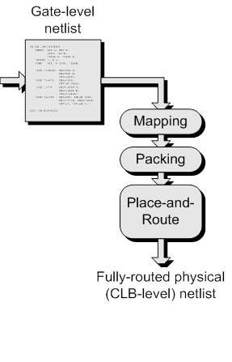
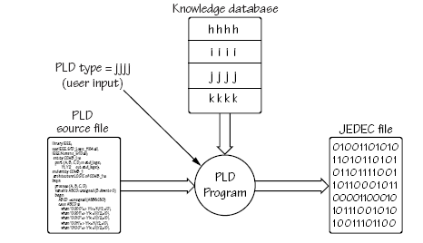
Designing Logic with FPGAs
High level Description of Logic Design (HDL)
Synthesise into a Netlist
  Boolean Logic Representation
Target FPGA Device
  Translate
  Mapping
  Routing
Bit File for FPGA
Notes:
‘outline’ of coverage
time-plan
- What is an FPGA
- And why are they important for HEP
questions
- any time

Slide 67
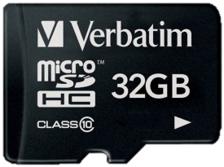
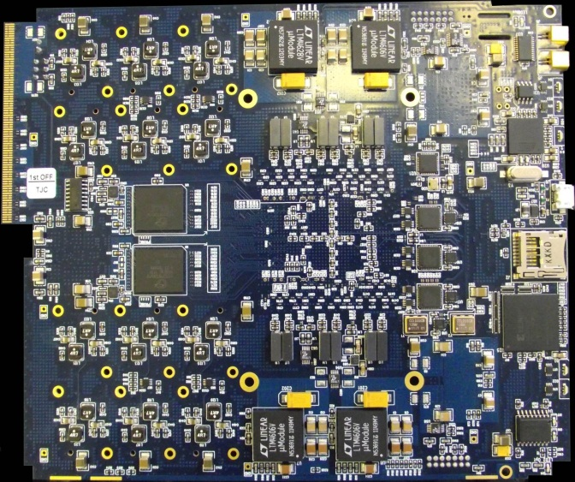
Configuring an FPGA
Millions of SRAM cells holding LUTs and Interconnect Routing
Volatile Memory: Lose configuration when board power is turned off.
Keep bit patterns describing the SRAM cells in non-Volatile Memory
e.g. PROM or memory card
Configuration
takes ~ secs
Notes:
‘outline’ of coverage
time-plan
- What is an FPGA
- And why are they important for HEP
questions
- any time

Slide 68
It doesn’t work: How to debug
Simulate, simulate & simulate again!
  Much quicker than debugging inside the FPGA
Route out signal to periphery
  Few debug pins always handy
  Can connect UART for uC debug (StdIn/StdOut)
Use chipscope
  Rebuild design with embedded logic analyser
    Can be a bit like quantum mechanics
    If you look (i.e. make a measurement) your code can behave differently
    Chipscope presence can affect the original design

Slide 69
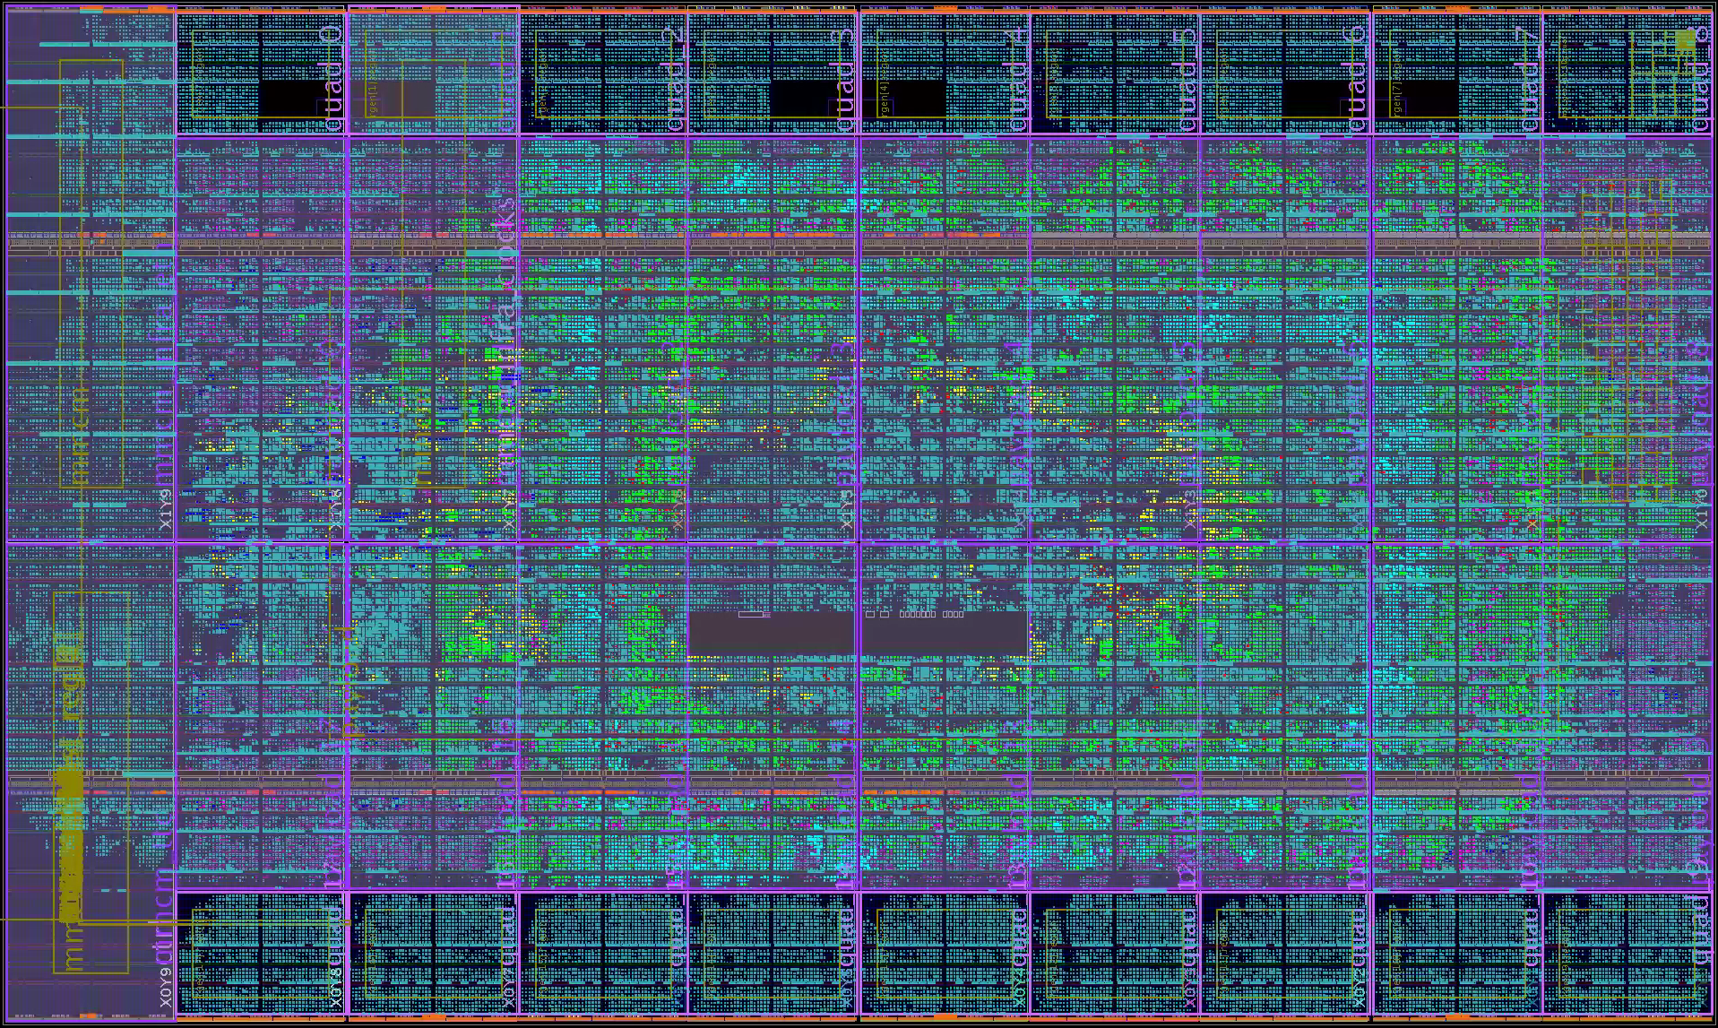
Floorplan of firmware in MP7

Slide 70
Floorplan of firmware in MP7
MGTs and DAQ buffers
Communication
Algorithms
DAQ
MGTs and DAQ buffers

Slide 71
When & why should I (not) use an FPGA?
FPGAs are expensive (high-end £10k-100k cf. £100)
FPGAs are power-hungry
Programming FPGAs is like designing logic circuits not like programming sequential microcontrollers
Large firmware build-times are tens of hours or days
Floating-point ops and iterative algorithms awkward in FPGAs (That said, you “control” the silicon, so, of course, it can be done)
FPGAs best for high through-put, low- and/or fixed-latency operations

Slide 72
Conclusion
FPGAs are intrinsically parallel
Modern FPGAs are exceptionally powerful
FPGAs are a monumental PAIN IN THE BACKSIDE to program
  Partly due to the clunky, verbose HDLs
  Mainly due to the difficulty of conceptualizing massively parallel logic and pipelined logic
Get them right and you can do magic
Get them wrong and you unleashed a world of pain on yourself

Slide 73
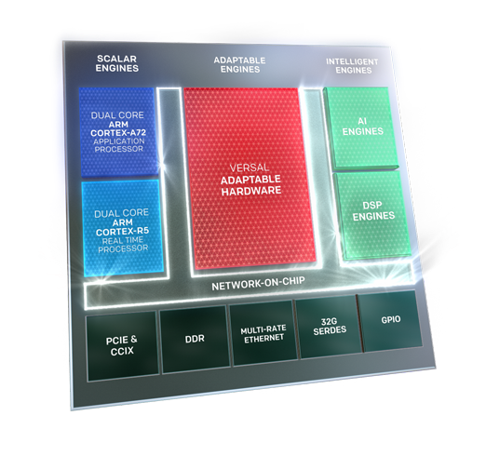
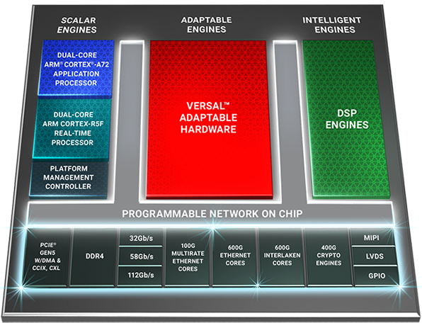
The Future of the FPGA?
Heterogenous computing on chip
But is it suitable for our typical applications in particle physics?
  Is it suitable for future applications?
  Hardware Triggers? Probably not – designed as co-processor
  Accelerated HLTs? Maybe – but GPUs more likely…

Slide 74
Thank you
Any questions?

Slide 75
Up against the speed of light…
Wait for the signal to propagate
“Sea-of-logic” approach
Limits clock speed
Do less each clock-cycle
Compensated for by much higher clock speeds

