Slide 1
The Discovery of the Neutrino
Elias Aramesch
Proseminar Astroteilchen-&Teilchenphysik
Universität Hamburg
06.05.2025

Slide 2
Table of Contents
1. Introduction: Elementary Particles & the Standard Model
2. Beta Decay & the Mystery of Missing Energy
3. Pauli and the Neutrino Hypothesis
4. The Cowan-Reines Experiment
5. The Muon Neutrino Experiment
6. The Tau Neutrino
7. Significance of the Neutrino Discoveries
8. Neutrino Oscillations & Current Research
9. Conclusion
10. Bibliography

Slide 3
Elementary Particle Physics
Goal: Understand fundamental building blocks of matter and interactions
Two categories of particles:
• Fermions (matter)
• Bosons (force carriers)
1. Introduction

Slide 4
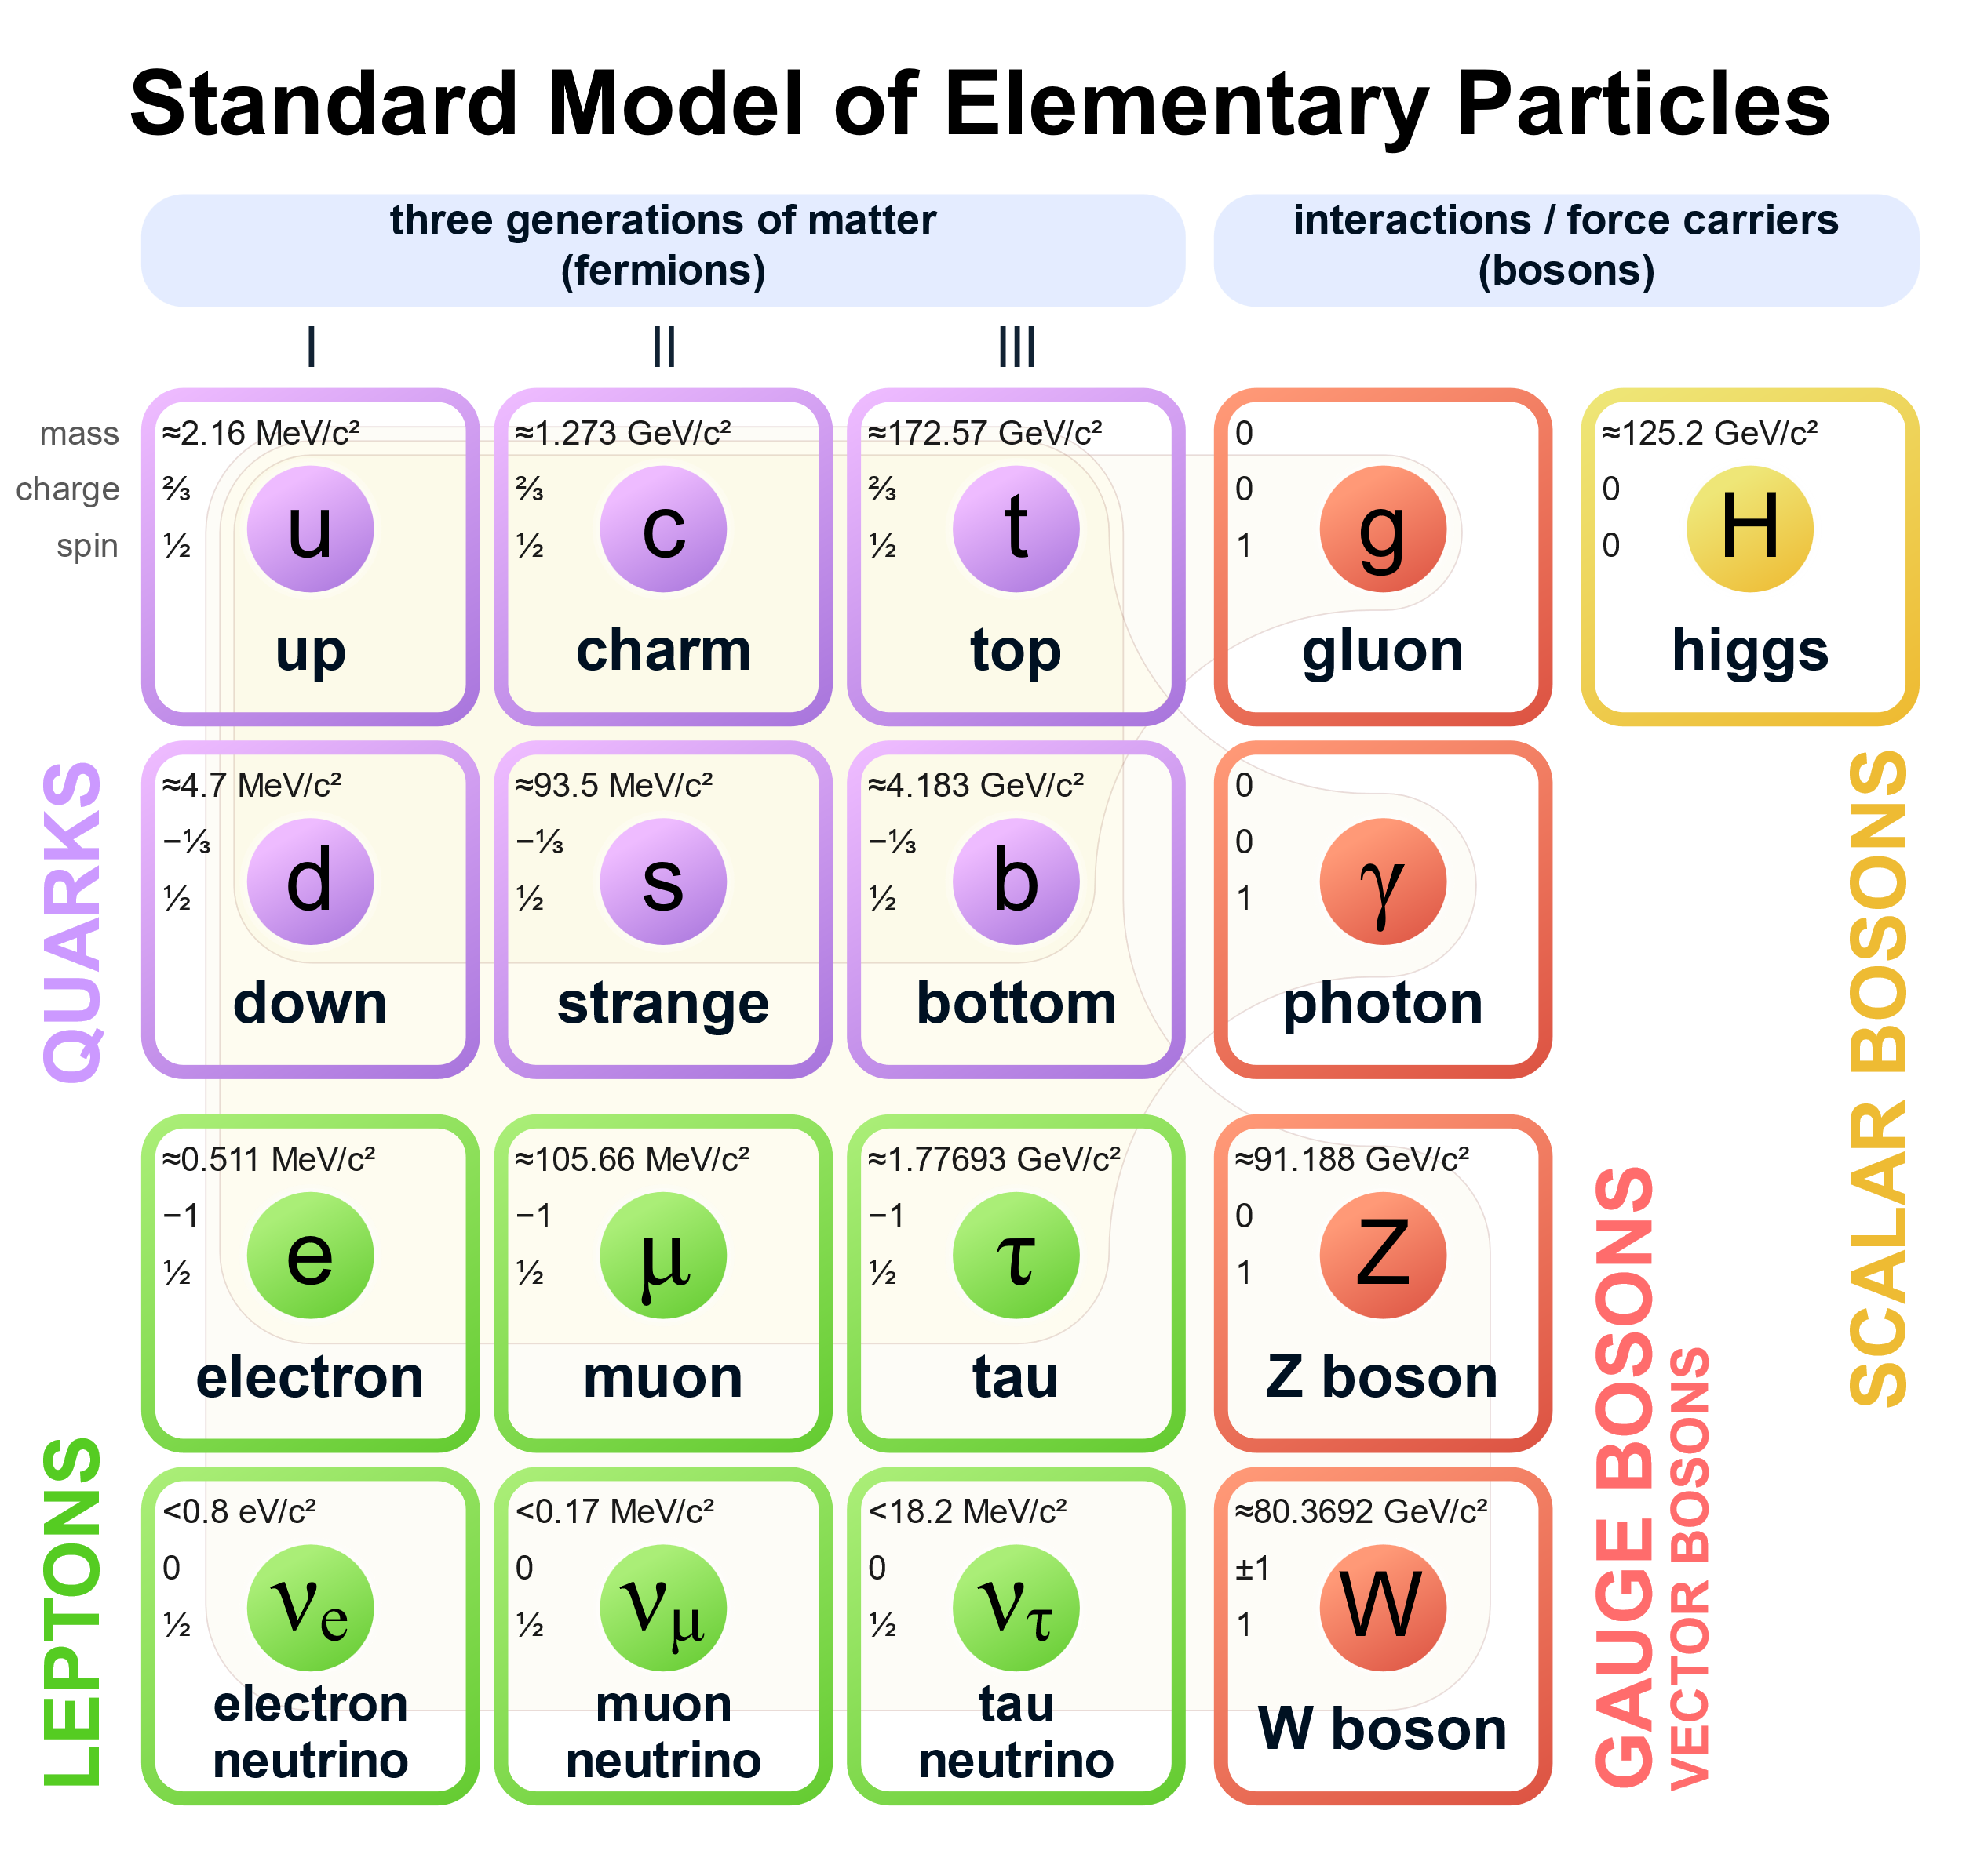
1. Introduction
Illustration: Standard Model of elementary particles

Slide 5
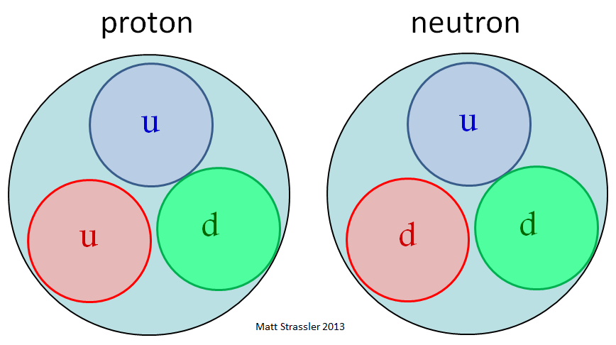
Quarks
Six flavors: up, down, charm, strange, top, bottom
Charges: up-type (+2/3), down-type (-1/3)
Protons = uud, Neutrons = udd
Held together by strong force (via gluon exchange)
Illustration: structure of proton and neutron
1. Introduction

Slide 6
Leptons
Electron, muon, tau and their associated neutrinos
Charged: electron, muon, tau
Neutral: neutrinos (νe, νμ, ντ)
Organized in three generations
1. Introduction

Slide 7
Force Carriers (Bosons)
Photon: Electromagnetic force
Gluon: Strong interaction
W and Z bosons: Weak interaction
Higgs boson: Mass generation (Higgs mechanism)
1. Introduction

Slide 8
Beta - Decay
Unstable neutron → proton (inside nucleus)
Quark-level: d (-1/3) → u (+2/3) via W⁻ emission
W⁻ decays into electron + electron antineutrino
Beta+ decay: proton → neutron + W⁺ → positron + neutrino
2. Beta - Decay

Slide 9
The Mystery of Missing Energy
Early 20th century: continuous beta spectrum confused physicists
Apparent violation of energy/momentum conservation
Something invisible must carry away energy
2. Beta - Decay

Slide 10
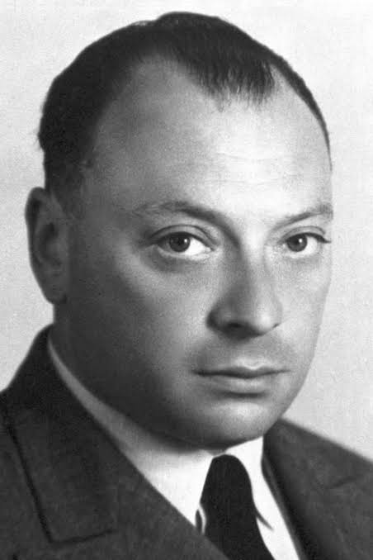
Wolfgang Pauli – A Short Biography
Born 1900 in Vienna, student of Sommerfeld
Wrote major relativity review at age 19
Professor at University of Hamburg (1923–1928)
Later ETH Zürich; Nobel Prize in 1945
3. Pauli‘s Hypothesis

Slide 11
Pauli’s Neutrino Hypothesis
1930: Proposed new neutral particle to save conservation laws
Quote: 'Liebe radioaktive Damen und Herren... eine verzweifelte Rettung'
Later named 'neutrino' by Fermi
3. Pauli‘s Hypothesis

Slide 12
Cowan-Reines Experiment – Historical Background
First successful detection of the neutrino in 1956
Frederick Reines & Clyde Cowan at Savannah River reactor
Used intense antineutrino flux from nuclear fission
Crucial test of Pauli's hypothesis
4. el. neutrino

Slide 13
Experimental Setup – Cowan-Reines
Water tank with cadmium chloride
Photomultiplier tubes to detect gamma rays
Heavy shielding to reduce background
Looked for delayed coincidence signals
4. el. neutrino

Slide 14
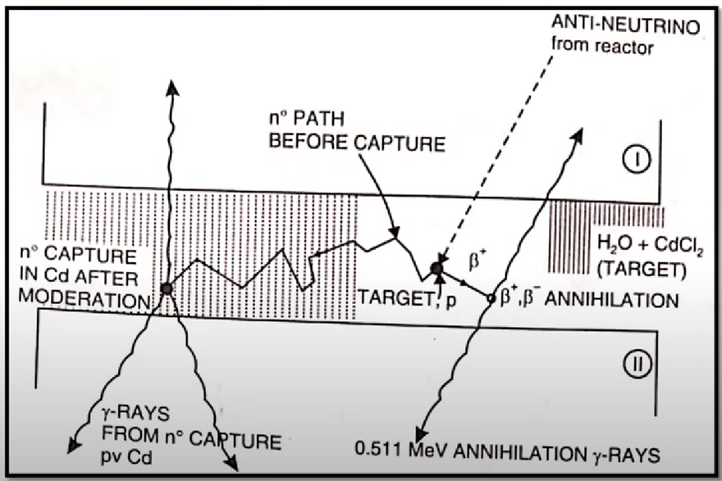
Illustration: Experimental setup of the Cowan Reines Experiment
4. el. neutrino

Slide 15
Detection Principle – Inverse Beta Decay
Reaction: ν̄ₑ + p → n + e⁺
e⁺ annihilates: emits two 511 keV gamma rays (prompt signal)
n captured: emits delayed gamma ray
Coincidence of prompt and delayed signals = neutrino interaction
4. el. neutrino

Slide 16
Results and Significance
Observed hundreds of coincidence events over background
Confirmed existence of neutrinos
Published in Science, 1956
Reines awarded Nobel Prize in Physics, 1995
4. el. neutrino

Slide 17
Discovery of the Muon Neutrino – Historical Context
1962 experiment at Brookhaven National Lab
Lederman, Schwartz, Steinberger
Question: Is ν_μ different from νₑ?
Used pion decay to isolate muon neutrinos
5. Muon Neutrino

Slide 18
Muon Decay
Muon decay: μ−→e−+νˉe​+νμ​
Why 2 (two) different types of neutrinos?
Muon decay with same neutrinos: μ−→e−+γ
Occurence theoretically vs. In reality
Conclusion: 2nd type of neutrino
5. Muon Neutrino

Slide 19
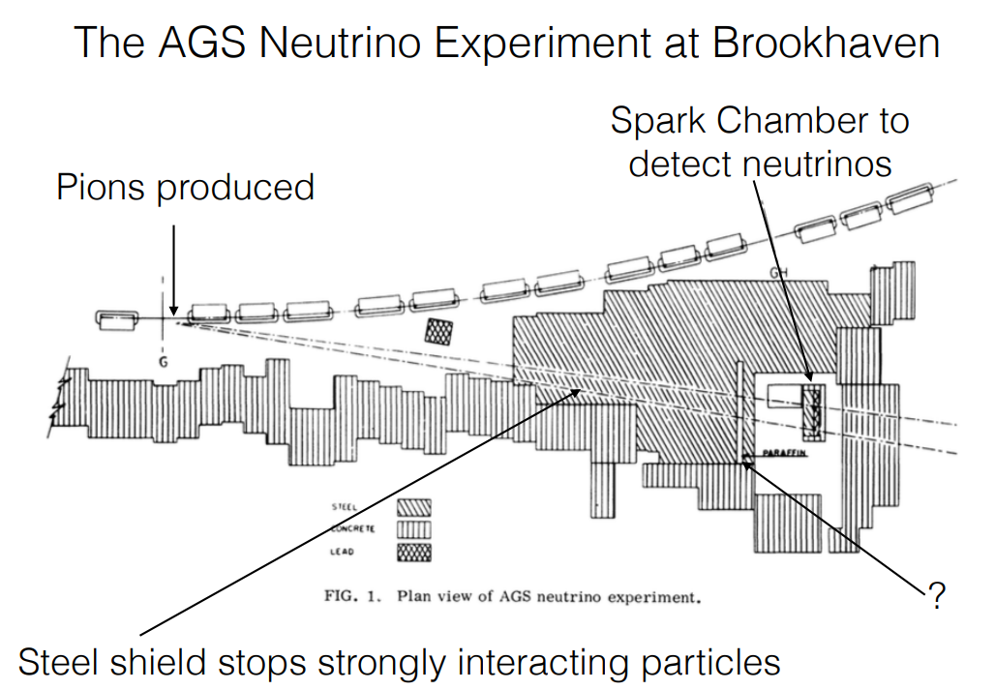
Illustration: Experiment setup at the AGS
5. Muon Neutrino

Slide 20
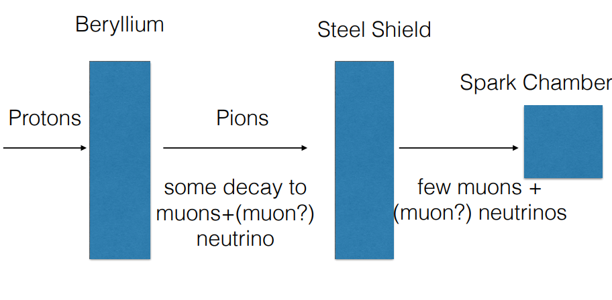
Illustration: Experiment setup for muon neutrino detection
5. Muon Neutrino

Slide 21
Muon Neutrino Experiment – Setup
15 GeV Proton beam hits Beryllium target → Pions produced
Pions hit 13,5m thick iron shield, 21m from target
→absorb strongly interacting particles
Some Pions decay into muon + (muon?)-neutrino
→π⁺ → μ⁺ + ν_μ
Muons absorbed by shield; only neutrinos pass
Detector: spark chamber, looked for muon events
5. Muon Neutrino

Slide 22
Muon Neutrino Experiment - Setup
5.5m of concrete on floor and roof to reduce cosmic muons
Interactions observed in a 10-ton aluminum spark chamber behind steel shield
If these neutrinos are muon neutrinos, they should only produce muons, not electrons
  electrons produce distinct shower, muons produce nice tracks
5. Muon Neutrino

Slide 23
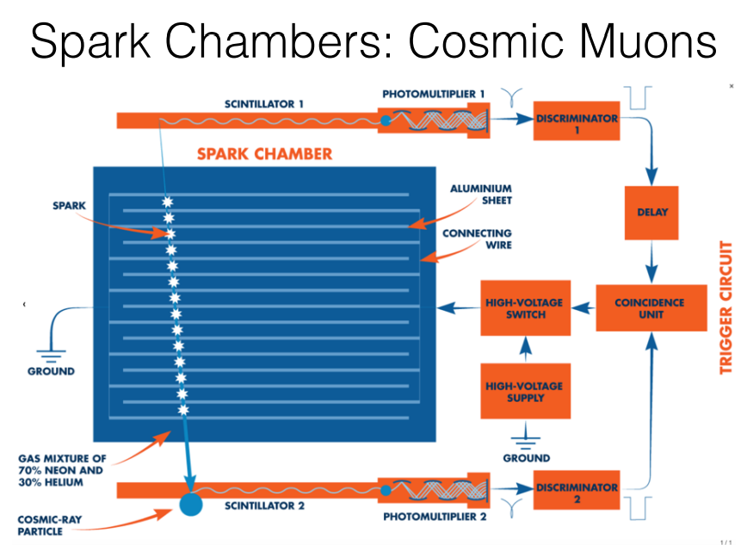
1. metal plates
2. gas
3. high voltage
4. scintillation detectors
Illustration: Setup of spark chamber
5. Muon Neutrino

Slide 24
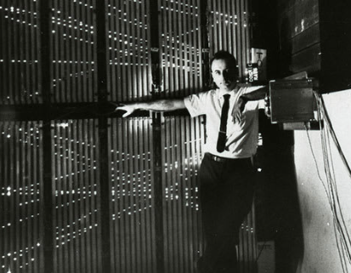
Illustration: Schwartz in front of the spark chamber
5. Muon Neutrino

Slide 25
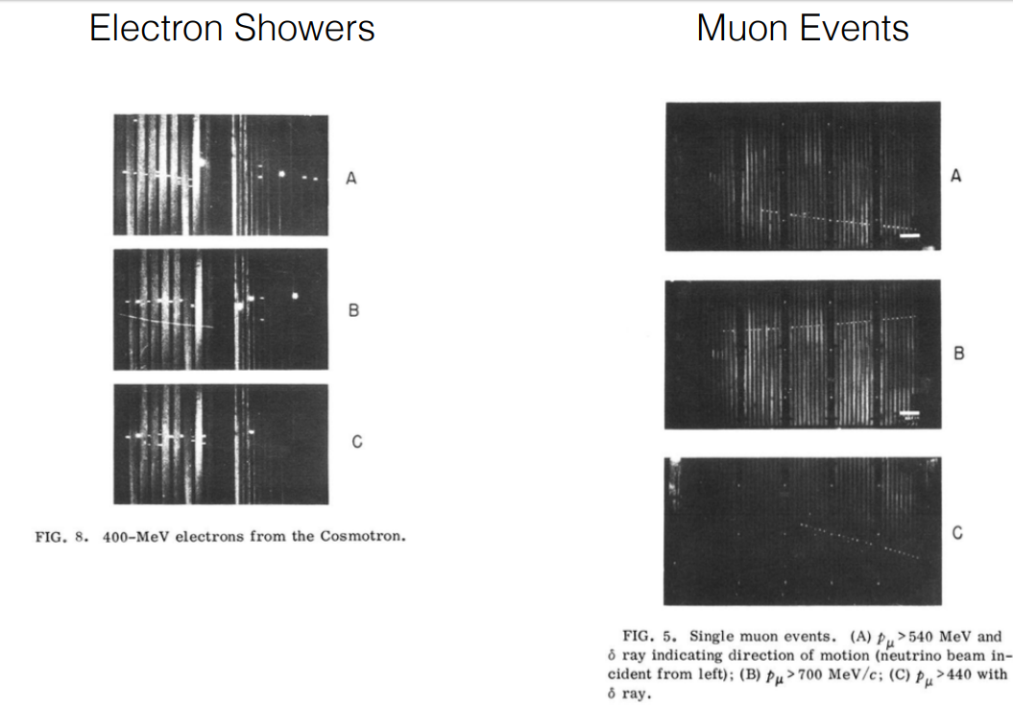
Illustration: electron showers & actual photographs of muon trail
5. Muon Neutrino

Slide 26
Muon Neutrino – Results and Impact
Detected muons, not electrons → ν_μ ≠ νₑ
Established lepton family structure
Nobel Prize awarded in 1988
Foundation for understanding neutrino generations
5. Muon Neutrino

Slide 27
Discovery of the Tau Neutrino
Third neutrino flavor (ν_τ) predicted after tau lepton discovery
Detected in 2000 by the DONUT experiment at Fermilab
Used emulsion detectors to observe τ-lepton decay events
Confirmed third lepton generation
6. Tau Neutrino

Slide 28
Method – Discovery of the Tau Neutrino
.
A Proton Beam hit a tungsten target, producing tau leptons and tau neutrinos via short lived particles
Neutrinos were directed into a detector made of emulsion and steel layers
Tau neutrino left specific track in the photographic emulsion
6. Tau Neutrino

Slide 29
Significance of Neutrino Discoveries
Confirmed existence of multiple neutrino flavors
Nobel Prizes:
• Reines (1995) – neutrino detection
• Lederman, Schwartz, Steinberger (1988) – muon neutrino
• Kajita & McDonald (2015) – neutrino oscillations
Crucial for the Standard Model and beyond
7. Significance

Slide 30
Neutrino Oscillations & Modern Research
Neutrinos change flavor as they travel (ν_e ↔ ν_μ ↔ ν_τ)
Implies that neutrinos have mass
Solved the solar neutrino problem
Experiments: Super-Kamiokande, SNO, IceCube, DUNE
8. Oscillations

Slide 31
Conclusion
Neutrinos went from hypothetical to essential particles
Experimental breakthroughs shaped our understanding of the universe
Still many open questions in neutrino physics
Future experiments may reveal even more surprises
9. Conclusion

Slide 32
Bibliography
Griffiths, D. – Introduction to Elementary Particles
Berger, C. – Elementarteilchenphysik (Springer)
Reines & Cowan – Science, 1956
NobelPrize.org (1995, 1988, 2015 summaries)
CERN Journal Club (https://indico.cern.ch/event/402462/...)
PBS Space Time (YouTube video on neutrinos)
Welt der Physik – Neutrinos
10. Bibliography

Slide 33
https://profmattstrassler.com/articles-and-posts/particle-physics-basics/the-structure-of-matter/protons-and-neutrons/
https://de.wikipedia.org/wiki/Elementarteilchen#/media/Datei:Standard_Model_of_Elementary_Particles-de.svg
https://www.nobelprize.org/prizes/physics/1945/pauli/facts/
https://youtu.be/y_T_UsZeo9Y?si=R2f2MvT0sAHu-dJZ
https://indico.cern.ch/event/402462/attachments/806290/1104933/JournalClub.pdf
10. Bibliography

