Slide 1
The Discovery of the Higgs Boson
Mark Ahner

Slide 2
Outline
Higgs Mechanism
Higgs Boson Phenomenology
The CMS and ATLAS Experiment
Results (Statistical Interpretation)
Outlook

Slide 3
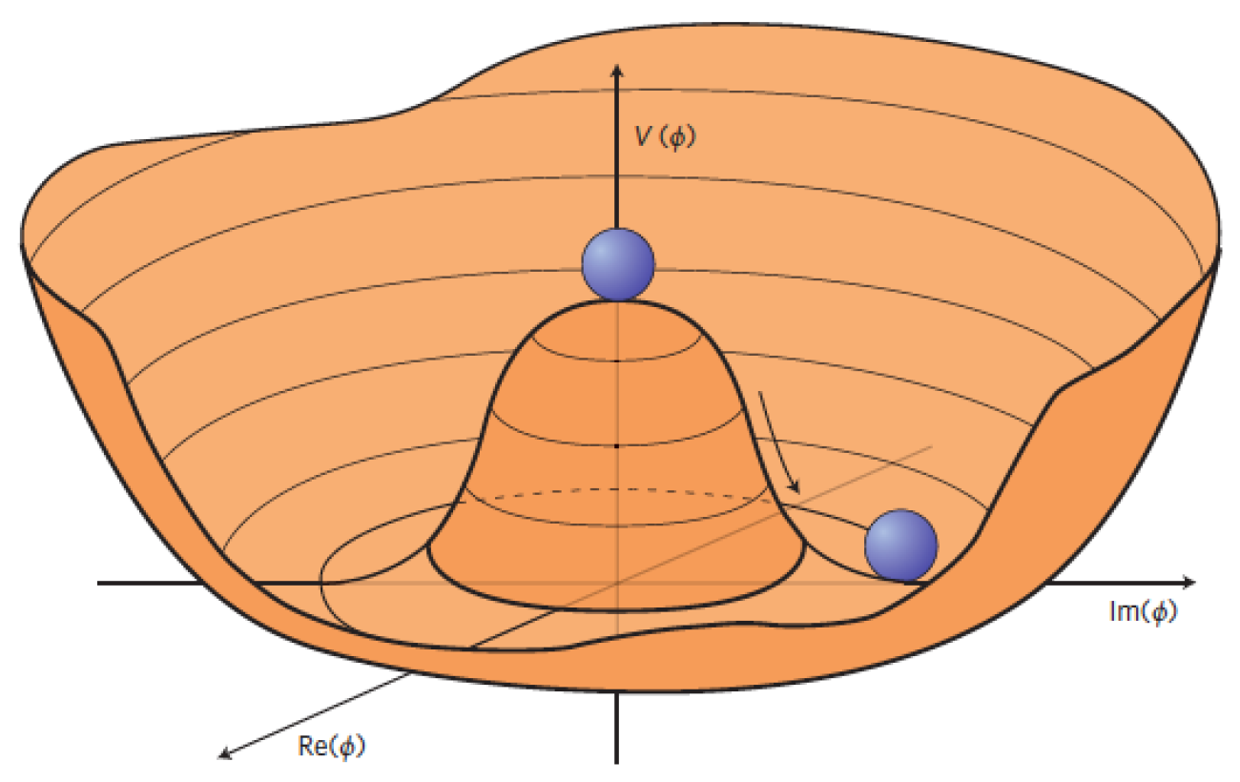
1. Higgs-Mechanism
[1]

Slide 4
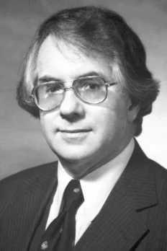

Elektroweak Unification
Sheldon L. Glashow (1961):
Weak interactions through unstable bosons
Parallels in QED and QFD
Problem:
Masses of W$±$ and Z⁰ violate gauge symmetry
Goldstone theorem
[2]
Notes:
Introduction of Z boson -> 3 unstable bosons in QFD
Theory: High Energy -> EM and weak forces identical, force carriers with no mass
Practice: Low Energy -> Z and W have mass: EM force stronger – symmetry broken, how?
Goldstone theorem: Global symmetry breaking – massless goldstone gauge boson – never observed

Slide 5

Higgs-Mechanism
Peter Higgs et al. (1964):
Spontaneous local symmetry breaking
Vacuum characterized by scalar field with non-vanishing expectation value
Massive particles interact (molasses)
Quantum mechanical excitations appear as scalar particle: Higgs boson
[3]
Notes:
Higgs: local symmetry breaking
Massive particles interact with a scalar field that has non zero vacuum expectation value
Analogy: molasses, field couples stronger to heavier particles
Exicitations of field appear as higgs bosons

Slide 6
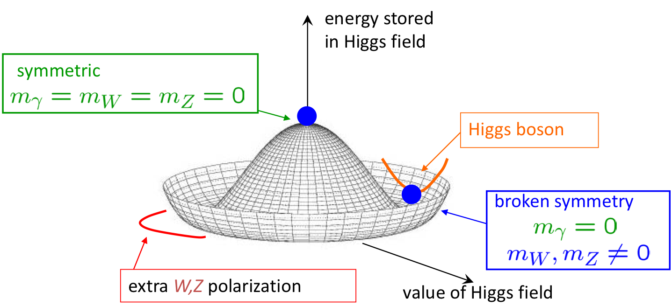

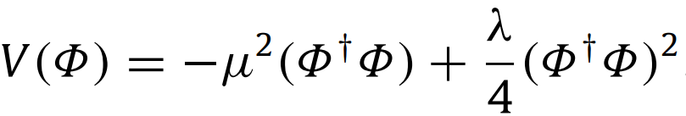
[4]
Notes:
Higgs potential against higgs value, mexican hat form, e.g. r^4-r^2+c (imposed by gauge theory but free parameters, more later)
High energies (early universe): symmetry, electroweak force combined
Lower energies: occupied state „rolls“ into energy minimum = nonzero values of higgs field, gauge bosons have mass
Oscillation around minimum appears as higgs boson

Slide 7

2. Higgs-Boson Phenomenology
[5]
Notes:
Picture shows H -> photon photon candidate

Slide 8
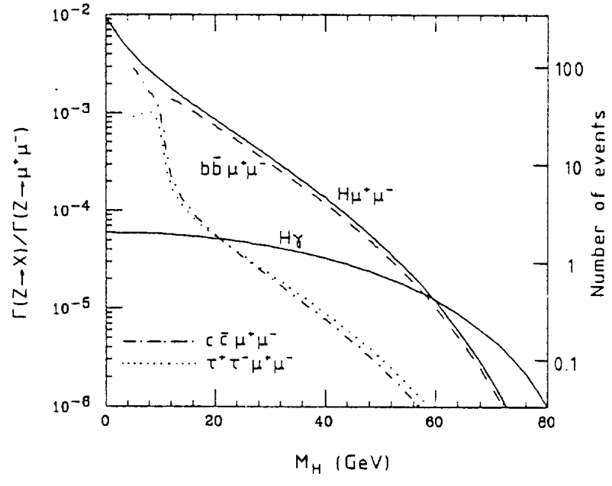
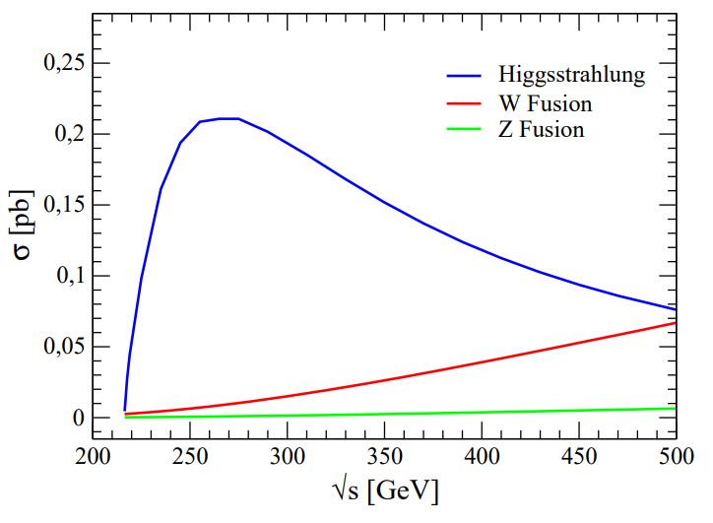
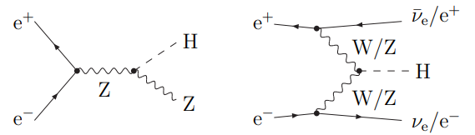
Production in e⁺e⁻-collisions
[6]
[7]
Notes:
Feynman Diagrams: Leading Order Main production channels, Higgs-strahlung or W/Z Fusion
Left diagram: Z-decay Higgs-strahlung partial width (√s = 209 GeV) -> only low m_H testable, cross sections = few fb
Right diagram: cross sections of higgs boson for different com energies
LEP energies: √s < 209 GeV, main search channel “Higgs-strahlung” with off-shell Z production
Modern colliders: Higher energies, W/Z fusion
Pro e+e-: high precision, clean events; contra: low energies (bremsstrahlung)

Slide 9
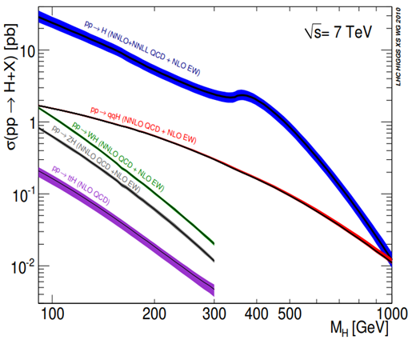
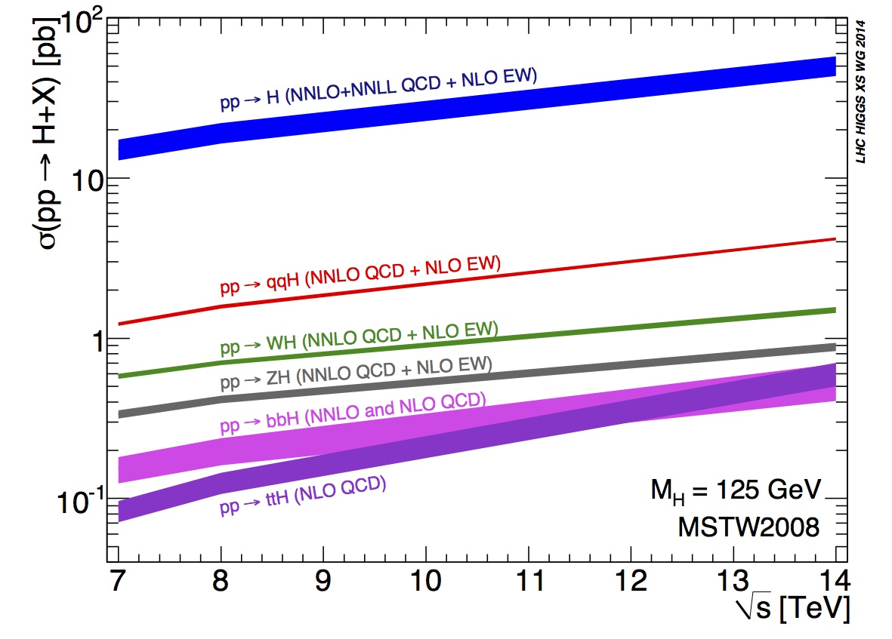
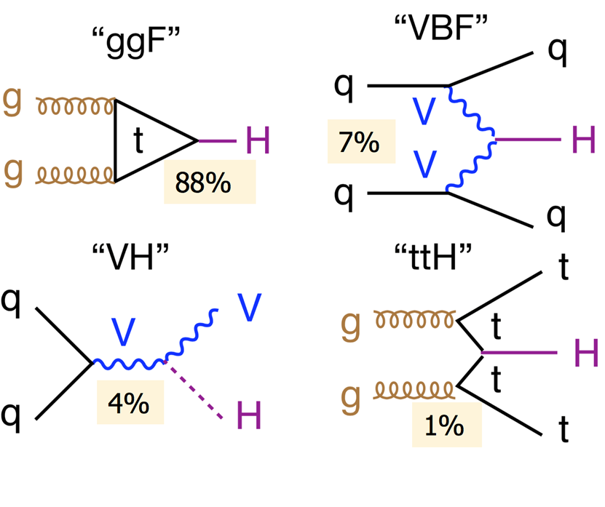

Production in pp-collisions
[9]
[10]
[9]
($\sqrt{s}=$7 TeV, $m_{H}=$125 GeV)
[8]
Notes:
pp-collisions: higher energies – higher cross sections
right diagram: bigger cross secionts (partons in protons more energy, Higgs creation more likely
left diagram: production rates for different higgs masses
Leading order diagrams of main production mechanisms at given $\sqrt{s}$ and m_H
88% gluon fusion (virtual heavy quark loop) – dominating (1 magnitude), because large gluon flux in pp collisions
7% vector boson fusion, production of light quarks – lower decrease (t-channel dominance) but competes only for 1 TeV Higgs
4% higgs-strahlung by vector boson (W/Z) – better for low energy (parton distribution function, ?), WH = 2 ZH (W+, W-)
1% heavy quark associated production – low because large inv mass needed. Channel interesting because direct access to higgs top yukawa coupling
Exploit all production modes!
Problem: low cross section (VH, ttH) hard to observe (only lower m_H limit), lots of background because pp

Slide 10
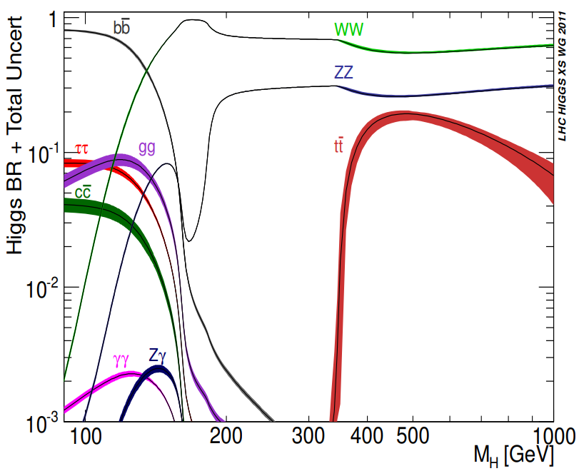
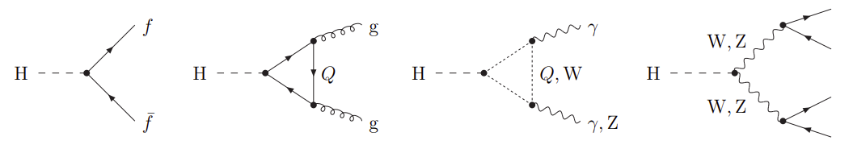
Higgs Decay Branching Ratios
[11]
Notes:
Decay into: two fermions / two vector bosons / virtual heavy quark loop -> two photons / photon & Z / two gluons
Diagram: Branching ratios for different m_H (theory)
highest branching ratios typically correspond to decays into the heaviest particle–antiparticle pair that are kinematically allowed
High mass: decay into WW, ZZ
Low mass: decay into bb, tau tau, WW, ZZ, gamma gamma
Problem: pp collisions – lots of hadrons, dominating decays hard to detect
Focus on leptonic endstates - very good mass resolution (1%): H -> 2 photons, H -> ZZ -> 4l

Slide 11
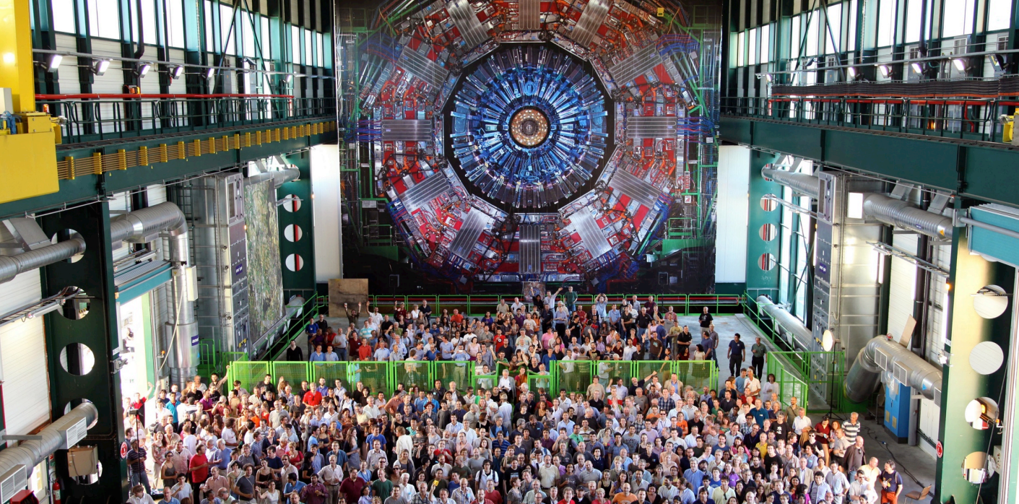
3. The CMS and ATLAS experiment
[12]
Notes:
Talk about CMS and ATLAS experiment that lead to discovery in 2012
You can see the CMS detector

Slide 12
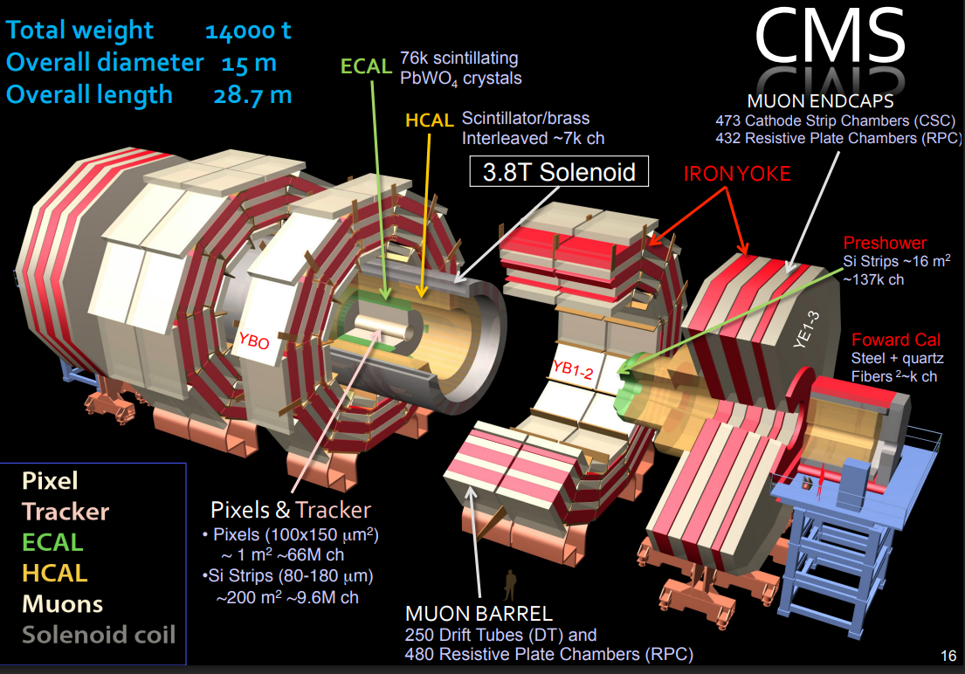
[15]
Notes:
Solenoid, big magnetic field, enables:
Pixels and tracker: tof and momentum measurements, very precise jet reconstruction - instantenous classification into e,μ,γ, charged and neutral hadrons, matches to origin after
ECAL: very precise measurements, great efficiency of energy measurements of electromagnetic showers REMEMBER
HCAL: energy measurements of hadrons
muon chambers: measure muons
Forward caps: e.g. measure luminosity

Slide 13
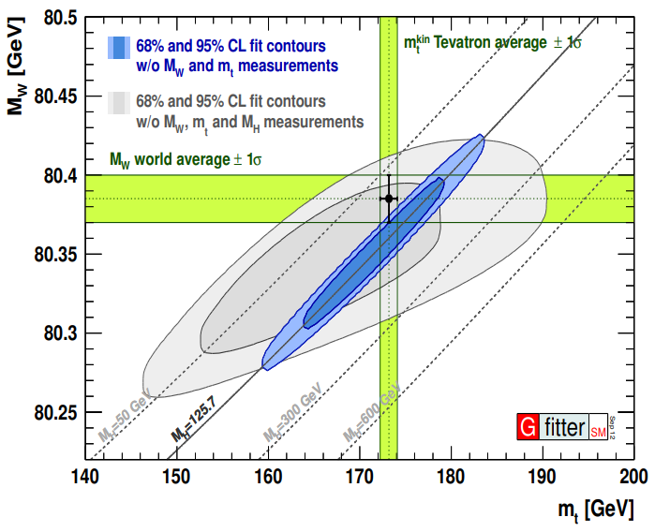
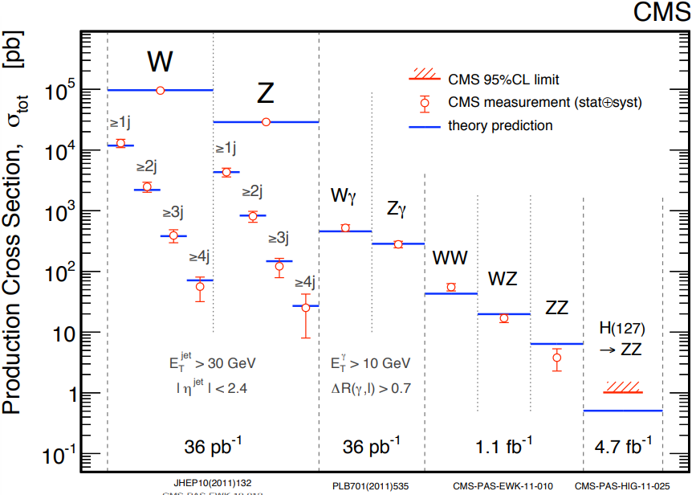

Preparing for the Higgs
[14]
[17]
$m_{H}≈{90}_{−20}^{+30}$ GeV
Notes:
Mass Regions: Tevatron excluded mass ranges MH = 100−103 GeV and MH = 147−180 GeV, largest deviation from background-only hypothesis MH = 120 GeV
Theory: SM: not many free parameters -> precision measurements m_W and m_t limit m_H; 125.7 is valid, 600 GeV very -> upper bound of ATLAS and CMS
LHC: Detector components get calibrated to reproduce known sm physics (iteratively for rarer processes) – right graphic, great results
2011 operation at 7 TeV, 2012 upgrade -> 25-30% higher cross section
Blind analysis – Don’t focus selection criteria on any mass regions, assume any m_H is possible, no bias
Possible mass region very small – 1 week before observation 115-127 GeV - evidence for new particle grows

Slide 14
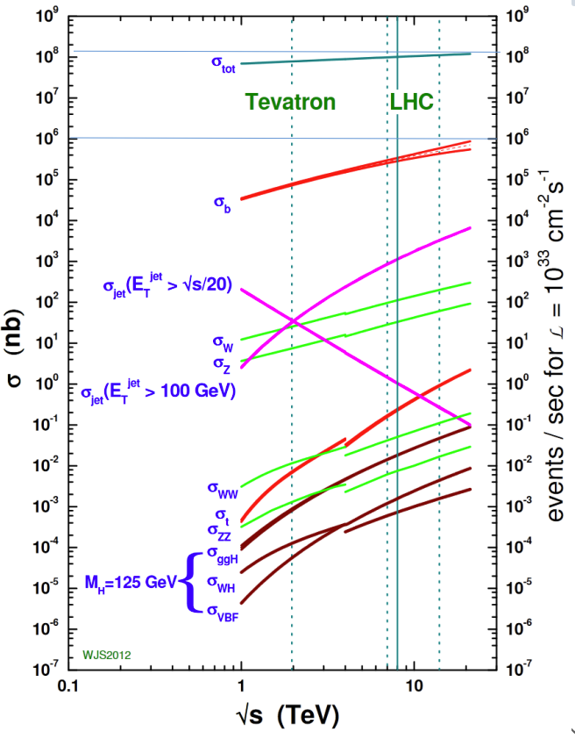

Data Selection
Monte Carlo simulation
Event measurement
Event isolation
Total Higgs Bosons:
$${10}^{15}→{10}^{11}→400 000 →60$$
[16]
Notes:
Theory:
First: Monte Carlo simulation: 1 000 000 000 Events/month, lots of optimizing: cost-efficient, used program based on computation complexity
Second: Measure Events: (2024, 13 TeV): bunches of 10^12 protons collide 40 million times per second, 20 overlayed proton-proton collisions per event
Final: Isolate events, reconstruct decays, match to monte carlo – very challenging! Filter data – only promising events (e.g. indications of H creation)
Lots of background! –Limited trigger capabilities! - optimize signal to background – isolation with sophisticated data analysis methods and machine learning techniques
only keep final states that contain at least one of: photon, electron, muon, hadronic tau-lepton decay or large missing transverse momentum (hadronic final states hard to separate from background)
Numbers: Up until 2012:
1 quadrillion proton proton collisions -> 100 billion measured proton proton collisions (surpassed filter)
-> expected: 400k higgs bosons (low cross section, show diagram, 1 in 1 to 10 billion) -> 60 observed excess events in H -> ZZ -> 4l and H -> 2 photon around 125 GeV

Slide 15
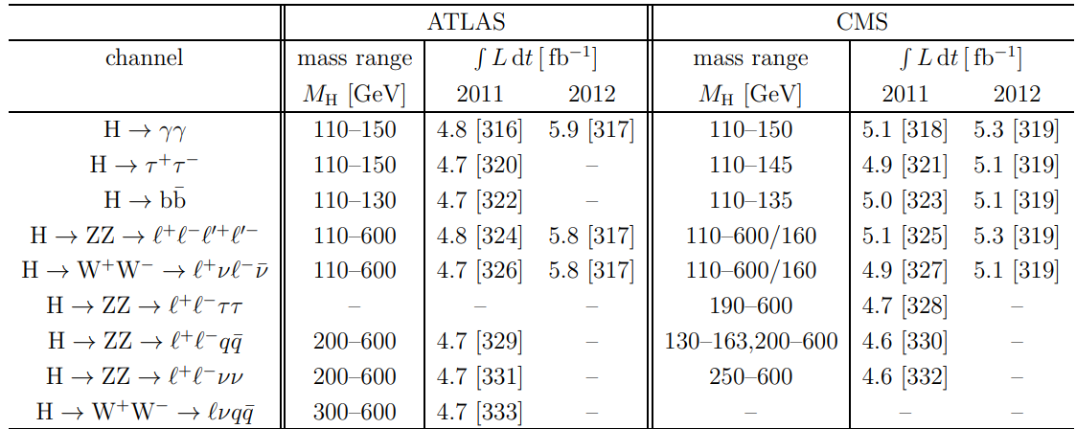
Decay Channels
[18]
Notes:
Decay channel needs: sufficient a priori signal rate (high cross section / branching ratio) - means to trigger on signal events with high efficiency - means to suppress the background to an acceptable level - means to estimate the uncertainties in the background prediction - in case of exclusion also the uncertainties in the signal prediction.
Low mass region: 110-150 GeV: H → γγ and H → ZZ → 4ℓ low rate but excellent resolution (1-2%), other decays high rate but H → WW → 2ℓ2ν good identification but no mass peak!, H → ττ and H → bb only 10-30% resolution
Intermediate mass region: 150−200 GeV: H → WW → 2ℓ2ν dominates, some H → ZZ → 4ℓ
High-mass region: 200−600 GeV: Dominating WW, ZZ with various decays – background hard to filter
As told before: Mass region isolated -> 2012 focus on H → γγ and H → ZZ → 4ℓ and H → WW → 2ℓ2ν in low mass regions!

Slide 16
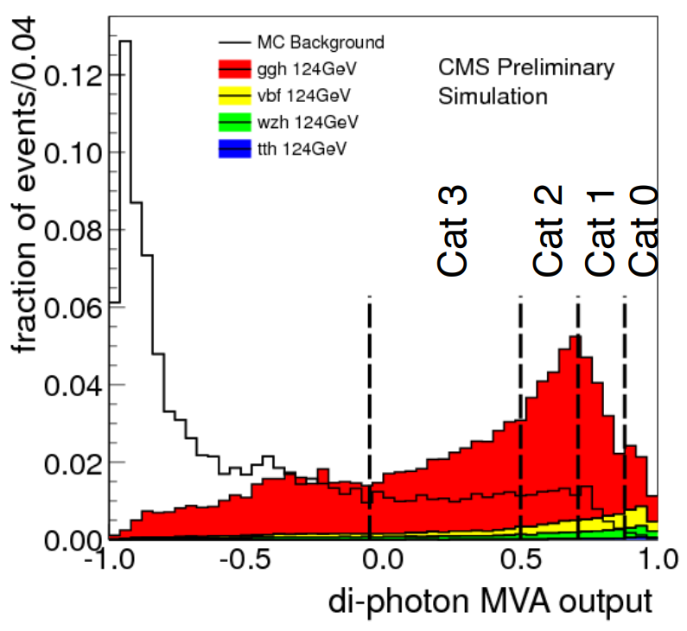
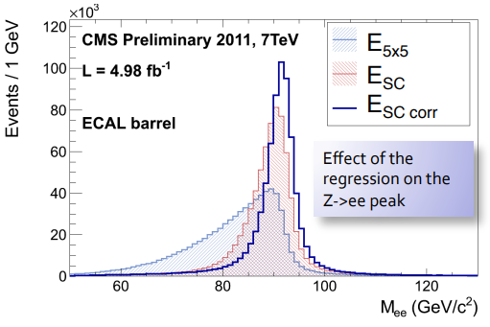
H → γγ channel
0.23% Branching Ratio
Search for di-photons
Multivariate Analysis
Di-jet tagging
ECAL and Vertex calibration
[19]
[20]
Notes:
Very rare decay (0.23% BR!) but very good S/B ratio achievable, very complex methods - overview!
Search for two isolated photons with large transverse momenta
Muti-Variate-Analysis in form of a boosted decision tree, cross-checked with other techniques – gives best results:
Concept: First pre-selection with mass of di-photon system, then: group events into 4 categories by using correlation of: isolation, shower shape, per event energy density, pseudorapidity (Machine Learning!)
The different groups get fitted independently and results are weighted by expected resolution of that group (different S/B separations)
Di-jet tagging: Identify di-photons from VBF (strong signature) and split them from rest -> again, improved results
Calibrate ECAL and Vertex Chamber for clusters using multivariate techniques:
ECAL efficiency for cluster energies with known decay Z -> ee using MC: –> really good fit
Vertex identification important for mass reconstruction, have to be within 1 cm or resolution gets worse than from ECAL deficiencies -> correct identification 80% of the time -> good

Slide 17
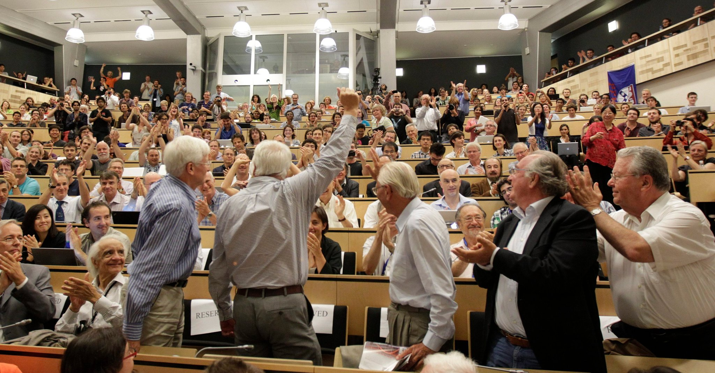
4. Results (Statistical Interpretation)
[22]
Notes:
Picture from higgs discovery announcement at lhc (04.07.20212)

Slide 18
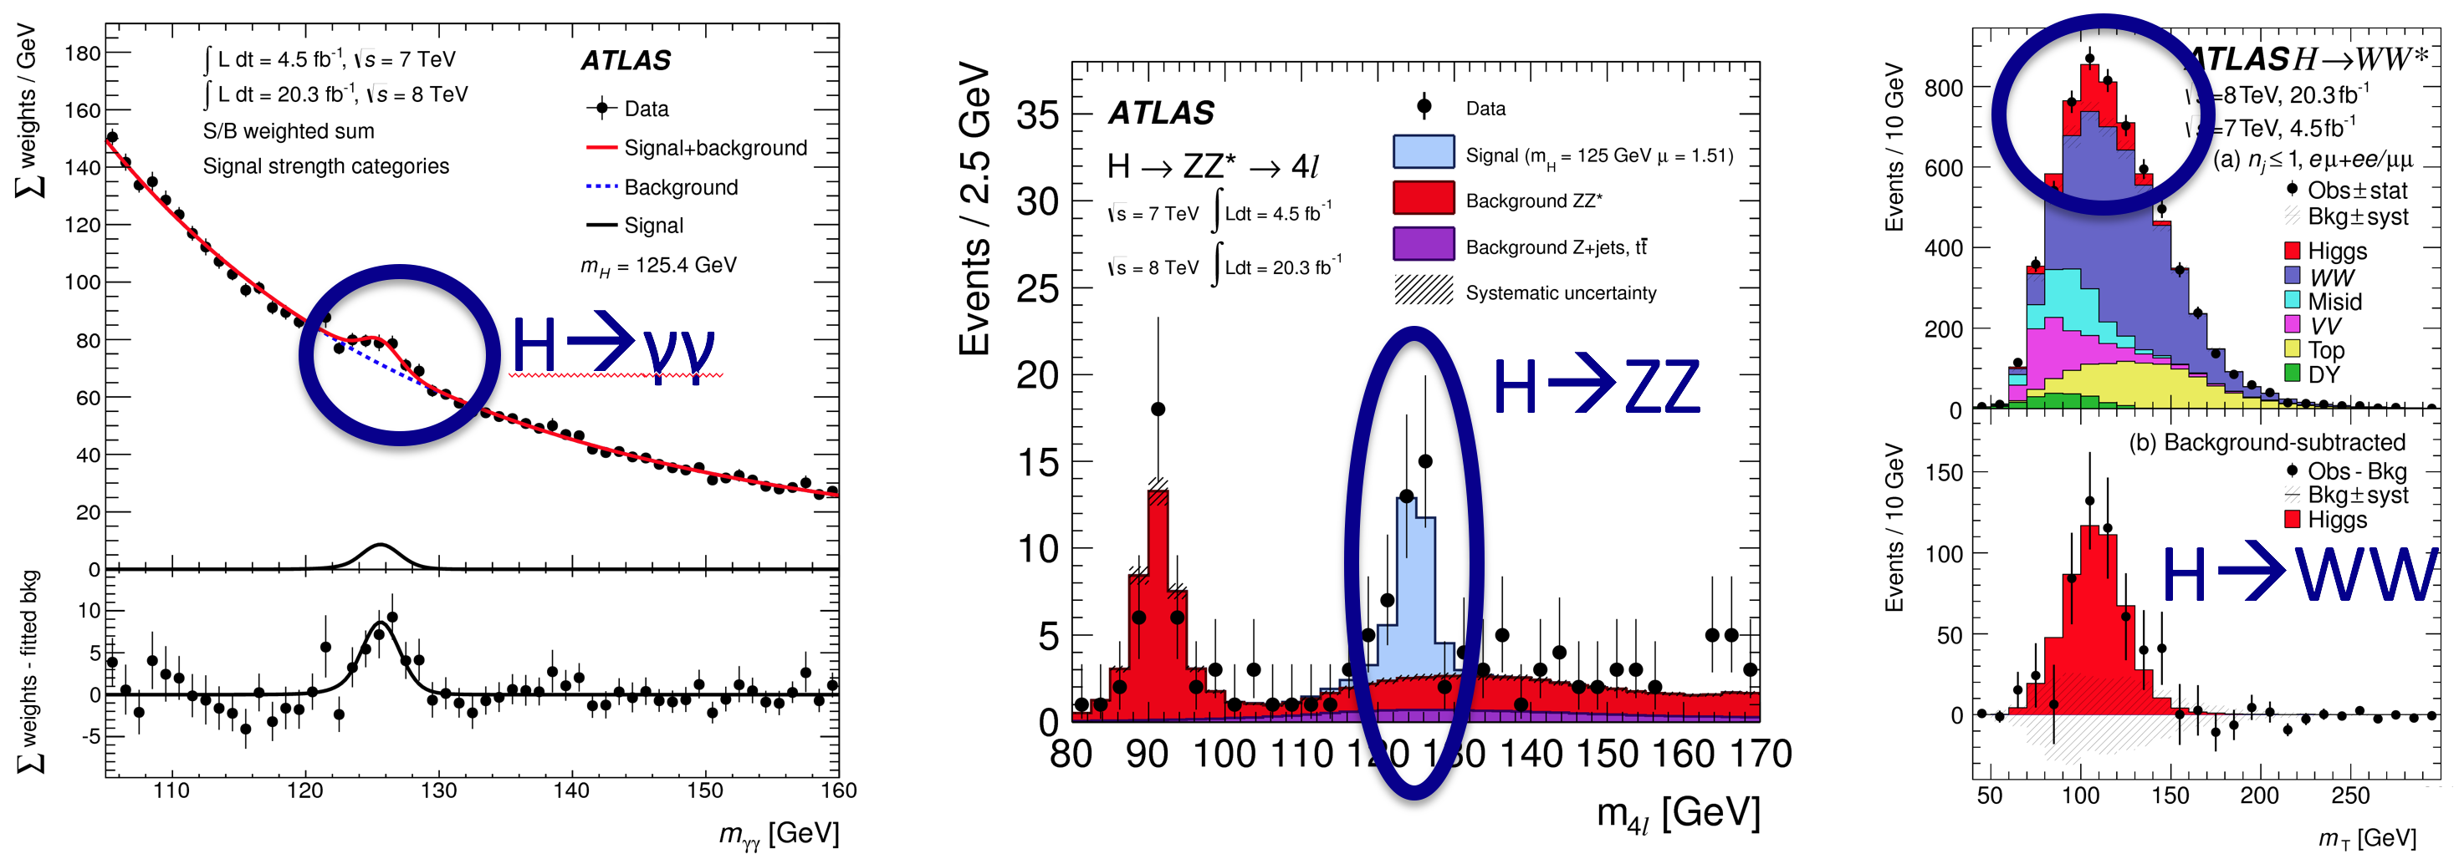
Resonance peaks
[23]
Notes:
Peaks in the three main search channels
H → γγ and H → ZZ → 4ℓ: resonance peaks in mass distribution of signals
H → WW → 2ℓ2ν general excess of events

Slide 19
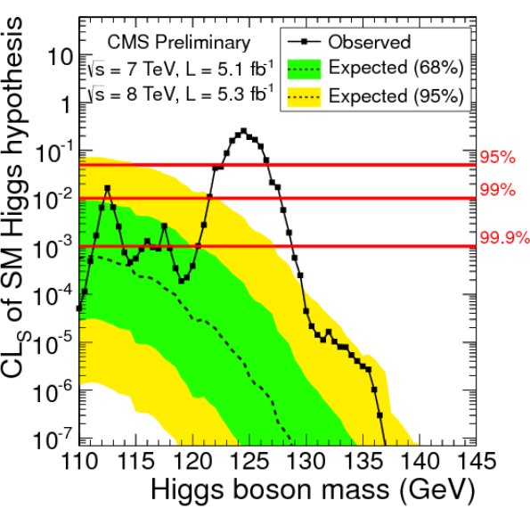
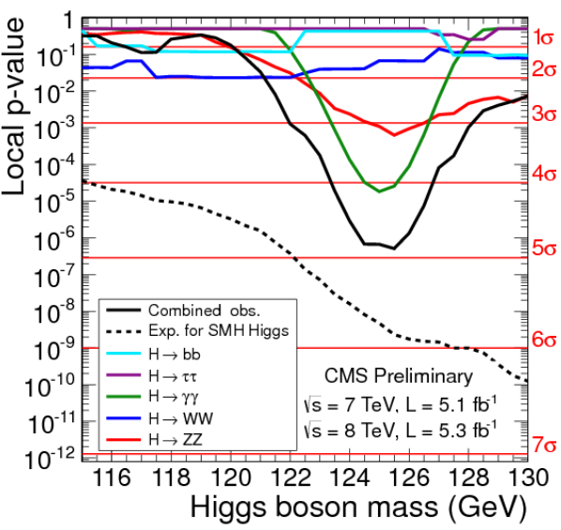
Statistical Interpretation
[24]
[25]
Notes:
CMS data: left – expected confidence levels for exclusion (background only), should be all below 95% - observed data shows no exclusion possible
Right – p-values, how likely are these results if there was no higgs, only from background fluctuation – something like 10^-6 = 4.9 standard deviations
Expected more exclusion but inclusion of hadronic channels makes it harder
Atlas only used photon photon, ZZ and WW channels and gets p-values of 5.9 standard deviations
In particle physics: need 5 standard deviations to claim discovery of new particle -> success

Slide 20

Final results
New particle discovered
CMS: m_{X} = 125.3 GeV $±$ 0.6 GeV (5.0 σ)
ATLAS: m_{X} = 126.0 GeV $±$ 0.6 GeV (5.9 σ)
Notes:
2012
Results are consistent, matches higgs boson well – even better confirmations published in next few years, now we’re basically sure

Slide 21
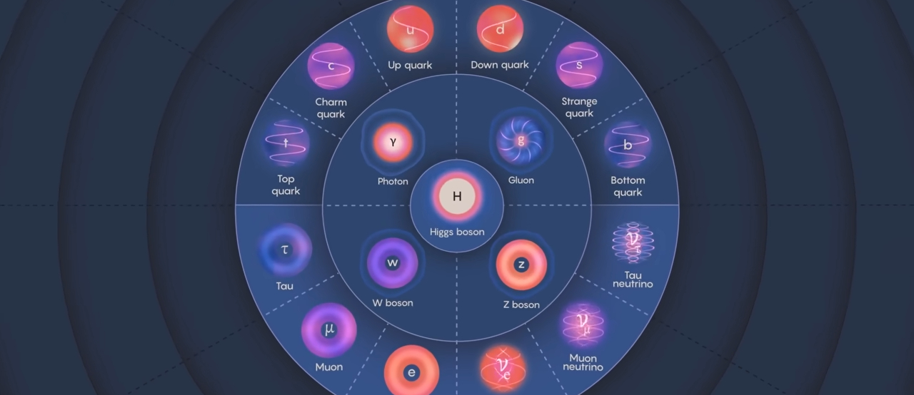
5. Outlook
[26]

Slide 22
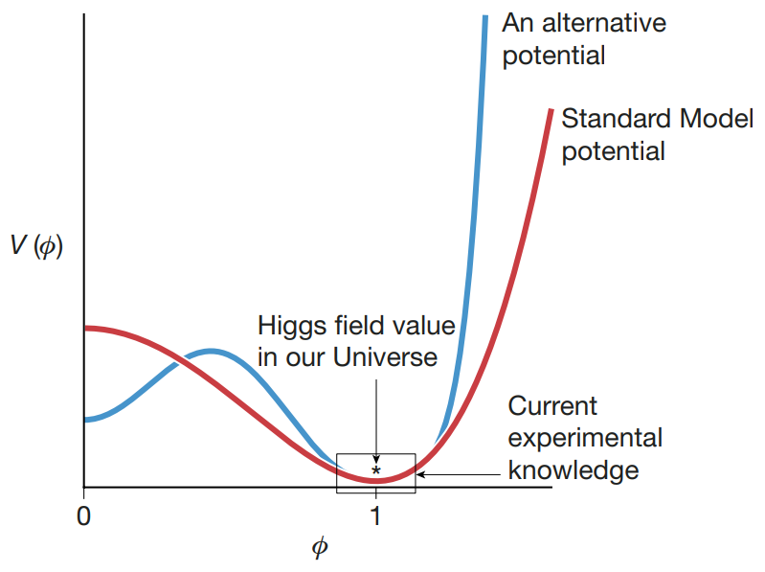

Precision Measurements
More L, √s and signal-to-background
m_{H} = 125.38 ± 0.14 GeV
Indirect methods:
Γ _{H} =${3.2}_{−1.7}^{+2.4}$ MeV
[27]
Notes:
Energy: 14 TeV, 3 to 8 times greater cross sections
Around 10 million Higgs-Bosons created -> more channels exploitable so a lot of data
Higgs potential -> measure parameters with coupling

Slide 23
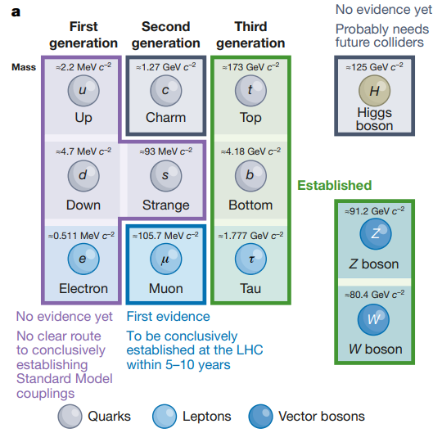
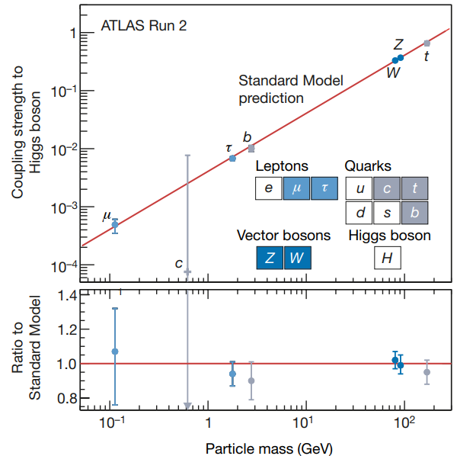
Observed Higgs-Coupling
[28]
[29]
Notes:
Machine learning -> better signal from background seperation -> clear observation of H -> bb
Higgs self coupling -> determine higgs potential
Coupling proportional to mass -> SM Higgs as of now

Slide 24
Open Questions
Exotic Decays?
Is the Higgs Boson elementary?
Are there more Higgs Bosons?
Mass predictions?
Matter-Antimatter symmetry?
Notes:
Exotic Decays?: Into light dark matter, new light particles of BSM theories (e.g. more spin 0) – possible explanation for gamma ray excess at universe center
Branching ratio: constrained to <34%, still very possible
Elementary?: BSM theories – composition, new theory like QCD?
More Higgs?: BSM theories – new symmetries with new bosons, charged higgs etc
Mass?: m_H is free parameter, very light, verge of electroweak vacuum stability
Matter-Antimatter?: Explanation for matter domination in higgs potential
The discovery of the Standard Model (SM) Higgs boson has opened up new avenues to search for physics beyond the SM (BSM) with perspectives to search for non-SM or “exotic” decays of the Higgs boson. Such searches could provide unique access to hidden-sector particles that are singlets under the SM gauge transformations. Exotic decays of the Higgs boson are predicted by many new-physics models, including those with an extended Higgs sector, dark matter (DM) models, models with a first-order electroweak phase transition and theories with neutral naturalness. These models have also been used to explain the observations of a γ-ray excess from the galactic centre (GC) by the Fermi Large Area Telescope. For example, a model for the GC γ-ray excess was proposed in which 30 GeV DM particles pair-annihilate dominantly through a CP-odd scalar mediator that subsequently decays into SM fermions. If the mediator is sufficiently lighter than the SM Higgs boson (H) then H decay into the mediator pair can be observed at the LHC.
Existing measurements constrain the BSM or “exotic” branching ratio (B) of the 125 GeV Higgs boson decays to less than approximately 34% at 95% confidence level. Due to the narrow width (∼ 4 MeV) of the Higgs boson, even a small non-SM coupling of O(10−2) can lead to O(10%) branching ratio into BSM states. This potentially large B(H → BSM states) motivates direct searches for exotic H decays. Searches for the Higgs boson with a mass of 125 GeV decaying into two spin-zero particles, H → aa, have been performed in various final states in ATLAS and CMS. The analysis presented in this Letter performs the search in the bbμμ final state. The a-boson can be either a scalar or a pseudo-scalar under parity transformations, since the decay mode considered in this search is not sensitive to the difference in coupling. Assuming that the a-boson mixes with the SM Higgs boson and inherits its Yukawa couplings to fermions, the largest branching ratio is expected to be to the heaviest fermions accessible by kinematics (2ma < mH ), where ma and mH are the a-boson and Higgs boson masses. For ma 􏰀 10 GeV this means the a-boson would decay preferentially into bb. However, in models with enhanced lepton couplings such as the Type-III 2HDM, the a → μμ branching ratio can also be relatively large. Additionally, the sensitivity of a given channel does not depend only on the expected signal rate in a particular model, but also on the efficiency for triggering and reconstructing events of interest. The presence of a clean di-muon resonance provides a distinctive signature that can be used for triggering and precision mass reconstruction, which helps to suppress background.

Slide 25

Thanks for listening!
Questions? (English/German)

Slide 26
References
Literature:
M. Thomson, Modern Particle Physics, Cambridge University Press, Cambridge, 2013, DOI: 10.1017/CBO9781139525367.
S. L. Glashow, Partial-symmetries of weak interactions, Nucl. Phys. 22 (1961) 579–588, DOI: 10.1016/0029-5582(61)90469-2.
P. W. Higgs, Broken Symmetries and the Masses of Gauge Bosons, Phys. Rev. Lett. 13 (1964) 508–509, DOI: 10.1103/PhysRevLett.13.508.
S. Weinberg, A Model of Leptons, Phys. Rev. Lett. 19 (1967) 1264–1266, DOI: 10.1103/PhysRevLett.19.1264.
ATLAS Collaboration, Observation of a new particle in the search for the Standard Model Higgs boson with the ATLAS detector at the LHC, Phys. Lett. B 716 (2012) 1–29, arXiv:1207.7214 [hep-ex].
CMS Collaboration, Observation of a new boson at a mass of 125 GeV with the CMS experiment at the LHC, Phys. Lett. B 716 (2012) 30–61, arXiv:1207.7235 [hep-ex].
ATLAS and CMS Collaboration, 4th July 2012, Seminar at CERN, http://dx.doi.org/10.17181/cds.1459513.
Dittmaier, S. and Schumacher, M, The Higgs boson in the Standard Model—From LEP to LHC: Expectations, Searches, and Discovery of a Candidate. Progress in Particle and Nuclear Physics 70, 1-54 (2013), http://dx.doi.org/10.1016/j.ppnp.2013.02.001
CMS Collaboration. A portrait of the Higgs boson by the CMS experiment ten years after the discovery. Nature 607, 60–68 (2022). https://doi.org/10.1038/s41586-022-04892-x
ATLAS Collaboration. A detailed map of Higgs boson interactions by the ATLAS experiment ten years after the discovery. Nature 607, 52–59 (2022). https://doi.org/10.1038/s41586-022-04893-w
Salam, G.P., Wang, LT. & Zanderighi, G. The Higgs boson turns ten. Nature 607, 41–47 (2022). https://doi.org/10.1038/s41586-022-04899-4
CMS Collaboration. Measurement of the Higgs boson width and evidence of its off-shell contributions to ZZ production. Nat. Phys. 18, 1329–1334 (2022). https://doi.org/10.1038/s41567-022-01682-0
CMS Collaboration. Measurements of inclusive and differential Higgs boson production cross sections at 13.6 TeV in the H → γγ decay channel (CMS-PAS-HIG-23-014) (2024). https://cds.cern.ch/record/2904882
Images:
[1] https://ep-news.web.cern.ch/content/higgs-boson-and-prospects-elementary-particle-physics
[2] https://www.nobelprize.org/prizes/physics/1979/glashow/facts/
[3] https://www.nobelprize.org/prizes/physics/2013/higgs/facts/
[4],[8],[23] https://www.marksneubauer.com/projects/4_project/
[5] https://cms.cern/book/export/html/1187
[6],[9],[14],[18] https://arxiv.org/pdf/1211.4828
[7] https://arxiv.org/abs/2301.13463
[10] https://opendata.atlas.cern/docs/visualization/the-higgs-boson
[11],[12],[15],[17],[19],[20].[24],[25] https://indico.cern.ch/event/197461/
[16] https://indico.cern.ch/event/432527/
[22] https://www.nytimes.com/2012/07/05/science/cern-physicists-may-have-discovered-higgs-boson-particle.html
[26] https://www.youtube.com/watch?v=Unl1jXFnzgo
[27],[28],[29] https://doi.org/10.1038/s41586-022-04899-4

Slide 27
Extra: Higgs Mechanism
Mathematik anhand der lagrangedichte
-> Rolle der masse
Zusammenfassung chapter 2.1-2.3 1211.4828

Slide 28
Extra: Higgs Boundaries
Lower and upper bounds (chapter 2.5)

