Slide 1
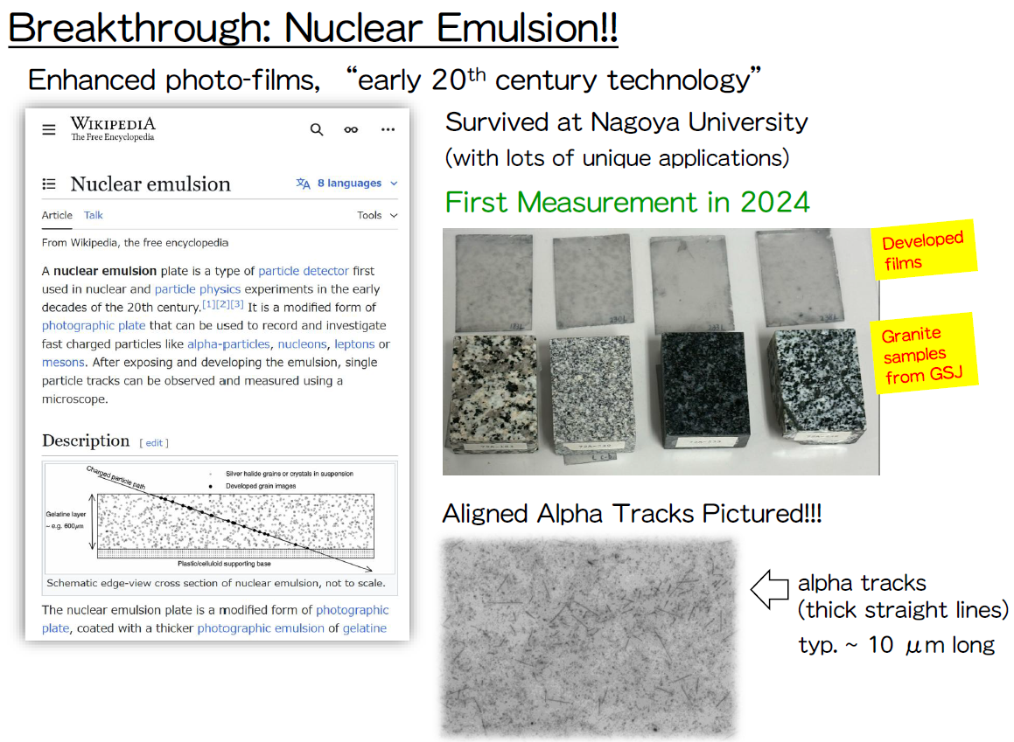
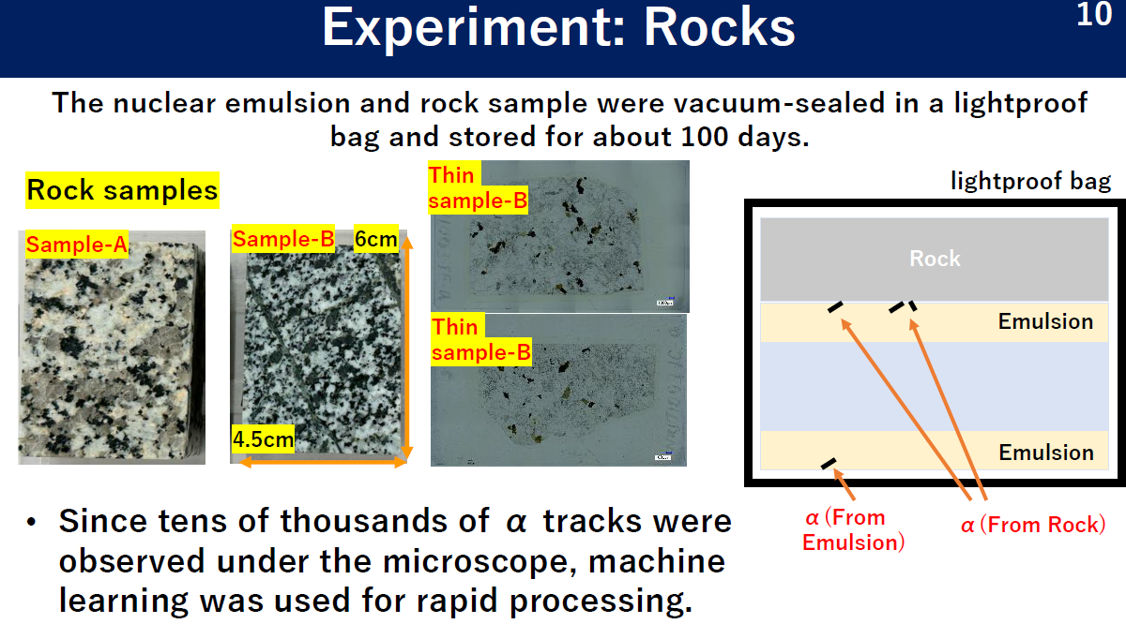

Thanks to Sanshiro’s talk
Thanks to Nishikiori’s talk
… my two cents on autoradiographic mapping…

Slide 2
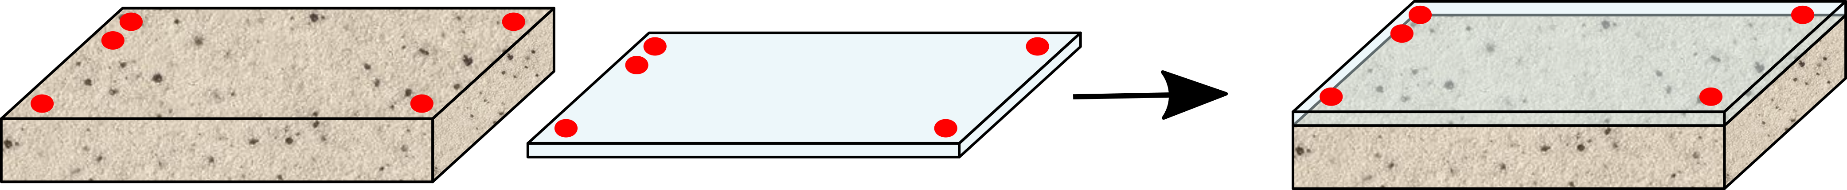
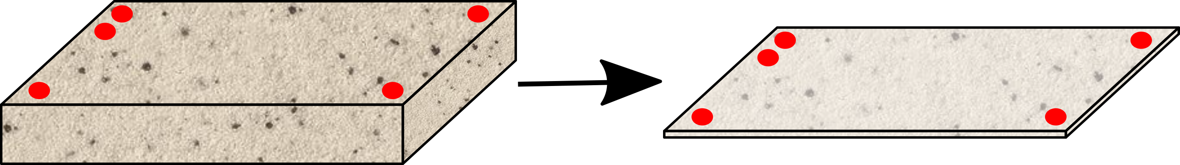
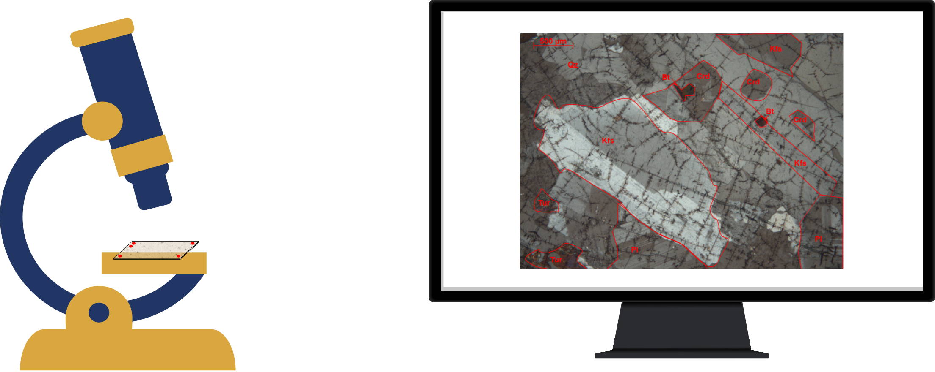
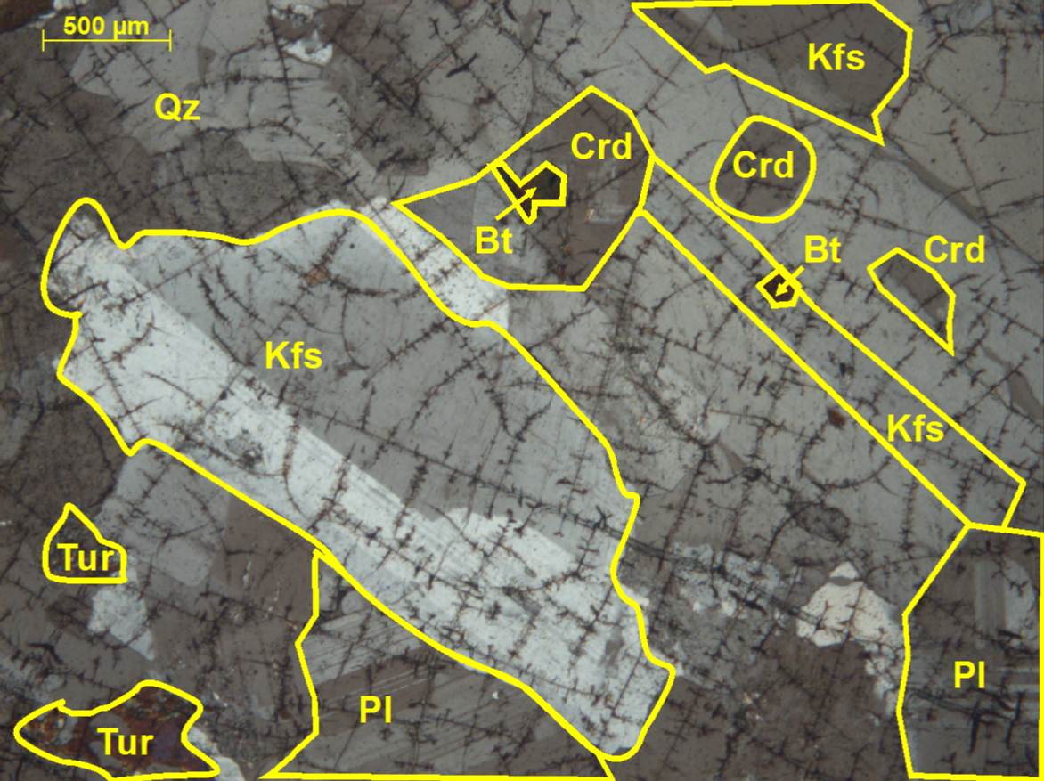
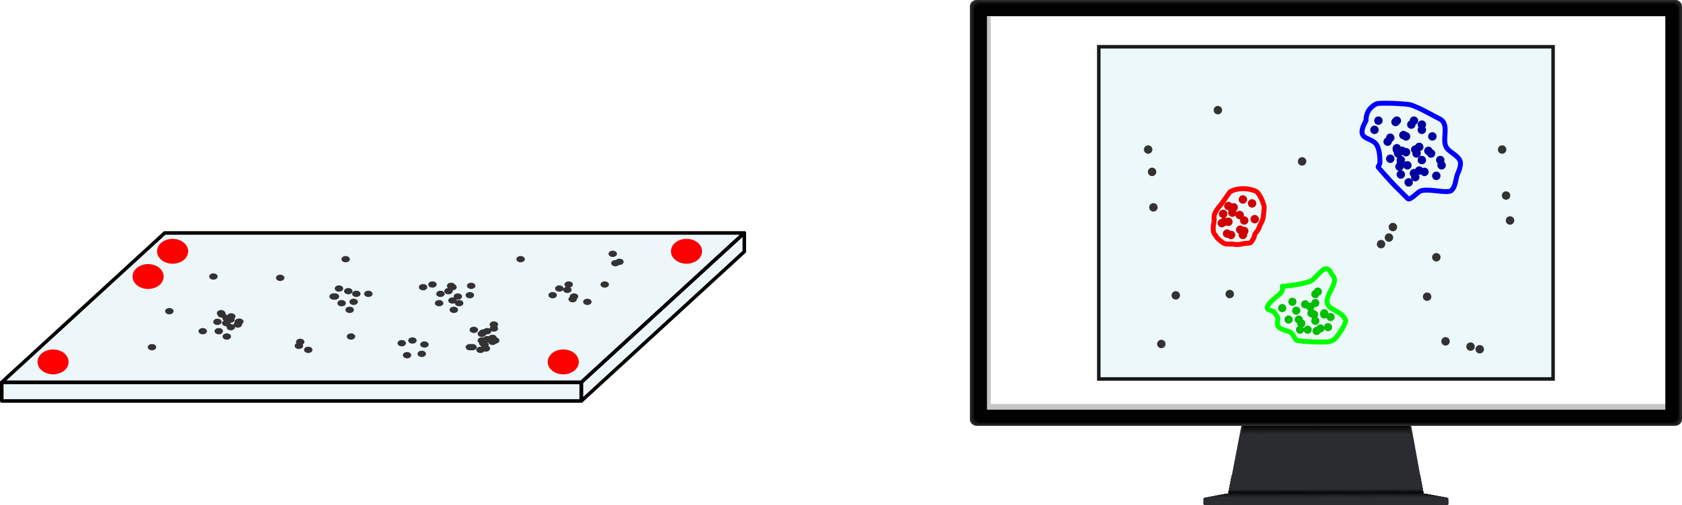
Methodology
Starting from a small granite block, we georeferenced a thin polycarbonate (CR-39) film sensitive to α emissions.
From the same block, a thin section (30 μm thickness) was prepared, allowing the main minerals to be observed under polarized light using a microscope.
The goal is to identify a spatial correspondence between macroscopic features, minerals observed under the microscope, and alpha decay events.

Slide 3
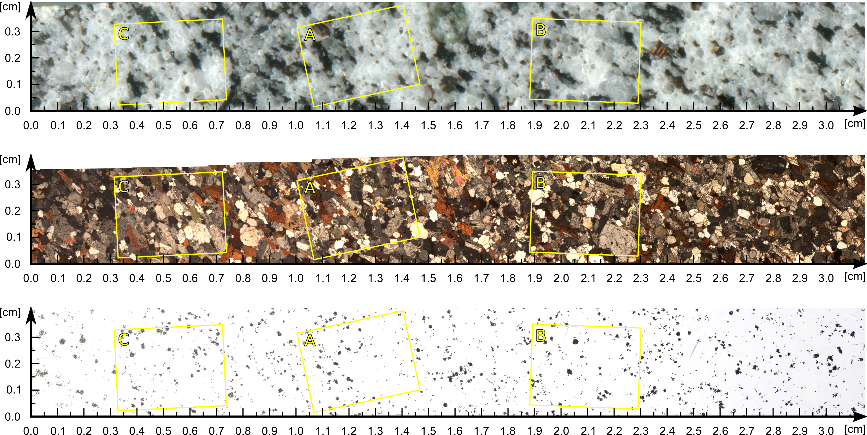
Image mosaic

Slide 4
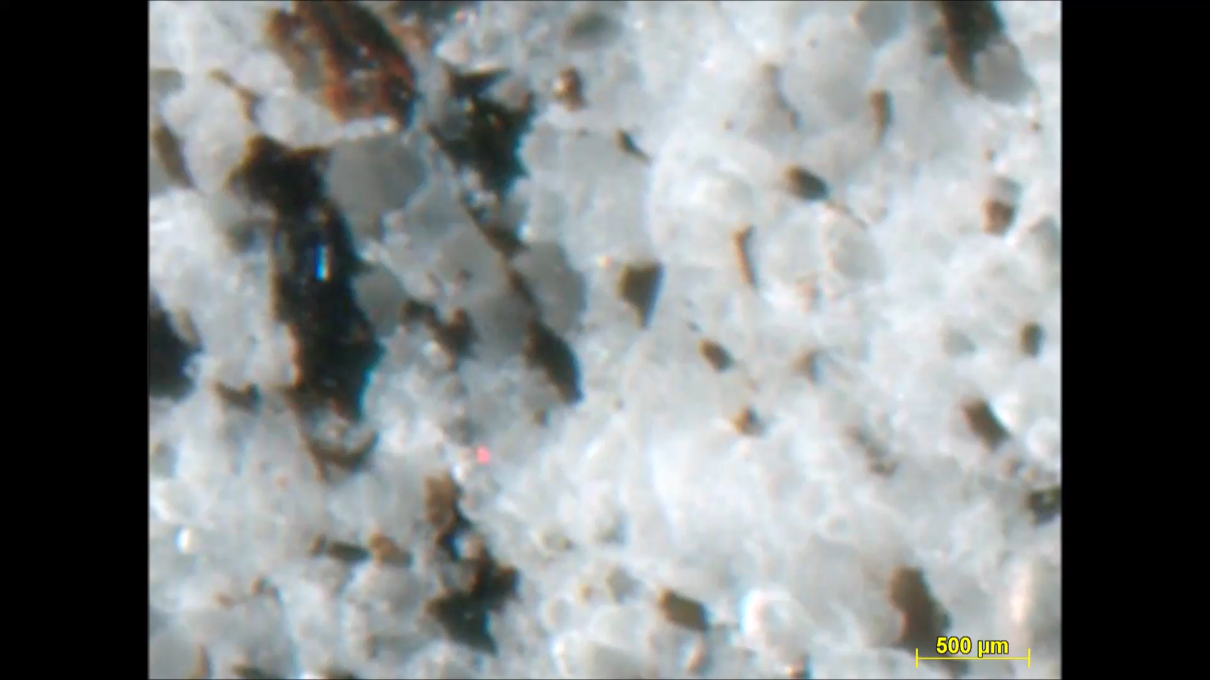

Slide 5
Distribution of alpha decays in different minerals

