Slide 1
A NOBL Experiment
Neutrino Geoscience Kingston, 27-30th Oct. 2025
Max Dornfest, University of Hawai’i
John Learned, Jackson Seligman, Brian Crow, Jeffrey Yepez, Nathan Silbert, Viacheslav Li (LLNL), Stephen Dye (HPU), Hiroko Watanabe, Ono Takanobu, Zhihao Xu, Bill McDonough (TohokuU.).
LLNL-CFPRES-2012819. This work was performed under the auspices of the U.S. Department of Energy by Lawrence Livermore National Laboratory under Contract DE-AC52-07NA273

Slide 2
Outline
3
Scientific Motivation
5
DUMAND / HanoHano
8
OBD
10
Risks
11
Station Aloha
13
Next Steps

Slide 3
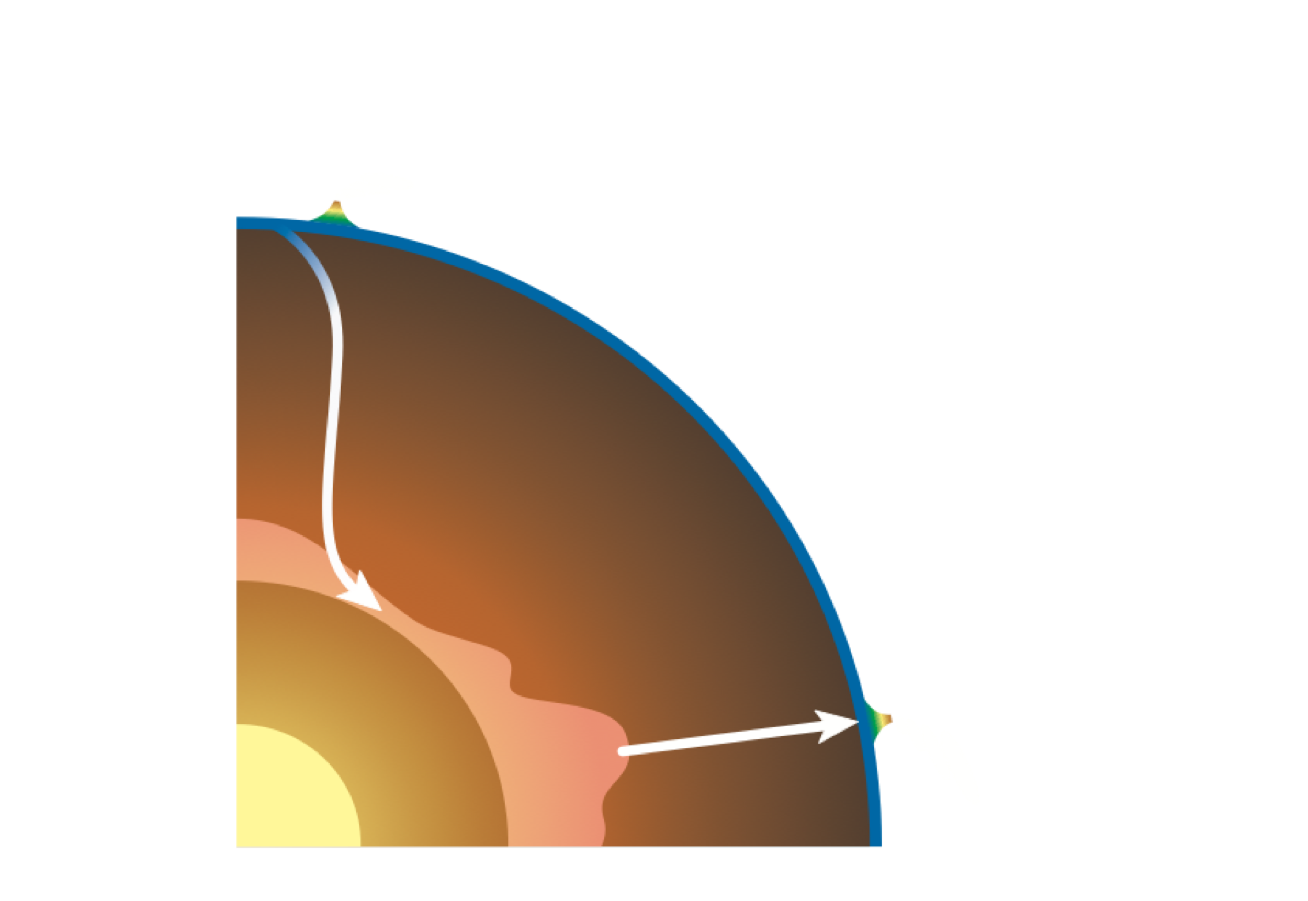
Scientific Motivation
- Quantifying the amount and distribution of heat producing elements in the Earth
- Mapping the compositional variation in the mantle
- Critically testing compositional models of the Earth
- Constraining the cooling history of the Earth

Slide 4


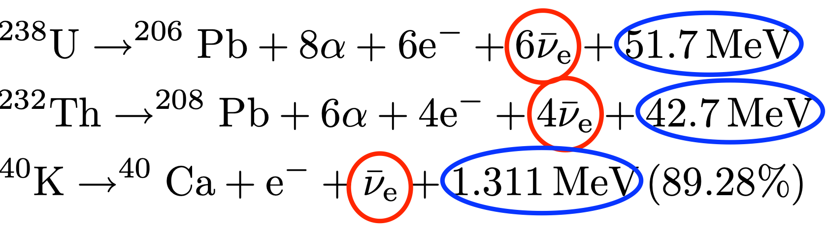
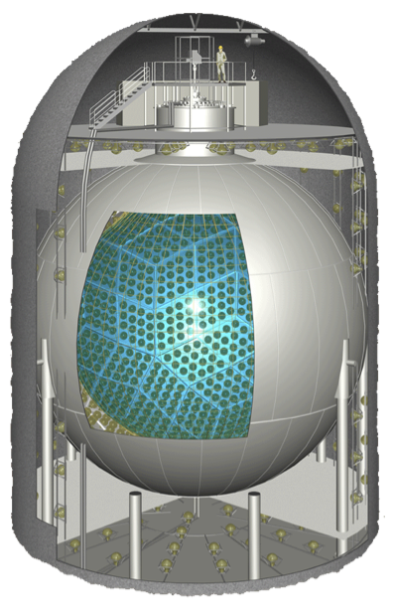


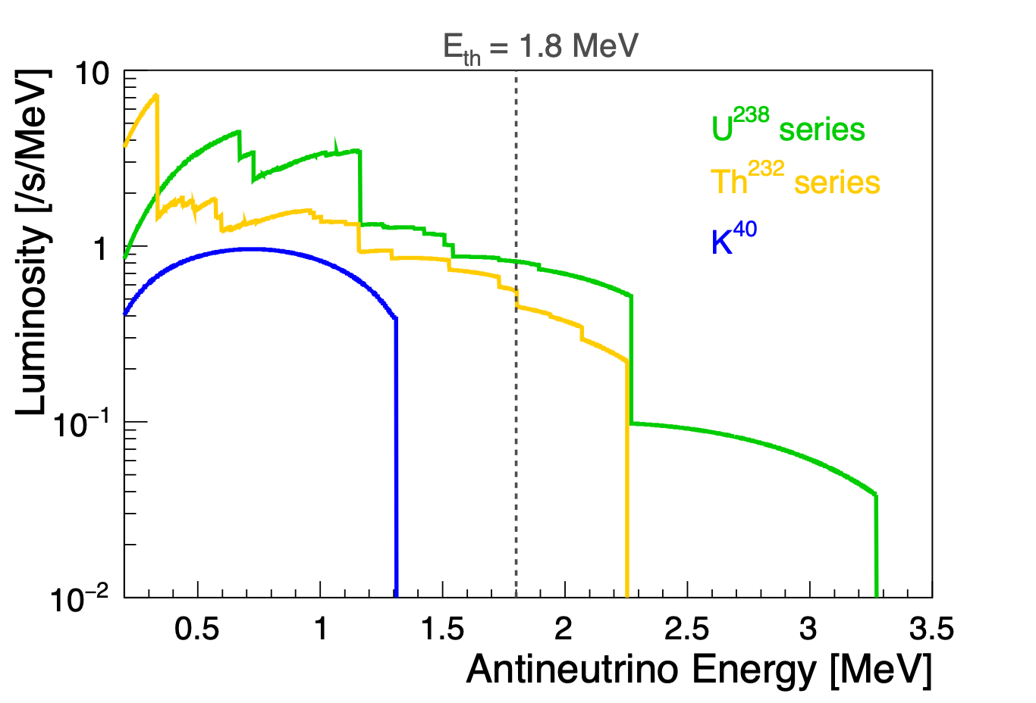
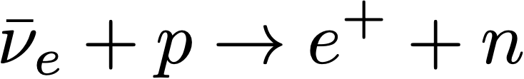

Scientific Motivation
Electron-antineutrinos from natural radioactive decays
9.5
β-decay
geo-neutrinos
Anti-neutrino Detector
(e.g. KamLAND)
Th
Energy threshold, 1.8 MeV
Th
inverse β-decay
Th
Th
Th
U
²³⁸U series
²³²Th series
⁴⁰K
U
Only geo-neutrinos from U and Th are detectable right now
⁴⁰K geo-neutrino detection needs another technology.
U
Th
Th
Th
Th
Th
Th
Th
U
Th
Number of geo
∝
amount of
U
Th
, radiogenic heat

Slide 5
History of Sub-Surface neutrino detection
Homestake mine (1968-70)
Solar neutrino problem
“missing” neutrinos! (conservation not until SNO 2003)
DUMAND workshop (1976)
Neutrino detectors made at UH
leading to
IMB - Irvine–Michigan–Brookhaven (detector)
HPW - Harvard-Purdue-Wisconsin
Kamioka
DUMAND - Deep Underwater Muon and Neutrino Detection
ultimately:
AMANDA, IceCube, Antares, Nestor and KM3
Bruce T. Cleveland et al 1998 ApJ 496 505 /
https://iopscience.iop.org/article/10.1086/305343/pdf

Slide 6

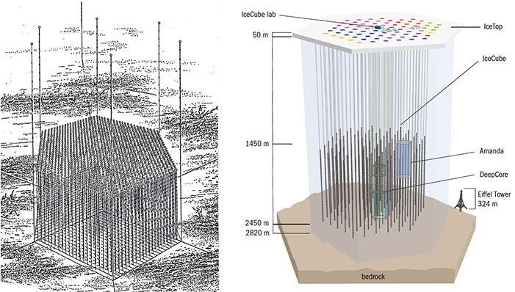
DUMAND
The original DUMAND project (left), cancelled in 1995, and IceCube located at the South Pole (right). Although there are no formal links between the two experiments, their configurations bear strong similarities.

Slide 7
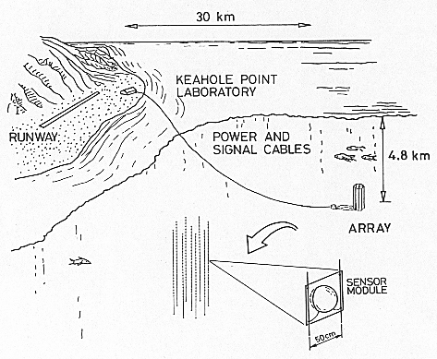
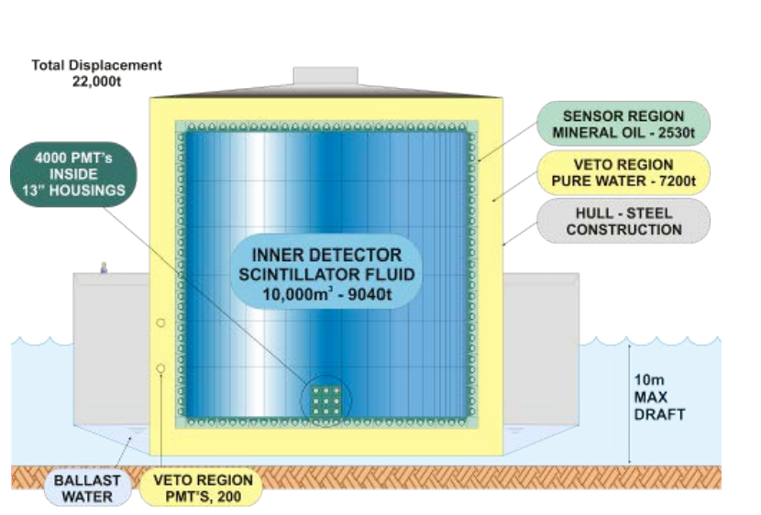
DUMAND and HanoHano
DUMAND
HanoHano
https://neutrinos.llnl.gov/sites/neutrinos/files/22_Learned.pdf

Slide 8

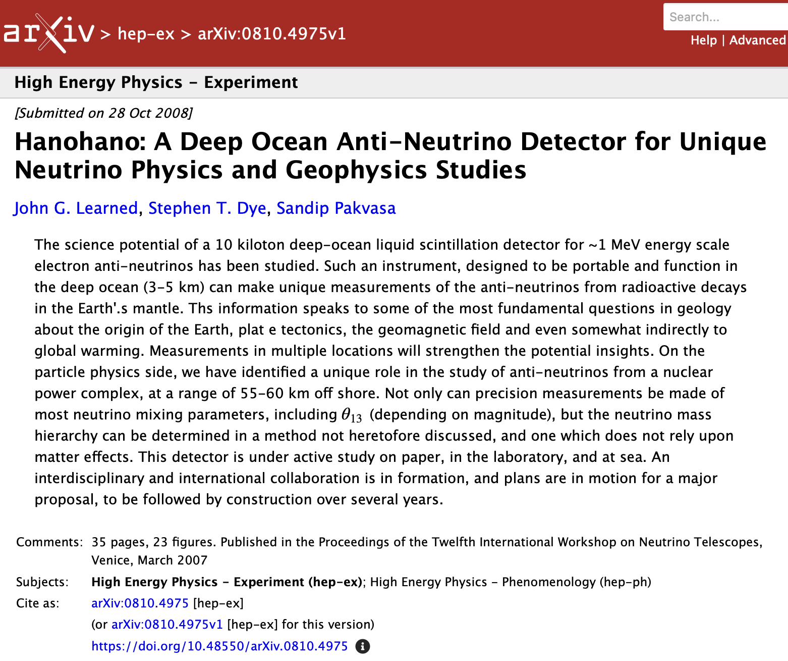
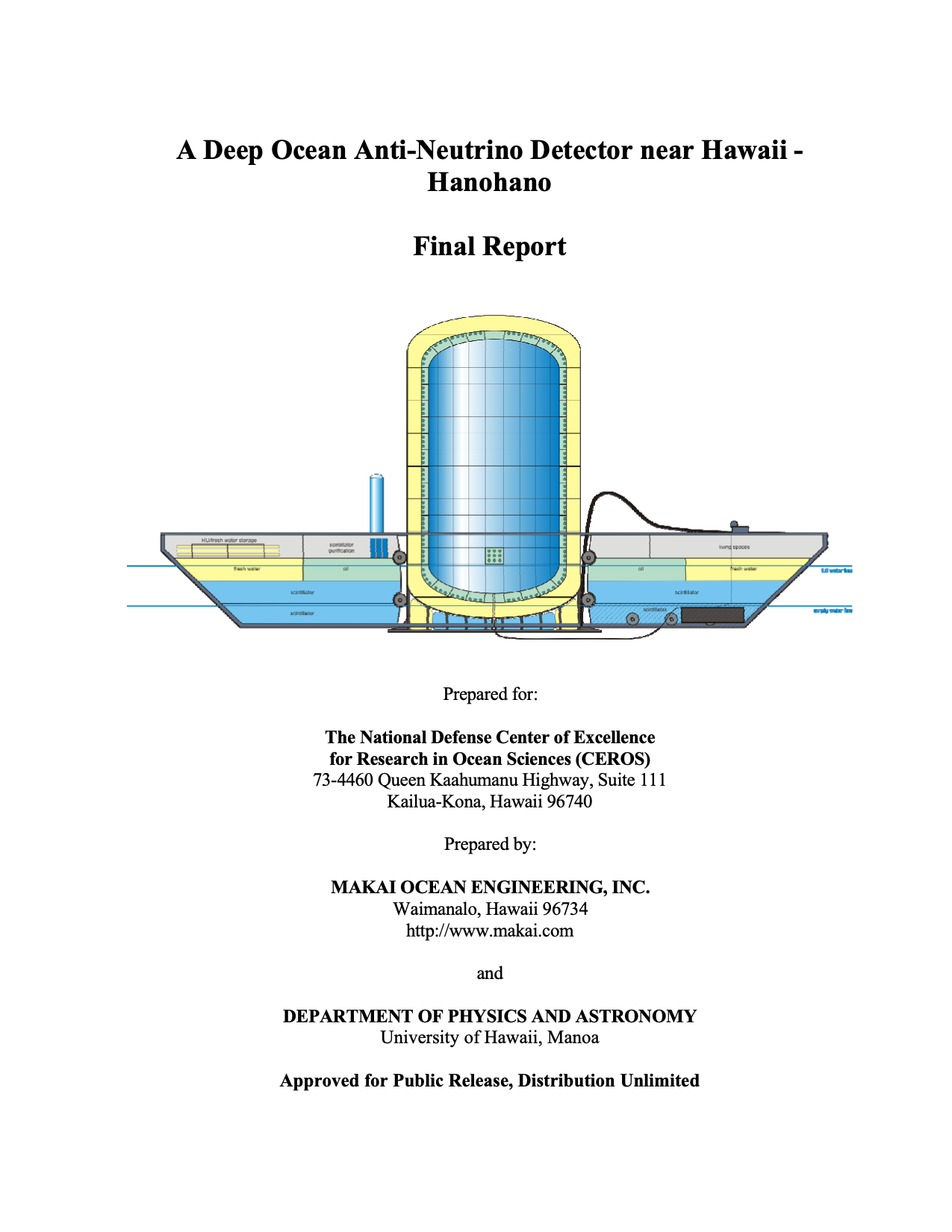
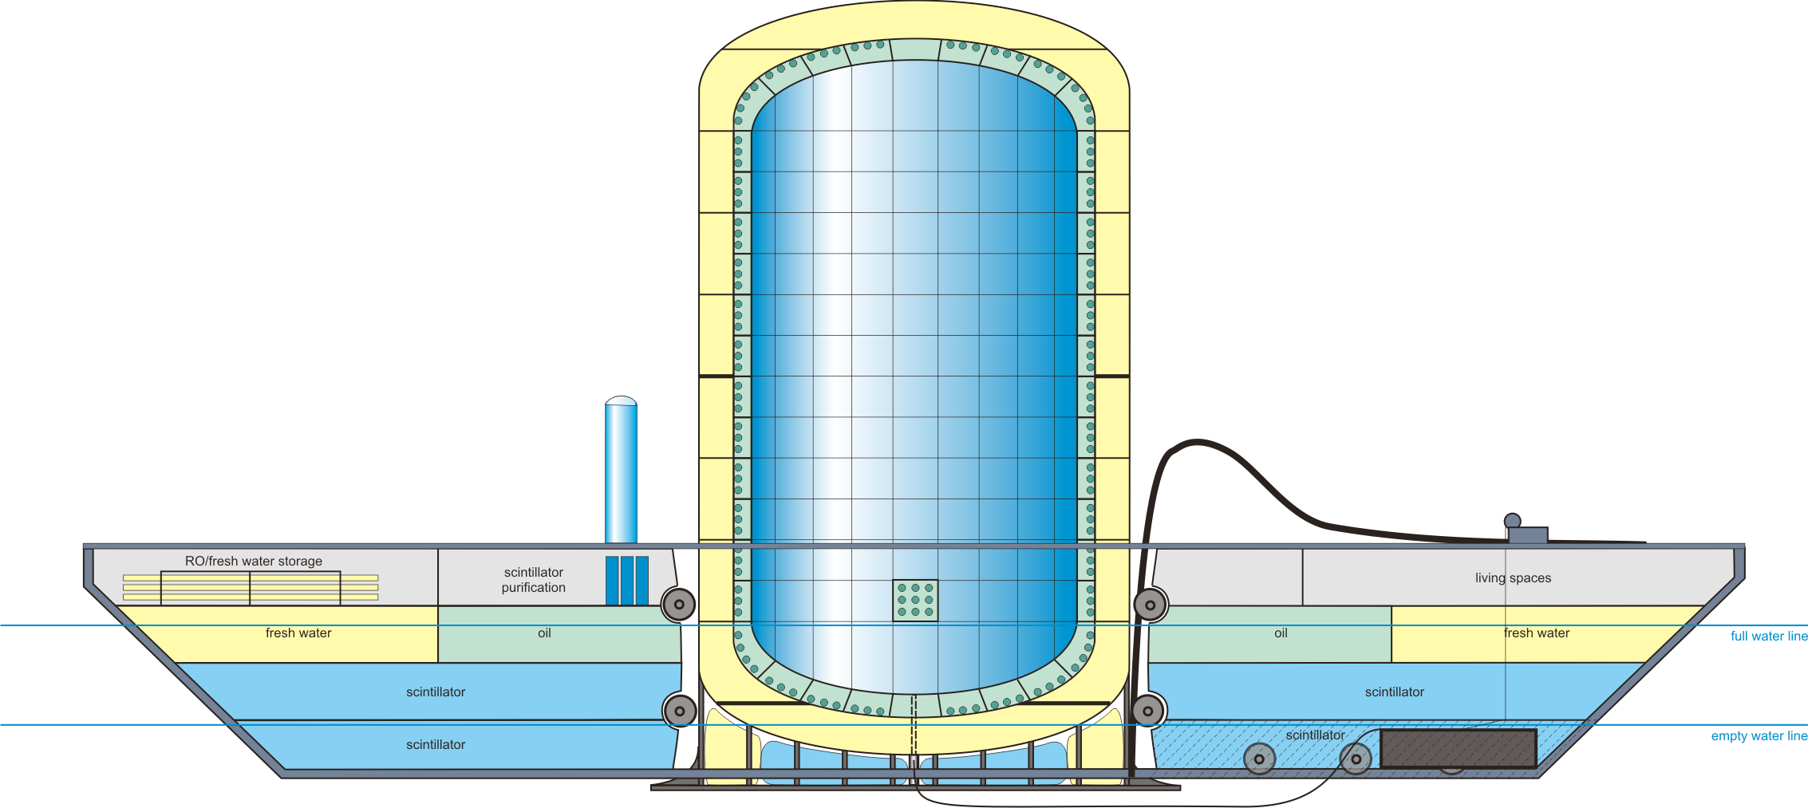
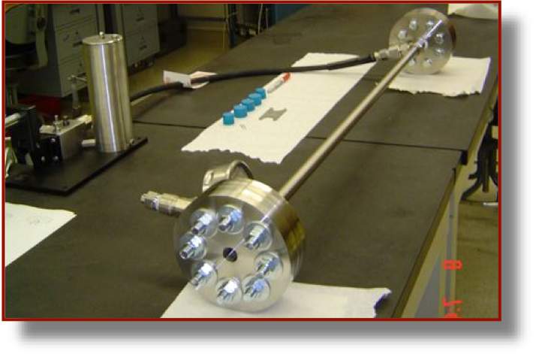
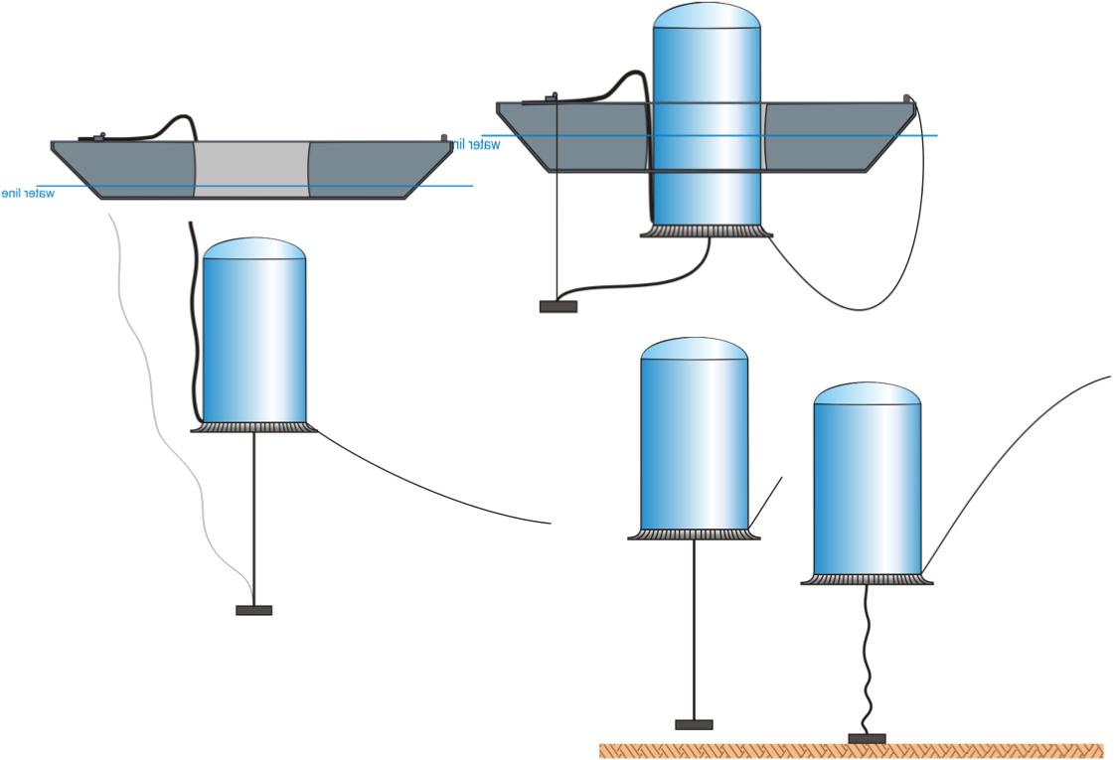
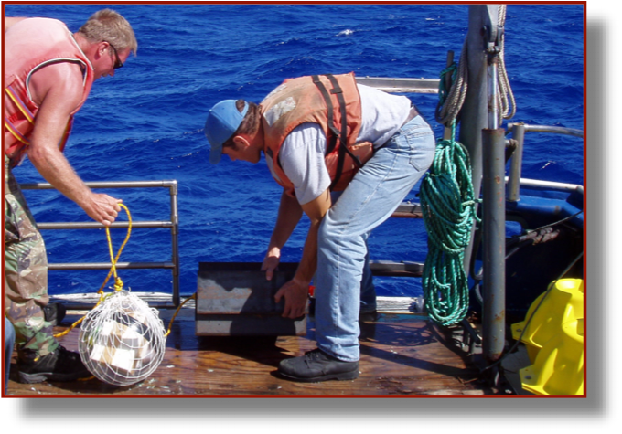
Hanohano
2005
2019
2020-2025
we are here
~20 kg
1-10 t
~1.5 kt
10-50 kt
“Hanohano”
2005
U. Hawaii & Makai Ocean Engineering
Technical tests and detector design
10~50 kT
1~5 kmwe
movable
45m
26m
Vessel : 112m × 32m

Slide 9
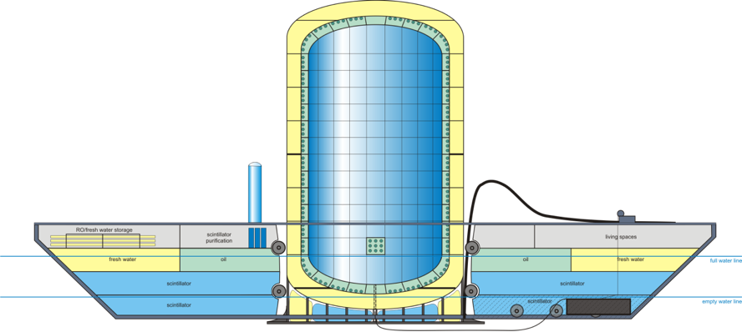

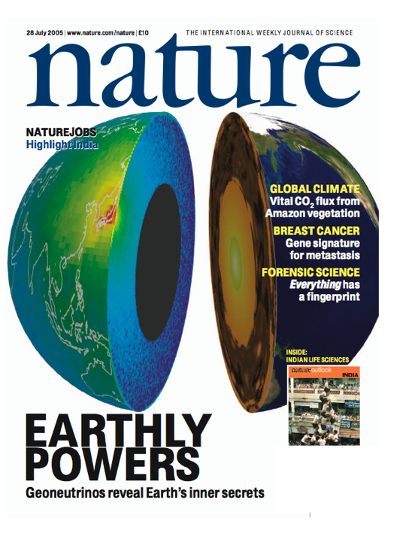




Neutrino Geoscience: Current and Future
what we need
improved accuracy of
measurement
&
modelling
multi-site measurement
directional sensitive detector
new type detector
An Ocean Bottom Detector
current generation
next generation
what we learn
total radiogenic heat in the Earth
resolving vertical and horizontal flux differences
Measuring
Measuring
Th/U ratio
Measuring
Next Target!
distinguishing mantle contribution
detecting
K geo-neutrino
Measuring
OBD: breakthrough
beyond modern land-based detector
transforming our vision of deep Earth
first measurement in 2005

Slide 10




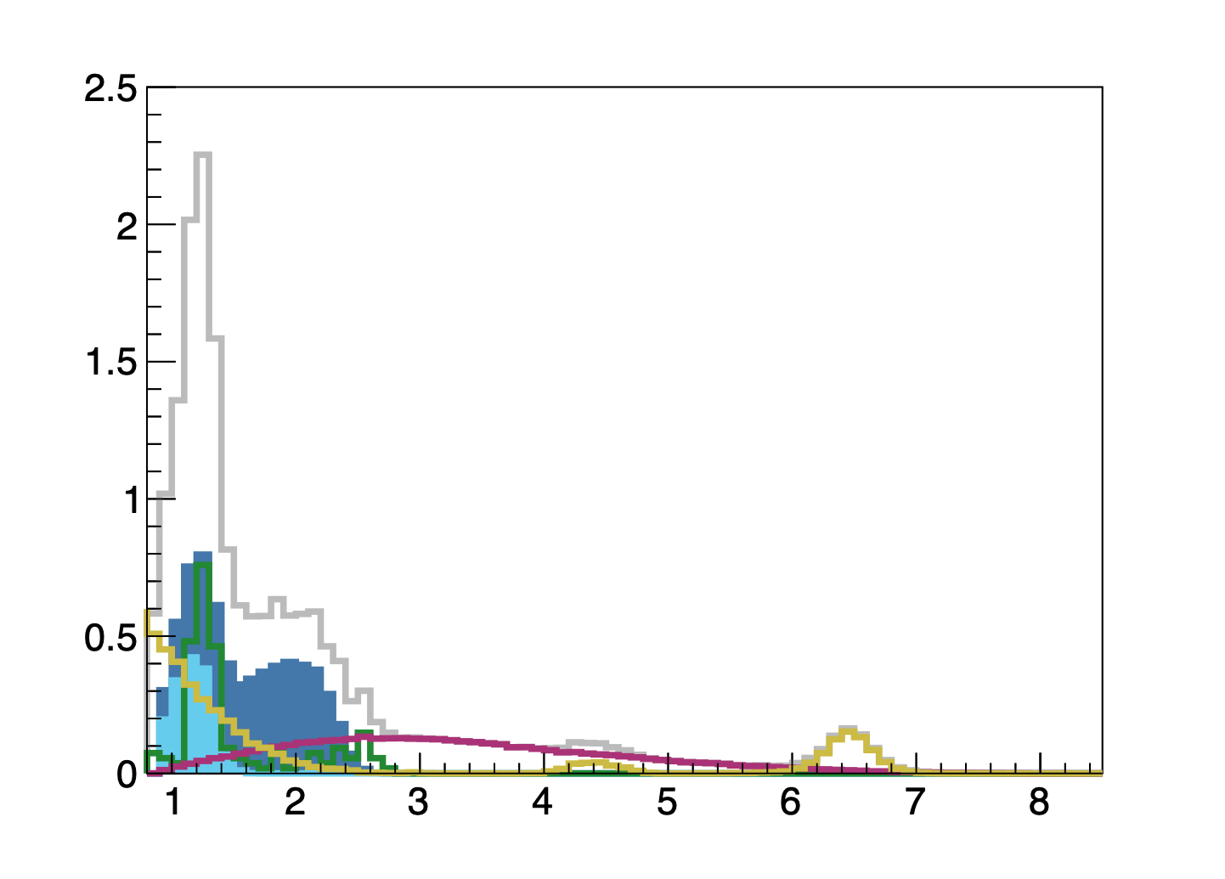
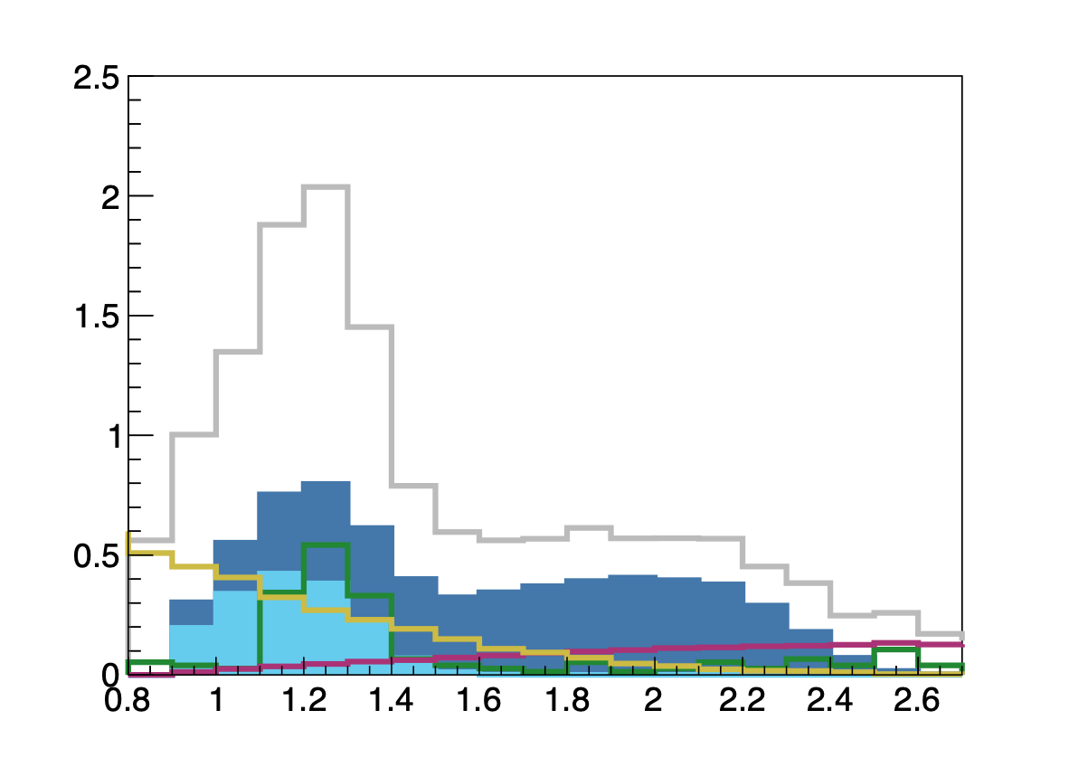

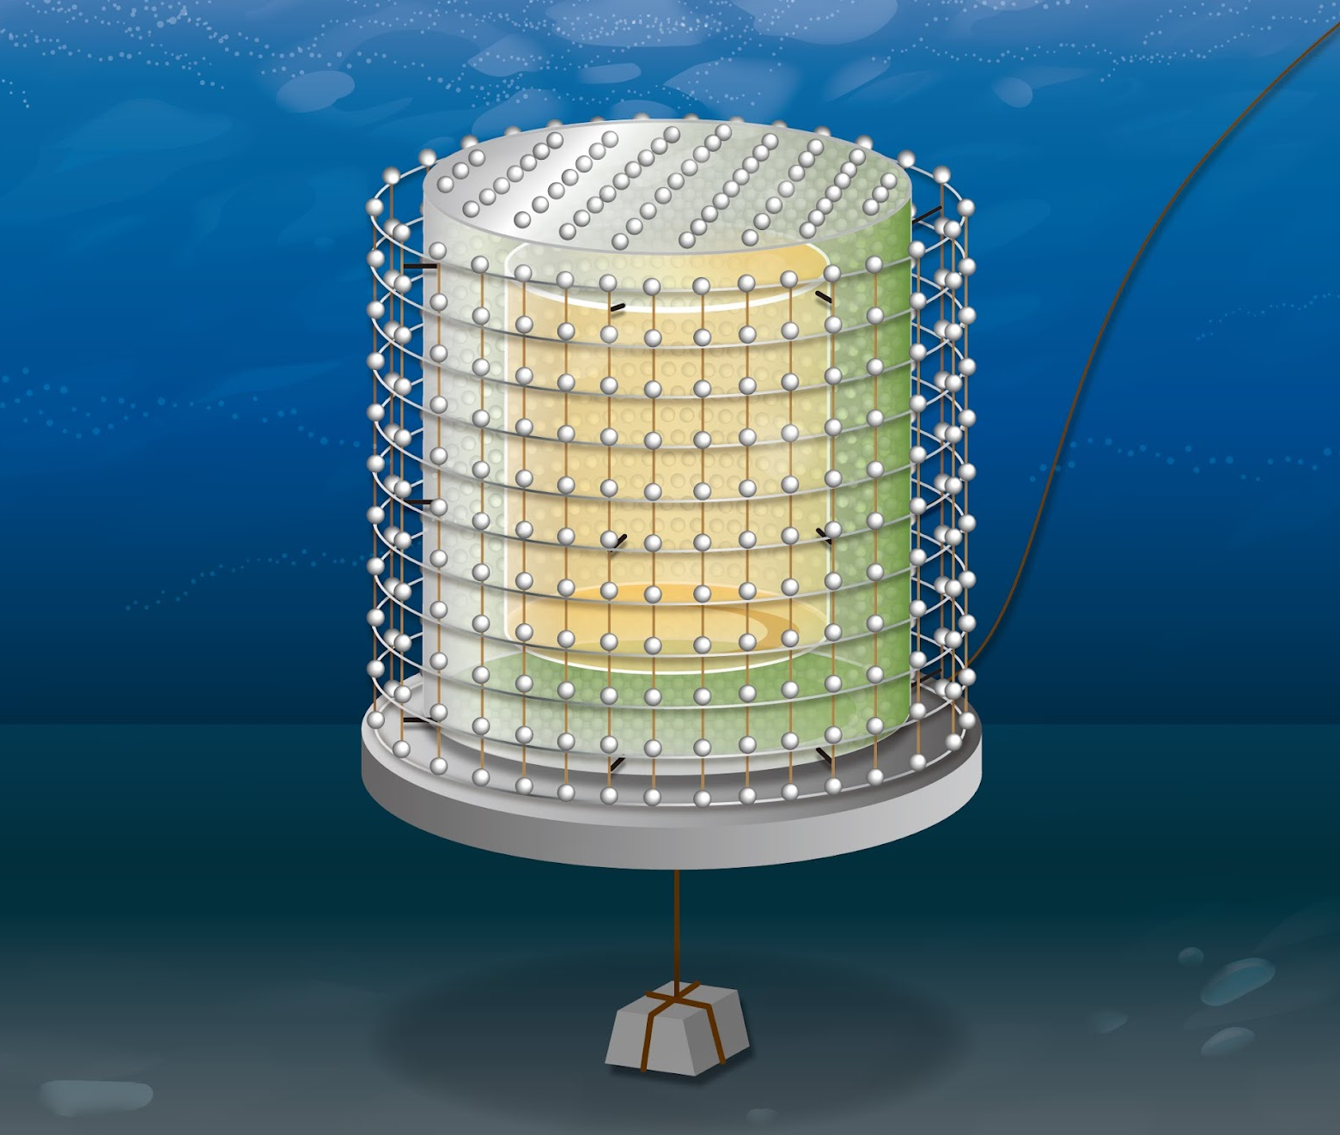
OBD Present & Future
we are here
funded
2005
2019
2020-2025
~20 kg
1-10 t
~1.5 kt
10-50 kt
Maturity of science
Technical demonstration & environment measurement in the sea
deep sea neutrino & muon flux, ocean water density & temperature, radioactivity
→ input parameters for ~1.5 kt detector design
deep sea neutrino & muon flux, ocean water density & temperature, radioactivity
→ input parameters for ~1.5 kt detector design
First clear mantle signal
Detector simulation study is in progress.
Hawaii is possible position.
Detector should be installed at ~4km deep sea to shield muons
Counts /0.1MeV/year
Stainless tank
OD PMT
Total
U
Th
Reactor neutrino
Accidental
(α,n)
Counts /0.1MeV/year
Total
U
Th
Accidental
Reactor neutrino
alpha,n
Buffer oil
ID PMT
Low T 2-4℃ High P 40MPa
Visible energy[MeV]
Acrylic vessel
LS
Signal
Backgrounds
E region | U | Th | Total | Reactor | Acci. | (α,n) | He-Li | Fast-neutron | Total
All | 6.59 (4.61) | 1.64 (1.15) | 8.23 (5.76) | 4.13 | 1.92 | 3.88 | 0 | <2.42 | 9.93
Geo-nu |  |  |  | 1.53 | 1.90 | 2.96 | 0 | <0.58 | 6.39
- 4 km deep sea
To reduce background caused by muons
ID PMT #3232
Placed inside the stainless tank
(mantle)
[Events/year]
Visible energy[MeV]
highQ model: 1year → 3.7σ
middleQ model: 3year→ 3.5σ
lowQ model: 10year→ 2.5σ
1month → 4.1σ
3month → 3.9σ
1year → 3.0σ
Mantle geoneutrino sensitivity
17 kt detector case

Slide 11
Risks
Glass PMTs implosion, leaks, etc.
Cost, deployment, mobility issues inertial mass
Cable Fiberoptics
Data?
Battery operation feasible?
Buffer and veto volumes most of inertial mass
Depth requirement
4 km
Detector mass:
1t-10kt

Slide 12
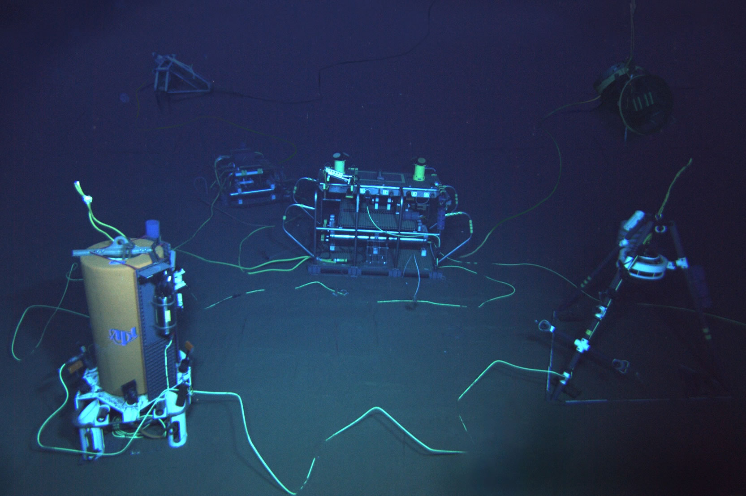
UH Meeting Station Aloha
Who? Blue Eisen (Marine Research Engineer)
What? Station ALOHA’s ALOHA Cabled Observatory (ACO)
When? Sept. 2025.
Where? 5km below the surface,
100km north of Oahu.
Why? Three methods to do
ocean bottom deployments,
SiPMs, etc.
https://aco-ssds.soest.hawaii.edu/

Slide 13
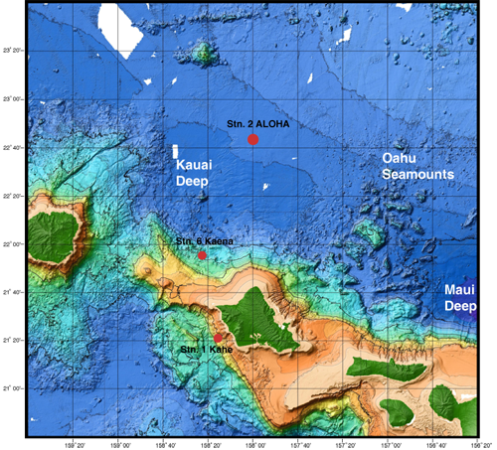
Station Aloha - ACO

Slide 14
Blue Eisen
thus suggested
the mineral oil method
for pressure tolerance.
1atm with nitrogen or air, cool old air
Expensive bulky heavy casing
Submerge in oil (40MPa)
Pressure balanced
Epoxy (40MPa)
Deep camera (Deep Sea Eye)
3d printed box, filled with epoxy
Will experience compression
Even matrix with chop fibers
Notes:
Slava says pros and cons, table,

Slide 15
Next steps
Step 1
Talk to other ocean bottom experiments (KM3NeT, etc.)
Step 2
Synergize with Tohoku U. on testing components for possible use in OBD.
Step 3
Work with national labs to facilitate next steps for both research and career.

Slide 16
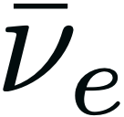
Summary
Measure Radiogenic Heat and the Core-Mantle Boundary: Unique composition measurement via geo-neutrinos.
Testing of Q models and flux via an Ocean Bottom Detector project lead by Tohoku U. Specifically, professors Hiroko Watanabe and Bill McDonough.
Risk white paper, input from Blue Eisen (UH Station Aloha).
Test SiPMs, coordinate with other deep ocean technology projects (many have military implications).

Slide 17




Thank you!

