Slide 1



Predicted Sensitivity of Neutrino Oscillation Tomography to the Properties of Large Low-Velocity Provinces in the Lower Mantle
Authors: Yael Deniz¹, Eric Mittelstaedt¹, Joao Coelho², Veronique VanElewyck^{2,3}, Isabel Goos^{2,4}, Stephanie Durand⁵, Nobuaki Fuji^{3,4}.
¹University of Idaho, Department of Earth and Spatial Sciences, Moscow, ID, United States
²Université Paris Cité, CNRS, Astroparticule et Cosmologie
³Institut Universitaire de France
⁴Université Paris Cité, Institut de Physique du Globe de Paris, CNRS
⁵Laboratoire de Géologie de Lyon: Terre, Planètes, Environnement, CNRS, UMR 5276, École Normale Supérieure de Lyon, Université de Lyon, Université Claude Bernard Lyon
EAR-2406115

Slide 2
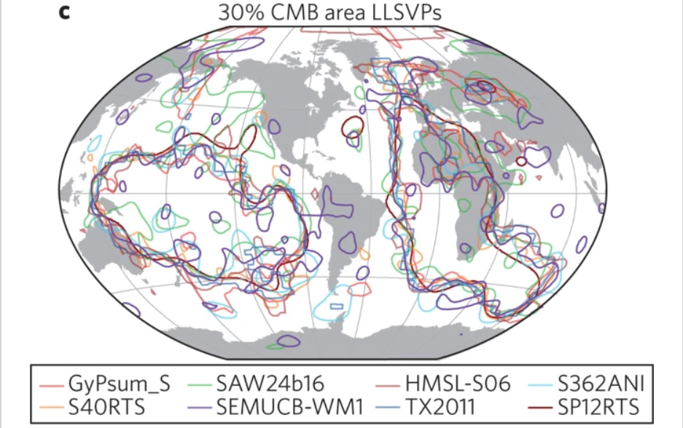
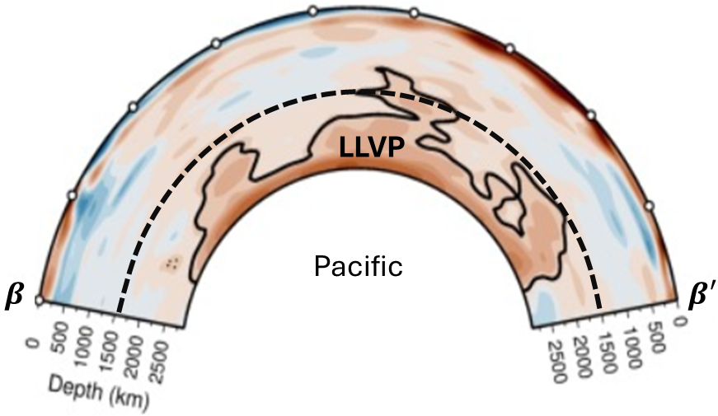
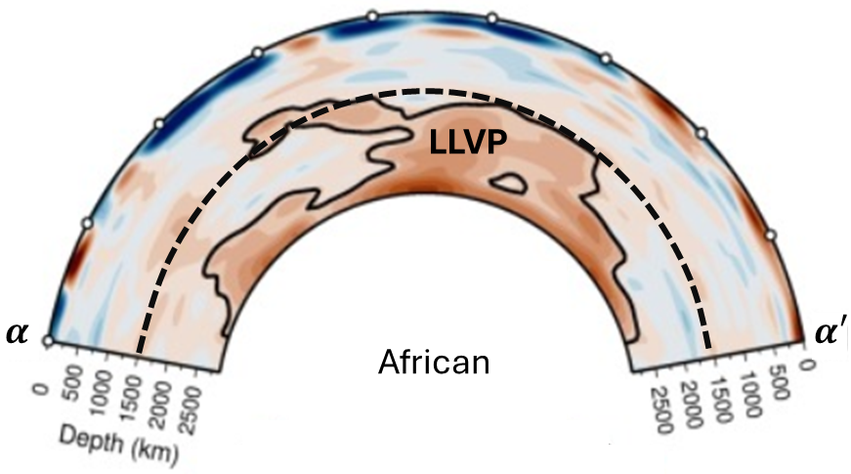

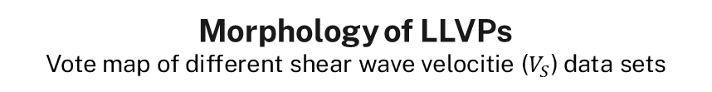
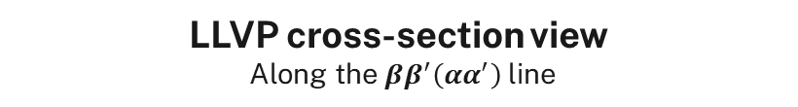

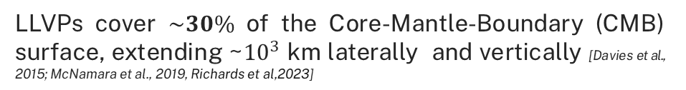


Seismic data reveals two Large Low Velocity Provinces (LLVPs) a top of the Core-Mantle-Boundary(CMB)
Morphology of LLVPs
Vote map of different shear wave velocitie ($V_{S}$) data sets
LLVP cross-section view
Along the $ββ^{′}\left(αα^{′}\right)$ line
$$α$$
$$β$$
Pacific
LLVP
$$β′$$
$$α′$$
Vote map modified from [Lekic et al., 2012; Garnero et al., 2016]
LLVPs cover $\sim 30\%$ of the Core-Mantle-Boundary (CMB) surface, extending ~${10}^{3}$ km laterally and vertically [Davies et al., 2015; McNamara et al., 2019, Richards et al,2023]
African
LLVP
Cross section views from [Richards et al,2023]

Slide 3
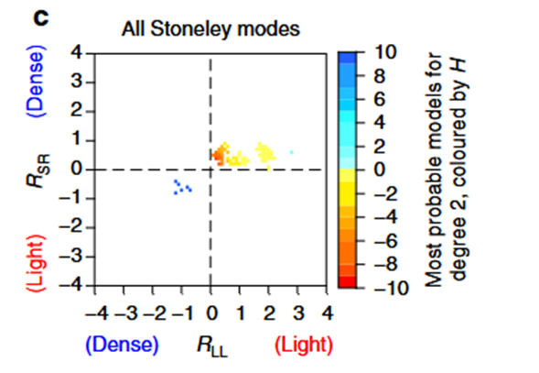
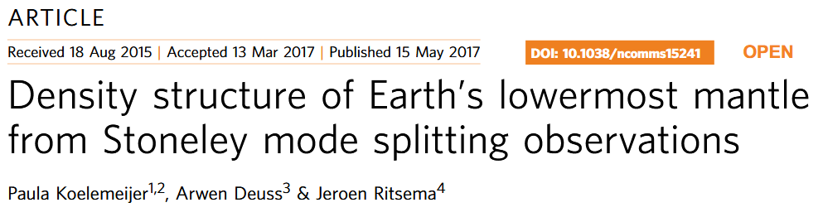
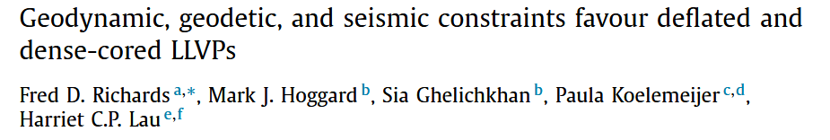
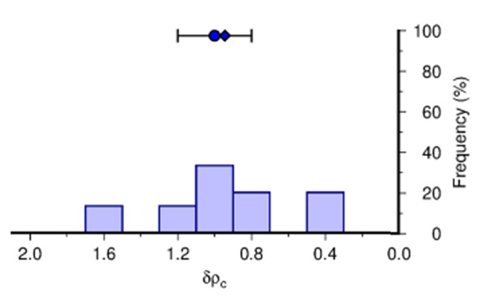
Current estimates of LLVP matter properties are uncertain. Different constraints sometimes produce contradictory results
Less dense
Most-probable models have overall less dense LLVPs relative to surroundings (~ −0.88% )
Modified from [Koelemeijer et al, 2017]
~200 km above the CMB
More dense
Bottom ~100–200 km of LLVPs is more dense
[Richards et al, 2023]

Slide 4
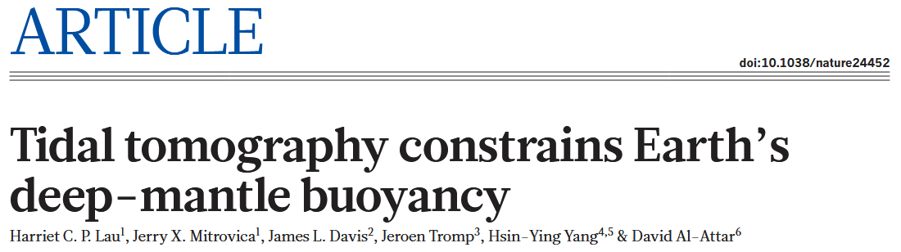
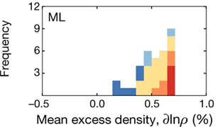
Current estimates of LLVP matter properties are uncertain. Different constraints sometimes produce contradictory results
Less dense
Denser LLVP
Most-probable models have overall less dense LLVPs relative to surroundings (~ −0.88% )
~300 km above the CMB
Modified from [Koelemeijer et al, 2017]
The bottom ~2/3 of the LLSVPs are about 0.5–0.6% denser than average mantle
~200 km above the CMB
More dense
Modified from [Lau et al, 2017]
Bottom ~100–200 km of LLVPs is more dense
[Richards et al, 2023]

Slide 5
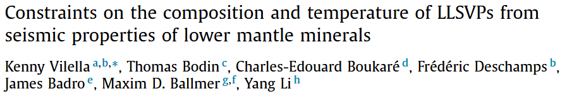
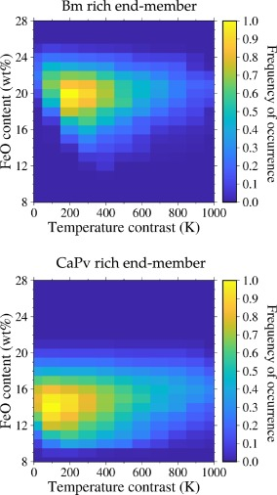
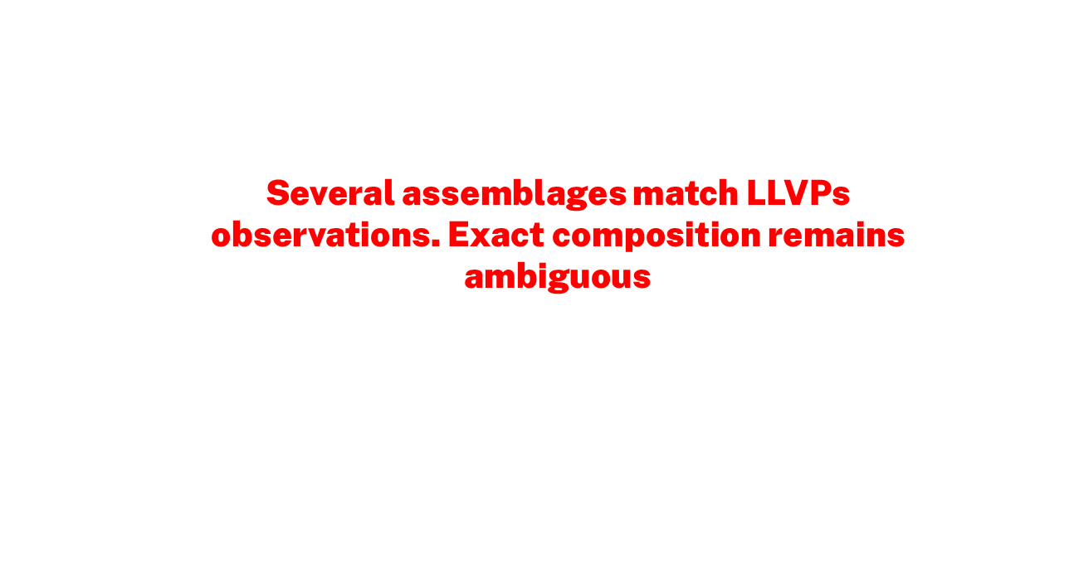
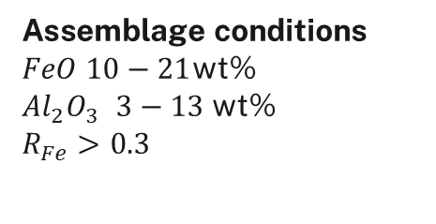
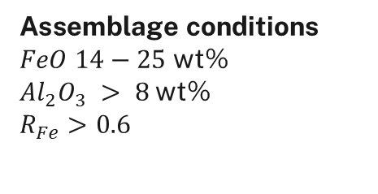
Current estimates of LLVP matter properties are uncertain. Different constraints sometimes produce contradictory results
79000 cases explain the
seismic observations
Bridgmanite (Bm)
[MgSiO3/ FeSiO3/ FeAlO3
Al2O3/ Fe2O3]
Ca-Perovskite (CaPv)
[CaSiO3]
Ferropericlase (Fper)
[MgO, FeO]
>40 Vol % of CaPv
<6 Vol % of Fper
>90 Vol % of Bm
<6 Vol % of Fper
Assemblage conditions
$FeO$ $14−25$wt%
$Al_{2}O_{3}$ $> 8$wt%
$R_{Fe}$ $>0.6$
Assemblage conditions
$FeO$ $10−21$wt%
$Al_{2}O_{3}$ $3−13$wt%
$R_{Fe}$ $>0.3$
Endmember histograms modified from [Vilella et al, 2021]

Slide 6
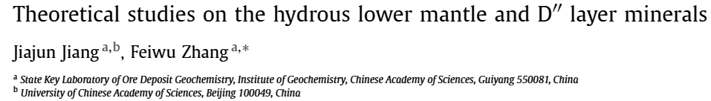
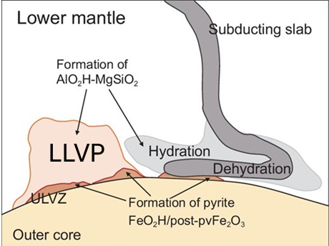
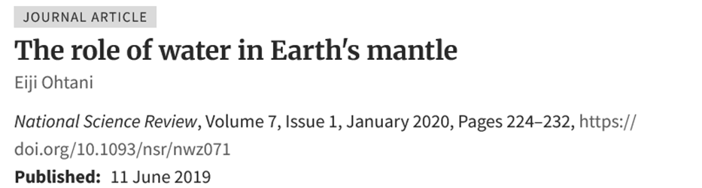
We have no constraints on the possible presence of hydrogen in LLVPs
Presence of hydrogen in lower mantle minerals
LLVP
Water (Hydrogen) inclusion in lower-mantle perovskites (e.g., Bridgmanite) may explain LLVP seismic signal
[Othani et al, 2019; Jiang & Zhang, 2019]
Modified from [Othani et al, 2019]
Constraints on lower-mantle hydrogen are scarce

Slide 7
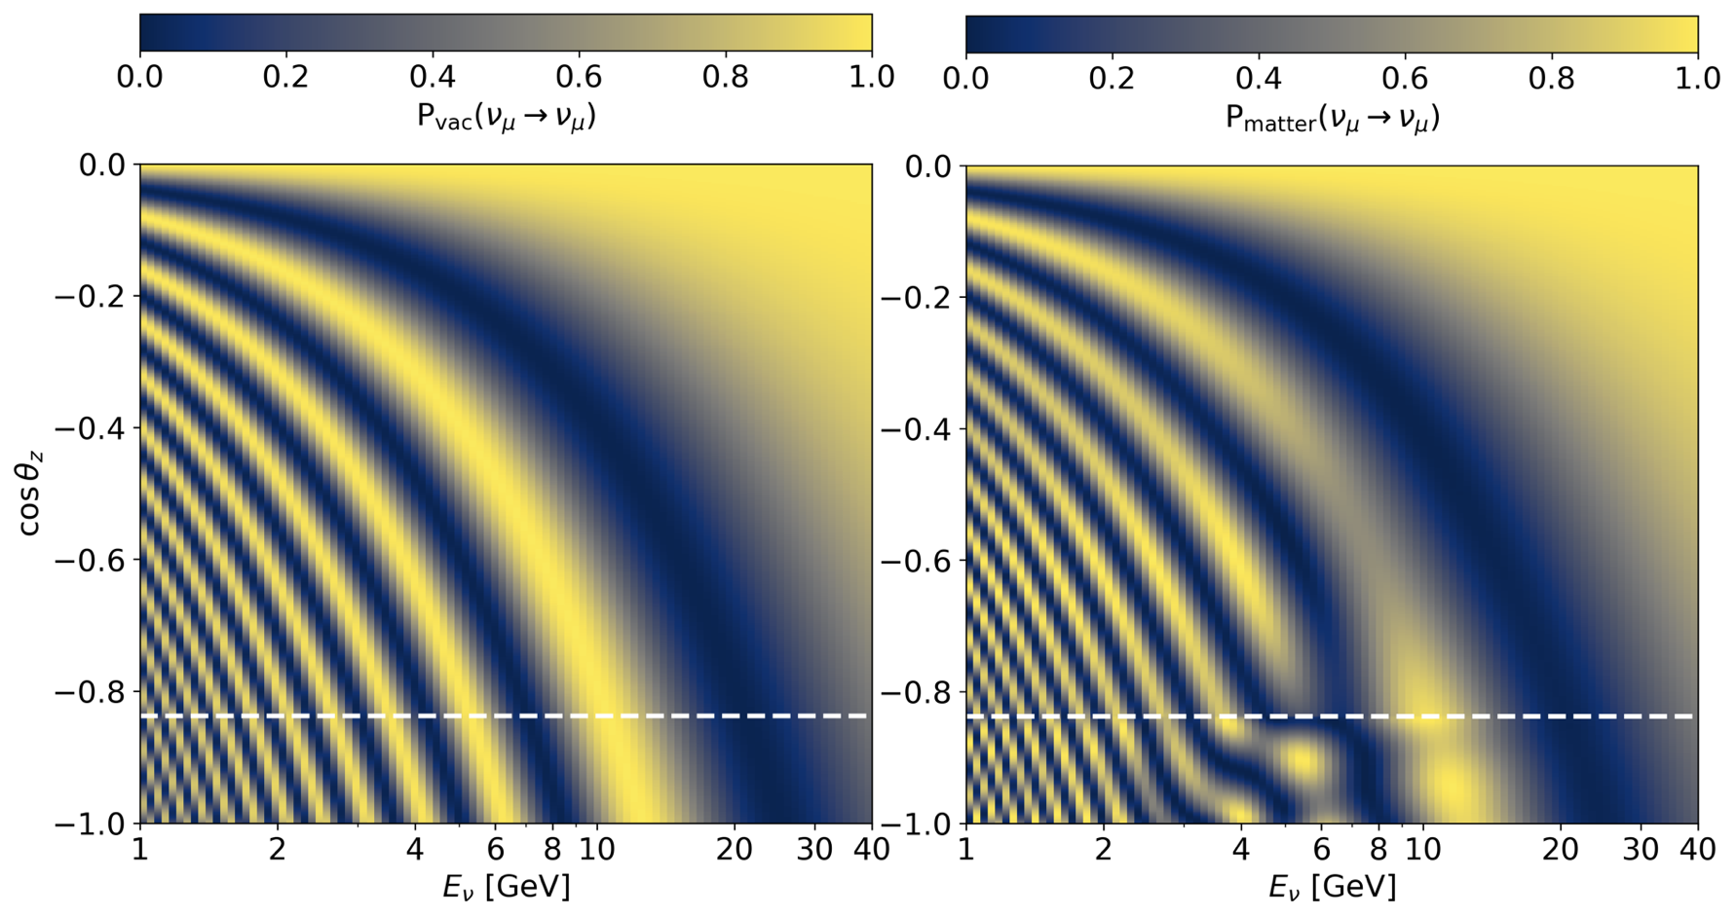
Different Earth matter profiles produce different neutrino oscillation probabilities
Oscillation probability distribution for different matter profiles
Oscillograms taken from [Goos et al]

Slide 8
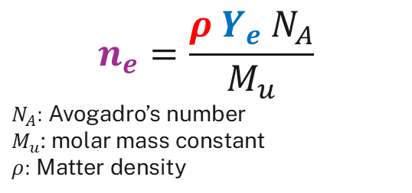
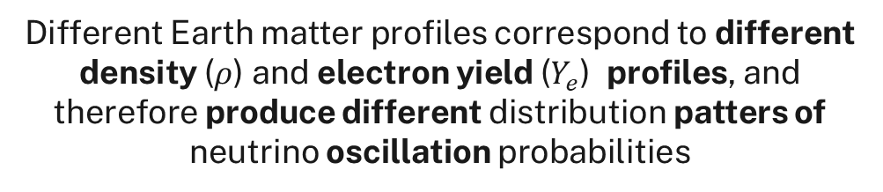
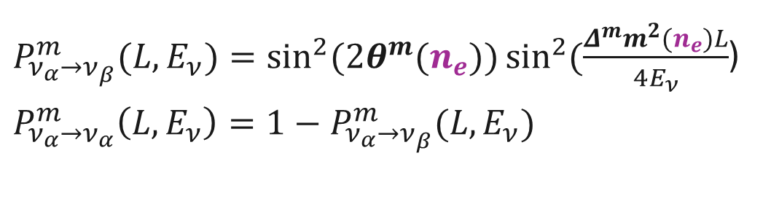
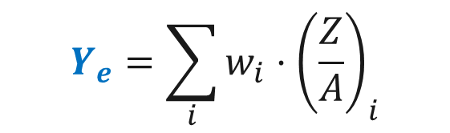
Different Earth matter profiles produce different neutrino oscillation probabilities
Oscillation probability distribution for different matter profiles
Two-flavor approximation oscillation probability
Electron number density:
$P_{ν_{α}→ν_{β}}^{m}(L,E_{ν})=\sin^{2}{(2θ^{m}(n_{e}))}\sin^{2}{(\frac{Δ^{m}m_{ }^{2}(n_{e})L}{4E_{ν}}}$)
$P_{ν_{α}→ν_{α}}^{m}\left(L,E_{ν}\right)=1−$ $P_{ν_{α}→ν_{β}}^{m}(L,E_{ν})$
$$n_{e}=\frac{ρ{ Y}_{e} N_{A}}{M_{u}}$$
$N_{A}:$ Avogadro’s number
$M_{u}$: molar mass constant
$ρ:$ Matter density
Electron yield
(Number ratio of protons (Z) to nucleons (A)):
Different Earth matter profiles correspond to different density ($ρ$) and electron yield ($Y_{e}$) profiles, and therefore produce different distribution patters of neutrino oscillation probabilities
$$Y_{e}=\sum_{i}{w_{i}⋅{\left(\frac{Z}{A}\right)}_{i}}$$
**Sum over all elements that make up the propagation medium
Oscillograms taken from [Goos et al]

Slide 9
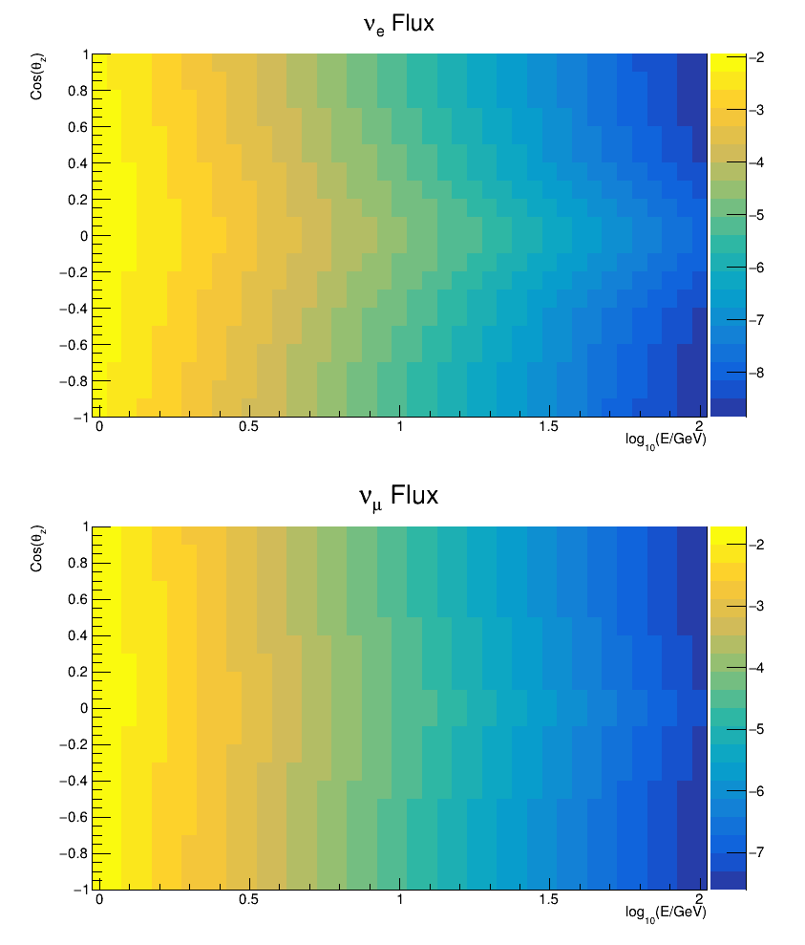
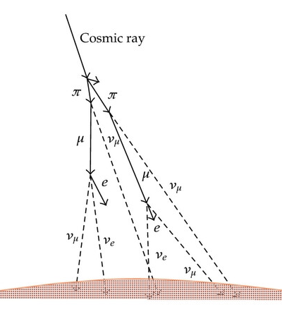
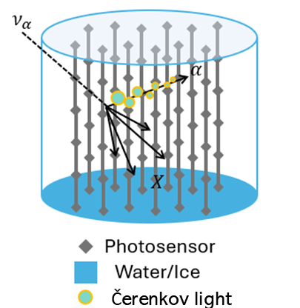






Oscillation tomography exploits the matter dependence of neutrino oscillation probabilities to probe Earth’s interior.
Oscillation Tomography: The Checklist
1) Neutrino Source: Atmosphere
2) Propagation model for the Earth
3) Neutrino detector
(e.g., Cherenkov)
$$θ_{z}=180°$$
$$p^{+}$$
$$p^{+}$$
LM
4
UP
OC
IC
$$ν_{μ}$$
$$ν_{e}$$
Modified from [Kajita, 2012]
Neutrino flux obtained by interpolating the Honda flux tables [Honda et al, 2015]
$$θ_{z}=90°$$
Cherenkov detector
Cartoon taken from [Kajita et al, 2010]

Slide 10
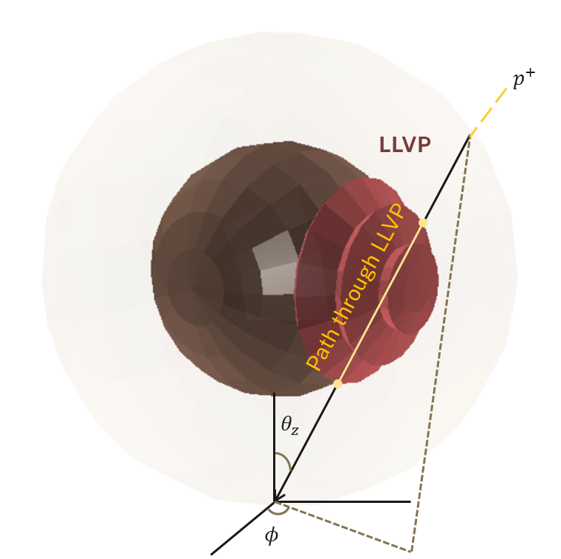
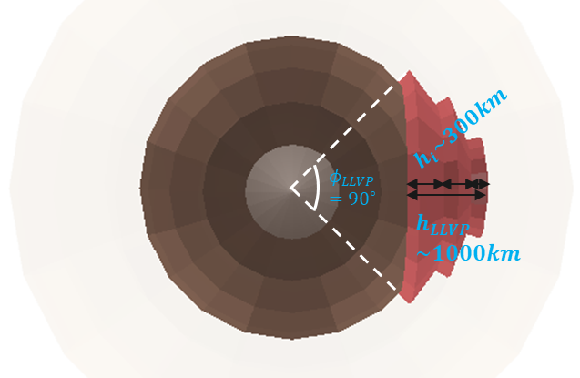
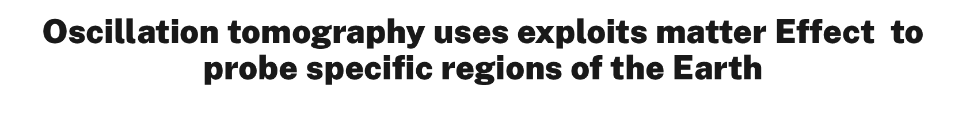
Oscillation tomography uses exploits matter Effect to probe specific regions of the Earth
The m-LLVP: a simplified geometric model that approximates the true, complex shape of LLVPs
Detector-Centered
Spherical Coordinates
Cherenkov detector
For simplicity, the detector location is chosen to be the South Pole.
the South Pole view

Slide 11
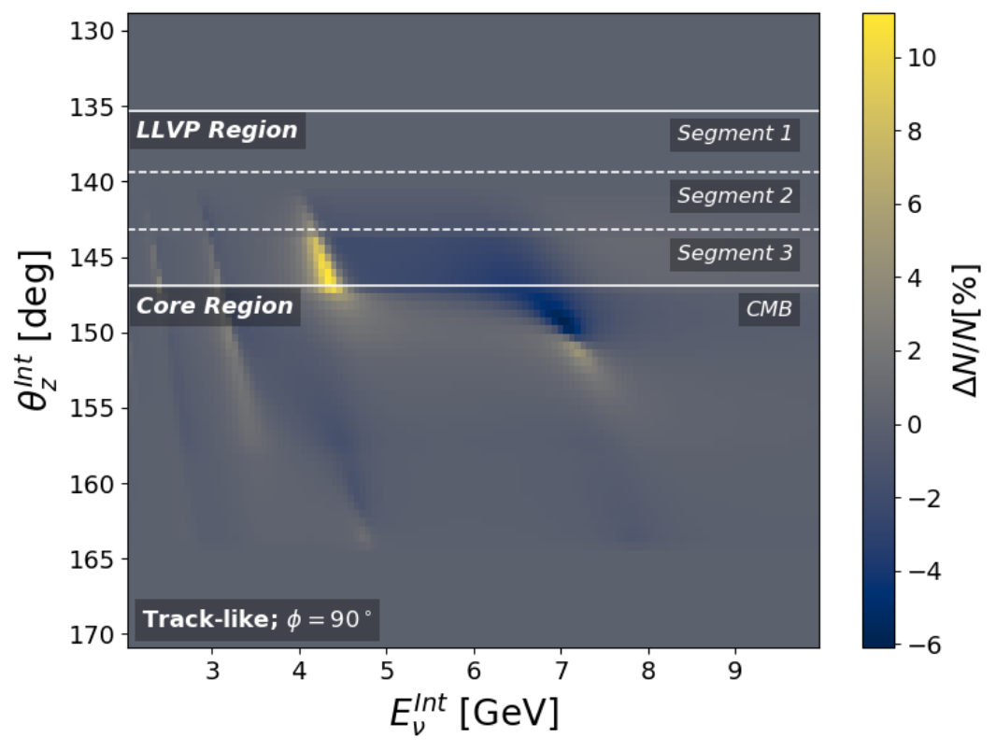





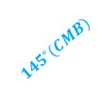


The Presence of the m-LLVP modifies the distribution of neutrino events
Ideal detector
Visualization of neutrino directions in model
$ν_{μ}+{\overline{ν}}_{μ}$ detections
$ν_{μ}+{\overline{ν}}_{μ}$ detections
South Pole
$$θ_{z}$$
$φ={90}^{∘}$
$${145}^{∘}(CMB)$$
$${145}^{∘}(LLVP top)$$
$$φ=0$$

Slide 12
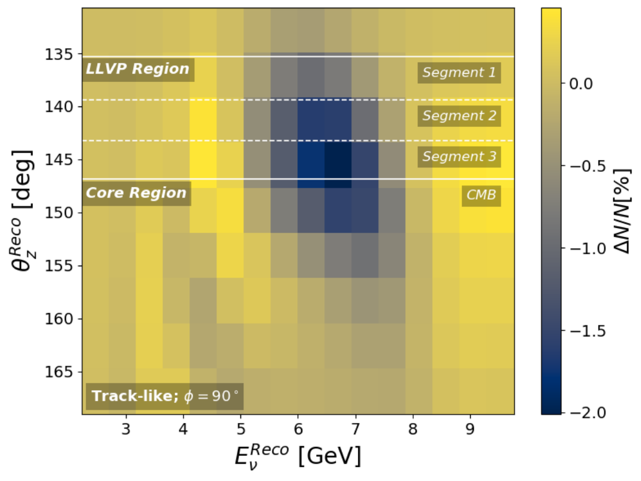

The Presence of the m-LLVP modifies the distribution of neutrino events
To generate a realistic event distribution, we must include detector resolution effects
Ideal detector
Realistic detector
**Resolution of a Next-Gen detector
$ν_{μ}+{\overline{ν}}_{μ}$ detections
$ν_{μ}+{\overline{ν}}_{μ}$ detections
Notes:
Mentioned th detector resolution of a next gen detector
5%+10%/\sqrt(E^{int})
2+10/\sqrt(E)

Slide 13
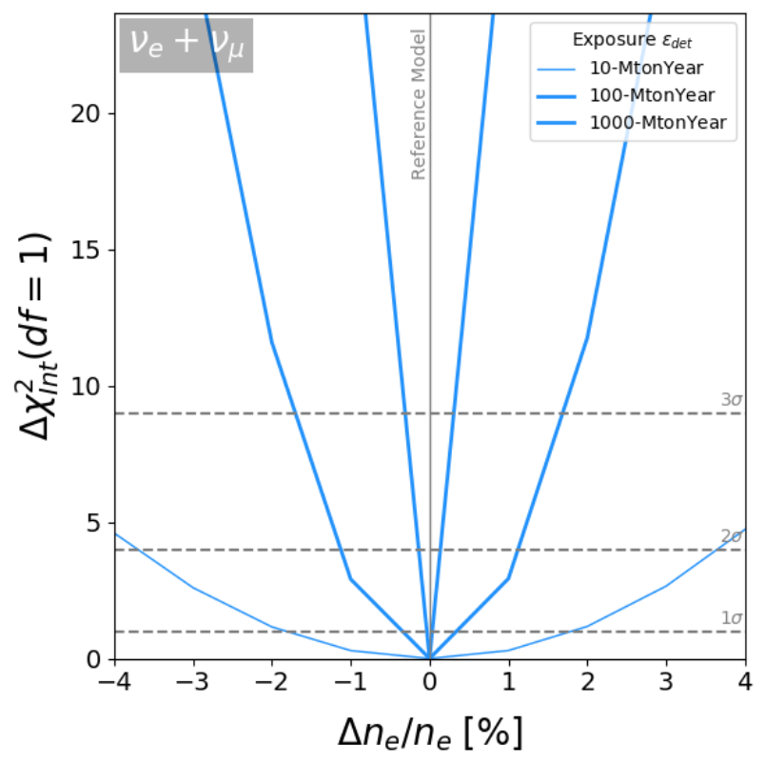
LLVPs are resolvable by neutrino detectors
The $Δ{χ(1)}^{2}$ test between $n_{\exp{ }}$(PREM) and $n_{\operatorname{obs}{ }}$(m-LLVP) gives sensitivity
Perfect resolution
Tracks +
Cascades
100-MtonYear
1000-MtonYear
Preliminary
10-GtonYear

Slide 14
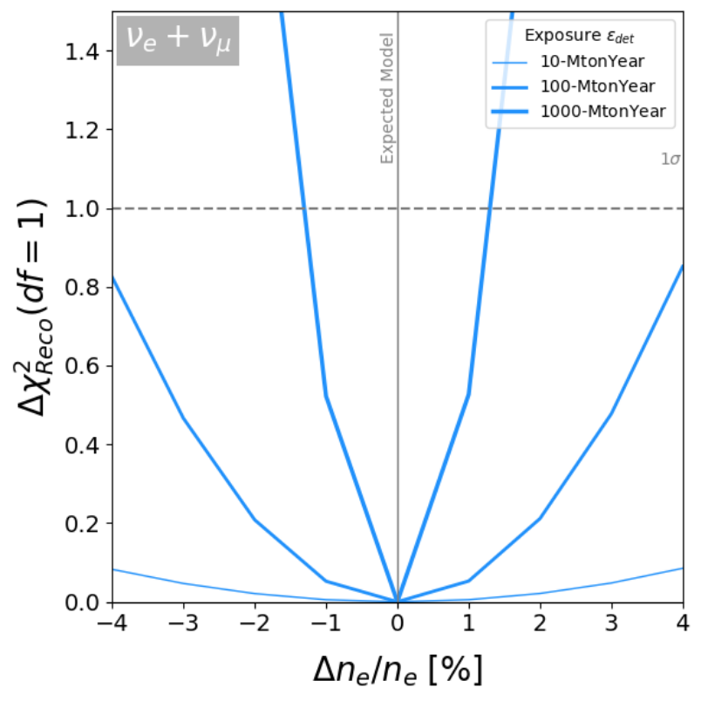
LLVPs are resolvable by neutrino detectors
The $Δ{χ(1)}^{2}$ test between $n_{\exp{ }}$(PREM) and $n_{\operatorname{obs}{ }}$(m-LLVP) gives sensitivity
Perfect resolution
Realistic resolution
Tracks +
Cascades
Tracks +
Cascades
100-MtonYear
100-MtonYear
1000-MtonYear
1000-MtonYear
Preliminary
10-GtonYear
Preliminary
10-GtonYear

Slide 15
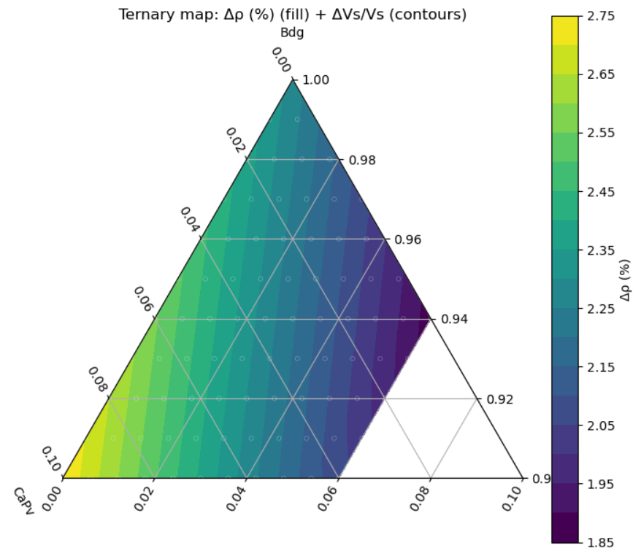
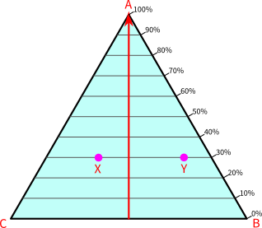
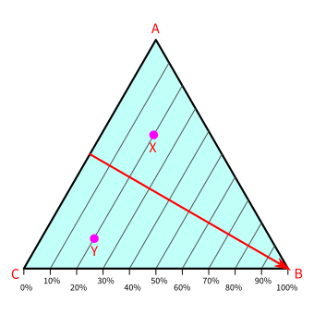
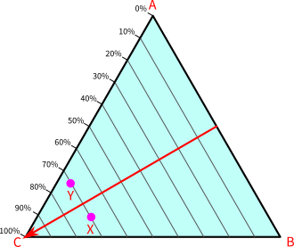
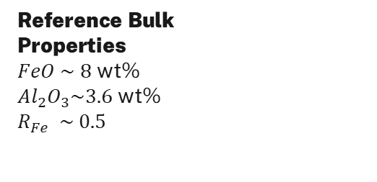
Using Vilella et al.’s end-member composition, we choose assemblages that meet the stated bulk conditions
Density contrast for different assemblages
How to read
Phases in the LLVP assemblage
Bm-rich like
Bridgmanite (Bm)
MgSiO3 / FeSiO3 / FeAlO3 / Al2O3 / Fe2O3
Reference mol % 89.6/ 3.7/ 3.7/ 3/ 0
Reference vol % 75
Ca-Perovskite (CaPv)
CaSiO3
Reference vol % 7
Ferropericlase (Fper)
MgO / FeO
Reference mol % 81.4/ 0.186
Reference vol % 18
CaPv
Bm
Reference composition
Reference Bulk
Properties
$FeO \sim 8$ wt%
$Al_{2}O_{3}\sim 3.6$ wt%
$$R_{Fe} \sim 0.5$$
Fp

Slide 16
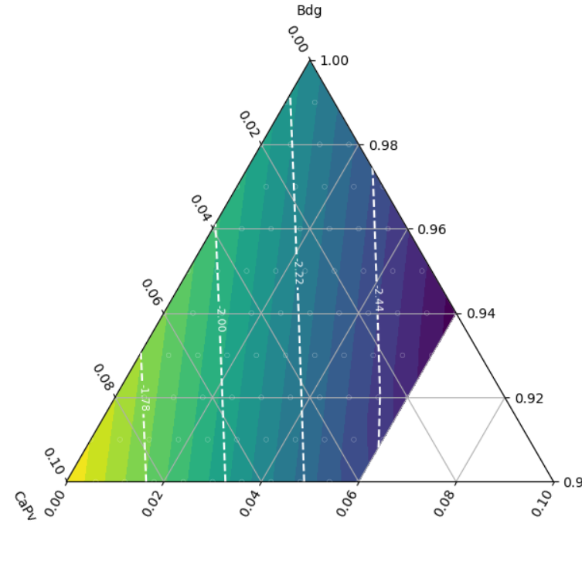

Using Vilella et al.’s end-member composition, we choose assemblages that meet the stated bulk conditions
Contours of same $V_{s}[\%]$ anomaly
Contours of same$n_{e}[\%]$ constrast
Bridgmanite (Bm)
MgSiO3 / FeSiO3 / FeAlO3 / Al2O3 / Fe2O3
Reference mol % 89.6/ 3.7/ 3.7/ 3/ 0
Reference vol % 75
Ca-Perovskite (CaPv)
CaSiO3
Reference vol % 7
Ferropericlase (Fper)
MgO / FeO
Reference mol % 81.4/ 0.186
Reference vol % 18
CaPv
CaPv
Bm
Bm
Reference composition
Fp
Fp

Slide 17
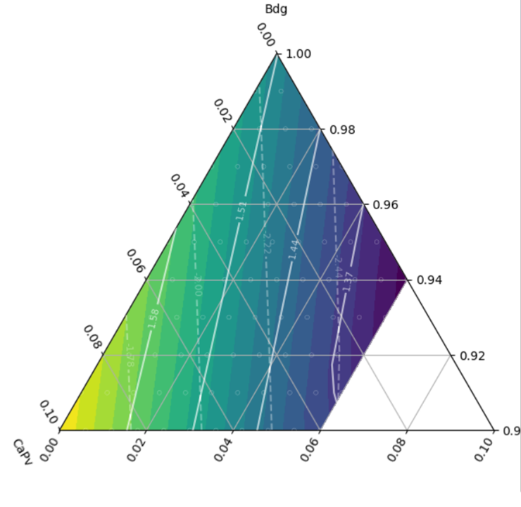
Using Vilella et al.’s end-member composition, we choose assemblages that meet the stated bulk conditions
Contours overlap
CaPv
Bm
Fp

Slide 18
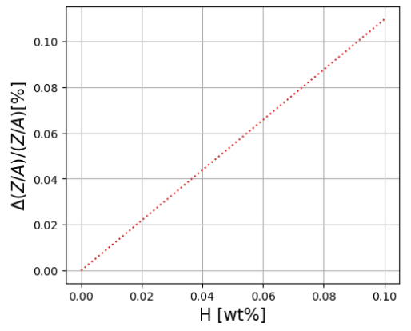
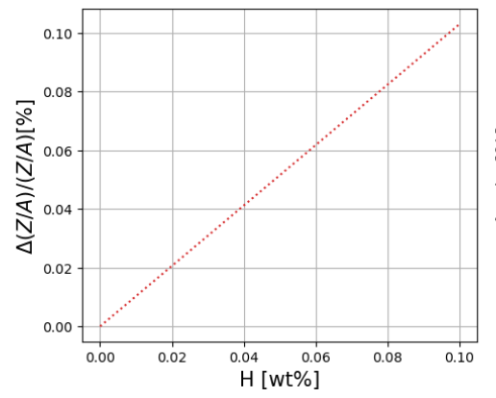

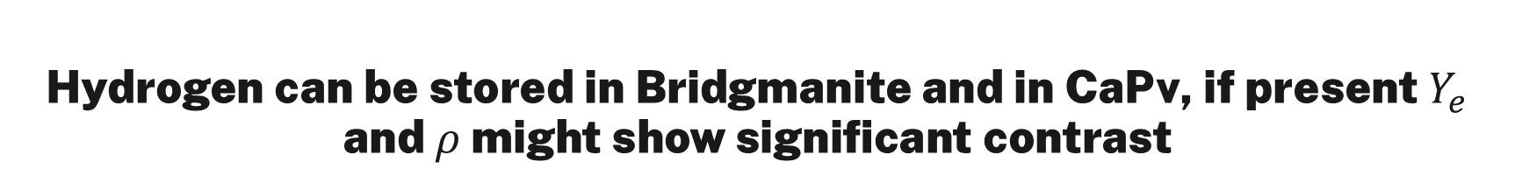



Hydrogen can be stored in Bridgmanite and in CaPv, if present $Y_{e}$ and $ρ$ might show significant contrast
Mechanism: $Mg_{1−x}H_{2x}SiO_{3}$
Mechanism: ${Ca}_{1−x}H_{2x}SiO_{3}$
Estimated storage capacity up to 0.1 wt%
Estimated storage capacity up to 0.2 wt%
Preliminary
Preliminary
$ΔY_{e}/Y_{e}$[%]
$ΔY_{e}/Y_{e}$[%]

Slide 19





Hydrogen can be stored in MgSiO3 and in CaPv, if present $Y_{e}$ and $ρ$ might show stronger contrast
Hydrous Bm: $Mg_{1−x}H_{2x}SiO_{3}$
Hydrous CaPv: ${Ca}_{1−x}H_{2x}SiO_{3}$
Hydrous Bridgmanite cell cluster
Estimated storage capacity up to 0.1 wt%
Estimated storage capacity up to 0.2 wt%
Preliminary
Preliminary
[Zhang et al, 2025]
$ΔY_{e}/Y_{e}$[%]
$ΔY_{e}/Y_{e}$[%]
The effect on density is not trivial. From self-consistent DFT calculations, the presence of hydrogen might increase the unit-cell volume of bridgmanite (and possibly CaPv), which can reduce density.

Slide 20

Concluding remarks
There is a theoretical LLVP signal. The job now is to increase sensitivity by:
  Pushing the detector performance as close as possible to the ideal case
  Increasing exposure, $ε_{exp}$, since $Δχ_{σ}^{2}=ε_{exp}Δχ^{2}$ → My proposal: multi-detector configuration
Electron number density could serve as a new independent constraint for deep Earth geophysics
Ongoing and Future Work
Improving sensitivity: exploring a multi-detector approach
Incorporating the effect of hydrogen in LLVP minerals

Slide 21

Thank you

Slide 22
Supplementary Slides

Slide 23


LLVP dimensions (Pacific)
Distance ($∘$)
From [Cottas & Lekic, 2016]

Slide 24

LLVP dimensions (African)
Distance ($∘$)
From [Cottas & Lekic, 2016]

Slide 25








Lower mantle minerology
Cation vacancy mechanisms:
Brigmanite ($MgSiO_{3}$-perovskite)
$Mg_{1−x}H_{2x}{SiO}_{3}$
$MgH_{4x}{{Si}_{1−x}O}_{3}$
Davemanite (Ca$SiO_{3}$-perovskite)
Bdm
${Ca}_{1−x}H_{2x}{SiO}_{3}$
Dvm
$CaH_{4x}{{Si}_{1−x}O}_{3}$
Fp
From [Garnero, 2016]
From [Kamisky, 2012]

Slide 26





Detector Parametrization
Taken from [Maderer et al; 2023]
Angular resolution parametrization
( Von-Mises Fisher )
$$\frac{κ}{4π\sinh{κ}}e^{{κ⋅x\left(θ_{z}^{int},φ^{int}\right)}^{T}μ\left(θ_{z}^{reco},φ^{reco }\right) }sinθ_{z}^{int}$$
Energy resolution parametrization
(Gaussian)
$$\frac{1}{\sqrt{2π}σ_{E}(E^{int})}⋅e^{−\frac{1}{2}\frac{ {\left(E^{int}−E^{reco}\right)}^{2}}{σ_{E}^{2}(E^{int})}}$$
Concentration parameter $κ$:
$$κ\left(E^{int}\right)={\left(\frac{1}{σ_{E}\left(E^{int}\right)}\right)}^{2}$$
Next-Gen detector:
$$σ_{E}(E^{int})/E^{int}=\text{5}\text{\%}\text{+10}\text{\%/}√E^{int}$$
$σ_{∘}=2^{∘}+10^{∘}/$ $√E^{int}$
Notes:
5%+10%/\sqrt(E^{int})
2+10/\sqrt(E)

Slide 27



Event Calculation and binning scheme
Interacting rates
Reconstructed rates
Adaptative binning in energy
Notes:
Binning scheme copy and paste

Slide 28



Log-likelihood test
For poison distributed Neutrino dataset $\vec{N}=\{n_{ijk\left(lmn\right)}\}$
Hypotheis
$H_{0}={\vec{N}}_{Exp}\sim {\vec{N}}_{Obs}$ (No difference in dataset)
$H_{ }={\vec{N}}_{Exp}≠{\vec{N}}_{Obs}$ (Dataset is different)

Slide 29



Multiple candidate pathways may accumulate the compositionally distinct material thought to form thermochemical LLVPs
Remanent of a Proto Planet (Theia) Material
Primordial material
Subducted oceanic crust
LLVP
LLVP
Modified from [Labrosse et al 2007]
Modified from [Li & McNamara, 2022]
Modified from [Yuan et al, 2023]

