Slide 1
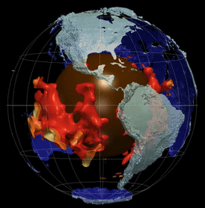
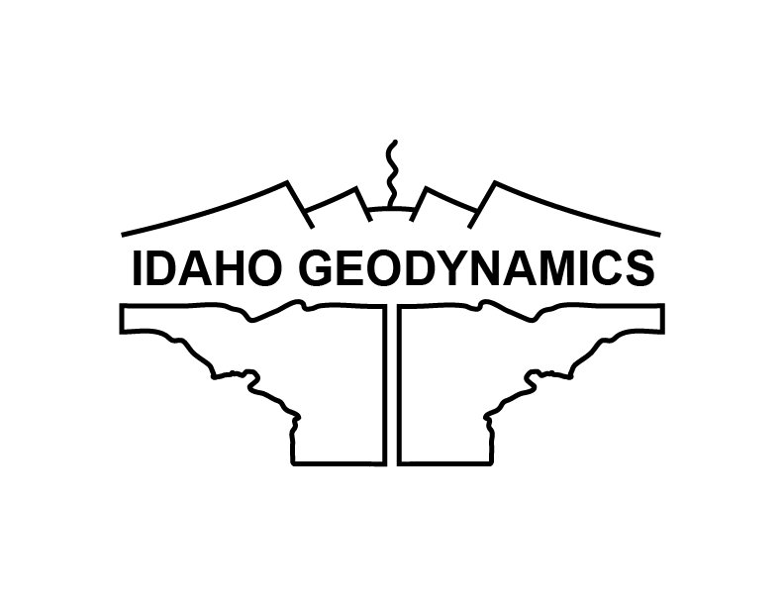



Effect of Coeval Continents and LLVPs on Mantle Dynamics and Earth’s Thermal Evolution
E. Mittelstaedt, Arnab Roy, Anna Sage Ross-Browning
University of Idaho
Hadeel Al Harthi, Catherine M. Cooper
Washington State University
Davaille & Romanowicz (2020)
Award # 2310324
Notes:
Thanks – convenors, intro, NSF
Today – want to talk about some ongoing work of my research group and that of Dr. Catherine Cooper at WSU. We are examining how both continents and large low velocity provinces (seen in red) may affect the heat and mass transfer through the mantle.

Slide 2
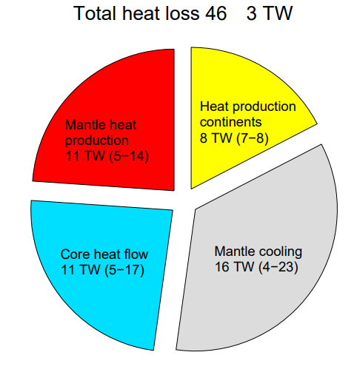
Heat Budget of the Earth
Total heat loss 46 ± 3 TW
The evolution of the Earth depends on its long-term heat budget.
Geoneutrinos promise to provide improved constraints on mantle heat production (and continental)
Geoneutrino evidence of residual heat (KamLAND, 2011)
The loss of primordial and radiogenic heat is regulated by cooling of the mantle through convective heat transfer.
(6-8)*
Mareschal et al., 2017
*Wipperfurth et al., 2020
Notes:
There has been much effort to delineate the Earth’s heat budget with new constraints being added over recent years from geoneutrinos.
Indeed, geoneutrino constraints are improving not only our understanding of mantle heat production, but much work is dedicated to modeling and, in effect, “measuring” the continental crust’s U–Th to subtract it cleanly from detector signals.
KamLAND evidence from geoneutrinos of residual heat remaining inside the Earth + low HPE’s signifies heat in core -> 2011 Nat Geo 4, 467-651
Bill mentioned that the core only cools as fast as the mantle wants it too…

Slide 3
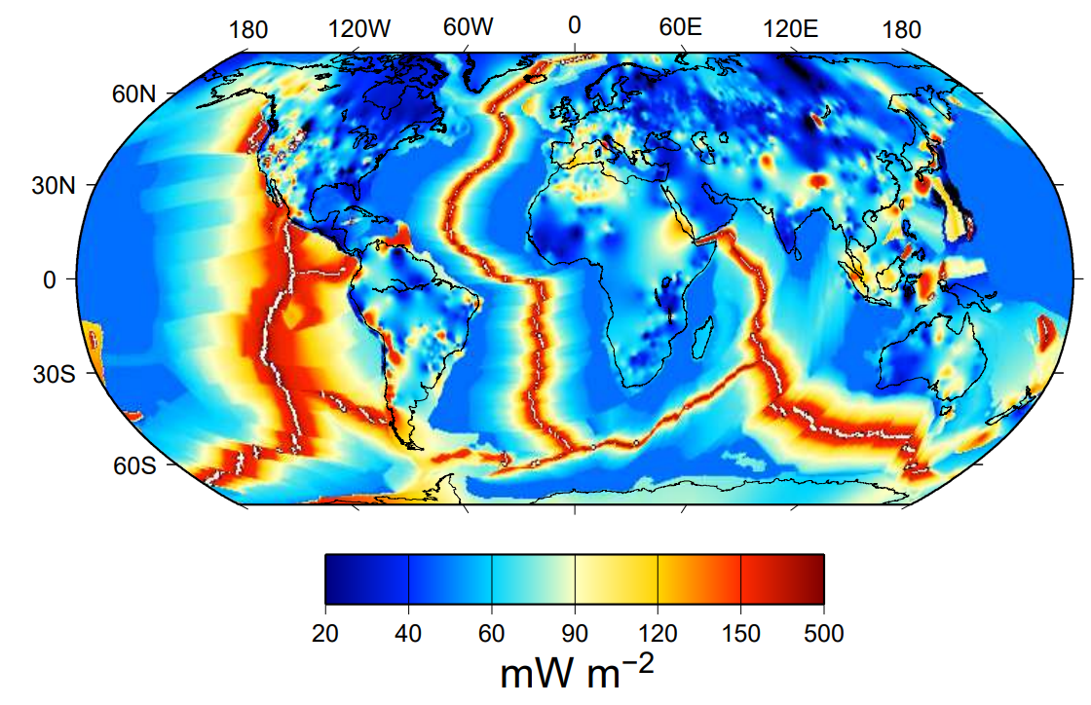
Heat Budget of the Earth
Total heat loss 46 ± 3 TW
The evolution of the Earth depends on its long-term heat budget.
The loss of primordial and radiogenic heat is regulated by cooling of the mantle through convective heat transfer.
Mantle dynamics is inherently driven by the conditions on the mantle boundaries.
Mareschal et al., 2017
105 mW/m²
Oceanic
heat flux
71 mW/m²
Continental
heat flux
92 mW/m²
Global
heat flux
+
Mareschal et al., 2017
Davies and Davies, 2010
*Wipperfurth et al., 2020
Notes:
For example, the relative proportion of continental to oceanic lithosphere.
It is not simply about heat transfer, however.
The distribution of cont vs oceanic lith also changes the behavior of the convective system.
Note: mean of continental and oceanic crust are 70.9 and 105.4 mW/m² (Davies et al., 2010)

Slide 4
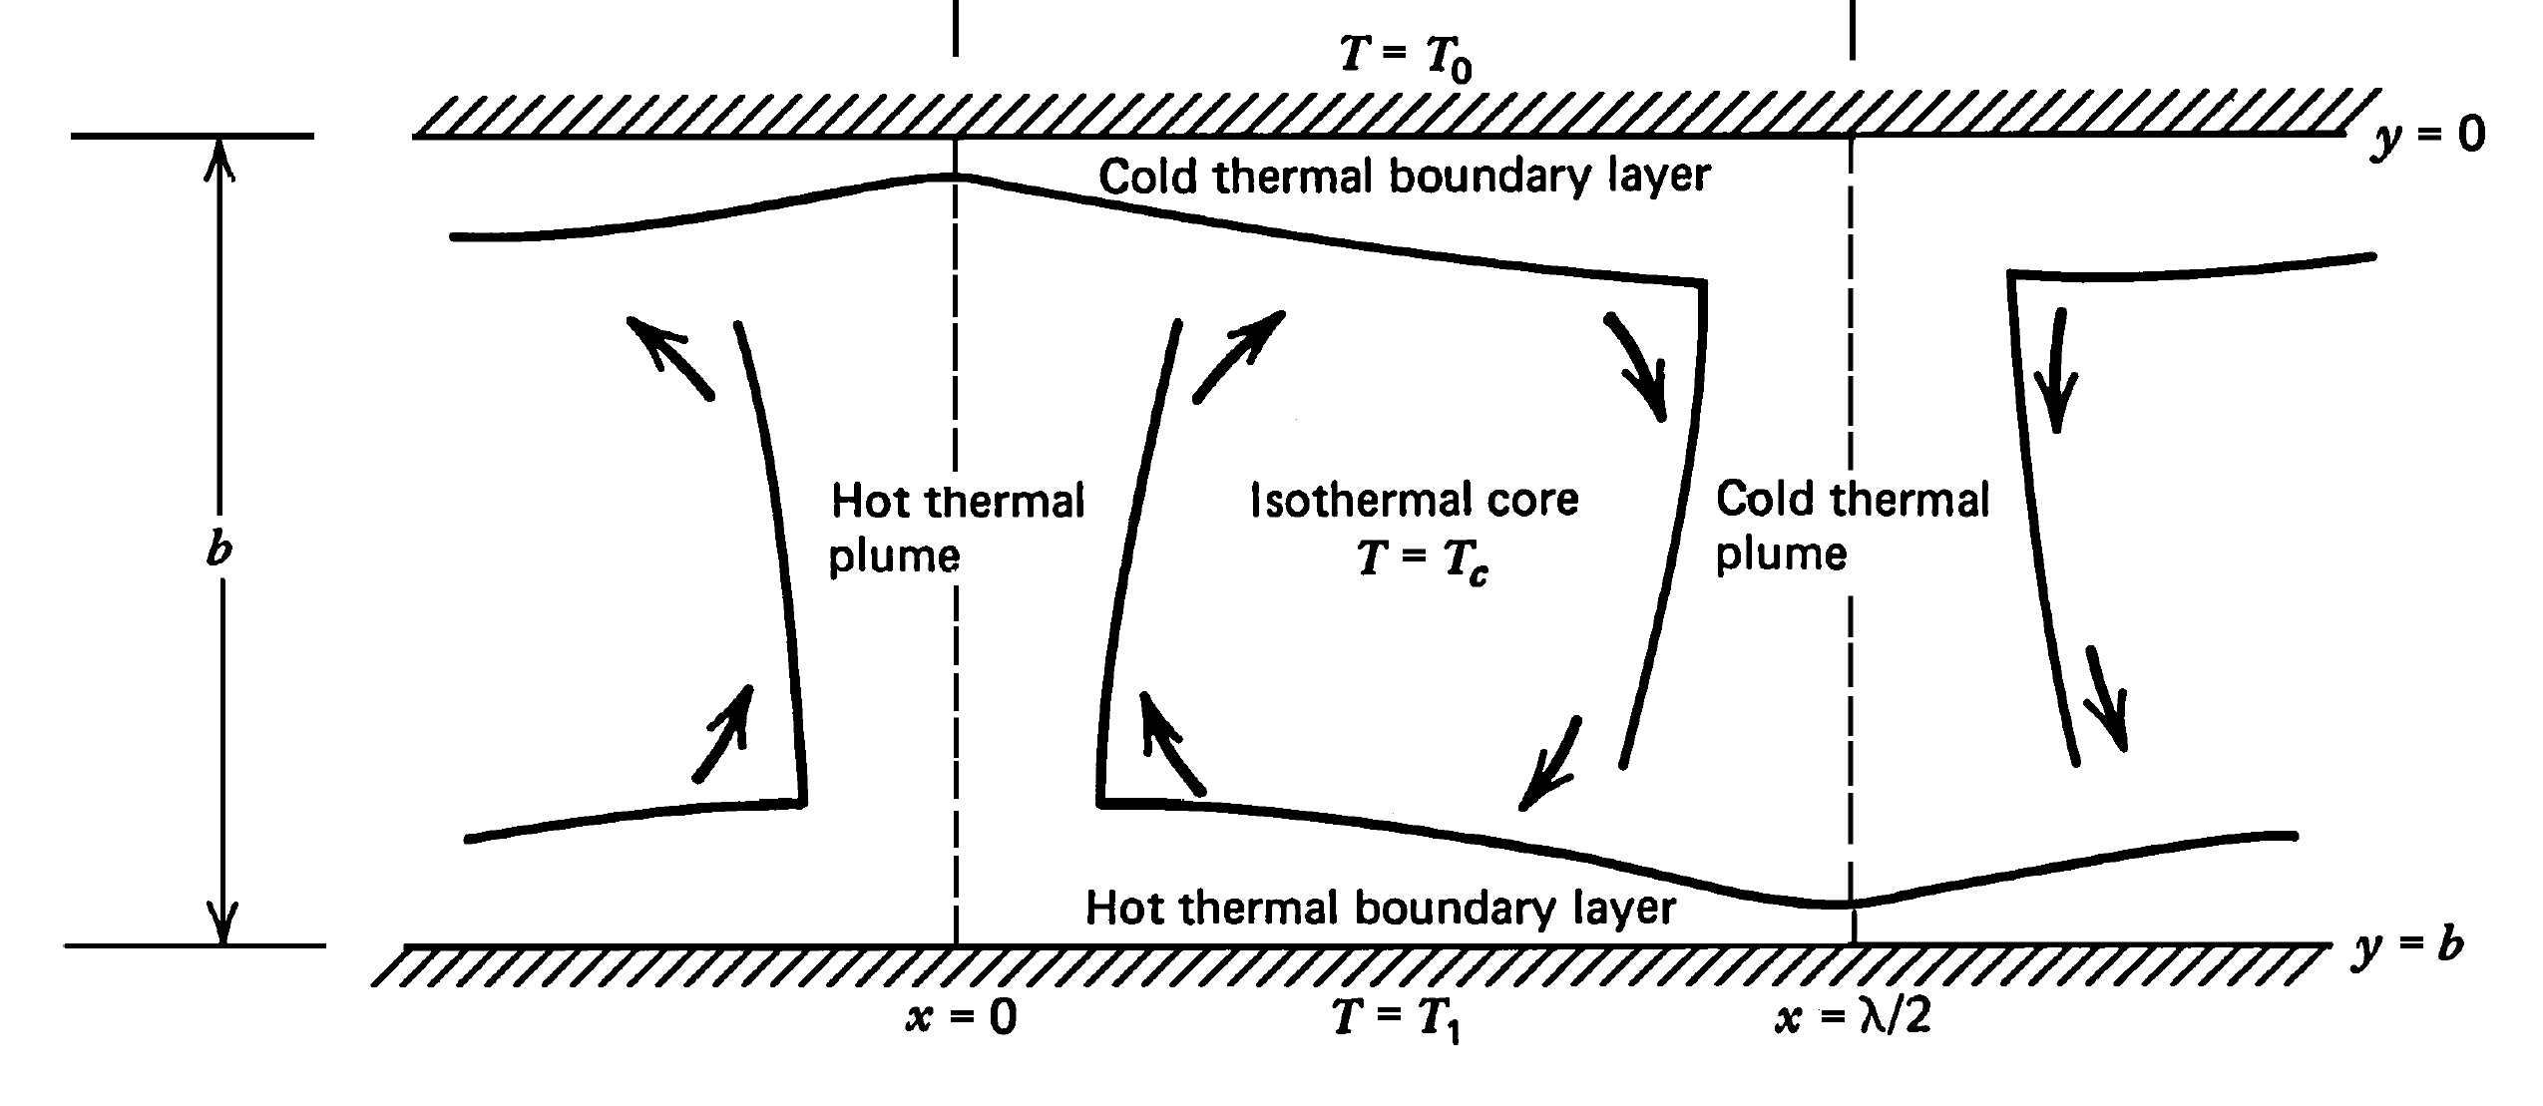
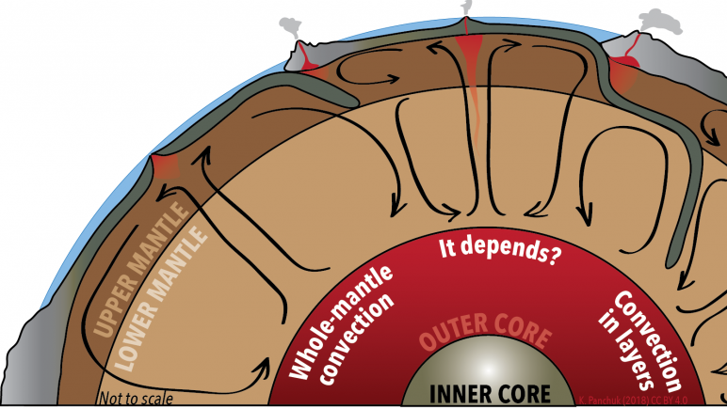
Thermal boundary layers modulate cooling
Convective stirring of the mantle drives planetary cooling.
Upper thermal boundary layer (TBL): oceanic lithosphere
Lower TBL: the region just above the core-mantle boundary (CMB)
The parts of the TBL that do not actively participate in convection transfer heat by conduction.
Turcotte and Schubert, 2002
LibreTexts, CC BY-NC-SA 4.0
Notes:
This explains why heat transfer is slower through the continents
More or less continental coverage will change the heat transfer through the lid of the planet

Slide 5
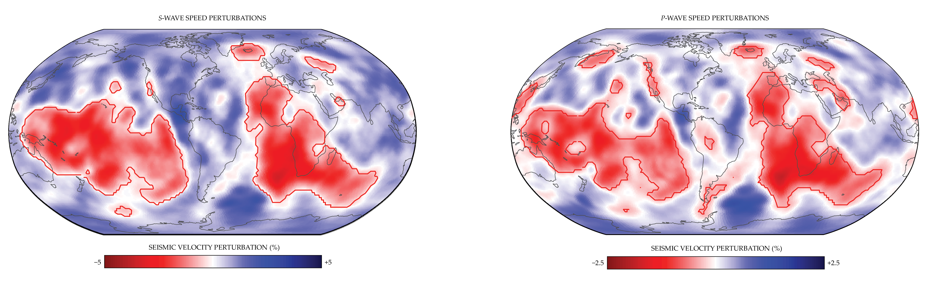
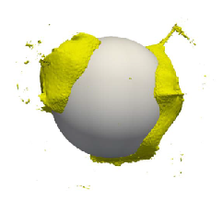
Large Low Velocity Provinces (LLVPs) – continent sized bodies on the CMB that may not actively participate in convection
Stable: 630 Myrs
LLVP
LLVP
CORE
Shi et al., (2024)
Garnero and Richardson, 2024, after Cai et al., 2024
Slow seismic wave speeds suggest higher T and distinct compositions.
LLVPs blanket ~30% of the CMB, similar to continents on the surface
Notes:
Shown here are S-wave and P-wave perturbation maps for the lowermost 100 km of the mantle.
Two large low-velocity provinces, outlined in red, cover around 30% of Earth’s core–mantle boundary surface area.
These areas may represent more dense, more viscous materials
If this is the case, simulations show that they do not convect,
remain stationary and thermo-chemical piles for at least 100’s of millions of years
Shi, et al., (2024) Sluggish thermochemical basal mantle structures support their long-lived stability.
Nat Commun 15, 10000 (2024). https://doi.org/10.1038/s41467-024-54416-6

Slide 6
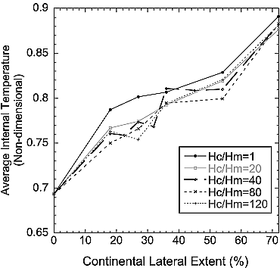
Continents and LLVPs alone alter heat transfer
Continents
warmer mantle
Cooper et al., 2006
Notes:
Cooper’s models (and updates) were cartesian 2D, later cartesian 3D
LLVP models
due to their buoyancy, density and viscosity which inhibits heat flow into the mantle thus creating an insulating layer (Langemeyer et al., 2020)

Slide 7
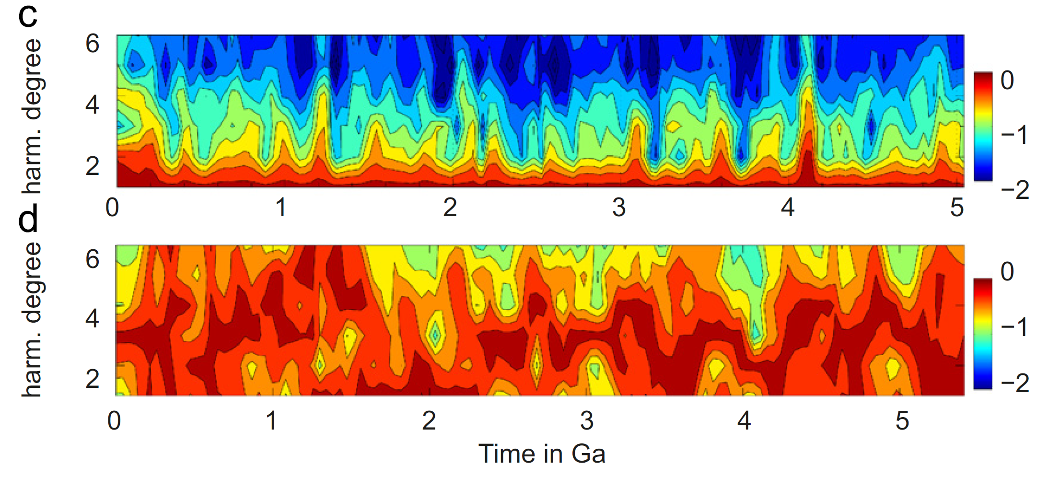
Continents and LLVPs alone alter heat transfer
Continents
WITH CONTINENTS
warmer mantle
WITHOUT CONTINENTS
Cooper et al., 2006
Notes:
Cooper’s models (and updates) were cartesian 2D, later cartesian 3D
LLVP models
due to their buoyancy, density and viscosity which inhibits heat flow into the mantle thus creating an insulating layer (Langemeyer et al., 2020)

Slide 8
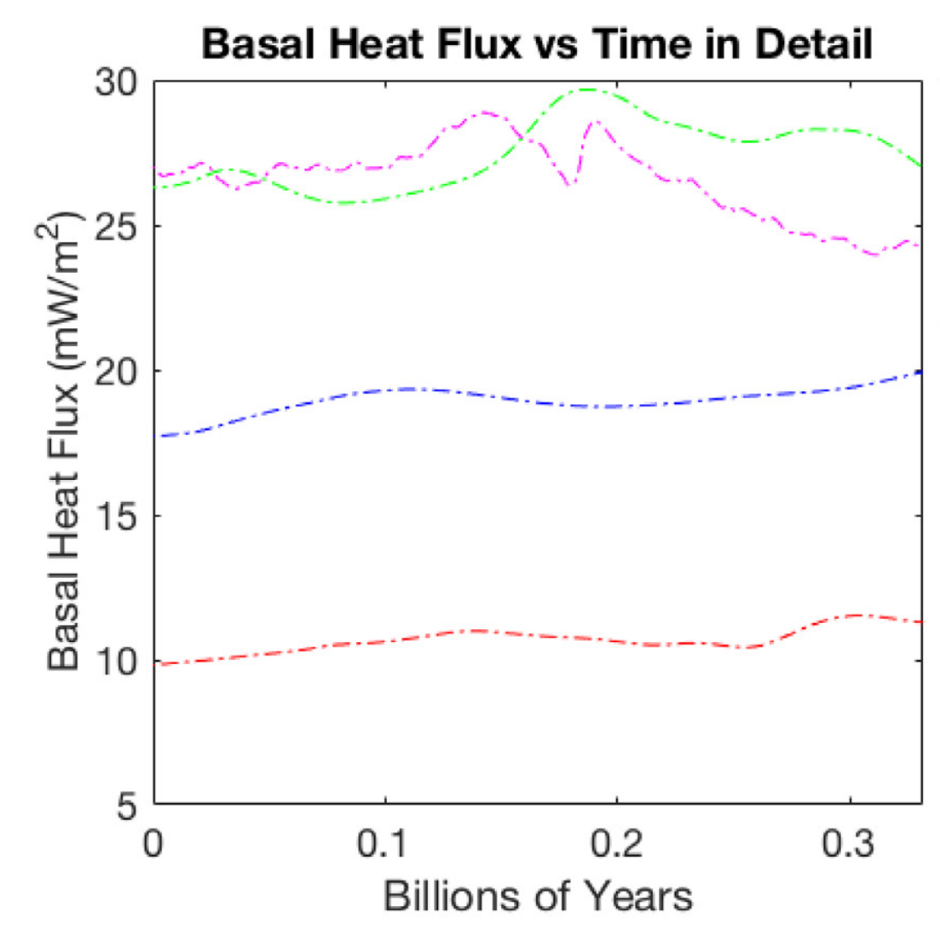
Continents and LLVPs alone alter heat transfer
Continents
LLVPs
t-dependent
coverage
warmer mantle
Heat flux
w/increasing
coverage
t₀
t_{3/4}
Langemeyer et al., 2020
Cooper et al., 2006
Notes:
Cooper’s models (and updates) were cartesian 2D, later cartesian 3D
LLVP models
due to their buoyancy, density and viscosity which inhibits heat flow into the mantle thus creating an insulating layer (Langemeyer et al., 2020)
Previous models:
Restricted to a single insulator
Cartesian coordinate system for continental simulations
LLVP coverage not systematically quantified

Slide 9
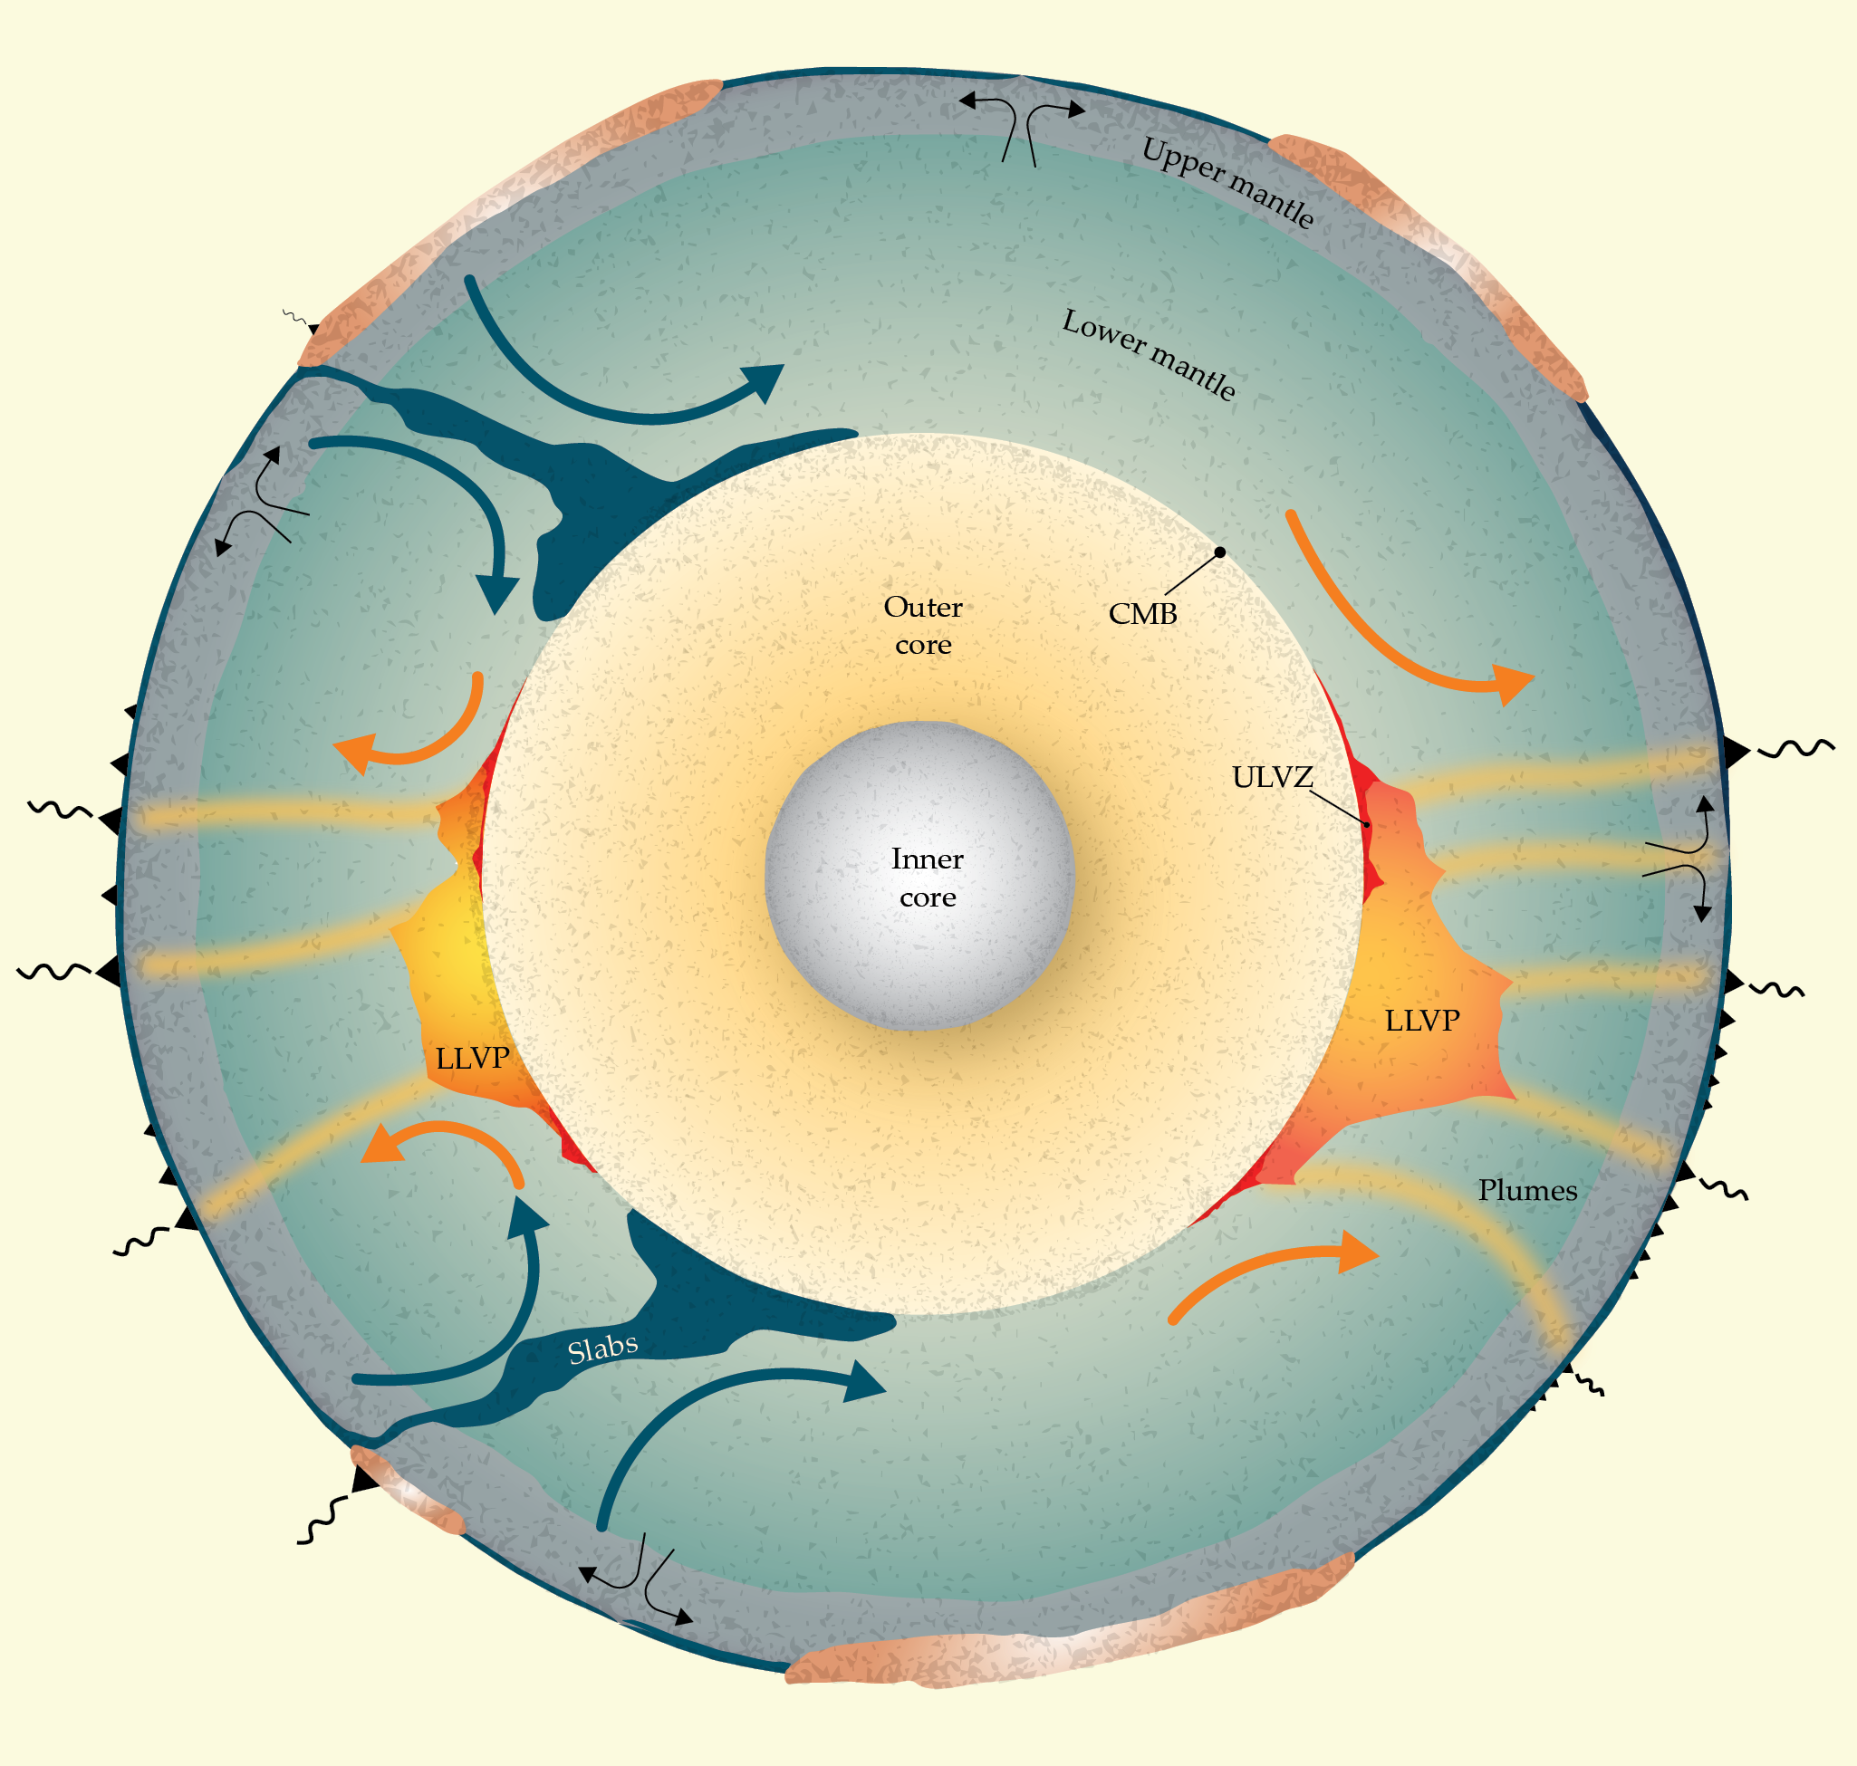
Putting Blankets on the Mantle TBLs
continent
First, we want to quantify the effects of systematically increasing coverage of an LLVP or a continent in a realistic geometry.
Then, we can ask: What happens when we have two insulators?
  Do the effects of continents and LLVP cancel out?
  Do the dynamics still change?
  How does mantle temperature evolve?
  How does the heat flux change?
continent
LLVP
LLVP
continent
Garnero and Richardson, 2024

Slide 10
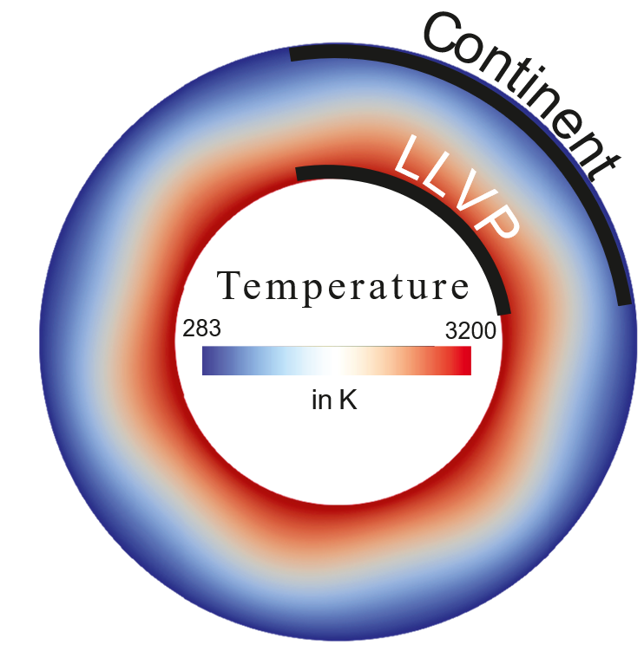
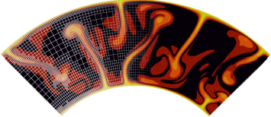
Numerical Model Setup
Two sets of simulations:
  Single insulator, incompressible
  Dual insulators, compressible, adiabatic and shear heating
LLVP / Continents - high viscosity layers, 200 km thick
Models run until steady state (~2 Gyr)
ASPECT
Parallel, finite element code
https://aspect.geodynamics.org
Notes:
Systematically increase the % areal coverage.
Run on 128 processors for each job (~3-4 days)

Slide 11
Single Insulator Runs
Systematic examination of LLVP or continent coverage

Slide 12
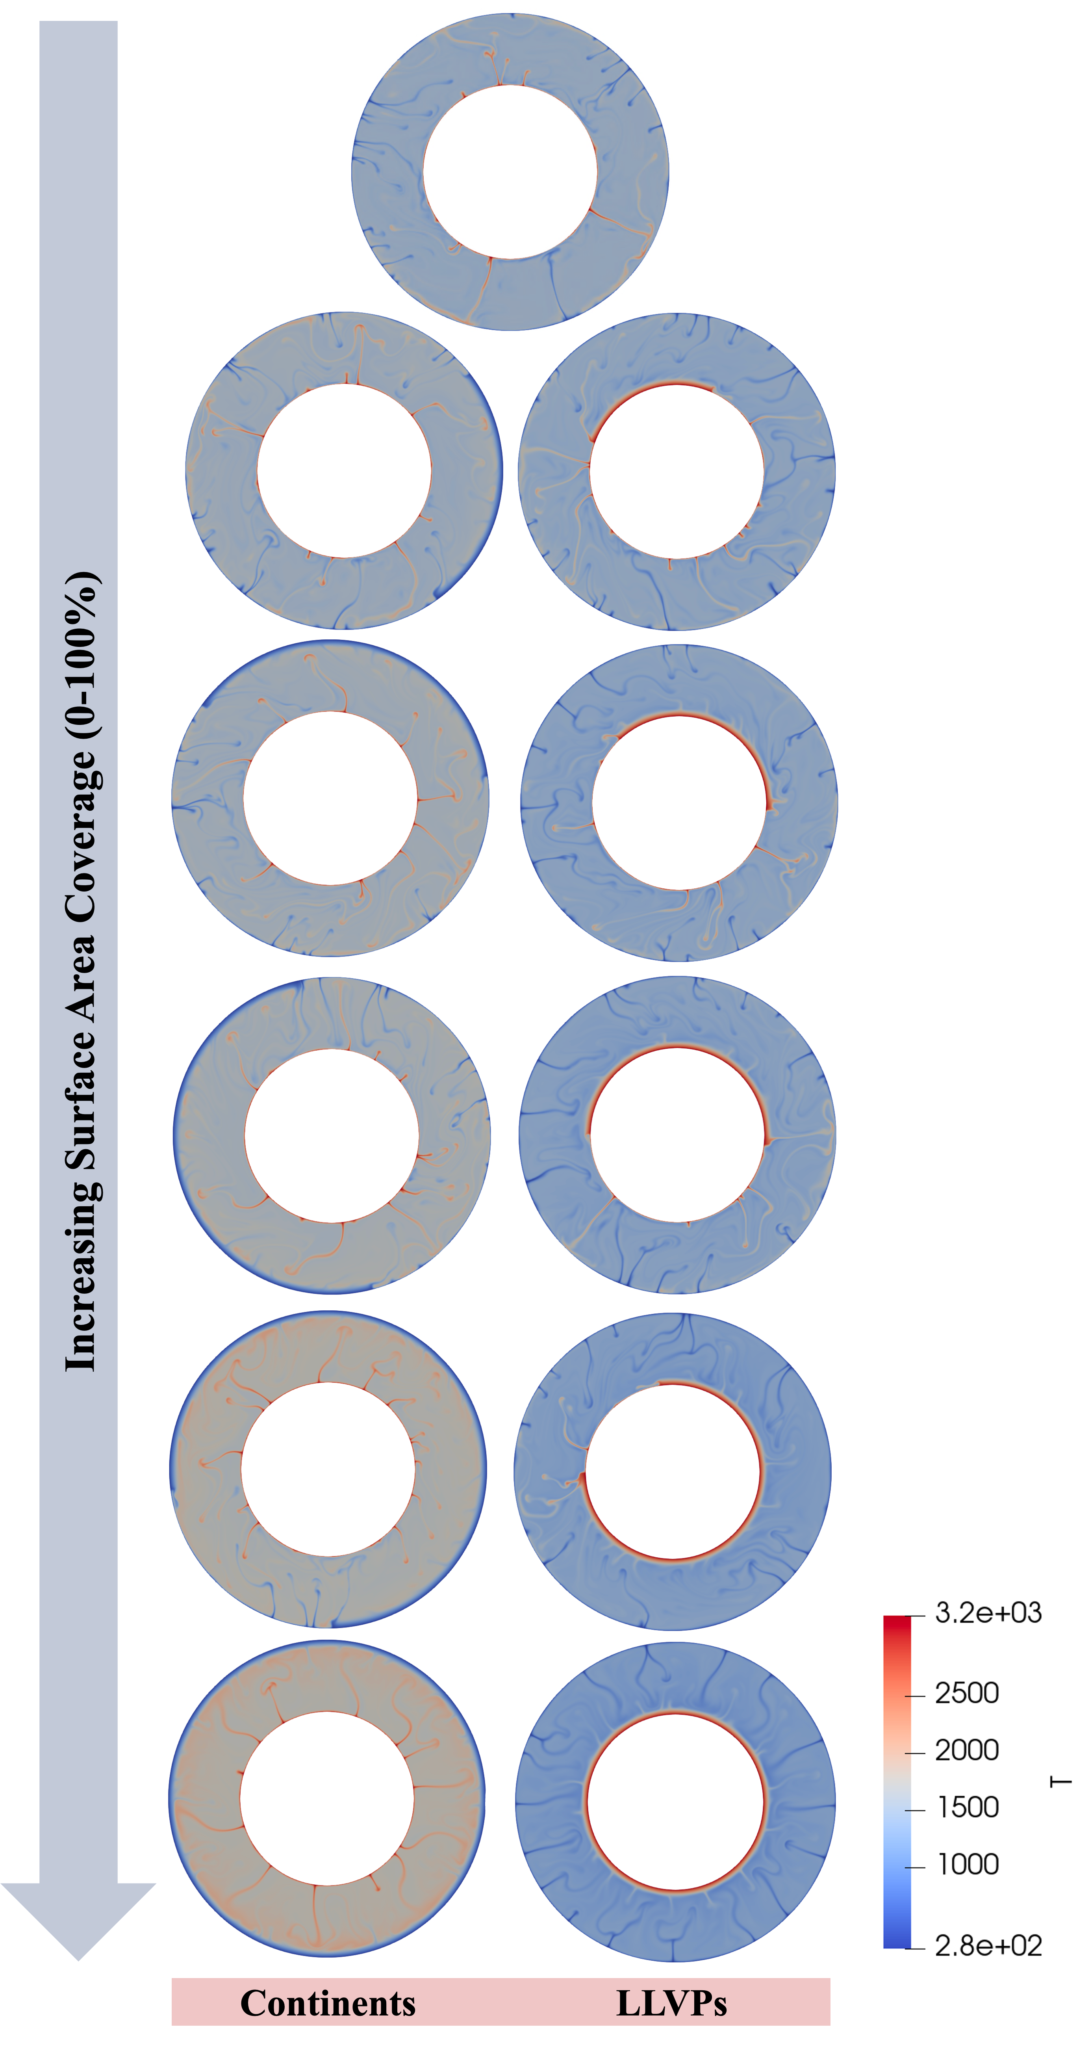
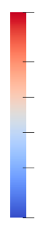
Increasing areal coverage of LLVP and Continents
Continents
(surface insulator)
25%
Continent
37.5%
Continent
50%
Continent
3200
2500
No
Insulators
2000
T (K)
Increasing areal coverage
1500
1000
280
t = 1 Gyr.
25%
LLVP
37.5%
LLVP
50%
LLVP
LLVP
(basal insulator)
Notes:
Figure 3: images of the temperature field for each model taken at 0.25Byr , the point at which the models approach steady state. The values used to calculate the running average for the points in Figure 2 start from this point. The color scale on the figure signifies temperature from 280K to 3200K.

Slide 13
Increasing areal coverage of LLVP and Continents
Continents
(surface insulator)
25%
Continent
37.5%
Continent
50%
Continent
3200
2500
No
Insulators
2000
T (K)
Increasing areal coverage
1500
1000
280
t = 1 Gyr.
25%
LLVP
37.5%
LLVP
50%
LLVP
LLVP
(basal insulator)
Notes:
Figure 3: images of the temperature field for each model taken at 0.25Byr , the point at which the models approach steady state. The values used to calculate the running average for the points in Figure 2 start from this point. The color scale on the figure signifies temperature from 280K to 3200K.

Slide 14
Increasing areal coverage of LLVP and Continents
Continents
(surface insulator)
25%
Continent
37.5%
Continent
50%
Continent
3200
2500
No
Insulators
2000
T (K)
Increasing areal coverage
1500
1000
280
t = 1 Gyr.
25%
LLVP
37.5%
LLVP
50%
LLVP
LLVP
(basal insulator)
Notes:
Figure 3: images of the temperature field for each model taken at 0.25Byr , the point at which the models approach steady state. The values used to calculate the running average for the points in Figure 2 start from this point. The color scale on the figure signifies temperature from 280K to 3200K.

Slide 15
Increasing areal coverage of LLVP and Continents
Continents
(surface insulator)
25%
Continent
37.5%
Continent
50%
Continent
3200
2500
No
Insulators
2000
T (K)
Increasing areal coverage
1500
1000
280
t = 1 Gyr.
25%
LLVP
37.5%
LLVP
50%
LLVP
LLVP
(basal insulator)
Notes:
Figure 3: images of the temperature field for each model taken at 0.25Byr , the point at which the models approach steady state. The values used to calculate the running average for the points in Figure 2 start from this point. The color scale on the figure signifies temperature from 280K to 3200K.

Slide 16
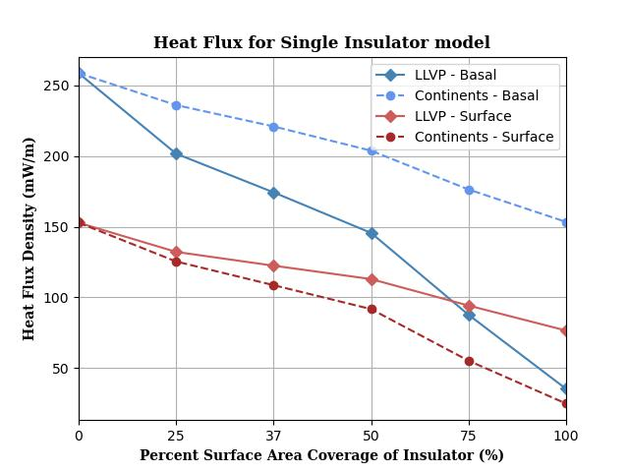
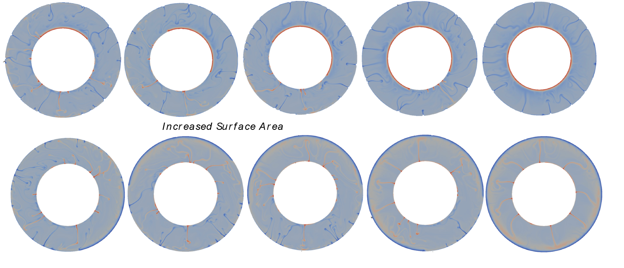
Continents and LLVP reduce boundary heat fluxes
Insulators decrease boundary heat flux
Regardless of location, insulators decrease heat flux on both boundaries.
For the same % coverage, a basal insulator (LLVP) causes a fractionally greater decrease in boundary heat flux.
BASAL HEAT FLUXES
continents
SURFACE HEAT FLUXES
LLVP
Notes:
Basal and surface heat flux vs surface area coverage for each insulator.

Slide 17
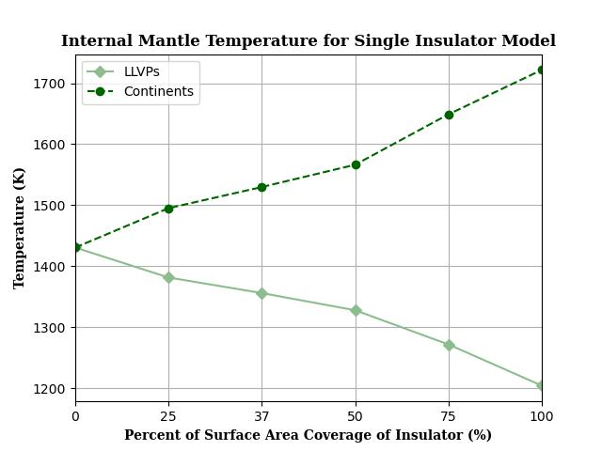
Continents and LLVP alter mantle temperature
Basal insulators result in lower mantle temperatures
Surface insulators result in higher mantle temperatures.
continents
LLVP
Notes:
Internal mantle temperature vs surface area coverage for each insulator.

Slide 18
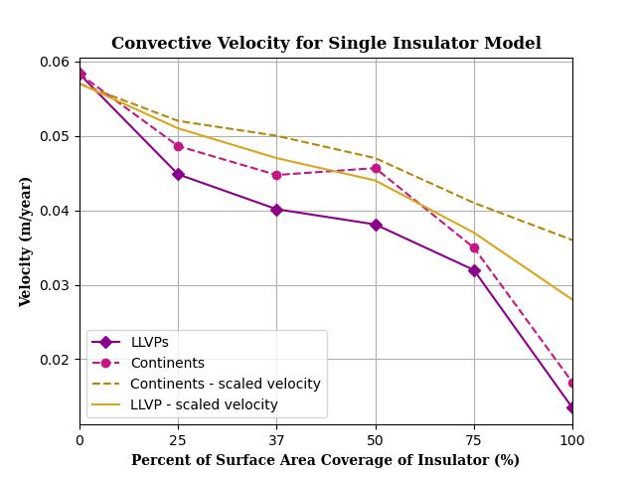

LLVPs and Continents decrease the vigor of convection
Insulators reduce the convective vigor of the mantle
Theory suggests this is driven two parameters:
  Decreased cross mantle temperature gradient
  Decreased thickness of the convecting layer
continents
theory
LLVP
$$Ra= \frac{ρgα∆TH^{3}}{κη}$$
temperature contrast
layer height
U ~ Ra^{(2/3)}
Notes:
Root mean square velocity and Rayleigh scaled velocity using temperature and thickness averaged over the boundaries vs surface area coverage for each insulator.

Slide 19
Effects of single insulators
LLVP
Continent
Both Continents and LLVP reduce boundary heat flux
LLVP reduce mantle temperature
Continents increase mantle temperature
Both cause changes in mantle dynamics (reduced velocities)
Notes:
Next step: dual-insulator models to determine how the competing effects operate in tandem.

Slide 20
Dual Insulator Runs
Systematic examination of coeval LLVP and continent coverage

Slide 21
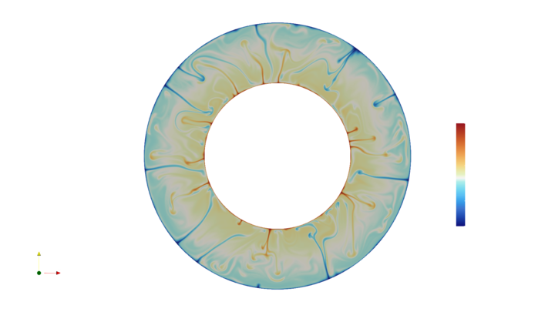
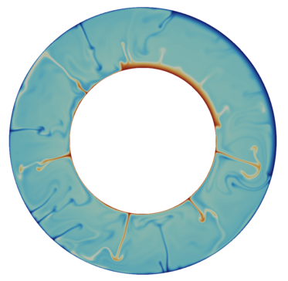
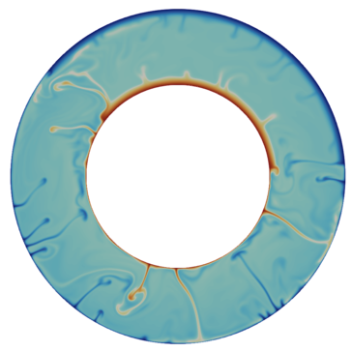
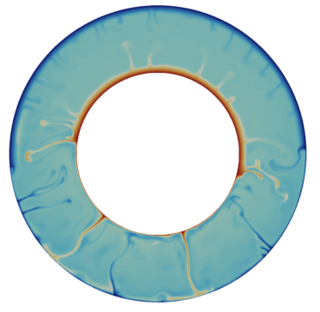
Dual Insulators
Shifting to a compressible mantle, we simultaneously increase the areal coverage of both the LLVP and the Continent
Decrease in vertical extent and number of mantle crossing plumes and slabs with increasing coverage.
No
Insulators
Increasing areal coverage
3200
2500
2000
T (K)
25 % LLVP
25 % Continent
37 % LLVP
37 % Continent
50 % LLVP
50 % Continent
1500
1000
280
t = 1 Gyr.

Slide 22
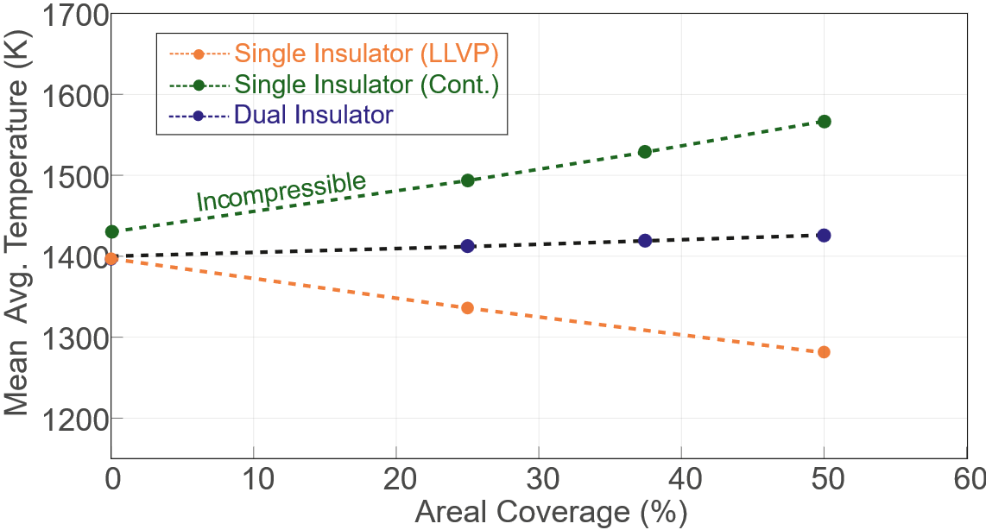
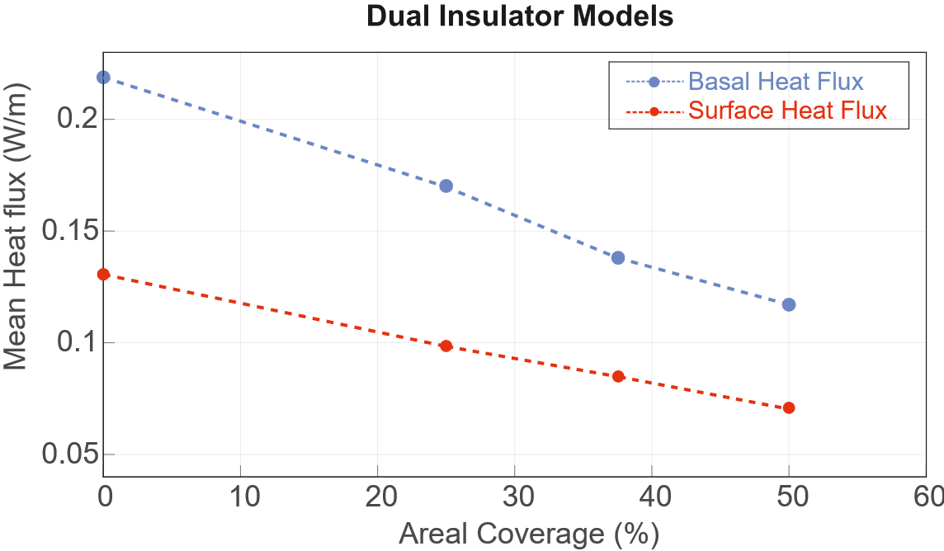
Dual Insulator Effects
Slight increases in mantle temperature with increasing coverage
Decrease in both surface and basal heat flux
Less heat escaping the core and mantle

Slide 23
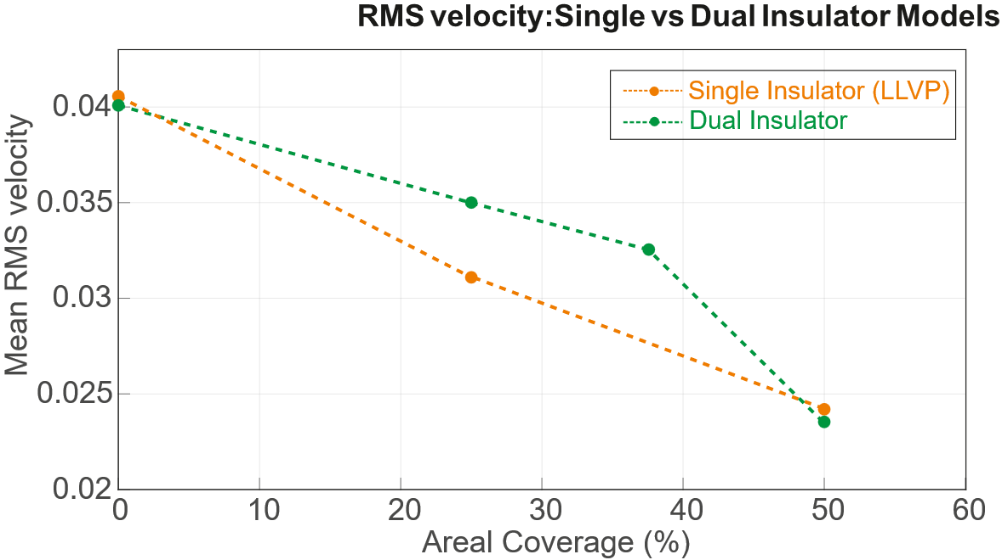
Dual insulators decrease convective vigor
Overall decrease in convective velocities
Slope of decrease is less at small coverages than for LLVP alone
These results depend upon the properties of the LLVP

Slide 24
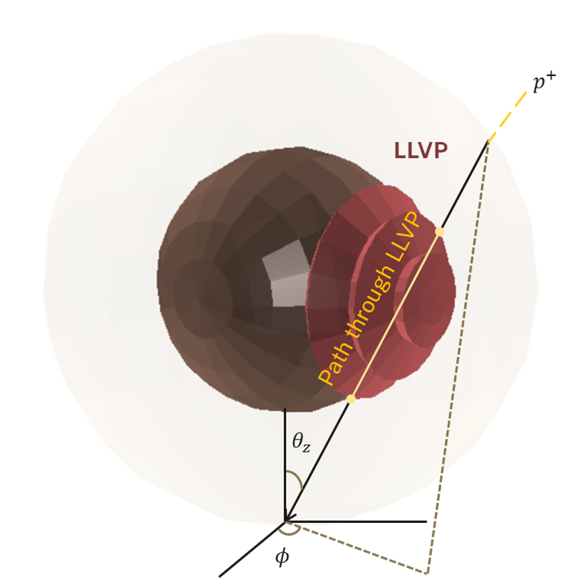
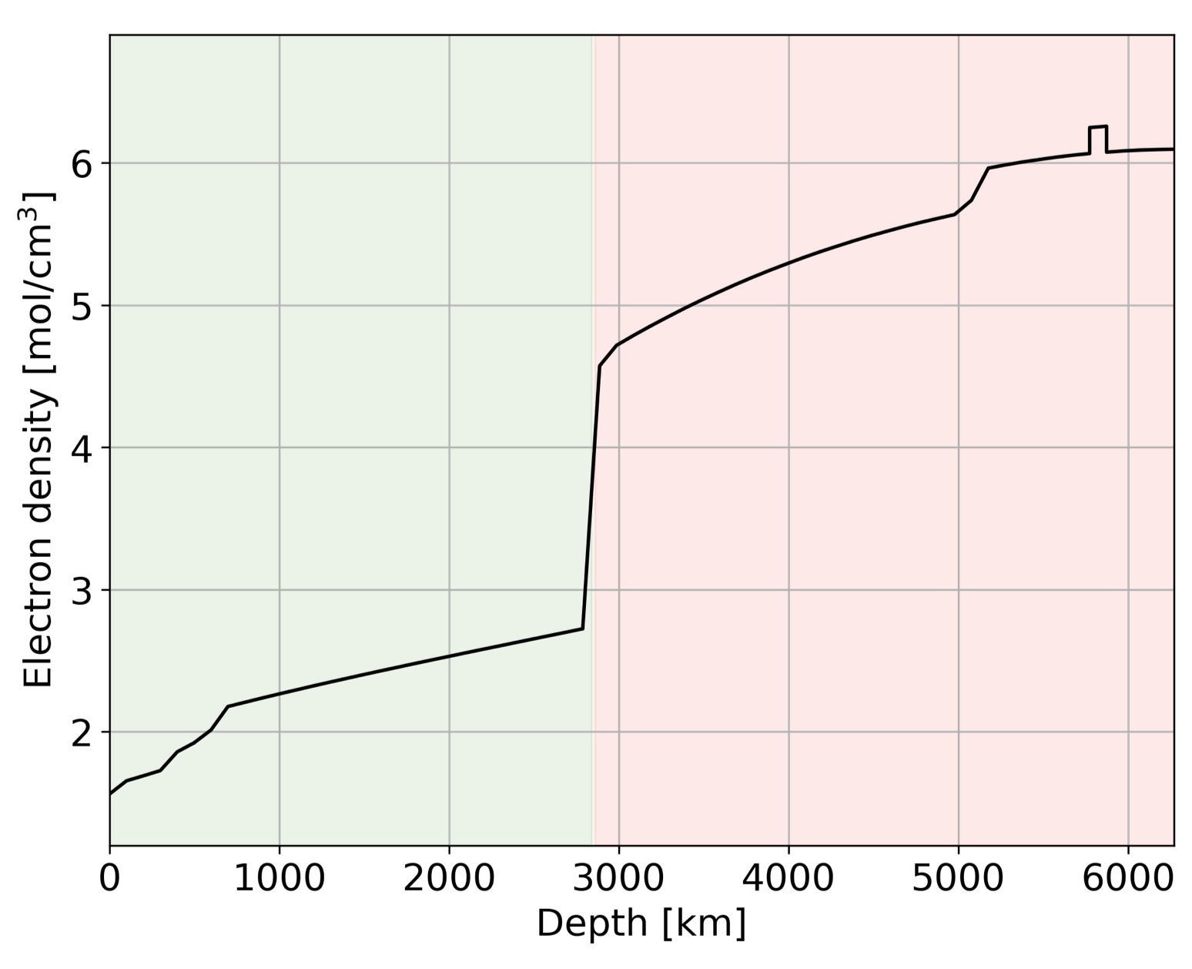
LLVP properties are poorly known – neutrinos can help!
The properties (composition, density, temperature, viscosity) of LLVPs are poorly known.
These properties will affect the results seen here.
Neutrino Oscillation Tomography could help!
Tomorrow’s talks by Isabel Goos and Yael Deniz will explore the use of neutrinos to constrain LLVP properties.
Deniz et al. (tomorrow)
3%
density
anomaly
Goos et al. (tomorrow)

Slide 25
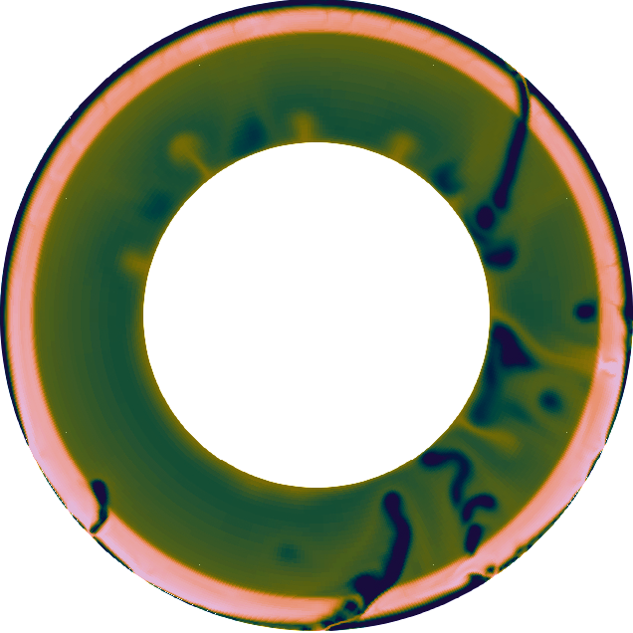
Conclusions and Future Directions
Conclusions
  LLVPs and continents act as thermal insulators.
  When both are present in the mantle:
    Decrease convective vigor of the mantle
    Reduce surface and basal heat flux
    Change the structure of upwelling and downwelling across the mantle
  Implications for early Earth and the thermal history of the planet
6e24
Future Directions
  Complex rheology (diffusion + dislocation creep, visco-plastic)
  Self-consistent plate tectonics
  Distribution of radiogenic elements between mantle, LLVP, and continents
1e23
1e21
1e20

Slide 27
