Slide 1


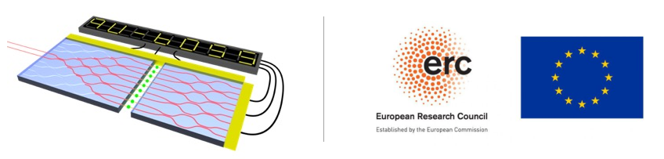
Scalable Architectures for
Photonic Quantum Computing
MAP-fis essay defense
April 24, 2025
Sara Franco
Universidade do Minho
Supervised by Ernesto F. Galvão (INL)
Co-supervised by Mikhail Vasilevskiy (Univ. Minho)

Slide 2
Contents
Introduction
Research Project
  State-of-the-art architectures
  Quantum error-correction
  Counterfactual quantum gates
Summary

Slide 3
Introduction
Photonic Quantum Computing

Slide 4
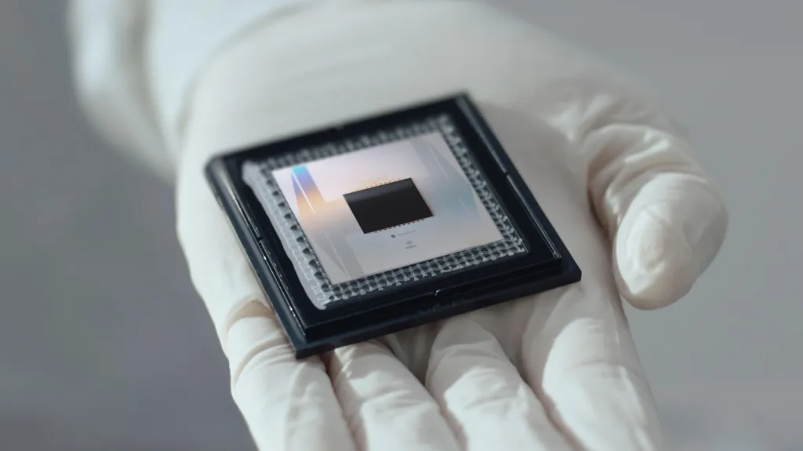
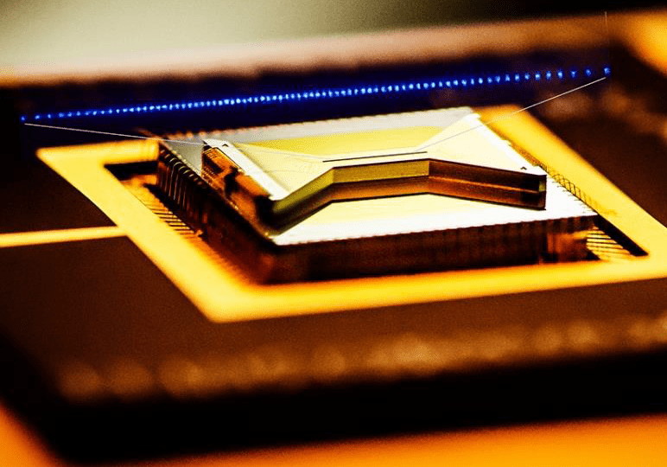
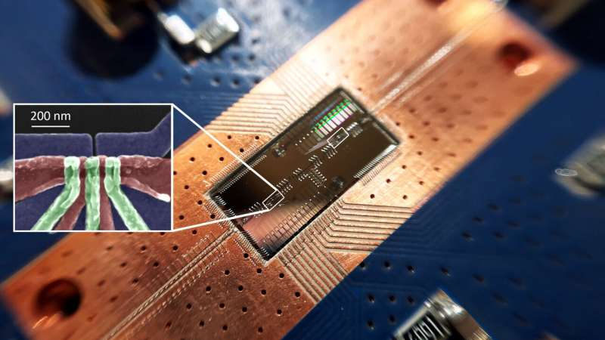
Quantum Computing Platforms
1. Introduction
2. Research Project
3. Conclusion
2.1. State-of-the-art architectures
2.2. Quantum Error-Correction
2.3. Counterfactual Quantum gates
Superconducting circuits
Trapped ions
Silicon spins
Credit: Google
Credit: Christopher Monroe
Credit: Felix Borjans, Princeton University

Slide 5
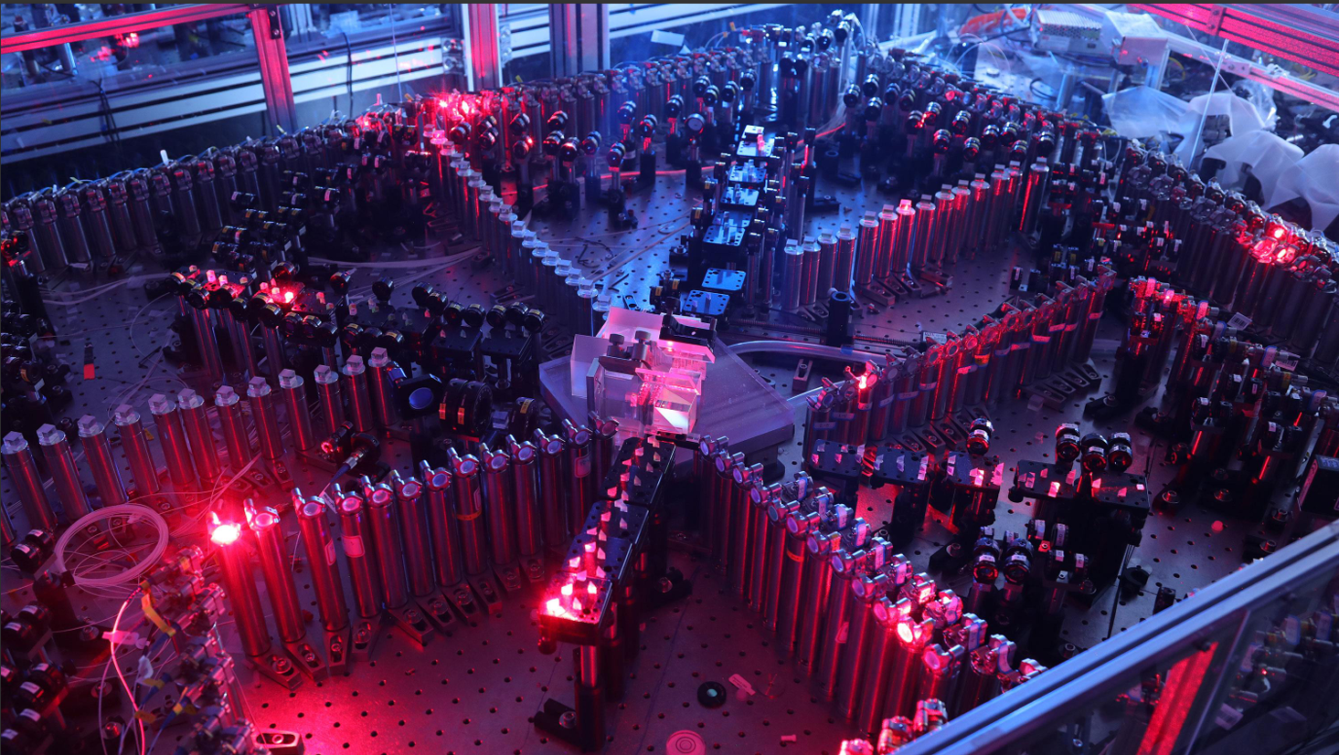
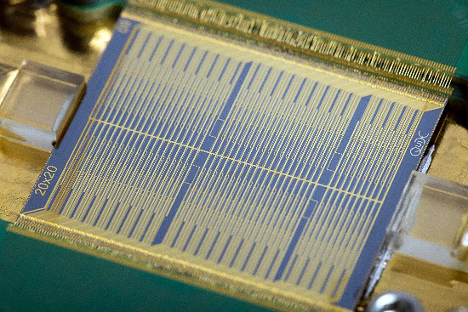
Photonic Quantum Computing
1. Introduction
2. Research Project
3. Conclusion
2.1. State-of-the-art architectures
2.2. Quantum Error-Correction
2.3. Counterfactual Quantum gates
Gaussian Boson Sampling
Photonic Integrated Circuits
Han-Sen Zhong et al., Science 370,1460-1463 (2020).
Credit: QuiX Quantum

Slide 6
2. Research Project
Scalable Architectures for
Photonic Quantum Computing

Slide 7
2.1. State-of-the-art architectures
Two recent proposals

Slide 8
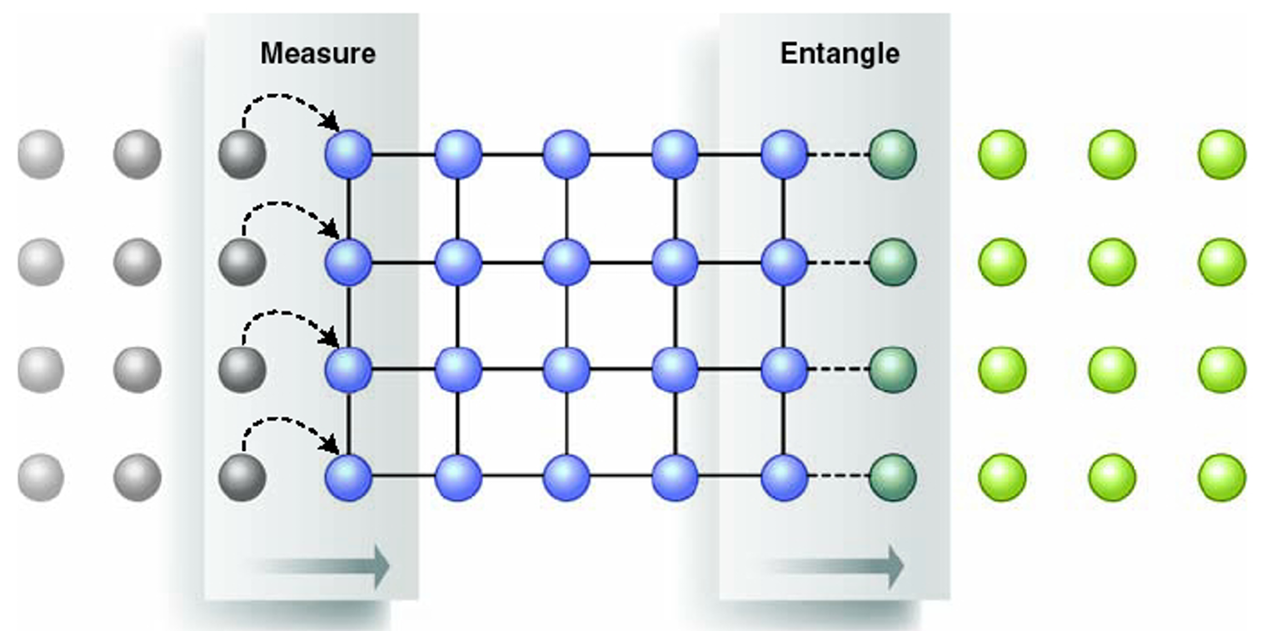
Fusion-based Quantum Computing (FBQC)
1. Introduction
2. Research Project
3. Conclusion
2.1. State-of-the-art architectures
2.2. Quantum Error-Correction
2.3. Counterfactual Quantum gates
Measurement-based Quantum Computing
Cluster state - large entangled state with regular geometry.
Computational steps driven by adaptive single-qubit measurement.
Alternating stages of measurement and cluster state growth.
J. O’Brien, Science 318,1567-1570 (2007).

Slide 9
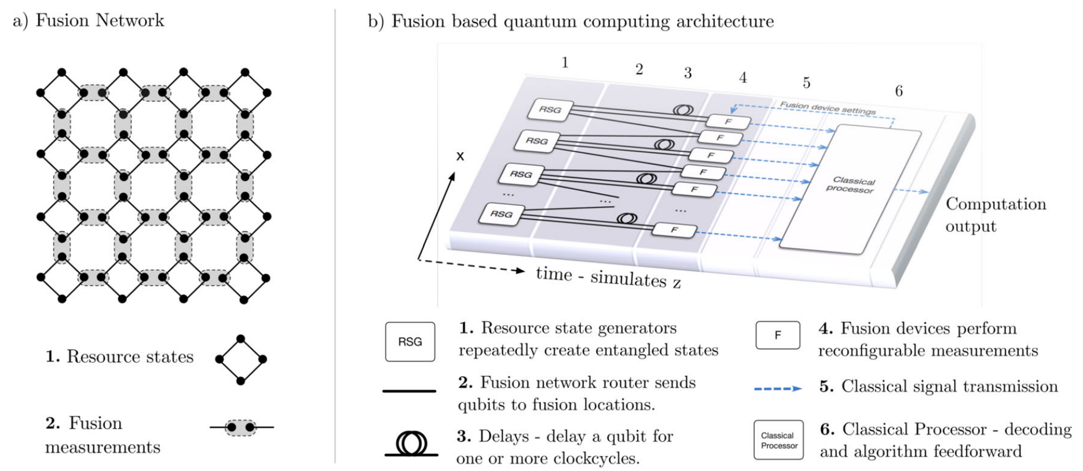
Fusion-based Quantum Computing (FBQC)
1. Introduction
2. Research Project
3. Conclusion
2.1. State-of-the-art architectures
2.2. Quantum Error-Correction
2.3. Counterfactual Quantum gates
Small entangled resource states with constant size and structure.
Fusions measurements used to construct fusion network.
Constant circuit depth limits spread of errors.
Limited switching and reconfiguration.
S. Bartolucci et al., Nat. Commun. 14, 912 (2023).

Slide 10
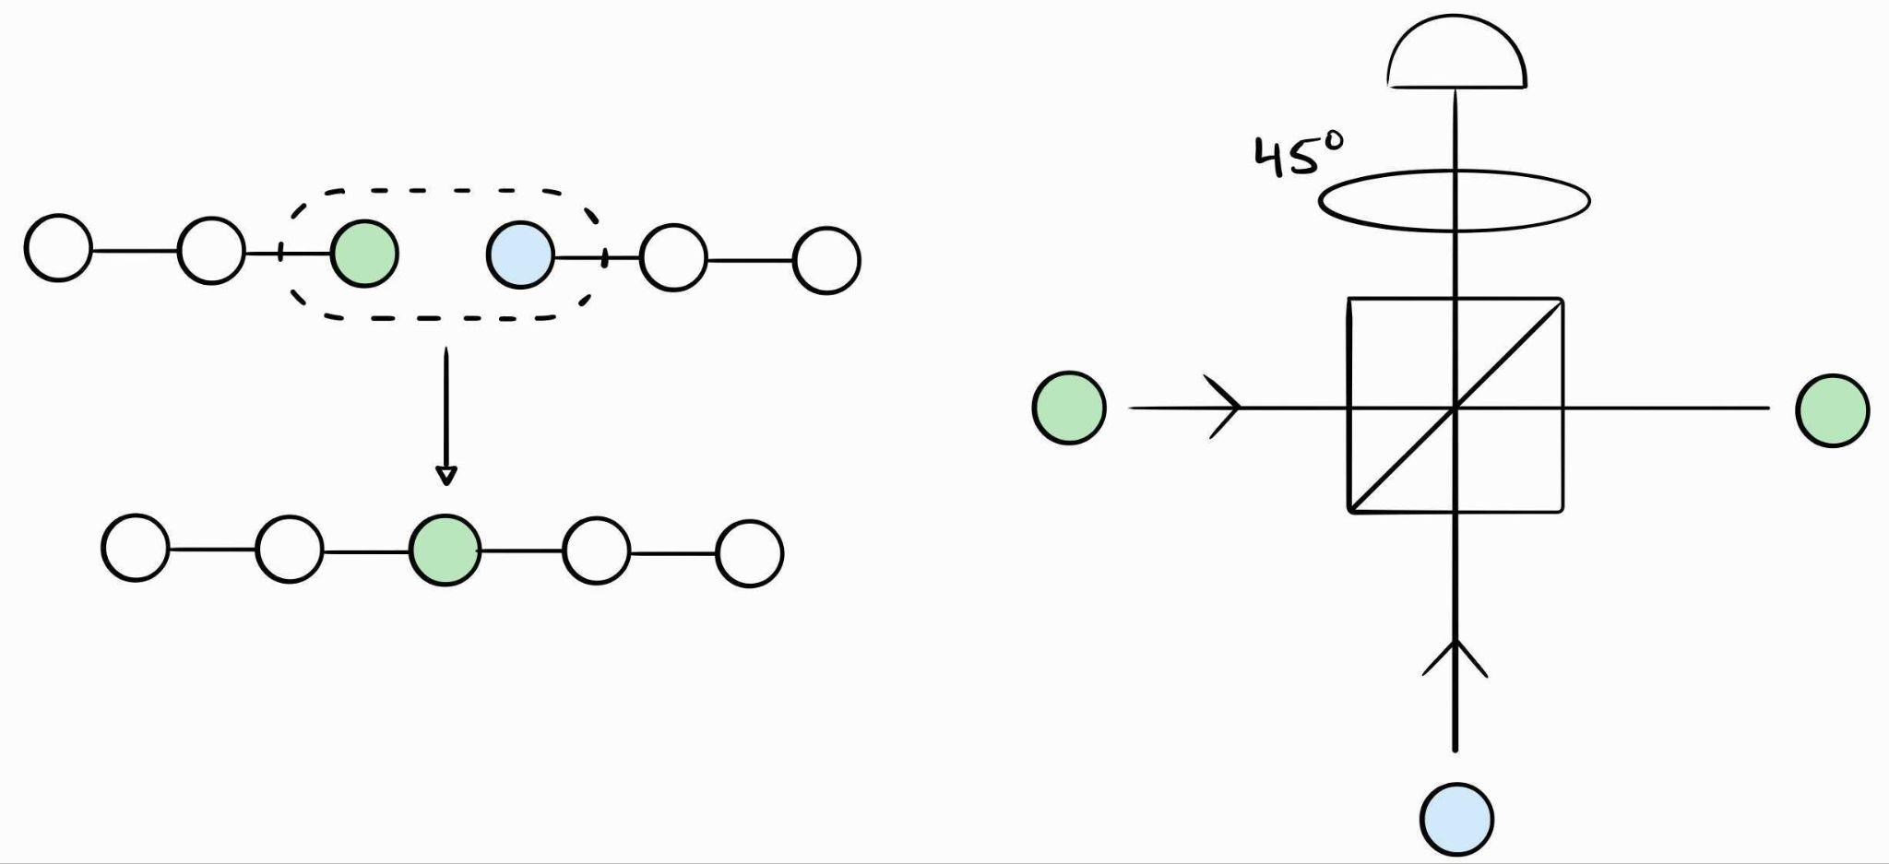
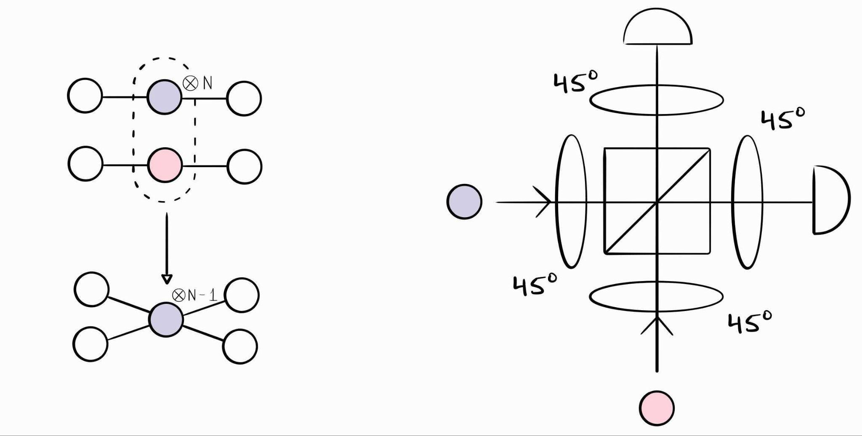
Fusion-based Quantum Computing (FBQC)
1. Introduction
2. Research Project
3. Conclusion
2.1. State-of-the-art architectures
2.2. Quantum Error-Correction
2.3. Counterfactual Quantum gates
Fusion Measurements
Probabilistic, linear-optical entangling gates
D. E. Browne and T. Rudolph, Phys. Rev. Lett. 95, 010501 (2005).

Slide 11
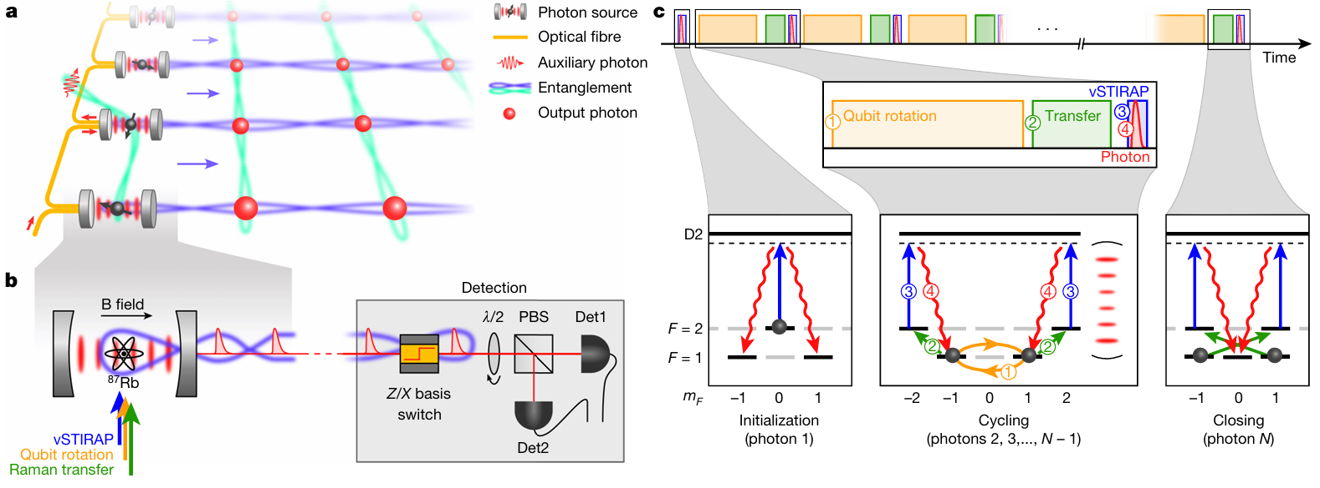
Spin-Optical Quantum Computing (SPOQC)
1. Introduction
2. Research Project
3. Conclusion
2.1. State-of-the-art architectures
2.2. Quantum Error-Correction
2.3. Counterfactual Quantum gates
Spin quantum emitters
“Photonic machine guns” - On-demand sources of single photons.
Deterministic, efficient generation of photonic entangled states.
P. Thomas et al., Nature 608, 677–681 (2022).

Slide 12
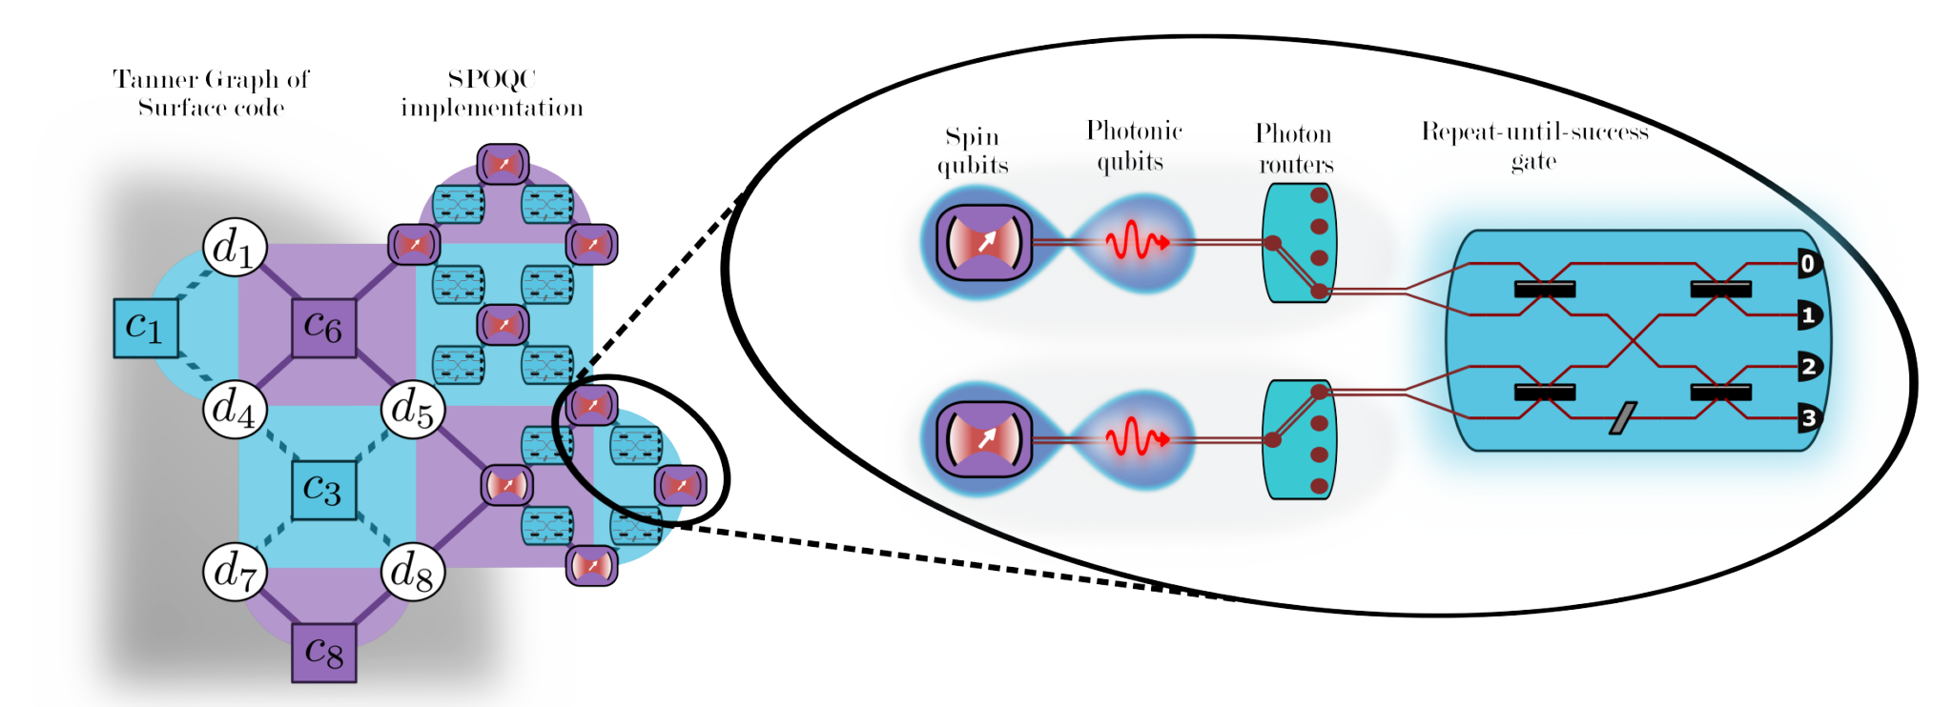
Spin-Optical Quantum Computing (SPOQC)
1. Introduction
2. Research Project
3. Conclusion
2.1. State-of-the-art architectures
2.2. Quantum Error-Correction
2.3. Counterfactual Quantum gates
Spin-entangled photons mediate interaction between spins.
Leverages strengths of both light and matter systems.
G. Gliniasty et al., Quantum 8. 1423 (2024).

Slide 13
2.2. Quantum error-correction
An essential ingredient for fault-tolerance

Slide 14
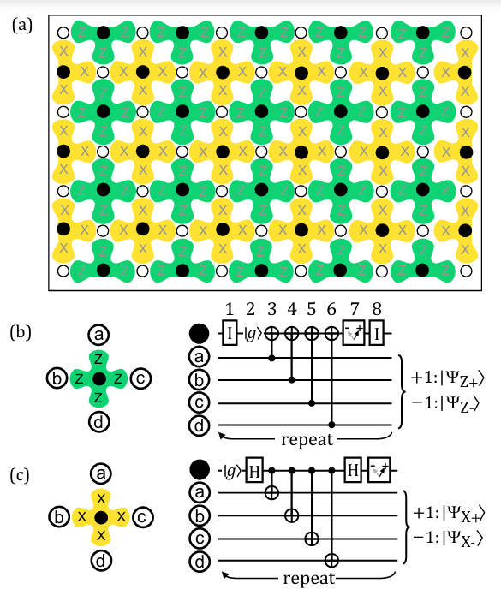
Surface and Low-density Parity Check codes
1. Introduction
2. Research Project
3. Conclusion
2.1. State-of-the-art architectures
2.2. Quantum Error-Correction
2.3. Counterfactual Quantum gates
Surface code - widely used in the literature.
Low-density parity check codes - constant encoding rate and linear distance.
A. Fowler et al., Phys. Rev. A 86, 032324 (2021).

Slide 15
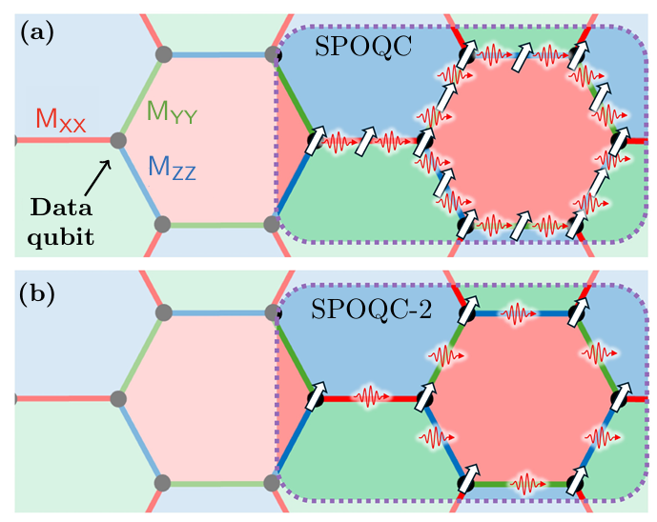
Floquet codes
1. Introduction
2. Research Project
3. Conclusion
2.1. State-of-the-art architectures
2.2. Quantum Error-Correction
2.3. Counterfactual Quantum gates
“Dynamical” version of surface code - periodic measurement of low-weight operators.
Honeycomb code - shown to outperform surface code in SPOQC variant.
P. Hilaire et al., preprint arXiv:2410.07065 [quant-ph] (2024).

Slide 16
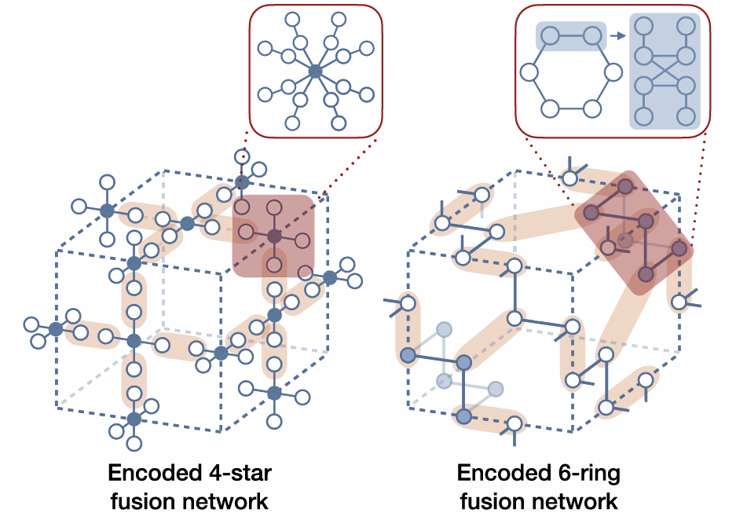
Optimize quantum error-correction strategies
1. Introduction
2. Research Project
3. Conclusion
2.1. State-of-the-art architectures
2.2. Quantum Error-Correction
2.3. Counterfactual Quantum gates
W. Song et al. Phys. Rev. Lett. 133, 050605 (2024).
P. Hilaire et al., preprint arXiv:2410.07065 [quant-ph] (2024).

Slide 17
2.3. Counterfactual quantum gates
A possible scheme for blind quantum computing

Slide 18
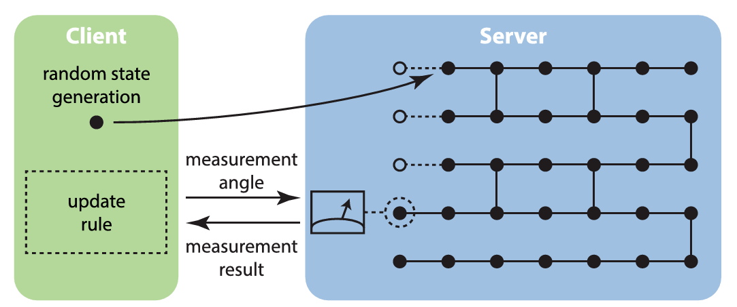
Blind Quantum Computing
1. Introduction
2. Research Project
3. Conclusion
2.1. State-of-the-art architectures
2.2. Quantum Error-Correction
2.3. Counterfactual Quantum gates
Secure client-server setting, where the server is blind to the quantum computation controlled by the client.
J. Fitzsimons, npj Quantum Information 23 (2017).

Slide 19
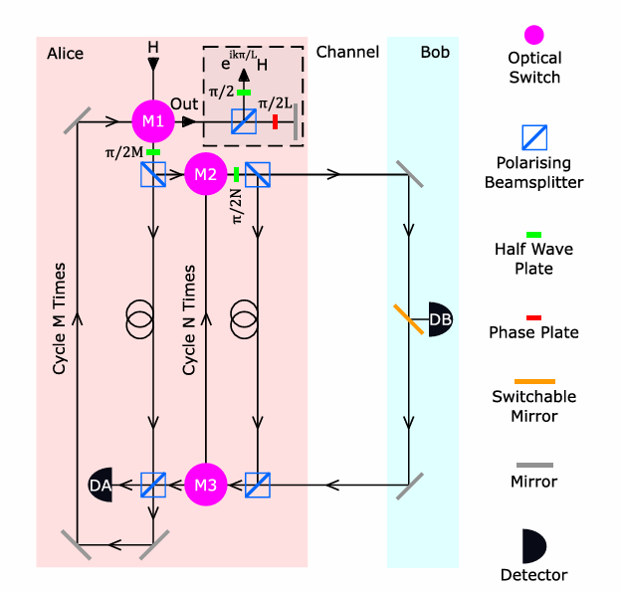
Counterfactual photonic quantum gate
1. Introduction
2. Research Project
3. Conclusion
2.1. State-of-the-art architectures
2.2. Quantum Error-Correction
2.3. Counterfactual Quantum gates
Bob can remotely apply an arbitrary single-qubit gate to a photonic qubit with a simple classical mechanism, without communicating with Alice.
H. Salih et al., New J. Phys. 23, 013004 (2021).

Slide 20
3. Summary

Slide 21
Summary
1. Introduction
2. Research Project
3. Summary
2.1. State-of-the-art architectures
2.2. Quantum Error-Correction
2.3. Counterfactual Quantum gates
Critical review of FBQC and SPOQC architectures, with the goal to improve on their modular building blocks by considering resource trade-offs in state-of-the-art schemes for photonic entangled state generation.
Investigate optimal strategies for implementing quantum error-correction in these architectures, in terms of the choice of resource and encoded states, error-correction code and fusion mechanisms.
Assess the security of a protocol for blind quantum computation using Salih et al’s counterfactual quantum gate.

Slide 22
Thank you for your attention
sara.franco@inl.int

Slide 23
References
S. Bartolucci et al., Nat. Commun. 14, 912 (2023).
D. E. Browne and T. Rudolph, Phys. Rev. Lett. 95, 010501 (2005).
J. Fitzsimons, npj Quantum Information 23 (2017).
A. Fowler et al., Phys. Rev. A 86, 032324 (2021).
G. Gliniasty et al., Quantum 8. 1423 (2024).
P. Hilaire et al., preprint arXiv:2410.07065 [quant-ph] (2024).
P. Kwiat, Physica Scripta. T76, 115-121 (1998).
J. O’Brien, Science 318,1567-1570 (2007).
R. Raussendorf and H. J. Briegel, Phys. Rev. Lett. 86, 5188 (2001).
H. Salih et al., New J. Phys. 23, 013004 (2021).
P. Thomas et al., Nature 608, 677–681 (2022).
Han-Sen Zhong et al., Science 370,1460-1463 (2020).

Slide 24
Spin-Optical Quantum Computing (SPOQC)
P. Thomas et al., Nature 608, 677–681 (2022).

Slide 25
Surface codes
1. Introduction
2. Research Project
3. Conclusion
2.1. State-of-the-art architectures
2.2. Quantum Error-Correction
2.3. Counterfactual Quantum gates
A. Fowler et al., Phys. Rev. A 86, 032324 (2021).

Slide 26
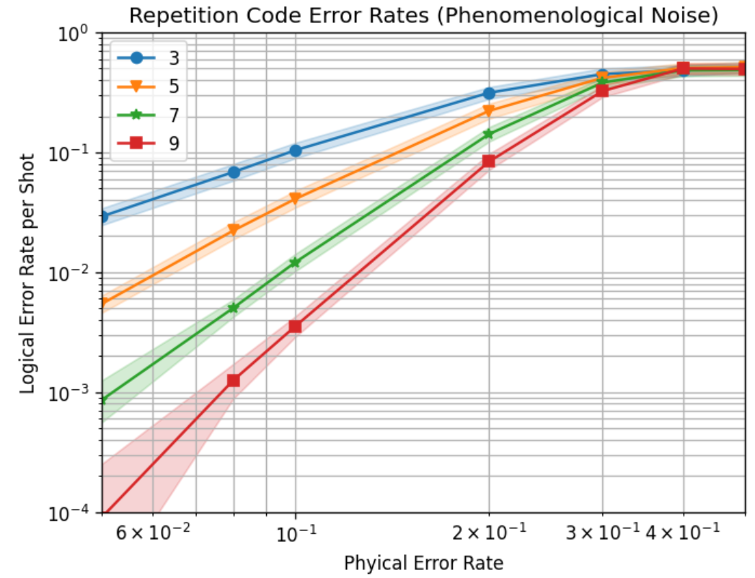
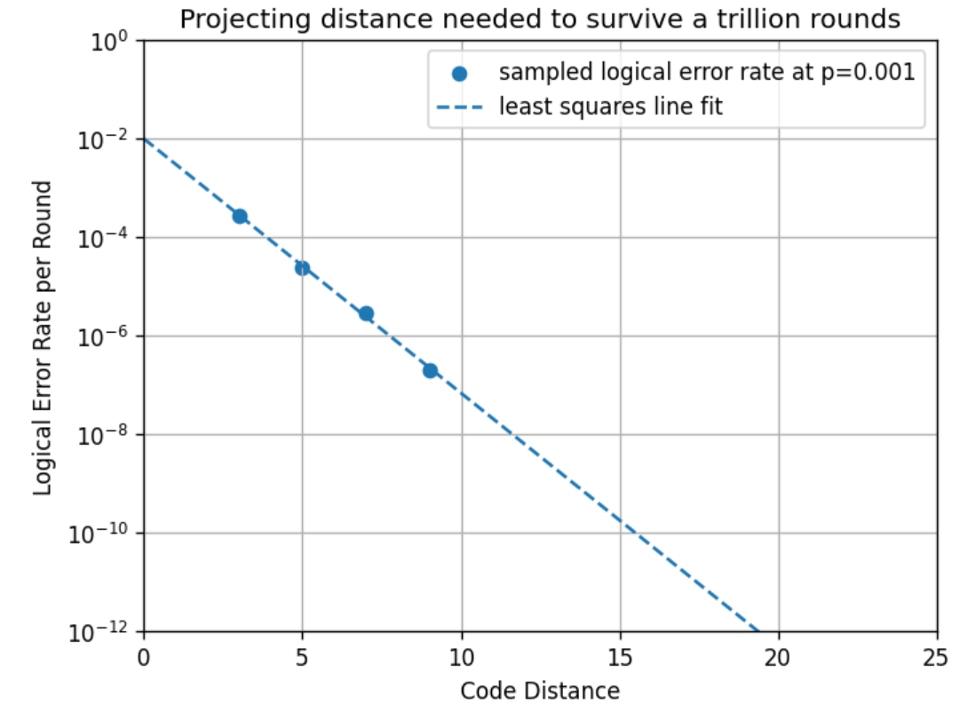
Quantum Error-Correction

