Slide 1
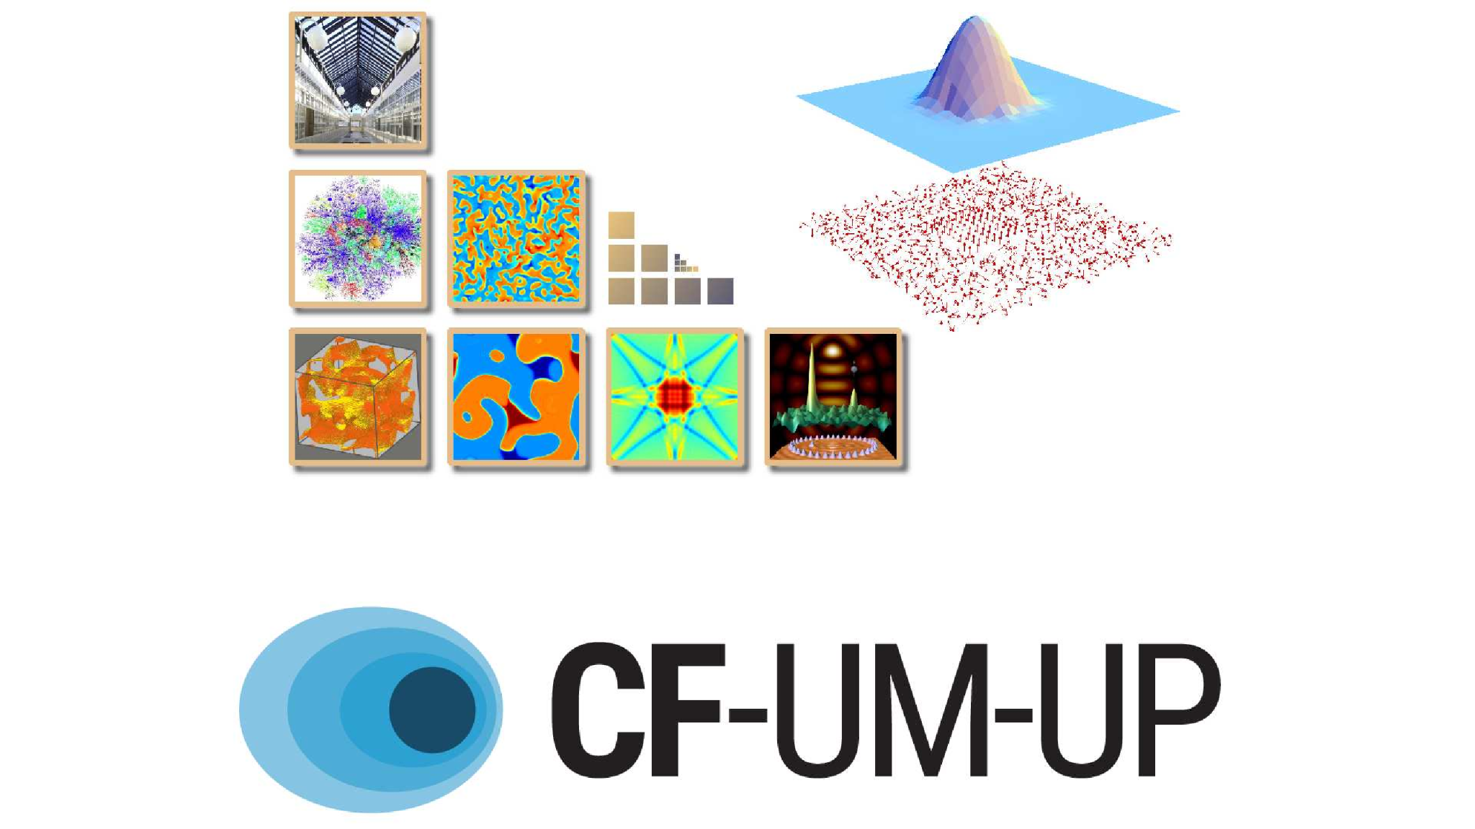
Unravelling Spin and Orbital Hall Effects in 2D Materials
Henrique P. Veiga
Supervisor: Professor J. M. Viana Parente Lopes
Co-Supervisor: Professor Aires Ferreira
Notes:
Hello everyone, good afternoon. Thank you for attending my presentation where I’ll describe the work plan of my PhD research project

Slide 2
An Overly Executive Summary of this PhD Programme
Combine state-of-the-art theoretical and computational methods to understand non-equilibrium phenomena relevant to current efforts in spin-orbitronics
Provide a microscopic description of non-equilibrium phenomena in realistic disordered systems
Notes:
If I had to describe it in a single sentence, I would say that this project aims at develop novel theoretical tools that will advance our understanding of orbital physics in realistic disordered systems.
The field of spin-orbitronics essentially emerged when it was discovered that electric fields generate a flow of spin angular momentum

Slide 3
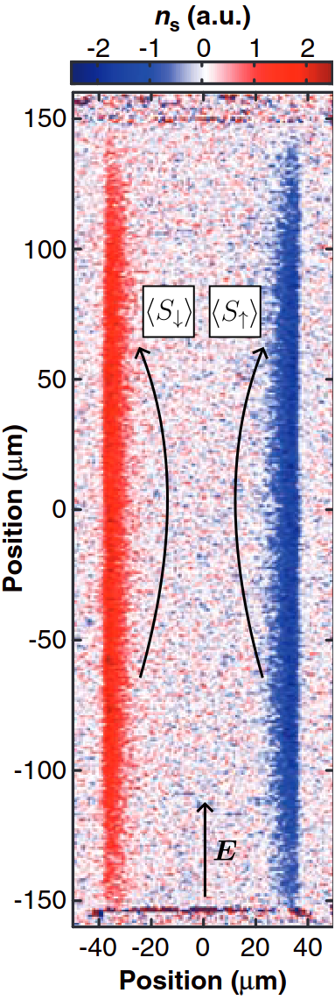
Bird’s-Eye View on Spin and Orbital Transport
Small electric fields generate flow of spin angular momentum (Hirsch, 1999);
Spintronics
Several emergent technologies from the spin Hall effect (SHE) and related transport phenomena;
SHE requires spin-orbit coupling (SOC);
Adapted from (Kato, 2004)

Slide 4
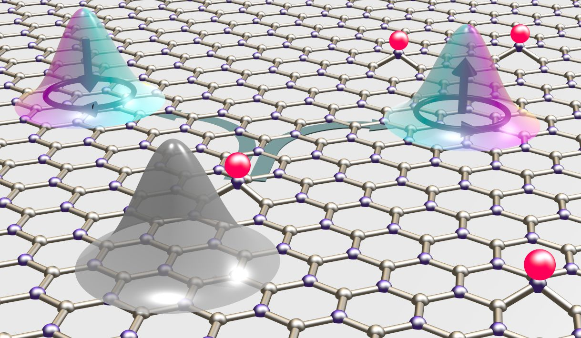
Bird’s-Eye View on Spin and Orbital Transport
Early work (Bernevig, 2005; Go, 2019; Cysne, 2021) suggest that orbital Hall effects (OHEs) are an appealing alternative to SHE;
No SOC required
(thus relevant for a large class of materials)
Orbital angular momentum (OAM) plays the role of spin
york.ac.uk/physics-engineering-technology/about/news/2025/orbitronics
Notes:
However, most work is done with imperfect samples, with imputirites and defects, and their role is still largely unknown

Slide 5
Bird’s-Eye View on Spin and Orbital Transport
Early work (Bernevig, 2005; Go, 2019; Cysne, 2021) suggest that orbital Hall effects (OHEs) are an appealing alternative to SHE;
No SOC required
(thus relevant for a large class of materials)
Orbital angular momentum (OAM) plays the role of spin
The role of impurity scattering is largely unknown
york.ac.uk/physics-engineering-technology/about/news/2025/orbitronics
Notes:
And this is where we come in

Slide 6
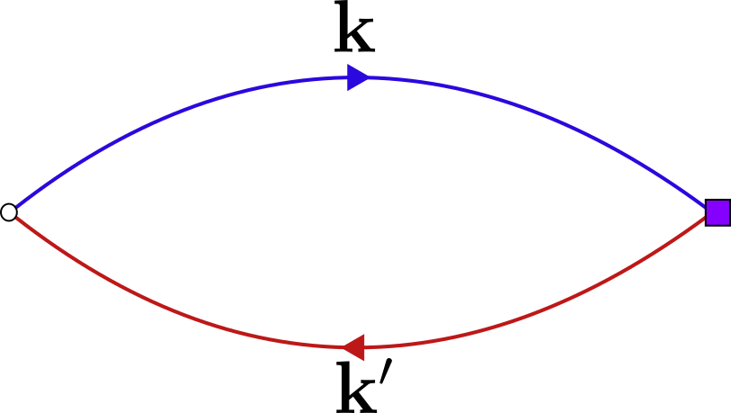

Twofold Approach
Complementary approach of cutting edge theoretical tools
Momentum-Space Diagrammatics
Real-Space Kernel Polynomial Method
(Covaci, Rappoport, Lopes, Ferreira, 2020)
Notes:
From here on forward I’ll use the diagram in parts of the project that are going to be done using momentum space approach, and the KITE logo will signify numerical work

Slide 7
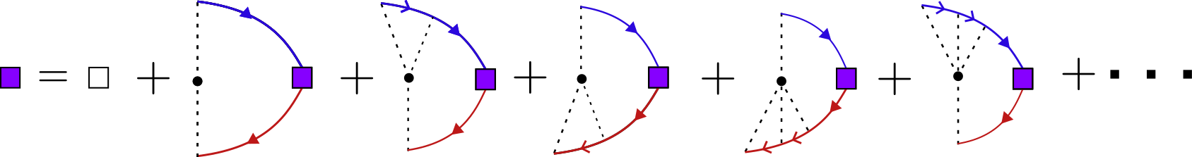
Twofold Approach
Resum the complete series of non-crossing diagrams
Diffusive Bulk Response
Develop self-consistent techniques for more realistic disorder landscapes
Construct a microscopic theory of OHE with random dilute impurities
Extending the work put forward in (Veneri, 2025)
Notes:
If we want to go beyond the diffusive response, then numerical methods are ideal

Slide 8
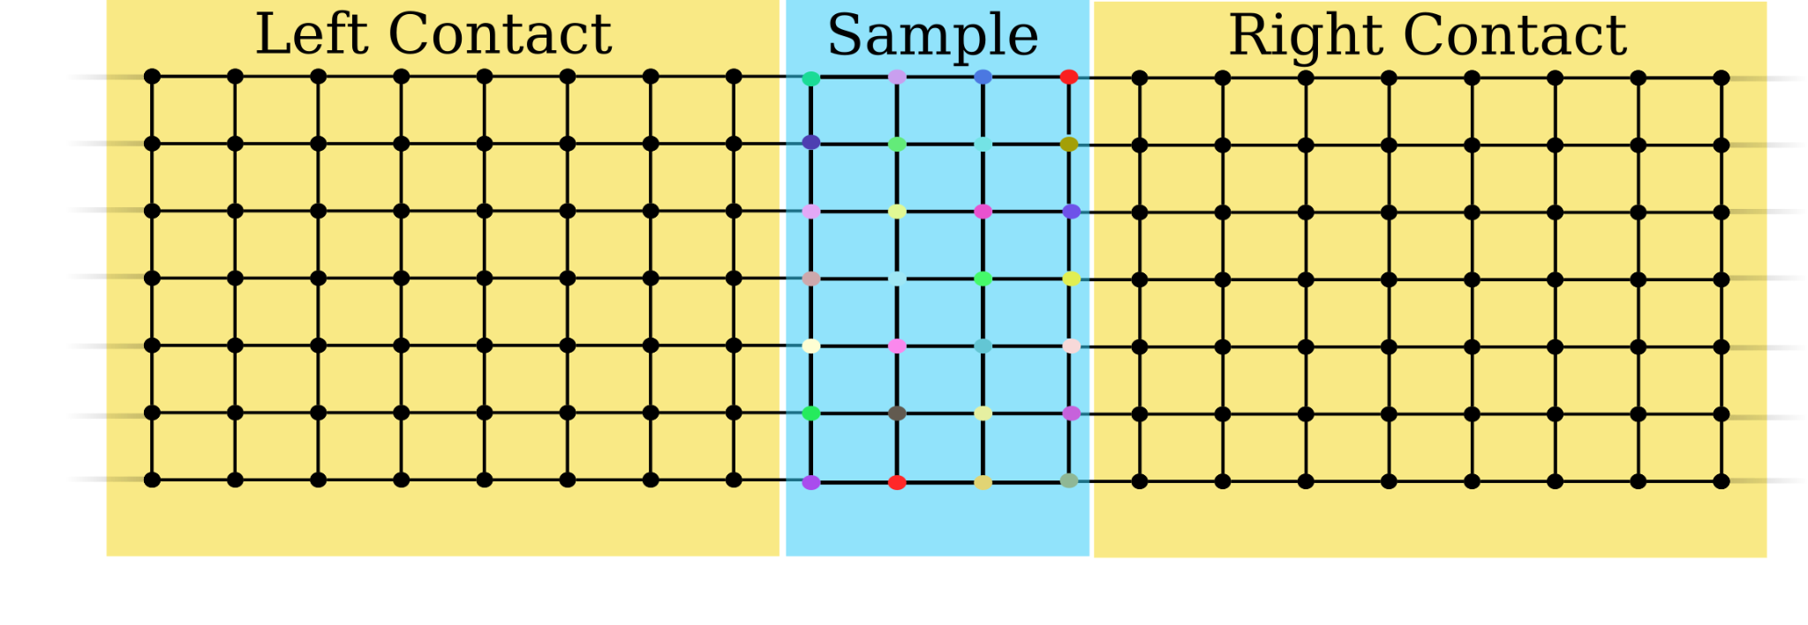
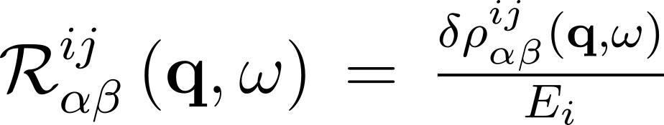
Twofold Approach
Numerical methods are ideal for fully non-perturbative studies of tight-binding models
Several additions to the KITE source code are planned
Generic linear response functions
Conductance in multi-terminal geometries
Notes:
planned, two examples of such additions, are

Slide 9
Twofold Approach
Real-space simulations will be crucial to go beyond the diffusive regime in both SHE and OHE
Nonlocal transport geometries have proven to be essential to observe certain phenomena within SHE (Sheng, 2005; Ren, 2006)
We expect the same to be important for future studies of the OHE
Notes:
The introduction of generic response functions will be important since real-space (...)
Aside from the both the analytical and numerical methods, we have planned three different work packages. The first of which is related to

Slide 10
Work Package
Clarifying the definition of the Orbital current operator
Recent evidence (Liu, 2025) indicates that the commonly used recipe to evaluate orbital currents is incomplete at best
Some calculations start from gauge dependent expressions;
Ignores intraband matrix elements;
More fundamentally, the position operator is ill defined in periodic systems (Marrazzo, 2016);
Numerical methods are ideal to clarify this issue
Nonperturbative by design
Open-boundary conditions

Slide 11
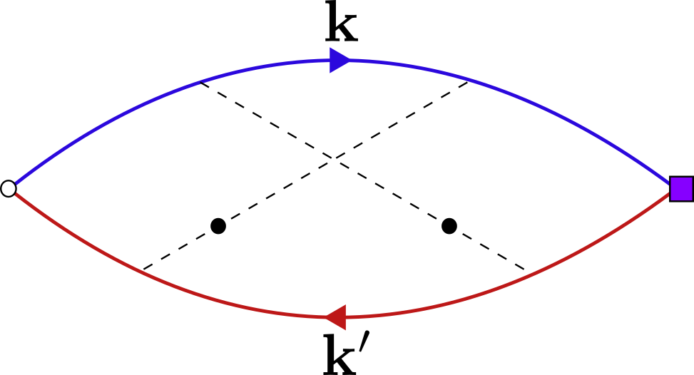
Work Package
Clarifying the definition of the Orbital current operator
Planned to implement the orbital response functi0n
Tests on simple model systems (e.g. Gapped Graphene, TMDs, ...)
Compare preliminary results against literature
Investigate the unphysical discontinuity of the orbital response reported in (Liu, 2024)
Gaussian disorder model;
Evaluation of crossing diagrams (Ado, 2015, Ferreira, 2016);

Slide 12
Work Package
Investigations on the SHE
Study the role of atomic defects and long-range potentials on the SHE
Bulk Conductivity
Multi-terminal Geometry
All evidence for skew-scattering has been theoretical based on momentum space. We wish to provide the first evidence for skew scattering in real-space
Twisting Effects
Notes:
Twisting effects, meaning twist angle disorder in twisted graphene. We are particularly interested in studying the impact that statistical fluctuations on the SOC can have in real-space
The last work package deals with the interplay between SHE and OHE, and we are interested in using the techniques from ongoing projects to get a real-space imaging

Slide 13
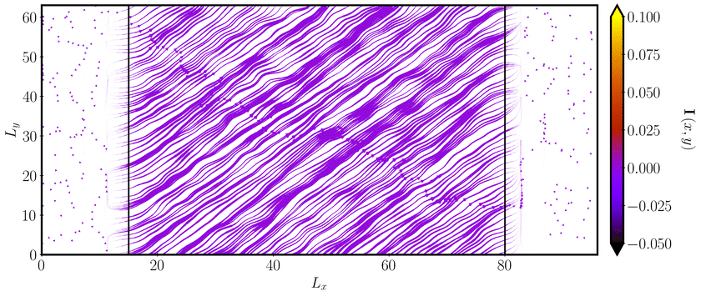
Work Package
Interplay between orbital and spin Hall effects
Real-space imaging of orbital currents in realistic transport geometries
We expect the knowledge drawn from ongoing projects to be key in shedding light at emergent orbital Hall effects (Gobel, 2024)
Notes:
Aside from this to unlock the interplay between SHE and OHE we will introduce the rashba effect

Slide 14
Work Package
Interplay between orbital and spin Hall effects
Generalise (Aires, 2021) and derive a quantum kinetic equation for OHE
Unlock the interplay of SHE and OHE
Introduction of Rashba effect
First steps to unified theory of spin-orbital dynamics in 2D materials
Real-Space orbital Edelstein effect

Slide 15
Research Project’s Goals
Develop new numerical methods
Clarify the proper evaluation of orbital currents
Construct a theory of diffusive OHE for 2D semiconductors
Perform real-space studies of OHE and SHE
Unveil the interplay between orbital and spin Hall effects

Slide 16
Research Project’s Goals
Develop new numerical methods
Clarify the proper evaluation of orbital currents
Construct a theory of diffusive OHE for 2D semiconductors
Perform real-space studies of OHE and SHE
Unveil the interplay between orbital and spin Hall effects

Slide 17
Research Project’s Goals
Develop new numerical methods
Clarify the proper evaluation of orbital currents
Construct a theory of diffusive OHE for 2D semiconductors
Perform real-space studies of OHE and SHE
Unveil the interplay between orbital and spin Hall effects

Slide 18
Research Project’s Goals
Develop new numerical methods
Clarify the proper evaluation of orbital currents
Construct a theory of diffusive OHE for 2D semiconductors
Perform real-space studies of OHE and SHE
Unveil the interplay between orbital and spin Hall effects

Slide 19
Research Project’s Goals
Develop new numerical methods
Clarify the proper evaluation of orbital currents
Construct a theory of diffusive OHE for 2D semiconductors
Perform real-space studies of OHE and SHE
Unveil the interplay between orbital and spin Hall effects

Slide 20
References
[1] M. Dyakonov and V. Perel, Current-induced spin orientation of electrons in semiconductors, Physics Letters A 35(6), 459 (1971), doi:10.1016/0375-9601(71)90196-4.
[2] J. E. Hirsch, Spin Hall Effect, Physical Review Letters 83(9), 1834 (1999), doi:10.1103/ PhysRevLett.83.1834.
[3] S. A.Wolf, D.D.Awschalom,R.A.Buhrman,J.M.Daughton,S.VonMolnár,M.L.Roukes, A. Y. Chtchelkanova and D. M. Treger, Spintronics: A Spin-Based Electronics Vision for the Future, Science 294(5546), 1488 (2001), doi:10.1126/science.1065389.
[4] Y. K. Kato, R. C. Myers, A. C. Gossard and D. D. Awschalom, Observation of the Spin Hall Effect in Semiconductors, Science 306(5703), 1910 (2004), doi:10.1126/science.1105514.
[5] D. Go, D. Jo, H.-W. Lee, M. Kläui and Y. Mokrousov, Orbitronics: Orbital currents in solids, EPL (Europhysics Letters) 135(3), 37001 (2021), doi:10.1209/0295-5075/ac2653.
[6] B. A. Bernevig, T. L. Hughes and S.-C. Zhang, Orbitronics: The Intrinsic Orbital Current in p-Doped Silicon, Physical Review Letters 95(6), 066601 (2005), doi:10.1103/PhysRevLett.95. 066601.
[7] H. Kontani, T. Tanaka, D. S. Hirashima, K. Yamada and J. Inoue, Giant Orbital Hall Effect in Transition Metals: Origin of Large Spin and Anomalous Hall Effects, Physical Review Letters 102(1), 016601 (2009), doi:10.1103/PhysRevLett.102.016601.
[8] I. V. Tokatly, Orbital momentum Hall effect in p-doped graphane, Physical Review B 82(16), 161404 (2010), doi:10.1103/PhysRevB.82.161404.
[9] D. Go, D. Jo, C. Kim and H.-W. Lee, Intrinsic Spin and Orbital Hall Effects from Orbital Texture, Physical Review Letters 121(8), 086602 (2018), doi:10.1103/PhysRevLett.121.086602.
[10] S. Wu, J. S. Ross, G.-B. Liu, G. Aivazian, A. Jones, Z. Fei, W. Zhu, D. Xiao, W. Yao, D. Cobden and X.Xu, Electrical tuning of valley magnetic moment through symmetry control in bilayer MoS2, Nature Physics 9(3), 149 (2013), doi:10.1038/nphys2524.
[11] Z. Song, R. Quhe, S. Liu, Y. Li, J. Feng, Y. Yang, J. Lu and J. Yang, Tunable Valley Polarization and Valley Orbital Magnetic Moment Hall Effect in Honeycomb Systems with Broken Inversion Symmetry, Scientific Reports 5(1), 13906 (2015), doi:10.1038/srep13906.
[12] S. Bhowal and G. Vignale, Orbital Hall effect as an alternative to valley Hall effect in gapped graphene, Physical Review B 103(19), 195309 (2021), doi:10.1103/PhysRevB.103.195309.
[13] Y.-G. Choi, D. Jo, K.-H. Ko, D. Go, K.-H. Kim, H. G. Park, C. Kim, B.-C. Min, G.-M. Choi and H.-W. Lee, Observation of the orbital Hall effect in a light metal Ti, Nature 619(7968), 52 (2023), doi:10.1038/s41586-023-06101-9.
[14] I. Lyalin, S. Alikhah, M. Berritta, P. M. Oppeneer and R. K. Kawakami, Magneto-Optical Detection of the Orbital Hall Effect in Chromium, Physical Review Letters 131(15), 156702 (2023), doi:10.1103/PhysRevLett.131.156702.

Slide 21
References
[15] A. ElHamdi,J.-Y. Chauleau, M.Boselli, C. Thibault, C. Gorini, A. Smogunov, C. Barreteau, S. Gariglio, J.-M. Triscone and M. Viret, Observation of the orbital inverse Rashba–Edelstein effect, Nature Physics 19(12), 1855 (2023), doi:10.1038/s41567-023-02121-4.
[16] M. Costa, B. Focassio, L. M. Canonico, T. P. Cysne, G. R. Schleder, R. Muniz, A. Fazzio and T. G. Rappoport, Connecting Higher-Order Topology with the Orbital Hall Effect in Monolayers of Transition Metal Dichalcogenides, Physical Review Letters 130(11), 116204 (2023), doi: 10.1103/PhysRevLett.130.116204.
[17] T. P. Cysne, M. Costa, M. B. Nardelli, R. B. Muniz and T. G. Rappoport, Ultrathin films of black phosphorus as suitable platforms for unambiguous observation of the orbital Hall effect, Physical Review B 108(16), 165415 (2023), doi:10.1103/PhysRevB.108.165415.
[18] A. Pezo, D. García Ovalle and A. Manchon, Orbital Hall physics in two-dimensional Dirac materials, Physical Review B 108(7), 075427 (2023), doi:10.1103/PhysRevB.108.075427.
[19] H. Liu and D. Culcer, Dominance of Extrinsic Scattering Mechanisms in the Orbital Hall Ef fect: Graphene, Transition Metal Dichalcogenides, and Topological Antiferromagnets, Physical Review Letters 132(18), 186302 (2024), doi:10.1103/PhysRevLett.132.186302.
[20] L. M. Canonico, J. H. Garcia and S. Roche, Orbital Hall responses in disordered topological materials, Physical Review B 110(14), L140201 (2024), doi:10.1103/PhysRevB.110.L140201.
[21] H. Veiga, S. M. João, J. M. Alendouro Pinho, J. P. Santos Pires and J. M. V. P. Lopes, Un ambiguous simulation of diffusive charge transport in disordered nanoribbons, SciPost Physics 17(6), 149 (2024), doi:10.21468/SciPostPhys.17.6.149.
[22] S. M. João, M. An ¯ delkovi´ c, L. Covaci, T. G. Rappoport, J. M. V. P. Lopes and A. Ferreira, KITE: high-performance accurate modelling of electronic structure and response functions of large molecules, disordered crystals and heterostructures, Royal Society Open Science 7(2), 191809 (2020), doi:10.1098/rsos.191809.
[23] S. G. De Castro, J. M. V. P. Lopes, A. Ferreira and D. Bahamon, Fast Fourier-Chebyshev Approach to Real-Space Simulations of the Kubo Formula, Physical Review Letters 132(7), 076302 (2024), doi:10.1103/PhysRevLett.132.076302.
[24] A. Pezo, D. García Ovalle and A. Manchon, Orbital Hall effect in crystals: Interatomic versus intra-atomic contributions, Physical Review B 106(10), 104414 (2022), doi:10.1103/ PhysRevB.106.104414.
[25] H.Liu,J.H.Cullen, D.P.ArovasandD.Culcer, Quantum Correction to the Orbital Hall Effect, Physical Review Letters 134(3), 036304 (2025), doi:10.1103/PhysRevLett.134.036304.
[26] A. Ferreira and E. R. Mucciolo, Critical Delocalization of Chiral Zero Energy Modes in Graphene, Physical Review Letters 115(10), 106601 (2015), doi:10.1103/PhysRevLett.115. 106601.

Slide 22
References
[27] M. Milletarì and A. Ferreira, Quantum diagrammatic theory of the extrinsic spin Hall effect in graphene, Physical Review B 94(13), 134202 (2016), doi:10.1103/PhysRevB.94.134202.
[28] P. J. Hirschfeld, P. Wölfle and D. Einzel, Consequences of resonant impurity scattering in anisotropic superconductors: Thermal and spin relaxation properties, Physical Review B 37(1), 83 (1988), doi:10.1103/PhysRevB.37.83.
[29] M. Milletarì, M. Offidani, A. Ferreira and R. Raimondi, Covariant Conservation Laws and the Spin Hall Effect in Dirac-Rashba Systems, Physical Review Letters 119(24), 246801 (2017), doi:10.1103/PhysRevLett.119.246801.
[30] A. Crépieux and P. Bruno, Theory of the anomalous Hall effect from the Kubo formula and the Dirac equation, Physical Review B 64(1), 014416 (2001), doi:10.1103/PhysRevB.64.014416.
[31] M. Offidani, M. Milletarì, R. Raimondi and A. Ferreira, Optimal Charge-to-Spin Conversion in Graphene on Transition-Metal Dichalcogenides, Physical Review Letters 119(19), 196801 (2017), doi:10.1103/PhysRevLett.119.196801.
[32] J. Sinova, S. O. Valenzuela, J. Wunderlich, C. Back and T. Jungwirth, Spin Hall effects, Reviews of Modern Physics 87(4), 1213 (2015), doi:10.1103/RevModPhys.87.1213.
[33] A. A. Kovalev, J. Sinova and Y. Tserkovnyak, Anomalous Hall Effect in Disordered Mult iband Metals, Physical Review Letters 105(3), 036601 (2010), doi:10.1103/PhysRevLett.105. 036601.
[34] I. A. Ado, I. A. Dmitriev, P. M. Ostrovsky and M. Titov, Anomalous Hall effect with massive Dirac fermions, EPL (Europhysics Letters) 111(3), 37004 (2015), doi:10.1209/0295-5075/ 111/37004.
[35] A. Veneri, T. G. Rappoport and A. Ferreira, Extrinsic Orbital Hall Effect: Orbital Skew Scat tering and Crossover between Diffusive and Intrinsic Orbital Transport, Physical Review Letters 134(13), 136201 (2025), doi:10.1103/PhysRevLett.134.136201.
[36] A. Pachoud, A. Ferreira, B. Özyilmaz and A. H. Castro Neto, Scattering theory of spin-orbit active adatoms on graphene, Physical Review B 90(3), 035444 (2014), doi:10.1103/PhysRevB. 90.035444.
[37] H. Tal-Ezer and R. Kosloff, An accurate and efficient scheme for propagating the time dependent Schrödinger equation, The Journal of Chemical Physics 81(9), 3967 (1984), doi:10.1063/1. 448136.
[38] J. Santos Pires, S. João, A. Ferreira, B. Amorim and J. Viana Parente Lopes, Anomalous Transport Signatures in Weyl Semimetals with Point Defects, Physical Review Letters 129(19), 196601 (2022), doi:10.1103/PhysRevLett.129.196601.
[39] B. K. Nikoli´ c, L. P. Zârbo and S. Souma, Mesoscopic spin Hall effect in multiprobe ballistic spin-orbit-coupled semiconductor bridges, Physical Review B 72(7), 075361 (2005), doi:10. 1103/PhysRevB.72.075361.

Slide 23
References
[40] L. Sheng, D. N. Sheng and C. S. Ting, Spin-Hall Effect in Two-Dimensional Electron Systems with Rashba Spin-Orbit Coupling and Disorder, Physical Review Letters 94(1), 016602 (2005), doi:10.1103/PhysRevLett.94.016602.
[41] W. Ren, Z. Qiao, J. Wang, Q. Sun and H. Guo, Universal Spin-Hall Conductance Fluctuations in TwoDimensions, Physical ReviewLetters 97(6), 066603 (2006), doi:10.1103/PhysRevLett. 97.066603.
[42] J. Sinova, D. Culcer, Q. Niu, N. A. Sinitsyn, T. Jungwirth and A. H. MacDonald, Uni versal Intrinsic Spin Hall Effect, Physical Review Letters 92(12), 126603 (2004), doi: 10.1103/PhysRevLett.92.126603.
[43] T. Thonhauser, D. Ceresoli, D. Vanderbilt and R. Resta, Orbital Magnetization in Periodic Insulators, Physical Review Letters 95(13), 137205 (2005), doi:10.1103/PhysRevLett.95. 137205.
[44] J. Shi, P. Zhang, D. Xiao and Q. Niu, Proper Definition of Spin Current in Spin-Orbit Coupled Systems, Physical ReviewLetters 96(7), 076604 (2006), doi:10.1103/PhysRevLett.96.076604.
[45] J. H. Cullen, H. Liu and D. Culcer, Giant orbital Hall effect due to the bulk states of 3D topolo gical insulators, doi:10.48550/arXiv.2501.17919, ArXiv:2501.17919 [cond-mat] (2025).
[46] B. Göbel and I. Mertig, Orbital Hall Effect Accompanying Quantum Hall Effect: Landau Levels Cause Orbital Polarized Edge Currents, Physical Review Letters 133(14), 146301 (2024), doi: 10.1103/PhysRevLett.133.146301.
[47] B. Göbel, L. Schimpf and I. Mertig, Topological orbital Hall effect caused by skyrmions and antiferromagnetic skyrmions, Communications Physics 8(1), 17 (2025), doi:10.1038/ s42005-024-01925-x.
[48] E. McCann and V. I. Fal’ko, Degeneracy breaking and intervalley scattering due to short-ranged impurities in finite single-wall carbon nanotubes, Physical Review B 71(8), 085415 (2005), doi: 10.1103/PhysRevB.71.085415.
[49] H.-Z. Lu, W. Yao, D. Xiao and S.-Q. Shen, Intervalley Scattering and Localization Behaviors of Spin-Valley Coupled Dirac Fermions, Physical Review Letters 110(1), 016806 (2013), doi: 10.1103/PhysRevLett.110.016806.
[50] L. Sun, L. Rademaker, D. Mauro, A. Scarfato, Pásztor, I. Gutiérrez-Lezama, Z. Wang, J. Martinez-Castro, A. F. Morpurgo and C. Renner, Determining spin-orbit coupling in graphene by quasiparticle interference imaging, Nature Communications 14(1), 3771 (2023), doi:10.1038/s41467-023-39453-x.
[51] D. Kochan, M. Gmitra and J. Fabian, Spin Relaxation Mechanism in Graphene: Resonant Scattering by Magnetic Impurities, Physical Review Letters 112(11), 116602 (2014), doi: 10.1103/PhysRevLett.112.116602.
[52] A. Ferreira, Theory of spin–charge-coupled transport in proximitized graphene: an SO(5) algeb raic approach, Journal of Physics: Materials 4(4), 045006 (2021), doi:10.1088/2515-7639/ ac31b5.

