Slide 1
VARIATIONS OF THE MID-LATITUDINAL IONOSPHERE DRIVEN BY SPACE WEATHER
BY
CHIAHA SHEDRACH OBUMNEME
UP202308817
SUPERVISORS:
ANNA MOROZOVA, UNIVERSITY OF COIMBRA.
TERESA BARATA, UNIVERSITY OF COIMBRA.
JOÃO LIMA, UNIVERSITY OF PORTO.

Slide 2
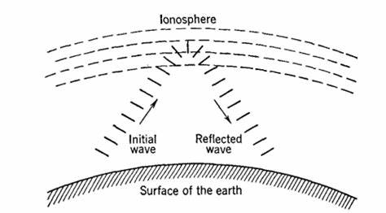
CONCEPT OF THE STUDY
Propagation of radio and communication signals varies with the condition of the ionosphere
Figure 2: Radio blackouts on 19 may 2022 (Source: National oceanic & atmospheric administration
Figure 1: Propagation of radio waves via the ionosphere (https://vias.org/albert_ecomm/aec12_radio_wave_propagation_007.html)

Slide 3
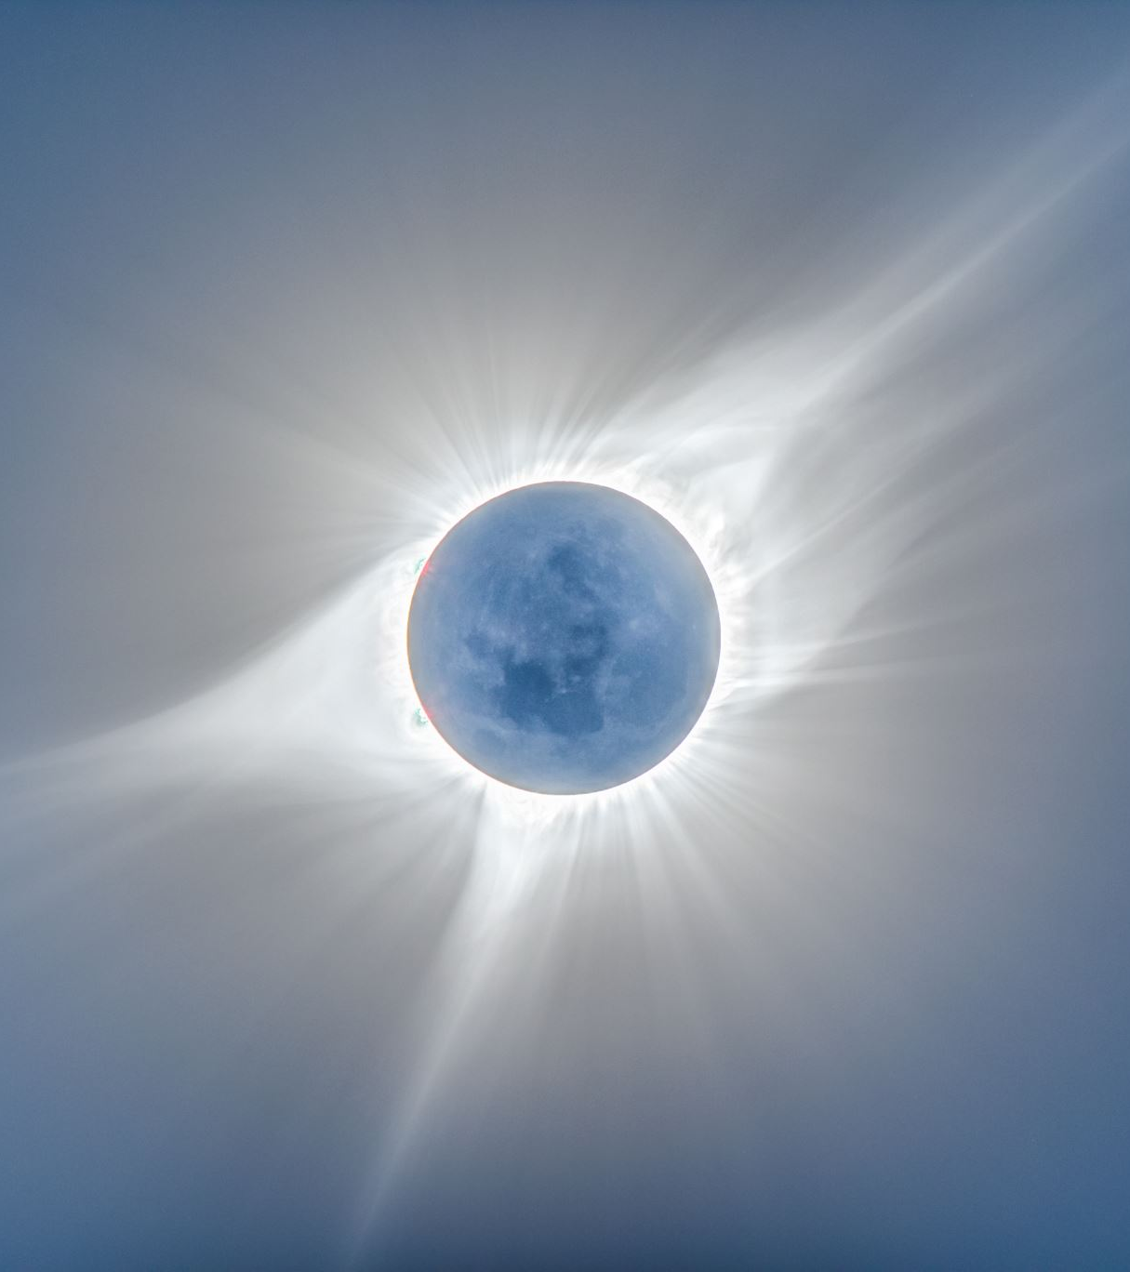
DEFINITION OF TERMS
SUN AND SOLAR WIND:
Fusion reaction of hydrogen in the suns core, together with its differential rotation
Creates the suns magnetic field which are released into interplanetary space with the solar wind.

Slide 4
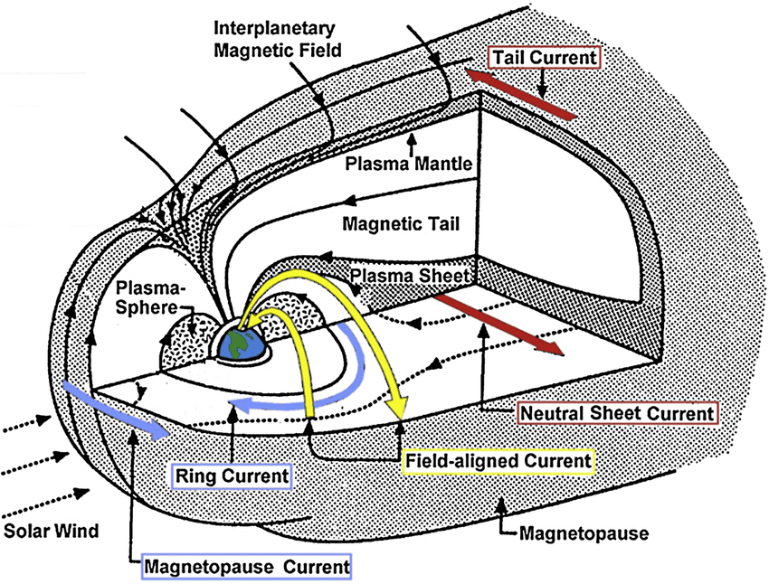
MAGNETOSPHERE:
a region of space surrounding Earth and distinguished by four currents depending on flow of charged particles (Maltsev and Ostapenko, 2000):
1.Magnetopause current
2. Ring current
3. Magnetotail current
4. Field aligned current
Fig. 3: A sketch of the magnetosphere in Kivelson and Russel (1995)

Slide 5
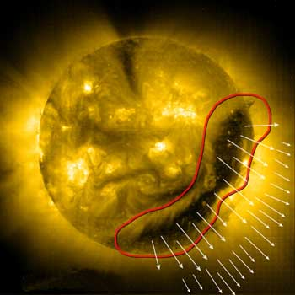
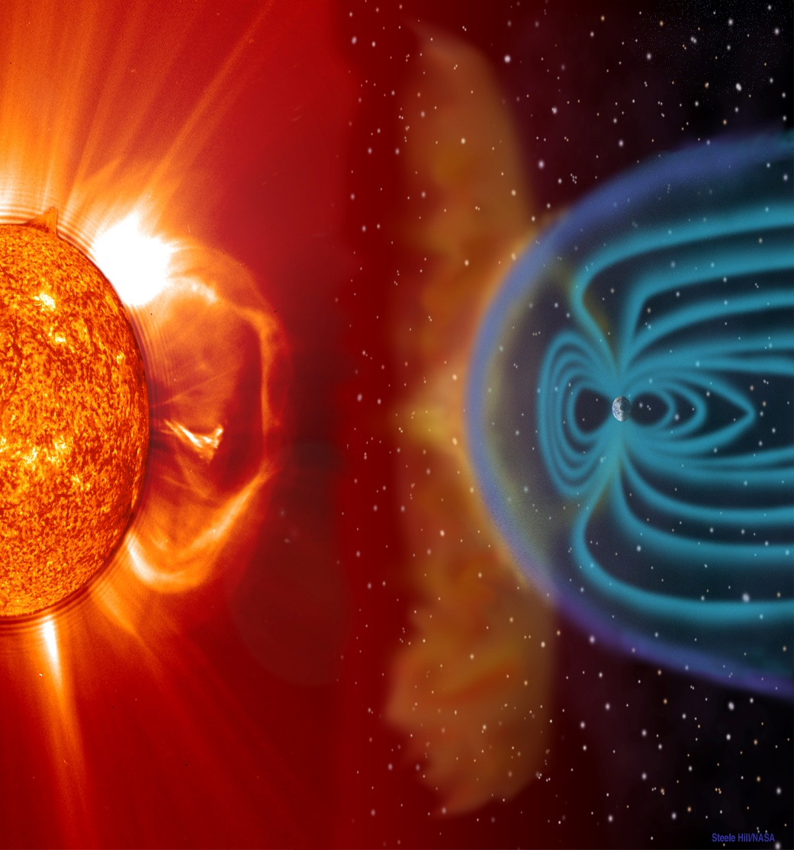
SOURCES OF GEOMAGNETIC STORMS (GMs)
Figure 4: GM storm from CIR
Corotating interaction regions (CIRs) are associated with gradual storms – frequent during declining phase
Coranal mass ejection (CMEs) are associated with sudden geomagnetic storms – Solar maxima
Associated with different types of magnetic field on the sun.
Their contributions to geomagnetic activity strongly depend on the 11-year solar cycle (Legrand & Simon, 1981).
Figure 5: GM storm from CME (European Space Agency)

Slide 6
DISTURBANCE STORM TIME & INTENSITY LEVELS
Dst index - Measures the strength of the ring current around earth
Table 1: Definition of geomagnetic activity intensity levels (Echer et al., 2006)
Level | Dst, (nT)
Intense | Dst ≤ -100
Moderate | -50 ≥ Dst < -100
Weak | -30 ≥ Dst < -50
Quiet | Dst > -30
Figure 6: Schematic of sudden & gradual geomagnetic storms

Slide 7
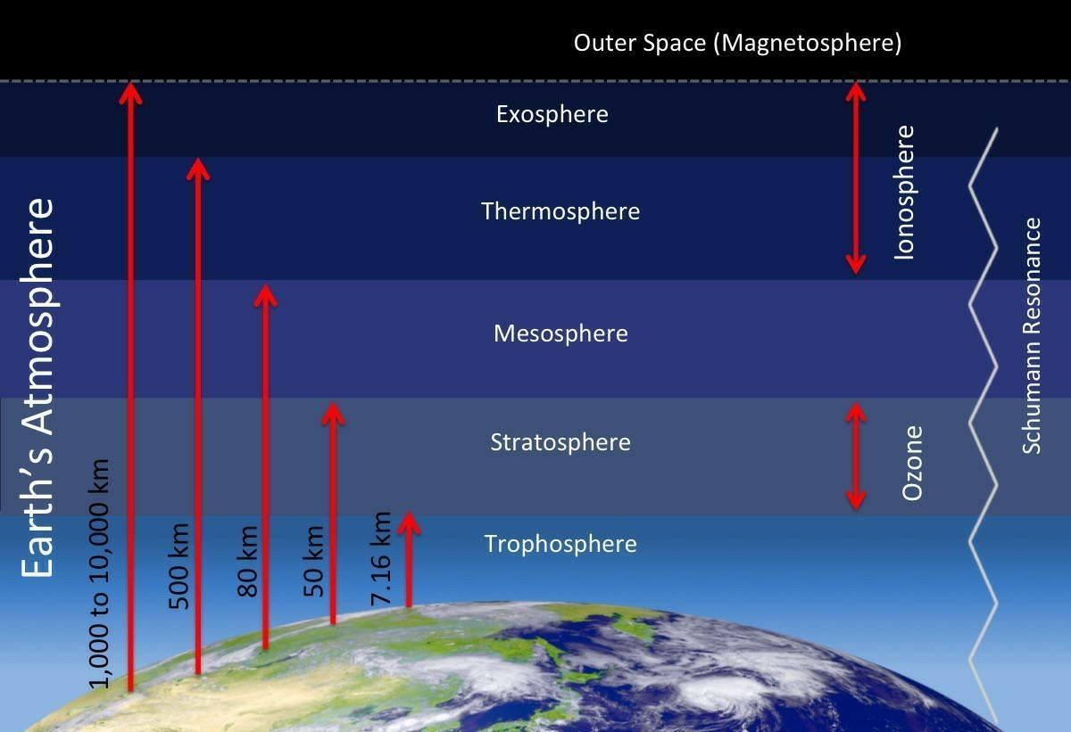
IONOSPHERE
A region within the upper atmosphere where large concentrations of ions and free electrons exist.
Figure 7: Layers of earths atmosphere (https://ar.inspiredpencil.com/pictures-2023/ionosphere-layers-atmosphere)

Slide 8
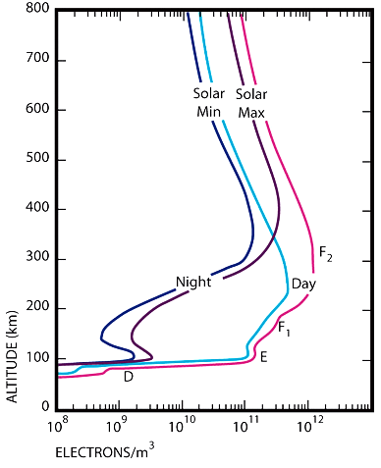
LAYERS OF THE IONOSPHERE
It is divided into D, E, F1 & F2 layer which are distinct in daytime.
Figure 8: Layers oaf the ionosphere (Lanzerotti et al. 2007)

Slide 9
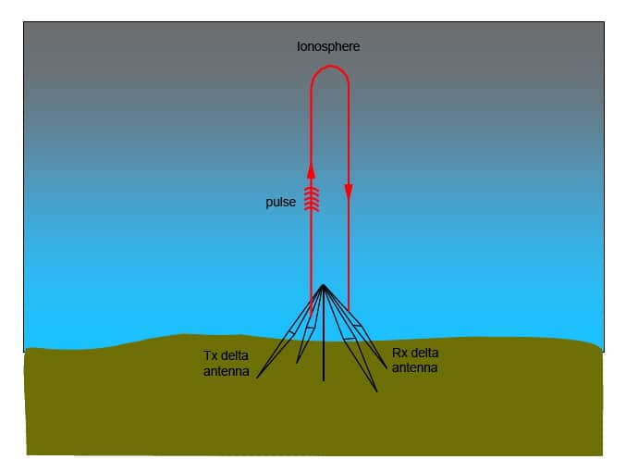
MEASUREMENT OF TOTAL ELECTRON CONTENT (TEC)
Ionization and density varies with height
Critical freq. of each layer is related to density (Ne) by
𝑓𝑜𝐹2 = 9∗√𝑁𝑒 1.1
where Ne is maximum electron density per m3 and fo is in Hz
TEC - A measure of the number of electrons of the ionosphere in a unit cross-section column above an observatory.
1 TEC unit = 1016m^(−2)
Figure 9: Measurement of TEC using GNSS receivers in Naumov et al. 2024
Figure 10: Measurement of TEC using ionosondes in Australian Bureau of meteorology

Slide 10
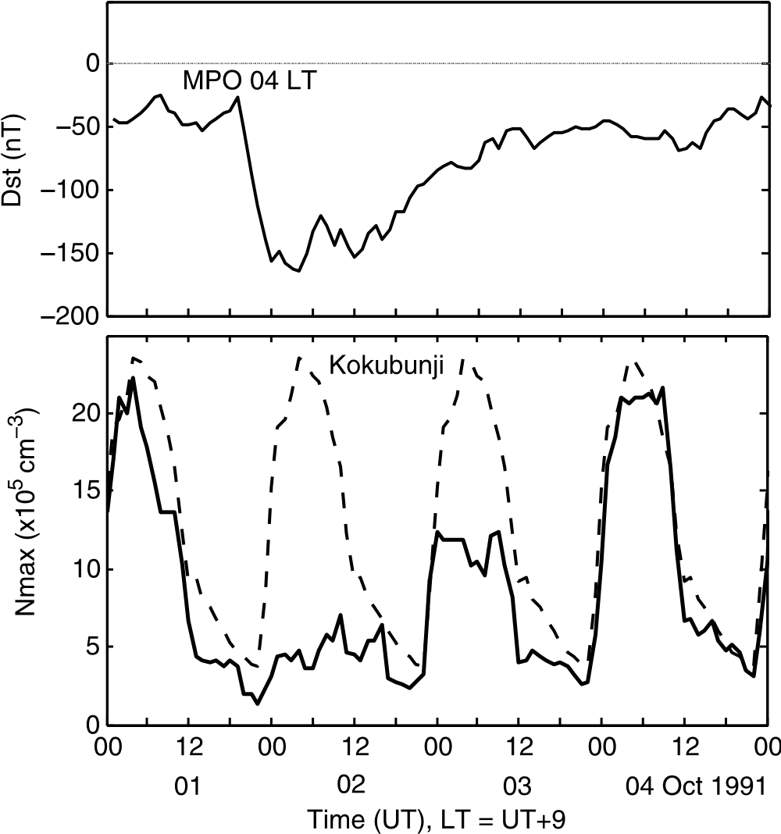
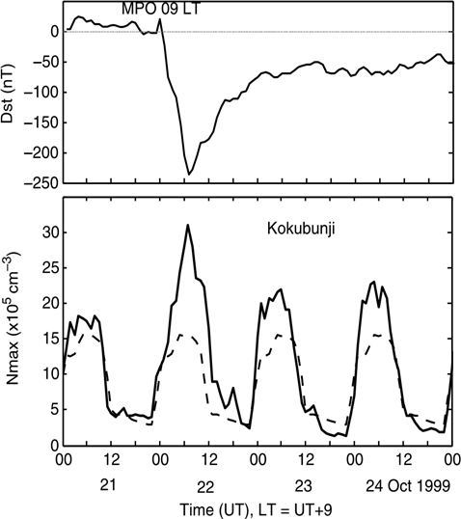
IONOSPHERIC STORMS
Are increase (positive storms) or decrease (negative storms) of f0F2 or TEC.
Positive storms – enhancement of ionization
hv + X → X⁺ + e
hv + XY → XY⁺ + e
Negative storms – enhancement of recombination process
X⁺ + e → X + hv
XY + e → X* + Y*
Figure 11: (bottom) Example of a negative ionospheric storm at Kokubunji during (top) the geomagnetic storm of 2-4 October 1991 in Lekshmi et al. (2011)
Figure 12: (bottom) Example of a positive ionospheric storm at Kokubunji during (top) the geomagnetic storm of 22-25 October 1999 in Lekshmi et al. (2011)

Slide 11
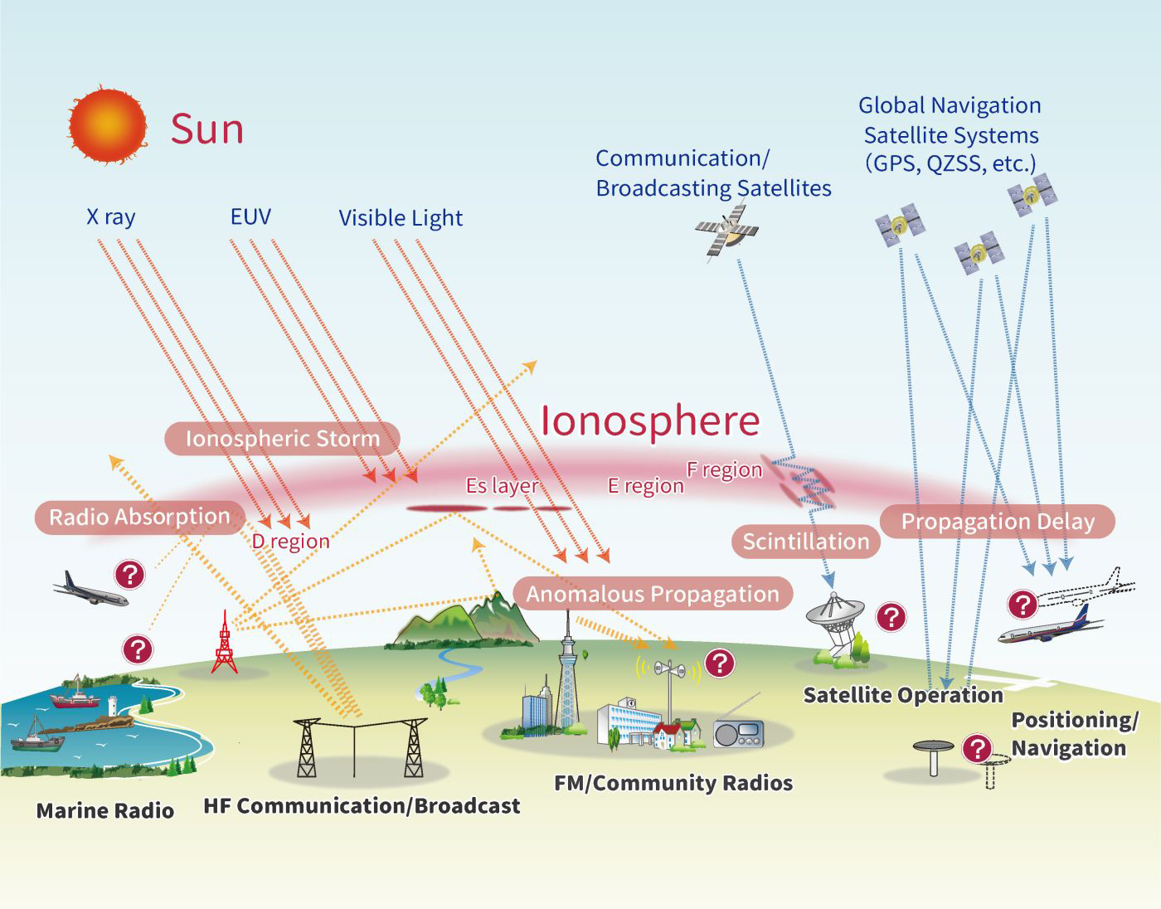
EFFECTS OF IONOSPHERIC STORMS
source: swc.nict.go.jp

Slide 12
PURPOSE OF THIS PHD PROJECT
Variations of TEC during GMs in relation to
local time, seasons, severity of the geomagnetic storms,
the type of storms (sudden or gradual) and the phase of the solar cycle
identification of +, - ionospheric storms
estimate their strength during geomagnetic storms.
estimation of the standard deviation of the measured TEC

Slide 13
LITERATURE REVIEW
A summary of TEC patterns during GMs are :
Variations in the peaks of positive & negative ionospheric response with latitude.
2. positive storms are more pronounced in winter and negative storms are more pronounced in summer.
3. Well defined positive phase for daytime storms
4. Negative phase depth linked to severity of storms.

Slide 14
TEC DATA
between January 2015 and December 2019, corresponding to the decreasing phase of solar cycle 24.
National Network of Permanent GNSS Stations (ReNEP), (https://renep.dgterritorio.gov.pt/).

Slide 15
TABLE 2: COORDINATES OF GNSS RECEIVERS
Location Latitude Longitude
Lisbon (Cascais) 38.7N 9.14W
Azores (Furnas) 37.8N 25.4W
Madeira (Funchal) 32.7N 16.9W

Slide 16

METHODS OF DATA ANALYSIS
Average of the five quietest days
$\overline{{TEC}_{QD}}=\frac{1}{5}\sum_{i=1}^{5}{{TEC}_{i}}$ (1.2)
Standard deviation of the quiet day TEC values
σ = SD =$\sqrt{\frac{1}{24}\sum_{H=0}^{23}{({TEC}_{QD}\left(H\right)−}{\overline{{TEC}_{QD}})}^{2}}$ (1.3)

Slide 17
METHODS OF DATA ANALYSIS CONTD.
Variations of TEC during geomagnetic storms
ΔTEC = TEC – TECQD (1.4)
σ = SD – Used to determine the values of ΔTEC that was statistically significant.
Only ΔTEC values exceeding ±2σ are considered statistically significant.

Slide 18
TABLE 3: SELECTED TABLE OF GEOMAGNETIC STORMS
S/N | Storm dates | SSC (Y/N)? | Storm commencement time UTC | Storm Dst minimum, UTC | Dst min, nT | Kp max | Ionospheric response (type, max amplitude in TECu & SD, synchrony: Y/N)
1. | 01.03.2017 | Y | 01.03.2017 8h | 01.03.2017 22h | -62 | 6- | + 16-23 TECu (9-13 SD) Y
2. | 27.03.2017 | Y | 26.03.2017 22h | 27.03.2017 17h | -71 | 6+ | + 10-13 TECu (4-5 SD) Y
3. | 27-28.05.2017 | Y | 27.05.2017 22h | 28.05.2017 8h | -146 | 6+ | -/+ 10 – 12 TECu (5 – 6 SD) Y

Slide 19
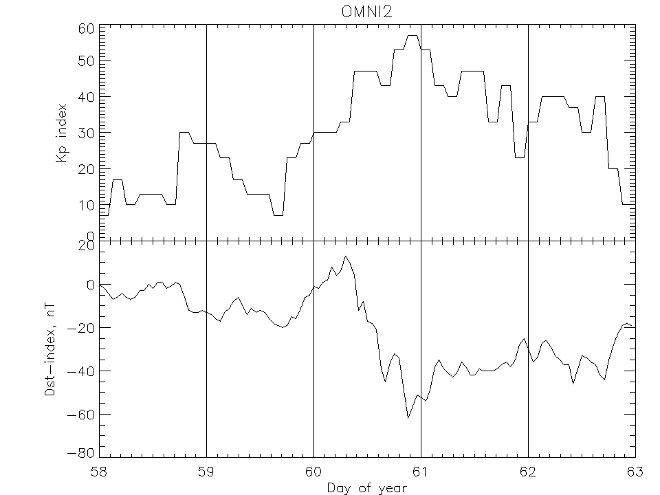
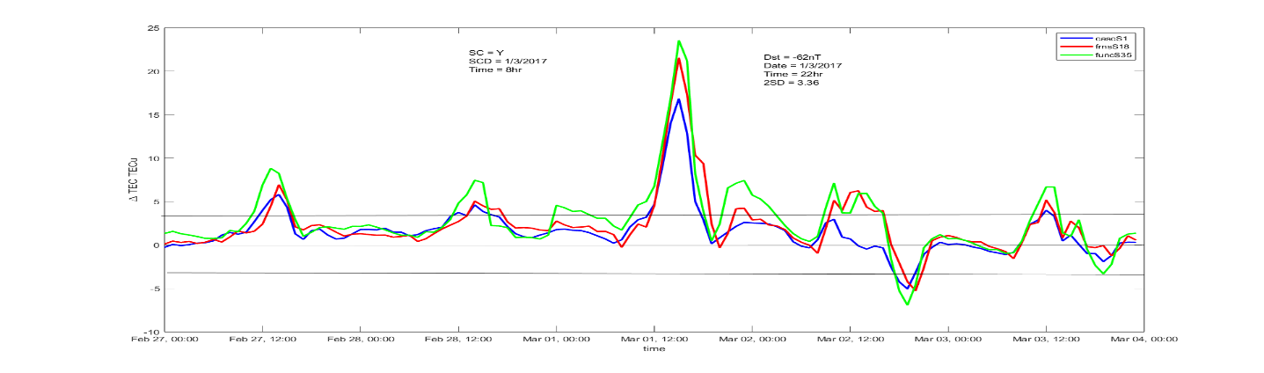
RESULTS
Figure 13: Plots of Dst index (top) and change in TEC (bottom) for 27.02.2017 - 03.03.2017

Slide 20
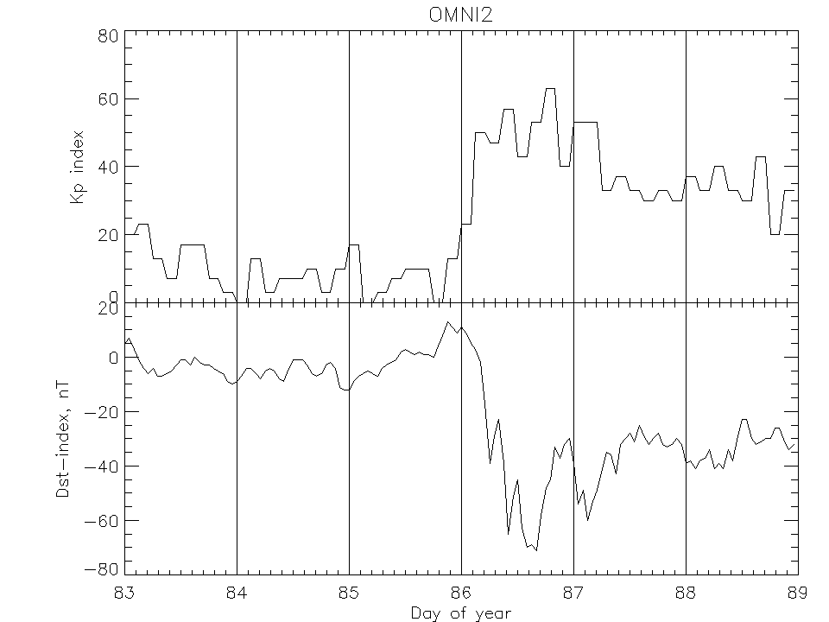
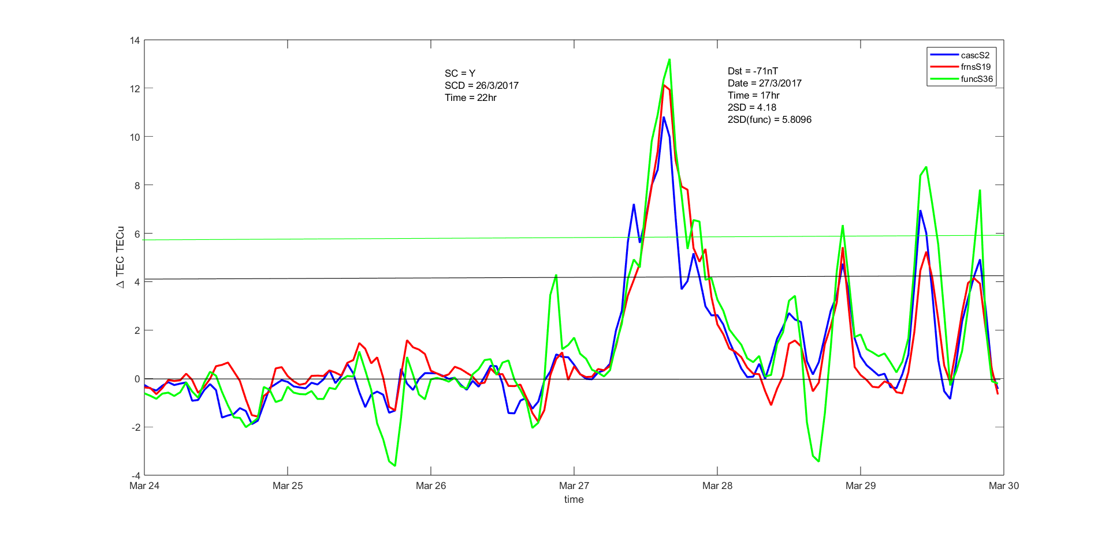
Figure 14: Same as Figure 7 but for 24.03.2017 - 29.03.2017

Slide 21
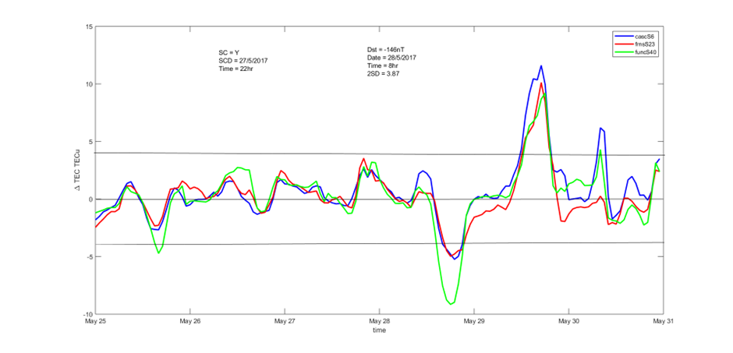
Figure 15: Same as Figure 7 but for 25.05.2017 - 30.05.2017

Slide 22
CONCLUSION
All three stations had ionospheric response
Further discussions of other geomagnetic storms would be able to reveal effects of
seasons, onset & severity of GMs.
Also, modelling could be done to reveal the solar wind & IMF drivers of ionospheric storms

