Slide 1

Essay MAP-fis
COMPOSITE SCINTILLATING NANOFIBERS BY ELECTROSPINNING FOR RADIATION DETECTION
Áureo Ucuanjongo
id11632

Slide 2
Introduction
Scintillator materials have found applications in various fields

Slide 3
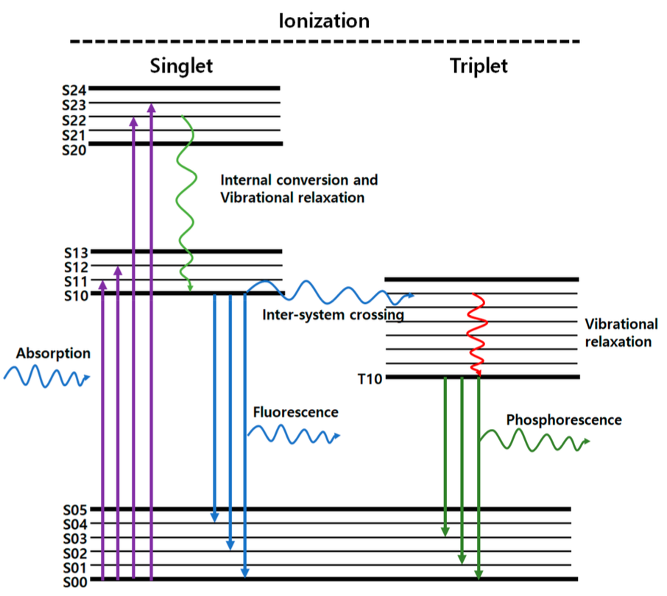
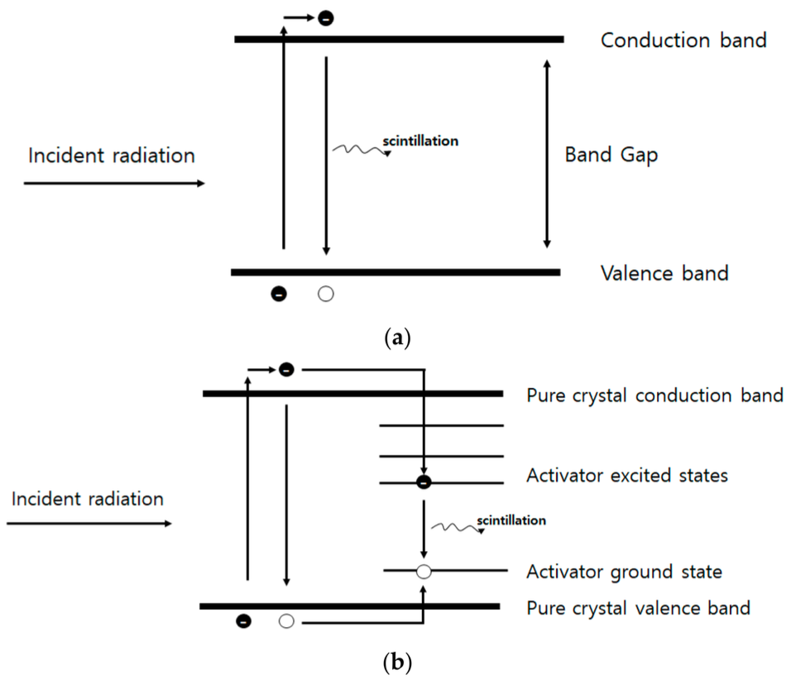
The Scintillation Process
Scintillation mechanism in organic scintillator
Scintillation mechanism in inorganic scintillator

Slide 4
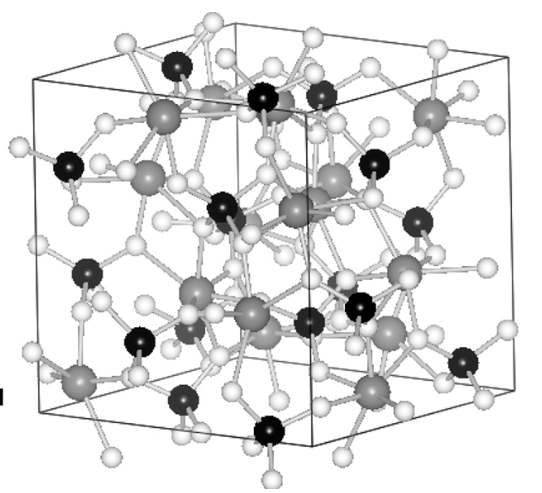
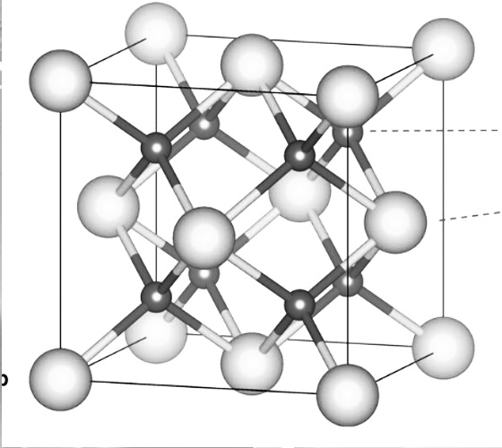


The most commercial scintillators
$${Bi}_{4}{Ge}_{3}O_{12}$$
Shortcomings
Harsh Fabrication Conditions
High Costs
$${BaF}_{2}$$
Sensitivity to Humidity
Sensitivity to Oxygen
Toxicity

Slide 5


Organic Scintillators
Examples
Antracene $C_{14}H_{10}$
Stilbene $C_{14}H_{12}$
1-fenil-3-(2-oxazolil)-benzoxazol (POP)
1,4-bis[2-(5-fenil-oxazolil)]benzeno (POPOP)

Slide 6
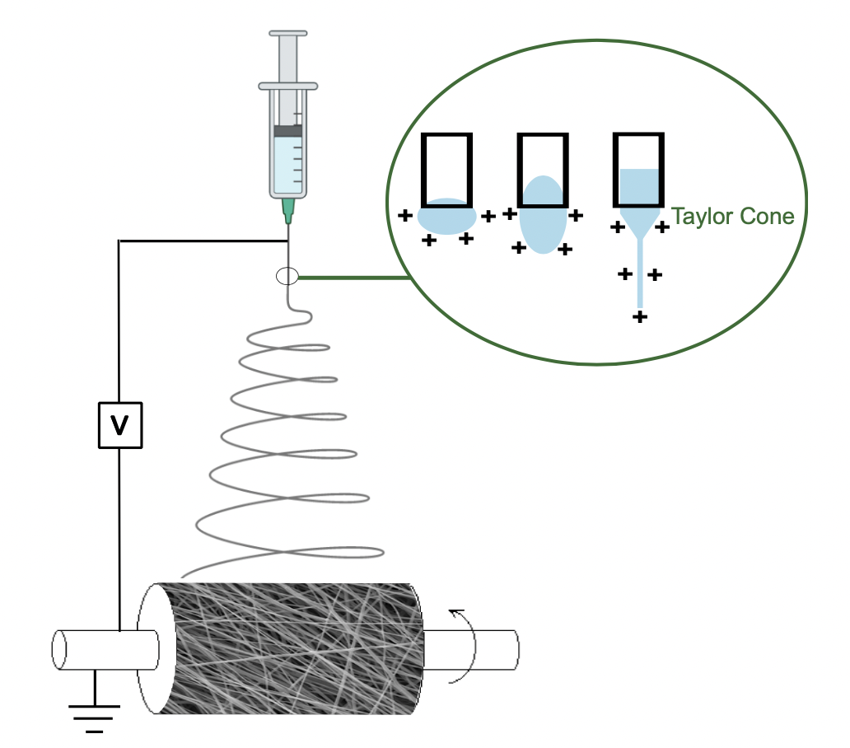
Electrospinning technique
1- Capillary tube is filled with a polymer
Solution
2- Voltage in the needle
3- Polymer droplet suspended from the needle
4- Taylor cone formation
5- Polymer solution ejected from the Taylor cone
6-Solvent evaporation
7- Fiber collected on the collector

Slide 7
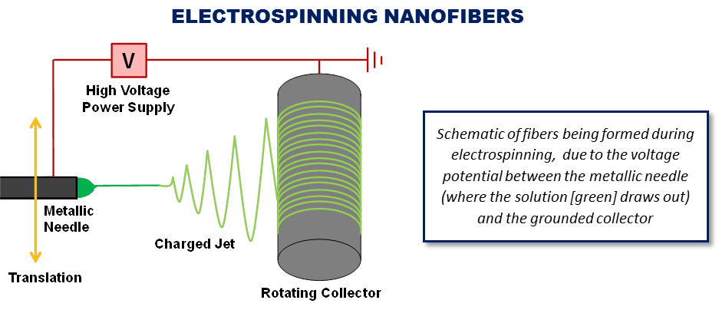
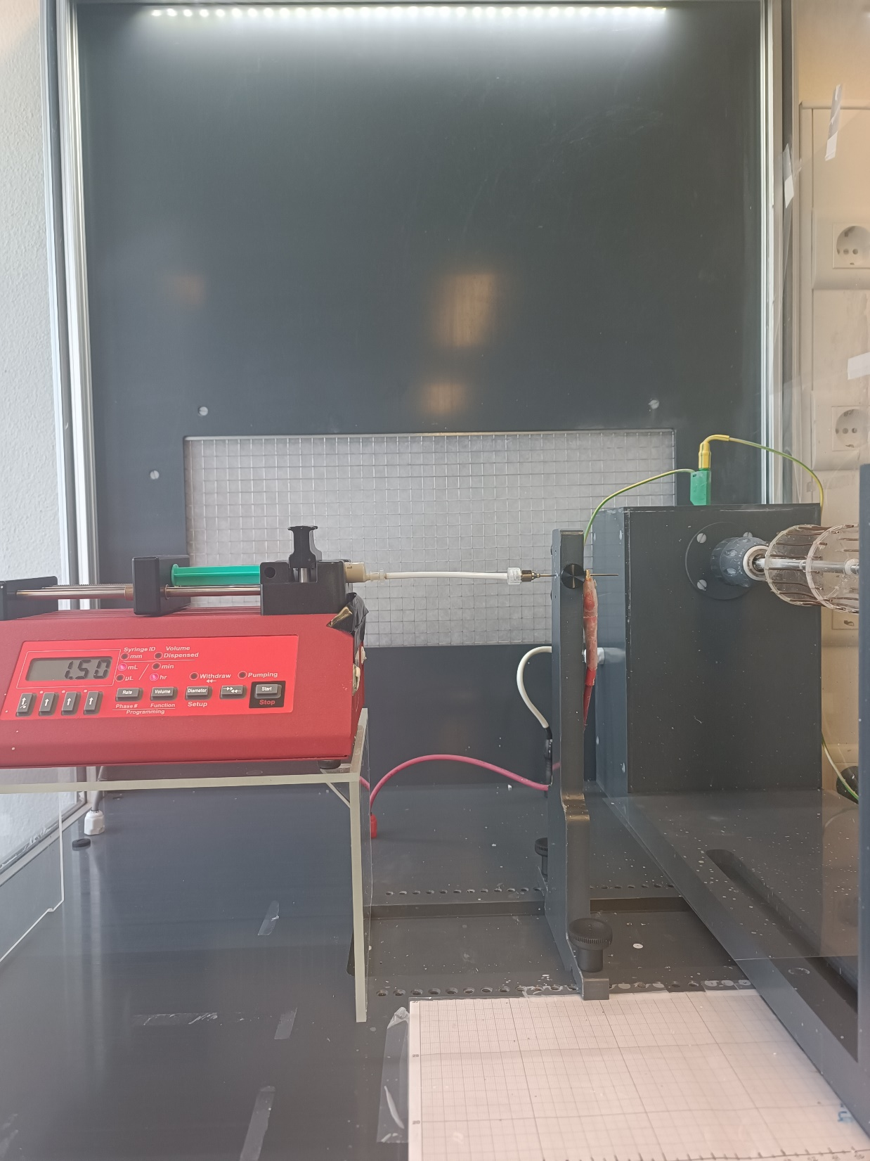
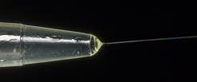
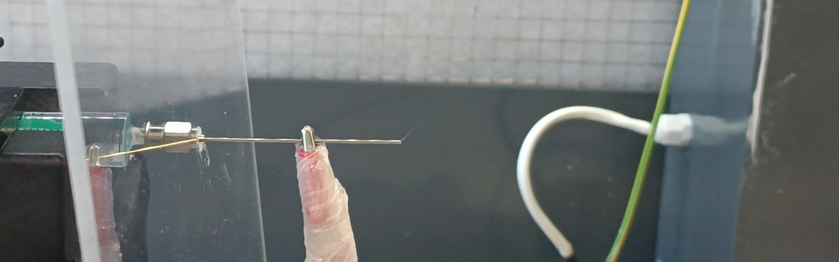
Electrospinning
IN-FLIGHT, THE EMITTED JET IS STRETCHED, THE SOLVENT EVAPORATES AND THE FIBERS ARE FORMED, OCCURRING CRYSTALLIZATION OF THE CARRIER POLYMER AND OF THE ACTIVE MOLECULES INSIDE IT.
Notes:
The electrospinning process begins when a high voltage electric field is applied to the polymer solution via the metallic needle.
When the strength of the electrical field is sufficient to overcome the surface tension of the solution, in the tip of the needle, ultrafine nanofibers emerge from the droplet, which are collected on the metallic collector kept at an optimized distance.

Slide 8
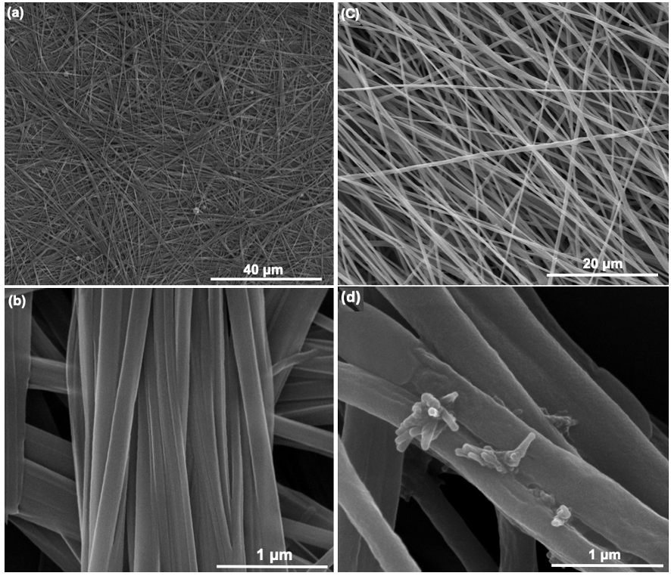
Electrospun nanofibers
SEM images of electrospun nanofibers
Nanofibers of Cyclo-L-Tryptophan-L-Tyrosine Dipeptide

Slide 9
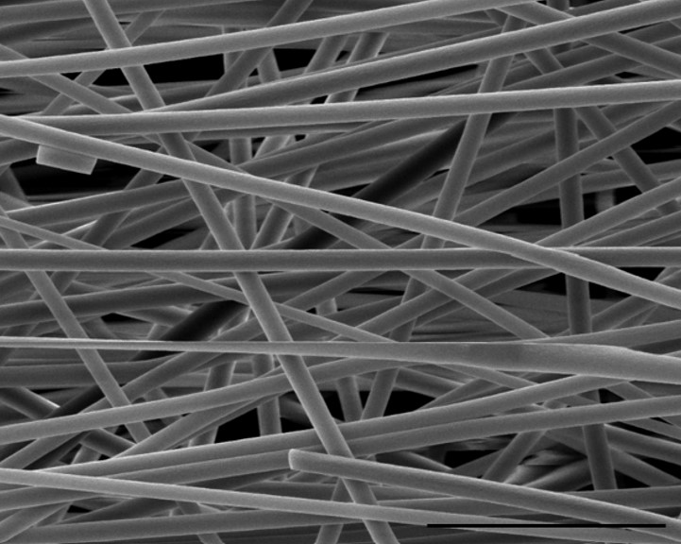
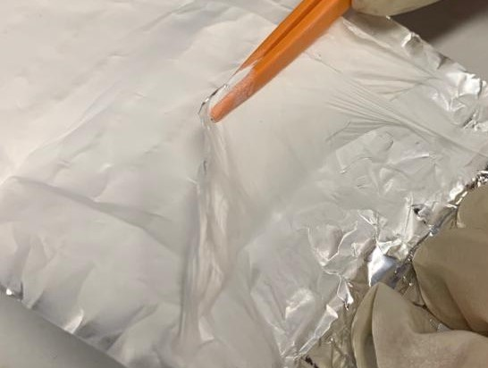
Electrospinning
20 µm
SEM image of the polymeric nanofibers
Fiber mat
Notes:
Electrospinning can be used to produce highly aligned polymeric nanofibers with embedded organic guest molecules, resulting in crystalline assemblies that exhibit significantly improved piezoelectric and nonlinear optical properties. Additionally, using piezoelectric biopolymers, such as nanocellulose or PLLA, eco-friendly fibers can be attained.

Slide 10
Objectives
General objective
The project aims to develop nanofibers prepared by electrospinning for radiation detectors, focusing on a new generation of composite nanofiber mats embedded with inorganic nanoparticles and organic scintillation materials

Slide 11
Specific Objectives
1.
SYNTHESIS OF COMPOSITE NANOFIBERS EMBED WITH ORGANIC ACTIVE COMPOUNDS
SYSTEMATIC STUDY OF THE STRUCTURAL, CHEMICAL AND MORPHOLOGICAL PROPERTIES OF THE COMPOSITE NANOFIBERS
2.
DETAILED STUDY OF THE SELF-ASSEMBLY PROPERTIES OF THE NANOPARTICLES AND ORGANIC SCINTILLATORS IN ELECTROSPUN NANOFIBERS
3.
DETAILED CHARACTERIZATION OF THE STATIC AND FREQUENCY DEPENDENT ELECTRIC PROPERTIES AND RELAXATION BEHAVIOR OF THE FIBERS
4.
5.
SYSTEMATIC STUDY OF THE OPTICAL ABSORPTION AND PHOTOLUMINESCENCE OF THE COMPOSITE NANOFIBERS
6.
SYSTEMATIC STUDY OF THE SCINTILLATION RESPONSE OF THE INDIVIDUAL COMPOUNDS AND COMPOSITE FIBERS

Slide 12
Research work plan
TASK 2
STRUCTURAL, CHEMICAL, MECHANICAL AND THERMAL ANALYSIS
TASK 4
OPTICAL, LUMINESCENT AND NONLINEAR OPTICAL PROPERTIES
TASK 1
SYNTHESIS of RADIOLUMINESCENT ELECTROSPUN SINGLE AND COMPOSITE FIBERS
TASK 3
STUDY OF THE ELECTRIC PROPERTIES OF THE FIBERS
TASK 5
ASSESSMENT OF THE SCINTILLATION PROPERTIES OF THE NANOFIBERS

Slide 13
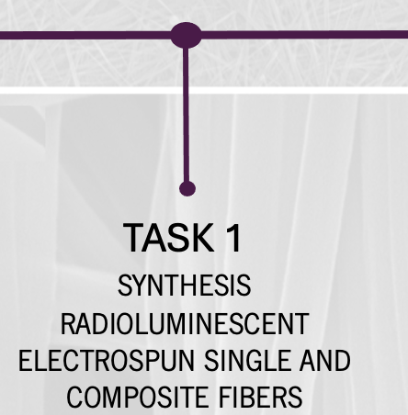
Research work plan
THERMOPLASTIC POLYMERS: PET, PVC, PA11, PA66, and PCL
ORGANICS SCINTILLATOR:
Stilbene,
1-fenil-3-(2-oxazolil)-benzoxazol (POP)
1,4-bis[2-(5-phenyl- oxazolyl)]benzene (POPOP)
X-RAY ABSORBERS:
4-N-carbazolyl-2,6-dichlorophenyl)bis- (2,4,6-trichlorophenyl)methyl
2,5-diphenyl-oxazole

Slide 14

Research work plan
XRD: crystallinity and phases present in the fibers, as well as lattice parameters, strain states and preferential orientations
Cryo -TEM/STEM : deeper study of the local microstructure of the scintillator materials and inclusions in the polymer nanocomposite fibers
SEM & AFM: morphology and surface characterization of the fibers
TEM/STEM, EDX and EELS : oriented growth of the inclusions inside the polymeric fiber matrix, imaging and chemical analysis of the different individual inclusion at the atomic scale, with high spatial resolution
RAMAN & INFRARED REFLECTIVITY: information on structural order, stress, and chemical state, before and after the radioluminescent incorporation in the nanofibers.
TGA & DSC: thermal stability.
MECHANICAL PROPERTIES: dynamic mechanical analysis and uniaxial tensile testing

Slide 15
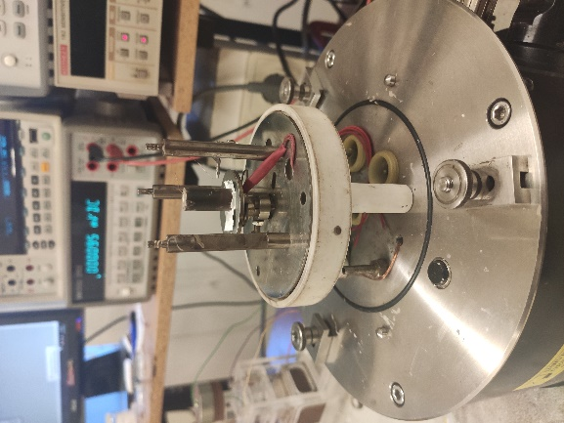
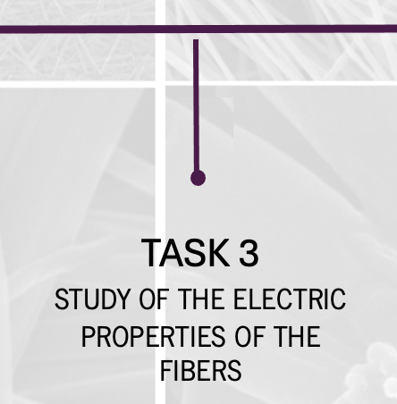
Research work plan
DIELECTRIC & CONDUCTIVITY : measurements by impedance spectroscopy, as a function of temperature and frequency

Slide 16
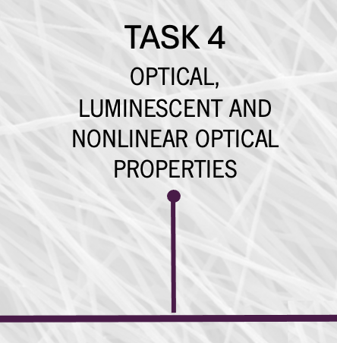
Research work plan
OPTICAL ABSORPTION, DYNAMIC LIGHT SCATTERING AND PHOTOLUMINESCENCE: investigation of the optical properties of the scintillators and electrospun composite fibers
NON-LINEAR OPTICAL SECOND HARMONIC GENERATION (SHG) :information on the spatial distribution and crystal orientations of the fiber and on it non-linear-optical conversion capability.

Slide 17
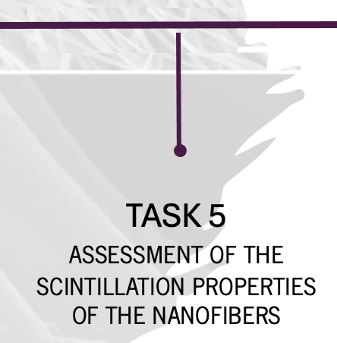
Research work plan
Selected nanofiber samples with radioluminescent inclusions will be measured for scintillation using a photodiode/photomultiplier and an X-ray source. The aim is to create a flexible, wearable, and precise dosimeter with high sensitivity and energy/dose independence, exploring the role of nanoparticles and scintillators. This research seeks to develop new radiation detectors and personal dosimeter systems

Slide 18
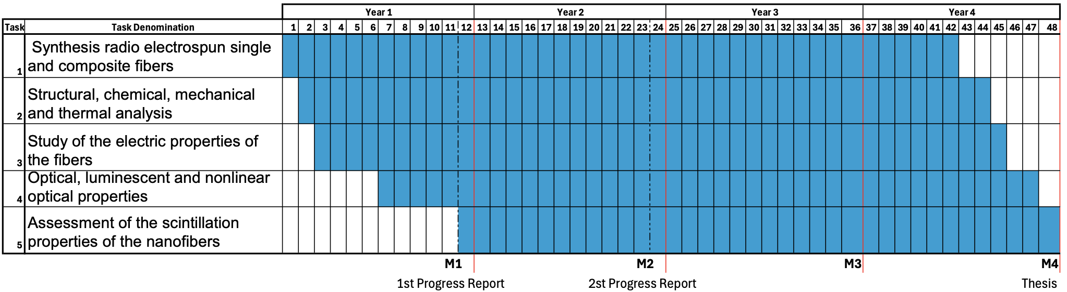
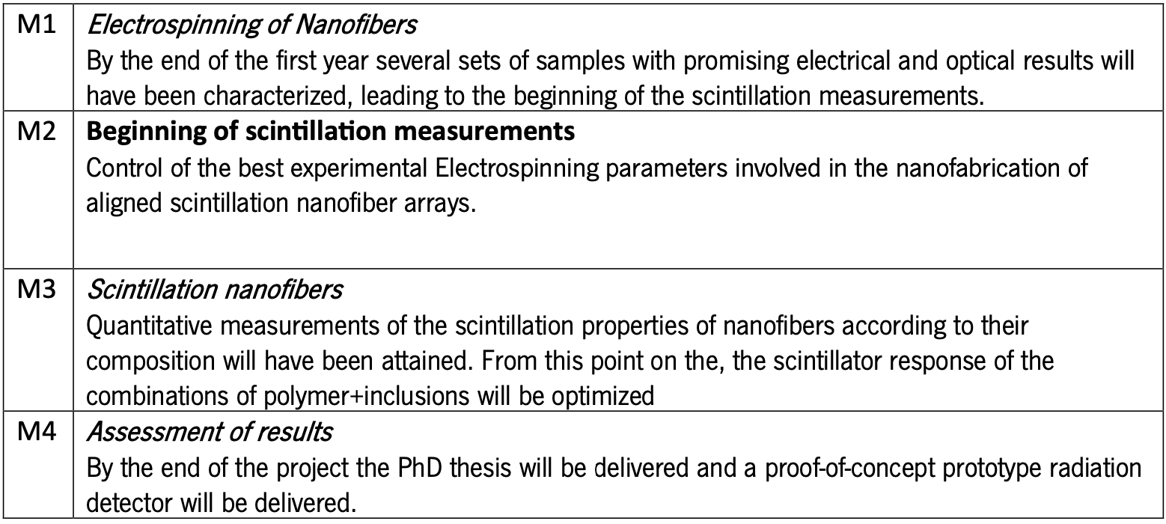
Research timeline

Slide 19
THANK YOU!

