Slide 1
Activities of the
Tandem Laboratory of NCSR “Demokritos”
A. Lagoyannis
Institute of Nuclear and Particle Physics, NCSR “Demokritos”

Slide 2
The Group
2 permanent researchers
A. Lagoyannis, M. Axiotis (S. Harissopulos retired)
PhD Students
M. Peoviti, K. Preketes-Sigalas, E. Taimpiri, A. Ziagova
Technicians
A. Andrianis (Head operator), V. Andreopoulos, E. Tsopanakis

Slide 3
FUNDING
Cluster of Accelerator Laboratories for Ion-Beam Research and Applications - CALIBRA
ΕΣΠΑ, S. Harissopulos, Ends 2024, 3.440 MEuro +500 kEuro
IFIGENEIA
HORIZON-WIDERA-2023-ACCESS-07, Partner, A. Karydas, Ends 2029, 6 Meuro (200 kEuro)
EuroFusion – Tandem Lab
Partner, Started in 2021 , 9000 kEuro
Access to Ion and Neutron Beams at NCSR “Demokritos”
IAEA, A. Lagoyannis, Ends 2024 , Budget: 15 kEuro
Differential Cross Section Measurement of proton reactions on fusion related light elements
IAEA, M. Axiotis, 4 years, Budget: 16 kEuro
ARENA
ELIDEK, S. Harissopulos, Ends 2025, 188 kEuro

Slide 4
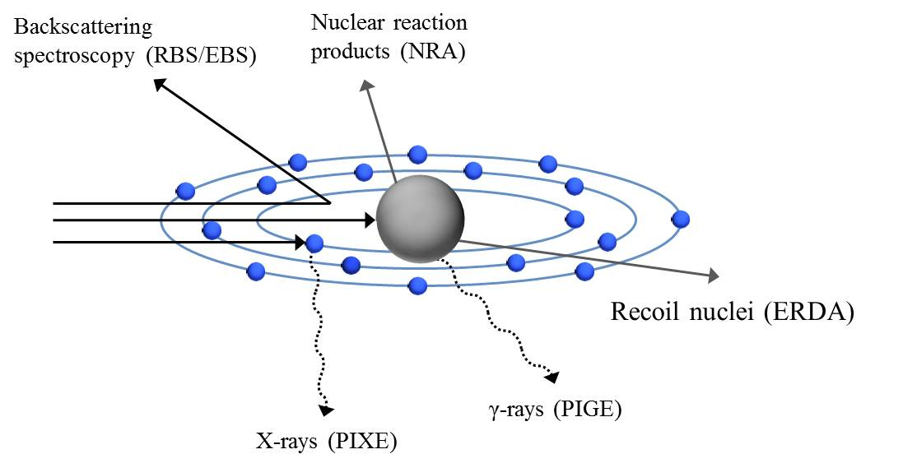
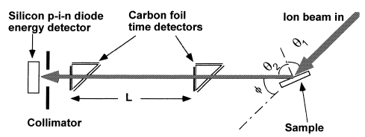


ToF ERDA
ERDA (Elastic Recoil Detection Analysis) - TOF-ERDA (Time Of Flight – ERDA) – detection of the recoiled elements
Heavy Ion beam – I, Cu, Cl,.
Based on the detection of charged particles/recoils
ToF - ERDA : suitable for detection of light/medium elements lighter of the beam mass
Heavy Ion beam impinges on sample with incident angle θ₁ < 90º
Recoiled (and/or scattered) atoms are extracted and detected at forward exit angles with respect to the beam axis φ ~ 25^{ο} - 45^{ο}
Correlation between the time-of-flight and the energy of the recoil ion is:
SSB Detector
Time detectors
$$t=\frac{L}{v}=L\sqrt{\frac{m}{2E}}$$

Slide 5
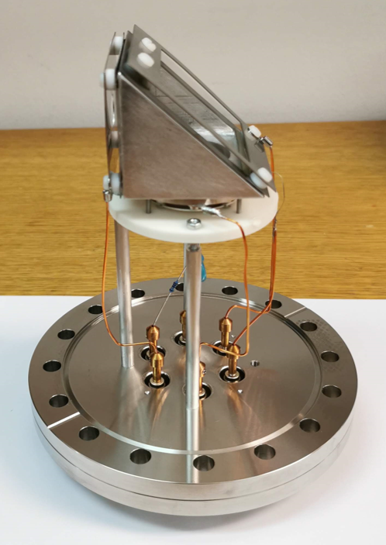
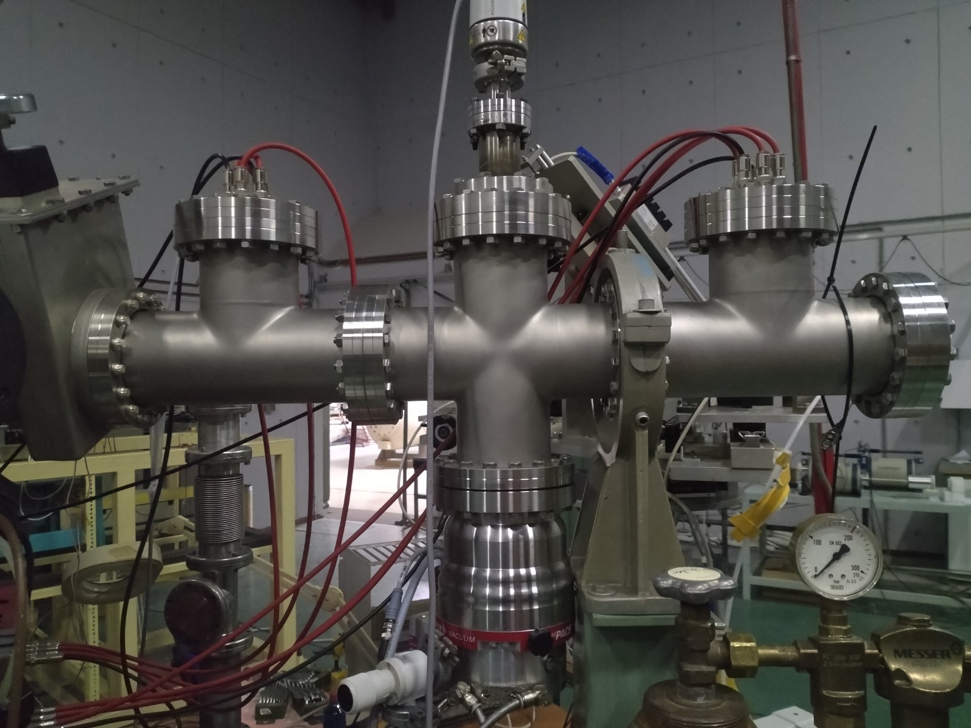
ToF ERDA
Start timing gate
Stop timing gate
Mirror grid (-4.0kV)
Foil holder (-3.0kV)
Drift region (-2.0 kV)
MCP detector
(-1.8 kV)
SSB Detector
Detection system consists of:
Two timing detectors (MCPs) for the detection of the recoiled ions. Distance between them: L = 540mm
One Silicon Surface Barrier Detector (SSB) placed 5mm away of the second MCP detector
Electronics:
MCP detectors: 2 CFD modules are receiving the signal from the MCPs and provide a start and stop signal for the Time to Amplitude Converter
SSB detector: the signal passes through a pre-amplifier & an amplifier

Slide 6
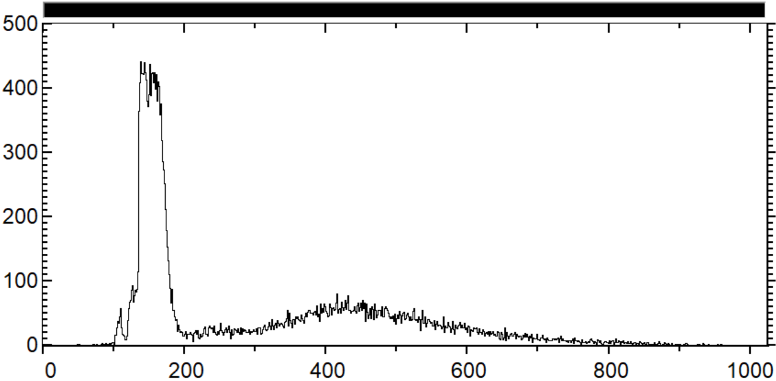
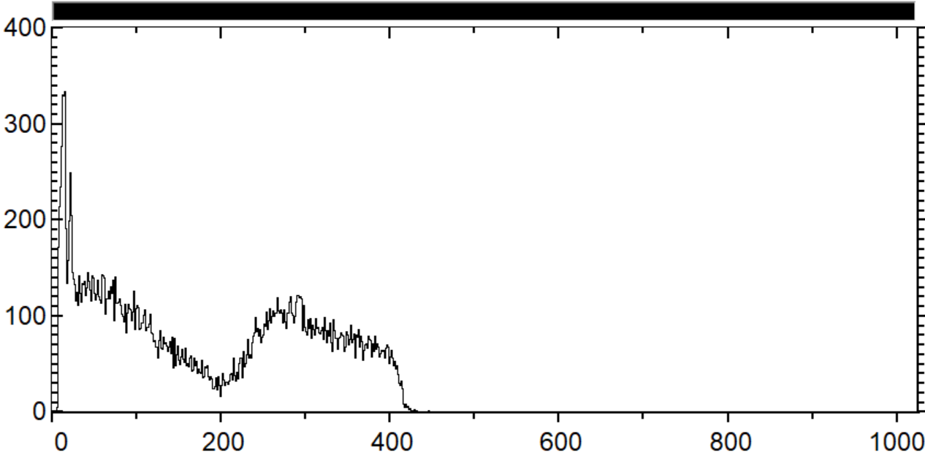
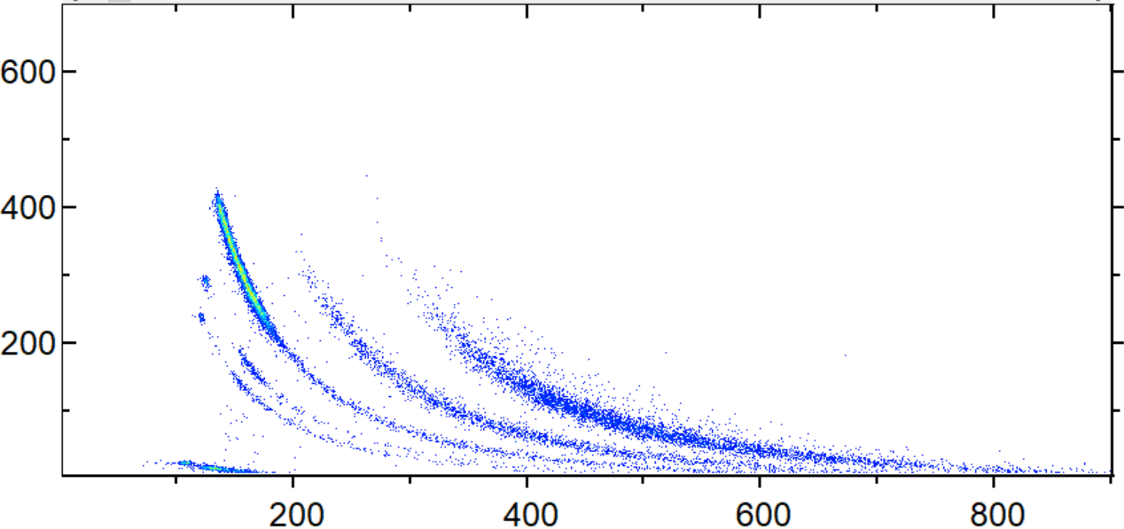
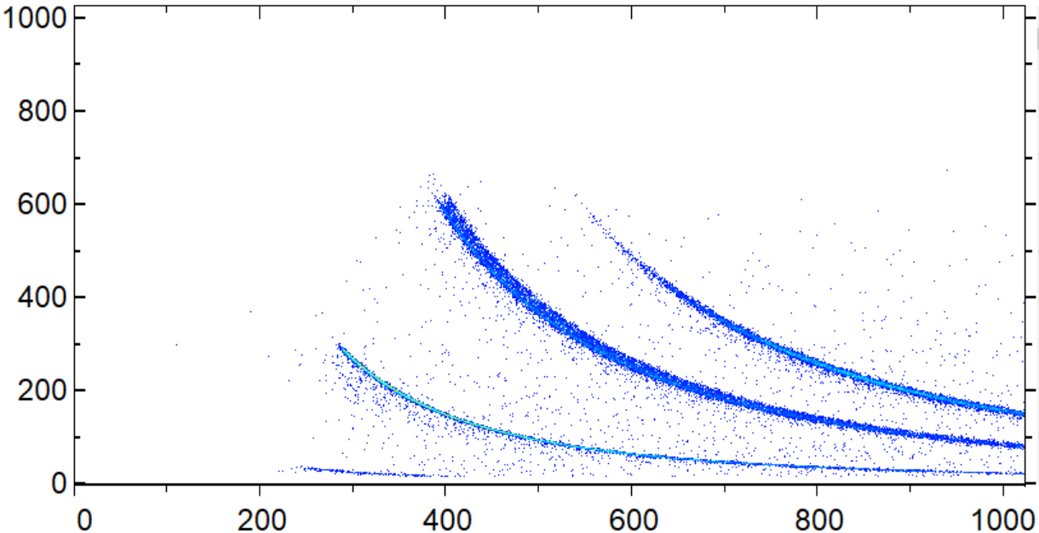
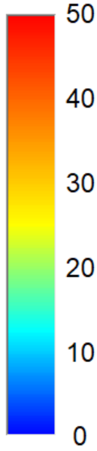
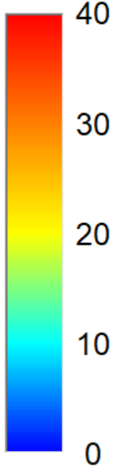
ToF ERDA
Counts
Counts
Time of flight (channel)
Energy (Channel)
20MeV ¹²⁷I on Aluminum thin foil
23 MeV Iodine beam on a ZnO target
Scattered Iodine
Al
Zn
Energy (Channel)
O
Scattered Iodine
C
O
Energy (Channel)
H
H
Time of flight (channel)
Time of flight (channel)

Slide 7
ToF ERDA
100% for energy detector - Varies with respect to the ion type and energy / Less than 100% for ions due to different energy loss values in MCP foils
Different ion beams are scattered from thick Au target
Relative detection efficiency for each ion type is given by:
$\frac{\# of scattered ions in ToF−E coincidence spectrum}{\# of particles detected by SSB detector}×100\%$
increase of the setup detection efficiency over 40% for Hydrogen in low energy region and ~ 10% for higher energies

Slide 8
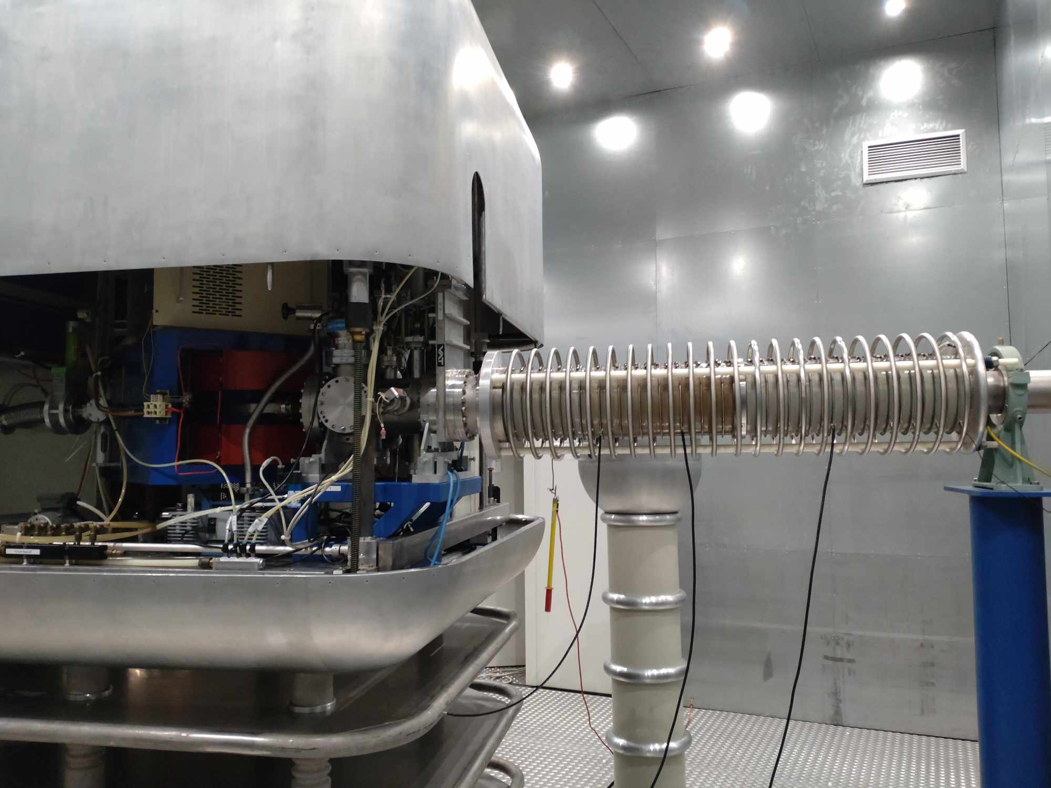
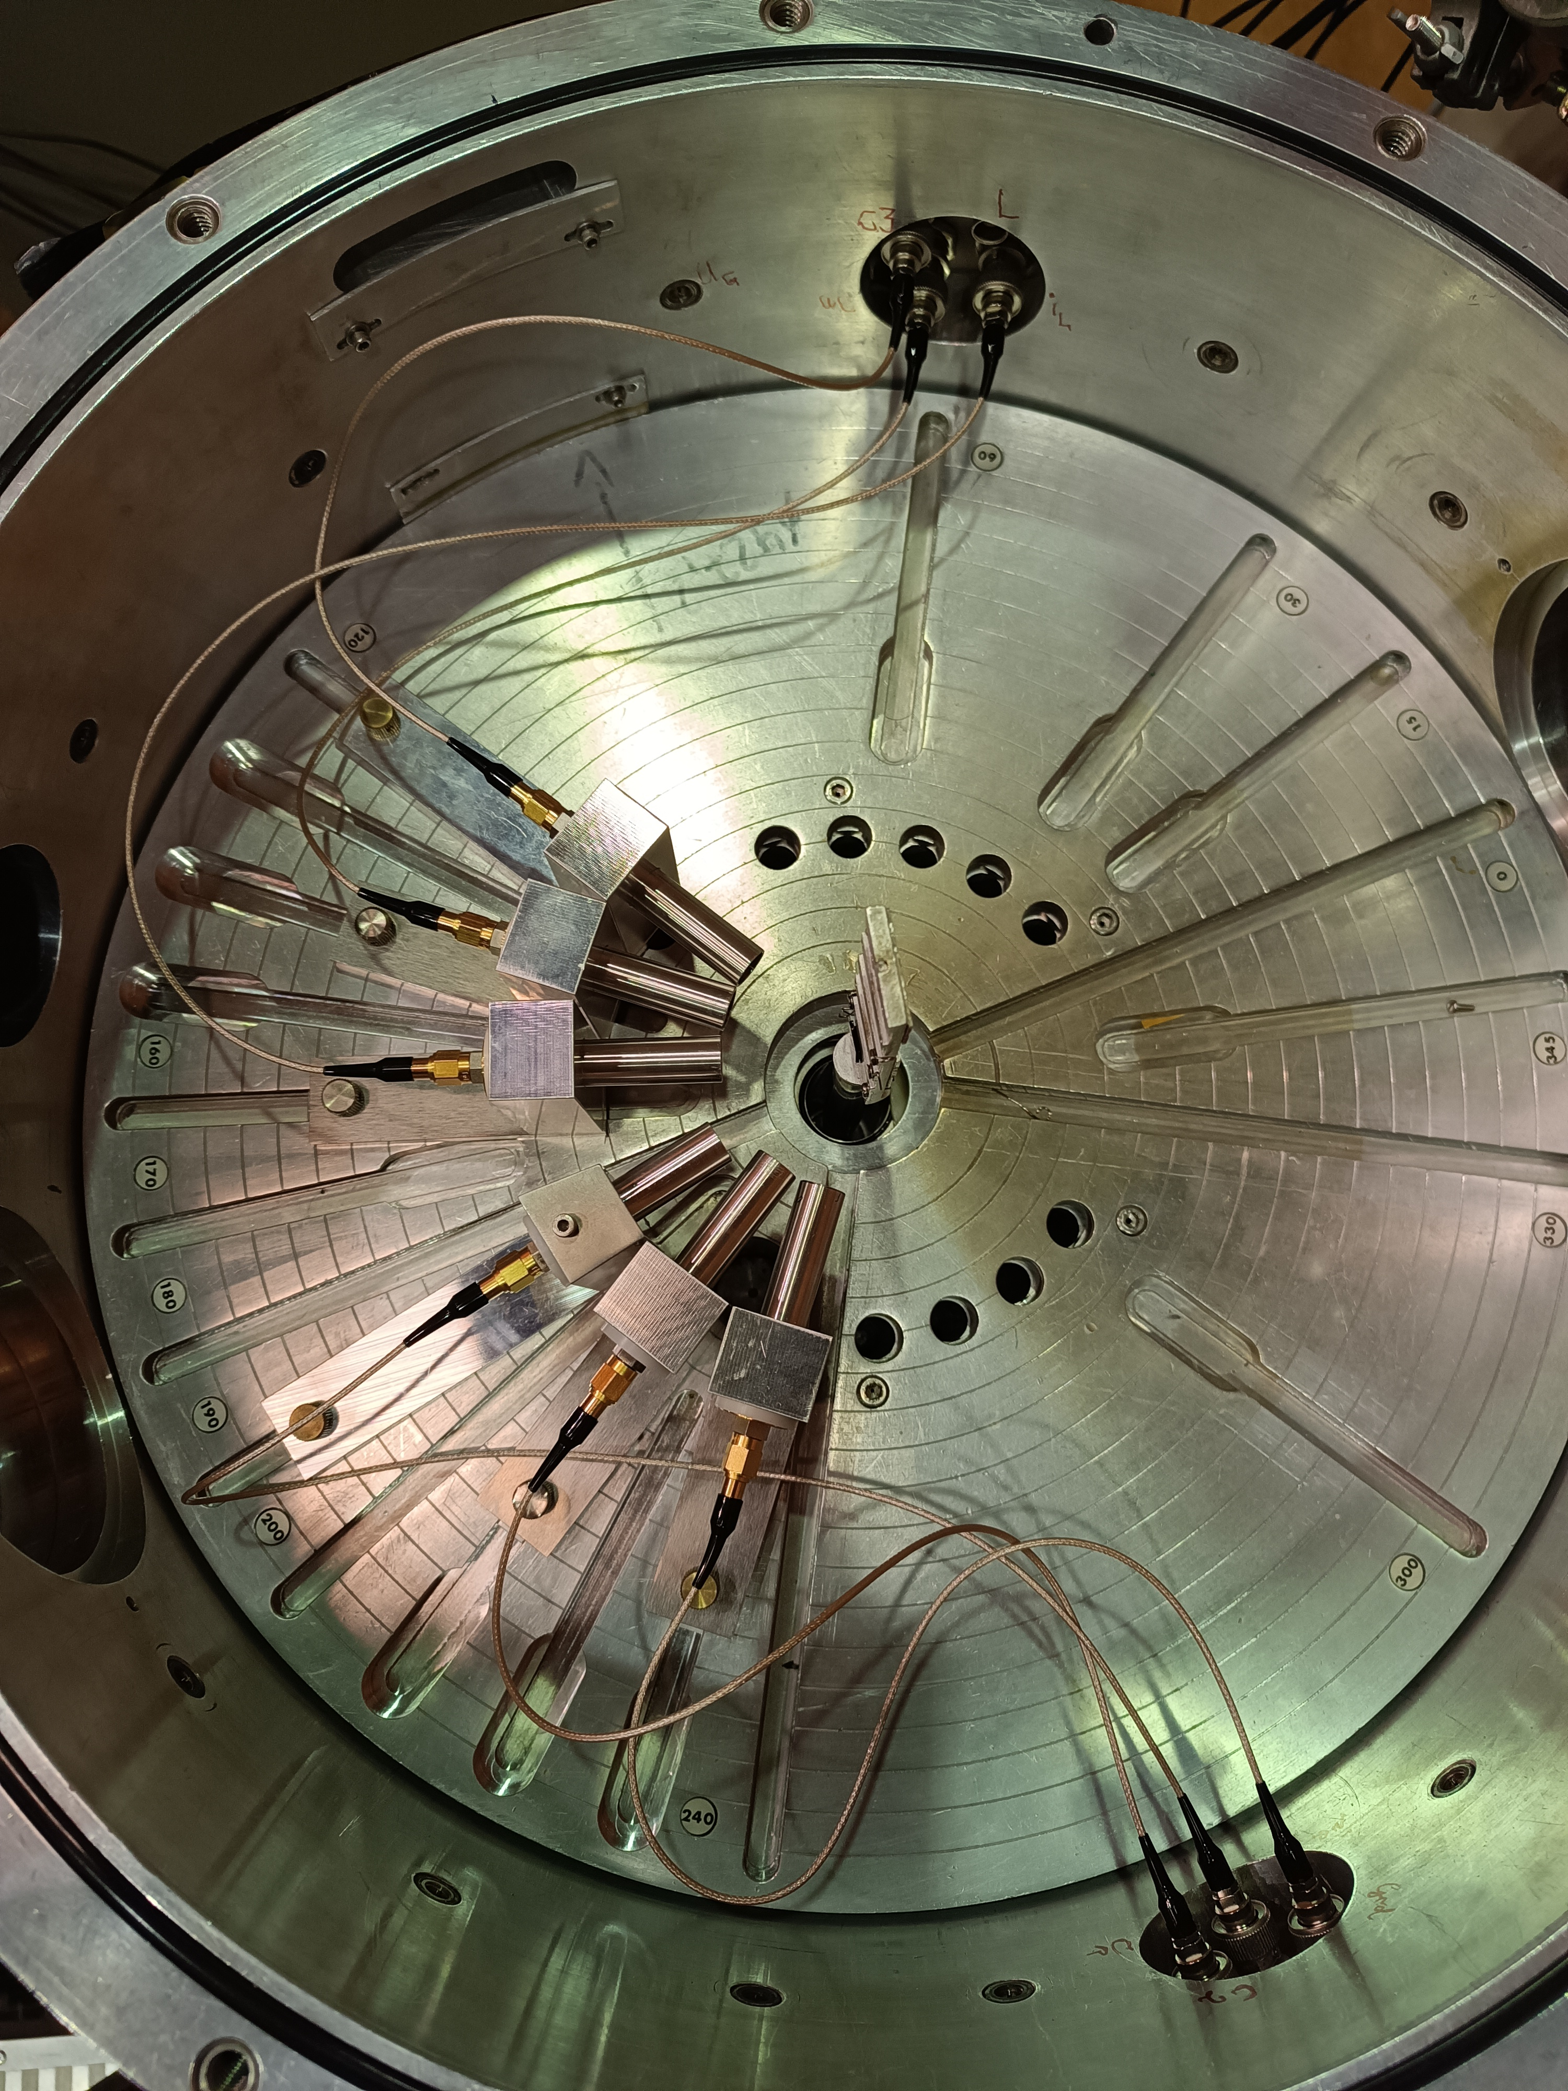
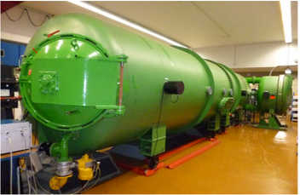
11B(p,a0)8Be and 6Li(p,3He)4He low energy range
Proton energy range: 140 – 340 keV
450 kV Accelerator
goniometer chamber diameter: 50 cm
Proton energy range: 300 – 1000 keV
140°
4 MV Dynamitron Accelerator
targets
160°
170°
150°
Detection systems
130°
Five backscattering detection angles
3 SSB detectors placed at 130°, 140° and 160°
2 PIPS detectors placed at 150° and 170°
~ 7.5 cm far from the targets
~ ± 1.5° angular uncertainty

Slide 9
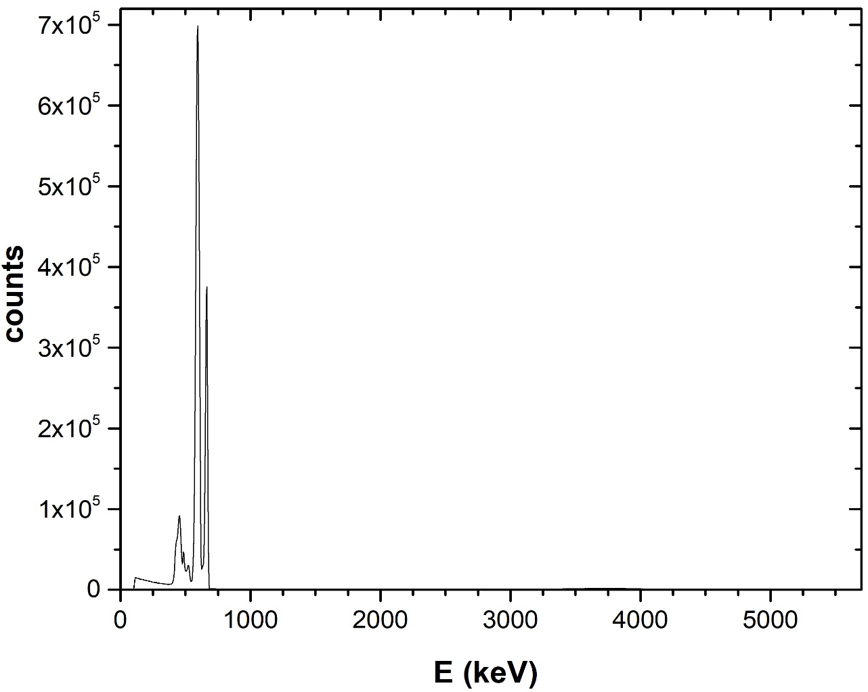
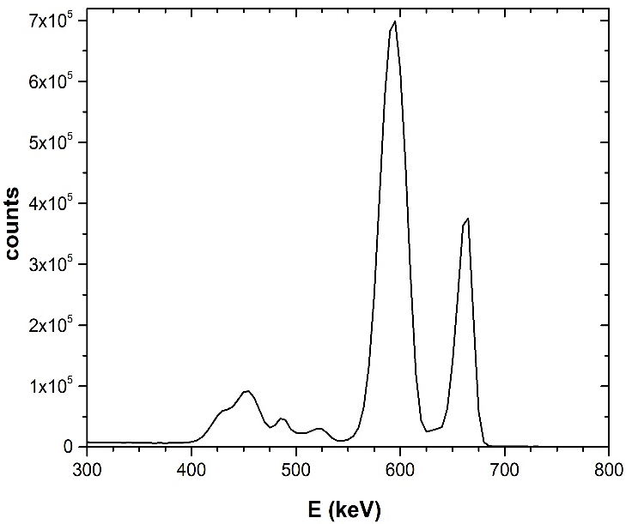
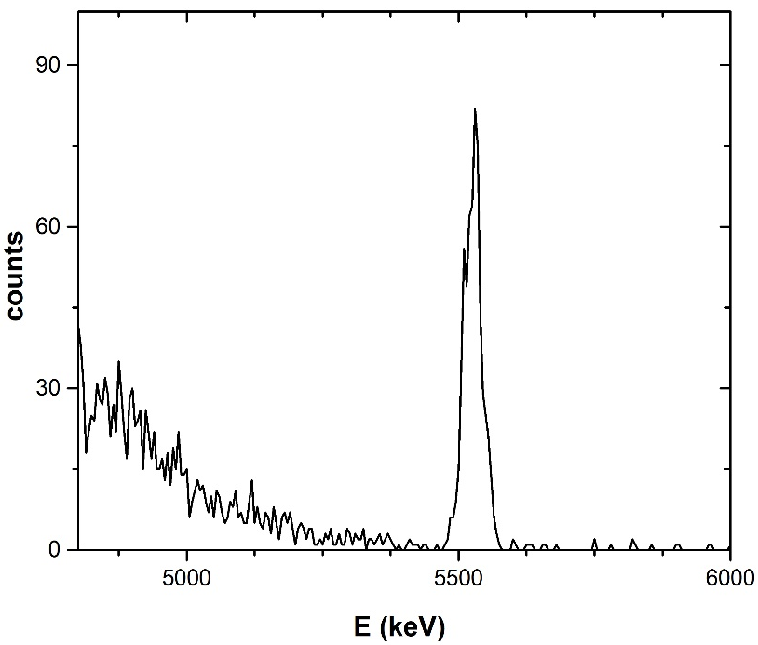

11B(p,a0)8Be
Peak integration via the TV code
$$Ε_{p}=675 keV, θ=170°$$
^{nat}B target
Cu_{el}
¹¹B(p,a₀)⁸Be
Au_{el}
B_{el}
C_{el}
O_{el}

Slide 10
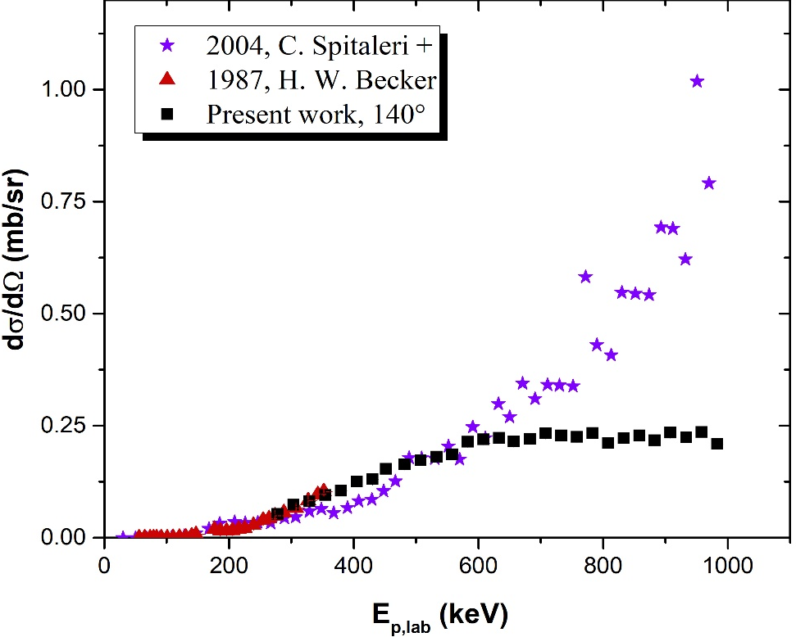
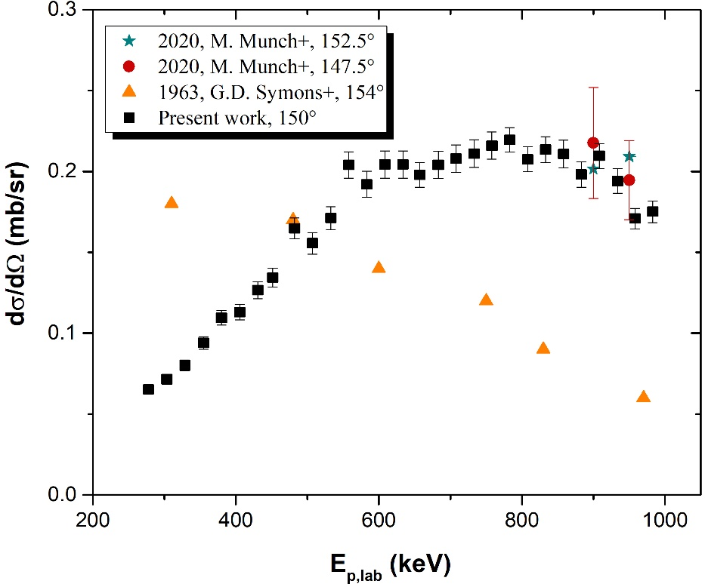
11B(p,a0)8Be
Comparison with present work’s results at 140$°$ and data of total cross-sections from the literature by H. W. Becker and C. Spitaleri et al. (divided with $4π$)
140°
150°

Slide 11
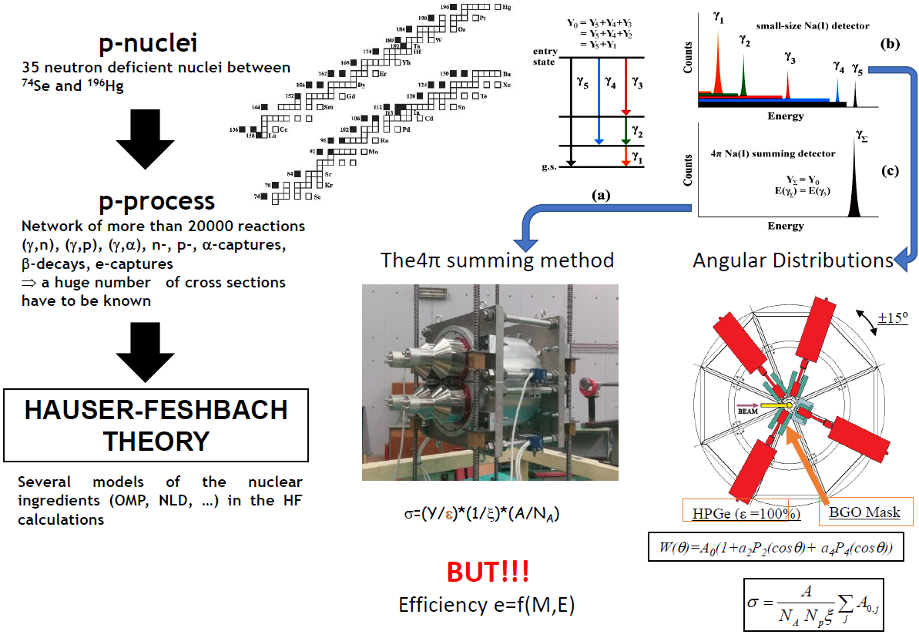
Nuclear Astrophysics
See M. Peoviti presentation

Slide 12
Nuclear Astrophysics

Slide 13
Nuclear Astrophysics

Slide 14
Thank you for your attention

