Slide 1



Study of the ¹¹B(p,a₀)⁸Be and ⁶Li(p,³He)⁴He reactions in the low energy range, suitable for NRA purposes
E. Taimpiri^{1,2,}, M. Axiotis¹, H. W. Becker³, V. Foteinou³, M. Kokkoris², A. Lagoyannis¹
F. Maragkos^{2,3}
¹ Tandem Accelerator Laboratory, Institute of Nuclear and Particle Physics, N.C.S.R. “Demokritos”, Aghia Paraskevi, 15310 Athens, Greece
² Department of Physics, National Technical University of Athens, Zografou campus, 15780 Athens, Greece
³ Central Unit for Ion Beams and Radionuclides, Ruhr University Bochum, 44801 Bochum, Germany
INPP Annual Meeting 2024

Slide 2
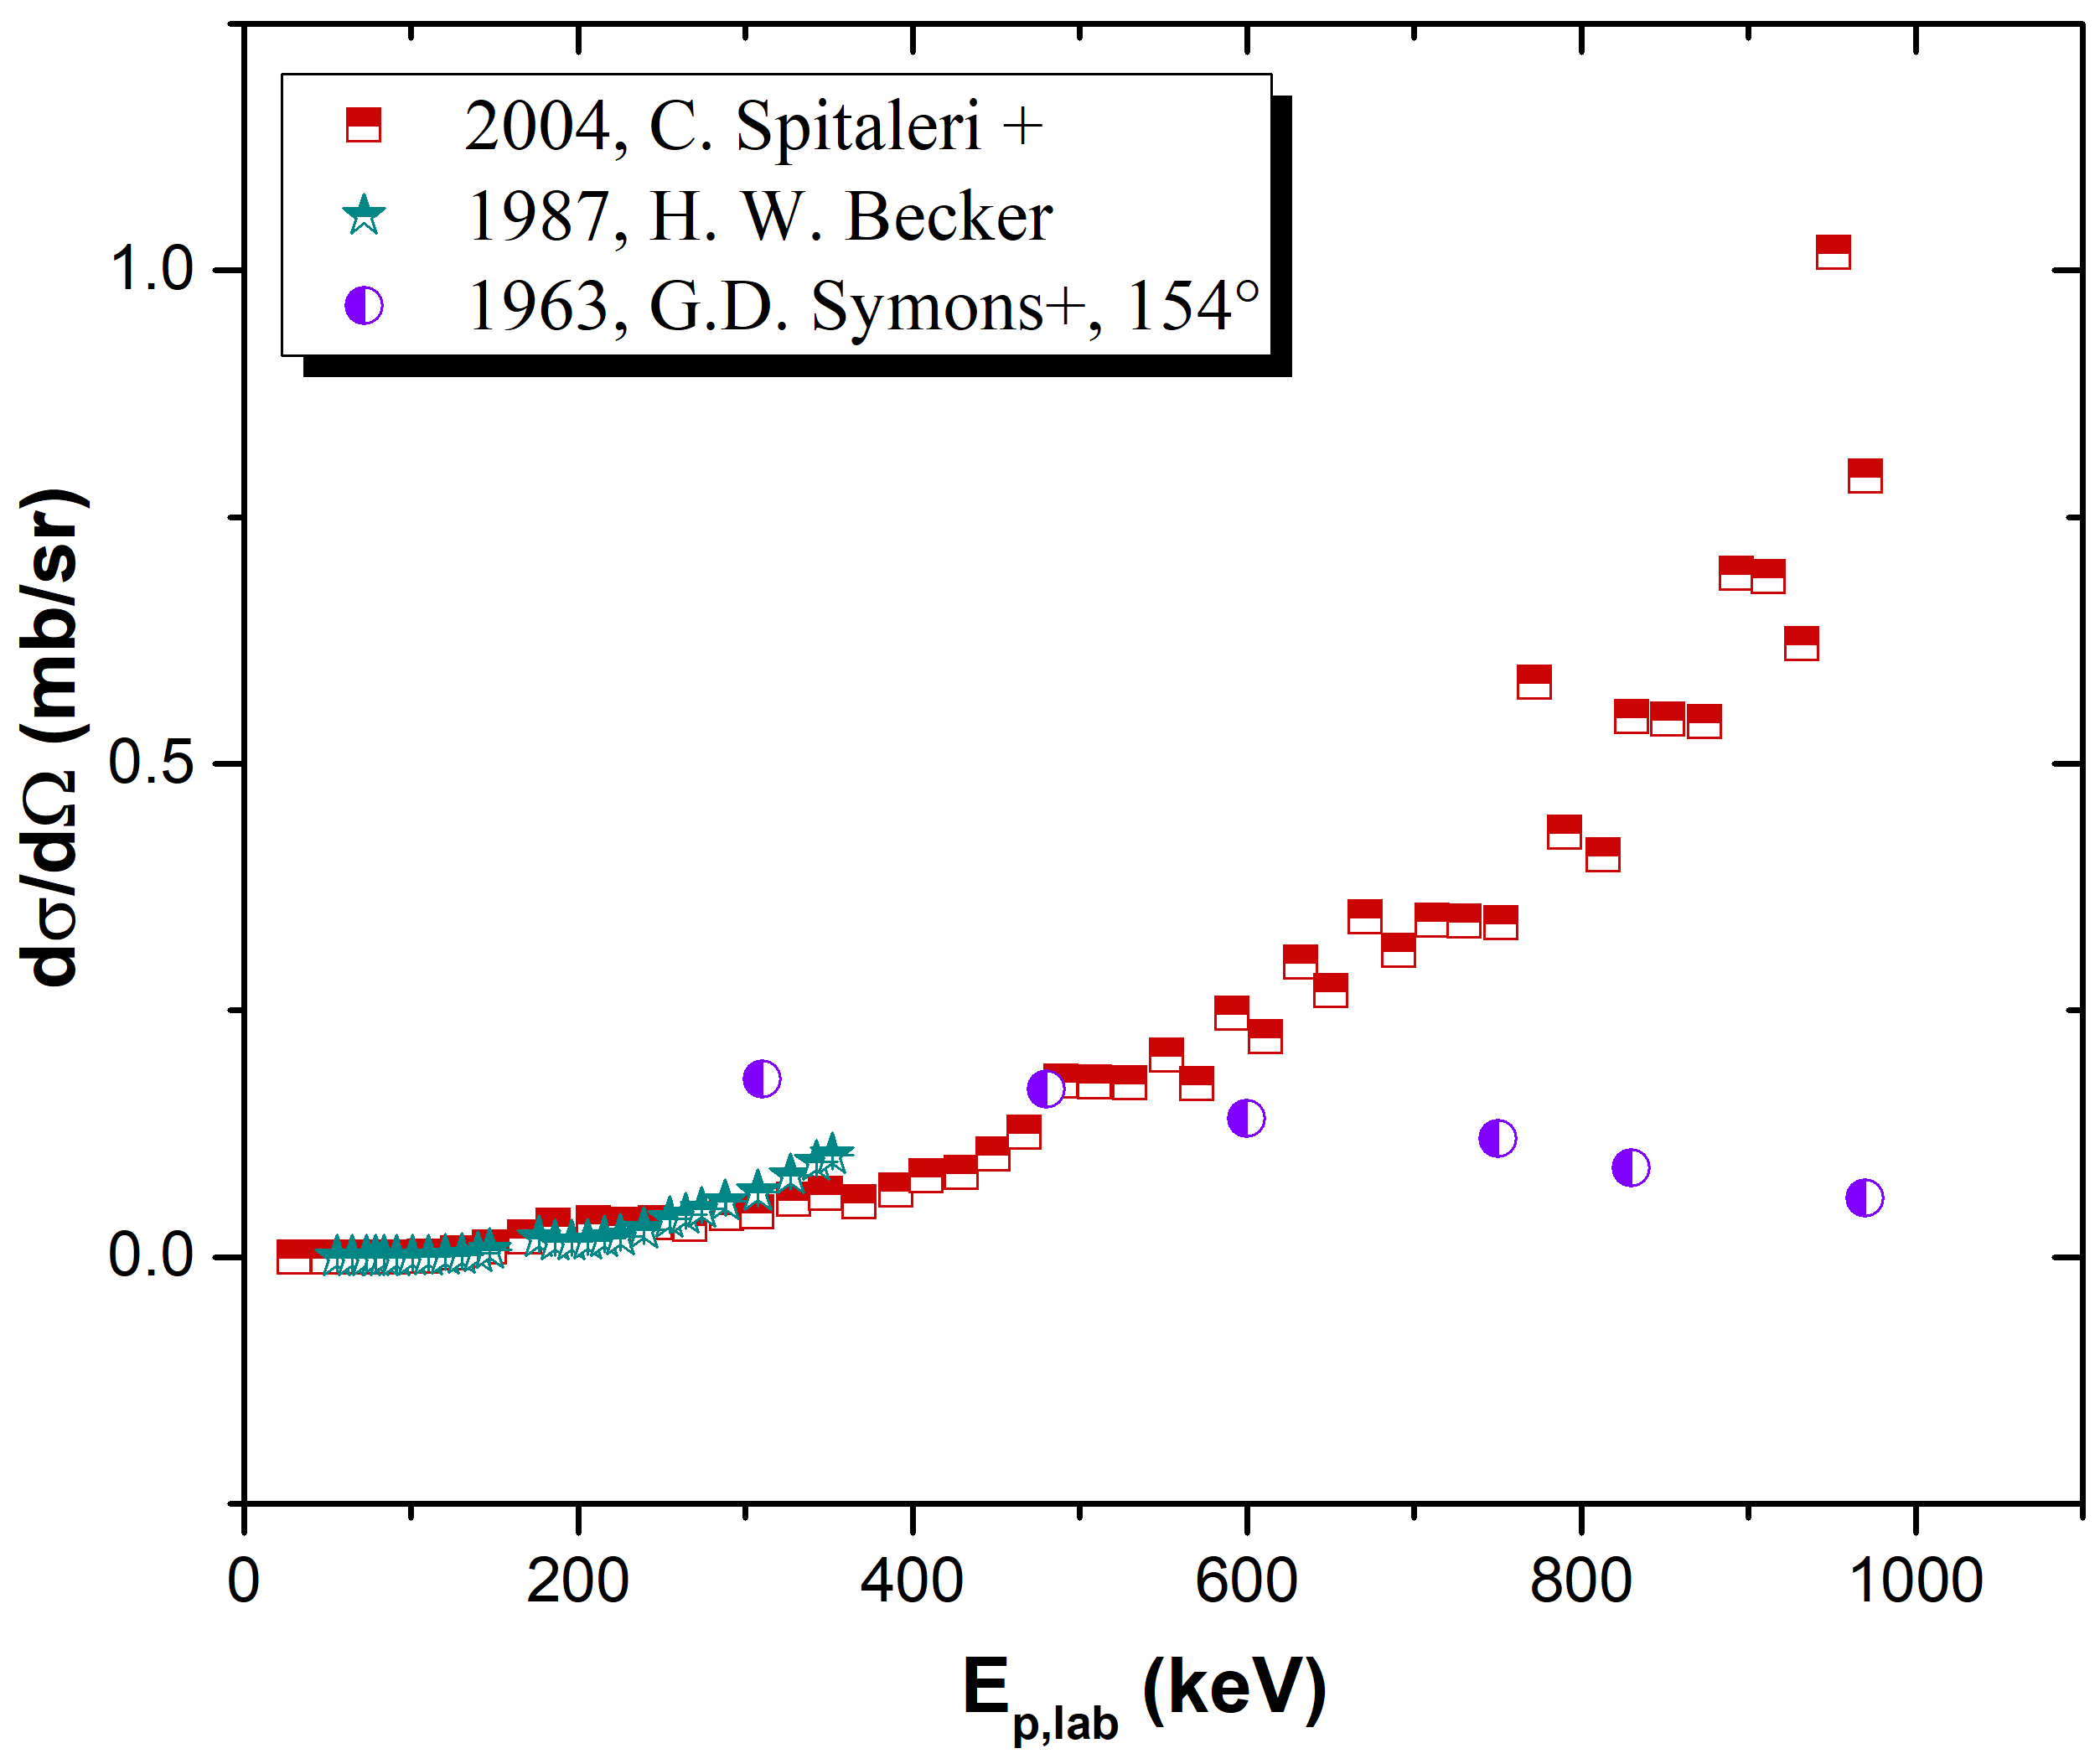
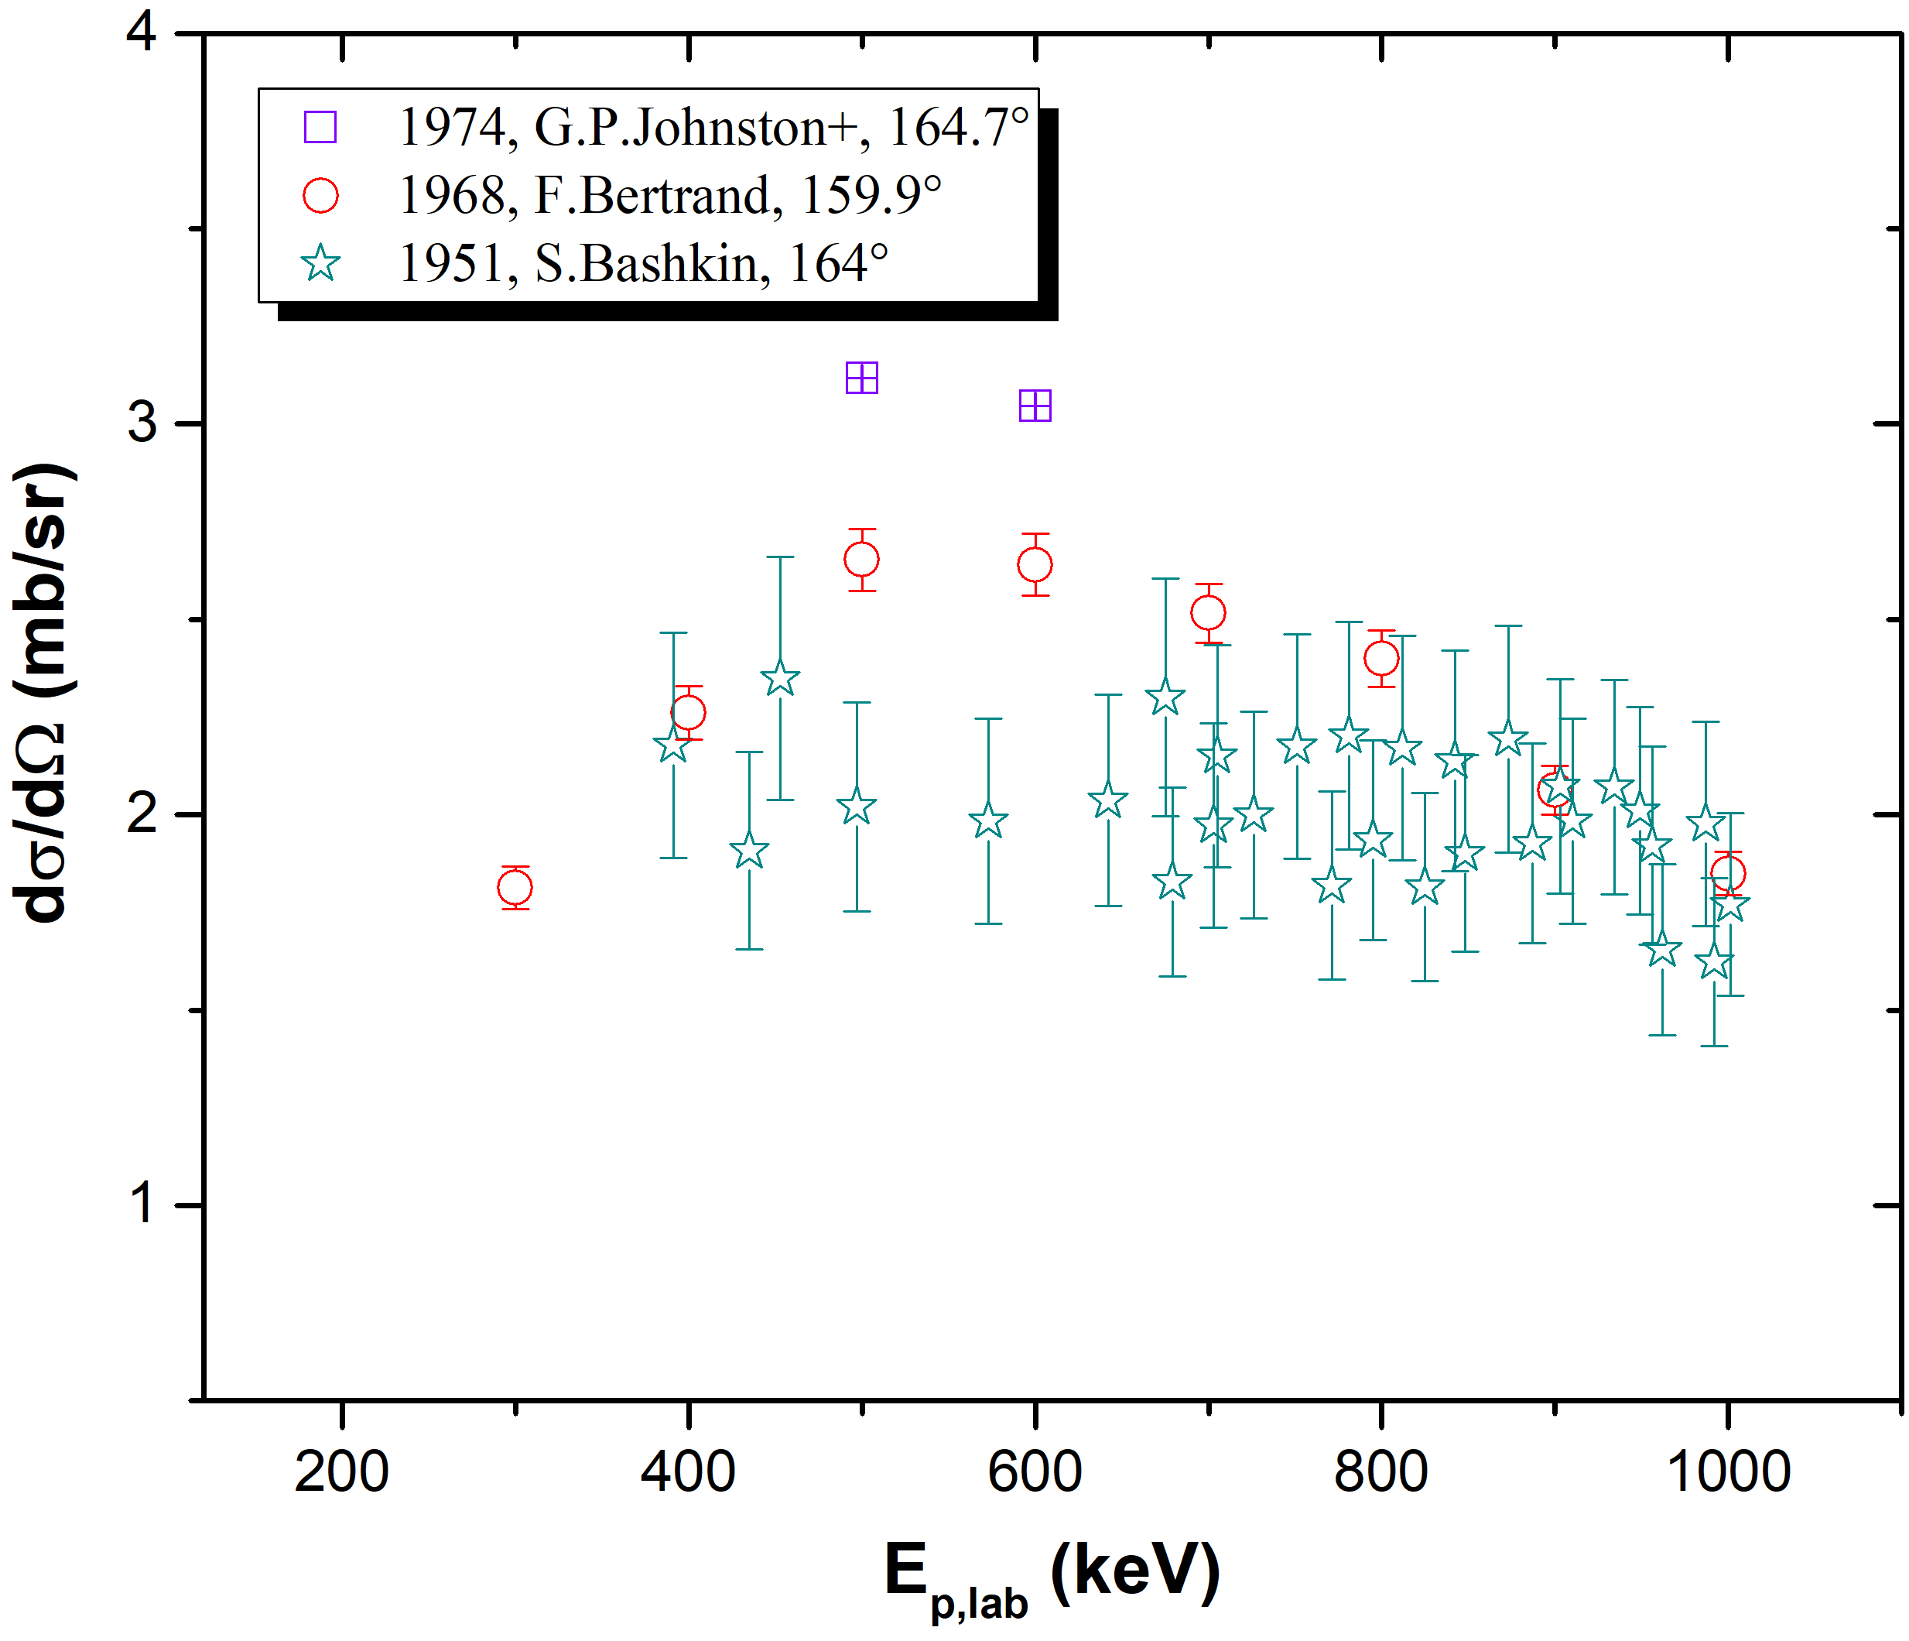
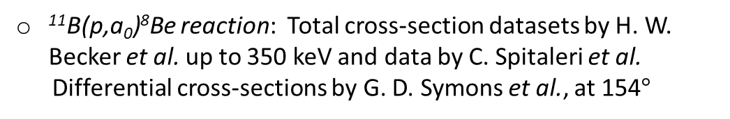
Motivation
Lithium (natural abundance 92.5% ⁷Li, 7.5% ⁶Li)
Widely used in many applications
Boron (natural abundance: 80.1% ¹¹B, 19.9% ¹⁰B)
Need for detection and depth profile determination via the NRA (Nuclear Reaction Analysis) technique
Effective MEIS (Medium Energy Ion Scattering) technique
Highly sensitive to surface layers (nanometer scale)
Necessity of reliable differential cross sections
Existing data in literature:
¹¹B(p,a₀)⁸Be reaction: Total cross-section datasets by H. W. Becker et al. up to 350 keV and data by C. Spitaleri et al.
Differential cross-sections by G. D. Symons et al., at 154$°$
⁶Li(p,³He)⁴He reaction: Incoherent data by G. P. Johnston et al., F. Bertrand et al., S. Bashkin et al. and A. J. Elwyn et al., at several energies and angles
Aim
Differential cross-section data for the ¹¹B(p,a₀)⁸Be (Q_{value}=8590.09 keV) and ⁶Li(p,³He)⁴He (Q_{value}=4019.72 keV) reactions

Slide 3
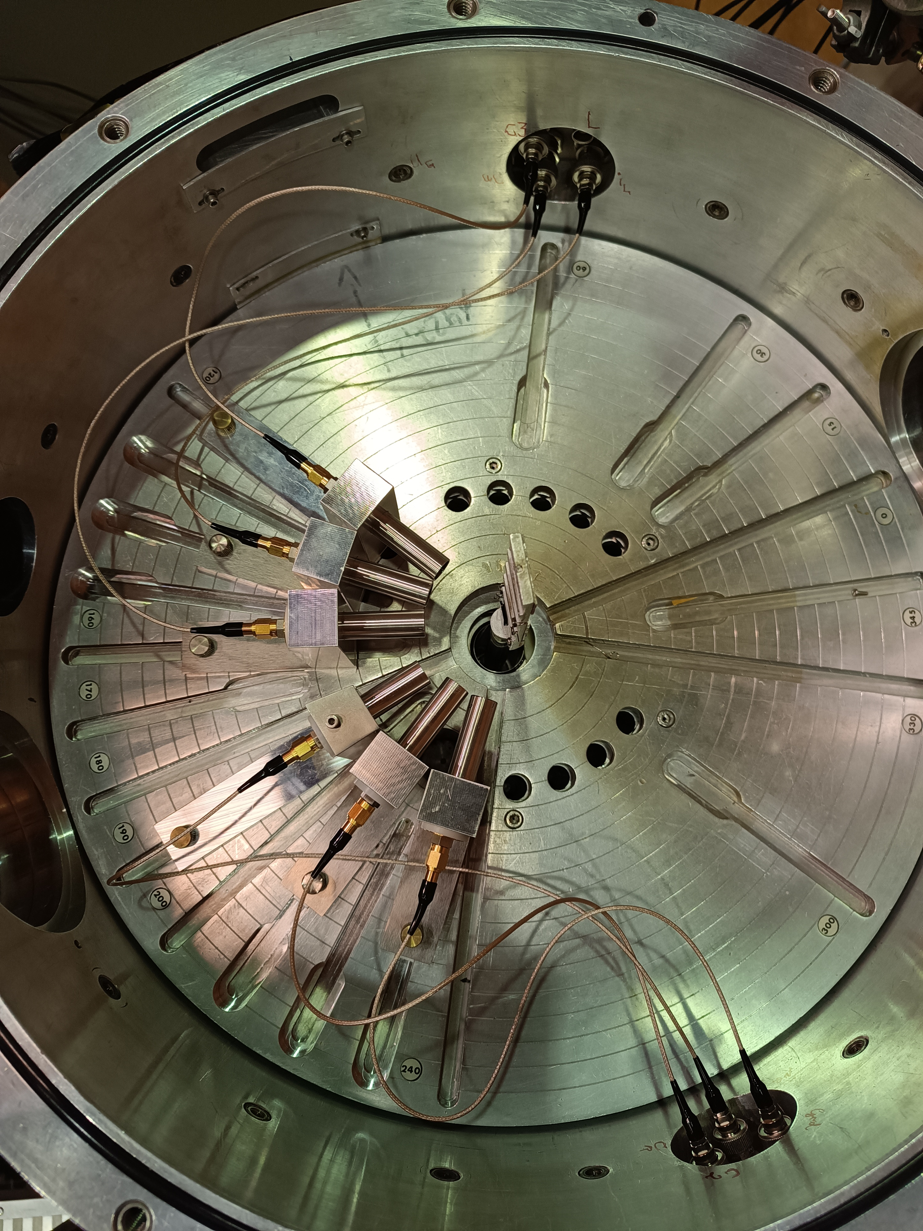
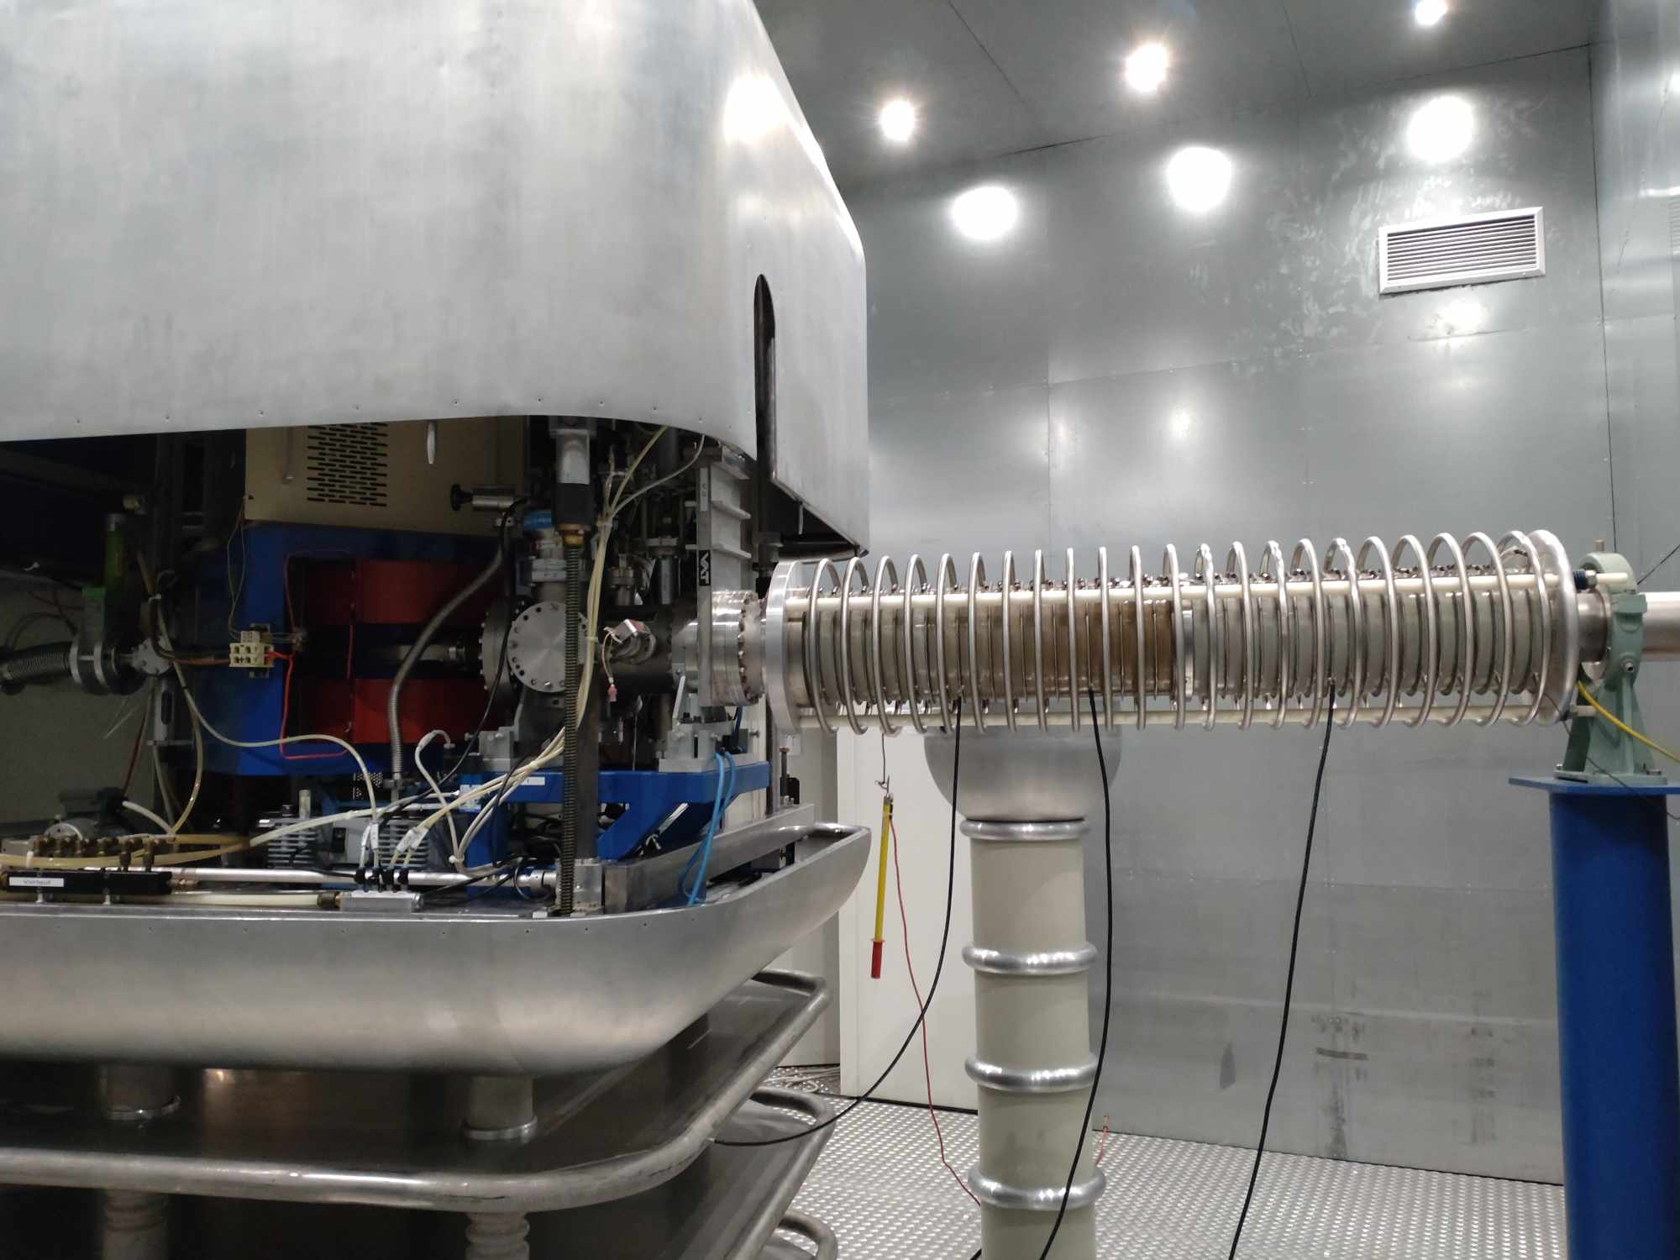
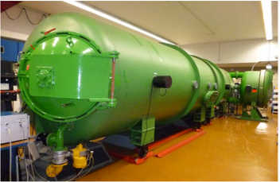
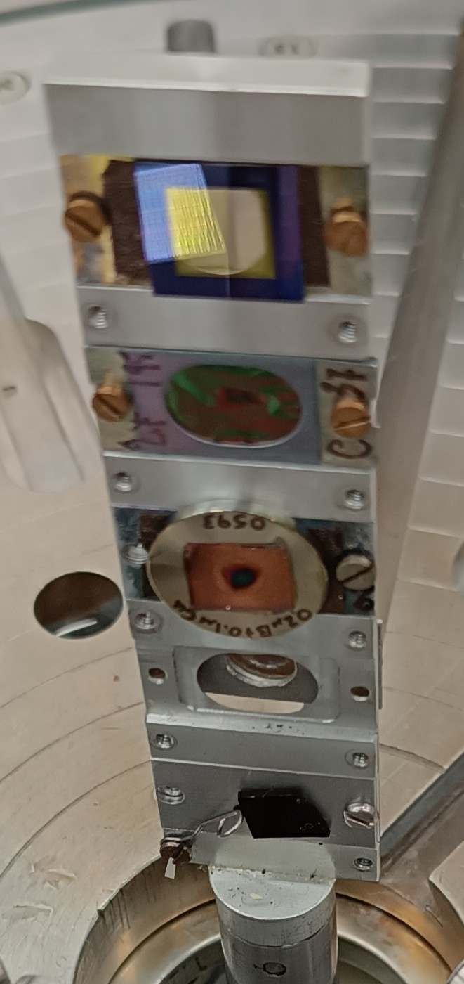
Experimental setup
Tandem Laboratory of RUBION, Ruhr University Bochum, Germany
goniometer chamber diameter: 50 cm
450 kV Accelerator
Proton energy range: 140 – 340 keV
variable keV step
Energy calibration: Ripple: 0.8 keV
140°
targets
160°
4 MV Dynamitron Accelerator
Proton energy range: 300 – 1000 keV
170°
25 keV step
150°
Energy calibration: Ripple: 0.4 keV
130°
Detection systems
Targets
Thin ^{nat}B (80.1 % ¹¹B)
2 thin LiF (95% ⁶Li, 5% ⁷Li)
Five backscattering detection angles
¹⁹⁷Au - ⁶LiF - ^{nat}C
⁶LiF - ^{nat}C
¹⁹⁷Au - ^{nat}B - ^{nat}Cu
3 SSB detectors placed at 130°, 140° and 160°
2 PIPS detectors placed at 150° and 170°
~ 7.5 cm far from the targets
~ ± 1.5° angular uncertainty
* ¹⁹⁷Au and ¹⁹F were used for normalization purposes

Slide 4
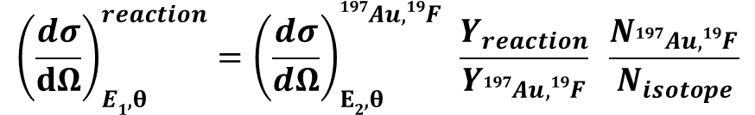
Data Analysis
Relative measurement
$${\left(\frac{dσ}{dΩ}\right)}_{E1, θ}^{reaction}={\left(\frac{dσ}{dΩ}\right)}_{Ε2, θ }^{197Au,19F }\frac{Y_{reaction}}{Y_{197Au,19F}} \frac{N_{197Au,19F}}{N_{isotope}}$$
where,
${\left(\frac{dσ}{dΩ}\right)}_{Ε2, θ }^{197Au,19F}$: the differential cross-section of Au, F, where $Ε2$ corresponds to the energy at half of ¹⁹⁷Au,¹²F thickness and θ the detection angle in the lab frame
For ${\left(\frac{dσ}{dΩ}\right)}_{Ε2, θ }^{197Au}$, the Rutherford formula was used, corrected for the electronic screening effect
For ${\left(\frac{dσ}{dΩ}\right)}_{Ε2, θ }^{19F}$, evaluated data were used, provided by the SigmaCalc code
$\frac{Y_{reaction}}{Y_{197Au,19F}}$ : $\frac{\text{experimental} \text{yield} \text{of} \text{the} \text{studied} \text{reaction}}{\text{experimental} \text{yield} \text{of} {}_{}^{197}{Au}\text{,}{}_{}^{19}F \text{peak} }$ : Yield ratio
$\frac{N_{197Au,19F}}{N_{isotope}}$ : $\frac{\text{thickness} \text{of} \text{the} {}_{}^{197}{Au}\text{,}{}_{}^{19}F \text{layer}\text{, }\text{in} atoms/{cm}^{2}}{\text{thickness} \text{of} \text{the} \text{studied} \text{isotope} \text{layer}\text{, }\text{in} atoms/{cm}^{2}}$ : Thickness ratio

Slide 5
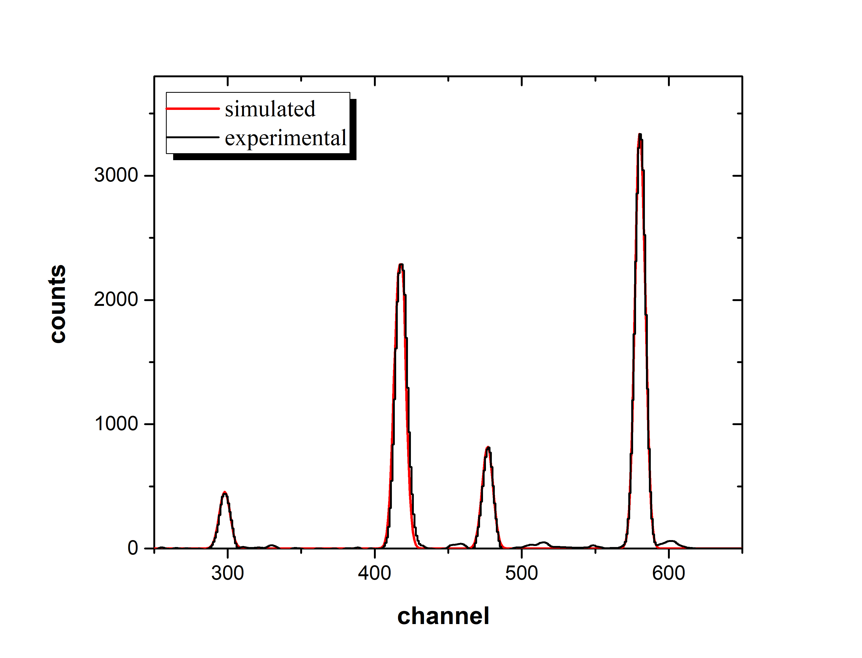


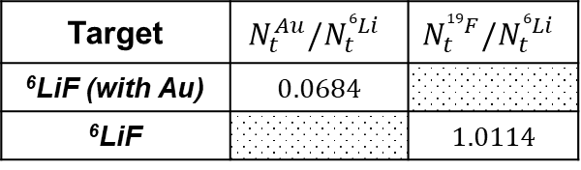
Data Analysis: Thickness ratio
⁶LiF (95% ⁶Li, 5% ⁷Li) targets: via the EBS technique, for proton energies of $E_{p}=1.3 MeV \& 1.62 MeV$
Simulation via the SIMNRA code
For both ⁶LiF targets : Evaluated cross-section data for ¹²C(p,p₀) ¹²C reaction
Data for ⁶Li(p,p₀) ⁶Li reaction: U. Fasoli et al.
$$E_{p}=1.3 MeV, θ=170°$$
With Au: Rutherford cross section for ¹⁹⁷Au
¹⁹⁷Au(p,p₀)¹⁹⁷Au
Without Au: Evaluated cross-section data for the
¹⁹F(p,p₀) ¹⁹F reaction
⁶LiF target (with Au)
¹²C(p,p₀)¹²C
¹⁹F(p,p₀)¹⁹F
Target | $$N_{t}^{Au}/N_{t}^{6Li}$$ | $$N_{t}^{19F}/N_{t}^{6Li}$$
⁶LiF (with Au) | $$0.0684$$
⁶LiF |  | $$1.0114$$
⁶Li(p,p₀)⁶Li
Uncertainty: $<5\%,$ for both measurements

Slide 6
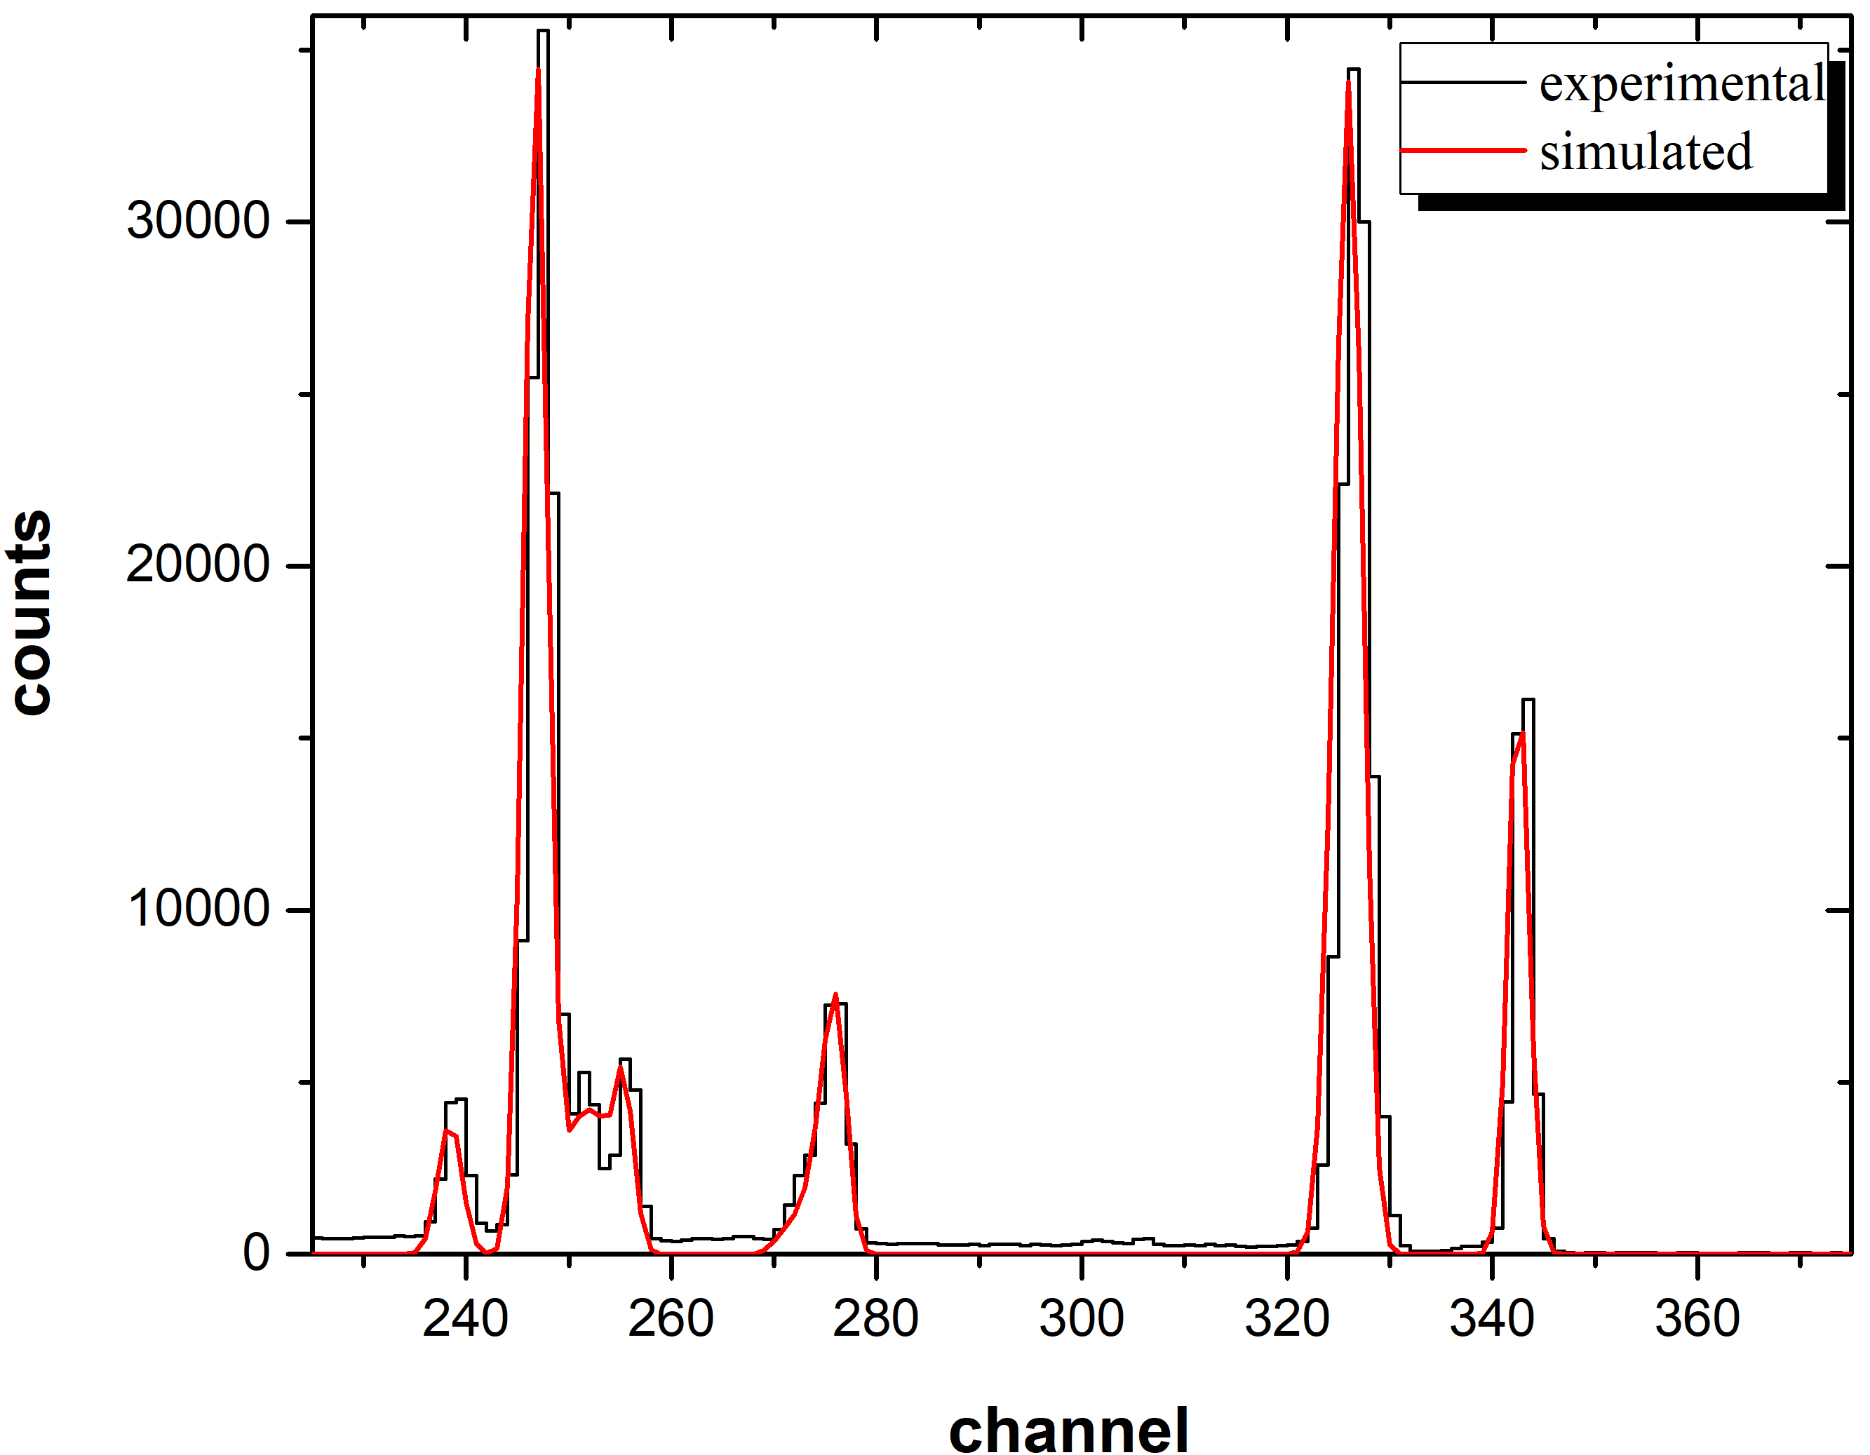
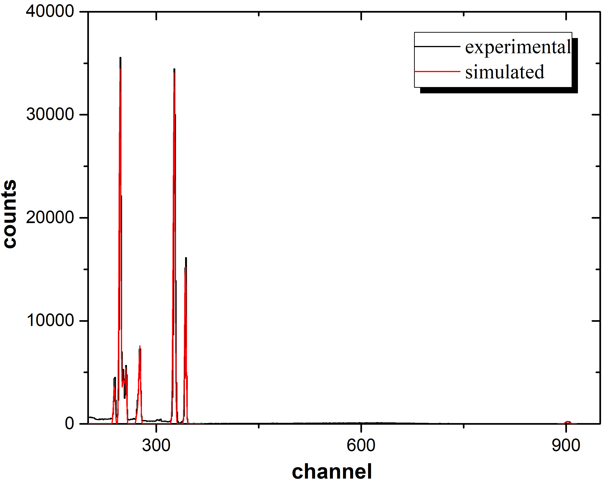
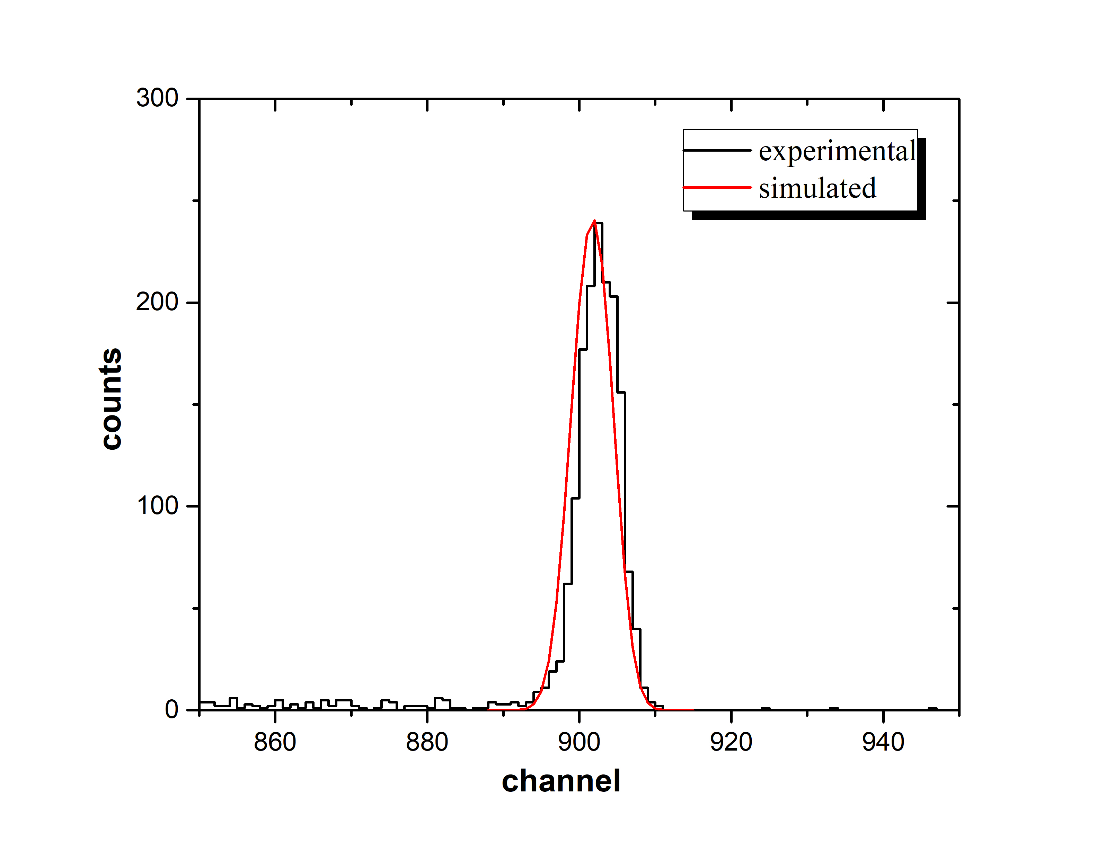


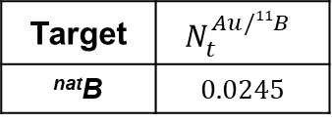
Data Analysis: Thickness ratio
^{nat}B (80.1% ¹¹B, 19.9% ¹⁰B) target: via the EBS technique, for proton energy of $E_{p}=2.3 MeV \& 3 MeV$
Simulation via the SIMNRA code
^{nat}B target: Cross-section data for ¹¹B(p,p₀) ¹¹B & ¹¹B(p,a₀) ⁸Be reactions: M. Kokkoris et al.
Rutherford cross section for ¹⁹⁷Au
$$E_{p}=2.3 MeV, θ=150°$$
^{nat}Cu(p,p₀)^{nat}Cu
^{nat}B target
¹¹B(p,p₀)¹¹B
¹⁹⁷Au(p,p₀)¹⁹⁷Au
¹²C(p,p₀)¹²C
¹¹B(p,a₀)⁸Be
¹⁶O(p,p₀)¹⁶O
¹⁰B
Target | $$N_{t}^{Au/11B}$$
^{nat}B | $$0.0245$$
Uncertainty: $<5\%$

Slide 7
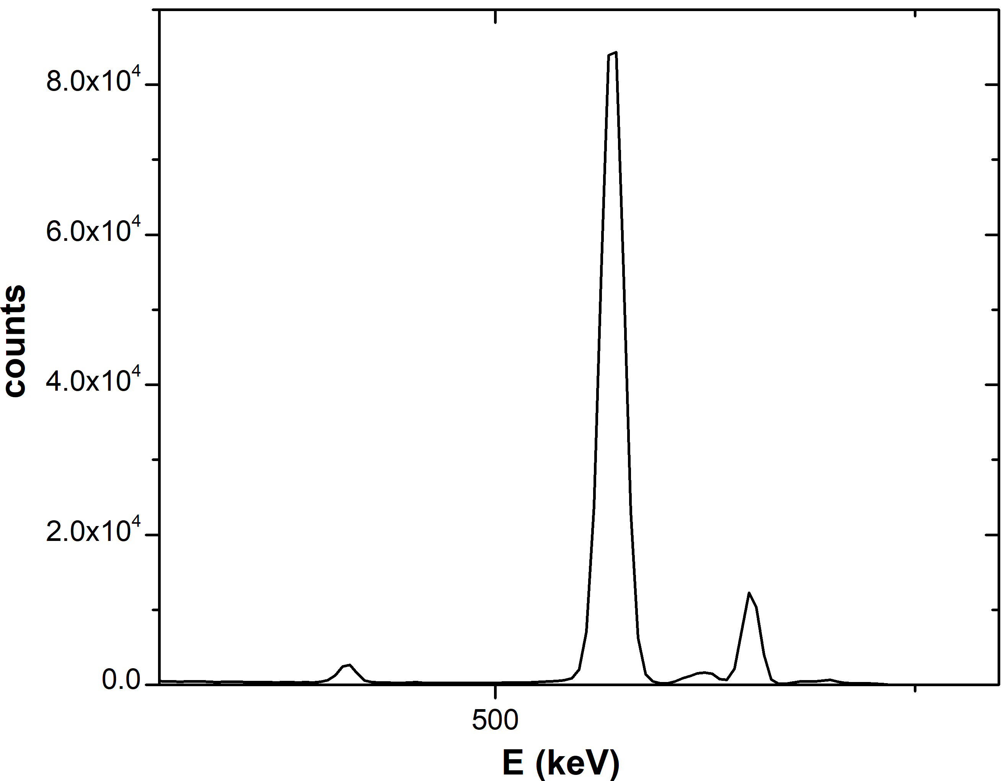
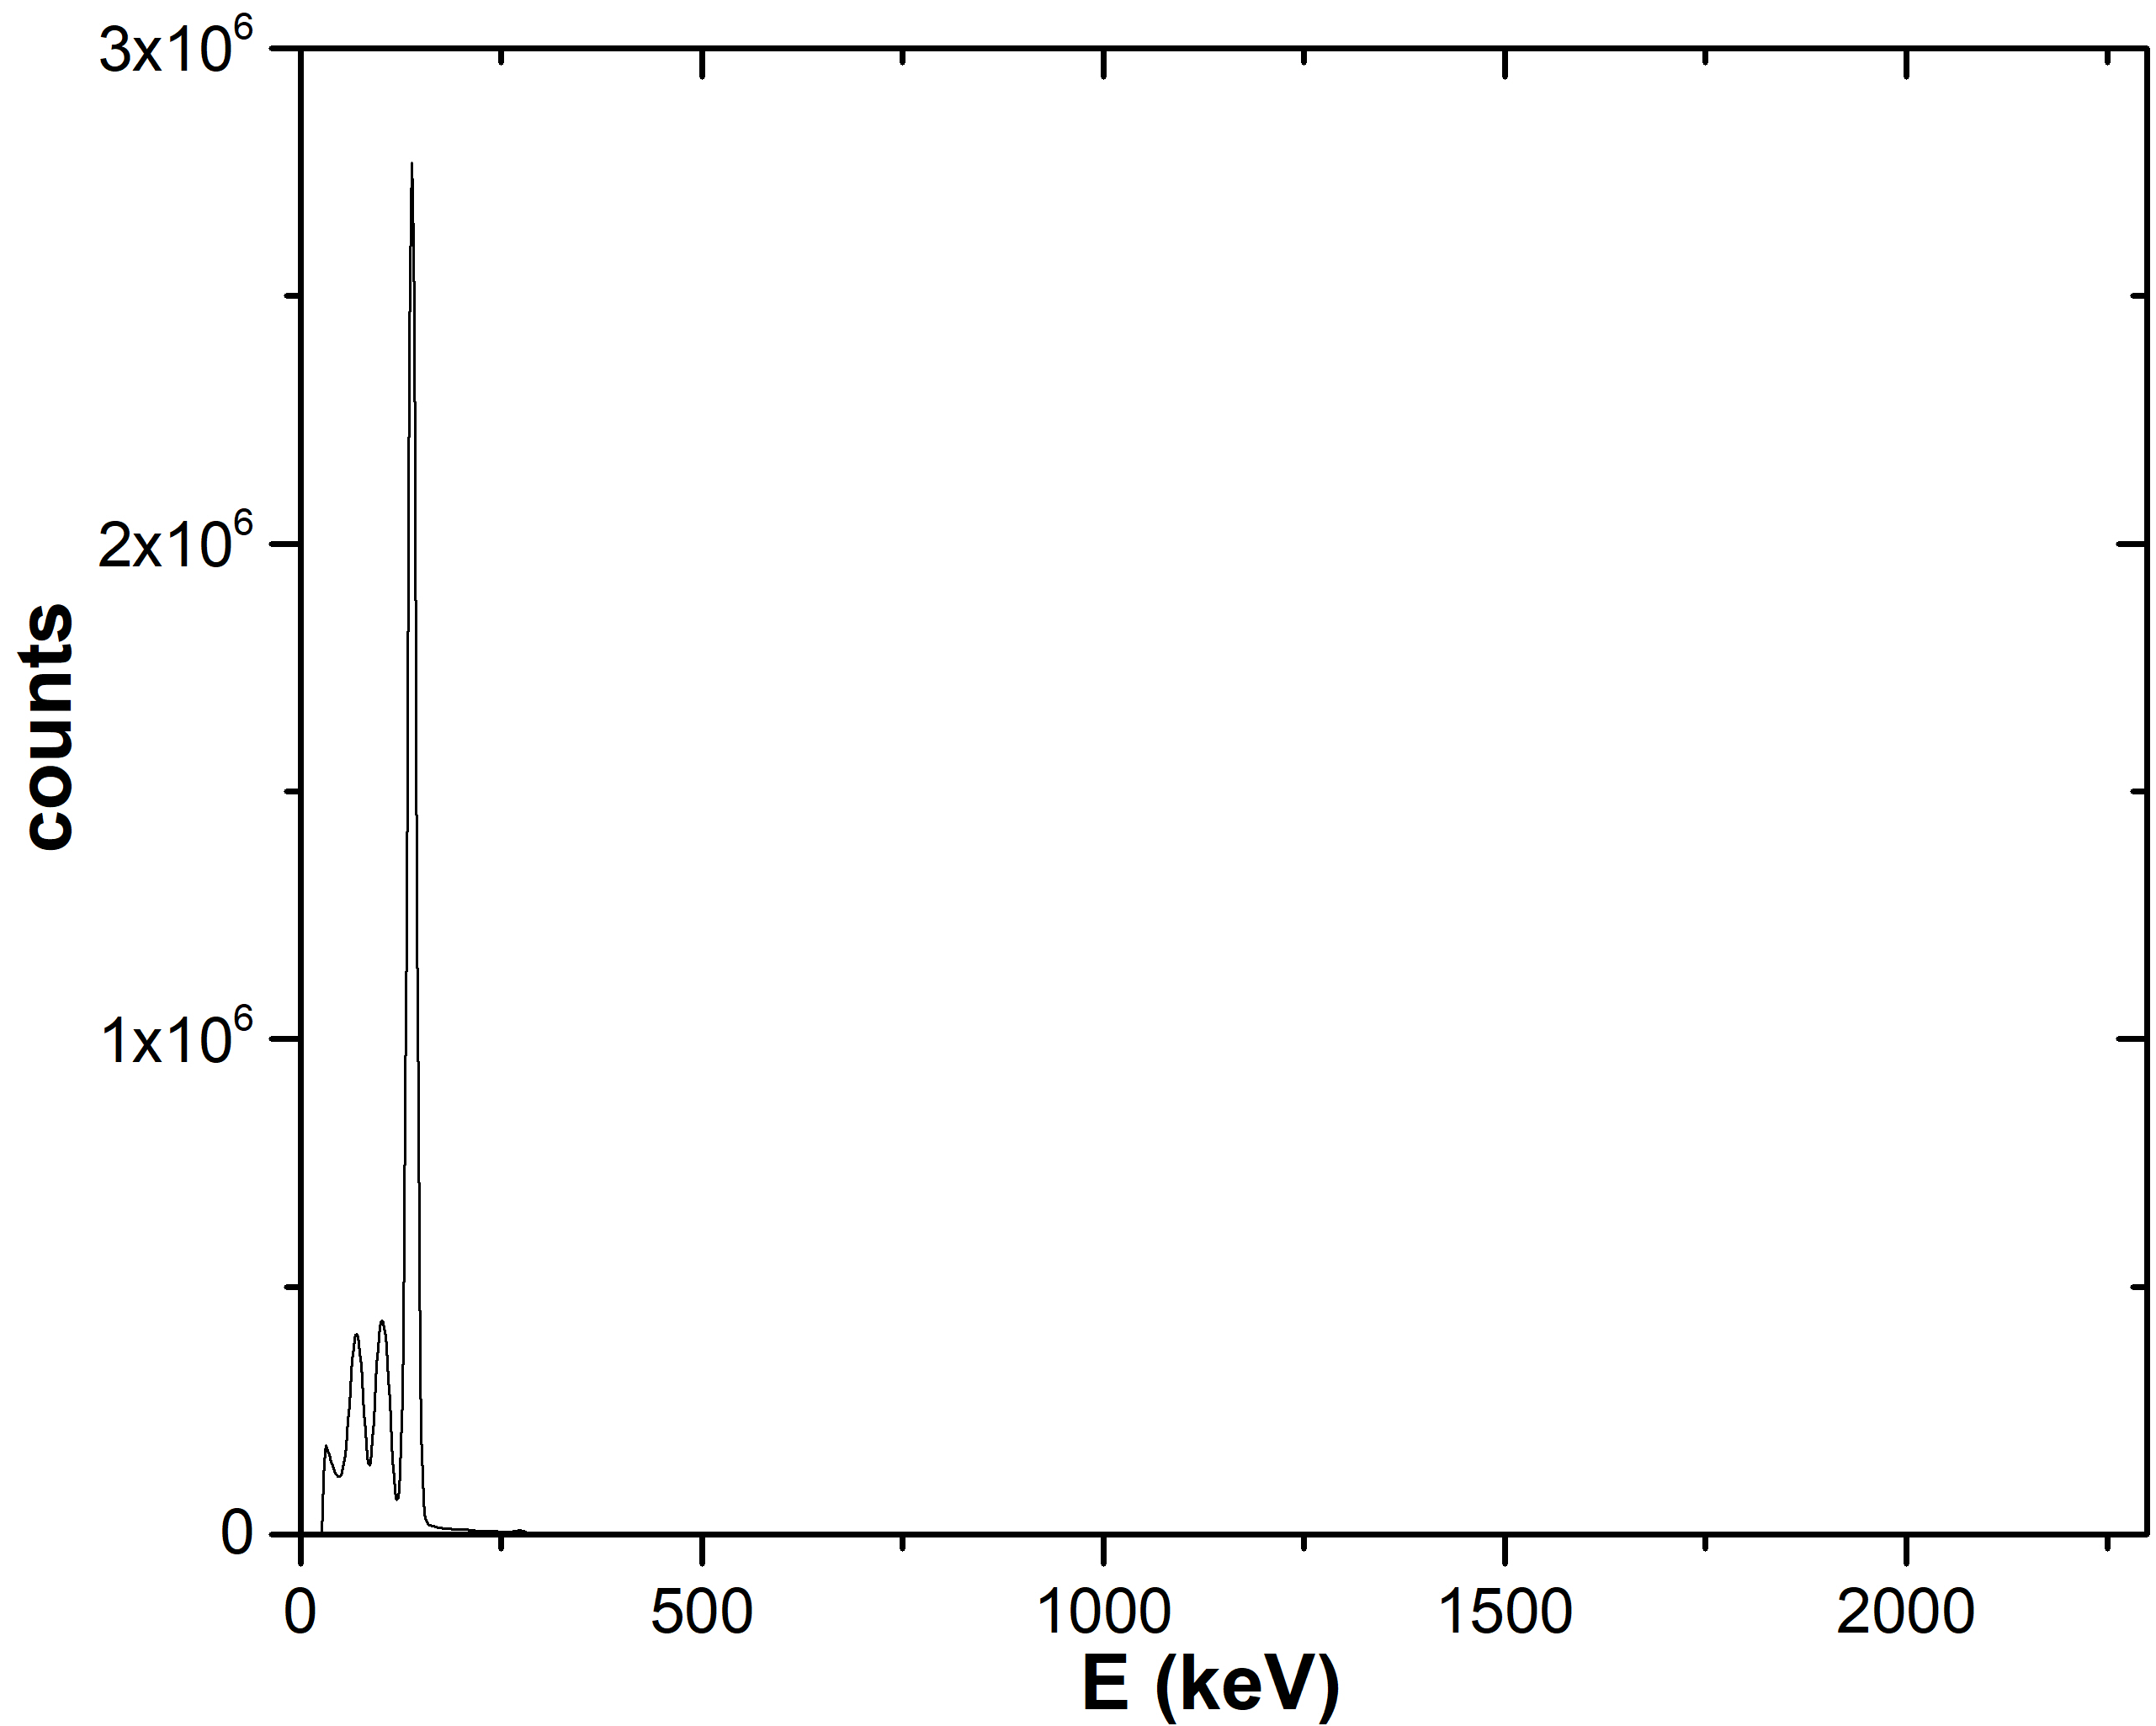
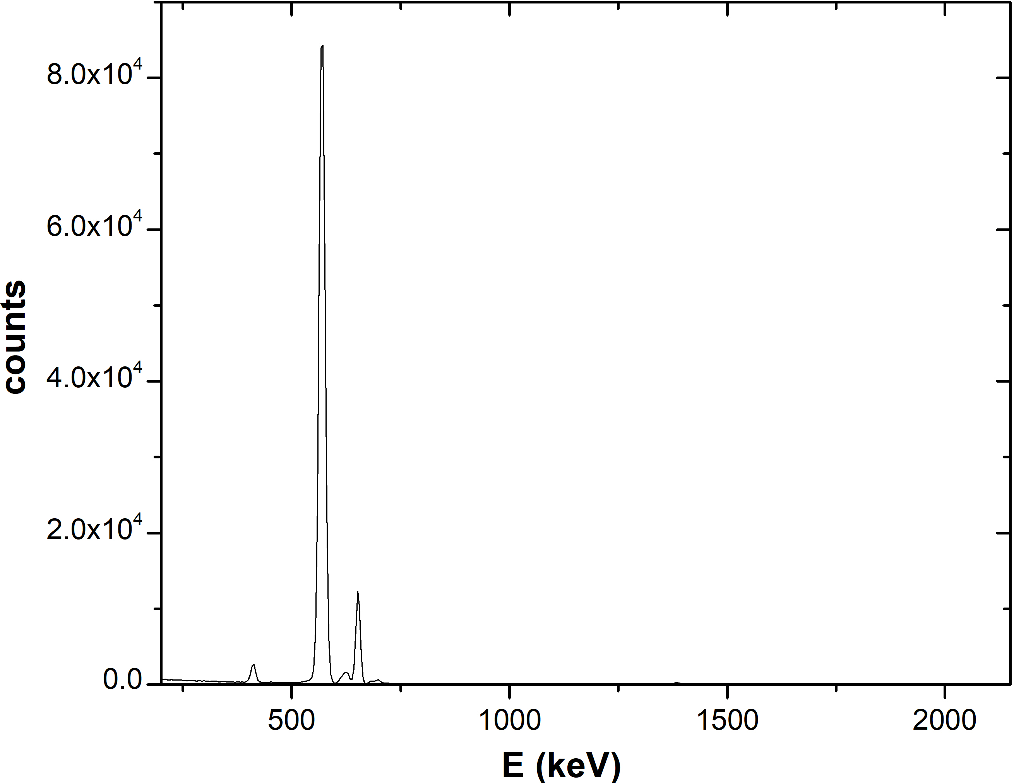
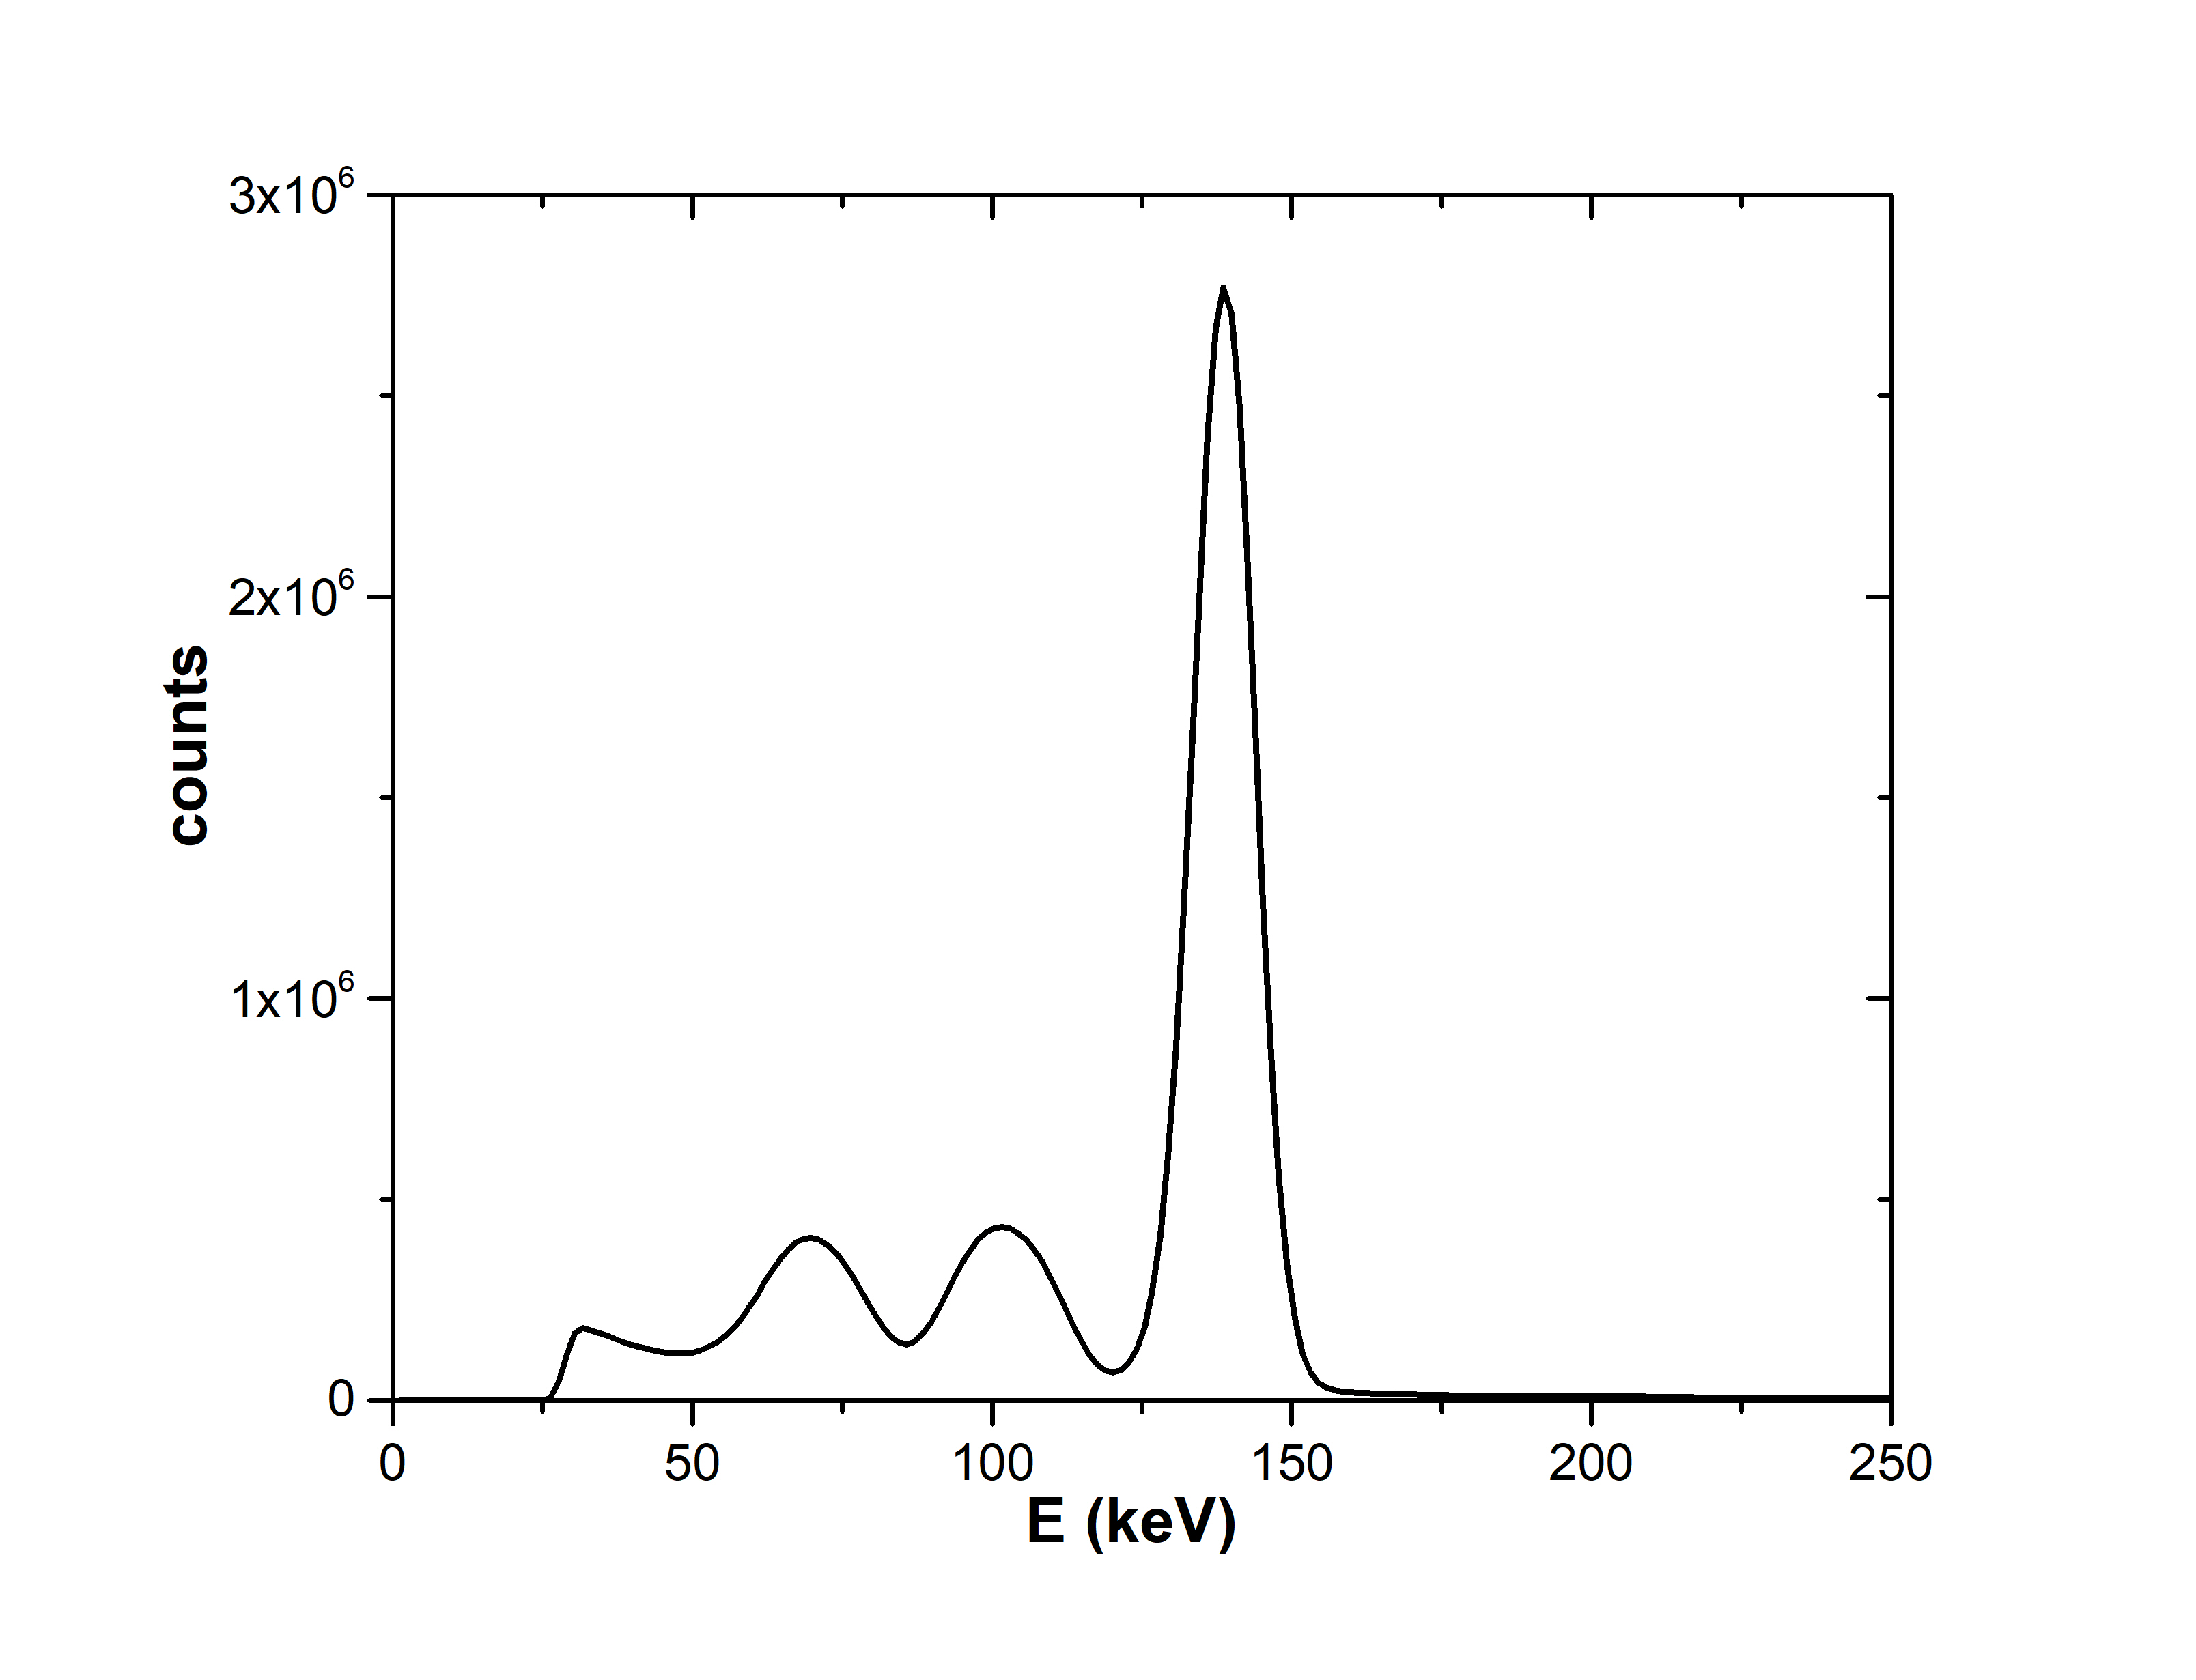
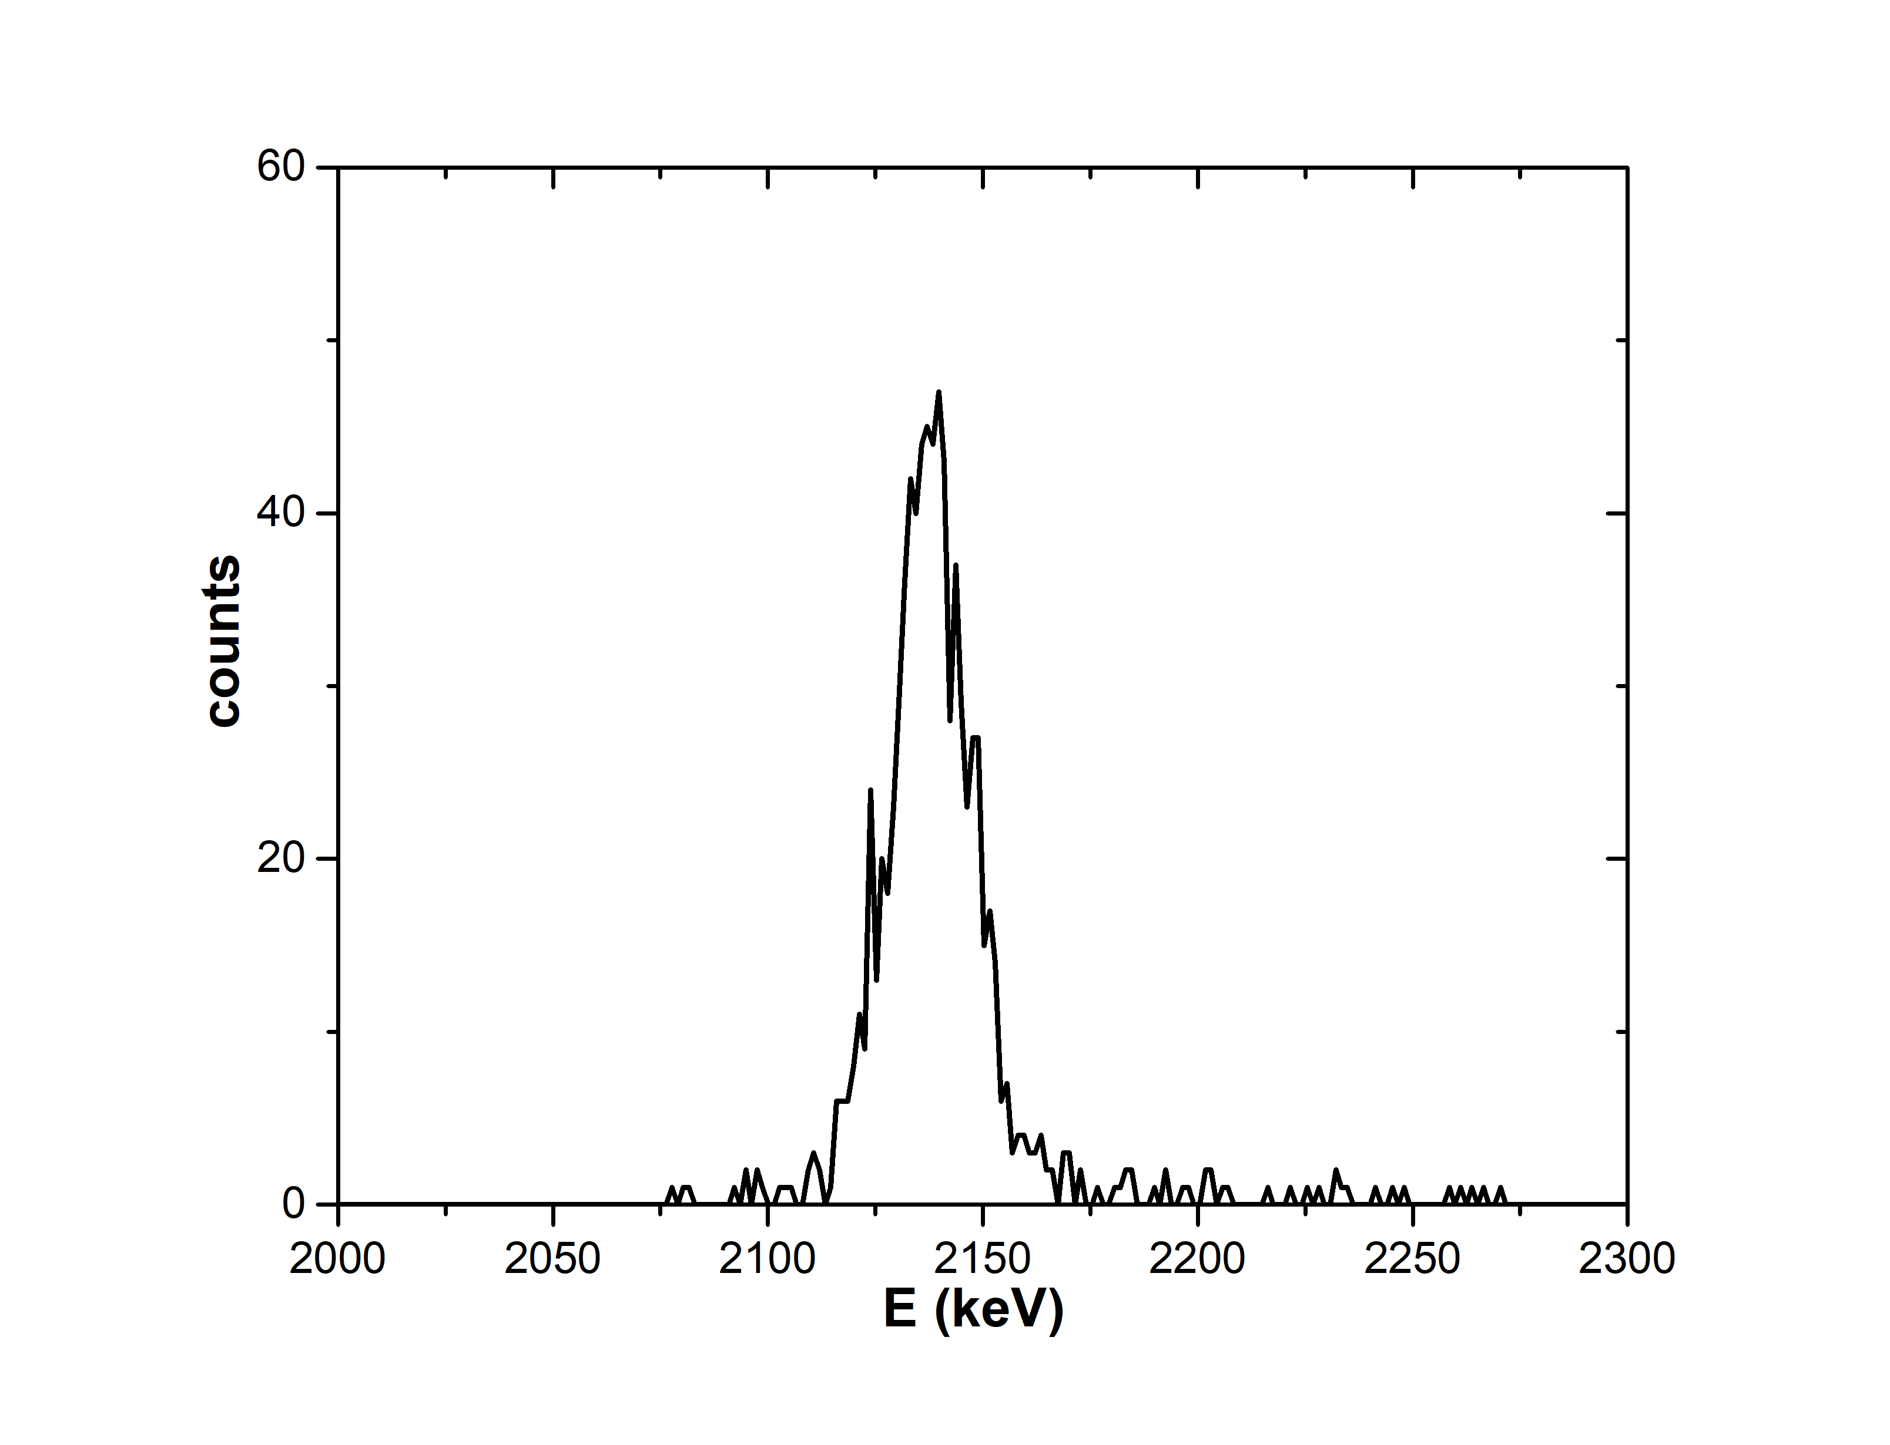
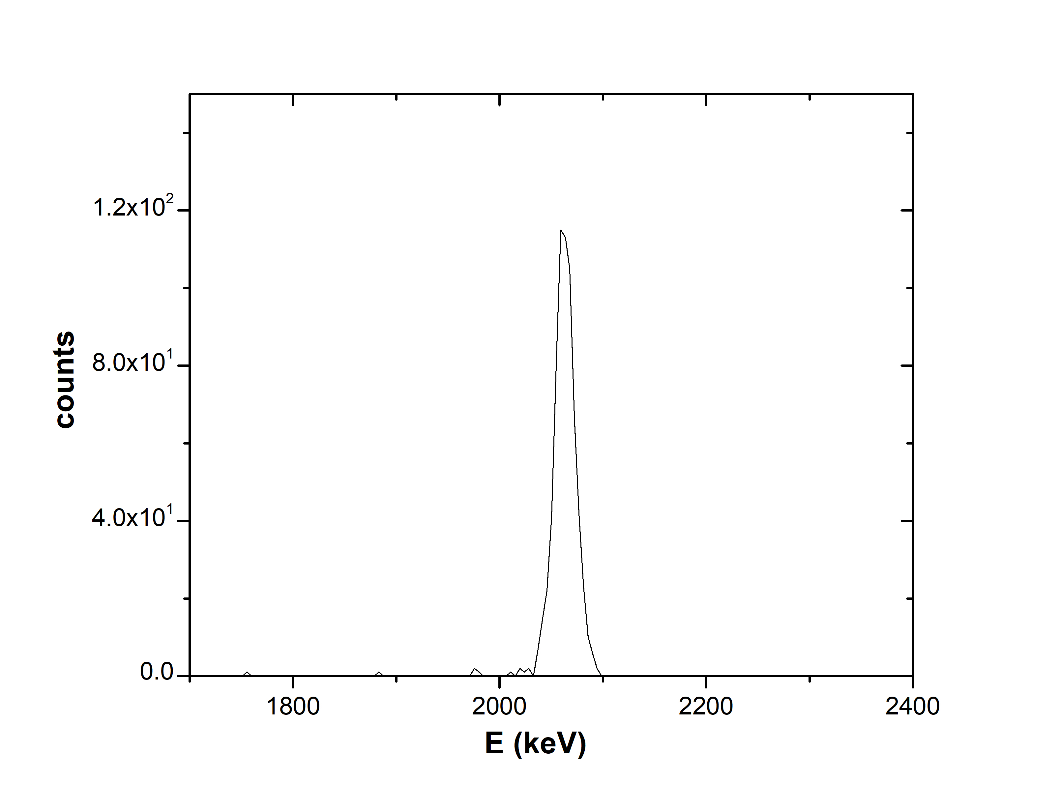


Data Analysis: Yield ratio
Peak integration via the TV code, Uncertainty: $\sim 5 \%$ for ⁶Li, $\sim 7\%$ for ¹⁹F & $\sim 0.1 \%$ for Au peaks, in all spectra
$$Ε_{p}=150 keV, θ=160°$$
$$Ε_{p}=800 keV, θ=160°$$
⁶LiF target (with Au)
⁶LiF target
C_{el}
Au_{el}
F_{el}
Li_{el}
C_{el}
F_{el}
⁶Li(p,³He)⁴He
⁶Li(p,³He)⁴He

Slide 8
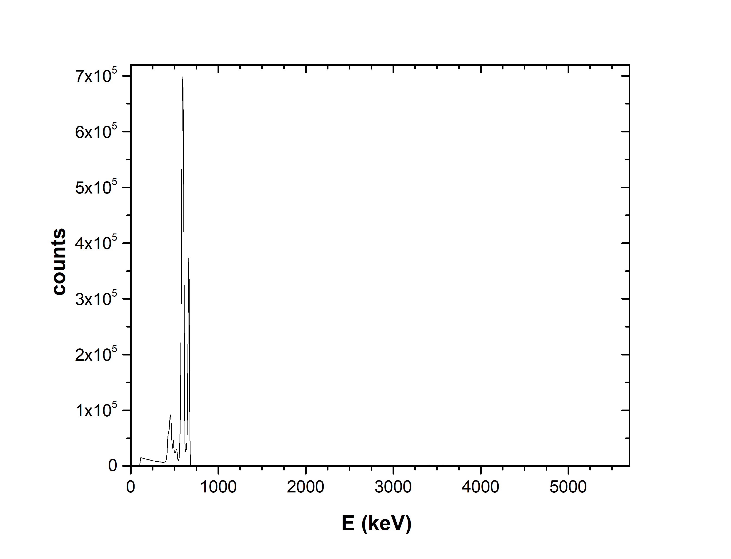
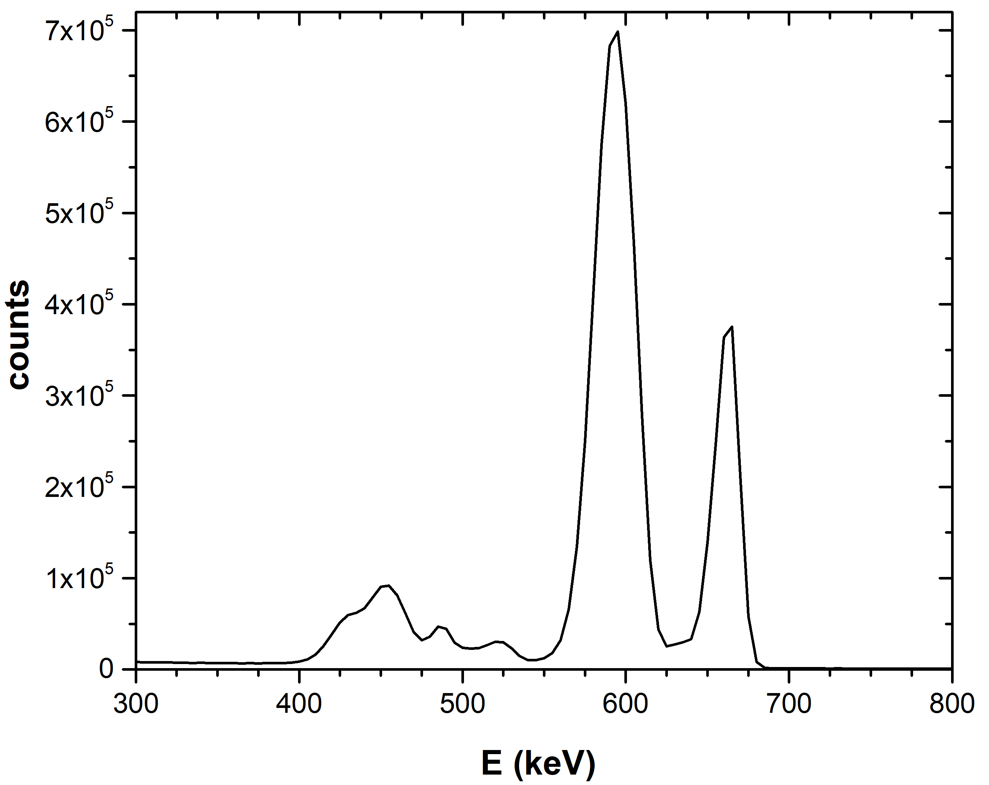
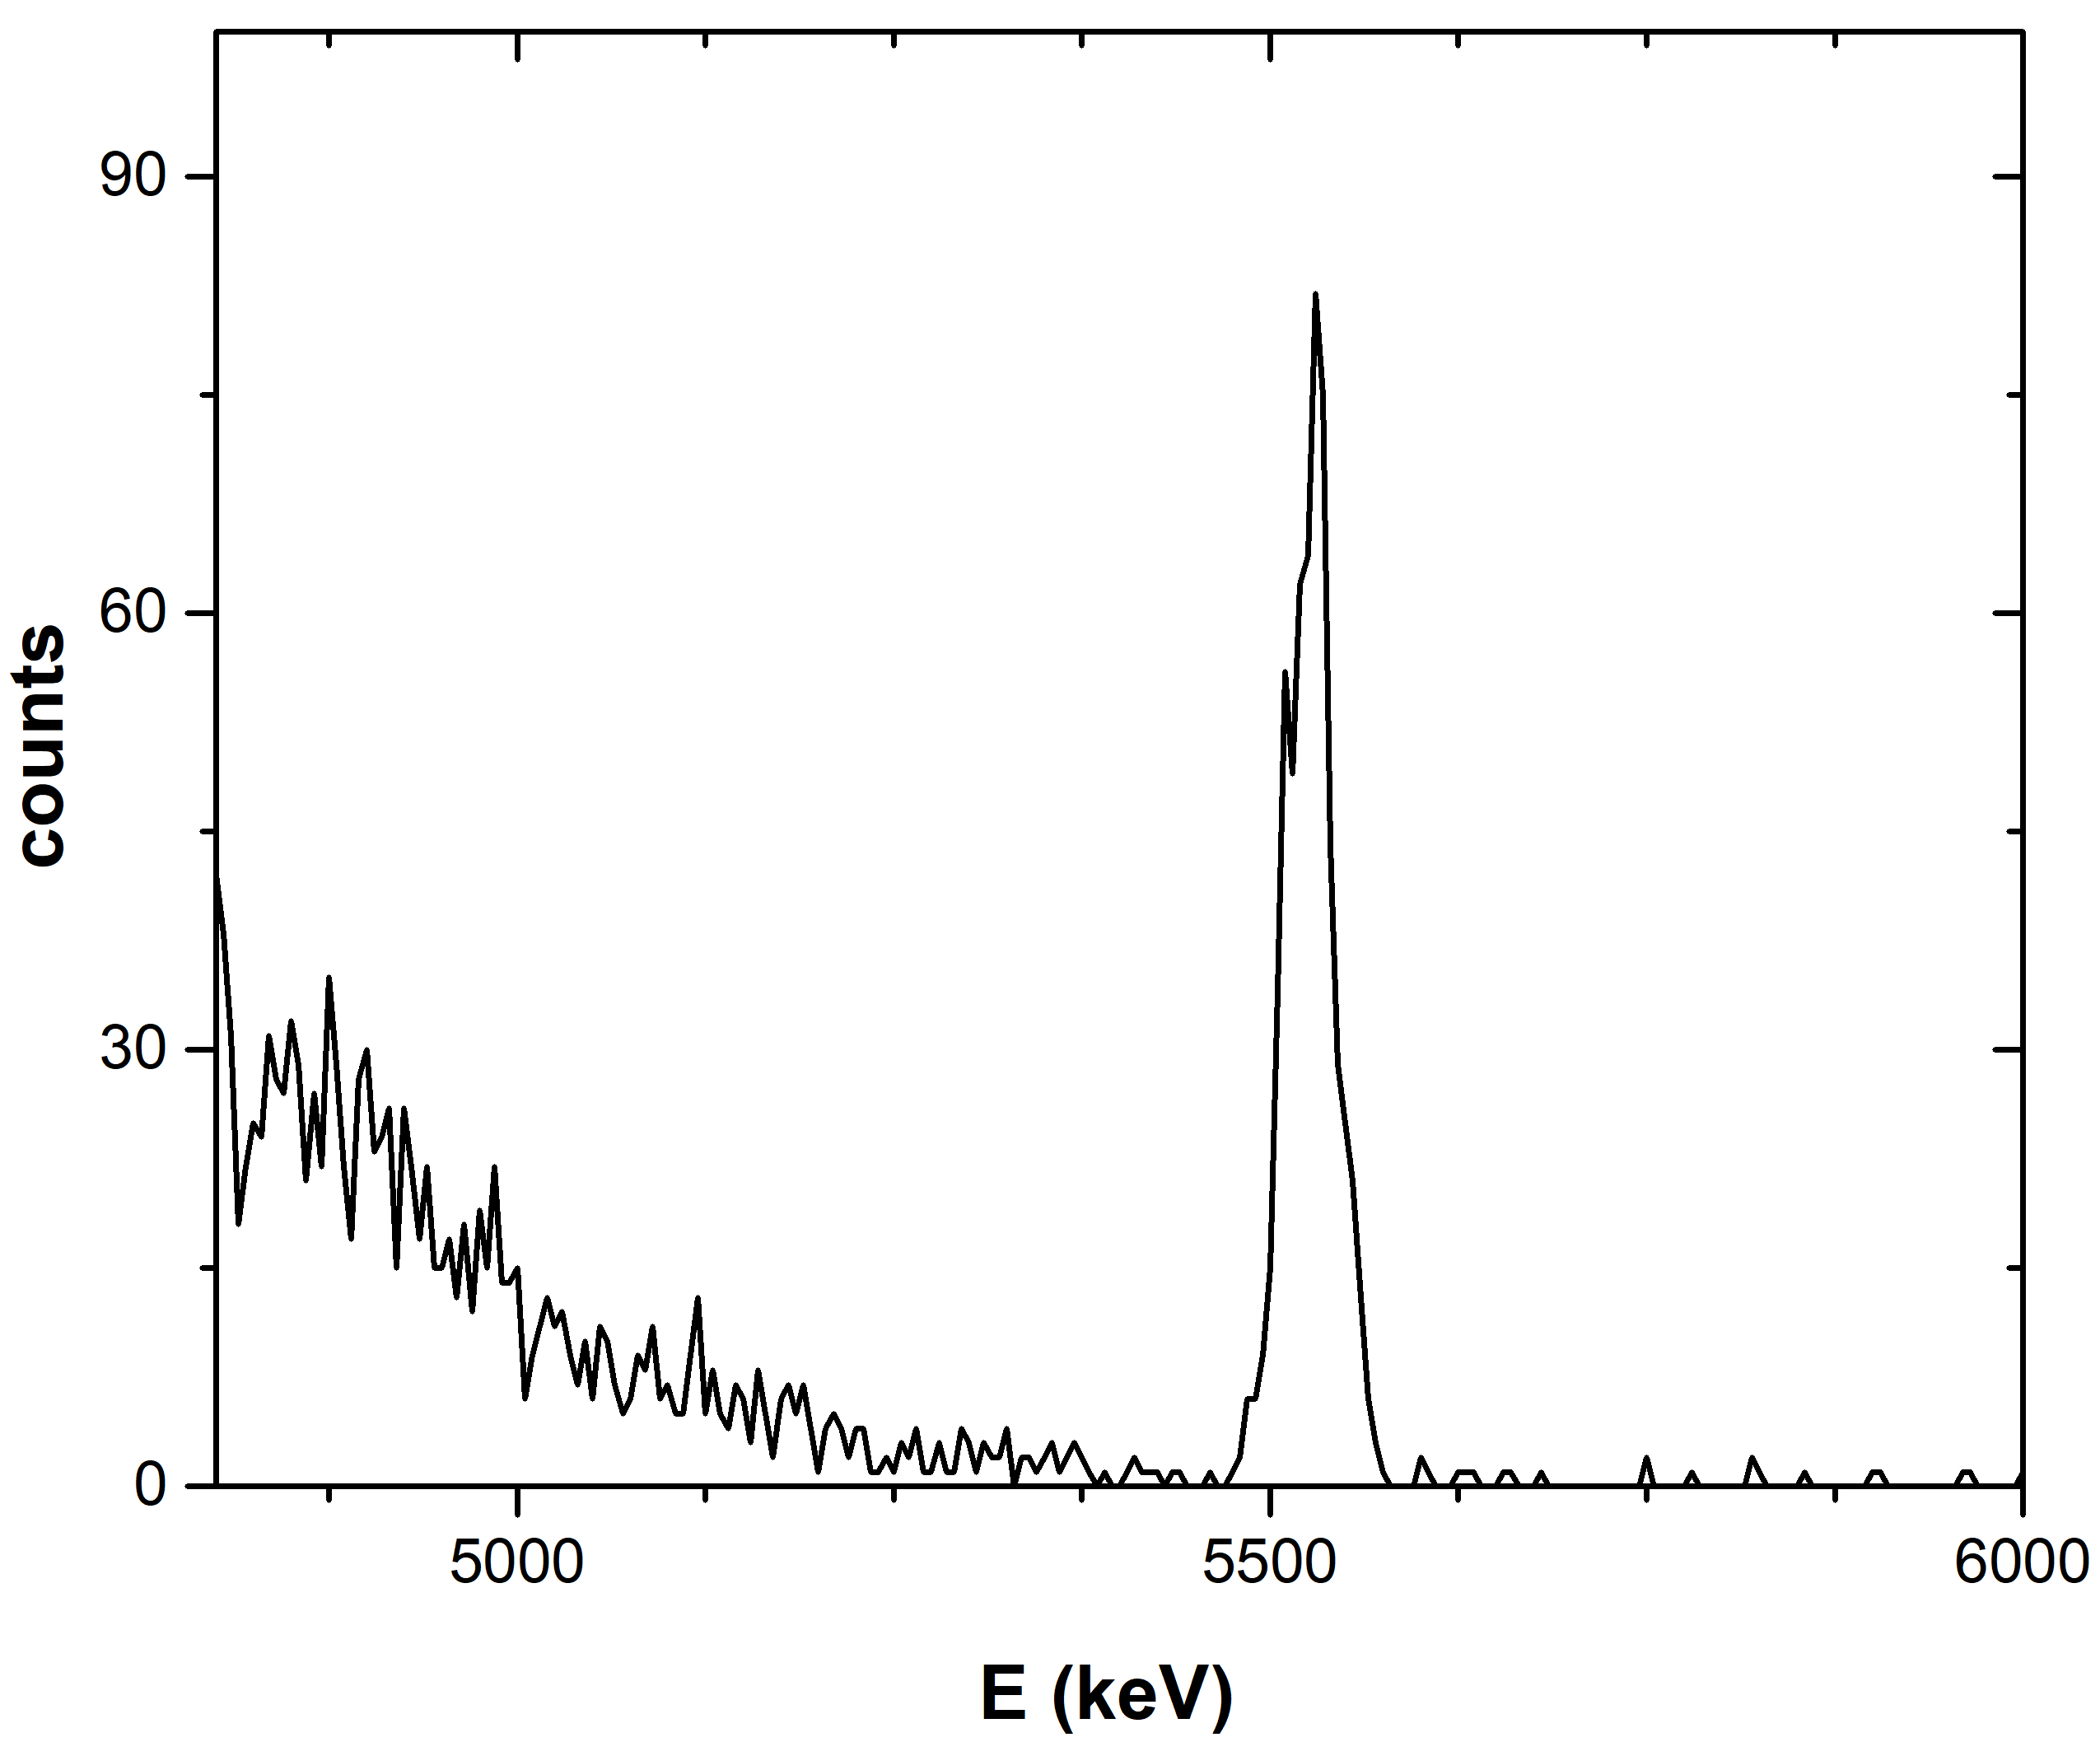

Data Analysis: Yield ratio
Peak integration via the TV code, Uncertainty: $\sim 5 \%$ for ¹¹B & $\sim 0.1 \%$ for Au peaks, in all spectra
$$Ε_{p}=675 keV, θ=170°$$
^{nat}B target
Cu_{el}
Au_{el}
¹¹B(p,a₀)⁸Be
B_{el}
C_{el}
O_{el}

Slide 9
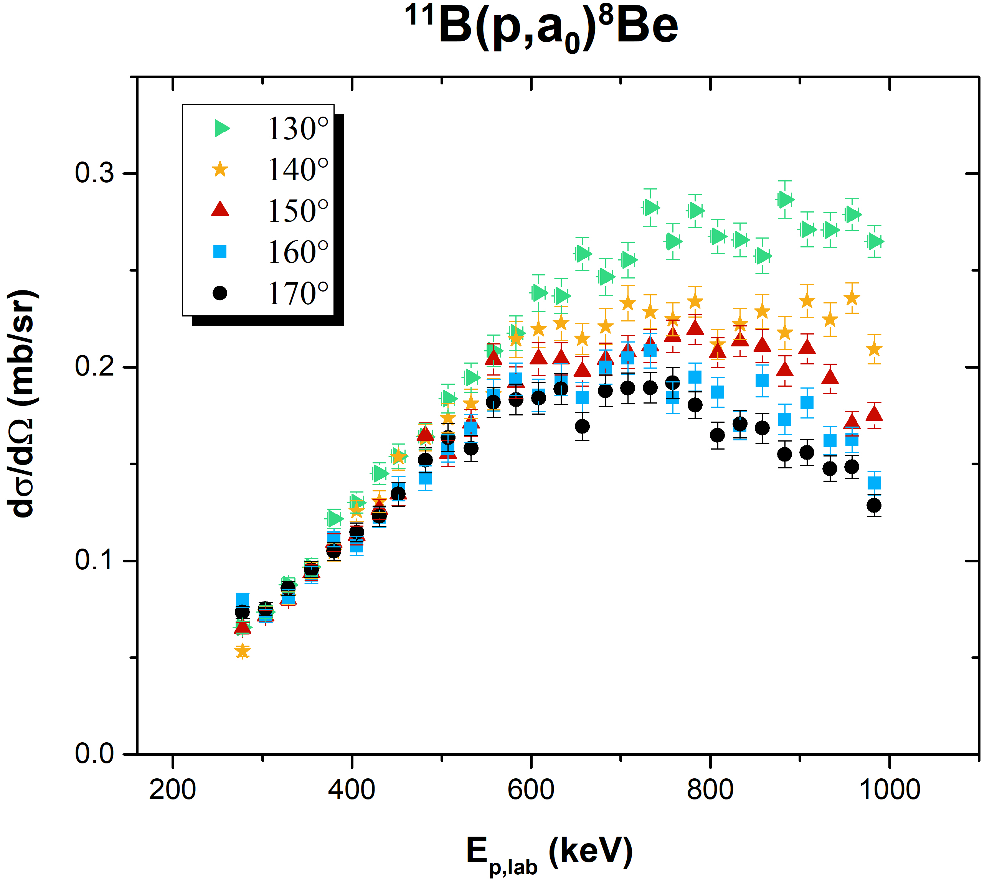
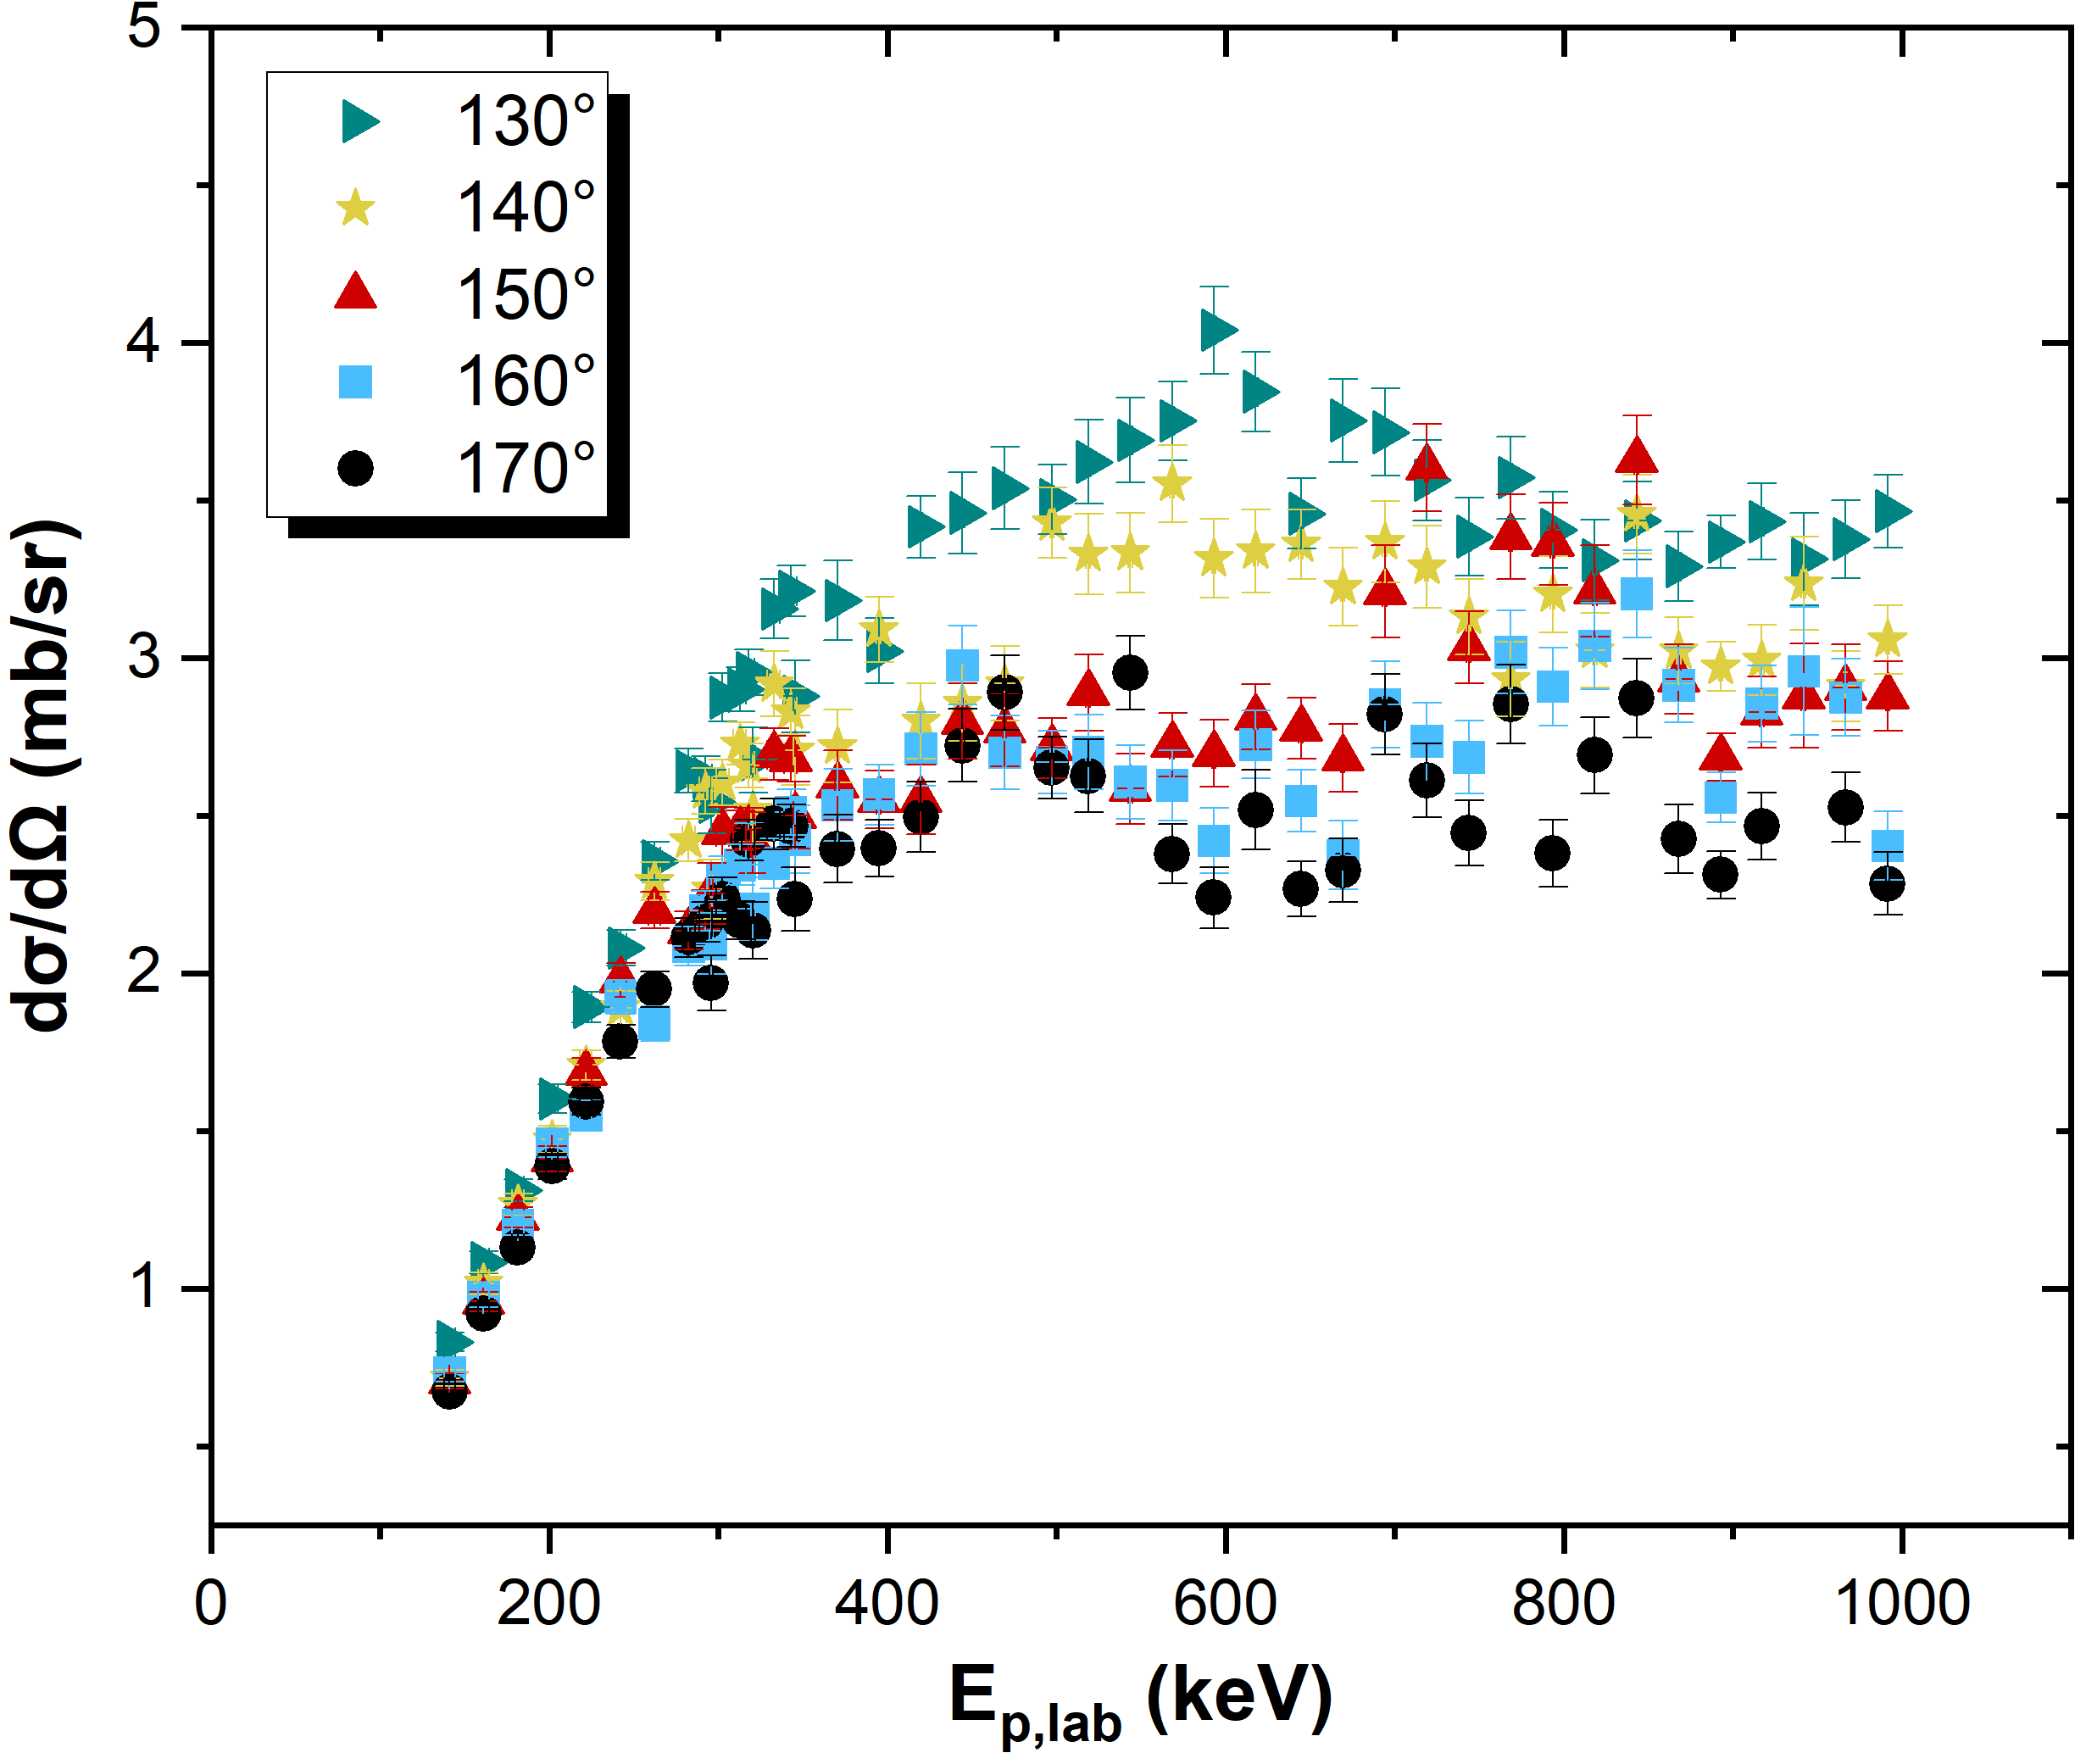



Results: Differential cross sections
⁶Li(p,³He)⁴He
$δΕ\sim 3.5 keV , up to 340 keV$
$δΕ\sim 7 keV$
$δΕ\sim 2 keV, up to 1000 keV$

Slide 10
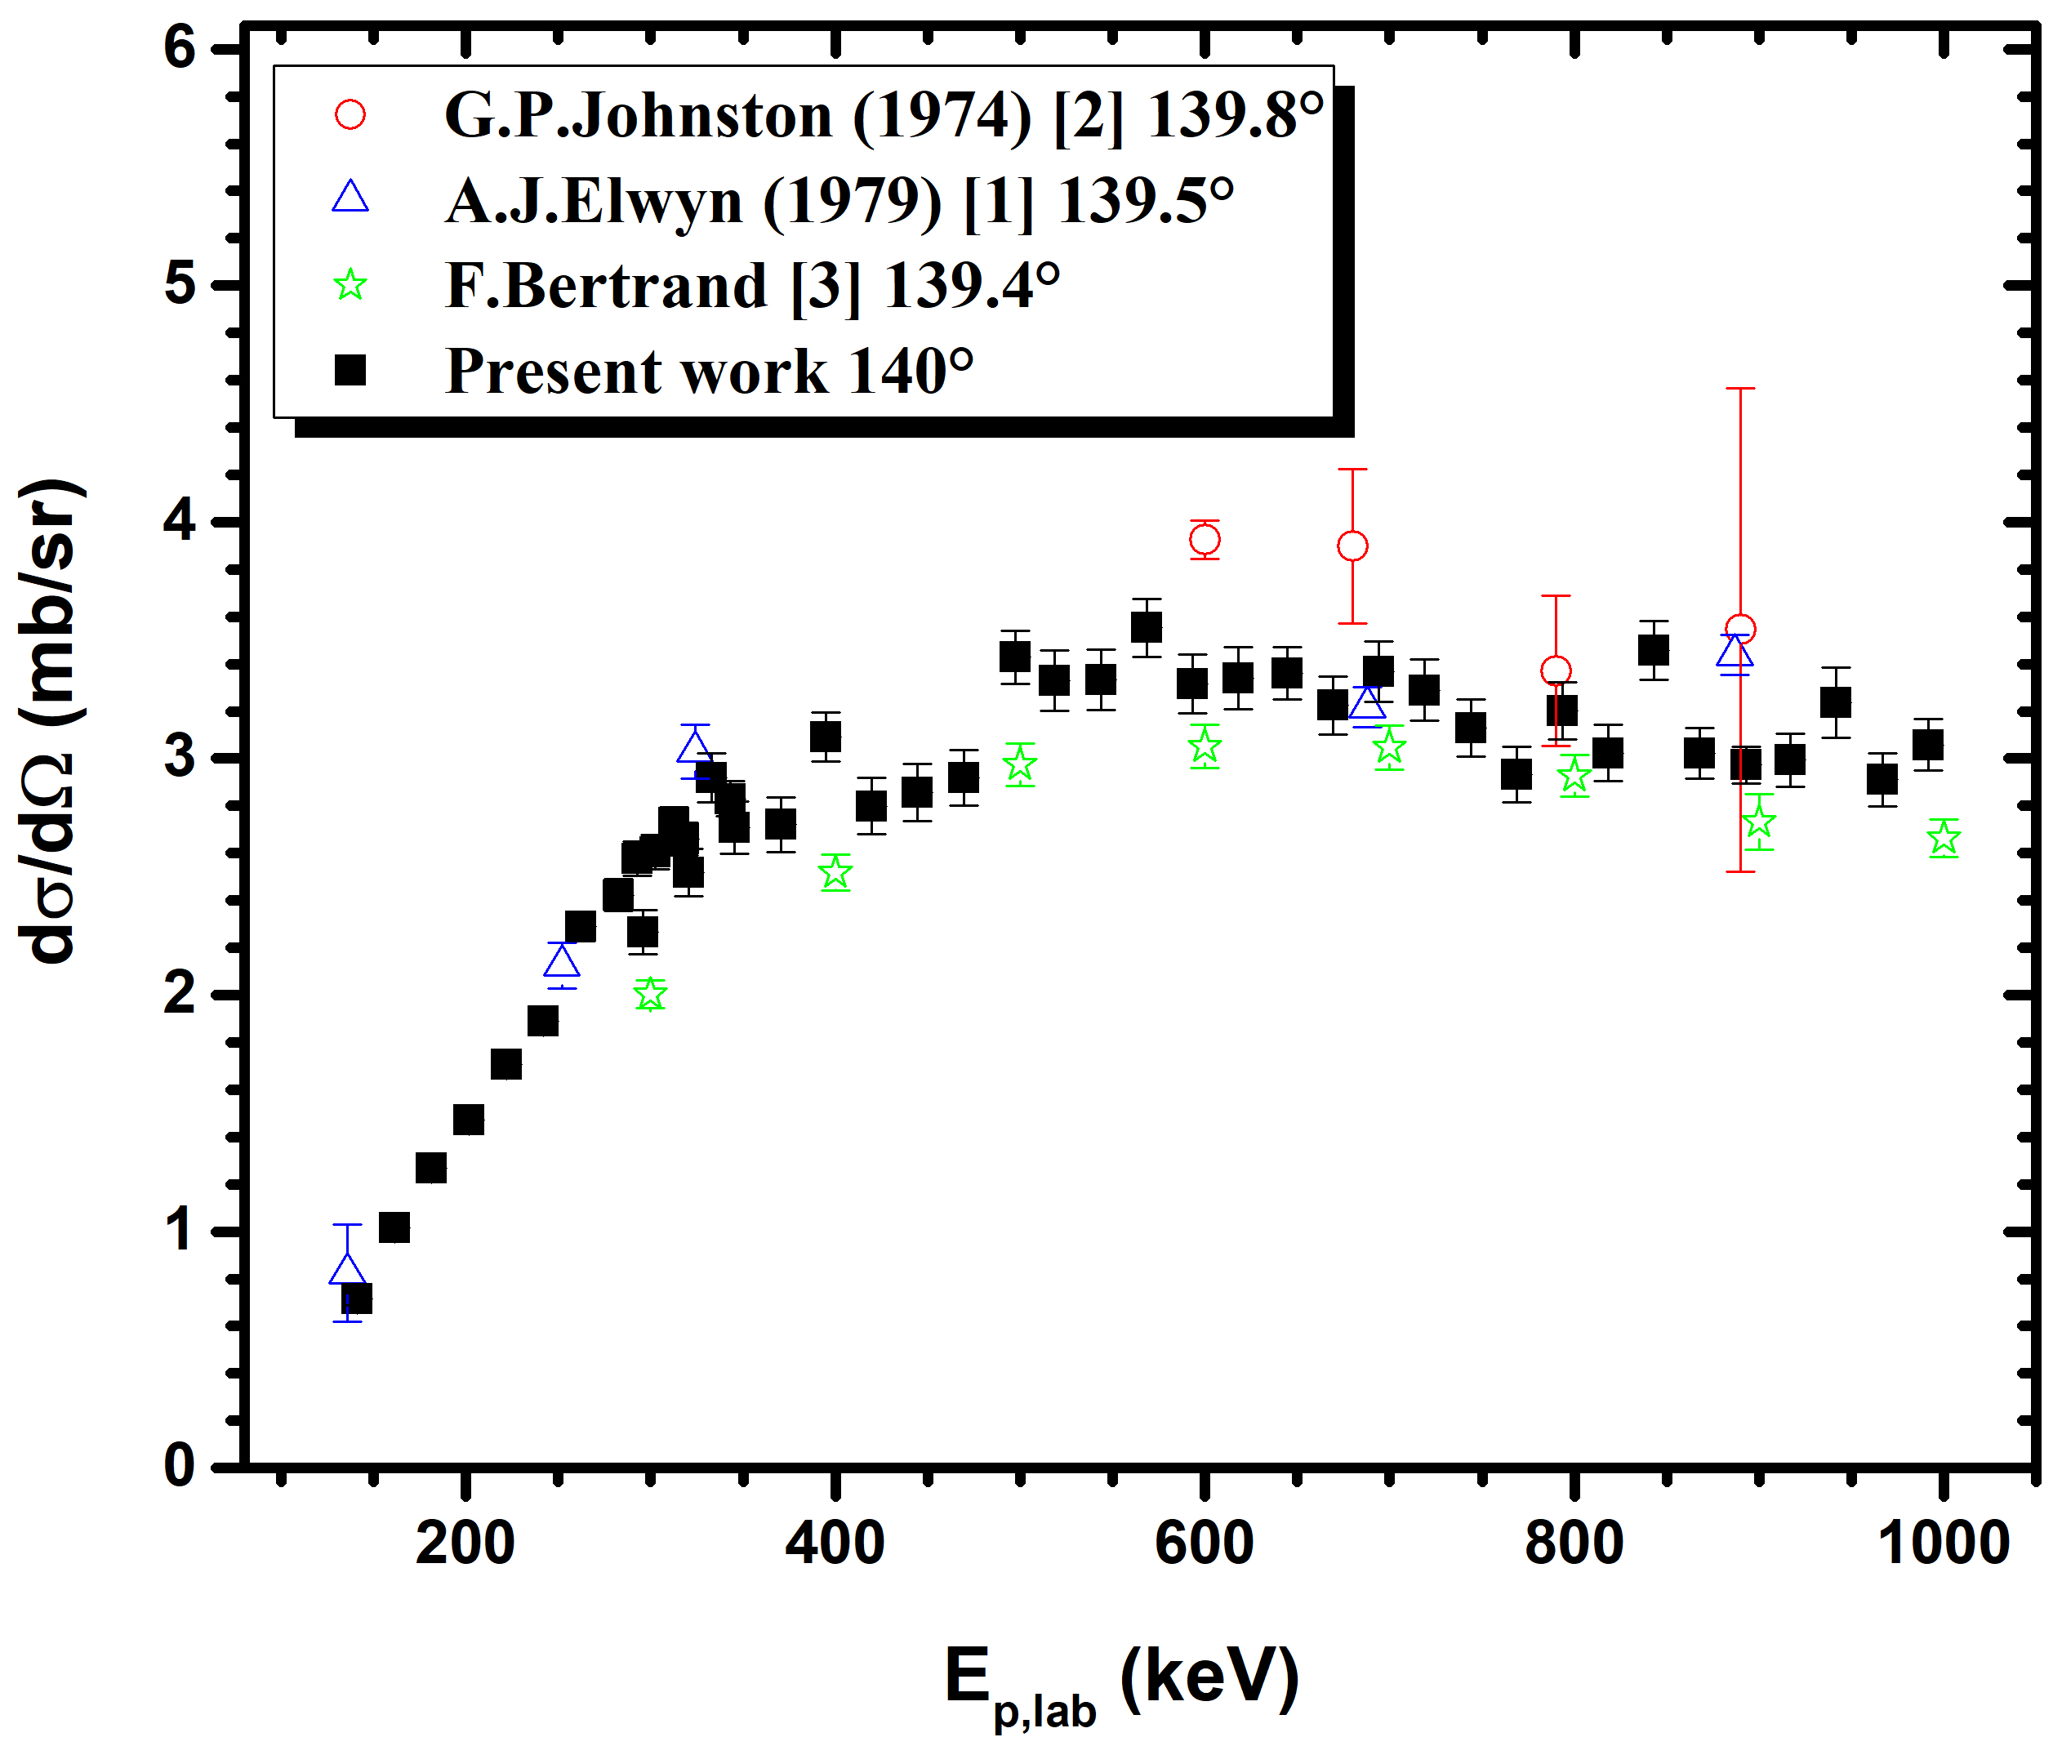
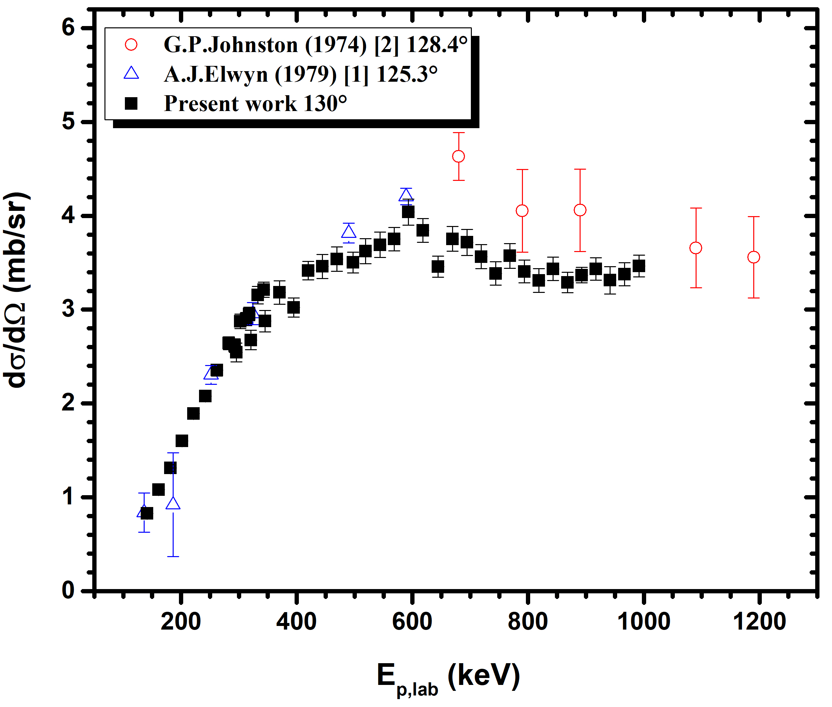
Results: Comparison with literature
⁶Li(p,³He)⁴He
Comparison with present work’s results at 130$°$ & 140$°$ and existing data by G. P. Johnston et al., A. J. Elwyn et al. and F. Bertrand et al., at similar angles
130°
140°
Overestimation of data by G. P. Johnston et al. ($\sim$ 30%)
Good agreement with data by A. J. Elwyn et al.
Differences with F. Bertrand et al. in most cases ($\sim$ 35%)

Slide 11
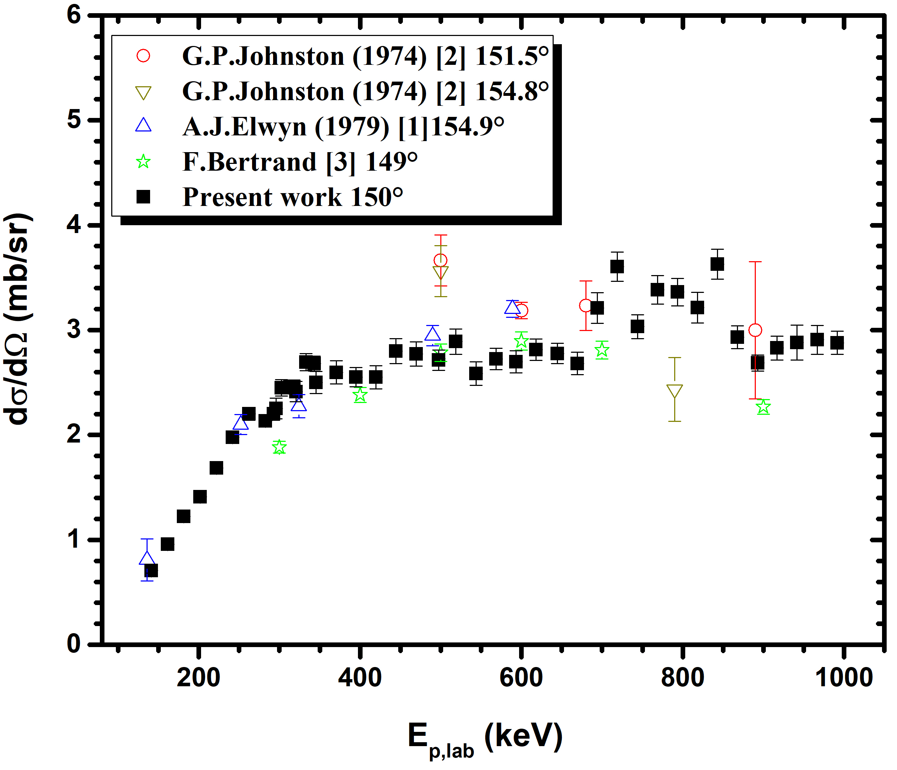
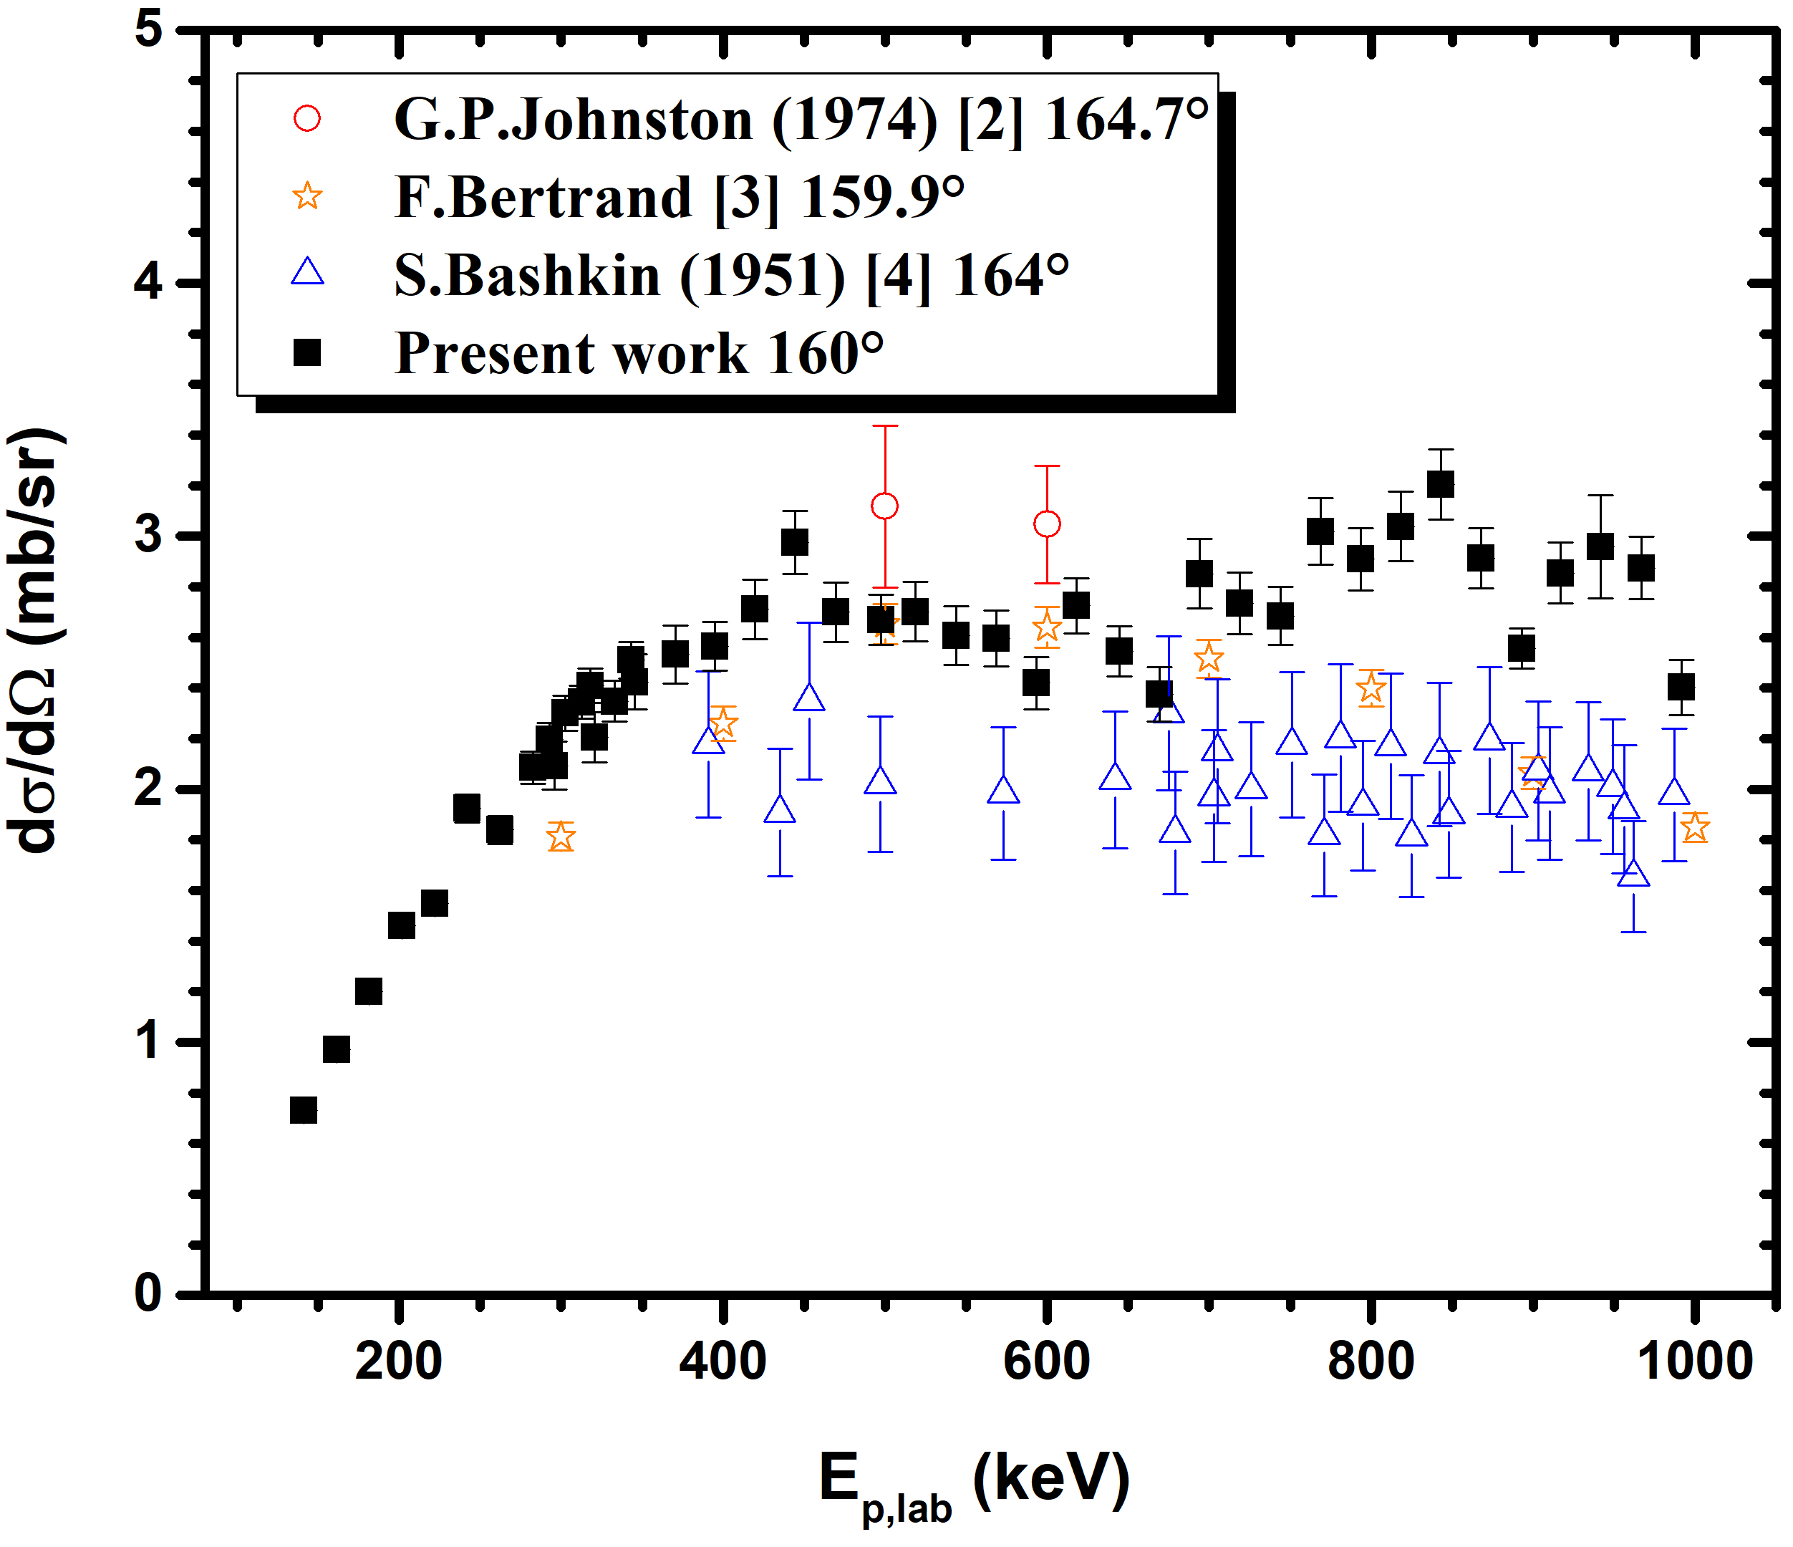
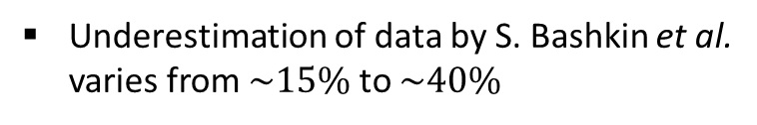
Results: Comparison with literature
⁶Li(p,³He)⁴He
Comparison with present work’s results at 150$°$ & 160$°$ and existing data by G. P. Johnston et al., A. J. Elwyn et al., F. Bertrand et al. and S. Bashkin et al, at similar angles
150°
160°
Good agreement with data by A. J. Elwyn et al.
Underestimation of data by S. Bashkin et al. varies from $\sim 15\%$ to $\sim 40\%$
Discrepancies with F. Bertrand et al. and G. P. Johnston et al.

Slide 12
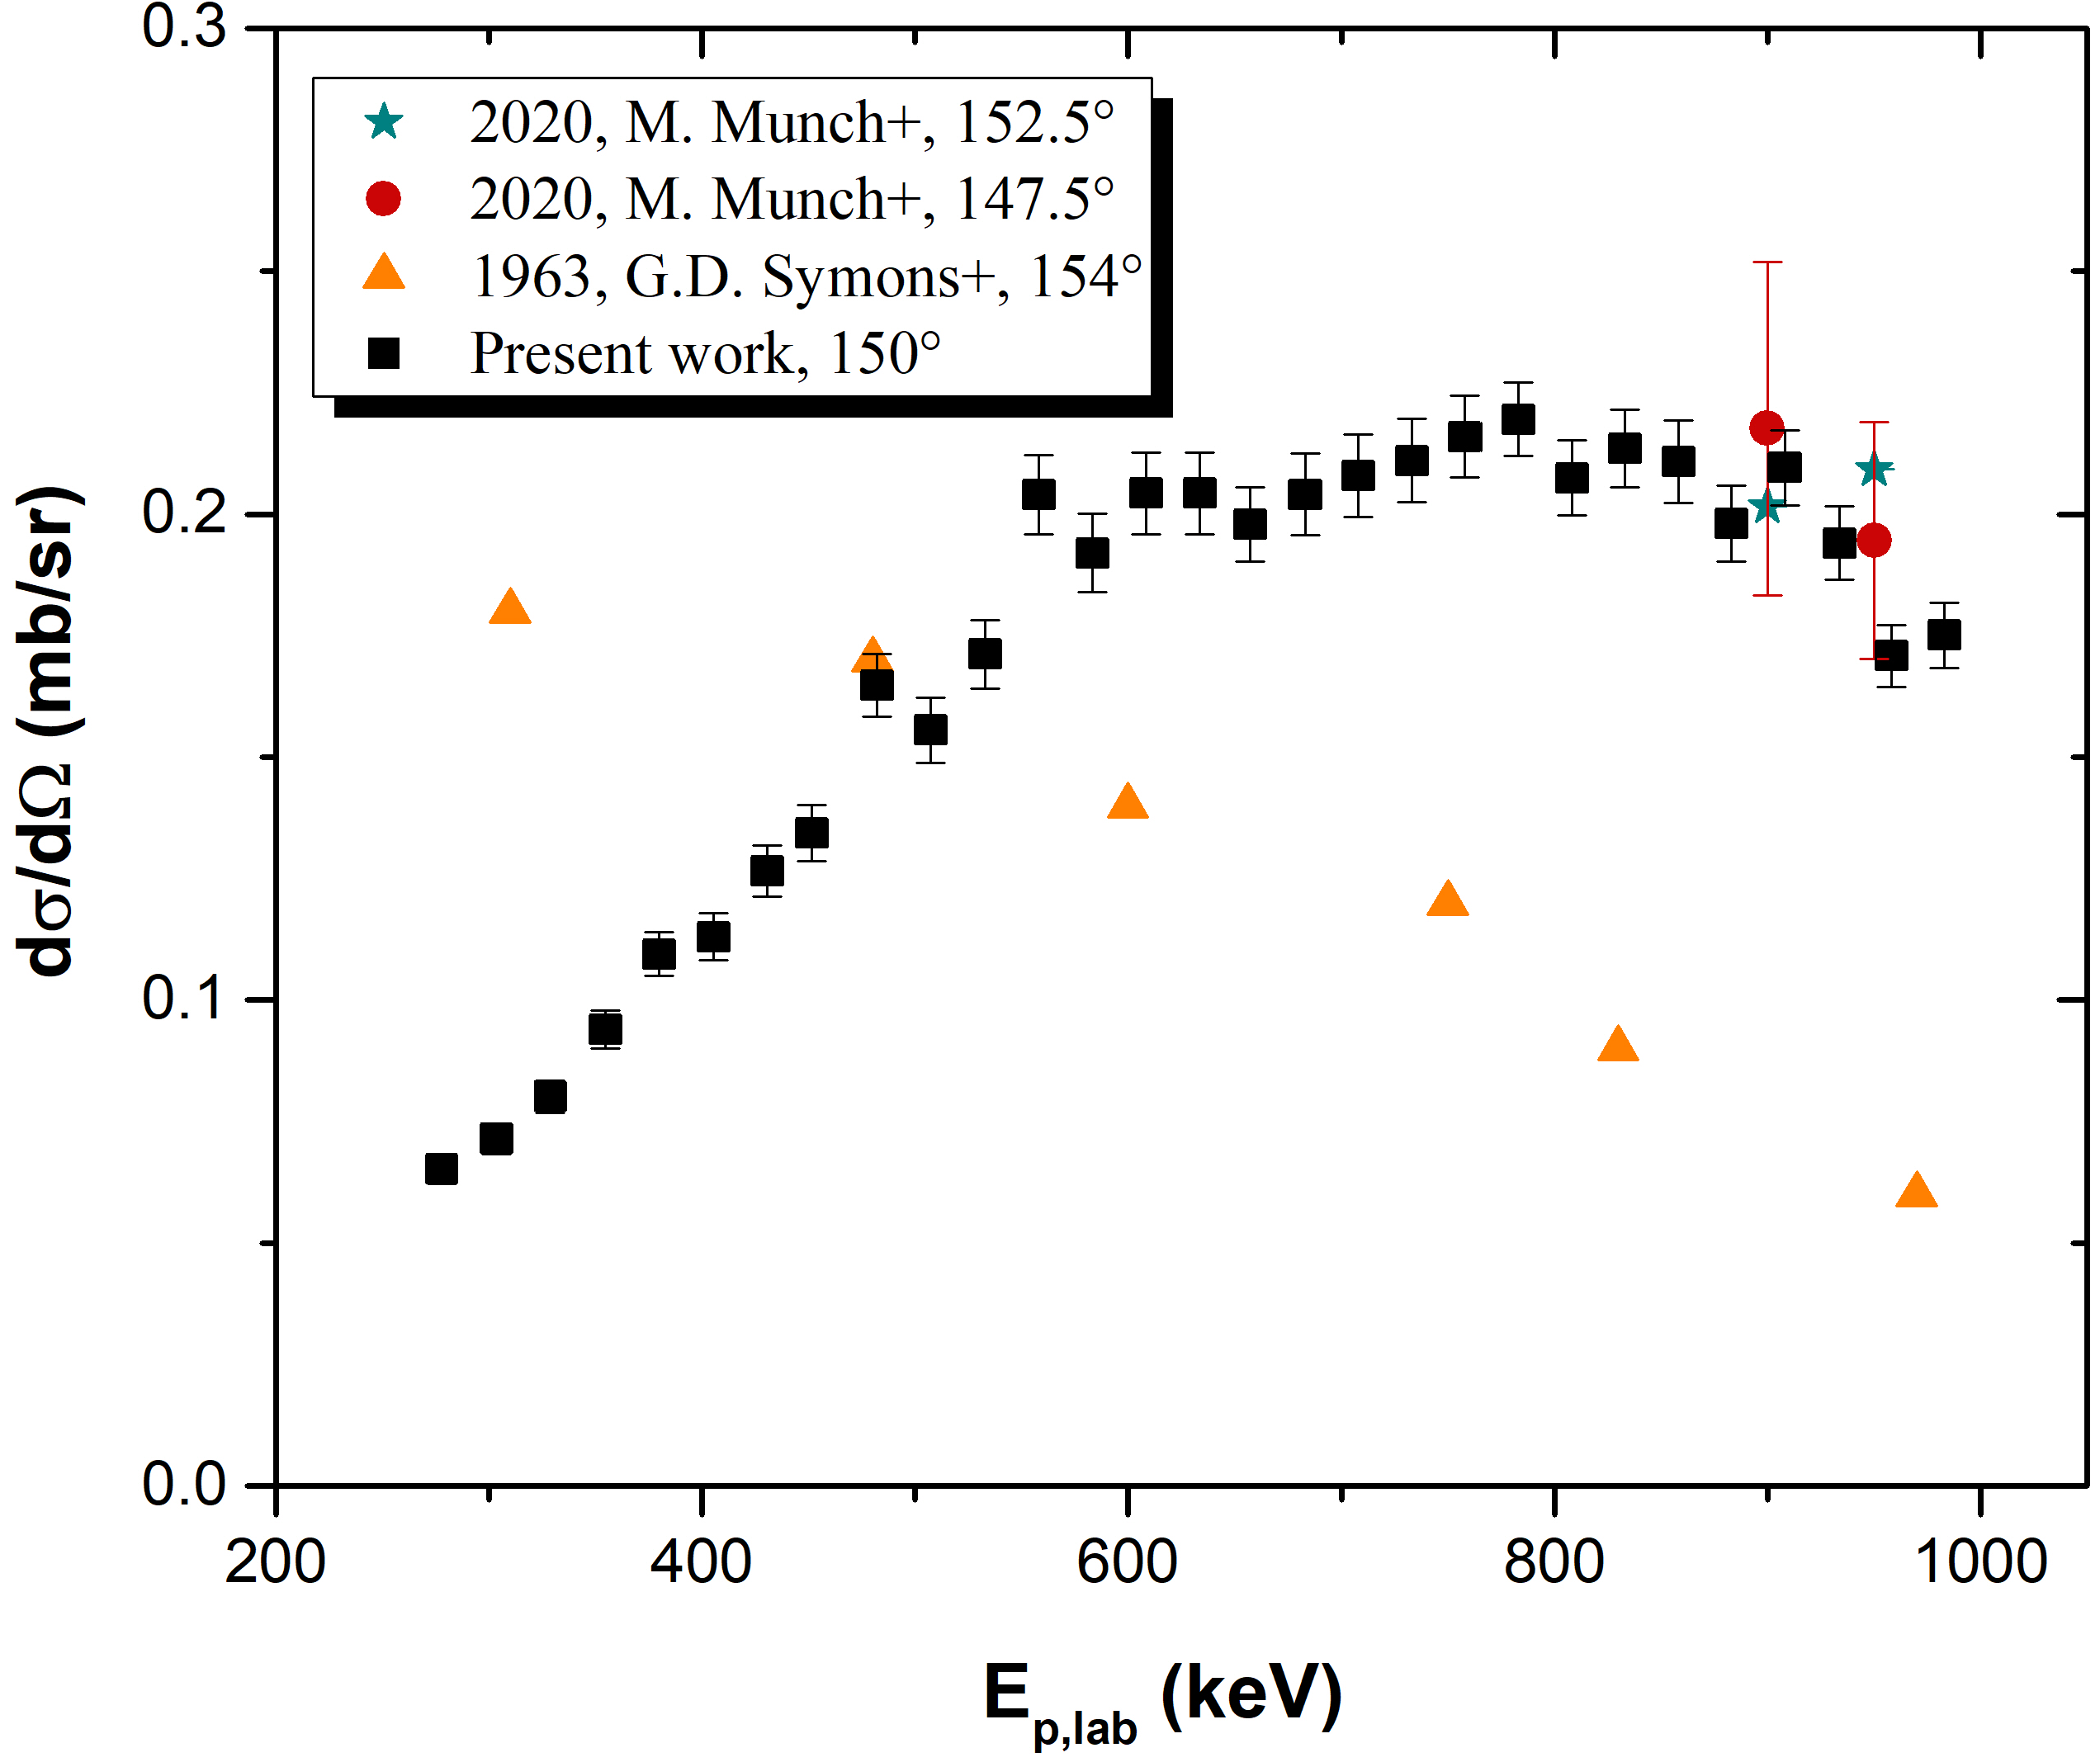
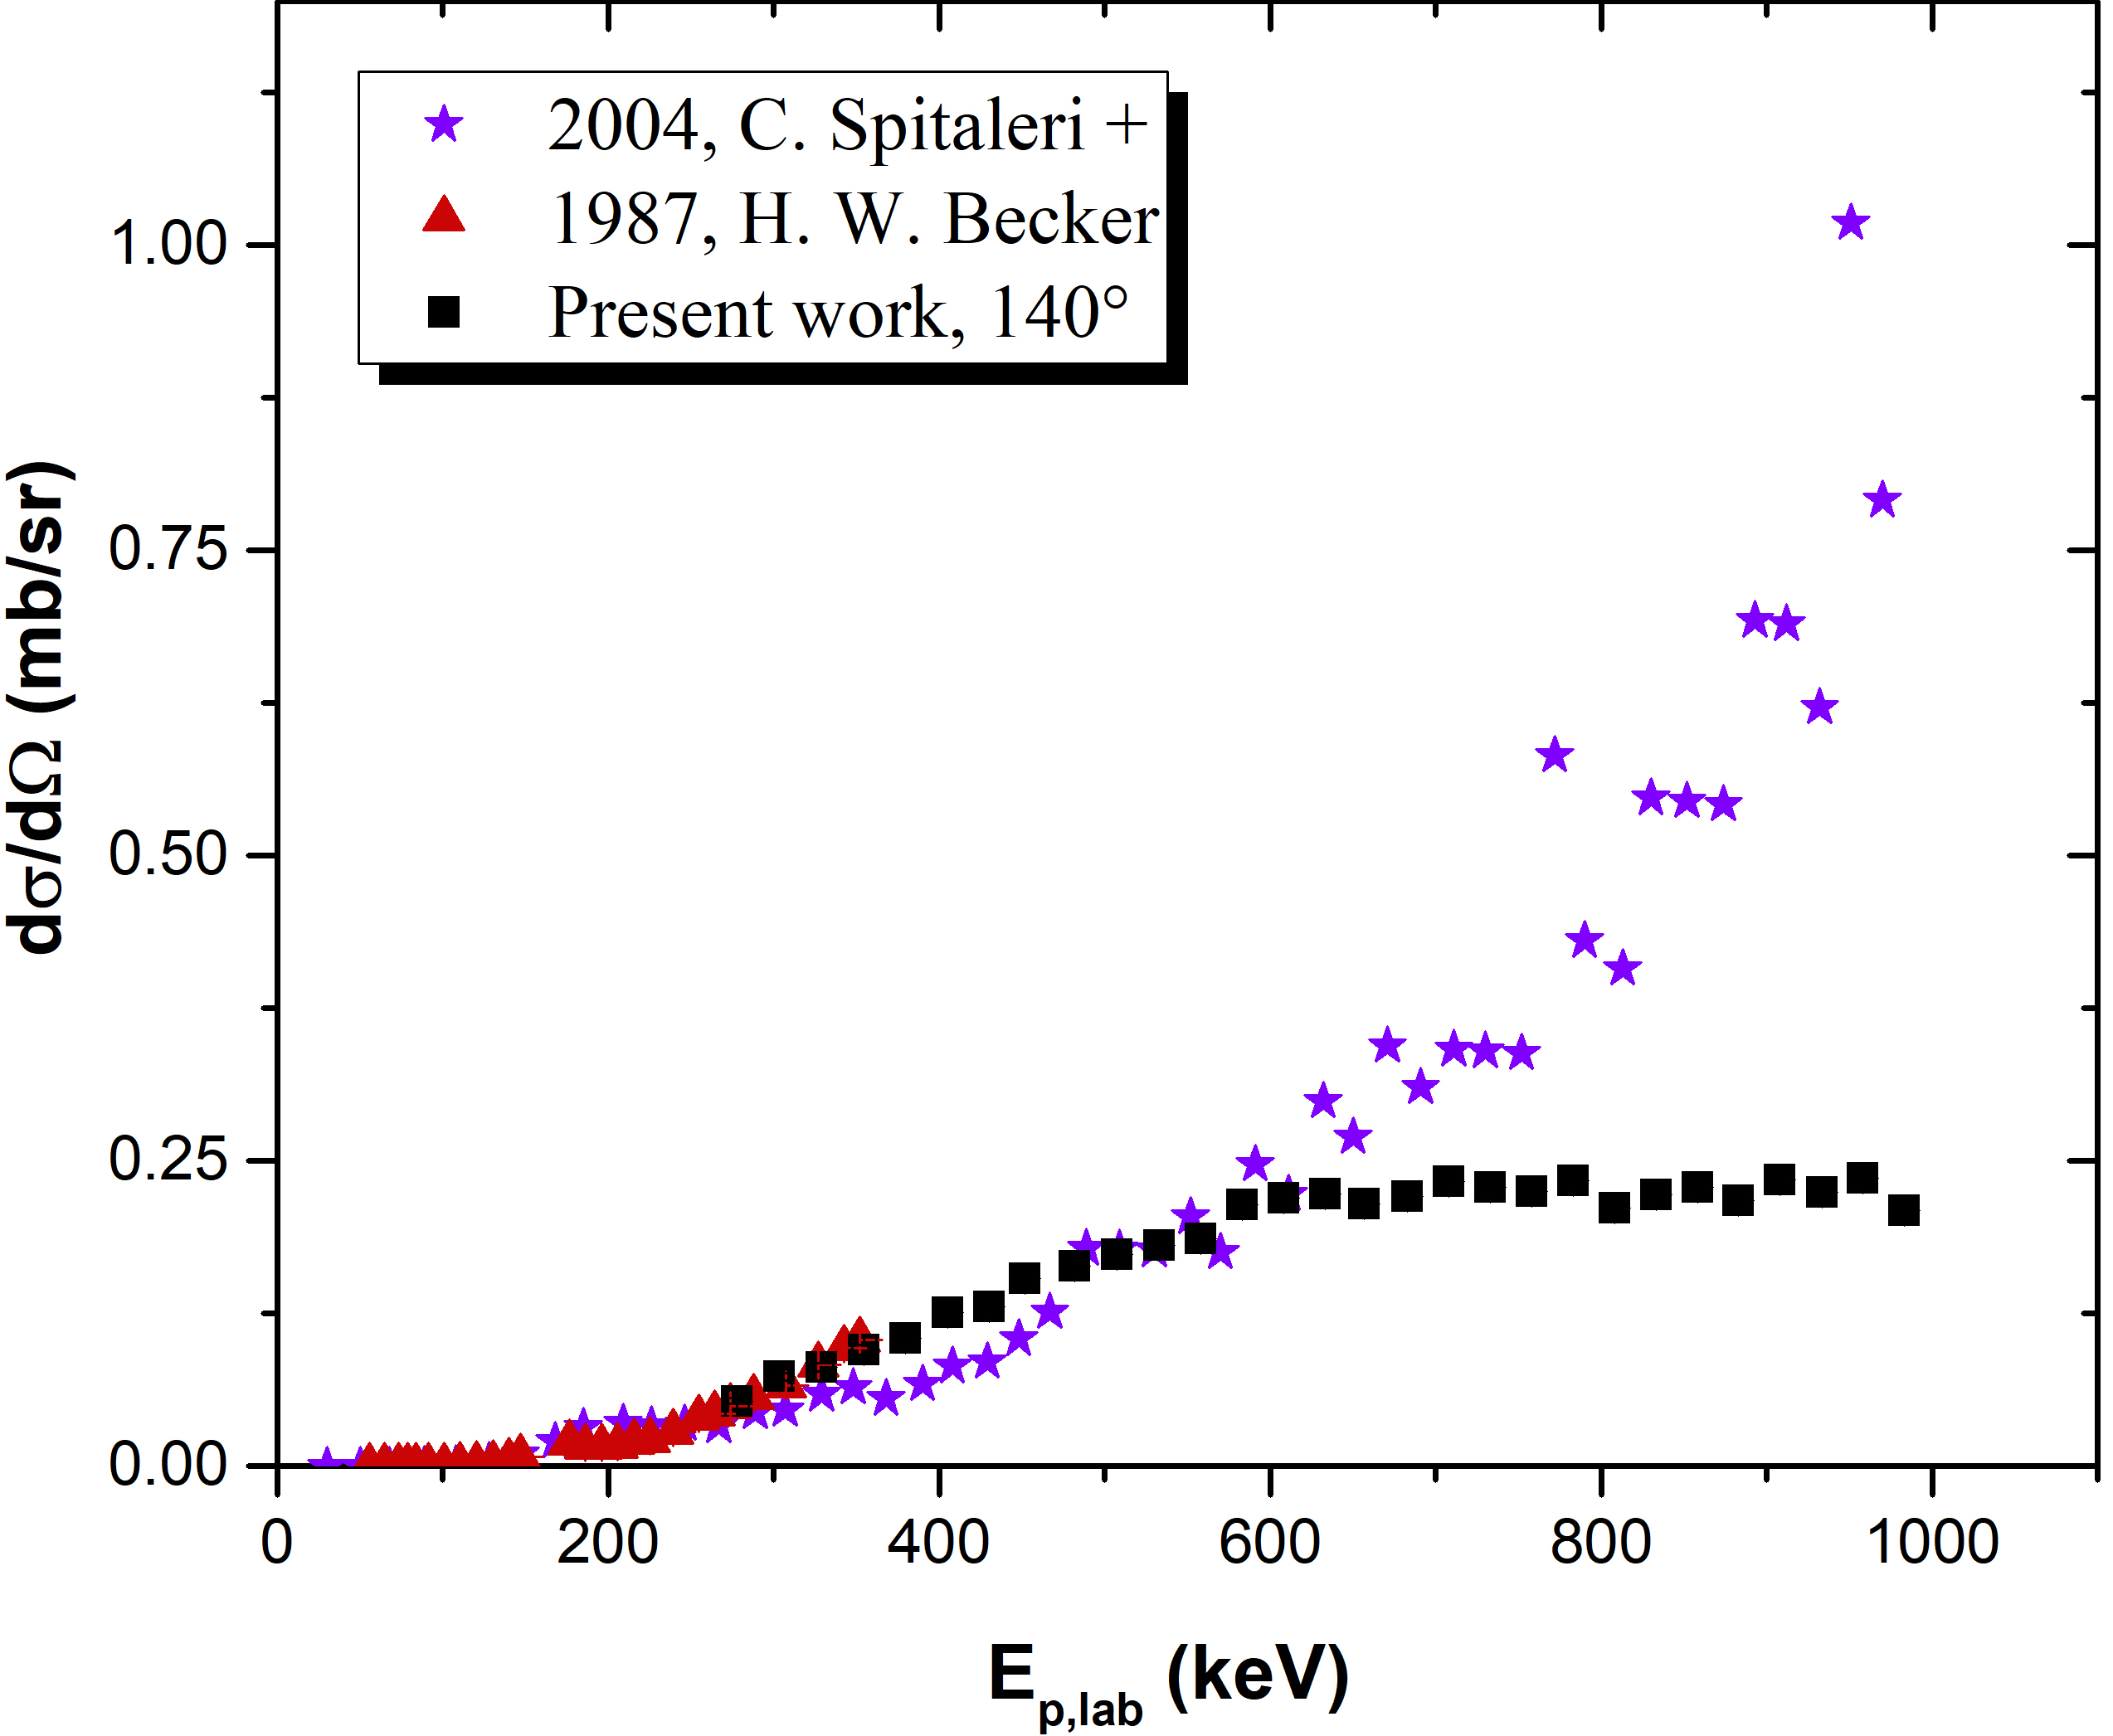
Results: Comparison with literature
¹¹B(p,a₀)⁸Be
Comparison with present work’s results at 140$°$ and data of total cross-sections from the literature by H. W. Becker and C. Spitaleri et al. (divided with $4π$)
150°
140°
Very good agreement with data by H. W. Becker et al. ( $\sim 7\%$ differences, on average) and Munch et al.
Important differences between present work and data by C. Spitaleri et al. (factor of $3$ for higher energies)
Disagreement with data by G. D. Symons et al., at 154$°$

Slide 13
Conclusions and Future perspectives
Differential cross-section measurements of the ⁶Li(p,³He)⁴He and ¹¹B(p,a₀)⁸Be reactions
Proton energy range: 140 keV – 1000 keV, θ = 130$°$ - 170$°$ with a 10$°$ step
Satisfactory agreement with some of the existing data for the ⁶Li(p,³He)⁴He reaction
Very good agreement for the ¹¹B(p,a₀)⁸Be reaction up to 350 keV, significant discrepancies up to 1000 keV
Extension of differential cross-section measurements for the ¹¹B(p,a₀)⁸Be reaction, below 350 keV
Differential cross-section measurements for the ¹³C(p,p₀)¹³C and ¹⁹F(p,p₀)¹⁹F reaction, in the medium energy range
Benchmarking experiment for the under-study reactions

Slide 14
Thank you for your attention!

Slide 15
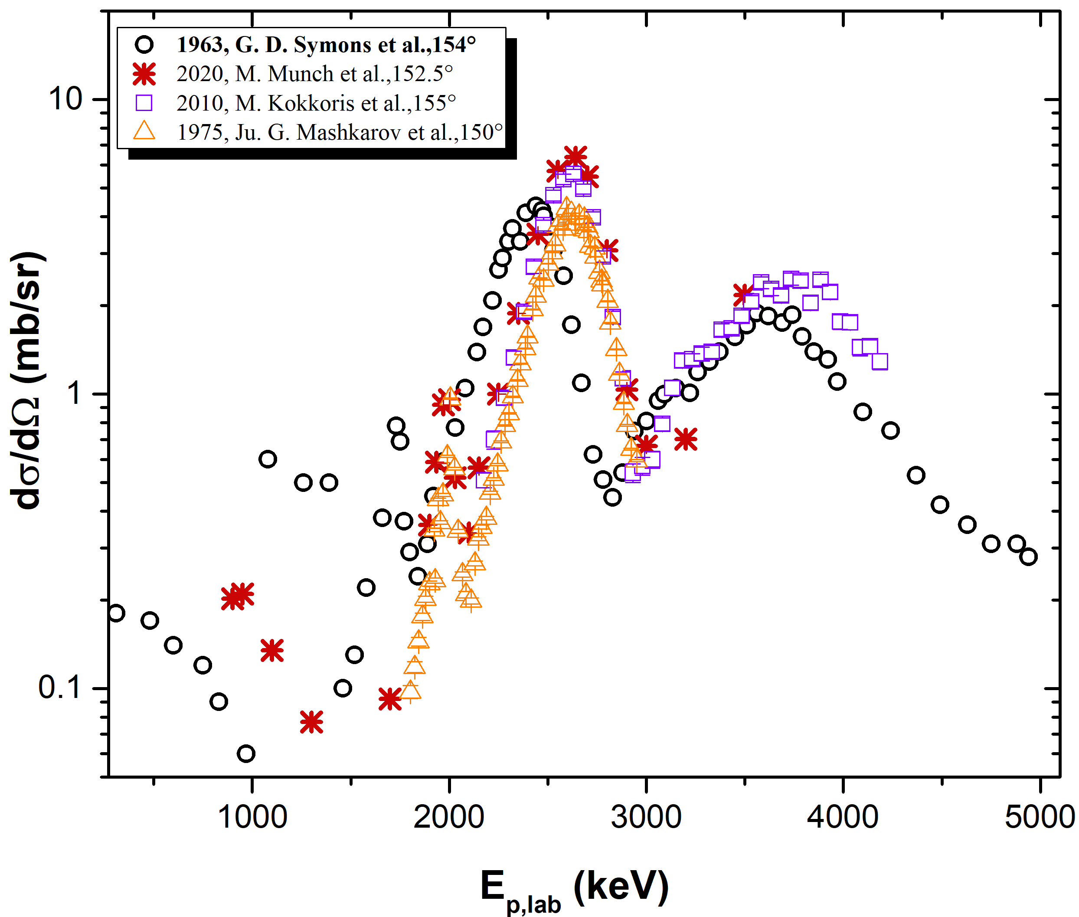




Back-up slides
$\sim$ 2.64 MeV
Energy shift by G. D. Symons et al. compared to data by M. Munch et al., M. Kokkoris et al. and Ju. G. Mashkarov et al. , at similar angles
$\sim$2.44 MeV
$\sim$2 MeV
$\sim$1.73 MeV

Slide 16
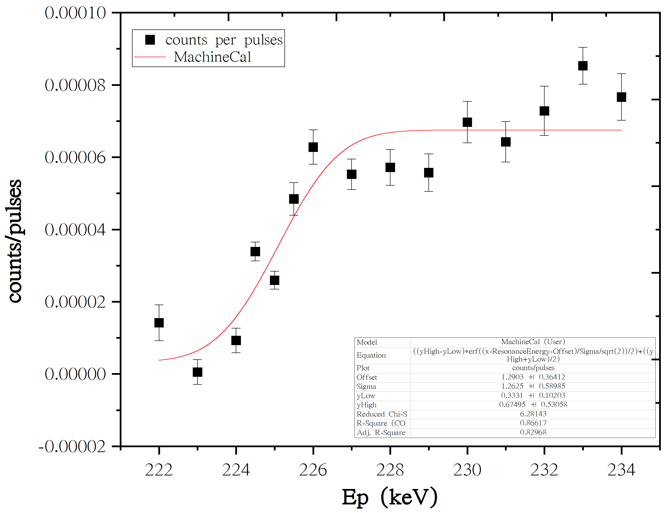
Back-up slides
Machine Calibration for the 450 kV Accelerator
Use of the ²⁴Mg(p,γ)²⁵Al resonance at E_{p}=223.8 keV , E_{γ}=451.7 keV
Energy offset = 1.29 keV
Ripple = 0.852

Slide 17
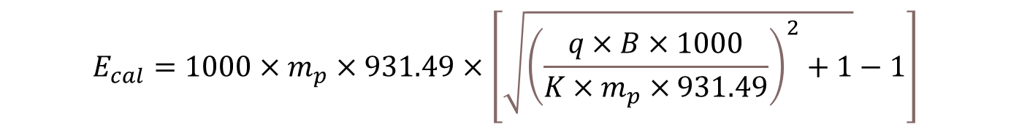
Back-up slides
Machine Calibration for the 4 MV Dynamitron Accelerator
Use of a Nuclear Magnetic Resonance (NMR) system
Magnetic constant of the analyzer magnet: K = 5.2241 mT/MeV
Ripple = 0.4 keV
Confirmation with the use of the ²⁷Al(p,γ)²⁸Si resonance at E_{p}=991.8 keV
$$E_{cal}=1000×m_{p}×931.49×\left[\sqrt{{\left(\frac{q×B×1000}{K×m_{p}×931.49}\right)}^{2}+1}−1\right]$$
where,
m_{p} = 1.007825032 amu
q=1

