Slide 1


National Center for Scientific Research “Demokritos”
Institute of Nuclear and Particle Physics
Overview of
X- ray Fluorescence Laboratory (XRF-Lab)
Institute of Nuclear and Particle Physics
activities
http://www.inp.demokritos.gr/xrf/

Slide 2
XRF group: 2024
Lab Director
Dr Andreas Karydas
Research team
Dr Maria Kaparou (up to 5/2024)
Dr Artemios Oikonomou (up to 5/24)
PhD candidates
Ermioni Vassiou, UNIWA
Kalliopi Tsampa, NTUA
Collaborators (PhD Candidates)
Stefanos Papagiannis, UoI, ENRACT Lab
Nikoletta-Kanella Kladouri, Conservator, UoP
Giasemi Frantzi, Conservator, UNIWA
Nefeli Karra, Archaeologist, NKUA

Slide 3
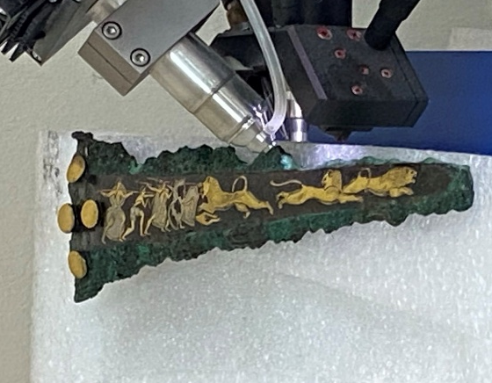
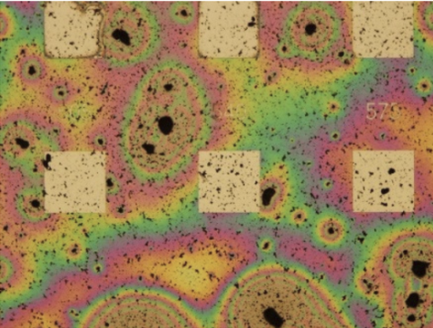
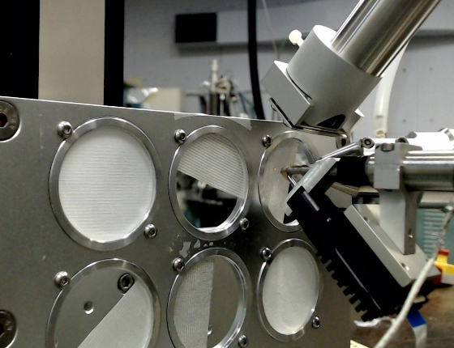
Research activities
Fundamental research in X-ray spectrometry, targeting the improvement of XRF analytical methodologies
@ XRF Laboratory
@ Elettra SR
X-ray Fluorescence Applications
@ XRF Laboratory
@ Elettra SR
@ Tandem
Development of custom XRF spectrometers for tailored applications
Knowledge & Technology
Transfer
Over 15 publications in CH peer review journals since 2019
Advanced Materials characterization
Environmental
monitoring
Cultural Heritage

Slide 4


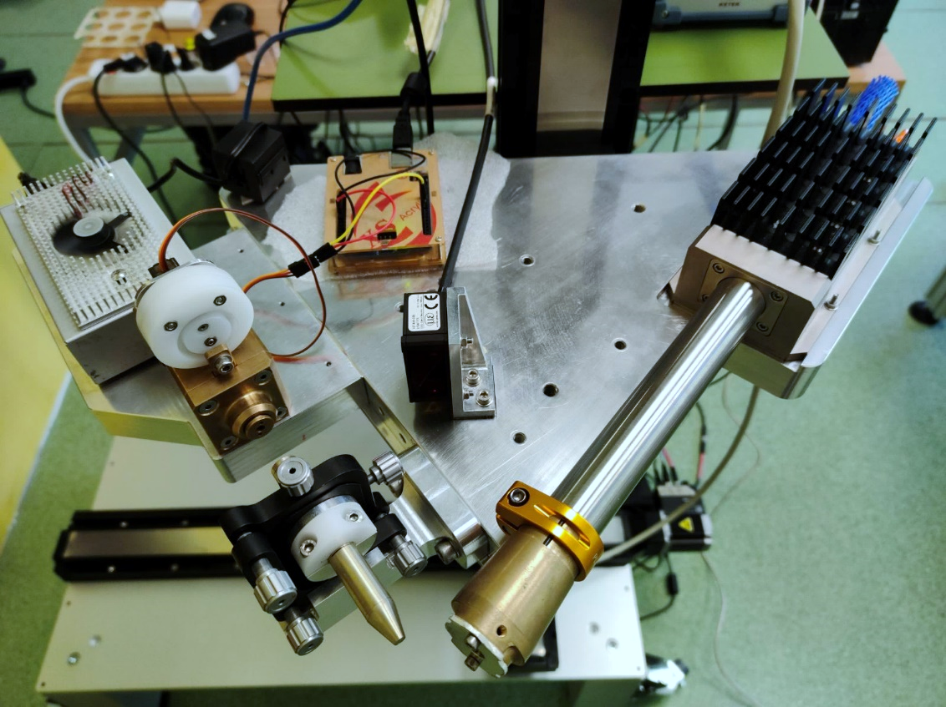
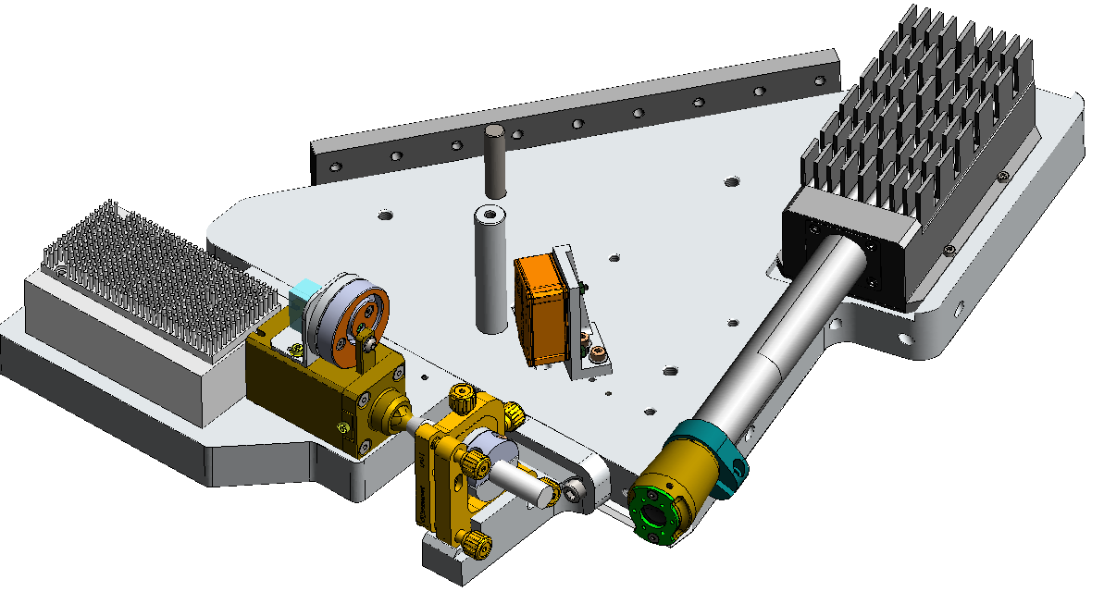


Portable MA-XRF spectrometer
Infrastructure
Polycapillary Lens configuration
Automatic shutter control
Laser triangulation sensor
Low power X-ray tube
SDD Detector 150 mm²
Polycapillary X-ray Lens
FWHM @10 keV ~ 87μm
Polycapillary lens
Fixed position of the SDD
Adjustable position of the X-ray tube
Identical focus position for pinhole and lens

Slide 5

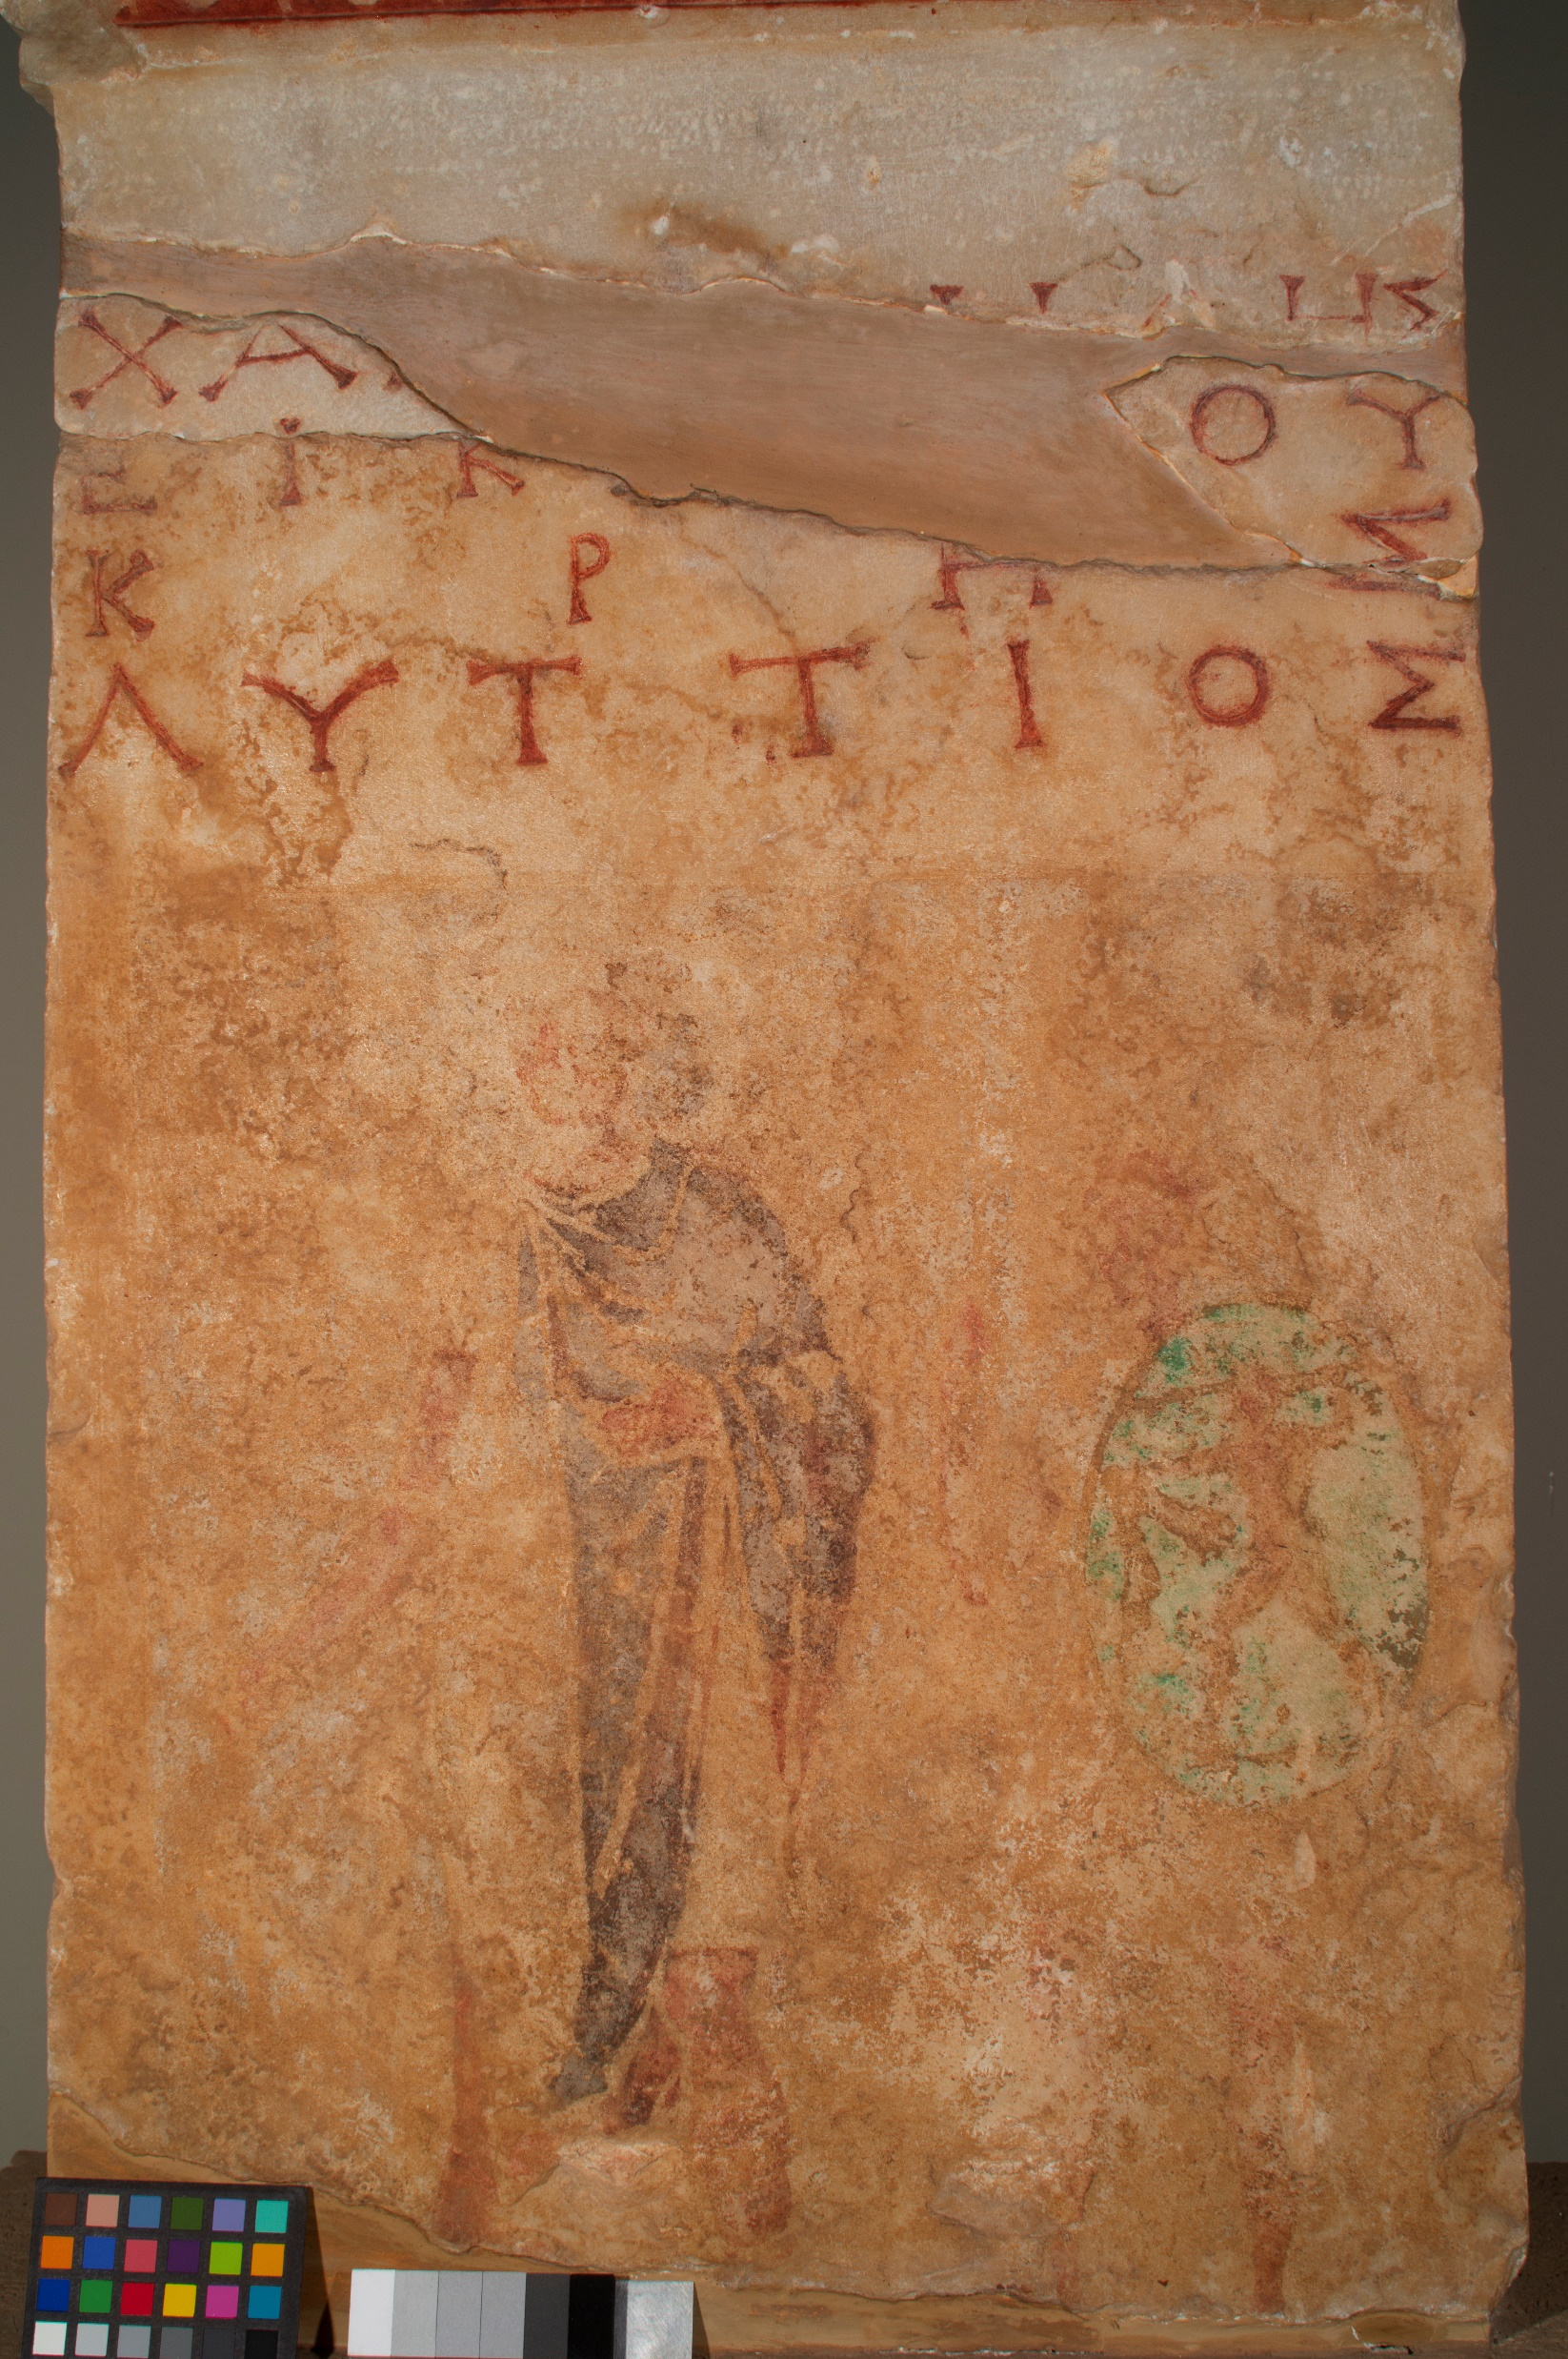
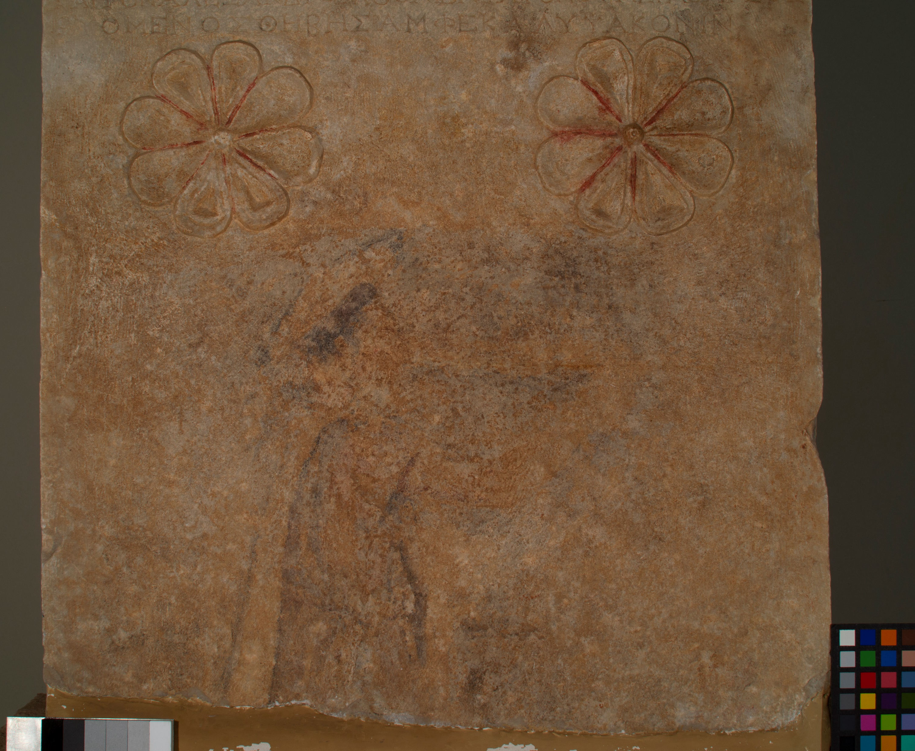
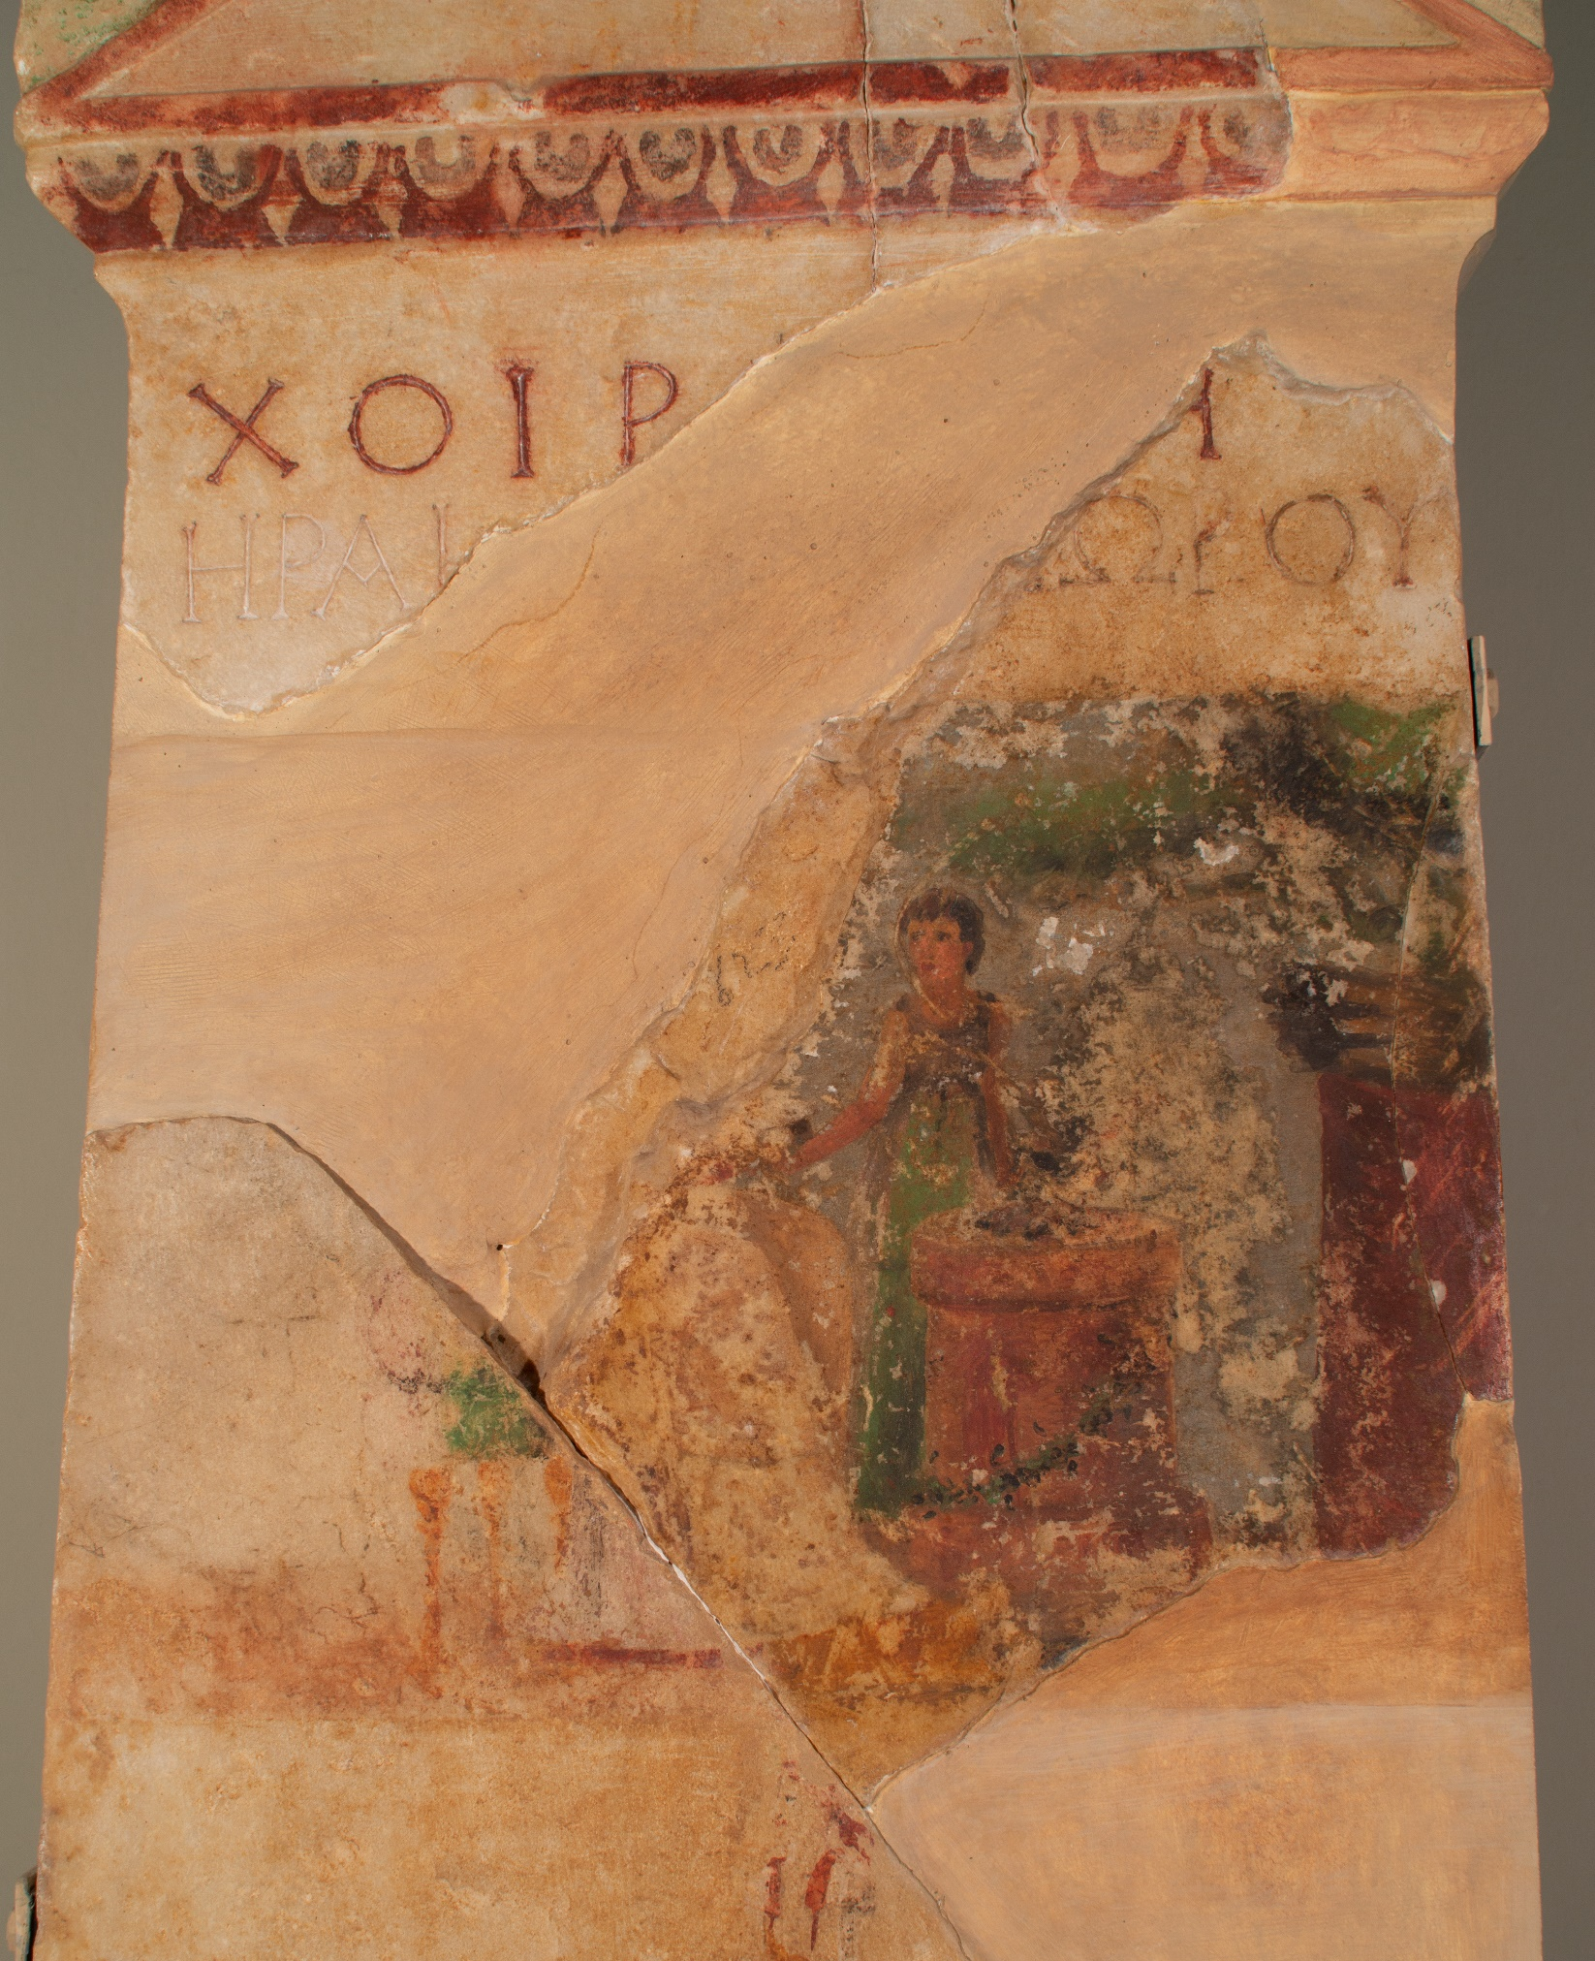


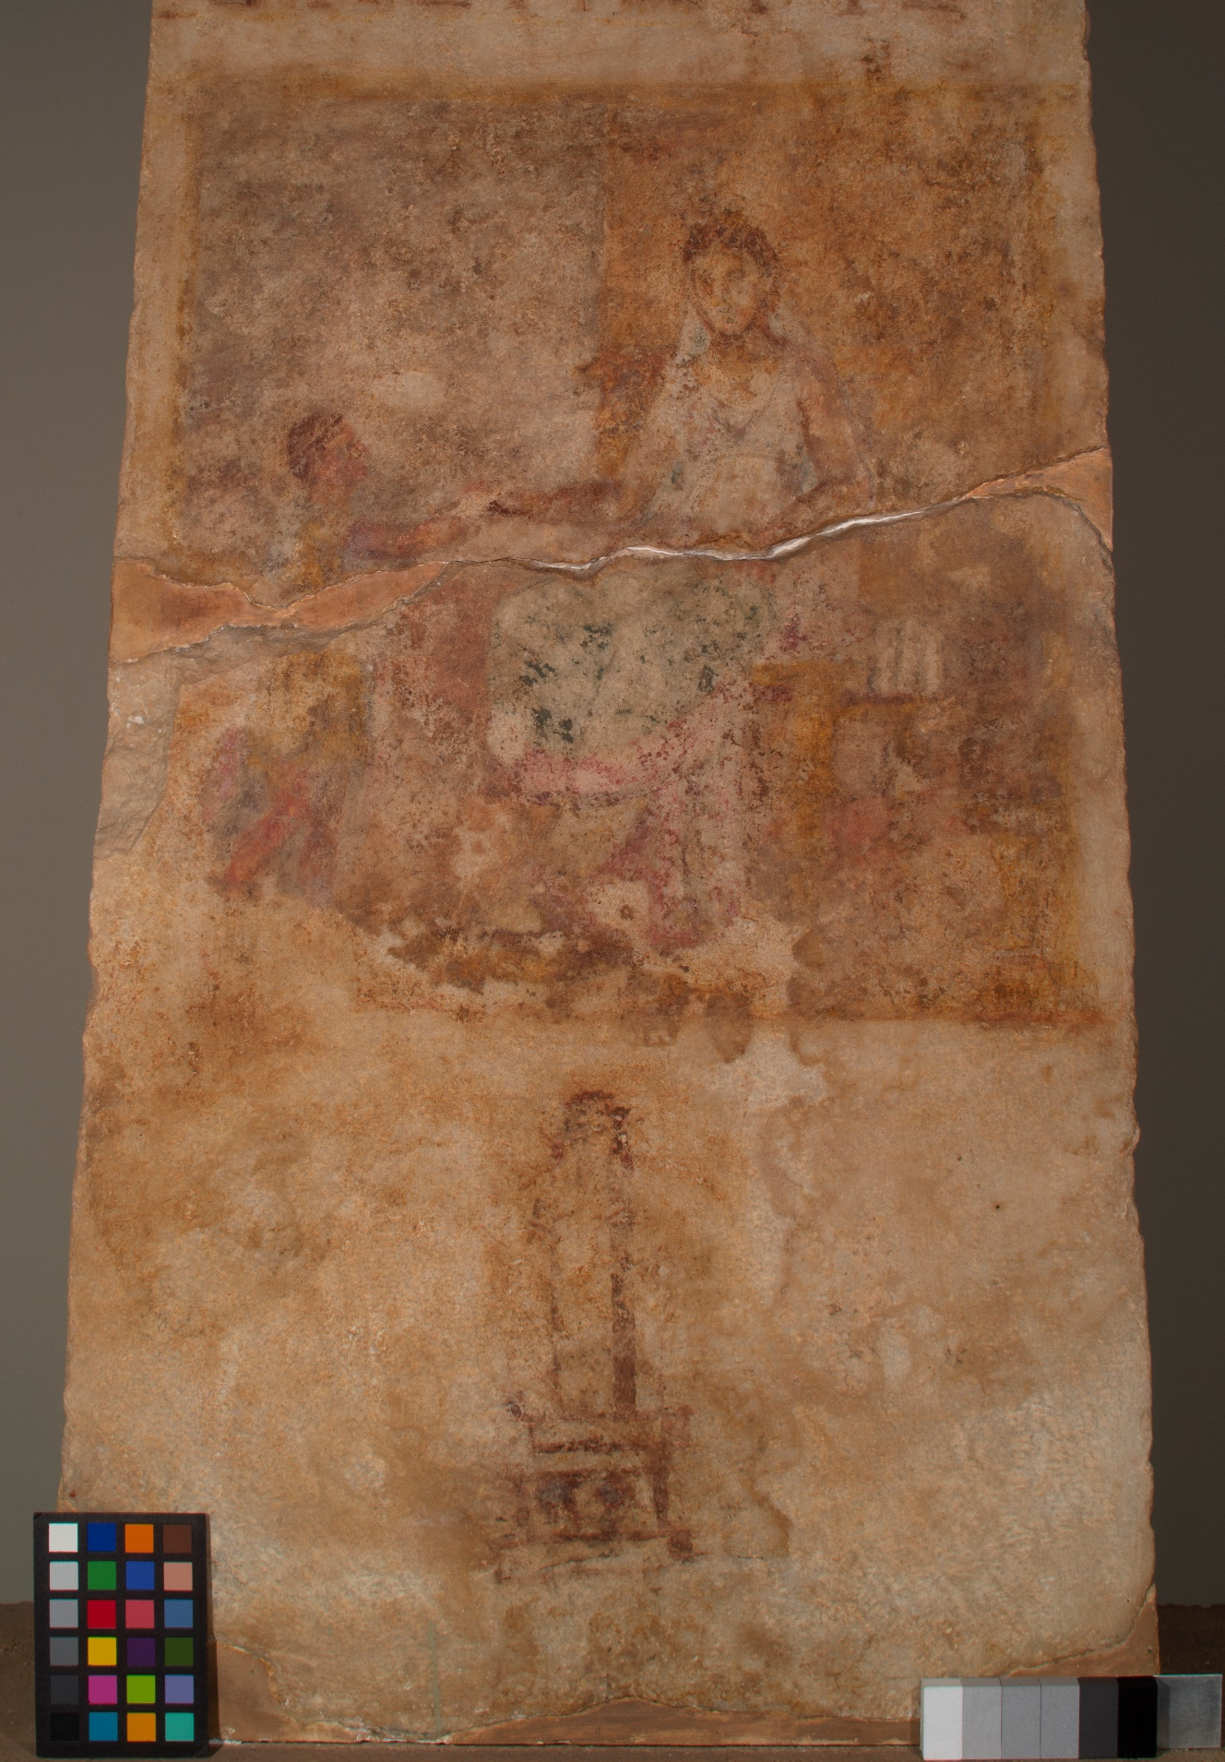
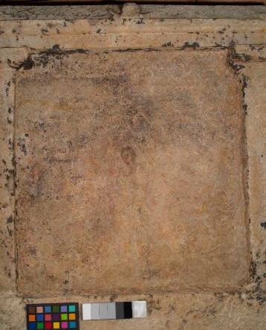
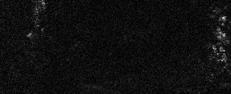

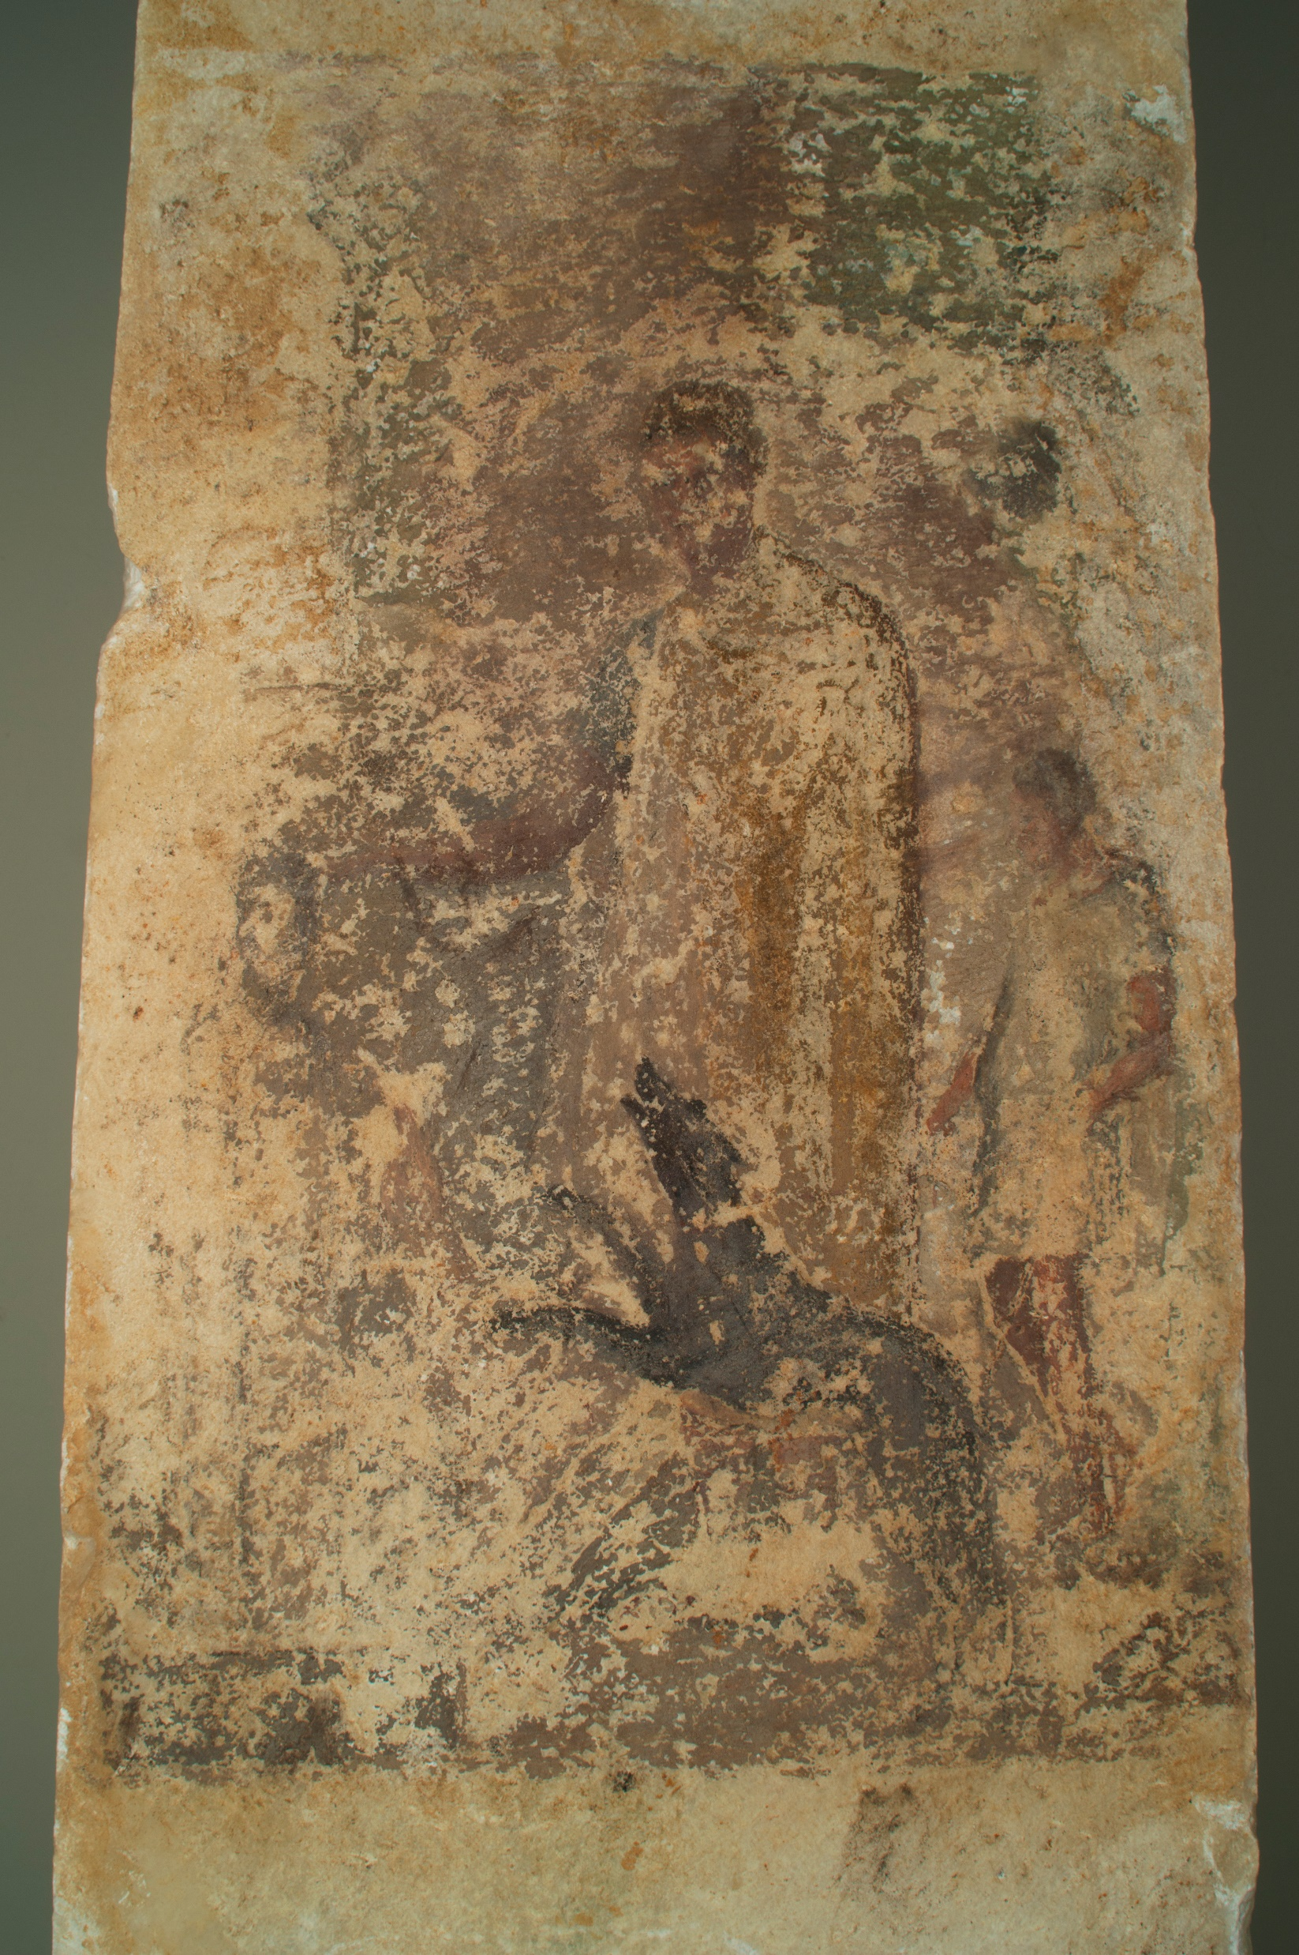
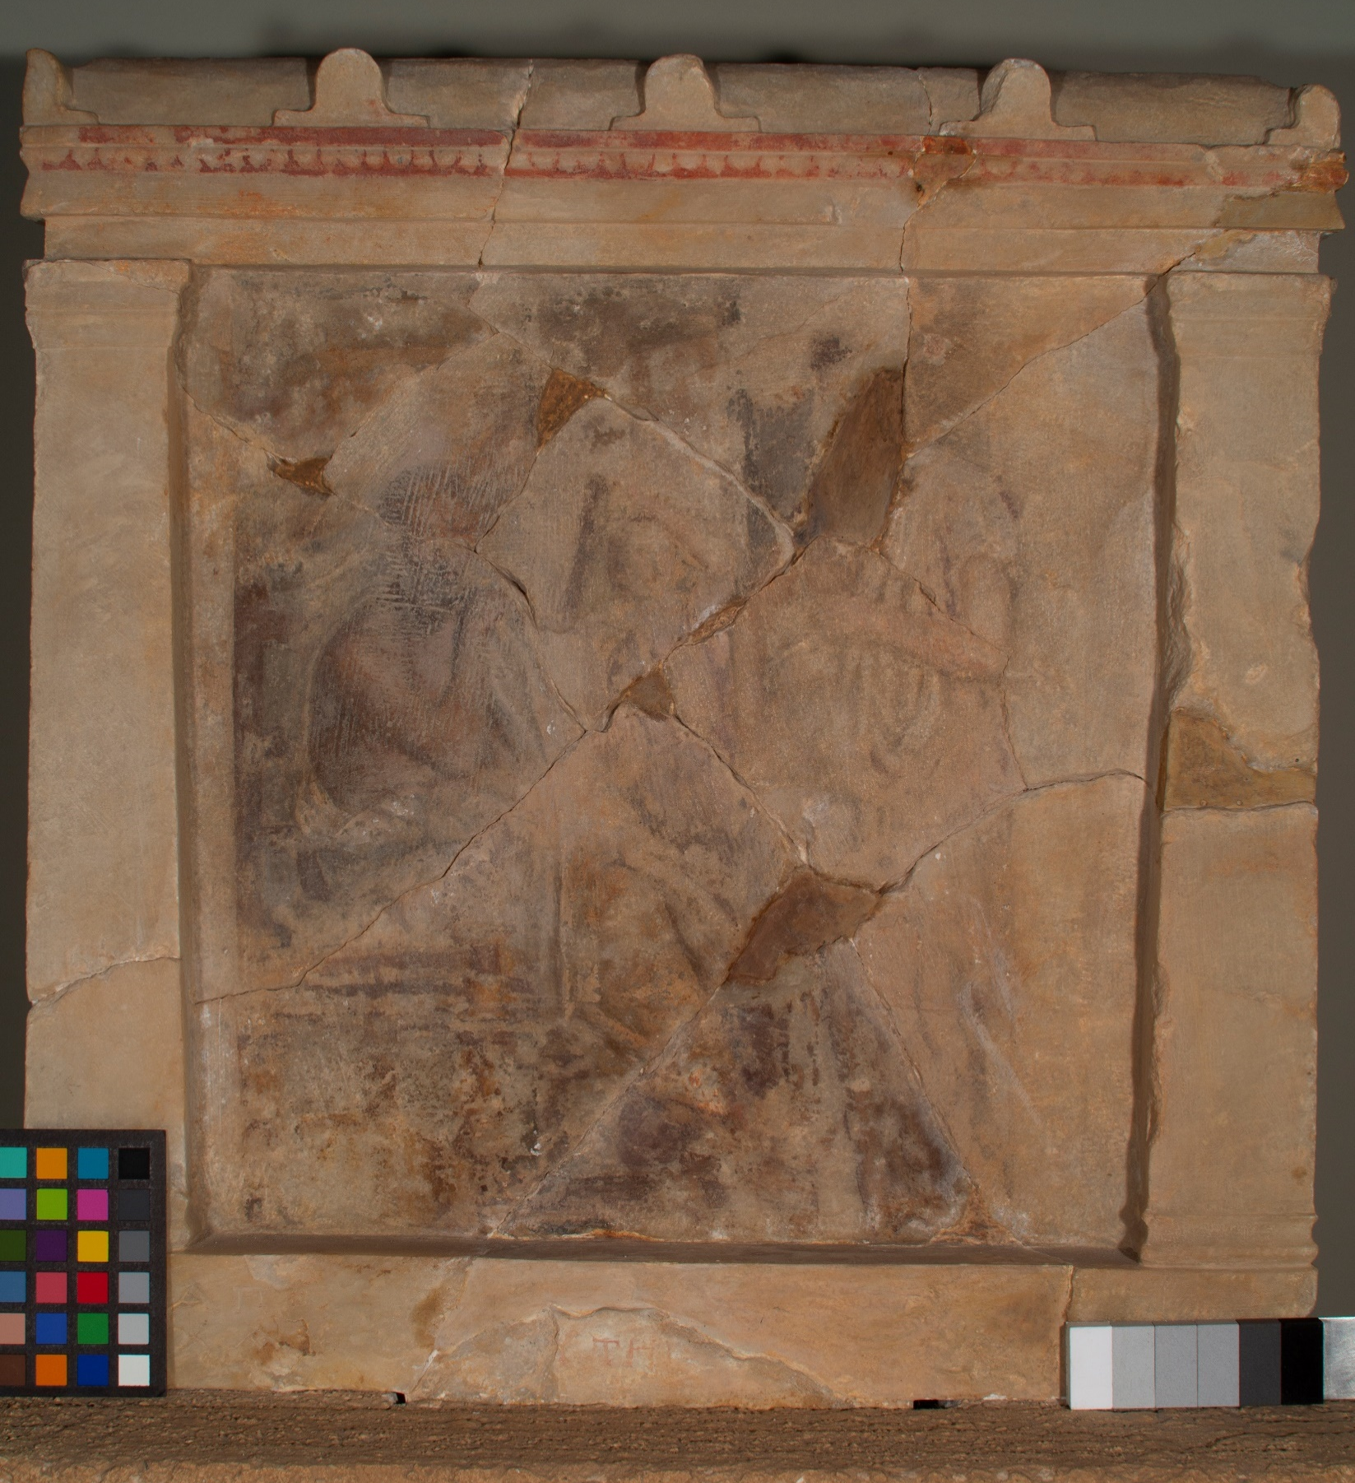
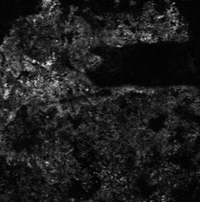
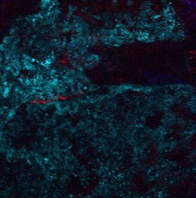

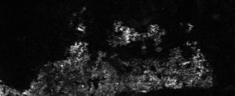
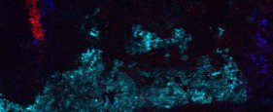
Portable MA-XRF spectrometer
Understanding the iconography and painting techniques
Research Activities
Funeral stelai of Demetrias (n=23)
Fe
Cu
Pb
Fe Cu Pb
Archaeological Museum of Volos
Prof. Maria Stamatopoulou - Classical Art and Archaeology, Lincoln College, University of Oxford, UK
Αss. Prof. Maria Kokkori - Center for Scientific Studies in the Arts, Northwestern University, Chicago, USA

Slide 6
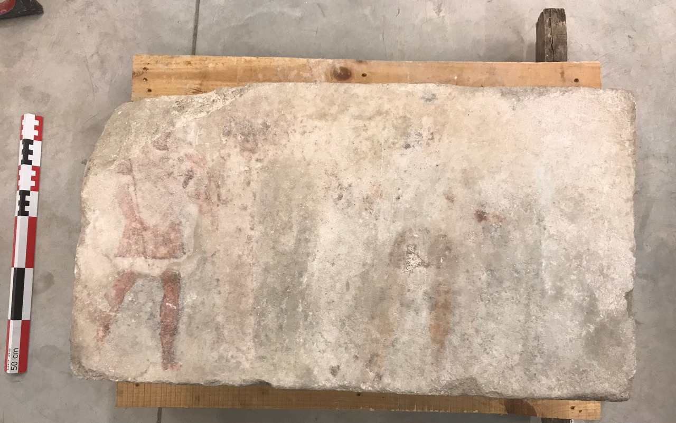
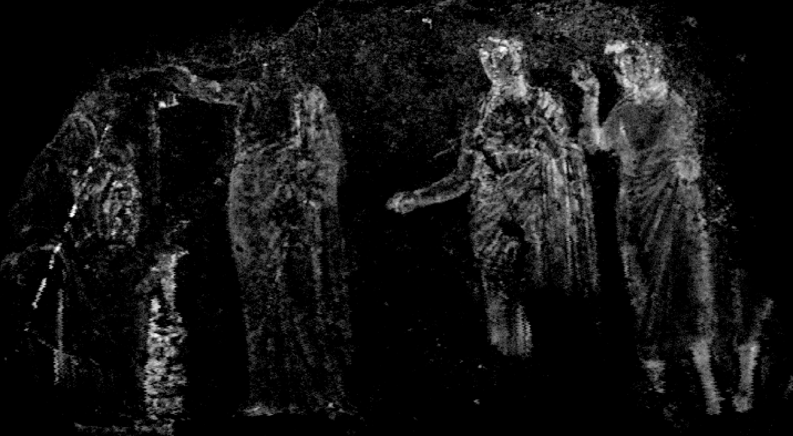
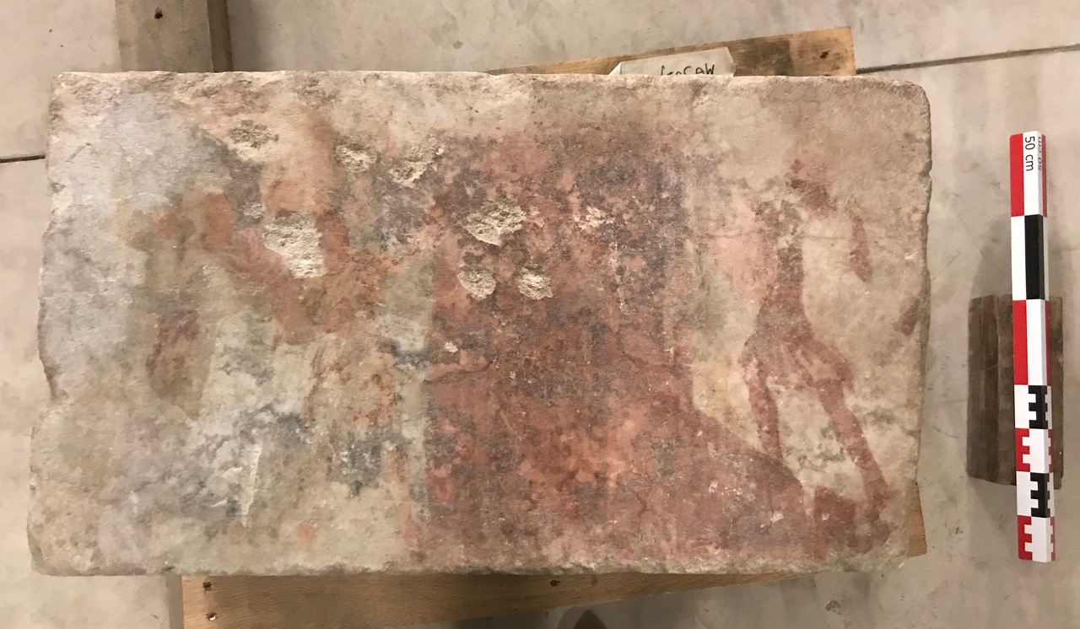
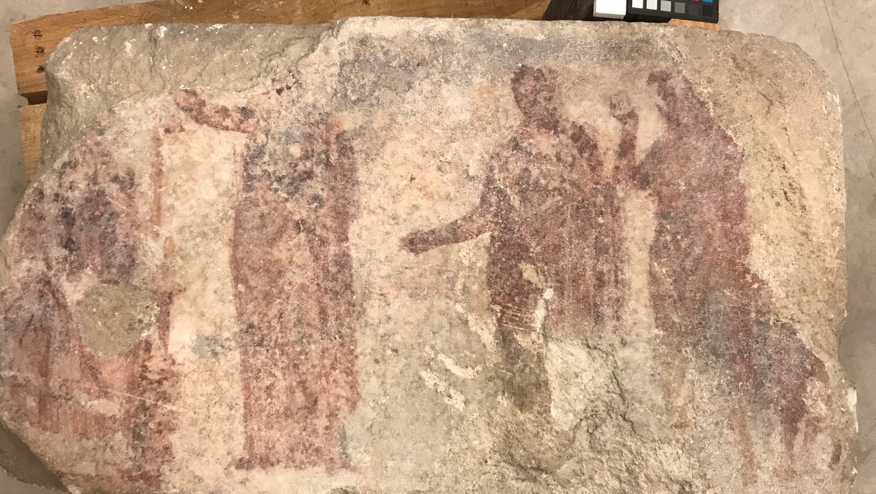
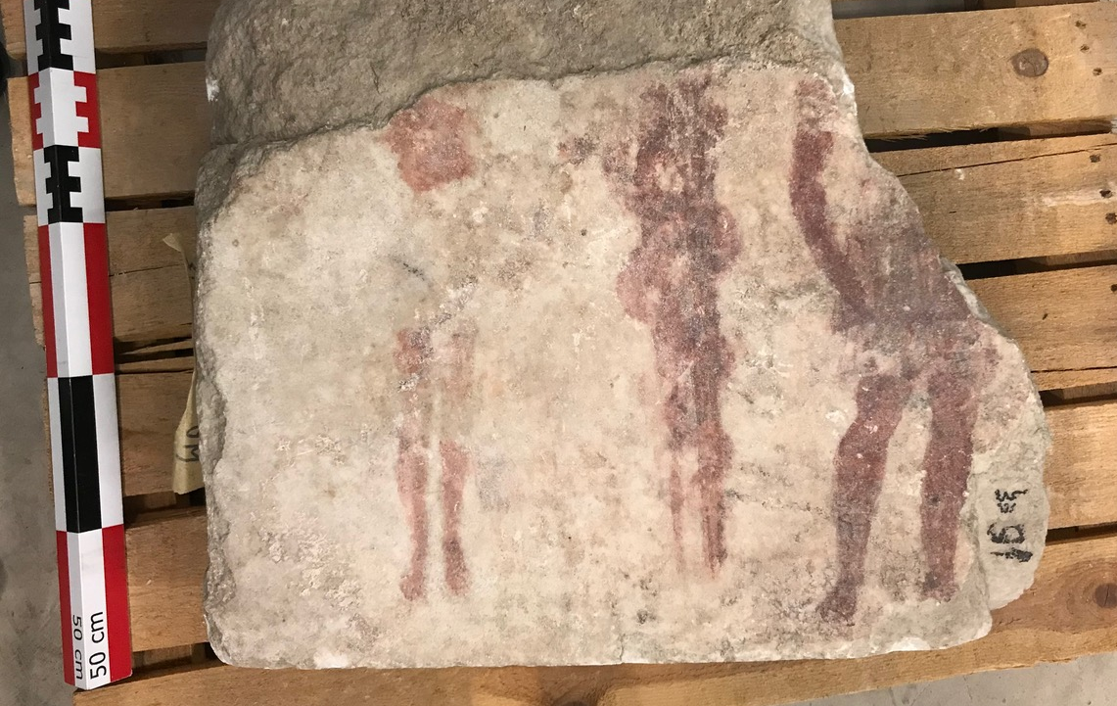
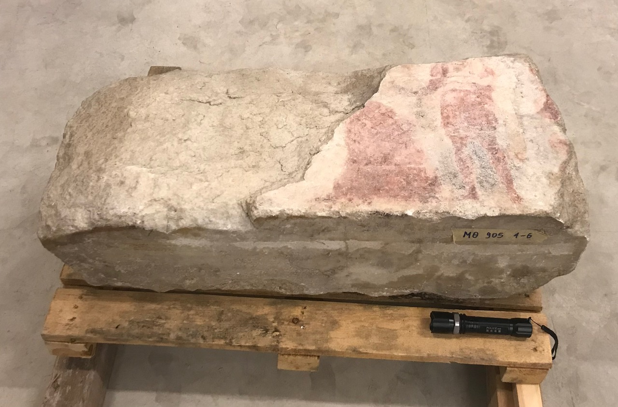
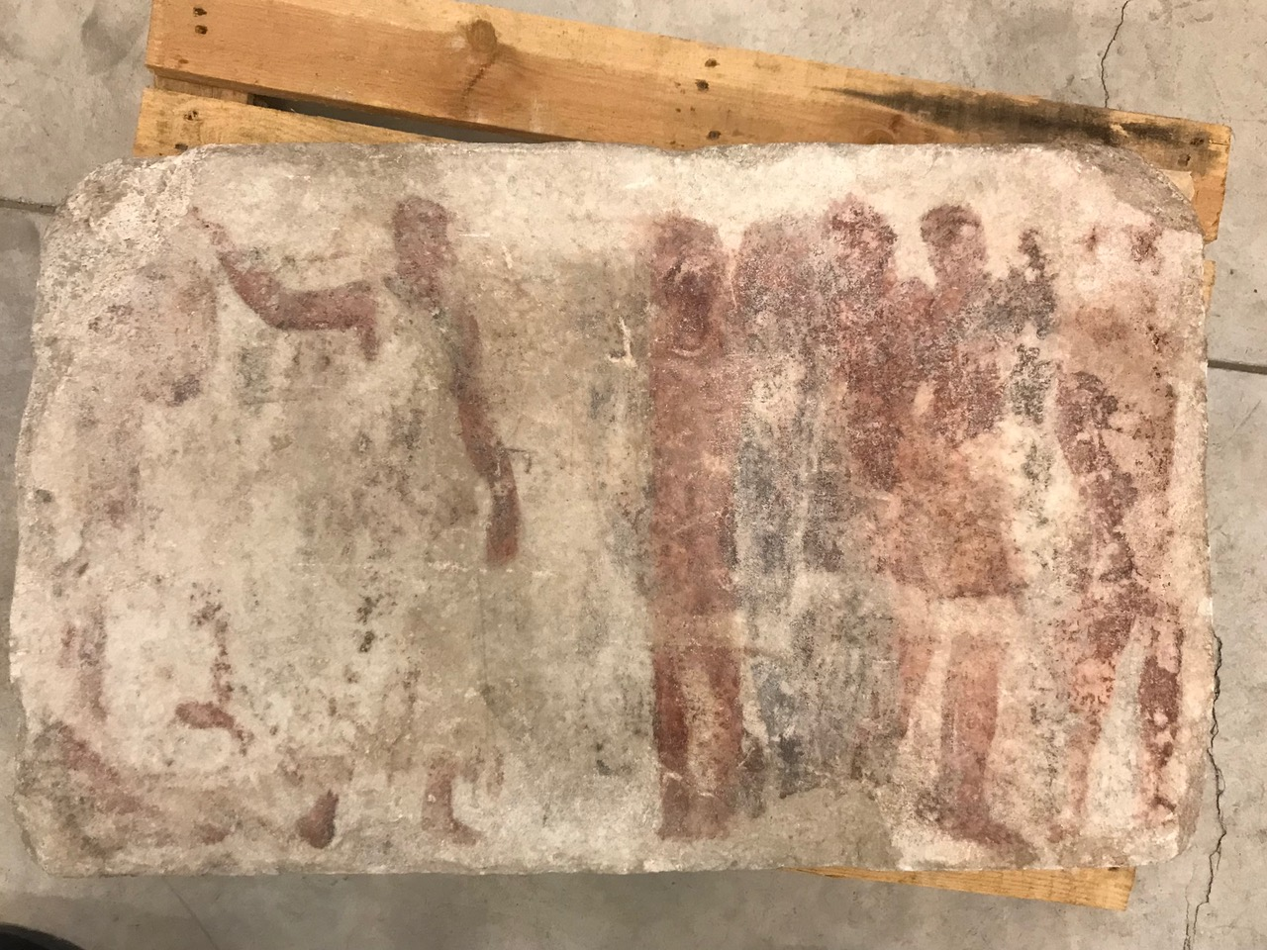
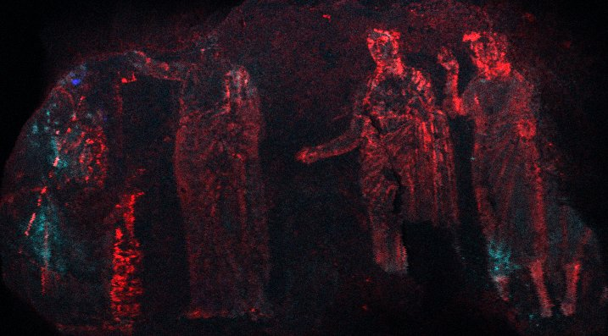
Portable MA-XRF spectrometer
Understanding the iconography and painting techniques
Research Activities
Hellenistic Painted Slabs (n=6)
Fe
log
scale
Fe
Archaeological Museum of Thessaloniki
Cu
Αss. Prof. Maria Kokkori - Center for Scientific Studies in the Arts, Northwestern University, Chicago, USA
Pb

Slide 7
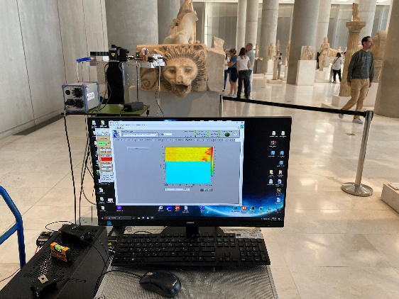
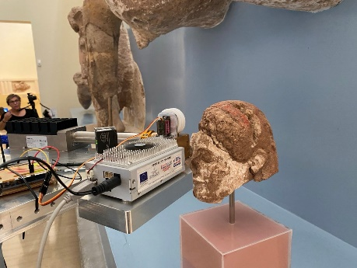
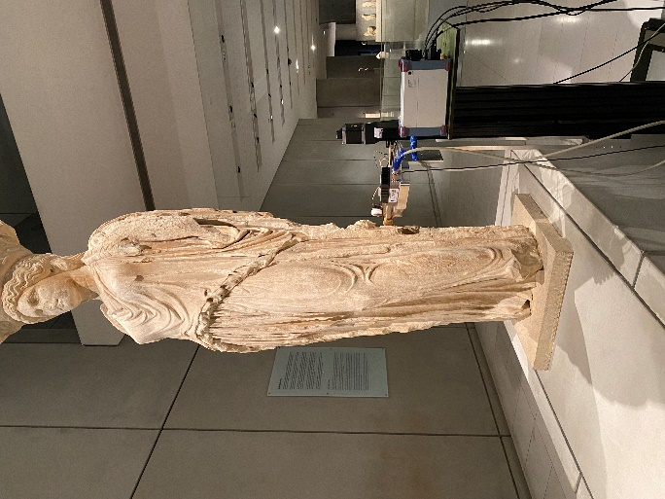
Portable MA-XRF spectrometer
Understanding the iconography and painting techniques
Research Activities
Archaic period sculptures
Archaeological Museum of Athens/ Delfoi / Akropolis
Giasemi Frantzi - PhD thesis, University of West Attica

Slide 8
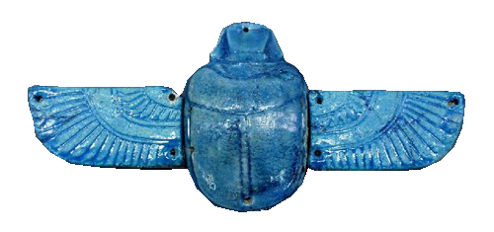
Tracing the trajectories of Egyptian blue production technology
Research Activities
Analysis of Egyptian blue samples from a range well documented archaeological sites.
Egyptian blue is an inorganic artificial material with a long history of production and use. The analysis of samples of different provenance that cover a wide timespan aims to shed light on the manufacturing process and hence deepen our understanding of the production across time and space.
XRF and XANES analysis of samples from the Mycenaean to the Roman period
Elettra Sincrotrone Trieste
Ariadne Kostomitsopoulou-Marketou (MF Norwegian School of Theology, Religion and Society)
Haricleia Brecoulaki, A.S. Rodler, Paolo Romano, Andreas Karydas

Slide 9

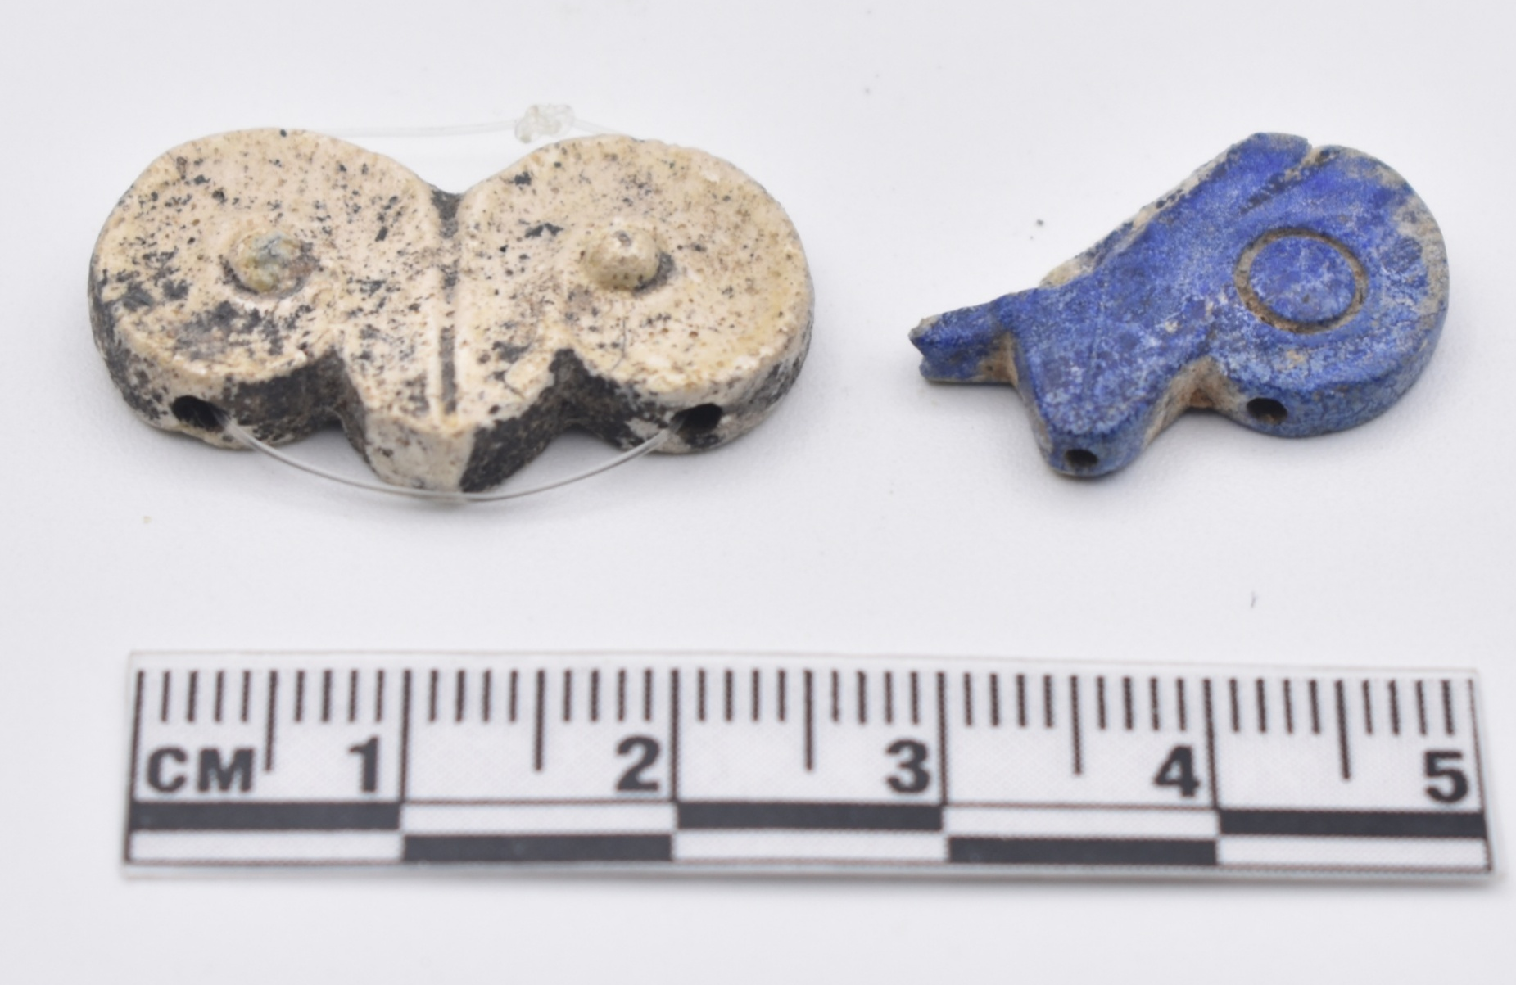
Mycenaean Vitreous Production: A novel interdisciplinary approach towards resolving critical taxonomy issues
Research Activities
AIM
To offer the academic community a complete Handbook compiled by the generation of a systematic set of visual corrosion-related characteristics towards successful taxonomy of vitreous materials.
To investigate (100) Mycenaean vitreous objects by performing holistic examination by means of non-invasive, well- established and state-of-the-art scientific methods.
To analyze, document and identify the specific compositional changes that occur due to degradation mechanisms at different spatial dimensions, within the surface, near-surface layers, but also in-depth
to propose firm associations of the analytical data with the observed visual characteristics of the materials.
The research project was supported by the Hellenic Foundation for Research and Innovation (H.F.R.I.) under the “3rd Call for H.F.R.I. Research Projects to support Post-Doctoral Researchers” (Project Number: 7195).
National Archaeological Museum of Athens
NCSR “Demokritos”
Artemis Oikonomou – INPP, NCSR “D”
Maria Kaparou – INPP, NCSR “D”

Slide 10
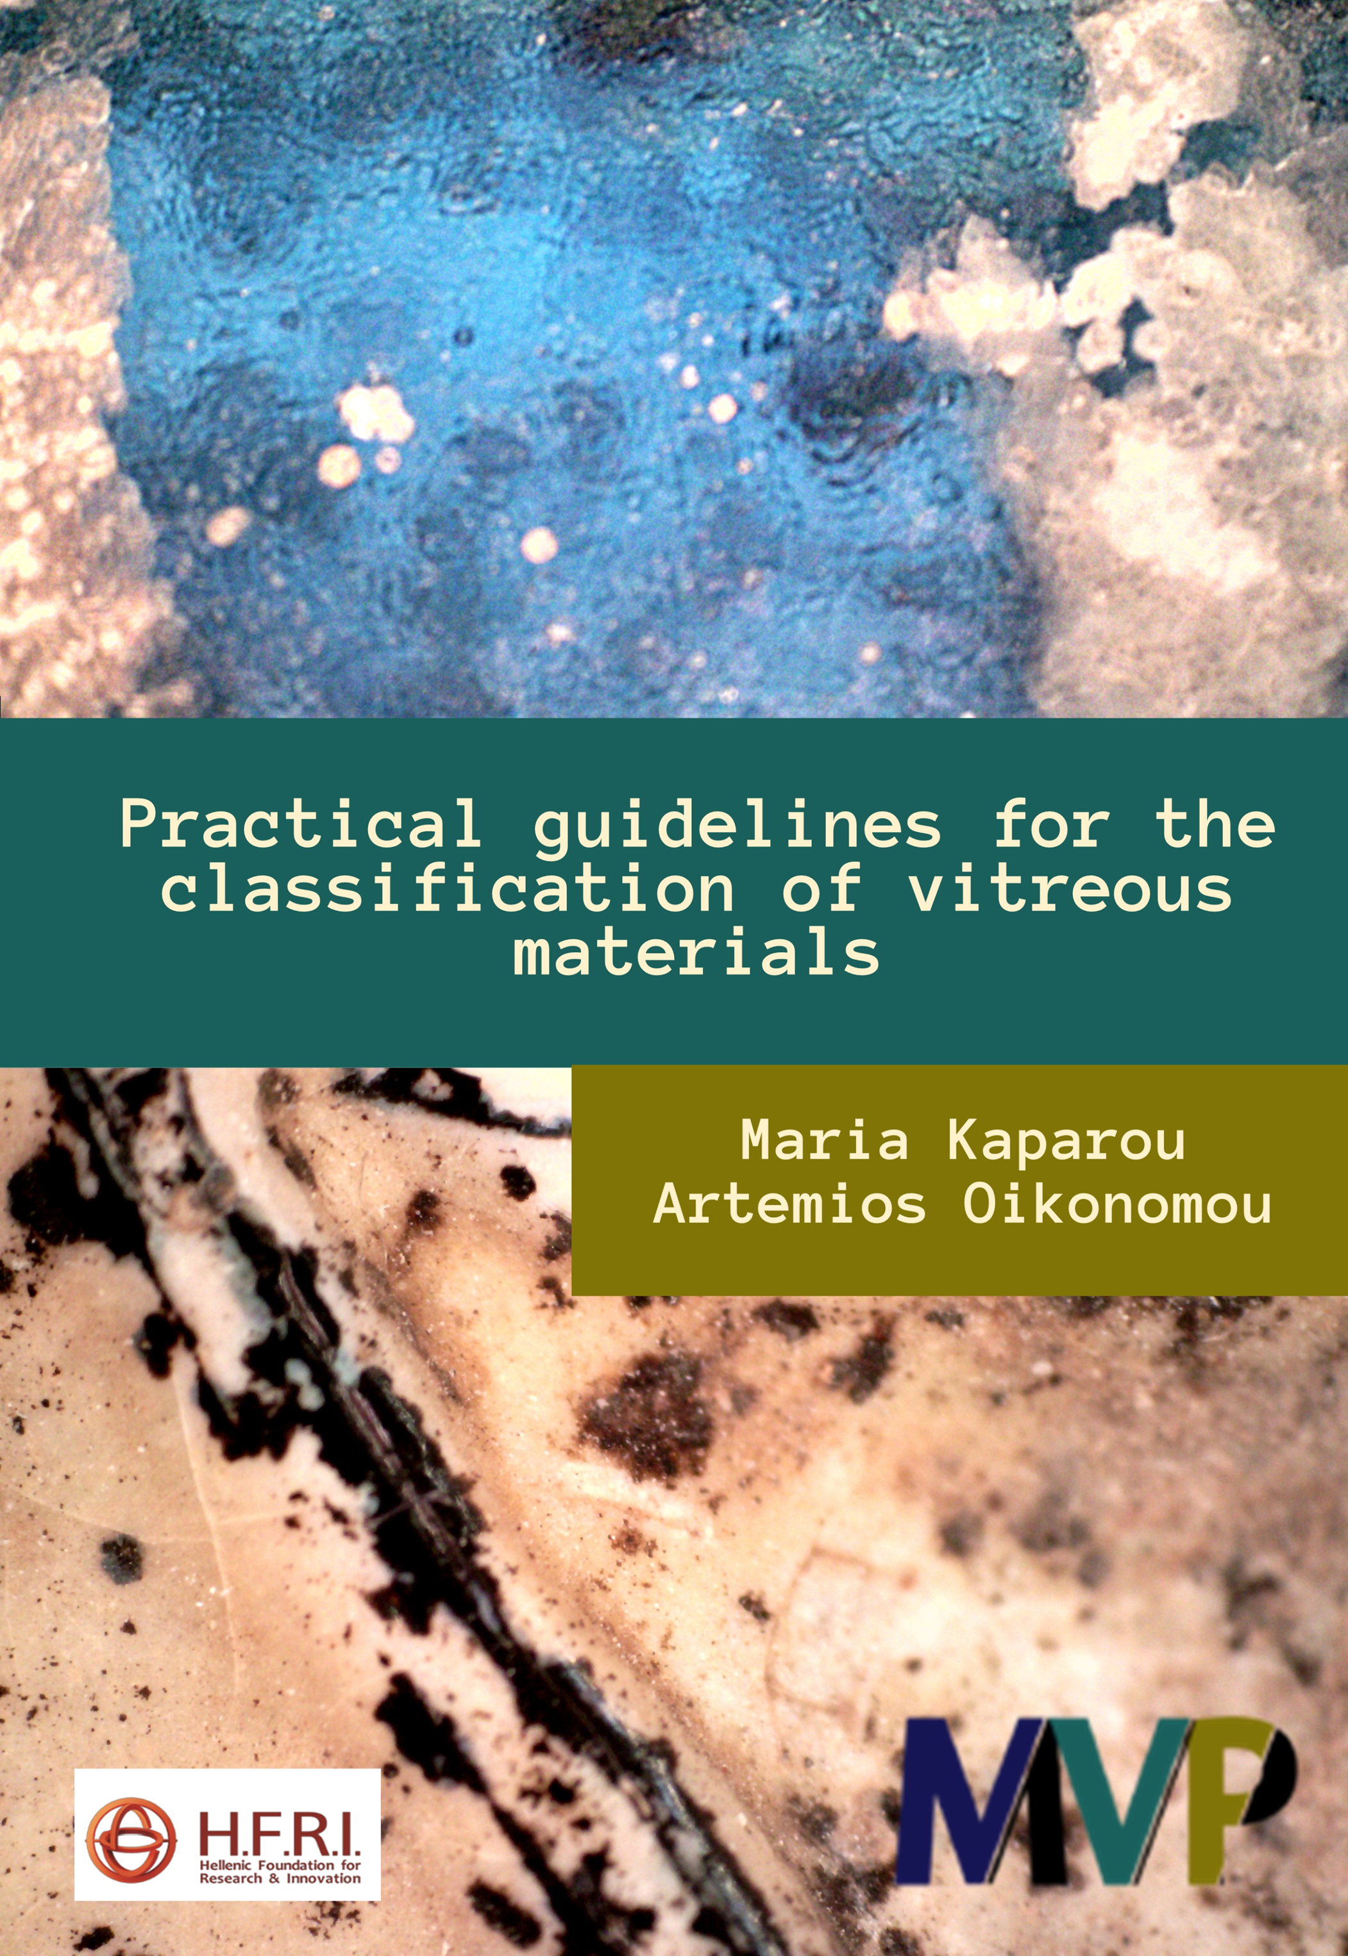
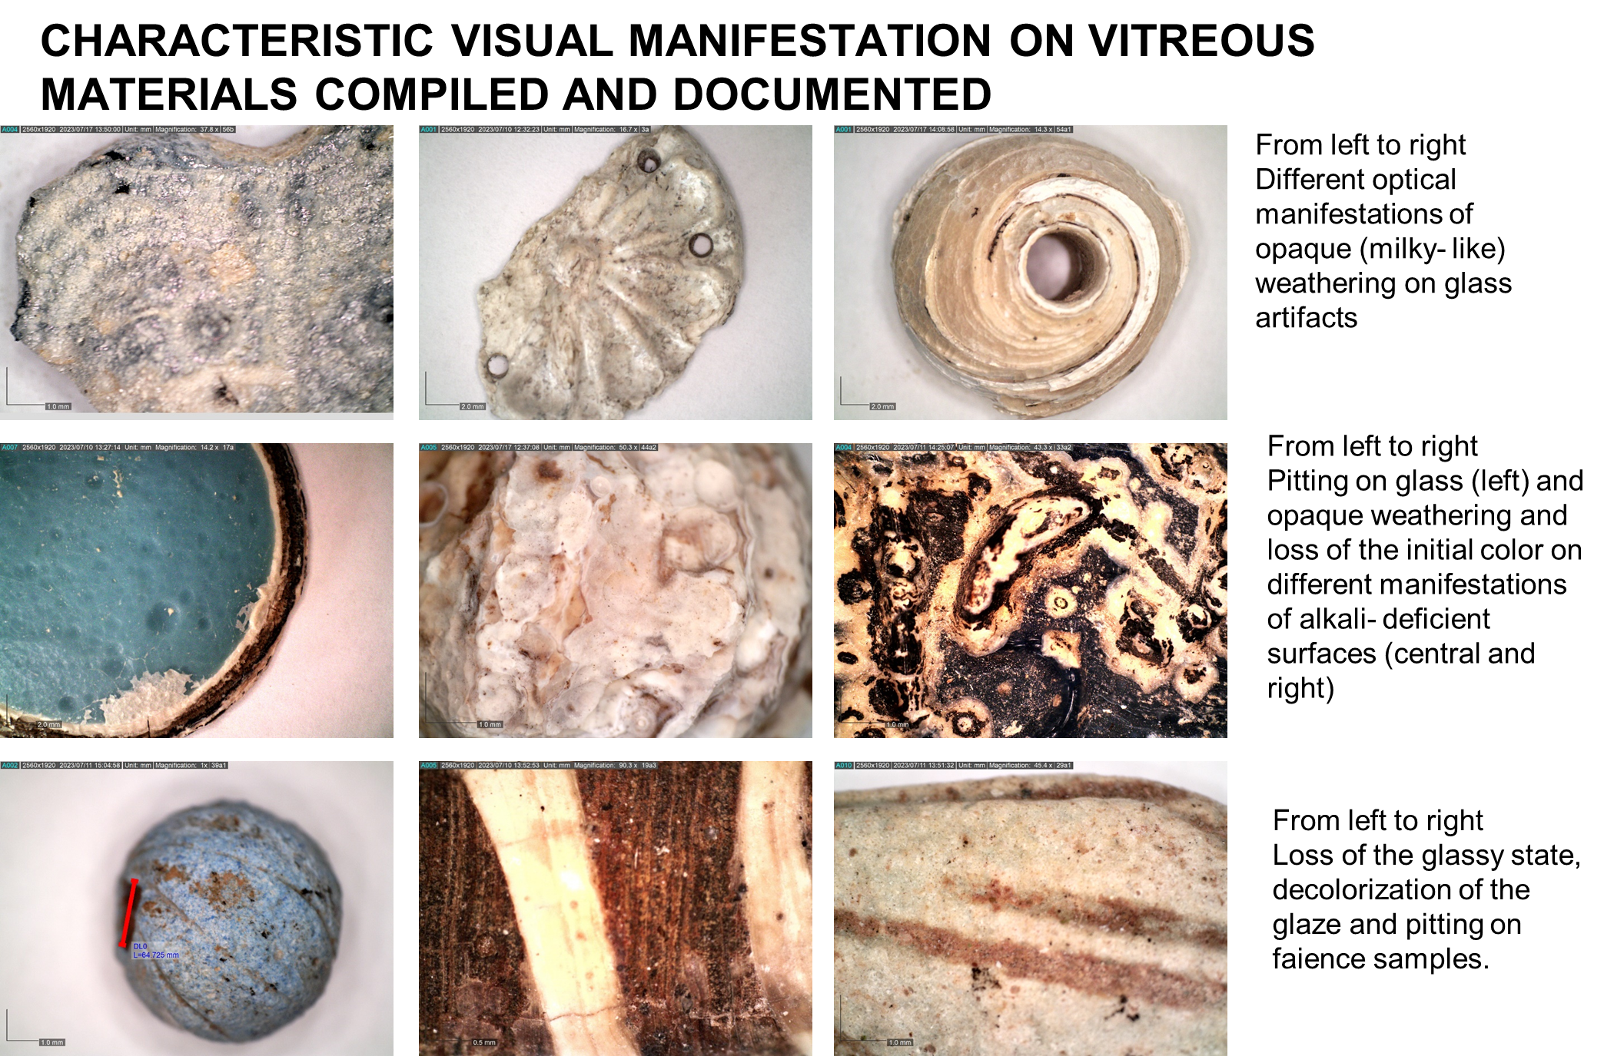
Mycenaean Vitreous Production: A novel interdisciplinary approach towards resolving critical taxonomy issues
Research Activities

Slide 11
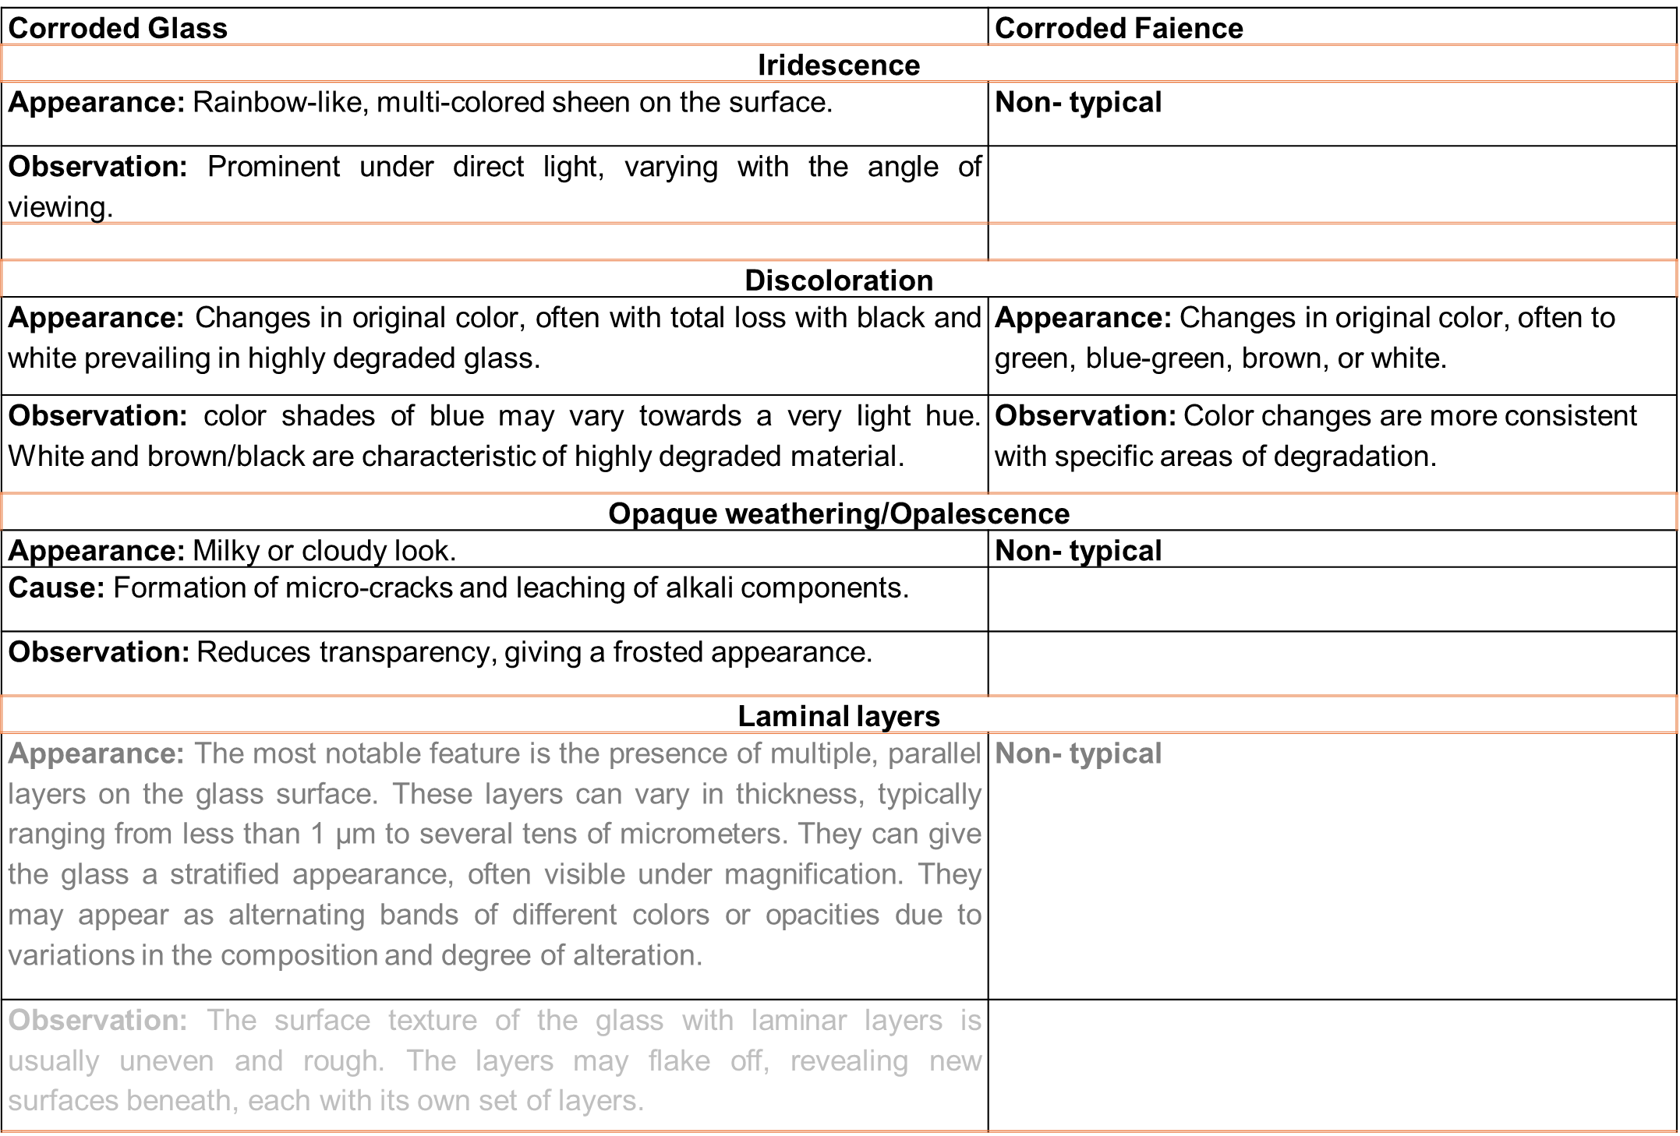
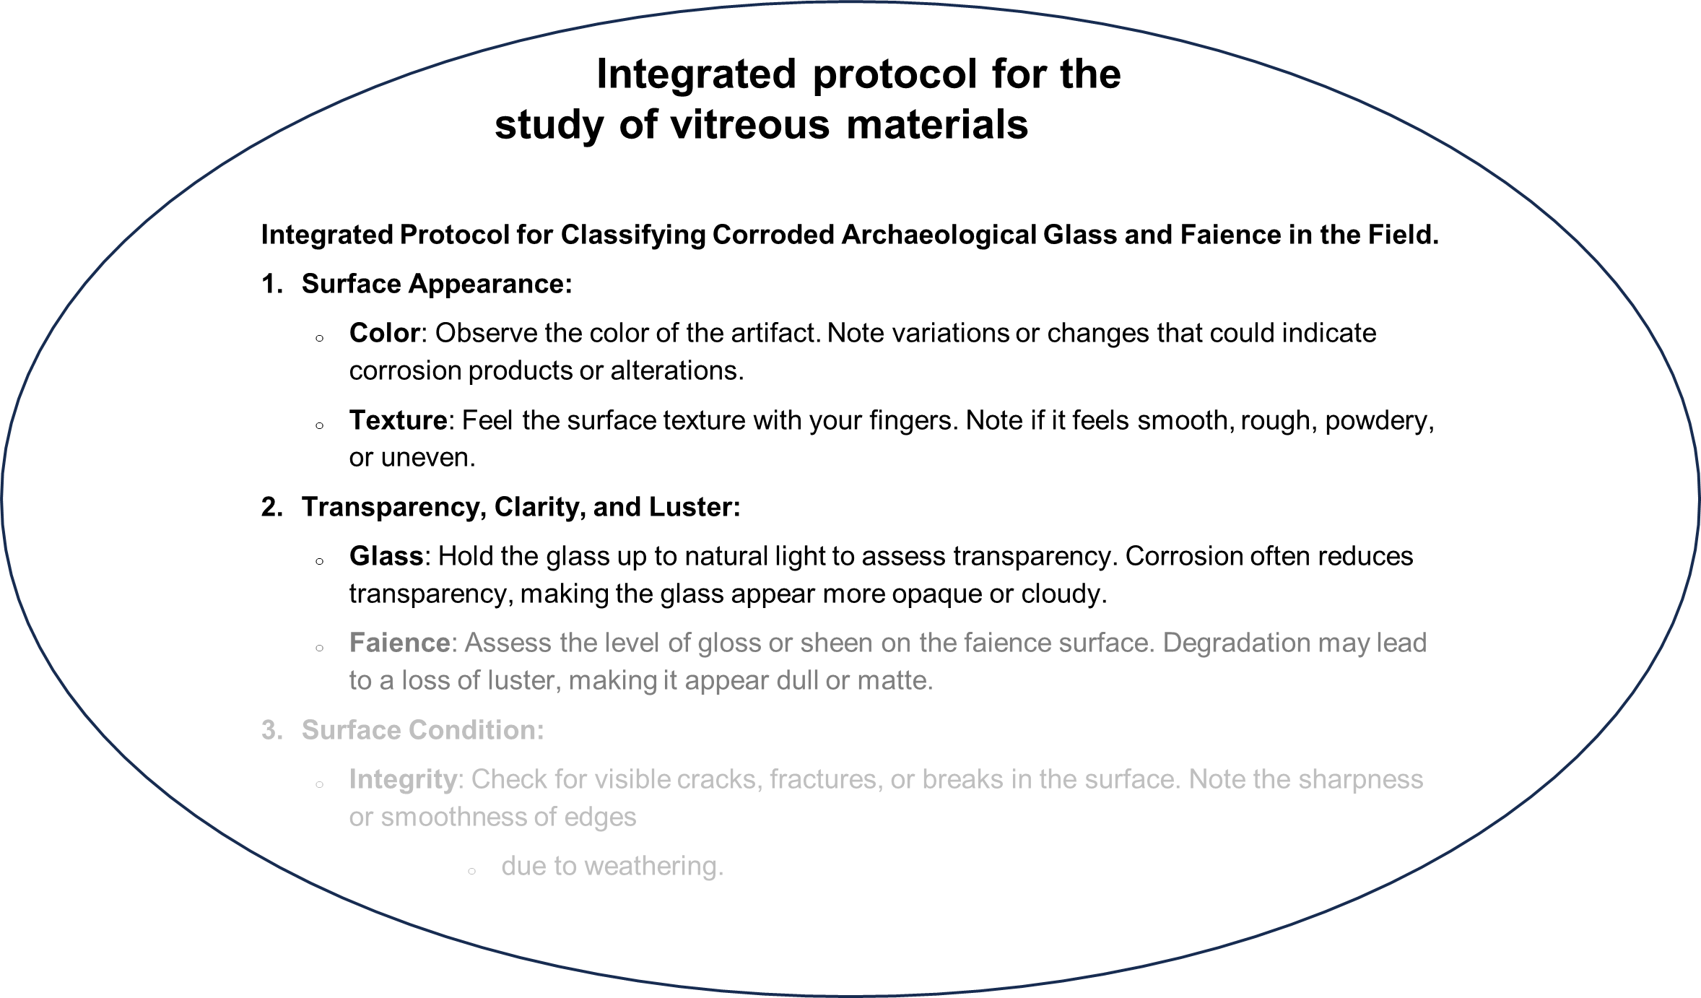
Mycenaean Vitreous Production: A novel interdisciplinary approach towards resolving critical taxonomy issues
Research Activities

Slide 12
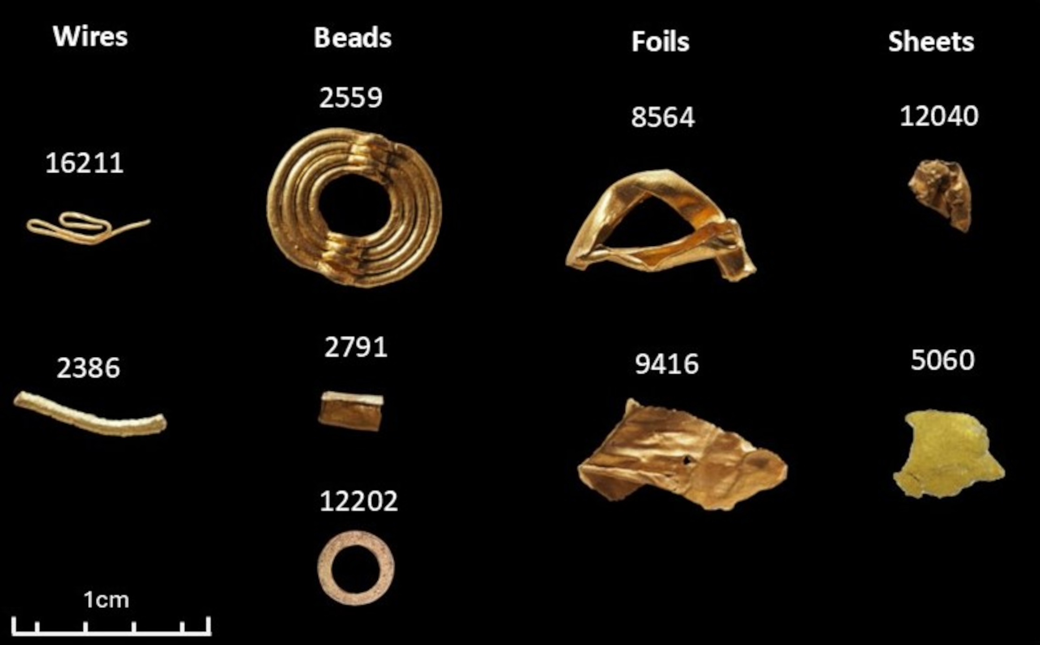
Keros project
Research Activities
Micro-X-Ray Fluorescence analysis of Early Bronze Age (ΙΙΙ) gold artefacts from Dhaskalio, Keros
Kalliopi Tsampa, Andreas G. Karydas, Myrto Georgakopoulou, Michael J. Boyd, Colin Renfrew
Oral presentation @ ICAS-EMME4
Submitted manuscript @ Journal of Archaeological Sciences: Reports
Archaeological Museum of Naxos
Dr Michael Boyd - McDonald Institute for Archaeological Research, University of Cambridge

Slide 13


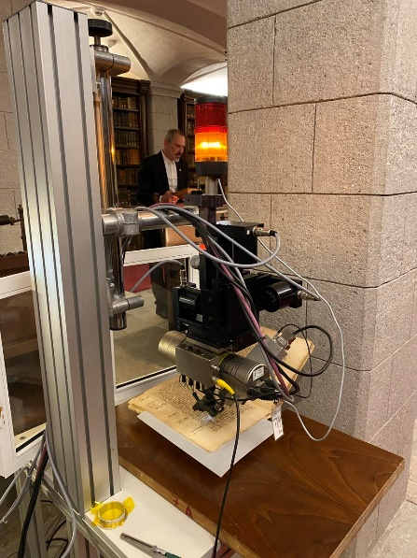
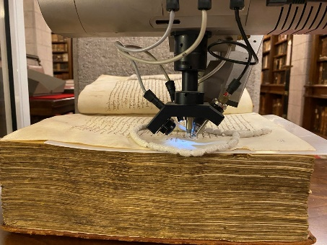
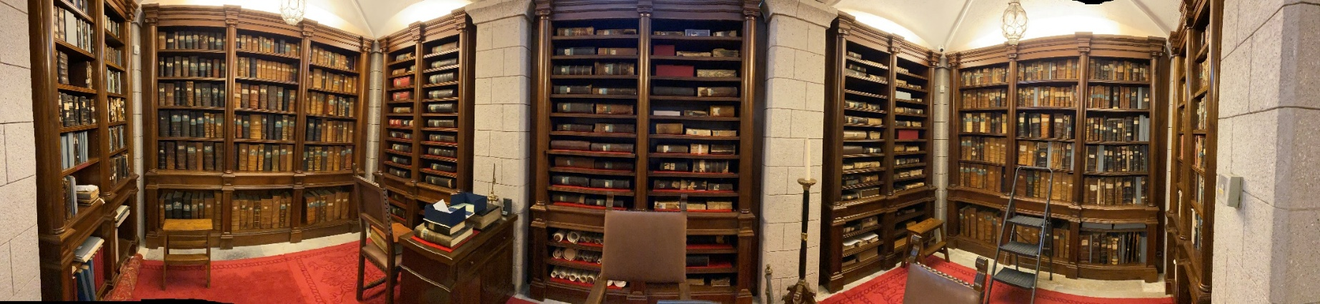
Supervisor: Dr. Andreas Karydas,
Director of Research, Institute of Nuclear and Particle Physics, NCSR "Demokritos“
Advisory Committee : Prof. Stamatios Boyatzis,
Department of Conservation of Antiquities and Works of Art
Assoc. Prof. Vasiliki Kokla,
Department of Conservation of Antiquities and Works of Art
“Chemical degradation of iron gall inks based on historical Byzantine recipes. Investigation of the role of metal ions by non-destructive analytical spectroscopic techniques.”
PhD Candidate: Ermioni Vassiou

Slide 14

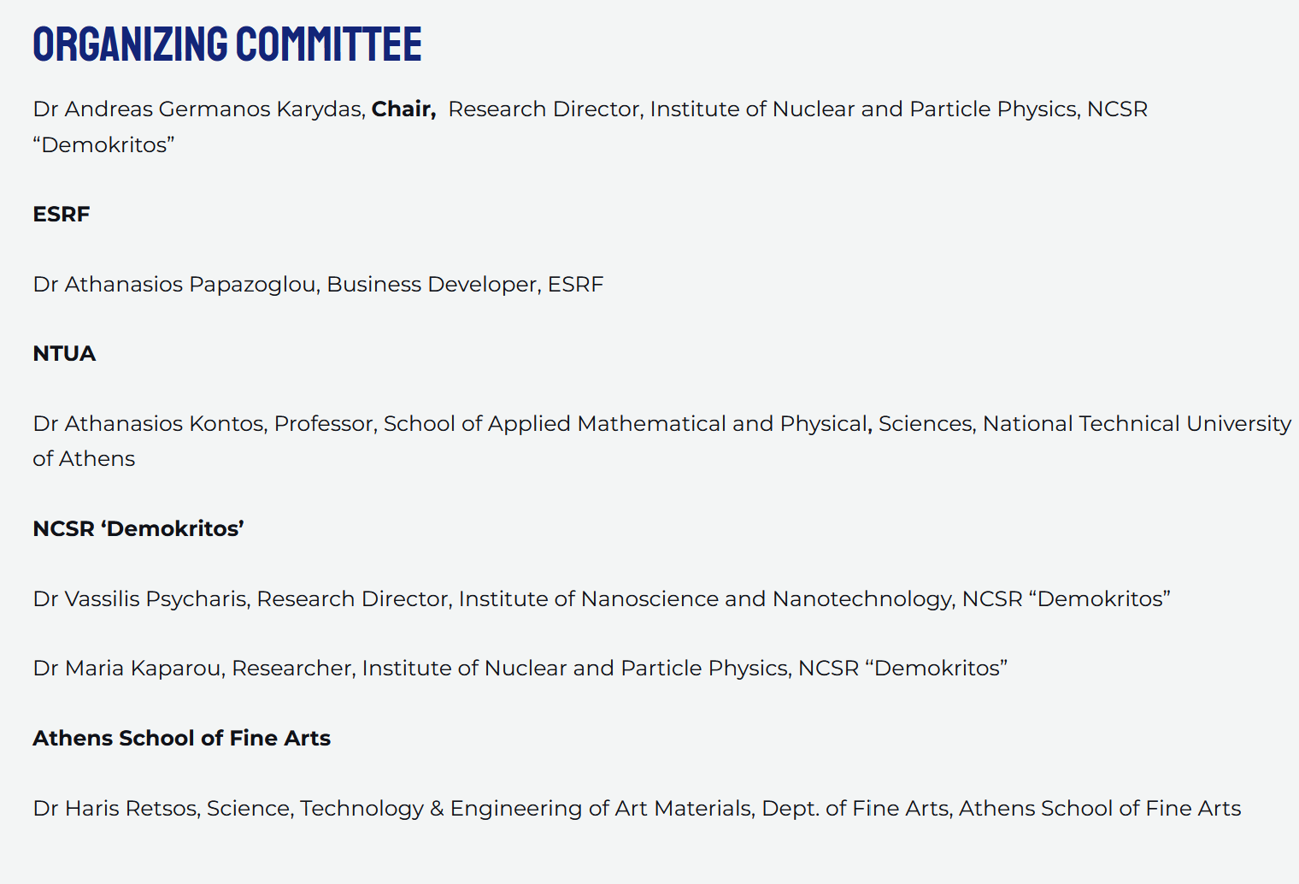
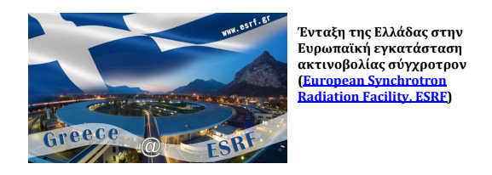
Workshop
The Workshop ESRF membership: Catalyzing Greek Scientific Excellence is part of the actions of the GrSUN founded in 2022 bringing together all scientists, businesses and potential users of Synchrotron Radiation facilities in order for Greece to become a member of ESRF community.

Slide 15

EXRS 2024 - Local Organizing Committee
Technical University of Crete
Nikolaos Kallithrakas-Kontos
Institute of Nuclear and Particle Physics, NCSR “Demokritos”
Andreas G. Karydas
Maria Kaparou
Artemios Oikonomou
Kalliopi Tsampa
Nikoletta-Kanella Kladouri
Ermioni Vassiou
Stefanos Papagiannis
University of Ioannina
Dimitrios Anagnostopoulos
Anastasios Asvestas
Aristotle University of Thessaloniki
Maria Katsikini
Fani Pinakidou

Slide 16

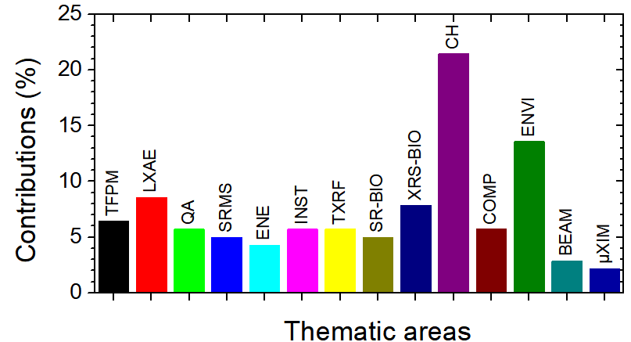
EXRS 2024
One key-note and nine (9) plenary invited talks
103 oral and 141 poster presentations
Total participants: 287+(25)=306
Seniors-Post-Docs: 201
Students: 62
Vendors representatives : 24
Accompanying persons: 25
TFPM: Theory, Fundamental parameters/processes, Modeling
LXAE: Laboratory X-ray Absorption/Emission
QA: Quantitative analysis
SRMS: Synchrotron Radiation in Material Sciences
ENE: Batteries and Energy Materials
NCI: New Commercial Instrumentation
INST: XRS instrumentation: New Developments
TXRF: Total Reflection, Grazing Incidence/Exit XRF
SR-BIO: Multimodal nano/micro imaging in Biology – Biomedicine
XRS-BIO: XRS applications in Biology - Biomedicine
CH: XRS applications in Cultural Heritage
COMP: Complementary XRS techniques
ENVI: XRS applications in Environmental studies
BEAM: Synchrotron Radiation Beamlines
μXIM : Micro-XRF imaging applications

Slide 17
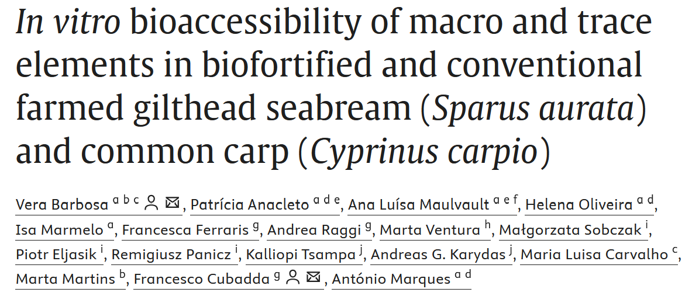
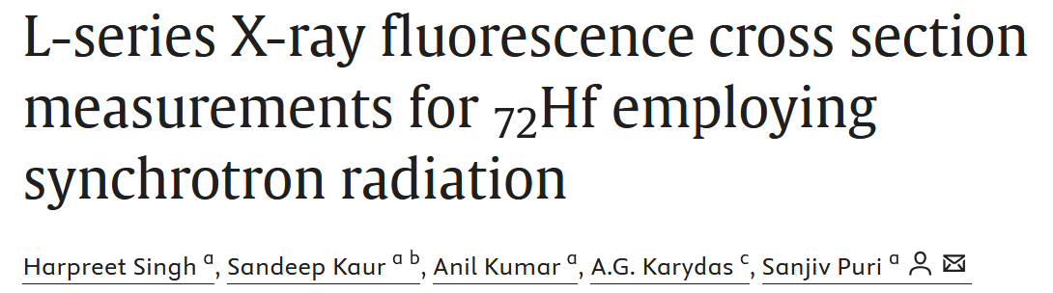


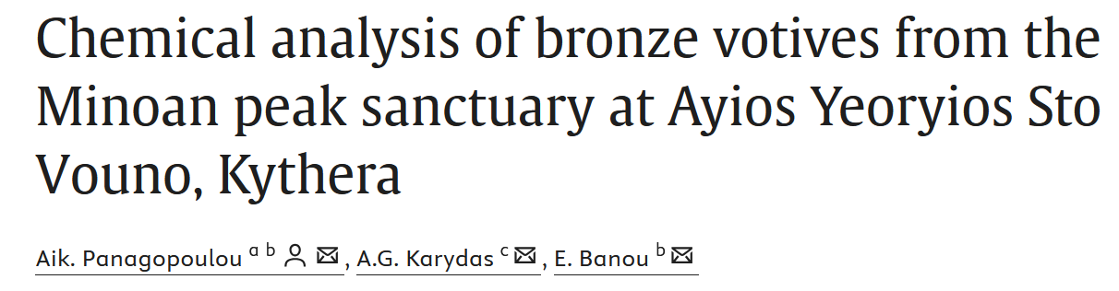

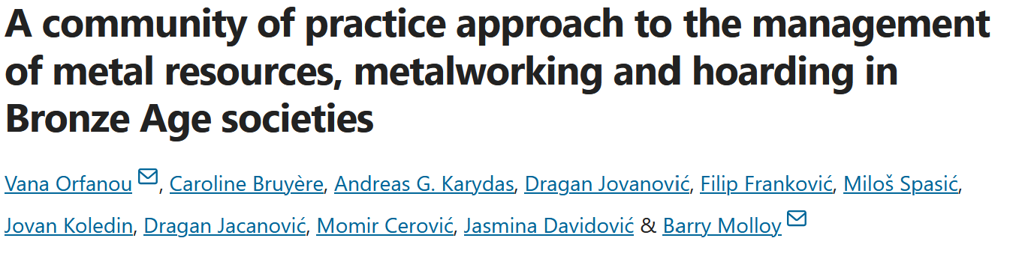

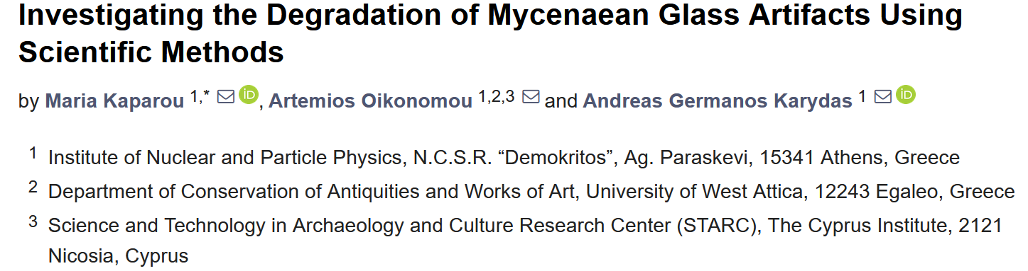
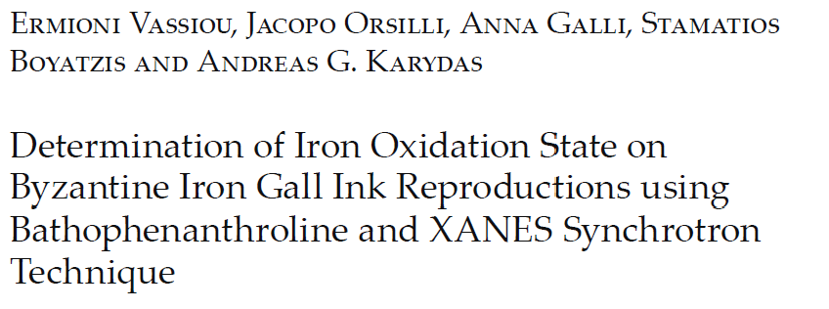

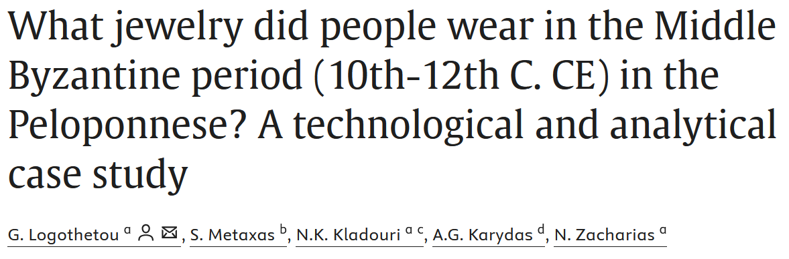
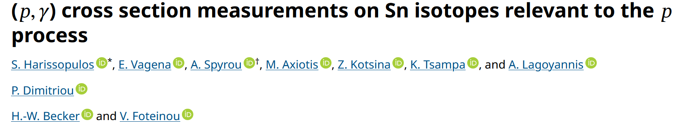


Publications – Peer Reviewed
8 peer reviewed publications

Slide 18
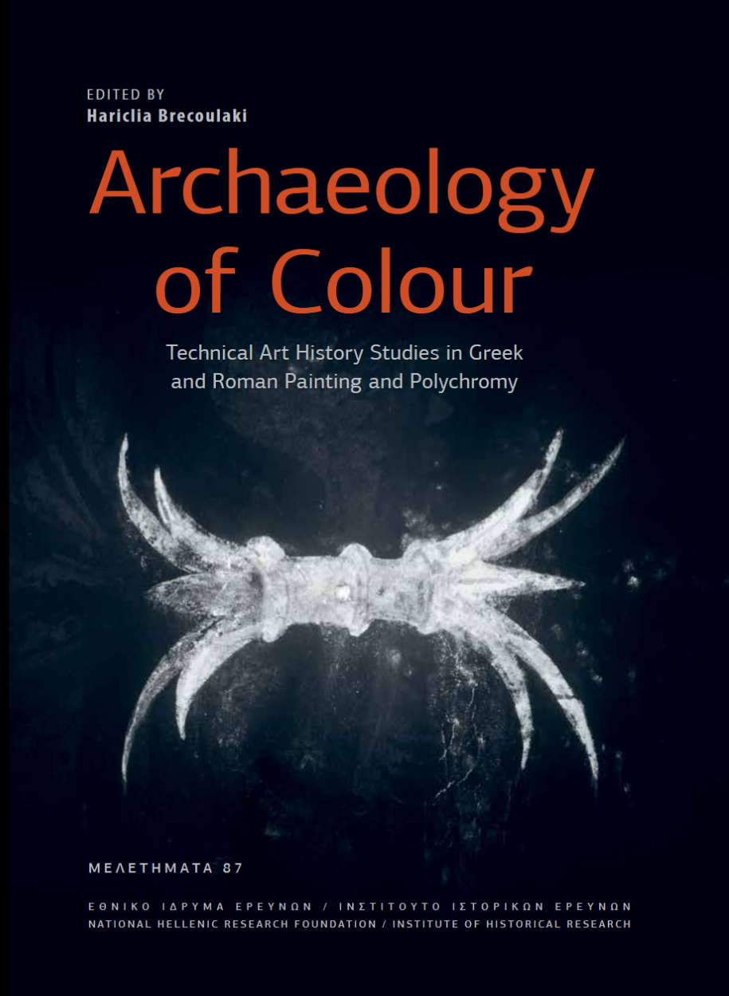


Publications – Books
Edited by Hariclia Brecoulaki
Institute for Historical Research, National Hellenic Research Foundation

Slide 19







Conferences and contributions in BoA
European X-ray Spectrometry 2024 (EXRS2024) Athens 24-28 June 2024
ICAS – EMME4
Poster: 2
Invited talks
Posters: 9
Oral: 1
Oral: 3
Oral: 6
30th EAA (European Association of Archaeologists) Annual Meeting in Rome, Italy, 28 - 31 August 2024
Oral: 1
Posters: 11
Oral: 12
Gordon Conference, Advances and Challenges in Heritage Materials Characterization and Data Interpretation, July 7 - 12, 2024, Les Diablerets Conference Center, Les Diablerets, Vaud (fr), Switzerland
Oral: 1

