Slide 1

TR-HEP Outreach Activities
Serkant Ali Çetin

Slide 2
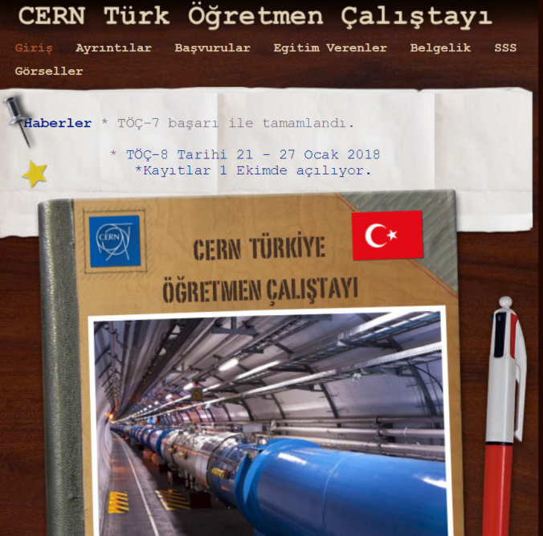
CERN – Turkish Teacher’s Program
29 Jan - 03 Feb 2017 Turkish Teacher Programme / Türk Öğretmen Çalıştayı 7
26 Jun - 01 Jul 2016 Turkish Teacher Programme / Türk Öğretmen Çalıştayı 6
31 Jan - 05 Feb 2016 Turkish Teachers Program / Türk Öğretmen Çalıştayı 5
19 Jul - 24 Jul 2015 Turkish Teachers Program / Türk Öğretmen Çalıştayı 4
25 Jan - 30 Jan 2015 Turkish Teachers Programme 3
7 Programs conducted in the last 3 years
>250 teachers
27 Jul - 01 Aug 2014 Turkish Teachers Programme
23 Feb - 27 Feb 2014 Turkish Teachers Programme

Slide 3
Various summer/winter schools for physics sudents
Some examples:

Slide 4
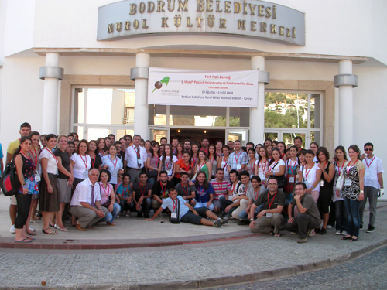
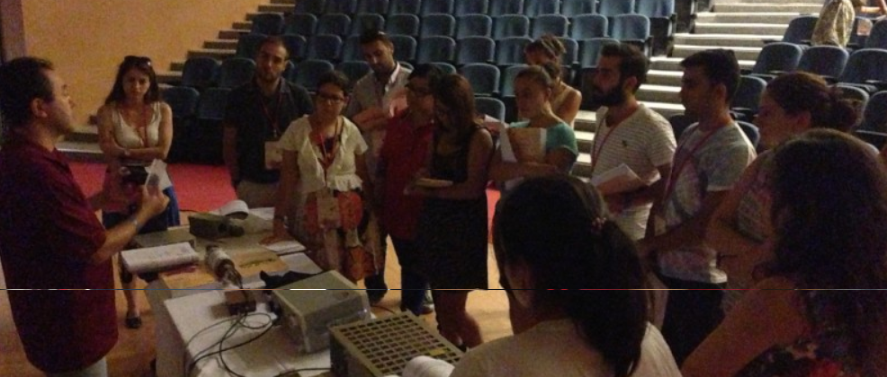
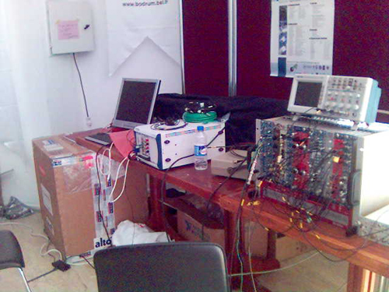
Particle Accelerators and Detectors Summer Schools
Organized by Turkish Physical Society
13 Schools organized
since 2005

Slide 5
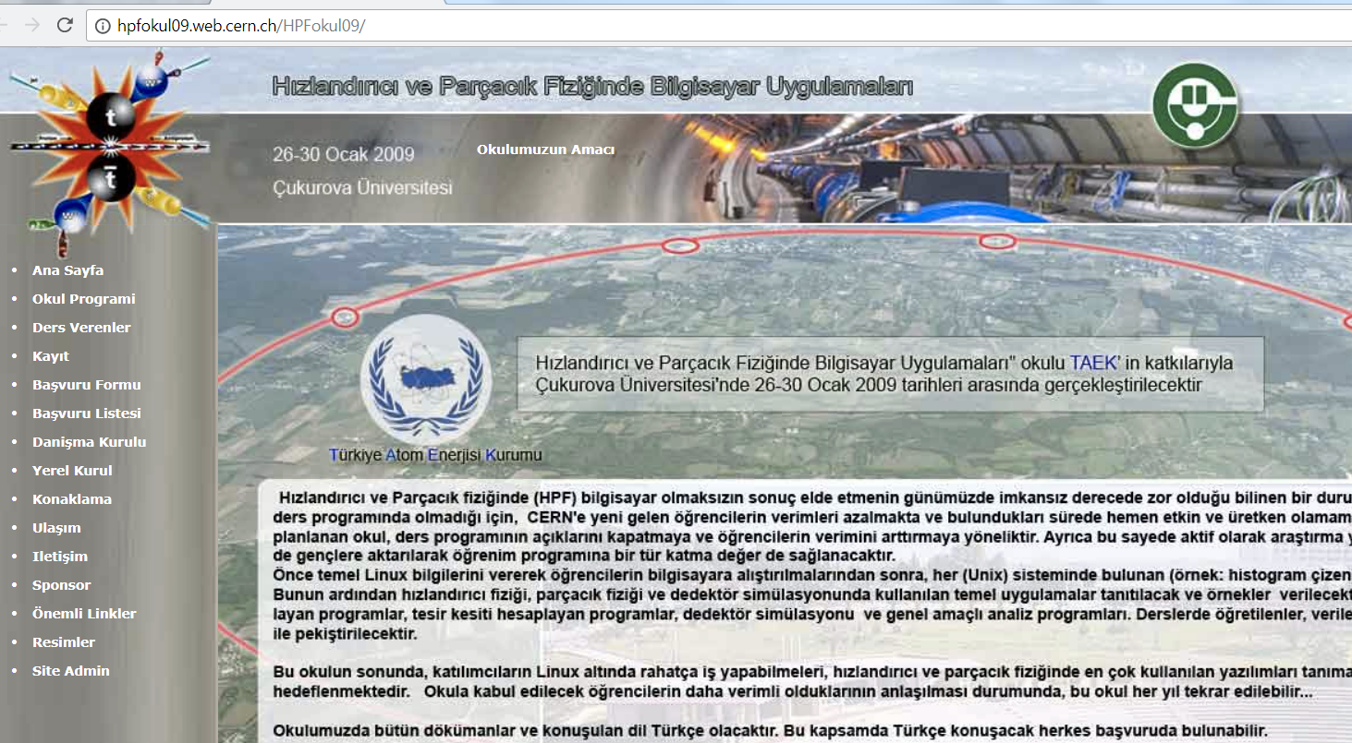
School on Computational Applications in Accelerator and Particle Physics
Jan 2009 – Çukurova Univeristy

Slide 6
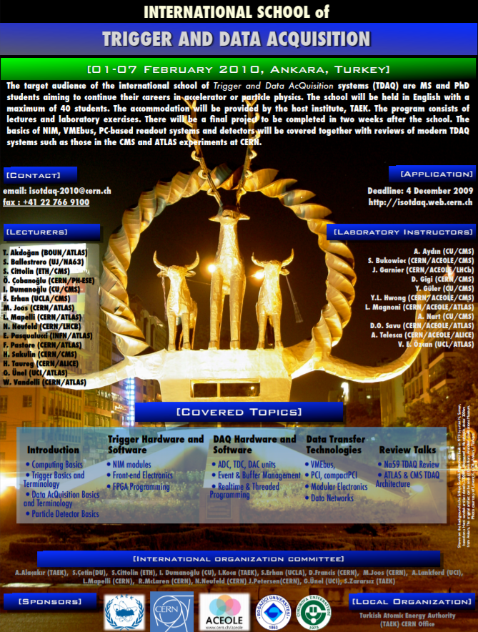
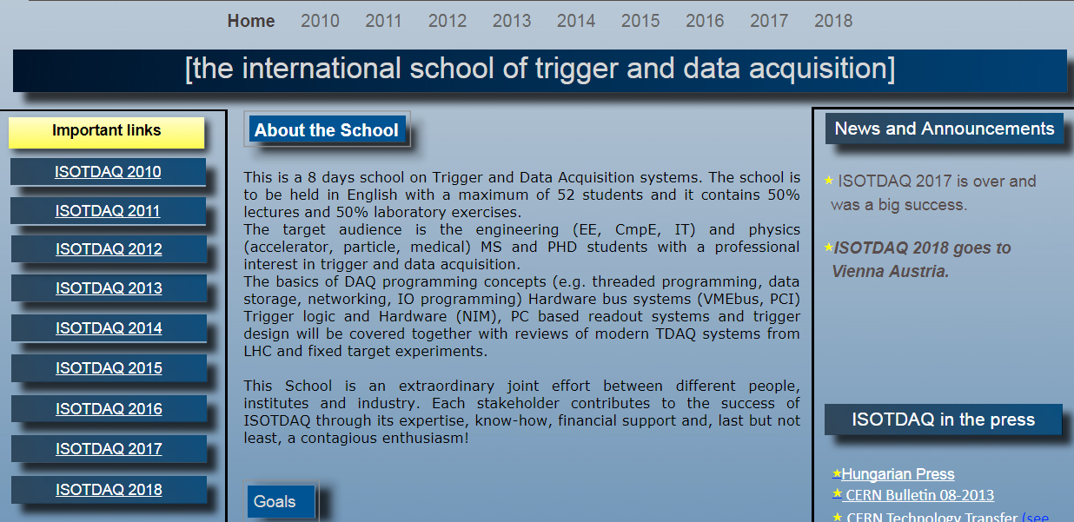
1st ISOTDAQ hosted in Ankara by
TAEK (2010)

Slide 7
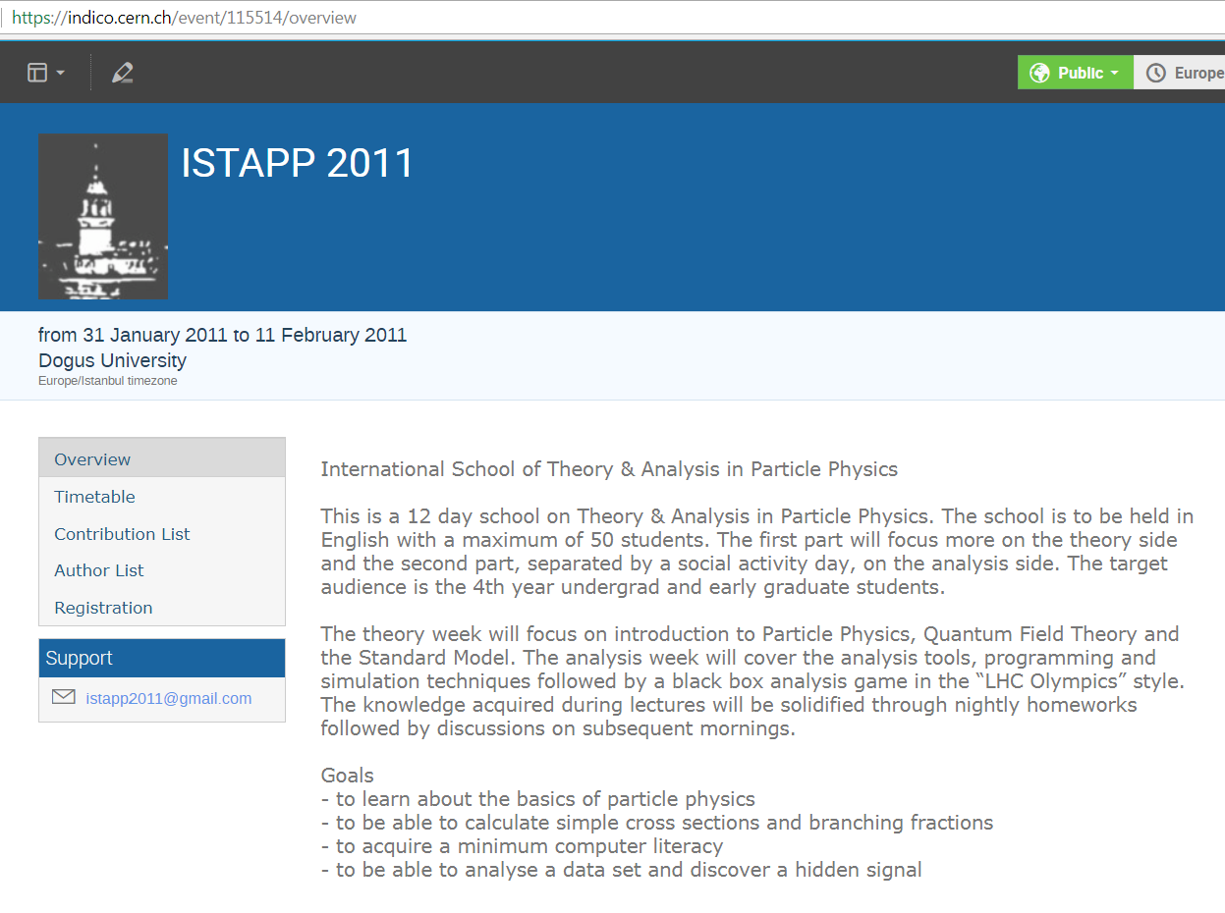

Slide 8
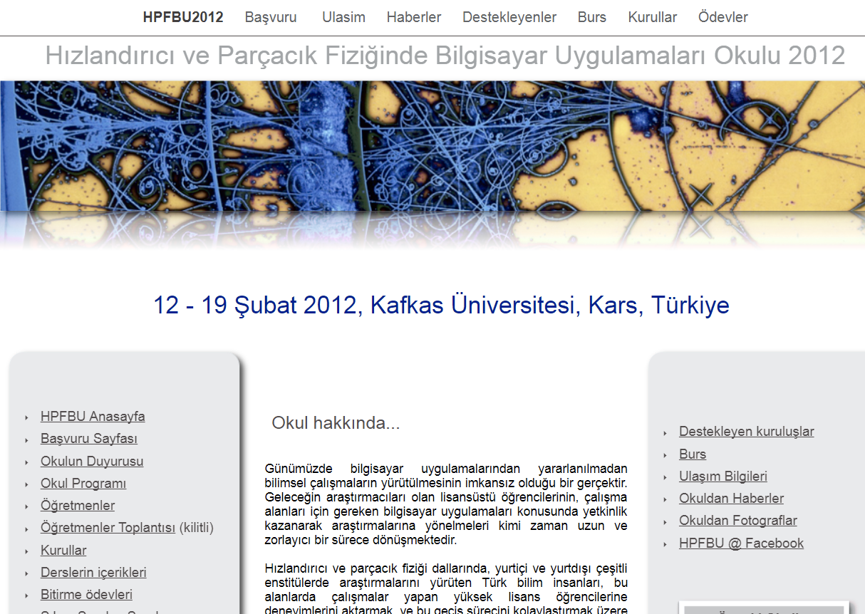
School on Computational Applications in Accelerator and Particle Physics
Feb 2012 – Kafkas Univeristy

Slide 9
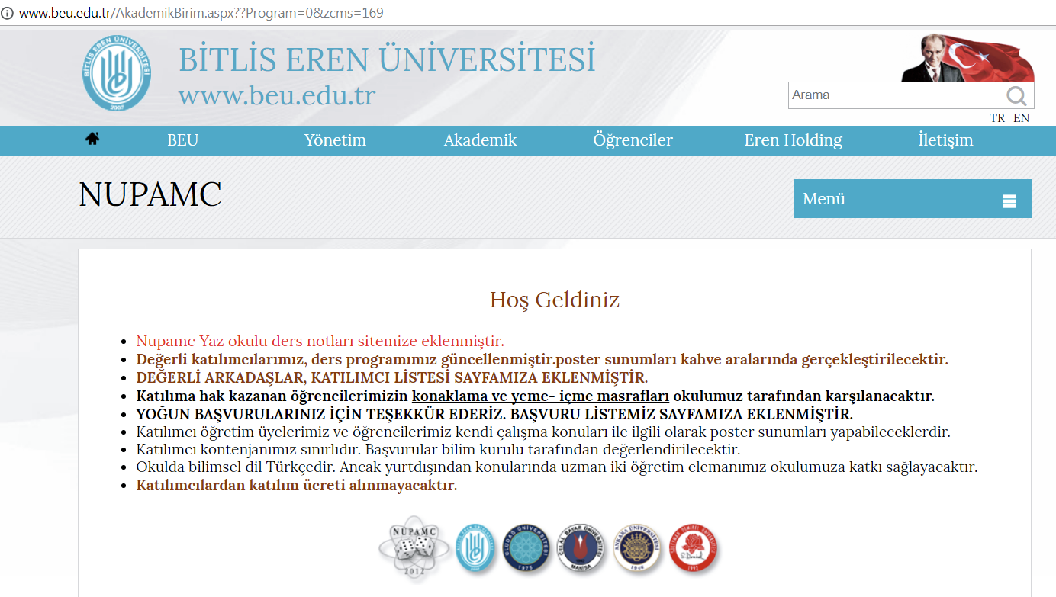
Summer School on Monte Carlo Applications in Nuclear and Particle Physics
May 2012 – Bitlis Eren University

Slide 10
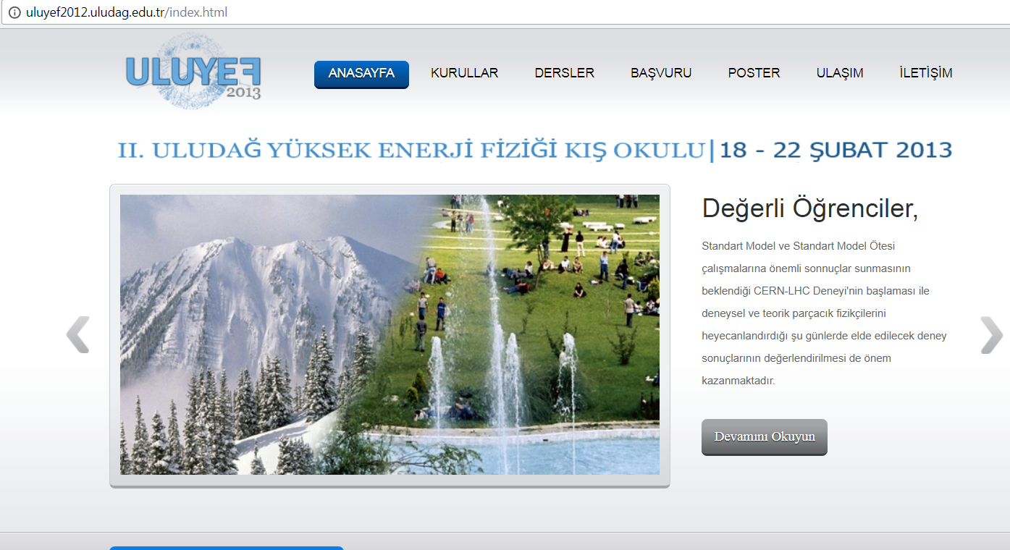
High Energy Physics Winter School
Feb. 2013 – Uludağ university

Slide 11
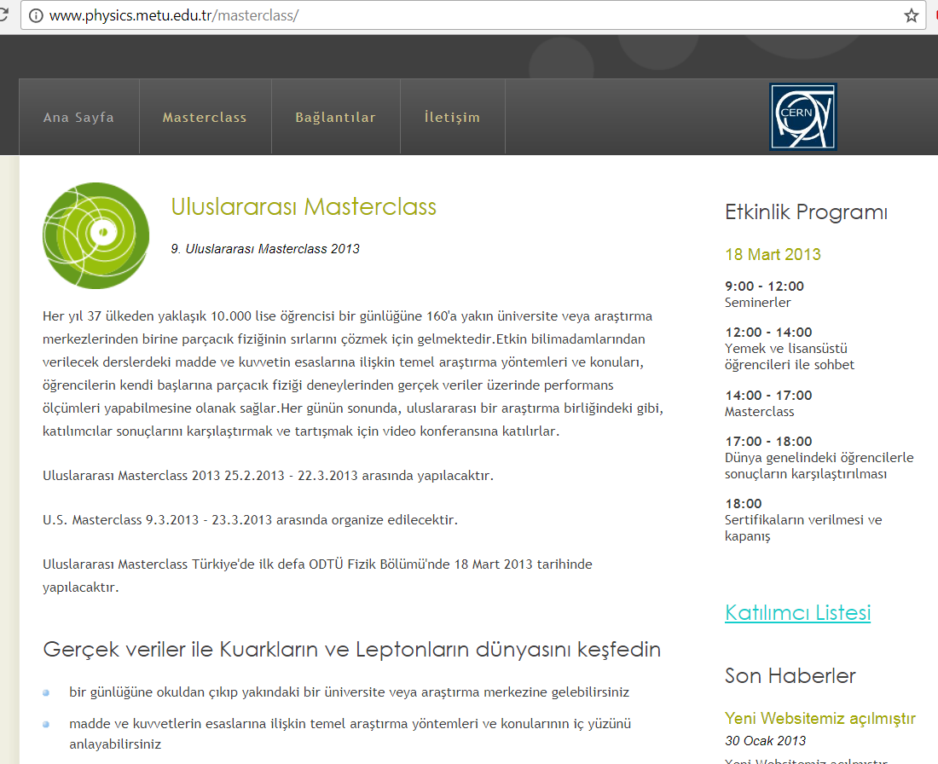

Slide 12
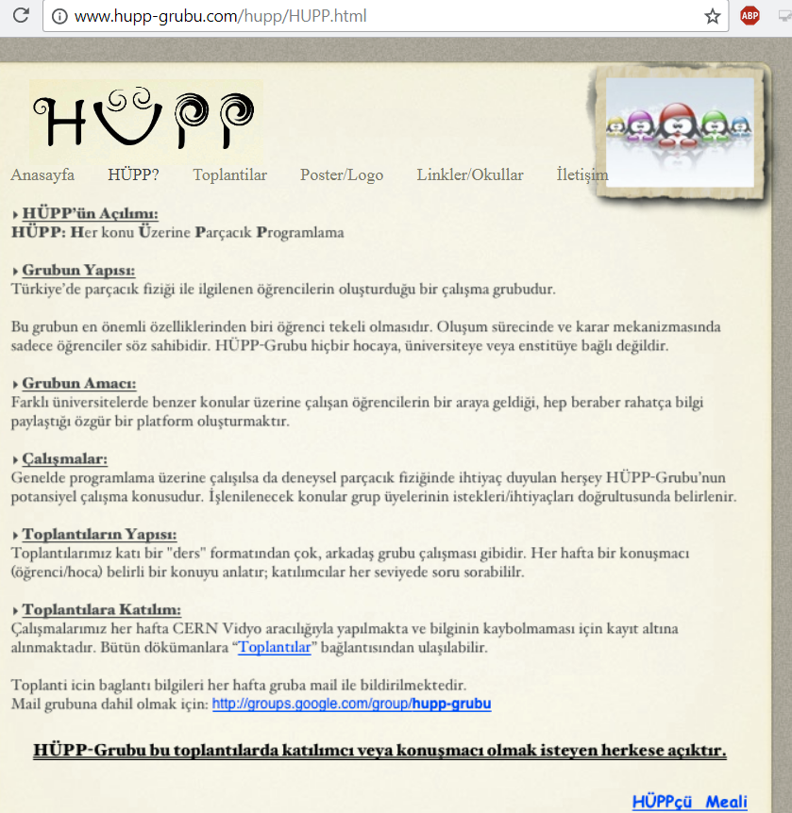
Programming Particles on Every Subject (HÜPP)
A study group by students interested in particle physics.
Many meetings and also online activities organized since 2011 (at least 10 events/year)

Slide 13
Personal activities by many of us
Many conference talks to high schools
Public talks at libraries or culture centers
Seminars to teams of students from different schools promoting BL4S
TV programs (single or group of physicists)
Articles in magazines
…

Slide 14
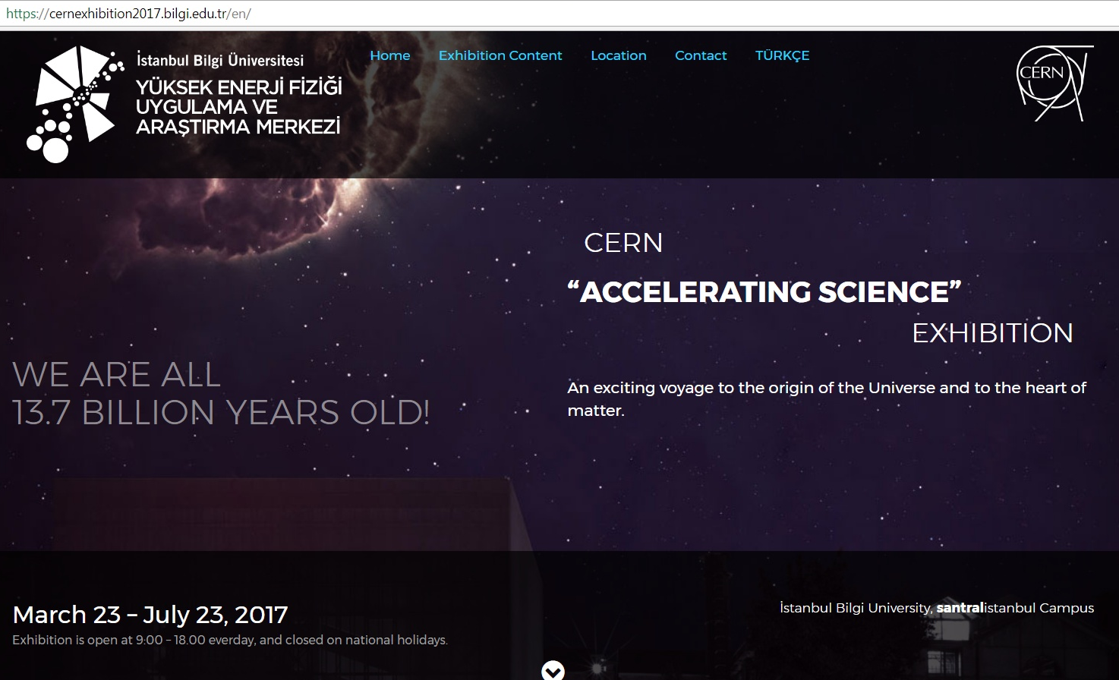

Slide 15
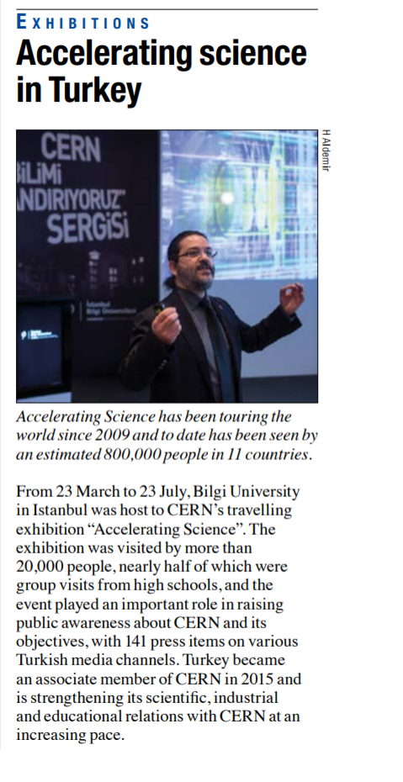
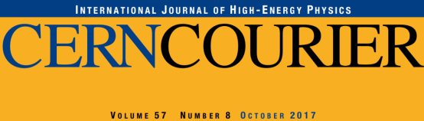
CERN’s travelling Exhibition
Visited Turkey twice
  2011 Ankara
    hosted for 6 months by METU)
  2017 İstanbul
    hosted for 4 months by Bilgi
45k+ visitors in total

Slide 16
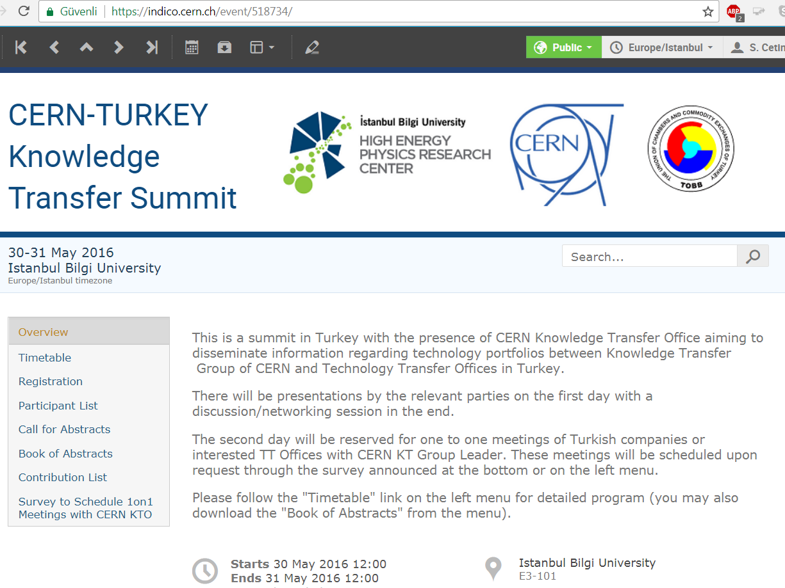

Slide 17
Union of Chambers and
Commodity Exchanges (TOBB)
Very efficient network established
Meetings with chambers at different cities
We are also invited to give talks about CERN and mention the how HEP triggers technologies
There is also strong media presence of the president of TOBB about CERN as well

Slide 18
Concluding Remarks
Many national and international schools in HEP
High rate of public conferences by the community
Visiting high schools to raise awareness and interest.
BL4S attracts huge attention among high school students.
Media shows interest for news about CERN; also various tv programs on the subject.
Exhibitions are very effective; there are even local exhibitions prepared to promote science at CERN.
TR-CERN-ILO facilitates efficiently industry interest and community is involved as well

