Slide 1


RECFA Country Visit - Open Session
6-7 October 2017
Dr. Gulfem SUSOY DOGAN
Turkish Physical Society
Member of the Executive Committee
Notes:
First of all I would like to thank to Organizing Committee of this Meeting, President of ESP and President of BPU for your hospitality.

Slide 2
TURKISH PHYSICAL SOCIETY
History
Activities
Aim
Awards

Slide 3
TURKISH PHYSICAL SOCIETY
History
Physics Society had been founded by the leading national scientists in Çemberlitaş, Istanbul in March 27th, 1950.
The name as “Turkish Physical Society” had been accepted and issued in offical journal by the 7/12434 numbered decision of the Council of Ministers on October 12, 1976.
It had been warranted that Turkish Physical Society could cooperate with European Phyical Society (EPS) by the 7/1726 numbered decision of the Council of Ministers on February 5, 1979.
Notes:
is a public interest association that advocates Ataturk's principles and revolutions, Modern, Democratic and Secular Republic.

Slide 4
TURKISH PHYSICAL SOCIETY
Activities
During Erdal İNÖNÜ’s presidential of Turkish Physical Society between 1976 – 1987, he organized the meeting in the other universities to spread the interest and for this reason he ensured to constitute branches in couple of cities and he made possible to organize TPS Physics Congresses for 8 times.
Also, “5th Physics Congress of the European Physical Society (EPS)” was organized in Boğaziçi University between September 7 – 11, 1981.
K.Gediz AKDENIZ was selected as chairman of the administrative board in the General Commission meeting of Turkish Physical Society in 1987. During ten years period between 1987 and 1997 he made possible to organize TFD Physics Congresses for eight times and TFD internationally Physics Summer Schools;

Slide 5
TURKISH PHYSICAL SOCIETY
After his contacts and work with Balkan Physical Union, K.Gediz AKDENIZ made TFD a member of the Balkan Physical Union with the approval of Council of Ministers in Bucharest in 1987 and he elected as President of the Balkan Physical Union in 1989 and held this mission until 1997.
While he was president of Balkan Physical Union he held the Balkan Physics Congress in Salonika (1991), Istanbul (1994) and in Cluj-Napoca (1997) and he provide to establish the first issue of Balkan Physical Letters-BPL in 1992 by major support of both Boğaziçi University and Turkish – Balkan International Applied Physics Research Center and also with the selfless utility of editor “ Emine RIZAOGLU”.

Slide 6
TURKISH PHYSICAL SOCIETY
Activities
In the 3. General Commission meeting of Turkish Physical Society on 24 May 1997 Metin ARIK, was selected as chairman of the administrative board and organized the following activities;
Balkan Physıcal Union, Balkan School on Nuclear Physics between 1-10 September 1998 at Istanbul University,
Turkish Physical Society 17thInternational Physics Congress between 27-31 October 1998 at Alanya Grand Kaptan Hotel,
ICFA’ 99 -Istanbul, ICFA School on Instrumentation In Elementary Particle Physics between 28 Jun and 10 July 1999,
Turkish Physical Society 18th International Physics Congress between 25-28 October 1999 at Cukurova University-Adana,
II. National Congress of Condensed Matter Physıcs between 22-24 June 2000 at Atatürk University-Erzurum,
The Second International Balkan School on Nuclear Physics between 12-19 September 2000 at Bodrum and finally
Turkish Physical Society 19th International Physics Congress between 26-29 September 2000 at Fırat University-Elazığ.

Slide 7
TURKISH PHYSICAL SOCIETY
Activities
In the 4.General Commission meeting of Turkish Physical Society on 17 February 2001 Engin ARIK, was selected as vice chairman and the following activities was organized;
The Second International Balkan Workshop on Nuclear Physics between 14-18 May 2001 at Trakya University,
International physics and Applied Mathematics Research Centre-ICPAM-Edirne,
The First Hellenic-Turkish International Physics Conference with the collaboration of Turkish Physical Society and Greek Physical Society at Bodrum and Greece,
Turkish Physical Society 21th International Physics Congress between 11-14 September 2002 at Süleyman Demirel University-Isparta,
1st Internationally Participated Congress on Particle Accelerators and Applications between 25-26 October 2001 at TAEK, Ankara
SEENet (South East European Nuclear Physics Network) to ensure more effective representation of the Balkan countries under the European Union 6.Framework Programme between 2-3 December 2002 at Istanbul University
Workshop on Thorium Fueled Nuclear Technologies between 6-7 January 2003 at Osmangazi University.

Slide 8
TURKISH PHYSICAL SOCIETY
Activities
In the 5. and 6. General Commission meeting of Turkish Physical Society on 15 March 2003 Baki AKKUS, was selected as chairman and the following activities was organized;
2th Internationally Participated Congress on Particle Accelerators and Applications between 7-9 June 2004 at ATO, ANKARA.
Turkish Physical Society 22th International Physics Congress between 14-19 September 2004 at Bodrum with approximately 500 participant and 39 invited speaker.
Fourth International Balkan Summer School on Nuclear Physics between 22-29 September 2004 with participant of nearly 100 master and doctoral students, was organized at Bodrum.
2005 was the world year of Physics so President of Turkish Physical Society decided to organize following activities;
“2005 World year of Physics, Turkish Physical Society, Display of Natural Phenomena in Physics Photo Contest” by ANKARA branch,
“2005 World year of Physics, Turkish Physical Society, 1st Internationally Participated Summer School on Particle Accelerators” (4-9 July 2005) at Ankara University with 91 participant.

Slide 9
TURKISH PHYSICAL SOCIETY
Activities
2005 World year of Physics, Turkish Physical Society, 4th Internationally Physics Congress and Festival for Students between 31 August and 3 September 2005 at Dokuz Eylül University-Izmir.
Turkish Physical Society 23th International Physics Congress was organized between 13-16 September 2005 at Muğla University with high participation. There were about 783 applicant and application with 274 oral presentations and 275 poster presentations was accepted. Otherwise, there were some panels respectively; “2005 World Physics Year, Panel of Turkey and Cern”, 2005 World year of Physics, Panel of What Should Turkey Do About Earthquake?”, “2005 World year of Physics, Education in Turkey”, “2005 World year of Physics, Panel of Future Technology of Photonics”.
BPU-6, Sixth International Conference of the Balkan Physical Union was organized at Istanbul University between 22-26 August 2006. There were about 800 applicant and application with 300 oral presentations and 450 poster presentations was accepted. On the other hand full texts of the conference was provided to published in Journal of American Institute Physics. During conference, “Prof.Dr.Metin ARIK” instructor at Boğaziçi University and old President of Turkish Physical Society was selected as President of Balkan Physical Union at the meeting of Balkan Physical Union.

Slide 10
TURKISH PHYSICAL SOCIETY
Activities
ISCBPU-4, Fourth International Student Conference of the Balkan Physical Union was organized with 350 participant and 20 invited spikers at Nurol Culture Centre-Bodrum between 29 August and 1 September 2006
Turkish Physical Society 2nd Summer School on Particle Accelerators and Detectors was organized between 18-24 September 2006, Bodrum with totally 85 participant.
3th Internationally Participated Congress on Particle Accelerators and Applications between 17-19 September 2007 at Bodrum with 51 participant.
3th Internationally Participated Summer School on Particle Accelerators and Detectors between 20-24 September 2007, Bodrum.
Turkish Physical Society 24th International Physics Congress between 28-31 September 2007 at Malatya.
Turkish Physical Society 25th International Physics Congress was organized with the significant contribution between 28-31 September 2008 at Bodrum Nurol Cultural Center-Bodrum. Physicist that was died in 2007 has been commemorated at this congress.

Slide 11
TURKISH PHYSICAL SOCIETY
Activities
4th Internationally Participated Summer School on Particle Accelerators and Detectors was organized between 1-5 September 2008 at Bodrum. There were about 97 applicant.
5th Internationally Participated Summer School on Particle Accelerators and Detectors was organized between 28 August and 3 September 2009 There were about 107 applicant.
The 7th International Balkan Physics Students Conference was organized between 4-7 September 2009
5. International Core of The Nuclear Shape-Phase Transitions and Critical Point Workshop was organized at Bodrum between 16-18 September 2009.
Turkish Physical Society 26th International Physics Congress was organized between 24-27 September 2009 at Bodrum. There were about 727 applicant.
4th Internationally Participated Congress on Particle Accelerators and Applications between 30 August and 01 September 2010 at Bodrum, (727 applicant)
6th Internationally Participated Summer School on Particle Accelerators and Detectors was organized between 2-7 September 2010. There were about 117 applicant.

Slide 12
TURKISH PHYSICAL SOCIETY
Activities
Turkish Physical Society 27th International Physics Congress was organized between 14-17 September 2010 at Istanbul University. There were about 1169 applicant and application with 337 oral presentations and 390 poster presentations was accepted by members of the scientific comittee. Moreover, it was an honor to see “Dr. Klaus von KLITZING” (The Nobel Prize in Physics 1985) and “Prof. Dr.Gerardus’t HOOFT” (The Nobel Prize in Physics 1999) in our scientific meeting.
7th Internationally Participated Summer School on Particle Accelerators and Detectors was organized between 20-26 August 2011 at Bodrum. (108 applicant)
Turkish Physical Society 28th International Physics Congress was organized between 6-9 September 2011 at Bodrum. There were about 1015 applicant
8th Internationally Participated Summer School on Particle Accelerators and Detectors was organized between 10-15 September 2012 at Bodrum.
Turkish Physical Society 29th International Physics Congress was organized between 5-8 September 2012 at Nurol Culture Centre-Bodrum. There were about 1100 applicant and application with 306 oral presentations and 422 poster presentations was accepted by members of the scientific comittee. Moreover, it was an honor to see “Prof. Dr. Murray GELL – MANN” (The Nobel Prize in Physics 1969) in our scientific meeting.

Slide 13
TURKISH PHYSICAL SOCIETY
Activities
Turkish Physical Society 30th International Physics Congress was organized between 2-5 September 2013 at Istanbul University. There were about 730 applicant and application with 262 oral presentations and 339 poster presentations was accepted by members of the scientific comittee.
The 10th International Balkan Physics Students Conference was organized between 3-5 September 2013. It was an honor to see “Prof.Dr.Carlo RUBBIA” (The Nobel Prize in Physics 1984) in this scientific meeting.
5th Internationally Participated Congress on Particle Accelerators and Applications was organized between 7-9 September 2013 at Nurol Culture Centre-Bodrum.
9th Internationally Participated Summer School on Particle Accelerators and Detectors was organized between 10-15 September 2013 at Bodrum.
Turkish Physical Society 31th International Physics Congress was organized between 21-24 July 2014 at Nurol Culture Centre-Bodrum. There were about 613 applicant.
10th Internationally Participated Summer School on Particle Accelerators and Detectors was organized between 14-19 July 2014 at Nurol Culture Centre-Bodrum.

Slide 14
TURKISH PHYSICAL SOCIETY
Activities
9th International Physics Conference of the Balkan Physical Union – BPU9 was organized between 24-27 August 2015 at Istanbul University. There were about 1100 applicant and application with 302 oral presentations and 469 poster presentations was accepted by members of the scientific comittee.
6th Internationally Participated Congress on Particle Accelerators and Applications between 29-30 August 2016 Bodrum.
11th Internationally Participated Summer School on Particle Accelerators and Detectors between 29 August and 4 September 2016.
Turkish Physical Society 32nd International Physics Congress was organized between 6-9 September 2016 at Herodot Culture Centre-Bodrum. There were about 1100 applicant.
Turkish Physical Society 33rd International Physics Congress was organized between 6-10 September 2017 at Herodot Culture Centre-Bodrum.

Slide 15
TURKISH PHYSICAL SOCIETY
Aims and Objectives
To provide the development of physics and sciences related to physics and led to spread within the country.
To make a significant contribution to this field, which is an essential element of the overall culture and technology, make this field beneficial for public by using modern scientific methods at the educational institutions at all levels.
To promote physics and Turkish physicists about research, evaluate and deal of the country’s technological and economic development
To provide professional solidarity among those who have studied in physics.

Slide 16
TURKISH PHYSICAL SOCIETY
Awards
Turkish Physical Society gives various types of awards every year who make contribution to physics researches and teaching.

Slide 17
TURKISH PHYSICAL SOCIETY
The Board of the Turkish Physical Society decided to give a “Turkish Physical Society Special Honor Award“ to a non-physicist person who contributed to the promotion of physics science and to raise awareness in the field of science and technology , with a decision taken in 2012.
Starting from the beginning of 2008, the board of Turkish Physical Society decided to give Honor Awards to esteemed physicists who supported young people and have contributions to the physics.
Starting from the beginning of 2008, The Board of the Turkish Physical Society decided to give “Turkish Physical Society Prof.Dr. Engin Arık Scientist Award” in the field of physics as a memory of Prof. Dr. Engin ARIK who had contributions to the development of physics .
Starting from the beginning of 2004, The Turkish Physical Society Board decided to give “Turkish Physical Society Prof.Dr. Sevket Erk Young Scientist Award” every year as a memory of Prof.Dr.Sevket Erk. The award is given to young physicists who have contributions to science and is under 35 years old. The winners are awarded with amount of 1000$ and the Certificate of the Turkish Physical Society.
Turkish Physical Society Özgen Berkol DOĞAN Best Experimental Poster Presentation Award
Turkish Physical Society Engin ABAT Best Theoretical Poster Presentation Award

Slide 18
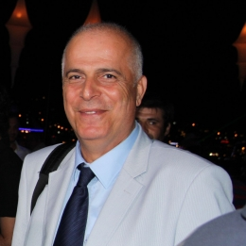
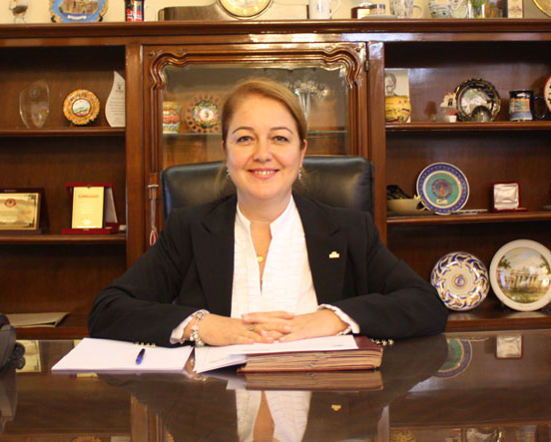
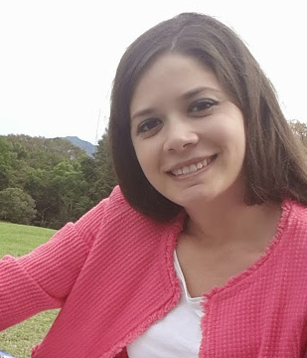


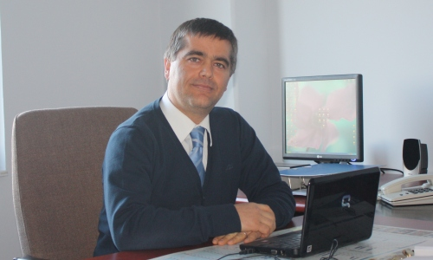
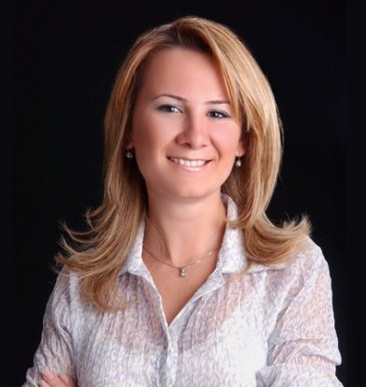
TURKISH PHYSICAL SOCIETY
To ensure the achievement of these aims our Executive Committee Members
Prof. Dr. Baki AKKUŞ
President
Prof. Dr. Yeşim ÖKTEM
Vice President
Dr. Gülfem SÜSOY DOĞAN
Secretary
Osman Azmi BARUT
Treasurer
Prof. Dr. Pervin ARIKAN
Member
Prof. Dr. Tamer AKAN
Member
Assoc. Prof. Dr. R. Burcu ÇAKIRLI MUTLU
Member

Slide 19
TURKISH PHYSICAL SOCIETY
trying to organize its all scientific events in a suitable form for national physicists
in international level
quality
achieving this purpose
to improve implementation and teaching of physics
Organizes conference, seminar and summer schools or support organizations in order

Slide 20



TURKISH PHYSICAL SOCIETY
Conference Prooceedings
BPU2 Conference Proceedings published in the BPU journal Balkan Physics Letters.
BPU6, BPU9 and TPS32 Conference Proceedings published in a Special Volume of the world-renowned
AIP Conference Proceedings.
Accepted manuscripts of the TPS-33
will preferably be published either in a Special Volume of the American Institute of Physics (AIP) Conference Series
or
the Canadian Journal of Physics (CJP).

Slide 21

TURKISH PHYSICAL SOCIETY
Invited and welcomed
Nobel Prize winner physicists

Slide 22
TURKISH PHYSICAL SOCIETY
Thank you very much for your attendance.

