Slide 1
Industrial Involvement @ CERN
Report by Hakan KIZILTOPRAK
Special Advisor to President
CERN Industrial Liaison Officer for Turkey

Slide 2
The Union of Chambers and Commodity Exchanges of Turkey (TOBB)
The umbrella organization of the Turkish private sector
  1.5 million members
    85% of National Income
    77% of Investments
    100% of Exports

Slide 3
The Union of Chambers and Commodity Exchanges of Turkey (TOBB)
A strong organization, covering the whole economy
  365 Local Chambers and Commodity Exchanges
    81 Provinces
    160 Districts
  61 Sectoral Assemblies
  Offers over 60 different services to its members
  Manages over 40 national and international projects

Slide 4
The Union of Chambers and Commodity Exchanges of Turkey (TOBB)
SECTORAL ASSEMBLIES - Leaders of the sectors
61 different Assemblies in the primary sectors
Each sectoral assembly holds:
  The top 40 companies of the sector (as turnover)
  Senior bureaucrats of the relevant public institutions
  Sectorial associations
Overall, Sectoral Assemblies brings together:
  1.460 companies representing all regions
  15 ministries, 57 public institutions
  377 non-governmental organizations /associations

Slide 5
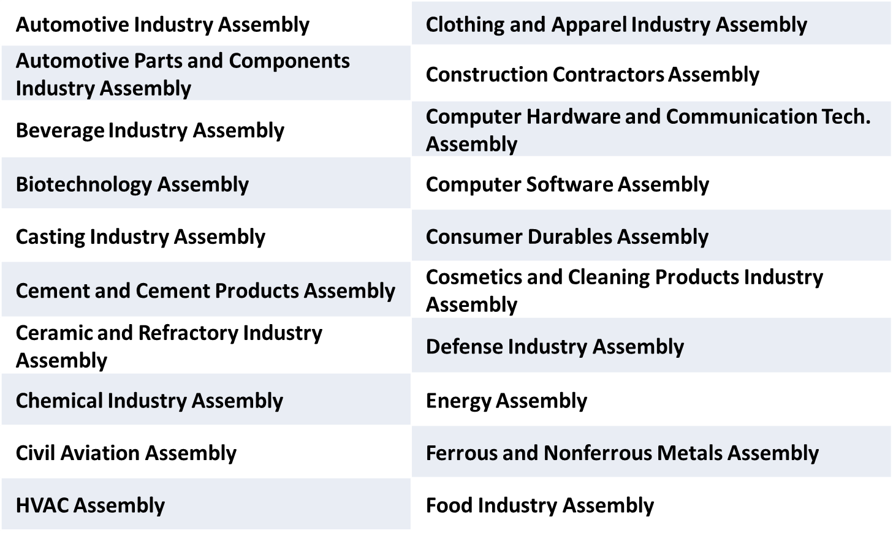
The Union of Chambers and Commodity Exchanges of Turkey (TOBB)
SECTORAL ASSEMBLIES – (Industrial)

Slide 6
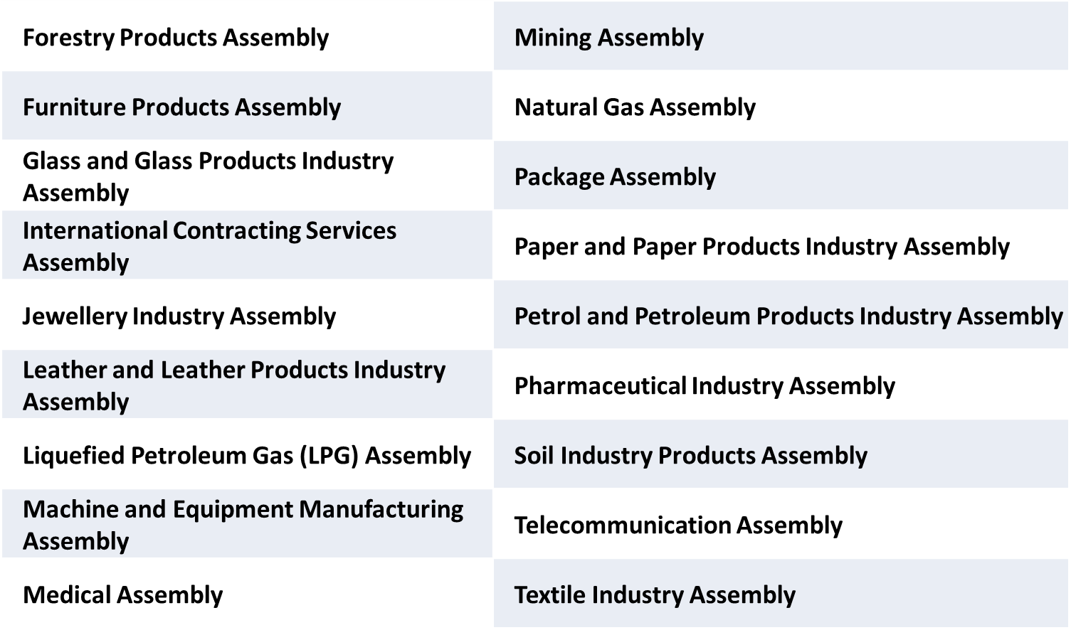
The Union of Chambers and Commodity Exchanges of Turkey (TOBB)
SECTORAL ASSEMBLIES – (Industrial)

Slide 7
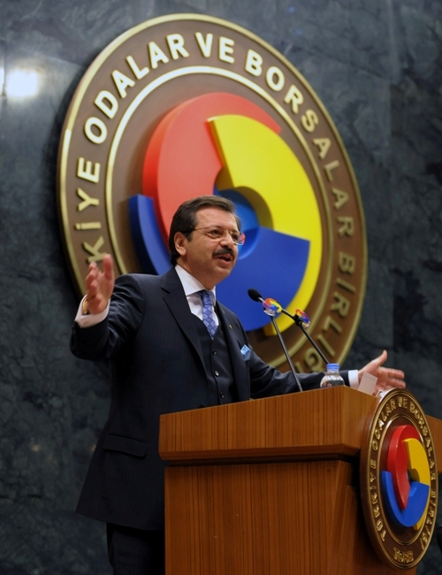
The Union of Chambers and Commodity Exchanges of Turkey (TOBB)
Very active President nationally and internationally
Vice President of EUROCHAMBRES
Vice President of Islamic Chamber of Commerce, Industry and Agriculture (ICCIA)
Member of the Executive Board of ICC (International Chamber of Commerce),
Chairman of ICC Turkey, ICC G-20 Advisory Group Member
B20 Turkey Chair
Vice President of the Confederation of Asia-Pacific Chambers of Commerce and Industry (CACCI )
Co-President of the Turkish-Arab Chamber
International President of the Jerusalem Arbitration Center
Member of the Board of the Association of Balkan Chambers (ABC)
Co-Chairman of the EU-Turkey Joint Consultative Committee
President of the Board of Trustees of TOBB University of Economics and Technology
President of TEPAV (The Economic Policy Research Foundation of Turkey)
Member of The Supreme Council for Science and Technology of TUBITAK (The Scientific and Technological Research Council of Turkey)
….

Slide 8
TOBB CERN Industrial Liaison Office
Journey of CERN
  May 2015 MOU with TAEK
  June 2015 First Council Meeting Attendance
  (never missed one since)
  Aug 2015 First Visit to Heads of Departments
  Oct 2015 First CERN Industrial Event
  Dec 2015 Training of Local Chambers’ Reps
  Apr 2016 CMS & Hi-Lumi Event
  May 2016 KT – TTO Summit
  Oct 2016 Hi-Lumi Event (Portugal)
  May 2017 Hi-Lumi Event (UK)

Slide 9
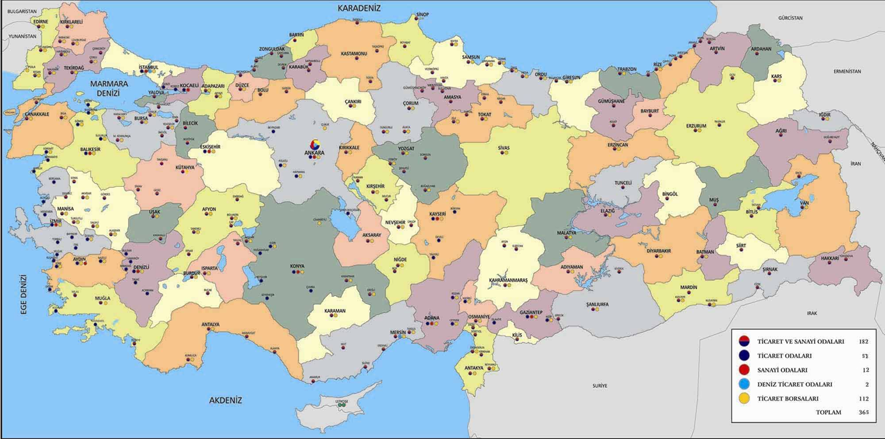
TOBB CERN Industrial Liaison Office
(26 events – 3 with CERN)
Journey of CERN

Slide 10
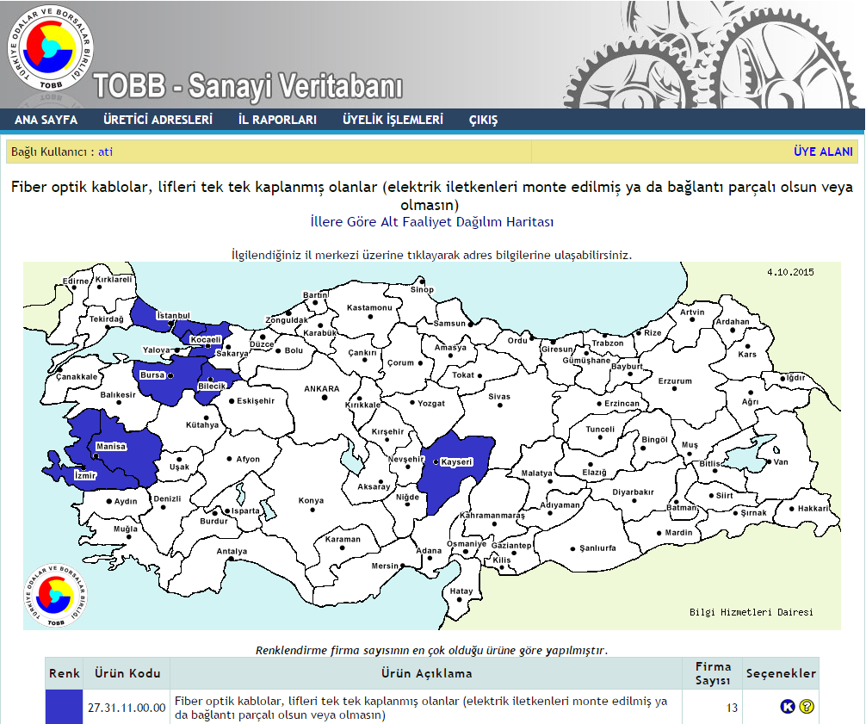
TOBB CERN Industrial Liaison Office
Journey of CERN
  Industrial Database of Turkey
    Capacity data of industrial companies
      The company output with its available machinery and employees?
    Capacity reports of 73.000 companies
    Statistics of machinery and stock
    Province, product and sectoral basis searching
  Not all related to CERN Inquiries
  ~6.000 – 9.000 Solid Firms
  ~2.000 Med-Hi Tech to High-Tech
  ~1.200+ In our TOBB-CERN Network

Slide 11
TOBB CERN Industrial Liaison Office
Journey of CERN – Our Network
  Variety of our Network
    Owners, Executives or High Level Sr. Representatives
    Associations of Major Sectors
    Local Chambers’ network
    Technoparks
    Industrial Zones
  Capacity of our Network
    They are good and busy…
    They want the challenge of CERN jobs but are carefull
    They are communicating each other and with us.
    Transition we are in. (Defense to civil apps)

Slide 12
TOBB CERN Industrial Liaison Office
Journey of CERN – Issues as a new comer
  CERN’s hesitance
    Criticality of many tenders
    Time frames
    Level of Trust / getting to know each other
    No visits to Turkish Firms
    Different Approach from one Technical team to another

Slide 13
TOBB CERN Industrial Liaison Office
Journey of CERN – Issues as a new comer
  Our Internal Knowledge of CERN
    New territory
    Who does what? & How?
    Limited stay and time at CERN
    ILO Forum & Procurement
  Some Limitations
    Not everything is done in-house.
    Level of English
    Comfort Zone vs New Time-Effort in an unknown territory
    Short Time frame with DOs

Slide 14
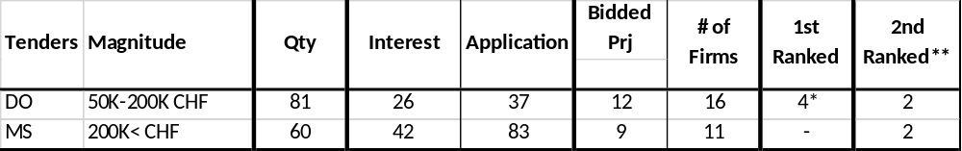
TOBB CERN Industrial Liaison Office
Journey of CERN – Overall
  2015 was a learning & organizing year for us.
  2016 was part learning and part involvement
    Major developments in the region and turmoil
    Stats for 2016

Slide 15
TOBB CERN Industrial Liaison Office
Journey of CERN – Overall
  2017 is going better in terms of Industrial Return
  Reached 9 firms of supply to CERN
  Introduced more than 50 good firms to CERN
  More variety of supplies and tender’s participated
  Executive Support to CERN is very promising
  Press and Public closely following the details
  Confident that Academia and Professional Involvement at CERN and FA will increase at a higher rate also

