Slide 1

Introduction to High Energy Physics in Turkey
Serkant Ali Çetin

Slide 2

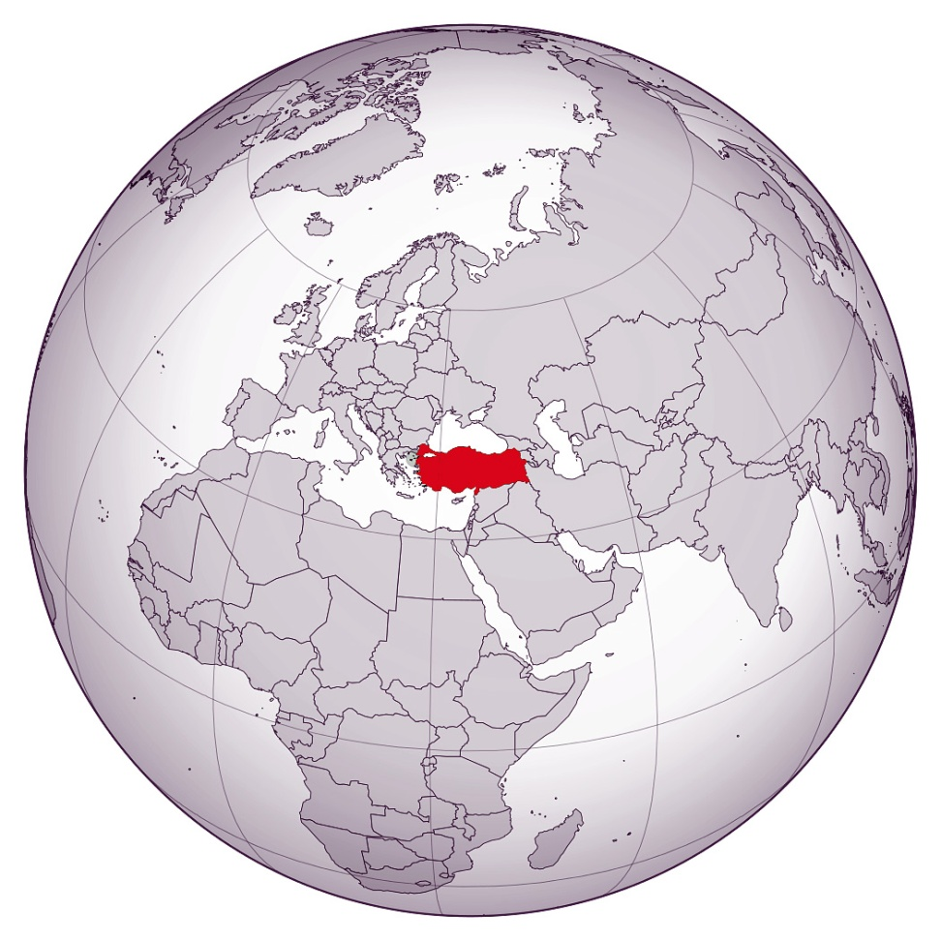
About Turkey
Republic of Turkey founded in 1923
Area: 783,562 km²
Currency: Turkish Lira (TRY)
  1 TRY = 0.28 $ = 0.24 €
Capital City: Ankara
Time Zone: UTC+3
Electricity: 220V at 50Hz (EU Plug)
Traffic:
  Drive on right side of the road
  50 km/h in developed areas
  90 km/h on two lane roads
  120 km/h on highways
Phone Code: +90
Emergency Numbers
  Dial 155 for Police
  Dial 112 for Medical
  Dial 110 for Fire

Slide 3
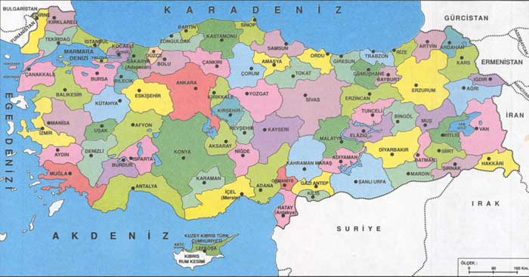
About Turkey
7 geographical regions with a total of 81 cities
Population:
  79.8M (2016)
    Age distribution: “0-14” 24%, “15-64” 68%, “65+”8%
  Growth rate 13.5% (2016)
  Most populated cities:
    İstanbul 14.8M
    Ankara 5.3M
    İzmir 4.2M
    Bursa 2.9M
    Antalya 2.3M
GDP: $821 billion (Ranks 17th)
  GDP growth rate ~5% (2017 2nd quarter)

Slide 4
Education
Compulsory education of 12 years starting from age of 6.
  4 years primary sch.
  4years secondary sch.
  4 years high school
Higher Education
  Vocational schools, 2 years
  Bachelor’s, 4 years
  Master’s, 2 years
  PhD, 4years

Slide 5
Higher Education
185 universities (2/3 state, 1/3 foundation)
  ~40 Universities admitting physics students
6.2M Vocational and Bachelor students (92% state)
  2.3M Voc.
  3.9M Bach.
    10k physics st.
    281k engineering st.
0.5M grad. st. (82% state)
  6.4k physics grad. st. (4.6k MSc, 1.8k PhD)
  62k engineering grad. st.

Slide 6
Higher Education
Total: 152k academics
(w 44%)
  Faculty: 72k (w 38%)
    Prof.: 23k (w 30%)
    Assoc. Prof.: 14k (w 37%)
    Assist. Prof.: 35k (w 42%)
  Instr.: 21k ( w 44%)
  Res. Assist.: 45k (w 50%)
  Others: 14k (w 57%)
In Physics: 1.96k academics (w 33%)
  Faculty: 1.35k (w 28%)
    Prof.: 0.59k (w 22%)
    Assoc. Prof.: 0.39k (w 28%)
    Assist. Prof.: 0.37k (w 37%)
  Instr.: 0.04k ( w 24%)
  Res. Assist.: 0.50k (w 44%)
  Others: 0.06k (w 40%)

Slide 7
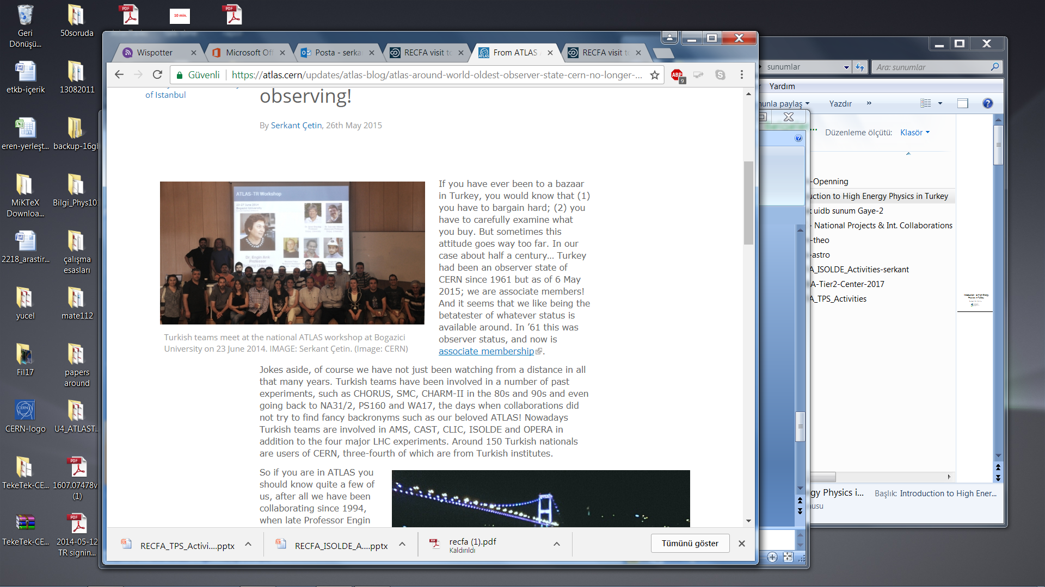
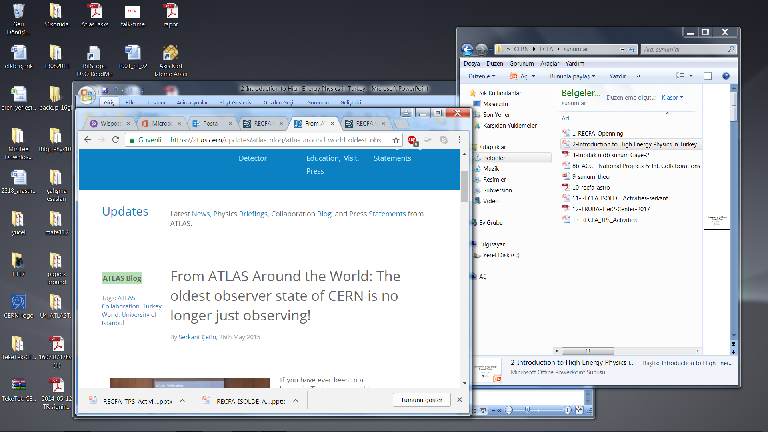
The story of Turkey-CERN relations
May 26th 2015

Slide 8
The story of Turkey-CERN relations

Slide 9
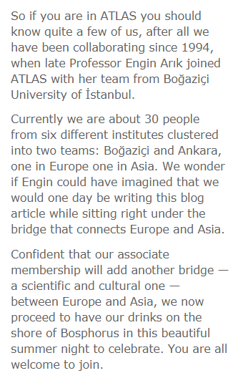
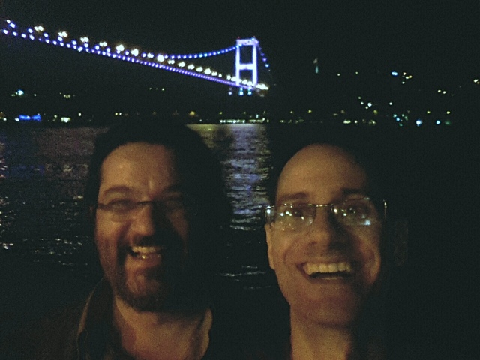
The story of Turkey-CERN relations
By S. Çetin & E. Özcan

Slide 10
The story of Turkey-CERN relations
Observer status in 1961
Collaborating at CERN programs initiated by individual attemps
Later on supported by TUBITAK and then by TAEK with partial financial supports
TAEK appointed as responsible for activities at CERN in 2006 by the prime minister
TAEK-CERN Collaboration Agreement signed in 2008
Turkey applied for full membership in 2009
CERN Council accepted the application in 2010 (together with four other countries) and started the procedure
In 2011 a Task Force came for evaluations; unofficial feedback was very positive but with a remark of the lacking corresponding body
In 2012 Turkey withdrew the full membership application and asked to convert it to associate membership application.
May 2014: Associate Membership agreement signed at CERN
Jan. 2015: Asscociate membership to CERN rectified in the parliament
May 2015: Associate membership officialized

Slide 11
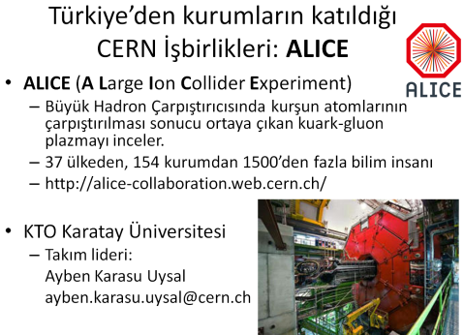
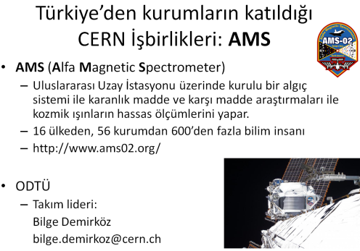
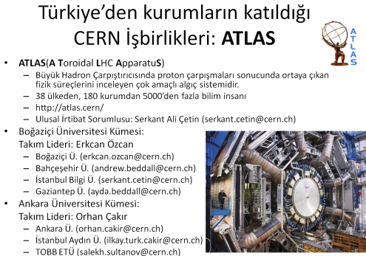
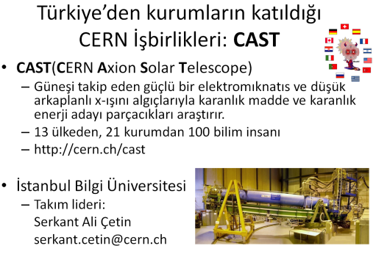
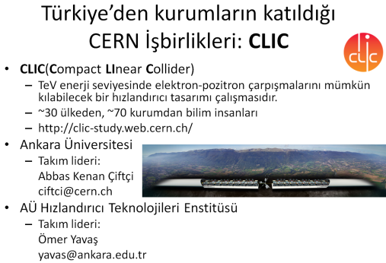
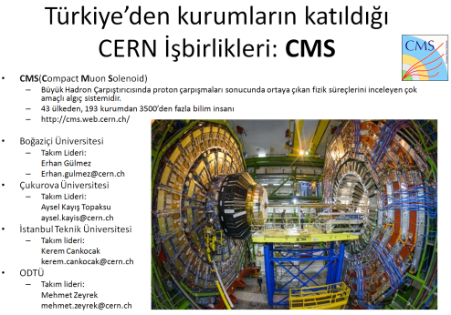
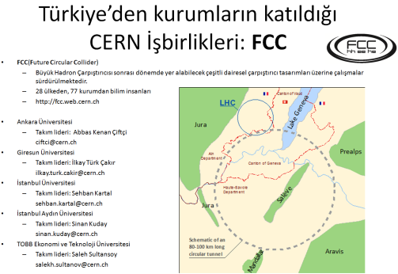
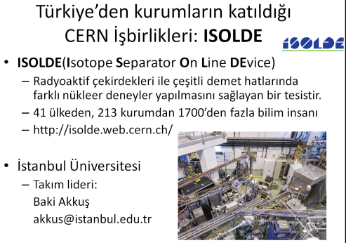
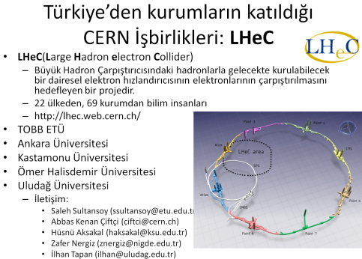
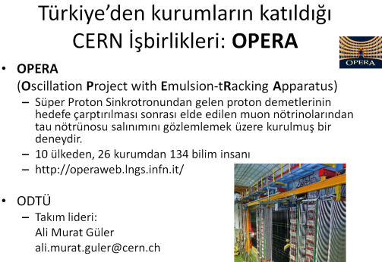
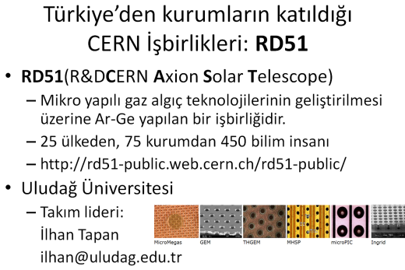
Details on these in following presentations…
CERN programs participated in all four categories of particle physics
Accelerator based experiments
Non-Accelerator based experiments
Accelerator R&D
Detector R&D

Slide 12
Funding Mechanisms
Ministry of Development
  Infrastructure supports
Ministry of Science Industry and Technology
  TÜBİTAK: “cover” supports
Ministry of Energy and Natural Resources
  TAEK: CERN travel support and MoU payments of some experiments
Adding up all three channels on the left might sound like we have support we need;
unfortunately this is not the case!
There are various diffucilties and bottlenecks in submitting projects by splitting in parts.

Slide 13
What are these bottlenecks?
Ministry of Development
    Training qualified personnel and reqruitment
    Operation costs and mobility
    Difficulties in managing the budget through the university’s finance divisions.
Ministry of Science Industry and Technology
    Limitted budget inconvenient for large scale projects
    Not supporting long stay travels
    Not covering lpng lasting national/international collaborations
Ministry of Energy and Natural Resources
    Supporting travels to CERN only; impossible to collaborate with other labs/institutes around the world, attending meetings at places other than CERN not funded.
    No travel money in Turkey
    50% of offical per diem paid for travel and the project member has to sign a letter of undertaking.

Slide 14
~Sustainable support received
TUBITAK projects supporting earlier and current experiments like CHORUS, CMS and ATLAS.
Support between 1994-2000
Then a big gap till TAEK support became available in ~2005
2006-2009: very efficient dialogue between the community and TAEK
“CERN Science Commitee” formulated by TAEK and called for meetings (~2-3/year) by TAEK (travels covered).
Country Report of Turkey for CERN membership was prepared during those times! (see following slides)
From 2010 and on, TAEK support weakened in many areas

Slide 15
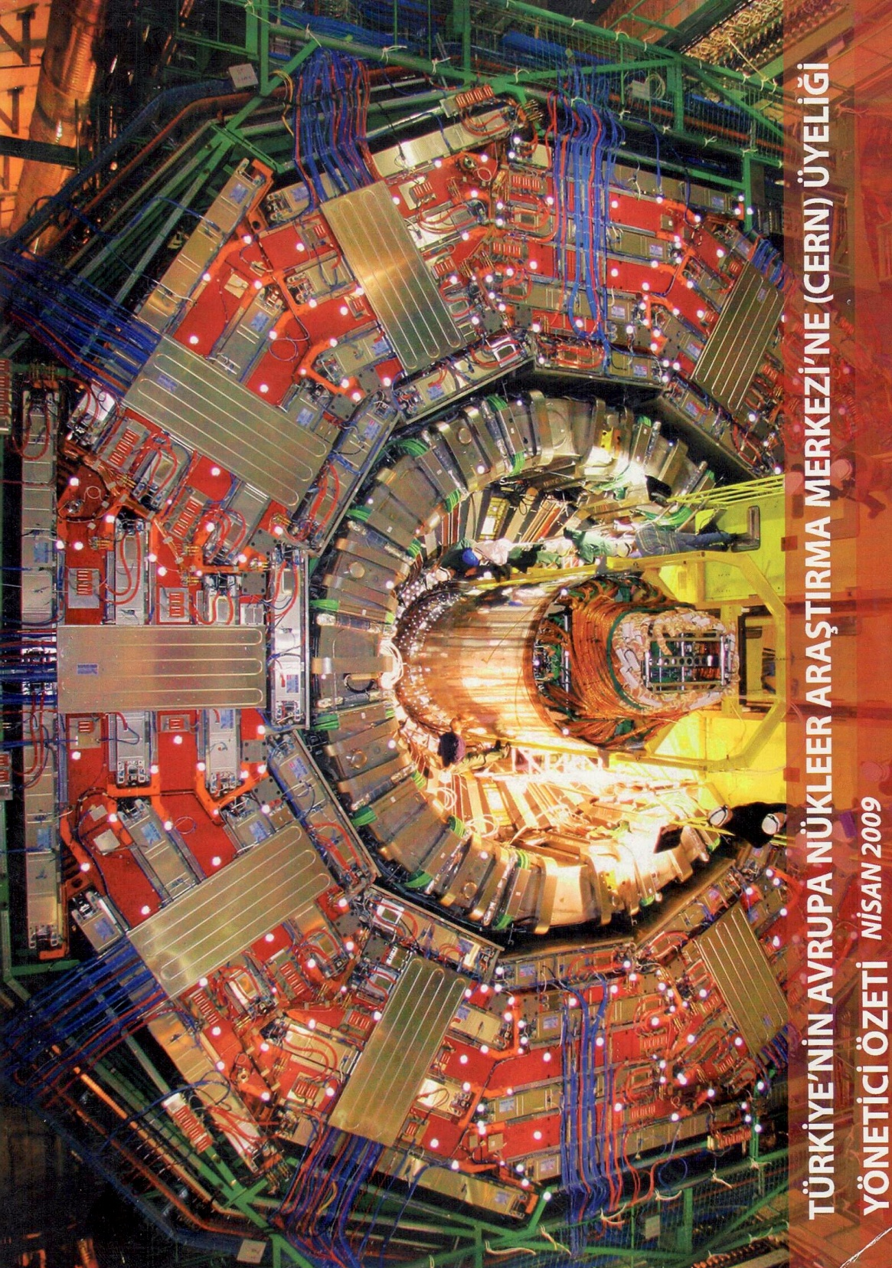
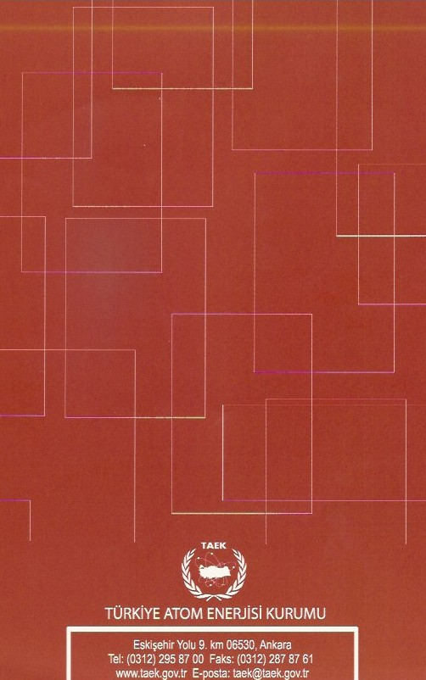
An executive Summary prepared by TAEK about CERN membership
April 2009 – 11 pages

Slide 16
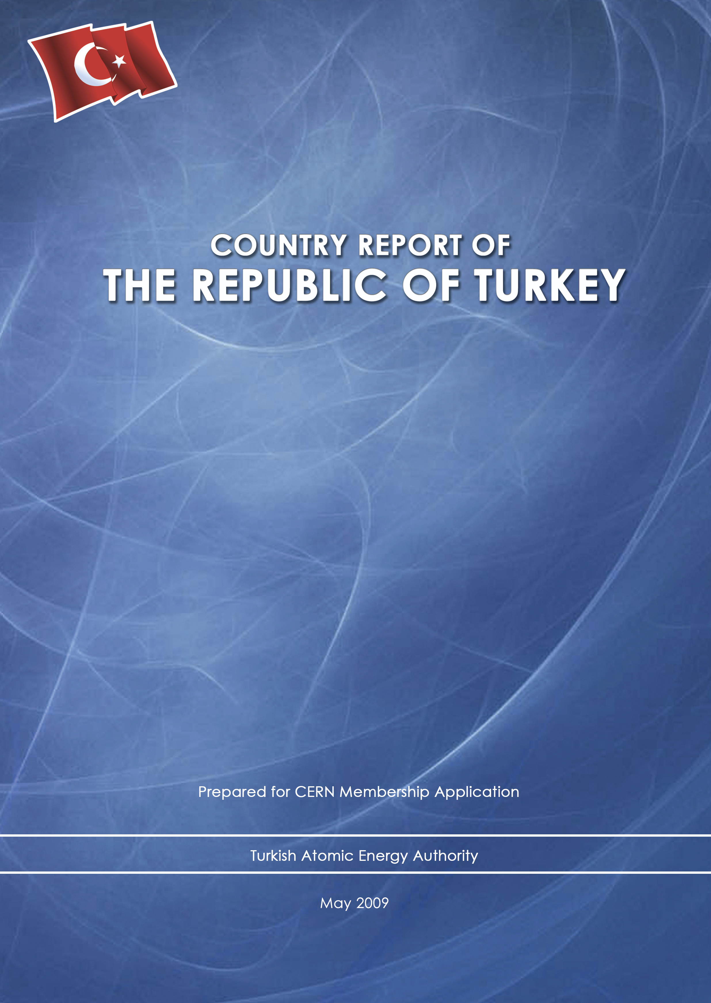
125 pages

Slide 17
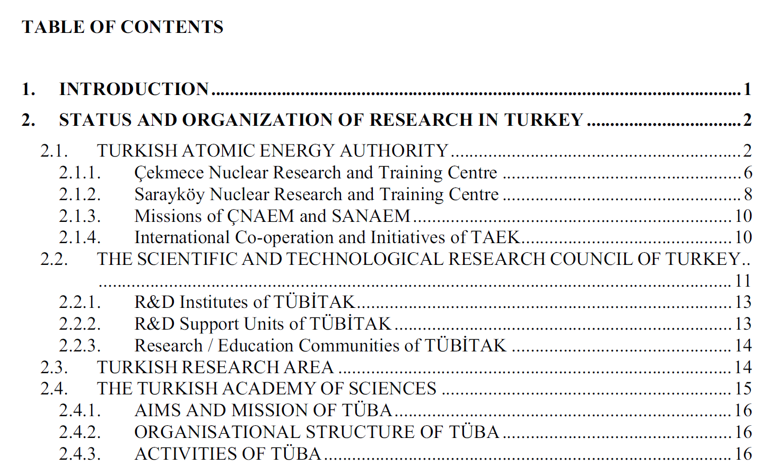

Slide 18
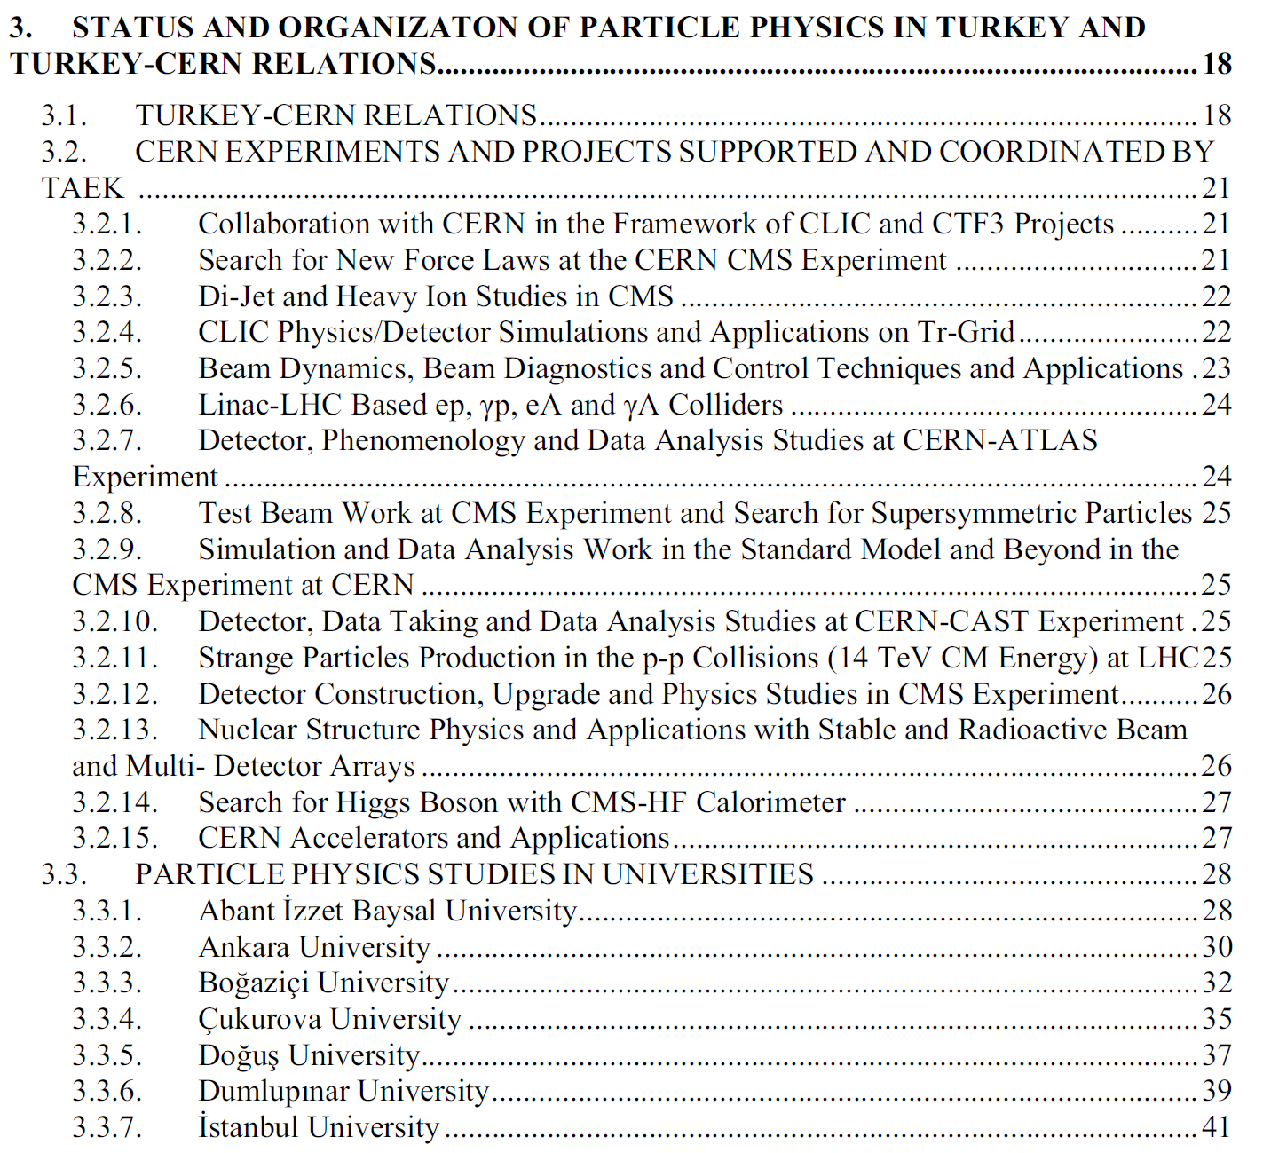

Slide 19
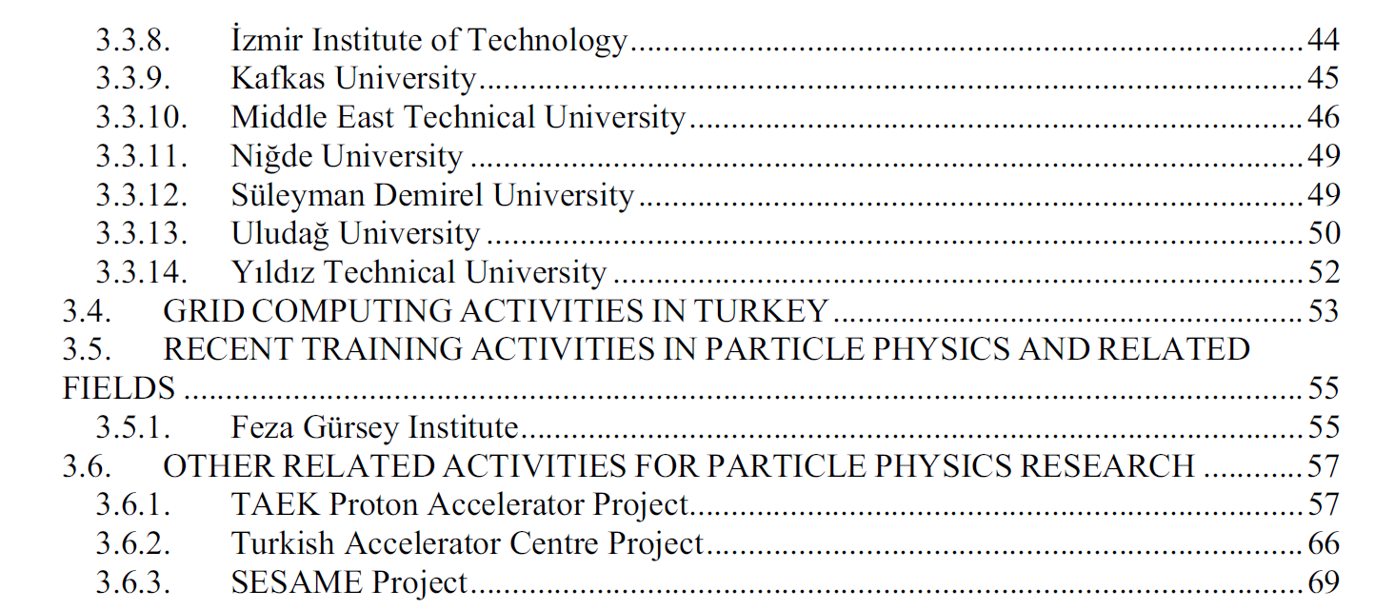

Slide 20
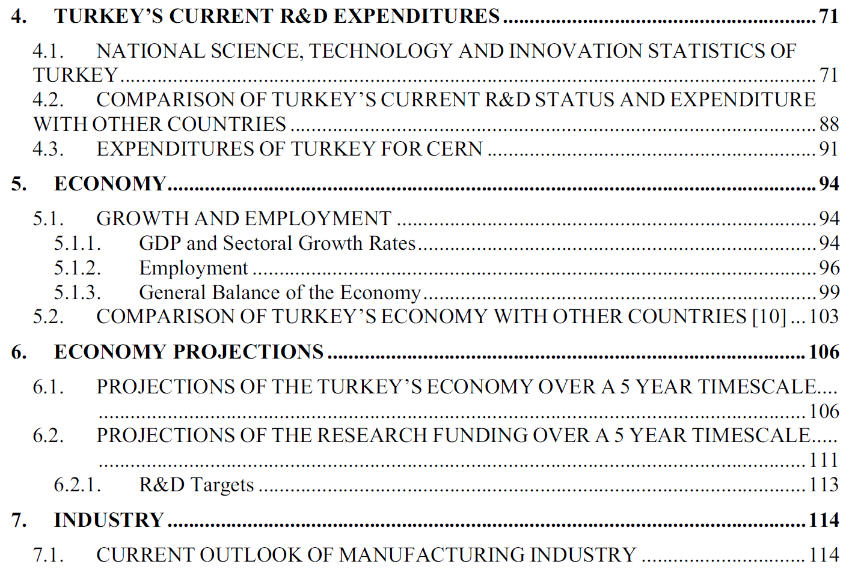

Slide 21
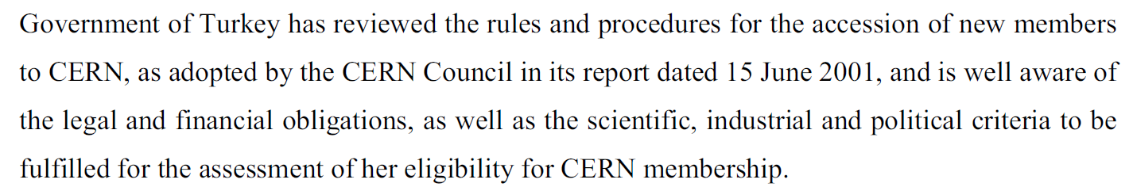
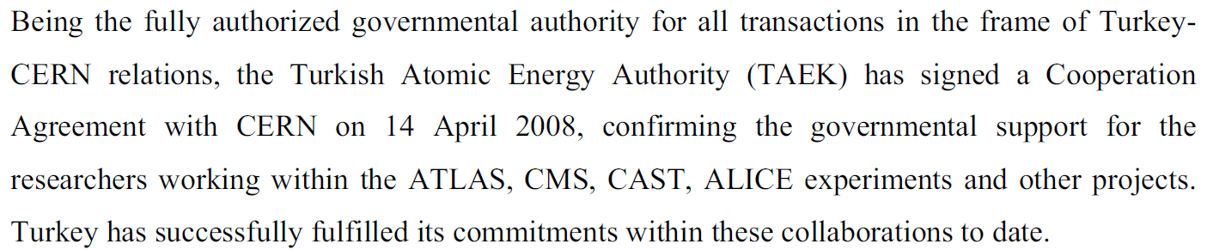

Slide 22
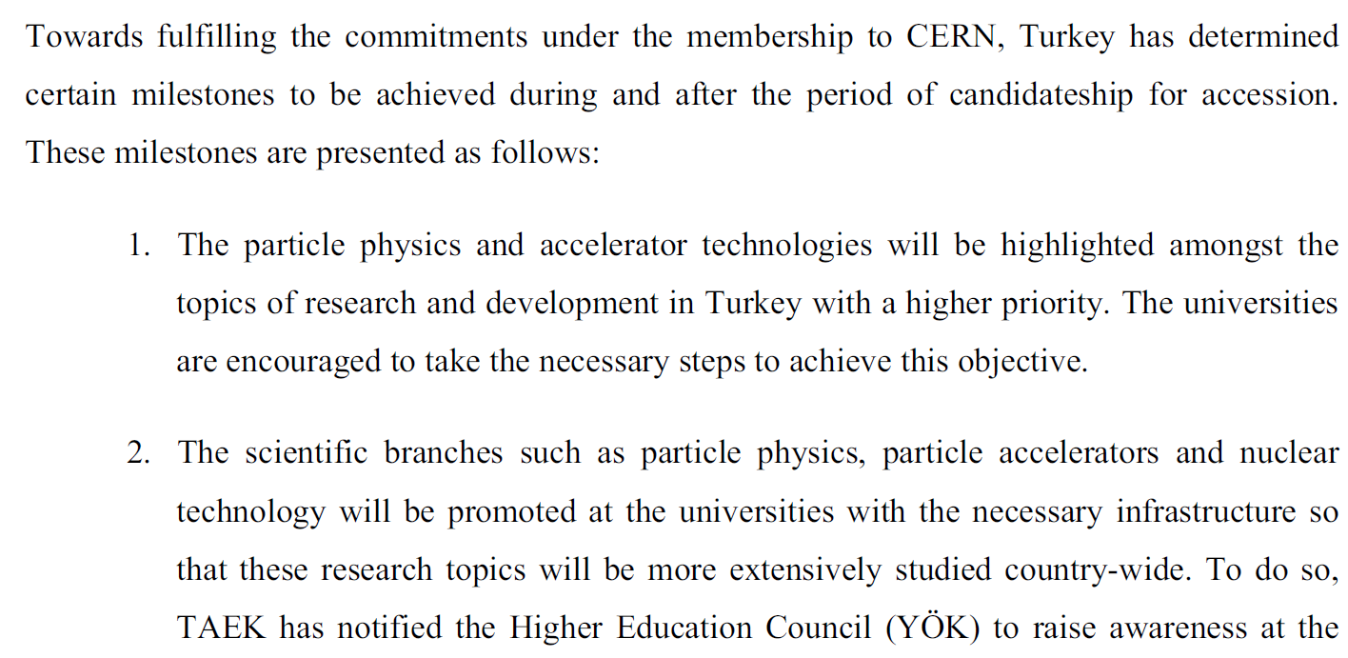
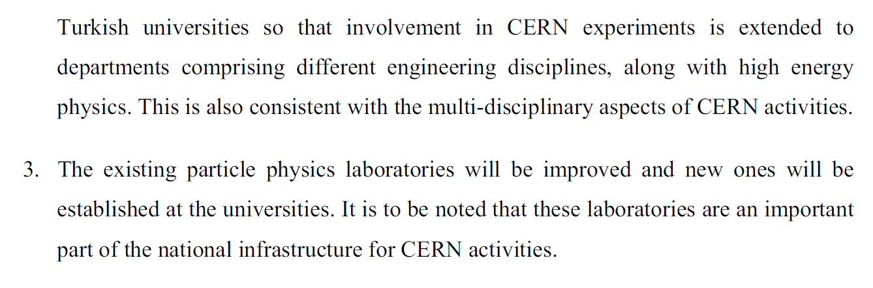

Slide 23
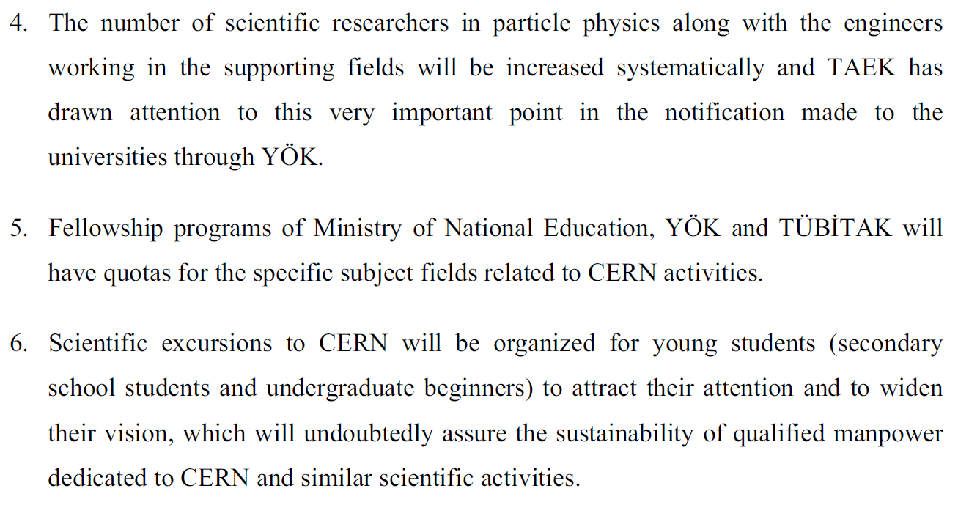

Slide 24
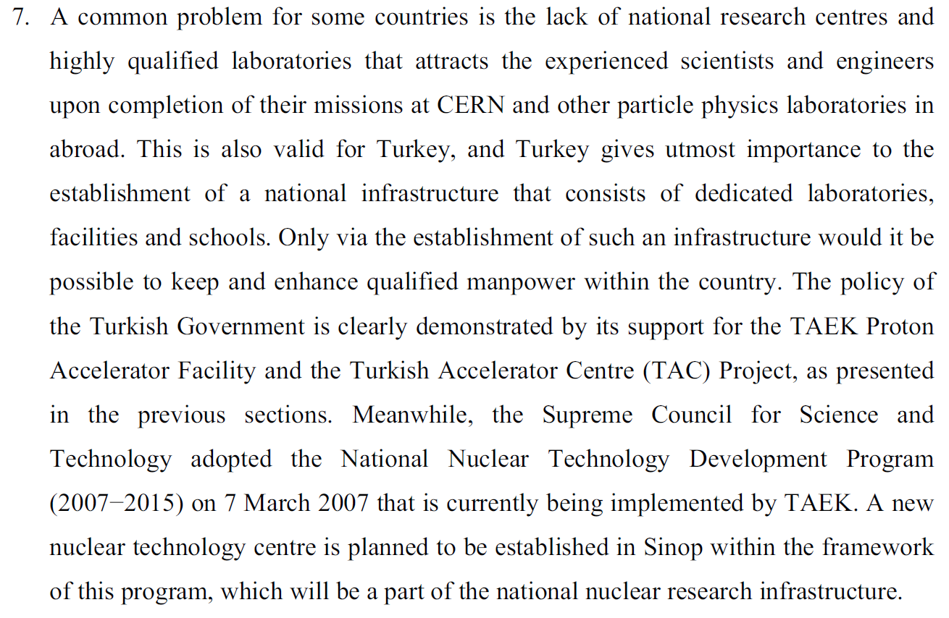

Slide 25
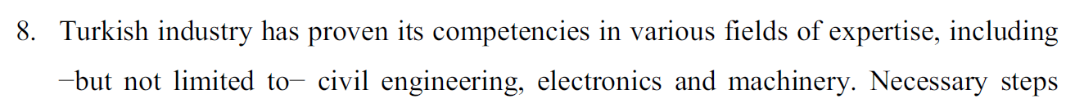
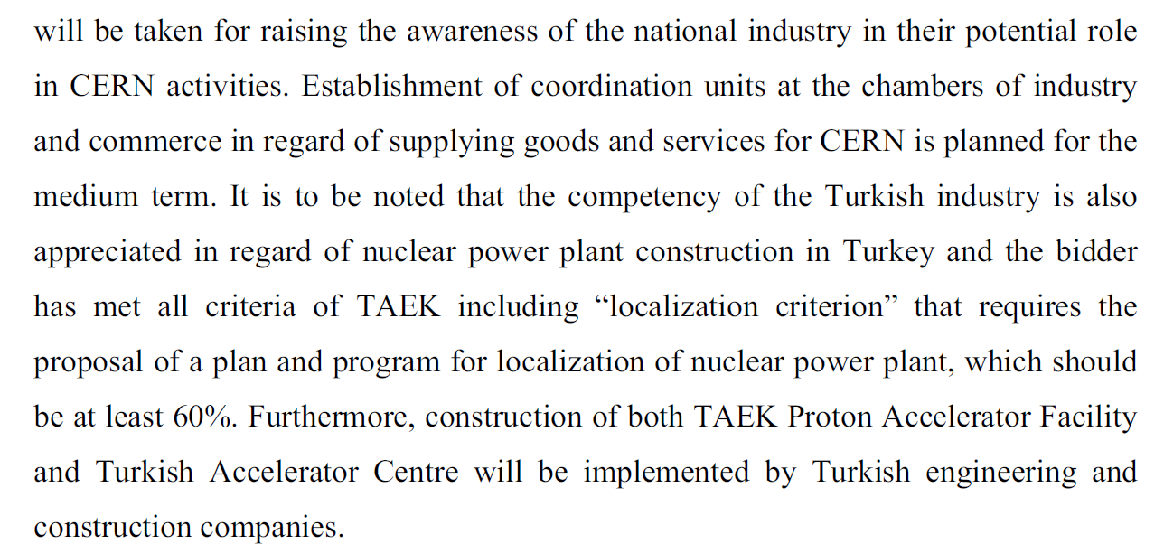

Slide 26
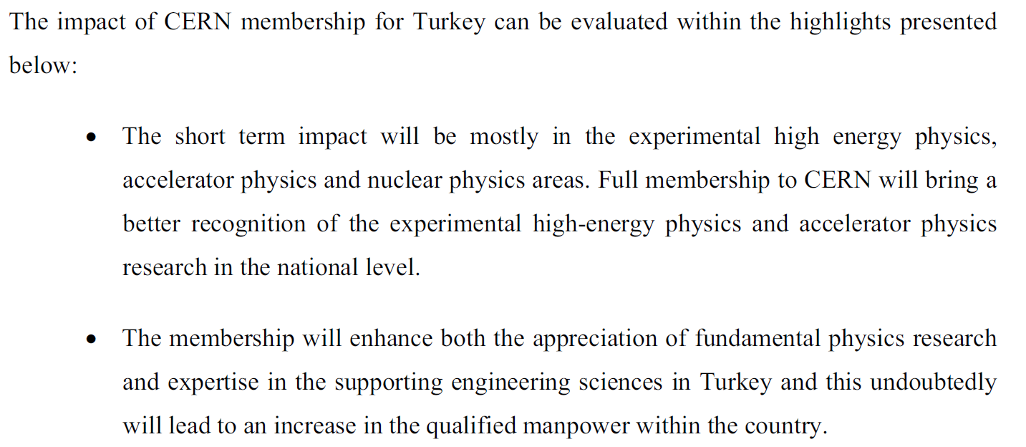

Slide 27
However…
After 2009, increasing lack of communication between community and FA
Community was not aware of the withdrawal of membership application from CERN in 2012.
In addition to the cuts on travel destinations and per diems, a limit on the number of qualified PhD’s in ATLAS and CMS was declared by FA in 2013 without any consultancy. At that time the limit was just the volume of ATLAS but half of that of CMS! This made it impossible for both experiments to grow and triggered a “survival” mode rather than growing ambitious teams…

Slide 28
Contacts with FA after 2009
Only 2 meeting calls by TAEK in 2014 and 2016
In 2015, university visits were done by TAEK to improve interaction with the teams and plan progress in the field… but was not transfered into any action item by TAEK later on.
One of the agenda items of the 2nd meeting was to set up a board from the community; and we were asked to formulate this.
This is when the community took the initiative to self-organize coordination meetings: first meeting on April 2016.

Slide 29
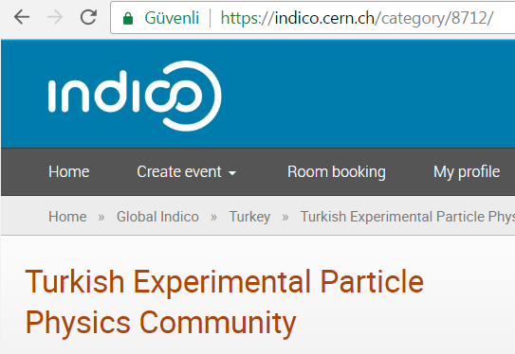
~80 people with Phd
  From 44 different institutions
  50-100 grad. st. (67 counted)
Participating in ~20 different collaborations
Major collaborations with >5 people, (desc. order): CMS, TAC, ATLAS, FCC, LHeC, CLIC

Slide 30
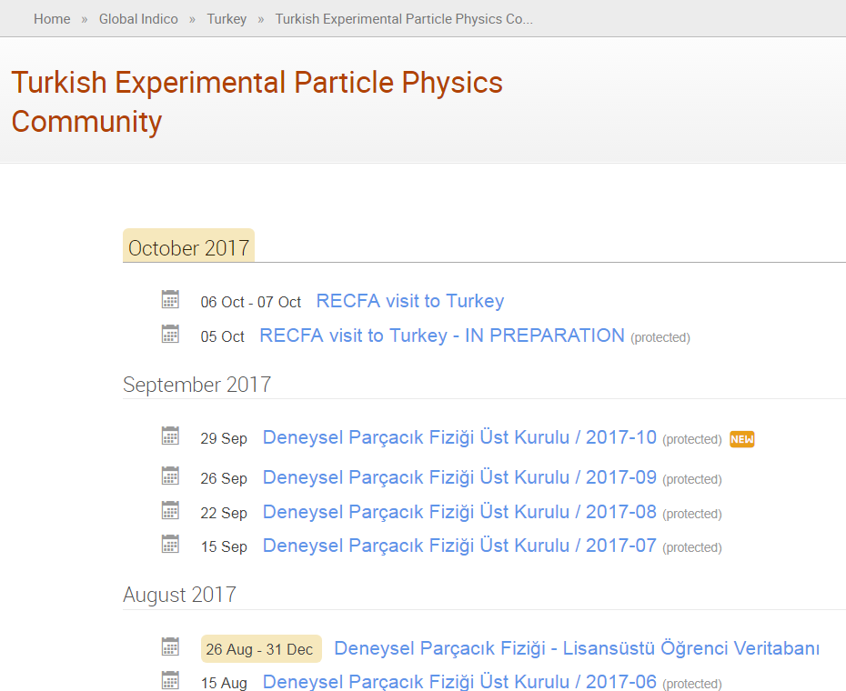
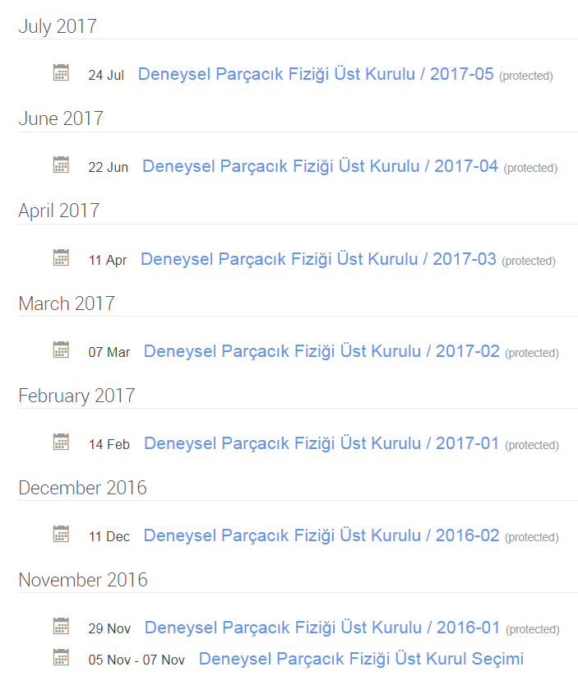
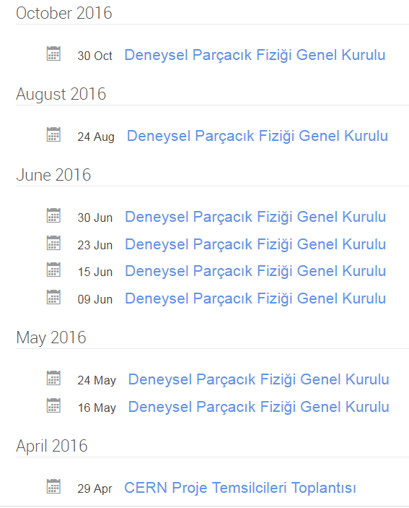

Slide 31
A Representative Board has been elected; Nov. 2016
Duties of the Rep. Board defined by the General Board
Members represent all fields of experimental particle physics
TAEK was informed throughout this process with many letters written
Also several letters written for presence within ECFA
Members of the representative Board:
Prof. Dr. Orhan Çakır (Ankara Ü.)
Prof. Dr. Serkant Ali Çetin (İstanbul Bilgi Ü.), Chair
Prof. Dr. İsa Dumanoğlu (Çukurova Ü.)
Prof. Dr. Ali Murat Güler (Orta Doğu Teknik Ü.)
Prof. Dr. Veysi Erkcan Özcan (Boğaziçi Ü.)
Prof. Dr. Suat Özkorucuklu (İstanbul Ü.)
Prof. Dr. Saleh Sultansoy (TOBB Ekonomi ve Teknoloji Ü.),
Prof. Dr. Aysel Kayış Topaksu (Çukurova Ü.)
Prof. Dr. Ömer Yavaş (Ankara Ü.)

Slide 32
Meanwhile with TÜBİTAK…
Two very important meetings were organized by TÜBİTAK and were in person chaired by the president of TÜBİTAK:
  20 Feb. 2017
  10 Apr. 2017
Through these meetings very ambitious studies have started to define a “National Road Map” for studies in particle accelerators and detectors.
As a followup, a wider 2 days workshop was organized to solidify the necessary steps to be taken:
  10-11 Temmuz 2017

Slide 33
Items from the projected road map
Accelerator Technologies
Usage of Accelerators
Electron Acc.
Proton Acc.
Other particles and heavy nuclei
Turnkey installations
Development and installation
Relations with labs abroad and education
The community will concentrate in finishing this document in the coming months…
Detector Technologies
National Projects
Gaseous trackers
Silicon trackers
Scintillators and calorimeters
Magnets
DAQ and electronics
Supercharm factory
Higgs factory (γγ)
GeV scale proton beams
Non-accelerator experiments

Slide 34
CERN Panel in Sept. 2017
Organized by the Turkish Physical Society
Panelists were:
  TÜBİTAK representative; vision of TÜBİTAK to support national projects in the field was mentioned
  TAEK representative; report on total budget spend for CERN programs was given and TAEK’s own R&D programs were introduced
  TOBB representative; progress of industrial awareness about CERN was reported with examples
  Science community representatives; the spectrum of research and current collaborations were summarized with strong remarks on recent problems with FA
  Industry representatives; shared their individual experiences while doing business with CERN

Slide 35
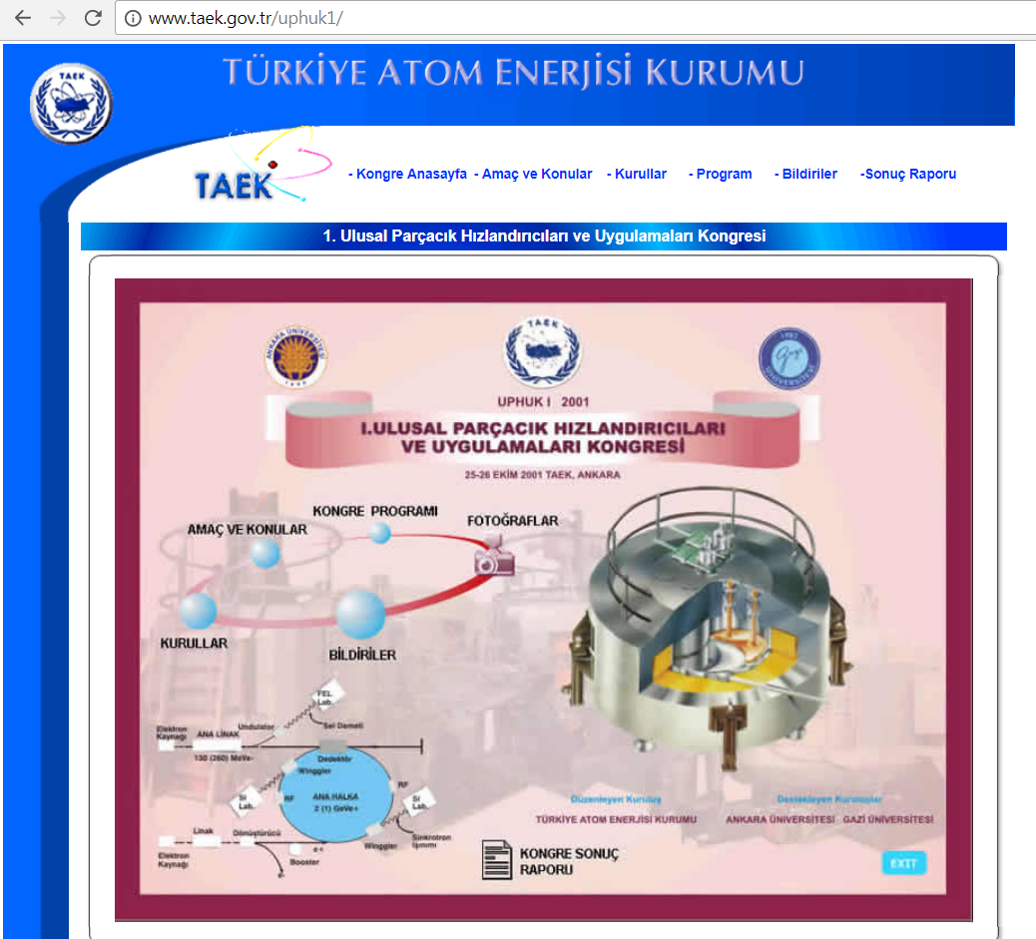
1st National Particle Accelerators and Applications Congress

Slide 36
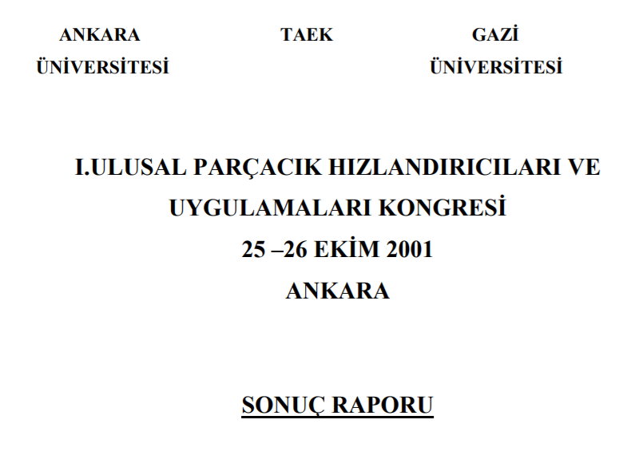
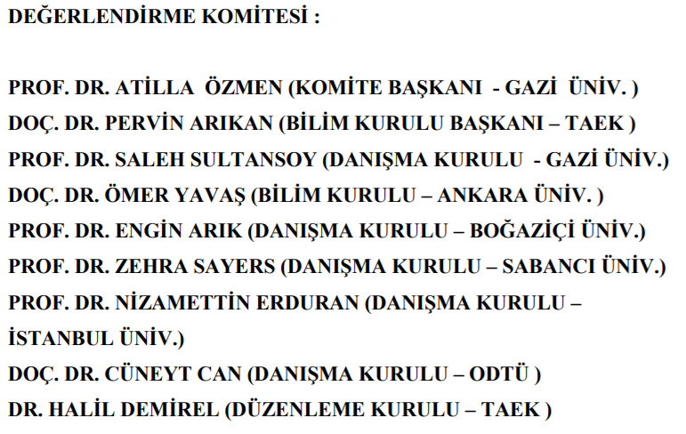
1st National Particle Accelerators and Applications Congress (2001)

Slide 37
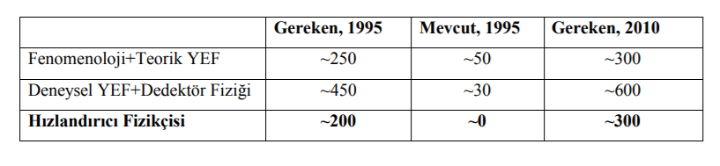
1st National Particle Accelerators and Applications Congress (2001)
From the conclusion of the summarizing report:
Needed in 95
Present in 95
Needed by 2010
HEP pheno + theo
Exp. HEP + det. Phys.
Acc. phys.

Slide 38
Recent TAEK Communication
Just yesterday, we received a call for a meeting by TAEK next month!
The program looks very similar to the current RECFA timetable.
Although TAEK didnot agree to send any representative to this RECFA meeting it looks like this meeting already triggered them to make such an organization.

Slide 39
Concluding Remarks
Community is interested in various fields and actively collaborates within many experiments
Long term and large scale projection is currently unavailable
Teams cannot grow in the desired pace
A “National Road Map” is the key missing ingredient that would secure functioning of the corresponding bodies efficiently
Lack of communication with authorities is unfortunately a reality

