Slide 1




RECFA Country Visit to Turkey
Open Session
October 6th, 2017
Boğaziçi University
Rectorate Conference Hall
Jointly hosted by
Boğaziçi University and
İstanbul Bilgi University

Slide 2
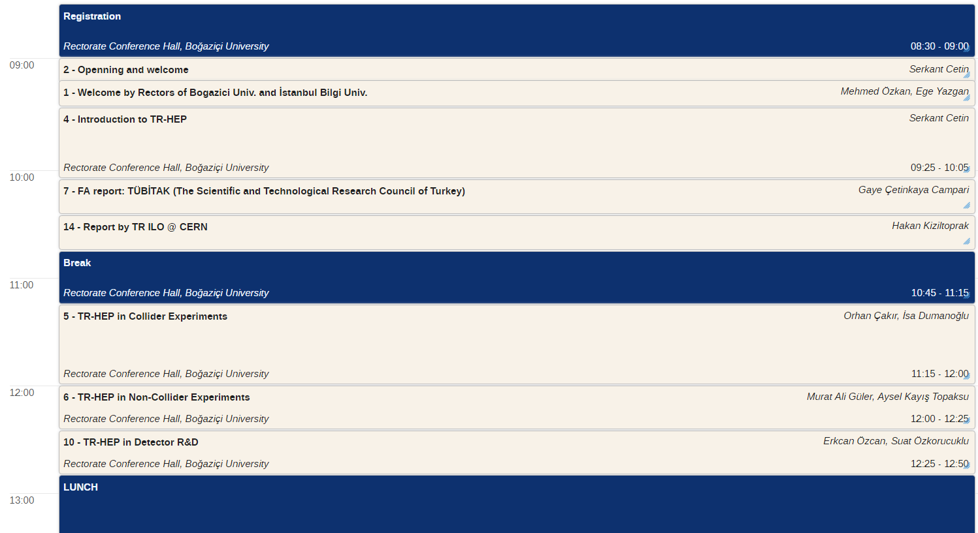
RECFA Country
Visit to Turkey
Open Session
Timetable

Slide 3
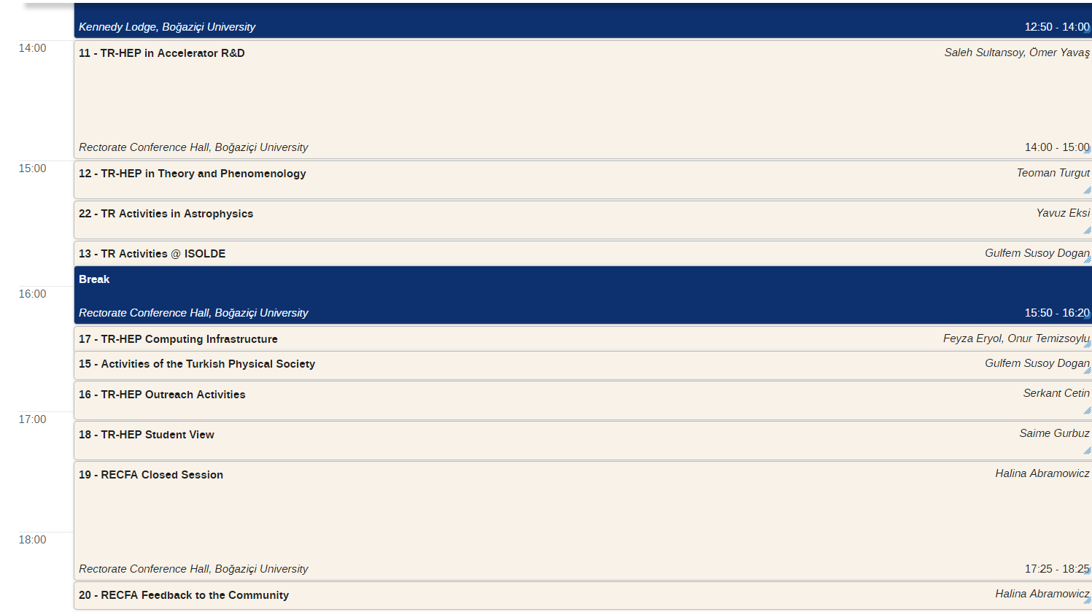
RECFA Country
Visit to Turkey
Open Session
Timetable

Slide 4
RECFA Country Visit to Turkey
Open Session
Welcome Address by
Mehmed Özkan
Rector of Boğaziçi University
October 6th, 2017
Boğaziçi University
Rectorate Conference Hall

Slide 5
RECFA Country Visit to Turkey
Open Session
Welcome Address by
Ege Yazgan
Rector of İstanbul Bilgi University
October 6th, 2017
Boğaziçi University
Rectorate Conference Hall

