Slide 1

Career Paths for Physics PhDs: Academia vs. Industry
Insights from a Tech Industry Executive
Gareth Noyes
  PhD Particle Physics, UoB 1994

Slide 2
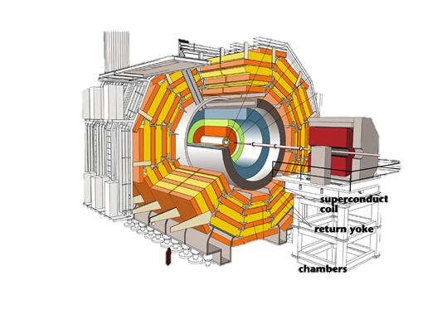







About Me
https://www.linkedin.com/in/garethnoyes/
1. RESEARCH
2. COMMERCIAL SOFTWARE
3. CONSULTING
10 years
25 years
2 years
Particle Physicist
Expert in detectors & data acquisition: Rutherford Appleton Laboratory, Large Hadron Collider at CERN
Chief Strategy Officer
Embedded systems, IoT and edge computing, range of operational roles. 15+ acquisitions, 3x sale of company
Software Strategy
Independent consultant: software for critical edge infrastructure offering strategy and M&A advisory services

Slide 3
Academia vs. Industry
Considerations
      Academia
Focus on research, teaching, publishing papers, and contributing to scientific knowledge.
      Industry
Application of scientific principles to solve real-world problems, product development, and innovation.
Pros
Cons
Pros
Cons
Intellectual freedom
Opportunity to contribute to fundamental research
Teaching and mentoring students
Limited funding and resources
Pressure to publish
Potentially slower career progression
Higher earning potential
Access to cutting-edge technology and resources
Faster career progression and diverse opportunities
Less focus on fundamental research
Potentially less intellectual freedom
Pressure to deliver results and meet business goals

Slide 4
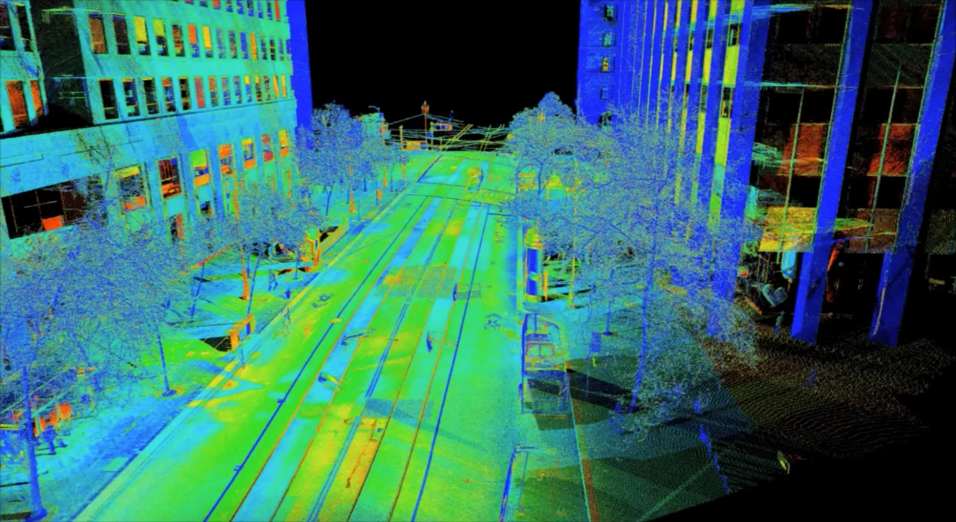




Rise of Deep Tech
Increasing importance of scientific knowledge
  Sensing & imaging technologies: Lidar in autonomous systems, sensor fusion
  Statistical methods and Big Data: AI, data-driven everything
  Silicon process technology: Moore’s Law and geopolitical tensions, complexity of system design
  Power generation (incl. Fusion): distributed power generation, huge increase in demand due to data centers and AI
  Quantum computing: at the dawn of a huge computing transformation

Slide 5
Call to Action
Suggestions for a switch to Industry
Understand your passions: what gets you jumping out of bed?
Identify your transferrable skills
Explore sectors or applications that pique your interest
Focus on companies that you admire
Gain experience: internships or graduate programs
Polish your soft skills
Network, network, network
Q&A

Slide 6


Thank You
  e: gareth@noyesconsulting.com
  m: +1 (510) 384-3285
https://www.linkedin.com/in/garethnoyes/

