Slide 1
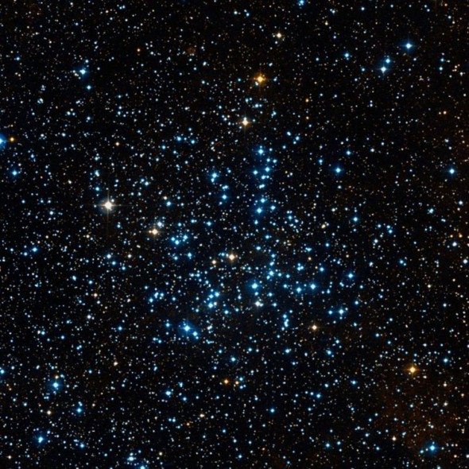

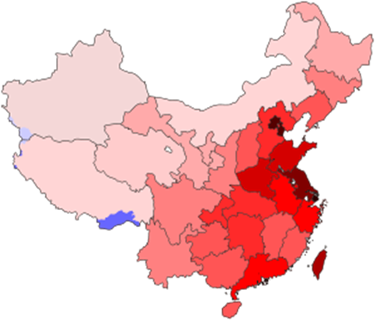
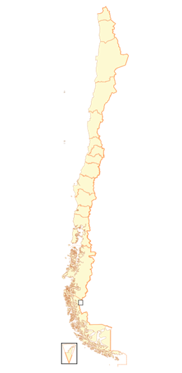
The joint astronomical research between
China and Chile
Guido Garay
Universidad de Chile
National Astronomical Observatories of China
7th China-Chile Bilateral Conference for Astronomy
University of Hong Kong, Hong Kong, China
January 6, 2026

Slide 2
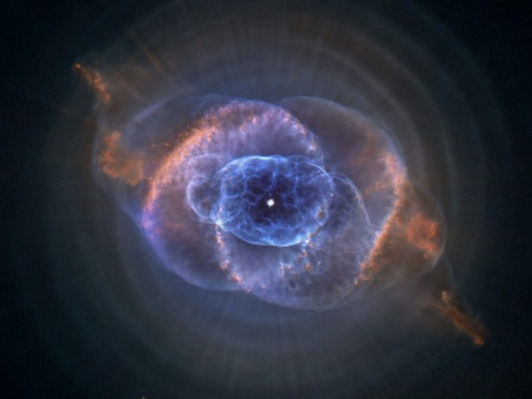
Chinese Academy of Sciences
South American Center for Astronomy
Creation: important result of the bilateral relationship between China and Chile for scientific and technological cooperation.
One of the first International Research Centers financed by
CAS, under its policy of establishing long-term ties with scientific communities from overseas.

Slide 3


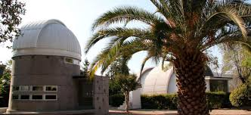
CASSACA started its
operation in Chile in
October, 2013.
Its offices are located in Cerro Calán, the campus of DAS and OAN.

Slide 4
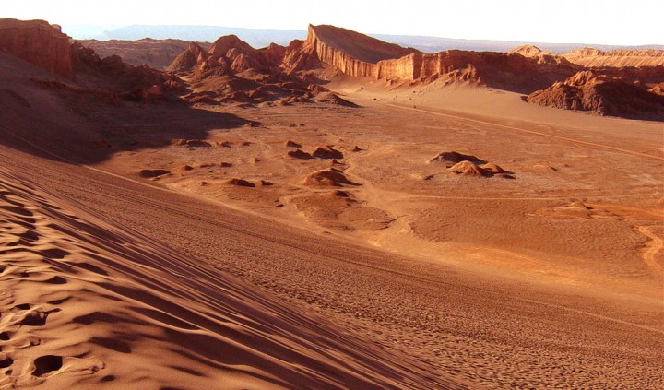

¿Why Chile?
• Chile has the most arid
desert in the world:
The Atacama Desert.
Sky: blue and transparent
Atmosphere: dry and stable
Ideal conditions for
astronomical observations.

Slide 5
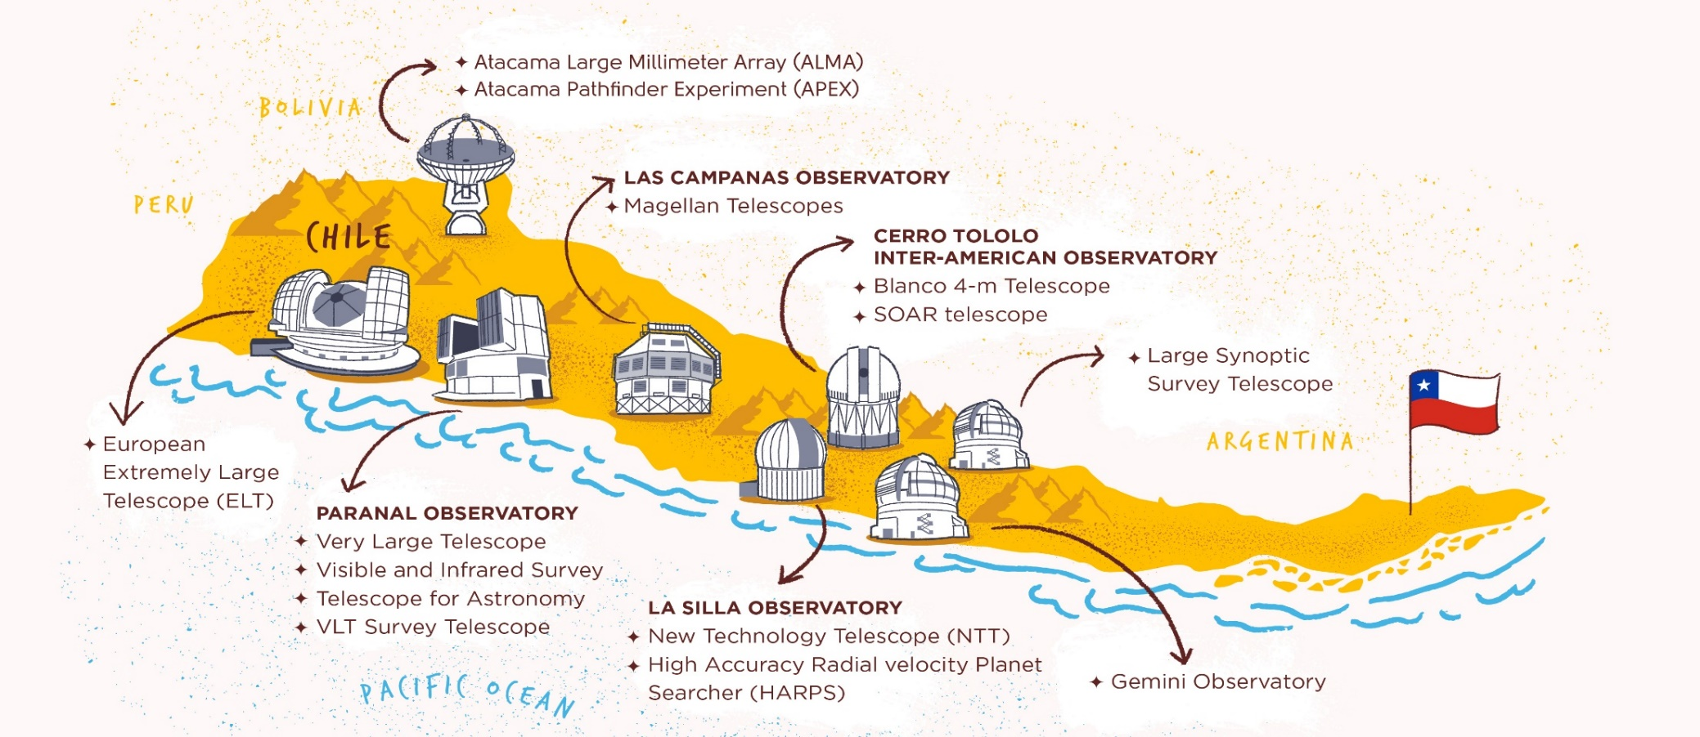
The Government of Chile, in particular University of
Chile, give to foreign institutions all the facilities to
install observatories in its territory.
By the end of this decade more than 50% of the world's
astronomical observation capacity will be located and
operational in Chilean territory.

Slide 6
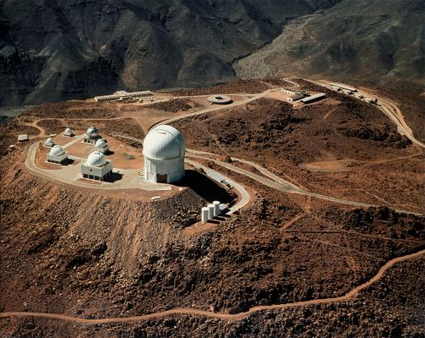
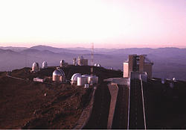
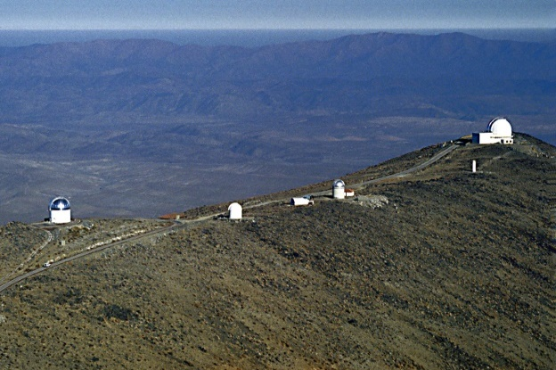
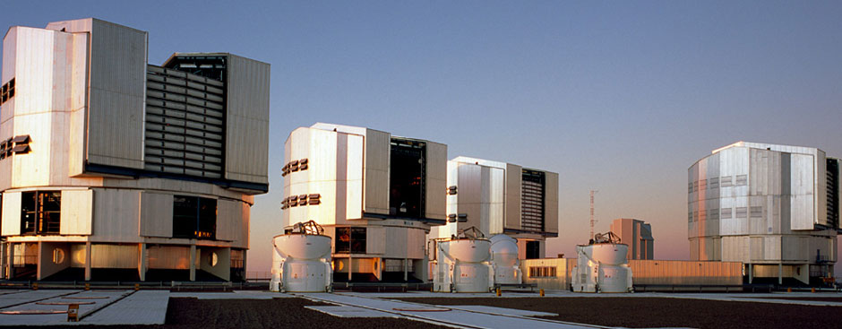
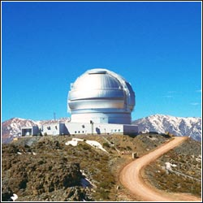
International Observatories:
1966 Cerro Tololo Inter-american
Observatory
1969 La Silla Observatory (ESO)
1971 Las Campanas Observatory
1999 Paranal Observatory (ESO)
2002 Gemini Observatory

Slide 7
MISSION
 Promote scientific research and collaboration in
astronomy between chinese and chilean astronomers.
 Tackle together fundamental problems in astrophysics
making use of the extraordinary infraestructure available
in Chile as well as in China.
Attract the young generations to astronomy providing
them the opportunity of performing frontier research.

Slide 8
Main infrastructure

Slide 9
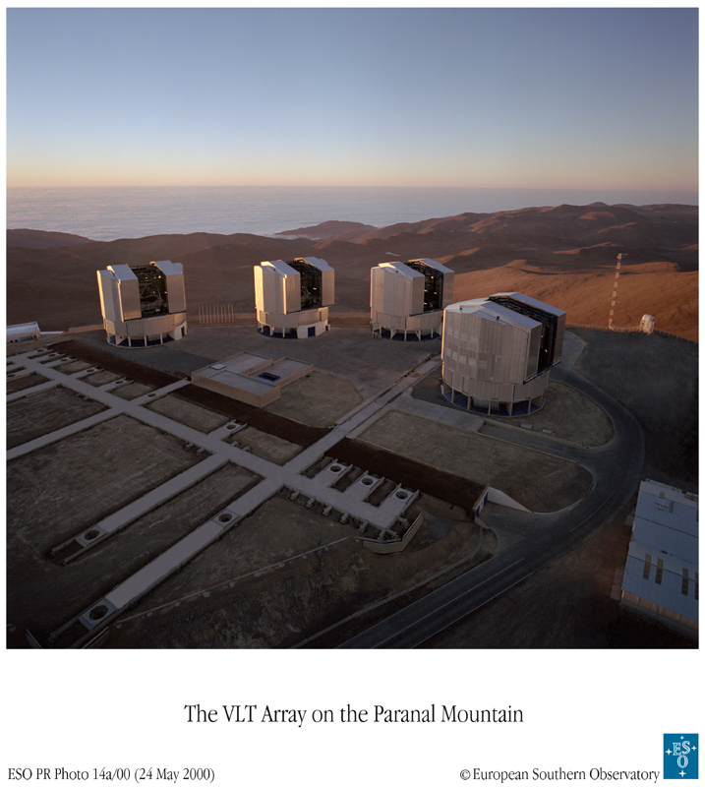

Can combine up to
three telescopes to
do interferometry.
4 × 8 m. telescopes in Paranal.

Slide 10
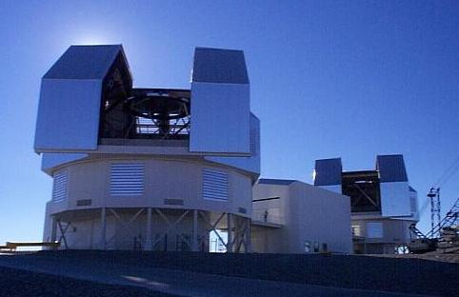
Magellan Telescope
2 × 6.5 m. telescopes in Las Campanas.

Slide 11
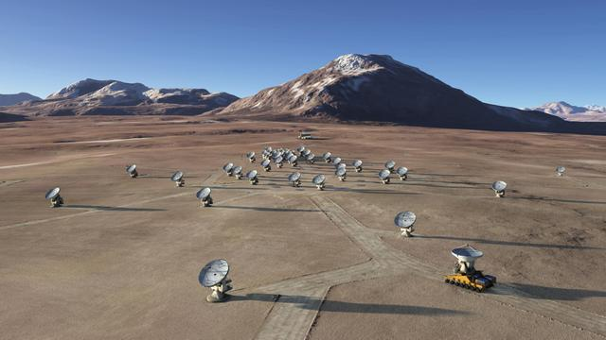
Atacama Large Millimeter Array
66 antennas:
54 x 12m.
12 x 7m.
Llano de Chajnantor
5100 m Atacama Desert
Wavelength range:
7 mm to 0.3 mm

Slide 12
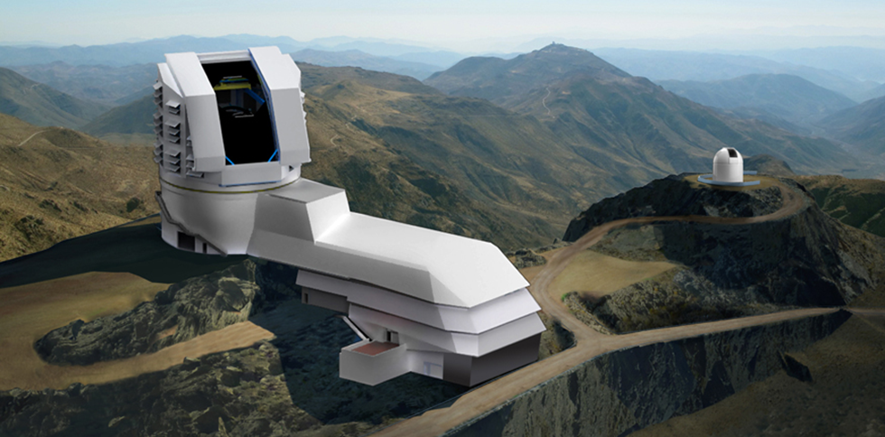
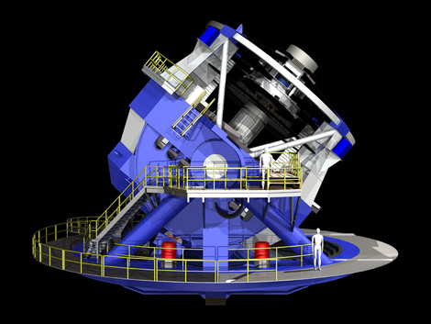
Vera Rubin Telescope (LSST)
8.4 m telescope at Cerro Pachón

Slide 13
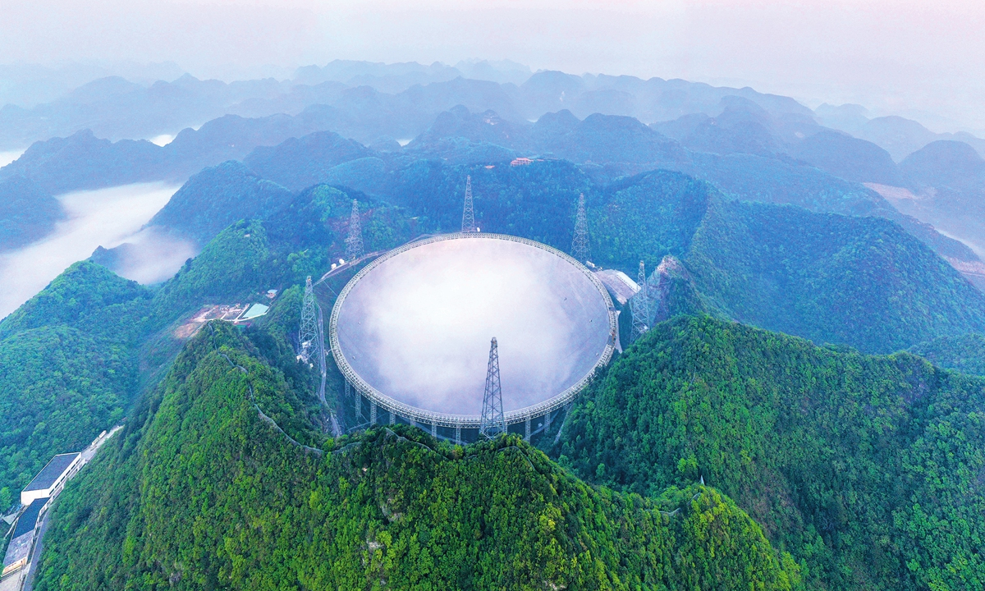
Five-hundred-meter Aperture Spherical Telescope (FAST)
Wavelength range:
10 cm to 4.3 m
Pingtang County, Guizhou

Slide 14

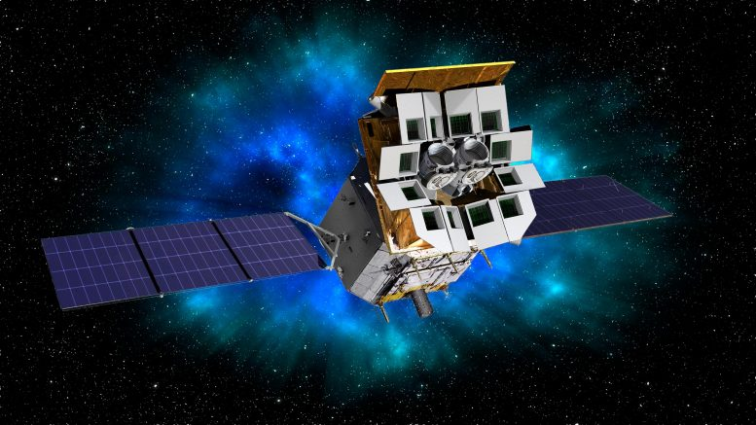

Einstein Probe Telescope
X-ray space telescope dedicated to time-domain high-energy astrophysics.

Slide 15
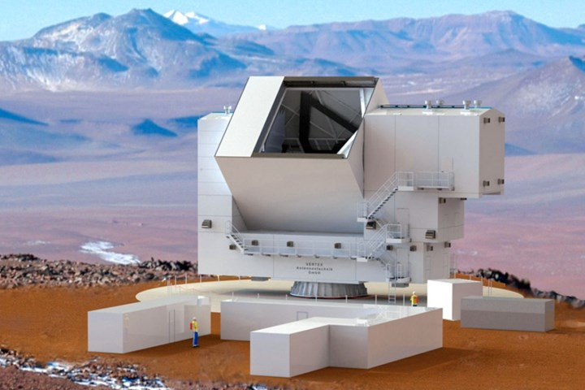
Fred Young Submillimeter Telescope
Chajnantor
5600 m.
6.0 m telescope operating at THz

Slide 16
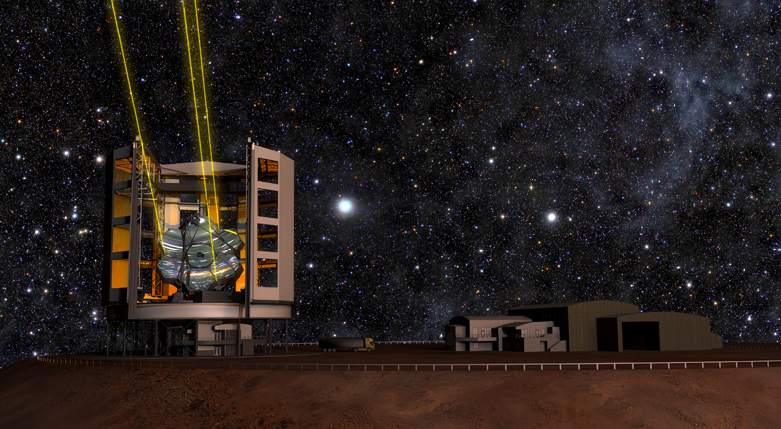
Giant Magellan Telescope (GMT)
24.5 m telescope at Cerro Las Campanas

Slide 17
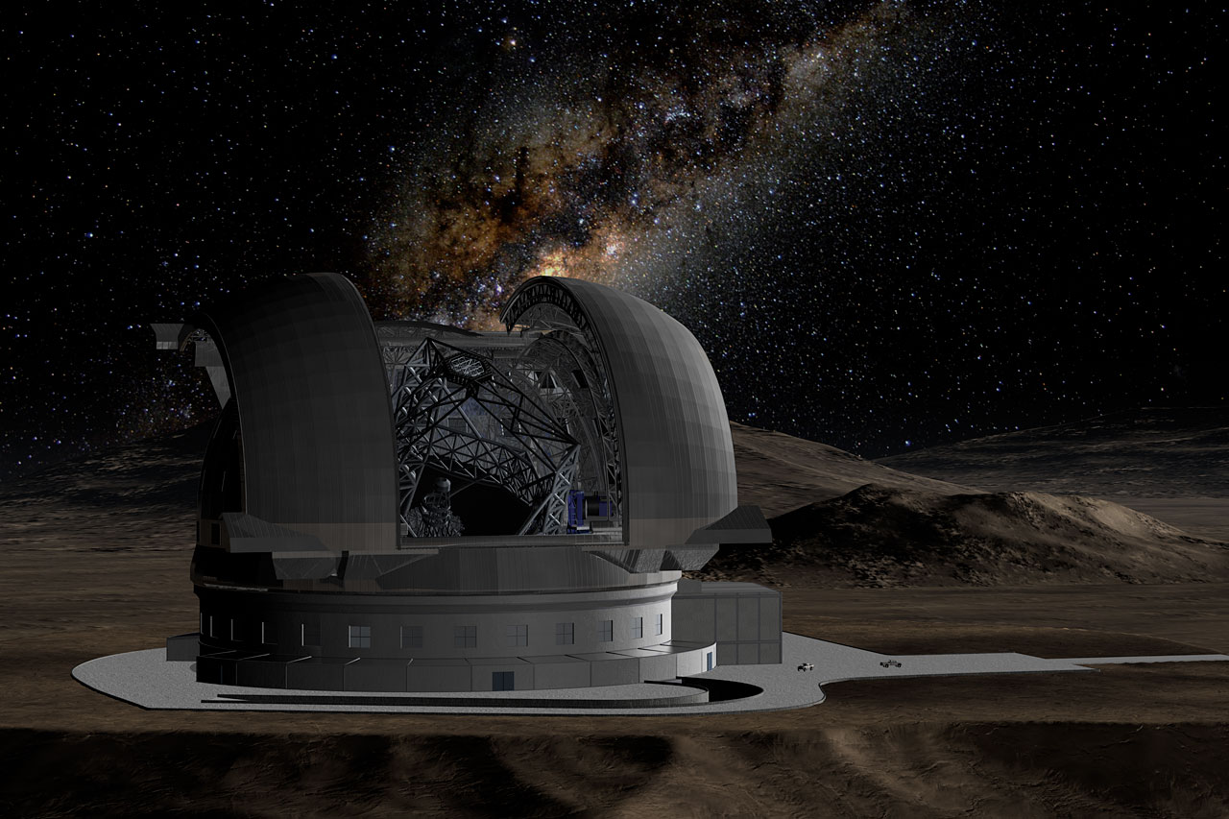
European Extremely Large Telescope (E-ELT)
39 m telescope at Cerro Armazones

Slide 18
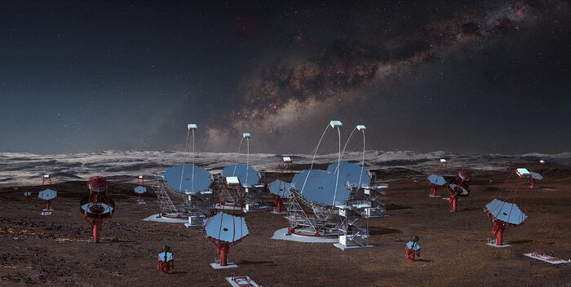
Cherenkov Telescope Array (CTA)
Gamma ray observatory at Cerro Paranal 99 telescopes

Slide 19

Main actions and projects
supported by CASSACA

Slide 20
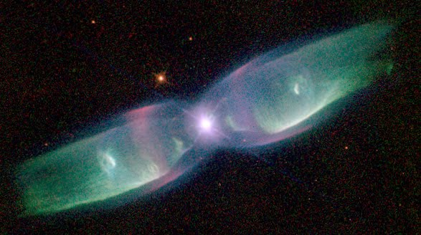
 China-Chile Joint Research Projects
Joint Research Fund created in March 2015, under an agreement between:
• National Astronomical Observatories of China
• Astronomical Society of China
• Astronomical Society of Chile
• CONICYT Chile
28 projects approved
since 2015
Objective: support programs of collaborative research
between China and Chile in astronomy and astrophysics.
♦ Principal Investigator must be from China or Chile.
♦ Duration: 1-2 years
♦ Financing: ∼US $75.000 per year

Slide 21

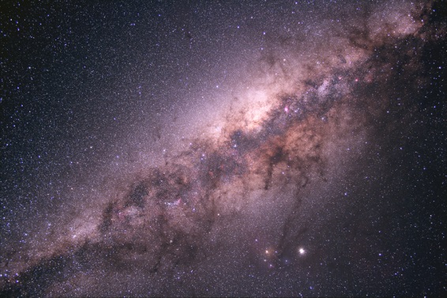
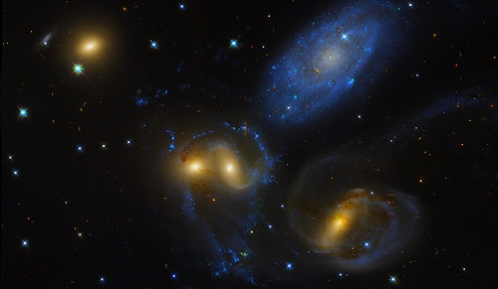
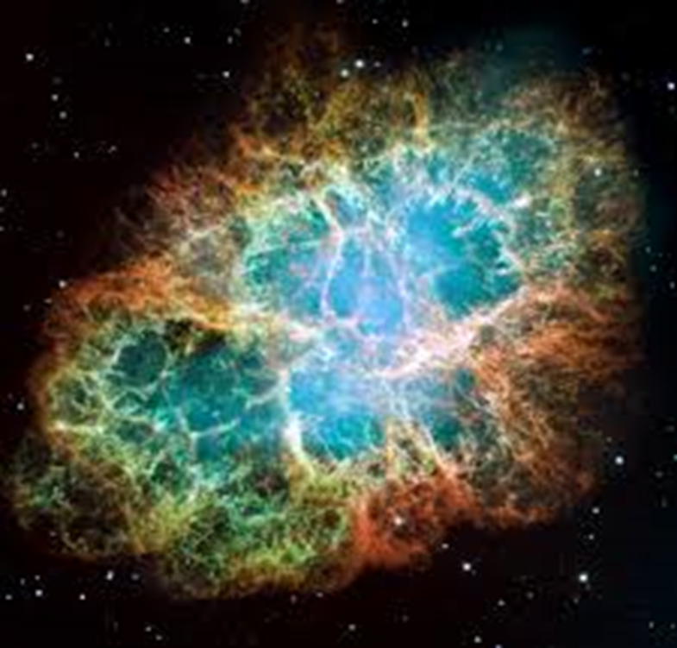
Probing the end of the cosmic
reionization era.
Modelling the Structure and
Kinematics of the Galactic Bulge
Linhua Jiang PU
Juntai Shen SHAO
Zhenya Zheng PUC
Manuela Zoccali PUC
Star formation in Clusters of Galaxies
Automatic search of Supernovas
Eric Peng KIAA
Subo Dong KIAA
Thomas Puzia PUC
Jose Prieto UDP

Slide 22
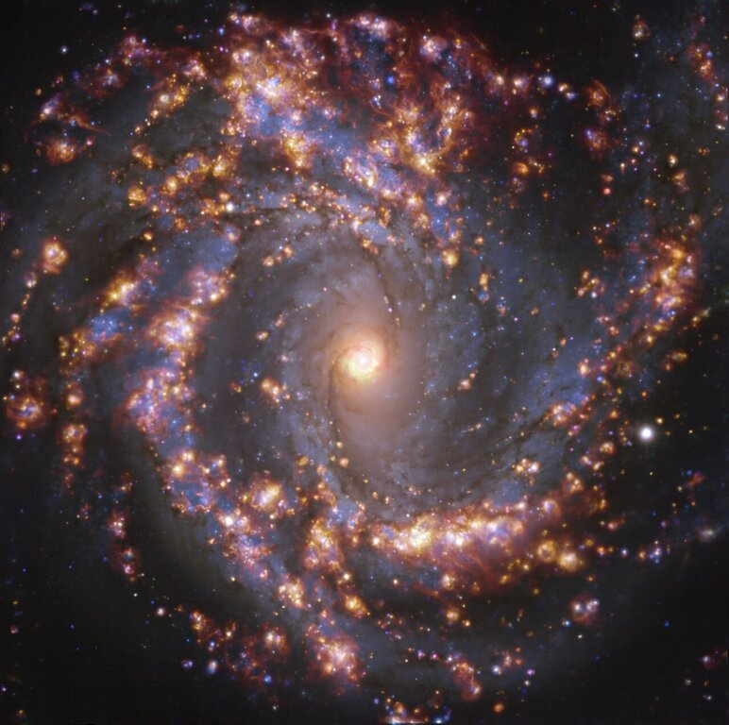

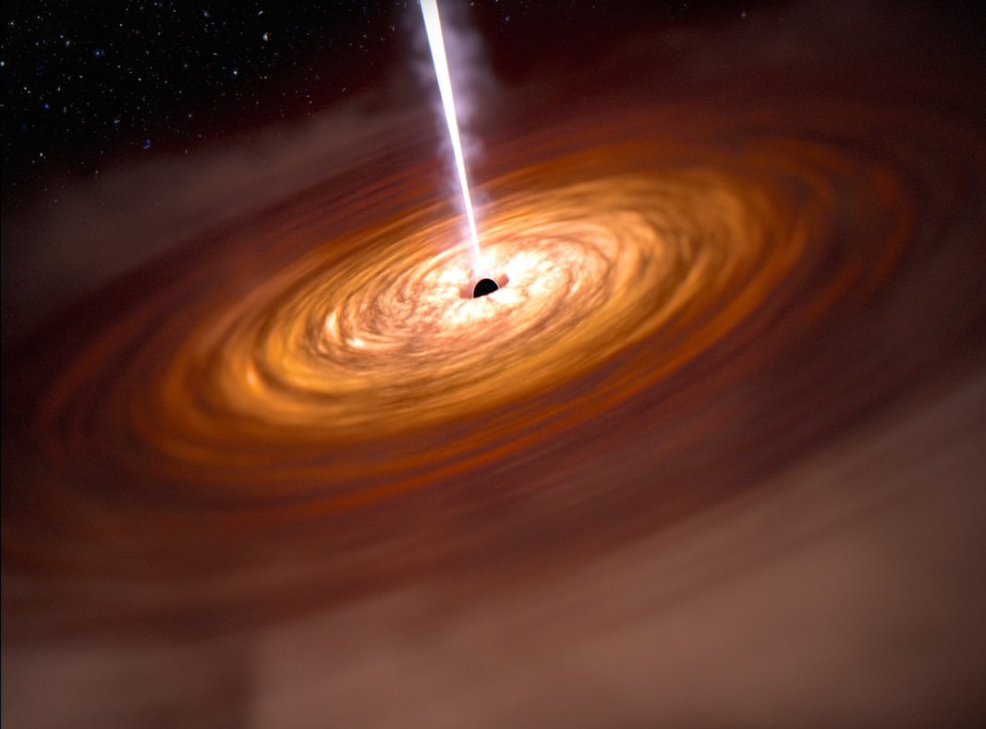
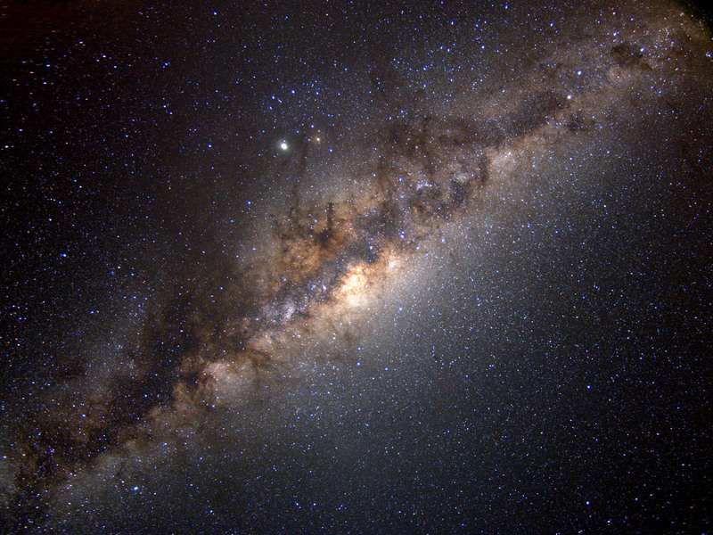
What Controls Galaxy Scale
Star Formation?
Charting ionization during the
epoch of reionization
Xianzhong Zheng PMO
Zhenya Zheng SHAO
Valentino Gonzalez UCh
Felipe Barrientos PUC
Probing accretion onto super massive black holes
The China-Chile Bulge Collaboration
Martin Smith SHAO
Luis Ho KIAA
Claudio Ricci UDP
Dante Minniti UNAB

Slide 23
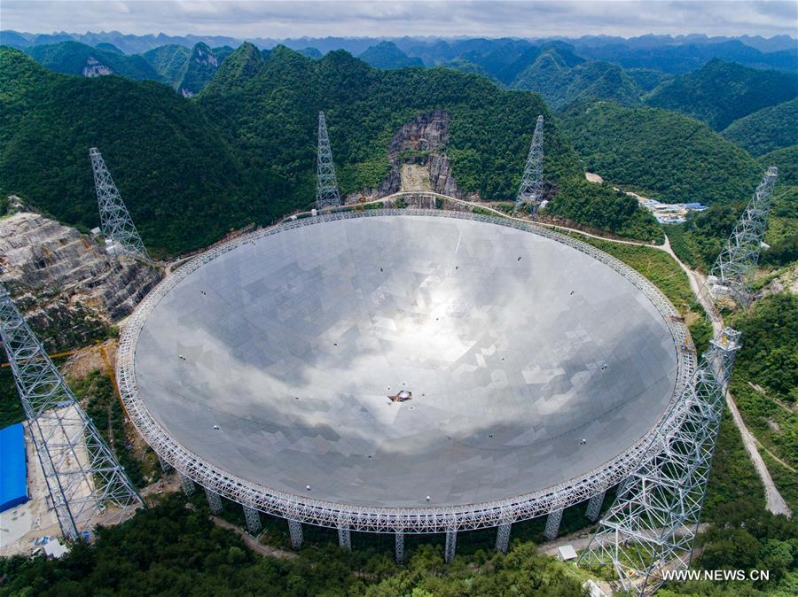
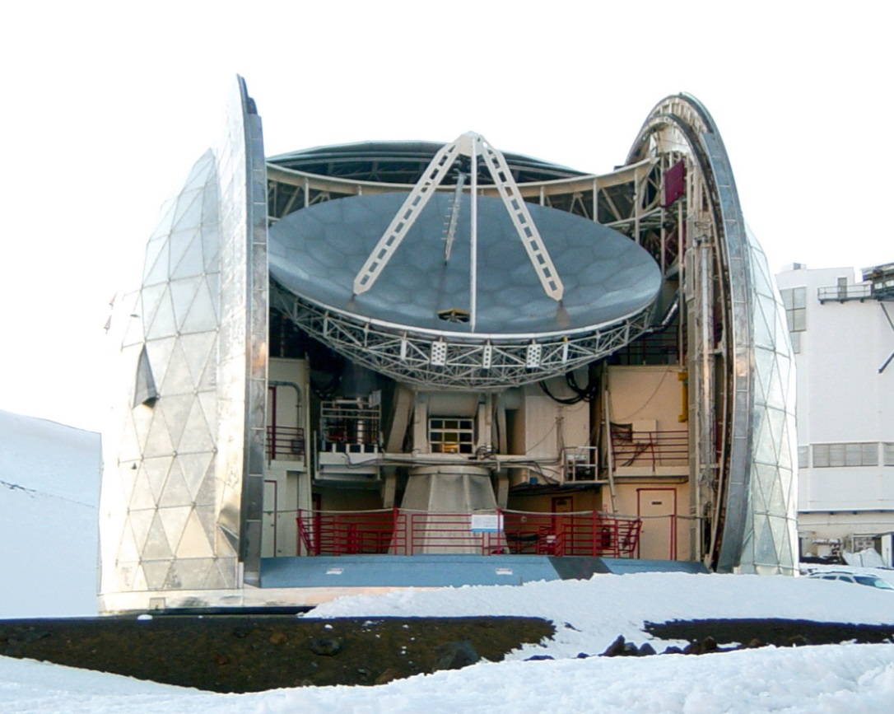
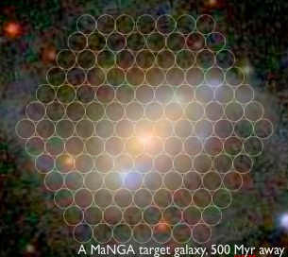
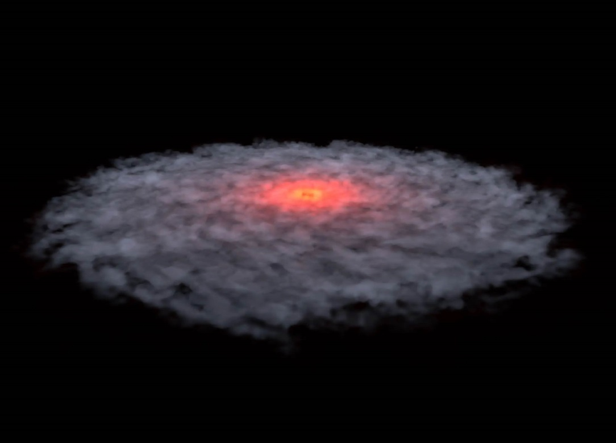
RFI Mitigation for FAST real time
FRB observations
LCT: a mm/sub-mm astronomy
platform for Chile and China
Ran Duan NAOC
Ricardo Finger UCh
Wanzhou Shi SNU
R. Reeves UCon
Exploring Star Formation Histories
of Galaxies from MaNGA Spectra
Dissecting the disk around an
isolated planetary mass object
Fainting Yuan SHAO
Yao Liu PMO
Mederic Boquien UAn
Amelia Bayo UVa

Slide 24
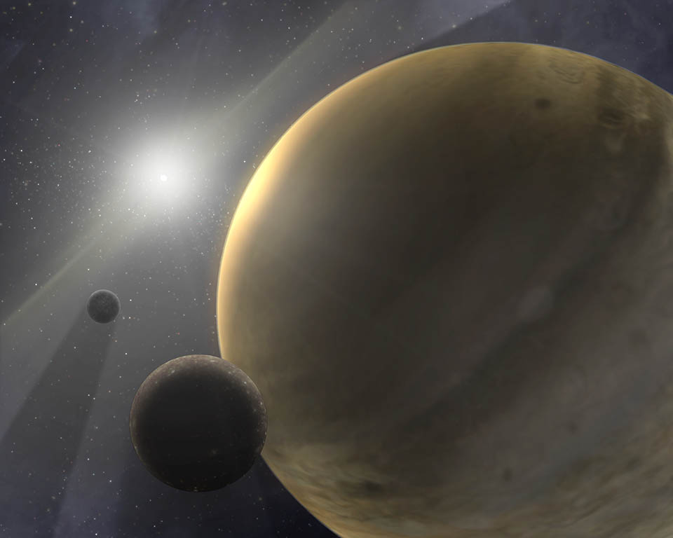
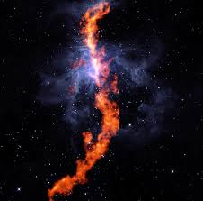
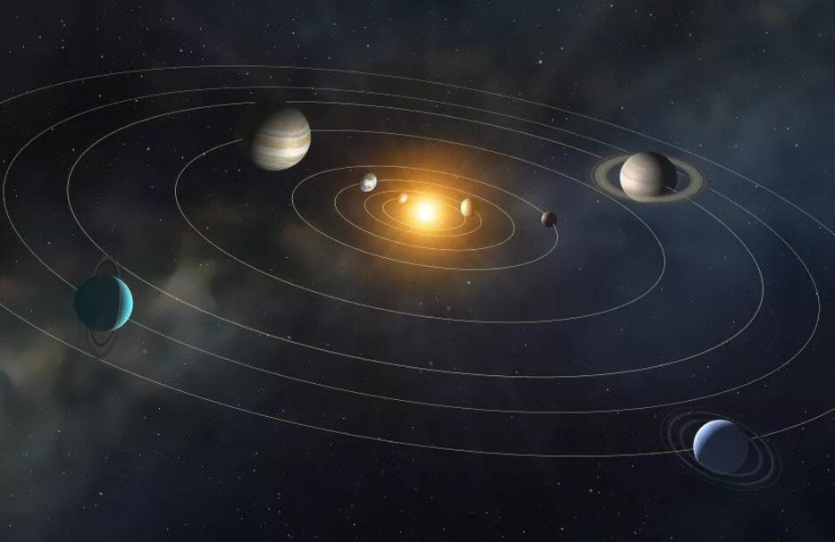

Population of Widely-Orbiting
Gas Giant Planets
The Orion GMC: Galactic Star
Formation with ALMA
T.-D. Lee Jiaotong U.
Ke Wang KIAA
James Jenkins UDP
Diego Mardones UCh
Revealing the Exoplanetary
System Architecture
Characterizing Primordial
Distant Comets
Wei Zhu Tsinghua U.
Yuhui Zhao PMO
Cristobal Petrovich PUC
Bin Yang UDP

Slide 25
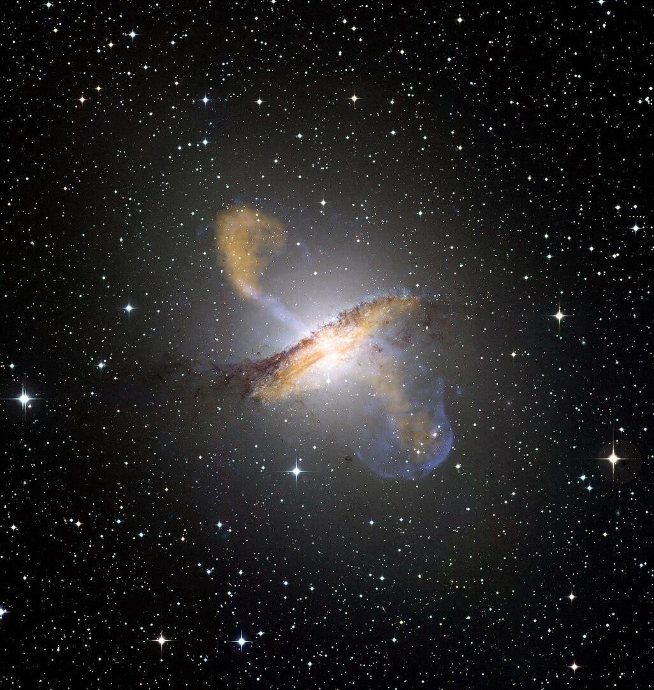

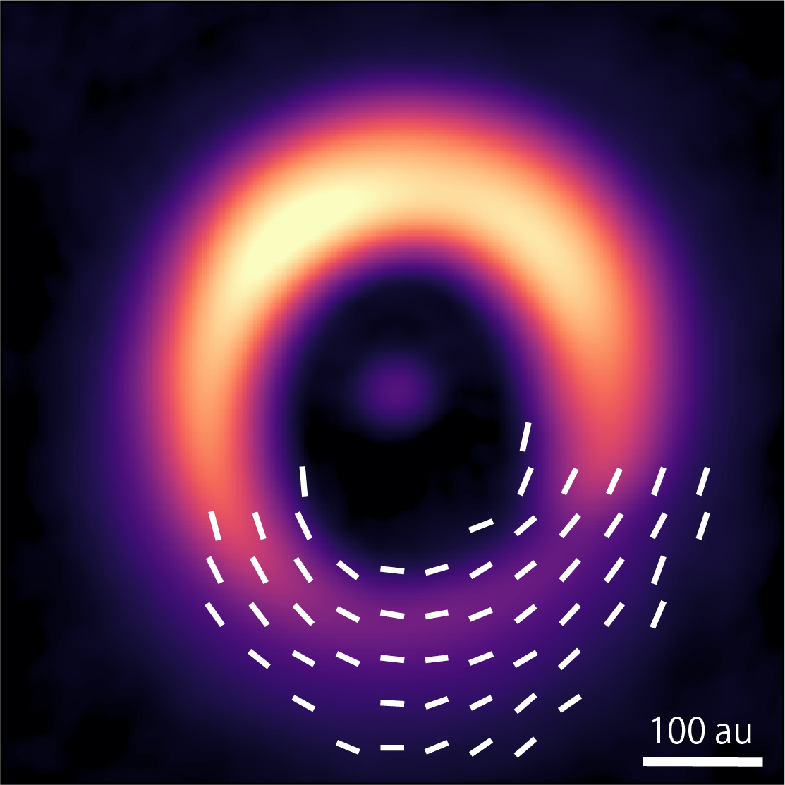
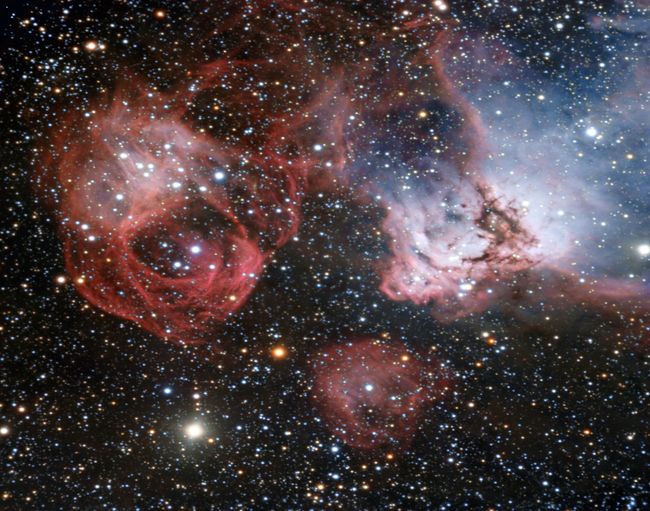
Spectroscopic Survey of Nearby
Bright AGNs
The Rowdy Planet Nursery
Yan-Rong Li IHEP
X.Wang Tsinghua U.
M. Martínez-Aldama UCon
Zhen Guo UVa
Probing Magnetic Fields in
Circumstellar Disks
MSF Across Galactic Environments
Haifeng Yang Zhejiang U.
Pablo Garcia NAOC
Laura Perez UCh
Amelia Stutz UCon
¨

Slide 26
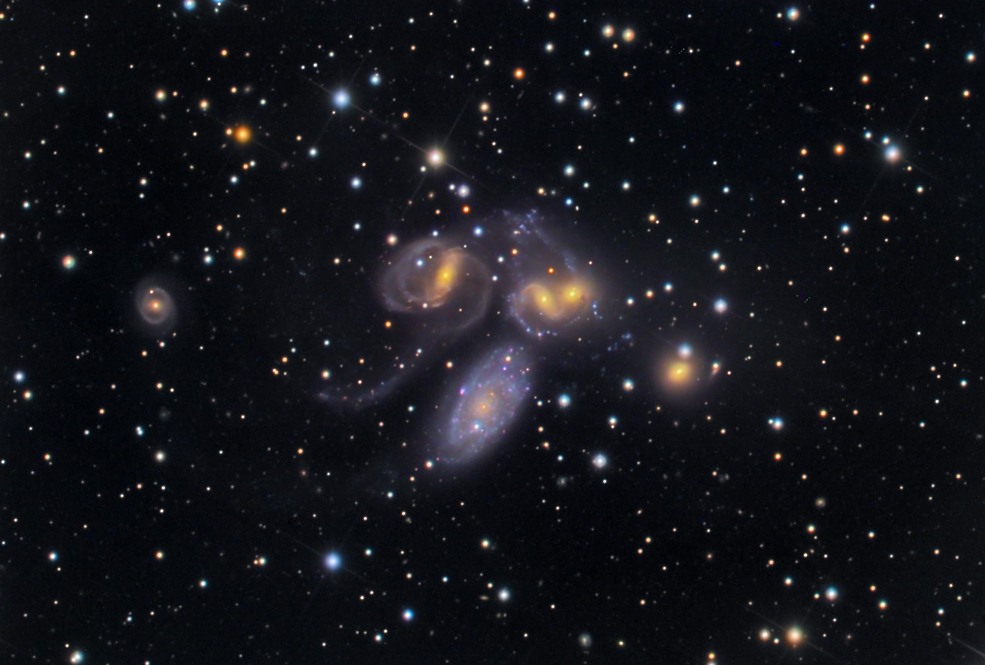
 China-CONICYT postdoctoral fellowships
Objective: strenghten the cooperation between China and
Chile in astronomy through the inclusion of young researchers.
The research is carried out in chilean institutions, with the possibility of continuing it in China.
26 fellowships granted
since 2014

Slide 27

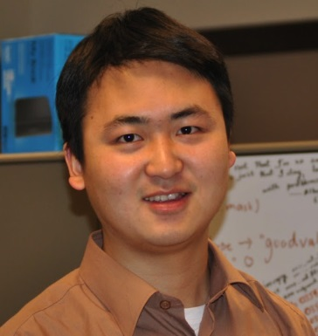
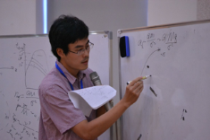
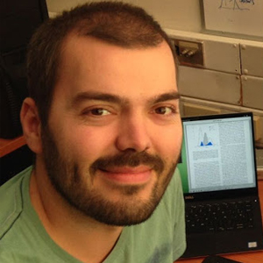



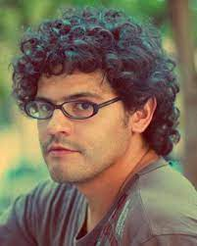
China-Chile postdoctoral fellows
Lan Zhang
Zhenya Zheng
Xian Chen
Julio Carballo
U. de Chile
U. Católica
U. Católica
U. Católica
Claudio Ricci
P. Eigenthaler
J. Gonzalez
S. Gonzalez
U. Católica
U. Católica
U. Diego Portales
U. de Chile

Slide 28

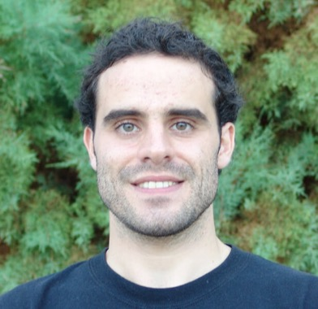
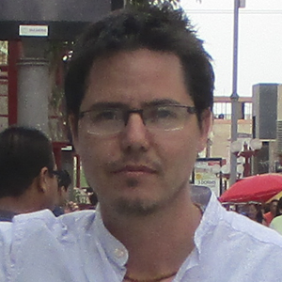
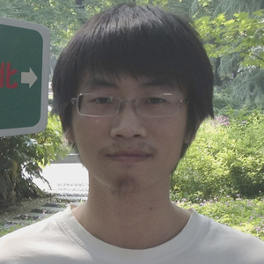
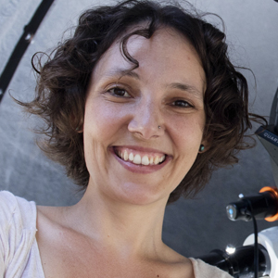
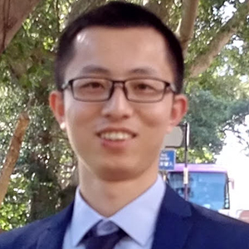


China-Chile postdoctoral fellows
Favio Vito
Tanio Diaz
M. Montecinos
Cheng Cheng
U. Católica
U. Diego Portales
U. Católica
U. Valparaíso
Maria Argudo
Hongli Liu
Cristina Romero
Lucia Guaita
U. Antofagasta
U. Concepción
U. Diego Portales
U. Diego Portales

Slide 29


 China-Chile Astronomical Data Center
Big collaboration project lead by CASSACA together with
Huawei and Universidad Técnica Federico Santa María.
CASSACA
Objective: Benefit the astronomical research of the Chinese
and Chilean communities allowing their researchers to process
the huge amount of data provided by the mega-telescopes as
well as its tranfer.

Slide 30

Signing ceremony May, 2015

Slide 31


 China-Chile Scientific Meetings
Objectives: Get together researchers from both countries
allowing them to establish ties based in common scientific interests as well as to boost the interchange of people.

Slide 32


Slide 33



The Baryon Cycle from Reionization to Cosmic Noon
Conference
Puerto Varas, Chile, December 2025

Slide 34

SUMMARY
The astronomical relationship between chinese and
chilean scientists has flowered during the last
twelve years thanks to the existence of CASSACA
… and we expect to continue blossom in the future.

Slide 35


Thanks

